Slide 1
Interstitial soluble salts in Dead Sea sediments as monitors of the East Mediterranean-Levant hydroclimate during the past ~ 100 kyr
Moti Stein, Omri Kalifa, Pamela Schimmer,
Amitai Katz, Boaz Lasar
The Hebrew University of Jerusalem

Slide 2
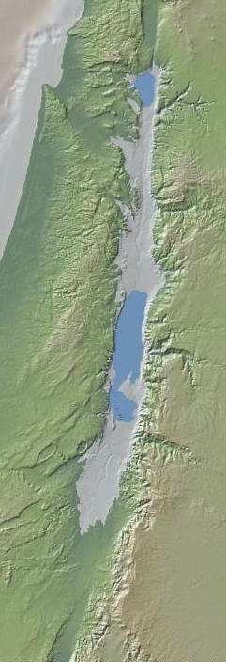
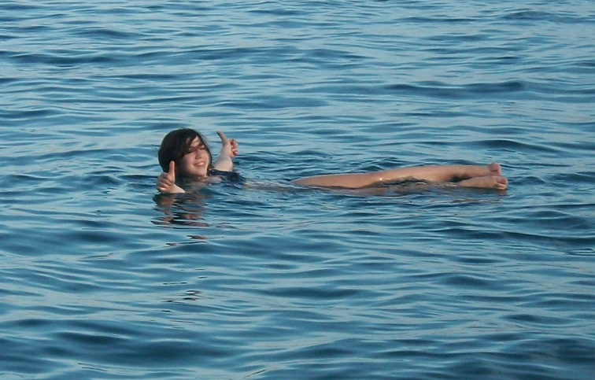
What so special with the Dead Sea?
1950
25000 y BP
The lowest place on Earth
Now at 440 m below mean sea-level
Expanded during glacials contracted during interglacial
25,000 years BP
100 years BP

Slide 3
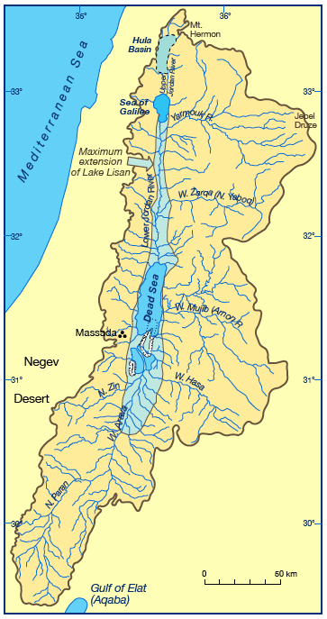
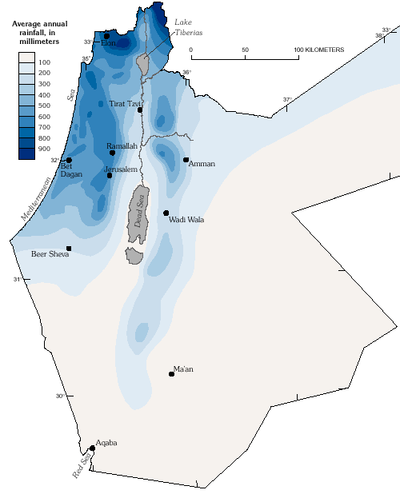
The Dead Sea watershed encompasses the areas that receive rains from the Mediterranean and the arid Negev Desert in the northern edge of the Sahara-Arabia desert belt

Slide 4
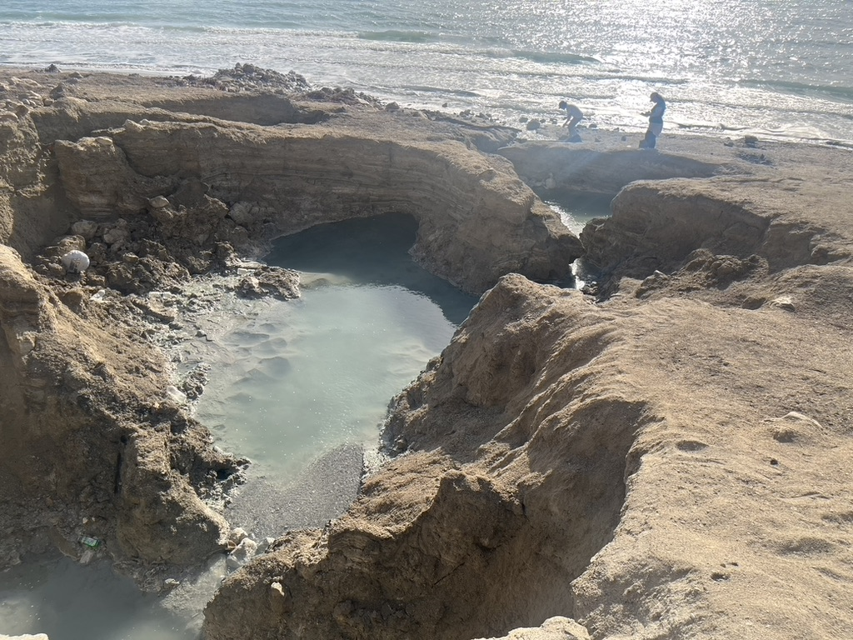
The Dead Sea solution comprises a Ca-chloride brine
Cl⁻ > Na⁺; and Ca²⁺ > HCO₃⁻ + SO₄²⁺ [equivalent concentrations]
Saline springs discharge the brine
to the Dead Sea
Notes:
Precipitation of halite and gypsum
Bacterial sulphate reduction produces bicarbonate for dolimitization
Depletion of bicarbonate and sulphate

Slide 5
The Ca-chloride brine was formed by interaction of evaporated seawater that ingressed in the late Miocene into the Dead Sea Basin (the ‘Sedom Lagoon’) with limestones of the regional aquifers

Slide 6
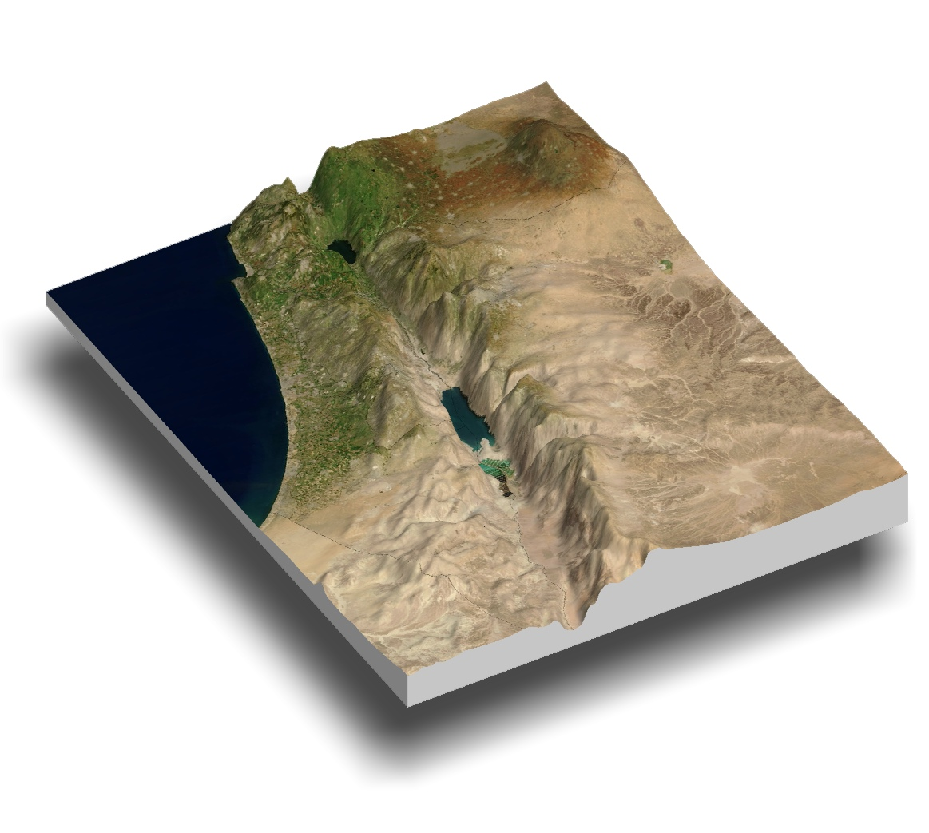
Ingression of the Sedom Lagoon into the Dead Sea Basin
Notes:
מהיכן המלח? נראה כעת תצפיות שמראות שמקור המלחים הוא במי הים.
נתחיל בתצפיות שמעידות על חדירה של הים דרך עמק יזרעאל.
נראה שהן מתאימות בגיל לגיל המלח.
לבסוף נבין את המנגנון שמאפשר את הצטברותן של שכבות מלח כה עבות.
צריך לזכור שהנוף לפני 6-4 מיליון שנה הנוף הוא מתון יותר מהיום. הרי ירושלים עוד לא התרוממו, כך גם השומרון, הכרמל והגליל.
סביר שהחדירה הייתה עמק יזרעאל. אבל חיבור דרך בקעת באר שבע ודימונה גם הוא אפשרי, נבדק, ואין ראיות טובות.

Slide 7
Ingression of the Sedom Lagoon into the Dead Sea Basin
Notes:
מהיכן המלח? נראה כעת תצפיות שמראות שמקור המלחים הוא במי הים.
נתחיל בתצפיות שמעידות על חדירה של הים דרך עמק יזרעאל.
נראה שהן מתאימות בגיל לגיל המלח.
לבסוף נבין את המנגנון שמאפשר את הצטברותן של שכבות מלח כה עבות.
צריך לזכור שהנוף לפני 6-4 מיליון שנה הנוף הוא מתון יותר מהיום. הרי ירושלים עוד לא התרוממו, כך גם השומרון, הכרמל והגליל.
סביר שהחדירה הייתה עמק יזרעאל. אבל חיבור דרך בקעת באר שבע ודימונה גם הוא אפשרי, נבדק, ואין ראיות טובות.

Slide 8

The Sedom Lagoon model and formation of the Ca—Cl brine
W
E_{lg}=W
P=W
Sedom Lagoon
inf
sed
M
W+M
sp
S_{lg}
Mediterranean Sea
S_{sw}
Halite
limestones
Dolomite lenses
Stein et al. 2000

Slide 9
After the disconnection of the Sedom lagoon from the open sea, a series of lakes occupied the Dead Sea Basin filled with the Ca- chlorine brine and freshwater from the large watershed

Slide 10
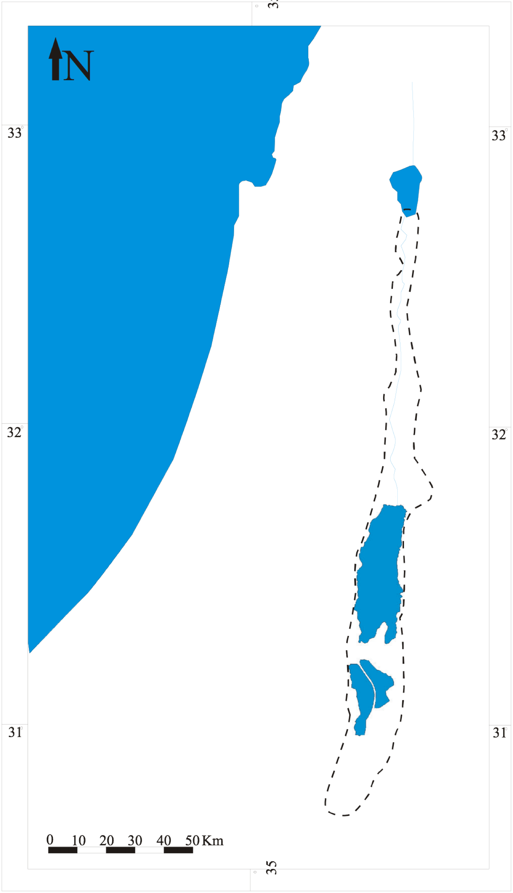
After the disconnection of the Sedom Lagoon from the open sea a series of lakes were developed in the Dead Sea Basin
Dead Sea
Lake Lisan
Lake Samra
Lake Amora
Sedom
Lagoon
Holocene
Upper
Pleistocene
(70-14 ka BP)
MIS-5 (130-80 ka BP)
Mid (?) – Upper
Pleistocene
Pliocene –
Miocene (?)
Notes:
In the late Neogene, the DSB was occupied by the Sedom Lagoon
A series of terminal lakes occupied the DSB when the lagoon closed
As the climate fluctuated through glacial and interglacial cycles, the Dead Sea lakes responded with changes in lake level and brine compositions

Slide 11
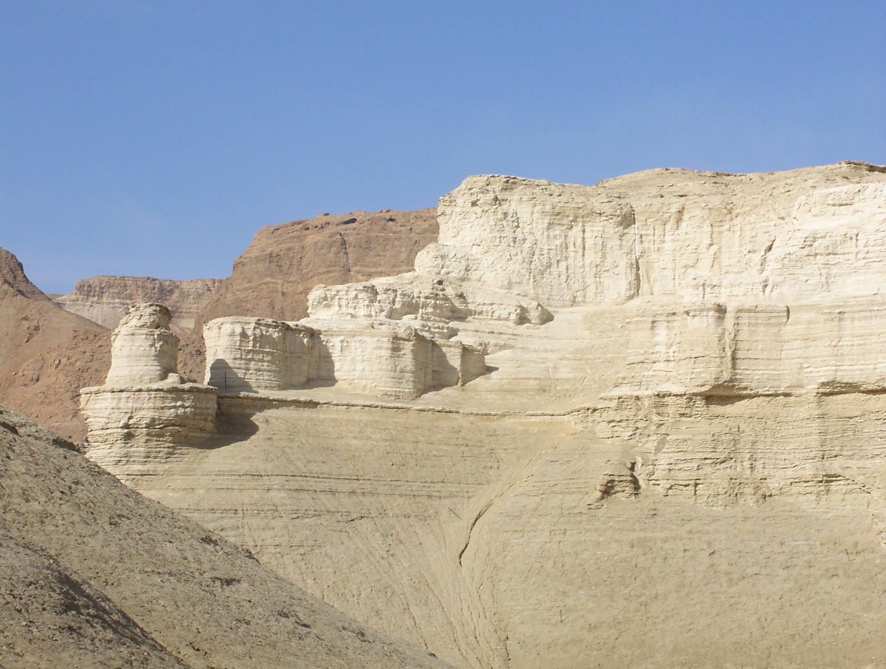
The exposures of the last Glacial (70-14) Lisan Formation
14 ka
70 ka

Slide 12
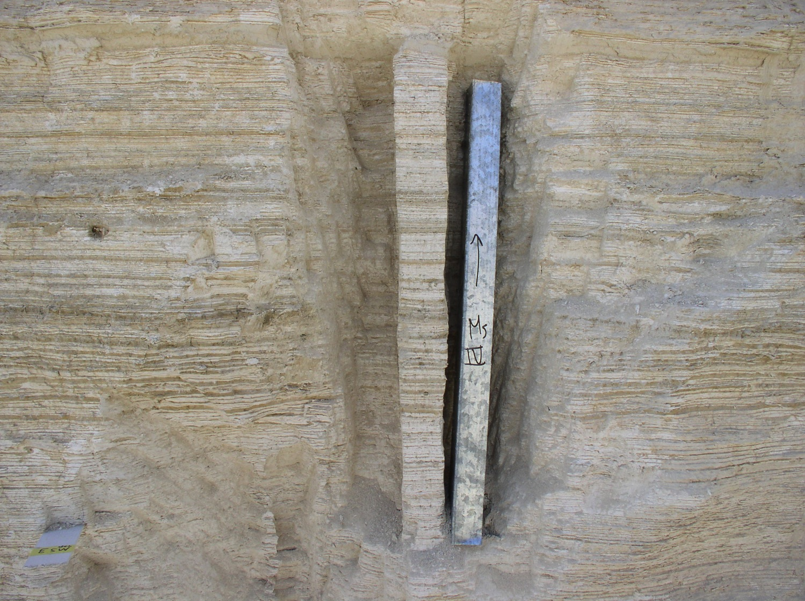
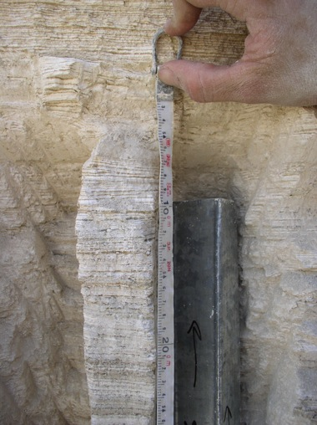
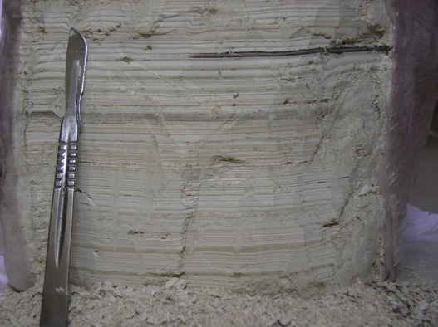
Layering

Slide 13
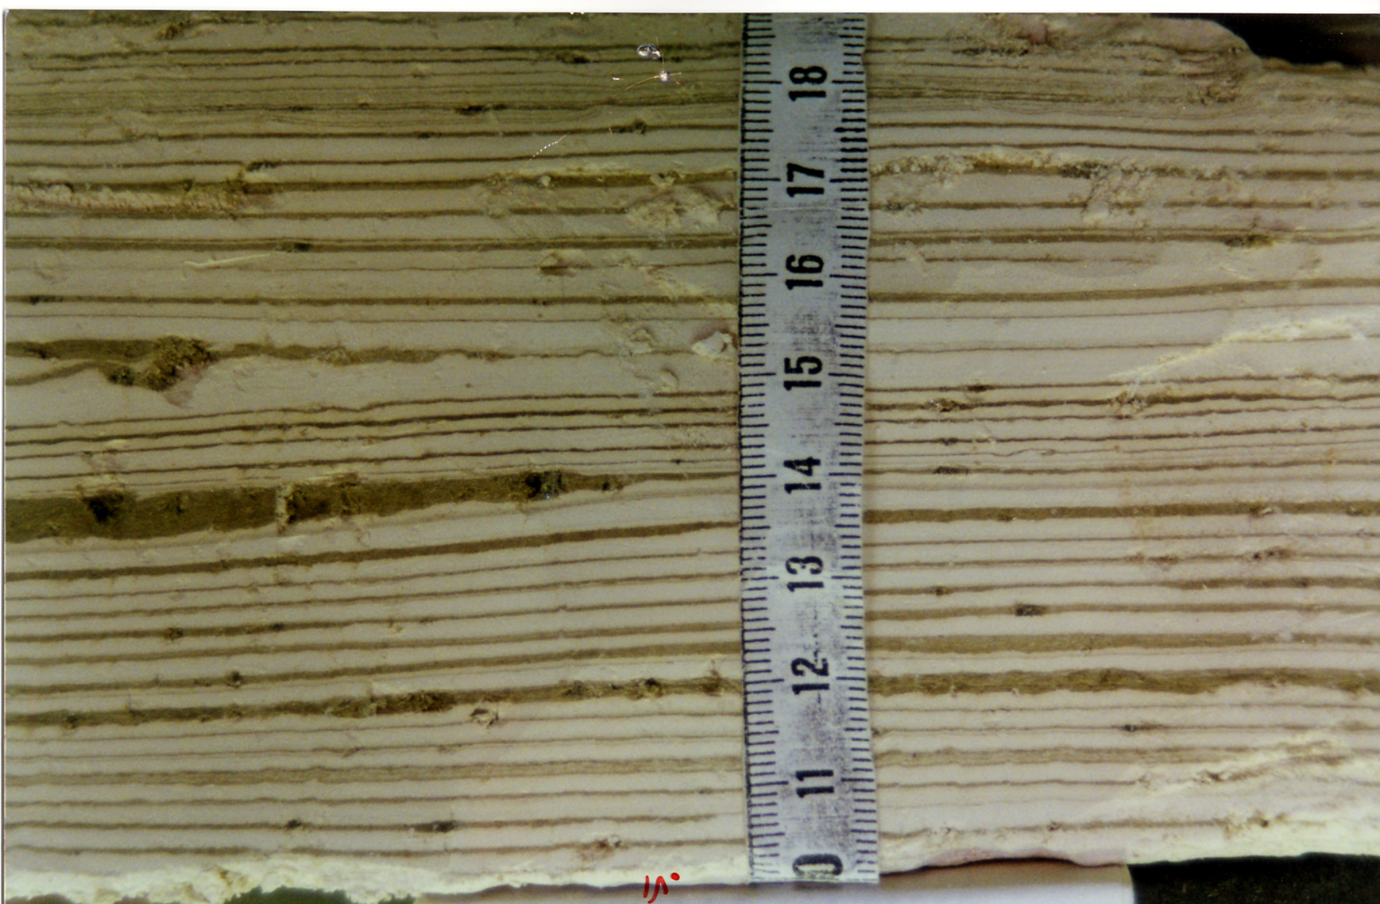
The white laminae comprise CaCO3 as aragonite
that was deposited from the lake’s water

Slide 14
The long term mixing of the Ca-chloride brines with freshwaters and the cycling of the brine between the regional aquifers and the lake is controleed by the regional hydroclimate

Slide 15
Soluble Salts as tracers of Dead Sea brine composition
Soluble salts: salts precipitated within the pore spaces of sediment from pore fluids
Tracers of Dead Sea brine composition
Potential for higher resolution sampling (compared to pore fluids)

Slide 16
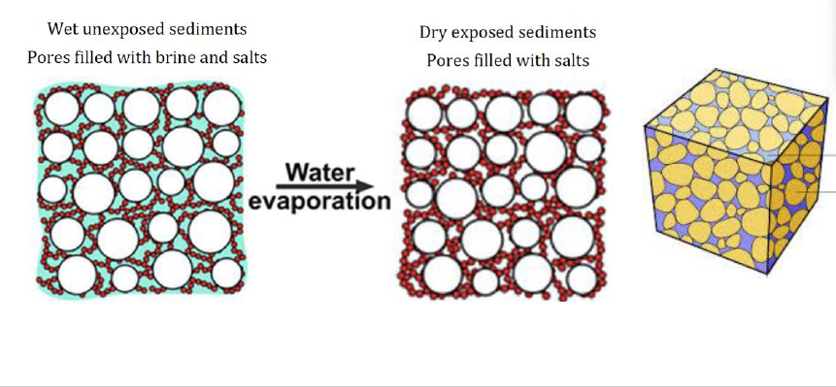
Soluble Salts as Dead Sea Brine composition Tracers
Soluble salts: salts precipitated within the pore spaces of sediment from pore fluids
Can be a good tracer for brine composition
Potential for higher resolution results
Notes:
Move to middle

Slide 17
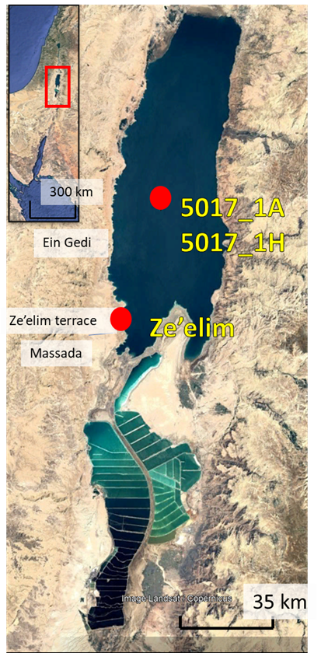
Sampling sites
The exposures of the last Glacial (70-14) Lisan Formation at the foothill of the Masada fortress
DSDDP CORES
14 ka
70 ka

Slide 18
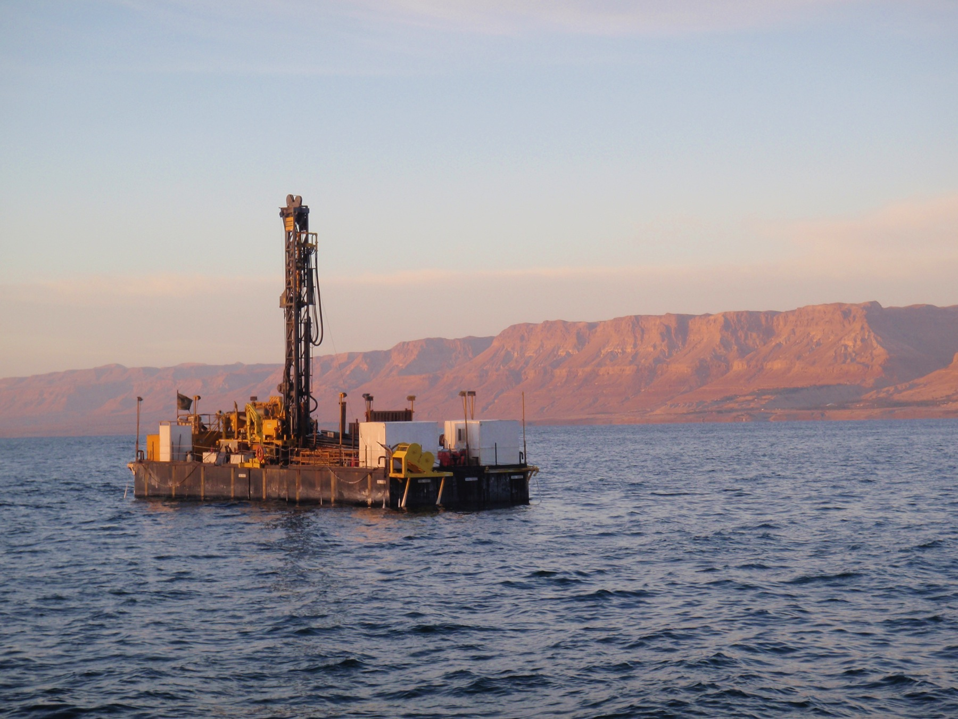
The ICDP –DSDDP drilling project

Slide 19
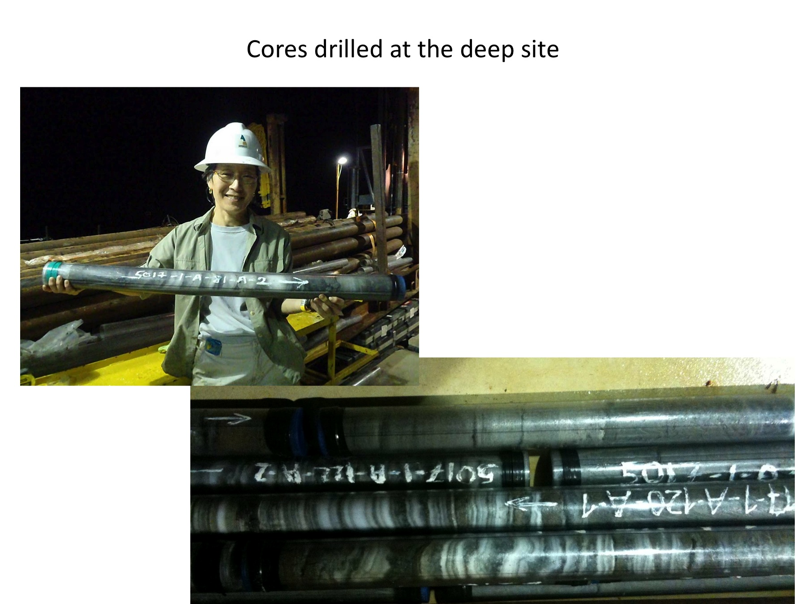
Prof. Emi Ito holds a core comprises of salts and “mud”

Slide 20
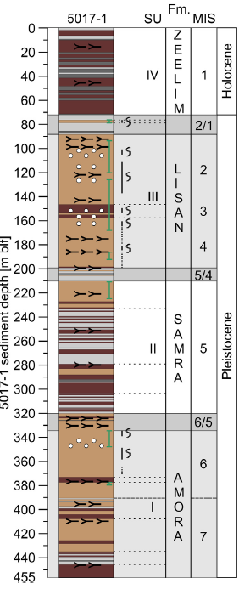
present
The deep core drilled at the Dead Sea floor below water depth of 300m
recovers 220 kyr history of the lake
220 ka
Neugebauer et al 2014, Torfstein et al., 2015

Slide 21
Pore-fluids extracted from the deep core are tracers of the composition of the hyplimnion (lower lake’s layer) brine during the past 220 kyr

Slide 22
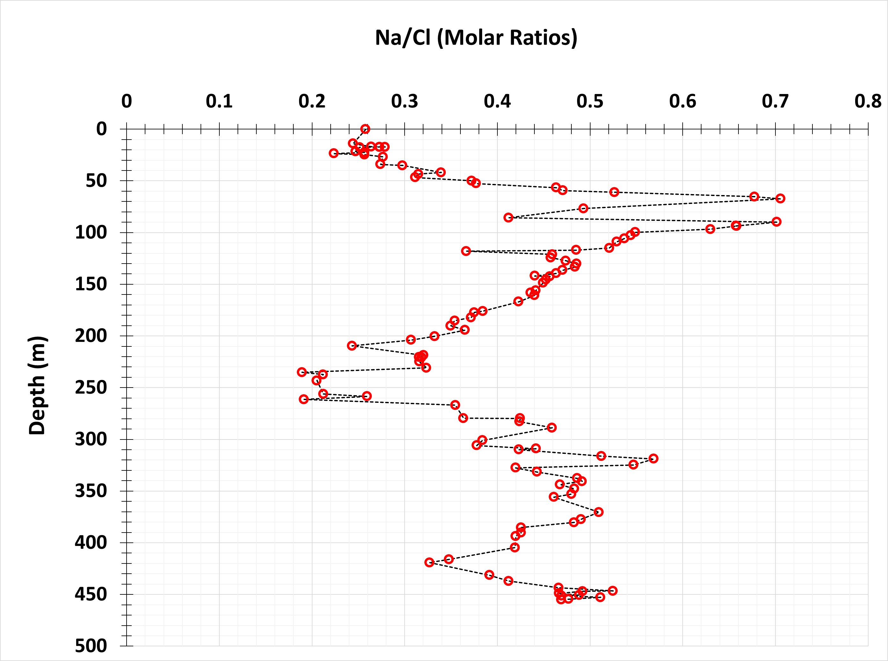
The Na/Cl ratio as monitor of halite deposition/dissolution
(Levy et al., 2018)
Notes:
Na/Cl recycling from Mt. Sedom
Because Cl>>Na, dissolution and precipitation of halite found by Levy at al
Climate variations
Therefore climate changes can be seen in Na/Cl variations

Slide 23
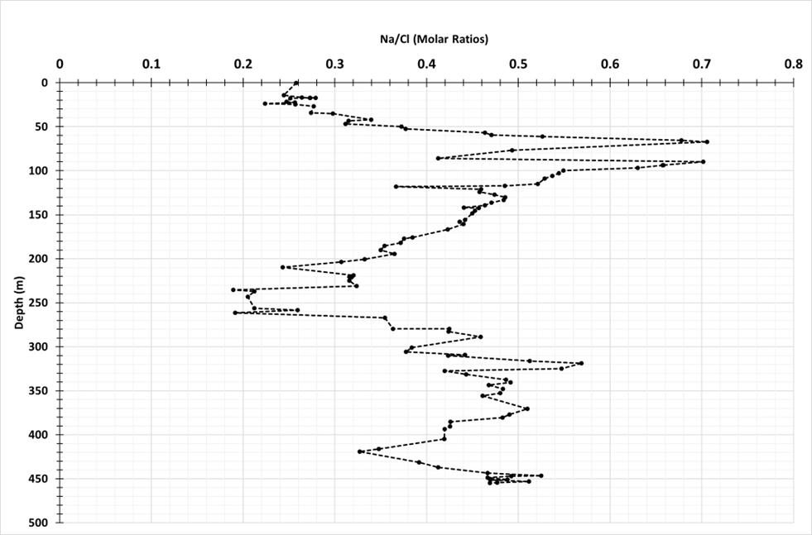
Na/Cl molar
Depth m
Pore fluids from the deep core
(Levy et al., 2018)
Notes:
Na/Cl recycling from Mt. Sedom
Because Cl>>Na, dissolution and precipitation of halite found by Levy at al
Climate variations
Therefore climate changes can be seen in Na/Cl variations

Slide 24
Na/Cl molar
Halite dissolution
Depth m
Halite deposition
Pore fluids from the deep core
(Levy et al., 2018)
Notes:
Na/Cl recycling from Mt. Sedom
Because Cl>>Na, dissolution and precipitation of halite found by Levy at al
Climate variations
Therefore climate changes can be seen in Na/Cl variations

Slide 25
Na/Cl molar
Na/Cl molar
Halite dissolution
Wet periods in the watershed
Depth m
Halite deposition
Arid periods in the watershed
Pore fluids from the deep core
(Levy et al., 2018)
Notes:
Na/Cl recycling from Mt. Sedom
Because Cl>>Na, dissolution and precipitation of halite found by Levy at al
Climate variations
Therefore climate changes can be seen in Na/Cl variations

Slide 26
Mount Sedom Salt diapir
Source of Na and Cl ions to the Dead Sea

Slide 27
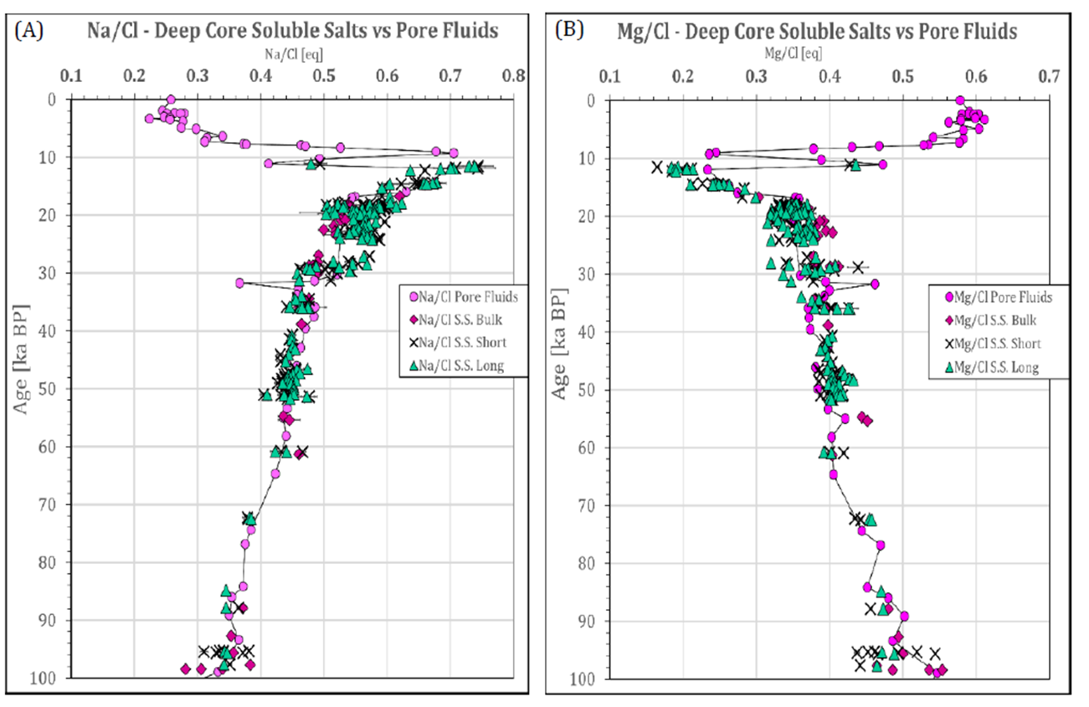
Agreement between pore fluids and soluble salts
(Khalifa, 2021)
Notes:
Increased resolution too

Slide 28
14 ka
Lisan period
100 ka
Neugebauer et al 2014, Torfstein et al., 2015

Slide 30
100 to 30 ka (MIS5a, 4, 3)
The hypolimnion brine was evolved via moderate secular chemical changes:
Weak increase in the Na/Cl ratio reflecting the dissolution of halite that accumulated
at the lake’s margins during the last interglacial hyper arid periods of MIS 5e and MIS 5c

Slide 31
30-18 ka (MIS2)
During MIS2, when the lake reached its highest elevations and maximum spatial expansion,
the Na/Cl, ratios of the hypolimnion brine show moderate though frequent variations reflecting centennial cycles of
halite dissolution/brines mixing during wetter/drier periods in the lakes’ watershed.

Slide 32
Take Home
The soluble salts provide, high-resolution chemical record of the Dead Sea brine during the past 220 kyr
High/Low Na/Cl ratios indicate halite dissolution/formation during wet/dry periods
At 100-30 ka halite was mainly dissolved from the lakes margins, where it accunnulated during the hyper arid MIS5e and MIS5c
During MIS2 (30-14 ka) when lake level arrived to its highests stands halite is mainly dissolved from the rising Mount Sedom salt diapir providing Na and Cl ions to hypolimnion

Slide 33
