Slide 1
Exploring the advantages of automated stations to retrieve continuous weather and snow-related data in high-elevations sites
(Monte Rosa massif – Western Italian Alps)
Mario Gallarate*^{1,2}, Nicola Colombo³, Cristina Viani¹, Enrico Gazzola⁴, Patrick Henkel⁵, Markus Lamm⁵, Michele Maiorano⁶, Michele Freppaz³, Marco Giardino¹, Fiorella Acquaotta¹
Additional Materials
EGU General Assembly – 1st May 2025

Slide 2
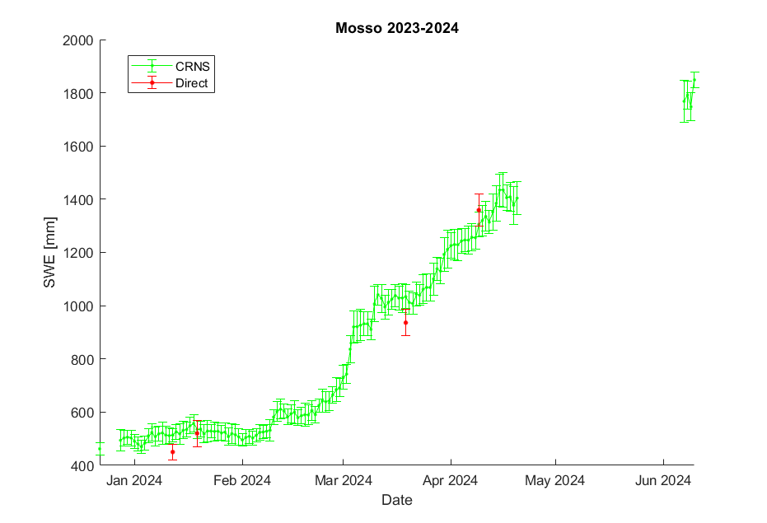
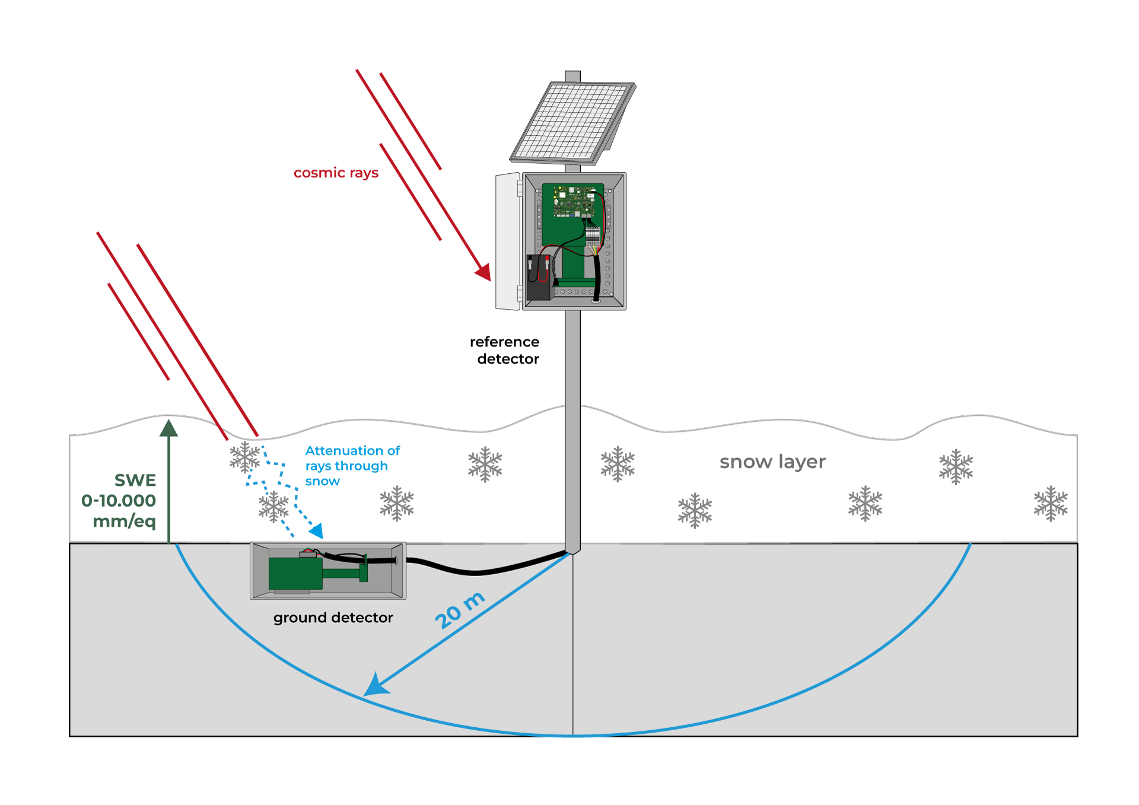
CRNS previous season and schematics
EGU General Assembly – 1st May 2025

Slide 3
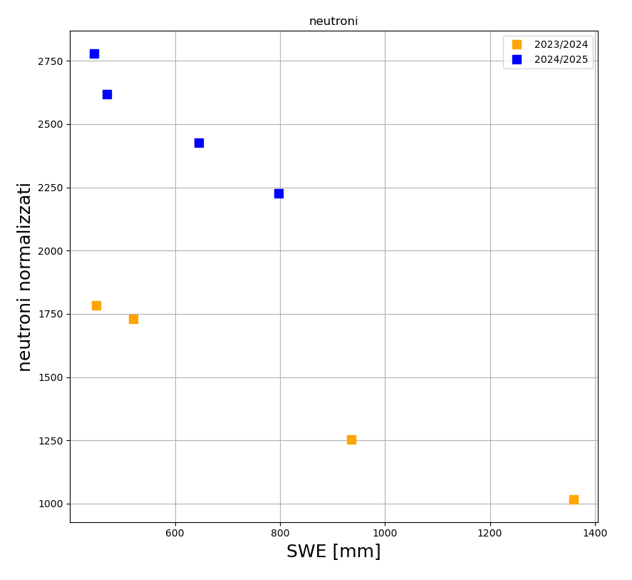
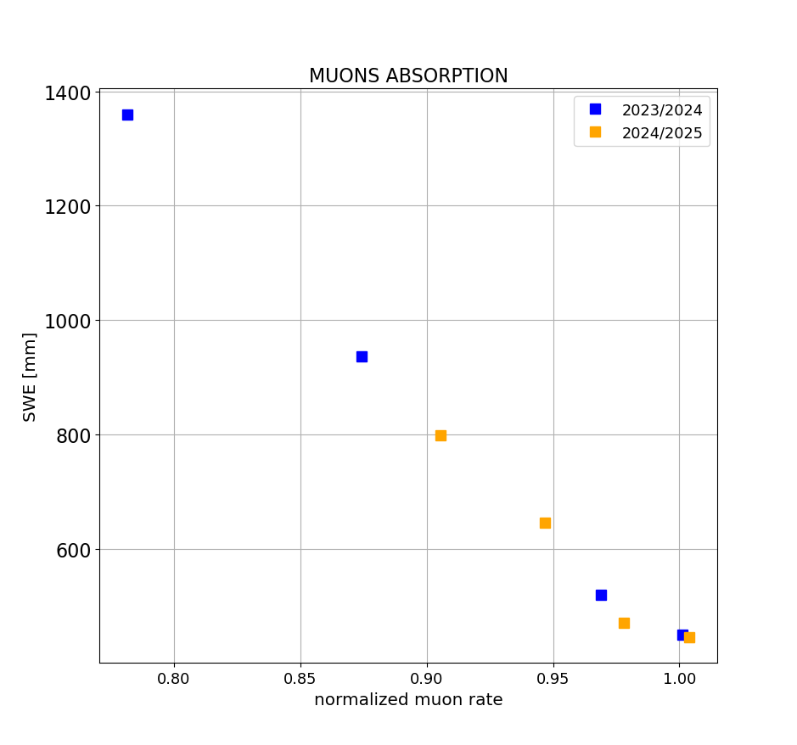
CRNS comparison with previous season
EGU General Assembly – 1st May 2025

Slide 4
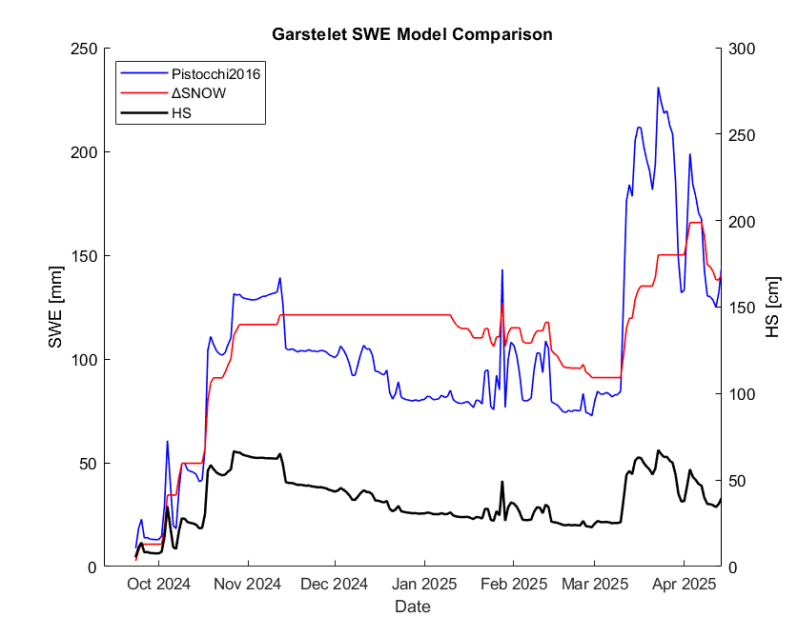
SWE model comparison at Garstelet
Winkler, M., et al., 2021 - Snow water equivalents exclusively from snow depths and their temporal changes: the Δsnow model, Hydrol. Earth Syst. Sci.
EGU General Assembly – 1st May 2025

Slide 5
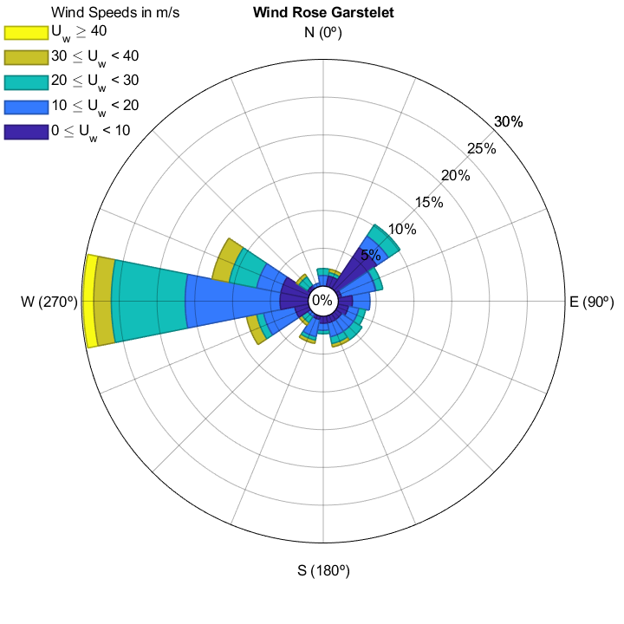
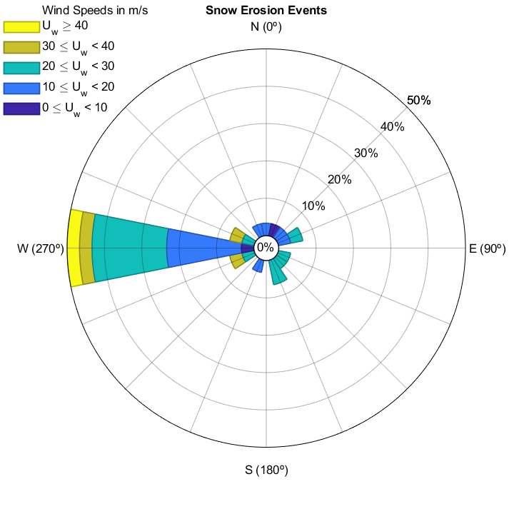
Snow erosion episodes at Garstelet
General Windrose
Erosion Events Windrose
EGU General Assembly – 1st May 2025

Slide 6
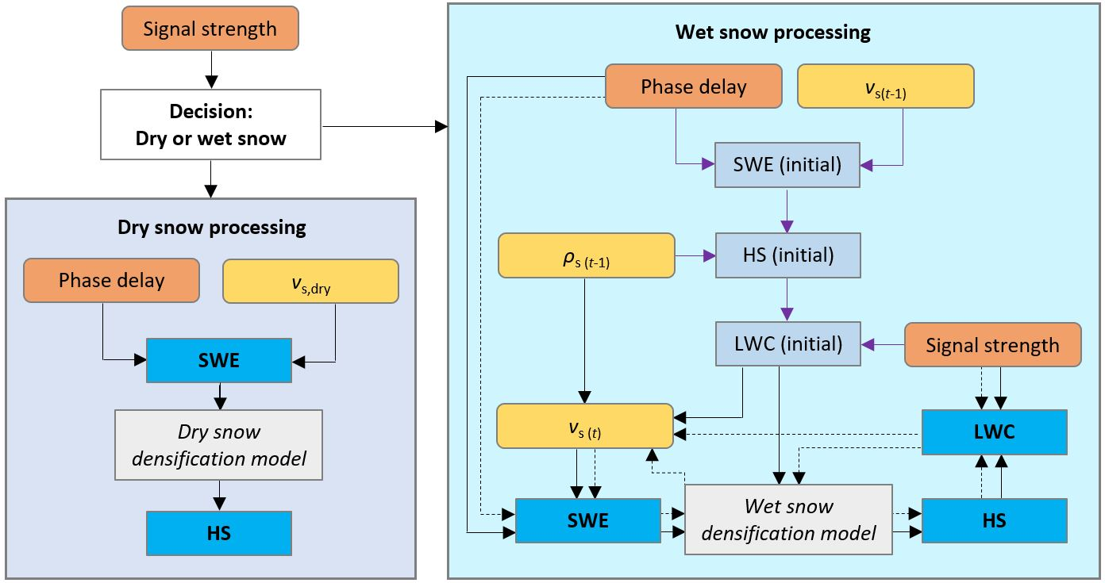
GNSS schematics
All pictures courtesy of ANavS GmbH
References: Koch et al. 2014 (Sensors); Schmid et al., 2015 (GRL); Henkel et al., 2018 (IEEE TGRS); Koch et al., 2019 (WRR); Appel et al., 2019; Capelli et al., 2021 (TCD)
EGU General Assembly – 1st May 2025

