Slide 1
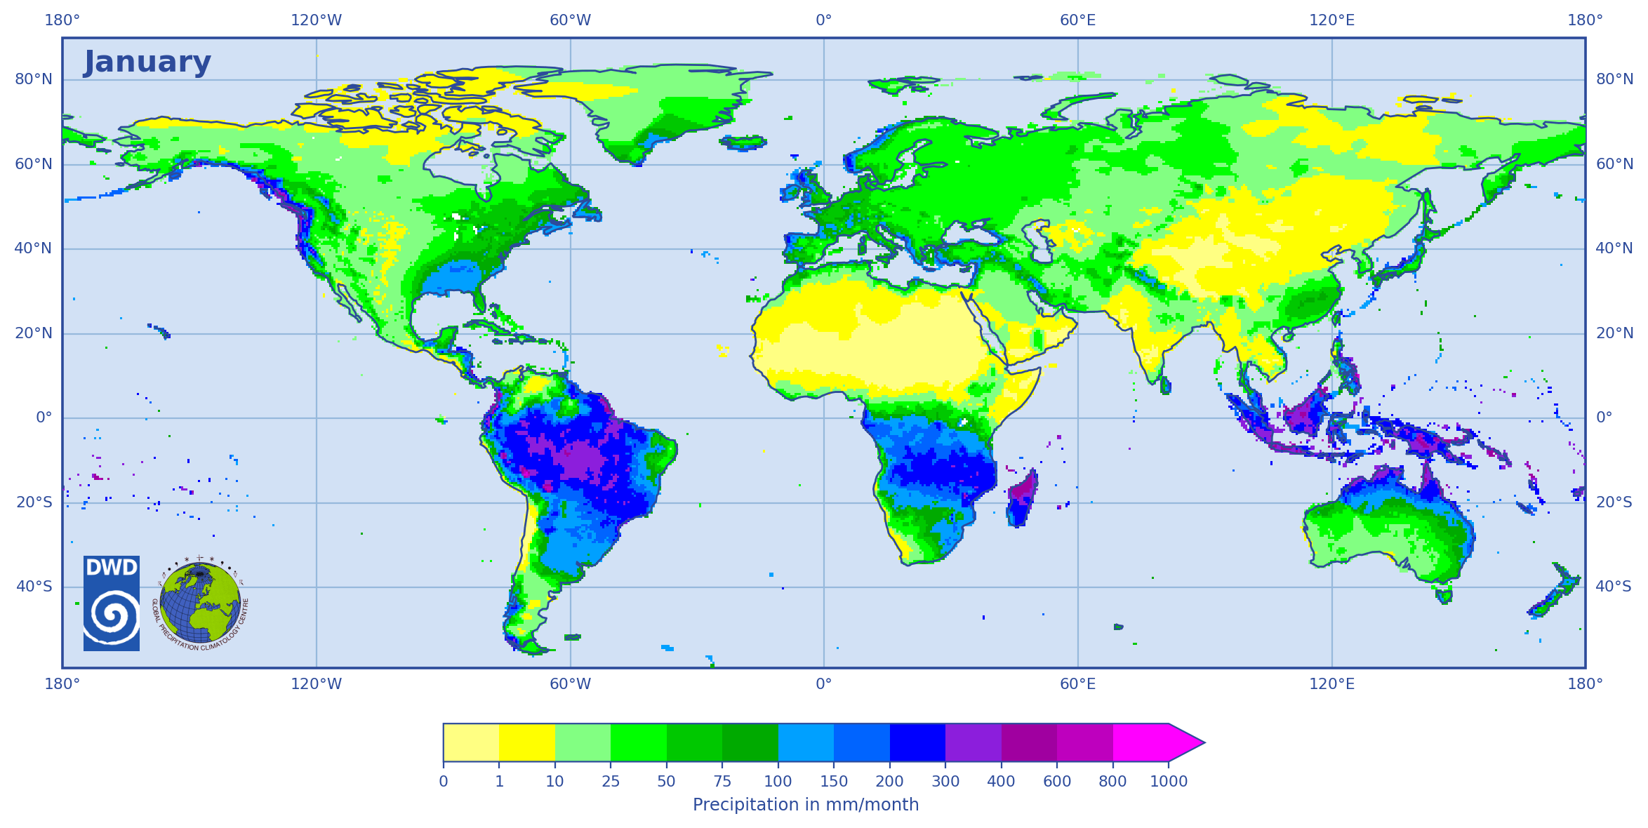

Global Precipitation Climatology Centre GPCC
Webpage:
  https://gpcc.dwd.de/
Dowload gate:
  https://opendata.dwd.de/climate_environment/GPCC/html/download_gate.html
Contact:
  gpcc@dwd.de
Figure: Precipitation Climatology Version 2022 (reference period 1951 - 2000)

Slide 2

New products of the
Global Precipitation Climatology Centre
Zora Schirmeister, Markus Ziese, Elke Rustemeier, Peter Finger, Astrid Heller, Raphaele Schulze, Magdalena Zepperitz, Siegfried Fränkling, Michael Jahn, Jan Nicolas Breidenbach

Slide 3
Why a Global Precipitation Climatology Centre?
To provide reliable reference information for the assessment of precipitation events and the quantification of the global water cycle
Climate change enhances the demand for reliable and up to date reference information
GPCC was established at the beginning of 1989 at Deutscher Wetterdienst (DWD) on invitation by WMO; now in operation for more than 35 years
GPCC’s main task is the analysis of precipitation on the basis of in-situ data for the land-surface
GPCC is contributing to GEWEX (Global Energy and Water Exchanges Project) and to GCOS (Global Climate Observing System)
Within GDAP it is the component for the analysis of the in-situ measurements for the GPCP (Global Precipitation Climatology Project)
Tasks
  Continuous collection, quality controlling and archiving of global precipitation observation
  Provision of gridded precipitation analyses for monthly and daily sums
  Available here: https://gpcc.dwd.de/
HOME
GPCC Background
Data base
Interpolation
GPCC‘s Analyses
Literature
Summary

Slide 4
GPCC application areas
Science:
  Water cycle
  Drought monitoring
  Changes in precipitation (due to climate change)
  Occurrence/spread of plants and animals (e.g. spread of ticks)
Calibration of satellite data
Validation/Tuning numerical weather-/climate models
Industry (water availability, yield forecasts)
… and for holiday planning
HOME
GPCC Background
Data base
Interpolation
GPCC‘s Analyses
Literature
Summary
Notes:
https://kunden.dwd.de/GPCC/Visualizer

Slide 5
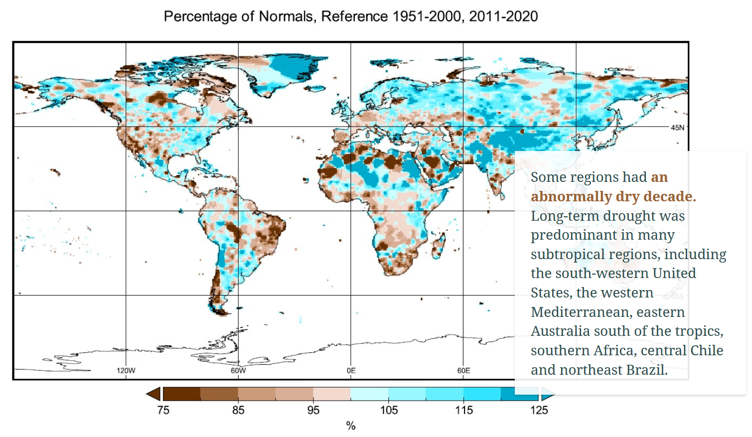
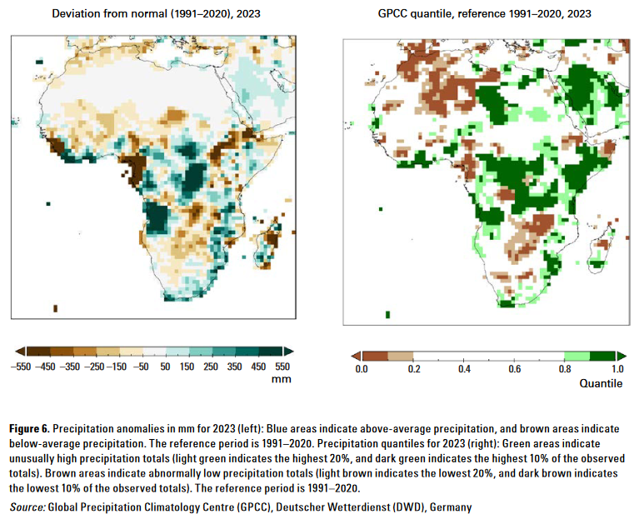
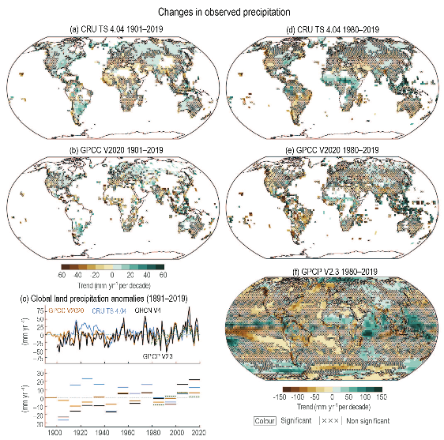
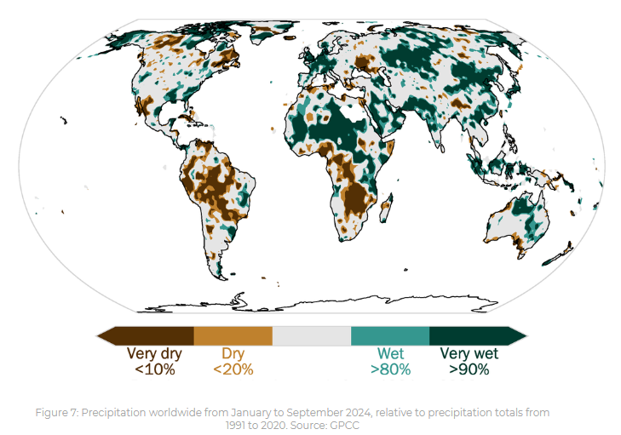
Usage of GPCC products in Publications (examples)
WMO Decadal State of the Climate 2011-2020
IPCC AR6 WG1
WMO State of the Climate in Africa 2023
GPCC contributes also to DWD reports
WMO State of the Climate 2024
HOME
GPCC Background
Data base
Interpolation
GPCC‘s Analyses
Literature
Summary

Slide 6
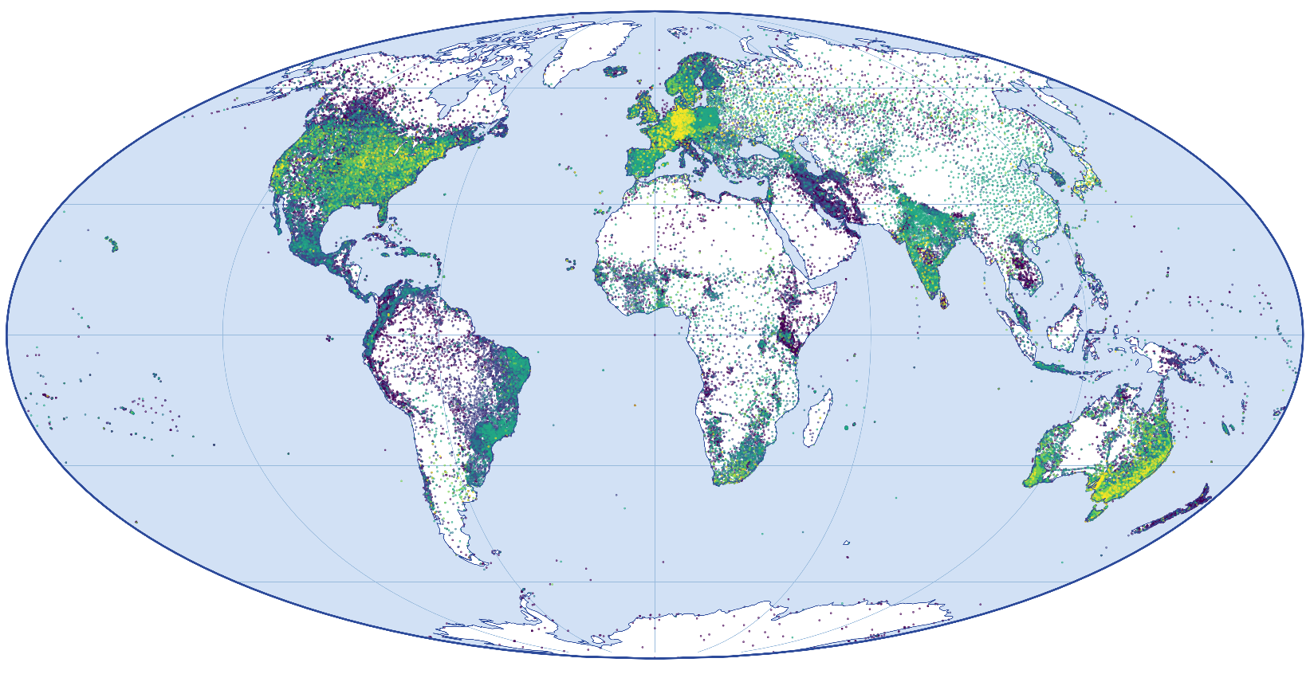
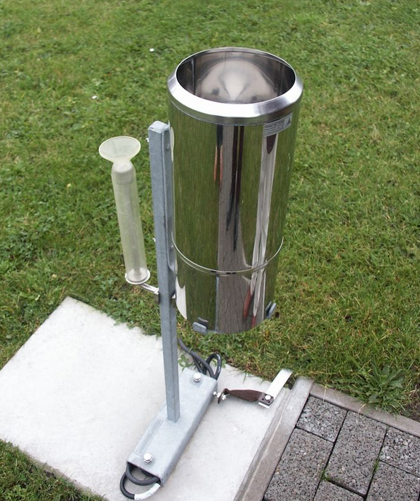
GPCC data base
Spatial distribution and length of time series of stations
more than 100 years
80 to 100 years
60 to 80 years
40 to 60 years
20 to 40 years
up to 20 years
Source: Deutscher Wetterdienst
HOME
GPCC Background
Data base
Interpolation
GPCC‘s Analyses
Literature
Summary

Slide 7
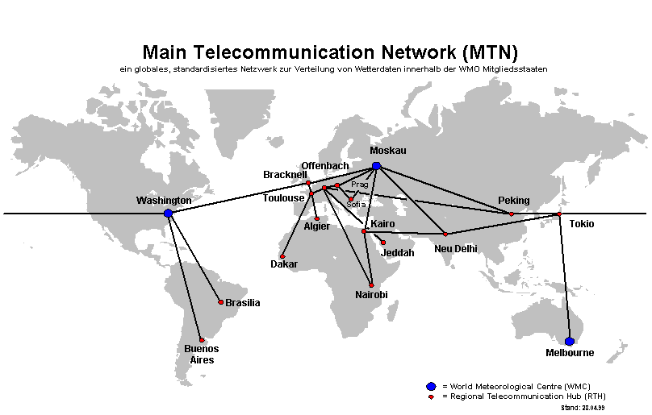
GPCC data sources
GTS = Global Telecommunication System;
a data exchange system of WMO
Near real-time:
  GTS SYNOP (DWD RTH Offenbach)
  GTS CLIMAT (DWD RTH Offenbach)
  GTS CLIMAT (JMA RTH Tokyo)
  SYNOP-based (NOAA RTH Washington)
Non real-time:
  Additional data from ca. 190 countries [here]
  International project data (GEWEX-related and other)
  Historical data collections (CRU, FAO, GHCN, ECA&D, …)
Source: Deutscher Wetterdienst
HOME
GPCC Background
Data base
Interpolation
GPCC‘s Analyses
Literature
Summary

Slide 8
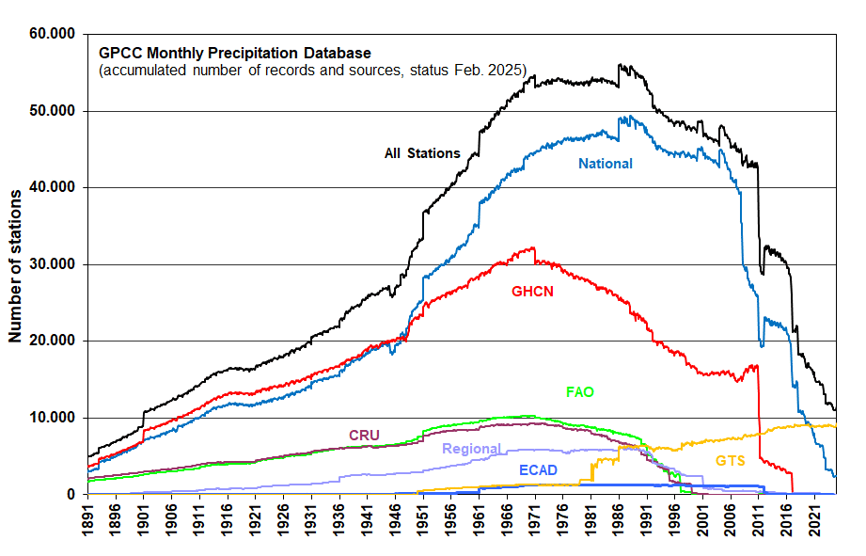
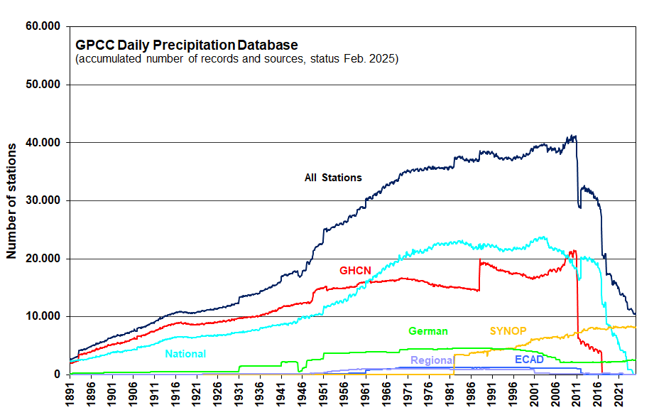
GPCC data base
Source: Deutscher Wetterdienst
Monthly totals, collected, quality controlled and integrated since 1989
Daily totals, collected, quality controlled and integrated since 2012
Number of stations in data bank: more than 126,000
HOME
GPCC Background
Data base
Interpolation
GPCC‘s Analyses
Literature
Summary

Slide 9
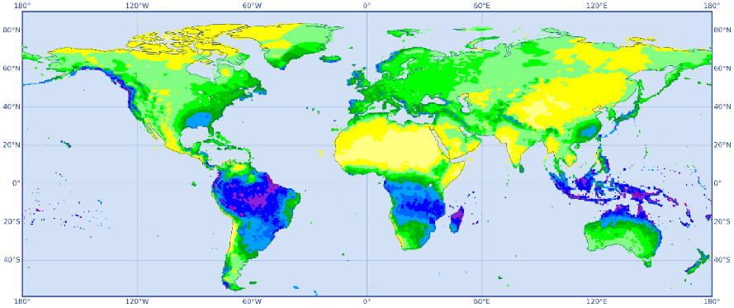
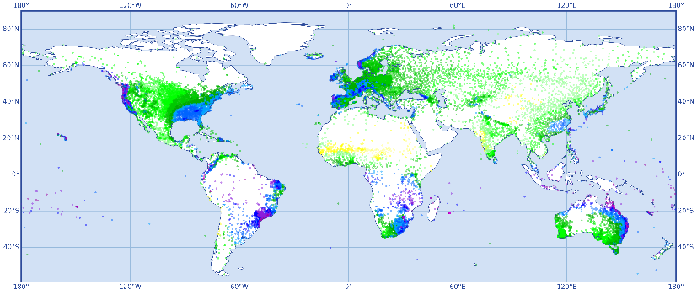
GPCC data flow
Gridded precipitation analyses
Rain gauge measurements
Quality Control
HOME
GPCC Background
Data base
Interpolation
GPCC‘s Analyses
Literature
Summary

Slide 10
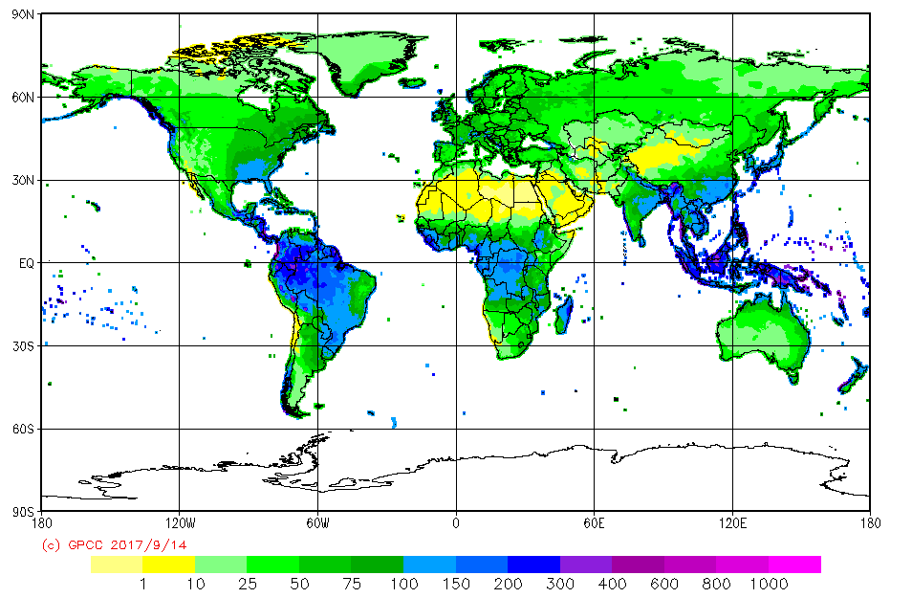
GPCC data flow
Data stored in data bank
All data in same format
Data delivered in different formats
Quality Control
Quality Control
Extracted data for analyses
Quality Control
HOME
GPCC Background
Data base
Interpolation
GPCC‘s Analyses
Literature
Summary

Slide 11
GPCC quality control
A multi-layer quality control procedure is implemented at GPCC, combining automatic and manual routines depending on data source and product
Coding of data, missing values, trace amounts
Coordinate reference of meta data
Check meta data against existing stations in DB
Check new data against station/grid statistics
Visual spatial comparison of extreme values
Homogenization of time series (possible only for regions with high station densities)
Applied QC-flags: original, confirmed, corrected & deleted (not physical)
HOME
GPCC Background
Data base
Interpolation
GPCC‘s Analyses
Literature
Summary

Slide 12
GPCC quality control
Examples for typical errors detected in the QC processing
Data sometimes shifted by a month, or even a year
Factor*10 errors in precipitation rates
Typing or coding errors
Errors in the conversion of inch, mm etc. (mostly with historical data)
Incorrect flagging of missing precipitation observations (might be misinterpreted as ”0“)
Different definition of a day
Wrong metadata (coordinates / height)
Data from different sources are stored separately in the data base, being very helpful in the quality control processing.
HOME
GPCC Background
Data base
Interpolation
GPCC‘s Analyses
Literature
Summary

Slide 13
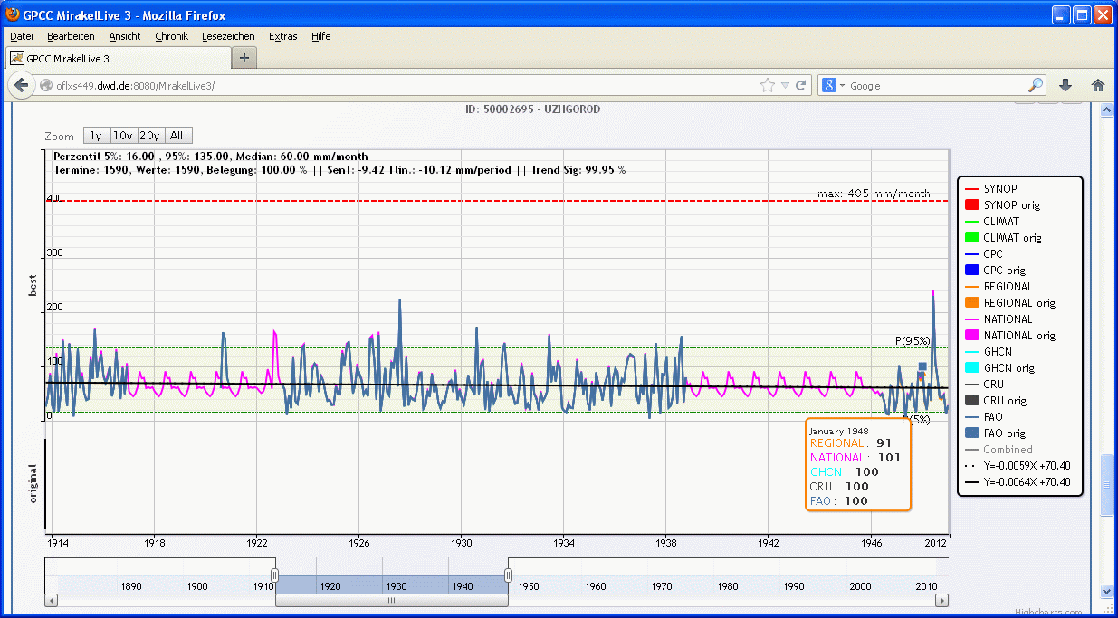
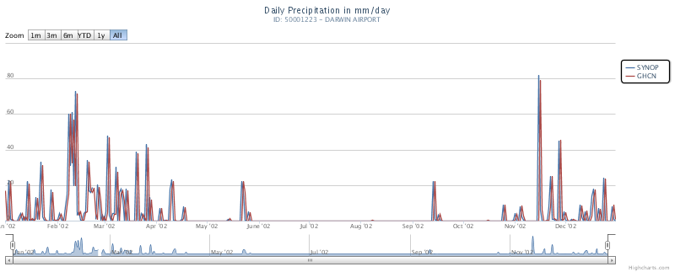
GPCC quality control - examples
Gaps filled with long-term means:
Time stamp shifted by one day:
HOME
GPCC Background
Data base
Interpolation
GPCC‘s Analyses
Literature
Summary

Slide 14
Interpolation
Modified SPHEREMAP
Willmott et al. (1985)
Application of Shepard’s scheme on a sphere (Shepard, 1968)
Current operational interpolation scheme at GPCC
Combines angular and distance weighting
Uses at least 4, at most 10 stations
Search radius depends on station density
For more information see Becker et al. (2013).
HOME
GPCC Background
Data base
Interpolation
GPCC‘s Analyses
Literature
Summary

Slide 15
GPCC‘s Analyses
More...
First Guess Monthly
1.0°
2004 – present
Monitoring Version 2022
1.0°, 2.5°
1982 – present
Full Data Monthly Version 2022
0.25°, 0.5°, 1.0°, 2.5°
1891 – 2020
Drought monitoring
Calibration of satellite data
Hydrologi-cal studies
Monthly Totals
Daily Totals
Updated in 2024!
Will be updated in 2025!
HOMPRA Europe V. 2
0.5°, 1.0°, 2.5°
1951 – 2015
Trend analysis
Precipitation Climatology Version 2022
0.25°, 0.5°, 1.0°, 2.5°
1951 / 2000
As a reference,
and for utilization of the anomaly interpola-tion method
Drought Index
1.0°
1952 – present
GPCC Visualizer
Create maps with your of the GPCC products
Drought monitoring
First Guess Daily
1.0°
2009 – present
Full Data Daily Version 2022
1.0°
1982 – 2020
Analysis of extremes
Analysis of extremes
Will be updated in 2025!
Will be updated in 2025!
Will be updated in 2025!
HOME
GPCC Background
Data base
Interpolation
GPCC‘s Analyses
Literature
Summary

Slide 16
GPCC product updates
Update in 2024:
GPCC Homogenized Precipitation Analysis HOMPRA for Europe Version 2.0
  Version 1: 1951 – 2005 → 1951 – 2015
Updates in autumn 2025:
Precipitation Climatology V. 2022 → Version 2025
  Include the newest station data
Full Data Monthly V. 2022 → Version 2025
  Version 2022: 1891 – 2020 → 1891 – 202x
Full Data Daily V. 2022 → Version 2025
  Version 2022: 1982 – 2020 → 1982 – 202x
Monitoring V. 2022 → Version 2025
  Some major changes
HOME
GPCC Background
Data base
Interpolation
GPCC‘s Analyses
Literature
Summary

Slide 17
GPCC product distribution
Various analysis products for different usage requirements
Only gridded analyses distributed
  No station (meta) data
DWD OpenData-Server
Files in NetCDF-format
All data available at DWD’s OpenData-Server
https://opendata.dwd.de/climate_environment/GPCC/html/download_gate.html
HOME
GPCC Background
Data base
Interpolation
GPCC‘s Analyses
Literature
Summary

Slide 18
Will be updated in 2025!
GPCC’s Precipitation Climatology Version 2022
[here]
Globally Gridded Monthly Totals
Based on 1951 / 2000
Monthly totals & Total Year
0.25°, 0.5°, 1.0°, 2.5°
Consists of normals from ca. 86,000 stations
Also for 30-year reference periods for 1961-1990, 1951-1980 or 1971-2000
As a reference, and for utilization of the anomaly interpolation method
HOME
GPCC Background
Data base
Interpolation
GPCC‘s Analyses
Literature
Summary

Slide 19
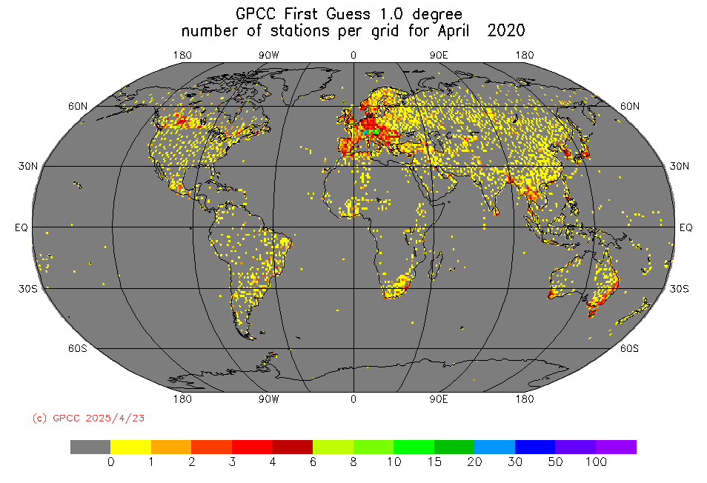
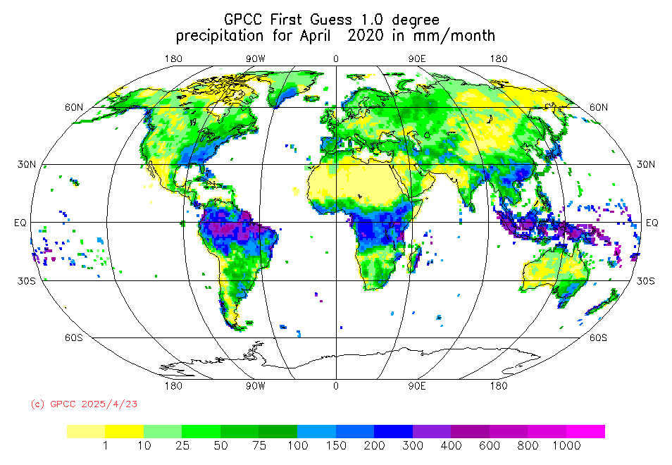
GPCC‘s First Guess Monthly Product
[here]
Near Real-Time First Guess Monthly Land-Surface Precipitation
Monthly update cycle
From August 2004 until the previous month (3-5 days after its completion)
From Rain-Gauges based on SYNOP Data from WMO GTS
1.0° x 1.0° grid resolution
Basic quality control
Anomalie interpolation
For purposes with high timeliness, e.g., for drought monitoring or watch purposes
HOME
GPCC Background
Data base
Interpolation
GPCC‘s Analyses
Literature
Summary

Slide 20
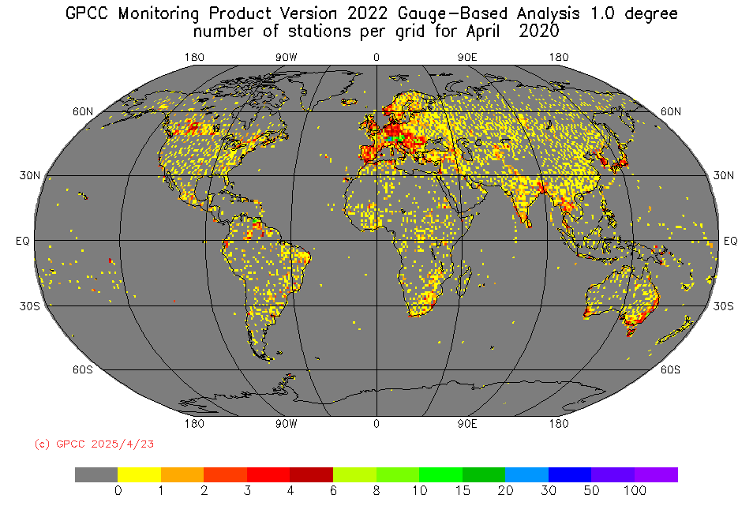

GPCC‘s Monitoring Product
[here]
Near Real-Time Monthly Land-Surface Precipitation from Rain-Gauges
Based on SYNOP and CLIMAT data from WMO GTS
1.0° x 1.0° and 2.5° x 2.5°
Monthly update cycle with 2-month delay
Quality controlled data
In situ component to the satellite-gauge combined precipitation analyses of the Global Precipitation Climatology Product (GPCP) and the CPC Merged Analysis of Precipitation (CMAP)
Supports regional climate monitoring
Will be updated in 2025!
HOME
GPCC Background
Data base
Interpolation
GPCC‘s Analyses
Literature
Summary

Slide 21
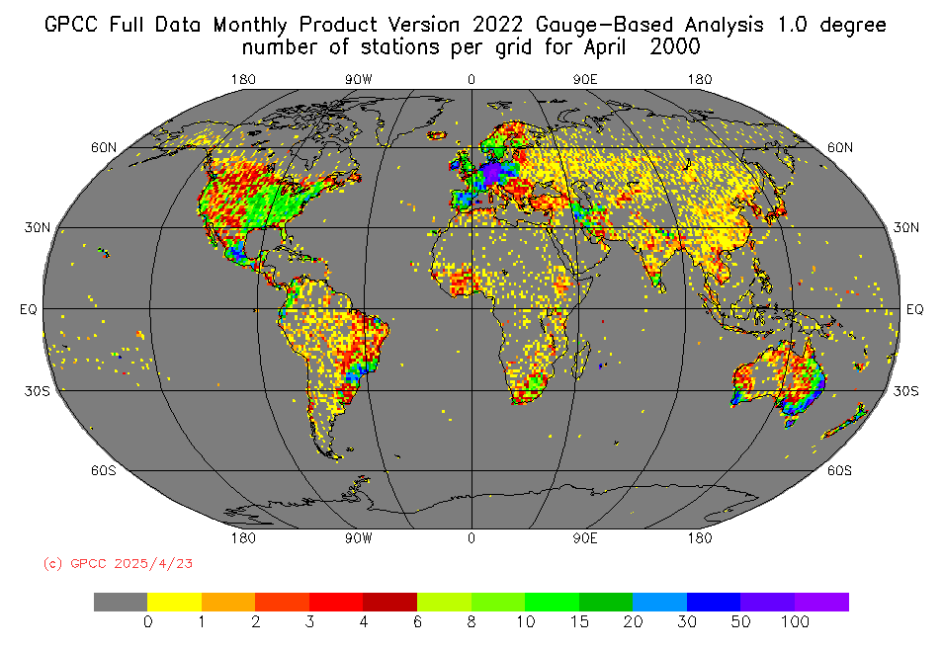
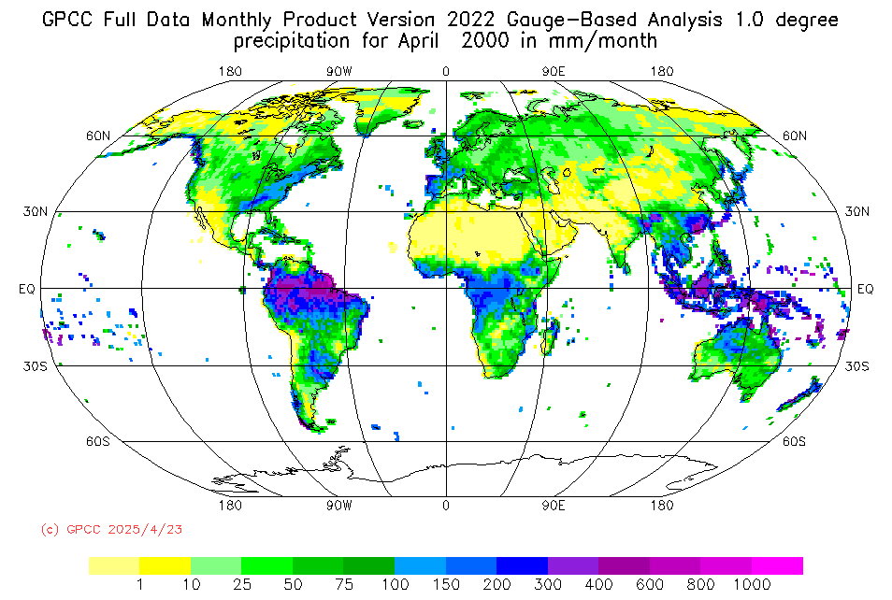
GPCC‘s Full Data Monthly Product
[here]
Monthly Land-Surface Precipitation from Rain-Gauges
1891 - 2020
Built on GTS-based and Historical Data (from national meteorological and hydrological services, regional and global data collections )
0.25°, 0.5°, 1.0°, 2.5°
Based on ca. 86,000 stations world-wide
Extensive quality control
Data coverage per month varies from ~20,000 to more than 52,000 stations
Application: hydrological studies
Will be updated in 2025!
HOME
GPCC Background
Data base
Interpolation
GPCC‘s Analyses
Literature
Summary

Slide 22
GPCC‘s First Guess Daily Product
[here]
Near Real-Time First Guess Daily Land-Surface Precipitation
From 2009 until the previous month
  3-5 days after its completion available
Monthly update cycle
From rain gauges based on SYNOP Data from WMO GTS
1.0° grid resolution
Basic quality control
For purposes with high timeliness, e.g.,
  For drought monitoring or watch purposes
  Globally study extreme events and related statistics at daily resolution
GPCC‘s Full Data Daily Product
[here]
Daily Land-Surface Precipitation from Rain-Gauges
1982 - 2020
Built on data provided by national meteorological and hydrological services, regional and global data collections as well as WMO GTS-data (all available data)
1.0° grid resolution
Extensive quality control
Recommended for analyses of extreme events and related statistics at daily resolution
Will be updated in 2025!
HOME
GPCC Background
Data base
Interpolation
GPCC‘s Analyses
Literature
Summary

Slide 23
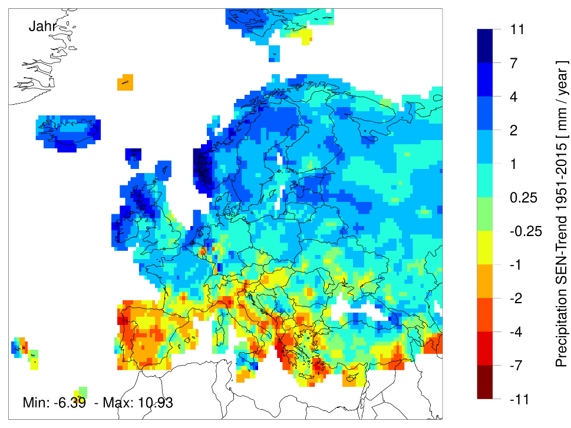
Precipitation SEN-Trend 1951 – 2015 based on HOMPRA Europe V. 2
GPCC Homogenized Precipitation Analysis HOMPRA for Europe Version 2.0
[here]
Homogenized Monthly Land-Surface Precipitation and Precipitation Normals from Rain-Gauges
0.5°, 1.0°, 2.5°
Built on quality controlled GTS-based and Historic Data
1951 - 2015
Consists of data from ca. 7916 stations over Europe
Only stations with at least 80% complete years of precipitation values
Updated in 2024!
HOME
GPCC Background
Data base
Interpolation
GPCC‘s Analyses
Literature
Summary

Slide 24
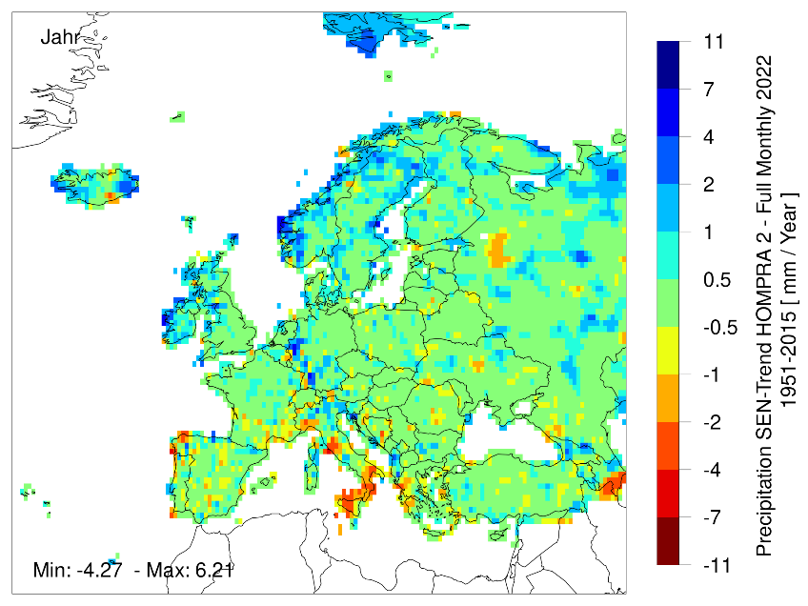
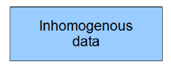
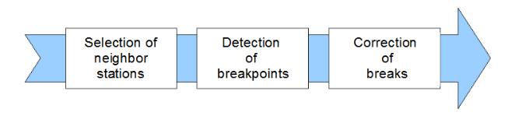
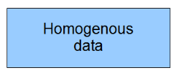
Difference between SEN-Trends 1951 – 2015 of HOMPRA Europe V. 2 and Full Data Monthly V. 2022
GPCC Homogenized Precipitation Analysis HOMPRA for Europe Version 2.0
[here]
Method
Rustemeier E. et al. (2017): HOMPRA Europe – A gridded precipitation data set from European homogenized time series in World Climate Data and Monitoring Programme (WCDMP) series 85, 88-10 [here]
HOME
GPCC Background
Data base
Interpolation
GPCC‘s Analyses
Literature
Summary

Slide 25
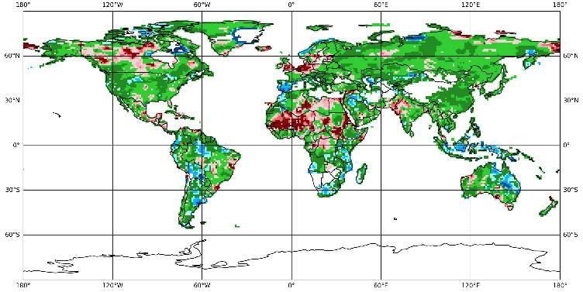
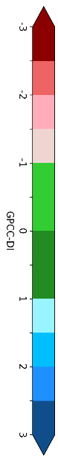

March 2025 – 1-month GPCC Drought Index
GPCC‘s Drought Index
[here, here]
Globally Gridded Drought Index
Retrospective analysis [here] and up-to-date version [here]
1952 – present
Updated on the 10th of the following month
Multiple aggregation periods (1, 3, 6, 9, 12, 24 & 48) months to account for different drought impacts
1.0° grid resolution
Combination of the Standardized Precipitation Index (SPI) in the DWD modification according to Pietzsch et al. (2011) and the water balance-based index Standardized Precipitation Evapotranspiration Index (SPEI)
Build of NOAA's Climate Prediction Center (CPC) Monthly Global Surface Air Temperature Data Set and GPCC’s First Guess Product
January to March 2025 – 3-month GPCC Drought Index
HOME
GPCC Background
Data base
Interpolation
GPCC‘s Analyses
Literature
Summary

Slide 26
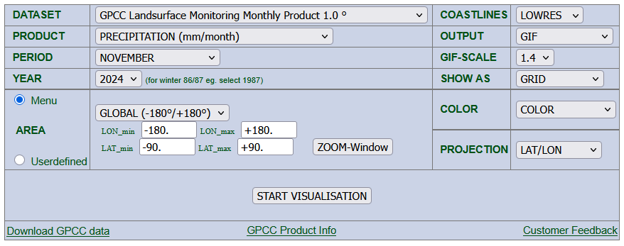
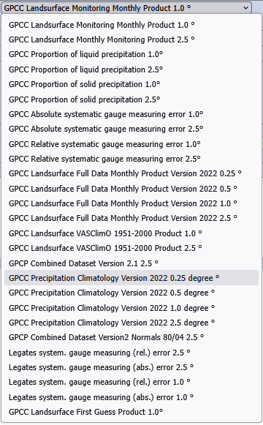
GPCC‘s Visualizer
https://kunden.dwd.de/GPCC/Visualizer
HOME
GPCC Background
Data base
Interpolation
GPCC‘s Analyses
Literature
Summary

Slide 27
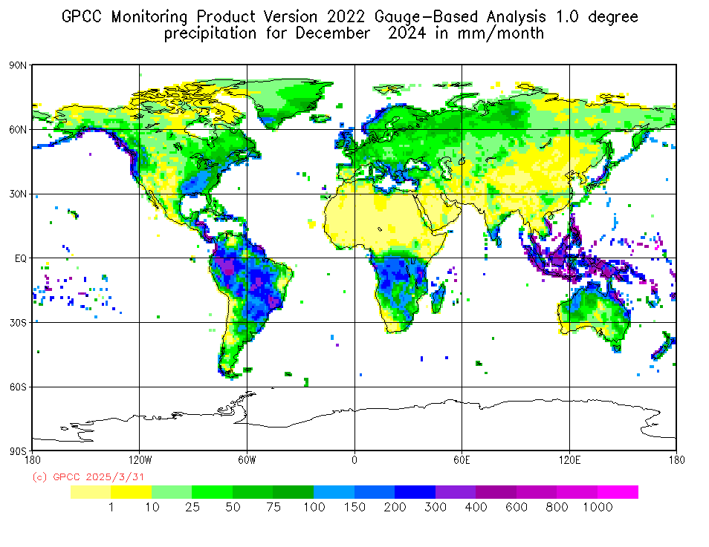
GPCC‘s Visualizer
https://kunden.dwd.de/GPCC/Visualizer
HOME
GPCC Background
Data base
Interpolation
GPCC‘s Analyses
Literature
Summary

Slide 28
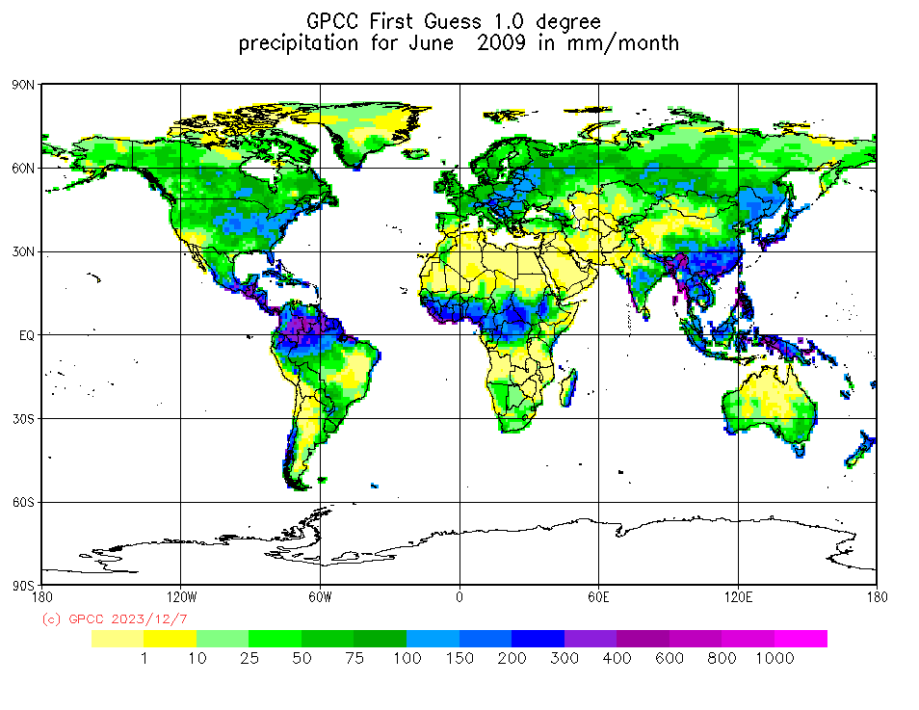
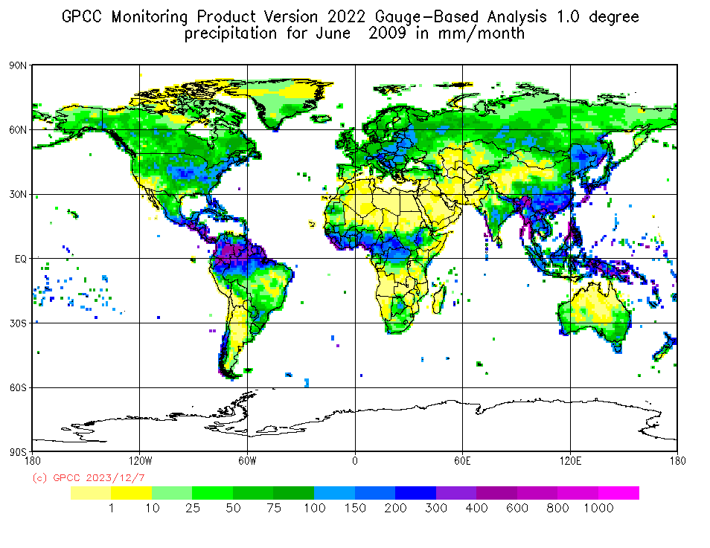

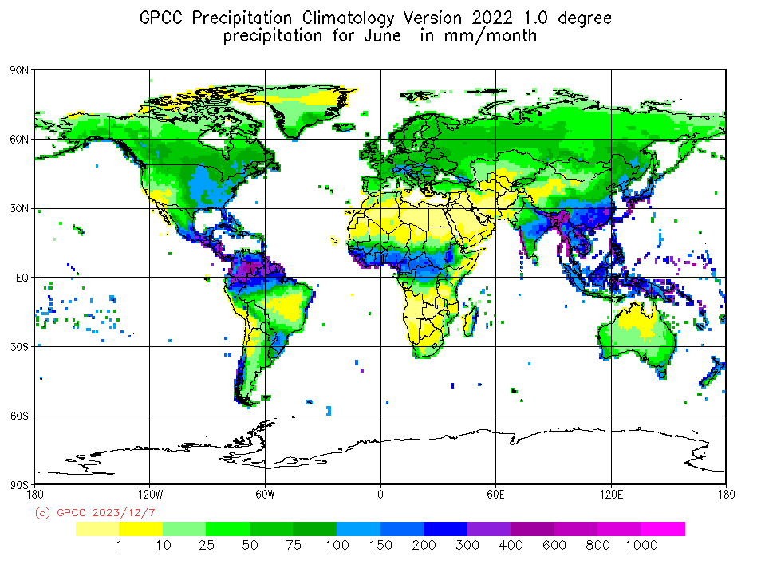
Differences in
GPCC’s products
First Guess Monthly
Monitoring Product
Example June 2009
Different data base and quality control
More data brings more structure
Full Data Monthly
Normals
→ Highlights regions with clear differences between the analyses
HOME
GPCC Background
Data base
Interpolation
GPCC‘s Analyses
Literature
Summary

Slide 29
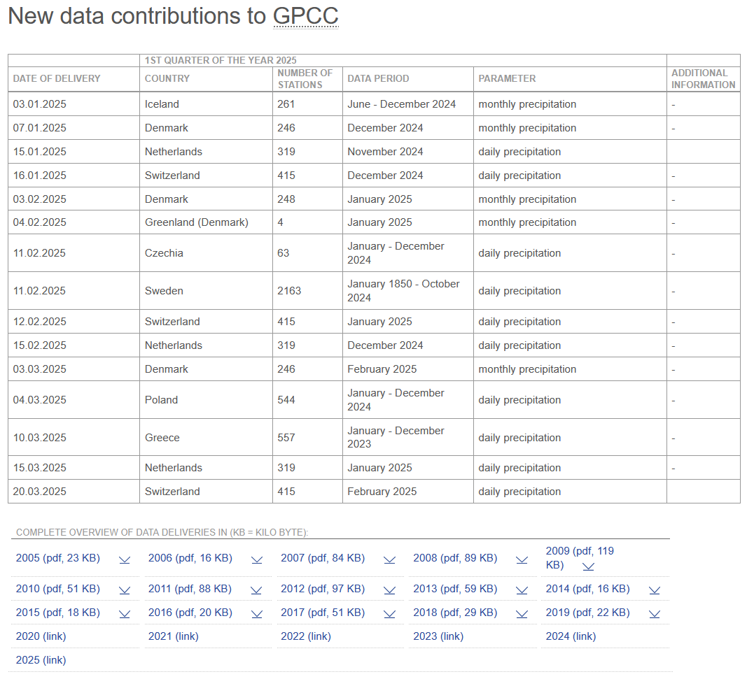
Many thanks to the data suppliers!
[here]
HOME
GPCC Background
Data base
Interpolation
GPCC‘s Analyses
Literature
Summary

Slide 30
GPCC‘s Literature (selection)
Adler, R. F., Sapiano, M. R. P., Huffman, G.J., Wang, J.-J., Gu, G., Bolvin, D., Chiu, L., Schneider, U., Becker, A., Nelkin, E., Xie, P., Ferraro, R., and D.-B. Shin, 2018: The Global Precipitation Climatology Project (GPCP) Monthly Analysis (New Version 2.3) and a Review of 2017 Global Precipitation. Atmosphere, 9(4), 138. doi:10.3390/atmos9040138
Becker, A., Finger, P., Meyer-Christoffer, A., Rudolf, B., Schamm, K., Schneider, U., and M. Ziese, 2013: A description of the global land-surface precipitation data products of the Global Precipitation Climatology Centre with sample applications including centennial (trend) analysis from 1901–present, Earth Syst. Sci. Data 5, 71-99. doi:10.5194/essd-5-71-2013
Rustemeier E. et al. (2017): HOMPRA Europe – A gridded precipitation data set from European homogenized time series in World Climate Data and Monitoring Programme (WCDMP) series 85, 88-10 [here]
Schamm, K., Ziese, M., Becker, A., Finger, P., Meyer-Christoffer, A., Schneider, U., Schröder, M., and Stender, P., 2014: Global gridded precipitation over land: a description of the new GPCC First Guess Daily product, Earth Syst. Sci. Data, 6, 49-60. doi:10.5194/essd-6-49-2014
Schneider, U., Becker, A., Finger, P., Meyer-Christoffer, A., Ziese, M. and B. Rudolf, 2014: GPCC's new land surface precipitation climatology based on quality-controlled in situ data and its role in quantifying the global water cycle. Theor. Appl. Climatol. 115, 15-40. doi:10.1007/s00704-013-0860-x
Schneider, U., Ziese, M., Meyer-Christoffer, A., Finger, P., Rustemeier, E., and A. Becker, 2016: The new portfolio of global precipitation data products of the Global Precipitation Climatology Centre suitable to assess and quantify the global water cycle and resources. Proc. IAHS, 93, 1-6. doi:10.5194/piahs-374-29-2016
Schneider, U., Finger, P., Meyer-Christoffer, A., Rustemeier, E., Ziese, M. and A. Becker, 2017: Evaluating the Hydrological Cycle over Land Using the Newly-Corrected Precipitation Climatology from the Global Precipitation Climatology Centre (GPCC), Atmosphere, 8(3), 52. doi:10.3390/atmos8030052
Ziese M., Schneider, U., Meyer-Christoffer, A., Schamm, K, Vido, J., Finger, P., Bissolli, P., Pietzsch, S. and A. Becker, 2014: GPCC Drought Index – a new, combined, and gridded global drought index Earth Syst. Sci. Data, 6, 285-295. doi:10.5194/essd-6-285-2014
Many more on https://www.dwd.de/EN/ourservices/gpcc/reports_publications/home_reports_publications.html
HOME
GPCC Background
Data base
Interpolation
GPCC‘s Analyses
Literature
Summary

Slide 31
Literature (beyond GPCC)
Pietzsch, S. and Bissolli, P.: A modified drought index for WMO RA VI, Adv. Sci. Res., 6, 275–279, https://doi.org/10.5194/asr-6-275-2011, 2011.
D. Shepard. A two-dimensional interpolation function for irregularly-spaced data. In Proceedings of the 1968 23rd ACM national conference, pages 517–524, 1968.
C. J. Willmott, C. M. Rowe, and W. D. Philpot. Small-scale climate maps: A sensitivity analysis of some common assumptions associated with grid-point interpolation and contouring. The American Cartographer, 12(1):5–16, 1985.
HOME
GPCC Background
Data base
Interpolation
GPCC‘s Analyses
Literature
Summary

Slide 32
Summary
Updated Products in 2025
Climatology
Full Data Monthly
Full Data daily
Monitoring Product
Updated in 2024
HOMPRA Europe Version 2
Products are available from GPCCs website https://gpcc.dwd.de
HOME
GPCC Background
Data base
Interpolation
GPCC‘s Analyses
Literature
Summary

Slide 33
Downloadgate
DWD OpenData-Server
https://opendata.dwd.de/climate_environment/GPCC/html/download_gate.html
https://gpcc.dwd.de
HOME
GPCC Background
Data base
Interpolation
GPCC‘s Analyses
Literature
Summary

Slide 34
DOI referenced GPCC products
First Guess Monthly Product [here]
First Guess Daily Product [here]
Monitoring Product Version 2022 [here]
Full Data Monthly Product Version 2022 [here]
Full Data Daily Version 2022 [here]
HOAPS/GPCC global daily precipitation data record with uncertainty estimates using satellite and gauge based observations Version 2 [here]
Homogenized Precipitation Analysis ”HOMPRA” for Europe , Version 2.0 [here]
Precipitation Climatology Version 2022 [here]
GPCC Drought Index Product (GPCC DI) [here]
GPCC Drought Index Product (GPCC DI), Version 1.1 [here]
Non-DOI referenced product
Provisional daily precipitation analyses [here]
HOME
GPCC Background
Data base
Interpolation
GPCC‘s Analyses
Literature
Summary

Slide 35
Thank you for your attention!
We would also like to thank our data providers for the good and long cooperation, which made these analyses and product developments possible.
- the GPCC team -
HOME
GPCC Background
Data base
Interpolation
GPCC‘s Analyses
Literature
Summary

