Slide 1
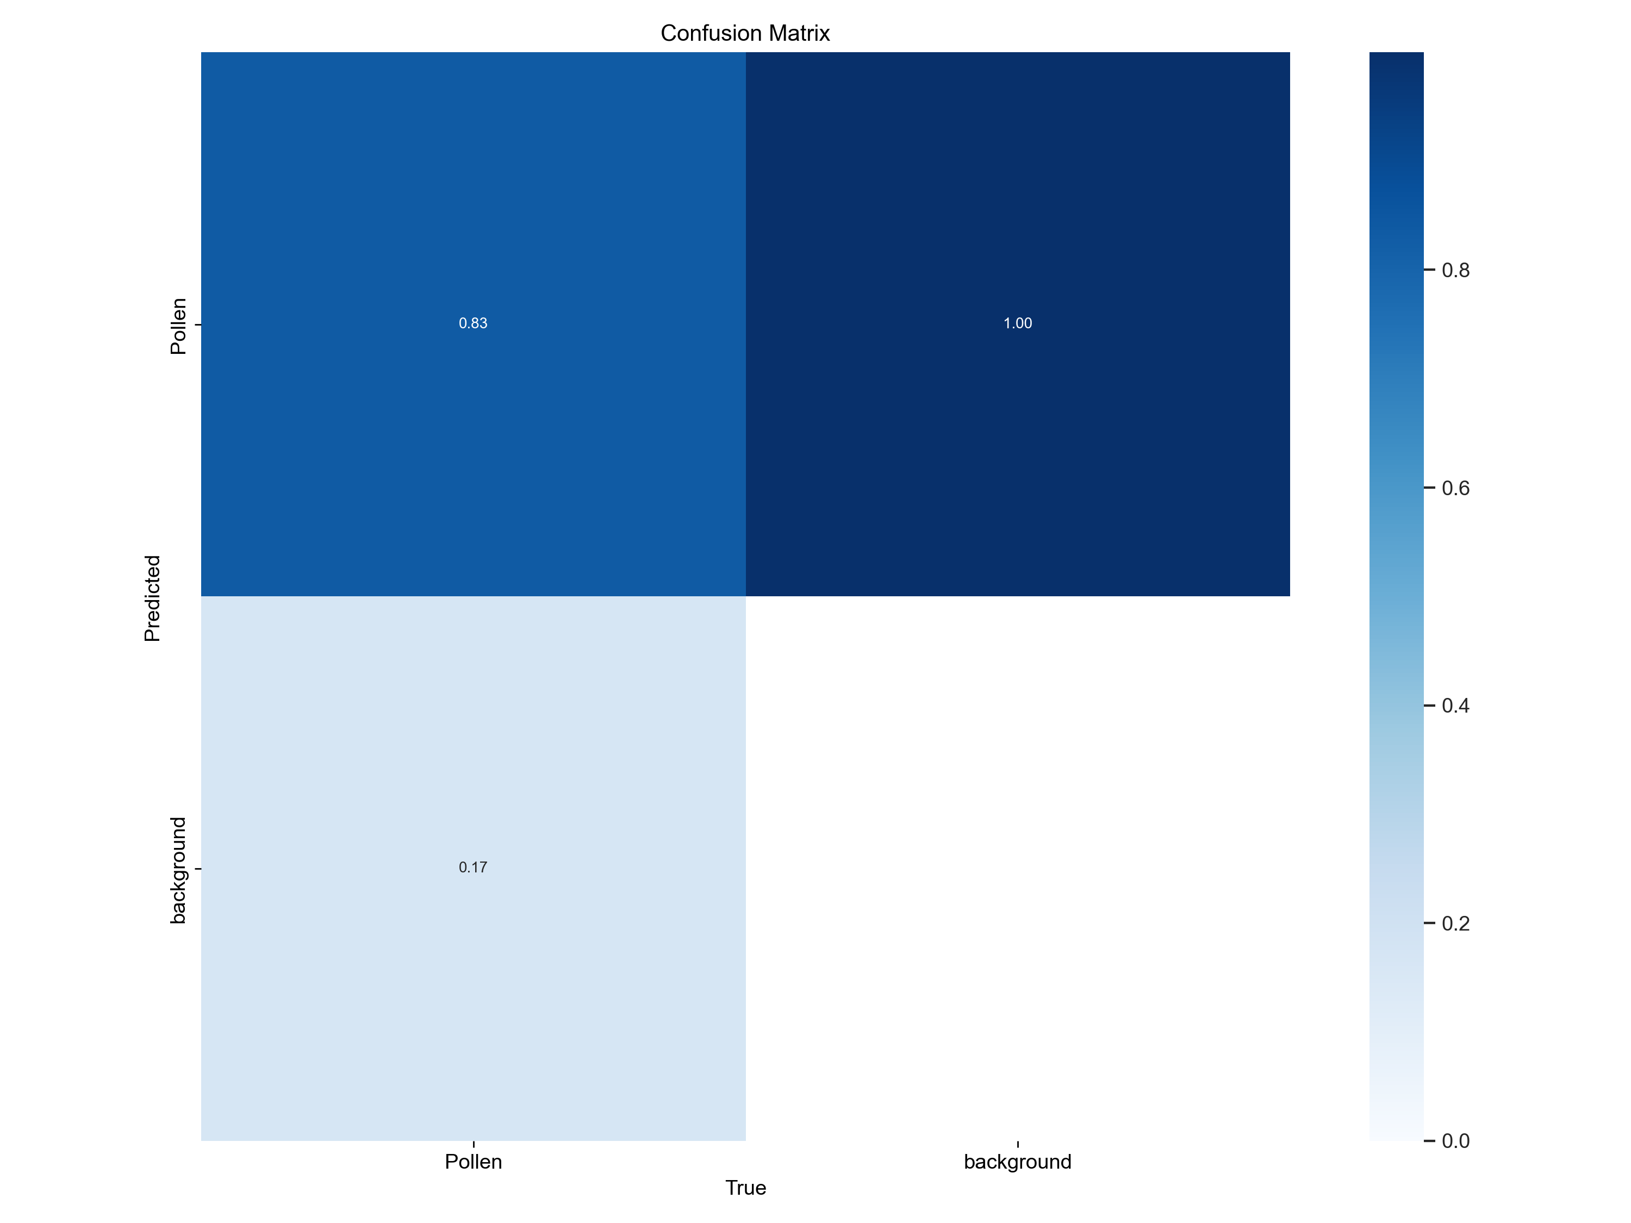
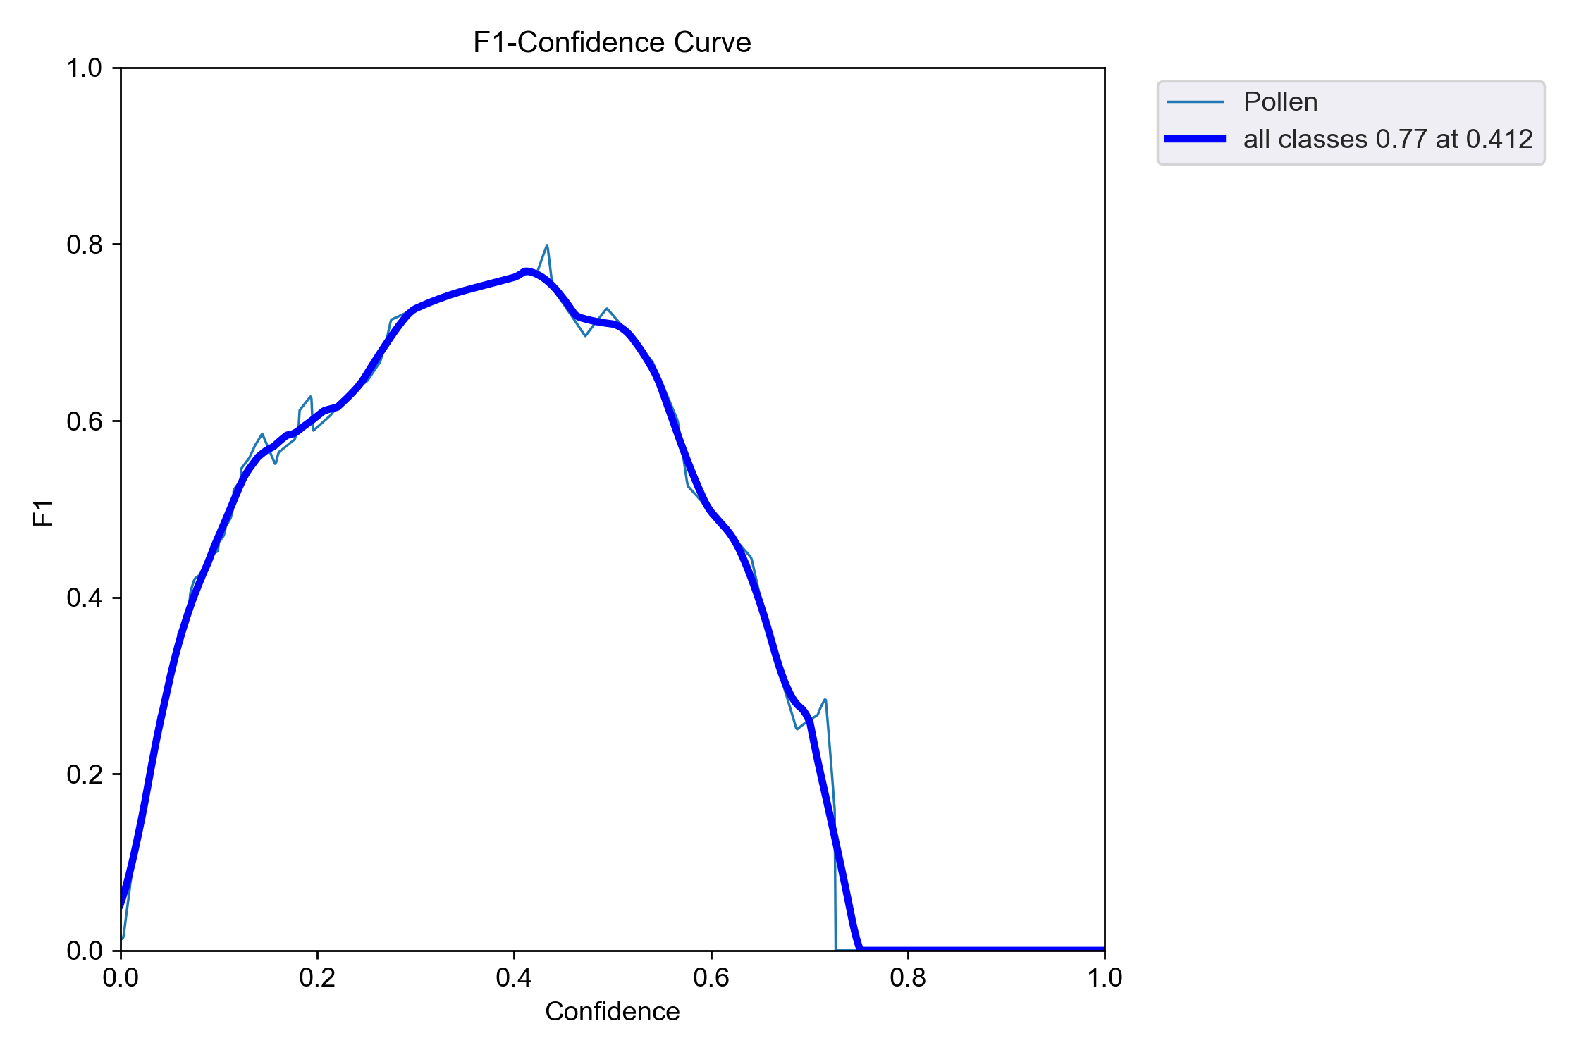
Label-free Ambient Pollen Identification and Classification Using Total Internal Reflection Microscopy and Deep Learning
Sachin Dhawan ^{1,*}, Anuj Saxena ², Anand Kumar ², Mukesh Khare ^{1,3}, Dalip Singh Mehta ^{1,2,4}
¹ School of Interdisciplinary Research, Indian Institute of Technology, Delhi, 110016
² Centre for Sensors, Instrumentation and Cyber-physical System Engineering (SeNSE), Indian Institute of Technology, Delhi, 110016
³ Department of Civil Engineering, Indian Institute of Technology, Delhi, 110016
⁴ Department of Physics, Indian Institute of Technology, Delhi, 110016
* sdhawan586@gmail.com
Indian Institute of Technology Delhi, India
EGU25-974
1. Introduction
Pollen particles are the most abundant primary biological airborne particles among different atmospheric bioaerosols.
Responsible for pathogenesis of respiratory allergic diseases, particularly asthma and rhinitis.
Ambient sample complexity increases detection difficulty
Conventional BF microscopy = low contrast + high noise
TIR microscopy improves contrast, reduces background noise and enhances surface features
The application of AI and ML in pollen identification marks a significant shift from traditional methods
2. The Need
Non-invasive, no-sample preparation and precise identification of pollen in ambient samples
Better visualization of pollen boundary and additional surface features, such as the polarity and aperture patterns
Rapid, real-time classification of pollen species
4. Total Internal Reflection Microscopy
Total Internal Reflection Microscopy (TIR) uses the unique properties of an evanescent wave formed when a light beam undergoes total internal reflection at an optical interface.
This field illuminates the sample up to a certain depth (~500nm), avoiding background noise and producing high-contrast images with high SNR.
6. Label-free Identification using TIR
Bright Field Image
Glass Slide
Ambient Pollen Sample
TIR LED
TIR microscopy stands out by enabling pollen identification while significantly reducing background noise
This distinctive feature showcases TIR microscopy's efficacy in enhancing clarity and ease of pollen visualization compared to BF microscopy
TIR Image
7. Object Detection Model Performance
5. One-stage Object Detection Model Architecture
The model demonstrates strong performance, with a high F1 score for detecting pollen (0.83) and a well-balanced overall performance (F1 score of 0.77 for all classes).
The model’s mean average performance is 76.7% across all classes at a threshold of 0.5, indicating good performance.
3. The Challenge
Complex Backgrounds and Feature Extraction
Dataset Limitations
Eliminating the need for human-defined features
Autonomously learning features from images
1. Input
Pre-processed image data (e.g., 640x640 pixels).
Operations: Resizing, normalization, and augmentation for feature enhancement.
2. Feature Extraction: CNN-Based Backbone
Purpose: Extracts meaningful features from the input.
Key Details:
Uses convolutional layers with advanced connectivity (e.g., partial connections) to optimize computation.
3. Feature Aggregation: Multi-Scale Feature Fusion
Purpose: Combines features from different layers for multi-scale detection.
4. Decision-Making: Detection Head
Purpose: Predicts object locations and classifications.
Key Details:
Uses anchor-based bounding box regression.
Outputs object confidence and class probabilities for multiple scales.
8. Conclusion
TIR microscopy combined with automated analysis offers a label-free, real-time, and field-deployable solution
These results highlight the novel potential of TIR microscopy with deep learning as a method for precise, effective, and scalable pollen monitoring.
References: 1. Rostami, M.A., Balmaki, B., Dyer, L.A., Allen, J.M., Sallam, M.F., Frontalini, F., 2023. Efficient pollen grain classification using pre-trained Convolutional Neural Networks: a comprehensive study. J Big Data 10. https://doi.org/10.1186/s40537-023-00815-3
2. S. Dhawan, A. Kumar, M. Khare, and D. S. Mehta, “Design and Validation of a portable sampler to monitor pollens at street level in the ambient environment,” in EGU General Assembly 2024, 2024. doi: 10.5194/egusphere-egu24-198.
3. J. Y. Walz, “Measuring particle interactions with total internal reflection microscopy,” Curr Opin Colloid Interface Sci, vol. 2, no. 6, pp. 600–606, Dec. 1997, doi: 10.1016/s1359 0294(97)80052-0.
Acknowledgement S. Dhawan sincerely acknowledge the support provided by the Indian Institute of Technology Delhi for enabling this research work.

