Slide 1



Ten-year trend of PM_{2.5} sulfate, nitrate, and other inorganic constituents from 2012 to 2021 at urban and suburban sites of Hong Kong, China
EGU25-9750
Session AS3.32
Presenter: Zijing ZHANG
Email: zzhangfi@connect.ust.hk
April 28, 2025
Zhang, Z. and Yu, J.: Ten-year trend of PM2.5 sulfate, nitrate, and other inorganic constituents from 2012 to 2021 in urban and suburban sites of Hong Kong, China, EGU General Assembly 2025, Vienna, Austria, 27 Apr–2 May 2025, EGU25-9750, https://doi.org/10.5194/egusphere-egu25-9750, 2025.

Slide 2

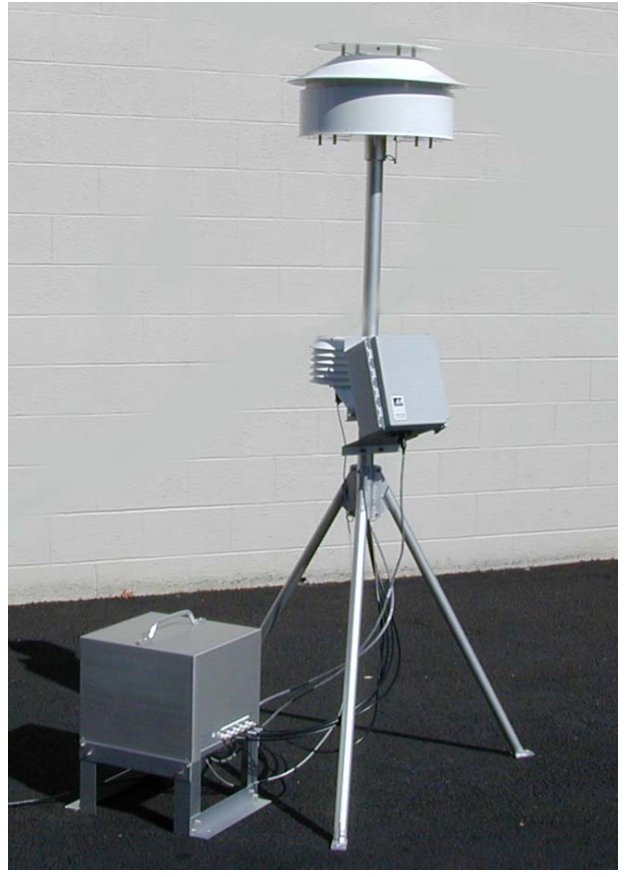
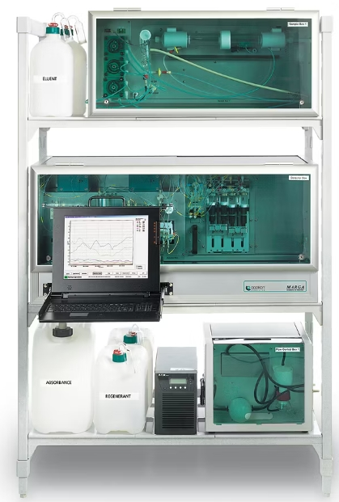
1. Introduction and Method
Sampling sites
  Urban: Yuen Long Air Quality Monitoring Station (YL)
  Suburban: HKUST Supersite (UST)
Offline vs. online monitoring
  Offline: Mid-volume sampler with Teflon filters
  Online: Monitor for AeRosols and Gases in Ambient air (MARGA)
YL
UST
Offline sampler
Online MARGA

Slide 3
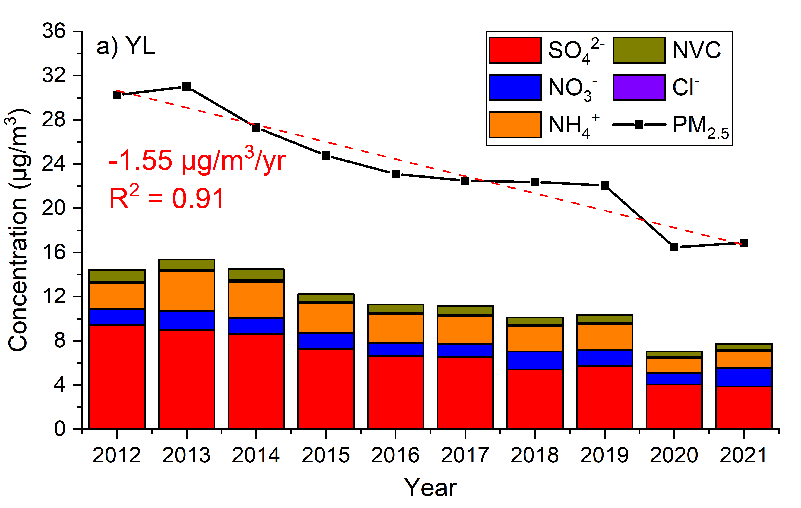
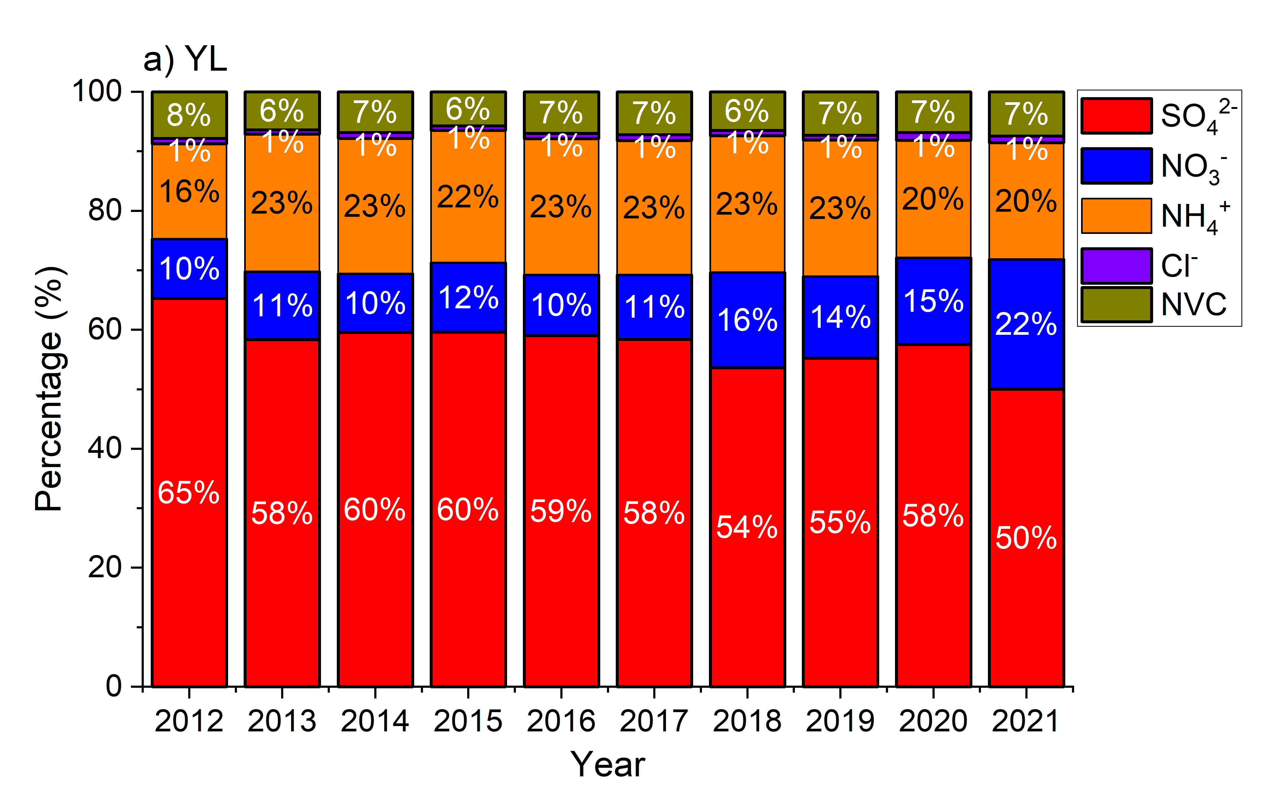
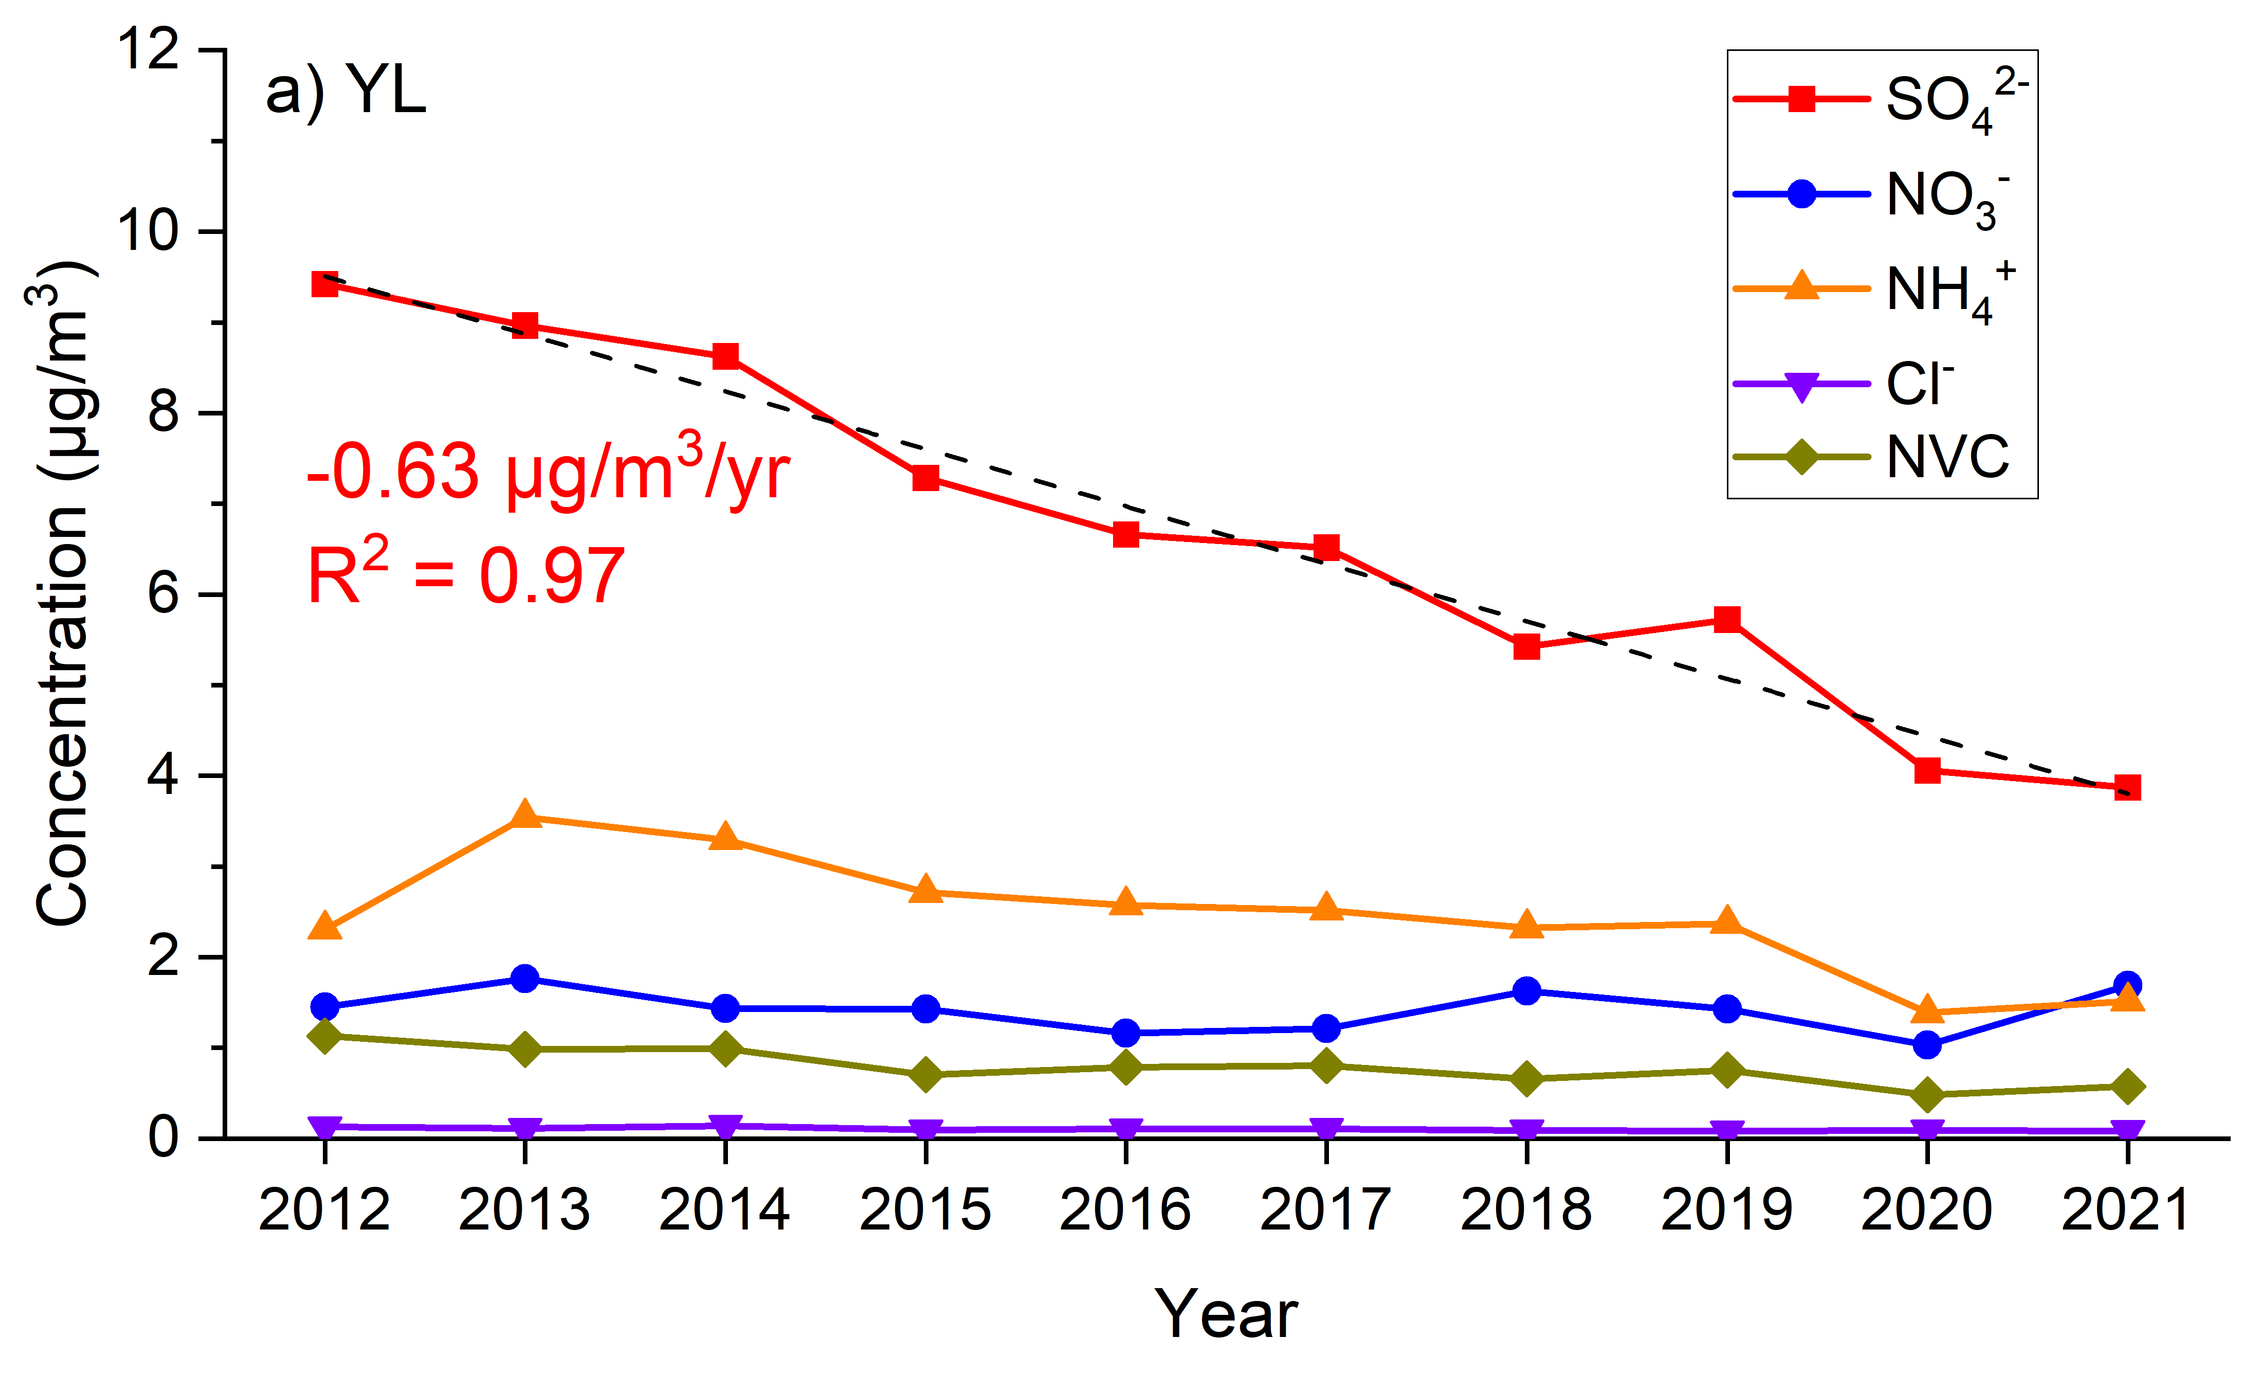
2. Results and conclusions
Fig. 3 Annual trend of filter-measured mass fractions of inorganic ions.
Fig. 1 Annual trend of filter measured concentration of PM_{2.5} and total inorganic ions.
PM_{2.5} showed a decreasing trend over the years (p < 0.01), and sulfate contributed around 40% of the reduction.
Nitrate and ammonium took up a larger mass fraction of PM_{2.5}.
Fig. 2 Annual trend of filter measured concentration of each ion.

Slide 4
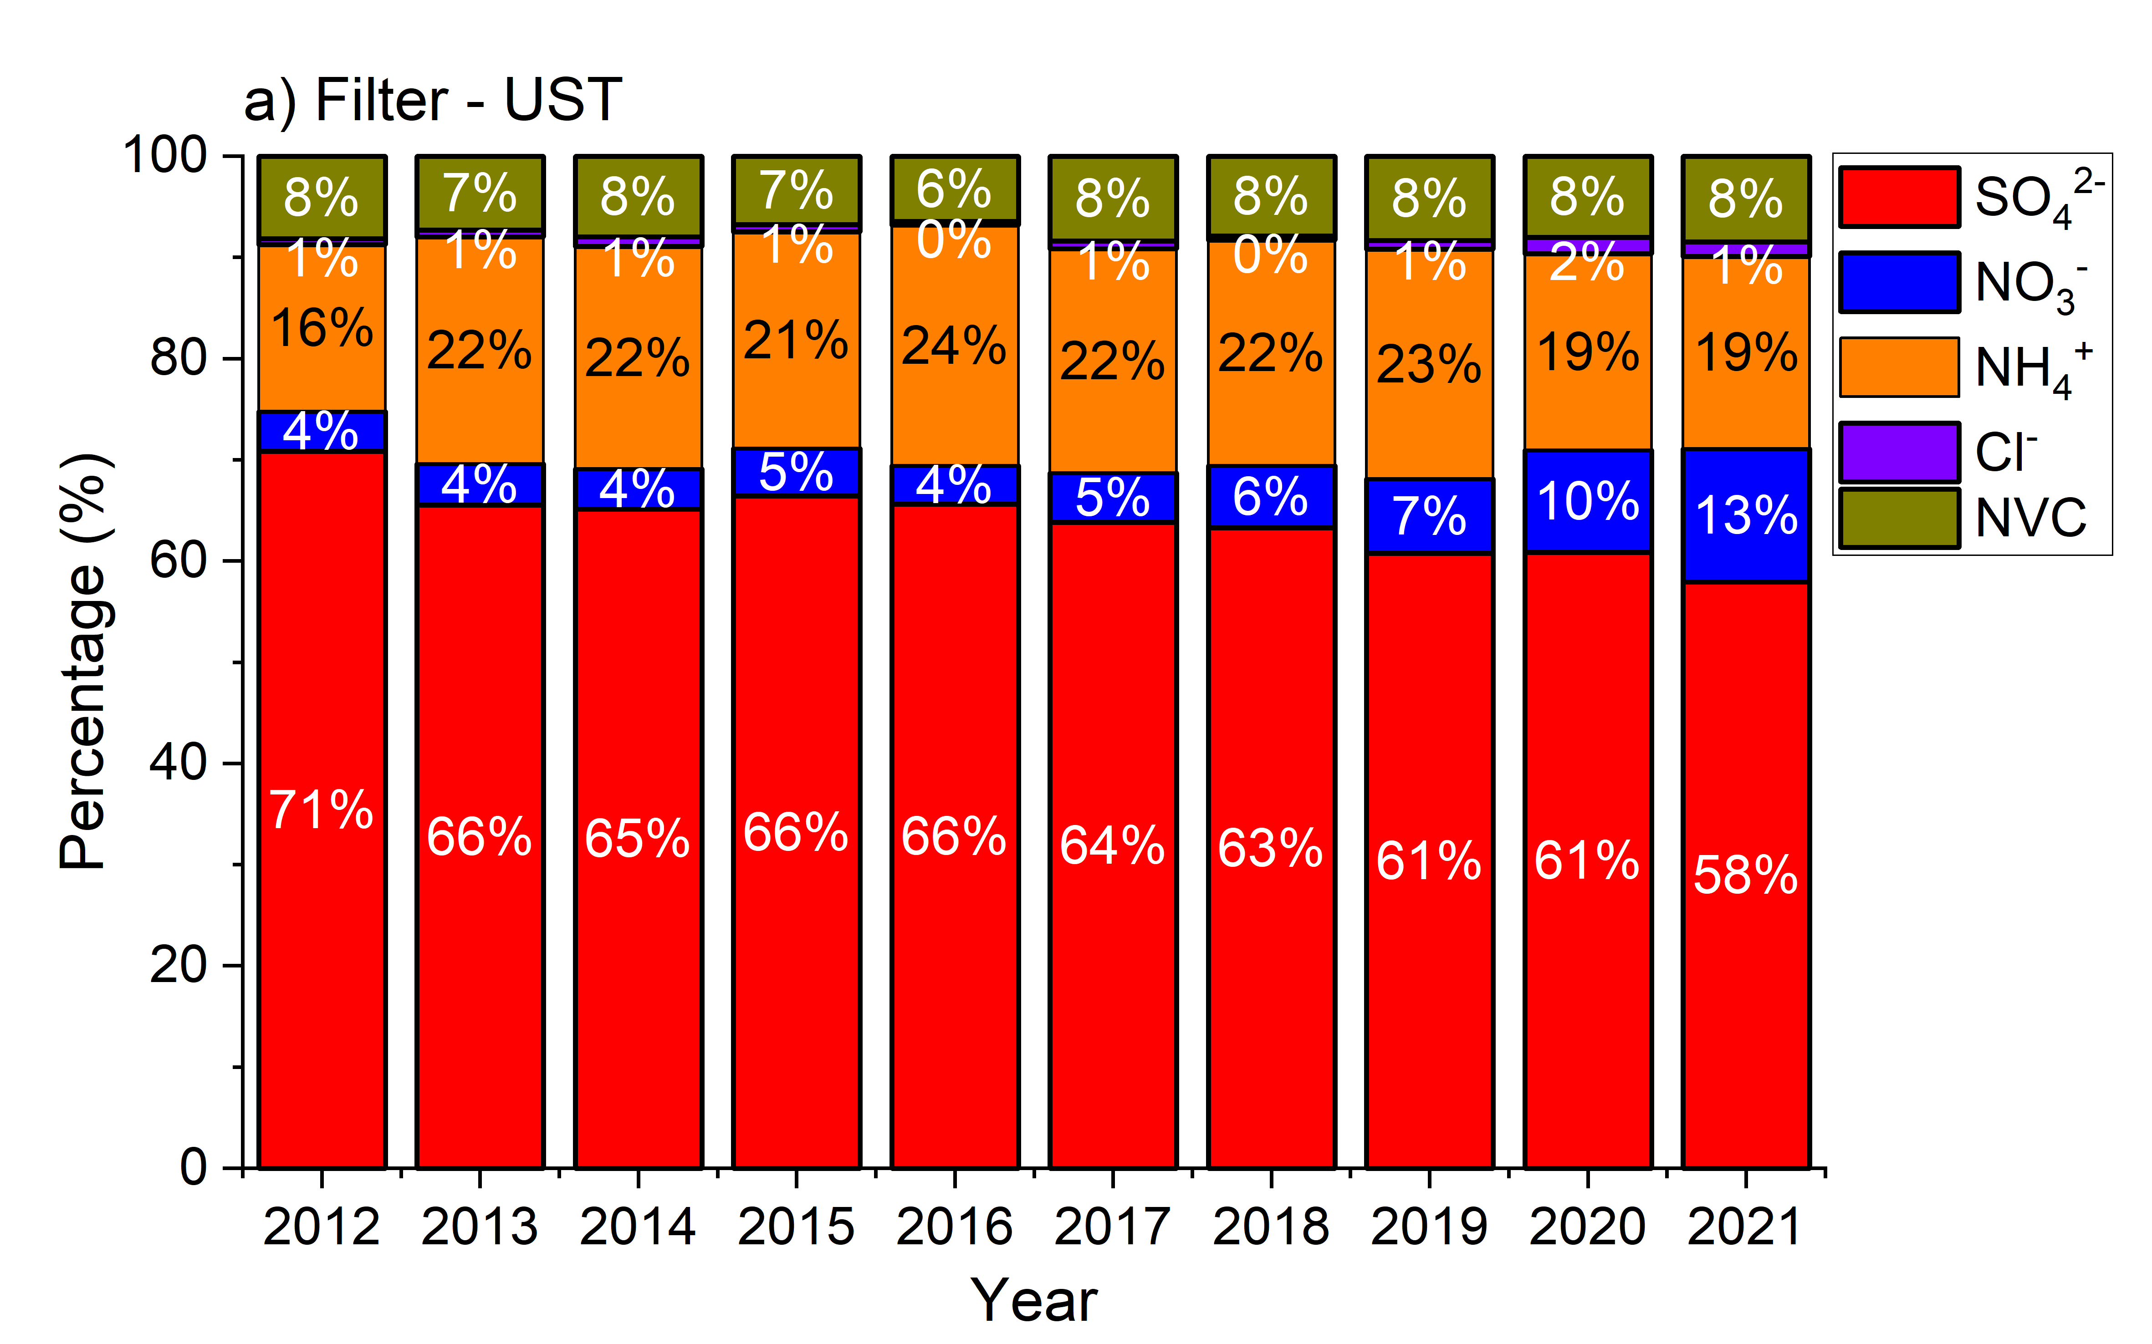
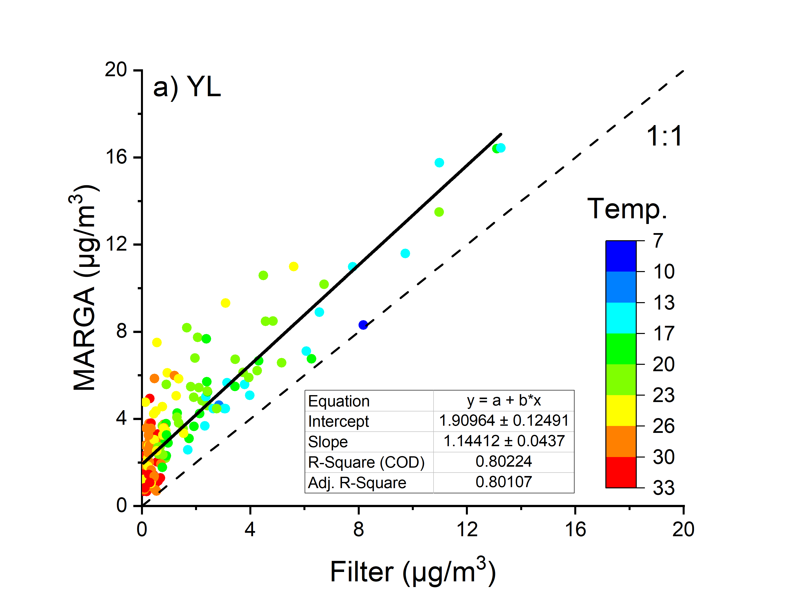
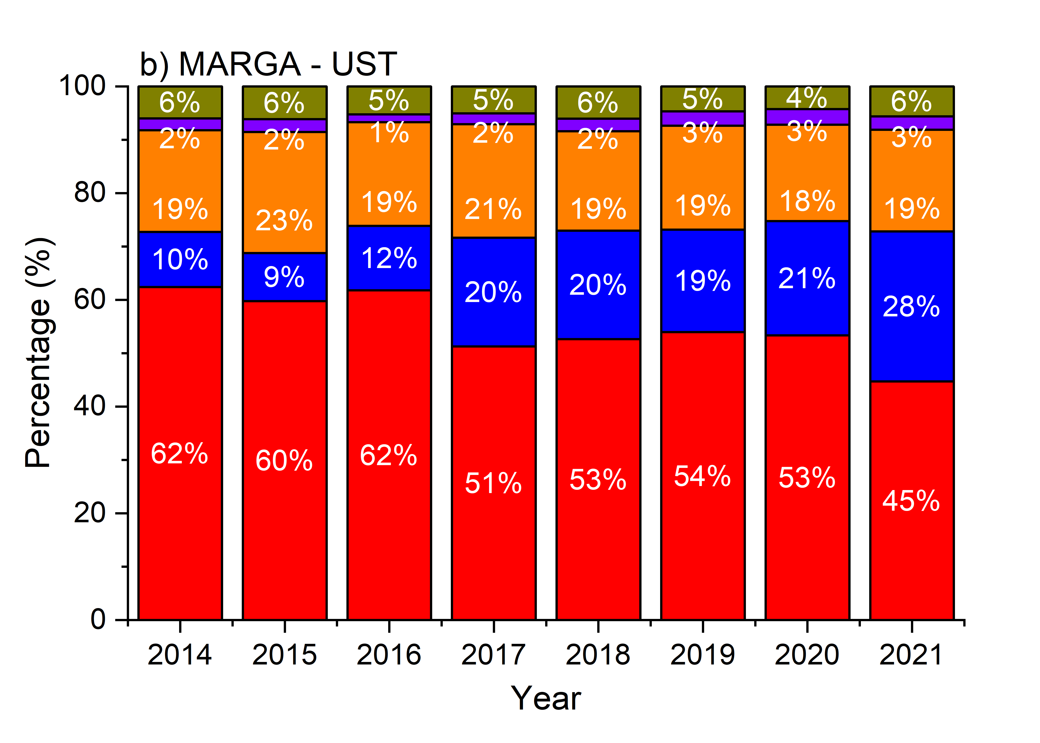
2. Results and conclusions
Filter
Fig. 5 Annual trend of mass fractions of inorganic ions
Fig. 4 Comparison between offline filter- and online MARGA-measured nitrate concentrations
MARGA
Particulate nitrate concentration was under-measured by filter-based sampling under high temperature conditions (>23ºC).

Slide 5
Thank you for your attention!
EGU25-9750
Session AS3.32

Slide 6
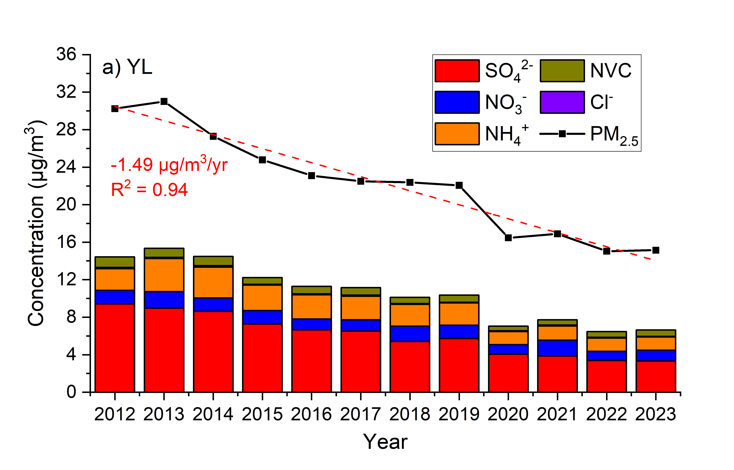
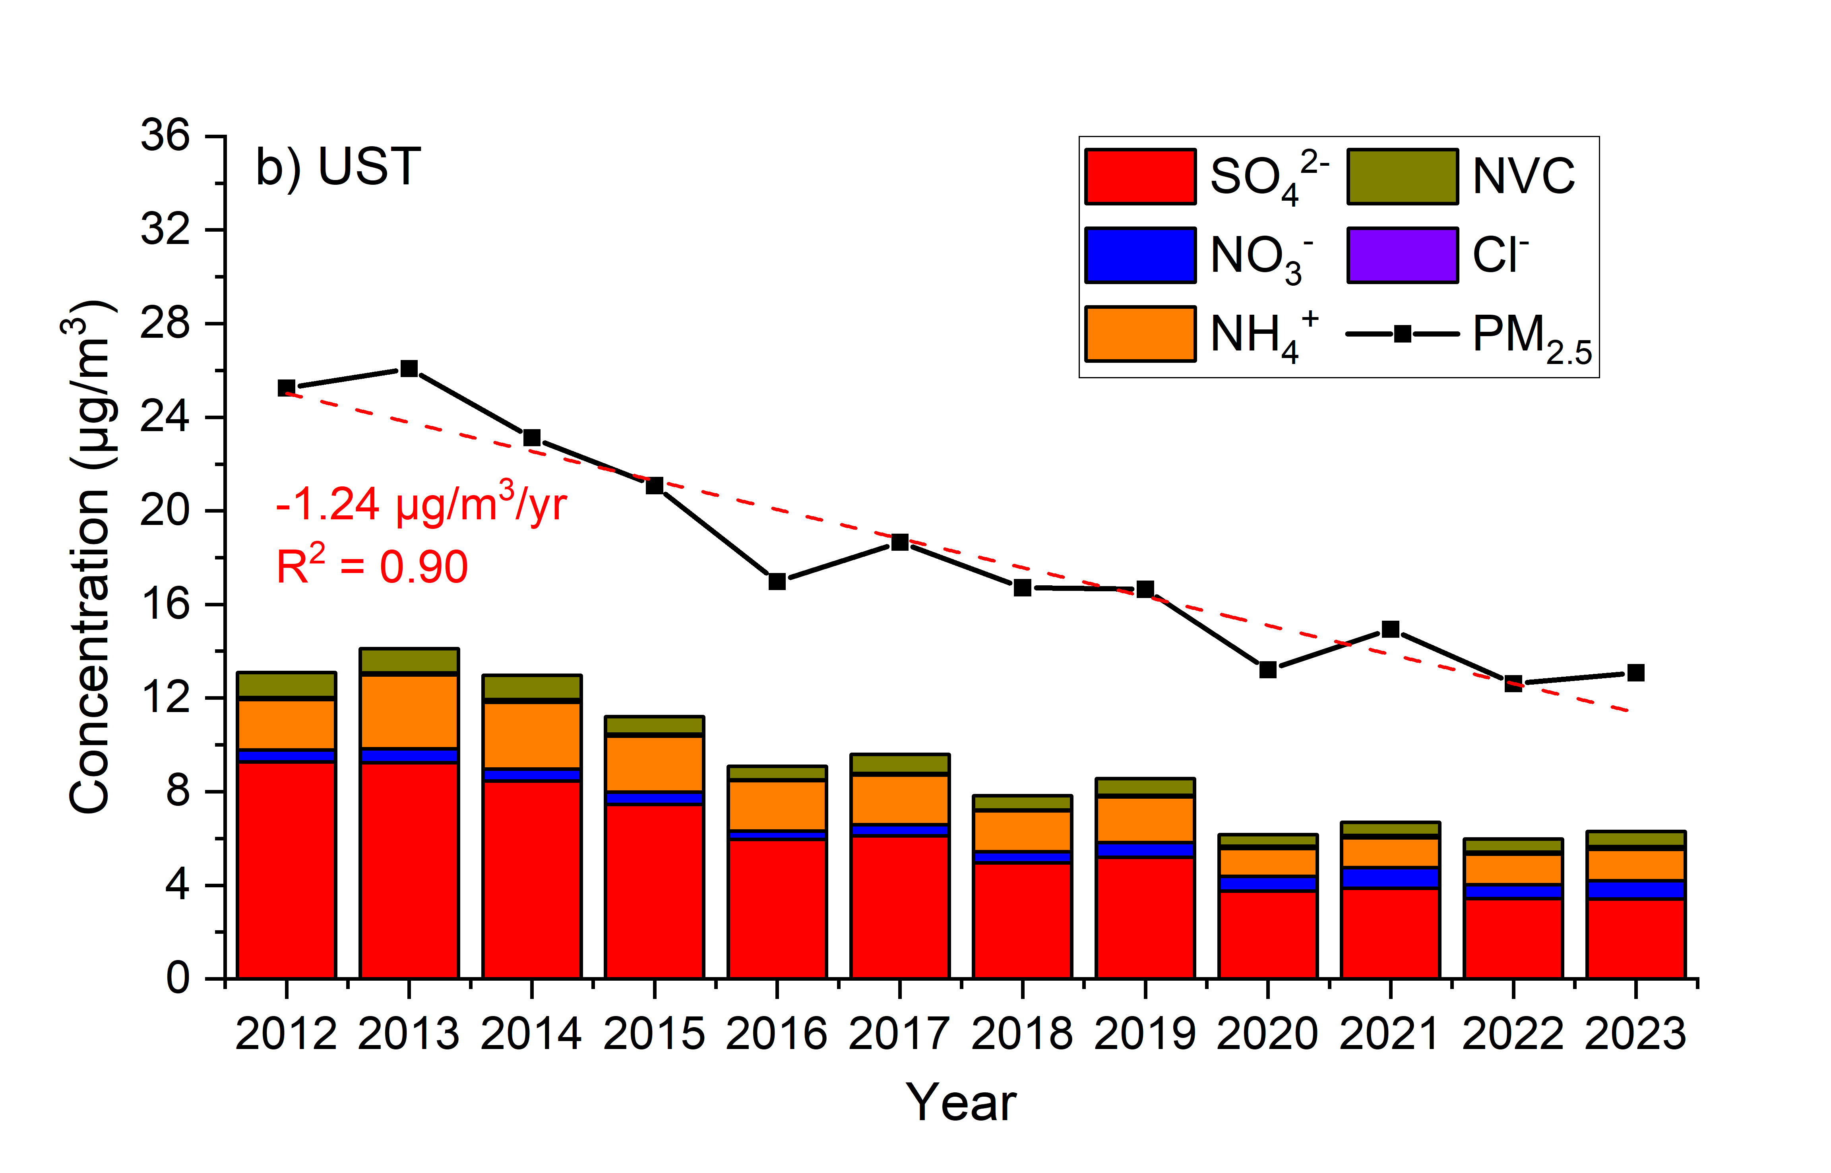
Offline filter results
Annual trend of PM_{2.5} and the inorganic constituents
PM_{2.5} concentration decreased by 1.49 ug/m³ and 1.24 ug/m³ per year on average in YL and UST, respectively. Inorganic compounds took up ~50% of PM_{2.5} mass.
Sulfate was the dominant constituent in both sites.

Slide 7
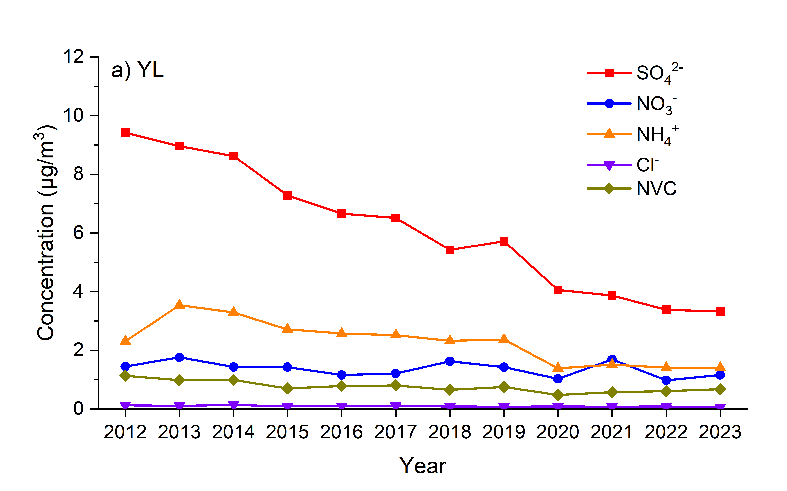
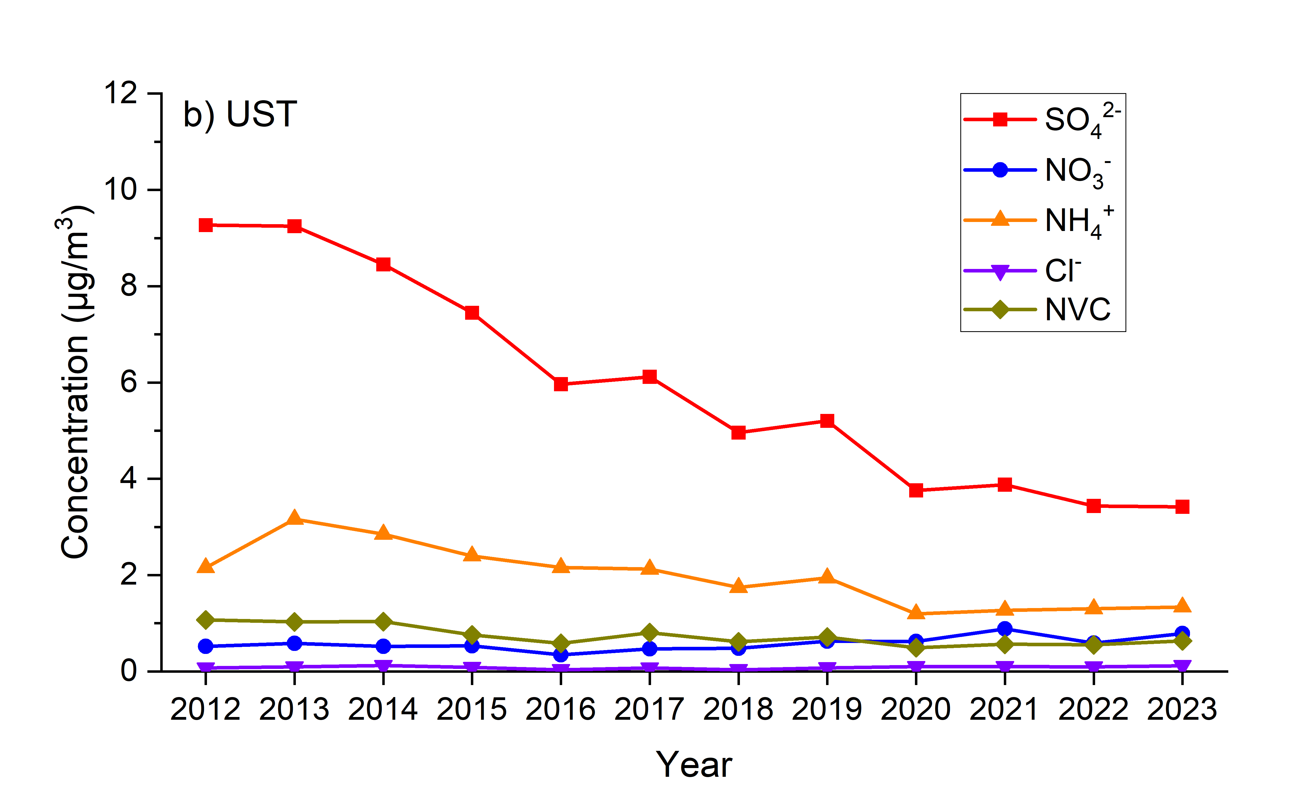
Offline filter results
Annual trend of PM_{2.5} and the inorganic constituents
Variation (μg/m³/yr) | SO₄²⁻ | NO₃⁻ | NH₄⁺ | Cl⁻ | NVC | PM_{2.5}
YL | -0.60 | -0.03 | -0.17 | -0.005 | -0.04 | -1.49
UST | -0.60 | +0.02 | -0.15 | 0.00 | -0.05 | -1.24

Slide 8
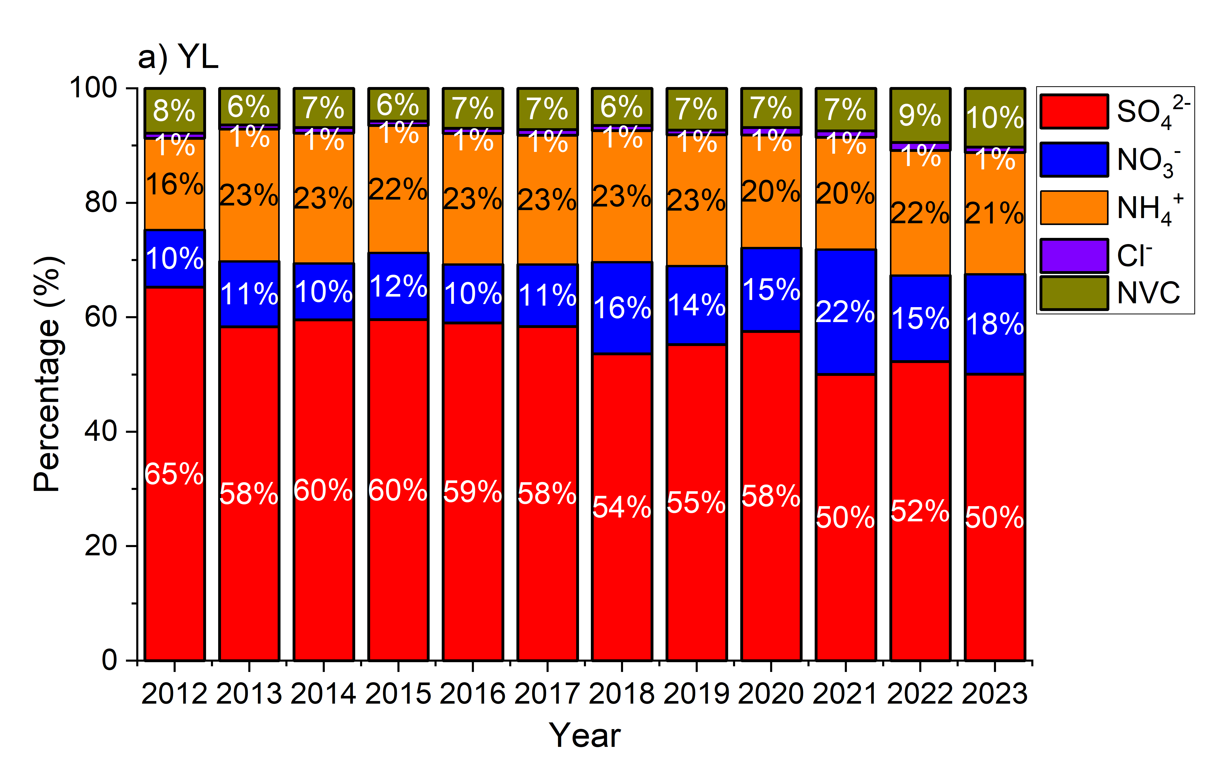
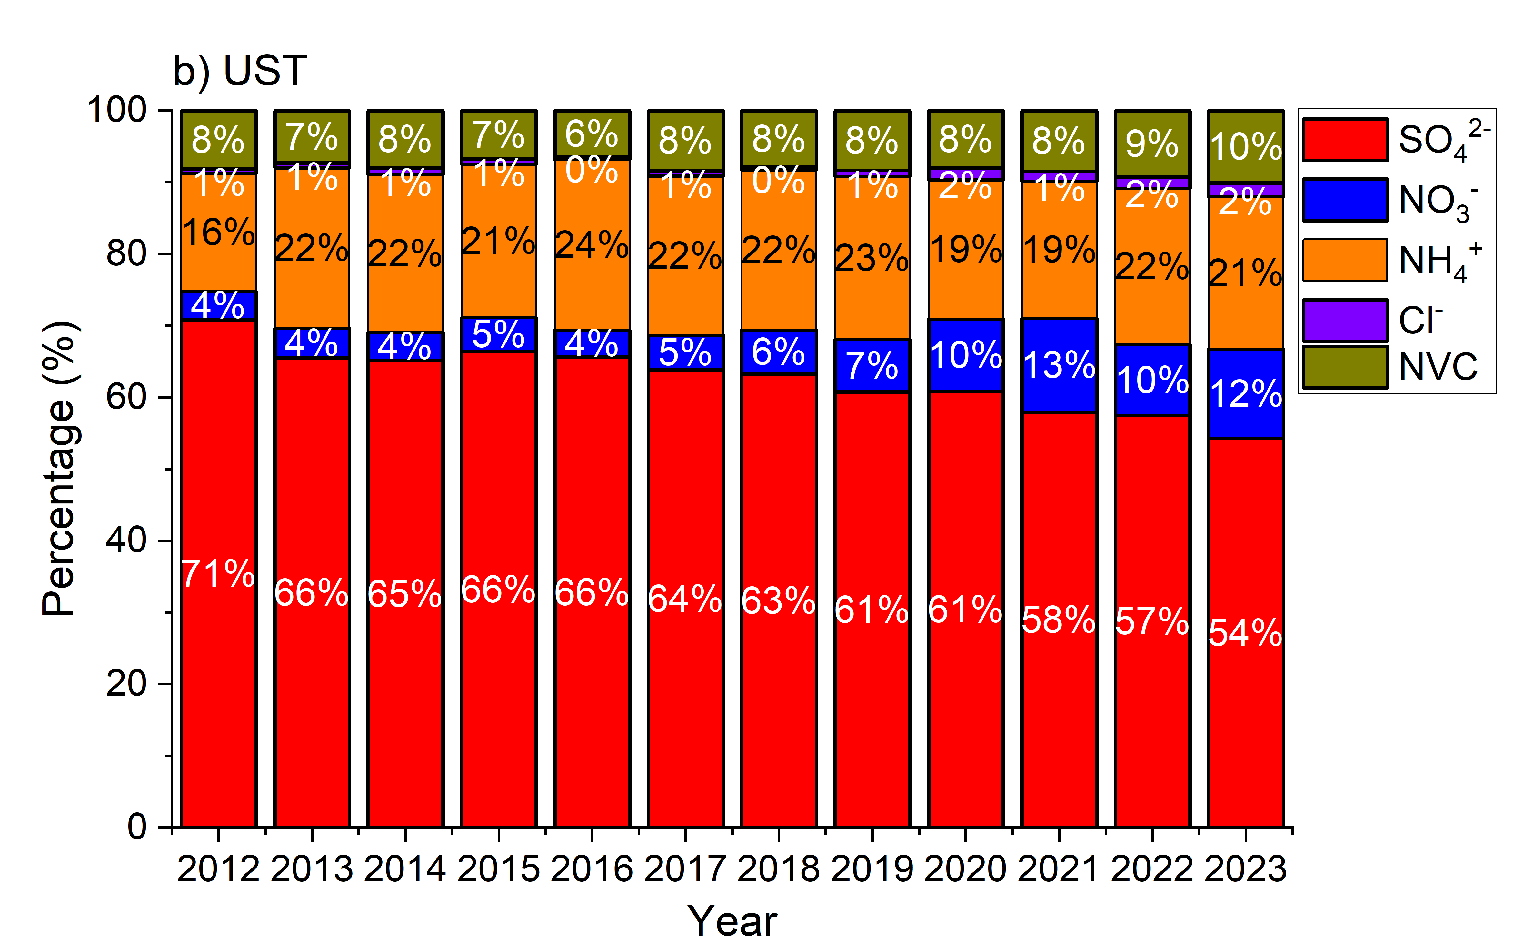
Offline filter results
Annual trend of mass fraction of inorganic constituents
The mass fraction of sulfate in inorganic compounds gradually decreased, while the fraction of nitrate increased over the years in both sites.

Slide 9
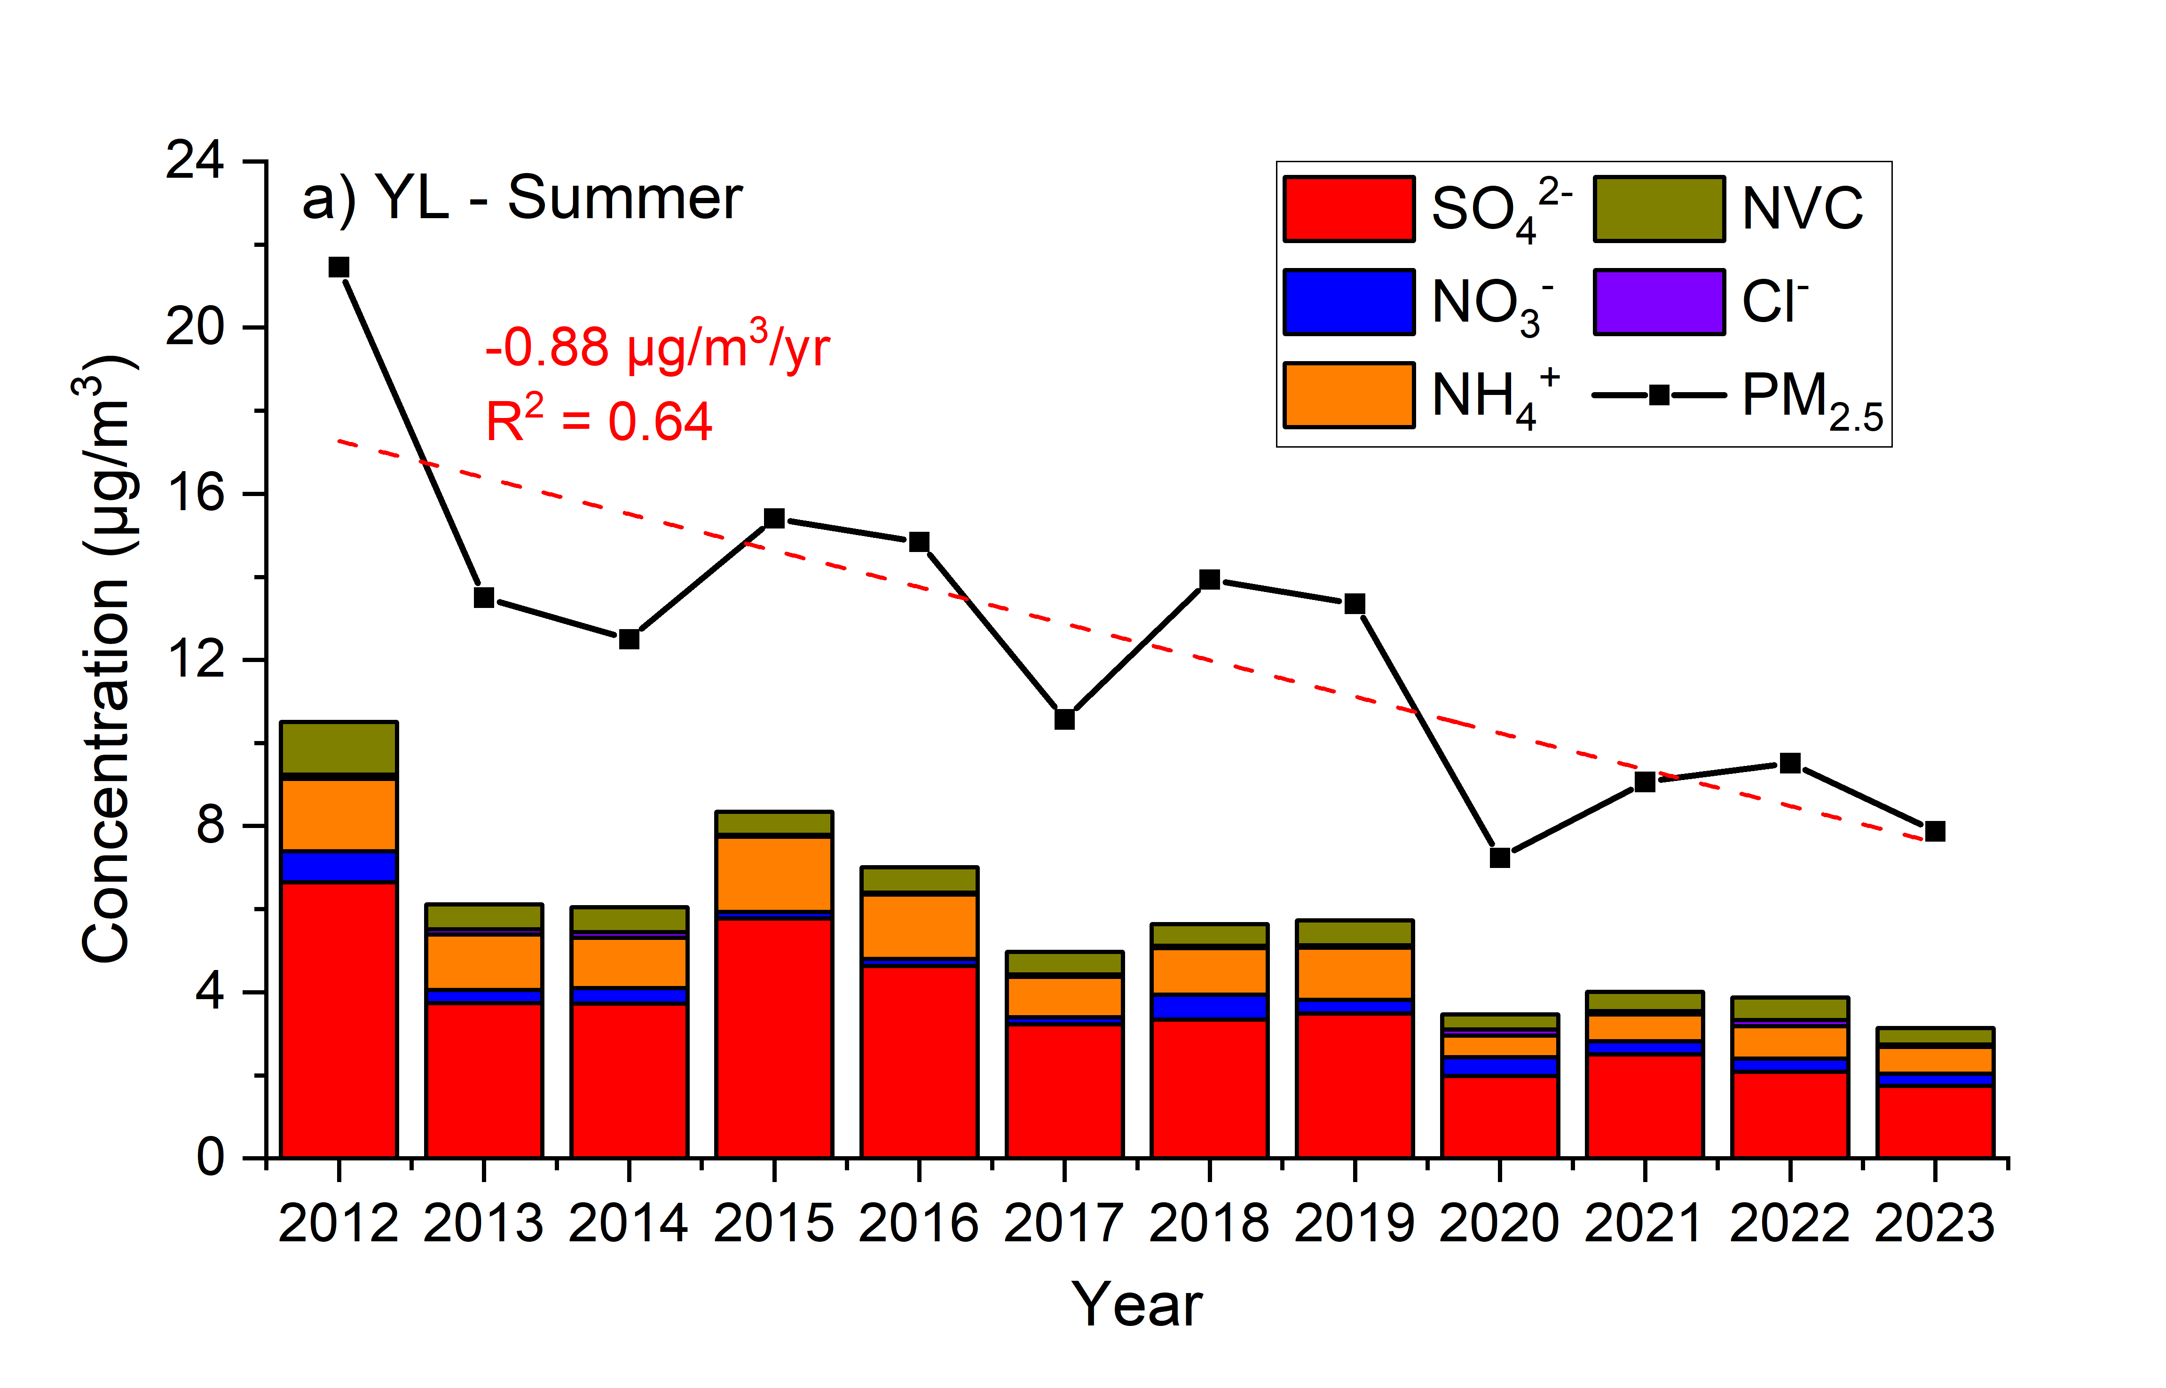
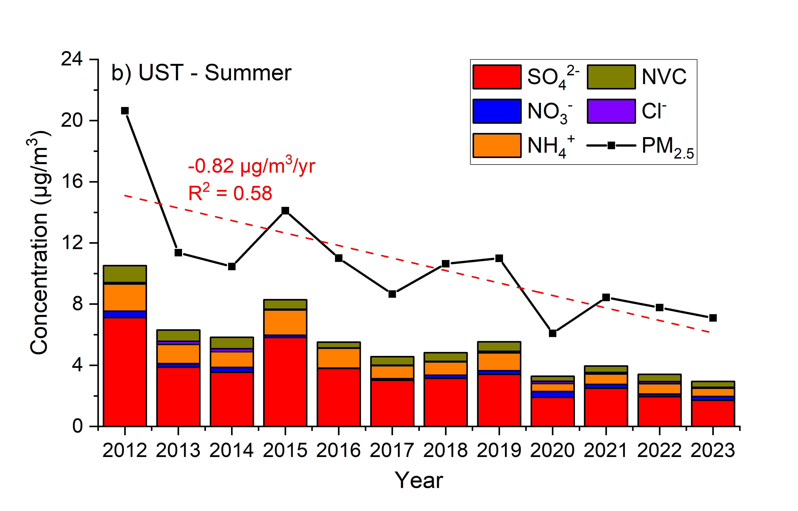
Offline filter results
Annual trend of PM_{2.5} and the inorganic constituents during summer in urban YL and suburban UST
The trend was comparable between YL and UST.
Nitrate concentration was very low in summer according to filter measurement result.

Slide 10
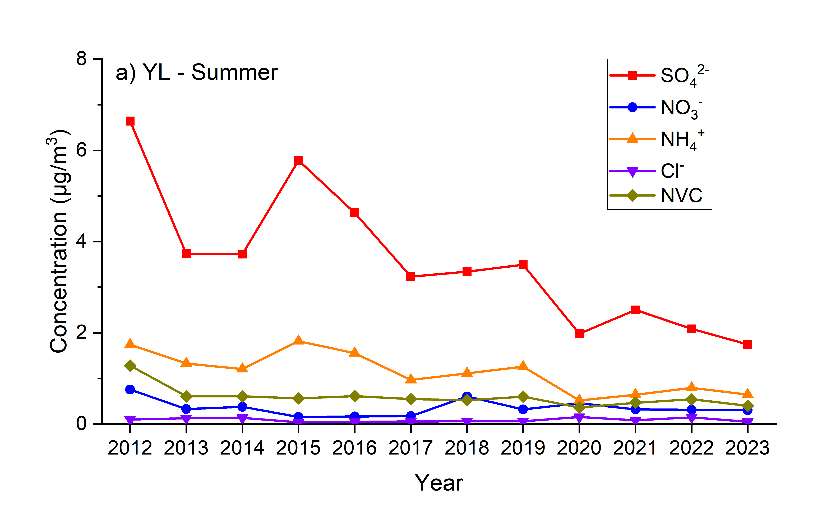
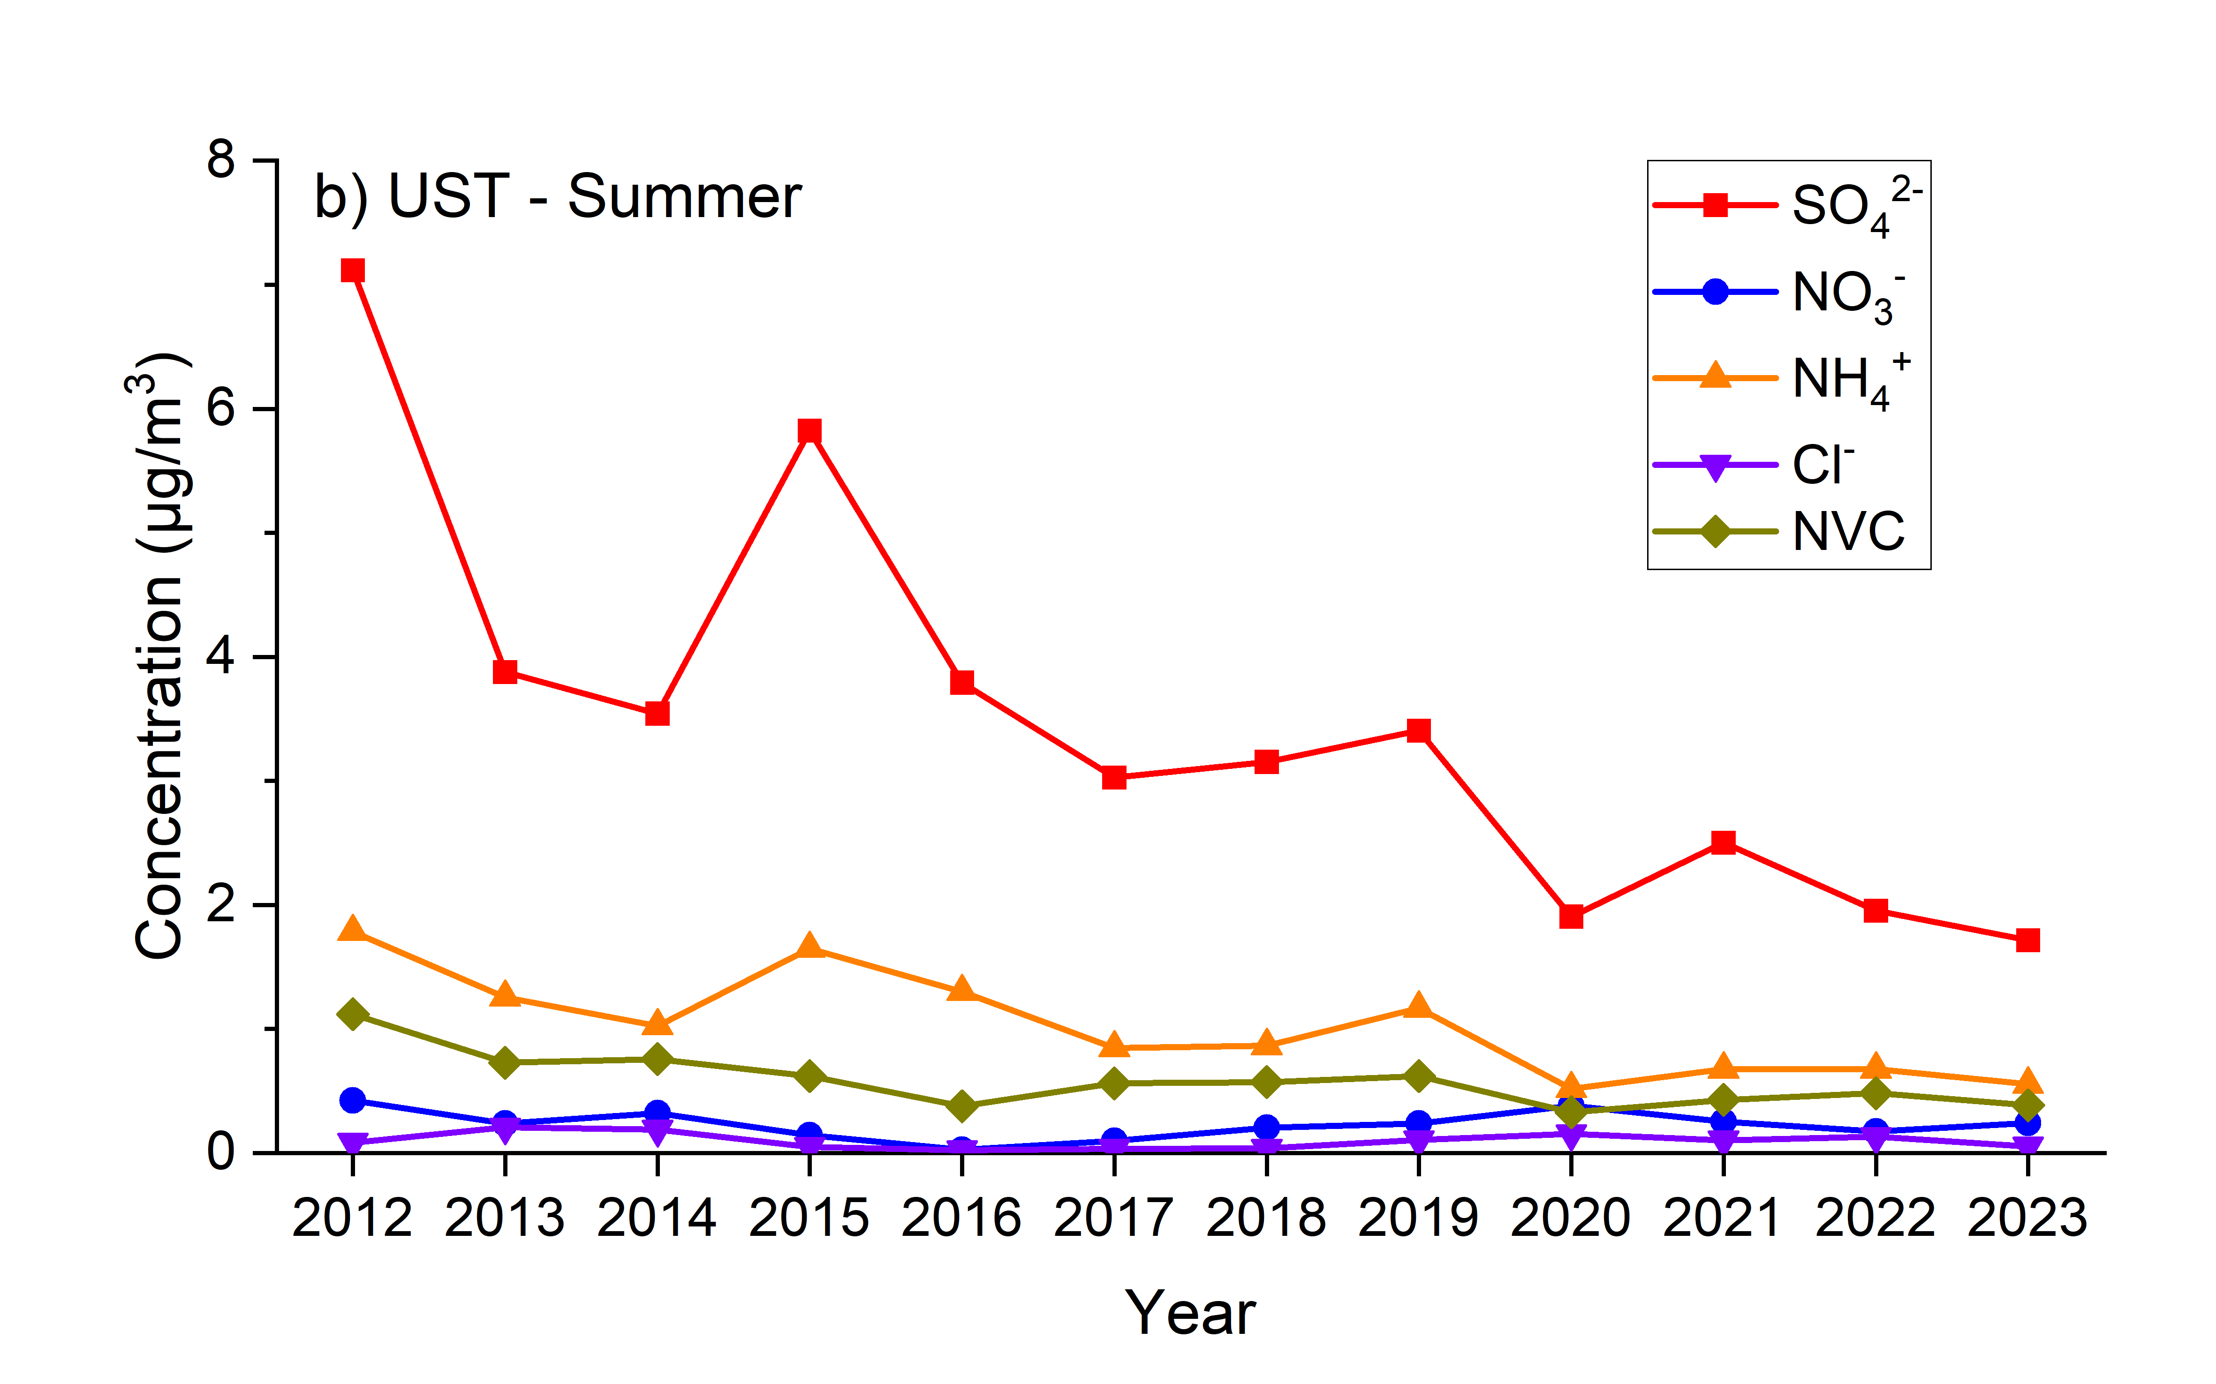
Offline filter results
Annual trend of PM_{2.5} and the inorganic constituents during summer in urban YL and suburban UST
Variation (μg/m³/yr) | SO₄²⁻ | NO₃⁻ | NH₄⁺ | Cl⁻ | NVC | PM_{2.5}
YL | -0.35 | -0.01 | -0.10 | 0.00 | -0.04 | -0.88
UST | -0.37 | 0.00 | -0.10 | 0.00 | -0.05 | -0.82

Slide 11
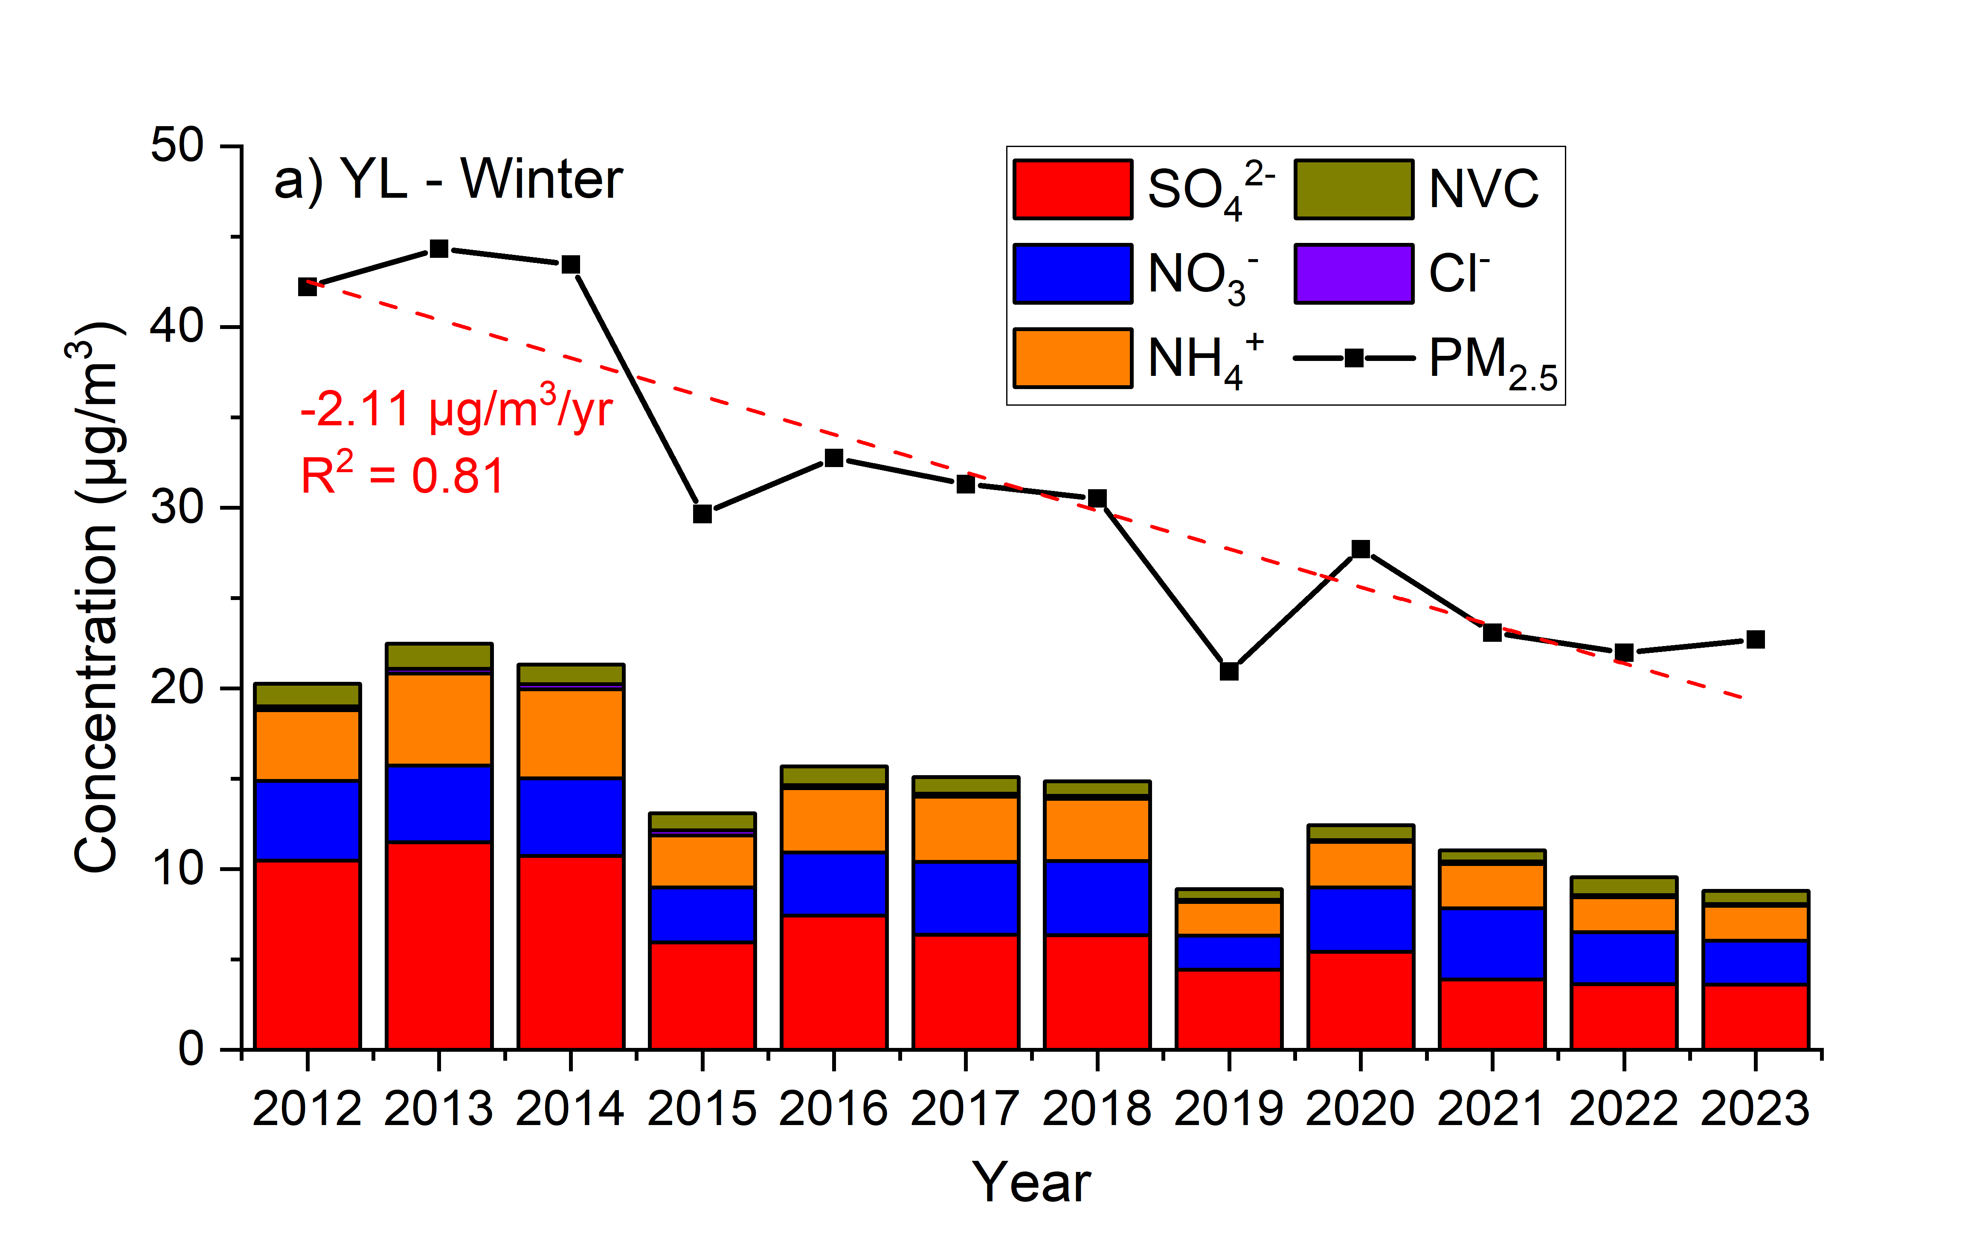
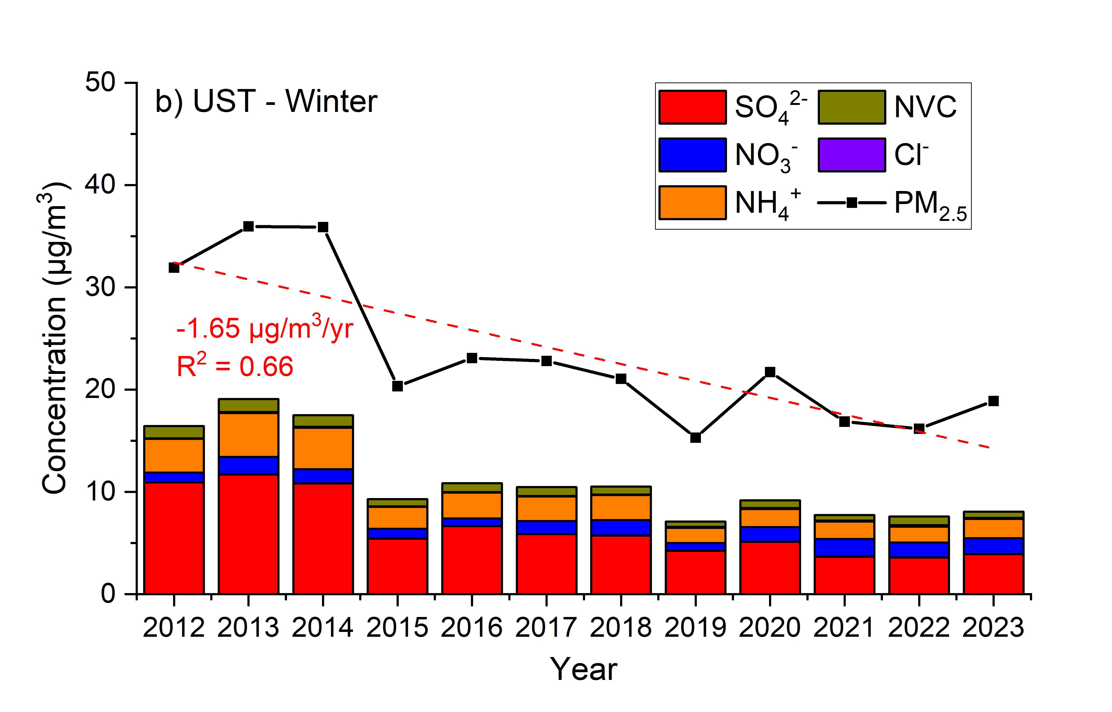
Offline filter results
Annual trend of PM_{2.5} and the inorganic constituents during winter in urban YL and suburban UST
The annual trend of winter was also comparable between YL and UST.
Nitrate concentration in urban YL was higher than in suburban UST

Slide 12
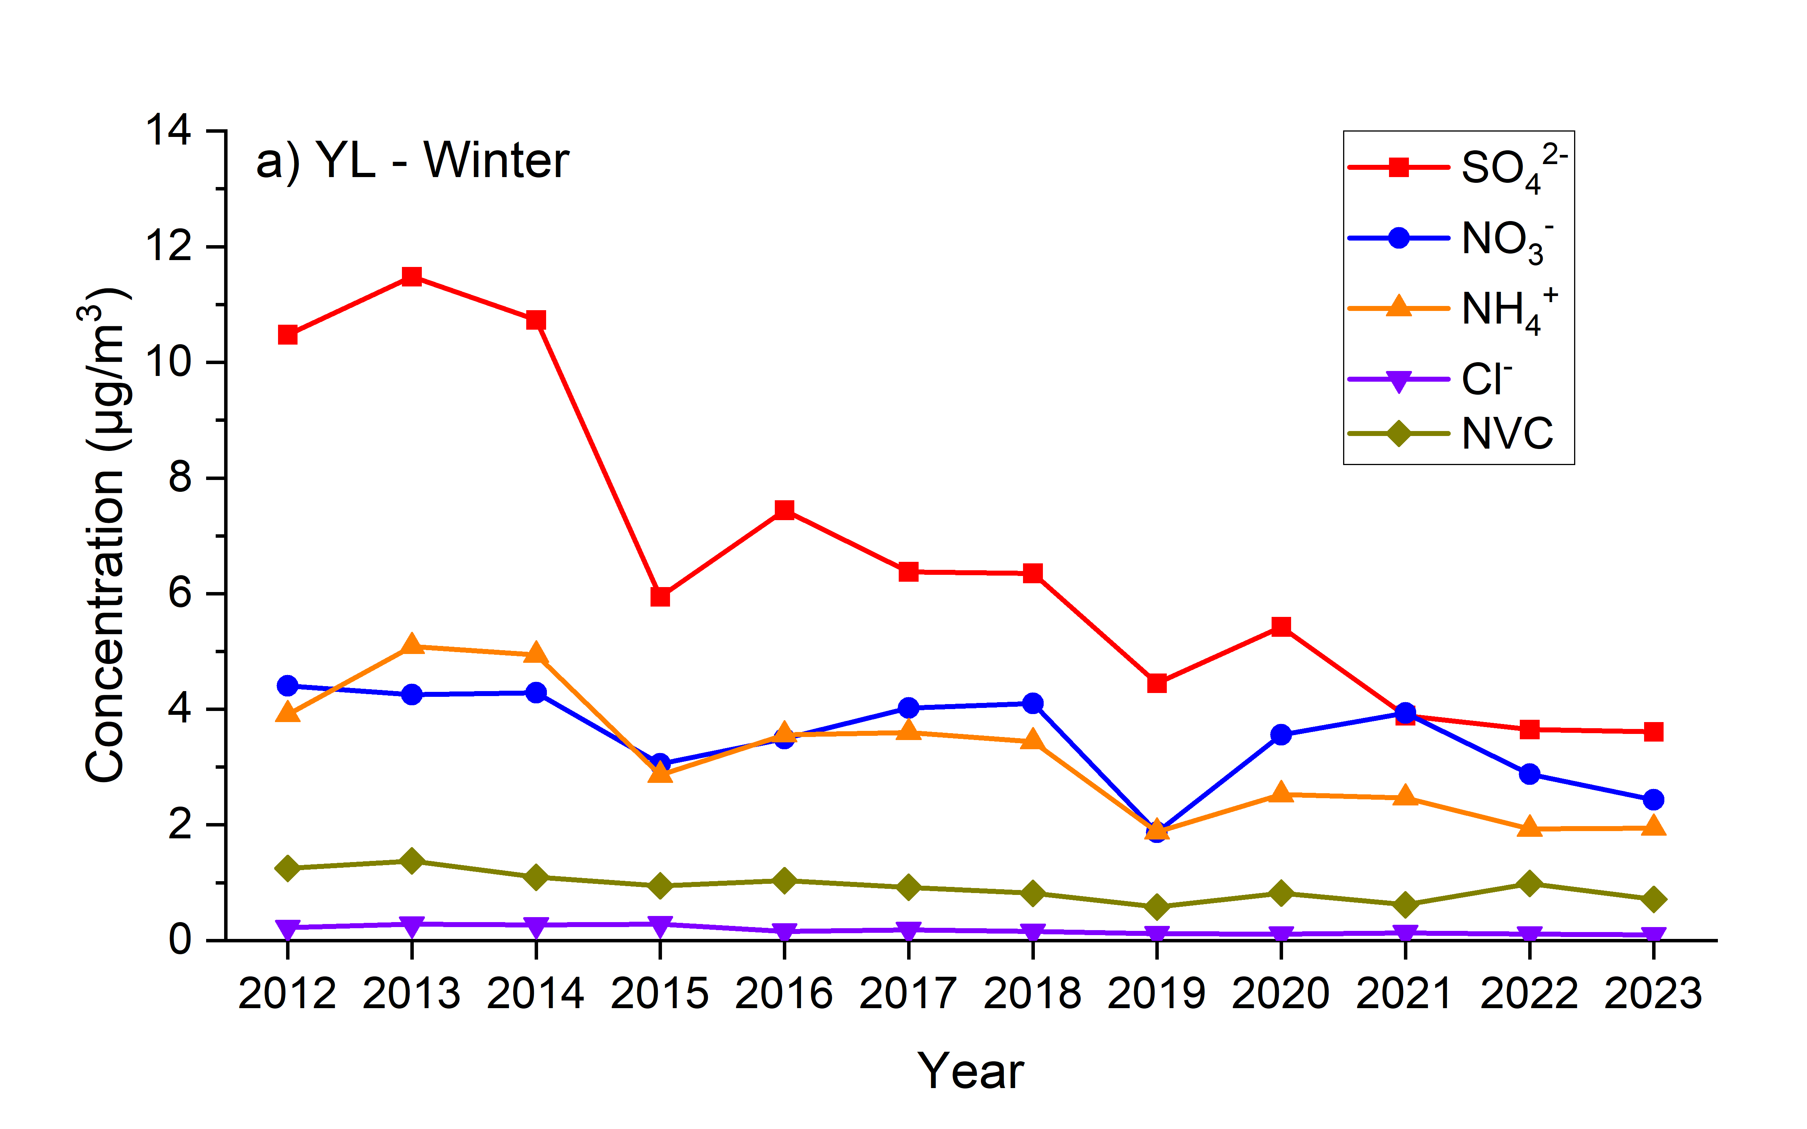
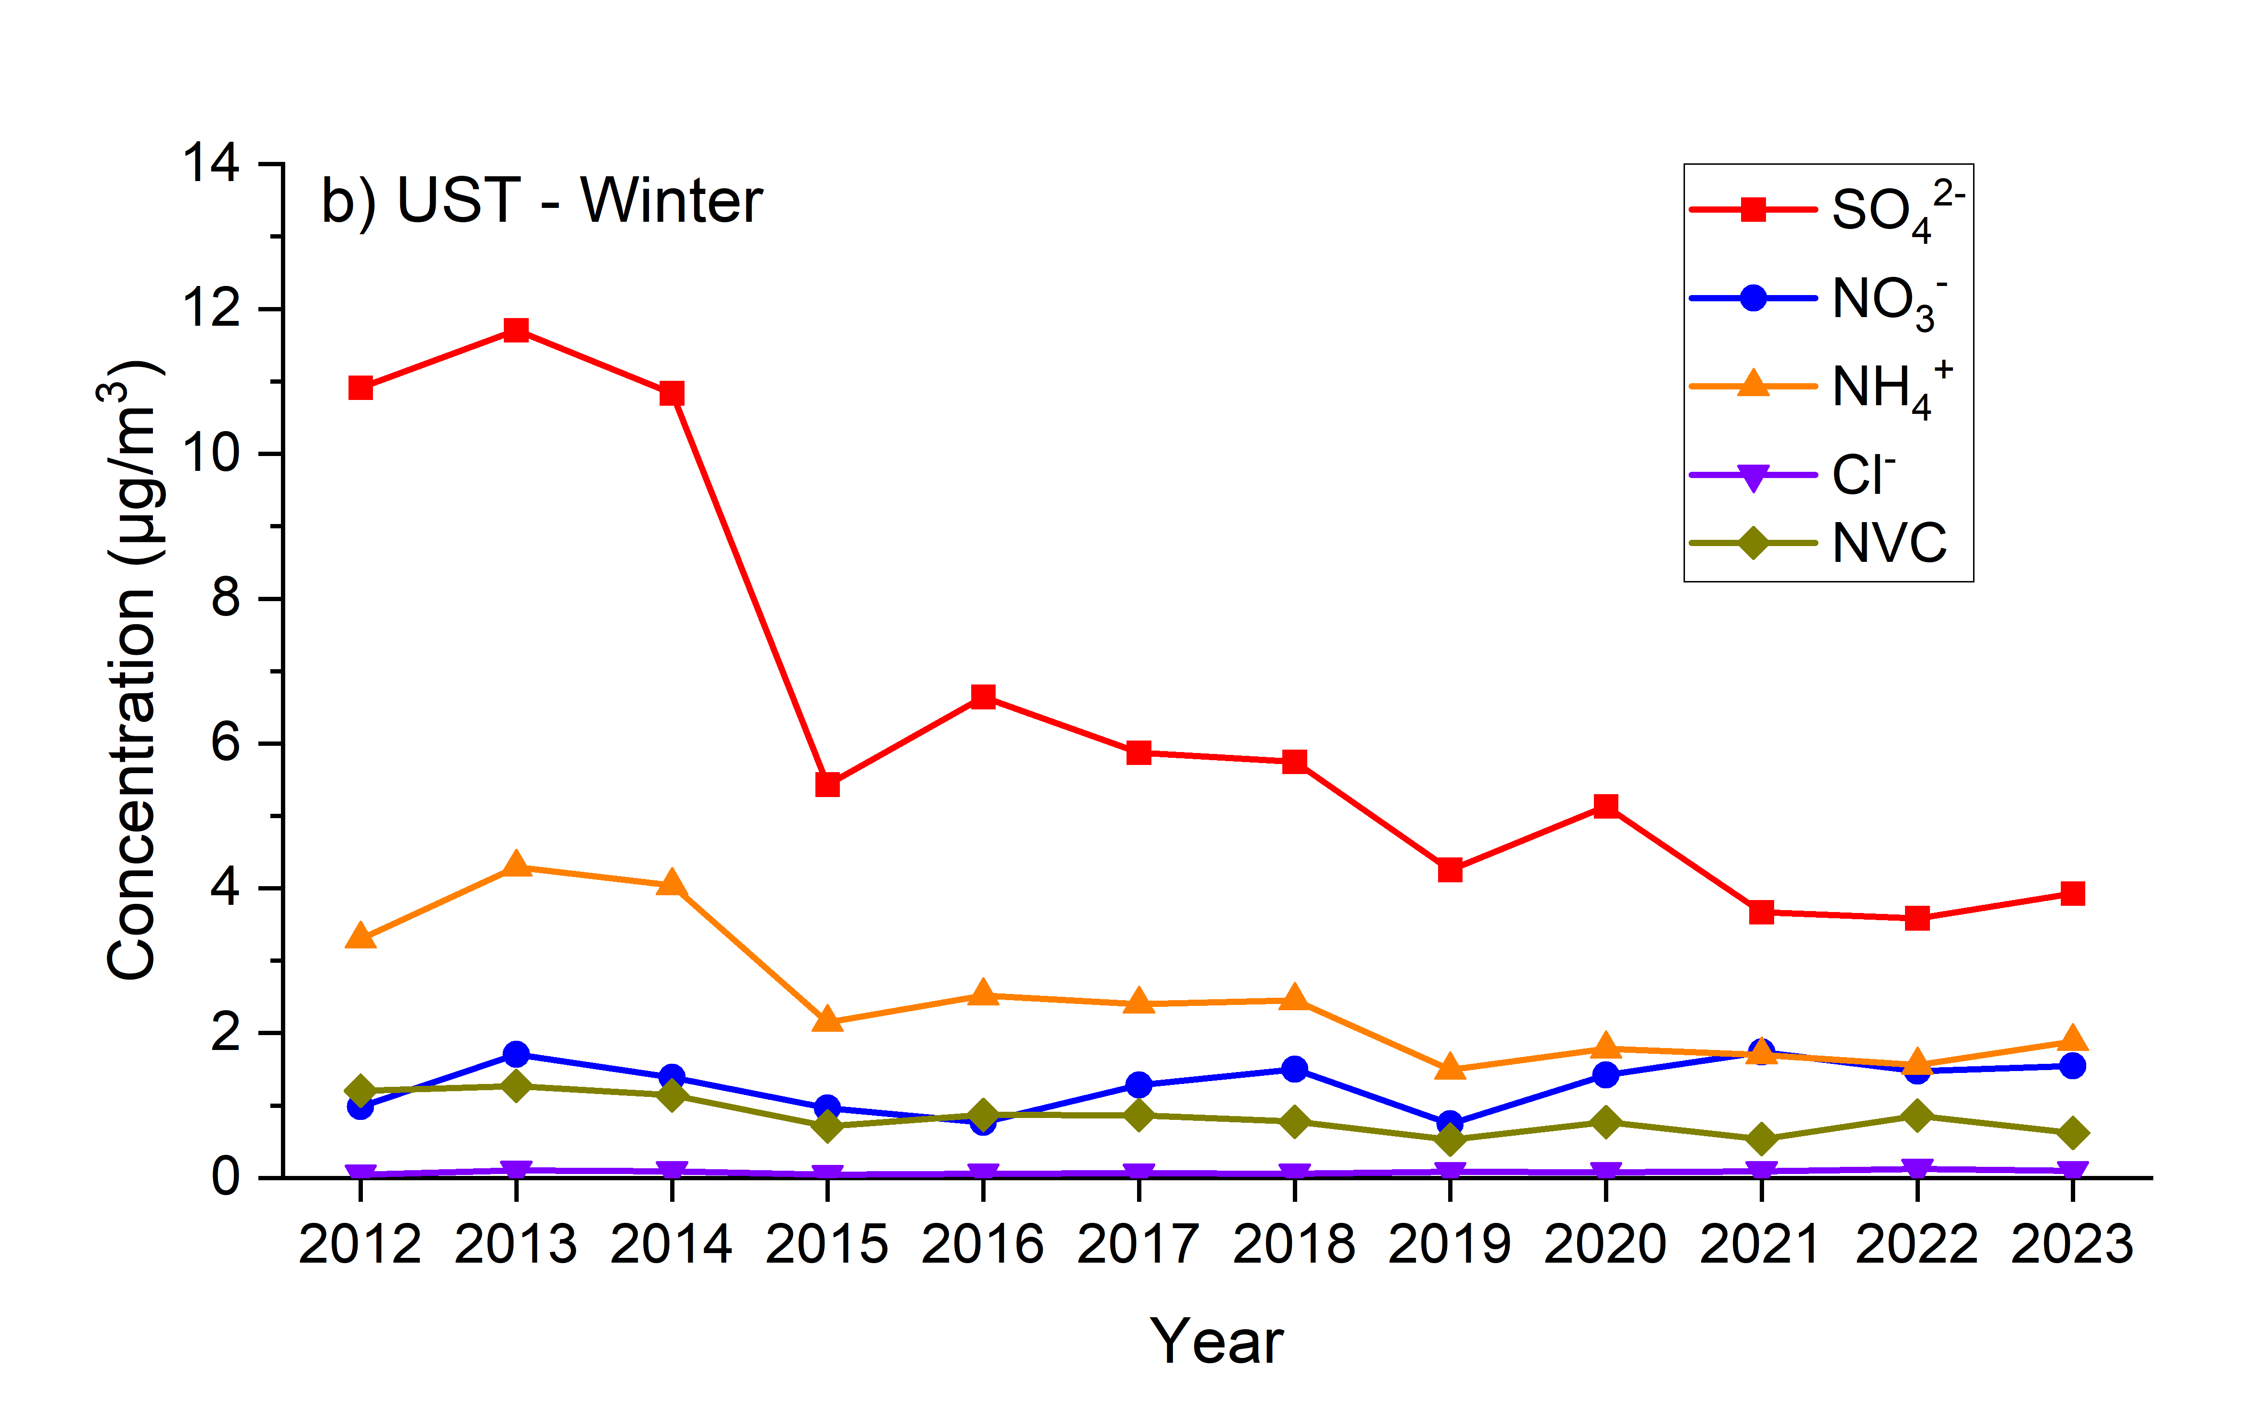
Offline filter results
Annual trend of PM_{2.5} and the inorganic constituents during winter in urban YL and suburban UST
Variation (μg/m³/yr) | SO₄²⁻ | NO₃⁻ | NH₄⁺ | Cl⁻ | NVC | PM_{2.5}
YL | -0.72 | -0.14 | -0.26 | -0.02 | -0.05 | -2.11
UST | -0.73 | +0.03 | -0.21 | 0.00 | -0.05 | -1.65

Slide 13
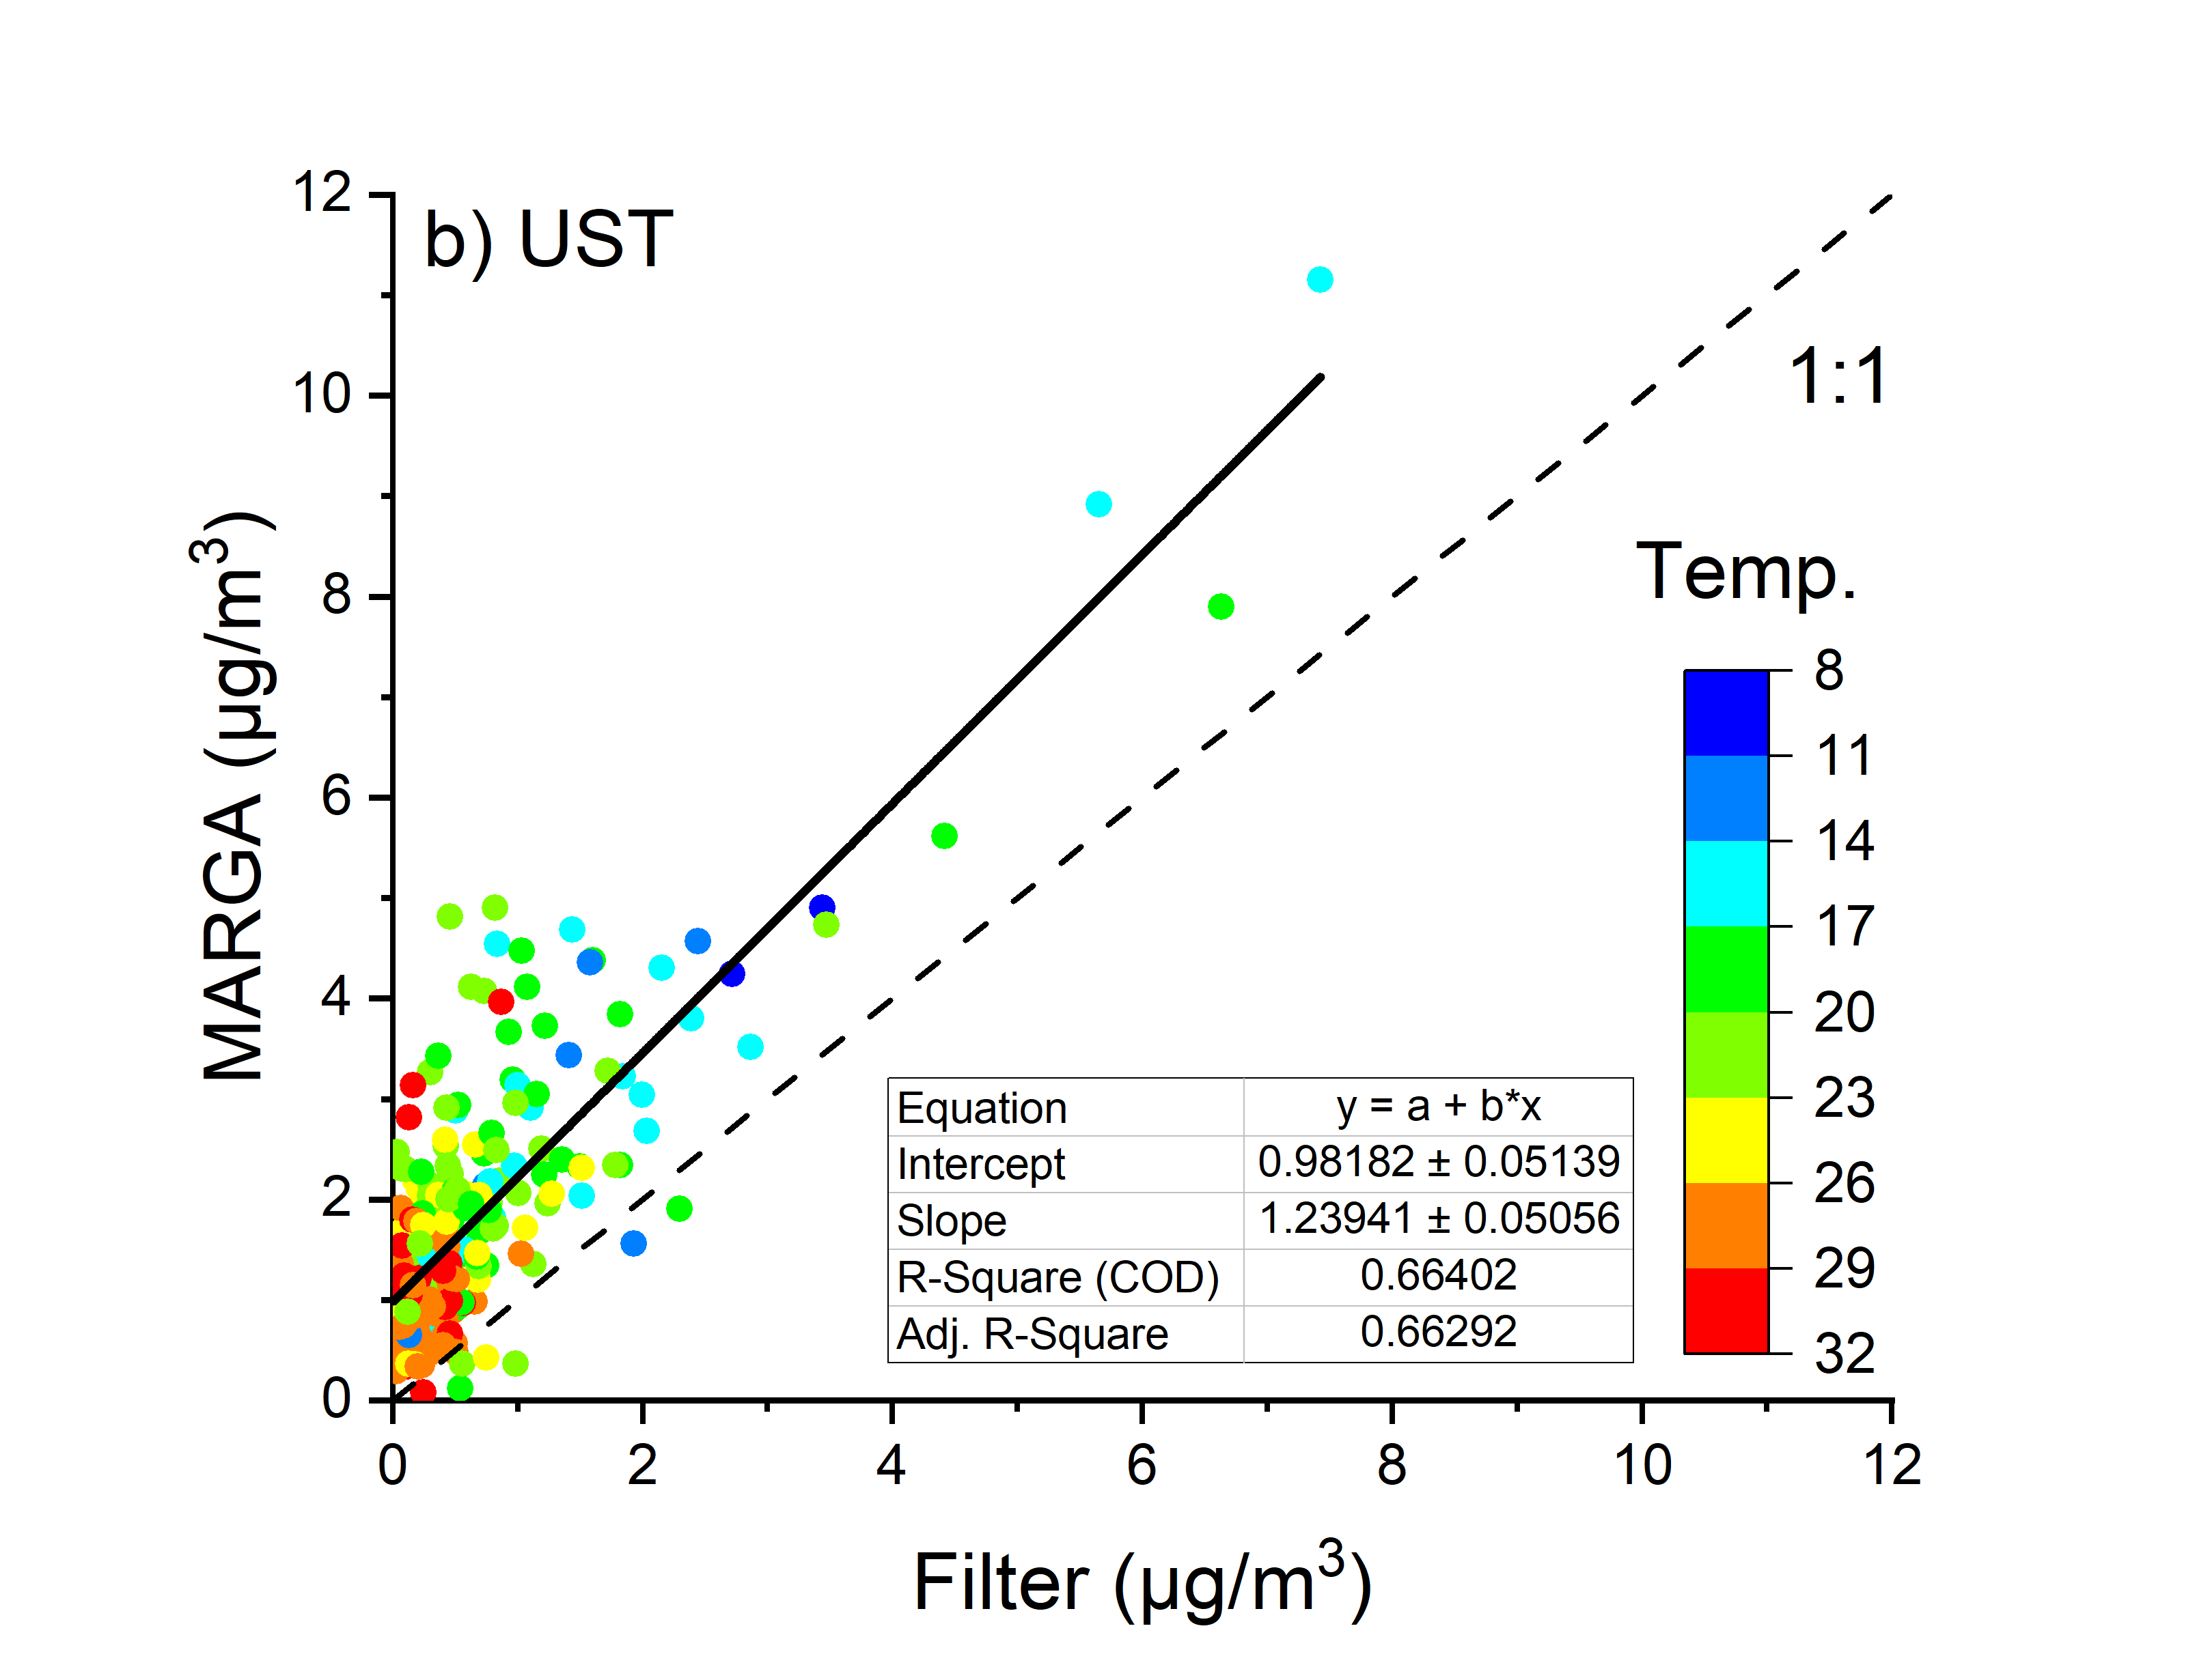
Offline vs. Online
Comparison between offline filter measured and online MARGA measured nitrate concentration.
The correlation was less satisfying under high temperature conditions.
High temperature will introduce more uncertainty into offline filter measurement.

Slide 14
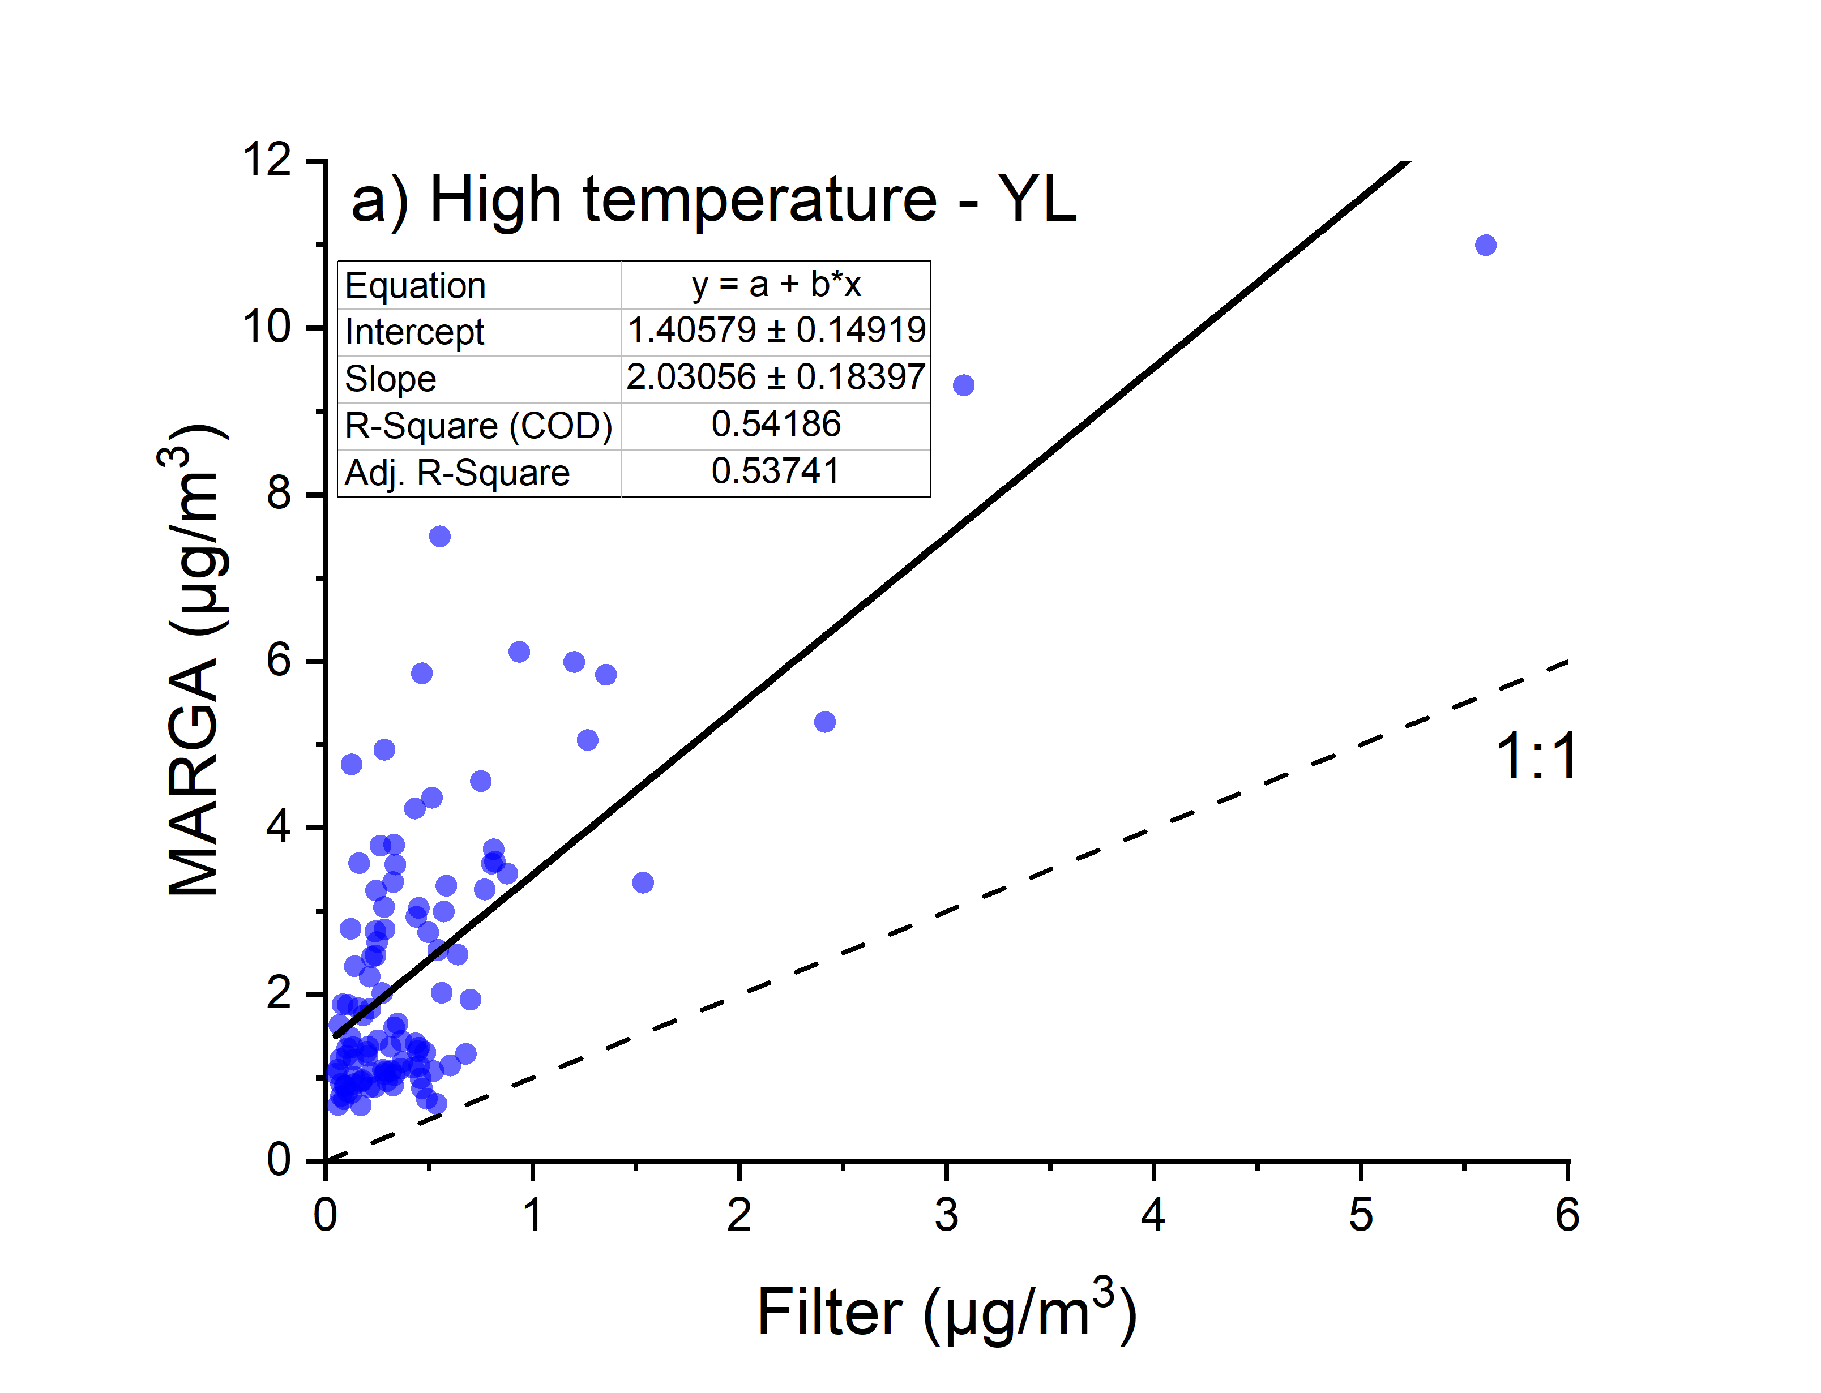
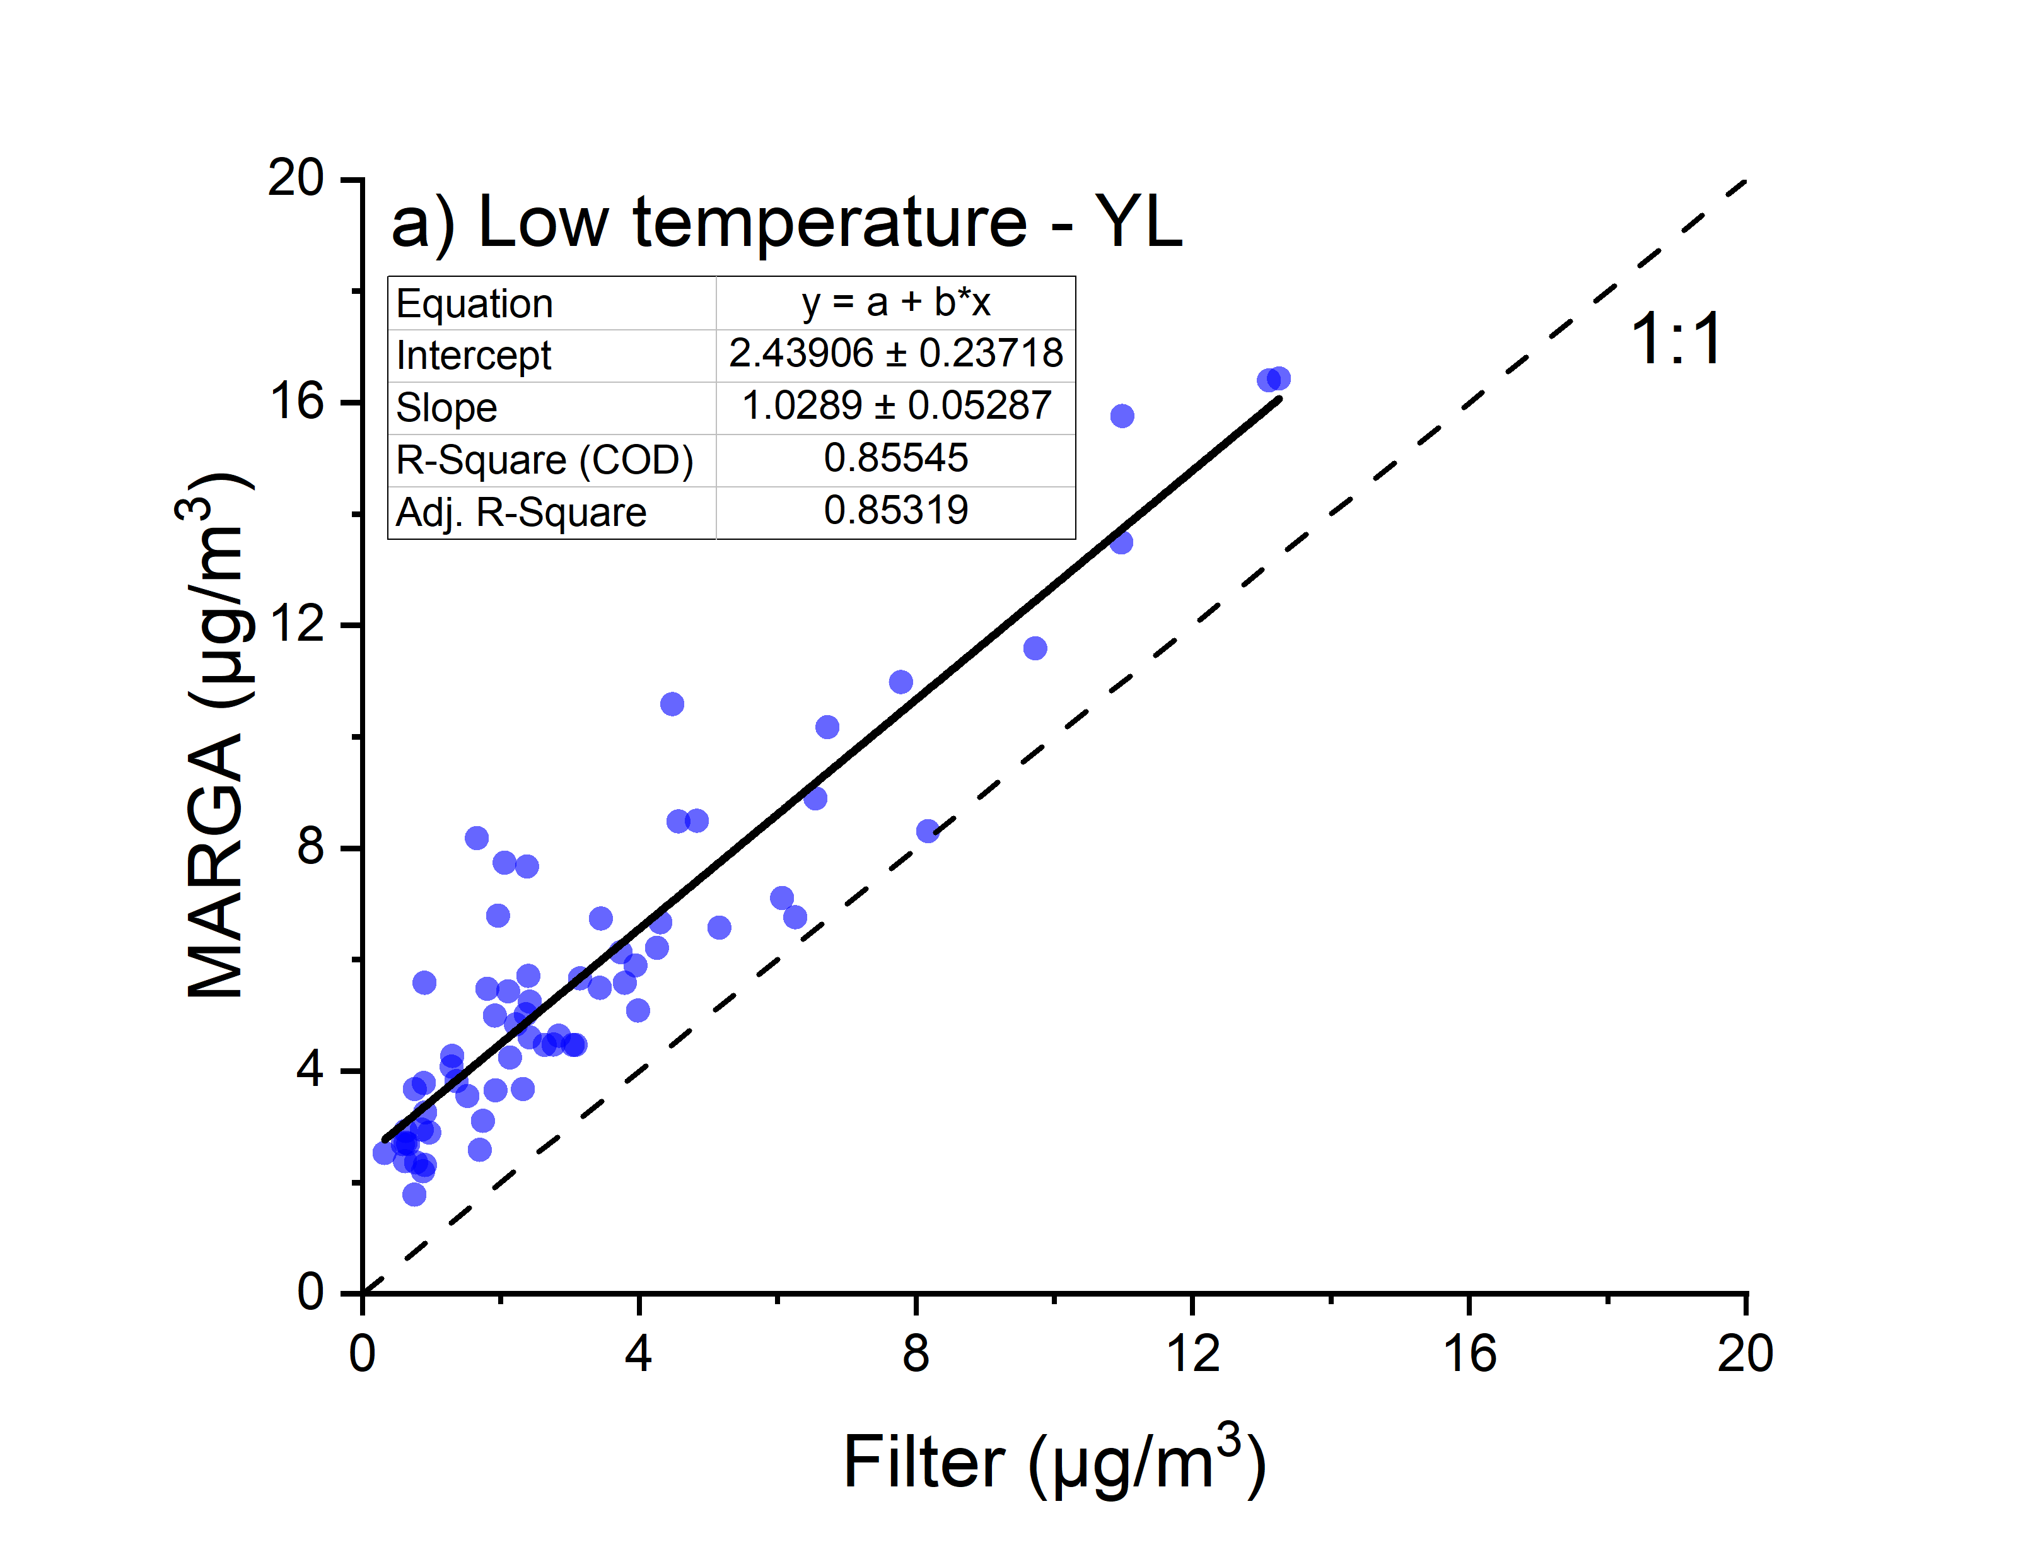
Offline vs. Online
Comparison between offline filter measured and online MARGA measured nitrate concentration under high and low temperature condition.
The correlation was much better under low temperature condition.

Slide 15
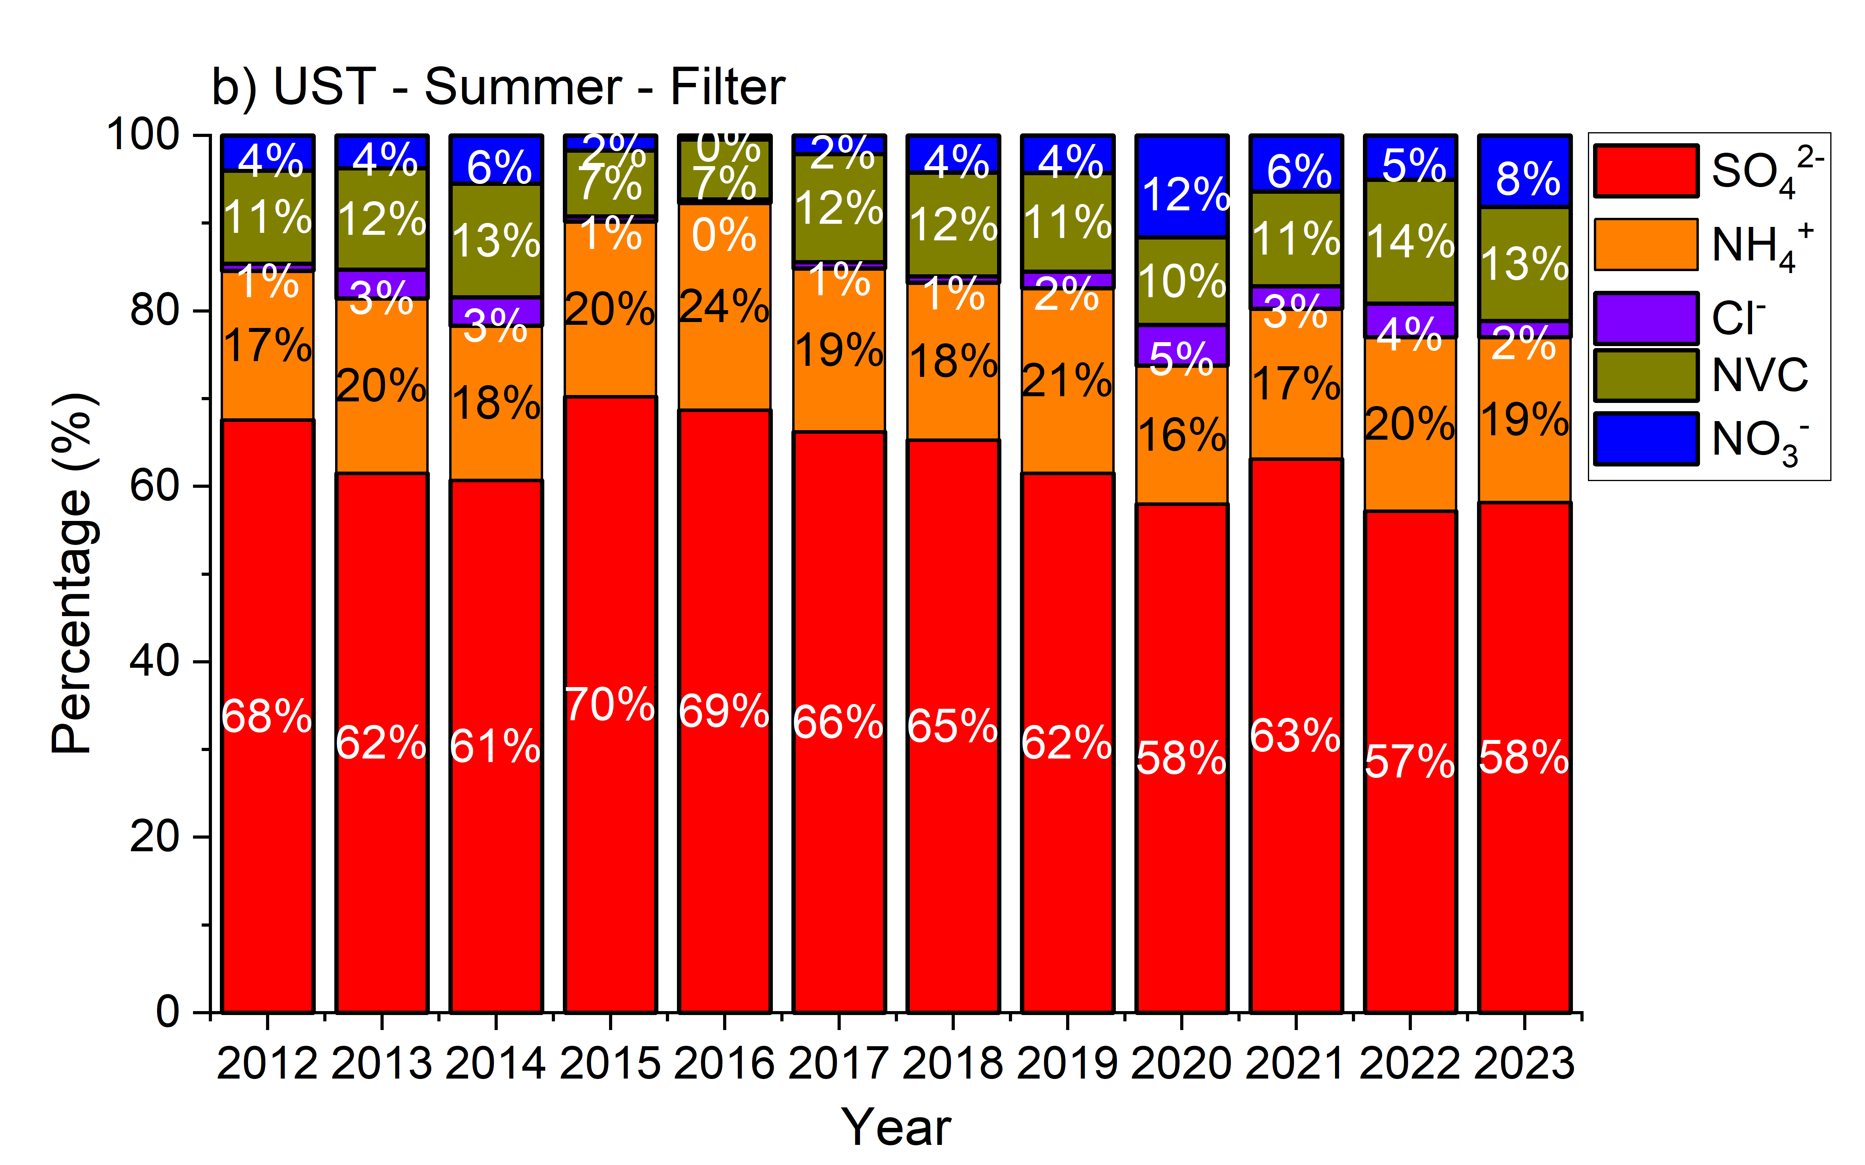
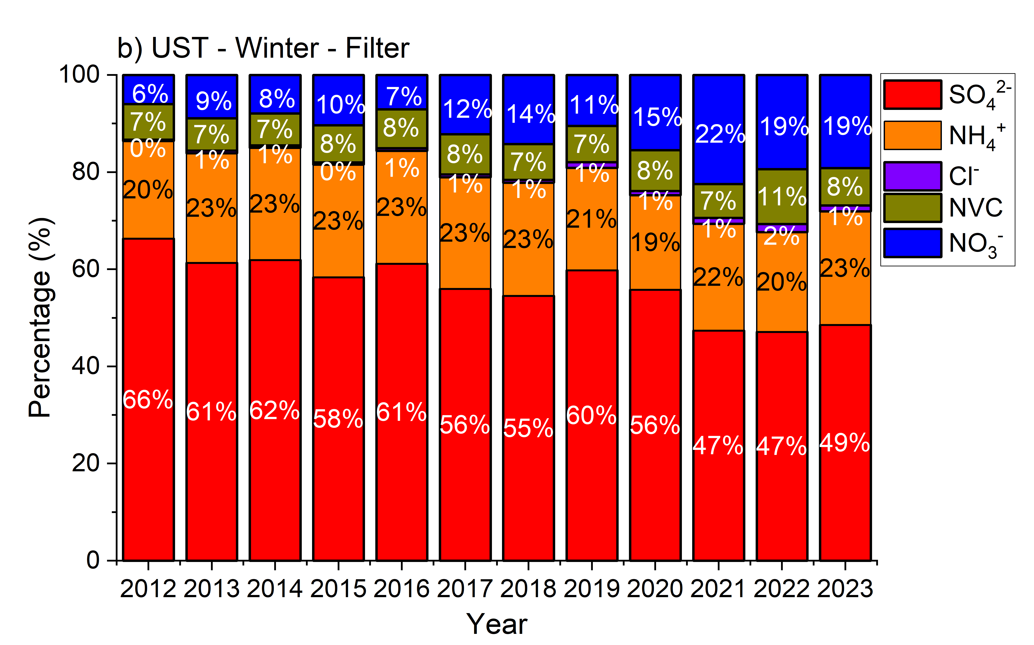
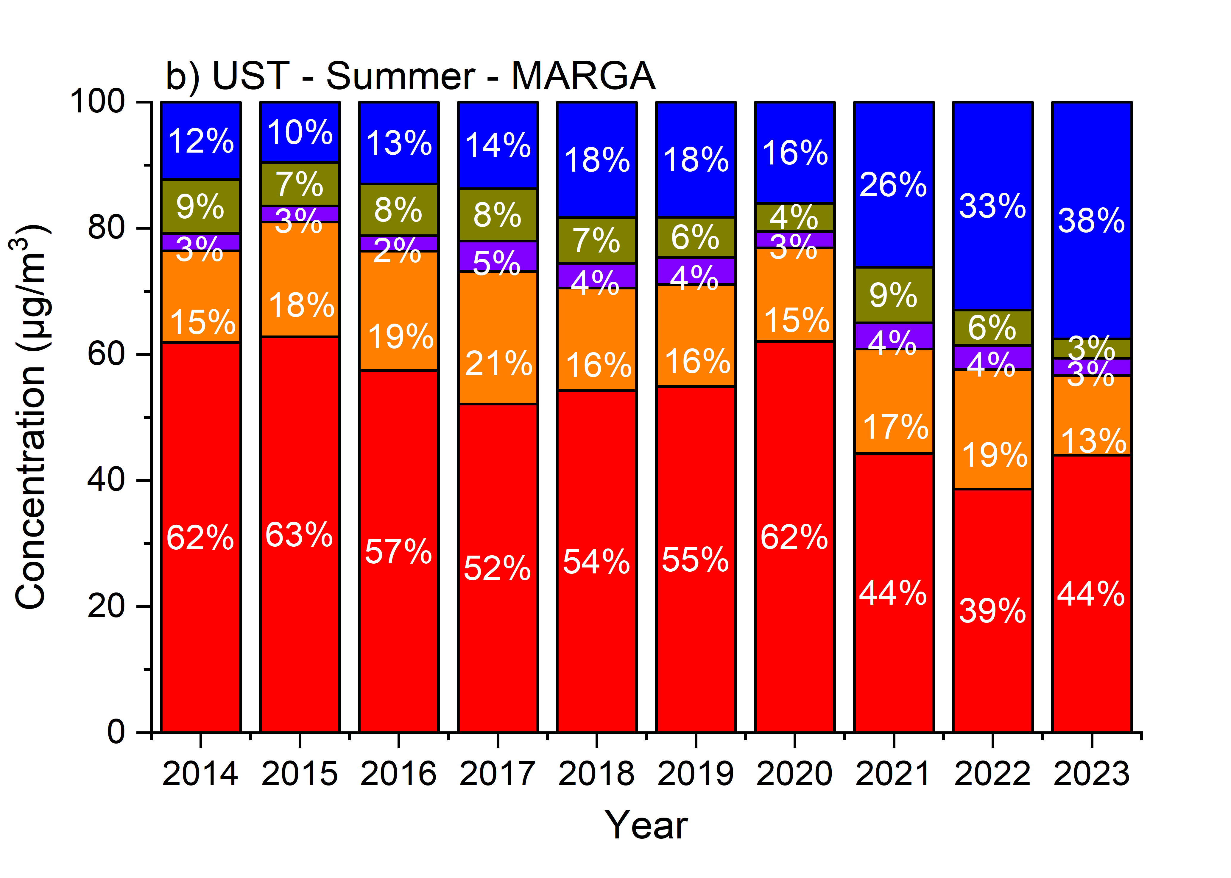
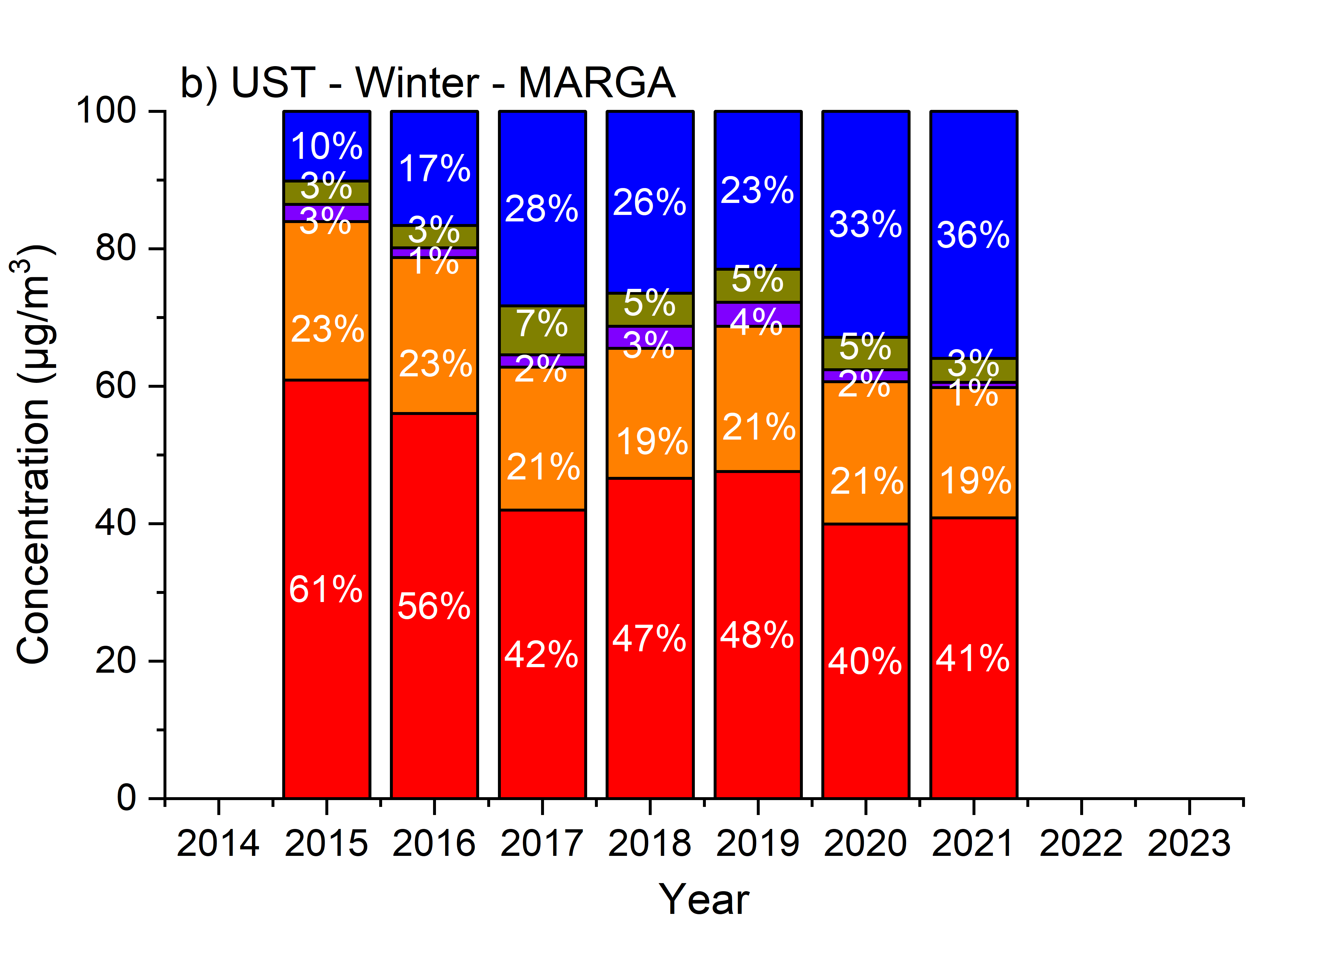
Offline vs. Online
Filter
MARGA

Slide 16
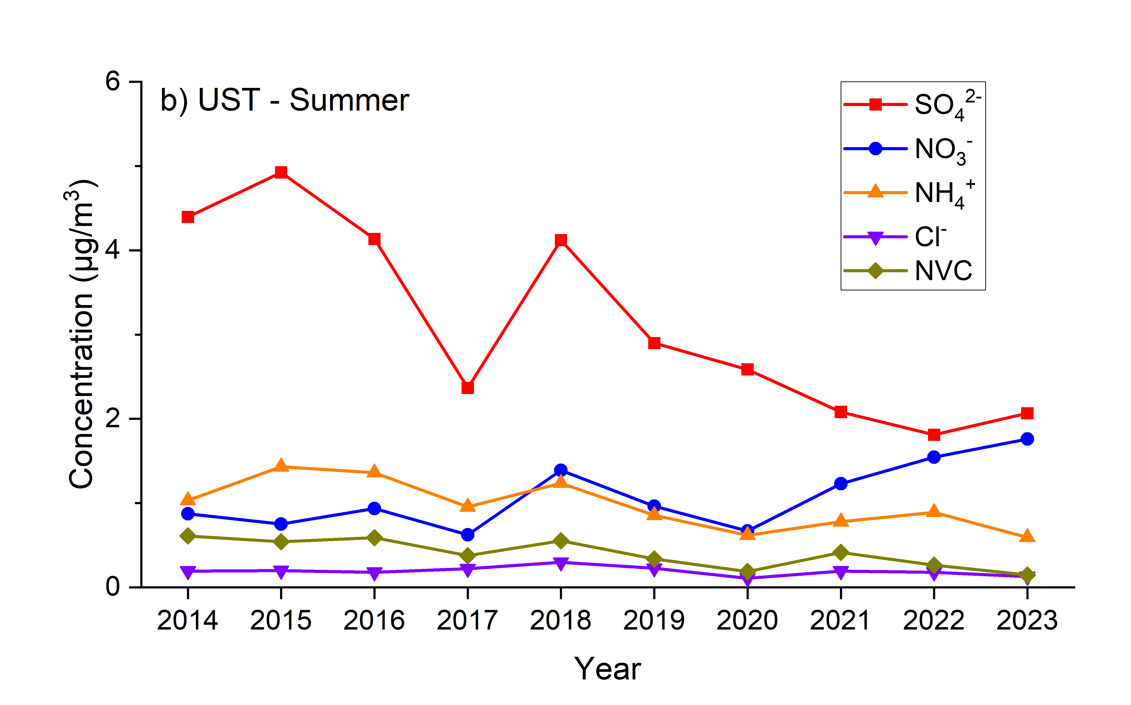
Offline vs. Online
Comparison between annual trend of summer derived from offline filter and online MARGA
Filter
MARGA
Variation (μg/m³/yr) | SO₄²⁻ | NO₃⁻ | NH₄⁺ | Cl⁻ | NVC | PM_{2.5}
Filter | -0.37 | 0.00 | -0.10 | 0.00 | -0.05 | -0.82
MARGA | -0.33 | +0.09 | -0.07 | 0.00 | -0.05 | -

Slide 17
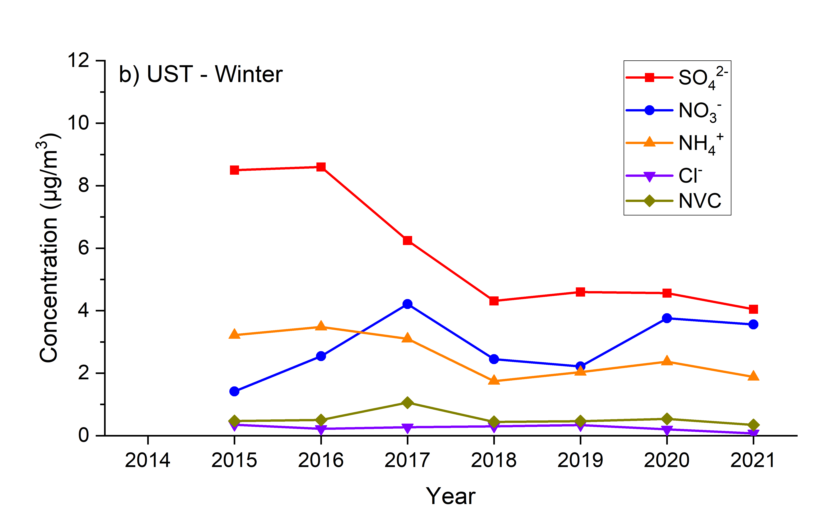
Offline vs. Online
Comparison between annual trend of winter derived from offline filter and online MARGA
Filter
MARGA
Variation (μg/m³/yr) | SO₄²⁻ | NO₃⁻ | NH₄⁺ | Cl⁻ | NVC | PM_{2.5}
Filter | -0.73 | +0.03 | -0.21 | 0.00 | -0.05 | -1.65
MARGA | -0.83 | +0.24 | -0.26 | -0.03 | -0.03 | -

Slide 18
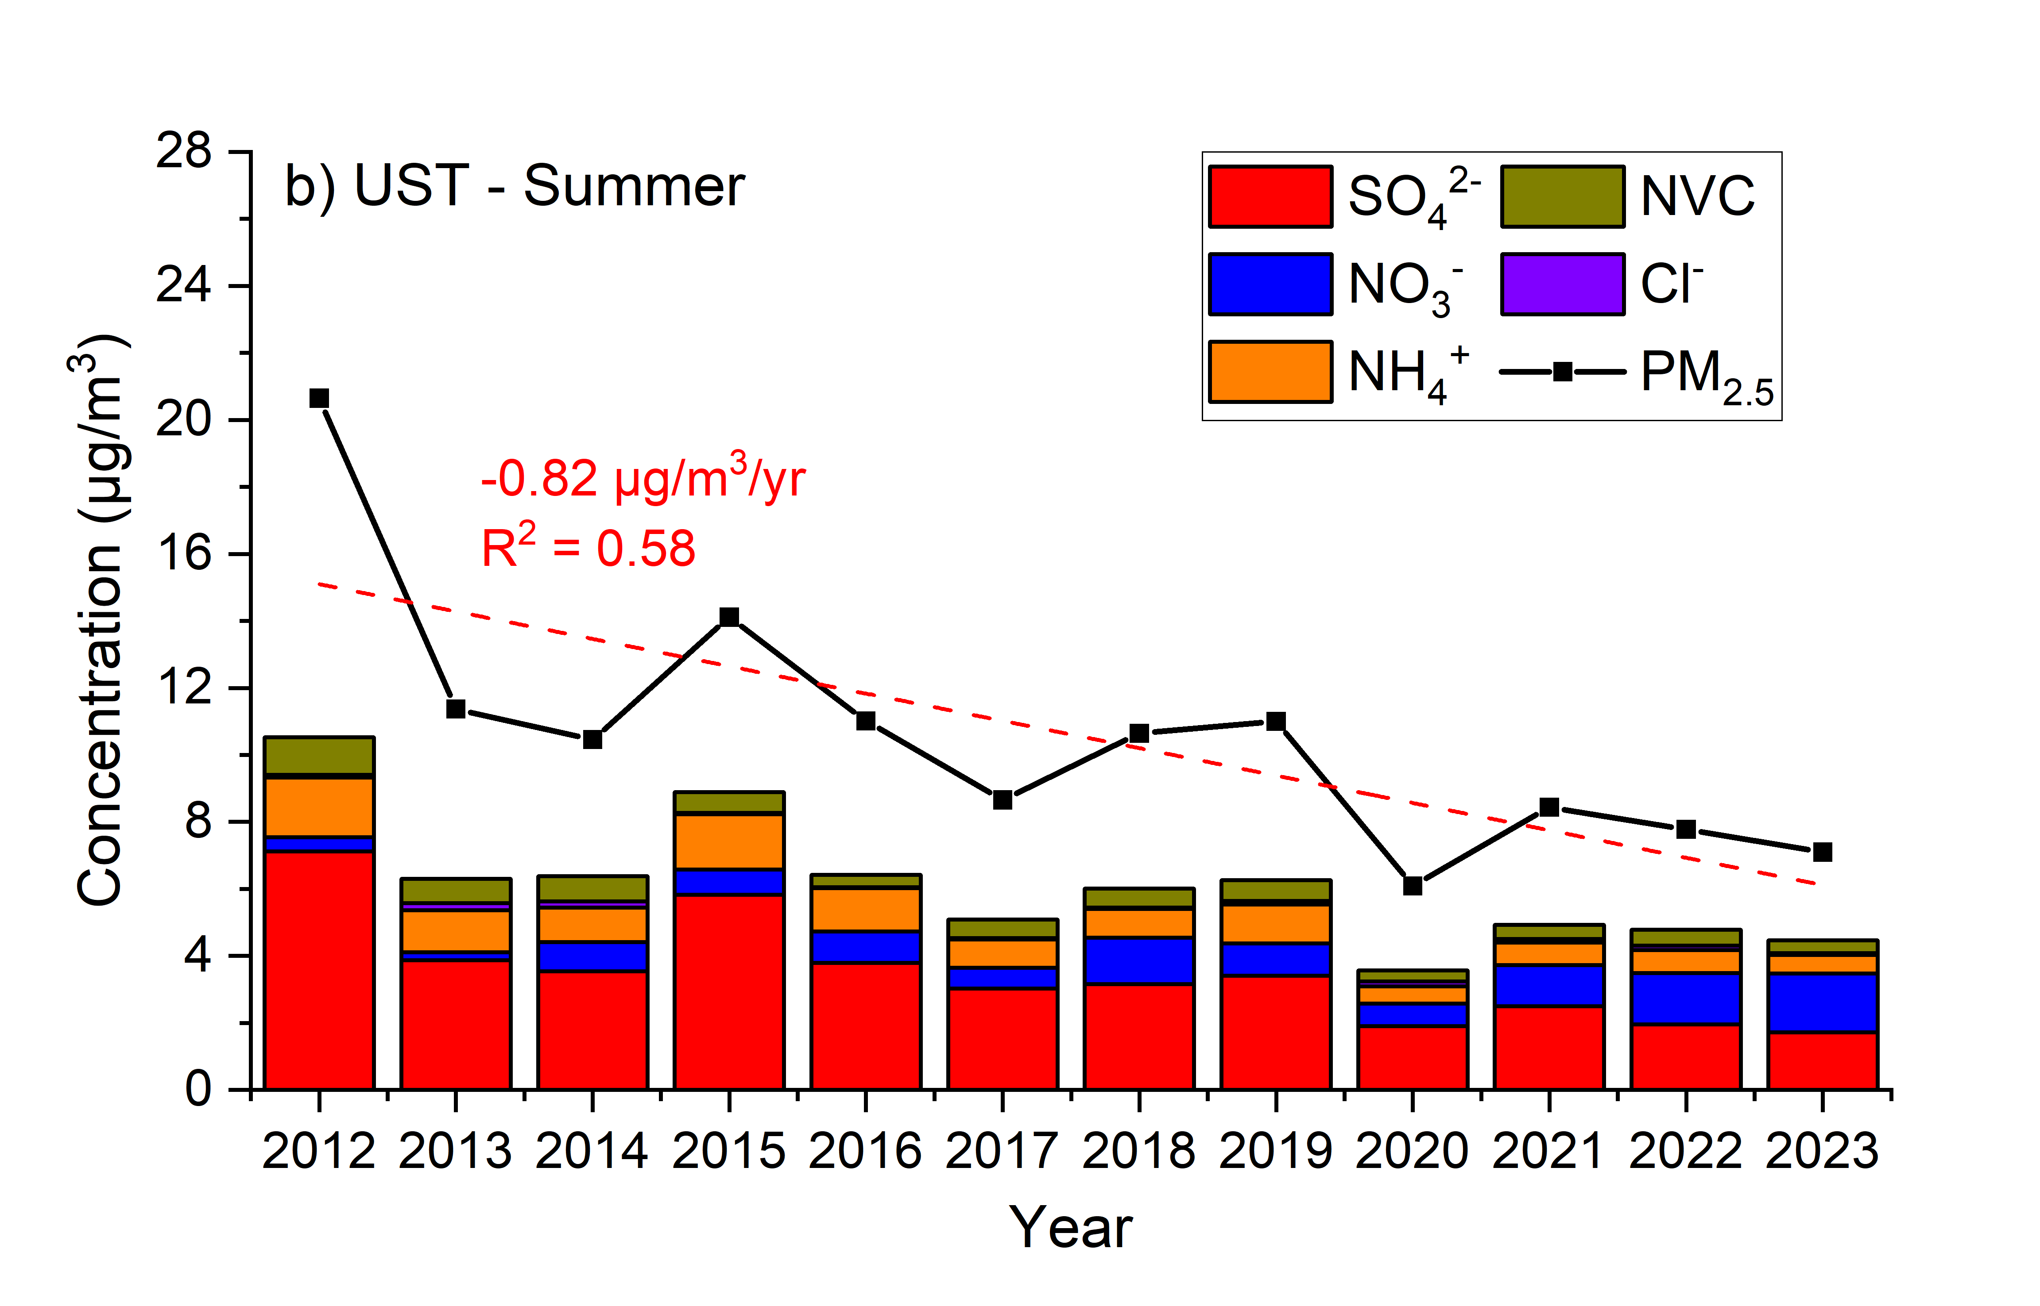
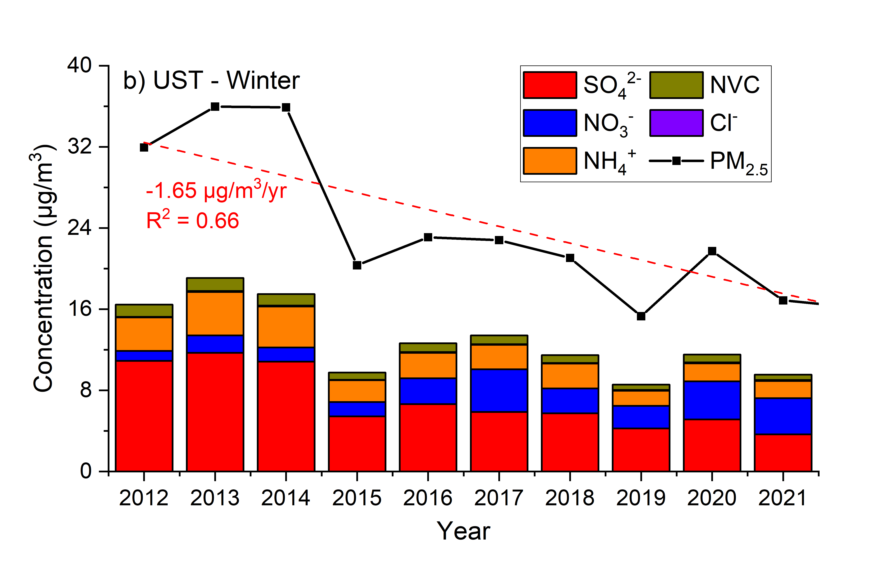
Offline vs. Online
Corrected annual trend of ion concentration in UST site with nitrate replaced by MARGA measured results.

