Slide 1


Characterization of an event of heatwave and particulate matter enhancement in Bologna – Supplementary Material
Andrea Faggi¹, Tiziano Maestri¹, Laura Tositti², Alessandro Zappi², Michele Martinazzo¹, and Erika Brattich¹
1) Department of Physics and Astronomy "Augusto Righi", Alma Mater Studiorum - University of Bologna, Bologna, Italy
2) Department of Chemistry "Giacomo Ciamician", Alma Mater Studiorum - University of Bologna, Bologna, Italy
Presenter:
Andrea Faggi
andrea.faggi3@unibo.it
EGU General Assembly, 27th April 2025 – 2nd May 2025, Wien

Slide 2
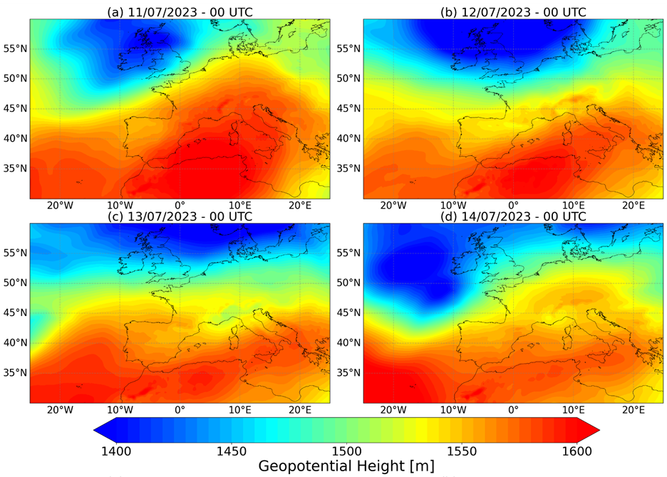
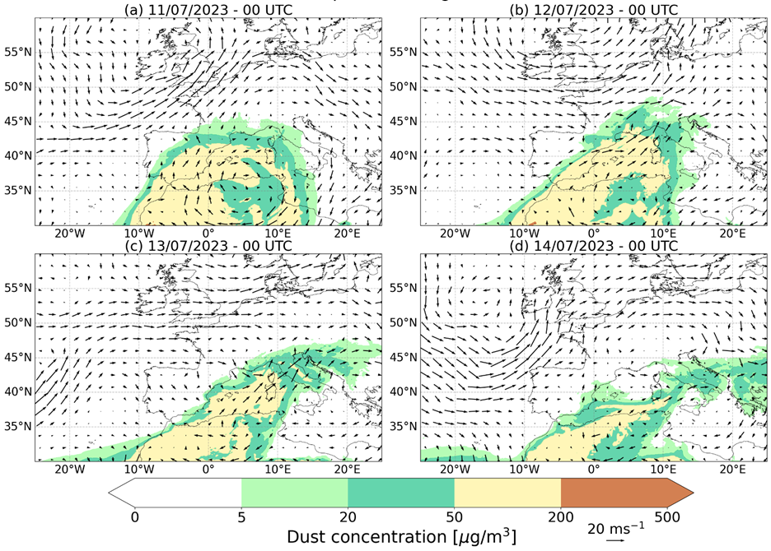
Supplementary Material
Geopotential height at 850 hPa at 00 UTC, 11th – 14th July 2023.
Data source: Copernicus
Dust concentration at 1000 m and horizontal wind at 850 hPa at 00 UTC, 11th – 14th July 2023.
Data source: Copernicus and CAMS
Session NH10.7, Wednesday 30th April 2025, EGU General Assembly 2025, Wien

Slide 3
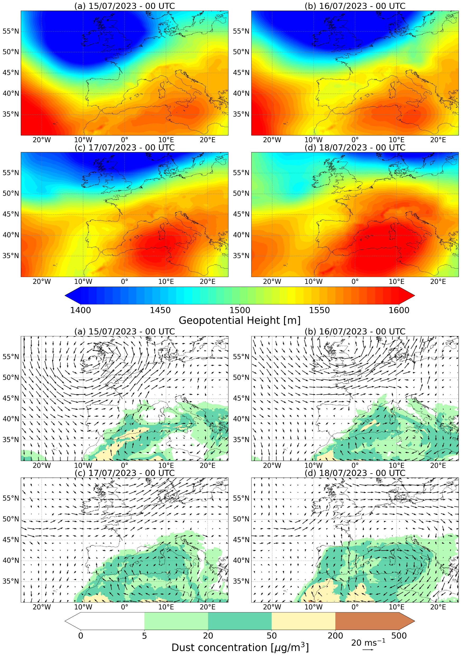
Supplementary Material
Geopotential height at 850 hPa at 00 UTC, 15th – 18th July 2023.
Data source: Copernicus
Dust concentration at 1000 m and horizontal wind at 850 hPa at 00 UTC, 15th – 18th July 2023.
Data source: Copernicus and CAMS
Session NH10.7, Wednesday 30th April 2025, EGU General Assembly 2025, Wien

Slide 4
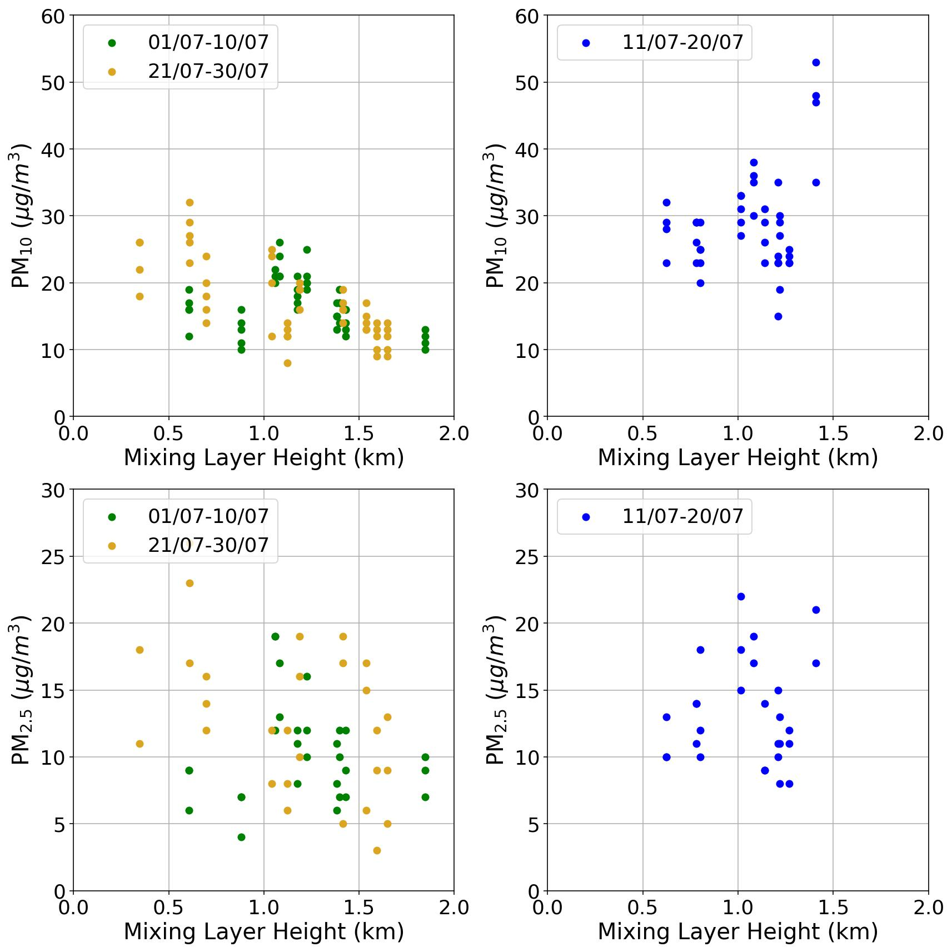
Supplementary Material
Scatterplot representing the daily PM10 and PM2.5 measured after the ARPAE stations against the mixing layer height at 12 UTC+2 estimated from radiosounding at San Pietro Capofiume in the dame day.
Session NH10.7, Wednesday 30th April 2025, EGU General Assembly 2025, Wien

