Slide 1
Crustal structure of the Tibetan Plateau and adjacent areas revealed from ambient noise tomography
Presenter: Tan Ping¹
Collaborators: Chen Yun², Liang Xiaofeng², Li Wei³, Wu Chenglong²
¹ Institute of Disaster Prevention, China
² Institute of Geology and Geophysics, Chinese Academy of Sciences
³ China University of Geosciences, Wuhan
2025.4.30

Slide 2
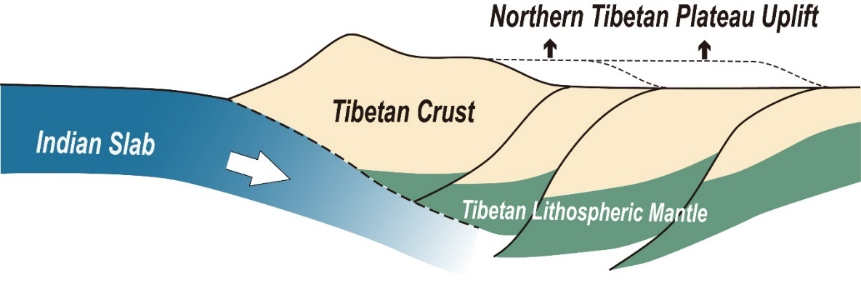
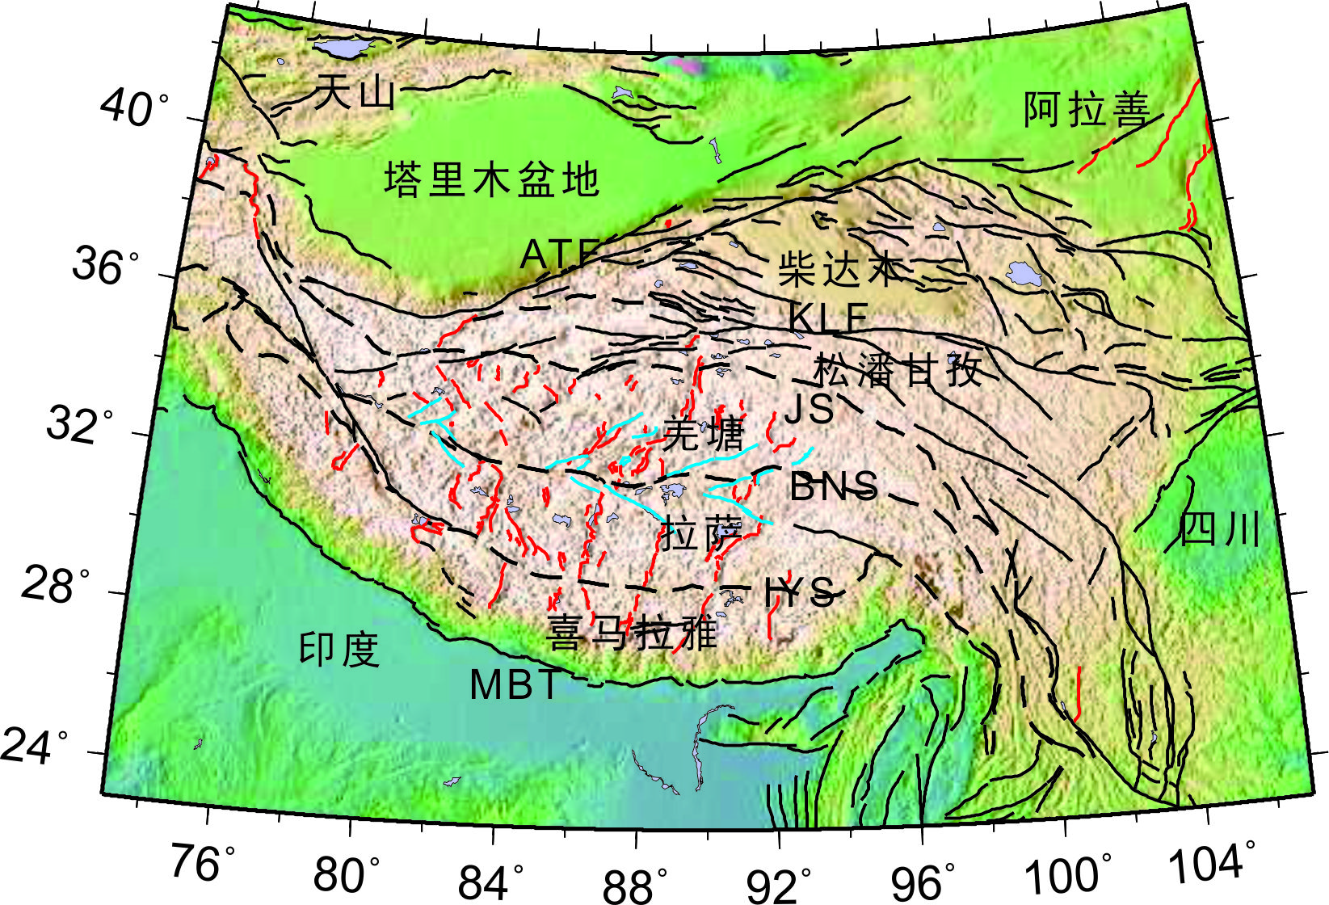
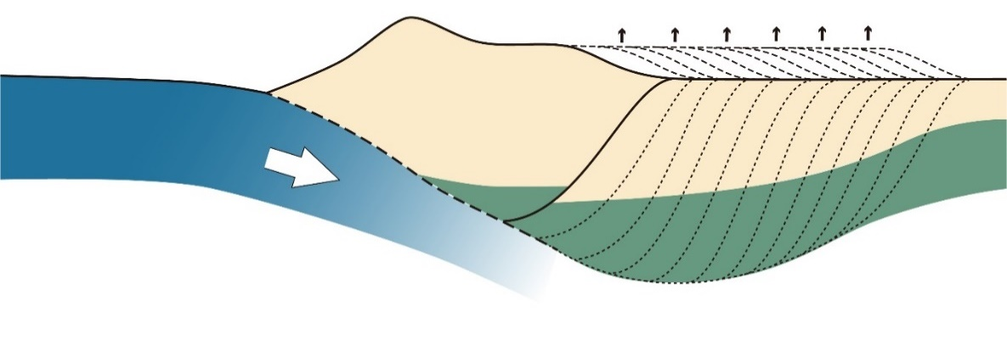
Key Scientific Questions
Tapponnier et al., 1982, 2001
England & Houseman, 1986, 1989
Tectonic Structure Map of the Tibetan Plateau and Adjacent Regions
Royden et al., 1997; Clark & Royden, 2000

Slide 3
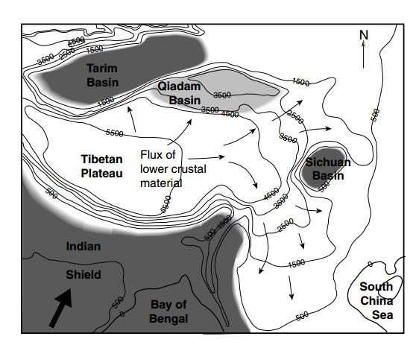
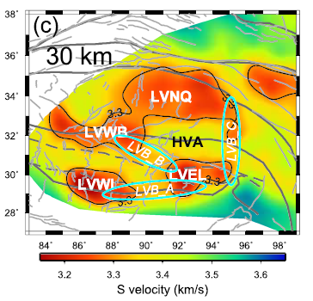
Key Scientific Questions
Crustal flow
Yang et al., 2012
Clark and Royden, 2000
The presence of LVZs serves as a key indicator of crustal flow dynamics.
The spatial distribution of LVZs exhibits significant discrepancies.
Huang et al., 2020

Slide 4
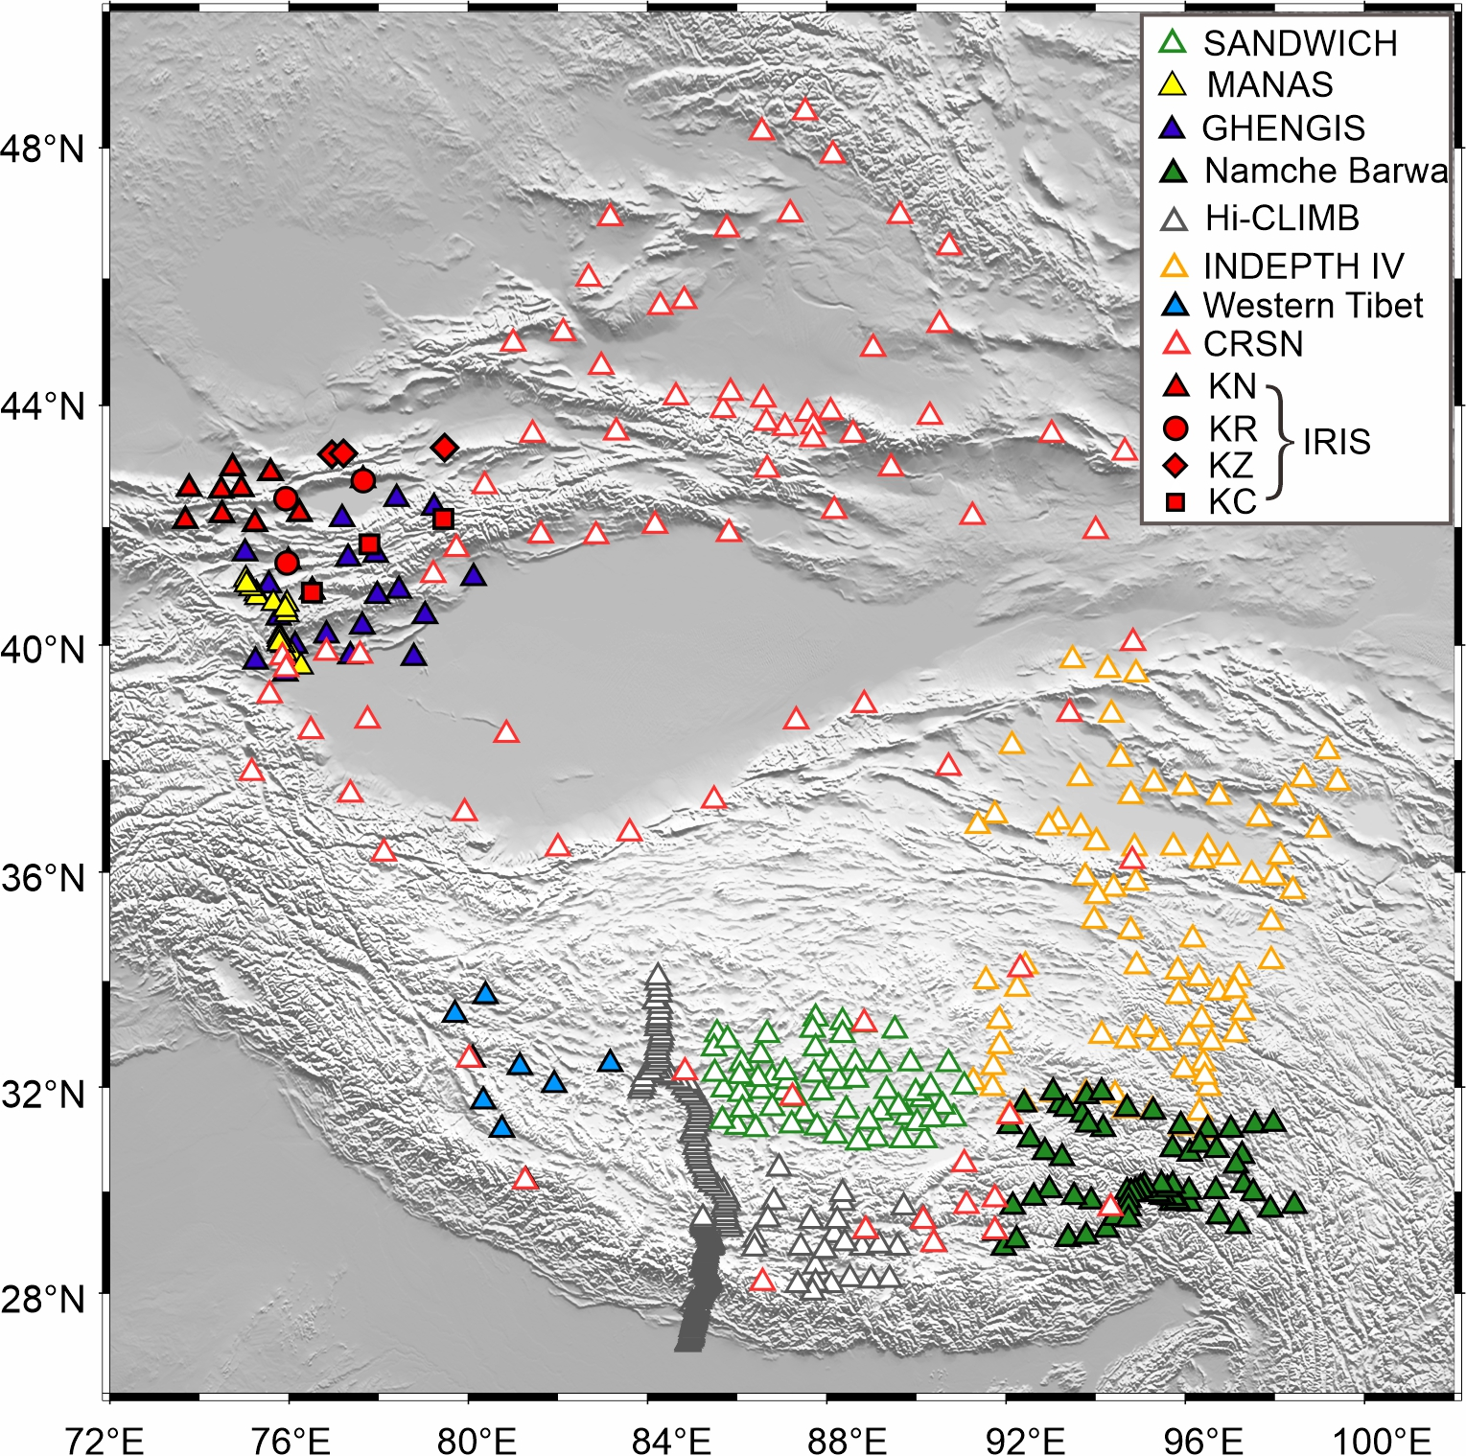
Data
Adding stations：
SANDWICH: 53
GHENGIS：22
MANAS：19
KC, KN, KR, KZ：19
A total of over 500 stations
Distribution Map of Stations

Slide 5
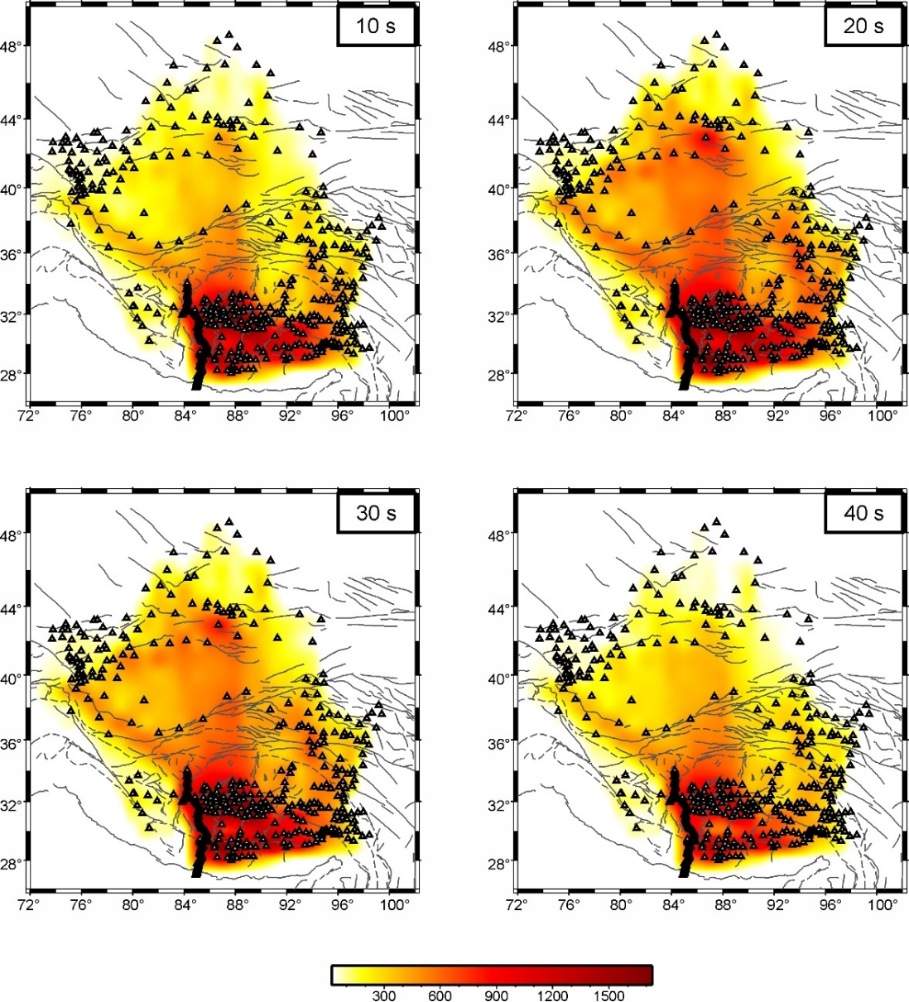
Result
Ray density
Checkerboard tests
(2º$×$2º)
(1º$×$1º)

Slide 6
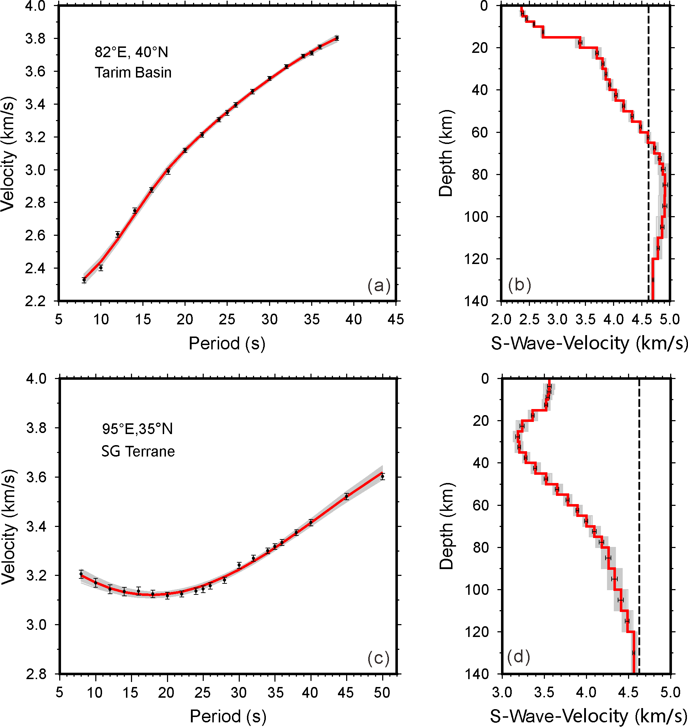
Result
Examples:
Tarim Basin
Pronounced low-velocity feature at shallow depths
Songpan-Ganzi Block
Negative gradient in the dispersion curve

Slide 7
Result

Slide 8
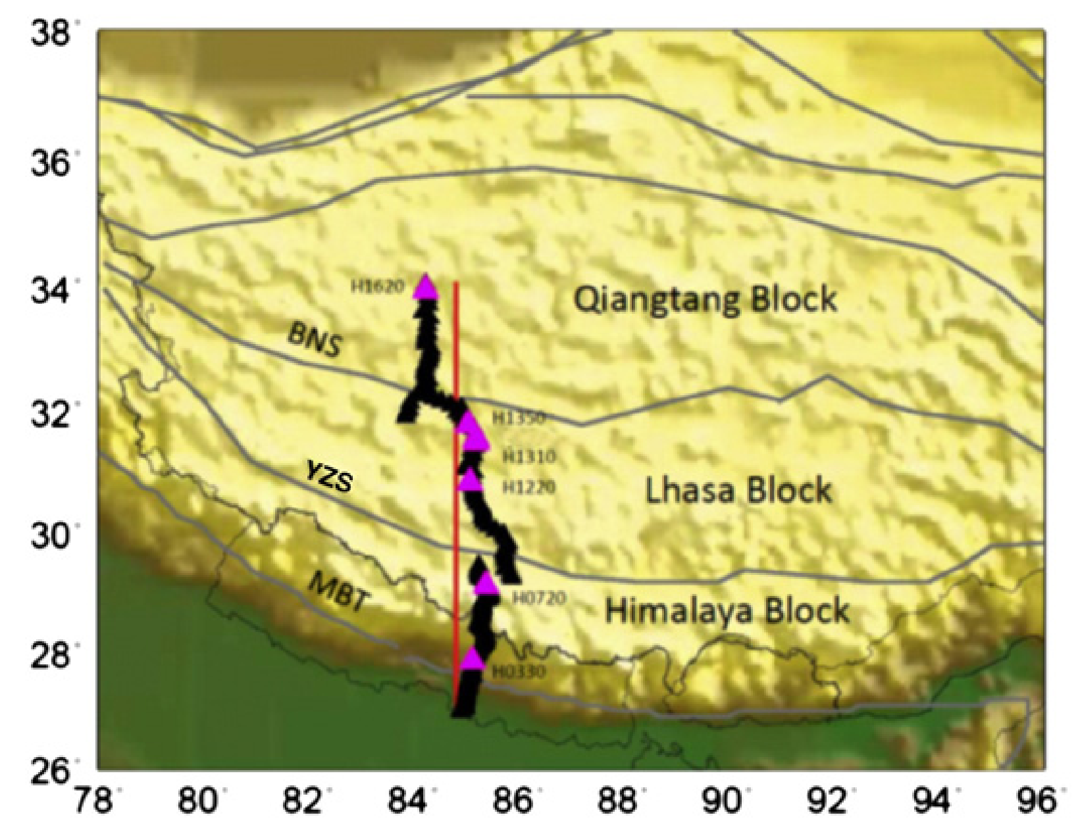
Discussion 1
Xu et al., 2013
Hi-CLIMB：discontinuous LVZs
Hetényi et al., 2011
Southern Tibet：discrete mid-crustal LVZs

Slide 9
Discussion 1
Clark and Royden, 2000
Mid-crustal LVZs exhibit a discontinuous distribution pattern
Absence of large-scale crustal material flow

Slide 10
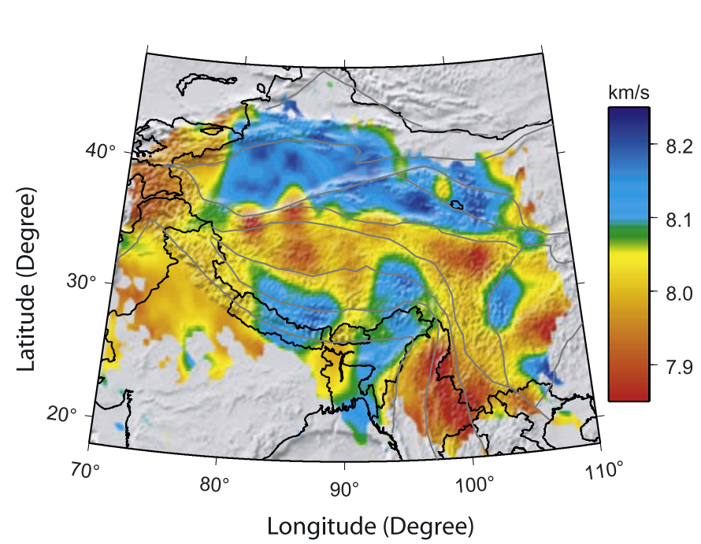
Discussion 2
Purple：recent potassic magmatism (15–0 Ma)
Chuang et al., 2005
Yellow：lavas and associated crustal xenoliths
Wang et al., 2016
Liang and Song, 2006
The LVZ in the northern plateau may be related to lithospheric delamination

Slide 11
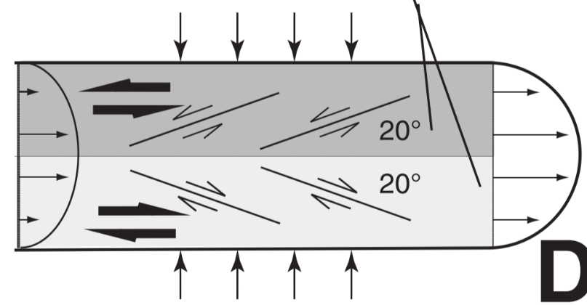
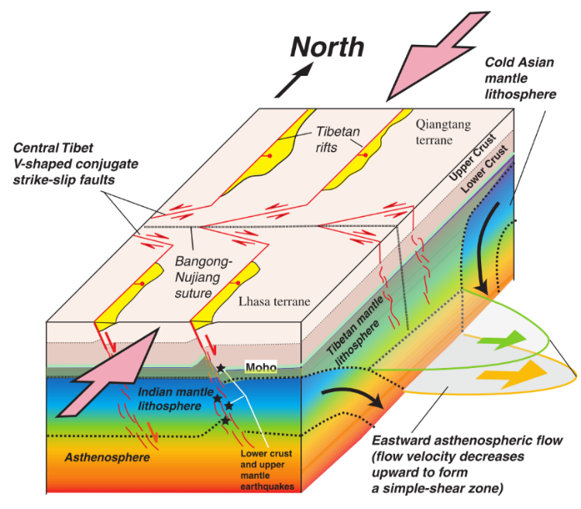
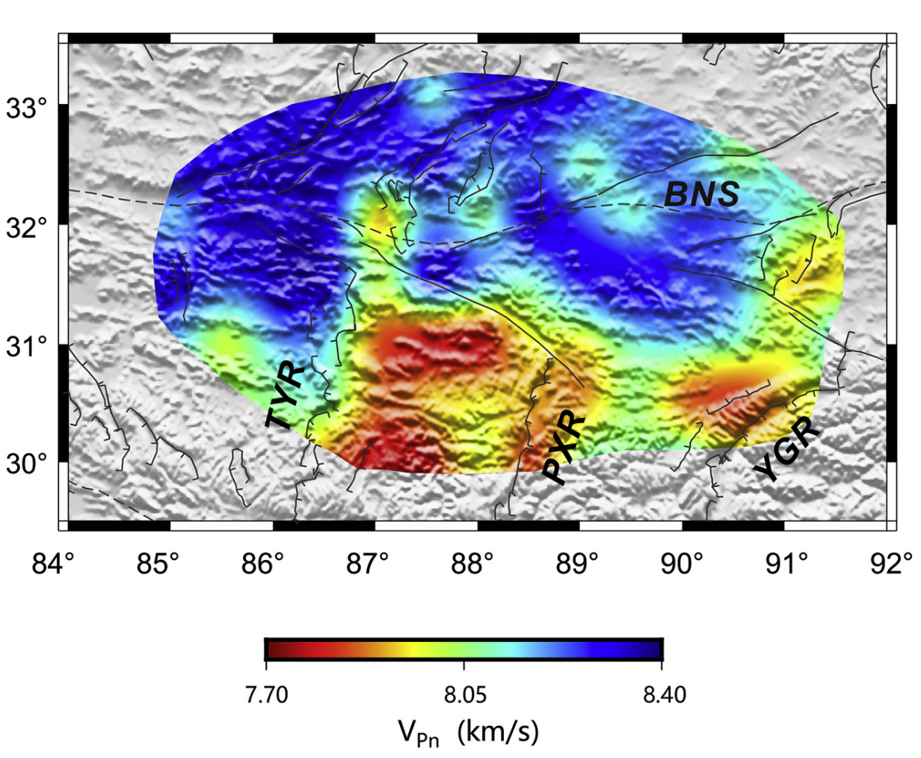
Discussion 3
Paired general-shear model
conjugate strike-slip faults
Yin and Taylor, 2011
Nie et al., 2020

Slide 12
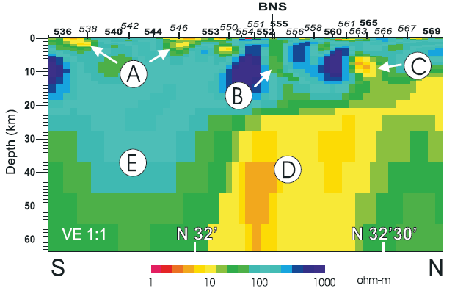
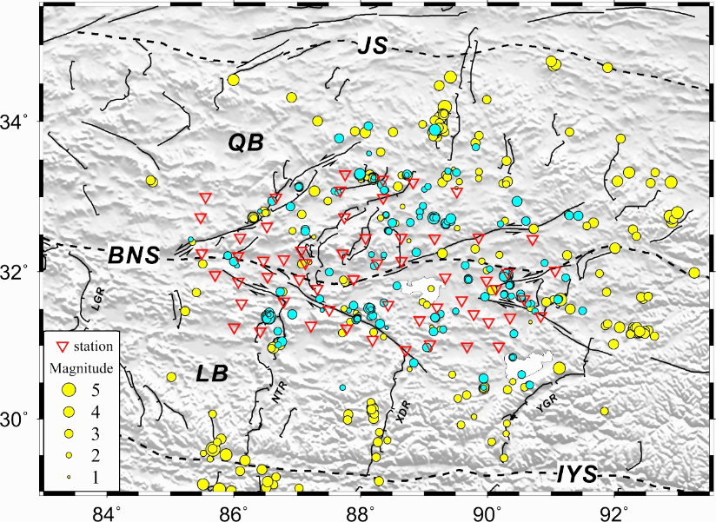
Discussion 3
30km, Vs < 3.3 km/s
High electrical conductivity
Absence of seismic activity
Solon et al., 2003
conjugate strike-slip faults
30 km
Zhu et al., 2017

Slide 13
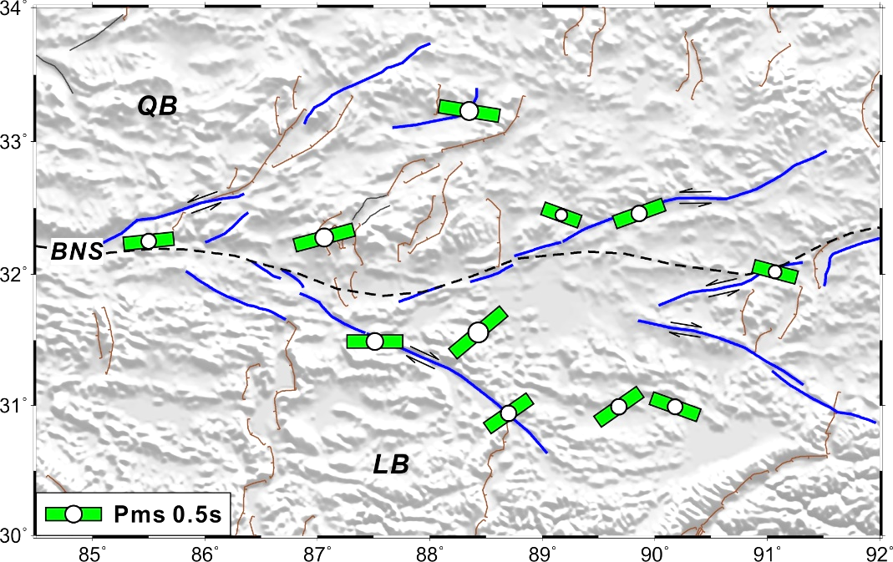
Localized crustal flow likely facilitated the formation of conjugate strike-slip faults
Discussion 3
conjugate strike-slip faults
Wu et al., 2019
The FPDs of crustal anisotropy is nearly east-west
Prominent mid-crustal LVZ

Slide 14
Discussion 4
Jin et al., 2022
Nie et al., 2020
Pronounced east-west segmented pattern in the LVZs
MT imaging and Pn-wave tomography reveal comparable segmentation characteristics

Slide 15
Discussion 4
Li et al., 2008
Zhao et al., 2010
The north-south trending low-velocity belt extends to the BNS

Slide 16
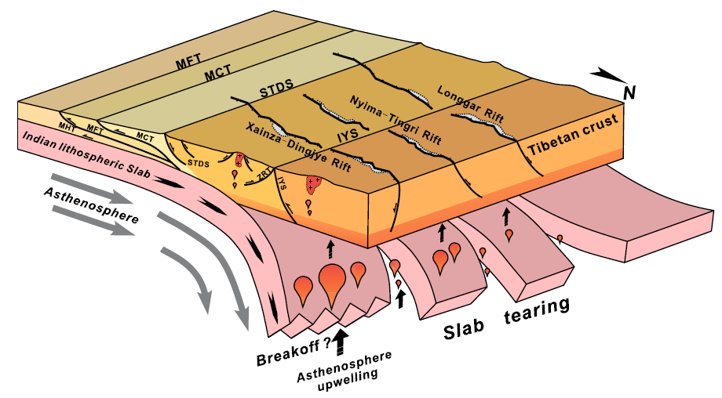
The geometry of the subducting slab likely controls the development of N-S trending rifts
Discussion 4
Chen et al., EPSL, 2015

Slide 17
Thank you for your attention and time.

