Slide 1






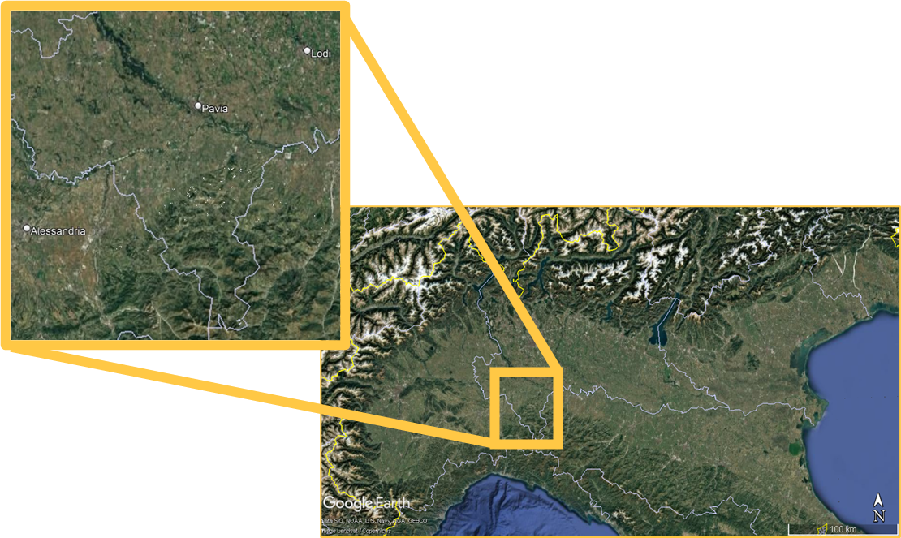
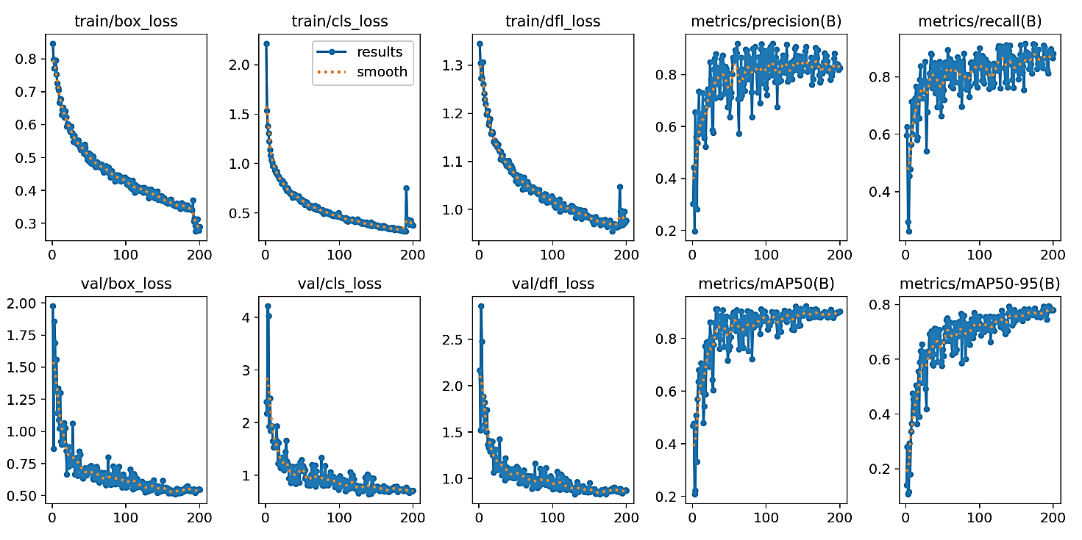
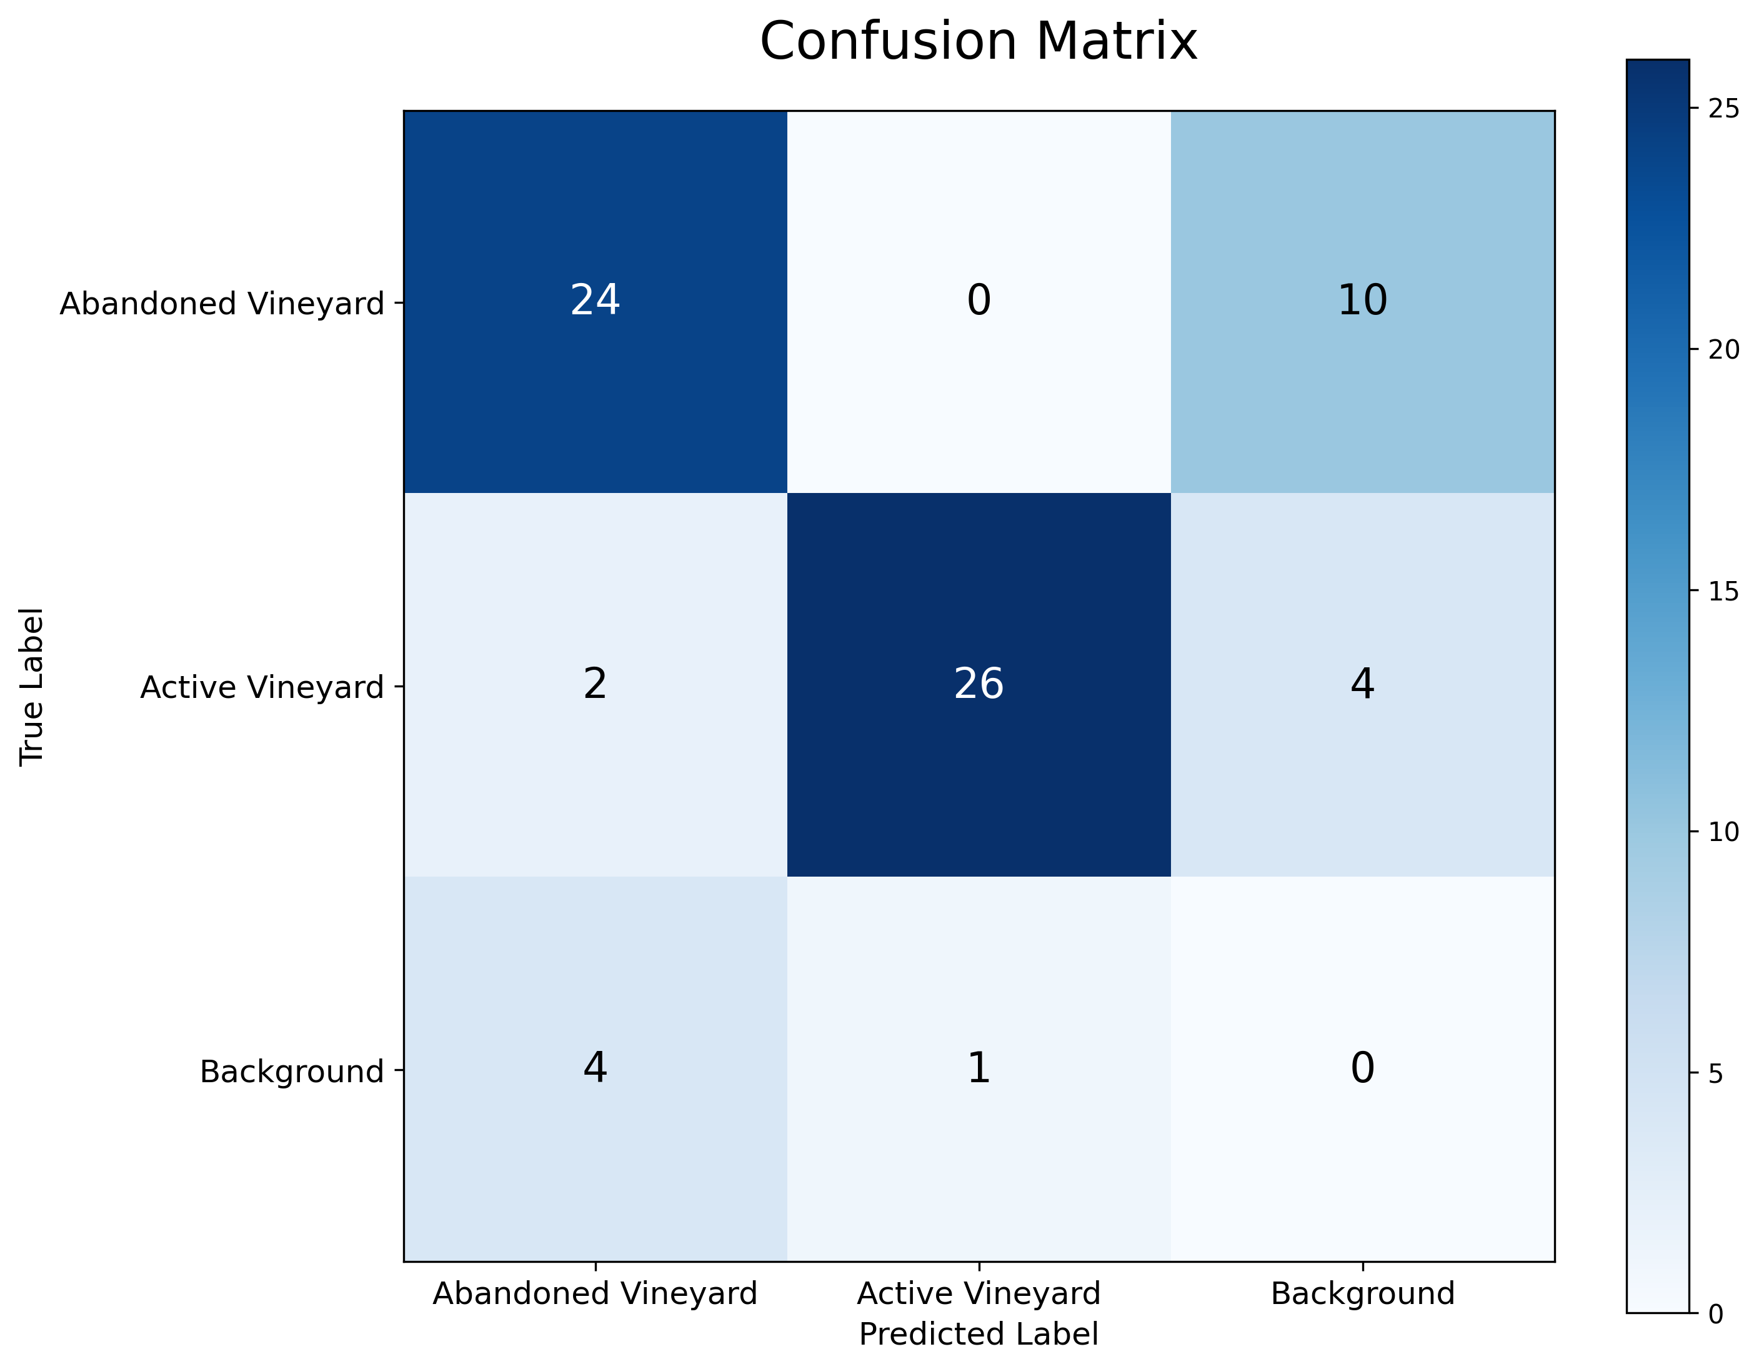
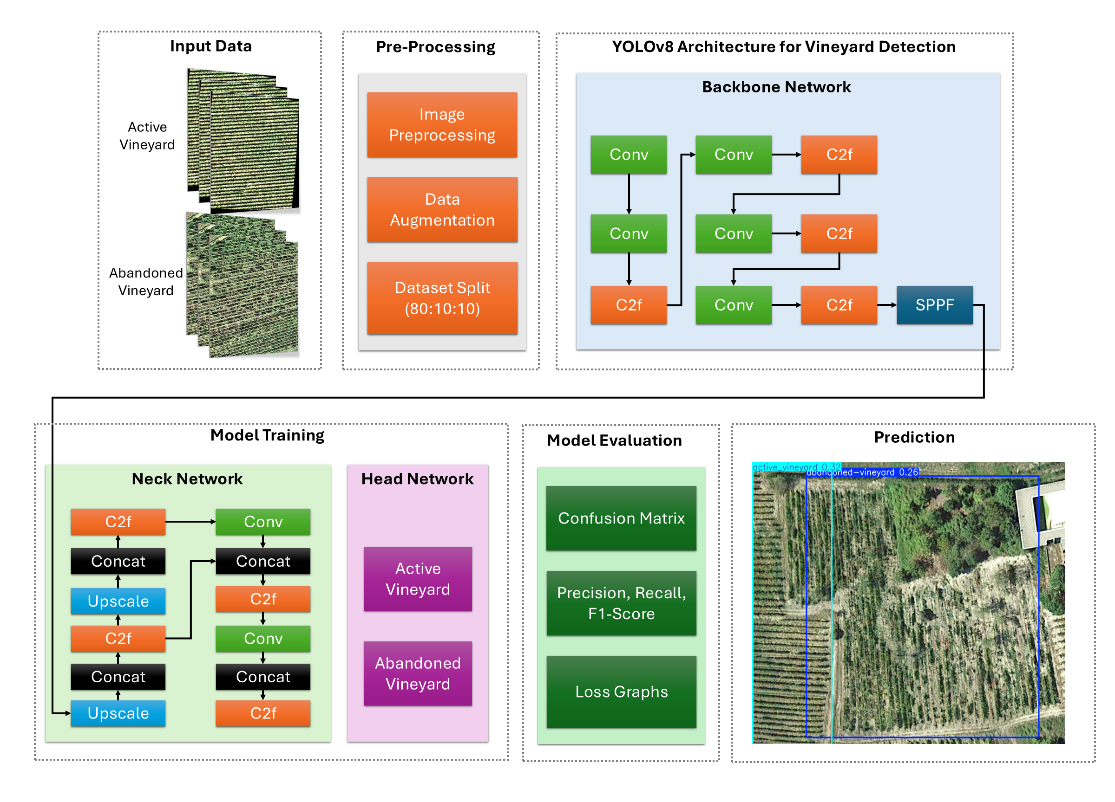

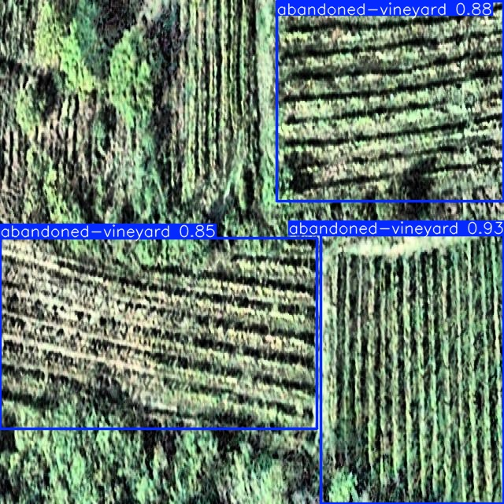
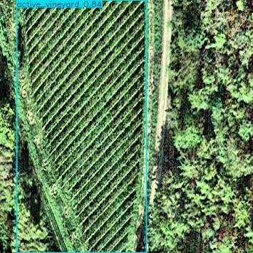


VINEYARD CONDITION DETECTION METHOD USING GOOGLE EARTH IMAGES AND THE YOLOv8 MODEL IN NORTHERN ITALY
¹Sohail Anwar, ²Giovanni Marchese, ¹Chiara Toffanin, ²Valentina Vaglia
¹Department of Electrical, Computer And Biomedical Engineering, University of Pavia, Via Ferrata 5, 27100 Pavia, Italy
²Department of Earth and Environmental Sciences, University of Pavia, Via S. Epifanio 14, 27100 Pavia, Italy
SPOKE 6
AGROINDUSTRIA PRIMARIA
Introduction
Data Augmentation:
Rotation, mirroring, scaling, brightness/contrast adjustments, noise injection (only on training set).
Model:
YOLOv8 architecture (CSPDarknet backbone, PANet neck, Anchor-free detection head).
Training:
80% train, 10% validation, 10% test; adaptive learning rate, 200 epochs, batch sizes (8,16,32).
Climate change impacts agricultural productivity, affecting viticulture significantly.
Oltrepò Pavese, renowned for Pinot Noir, faces vineyard abandonment due to climatic and socioeconomic challenges.
Abandoned vineyards increase risks of diseases like flavescence dorée.
Manual identification is inefficient; advanced methods using GIS, Remote Sensing, and Machine Learning (ML) are necessary.
Results
Objectives
Model | Batch Size | Recall (Val) | Recall (Test) | Params (M) | GFLOPs | Inference Time (ms) | Training Time (h)
YOLOv8n | 32 | 0.90 | 0.711 | 3.0 | 8.1 | 2.5 | 1.58
YOLOv8n | 16 | 0.833 | 0.632 | 3.0 | 8.1 | 2.5 | 1.73
YOLOv8n | 8 | 0.733 | 0.579 | 3.0 | 8.1 | 7.5 | 1.92
YOLOv8s | 8 | 0.885 | 0.658 | 11.1 | 28.4 | 6.0 | 1.99
YOLOv8m | 32 | 0.80 | 0.706 | 25.8 | 78.7 | 9.7 | 2.33
Develop a YOLOv8 deep learning model for automated detection and localization of active and abandoned vineyards.
Study Area
Oltrepò Pavese, Northern Italy: Continental climate, 200-1725m altitude, 700-998mm rainfall annually.
Prominent grape varieties: Pinot Noir, Croatina, Barbera.
Discussion
Methodology
Lightweight & efficient model ideal for real-time monitoring.
Advantage over CNNs/ViTs: Detects multiple vineyards per image without manual cropping.
Data Collection:
Orthophotos from Google Earth Pro (2014, 2015, 2018).
Data Annotation:
Manual annotations using Roboflow Annotator.
472 abandoned and 410 active vineyard instances.
Data Preprocessing:
Resizing (640×640 pixels), auto-orientation, cropping, adaptive contrast equalization.
Conclusion & Future Work
YOLOv8n (bs=32) achieved optimal performance with 90% recall for abandoned vineyard detection while maintaining computational efficiency.
Offers scalable vineyard monitoring framework beyond Oltrepò Pavese.
Enhance accuracy by integrating multi-year satellite/drone data.
Test latest YOLO models for enhanced vineyard detection and precise localization.
Questa iniziativa é realizzata nell’ambito del proqetto NODES, finanziato dal MUR sui fondi M4C2 - Investimento 1.5
Avviso "Ecosistemi dell’Innovazione”, nell’ambito del PNRR finanziato dall’Unione europea – NextGeneratianElJ (Grant agreement Cod. n.ECS00000036)

