Slide 1
Limiting processes in the non-linear and non-diffusive acceleration of radiation belt electrons by whistler-mode waves
Mirek Hanzelka
Y. Shprits, D. Wang, B. Haas
GFZ Helmholtz Centre for Geosciences
Vienna, 30 April 2025

Slide 2
Open Questions in Radiation Belt Modelling
When can we apply quasilinear theory?
Which range of wave parameters (amplitude, bandwidth, …)?
What region of velocity space?
When quasilinear theory fails – is diffusive approach justified?
On what timescales becomes diffusive description accurate?
Which method should be used to obtain diffusion coefficients?
If diffusive approach fails – which methods should be used?
Will introducing an advective term help?
Do we need a jump kernel (integral term) in the master equation?
Notes:
TODO figure: trajectories with plane wave and quasicoherent, basic parameters to the side; left lower energies, right RTA/URA
TODO: reduce number of trajectories in plane wave plot

Slide 3
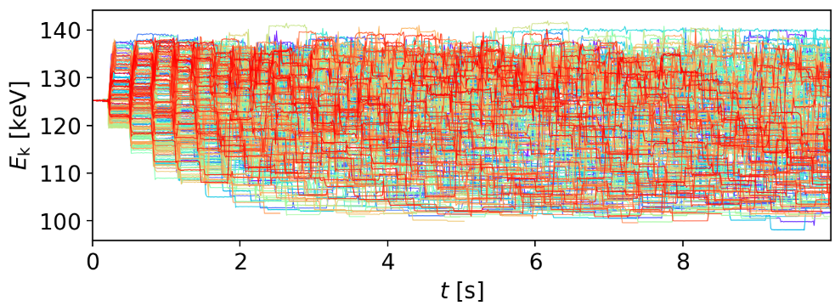
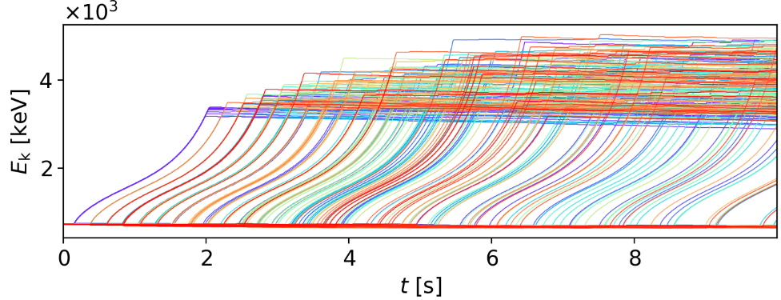
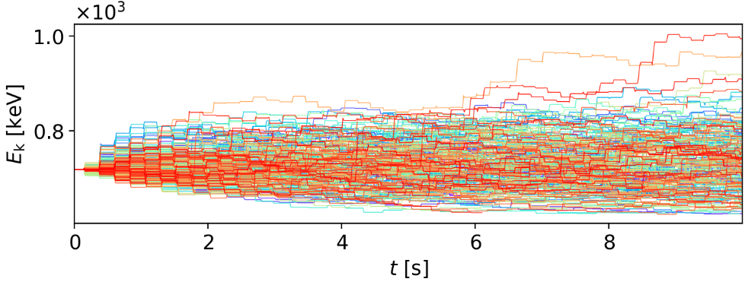
Plane wave vs. Quasi-coherent
Phase trapping
Plane wave
Quasi-coherent (Power FWHM $0.04f_{ce0}$)
125.2 keV, 56° PA
Phase bunching
Relativistic turning
acceleration
718 keV, 34° PA
Wave parameters: Field-aligned whistler mode, frequency $0.25f_{ce0}$, amplitude $0.003B_{0}$
Long-term test-particle mapping: Hanzelka+ 2025, JGR

Slide 4
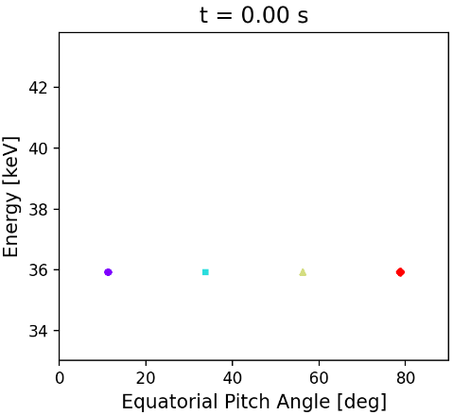
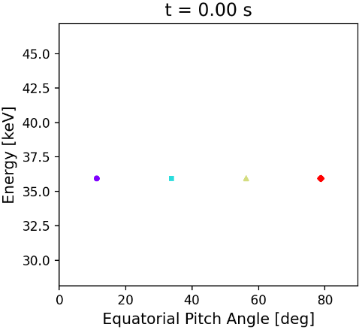
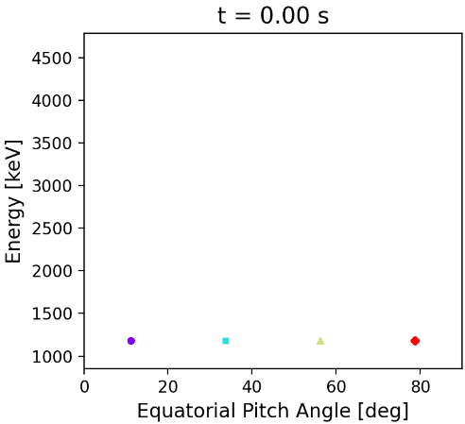
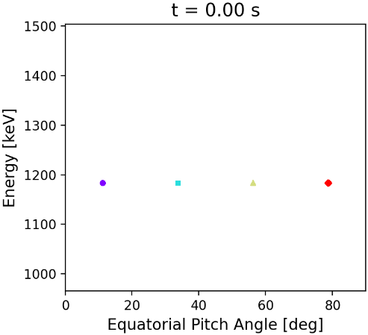
Plane wave
Quasi-coherent (Power FWHM $0.04f_{ce0}$)
35.9 keV
1190 keV

Slide 5
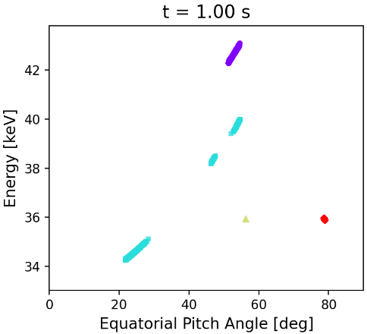
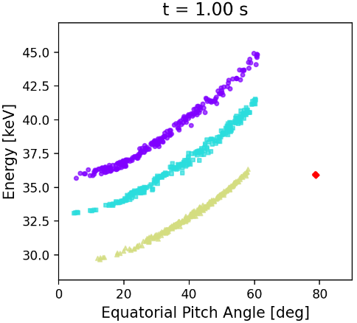
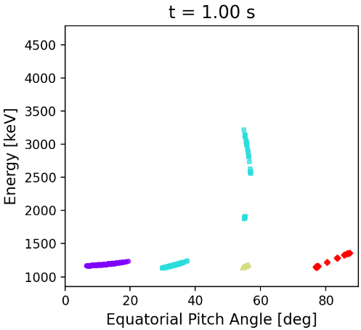
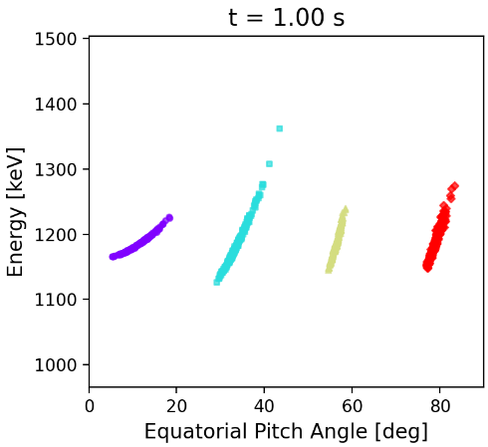
Plane wave
Quasi-coherent (Power FWHM $0.04f_{ce0}$)
35.9 keV
1190 keV

Slide 6
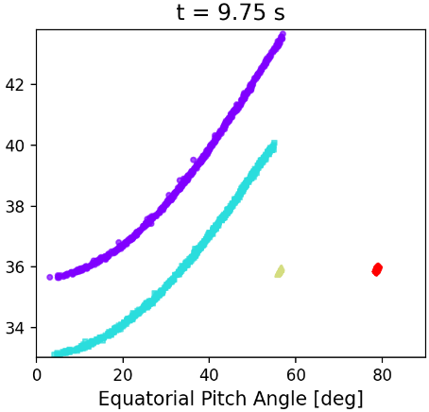
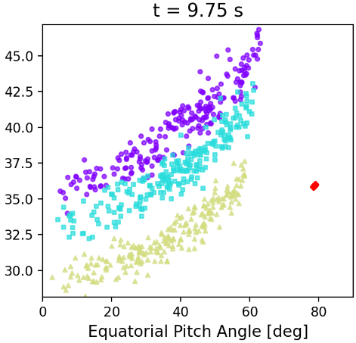
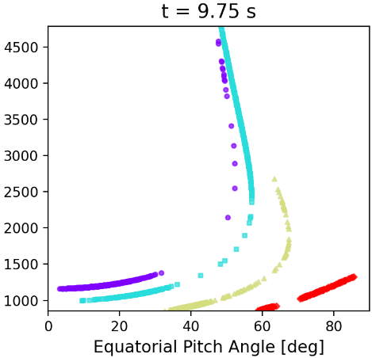
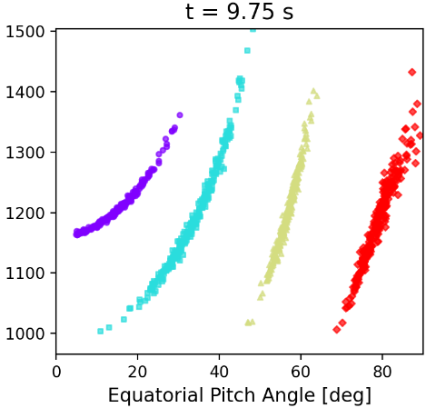
Plane wave
Quasi-coherent (Power FWHM $0.04f_{ce0}$)
35.9 keV
1190 keV

Slide 7
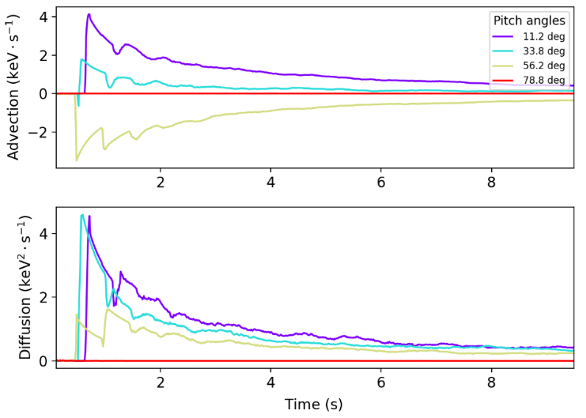
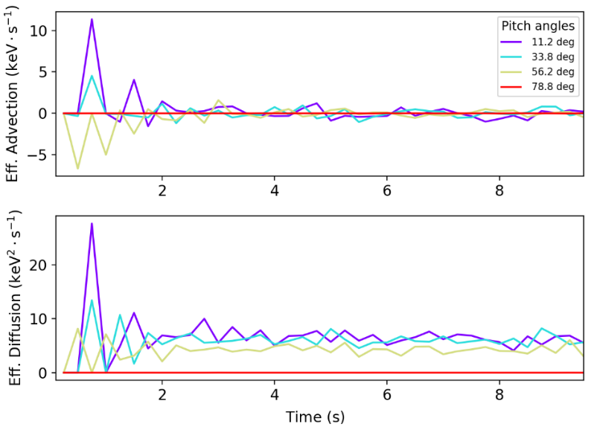
How to extract transport coefficients?
$T_{half}$ (PA = 11.25°)
Two approaches & their issues
After a ½- or ¼-bounce (Traditional):
Not in stochastic regime
Apparent high advection cannot be easily implemented, breaks stability
After many bounces:
Nonlocal, path-integrated coefficient => cannot be assigned to a single point in the energy–pitch-angle space
Fixed time steps => constant in time
6 s to 9 s average

Slide 8
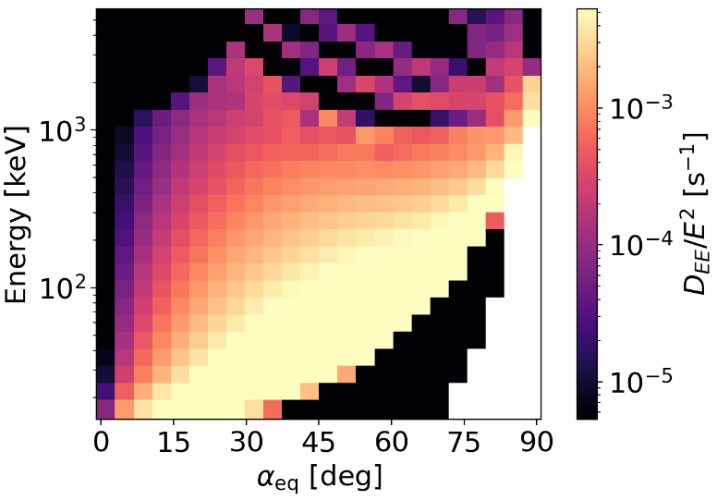
Method 1
Method 2
Advection can be neglected at all energies and PA
Diffusion is stronger in highlighted region
Quasilinear
LOWER
HIGHER
No saturation with amplitude
Notes:
TODO: Try to let particles return to the equator in the ½ bounce calculation

Slide 9
What’s next?
Study diffusion in resonance-curve-aligned coordinates
Obtained inhomogeneous resonant diffusion curves (iRDC) numerically
Set up a sharp PSD gradient along the iRDC
Run for at least 10 sec and fit the decay of the gradient with a 1D solution of the diffusion equation
Focus on the troublesome high-energy region
Sensitivity of RTA to bandwidth
Compare $D_{EE}$ and $D_{αα}$ from quasilinear theory and from test-particle
Extend analysis to periodic rising tones
Notes:
Future: try with rising tone
How to deal with URA/RTA?
„Painting“ diffusion along resonance curves
Should we use coordinates aligned to resonance curves? Would that result in different energy profile and loss rate? (use PSD map in future). It likely will result in a different PSD gradient, because the particles „remember“ teh resonance curve – not perfectly Markovian
Is Dpp/Daa ration same in QL as in NL

Slide 10
Takeaways
Particle transport by narrowband emissions closely follows well-defined inhomogeneous resonance curves
Quarter-bounce/half-bounce test-particle simulations are not appropriate for extraction of transport coefficients
New methods based on PSD evolution are needed
Download Link:
Contact: mirekhanzelka@gmail.com

