Slide 1
A new model for the thickness and thermal structure of the African lithosphere: implications for the distributions of kimberlites, carbonatites and critical mineral deposits
Siyuan Sui¹ <ss3216@cam.ac.uk>, Yihe Xu^{1,2}, Sergei Lebedev¹, Emilie Bowman¹, Javier Fullea³, Sally Gibson¹
1 Department of Earth Sciences, University of Cambridge, UK;
2 Department of Geophysics, Yunnan University, China;
3 Universidad Complutense de Madrid, Spain.
EGU 2025, Vienna, Austria; Poster EGU25-9976

Slide 2
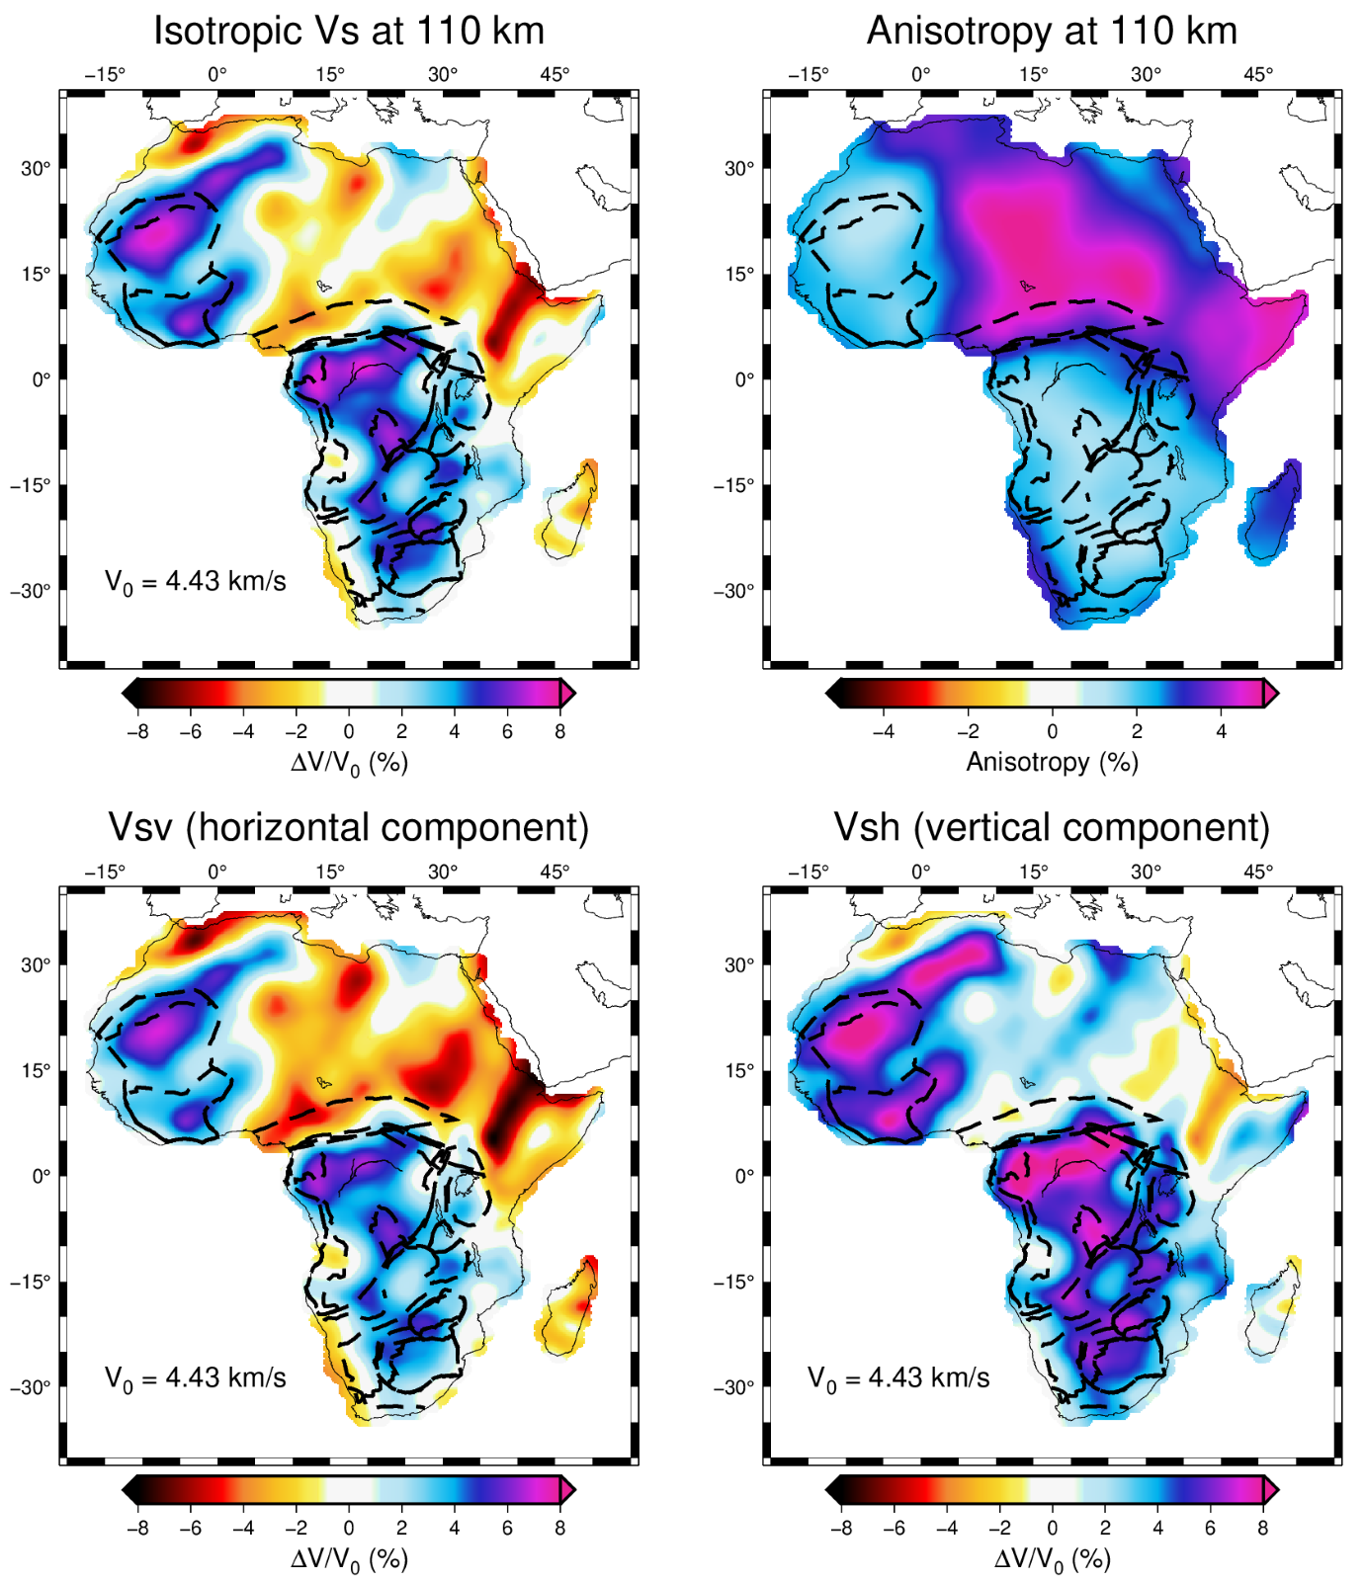
Seismic tomography
State-of-art seismic tomography models
Anisotropy included (to remove the effects of fabric and isolate isotropic-average elastic properties relatable to temperature
Isotropic Vs : AF2019 (Celli et al., 2020)
Anisotropy : LL2019 (Lavoué et al., EGU21-14987)

Slide 3
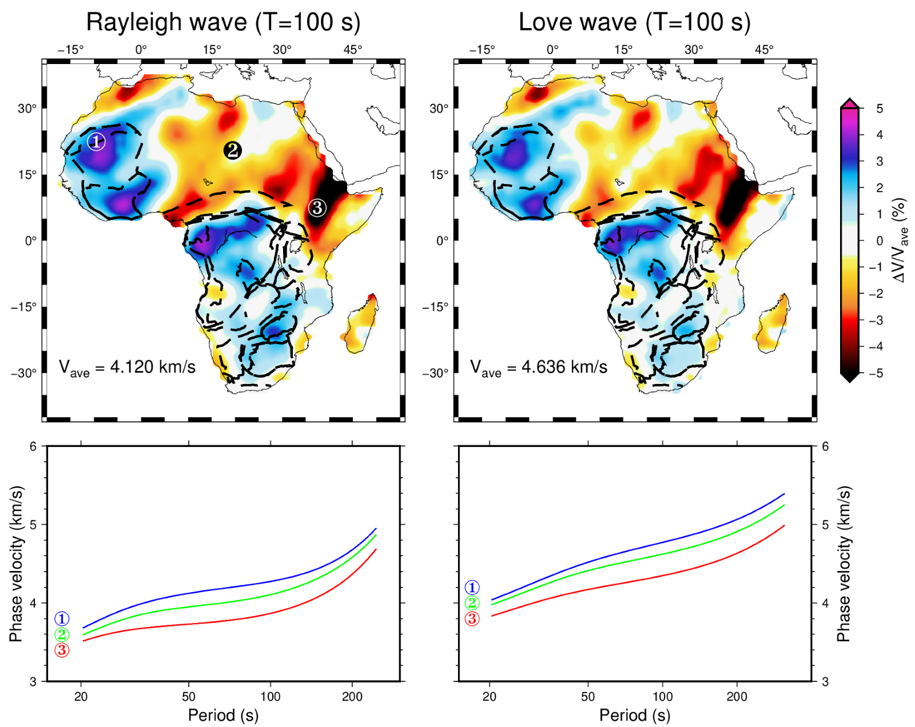
Seismic surface-wave dispersion data
Both Rayleigh and Love wave dispersion data
West Africa Craton
Sahara Meta-craton
East Africa Rift System

Slide 4
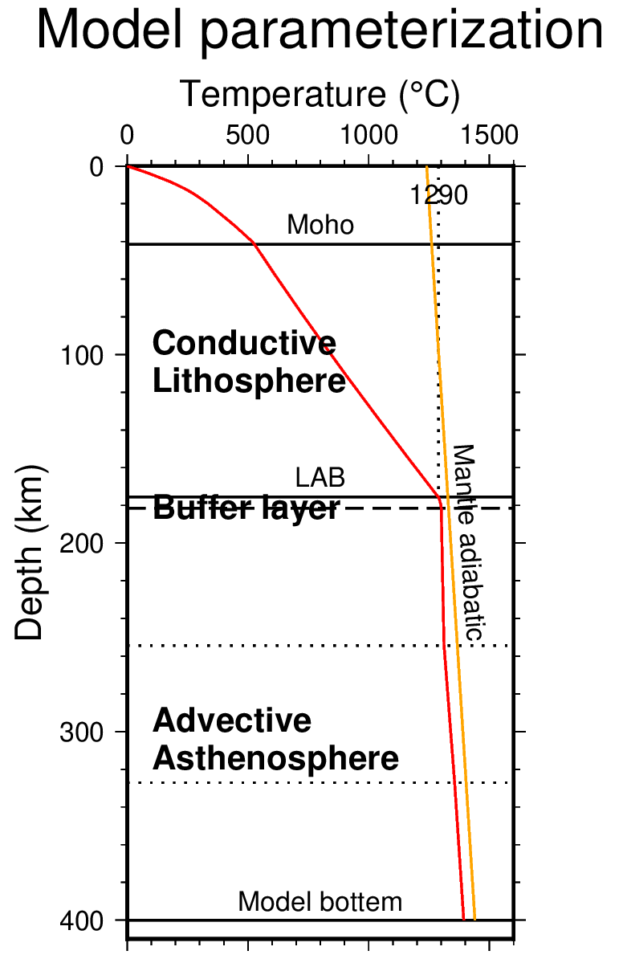
Model parameterization
1-D temperature profile
Lithosphere-asthenosphere boundary (LAB) defined by 1290 °C
Conductive lithospheric geotherm
Non-linear gradient search method

Slide 5
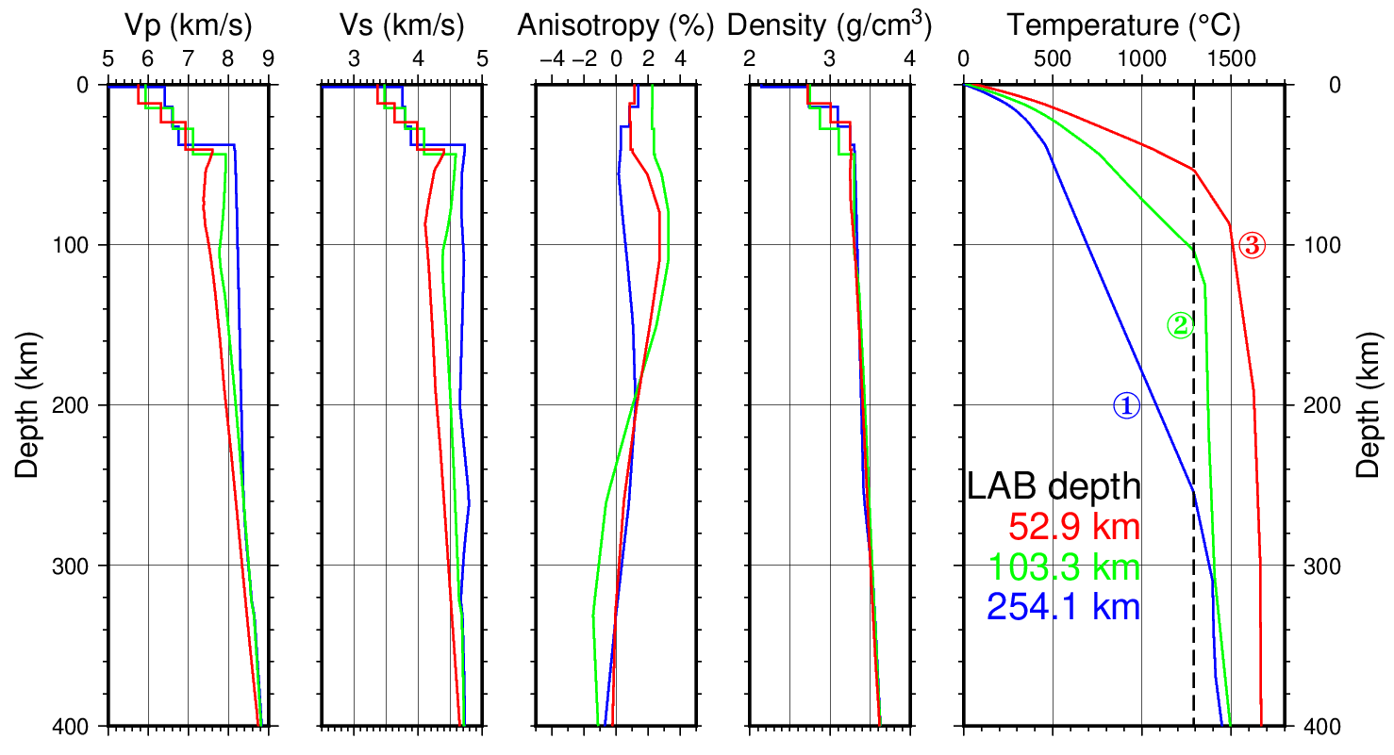
Inversion results – 1D profiles
West Africa Craton​
Sahara Meta-craton​
East Africa Rift System​

Slide 6
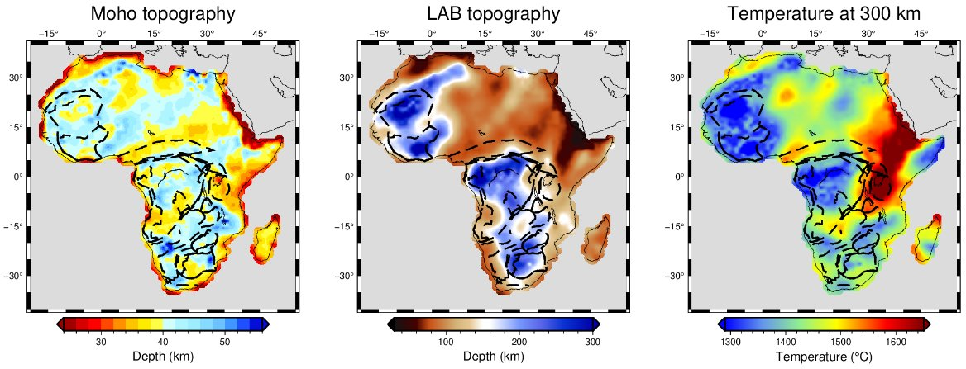
Inversion results – map views
AT
WAC
EAR
CC
ZC
KC
Thickest lithosphere (>220 km) : West African, Congo, Zimbabwe, Kaapvaal Cratons.
Thinnest lithosphere (<70 km) : East African Rift, Atlas Mountains

Slide 7
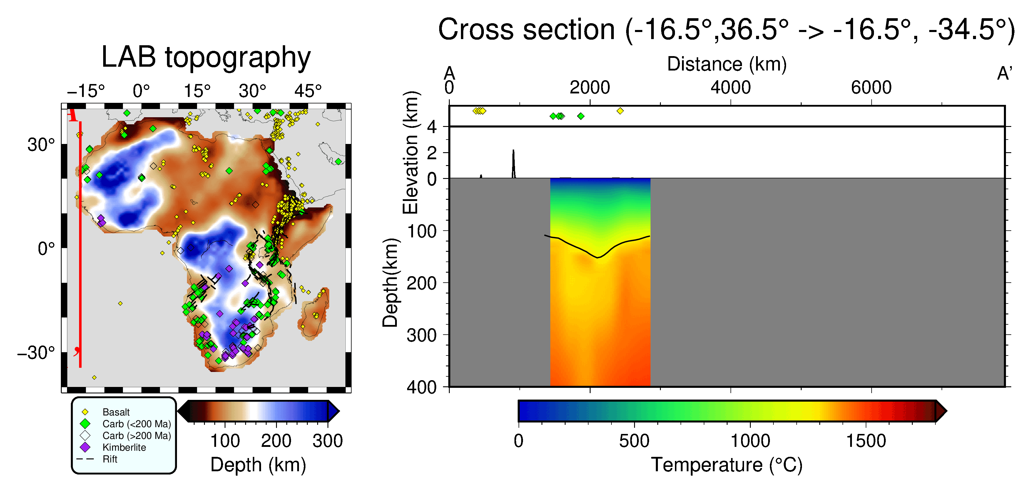
Inversion results – Cross sections

Slide 8
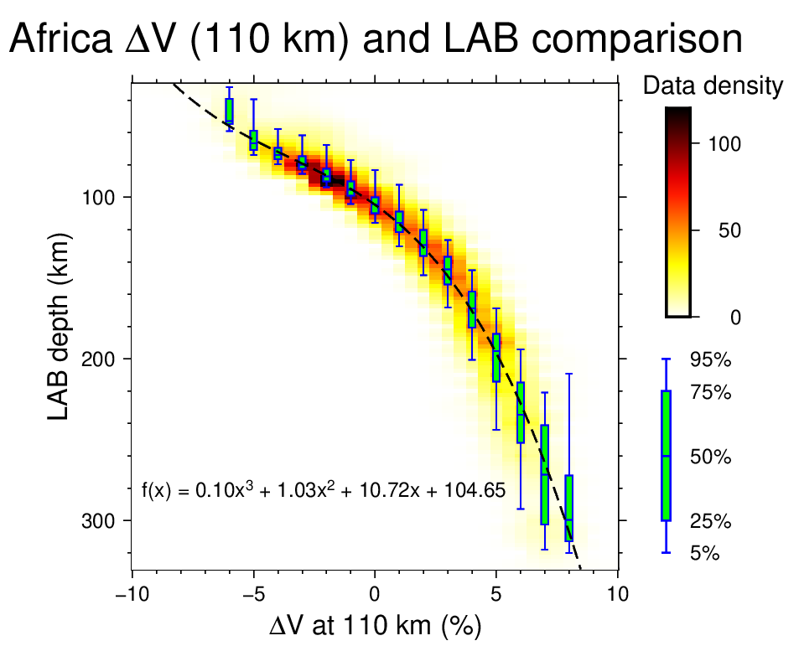
Corelation between Vs anomaly at 110 km depth and LAB depth
Vs anomaly at 110 km is an indicator of LAB depth in most but not all cases

Slide 9
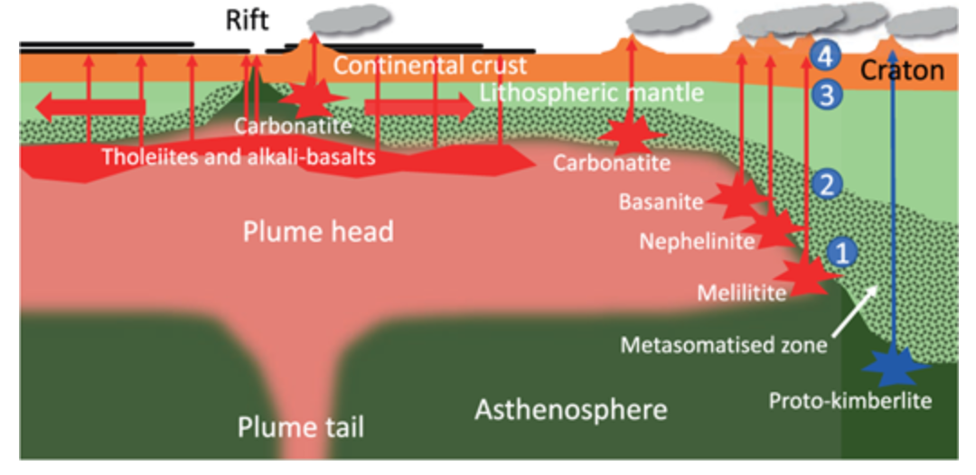
LAB depth differences corresponding to igneous rock types
Schematic diagram of igneous rock formations (Yaxley et al., 2021)
Data Source : Basalt - Ball et al., 2021; Carbonatite - Schmidt et al., 2024; Kimberlite - Dalton et al., 2024
LAB depth of where the igneous rocks originate:
Basalt < Carbonatite < Kimberlite

Slide 10
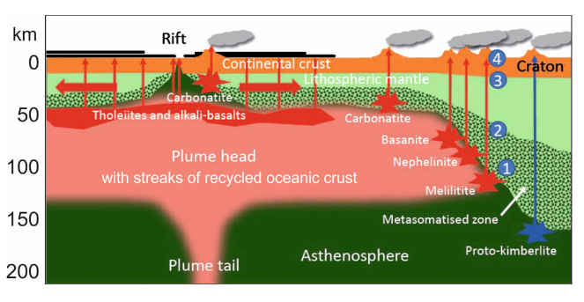
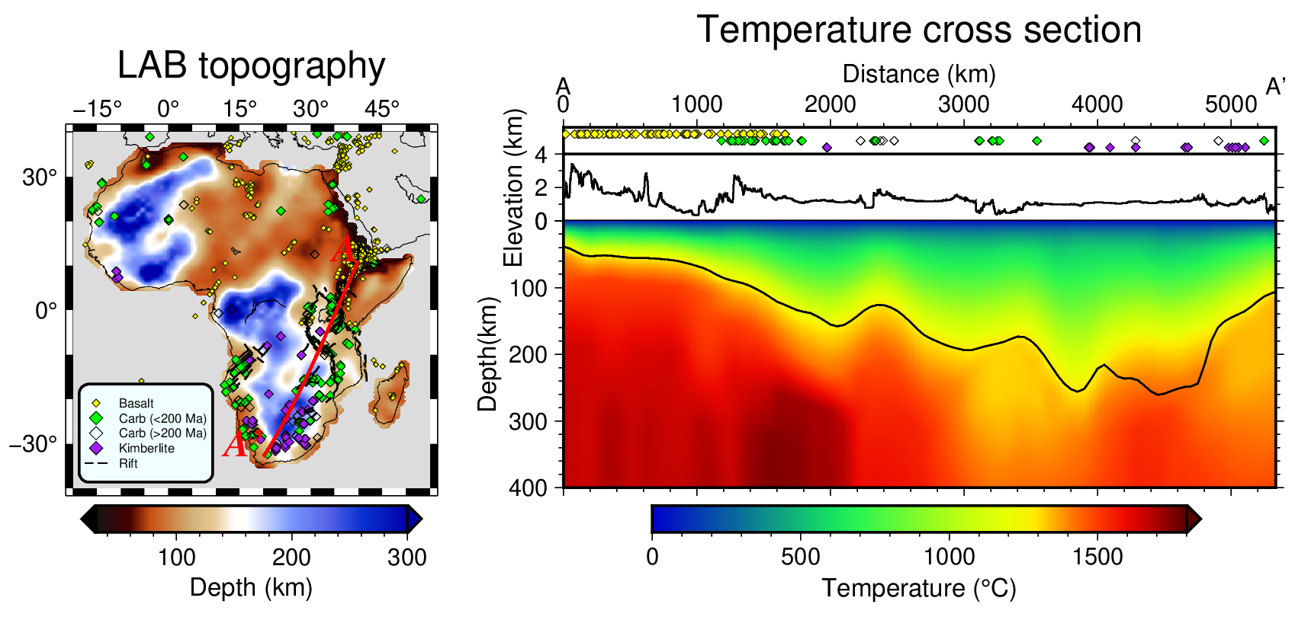
Possible settings for carbonatite formation in Africa
Direct partial melting of carbonated lithosphere near rifts or cratonic margins.
Evolution from carbonated silica-undersaturated silicate magmas.
EAR
ZC
KC
EAR : East African Rift;
ZC : Zimbabwe Craton;
KC : Kaapvaal Craton.

Slide 11
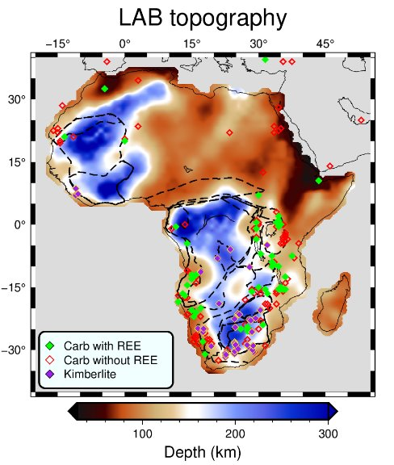
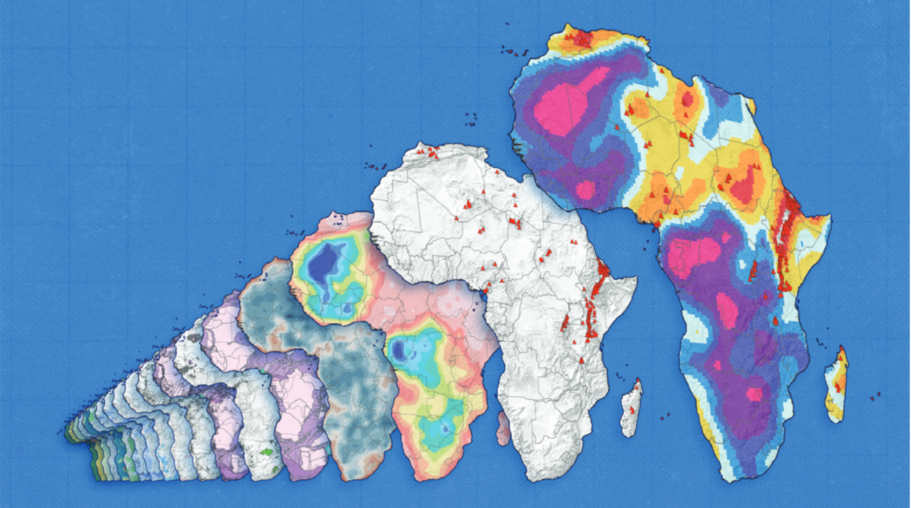
Toward the transition to green energy
Multiple datasets for identifying geothermal energy in Africa
Project InnerSpace (https://projectinnerspace.org)
Carbonatites and Kimberlites for identifying REE and critical metals

Slide 12
References
Ball, P.W., White, N.J., Maclennan, J. et al. Global influence of mantle temperature and plate thickness on intraplate volcanism. Nat Commun 12, 2045 (2021). https://doi.org/10.1038/s41467-021-22323-9
Celli, N.L., S. Lebedev, A.J. Schaeffer, C. Gaina. African cratonic lithosphere carved by mantle plumes. Nature Communications, 11, 92, doi:10.1038/s41467-019-13871-2, 2020.
Dalton, H., Giuliani, A., & Pearson, D. G. (2024). A new global kimberlite geochemistry dataset: the benefits of open and complete data sharing. International Kimberlite Conference Extended Abstracts. https://doi.org/10.29173/ikc4179
Gibson, S., McKenzie, D., & Lebedev, S. (2024). The distribution and generation of carbonatites. Geology, 52(9), 667–671. https://doi.org/10.1130/g52141.1
Lavoué, F., Lebedev, S., Celli, N., and Schaeffer, A.: Radially and azimuthally anisotropic shear-wave velocity model of the Earth’s upper mantle, EGU General Assembly 2021, online, 19–30 Apr 2021, EGU21-14987, https://doi.org/10.5194/egusphere-egu21-14987, 2021.
Lebedev, S., J. Fullea, Y. Xu, R. Bonadio. Seismic Thermography, Bulletin of the Seismological Society of America, "Modern Seismic Tomography" Special Section, 114, 1227-1242, https://doi.org/10.1785/0120230245, 2024.
Schmidt, M. W., Giuliani, A., & Poli, S. (2024). The origin of Carbonatites – Combining the Rock Record with Available Experimental Constraints. Journal of Petrology, 65(10). https://doi.org/10.1093/petrology/egae105
Yaxley, G. M., Kjarsgaard, B. A., & Jaques, A. L. (2021). Evolution of carbonatite magmas in the upper mantle and crust. Elements, 17(5), 315–320. https://doi.org/10.2138/gselements.17.5.315

