Slide 1




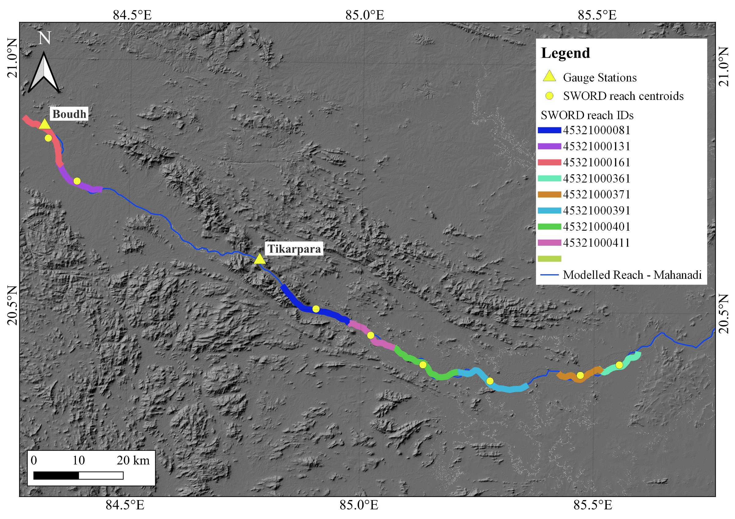
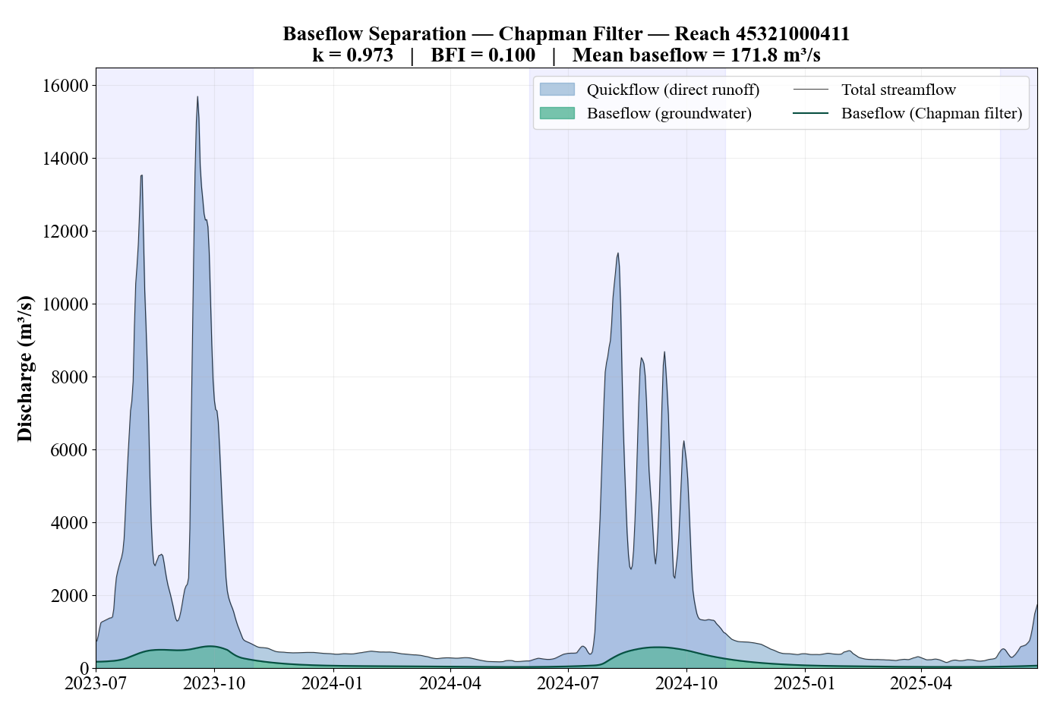
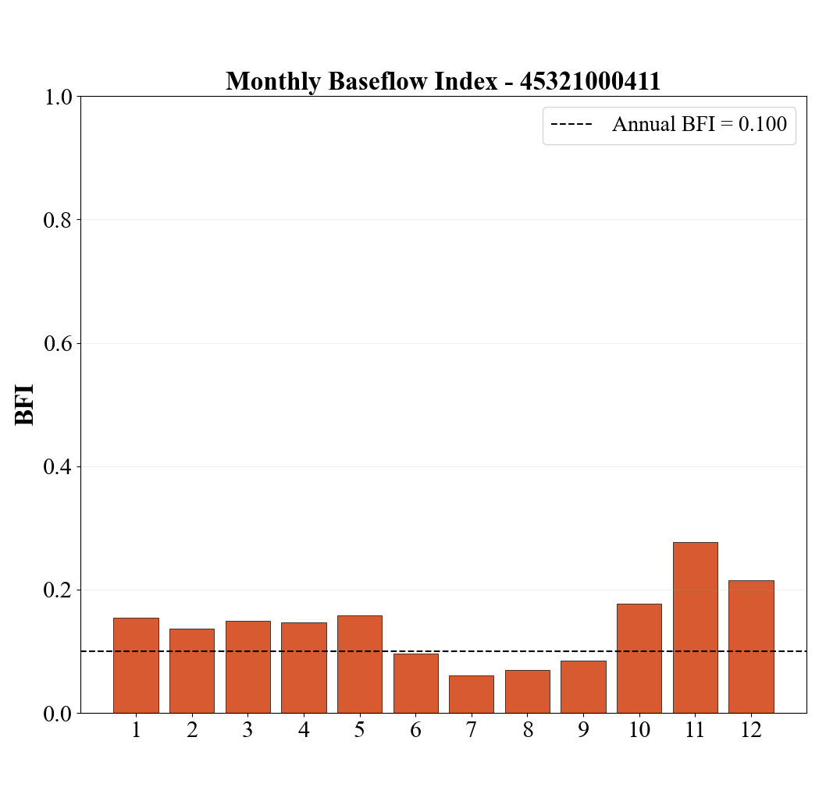
Characterizing Baseflow in Indian River Basins Using SWOT Discharge Observations
Rucha Sanjay Deshpande¹, Vidushi¹, and Tajdarul Hassan Syed¹
¹Department of Earth Sciences, Indian Institute of Technology, Kanpur, India
Background and Motivation
Methodology
Table 2: Baseflow separation characteristics across multiple reaches of the Mahanadi Basin using the Chapman filter.
Baseflow quantifies groundwater contribution to river flow, which is crucial especially in dry seasons.
Traditional methods need long, continuous daily gauge records, which are often sparse.
Gauge stations provide only point estimates with limited information on spatial variability of groundwater contribution.
The Surface Water and Ocean Topography (SWOT) measures water surface elevation every ~10 km globally every 21 days.
SWOT enables reach-scale baseflow estimation across entire river networks.
Accurate baseflow estimation can also provide insights on upstream groundwater storage changes at finer spatial scales compared to existing methods.
Reach ID | k | BFI | Mean Q | Mean BF | N Obs
45321000081 | 0.971 | 0.101 | 1719.4 | 174.3 | 731
45321000131 | 0.969 | 0.102 | 1720.8 | 174.9 | 731
45321000161 | 0.969 | 0.102 | 1451.1 | 147.7 | 731
45321000361 | 0.973 | 0.1 | 1718.2 | 171.8 | 731
45321000371 | 0.973 | 0.1 | 1718.2 | 171.7 | 731
45321000391 | 0.967 | 0.103 | 1718.5 | 177.9 | 731
45321000401 | 0.966 | 0.105 | 1718.9 | 179.7 | 731
45321000411 | 0.973 | 0.1 | 1719.1 | 171.8 | 731
NASA PO.DAAC
RiverSP Reach product
July 2023 – June 2025
ALOS PALSAR DEM
(Terrain)
209 cross-sections
Bhuuan’s LULC (manning’s n)
Calibration period: July 2023 to June 2024
Validation period: July 2024 to June 2025
Objectives
Results
To calibrate a 1D HEC-RAS hydraulic model using SWOT-derived WSE observations, enabling the generation of continuous daily discharge estimates at reach-scale resolution as a proxy for SWOT discharge.
To apply the Chapman digital filter to SWOT-derived daily discharge time series for baseflow separation and estimation of the baseflow recession parameter (k) and Baseflow Index (BFI).
To validate SWOT-derived baseflow estimates against independently computed baseflow from observed gauge discharge, assessing the capability of SWOT to replicate gauge-level baseflow estimates at ungauged reach locations.
Table 1: Calibration and validation performance of the HEC-RAS hydraulic model against SWOT-observed Water Surface Elevation (WSE) anomalies across selected reaches in the Mahanadi Basin.
Table 3: Baseflow separation characteristics across Boudh and Tikrapara Gauges
Reach ID | Calibration |  |  |  | Validation
 | NSE | KGE | R² | RMSE | NSE | KGE | R² | RMSE
45321000081 | 0.512 | 0.386 | 0.932 | 0.797 | 0.184 | 0.477 | 0.647 | 0.687
45321000131 | 0.74 | 0.686 | 0.877 | 0.378 | 0.88 | 0.855 | 0.913 | 0.534
45321000161 | 0.836 | 0.737 | 0.925 | 0.308 | 0.884 | 0.915 | 0.898 | 0.503
45321000361 | 0.744 | 0.782 | 0.827 | 0.438 | 0.893 | 0.883 | 0.916 | 0.515
45321000371 | 0.611 | 0.462 | 0.936 | 0.955 | 0.747 | 0.649 | 0.904 | 0.708
45321000391 | 0.802 | 0.76 | 0.887 | 0.482 | 0.985 | 0.933 | 0.99 | 0.194
45321000401 | 0.924 | 0.945 | 0.924 | 0.421 | 0.861 | 0.682 | 0.944 | 0.799
45321000411 | 0.852 | 0.857 | 0.887 | 0.504 | 0.921 | 0.835 | 0.938 | 0.474
Gauge | k | BFI | Mean Q | Mean BF | N Obs
Boudh | 0.976 | 0.097 | 1451.1 | 141.4 | 731
Tikrapara | 0.946 | 0.114 | 1576.0 | 180.2 | 731
Summary and Conclusions
Study Area
This study presents a workflow to convert SWOT’s 21-day water surface elevation observations into continuous daily discharge data using a calibrated 1D HEC-RAS model.
The selected reach of the Mahanadi River is mainly runoff-dominated, with groundwater contributing about 10% of the annual river flow (BFI ≈ 0.10).
The aquifer releases water slowly (k ≈ 0.97), helping maintain river flow during the post-monsoon and winter seasons.
SWOT-derived baseflow closely matches gauge-based estimates at the comparison locations.
This shows that SWOT-derived discharge products can estimate baseflow at reach scale across entire river networks with accuracy comparable to gauge stations.
Figure 3: Monthly distribution of the Baseflow Index (BFI) for Reach 45321000411.
Future work
Figure 2: Baseflow separation for the Mahanadi River at Reach 45321000411.
Mass-balance conversion of reach-scale baseflow to upstream groundwater storage changes, validated against GRACE-derived groundwater storage anomalies for the Mahanadi basin.
Figure 1: Study area showing the selected reach along the Mahanadi River, SWOT reach segments used for hydraulic model calibration, and locations of the Boudh and Tikrapara gauge stations.

