Slide 1
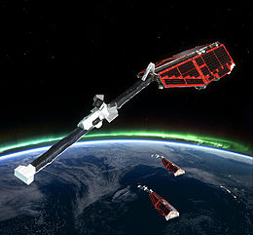


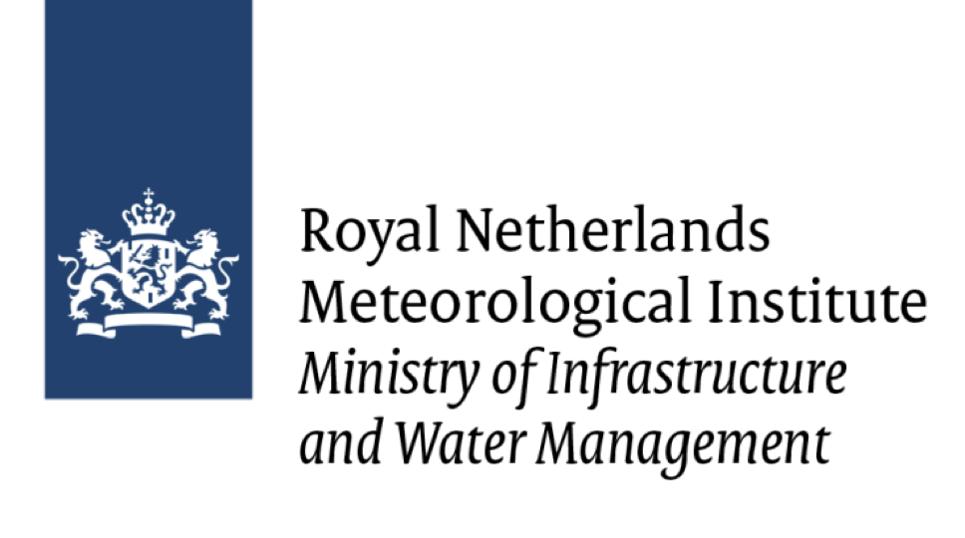



Swarm-VIP-Dynamic| Models of Ionospheric Variability
Swarm-VIP-Dynamic Team
Alan Wood^{1,2}, Jaroslav Urbar³, Daria Kotova⁴, Luca Spogli⁵, Yaqi Jin⁴, Eelco Doornbos⁶, Mainul Hoque⁷, Gareth Dorrian², Rayan Imam⁵, Kasper van Dam⁷, Lucilla Alfonsi⁵ & Wojciech Miloch⁴
Mer Office, UK
University of Birmingham, UK
Institute of Atmospheric Physics CAS, Prague, Czech Republic
University of Oslo, Norway
Istituto Nazionale di Geofisica e Vulcanologia, Italy
KNMI, Royal Netherlands Meteorological Institute, the Netherlands
German Aerospace Center (DLR), Germany
Funded within the 4D Ionosphere framework
Image Credit: ESA

Slide 2
Swarm-VIP-Dynamic| Models of Ionospheric Variability
Swarm-VIP-Dynamic
Create models of the variability of ionospheric plasma at multiple scale sizes in Low Earth Orbit
Determine the relative importance of the driving processes & which combination of driving processes best represent the ionospheric variability
Image Credit: ESA

Slide 3
Swarm-VIP-Dynamic| Models of Ionospheric Variability
Create models of the variability of ionospheric plasma at multiple scale sizes in Low Earth Orbit
Determine the relative importance of the driving processes & which combination of driving processes best represent the ionospheric variability
Dependent variables: Variability of ionospheric plasma on multiple spatial scales
Explanatory Variables: Proxies for the driving processes
Image Credit: ESA

Slide 4

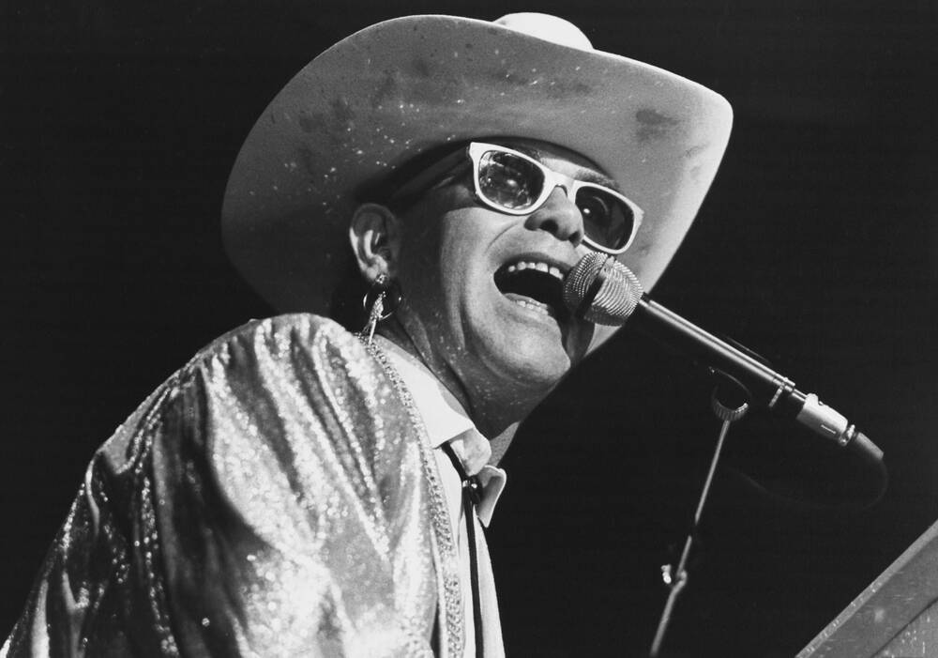

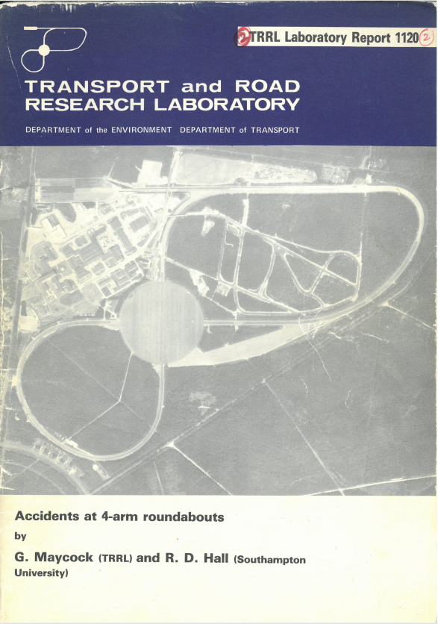

Method| A Quick Trip to 1984
Computational power was not sufficient for researchers to routinely use neural networks
Maycock and Hall (1984) used Generalised Linear Modelling to create a model of road accidents at four arm roundabouts
To predict the number of accidents at these junctions
Determine the relative importance of the explanatory variables, to identify and design out high-risk features
Maycock, G., Hall, R.D., 1984. Accidents at four-arm roundabouts. LR1120, TRL, Crowthorne, UK
Notes:
A neural network consists of multiple layers of connected nodes. These comprise an input layer, one or more hidden layers and an output layer. Each node has an associated weight and threshold. If the output of any individual node exceeds this threshold, then data is sent to the next layer of the network. The process of model fitting assigns weights to the nodes. These determine the importance of any given explanatory variable
Smirnov, A., Shprits, Y., Prol, F. et al. A novel neural network model of Earth’s topside ionosphere. Sci Rep 13, 1303 (2023). https://doi.org/10.1038/s41598-023-28034-z

Slide 5
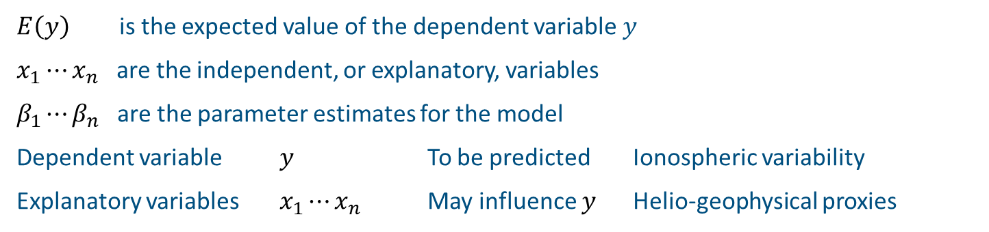
Generalised Linear Modelling| Method
Linear Model
$$E\left(y\right)=β_{0}+β_{1}∙x_{1}$$
Multivariate Linear Model
$E\left(y\right)=β_{0}+β_{1}∙x_{1}+⋯+$ $β_{n}∙x_{n}$
Generalised Linear Model
$g\left(E\left(y\right)\right)=β_{0}+β_{1}∙x_{1}+⋯+$ $β_{n}∙x_{n}$
The dependent variable does not have to follow a normal distribution
Equation may have a different form
$E\left(y\right)$ is the expected value of the dependent variable 𝑦
$x_{1}⋯x_{n}$ are the independent, or explanatory, variables
$β_{1}⋯β_{n}$ are the parameter estimates for the model
Dependent variable $y$ To be predicted Ionospheric variability
Explanatory variables $x_{1}⋯x_{n}$ May influence $y$ Helio-geophysical proxies

Slide 6
Swarm-VIP-Dynamic| Choice of Dependent Variables
Fit multiple models for the ionospheric variability on a range of scale sizes
Electron density: Taken from the IPDxIRR_2F data product, although these values are copied directly from the Langmuir probe files.
Grad_Ne@100km: The electron density gradient in a running window calculated via linear regression over 27 data points for the 2 Hz electron density data (taken from the IPDxIRR_2F data product) Horizontal spatial scale: ~100 km
RODI10s: Rate Of change of Density Index (RODI) is the standard deviation of ROD over 10 seconds (taken from the IPDxIRR_2F data product). Horizontal spatial scale: ~75 km
RODI1s_FP: Rate Of change of Density Index (RODI) is the standard deviation of ROD over 1 seconds (16 data points for the 16 Hz electron data). This is taken from the IPIR Faceplate dataset which was developed by Yaqi Jin during Swarm-VIP-Dynamic. Horizontal spatial scale: ~7.5 km
p: One-dimensional spectral index p calculated using log–log least squares fit to the PSD of the linearly detrended plasma density over a 10 s window centred around timestamp (160 data points for the 16 Hz electron data).

Slide 7
Swarm-VIP-Dynamic| Choice of Dependent Variables
Fit multiple models for the ionospheric variability on a range of scale sizes
Electron density: Taken from the IPDxIRR_2F data product, although these values are copied directly from the Langmuir probe files.
Grad_Ne@100km: The electron density gradient in a running window calculated via linear regression over 27 data points for the 2 Hz electron density data (taken from the IPDxIRR_2F data product) Horizontal spatial scale: ~100 km
RODI10s: Rate Of change of Density Index (RODI) is the standard deviation of ROD over 10 seconds (taken from the IPDxIRR_2F data product). Horizontal spatial scale: ~75 km
RODI1s_FP: Rate Of change of Density Index (RODI) is the standard deviation of ROD over 1 seconds (16 data points for the 16 Hz electron data). This is taken from the IPIR Faceplate dataset which was developed by Yaqi Jin during Swarm-VIP-Dynamic. Horizontal spatial scale: ~7.5 km
p: One-dimensional spectral index p calculated using log–log least squares fit to the PSD of the linearly detrended plasma density over a 10 s window centred around timestamp (160 data points for the 16 Hz electron data).

Slide 8

Generalised Linear Modelling| Method
Dependant Variables: Electron density, |Grad_Ne@100km|, |RODI10s|, |RODI1s_FP| and spectral index p
Linear Model
$$E\left(y\right)=β_{0}+β_{1}∙x_{1}$$
Multivariate Linear Model
$E\left(y\right)=β_{0}+β_{1}∙x_{1}+⋯+$ $β_{n}∙x_{n}$
Generalised Linear Model
$g\left(E\left(y\right)\right)=β_{0}+β_{1}∙x_{1}+⋯+$ $β_{n}∙x_{n}$
The dependent variable does not have to follow a normal distribution
Equation may have a different form
$E\left(y\right)$ is the expected value of the dependent variable 𝑦
$x_{1}⋯x_{n}$ are the independent, or explanatory, variables
$β_{1}⋯β_{n}$ are the parameter estimates for the model
Dependent variable $y$ To be predicted Ionospheric variability
Explanatory variables $x_{1}⋯x_{n}$ May influence $y$ Helio-geophysical proxies

Slide 9
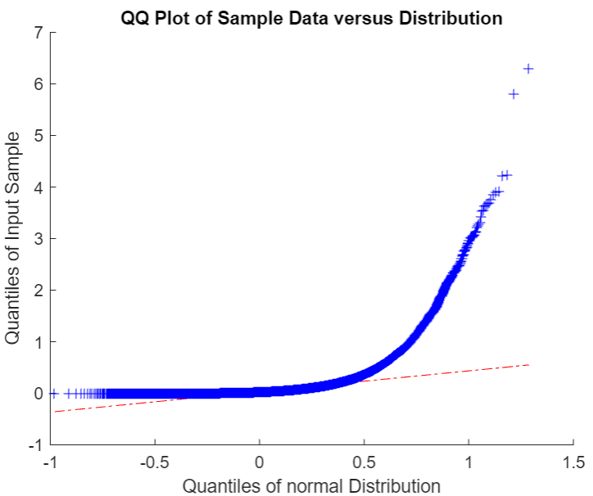
Model Development| Choice of Distribution
Example: Normal distribution
Find mean and standard deviation from the data
Create synthetic data based on this mean and standard deviation
Dependant Variable
y-axis: Quantiles of the data
x-axis: Quantiles of the model for an assumed distribution

Slide 10
Model Development| Choice of Distribution: Swarm-VIP
Distributions Trialled: Exponential, Extreme Value, Gamma, Half Normal, Inverse Gaussian, Logistic, Loglogistic, Lognormal, Nakagami, Normal and Weibull
Transformation: n^{th} root

Slide 11
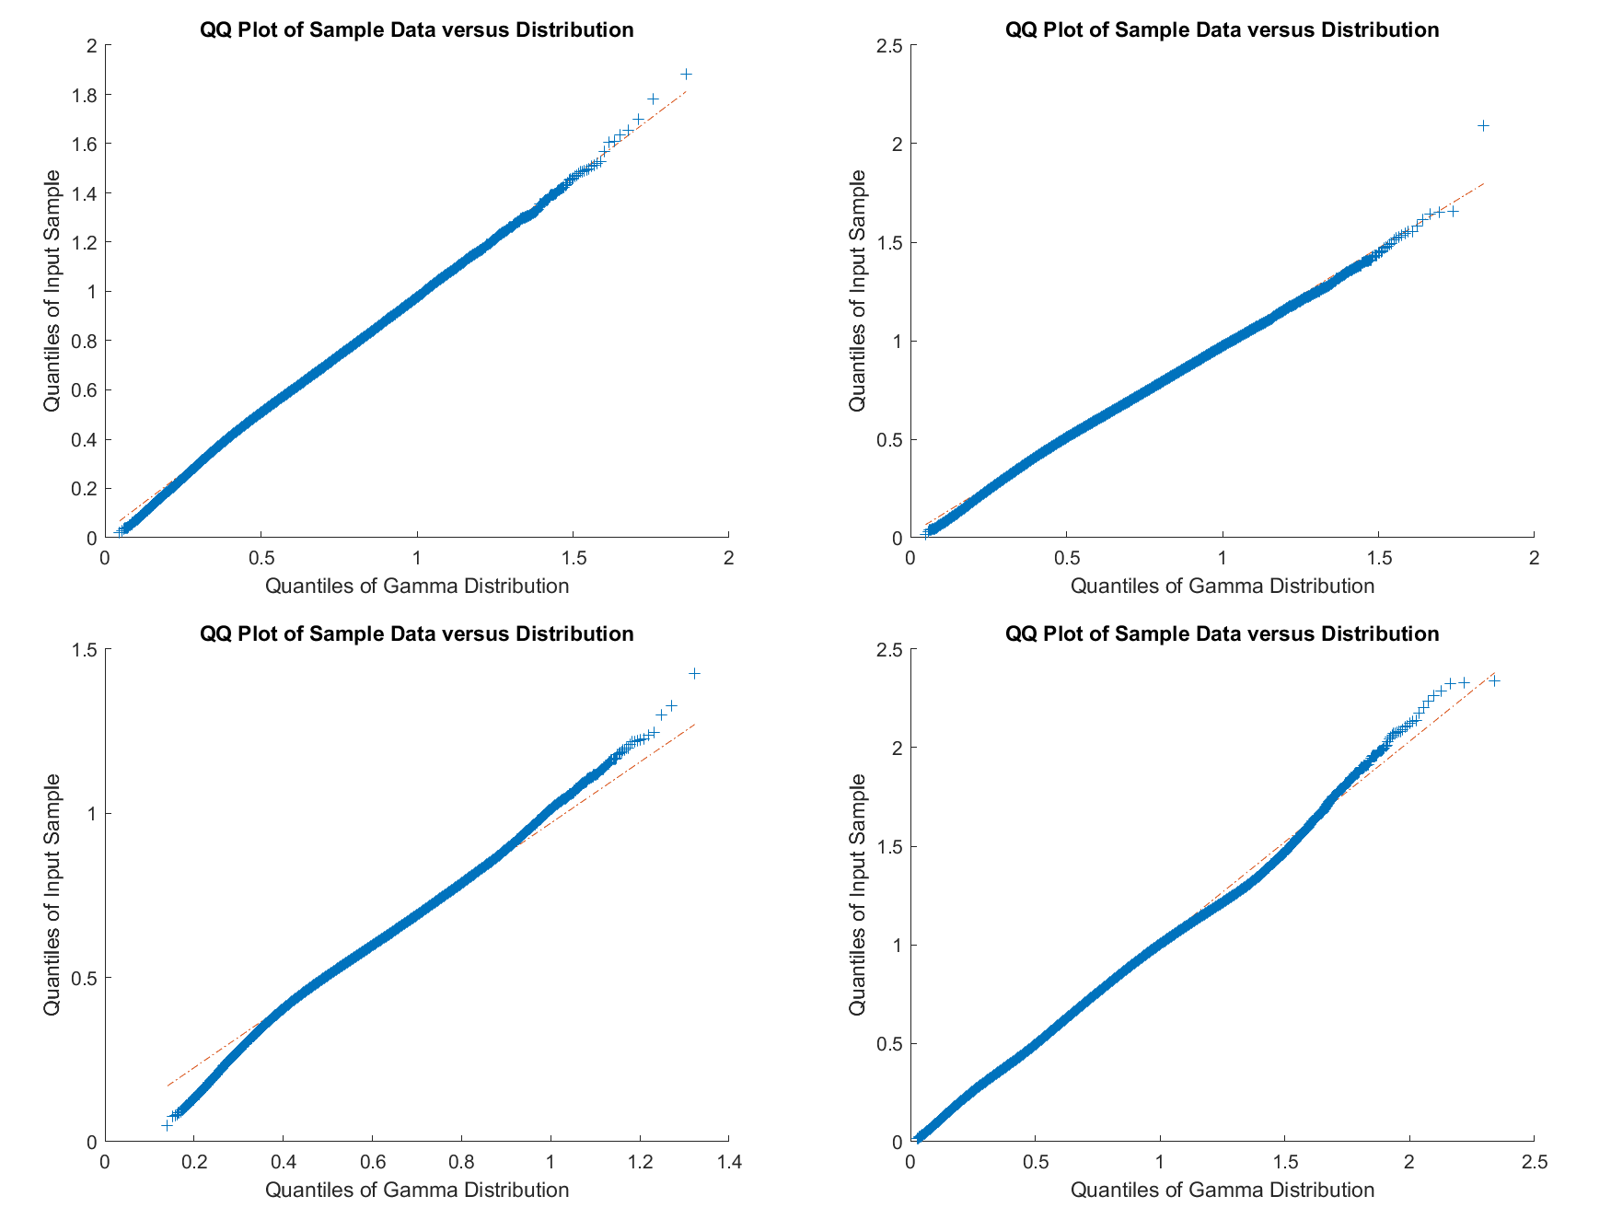
Model Development| Choice of Distribution: |Grad_Ne@100km|
Polar region
Gamma, 4th root
Auroral region
Gamma, 4th root
Midlatitude region
Gamma, 6th root
Equatorial region
Gamma, 4th root

Slide 12
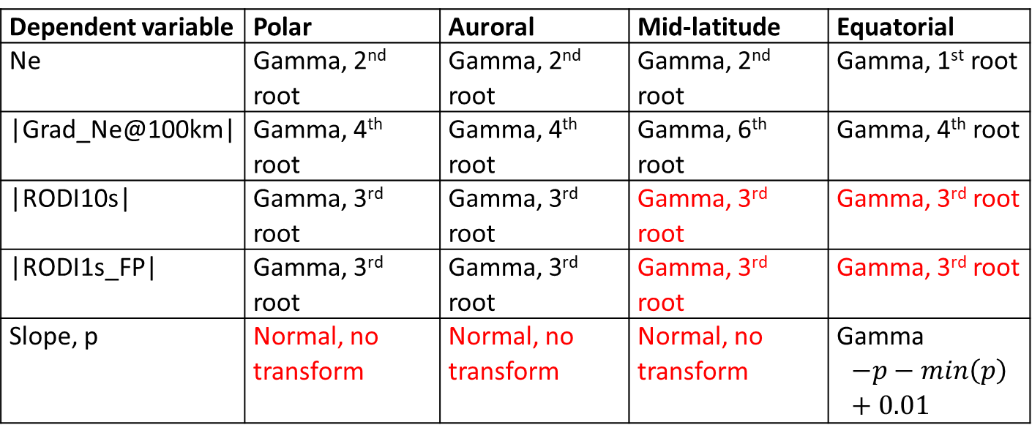
Swarm-VIP-Dynamic| Distributions Chosen
Dependent variable | Polar | Auroral | Mid-latitude | Equatorial
Ne | Gamma, 2nd root | Gamma, 2nd root | Gamma, 2nd root | Gamma, 1st root
|Grad_Ne@100km| | Gamma, 4th root | Gamma, 4th root | Gamma, 6th root | Gamma, 4th root
|RODI10s| | Gamma, 3rd root | Gamma, 3rd root | Gamma, 3rd root | Gamma, 3rd root
|RODI1s_FP| | Gamma, 3rd root | Gamma, 3rd root | Gamma, 3rd root | Gamma, 3rd root
Slope, p | Normal, no transform | Normal, no transform | Normal, no transform | Gamma $$−p−min\left(p\right)+0.01$$
These were the best distributions found, those shown in red had limitations

Slide 13
Generalised Linear Modelling| Method: Swarm-VIP-Dynamic
Dependant Variables: Electron density, |Grad_Ne@100km|, |RODI10s|, |RODI1s_FP| and spectral index p
Linear Model
$$E\left(y\right)=β_{0}+β_{1}∙x_{1}$$
Multivariate Linear Model
$E\left(y\right)=β_{0}+β_{1}∙x_{1}+⋯+$ $β_{n}∙x_{n}$
Generalised Linear Model
$g\left(E\left(y\right)\right)=β_{0}+β_{1}∙x_{1}+⋯+$ $β_{n}∙x_{n}$
The dependent variable does not have to follow a normal distribution
Form of equation given by link function
Multi term model: Which combination of heliogeophysical proxies, and hence which processes, best explain the variability of ionospheric plasma observed?
Separate models for the polar, auroral, midlatitude and equatorial regions

Slide 14
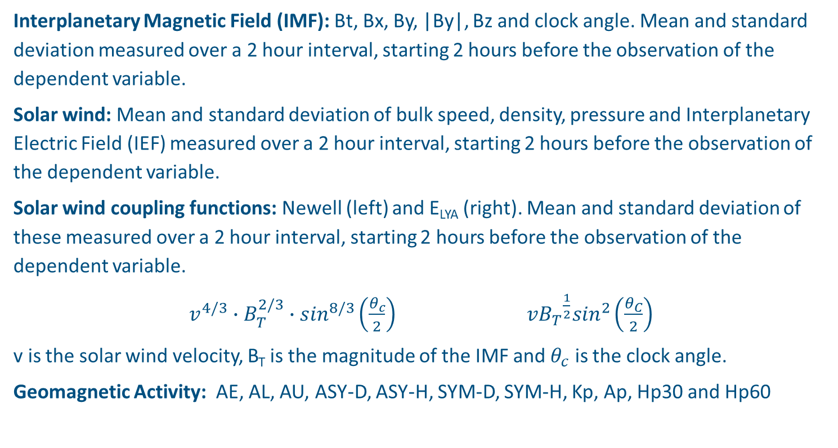
Explanatory Variables| Heliogeophysical Proxies
Interplanetary Magnetic Field (IMF): Bt, Bx, By, |By|, Bz and clock angle. Mean and standard deviation measured over a 2 hour interval, starting 2 hours before the observation of the dependent variable.
Solar wind: Mean and standard deviation of bulk speed, density, pressure and Interplanetary Electric Field (IEF) measured over a 2 hour interval, starting 2 hours before the observation of the dependent variable.
Solar wind coupling functions: Newell (left) and E_{LYA} (right). Mean and standard deviation of these measured over a 2 hour interval, starting 2 hours before the observation of the dependent variable.
$v^{4/3}∙B_{T}^{2/3}∙\sin^{8/3}\left(\frac{θ_{c}}{2}\right)$ $v{B_{T}}^{\frac{1}{2}}\sin^{2}\left(\frac{θ_{C}}{2}\right)$
v is the solar wind velocity, B_{T} is the magnitude of the IMF and $θ_{c}$ is the clock angle.
Geomagnetic Activity: AE, AL, AU, ASY-D, ASY-H, SYM-D, SYM-H, Kp, Ap, Hp30 and Hp60
Solar Activity: F10.7 cm & F30 cm solar flux (daily, 27 day median and 81 day median)
Other: Polar cap index (North), GLAT, GLON, MLAT, MLT and SZA. Lat_Diff = LAT – MLAT as a proxy for longitude variations

Slide 15
Explanatory Variables| Heliogeophysical Proxies
Thermosphere:
Thermospheric density from Swarm Precise Orbit Determination (POD) and accelerometer data
F10.7 cm Swarm: A proxy for the F10.7 cm solar flux inferred from Swarm observations of the thermospheric density
Current systems:
Field-aligned currents from Swarm FAC product
Functions:
A sine function varying annually, going from -1 on 21st December to +1 on 21st June
A sine function varying annually, going from -1 at midwinter to +1 at midsummer (so, on 21st December, this takes a value of -1 in the northern hemisphere and +1 in the southern hemisphere)
A sine function varying semiannually, going from -1 at the solstice to +1 at the equinox
A sine function varying daily, going from -1 at 00 LT to +1 at 12 LT
A sine function varying daily, going from -1 at 00 MLT to +1 at 12 MLT

Slide 16

Generalised Linear Modelling| Method: Swarm-VIP-Dynamic
Linear Model
$$E\left(y\right)=β_{0}+β_{1}∙x_{1}$$
Multivariate Linear Model
$E\left(y\right)=β_{0}+β_{1}∙x_{1}+⋯+$ $β_{n}∙x_{n}$
Generalised Linear Model
$g\left(E\left(y\right)\right)=β_{0}+β_{1}∙x_{1}+⋯+$ $β_{n}∙x_{n}$
Models were formulated for each geographic region for each dependent variable
The dependent variable does not have to follow a normal distribution
Form of equation given by link function
Multi term model: Which combination of heliogeophysical proxies, and hence which processes, best explain the variability of ionospheric plasma observed?
Add the heliogeophysical proxy which best explains the variability to the model
(the proxy with the highest correlation to the dependent variable)
Add the heliogeophysical proxy which best explains the remaining variability
(the proxy with the highest correlation to the dependent variable,
excluding any proxy which is correlated with any term already in the model by more than |0.25|)
Continue until no more proxies are available

Slide 17
Database| Breakdown into Training, Optimisation & Evaluation subsets
Observations from Swarm C: 19th July 2014 – 31st May 2024
The database was broken into sections based on the time taken for Swarm to cycle through all local times (approx. 130 days).
Optimisation
Evaluation
Ratio of Training : Optimisation : Evaluation subsets 3:1:1
All local times, seasons, geomagnetic conditions and solar conditions covered in each subset

Slide 18
Generalised Linear Modelling| Method
Training (using the training dataset): Model polar, auroral, midlatitude and equatorial regions separately
Formulate a model based on the correlations
Determine the parameter estimates, removing any terms which are not statistically significant at the 5 % level
Optimisation (using the optimisation dataset)
Refit the model and determine the parameter estimates, removing any terms which are not statistically significant at the 5 % level
In the polar, auroral and midlatitude regions, optimisation was conducted for each hemisphere separately. If the parameter estimates were significantly different in the different hemispheres, then separate models were used
Evaluation (using the evaluation dataset)
Predict the values of the dependent variable in the evaluation dataset
Evaluate the model performance using a range of goodness-of-fit statistics

Slide 19
Generalised Linear Modelling| Method
Training (using the training dataset): Model polar, auroral, midlatitude and equatorial regions separately
Formulate a model based on the correlations

Slide 20
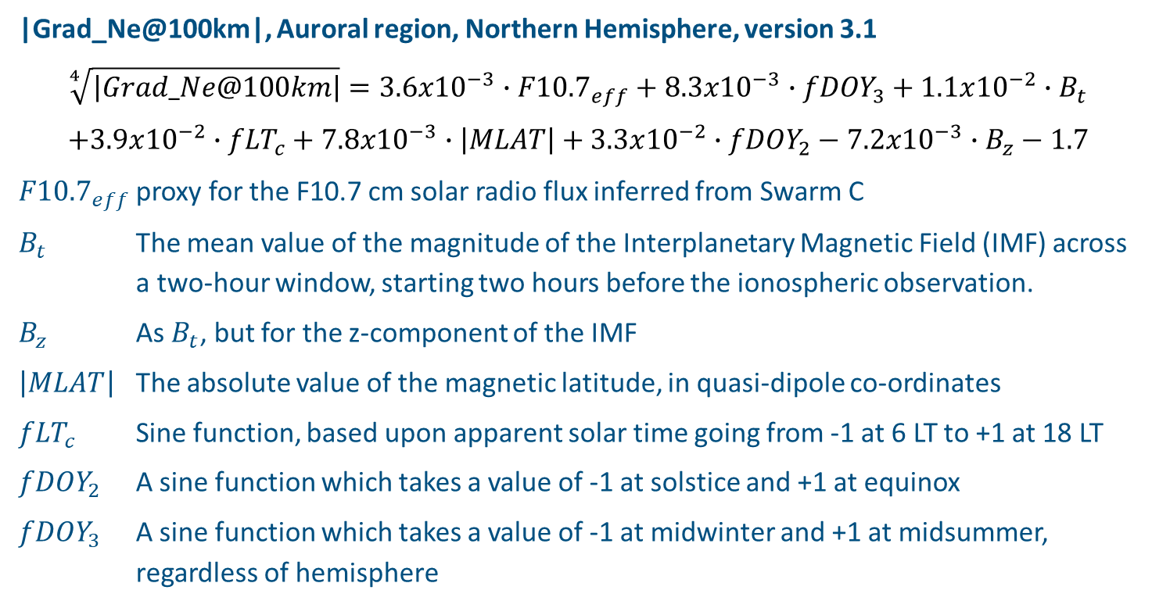
Generalised Linear Modelling| Example Model
|Grad_Ne@100km|, Auroral region, Northern Hemisphere, version 3.1
$$\sqrt[4]{\left|Grad_Ne@100km\right|}=3.6x{10}^{−3}∙{F10.7}_{eff}+8.3x{10}^{−3}∙{fDOY}_{3}+1.1x{10}^{−2}∙B_{t}$$
$$+3.9x{10}^{−2}∙{fLT}_{c}+7.8x{10}^{−3}∙\left|MLAT\right|+3.3x{10}^{−2}∙{fDOY}_{2}−7.2x{10}^{−3}∙B_{z}−1.7$$
${F10.7}_{eff}$ proxy for the F10.7 cm solar radio flux inferred from Swarm C
$B_{t}$ The mean value of the magnitude of the Interplanetary Magnetic Field (IMF) across a two-hour window, starting two hours before the ionospheric observation.
$B_{z}$ As $B_{t}$, but for the z-component of the IMF
$\left|MLAT\right|$ The absolute value of the magnetic latitude, in quasi-dipole co-ordinates
${fLT}_{c}$ Sine function, based upon apparent solar time going from -1 at 6 LT to +1 at 18 LT
${fDOY}_{2}$ A sine function which takes a value of -1 at solstice and +1 at equinox
${fDOY}_{3}$ A sine function which takes a value of -1 at midwinter and +1 at midsummer, regardless of hemisphere

Slide 21
Generalised Linear Modelling| Method
Training (using the training dataset): Model polar, auroral, midlatitude and equatorial regions separately
Formulate a model based on the correlations
Optimisation (using the optimisation dataset)
Refit the model and determine the parameter estimates, removing any terms which are not statistically significant at the 5 % level
Evaluation (using the evaluation dataset)
Evaluate the model performance using a range of goodness-of-fit statistics
All local times, seasons, geomagnetic conditions and solar conditions covered in each dataset

Slide 22



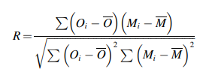
Swarm-VIP-Dynamic Model| Evaluation
Accuracy: RMSE
Expressed on a relative scale (divide RMSE by median of observations). If rRMSE=1 then the differences between observations and predictions are the same size as the predictions.
Bias: Mean Error
Positive: Model consistently overpredicts. Negative: Model consistently underpredicts. Expressed on a relative scale (rME, divide RMSE by median of observations).
Precision: Ratio of the standard deviations
If this is greater than 1, then the average standard deviation of the model values is greater than of the observed values. There is too much spread (noise) in the model values. If it is less than 1, then there is not enough spread in the model values (model is overfitted).
Association: Pearson Linear Correlation Coefficient
Ideal value: 0
Ideal value: 0
Ideal value: 1
Ideal value: 1
Model values are denoted by M, with individual values with the number set listed as M_{i}. Observational values are given the variable O, with individual data points called out by O_{i}. The total number of pairs in the data-model set is N.
Liemohn et al., RMSE is not enough: Guidelines to robust data-model comparisons for magnetospheric physics, JASTP, 218, 105624, 2021

Slide 23
Swarm-VIP-Dynamic Model| Evaluation
Electron Density Model
Evaluation
Accuracy: Often substantially less than 1
Bias: rME close to zero
Precision: Approaching theoretical best value of 1.0
Correlation: Reasonably close to 1
Goodness-of-fit statistics in the equatorial region show scope for improvement
Not capturing the double-peaked structure of the Equatorial Ionisation Anomaly

Slide 24
Swarm-VIP-Dynamic Model| Evaluation
Electron Density Model
Evaluation
Accuracy: Often substantially less than 1
Bias: rME close to zero
Precision: Approaching theoretical best value of 1.0
Correlation: Reasonably close to 1
Goodness-of-fit statistics in the equatorial region show scope for improvement

Slide 25
Swarm-VIP-Dynamic| Goodness-of-fit Statistics
Goodness-of-fit statistics worsen as go to smaller spatial scales
A process missing from the models?
Instability processes
Cannot be effectively captured by a statistical model. For example, Gradient Drift Instability growth rate needs:
Time series of electron density
Background electron density
Relative velocity of ions and neutrals
Wave activity from the lower atmosphere
Want to investigate at northern midlatitudes
0.84
0.54
0.60
0.37
0.58

Slide 26
Swarm-VIP-Dynamic| Versions of Models
Version 1: Main version of models
Version 2: Explanatory variables which are measured directly from Swarm, and which are only valid along the Swarm orbit, have been removed or replaced
Version 3: Version which has the potential to be run in near real time. Explanatory variables which are not available in near real time have been removed or replaced

Slide 27
Swarm-VIP-Dynamic| Goodness-of-fit Statistics
0.84
0.84
0.76
Model performance decreases as terms are removed from the models
Version 1
Version 2
Version 3

Slide 28
Performance Assessment| TIE-GCM and Swarm-VIP-Dynamic Models
TIE-GCM: A physics-based model of the ionosphere & thermosphere
Swarm-VIP-Dynamic models outperform TIE-GCM in polar, auroral and midlatitude regions
Reduced bias
Improved precision
But Swarm-VIP-Dynamic models only work at one altitude
The Swarm-VIP-Dynamic models could be assimilated into TIE-GCM to try to reduce the bias in TIE-GCM

Slide 29
Generalised Linear Modelling & Neural Networks| Method
Training (using the training dataset): Model polar, auroral, midlatitude and equatorial regions separately
Formulate a model based on the correlations
Optimisation (using the optimisation dataset)
Refit the model and determine the parameter estimates, removing any terms which are not statistically significant at the 5 % level
Evaluation (using the evaluation dataset)
Evaluate the model performance using a range of goodness-of-fit statistics
Generalised Linear Model
Neural Network

Slide 30
Swarm-VIP-Dynamic| Neural Networks
Neural network regression model
Trialled for all dependent variables, in all latitudinal regions
Limit the number of explanatory variables
Use the explanatory variables found by the Generalised Linear Model at the training stage
Use the optimisation dataset to train the neural network
Use the evaluation dataset to assess the performance of the neural network

Slide 31
Swarm-VIP-Dynamic| Neural Networks
Green: GLM outperforms neural network
Red: Neural network outperforms GLM

Slide 32
Swarm-VIP-Dynamic| Neural Network
When the distribution of the dependent variable is well-determined, the GLM has an advantage over the neural network
Model never predicts the larger values of the observations
Choice of distribution is poor

Slide 33
Swarm-VIP-Dynamic| Model Development Summary
We have a suite of models of the electron density and the variability of ionospheric plasma
Implemented in the KNMI timeline viewer
Midlatitude region: Is there a physical driver that is missing, such as wave activity from below?
Equatorial region: Clear scope for improvement
Improved performance compared to TIE-GCM, but only at limited altitude
Image Credit: ESA

Slide 34
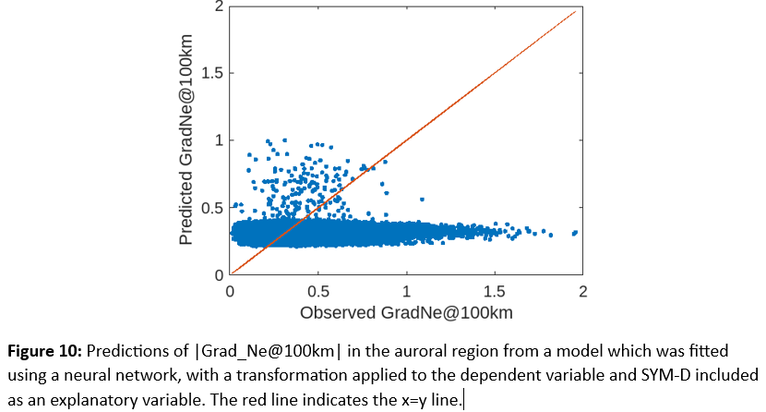
Swarm-VIP-Dynamic| Neural Network
Choice of distribution appeared to be poor
It may be that the distribution which has been implicitly assumed by the neural network is not appropriate
Notes:
Result from first round of modelling

Slide 35
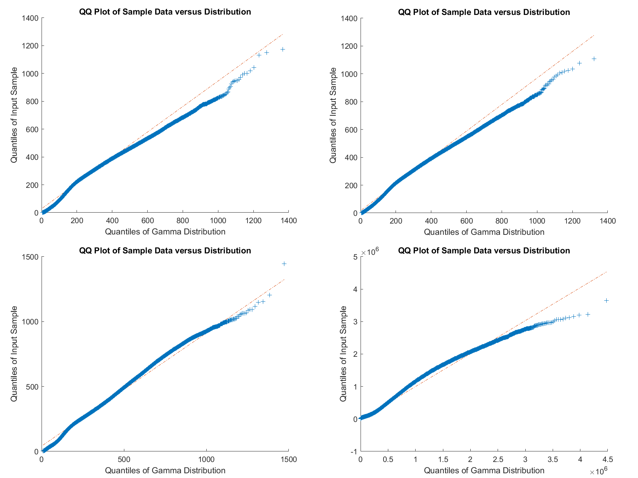
Model Development| Choice of Distribution: Electron Density
Polar region
Gamma, 2nd root
Auroral region
Gamma, 2nd root
Midlatitude region
Gamma, 2nd root
Equatorial region
Gamma, 1st root

Slide 36
Model Development| Choice of Distribution: |Grad_Ne@100km|
Polar region
Gamma, 4th root
Auroral region
Gamma, 4th root
Midlatitude region
Gamma, 6th root
Equatorial region
Gamma, 4th root

Slide 37
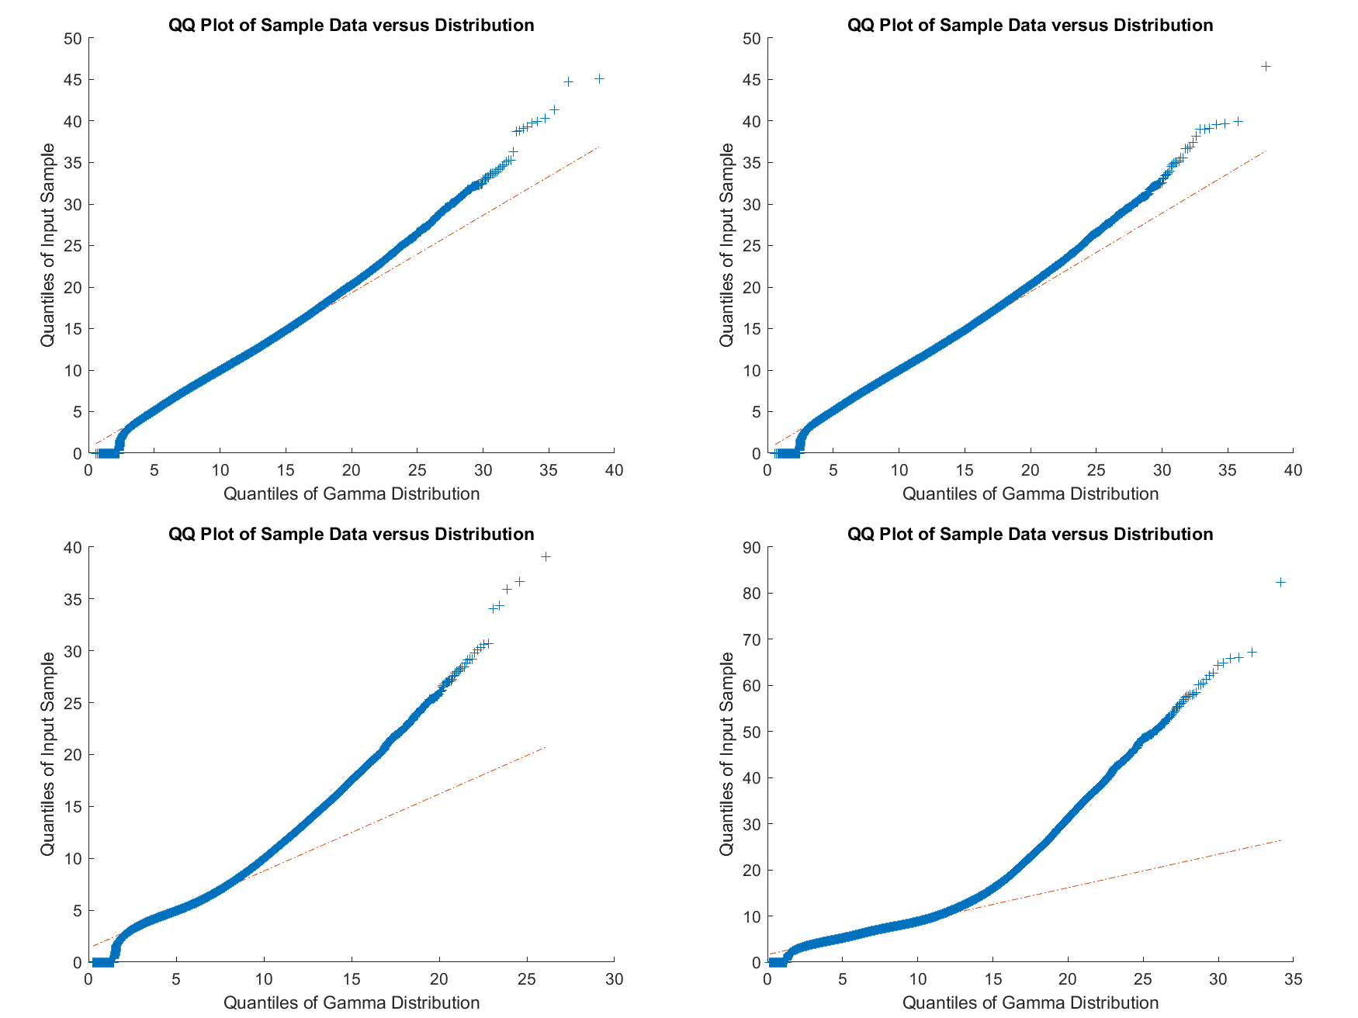
Model Development| Choice of Distribution: |RODI10s|
Polar region
Gamma, 3rd root
Auroral region
Gamma, 3rd root
Midlatitude region
Gamma, 3rd root
Equatorial region
Gamma, 3rd root

Slide 38
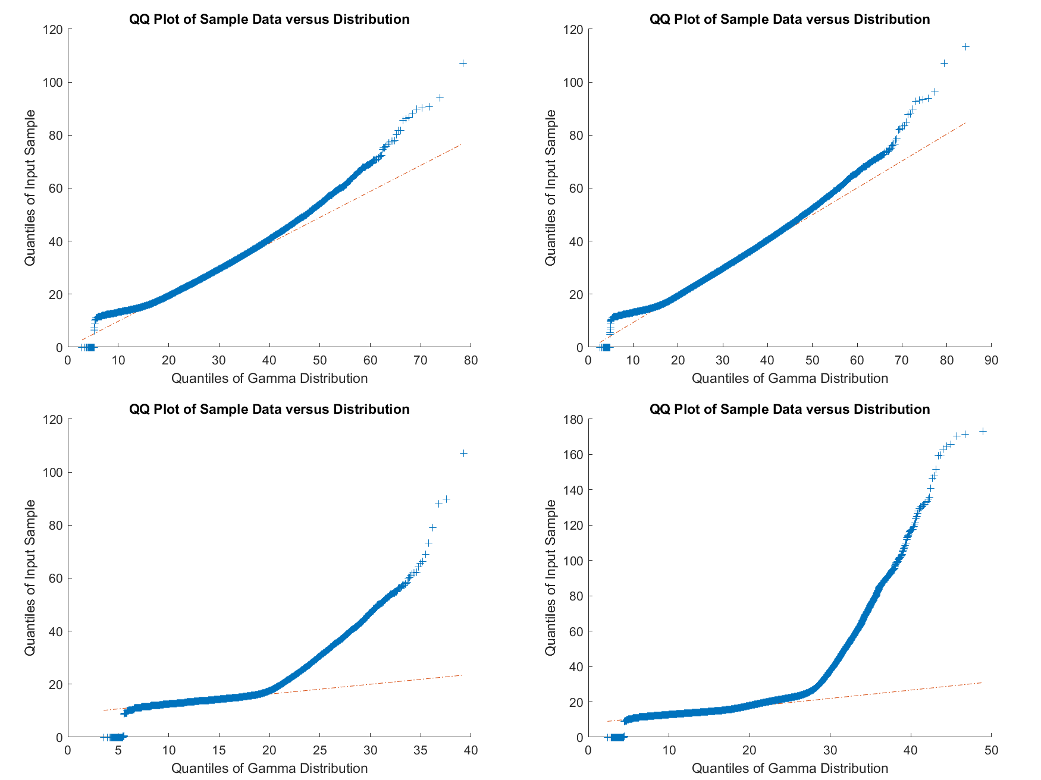
Model Development| Choice of Distribution: |RODI1s_FP|
Polar region
Gamma, 3rd root
Auroral region
Gamma, 3rd root
Midlatitude region
Gamma, 3rd root
Equatorial region
Gamma, 3rd root

Slide 39
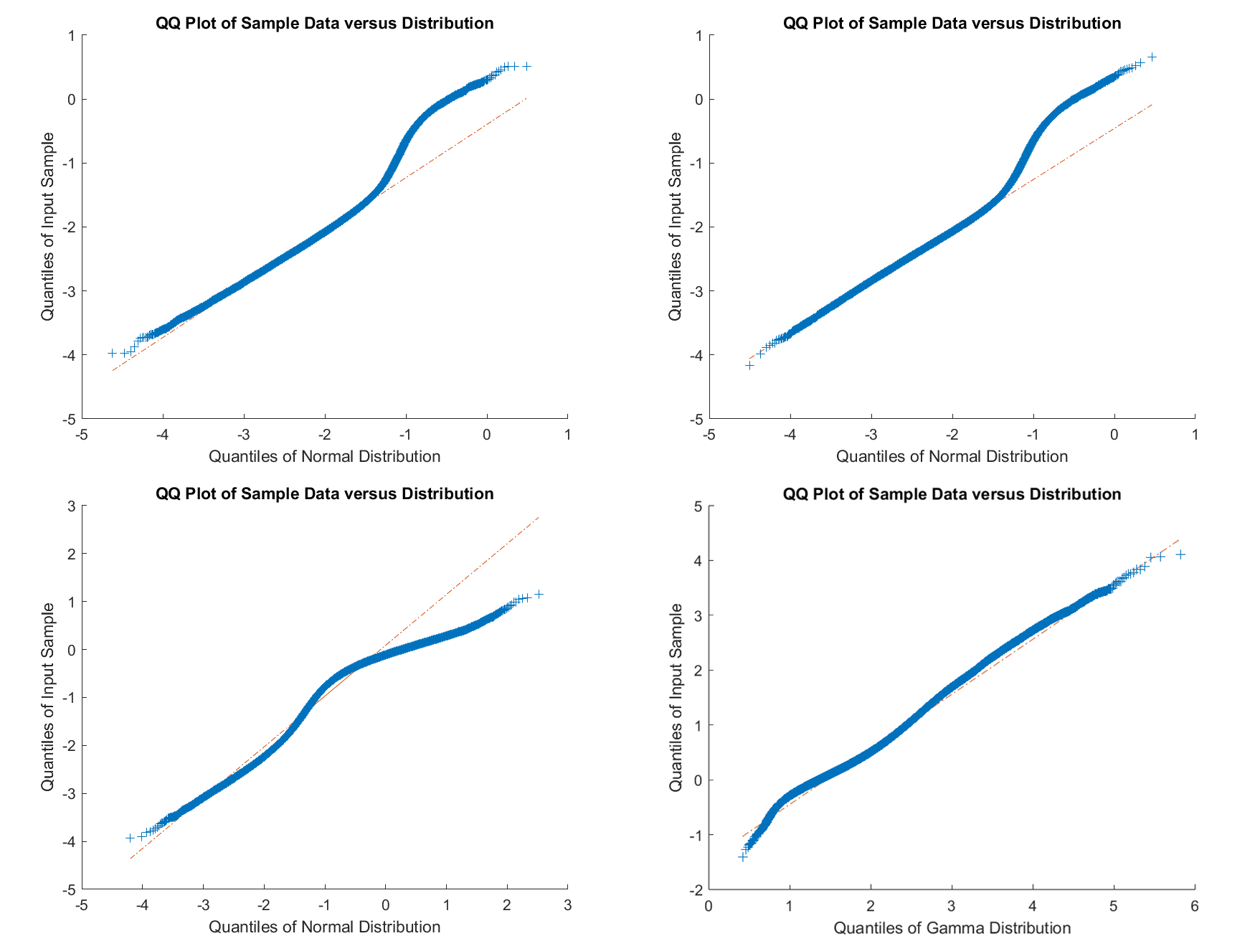
Model Development| Choice of Distribution: Slope
Polar region
Normal
Auroral region
Normal
Midlatitude region
Normal
Equatorial region
Gamma,
-p + min(p) + 0.01

Slide 40
Slope| Probability Distribution Functions
Polar region
Auroral region
Midlatitude region
Equatorial region

Slide 41
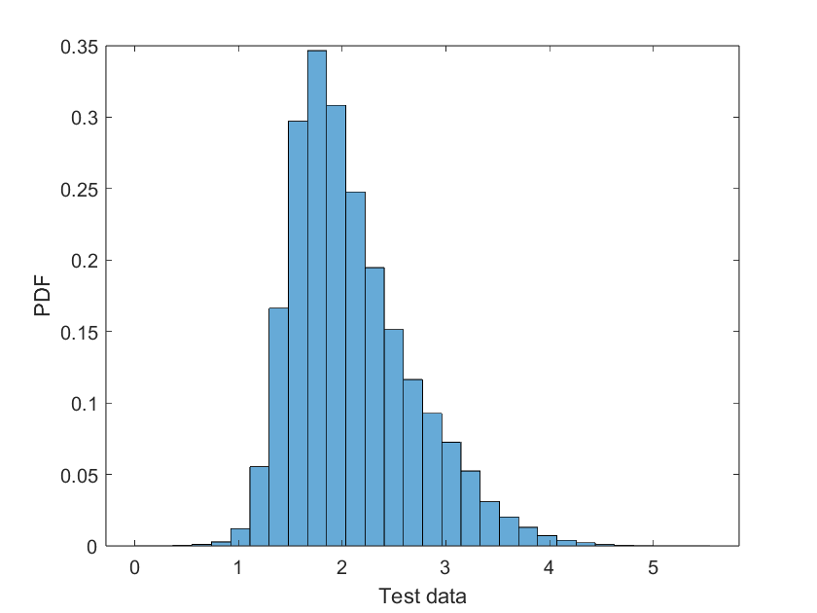
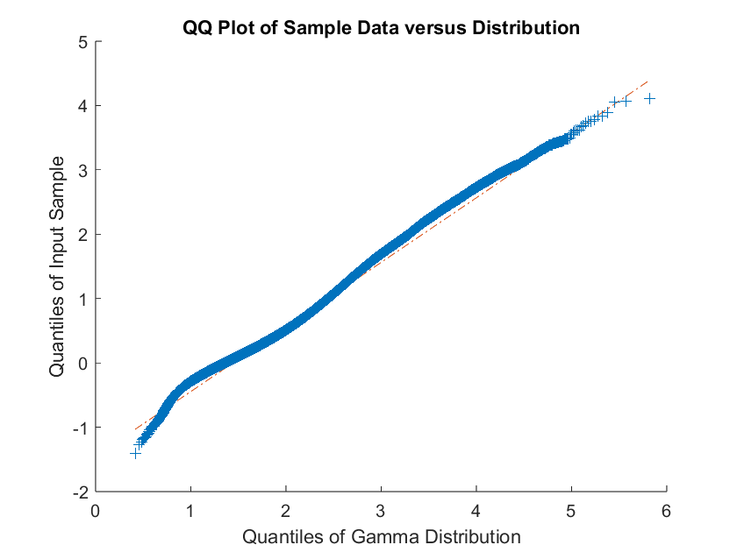
Slope| Distribution: Equatorial Region
Region 1
Region 2
Apply a transformation to flip and shift the data
$$−p−min\left(p\right)+0.01$$
$p$ is the spectral slope
Gamma distribution (no additional transformation) is a good fit

Slide 42
Slope| Distribution: Polar Region
Region 1
Region 1
Region 2
Region 2
Bump in q-q plot, corresponding to the break between regions 1 & 2
Distribution could be the combination of two Gaussians, or one Gaussian and something else with a high tail
Could fit a separate model in regions 1 & 2, but is there enough data to do this in region 2? Would it be useful anyway?
Proceed with normal distribution

Slide 43
Slope| Probability Distribution Functions
Midlatitude region looks like a combination of the auroral and equatorial regions. Is there spill-over from the auroral region due to the 75º MLAT cutoff used in the databases?
To reconsider based on results of performance assessment
Auroral region
Polar region
Midlatitude region
Equatorial region

Slide 44
Swarm-VIP-Dynamic| Model Formulation
Training data set: All latitudinal regions considered together
Correlation limit of |0.25|

Slide 45
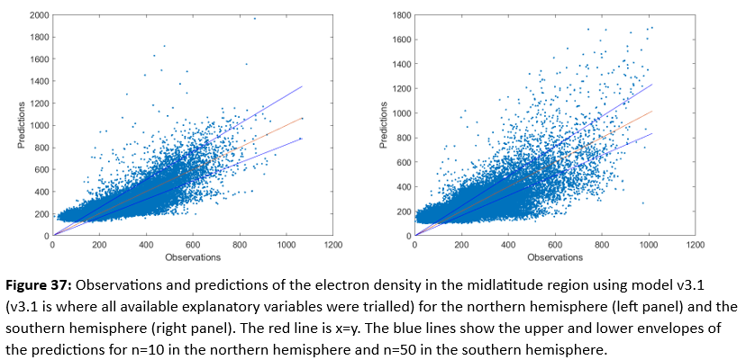
Reasonable Worst-Case Scenario| Electron Density, Midlatitude
Northern Hemisphere
n=10
Southern Hemisphere
n=50
n needs to be empirically determined

Slide 46
Swarm-VIP-Dynamic| Versions of Models
Version 3.1: Final version of models, for validation and performance analysis (where possible)
Version 3.2: Version where performance analysis is conducted using a different satellite mission or specific ground-based location. Explanatory variables which are measured directly from Swarm, and which are only valid along the Swarm orbit have been removed or replaced. This included removal of altitude.
Version 3.3: Version which has the potential to be run in near real time. Explanatory variables which are not available in near real time have been removed or replaced. Replacements included a geomagnetic index, for which Kp and Dst were preferred.

