Slide 1


Reducing Hydrological Uncertainty: A Multi-Variable SWAT Calibration Using Global AET Products
Mohamed Ouarani¹
Abdennabi Alitane¹, Yassine Ait Brahim¹ , Yassine Manyari¹ & David Mulla²
International Water Research Institute, Mohammed VI, Morocco
Department of Soil, Water, and Climate, Twin Cities, Minnesota, USA
EGU General Assembly 2026, 3–8 May 2026 in Vienna, Austria, and online
May 5th, 2026
Copyright © 2026 UM6P/IWRI
1

Slide 2


Outline
Context & Problem Statement
Introduction & Motivation
Objectives of the Study
Study Area
Methodology
Results
Discussions
Conclusions
Copyright © 2026 UM6P/IWRI
2

Slide 3
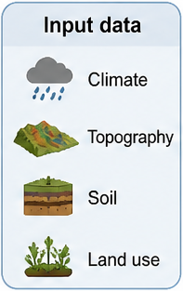
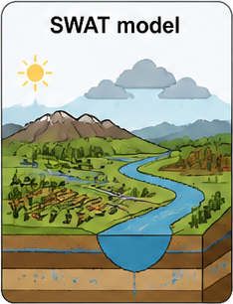
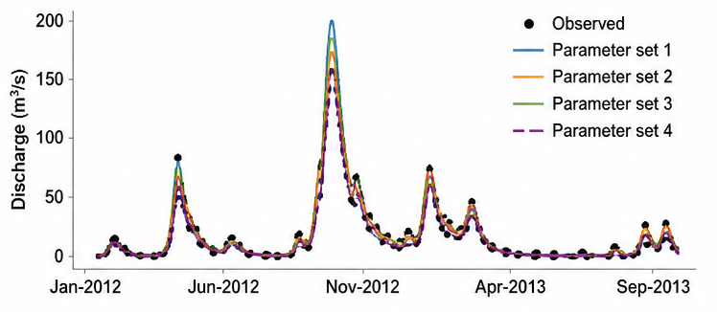
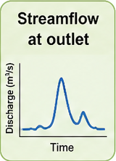

Context & Problem Statement
Process-based hydrological models are inherently affected by parameter equifinality
This limitation is particularly pronounced in data-scarce semi-arid regions
Predictions Reliability is reduced
Key processes are poorly constrained
Critical for water resources management in
Copyright © 2026 UM6P/IWRI
3

Slide 4








Objectives and Novelty
Objectives
Novelty
Main Goal:
Reduce parameters equifinality
Full water-cycle constraint:
Q + AET + Soil Moisture
(Fluxes + storage)
Approach:
-Multi-variable calibration
- Multi-scenario framework
Information-based calibration paradigm:
Moves beyond traditional performance metric
Quantitative Assessment:
Parameters identifiability, posterior uncertainty and model behavior across scenarios
Copyright © 2026 UM6P/IWRI
4

Slide 5
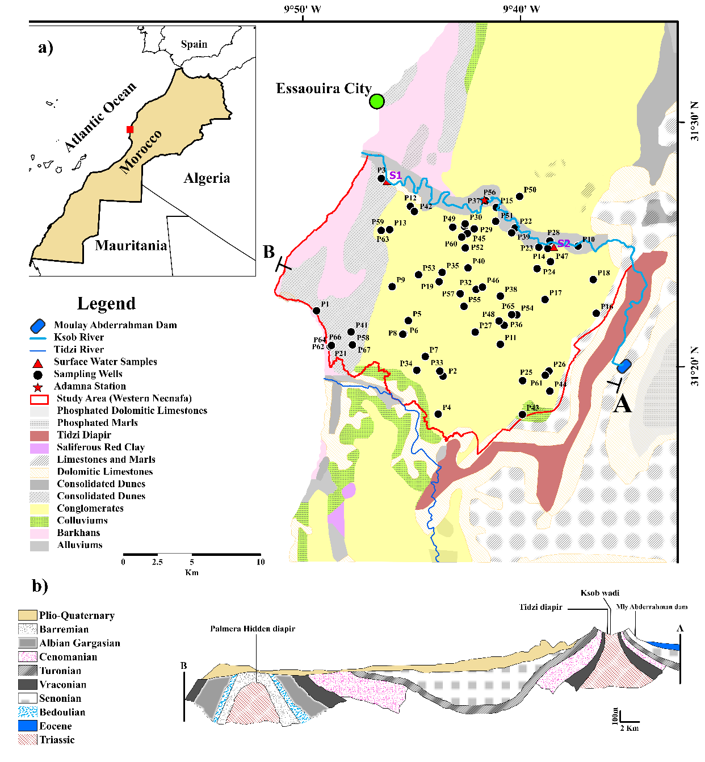

The Study Area Presentation
The focus of this study is limited to the coastal zone of the Essaouira basin,
Climate: Semi-arid region with average annual rainfall below 300 mm/year and an average temperature around 20 °C,
Hydrogeology: Presence of two main aquifers, the Plio-Quaternary (PQ) and Turonian aquifers, with a primary focus on the PQ aquifer,
Hydrology: Dominated by the Ksob river and its tributaries in shaping the hydrographic network within the region
Copyright © 2026 UM6P/IWRI
5

Slide 6


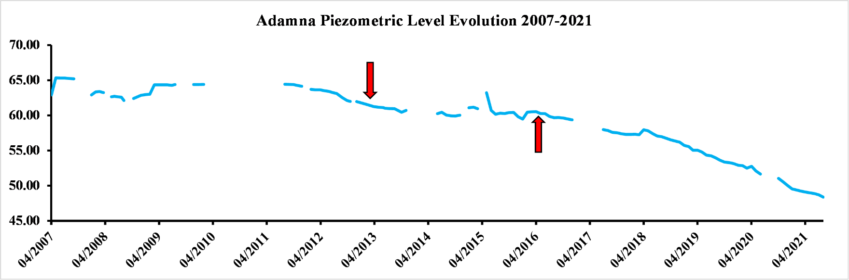
The Study Area Presentation
Essaouira coastal basin: typical example of semi-arid coastal areas
Water scarcity issue with rising pressure on groundwater water,
The Essaouira region is one the most important touristic sectors in Morocco (46 676 overnight stays in June 2023 and 556 904 overnight stays in 2019),
The impact of the successive dry cycles,
Water resources constitute a limiting factor for the socio-economic development in the region,
The aquifer is under-gauged with limited data available from only one piezometer capturing the aquifer.
Photo Credit : [1]
Photo Credit : [2]
Copyright © 2026 UM6P/IWRI
6

Slide 7
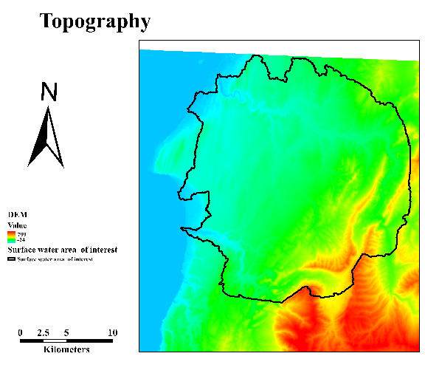
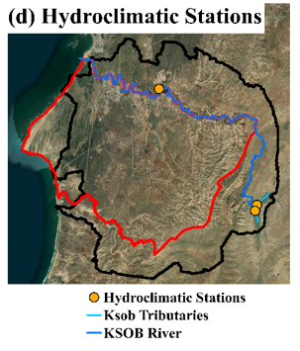
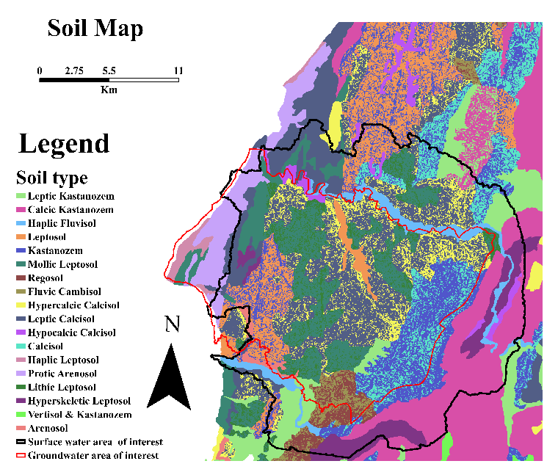
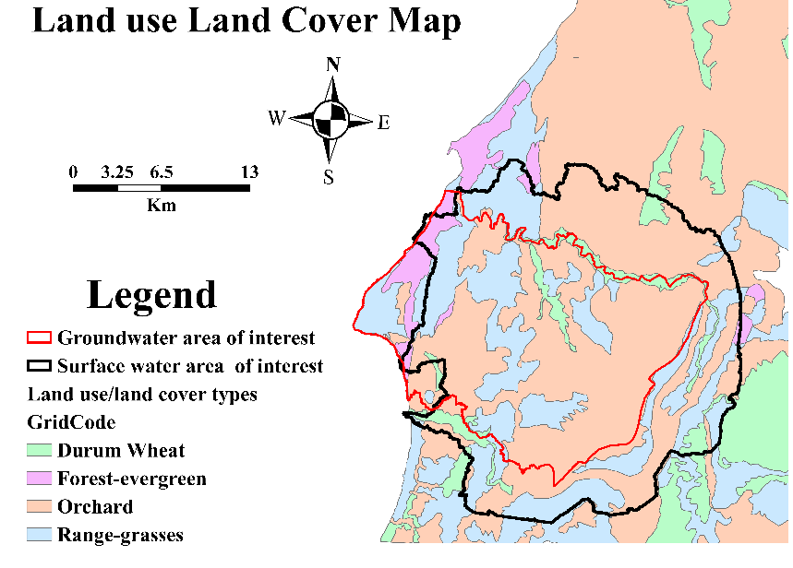
SWAT Model Input Data
Soil and LULC maps were prepared based on a study done in the study area in 2007,
SRTM 30 m DEM was used for topographical data,
Daily precipitation from Adamna station (1990-2010),
ERA5-Land reanalysis data were used to extract daily temperature (1990-2010).
Copyright © 2026 UM6P/IWRI
7

Slide 8
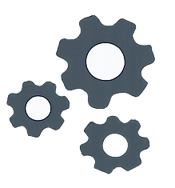


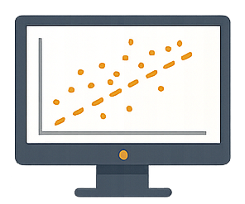



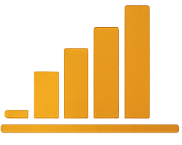


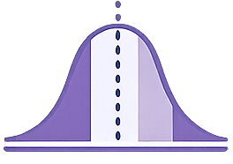

Methodology: Multi-variable calibration framework and identifiability assessment
INPUT DATA
SWAT MODEL Hydrological simulation framework
CALIBRATION SCENARIOS
Streamflow (Observed)
1. Streamflow Only
Latin Hypercube Sampling (LHS)–Based Parameter Sampling 10,000 parameters combinations
2. AET Only
3. Soil Moisture Only
Remote Sensing 5 AET Products
Best Parameters Sets Top 100 based on objective functions
4. Multi-variable
Remote Sensing 1 Soil Moisture Product
Outcome
Parameter Evaluation Quantify equifinality and parameter identifiability
Reduced equifinality and improved process representation
Copyright © 2026 UM6P/IWRI
8

Slide 9


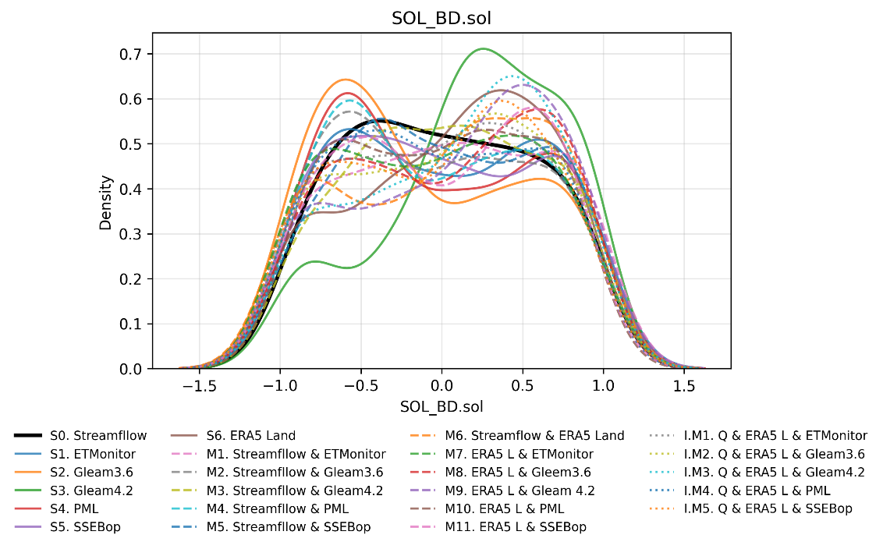
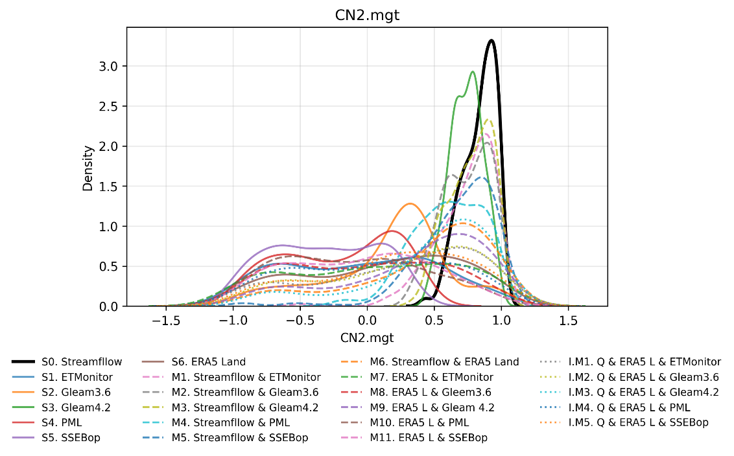
Results: Process-dependent identifiability
Soil Parameters Sol_BD
Runoff Parameters CN2
Multi-variable calibration improves identifiability
Strong effect on soil/storage parameters
Limited effect on runoff parameters
Copyright © 2026 UM6P/IWRI
9

Slide 10

Conclusions and Perspectives
Multi-variable calibration (Q + AET + SM) reduces parameter equifinality,
Parameter identifiability is process-dependent:
Runoff processes are primarily constrained by streamflow (Q)
Soil and storage processes are better constrained by AET and soil moisture
Soil moisture provides a direct constraint on internal storage dynamics, revealing hidden equifinality
This study introduces a multi-source calibration framework integrating fluxes (Q, AET) and state variables (SM)
The approach represents a shift from performance-based calibration → information-based identifiability analysis
Multi-variable calibration enables full water-cycle constraint, improving internal model consistency
👉 Multi-source calibration provides a robust pathway toward physically consistent and uncertainty-aware hydrological modeling
Copyright © 2026 UM6P/IWRI
10

Slide 11


Reducing Hydrological Uncertainty: A Multi-Variable SWAT Calibration Using Global AET Products
Mohamed Ouarani
Abdennabi Alitane¹, Yassine Ait Brahim¹ , Yassine Manyari¹ & David Mulla²
EGU General Assembly 2026, 3–8 May 2026 in Vienna, Austria, and online
Discussion
Mohamed.Ouarani@um6p.ma
May 5th, 2026
Copyright © 2026 UM6P/IWRI
11

