Slide 1




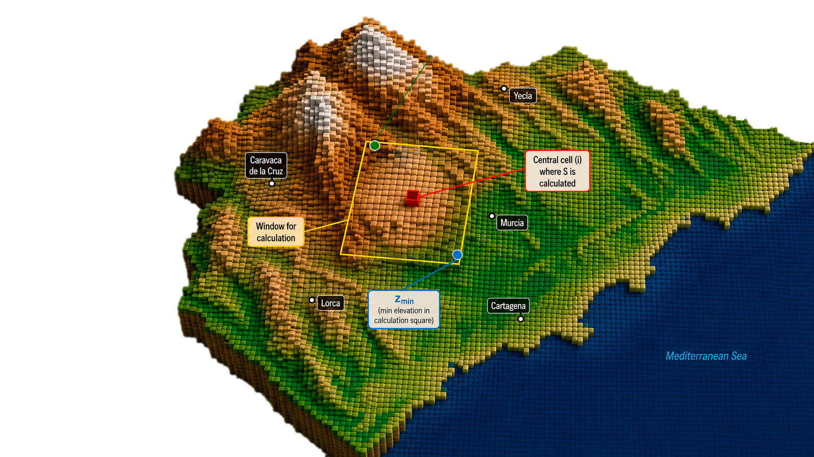
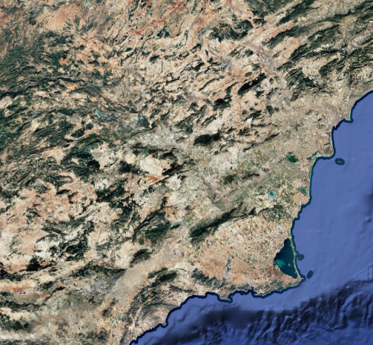
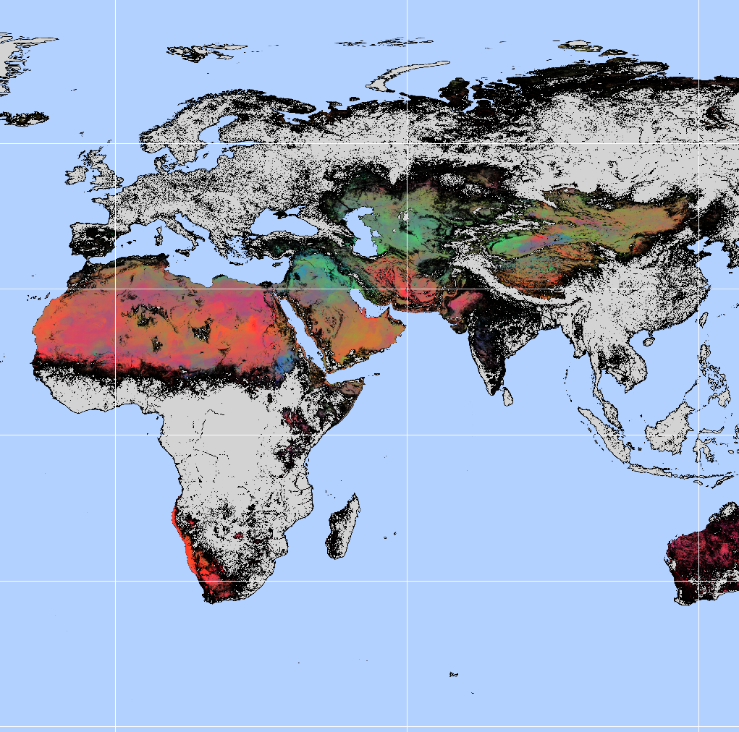
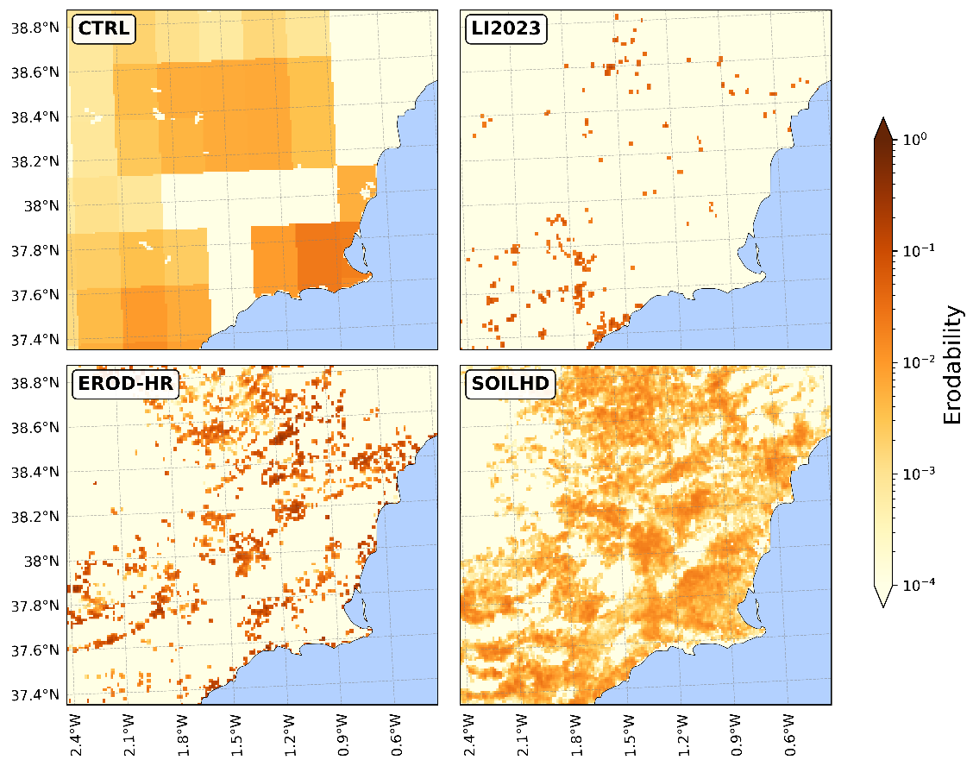
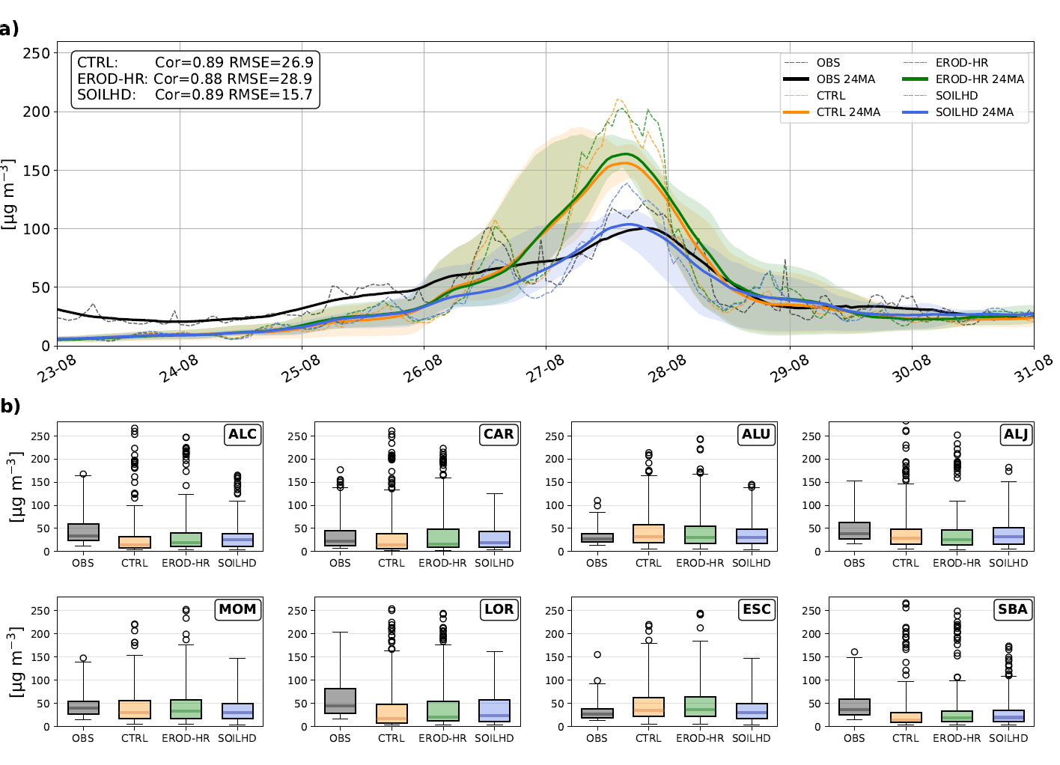
Improving dust emission in GOCART scheme using a HR erodibility dataset
Meet the authors
2 min madness
1 The challenge
2 The model
3 The datasets
4 The impact
5 The results

Slide 2
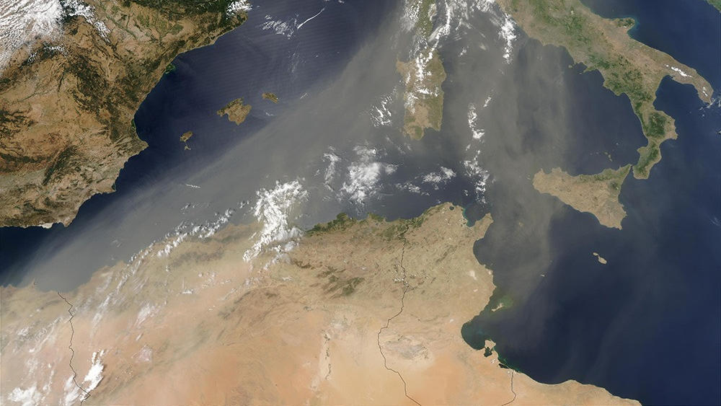





Improving dust emission in WRF-Chem GOCART scheme using a high-resolution erodibility dataset
Leandro Segado-Moreno, Juan Pedro Montávez, Eloisa Raluy-López, Ginés Garnés-Morales, Alejandro Cordero, Pedro Jiménez-Guerrero

Slide 3
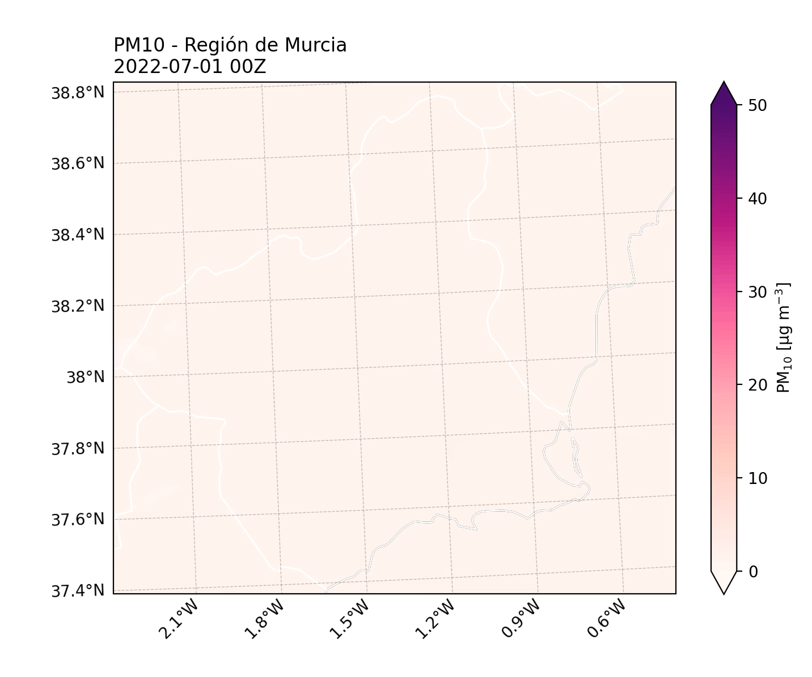
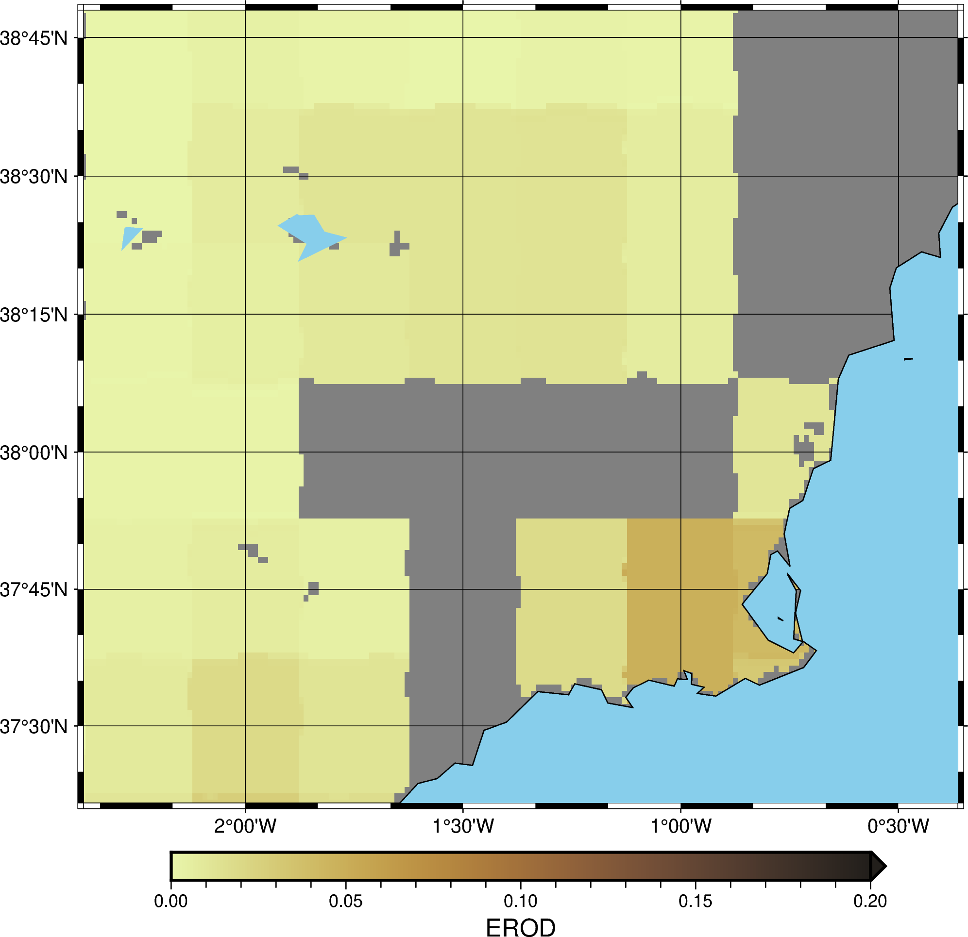
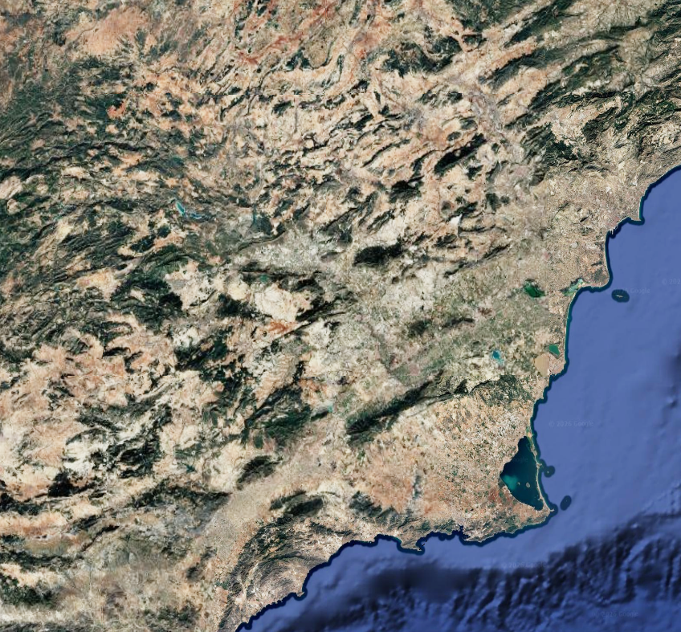
What is the challenge?
Coarse Erodibility vs Real World
Source: Google Earth

Slide 4
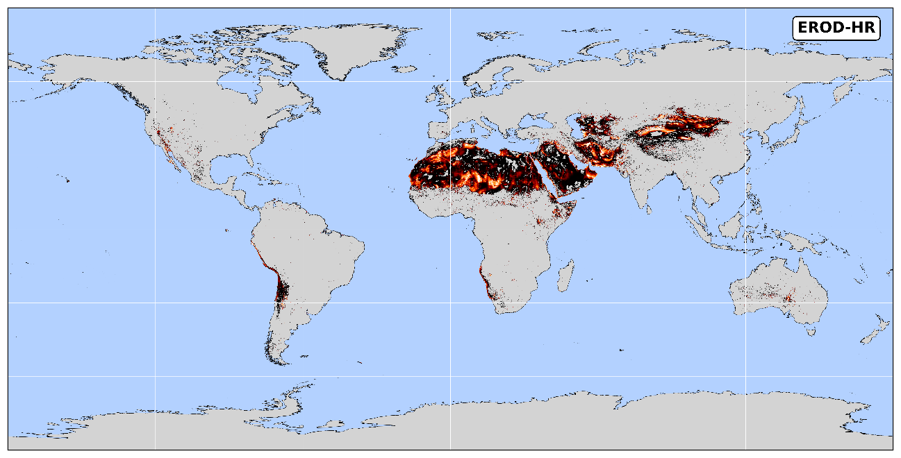

Creating a new DB: two approaches
Calculate again with HR topography
Fresh start, bare soil + soil texture
Visualization: Moritz Müller
Credit: Moritz Müller
Visualisation: Moritz Müller

Slide 5
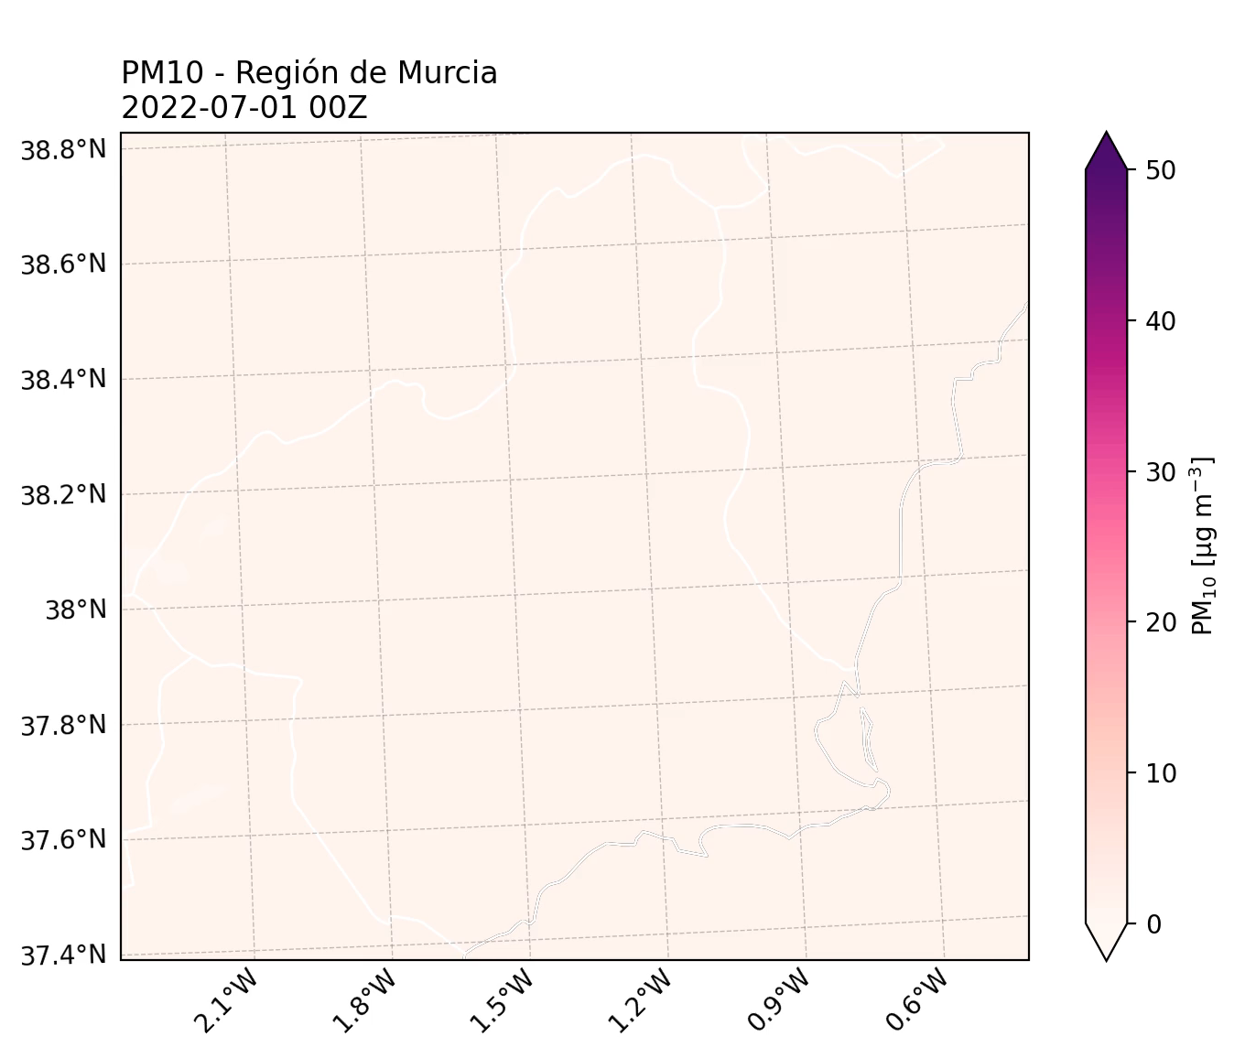
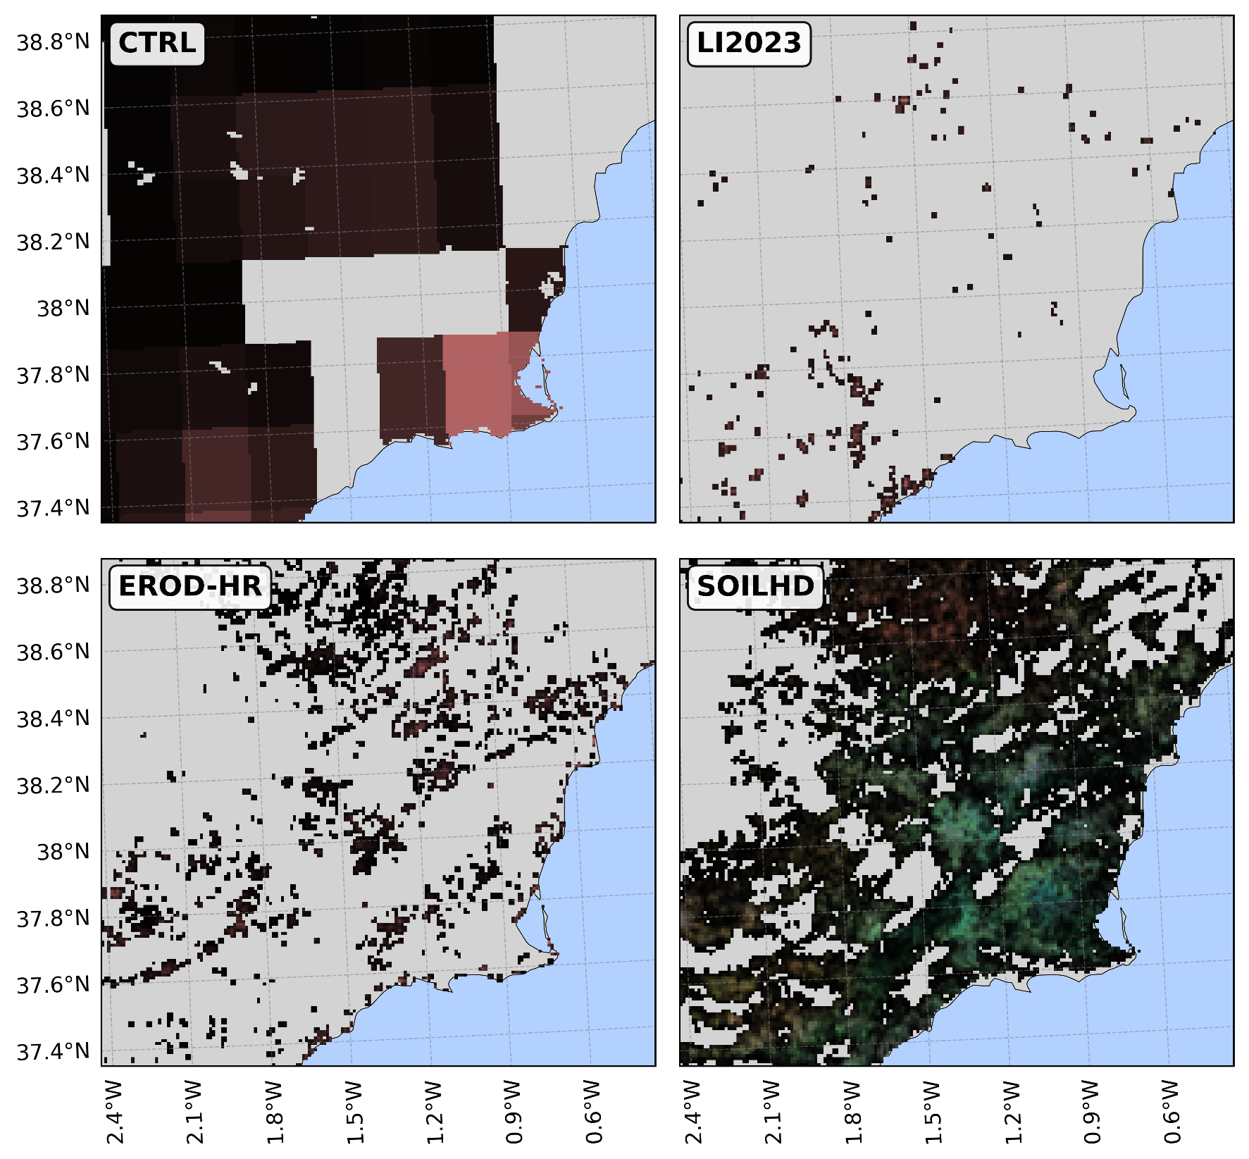
Creating a new DB: two approaches
From this
To this

Slide 6
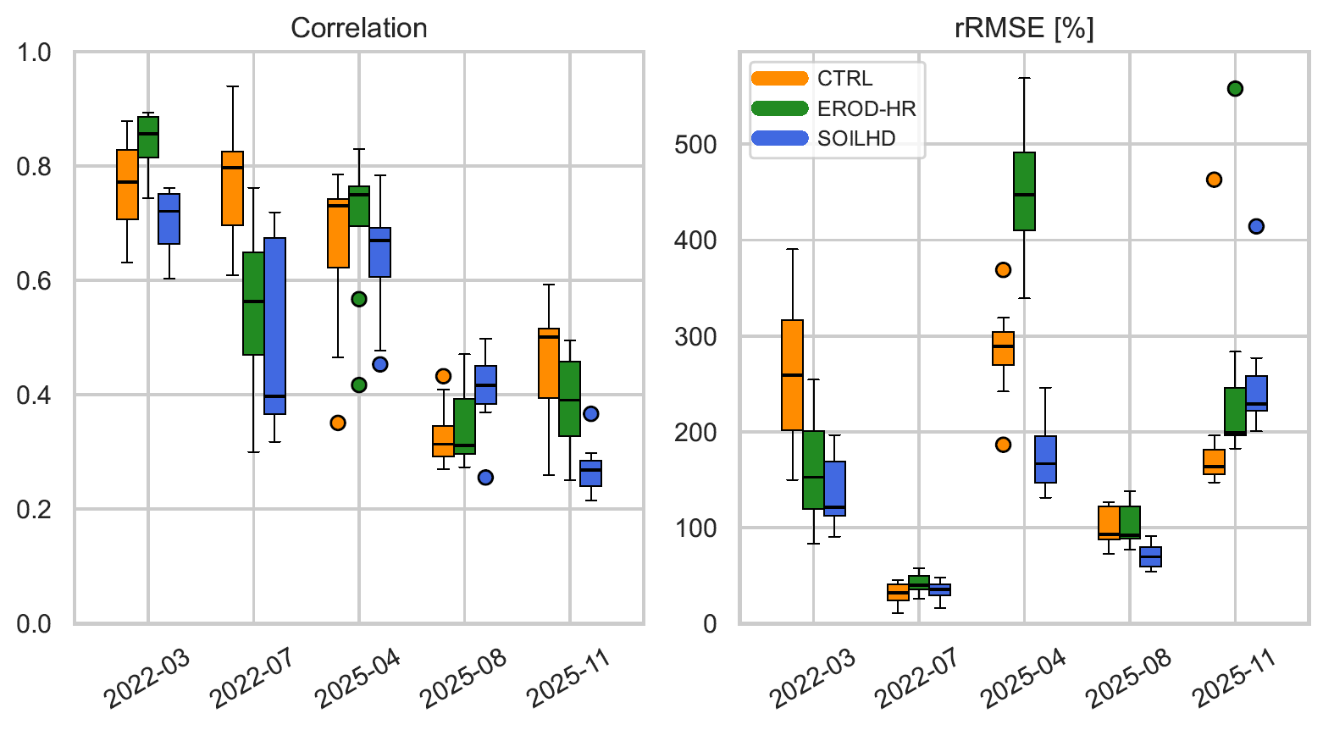
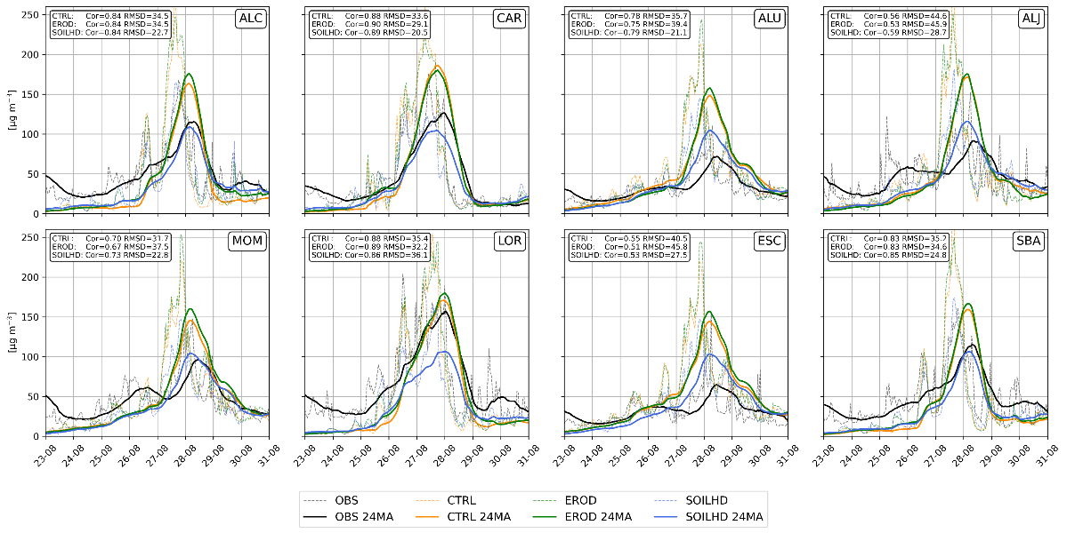
Impact on emissions
SOILHD retrieves the best PM concentration accordance with observational data (80%)

Slide 7











The team
Leandro Segado-Moreno¹, Juan Pedro Montávez¹, Eloisa Raluy-López¹, Ginés Garnés-Morales², Alejandro Cordero¹, Pedro Jiménez-Guerrero^{1,3}
¹ Physics of the Earth, Regional Campus of International Excellence (CEIR) “Campus Mare Nostrum”, University of Murcia, Spain. (leandrocristian.segadom@um.es)
² Department of Meteorology, University of Reading, Brian Hoskins Building, Whiteknights Road, Earley Gate, Reading, RG6 6ET, UK.
³ Biomedical Research Institute of Murcia (IMIB-Arrixaca), Carretera Buenavista s/n, 30120 El Palmar, Murcia, Spain

Slide 8
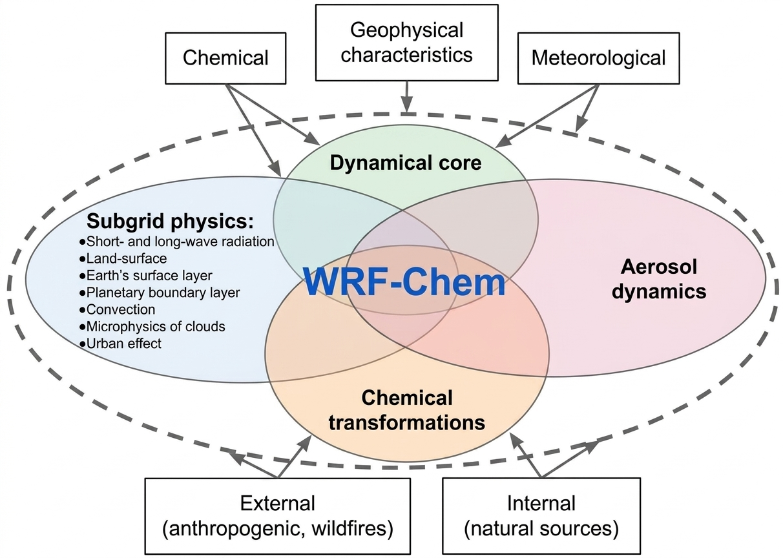



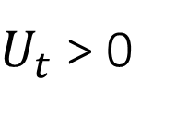

The model
GOCART
$${PM}_{2.5} {PM}_{10}$$
$$F_{p}=C·S·s_{p}·U^{2}\left(U−U_{t}\right)$$
$U_{t}$ > 0
See how S is calculated (cool graphics!)
Want to see the WRF configuration?

Slide 9
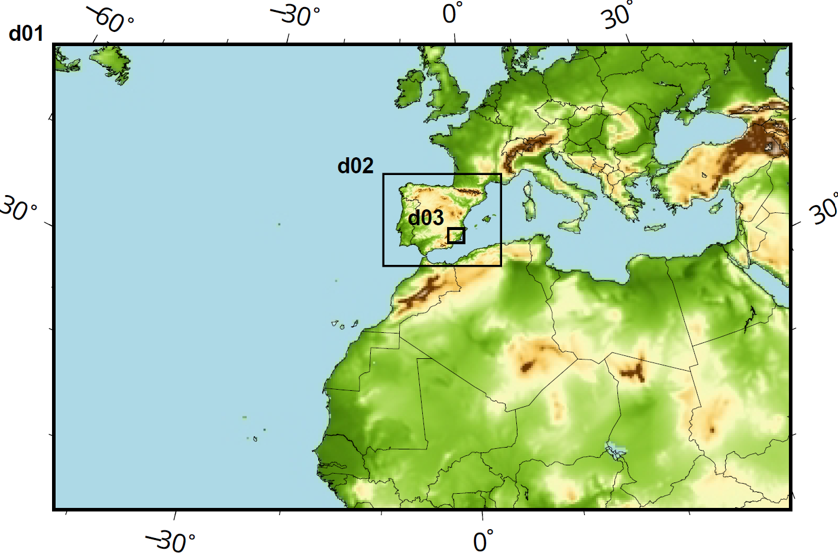
WRF configuration
Process | Option | Namelist option | Reference
Microphysics | Morrison 2-moment | mp_physics = 10 | Morrison et al. (2005)
Shortwave radiation | RRTMG | ra_sw_physics = 4 | Iacono et al. (2008)
Longwave radiation | RRTMG | ra_lw_physics = 4 | Iacono et al. (2008)
Cumulus parametrization | Grell-3D | cu_physics = 5 | Grell (1993); Grell and Dévényi (2002)
Boundary layer | YSU scheme | bl_pbl_physics = 1 | Hong et al. (2006)
Land surface model | Unified Noah | sf_surface_physics = 2 | Chen and Dudhia (2001)
Surface layer | Revised MM5 | sf_sfclay_physics = 1 | Jiménez et al. (2012)
Chemistry and aerosols | GOCART simple | chem_opt = 300 | Ginoux et al. (2001)

Slide 10
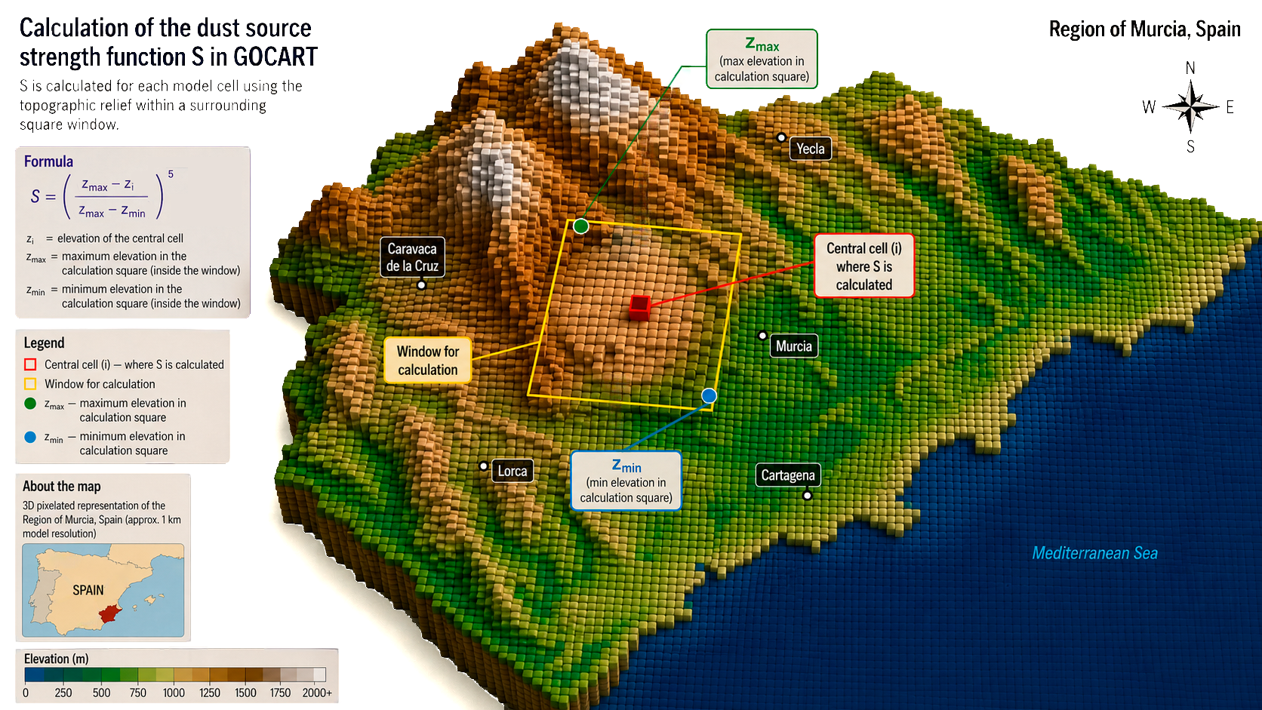
Visualization: Laura Torres

Slide 11
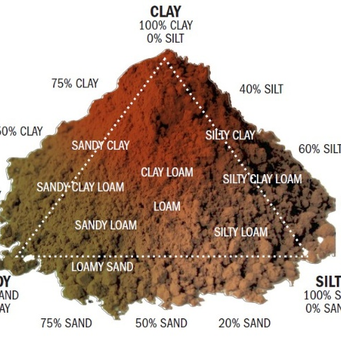
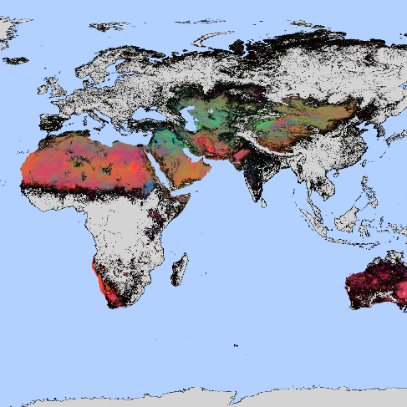
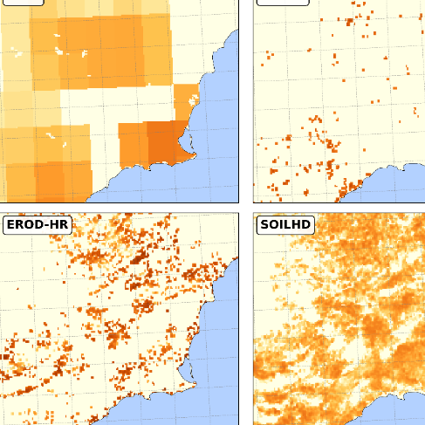
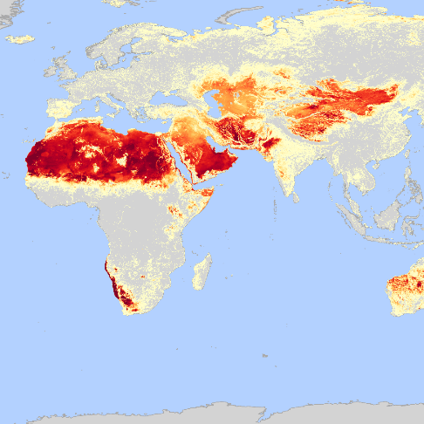
The datasets
SOILHD
Overview
EROD-HR
Erodibility
Assessment

Slide 12
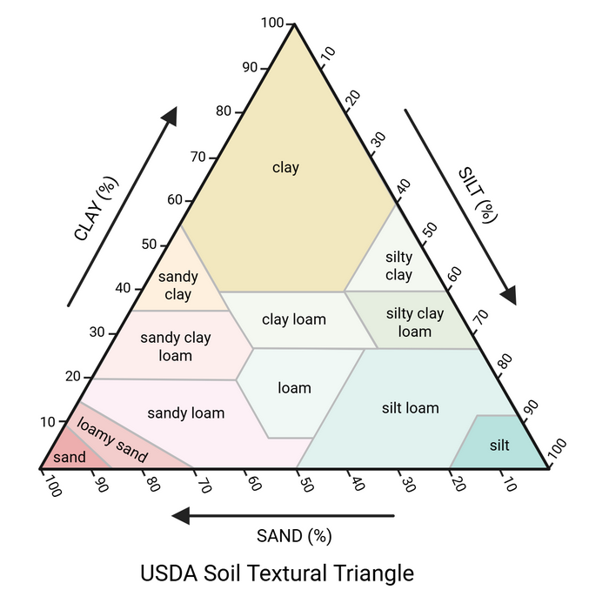
Overview
Dataset | Default | EROD-HR | SOILHD
Resolution | 0.25° (~28 km) | 5 km Global | 1 km Global
Topography | GTOPO30 (Coarse) | GMTED2010³ | None
Soil Texture | Fixed (50-25-25) | Fixed (50-25-25) | Heterogeneous (ISRIC⁵)
Bare Soil Mask | AVHRR bare soil² | MODIS land use⁴ | LCZ¹
Source: Biorender

Slide 13
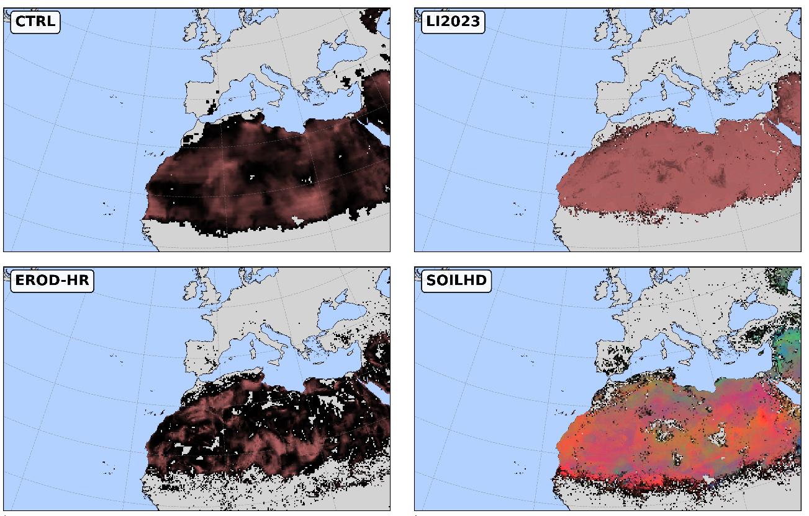
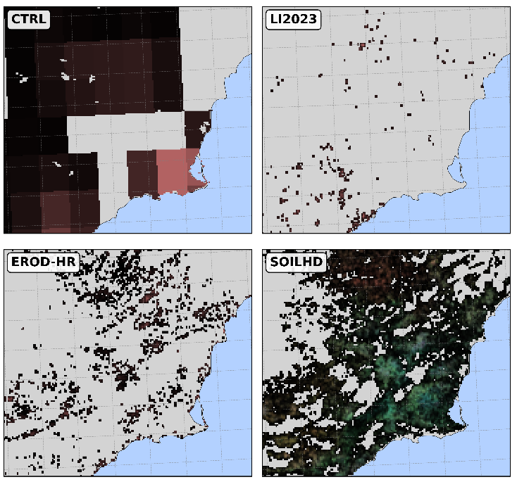
Overview

Slide 14

EROD-HR
Download the dataset!

Slide 15

SOILHD
SOILHD
Sand
Silt
Clay
Download the dataset!

Slide 16
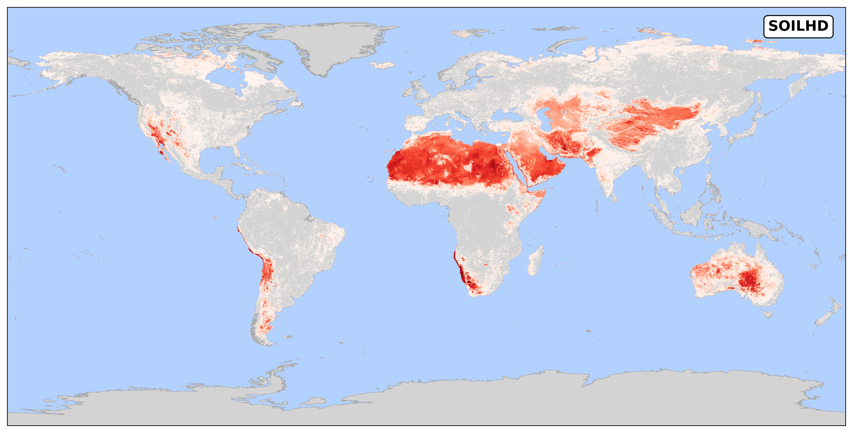
SOILHD
SOILHD
Sand
Silt
Clay
Download the dataset!

Slide 17
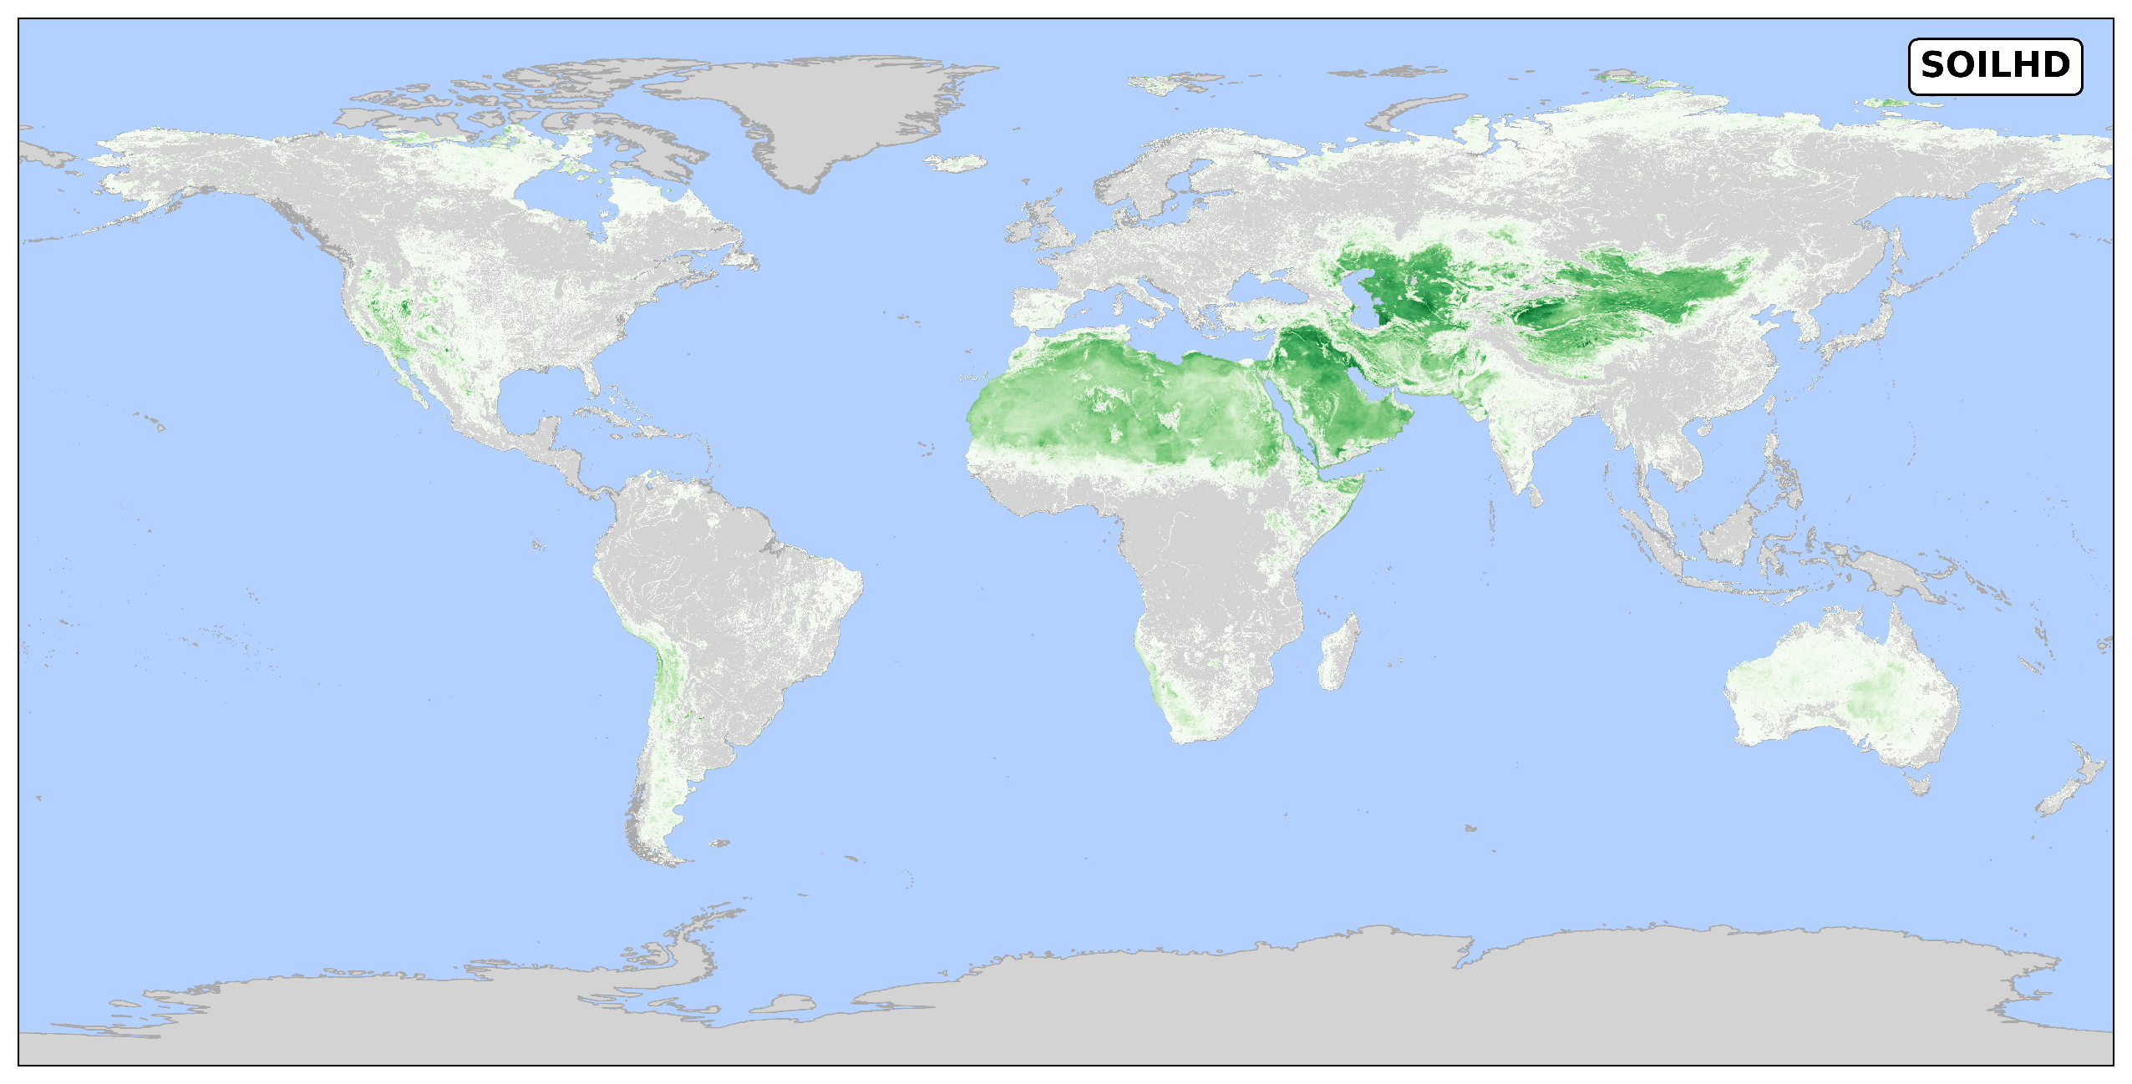
SOILHD
SOILHD
Sand
Silt
Clay
Download the dataset!

Slide 18
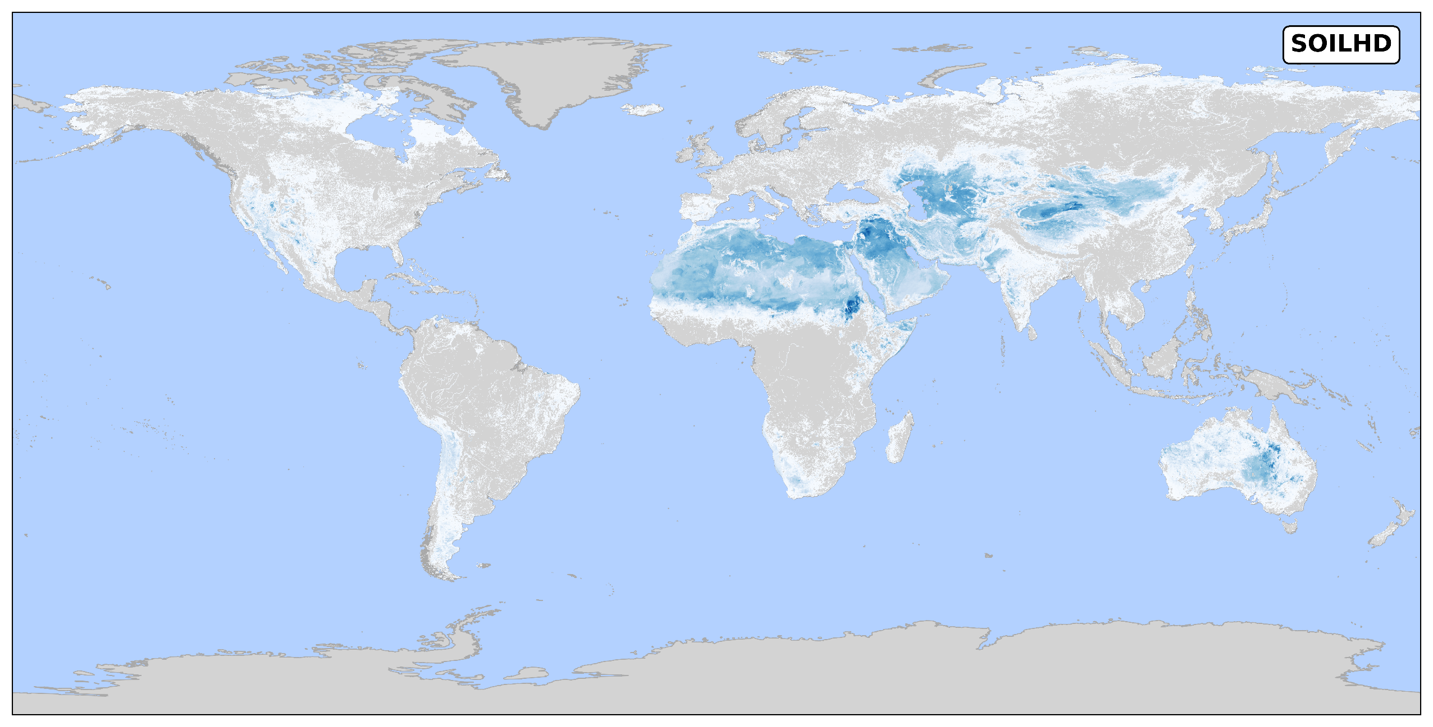
SOILHD
SOILHD
Sand
Silt
Clay
Download the dataset!

Slide 19


Download the datasets!
EROD-HR
SOILHD

Slide 20
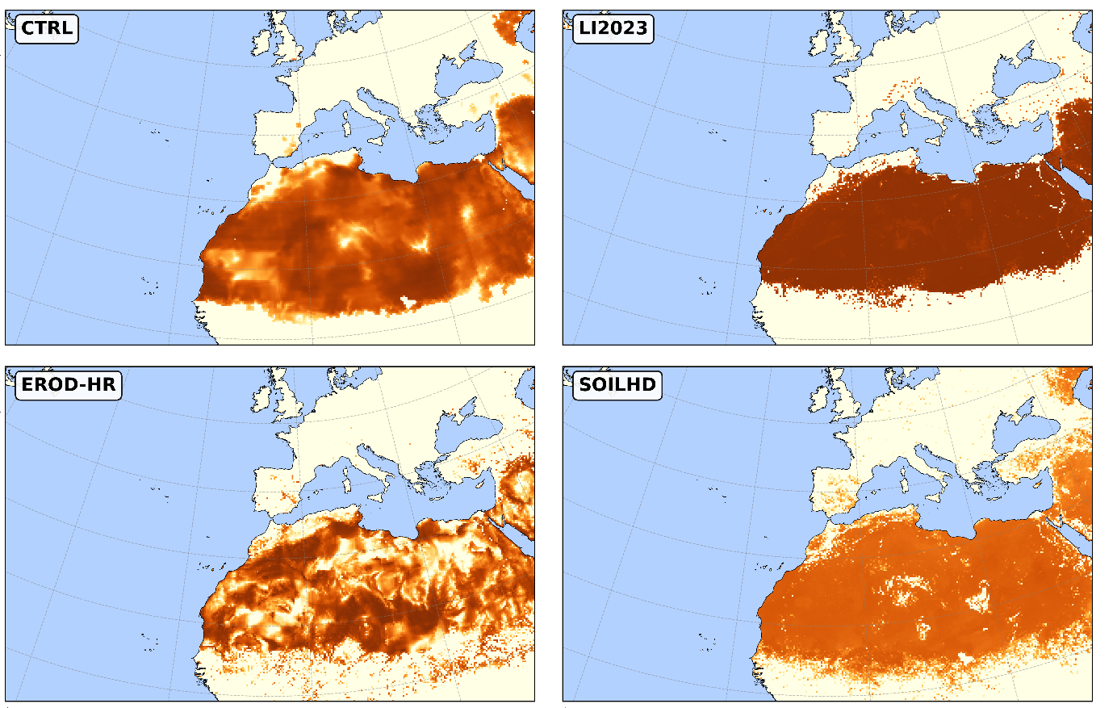
Erodibility assessment

Slide 21
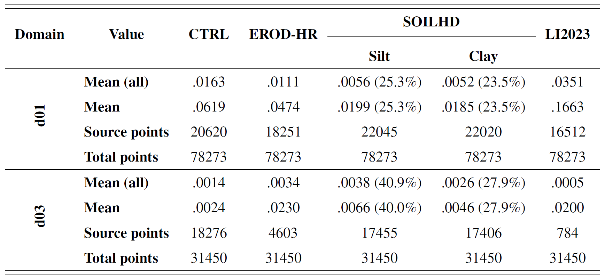
Erodibility assessment

Slide 22
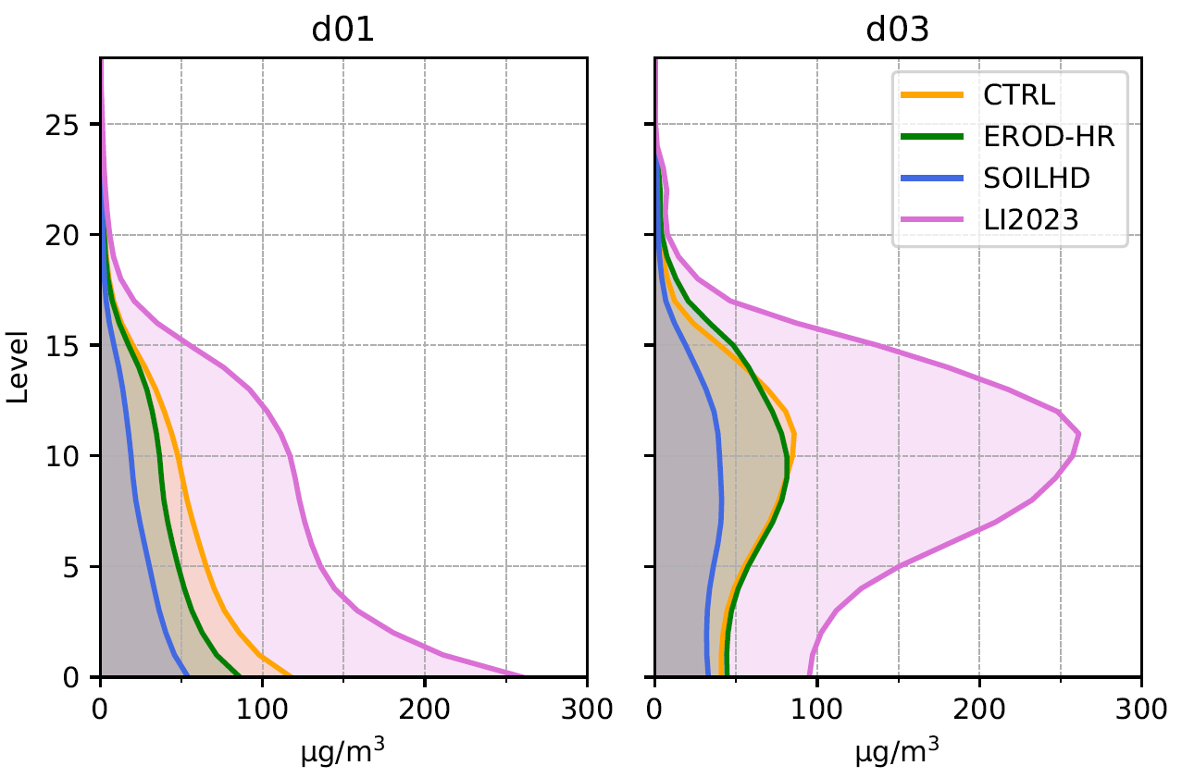
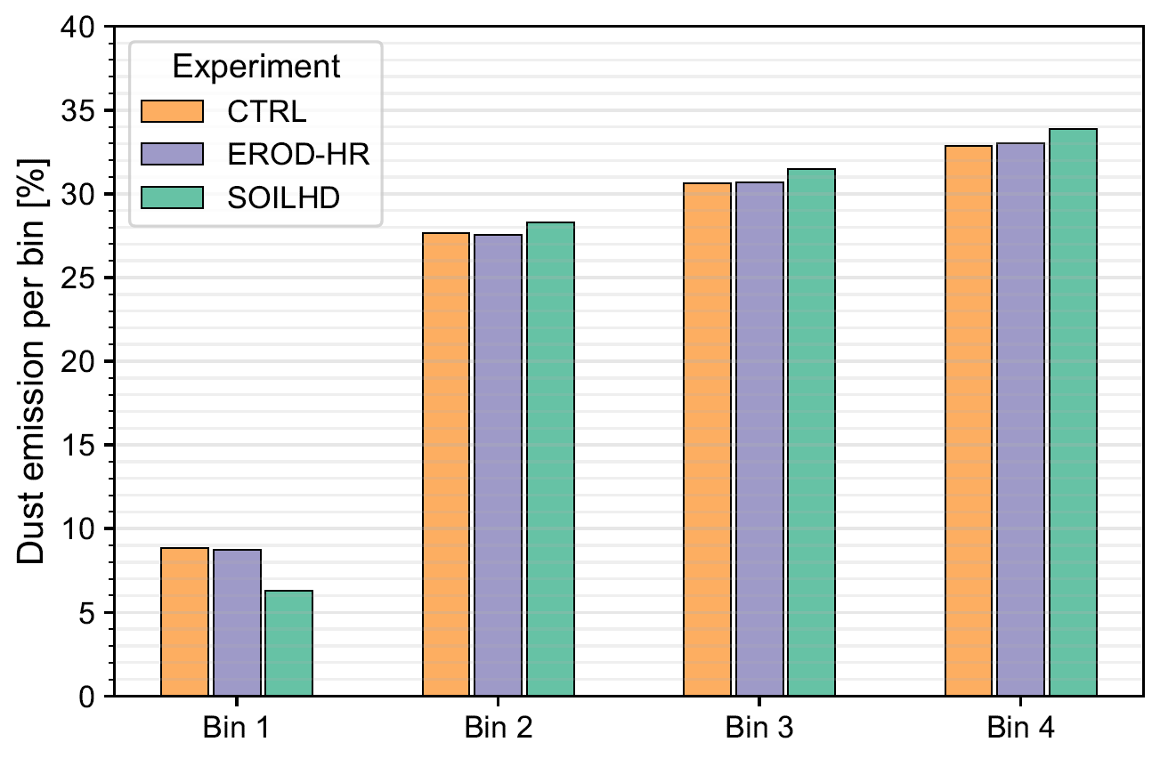
Restults
Impacts on PM10
See a case study
Which is the best model?

Slide 23
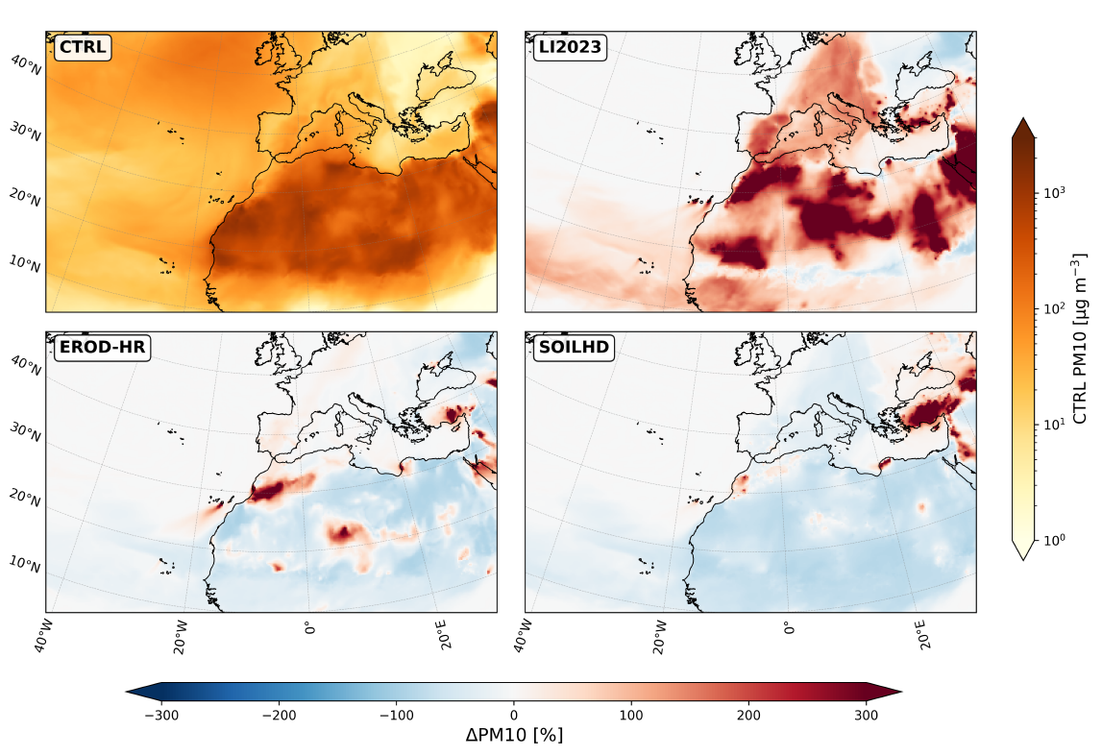
Case studies
Another dataset!
Simulation | Starting date | Ending date | Mean PM10 | Max. PM10
2022-03 | 2022-03-11 | 2022-03-19 | 98.8 | *1000.0
2022-07 | 2022-07-01 | 2022-07-08 | 35.8 | 133.0
2025-04 | 2025-04-26 | 2025-05-08 | 43.6 | 149.3
2025-08 | 2025-08-22 | 2025-08-31 | 52.0 | 204.5
2025-11 | 2025-11-08 | 2025-11-18 | 44.3 | *1000.0

Slide 24
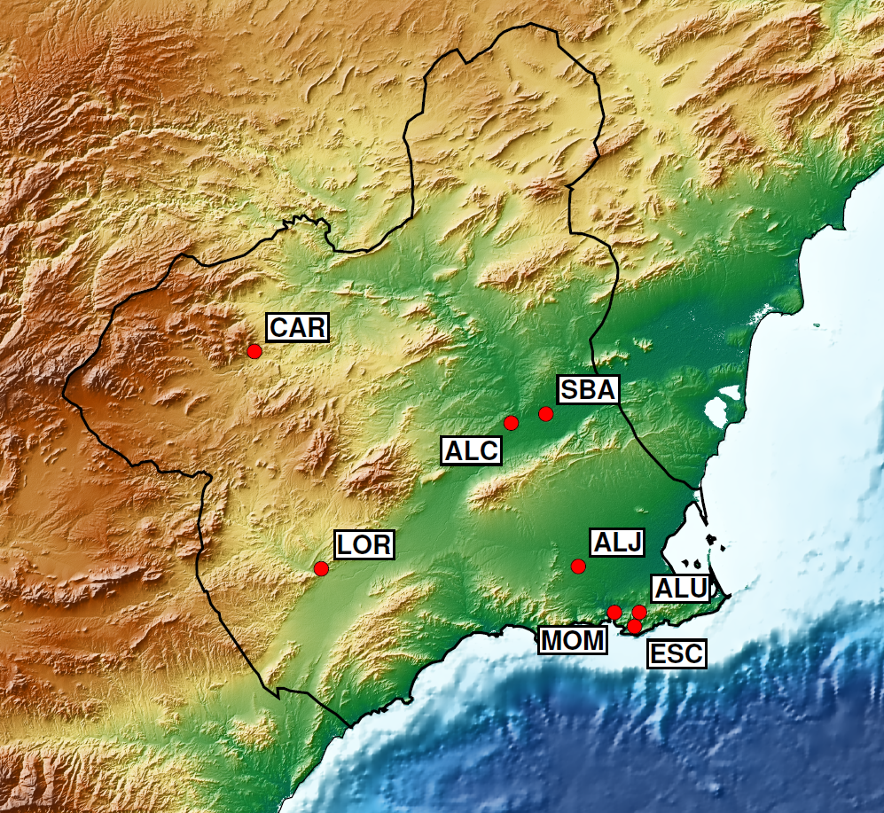
Want to see the stations?
Observational stations
Want to see the stats?
Best model?
Check the preprint!
No | Station | Longitude | Latitude | Name
1 | ALC | -1.232 | 37.975 | Alcantarilla
2 | CAR | -1.869 | 38.115 | Caravaca
3 | ALU | -0.914 | 37.602 | Alumbres
4 | ALJ | -1.066 | 37.693 | Aljorra
5 | MOM | -0.976 | 37.602 | Monpean
6 | LOR | -1.703 | 37.688 | Lorca
7 | ESC | -0.927 | 37.574 | Escombreras
8 | SBA | -1.146 | 37.992 | San Basilio

Slide 25
Want to see the stations?
Case 2022-08
Want to see the stats?
Best model?
Check the preprint!

Slide 26
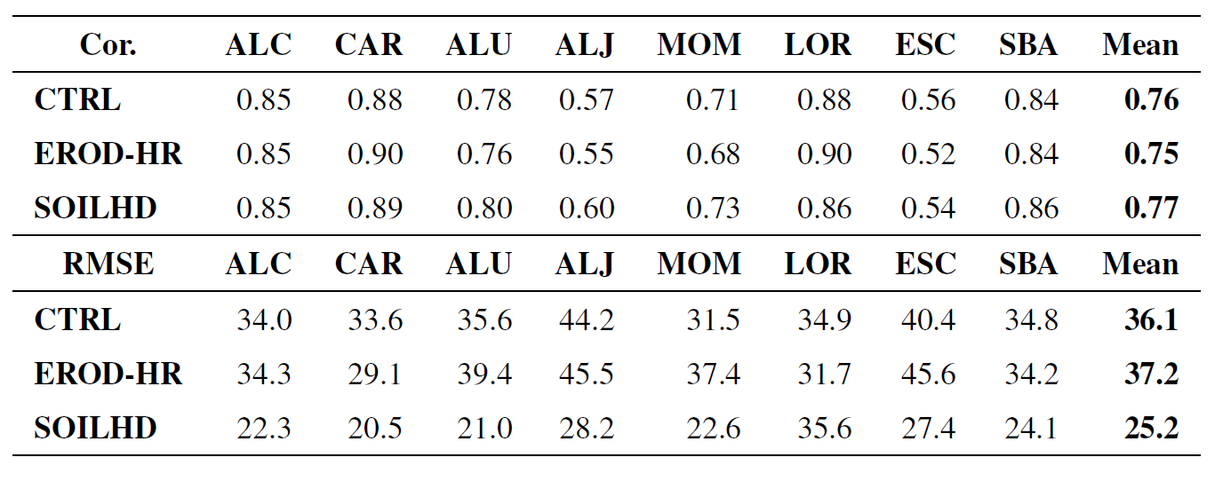
Want to see the stations?
Case 2022-08
Want to see the stats?
Best model?
Check the preprint!

Slide 27
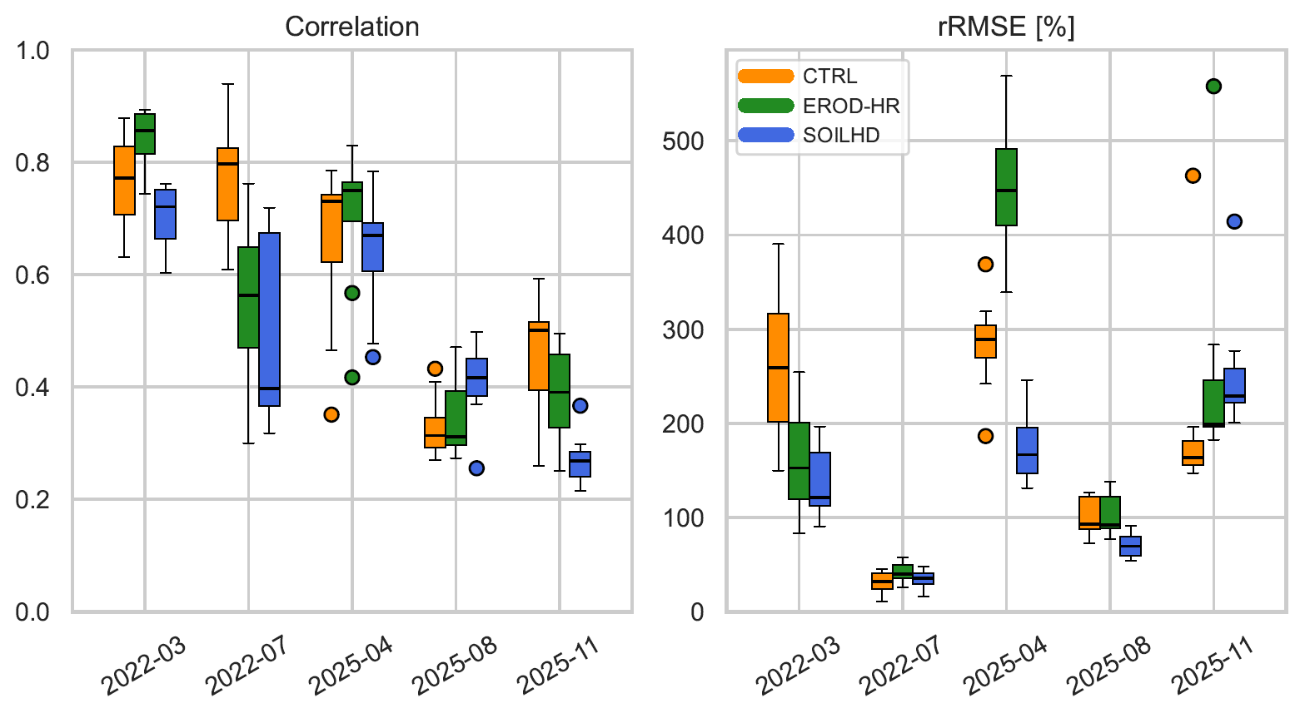
Want to see the stations?
Model performance
Want to see the stats?
Best model?
Check the preprint!
SOILHD achieves the highest correlation and lowest RMSE values in 80% of periods

Slide 28
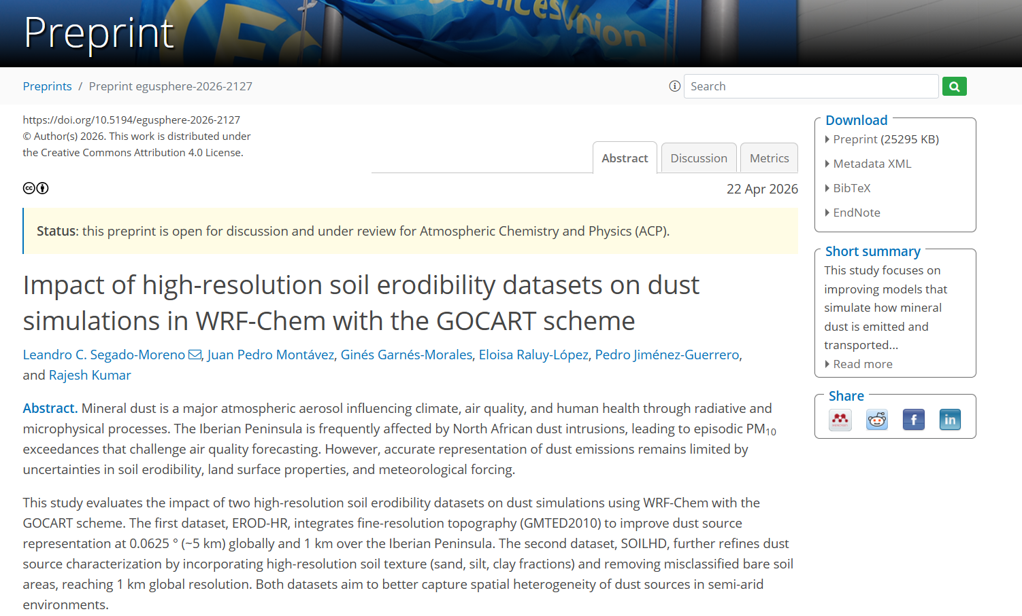

Check the preprint

Slide 29
References
Demuzere, M., Kittner, J., Martilli, A., Mills, G., Moede, C., Stewart, I. D., Van Vliet, J., and Bechtel, B.: A global map of Local Climate Zones to support earth system modelling and urban scale environmental science, Earth System Science Data Discussions, 2022, 1–57, https://doi.org/10.5194/essd-14-3835-2022
Ginoux, P., Chin, M., Tegen, I., Prospero, J. M., Holben, B., Dubovik, O., and Lin, S.-J.: Sources and distributions of dust aerosols simulated with the GOCART model, Journal of Geophysical Research: Atmospheres, 106, 20 255–20 273, https://doi.org/10.1029/2000JD000053, 2001.
Danielson, J. and Gesch, D.: Global multi-resolution terrain elevation data 2010 (GMTED2010), Tech. rep., U.S. Department of the Interior, https://doi.org/10.3133/ofr20111073 , 2011.
Friedl, M., McIver, D., Hodges, J., Zhang, X., Muchoney, D., Strahler, A., Woodcock, C., Gopal, S., Schneider, A., Cooper, A., Baccini, A., Gao, F., and Schaaf, C.: Global land cover mapping from MODIS: algorithms and early results, Remote Sensing of Environment, 83, 287–302, https://doi.org/10.1016/S0034-4257(02)00078-0 , the Moderate Resolution Imaging Spectroradiometer (MODIS): a new generationof Land Surface Monitoring, 2002.
Hengl, T., Mendes de Jesus, J., Heuvelink, G. B., Ruiperez Gonzalez, M., Kilibarda, M., Blagotic, A., Shangguan, W., Wright, M. N., Geng, X., Bauer-Marschallinger, B., et al.: SoilGrids250m: Global gridded soil information based on machine learning, PLoS one, 12, e0169 748, https://doi.org/10.1371/journal.pone.0169748, 2017.

