Slide 1
WBGeo: An Automated Framework for Geosystem Modeling with Advanced Mesh Generation Capabilities
Mauro Cacace¹, Marzieh Baes¹, Jan von Harten² , Alexander Lüpges³,
Denise Degen^{1,4}, Jan Niederau⁵, Tobias Rolf⁵ ,Magdalena Scheck-Wenderoth^{1,6},
Florian Wellmann², Bernhard Rumpe³, Nora Koltzer⁵, Simon Virgo⁷
(1) GFZ Helmholtz Centre for Geosciences, Potsdam, Germany
(2) Chair of Computational Geoscience, Geothermics and Reservoir Geophysics, RWTH Aachen University, Germany
(3) Software Engineering Department of Computer Science, RWTH Aachen University, Germany
(4) Institute of Applied Geosciences, Technische Universität Darmstadt, Germany
(5) Fraunhofer IEG, Fraunhofer Research Institution for Energy Infrastructures and Geotechnologies IEG, Germany
(6) Institute of Applied Geosciences, Technische Universität Berlin, Germany
(7) Terranigma Solutions GmbH

Slide 2
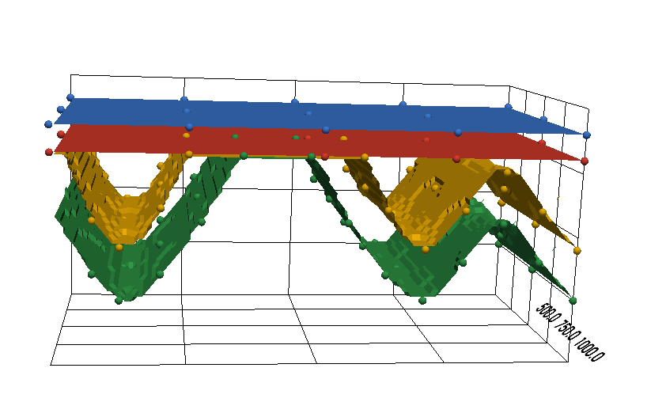
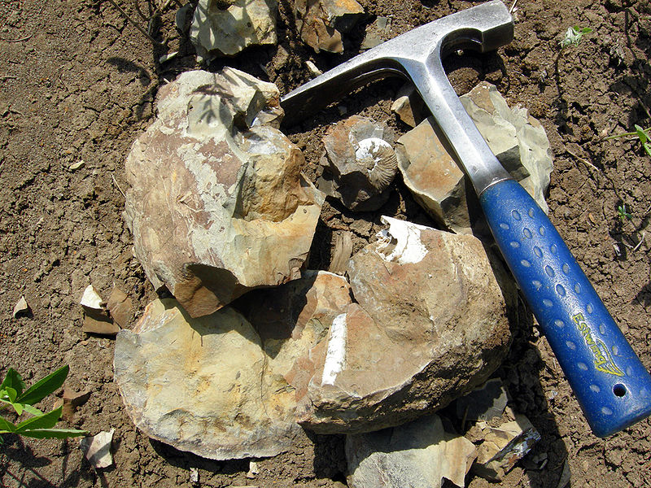
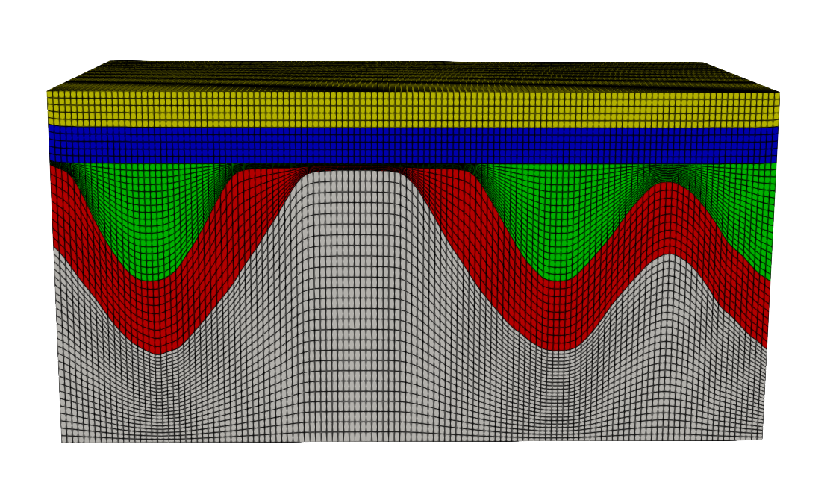
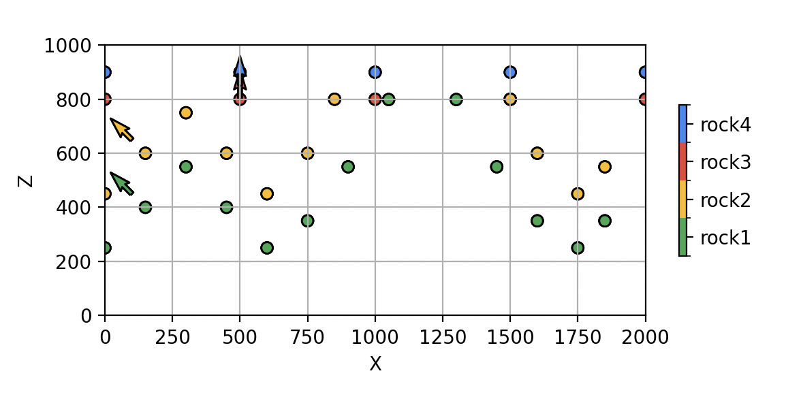


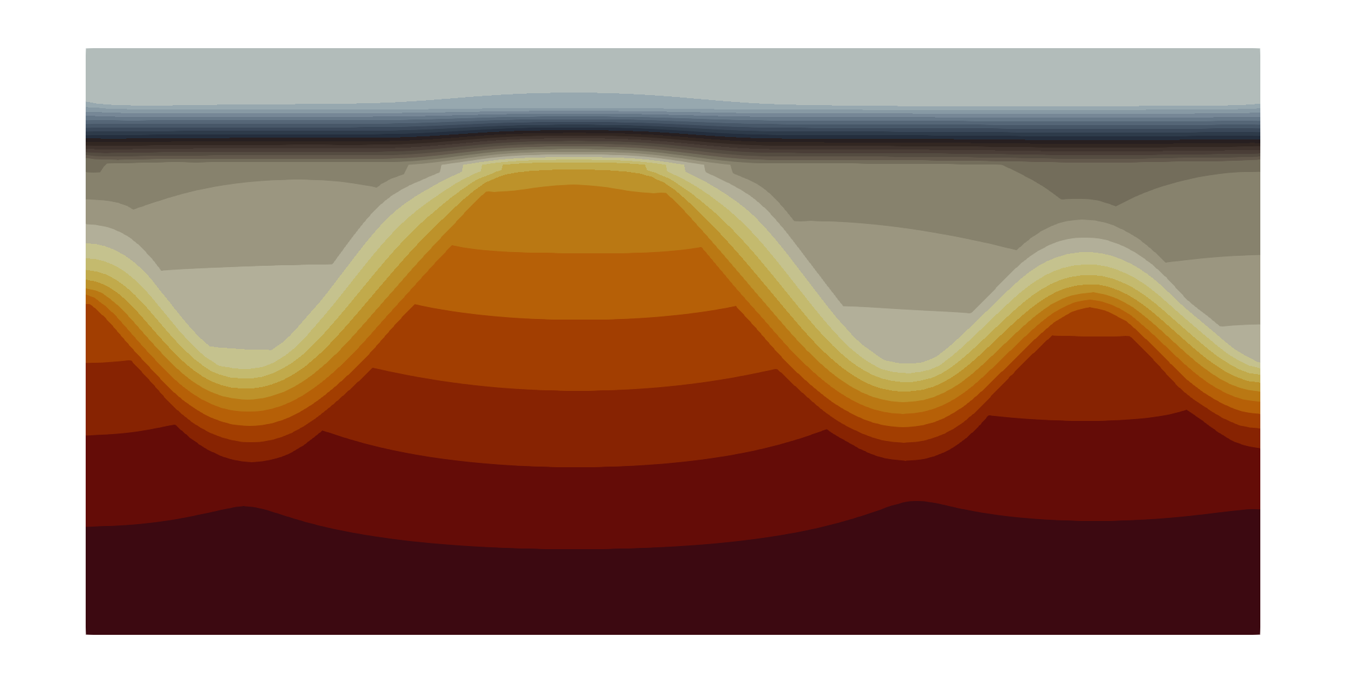

WBGeo (WorkBench for Digital Geosystem)
Automation
Poster | Wednesday, 06 May, 14:00–18:00 , Hall X4, X4.20
Von Harten, et. al: Integrating and comparing structural modeling methods within a digital workbench
Geological Data
Structural Modeling
Mesh Generating
FEFLOW
Visualization
Numerical Modeling

Slide 3
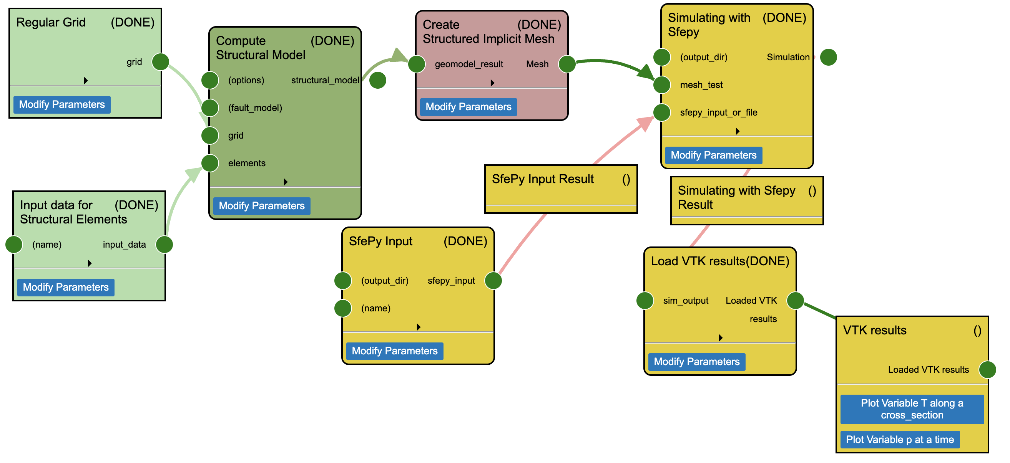

WBGeo (WorkBench for Digital Geosystem)
https://wbgeo-demo.cloud.luepg.es/gui/Home

Slide 4
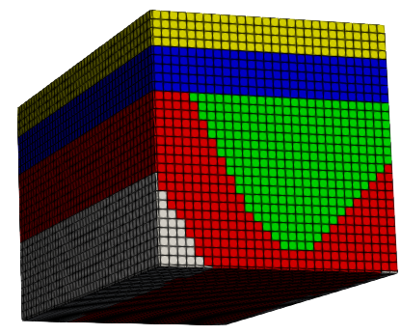
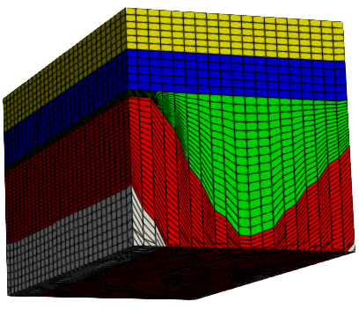
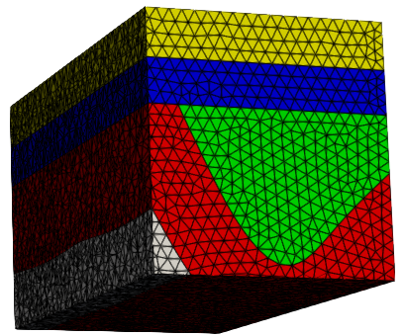
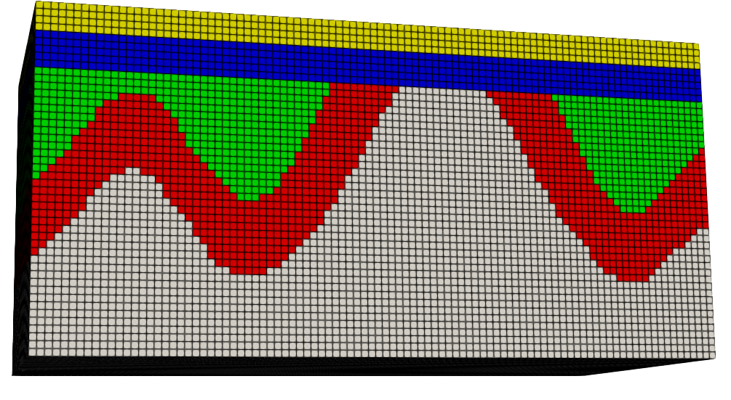
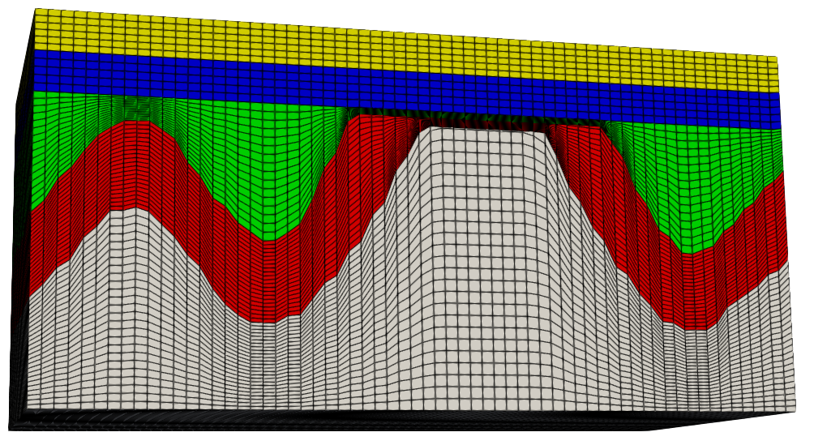
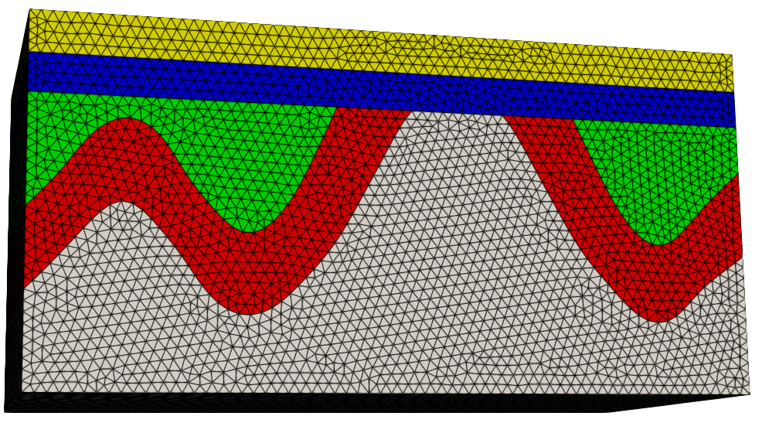
Meshing
Structured implicit mesh
Structured explicit mesh
Unstructured explicit mesh
(Obtained from structural modelling)
(Using a custom Python code)
(Using Gmsh Python API)

Slide 5
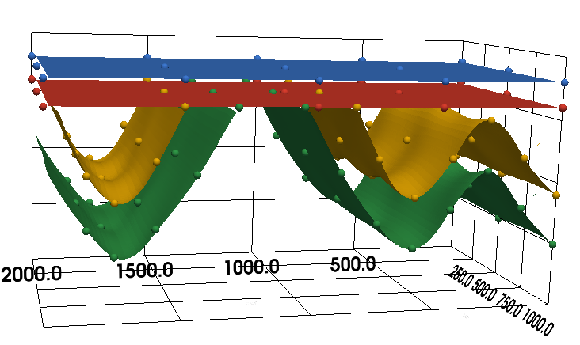
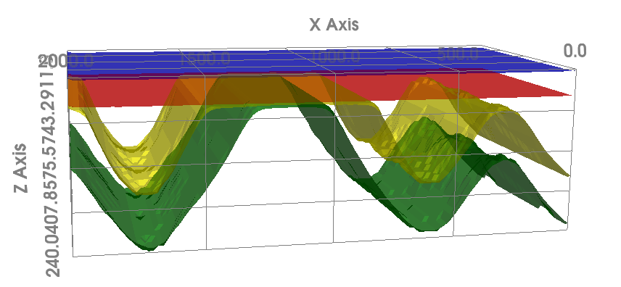
Structured Explicit Mesh
Step 1: organizing geological surface data into structured grids and
generating interpolated for all surfaces

Slide 6
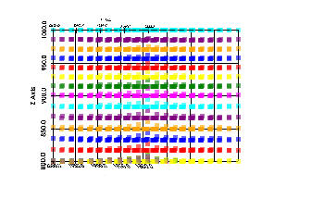
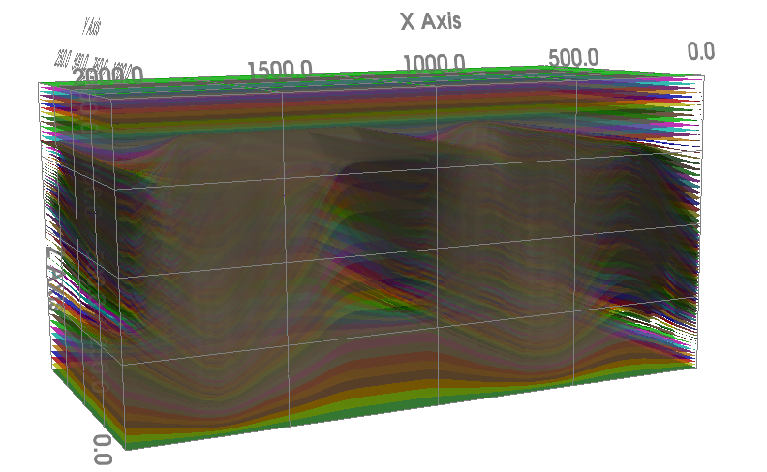
Structured Explicit Mesh
Step 2: Refinement of geological layers by
generating interpolated surfaces within each layer

Slide 7
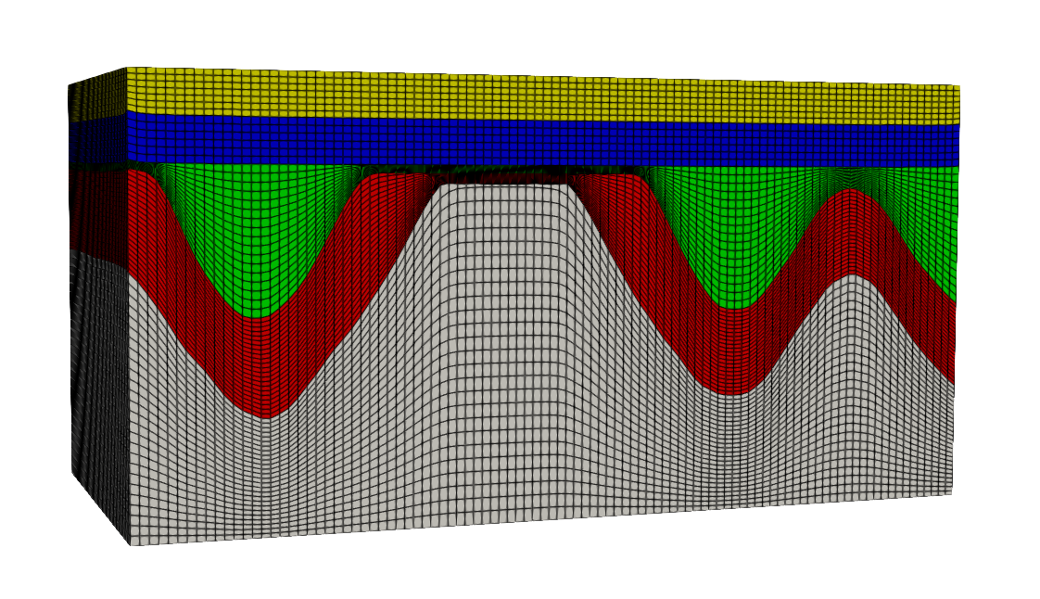
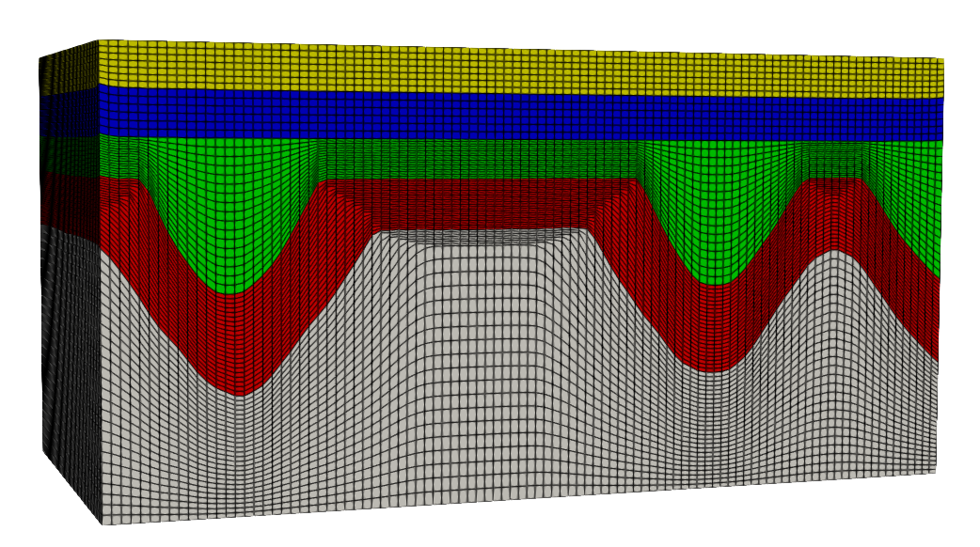
Structured Explicit Mesh
tolerance=1
tolerance=5
Step 3: Adjusting overlapping or very close layers and creating
hexahedral elements

Slide 8
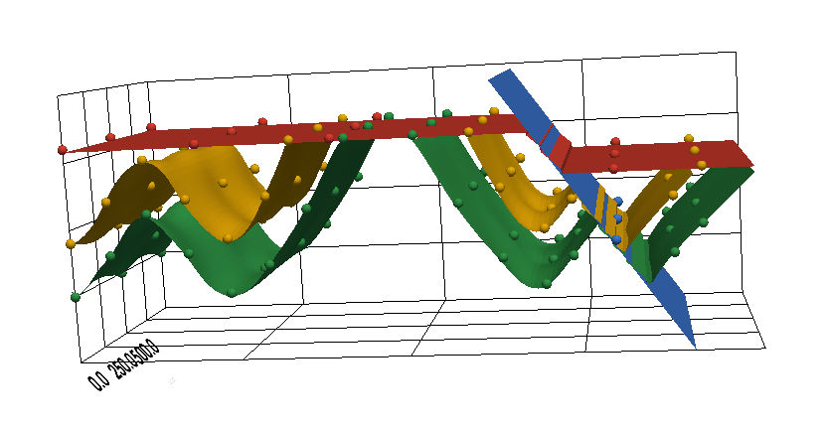
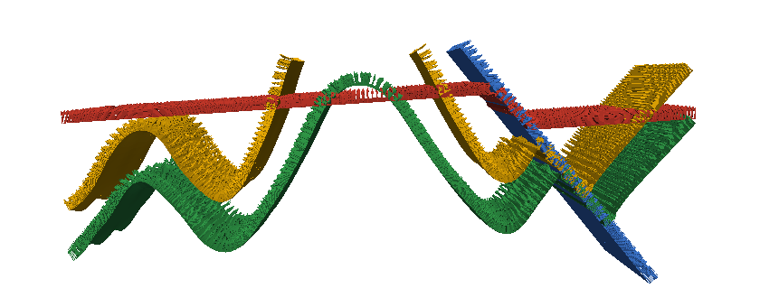
Unstructured Explicit Mesh
Overlapping areas
Step 1: Check for faults and, if present, remove overlapping areas,
cluster the disconnected parts and extrude them to cut the fault surfaces,
ensuring the data can be used to generate watertight meshes.

Slide 9
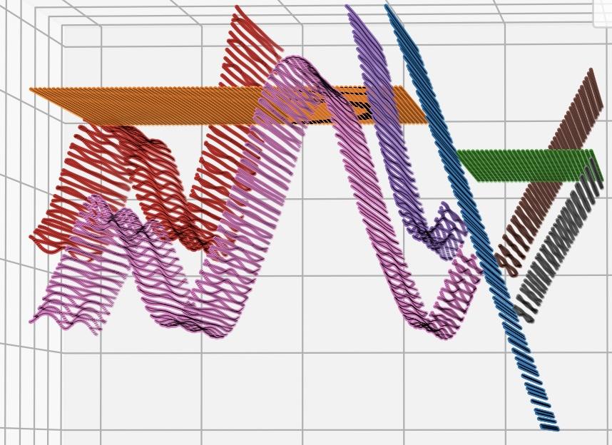
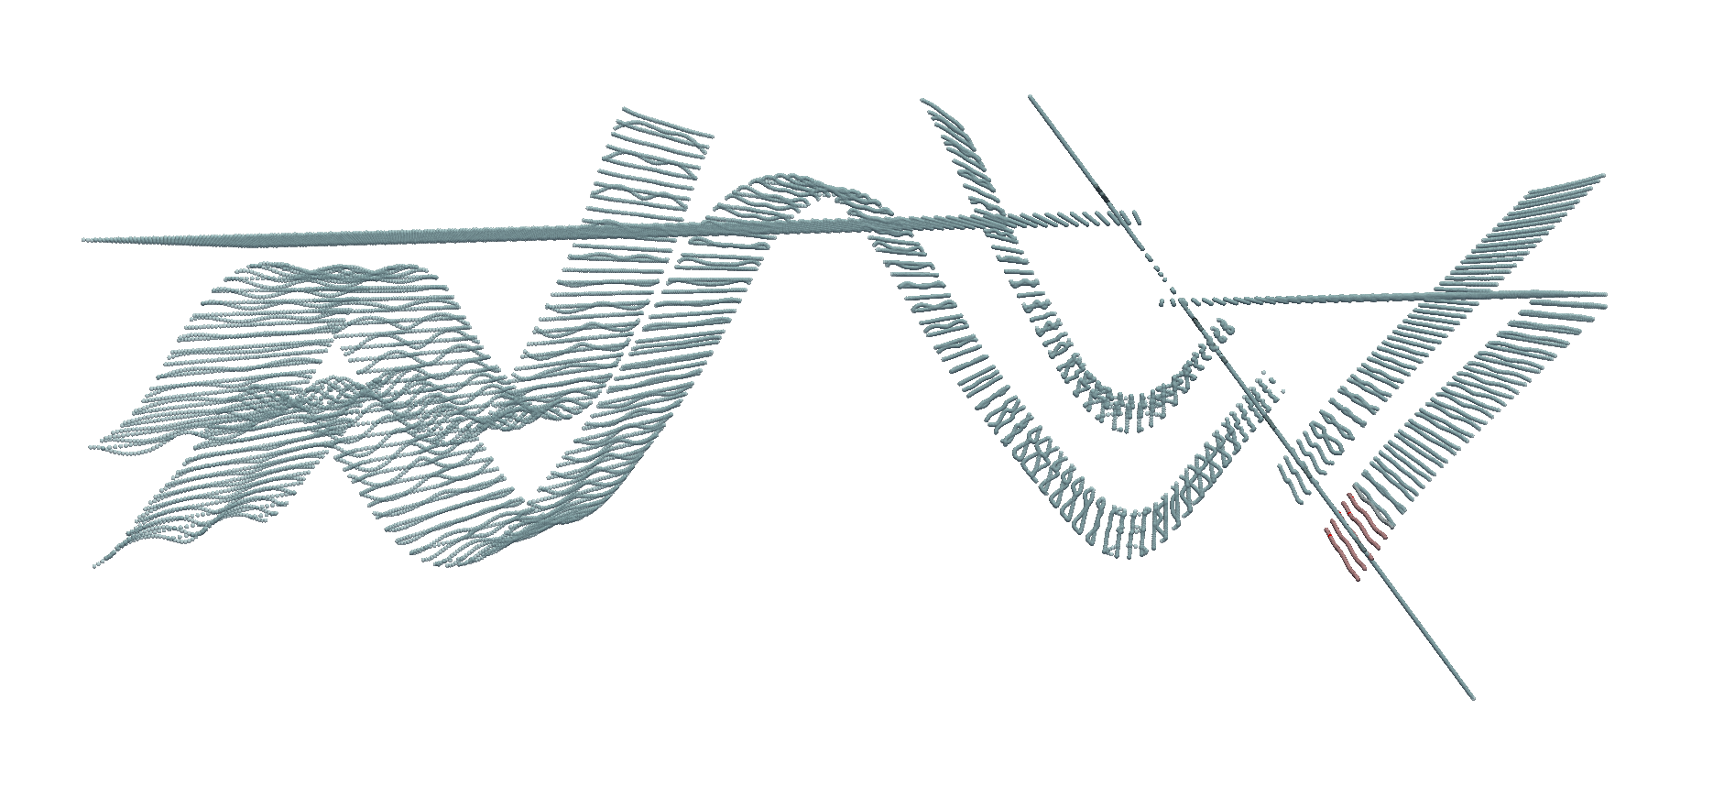
Unstructured Explicit Mesh

Slide 10
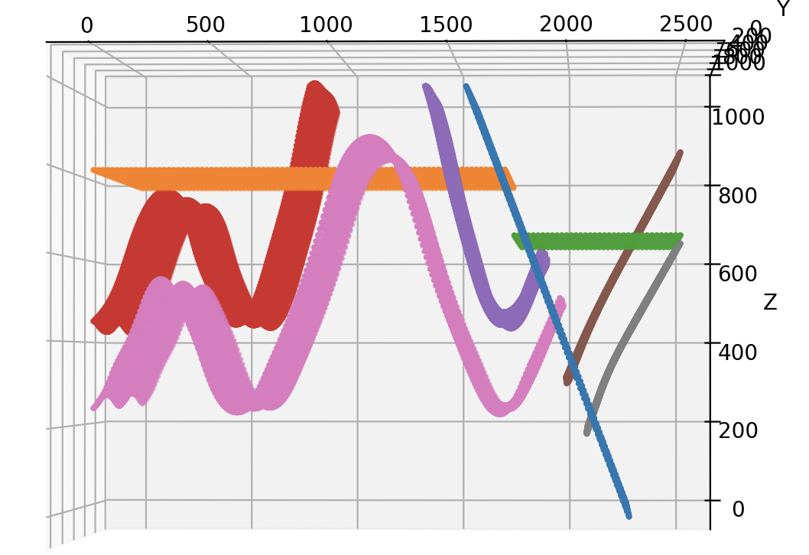
Unstructured Explicit Mesh
RBF interpolation followed by B-spline surface construction
Step 2: Organizing geological surface data into structured grids and
generating interpolated surfaces

Slide 11
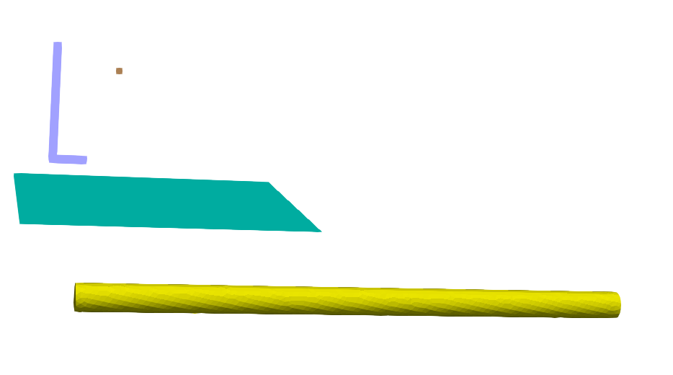


Unstructured Explicit Mesh
source points
wells as polylines
Ellipses
Triangulated surfaces
additional planar surfaces
mining shafts represented as cylinders
Step 3: Create wells, sour points, shafts, triangulated surfaces,
ellipses and extra planes

Slide 12
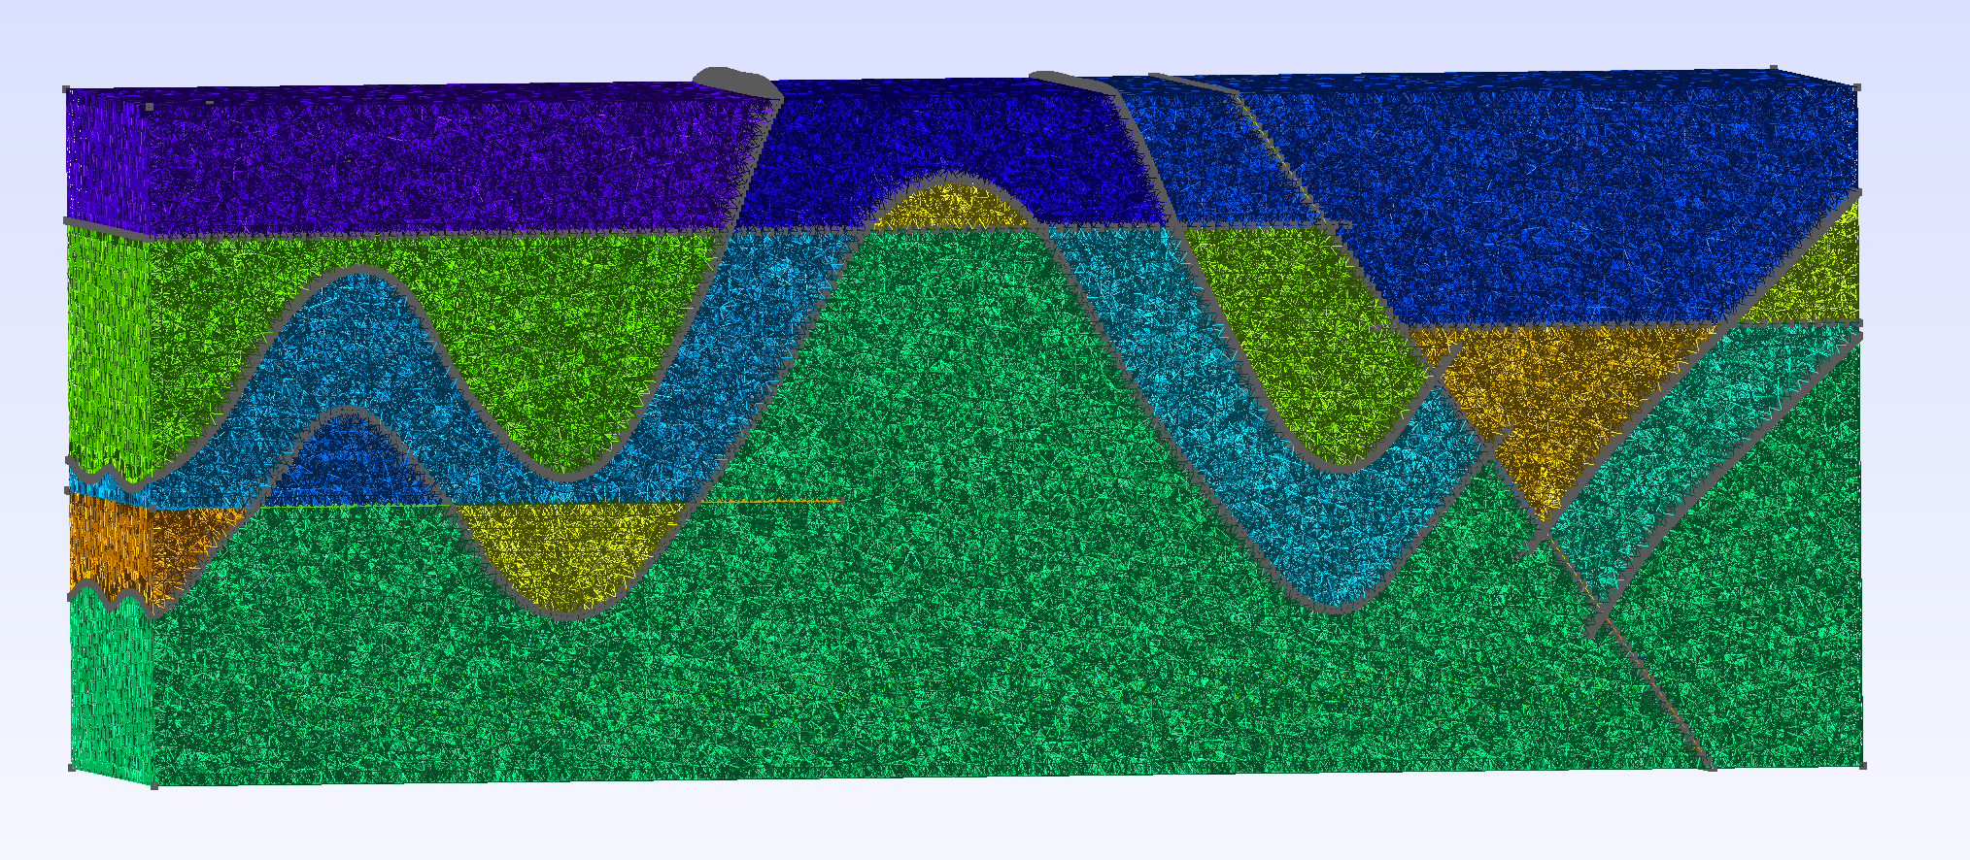
Unstructured Explicit Mesh
Step 4: Finding intersections between objects and fragmenting them

Slide 13
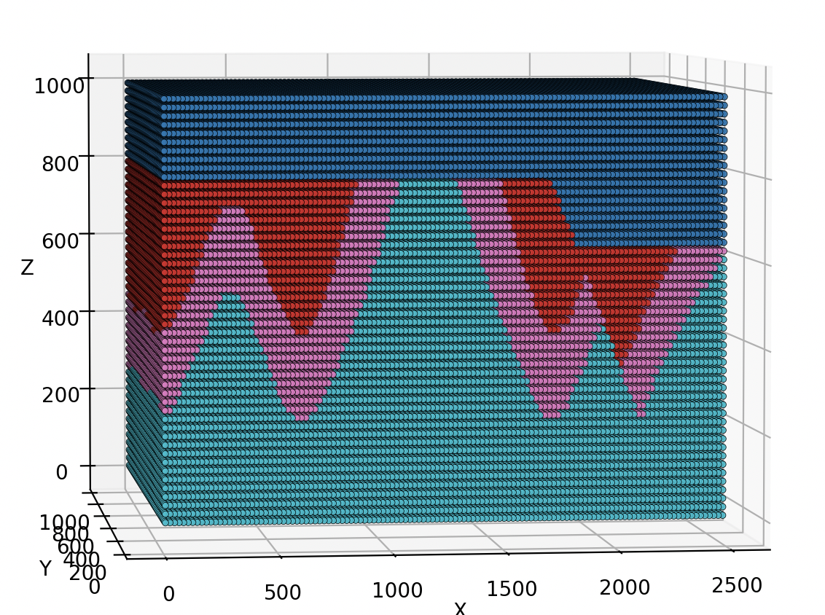
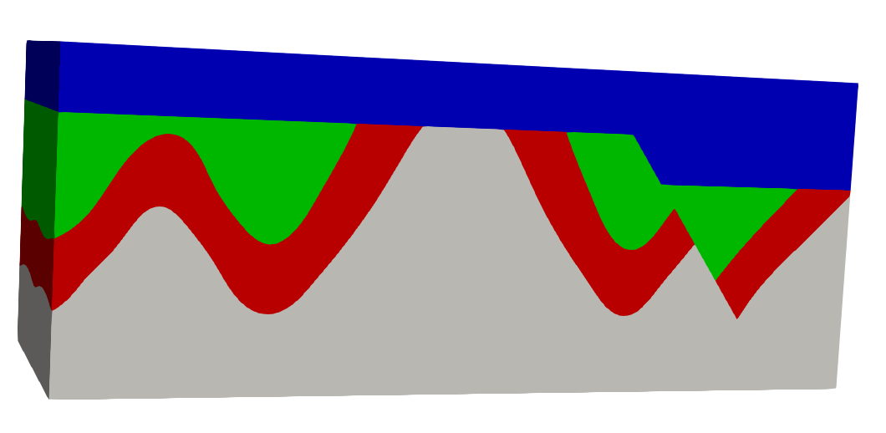
Unstructured Explicit Mesh
Step 5: Physical grouping of geological layers in GMSH

Slide 14
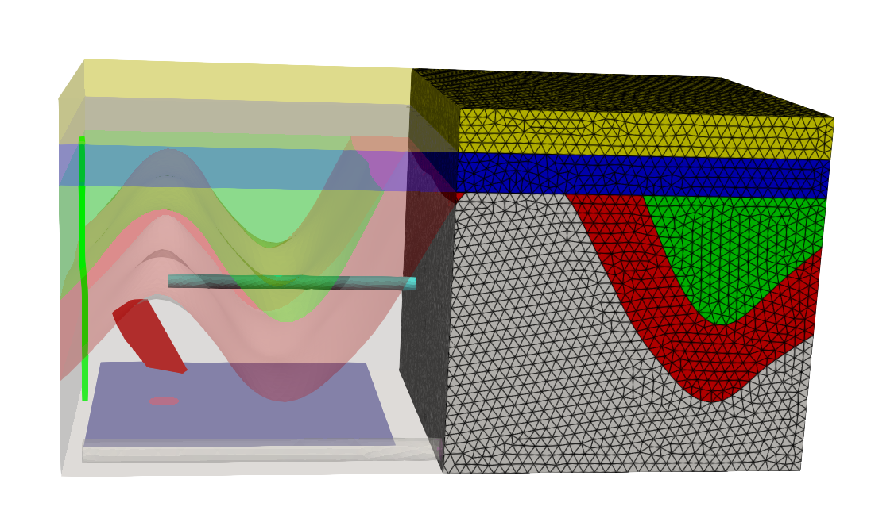
Unstructured Explicit Mesh
Step 6: Generate tetrahedral elements

Slide 15
Mesh Export
EXODUS (*.exo)
FEFLOW (*.fem)
ABAQUS (*.inp)
Mesh
Gmsh (*.msh)
ANSYS (*.msh)
VTU(*.vtu)
VTM (*.vtm)
VTK (*.vtk)

Slide 16


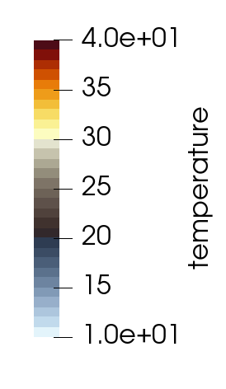
Mesh Validation
Structured implicit mesh
Structured explicit mesh
Unstructured explicit mesh

Slide 17
Summary
WBGeo: a modular workbench for geosystem modelling, enabling flexible workflow construction, transparent model building, and full reproducibility of simulations.
3 types of meshes: structured implicit mesh, structured explicit mesh, and unstructured explicit mesh.
Using the Gmsh API, unstructured explicit tetrahedral meshing can represent complex geometries and engineering objects (such as faults, wells, mining shafts, ellipses, irregular triangulated surfaces, and planar surfaces).
The generated meshes can be exported to different formats and used in various numerical simulation packages and back-end for online visualization.
Poster | Wednesday, 06 May, 14:00–18:00 , Hall X4, X4.20
Von Harten, et. al: Integrating and comparing structural modeling methods within a digital workbench
https://wbgeo-demo.cloud.luepg.es/gui/Home

Slide 18
Thank you for your attention.

