Slide 1
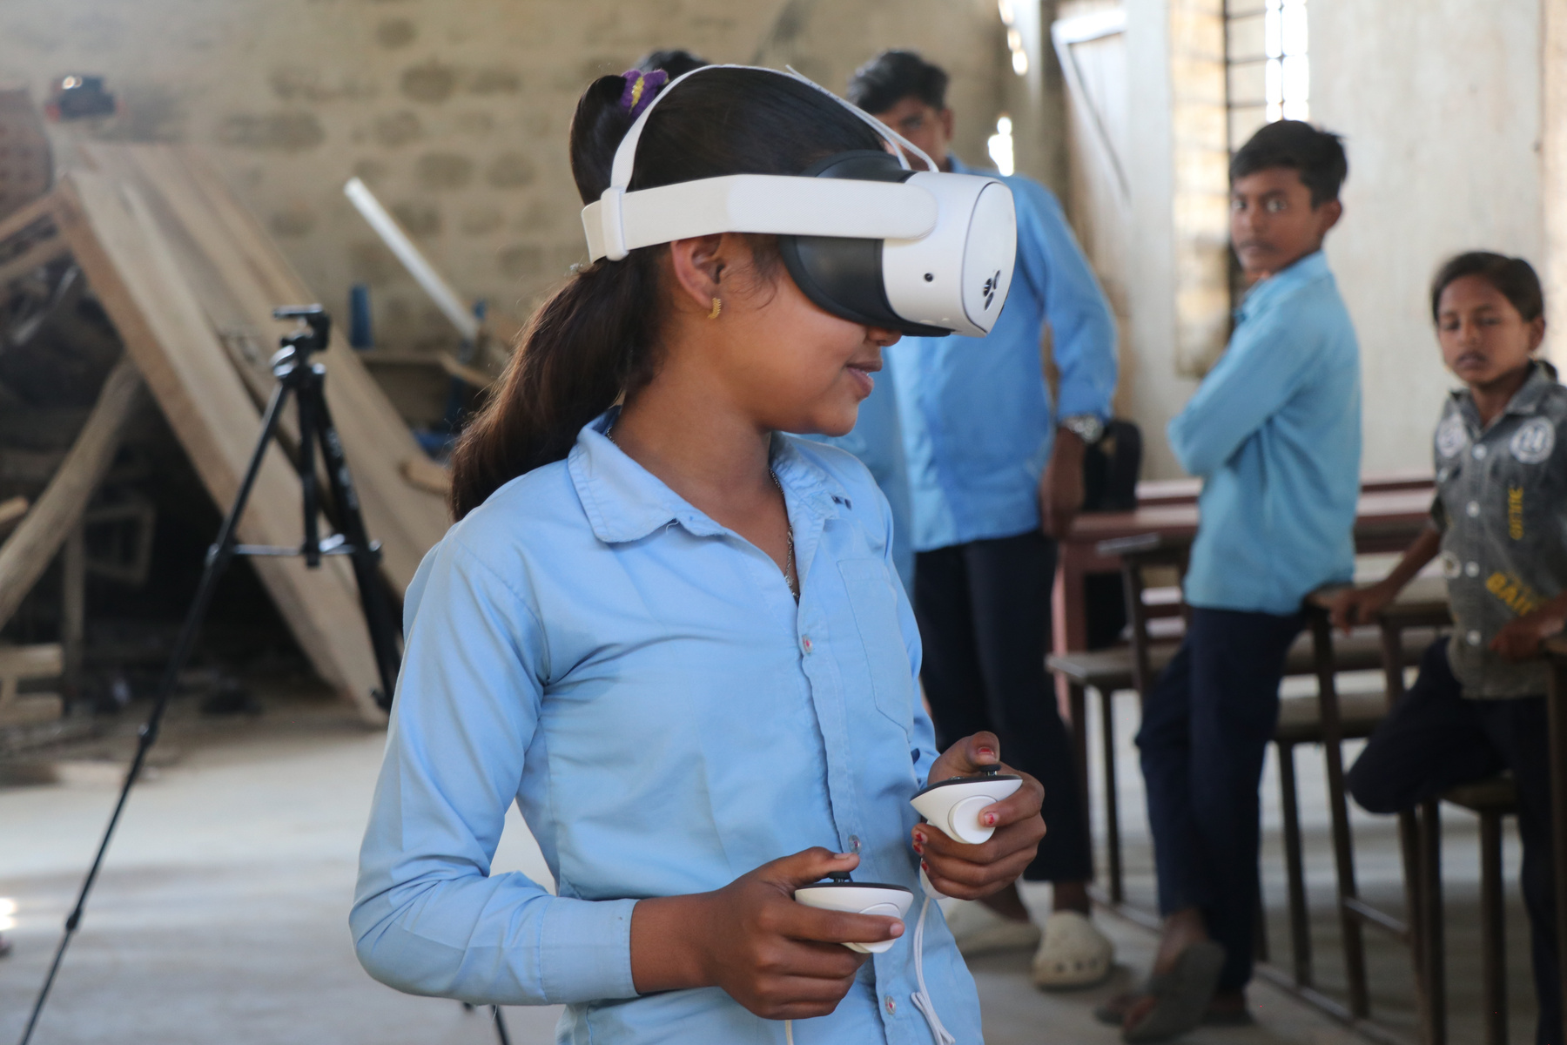

Enhancing Flood Preparedness Among Nepalese Students Using Immersive VR
Presented by
Binod Prasad Parajuli
8 May 2026

Slide 2
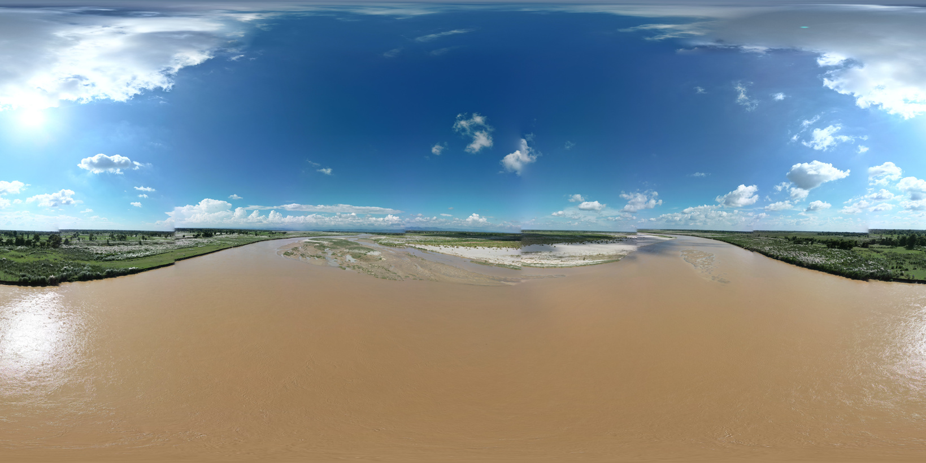
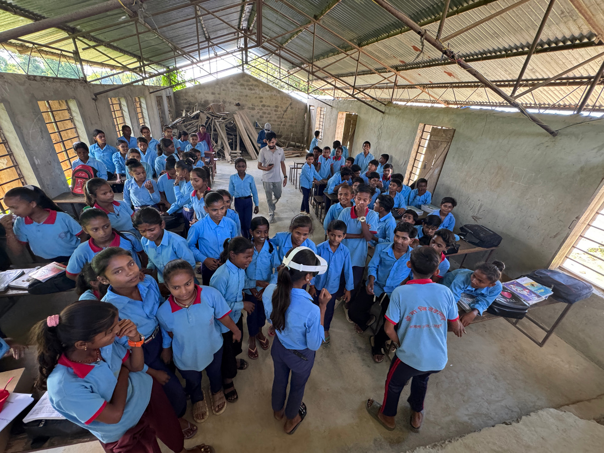
Impact
  Faster and more accurate risk assessment
  Improved early warning systems
  Enhanced decision-making and coordination
  Increased community awareness and preparedness
The Kamala River Basin in Nepal faces devastating monsoon floods annually, causing fatalities
The significant economic losses estimated at NPR 34.09 million between 2019-2025.
School communities in this region remain particularly vulnerable to repeated flood exposure.
Impact
  Faster and more accurate risk assessment
  Improved early warning systems
  Enhanced decision-making and coordination
  Increased community awareness and preparedness
  Despite awareness of flood risks, a critical gap persists between theoretical knowledge and actionable preparedness.
  Communities understand the dangers but lack practical skills to respond effectively during emergencies.
  This disconnect highlights the urgent need for innovative educational interventions that translate awareness into life-saving action.
Flood Risk in the
Kamala River Basin, Nepal

Slide 3
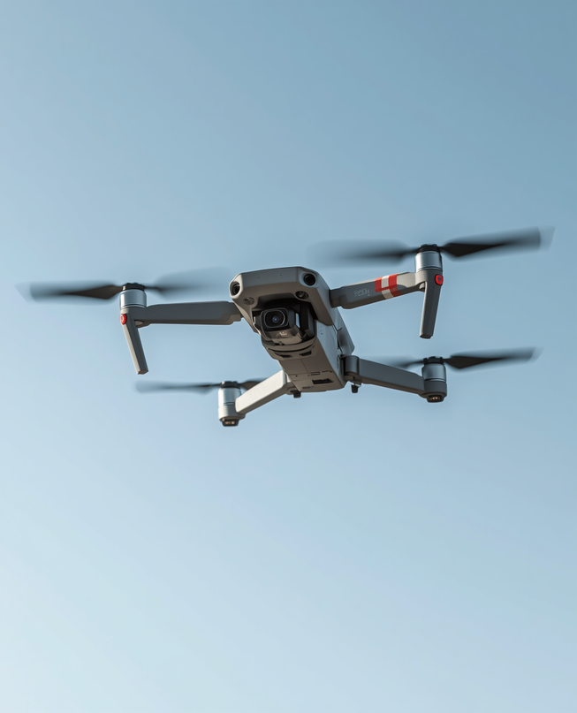
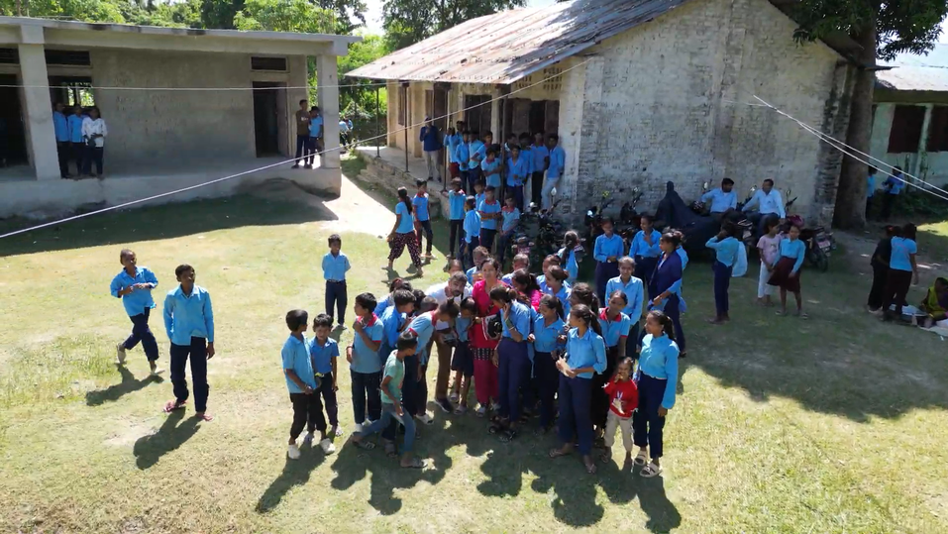
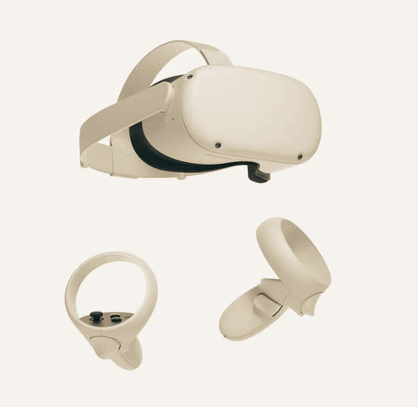
Study Site and Methodology Overview
Our methodology combined cutting-edge technologies:
  Drone-based aerial mapping using DJI Mini 3 Pro, producing high-resolution orthomosaic imagery and detailed 3D terrain models
  Unity3D-based VR simulation optimized specifically for Meta Quest 3 headsets
Impact
  Faster and more accurate risk assessment
  Improved early warning systems
  Enhanced decision-making and coordination
  Increased community awareness and preparedness
  The study was conducted at Shree Secondary School in the Kamala River Basin, Nepal, a community repeatedly affected by monsoon flooding and an ideal setting for testing VR-based disaster preparedness interventions.

Slide 4
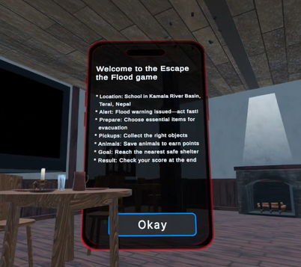
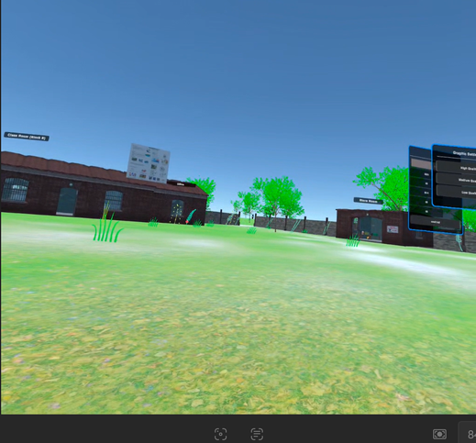
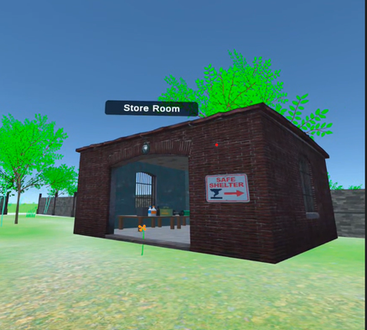
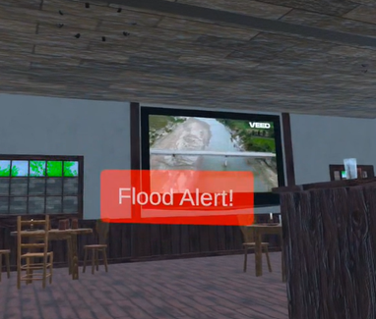
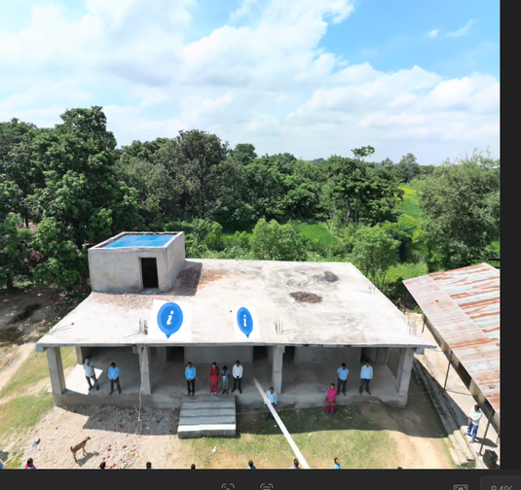
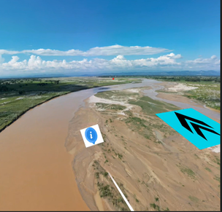
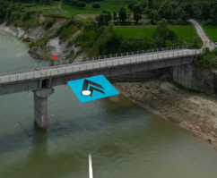
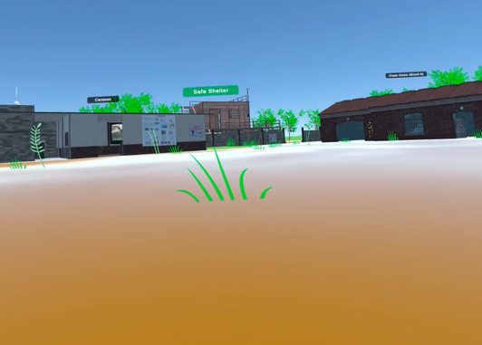
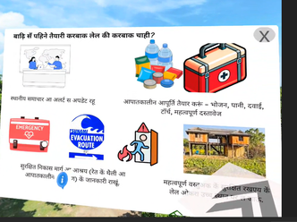
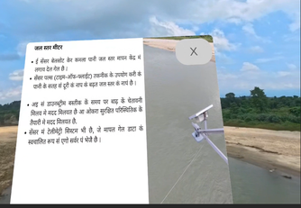
VR Intervention Modules
Module 1: Kamala River Virtual Tour
An immersive 360° interactive experience allowing students to explore:
  School and surrounding environment
  Kamala River and its flood-prone areas
  Local hydrometeorological monitoring stations
  Key landmarks and evacuation routes
Students navigate freely through realistic virtual scenes, building spatial awareness of their community's flood risk landscape.
Module 2: Escape the Flood
A 5-minute gamified flood simulation featuring:
  Dynamically rising floodwaters requiring quick decisions
  Immersive spatial audio with emergency sirens
  TV news alerts broadcasting evacuation warnings
  Time-pressure scenarios, testing preparedness skills
Students experience realistic flood conditions and practice emergency response in a safe virtual environment.

Slide 5
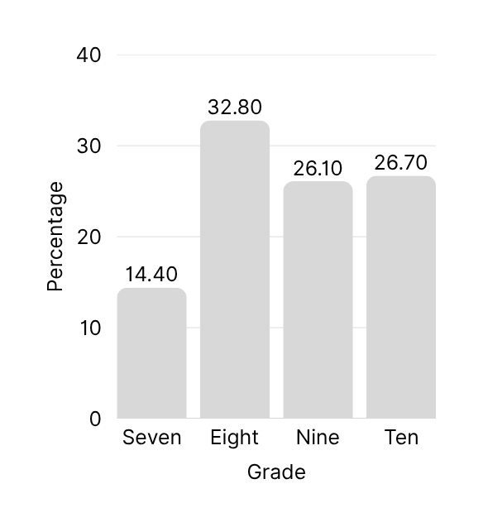



Study Design and
Participant Demographics
Quasi-experimental pre-post design with 180 students from grades 7-10 (aged 12-16). Baseline survey two months before VR intervention.
63.9%
Over 90% had no prior disaster education. Limited previous VR exposure among participants. Prior flood experience common.
5.0 %
28.3 %
11 to 12
Age Group
13 to 15
66.7 %
16 to 17

Slide 6
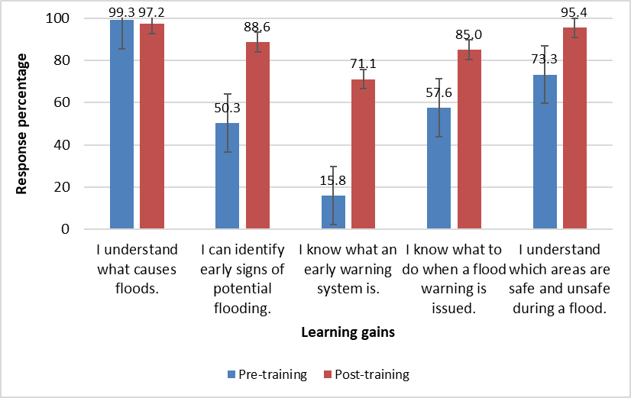
Key Results
Significant Knowledge Gains Post-Intervention
Early Warning System Awareness:
Dramatic increase from 15.8% to 71.1% (p < 0.001, effect size 0.41). Students demonstrated substantially improved understanding of how to receive and respond to official flood warnings.
Safe Area Recognition:
Significant improvement in students' ability to identify safe evacuation locations (p < 0.001). Knowledge of flood causes remained high due to ceiling effect from baseline.
Flood Signs Identification:
Recognition of early flood indicators improved from 50.3% to 88.6% (p < 0.001, effect size 0.21). Students gained practical skills to identify warning signs before official alerts are issued.
Understanding of flood causes remained consistently high with no meaningful change.

Slide 7
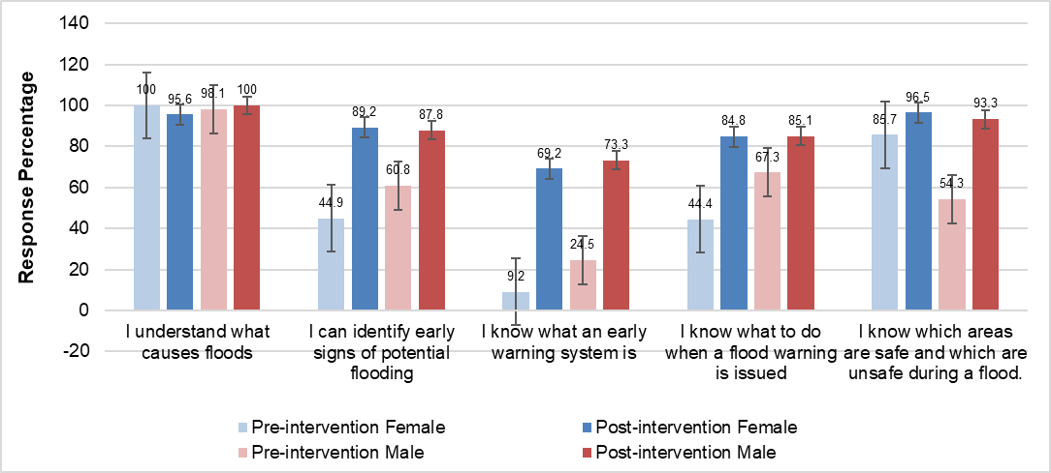
01
Female students showed remarkable improvement in early warning system awareness, jumping from 9.2% to 69.2% (+60%). They also demonstrated significant gains in flood warning actions with a +40.4% increase post-intervention.
02
Male students increased early warning system awareness from 24.5% to 73.6% (+48.8%). Both genders achieved similar post-intervention awareness levels, demonstrating VR's effectiveness across demographics.
Gender-Disaggregated Knowledge Gains
03
Males showed strongest improvement in safe area identification with +39.0% gain. While females led in warning action improvements (+40.4% vs +17.8%), both groups benefited significantly from the immersive VR intervention.

Slide 8
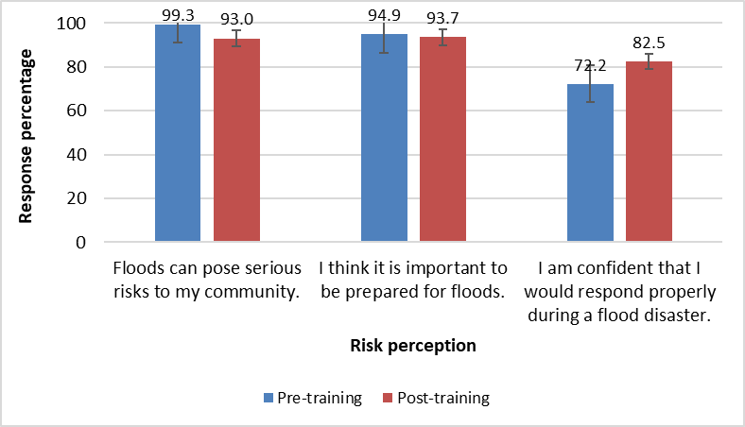
Changes in Risk Perception and Preparedness Behavior
Risk perception & preparedness:
Flood risk perception and preparedness were already very high and largely unchanged (risk: 93.3%→93.0%, statistically significant but negligible effect; preparedness: 94.9%→93.7%, no significant change), suggesting a ceiling effect.
Confidence to respond:
Confidence to respond to floods increased from 72.2% to 82.5%, indicating improved self-efficacy, though the change is not statistically significant.

Slide 9
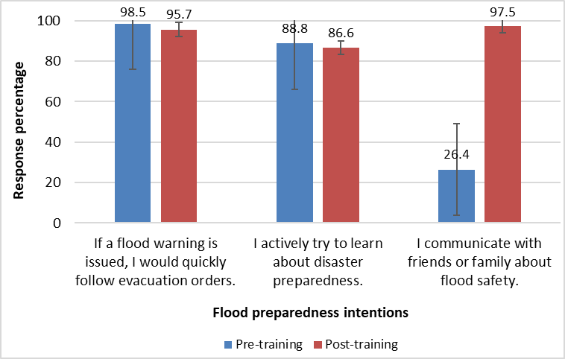
Behavioral Indicators
Communication and proactiveness metrics reveal strong behavioral engagement with flood preparedness following VR intervention, with particularly notable gains among female students.
Evacuation & learning:
Behavioral intentions were already high and showed minimal change (evacuation: 98.5%→95.7%; learning: 88.8%→86.6%, not statistically significant), indicating a ceiling effect.
Communication behavior
Both male and female students demonstrated significant gains in communication behavior, increasing from 73.1% to 100% for female and 74.1% to 94.3% for male, with a statistically significant and moderate effect, highlighting strong gains in peer/family engagement.

Slide 10
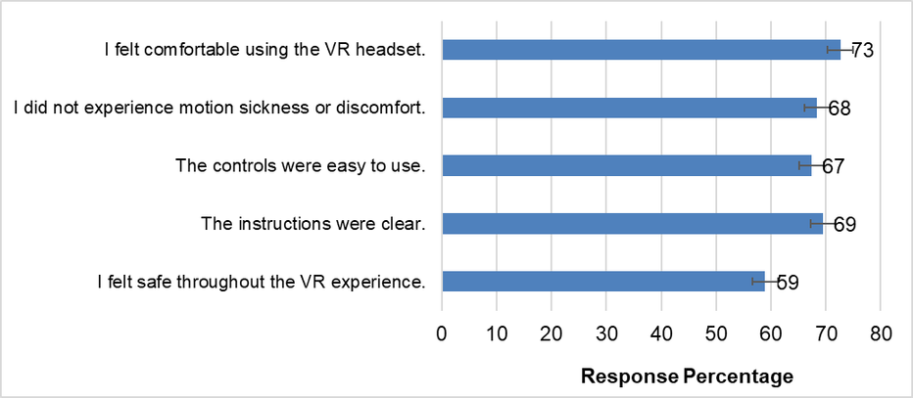
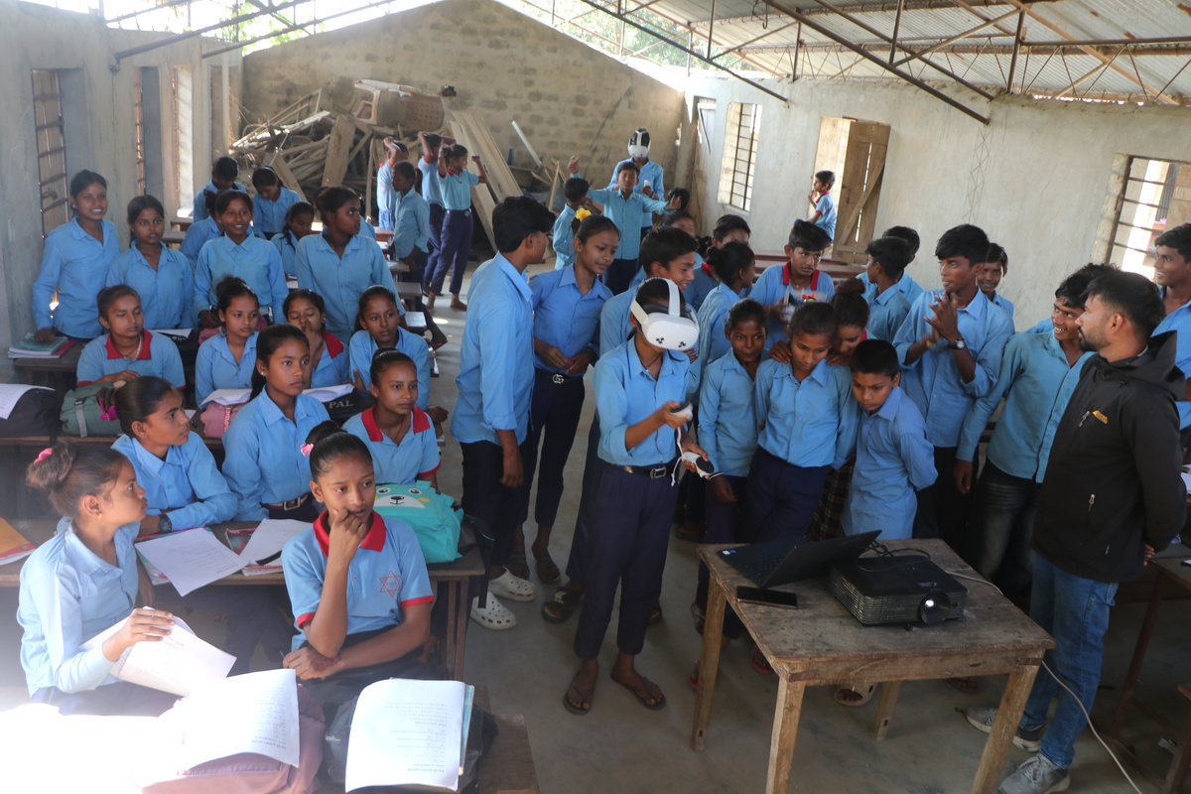
User Experience
and Acceptance of VR
Perception & engagement
  66% of students agreed that VR helps them learn about floods more effectively.
  59% expressed a preference for interactive tools over traditional lectures and videos, indicating strong acceptance of immersive learning approaches.56% of participants reported feeling excited to use VR technology.
  Among older students in Grades 9-10, 73% felt comfortable using the VR headset and 68% experienced no motion sickness during the simulation.
Challenges
  Key challenges emerged among younger students: language barriers (Maithili dialect) and comprehension difficulties affected response rates and engagement. These factors contributed to higher missing data in younger age groups.

Slide 11
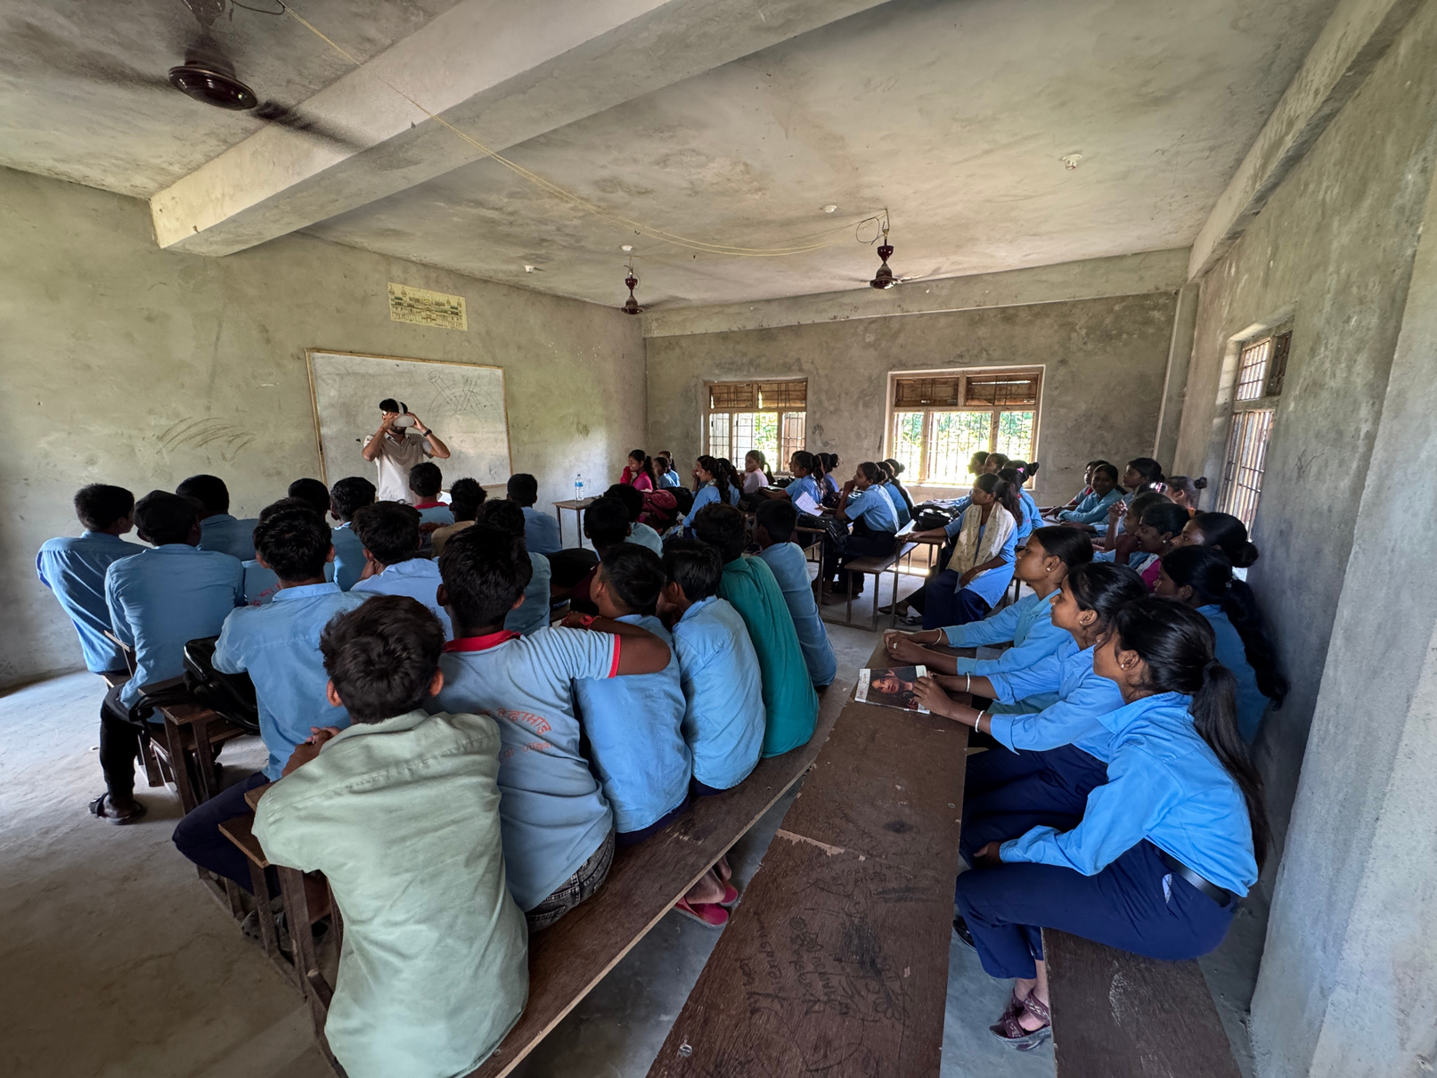
Study Limitations
  No control group limits causal inference—observed improvements cannot be definitively attributed to VR intervention alone. Single school setting (Shree Secondary School) restricts generalizability to other regions and educational contexts.
  High missing data due to language barriers (Maithili dialect) and comprehension challenges among younger students affected response rates and statistical power. All outcome measures were self-reported without objective behavioral assessments.
  No long-term follow-up to assess knowledge retention or real-life behavioral changes over time. Results may be influenced by social desirability bias and novelty effects associated with first-time VR exposure.

Slide 12
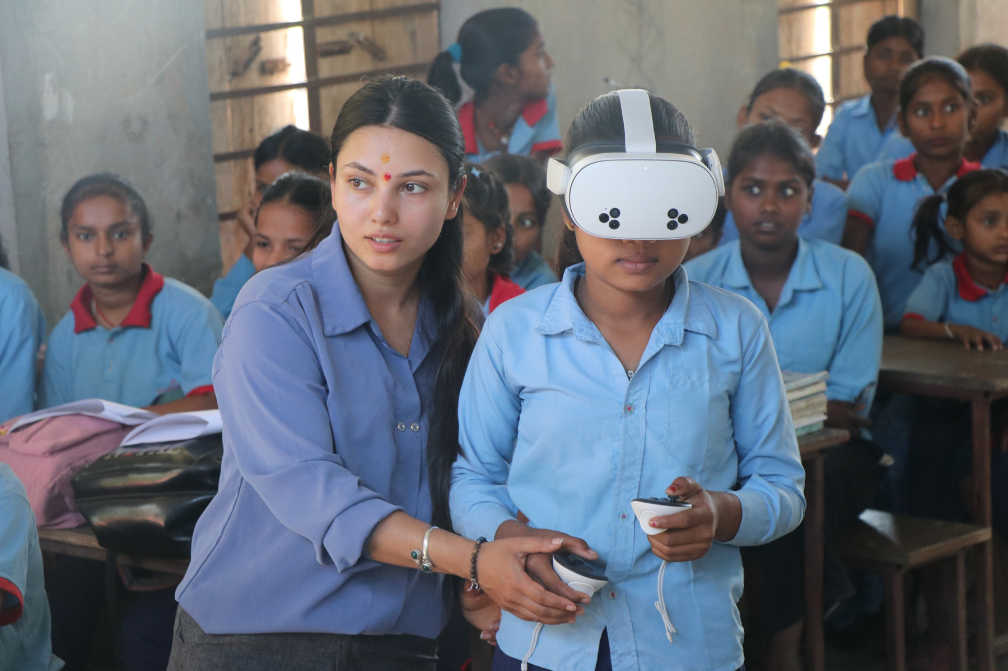
Conclusions and Implications
Immersive, context-specific VR significantly enhances practical flood preparedness, especially situational judgment, spatial understanding, and translating early warnings into action, while also improving communication and collective preparedness.
Limited changes in perception/ behavior and methodological constraints highlight the need for longitudinal, controlled, and multi-site studies, including real-world behavior tracking to assess long-term impact.
VR is a promising experiential learning tool with potential for broader application in disaster education. Further research is needed on long-term knowledge retention, real-life behavioral impacts, and scalability across diverse contexts.

Slide 13
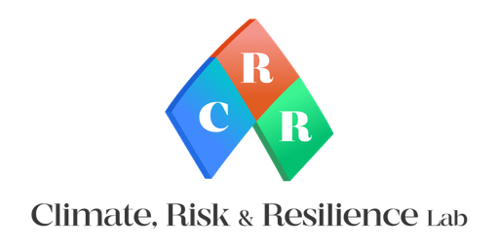
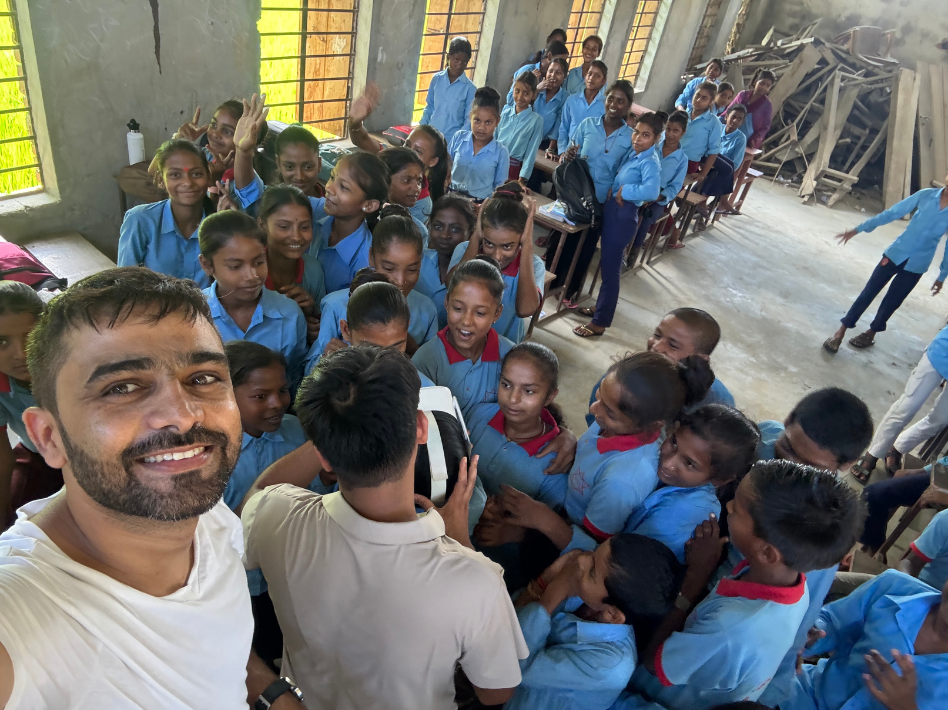



Thank You !!!
Any Questions ?
+977-9851228569
binod.parajuli@crrlab.com / binodpparajuli@gmail.com
Connect With Me
www.crrlab.com
Kathmandu, Nepal

