Slide 1
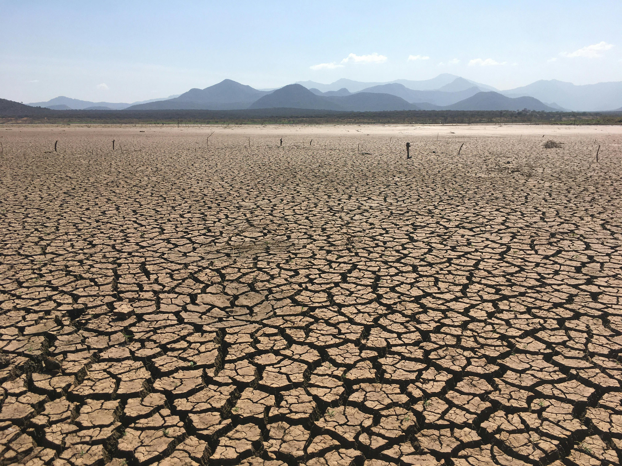



“Integration of stochastic and statistical approaches for drought risk estimation
through long-length time series”
Photo by Kiptoo Addi, via Pexels (https://www.pexels.com/el-gr/photo/14924252/)
Sofia Efraimia Vrettou¹, Demetris Koutsoyiannis², Panayiotis Dimitriadis², Theano Iliopoulou² and Alberto Montanari¹
¹Department of Civil, Chemical, Environmental and Materials Engineering (DICAM), Alma Mater Studiorum – University of Bologna, Bologna, Italy
²Department of Water Resources and Environmental Engineering, School of Civil Engineering, National Technical University of Athens (NTUA), Athens, Greece

Slide 2



“Integration of stochastic and statistical approaches for drought risk estimation through long-length time series”
Sofia Efraimia Vrettou¹, Demetris Koutsoyiannis², Panayiotis Dimitriadis², Theano Iliopoulou² and Alberto Montanari¹
Introduction:
Droughts are among the most impactful and costly natural hazard-related disasters.
Need for better understanding of the drivers and their underlying mechanisms leading to the droughts, mitigate impacts create resilient societies.
Stochastic models simulate the natural variability of the natural processes.
Scope of work:
Focus on the meteorological droughts → study of precipitation patterns
Specify the multi-year drought characteristics through the application of stochastic models
Methodology- Novelty:
Use as a case study the precipitation time series of Bologna, Italy.
Suggest a framework of integration of two different stochastic models applied in daily and annual time scales.
Apply Monte Carlo simulation approach.
Specify the multi-year drought characteristics: drought intensity, duration, frequency and maximum deficit through the application of run theory.
¹Department of Civil, Chemical, Environmental and Materials Engineering (DICAM), Alma Mater Studiorum – University of Bologna, Bologna, Italy
²Department of Water Resources and Environmental Engineering, School of Civil Engineering, National Technical University of Athens (NTUA), Athens, Greece

Slide 3

Thank you for your attention!
For results: PICO spot A.7
Acknowledgement: This study was carried out within the RETURN Extended Partnership and received funding from the European Union Next-Generation EU (National Recovery and Resilience Plan – NRRP, Mission 4, Component 2, Investment 1.3 – D.D. 1243 2/8/2022, PE0000005)

Slide 4



“Integration of stochastic and statistical approaches for drought risk estimation
through long-length time series”
Sofia Efraimia Vrettou¹, Demetris Koutsoyiannis², Panayiotis Dimitriadis², Theano Iliopoulou² and Alberto Montanari¹
Photo by Kiptoo Addi, via Pexels (https://www.pexels.com/el-gr/photo/14924252/)
Introduction
Objectives
Methodology
Theoretical background
Results
Run theory
ARFIMA model
CoSMoS model
¹Department of Civil, Chemical, Environmental and Materials Engineering (DICAM), Alma Mater Studiorum – University of Bologna, Bologna, Italy
²Department of Water Resources and Environmental Engineering, School of Civil Engineering, National Technical University of Athens (NTUA), Athens, Greece
Acknowledgement: This study was carried out within the RETURN Extended Partnership and received funding from the European Union Next-Generation EU (National Recovery and Resilience Plan – NRRP, Mission 4, Component 2, Investment 1.3 – D.D. 1243 2/8/2022, PE0000005)

Slide 5
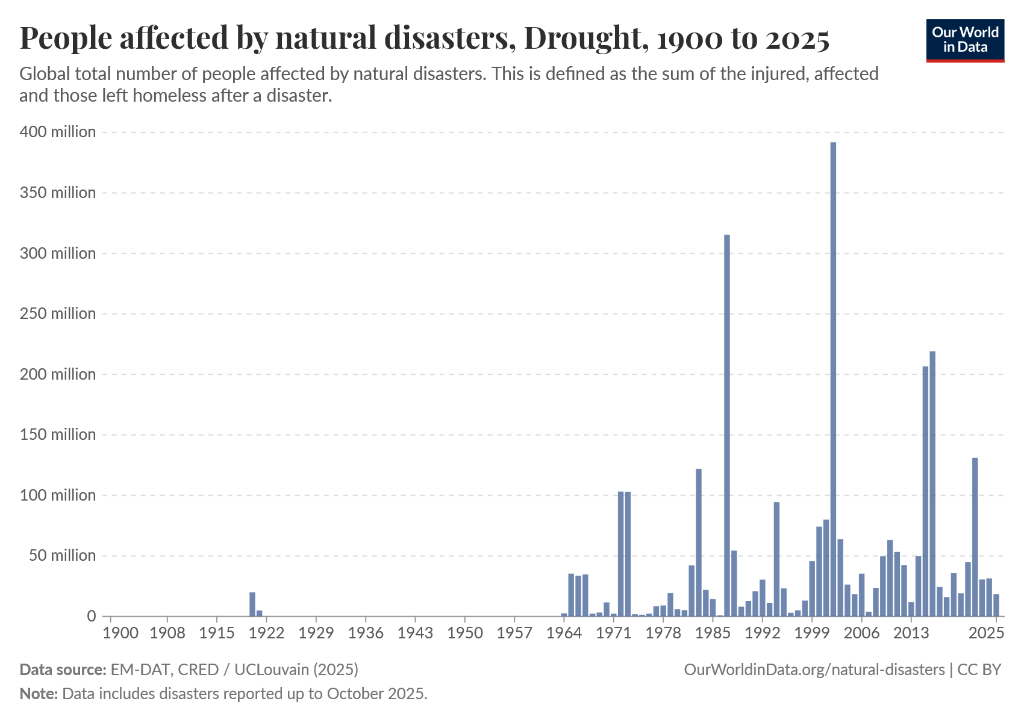




Droughts are among the most intense and impactful natural-hazard related disasters (IPCC, 2021; CRED, 2025).
In 2025 18.4 million people were affected* by drought phenomena (the natural disaster that affected the most people in 2025).
Droughts are characterized as “creeping disasters” because it is difficult to specify those onset, termination, extend and potential impact.
To limit the impacts and create resilient societies we need to study the drivers that lead to droughts and estimate their uncertainty.
*Affected people are those requiring immediate assistance due to the disaster.
“Integration of stochastic and statistical approaches for drought risk estimation through long-length time series”

Slide 6

Stochastic models are capable of capturing and simulating the inherent uncertainty and variability of natural hydroclimatic processes.
They enable the generation of ensembles of synthetic time series that reproduce the statistical characteristics of the observation record.
Through the generation of a synthetic and arbitrarily long time series provide valuable insights into the likelihood of occurrence of the natural process of interest.
Application of advanced stochastic methods pave the way for drought risk awareness and early detection systems like drought monitoring, which can provide societies with evidence for drought anticipation.
By incorporating a stochastic modeling approach, the inherent surprise factor of these natural phenomena could be significantly reduced, allowing policymakers to adopt more efficient mitigation strategies.
A key research challenge remains in the selection of the appropriate stochastic model and the amount of information required to optimize their performance in estimating the probability of occurrence of rare events. In particular, classical simulation models often underestimate the risk associated to multi-year droughts (Guo and Montanari, 2023).
“Integration of stochastic and statistical approaches for drought risk estimation through long-length time series”

Slide 7
We focus on the study of the meteorological droughts as the initial step of drought propagation.
Study precipitation time series, define precipitation patterns.
The scope of the study is to:
Improve the estimation of multi-year drought characteristics (drought frequency, intensity, duration, and maximum deficit percentage) applying the well-established run theory throught the implementation of stochastic models.
Propose an integrated framework of stochastic models that simulate short term variability and long term dependence.
Compare the resulting statistics with those obtained from climate model projections (SSP2.6, SSP8.5 scenarios).
“Integration of stochastic and statistical approaches for drought risk estimation through long-length time series”

Slide 8

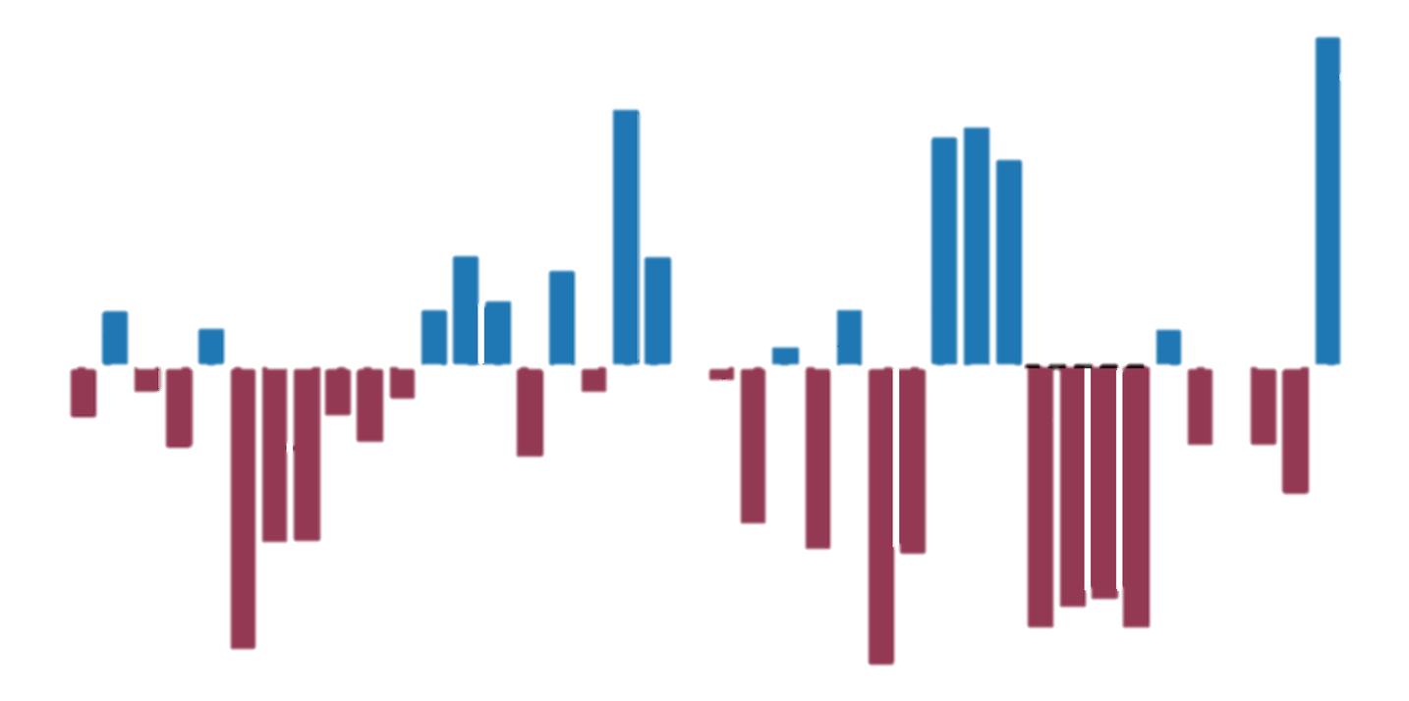
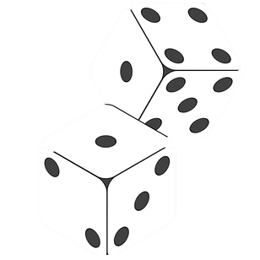
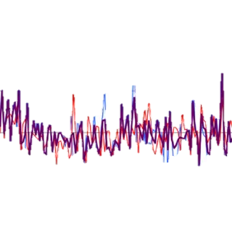

Methodology:
Stochastic modeling
CoSMoS framework
ARFIMA (0,d,0)
model
Run theory
Input data
Threshold
Precipitation time series of case study gauging station
Monte Carlo simulation
500 100-year synthetic time series, CoSMoS
500 100-year synthetic time series, ARFIMA
Wet spell
Dry spell
synthetic time series CoSMoS+ARFIMA
“Integration of stochastic and statistical approaches for drought risk estimation through long-length time series”

Slide 9
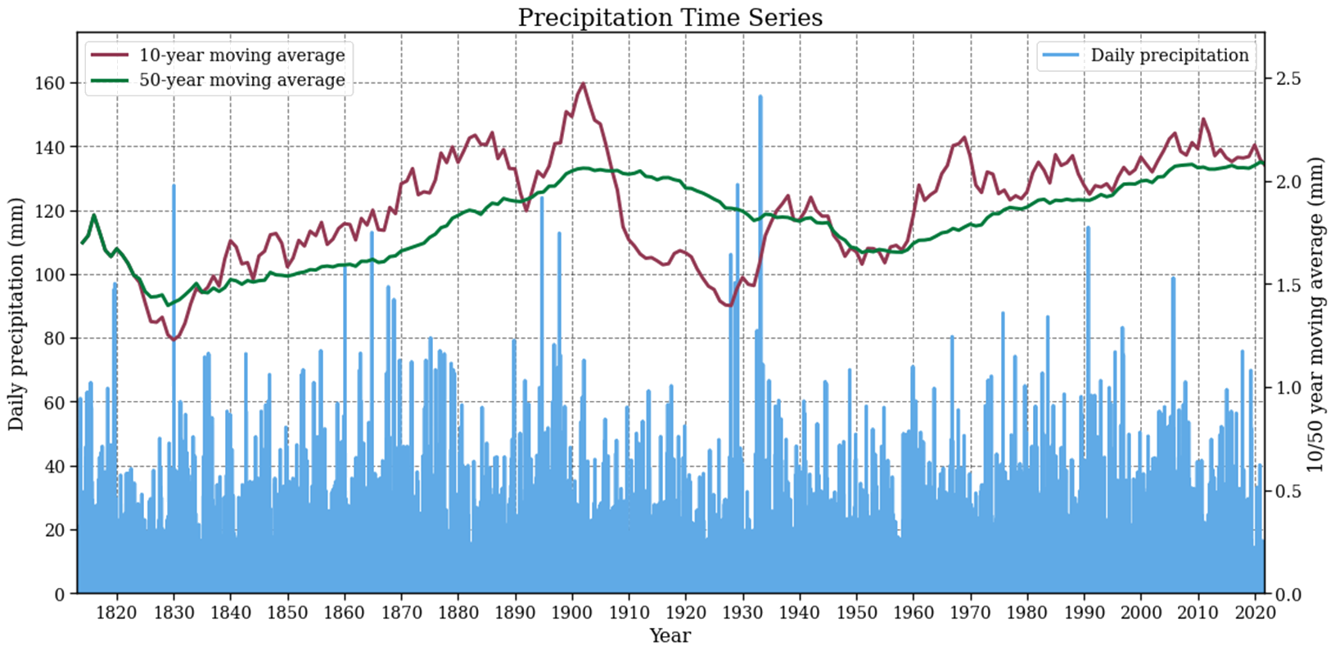
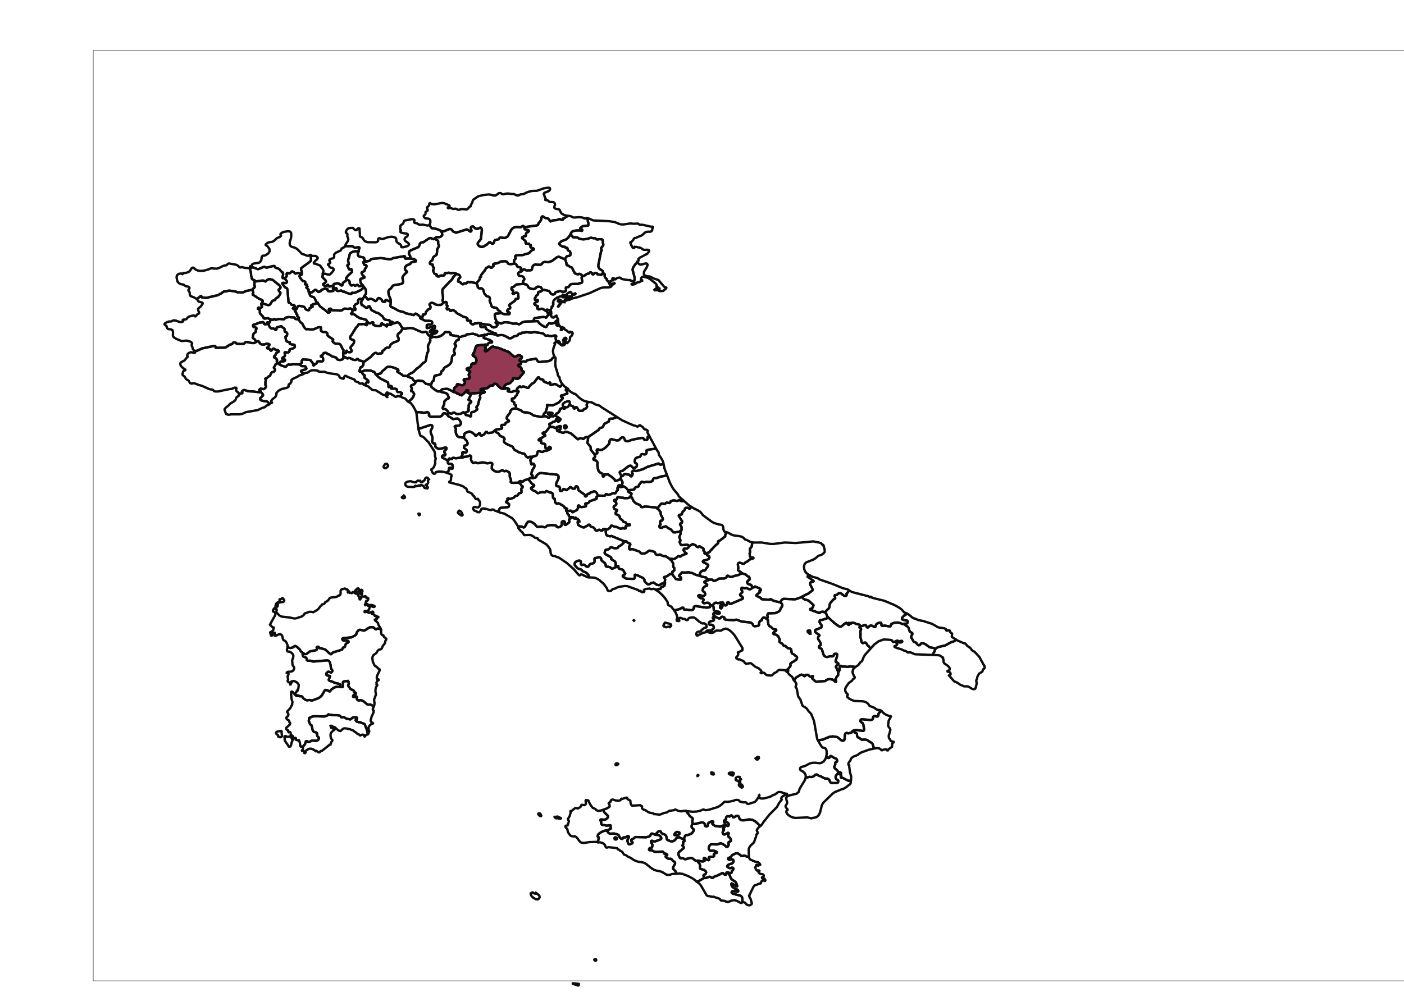

Case study:
Bologna, Italy
Daily statistics:
209 years of daily data
1813-2021
Moment | Daily values (mm)
Mean | 1.86
Standard Deviation | 6.02
Skewness | 6.17
Kurtosis | 58.97
“Integration of stochastic and statistical approaches for drought risk estimation through long-length time series”

Slide 10
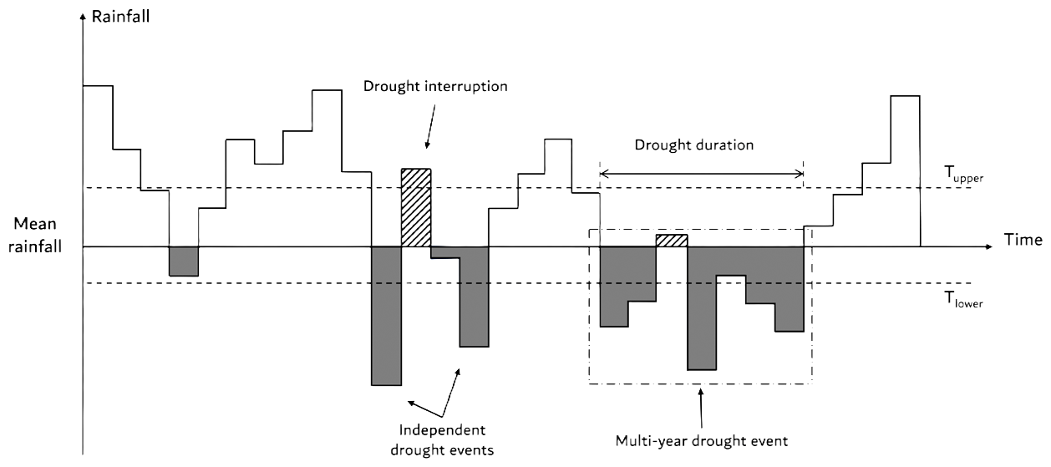

Run theory:
DD = time span between the start and the end of a negative run
DF = $\frac{Number of negative runs}{Lengh of observation period}$
DI = $\frac{DS}{DD}$ , DS= $\frac{Cumulative deficit}{T}$
MD = $\frac{Maximum deficit}{T}$
(Guo and Montanari, 2023)
Threshold (T) = mean annual rainfall T_{upper} and T_{lower} are defined as 20% higher and 10% lower than the defined T.
A negative run starts when x_{i} < T_{lower} is satisfied and ends when xi > T.
If the interval between two negative runs is equal to only one time interval and the rainfall in that time period is xi < T_{upper} these runs are combined and considered as a single drought event.
Multi-year droughts are identified as consecutive dry spells with duration exceeding 3 years.
“Integration of stochastic and statistical approaches for drought risk estimation through long-length time series”

Slide 11
ARFIMA:
The Autoregressive Fractionally Integrated Moving Average (ARFIMA) model is a generalization of classical time-series models that allows for long-range dependence in stochastic processes (Granger and Joyeux, 1980; Hosking, 1981). Unlike standard ARIMA models, which assume integer orders of differencing, ARFIMA models introduce a fractional differencing parameter that captures persistence over long time horizons.
The fractional parameter enables the model to represent slowly decaying autocorrelations commonly observed in economic, financial, hydrological, and geophysical data (Montanari et al., 1997).
In an ARFIMA (p, d, q) model, the p and q orders are related to the autoregressive (AR) and moving average (MA) structures, respectively. The fractional integration parameter d describes long term persistence. When (0 < d < 0.5), the process exhibits long-memory behaviour characterized by hyperbolically decaying autocorrelation functions.
ARFIMA models provide a flexible framework for modelling persistence. This property allows past observations to influence the present value with weights that decay gradually over time, therefore reproducing cycles of multi-year droughts.
“Integration of stochastic and statistical approaches for drought risk estimation through long-length time series”

Slide 12
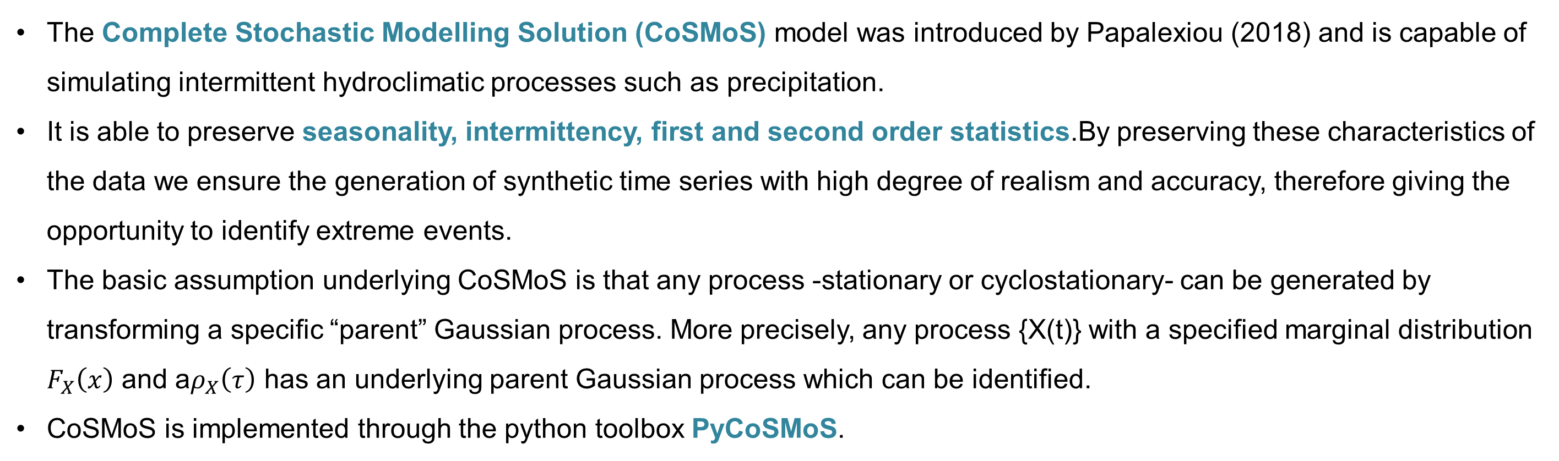
CoSMoS:
The Complete Stochastic Modelling Solution (CoSMoS) model was introduced by Papalexiou (2018) and is capable of simulating intermittent hydroclimatic processes such as precipitation.
It is able to preserve seasonality, intermittency, first and second order statistics.By preserving these characteristics of the data we ensure the generation of synthetic time series with high degree of realism and accuracy, therefore giving the opportunity to identify extreme events.
The basic assumption underlying CoSMoS is that any process -stationary or cyclostationary- can be generated by transforming a specific “parent” Gaussian process. More precisely, any process {X(t)} with a specified marginal distribution $F_{X}\left(x\right)$ and a$ρ_{X}\left(τ\right)$ has an underlying parent Gaussian process which can be identified.
CoSMoS is implemented through the python toolbox PyCoSMoS.
Model input:
the observed time series: 209 years of daily data
a specified marginal distribution function: Weibull type III
the autocorrelation function: Pareto type III
the desired number of lags: 50
“Integration of stochastic and statistical approaches for drought risk estimation through long-length time series”

Slide 13
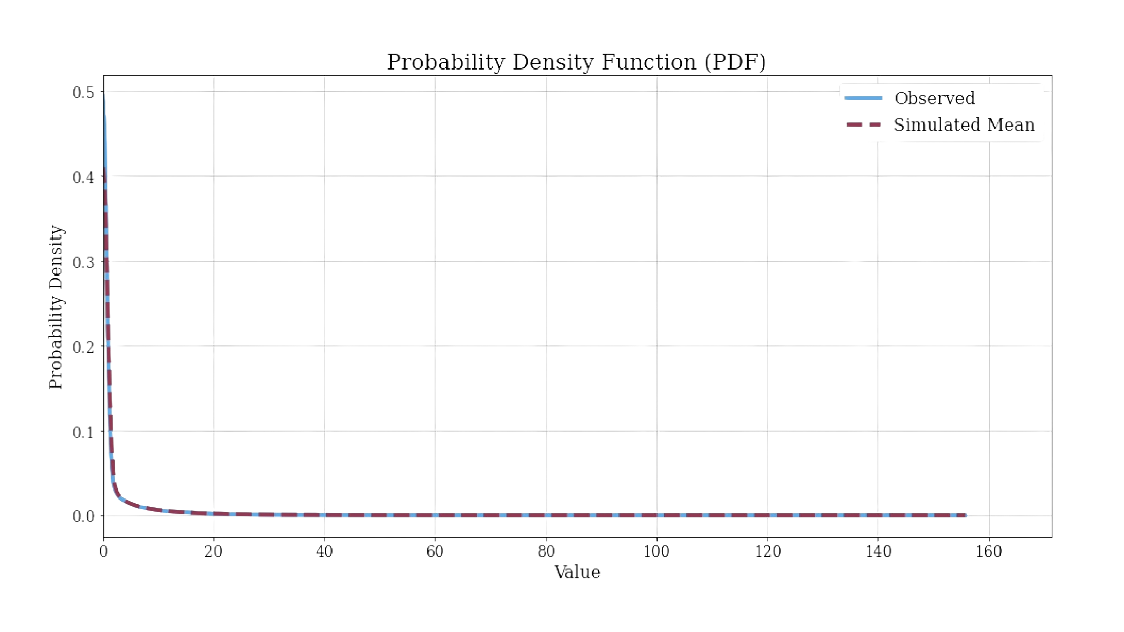
CoSMoS implementation:
“Integration of stochastic and statistical approaches for drought risk estimation through long-length time series”

Slide 14
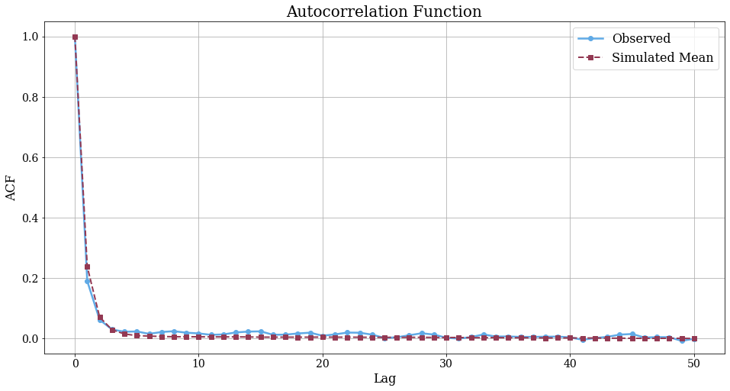
CoSMoS implementation:
“Integration of stochastic and statistical approaches for drought risk estimation through long-length time series”

Slide 15
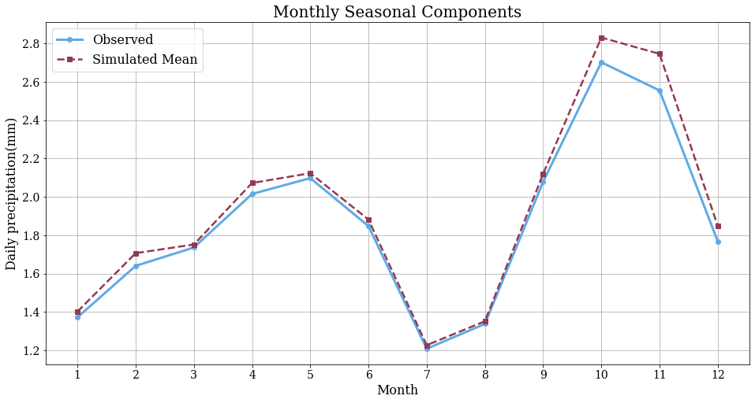
CoSMoS implementation:
“Integration of stochastic and statistical approaches for drought risk estimation through long-length time series”

Slide 16
CoSMoS implementation:
Month | diff_mean(mm) | diff_mean(%) | diff_std(mm) | diff_std(%) | diff_max(mm) | diff_max(%)
January | 0.04 | 2.64 | 0.21 | 0.04 | 44.03 | 0.34
February | -0.05 | -2.93 | -0.58 | -0.10 | -50.18 | -0.32
March | -0.20 | -11.71 | -0.36 | -0.07 | 6.73 | 0.08
April | -0.12 | -5.99 | -0.38 | -0.07 | -9.69 | -0.15
May | -0.10 | -4.72 | -0.15 | -0.02 | -3.69 | -0.05
June | -0.13 | -7.12 | -0.22 | -0.04 | -19.76 | -0.21
July | -0.11 | -9.22 | -0.42 | -0.08 | -20.69 | -0.25
August | 0.02 | 1.78 | 0.30 | 0.06 | 3.95 | 0.05
September | 0.11 | 5.30 | 0.30 | 0.04 | 0.49 | 0.00
October | -0.11 | -4.03 | -0.39 | -0.05 | 5.39 | 0.05
November | -0.07 | -2.65 | -0.22 | -0.03 | -21.87 | -0.19
December | -0.13 | -7.21 | -0.78 | -0.14 | -59.32 | -0.56
“Integration of stochastic and statistical approaches for drought risk estimation through long-length time series”

Slide 17
CoSMoS implementation – Bias correction:
The autocorrelation function, probability distribution function and seasonal structure of the simulated ensemble time series are in good agreement with the observations, discrepancies remain in the marginal moments.
The scope of this work is to identify and compare multi-year drought characteristics, so it is important to prevent any systematic error arising from mismatches in the marginal moments.
To correct biases in the simulated time series, we applied the method of quantile mapping (QM). The QM method adjusts the values of the simulated time series so that their cumulative distribution matches the one of the observations, while preserving the temporal dependences.
Time series Origin Moment | Observed | CoSMoS | CoSMoS Bias corrected
Mean | 675.40 | 701.36 | 680.43
Standard deviation | 185.21 | 154.70 | 183.37
Skewness | 0.22 | 0.43 | 0.30
Kurtosis | -0.20 | 0.27 | -0.22
“Integration of stochastic and statistical approaches for drought risk estimation through long-length time series”

Slide 18
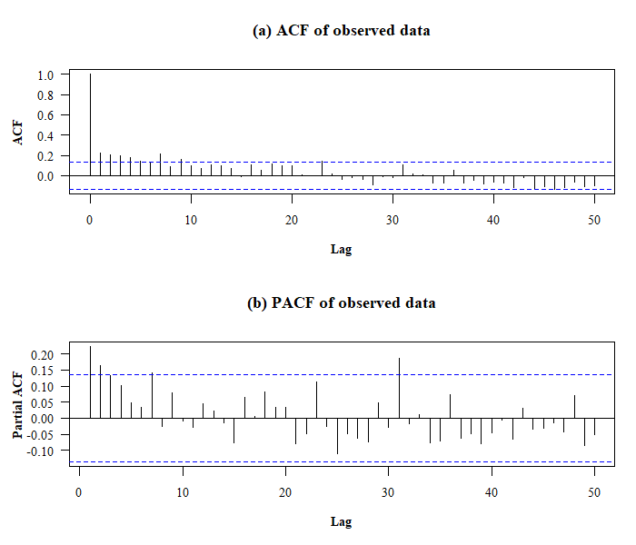
CoSMoS + ARFIMA implementation
s
ACF shows slow decay
PACF exhibits no sharp cutoff
Hurst parameter: H=0.63
Applied to the annual time series
“Integration of stochastic and statistical approaches for drought risk estimation through long-length time series”

Slide 19
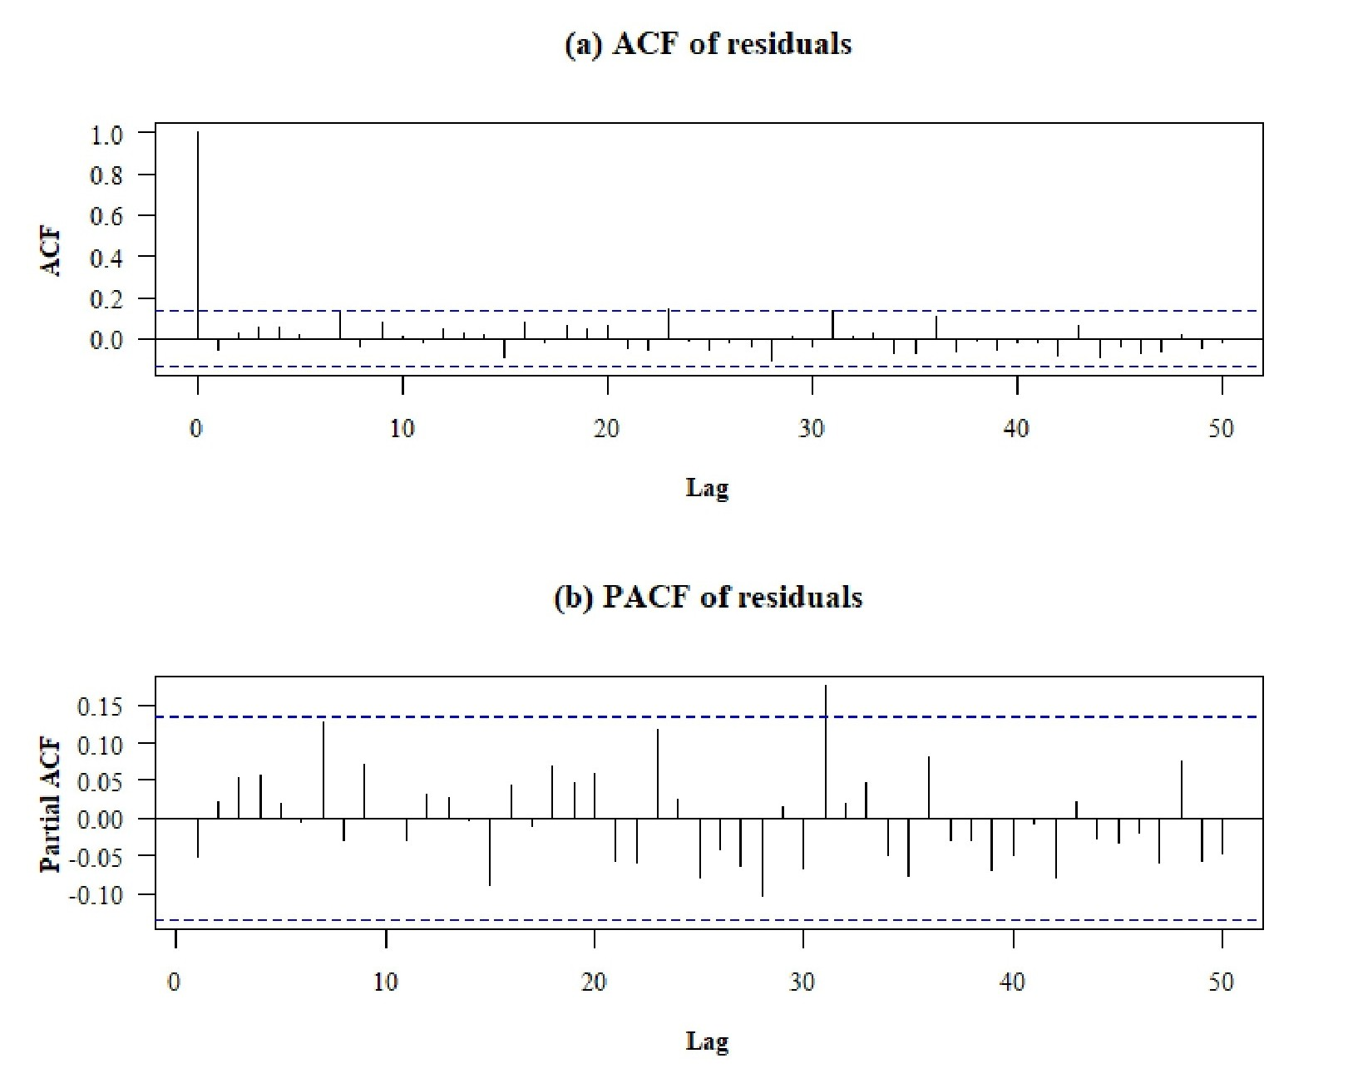
CoSMoS + ARFIMA implementation
Residuals exhibit white noise behavior which indicates that long-term dependence is captured by the ARFIMA model.
Preserves long-term dependence, persistence.
“Integration of stochastic and statistical approaches for drought risk estimation through long-length time series”

Slide 20
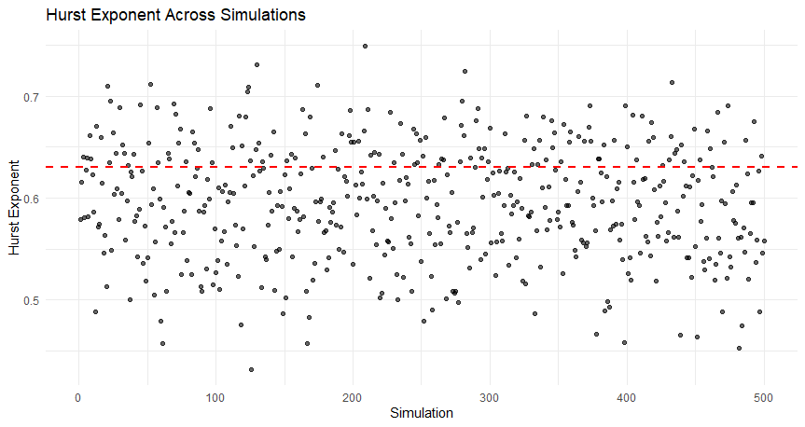
CoSMoS + ARFIMA implementation
Preserves long-term persistence
H_{sim}=0.59
“Integration of stochastic and statistical approaches for drought risk estimation through long-length time series”

Slide 21
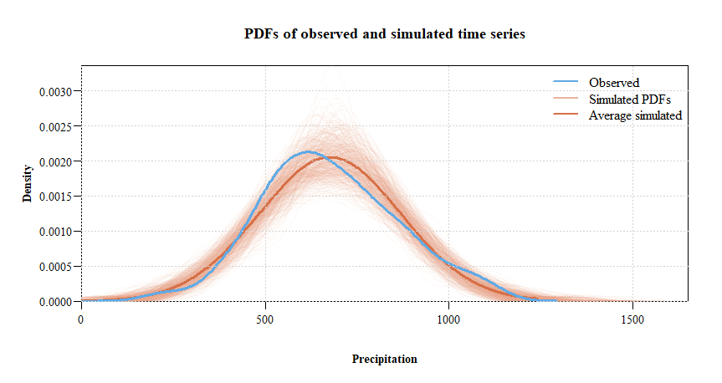
CoSMoS + ARFIMA implementation
Monte Carlo simulation:
100 years, adequate representation of multi-year droughts.
500 simulations to achieve a statistically stable estimates.
“Integration of stochastic and statistical approaches for drought risk estimation through long-length time series”

Slide 22
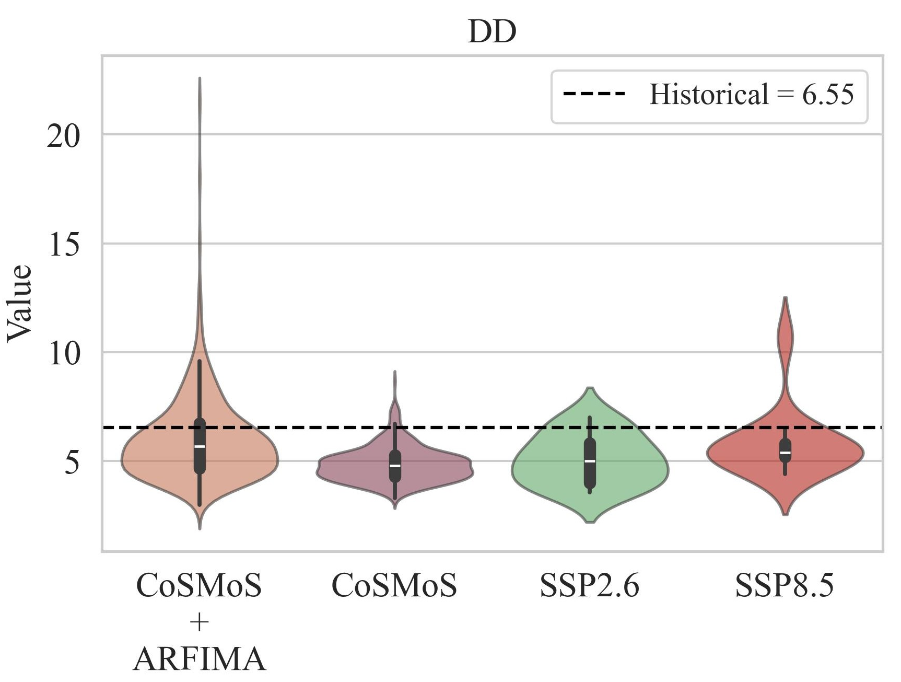

Run theory application:
Historical
MME of 13 GMCs from CMIP6
“Integration of stochastic and statistical approaches for drought risk estimation through long-length time series”

Slide 23

Run theory application:
Historical
MME of 13 GMCs from CMIP6
“Integration of stochastic and statistical approaches for drought risk estimation through long-length time series”

Slide 24

Run theory application:
Historical
MME of 13 GMCs from CMIP6
“Integration of stochastic and statistical approaches for drought risk estimation through long-length time series”

Slide 25
Run theory application:
Historical
MME of 13 GMCs from CMIP6
“Integration of stochastic and statistical approaches for drought risk estimation through long-length time series”

Slide 26
Conclusions:
We need to target on mitigating the impacts of droughts to avoid their adverse consequences.
Stochastic models serve as a valuable tool for generating synthetic time series incorporating the inherent variability, interdependence, intermittency and seasonality.
By applying stochastic methods we limit the lack of predictability and “surprise” related to natural processes.
The key point is to understand the advantages of each stochastic model and choose the appropriate for each specific goal.
The integration of stochastic models combines the advantages of both CoSMoS in the representation of daily (fine scale) precipitation structure and the ARFIMA in capturing the long-term persistence of the process.
The results offer valuable insights in drought risk estimation and consequently aid in adopting the appropriate mitigation strategies, water management policies and therefore creating drought resilient societies reducing the underlying surprise element.
“Integration of stochastic and statistical approaches for drought risk estimation through long-length time series”

