Slide 1
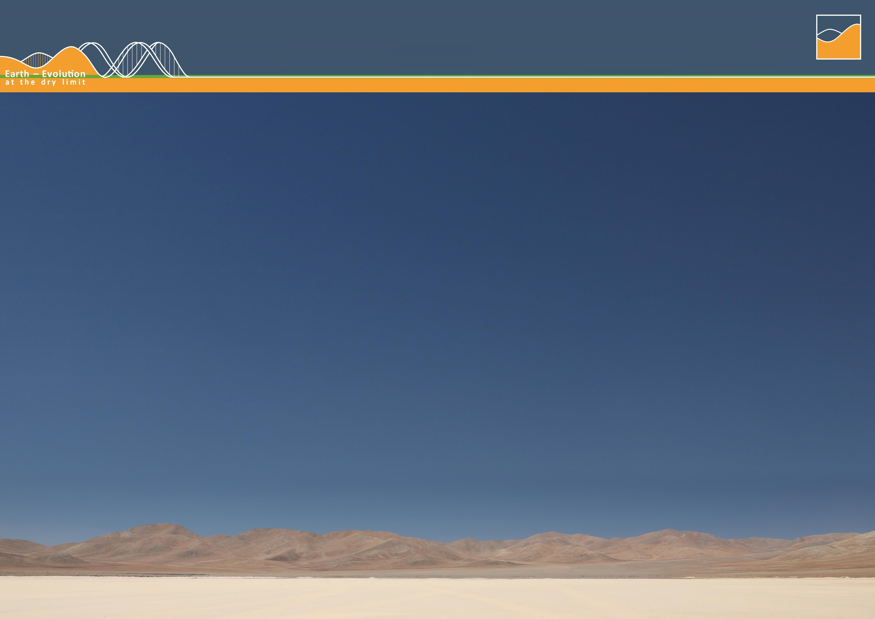





Suplemmentary material The Geologic Super-Cycle of Chilean Nitrate Deposition
CRC1211
D03
Camila J. Riffo Contreras, Guillermo Chong, Swea Klipsch, Michael E. Böttcher, Amelia Davies, and Michael Staubwasser
(criffoco@uni-koeln.de)
Institute of Geology and Mineralogy, University of Cologne, Germany
EGU26 General Assembly
May 6th, 2026

Slide 2
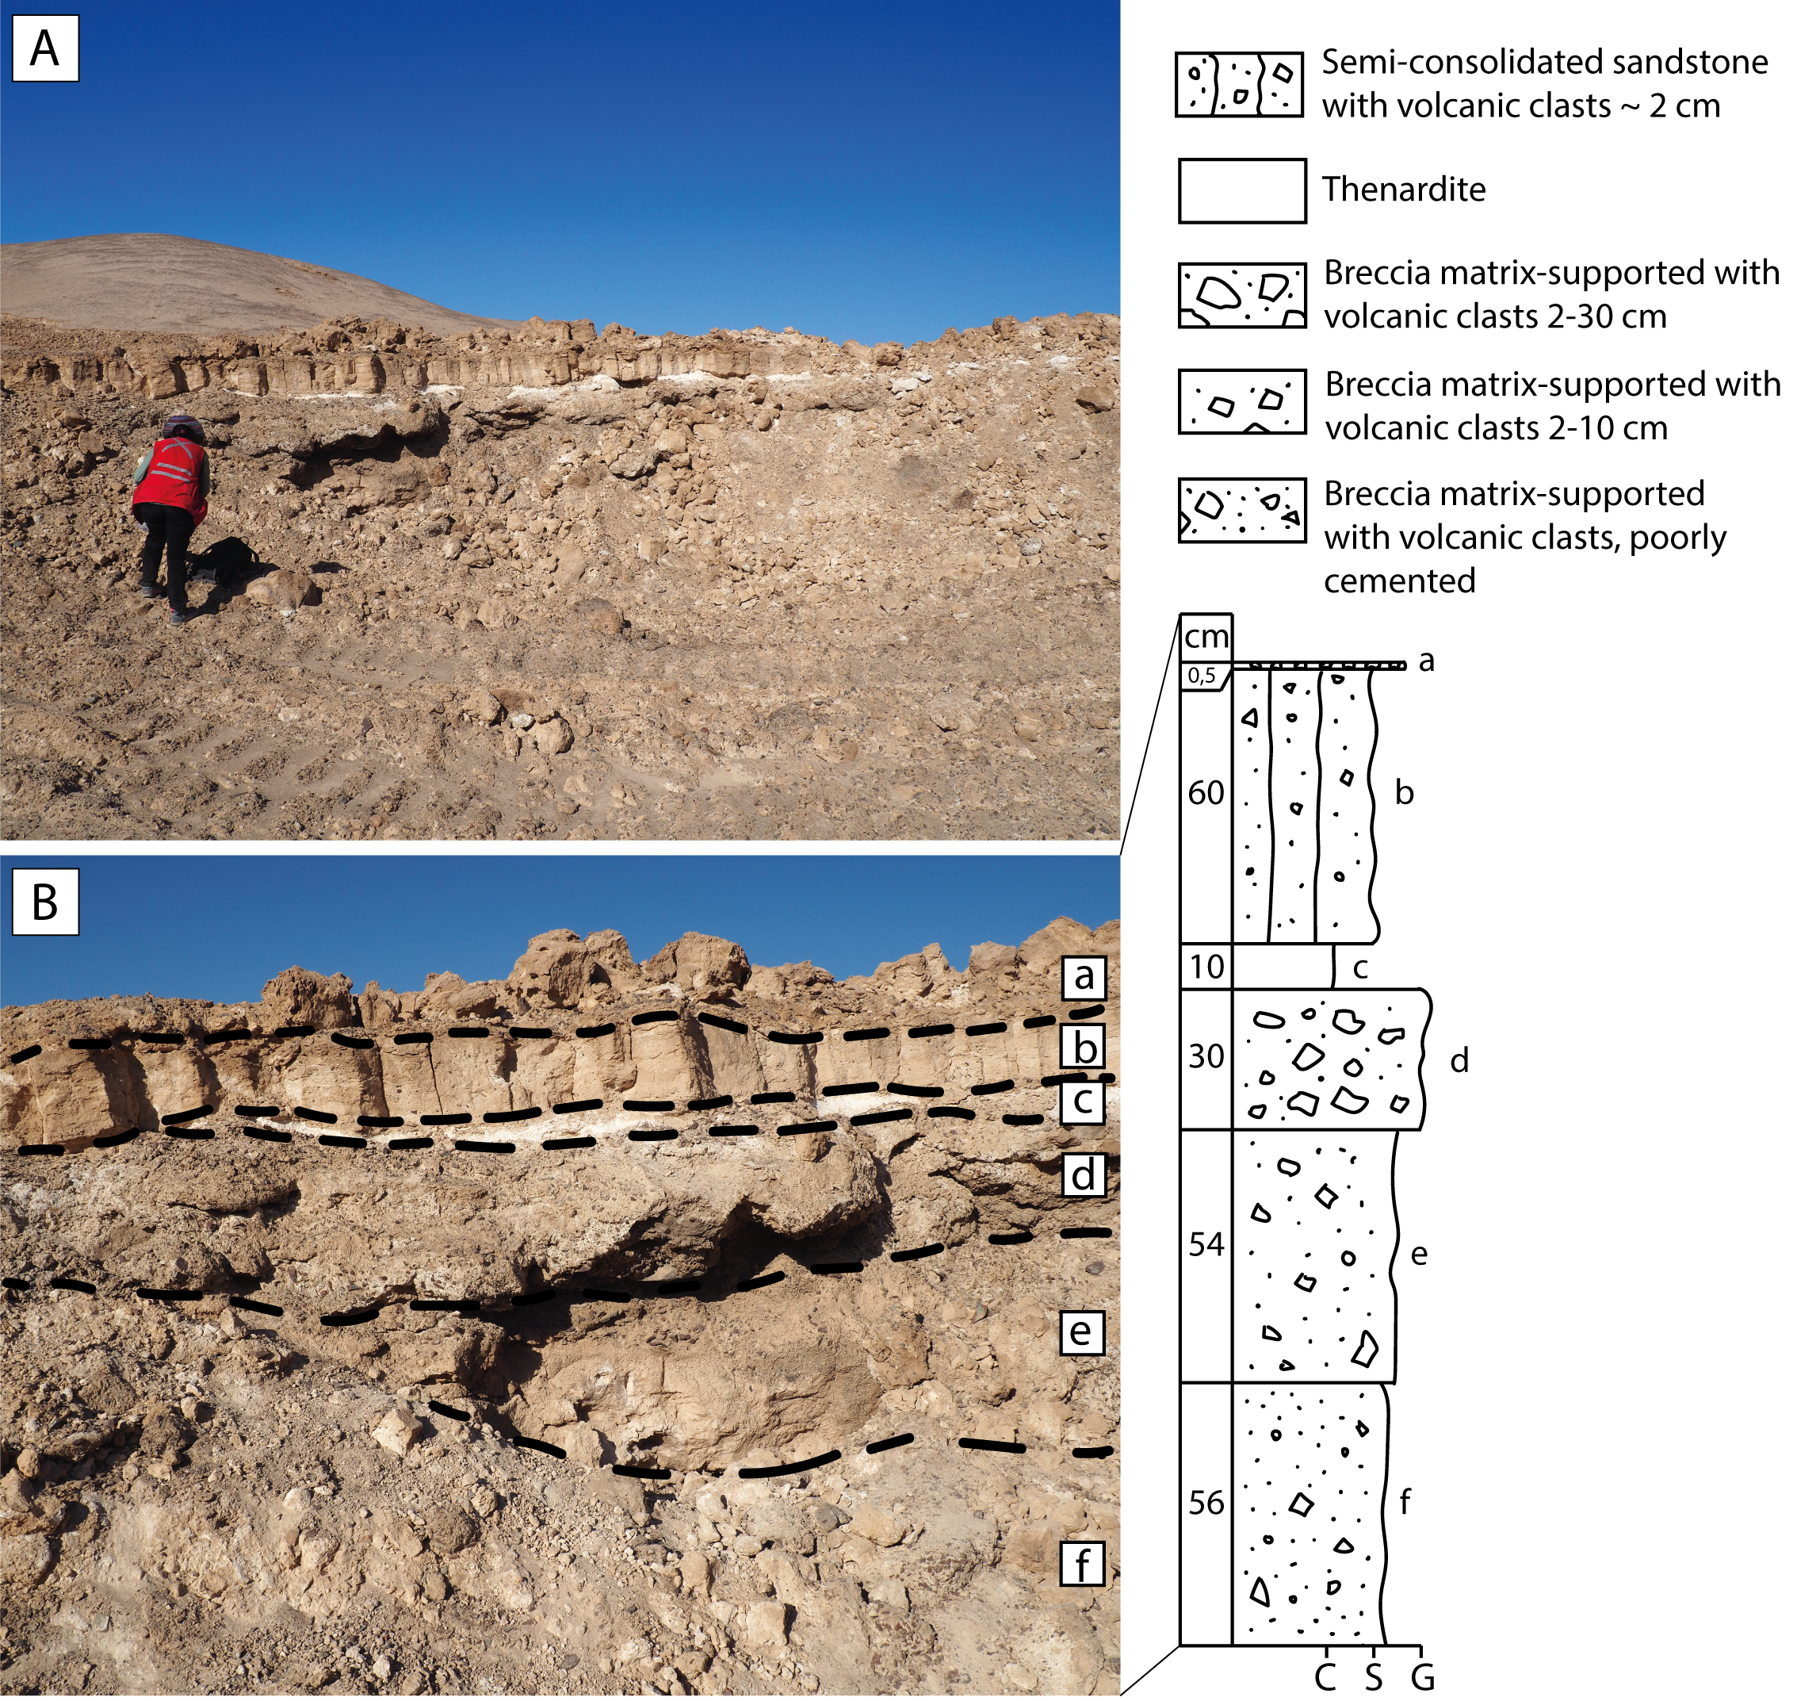




Nitrate Deposits
Sedimentary (type-i) deposit
Located in alluvial fan
characterized by horizontal layers of consolidated to semi-consolidated sedimentary rocks
Nitrate ore → (black) caliche
Surface crust
Chuca
Thenardite (Na2SO4)
Costra
Caliche
Coba
(Ericksen, 1981)
Figure 2. Sedimentary Deposit (type-i) from Aguas Blancas District (samples from ATA23-003/1). A) Sedimentary sequence in a proximal alluvial fan, showing the different layers of a type-I deposit. B) Close view from picture A. Photographs by Swea Klipsch.

Slide 3
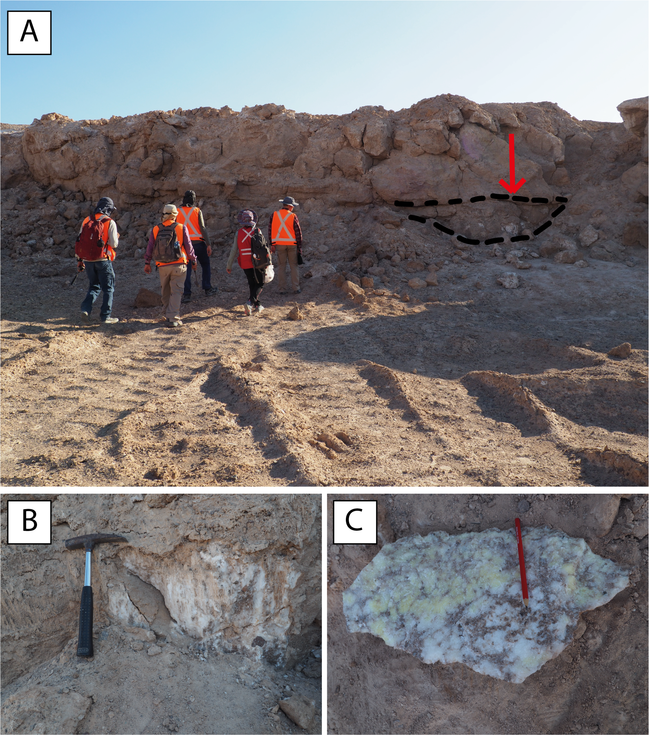





Nitrate Deposits
Veins in sedimentary deposits (type-iia)
mantos → horizontal structures filling sedimentary strata
Massive and fibrous, mixed with the caliche layer
10 – 50 cm thickness
Nitrate ore → (white/yellow) caliche
Figure 3. Veins in Sedimentary Deposit (type-iia) from Aguas Blancas District (samples from ATA23-003/2). A) Outcrop view. B) White fibrous manto cutting through type-i deposit. C) Massive white and yellow manto, with parts of the black caliche from a type-i deposit. Photographs by Swea Klipsch.

Slide 4
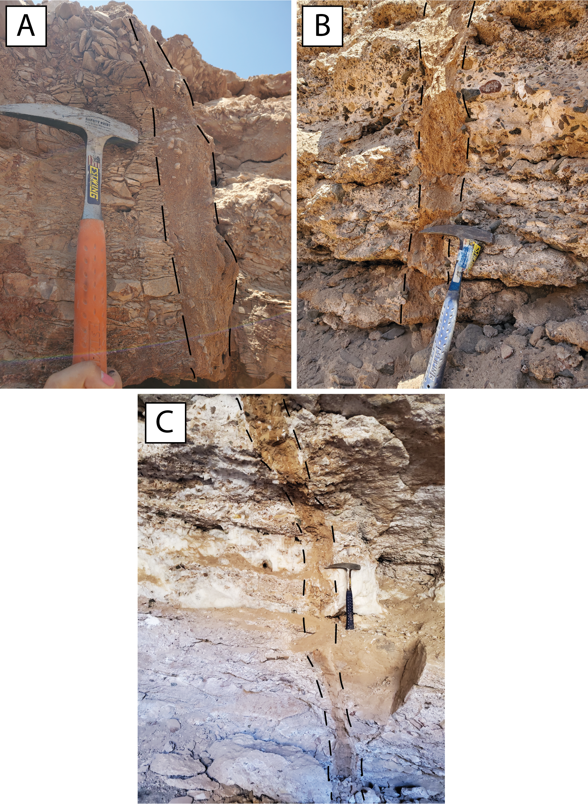



Nitrate Deposits
Neptunic/sand dykes (type-iib)
nitrate-cemented sand
formed by upward injection of liquified sand through high hydraulic pressure into a fracture
normally as a result of tectonic activity (Earthquake)
10 – 15 cm thickness
Nitrate ore → (black) caliche
Figure 4. Neptunic dykes (type-iib) cutting through different host rocks from various localities. A) Brecciated shale from Oficina Santa Rita (Sample ATA23-101d); B) breccia-matrix supported (Sample ATA23-111a); and C) nitrate vein (type-iic deposit) from Oficina California (Sample ATA23-111d). Photographs by the author.

Slide 5
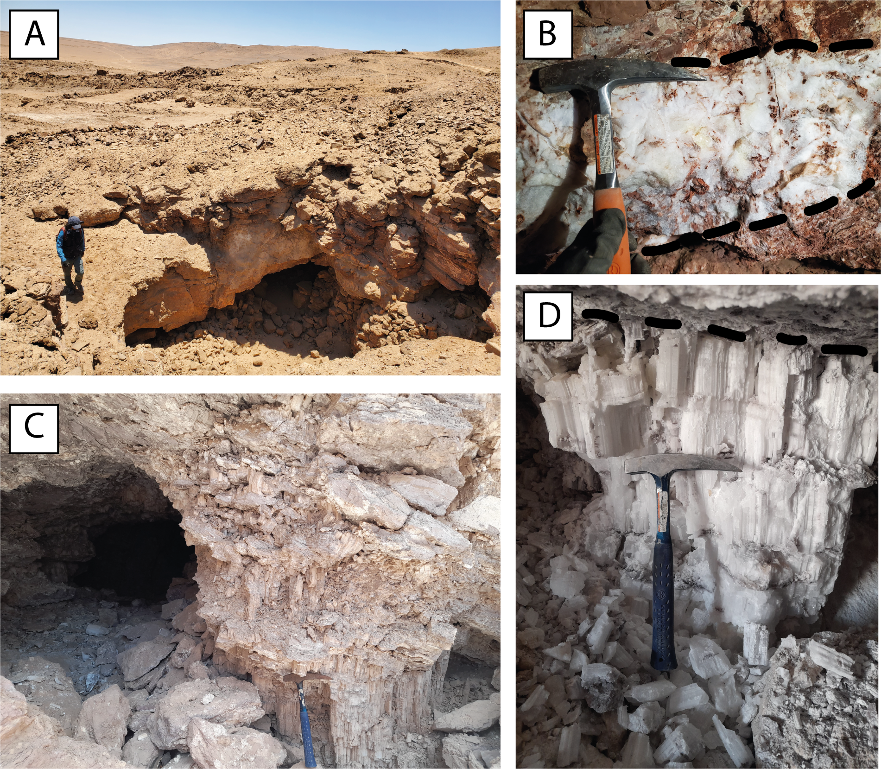











Nitrate Deposits
Veins in rocks (type-iic) deposits
Nitrate filling into fractures/cracks
mantos (horizontal) and veins (vertical)
Massive and fibrous
15 – 100 cm thickness
Volcanic and sedimentary host rocks
Nitrate ore → (white/yellow/blue) caliche
Figure 5. Veins in Rocks (type-iic). A) Landscape view of the entrance to a cave in the Oficina Santa Rita. B) A massive white vein from Oficina Santa Rita’s cave (Sample ATA23-101b). C) View of the entrance to the cave in the Oficina Domeyko. D) fibrous white manto cutting through rhyolites (Sample ATA22-020A) in the Oficina Domeyko’s cave. The hammer measures 30 cm long. Photographs by the author.

Slide 6
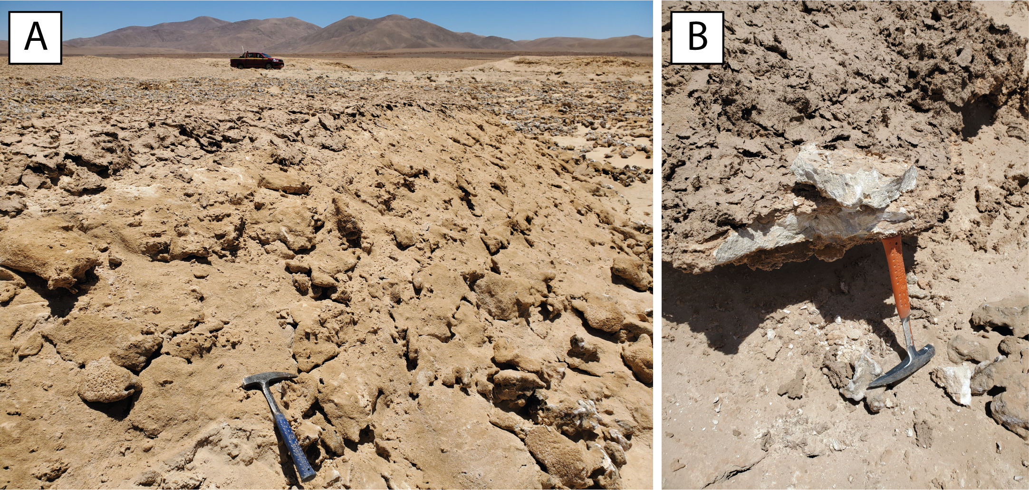
Nitrate Deposits
Salt flat /salar (type-iii deposit)
endorheic sedimentary basins filled by sedimentary rocks and evaporites
Saline crust on the surface
Nitrate ore → (clack) caliche
Figure 6. A) Salar Dolores (type-iii deposit). B) Well-cemented salt crust. Photographs by the author.

Slide 7
Triple Oxygen Isotopes
Oxygen Isotopes Overview
There are three stable oxygen isotopes:
¹⁶O (most abundant ~99.76%)
¹⁷O (rare ~0.04%)
¹⁸O (~0.20%)
Most studies focus on ¹⁸O/¹⁶O (reported as δ¹⁸O), but when you include ¹⁷O (as δ¹⁷O), you get “triple oxygen isotopes.”

Slide 8
Delta Notation (δ)
Isotope ratios are reported as deviations (in ‰) from a standard (usually VSMOW):
δ¹⁸O = [(¹⁸O/¹⁶O)_sample / (¹⁸O/¹⁶O)_standard − 1] × 1000
δ¹⁷O is similarly defined.

Slide 9
Mass-Dependent vs. Mass-Independent Fractionation
Mass-dependent fractionation: In processes like evaporation, the change in δ¹⁷O is about 0.52 × δ¹⁸O (because of mass difference).
Mass-independent fractionation (MIF): Deviations from this expected line. Expressed as:
Δ¹⁷O = δ¹⁷O − 0.52 × δ¹⁸O
A non-zero Δ¹⁷O suggests that the oxygen came from atmospheric processes, especially:
Ozone reactions
Stratospheric photochemistry
Atmospheric nitrate formation

Slide 10
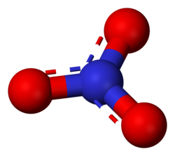
Nitrate = NO₃

Slide 11
Atmospheric Geochemistry
Atmospheric nitrate can be formed through different oxidation pathways of nitrogen oxides (NO_{x} = NO+NO₂) in the troposphere during daytime:
and during nighttime:
$${NO}_{2}+OH+M⟶{HNO}_{3}+M$$ | (3.5)
$${NO}_{2}+ O_{3} ⟶{NO}_{3}+O_{2}$$ | (3.6)
$${NO}_{3}+ HC, DMS ⟶{HNO}_{3}+products$$ | (3.7)
$${NO}_{2}+{NO}_{3} ⟶N_{2}O_{5}$$ | (3.8)
$$N_{2}O_{5}+H_{2}O_{(surf)} ⟶2HNO_{3(aq)}$$ | (3.9)
Notes:
In atmospheric geochemistry, M is a molecule that participate in the reaction by carrying away excess energy (energy transfer partner), often N₂ or O₂, but does not chemically change (Amedro et al., 2020);
HC refers to hydrocarbon, or broadly to volatile organic compounds (VOCs) of anthropogenic or biogenic origin;
and DMS stands for dimethyl sulfide (CH₃SCH₃), is a sulfur-containing compound emitted mainly by marine phytoplankton and it is a precursor to other atmospheric sulfur compounds such as SO₂, H₂SO₄.
The products in equation 3.7 can be organic nitrates, sulfur-containing products, or other oxidation products (Michalski et al., 2003; Morin et al., 2007; Savarino et al., 2013).
However, daytime NO₃ is negligible, except in shadowed/particle interiors, because it is rapidly photolyzed by sunlight; it only accumulates and reacts significantly at night.

Slide 12
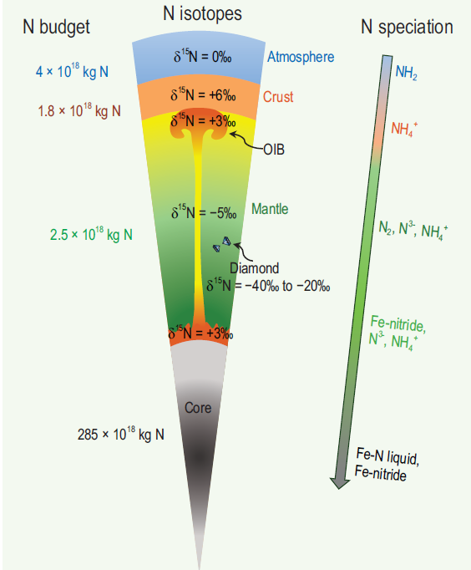

Slide 13
Nitrification is a multi-step oxidation process mediated by specialized autotrophic organisms, generating nitrogen oxides as intermediates and nitrate as the final product. It proceeds via two partial reactions, oxidation by Nitrosomas:
$${NH}_{4}^{+}→ {NO}_{2}^{−}$$ | (3.14)
and oxidation by Nitrobacter:
$${NO}_{2}^{−}→ {NO}_{3}^{−}$$ | (3.15)
The residual nitrate typically results in δ¹⁵N values between -3 to +5‰ (Casciotti, 2009). The second oxidation step exhibits an inverse kinetic isotope effect, producing a nitrate depleted in ¹⁵N (δ¹⁵N ≈ -13‰) as oxidation progresses (Casciotti, 2009).
Notes:
The first oxidation reaction (3.13) is comparatively slow, whereas the second (3.14) proceeds much faster. As a result, most of the nitrogen isotope fractionation occurs during the slow oxidation of ammonium (3.13).

Slide 14
Denitrification is also a multi-step reduction process, during which nitrate is biologically reduced through several intermediate nitrogen species. It typically occurs in poorly aerated soil and suboxic aquatic environments, leading to an enrichment in ¹⁵N in the residual nitrate as its concentration decreases. Denitrification produces significant isotope fractionation, leading to residual nitrate with δ¹⁵N up to 30‰ (Casciotti, 2009; Hoefs, 2018).

Slide 15
Anammox (anaerobic ammonium oxidation) is another dissimilatory pathway, involving the reaction of ammonia with nitrite to form dinitrogen gas, the dominant nitrogen loss mechanism in oxygen-minimum-zone waters (Hoefs, 2018):
$${NH}_{4}^{+}+ {NO}_{2}^{−}→ N_{2}+ 2H_{2}O$$ | (3.16)
This reaction (3.16) produces isotope fractionation similar in magnitude to that of denitrification, generating δ¹⁵N values up to 38‰ (Casciotti, 2009).

Slide 16
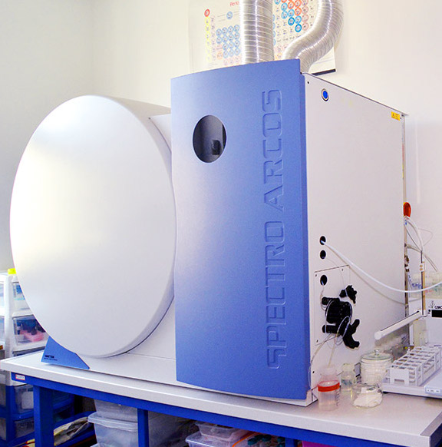
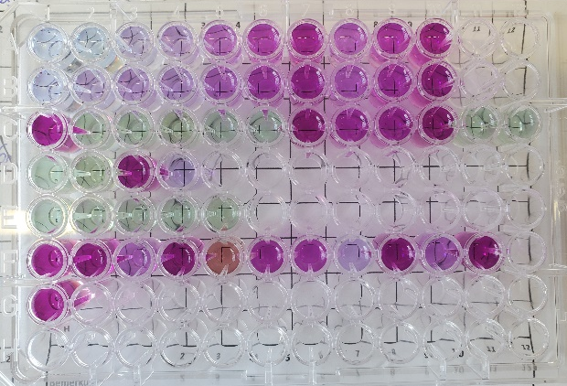
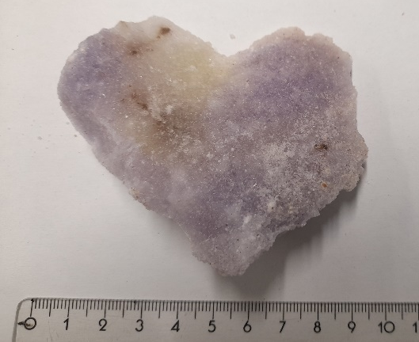
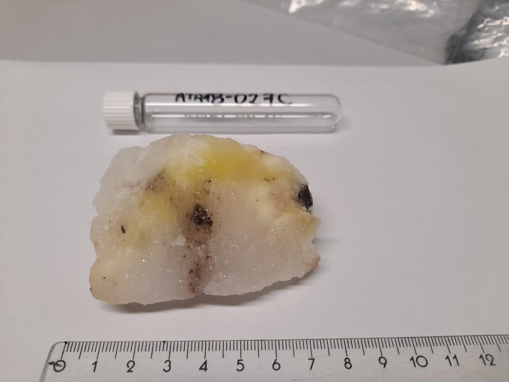
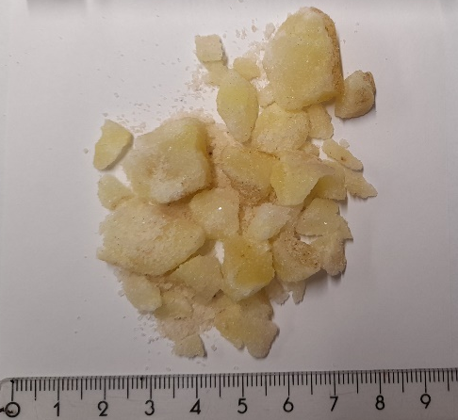
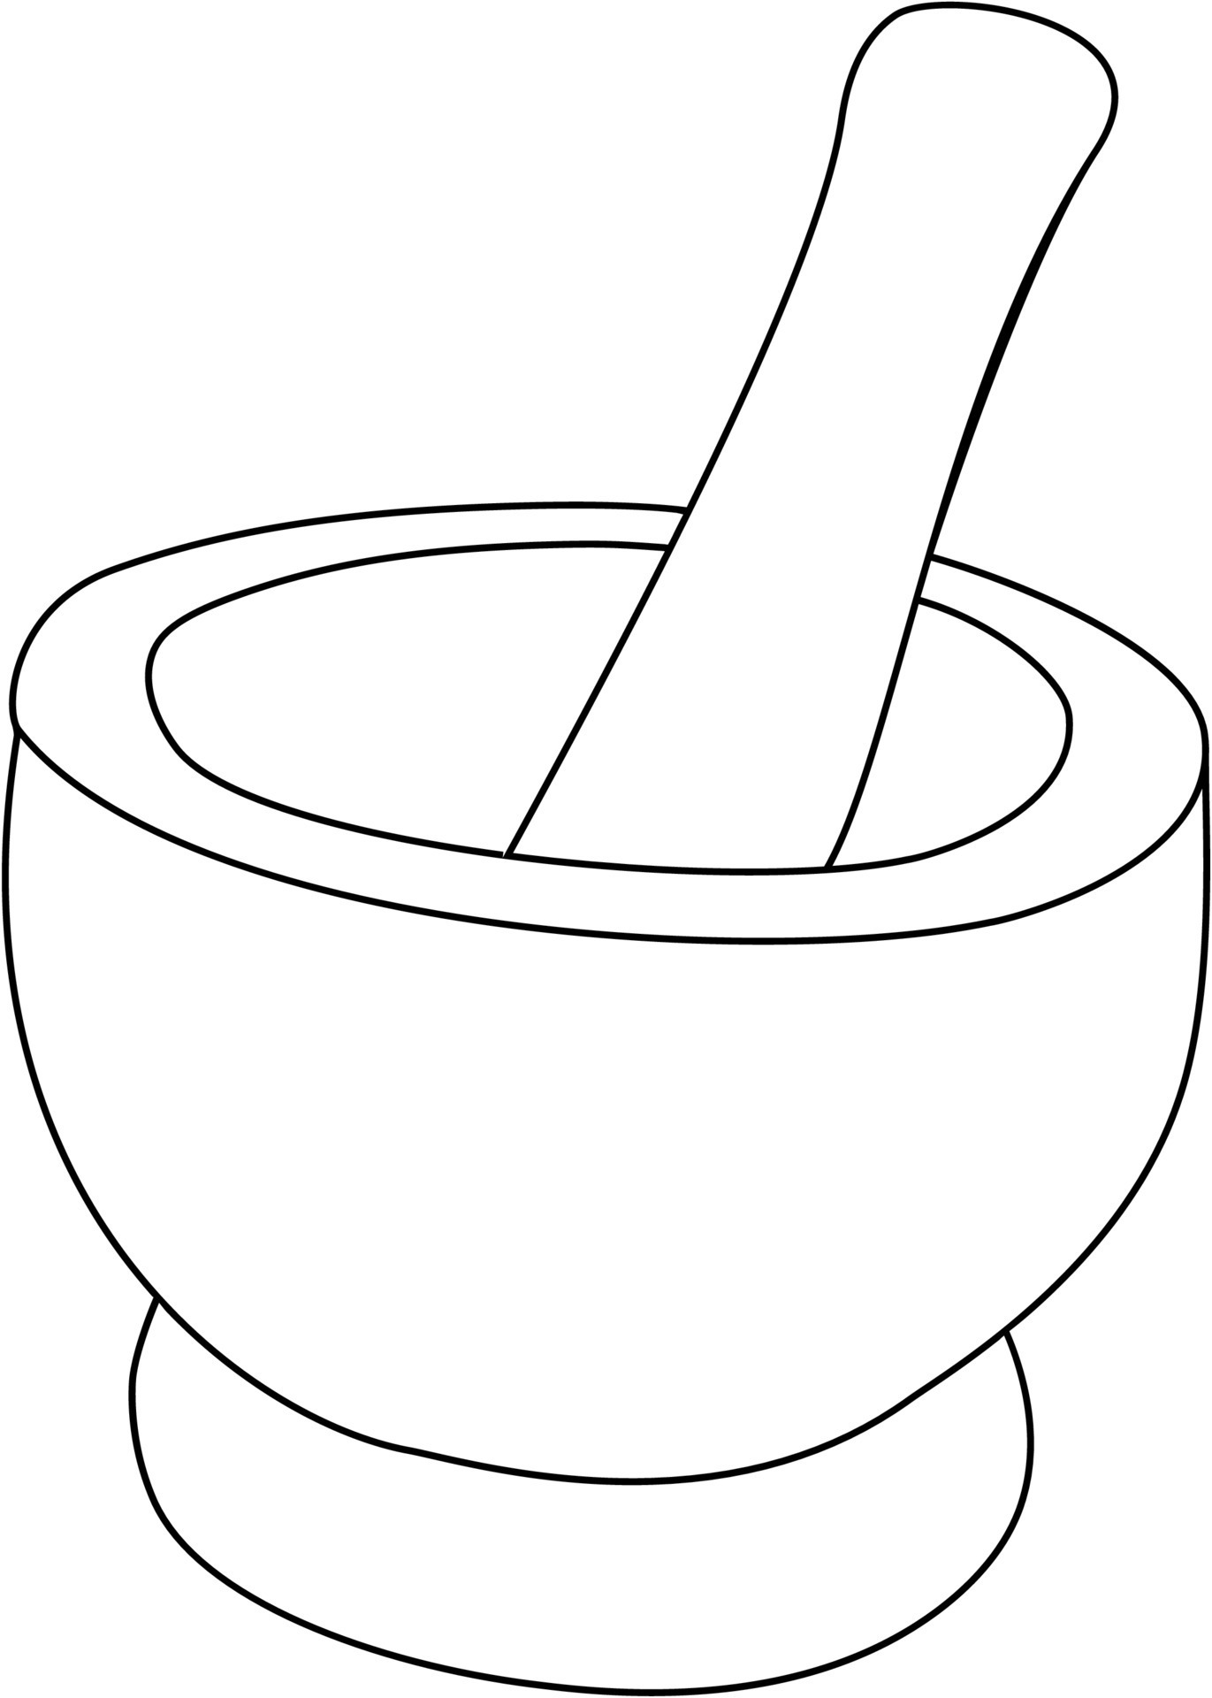
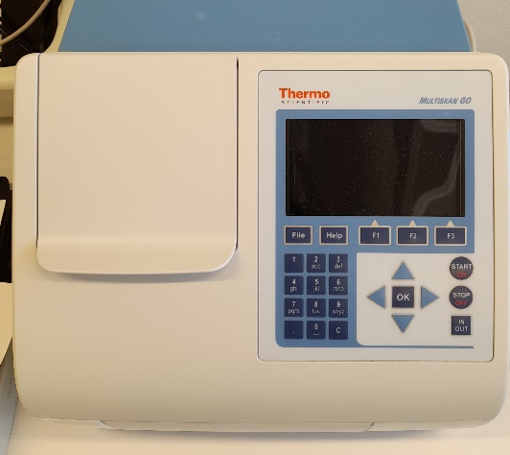
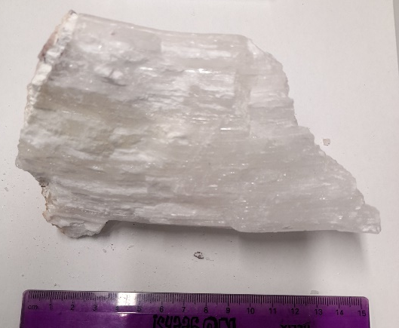
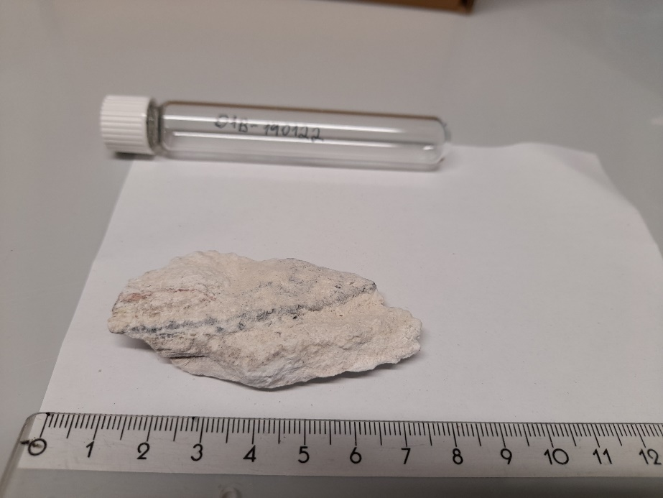
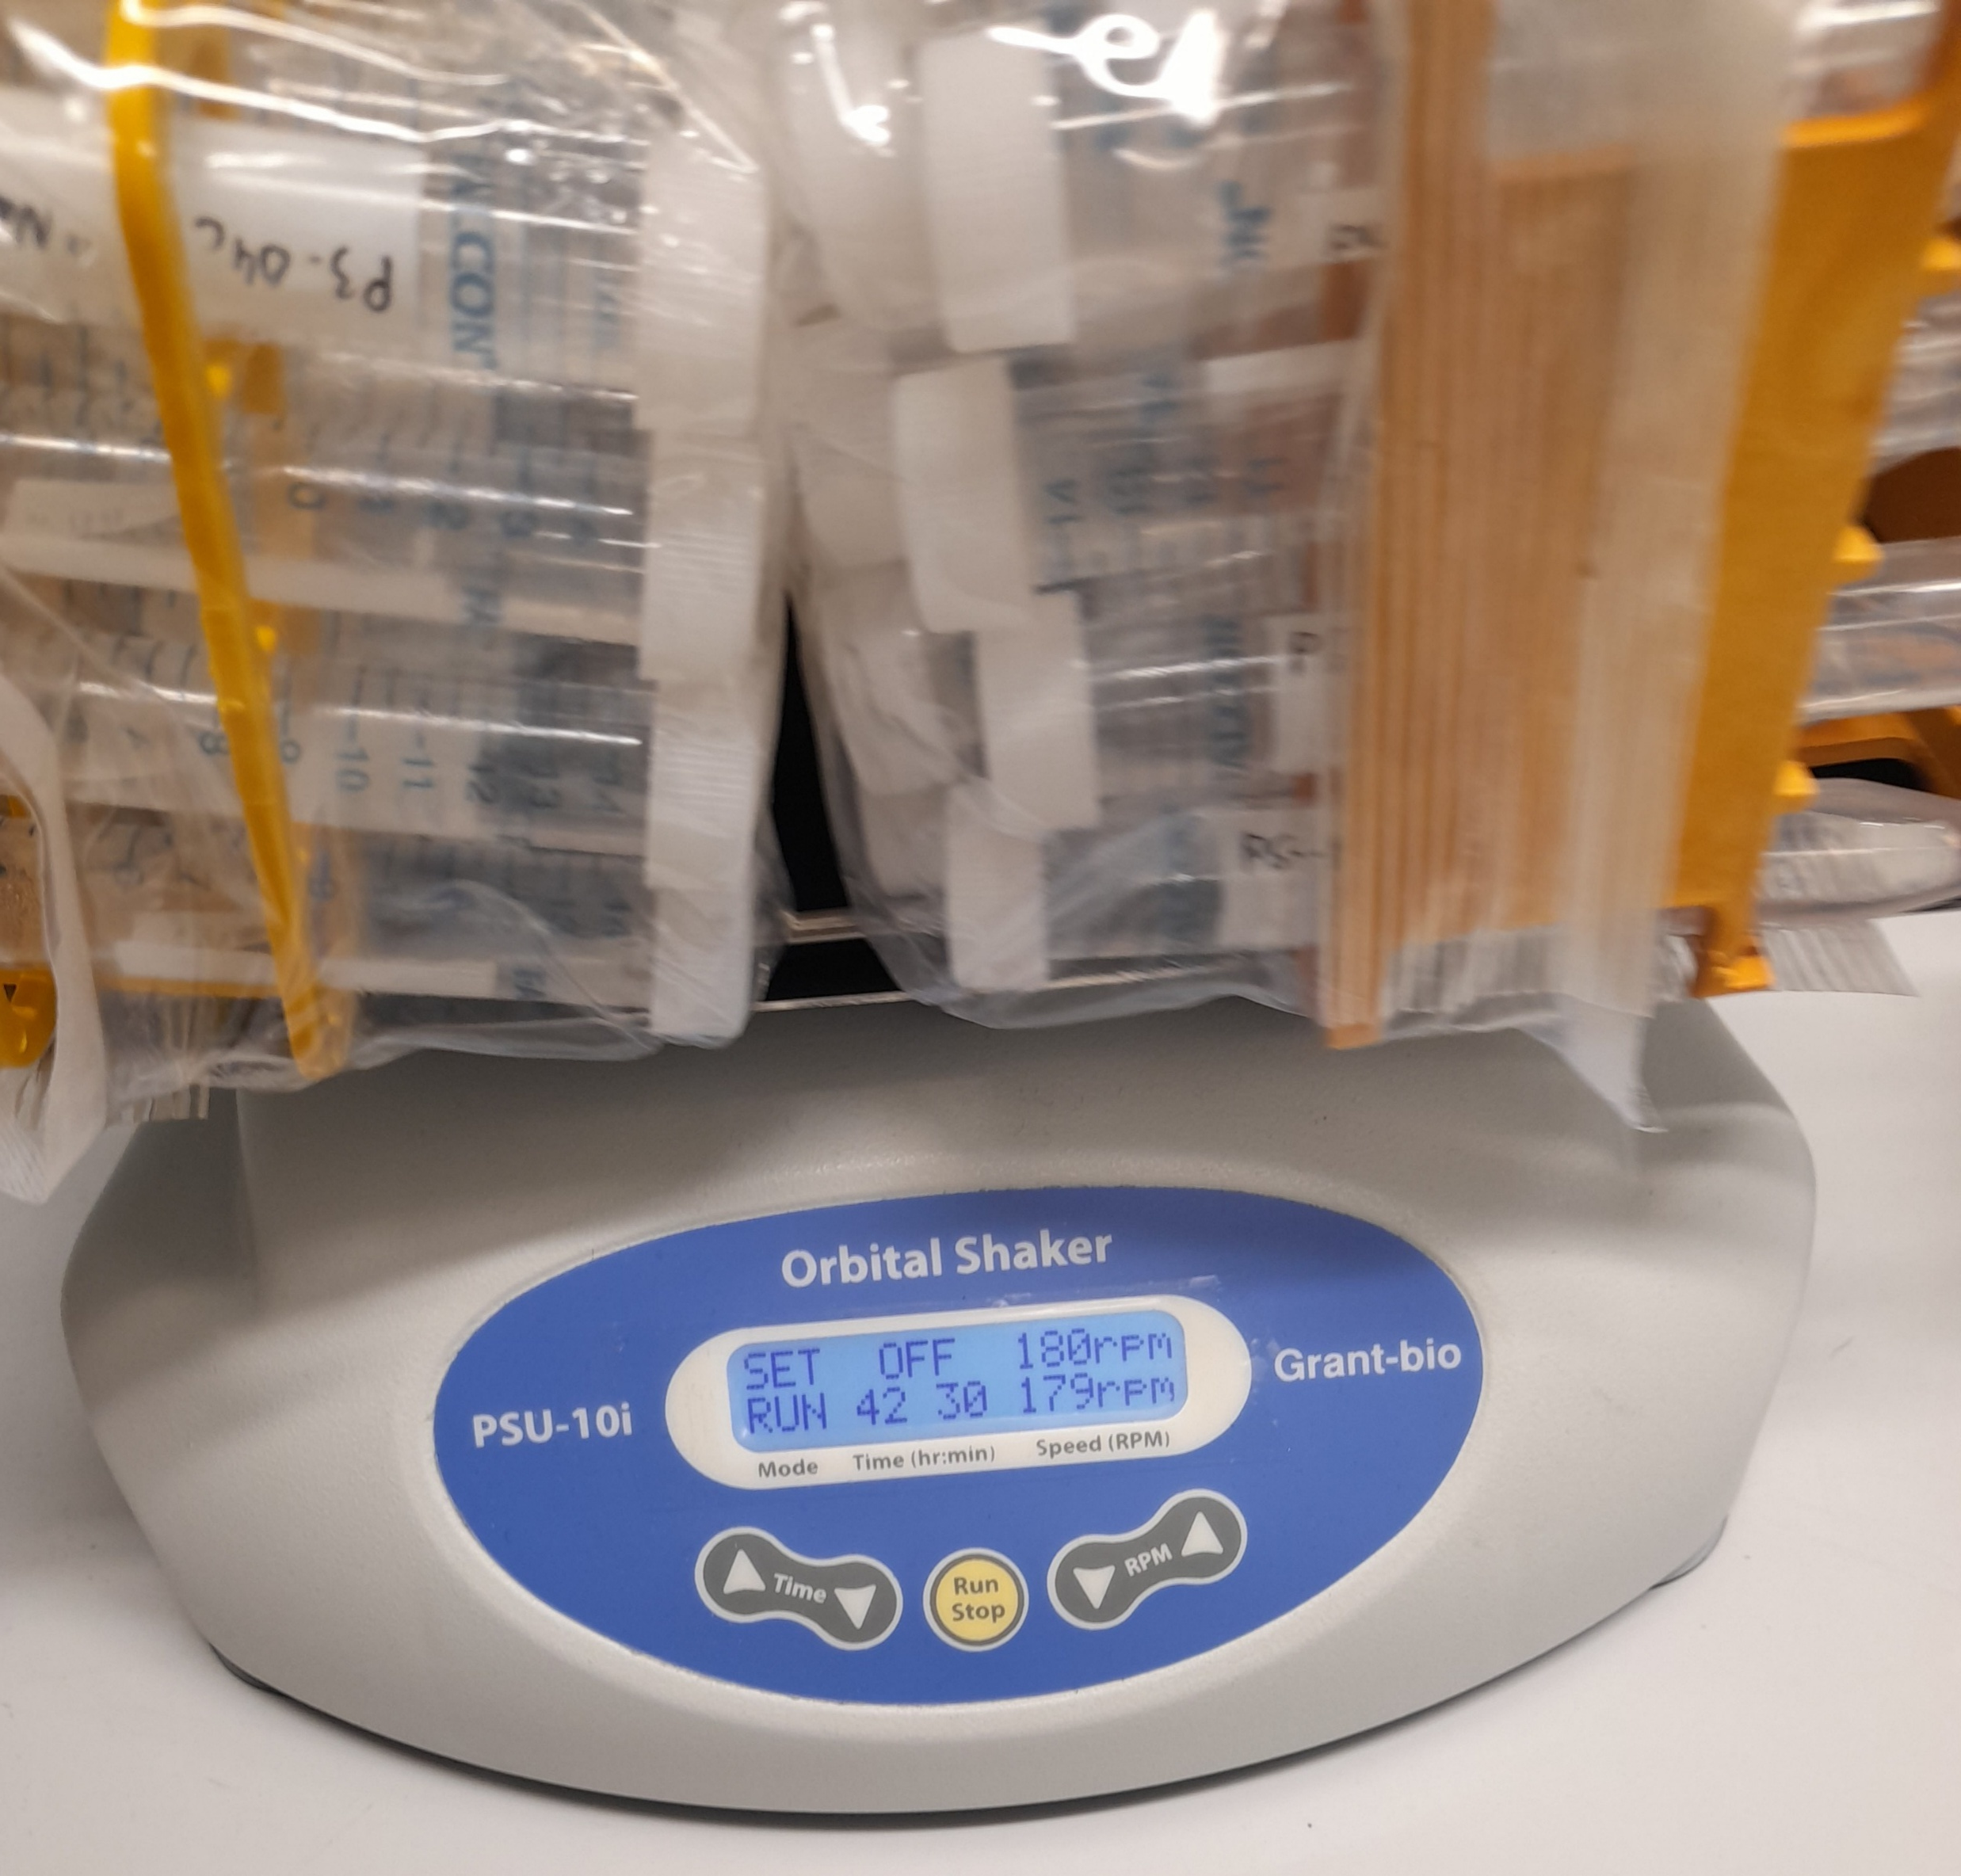
STEP 1
STEP 2
STEP 3
Sample preparation and leaching
(Voigt et al., 2020)
Nitrate quantification
(Miranda et al., 2001)
Major and minor elements
3.1) Dilute leached samples in 0,5M HNO3
1.1) 100 mg of sample + 10 ml of MQ H2O / Na₂CO₃
2.1) Dilute leached samples in water
3.2) Measure major (Na, K, Mg, Ca, Cl, S), and minor (Li, B, Br, Cr, As, I and Sr) elements concentrations using ICP-OES (Inductively coupled plasma optical emission spectroscopy)
2.2) vanadium (III) chloride reduction method → reduces NO₃⁻ to NO₂⁻, which then forms a purple-colored azo complex with high absorbance at 540 nm
2.3) Measure nitrate concentration using Spectrophotometry (Thermo Scientific Multiskan GO)
3.3) A multi-element calibration was performed using certified single-element standard solutions and five calibration points.
Reproducibility was typically better than ±0.18-13.29% SD for major elements and ±0.03-0.13% SD for trace elements, based on repeated measurements.
Table 1. Analytical precision and accuracy for nitrate (NOx) quantification by spectrophotometry. Cal 1 to 5 are the calibration range, and RM refers to the reference material (Anions-Whole Volume, Sigma-Aldrich).
1.2) Shake and centrifuge
ID | Target Concentration | Mean Measured Value | Standard Deviation | RSD | Recovery
 | [µM] | [µM] | [µM] | % | %
Cal 1 | 5 | 4.66 | 0.35 | 7.48 | 93.22
Cal 2 | 10 | 9.76 | 0.40 | 4.09 | 97.65
Cal 3 | 25 | 25.30 | 0.71 | 2.81 | 101.19
Cal 4 | 50 | 50.61 | 1.00 | 1.98 | 101.23
Cal 5 | 100 | 99.66 | 1.54 | 1.54 | 99.66
RM | 59.21 | 67.19 | 5.13 | 7.64 | 113.47
Method precision was better than 8% RSD
Recovery of 113.5% (n=90) of the RM

Slide 17
Supplementary
Soluble salt analysis
Sample preparation consists of grinding the solid samples in a quartz mortar
weighing 100 mg in a 15 ml tube, and adding 10 ml of deionized water.
Let the soluble salts leach out of the sample by shaking horizontally for 14 days at room temperature (~25°C).
Centrifuge and rinse three times with 1 ml of deionized water, and pipette off the supernatant.

Slide 18
Supplementary
Nitrate concentration was measured by spectrophotometry (Miranda et al. (2001), and Voigt et al. (2020))
the reduction of nitrate is achieved with vanadium (III) chloride and measured with Griess reactive.
In summary, 180 μl of the sample and standard solutions were placed into a 96-well microplate
+ 150 μl of a mixture containing 20 parts of vanadium (III) chloride (VCl₃) saturated solution, 1 part of sulfanilamide (SULF) solution 2%, and 1 part of N-(1-Naphthyl)ethylenediamine dihydrochloride (NEDD) solution 0,1% to each well.
Incubate for 60 minutes at 45°C
Measure the absorbance at 540 nm using a Thermo Scientific Multiskan GO plate reader.

Slide 19
Supplementary
Major and Minor ions (Na, Cl, Mg, K and As, Cr, I, Li, Sr, B, Br)
measured by inductively coupled plasma optical emission spectrometer (SPECTRO ARCOS ICP-OES).
The leached samples are diluted with 0.5M HNO₃, depending on their concentration, and measured in the ICP-OES.
The sulfate concentration of the samples is also measured in the ICP-OES, but as calcium sulfates dissolve to saturation in the leaching preparation, they must be dissolved with another solvent. We used 10 ml of 0.01M CaCO₃ to dissolve 100 mg of the sample (Voigt et al., 2020), shaking overnight at room temperature, centrifuge, and pipetting off supernatant, which is later measured in the ICP-OES.

Slide 20
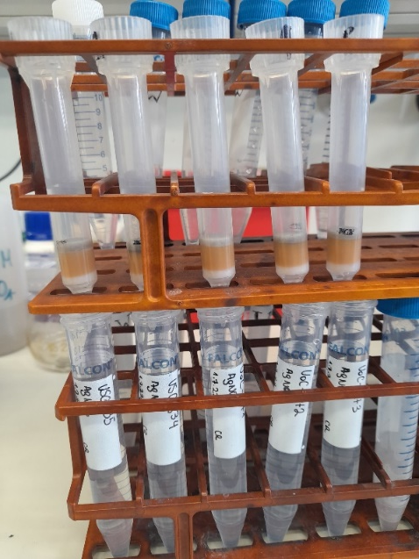
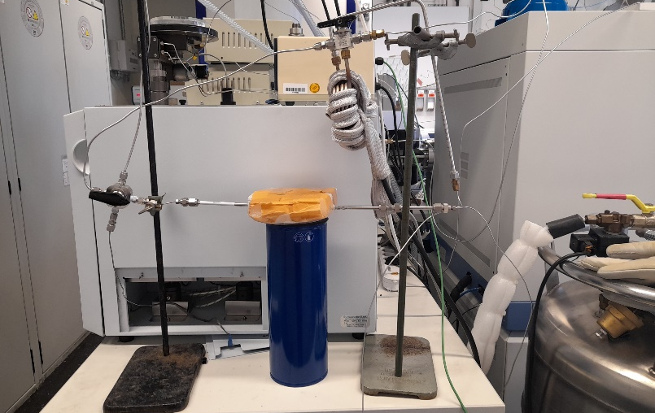
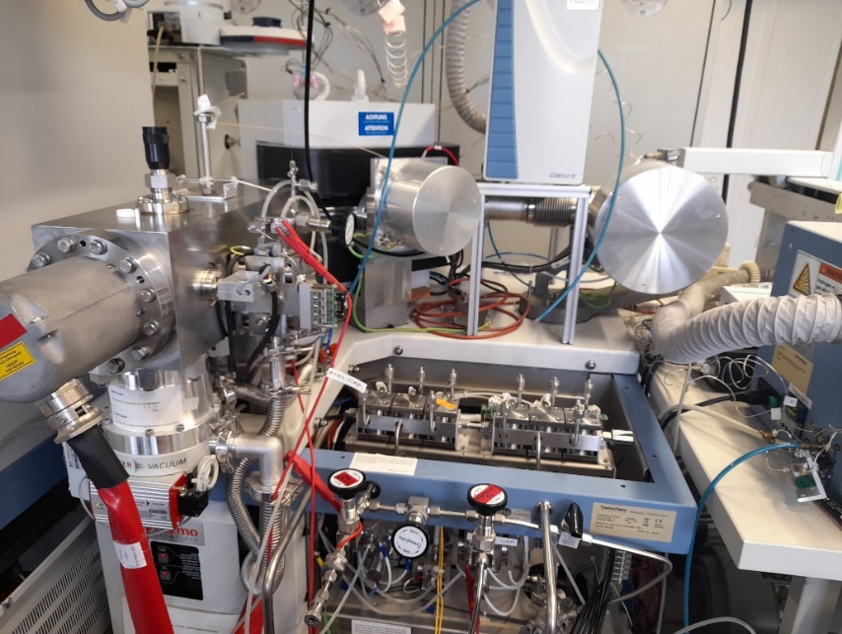
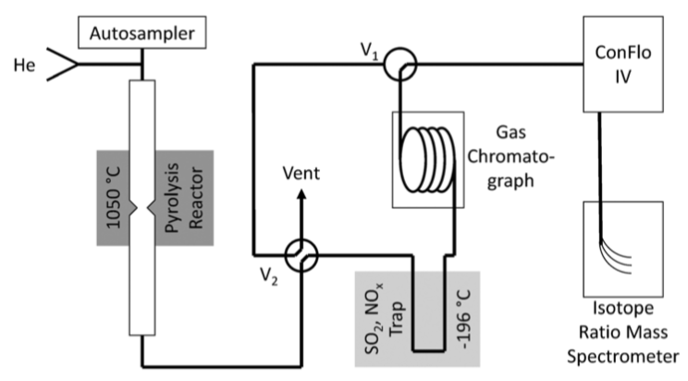
STEP 4
STEP 5
AgNO₃ generation for Triple oxygen isotope analysis
Thermal decomposition of AgNO₃
(1) Reactor furnace (580ºC)
(2) Condensation trap
(3) 1.5 m gas chromatography (GC) column
(4) Open Split interface (ConFloIV)
(5) Isotope ratio mass spectrometer (IRMS, MAT 253)
(3)
(4)
(1)
(2)
(5)
Silva et al. (2000);Gázquez & Claire (2018); Klipsch et al. (2021)
(4)
Oxygen isotope ratios (δ¹⁸O, δ¹⁸O, Δ¹⁷O) were normalized to the VSMOW (Vienna Standard Mean Ocean Water) scale
in-house nitrate standards calibrated against USGS-34 and USGS-35 reference materials (Böhlke et al., 2003; Michalski et al., 2002).
Analytical reproducibility was better than
±0.6‰ for δ¹⁸O and ±0.1-0.16‰ for Δ¹⁷O (1σ).
(1)
(3)
580°C
(2)
(5)
Pyrolysis method for AgNO3 thermal decomposition. Modified from Schauer et al. (2012) and Klipsch et al. (2021).
AgNO_{3(s)}→1/2 O_{2(g)} + NO_{2(g)} + Ag_{(s)} + N_{2(g) (trace)}
20

Slide 21
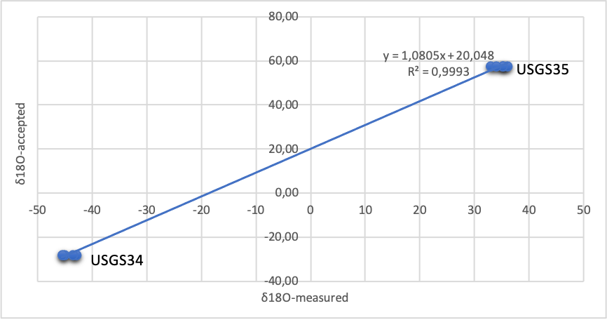
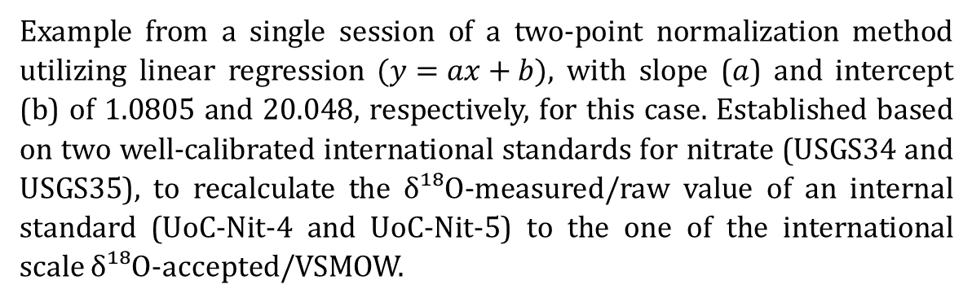
Example from a single session of a two-point normalization method utilizing linear regression $(y=ax+b)$, with slope ($a$) and intercept (b) of 1.0805 and 20.048, respectively, for this case. Established based on two well-calibrated international standards for nitrate (USGS34 and USGS35), to recalculate the δ¹⁸O-measured/raw value of an internal standard (UoC-Nit-4 and UoC-Nit-5) to the one of the international scale δ¹⁸O-accepted/VSMOW.
Notes:
To ensure traceability to international reference scales, oxygen isotope data (δ¹⁸O_{NO3} and Δ¹⁷O_{NO3}) were normalized using internal laboratory reference materials previously calibrated against internationally recognized reference materials USGS34 and USGS35 (Böhlke et al., 2003, and Michalski et al., 2002). Initially, two in-house nitrate standards (UoC-Nit-2 and UoC-Nit-3; see Appendix A2.1 for elaboration of standards) were calibrated against USGS34 (δ¹⁸O = –27.9‰, Δ¹⁷O = –0.1‰) and USGS35 (δ¹⁸O = +57.5‰, Δ¹⁷O = +21.6‰), following the normalization approach of Skrzypek (2012). A two-point linear regression was constructed for δ¹⁷O and δ¹⁸O separately (e.g., Figure 6.2), to calculate the slope and intercept between the measured (in-house standards) and accepted values (international reference materials). Measured standards values were then normalized by applying the regression line parameters for each analytical session.
The normalized Δ¹⁷O values of UoC-Nit-2 (δ¹⁸O = -9.6‰, Δ¹⁷O = +19.2‰) and UoC-Nit-3 (δ¹⁸O = -8.7‰, Δ¹⁷O = +26.6‰) were then used to calibrate sample data, ensuring that all reported Δ¹⁷O values are traceable to the VSMOW reference scale.
However, because UoC-Nit-2 and UoC-Nit-3 exhibited similar δ¹⁸O values (~ -9‰), δ¹⁸O normalization could not be accurately constrained during initial analyses. To address this, a second pair of in-house standards UoC-Nit-4 (δ¹⁸O = +40‰, Δ¹⁷O = 12.8‰) and UoC-Nit-5 (δ¹⁸O = +70‰, Δ¹⁷O = +21‰) were develop to extend the δ¹⁸O range (see Appendix A2.1 for elaboration of standards). These standards were likewise normalized against USGS34 and USGS35 using the same regression approach (Figure 6.2) as described above for both δ¹⁸O and Δ¹⁷O. This ensured consistent scale realization across both isotopic systems.
The external reproducibility (1σ) of the initial analysis, calibrated method with UoC-Nit-2 and UoC-Nit-3, is better than ±0.16‰ for Δ¹⁷O after rejecting all data that differ more than 0.91‰ (3σ reproducibility), and was determined as the standard deviation of repeated measurements (n=481) of internal standards calibrated against external reference materials USGS-34 and USGS-35 (Böhlke et al., 2003, and Michalski et al., 2002). For the analysis calibrated with UoC-Nit-4 and UoC-Nit-5, the external reproducibility (1σ) is better than ±0.6‰ for δ¹⁸O and ±0.1‰ for Δ¹⁷O after rejecting all data that differ more than 3.1‰ for δ¹⁸O, and 0.4‰ for Δ¹⁷O (3σ reproducibility), and was also determined as the standard deviation of repeated measurements (n=161) of internal standards calibrated against external reference materials. All isotope ratios are reported in per mil (‰) relative to VSMOW, and Δ¹⁷O was calculated using equation 3.4, with λ = 0.52 (see Section 3.1.3).

Slide 22
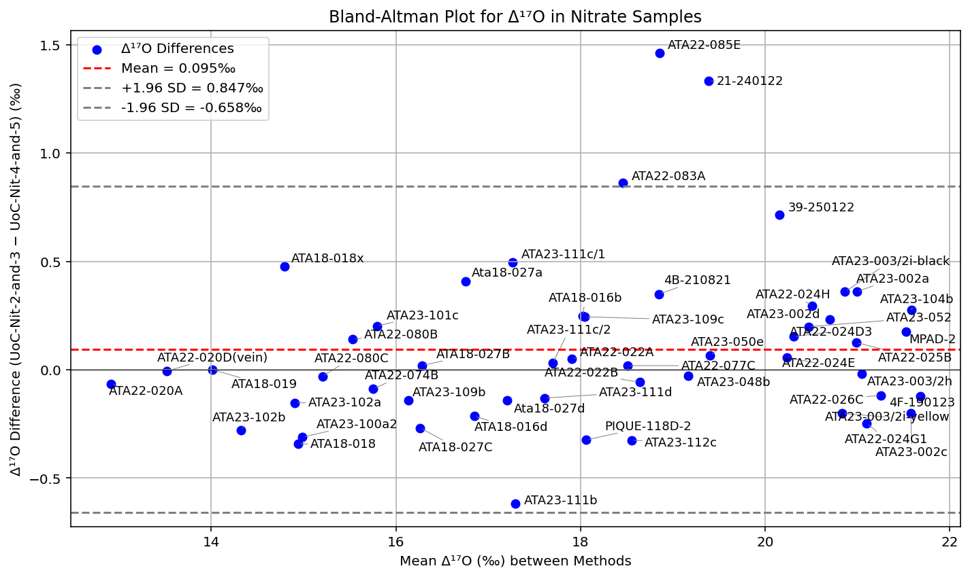
A) Bland-Altman plot comparing Δ¹⁷O in nitrates normalized with UoC-Nit-2/3 versus UoC-Nit-4/5. The mean difference was 0.095‰ and with a p-value of 0.081(paired t-test), indicating no significant systematic bias
Notes:
To assess the consistency between the two normalization schemes (UoC-Nit-2/3 and UoC-Nit-4/5), Δ¹⁷O values for replicate samples measured under both calibrations were statistically compared. Bland–Altman (B&A) analysis is used for assessing the method comparability, evaluating a bias between the mean differences (Bland and Altman, 1986; Giavarina, 2015). For the Δ¹⁷O analysis under the two normalizations, the B&A analysis shows a mean difference of 0.095‰, with a paired t-test indicating no significant offset (p = 0.081) between methods (Figure 6.3A). Linear regression yielded a slope of 0.956, an intercept of 0.710‰, and R² = 0.977 (p < 0.001), demonstrating near-unity proportionality and strong agreement (Figure 6.3B). These results confirm that both normalization schemes are analytically consistent within the uncertainty of Δ¹⁷O measurements (typically ± 0.1–0.16‰), and data from the two methods can be confidently combined for interpretation.
The absence of a statistically significant bias between normalization schemes indicates that differences in the isotopic range of internal standards (UoC-Nit-2/3 vs. UoC-Nit-4/5) did not affect the scale realization for Δ¹⁷O. Therefore, all normalized data are considered directly comparable on the VSMOW reference scale. Finally, the Δ¹⁷O normalized value was calculated with the average between the two methods for each sample.

Slide 23
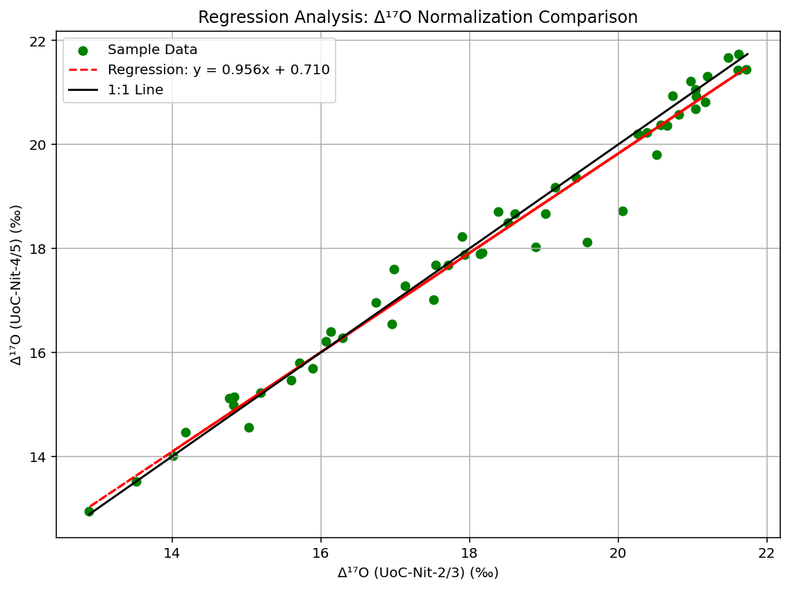
B) Regression plot comparing Δ¹⁷O from the same normalization strategies in A). The regression line (y = ax + b) closely follows the 1:1 line, with R² = 0.977 and p-value <0.001, confirming strong agreement and linearity, with a relation between the two methods highly significant statistically.
Notes:
For samples with multiple replicates, the mean and standard deviation (1σ) based on repeated analyses of each sample are reported. When only a single valid measurement was available (n = 1), the analytical uncertainty was estimated using the external reproducibility of the method, representing external analytical precision under identical instrumental conditions (Coplen, 2011; Paul et al., 2007). For combined Δ¹⁷O datasets obtained from both normalization schemes (UoC-Nit-2/3 and UoC-Nit-4/5), the overall analytical precision was calculated using the pooled standard deviation, following McDonald (2014).

Slide 24
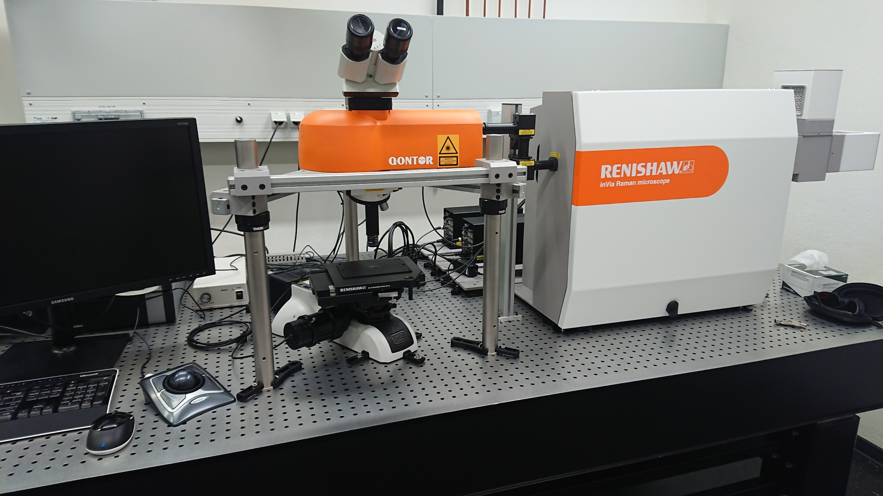
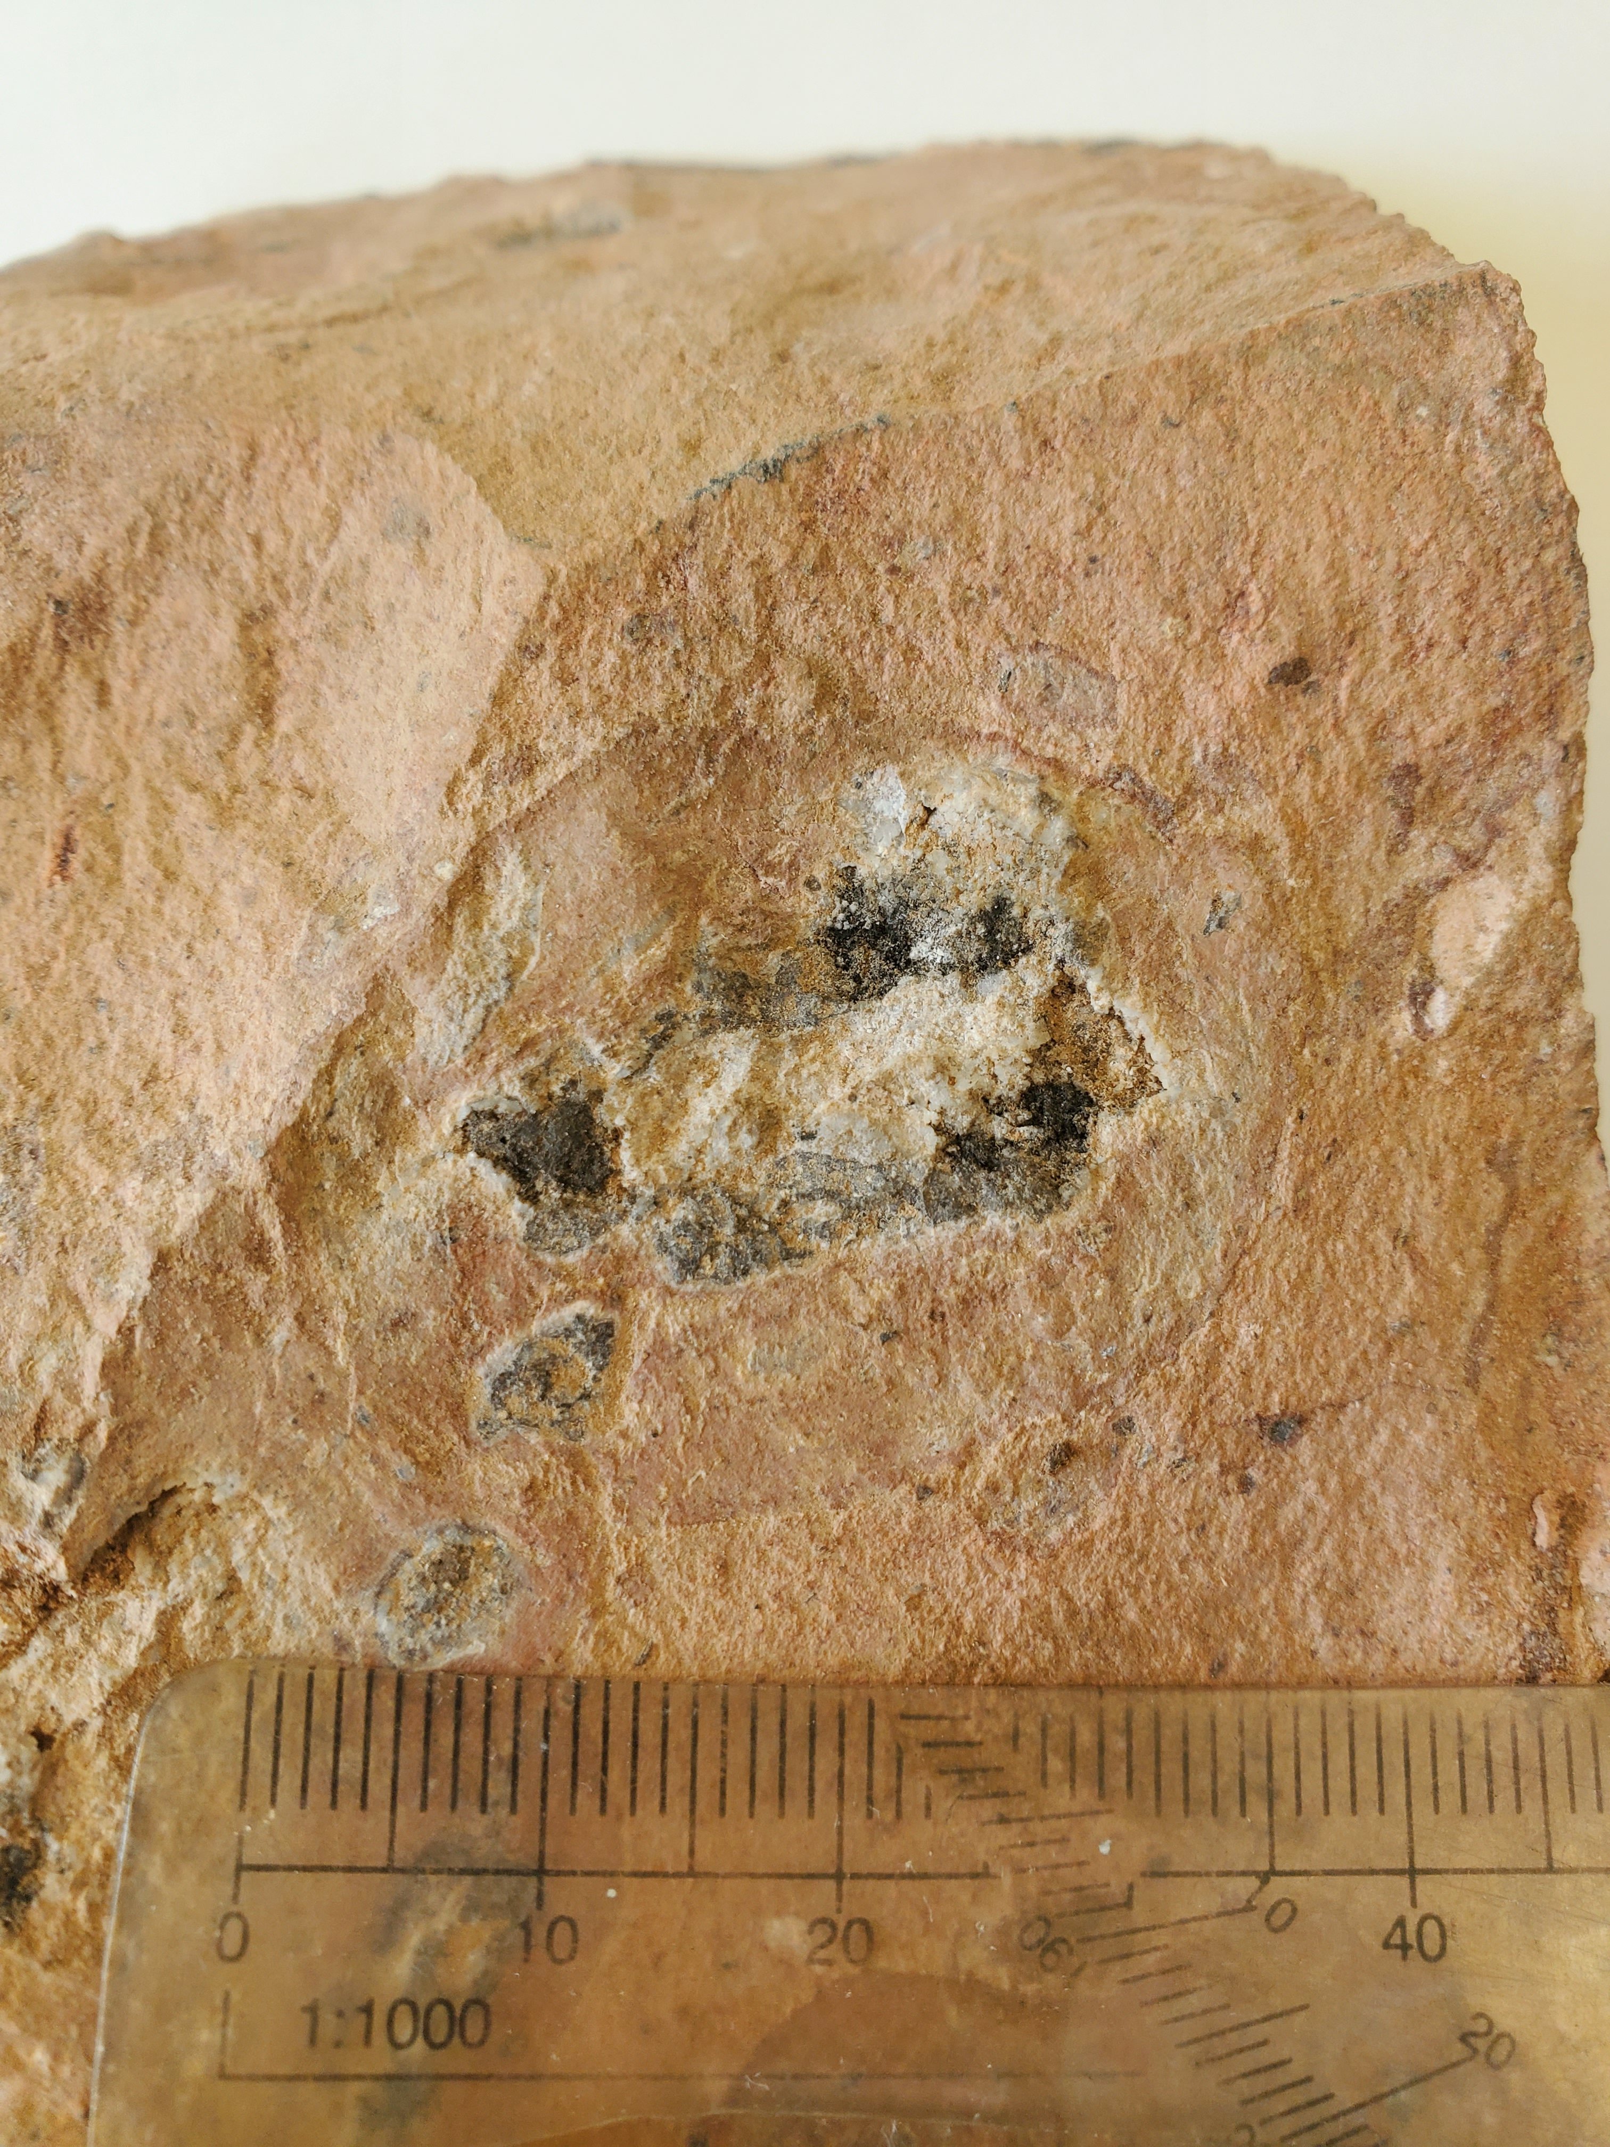
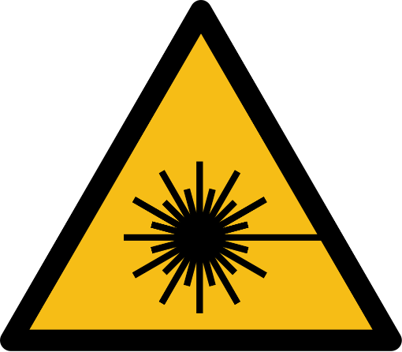

Raman Spectroscopy
Laser sources
Raman spectra were used for mineralogical characterization of exsolution phases in nitrate-host rhyolites from Oficina Domeyko
Renishaw InVia Qontor spectrometer with a 532 nm Nd;YAG laser (100mW) in backscatter geometry
The instrument was calibrated with a silicon standard, and all spectra were background-corrected.
Microscope
Spectrometer
Computer
XYZ-table
In collaboration with Dr.
Christoph Lenting

Slide 25
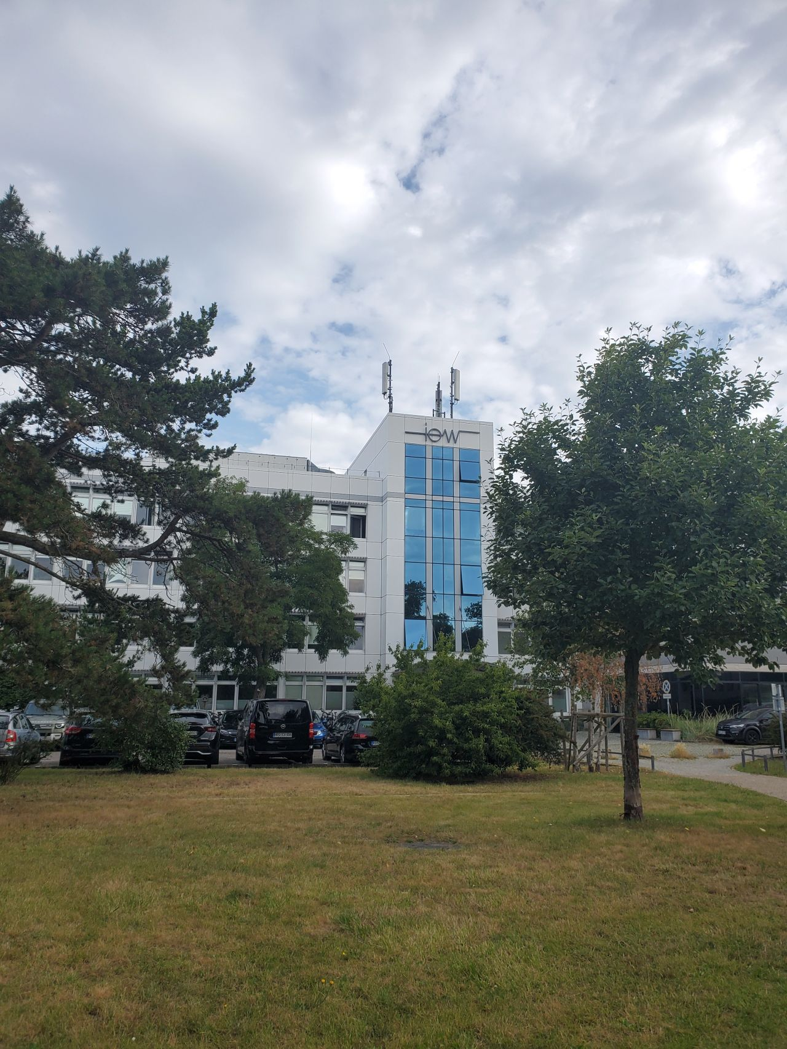

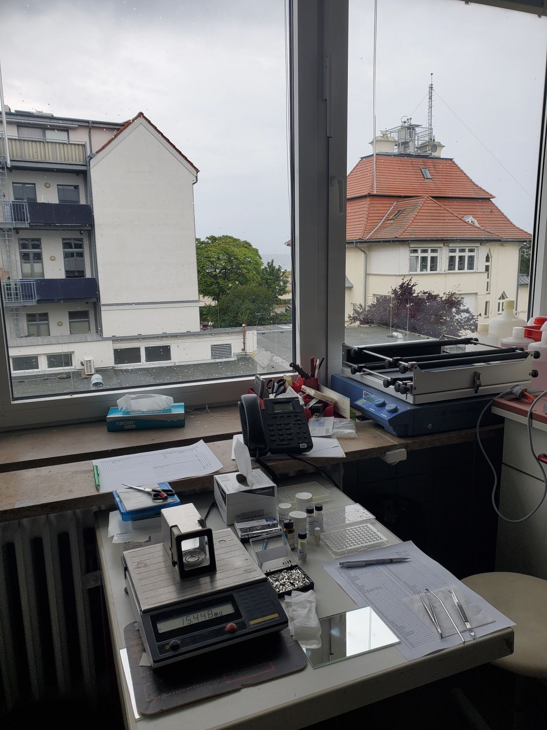

External measurements → δ¹⁵N and δ³⁴S
Combustion method → Thermo Scientific Flash EA Isolink Elemental Analyzer (EA), interfaced via a CF-IRMS
δ¹⁵N → reported relative to AIR
calibrated using IAEA-N-1 and IAEA-N-2 standards.
Analytical precision was better than ±0.15‰ (1σ; Pollmann et al., 2021).
δ³⁴S → was determined on barite precipitates derived from nitrate-associated sulfate and thenardite samples
Normalized to the VCDT (Vienna Canyon Diablo Troilite) scale with international reference materials (IAEA-S-2, IAEA-S-3, NBS 127).
External reproducibility was better than ±0.1‰ (1σ; Klipsch et al., 2023).
In collaboration with Prof. Dr.
Michael E. Böttcher.

