Slide 1





A preliminary study of the morphology and spatial distribution of funerary elements in Oman
Session: ESSI 1.7
EGU26-11193 PICO spot 2, PICO 2.5 06 May
Ana Sofia Meneses Pineda
and
Marco Solinas

Slide 2
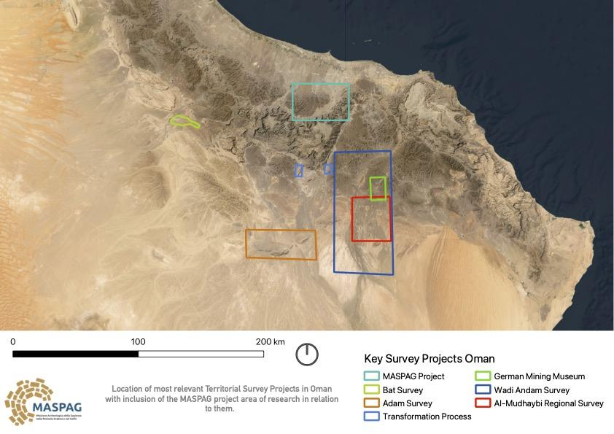
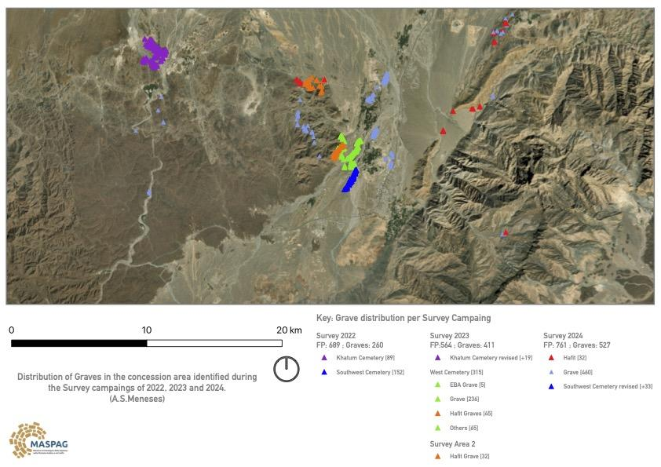
Archaeological Context
Ex novo context discovered in 2022 by the Sapienza sponsored MASPAG archaeological mission.
Multi Millenary context: Hafit Period > Umm an-Nar > Wadi Suq > Iron Age.
Funerary and Settlement contexts.
Ana Sofia Meneses – anasofia.menesespineda@uniroma1.it Marco Solinas – marco.solinas@ingv.it

Slide 3
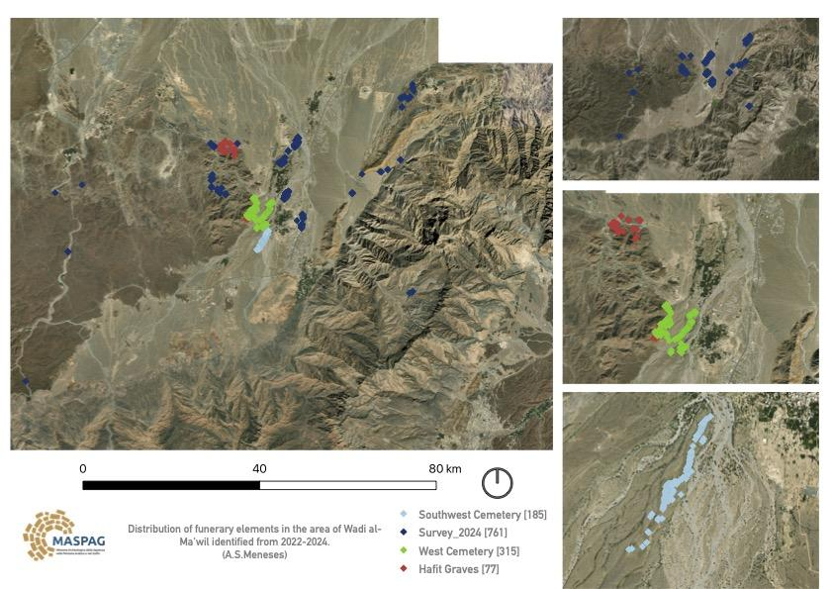
Archaeological Context
Funerary remains: One Necropoli and Two Cemeteries
West Cemetery: 315 tombs
Southwestern Cemetery: 185 tombs
Southwestern Cemetery: 185 tombs
Four geometric categories:
Circular
Rectangular
Ogival
Squared
On-site classification into categories and individual measurements.
Software used: Mergin Maps
Measurements taken: Diameter, Length, Width and Height
Ana Sofia Meneses – anasofia.menesespineda@uniroma1.it Marco Solinas – marco.solinas@ingv.it

Slide 4
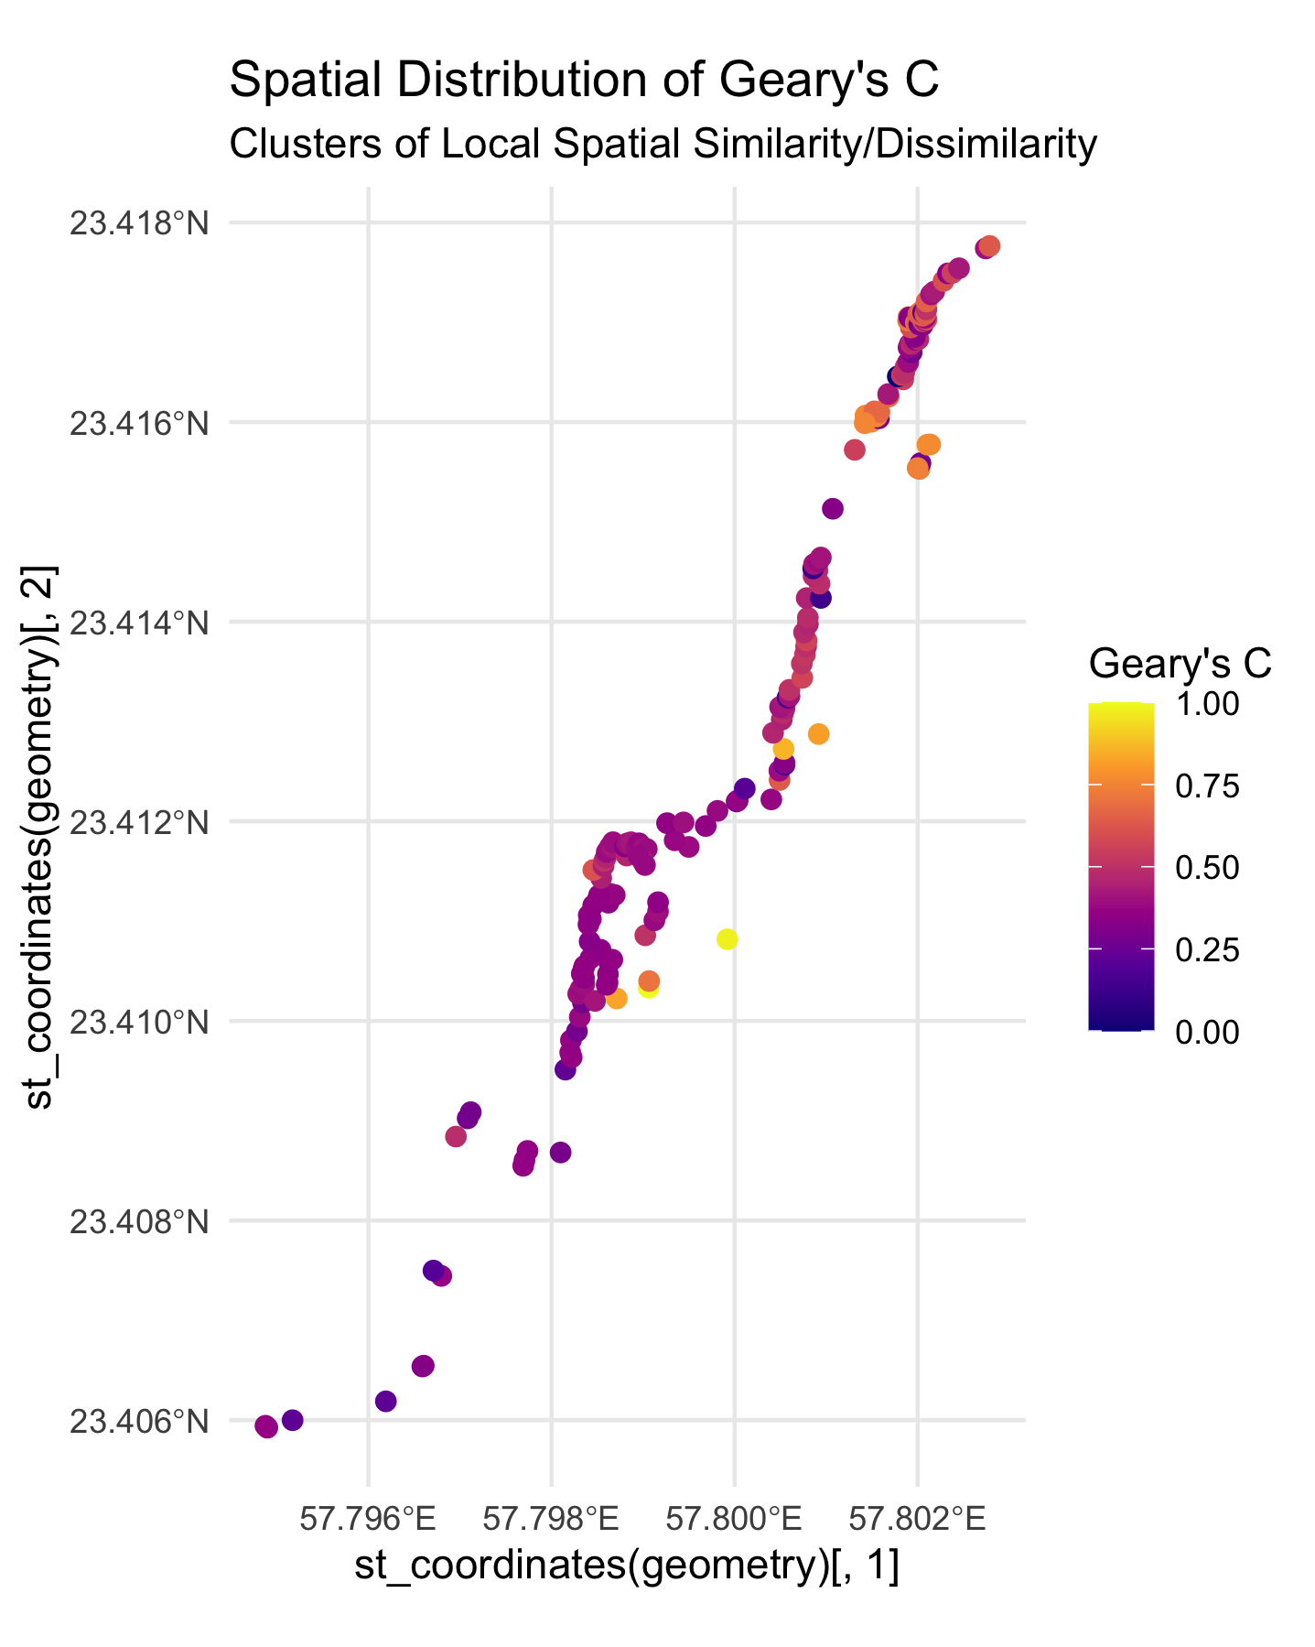
Spatial Statistics: Spatial Autocorrelation
Studies based solely in the Diameter and the Length.
Spatial Autocorrelation:
Moran’s global and local test: Similar values, with moderate strength.
Geary C’s test: C < 1
Positive results both tests identified the spatial autocorrelation as highly significant.
Discarded the randomness in the Spatial distribution of the funerary elements in the Southwestern Cemetery.
High spatial autocorrelation suggest the presence of clear spatial patterns embodied in the clustering of similar funerary elements.
Ana Sofia Meneses – anasofia.menesespineda@uniroma1.it Marco Solinas – marco.solinas@ingv.it

Slide 5
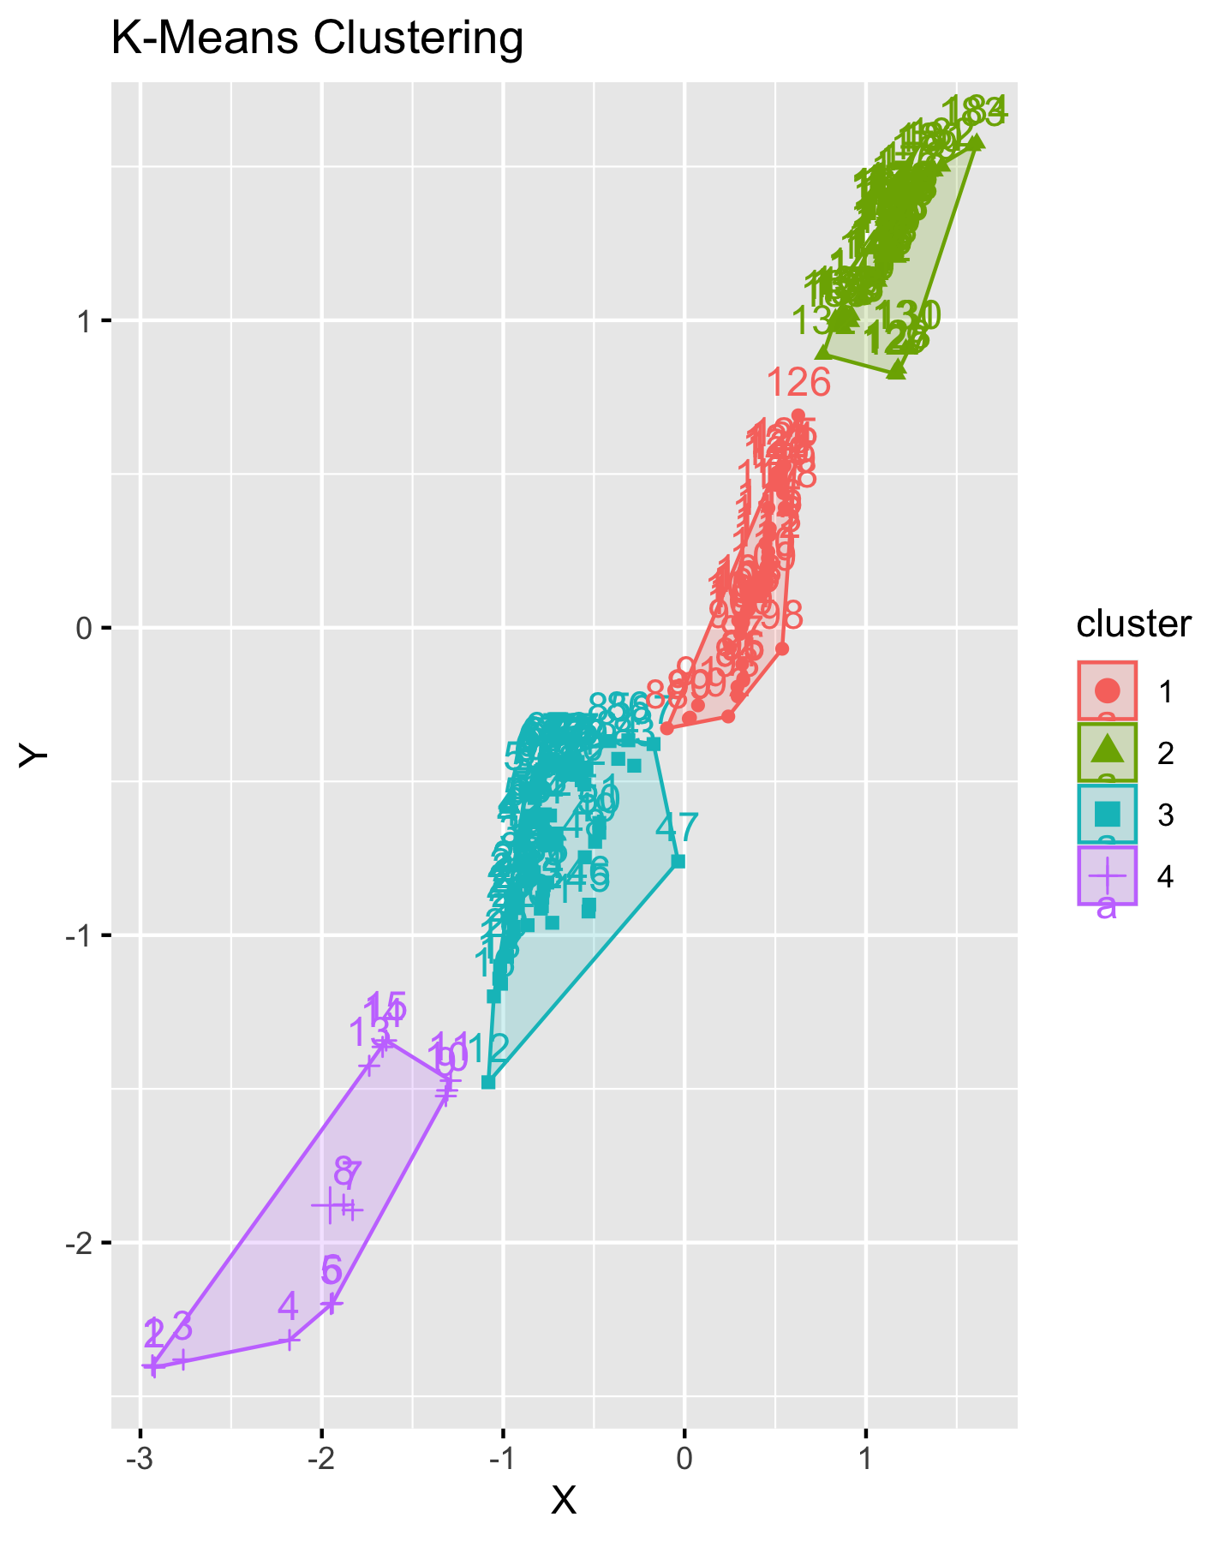
Spatial Statistics: Cluster Analysis
Elbow and Silhouette method to determine the optimal number of clusters for the dataset.
Result: 4 clusters.
K-Means clustering method for unsupervised classification, it assigns points to the nearest cluster centroid.
Higher concentration of points in the cluster number 3.
DBSCAN Clustering method is used to identify dense regions, local clusters and outlier points.
It shows a general clustering of 2 tombs at a local level, with few outlier tombs towards the southern part of the cemetery.
Ana Sofia Meneses – anasofia.menesespineda@uniroma1.it Marco Solinas – marco.solinas@ingv.it

Slide 6
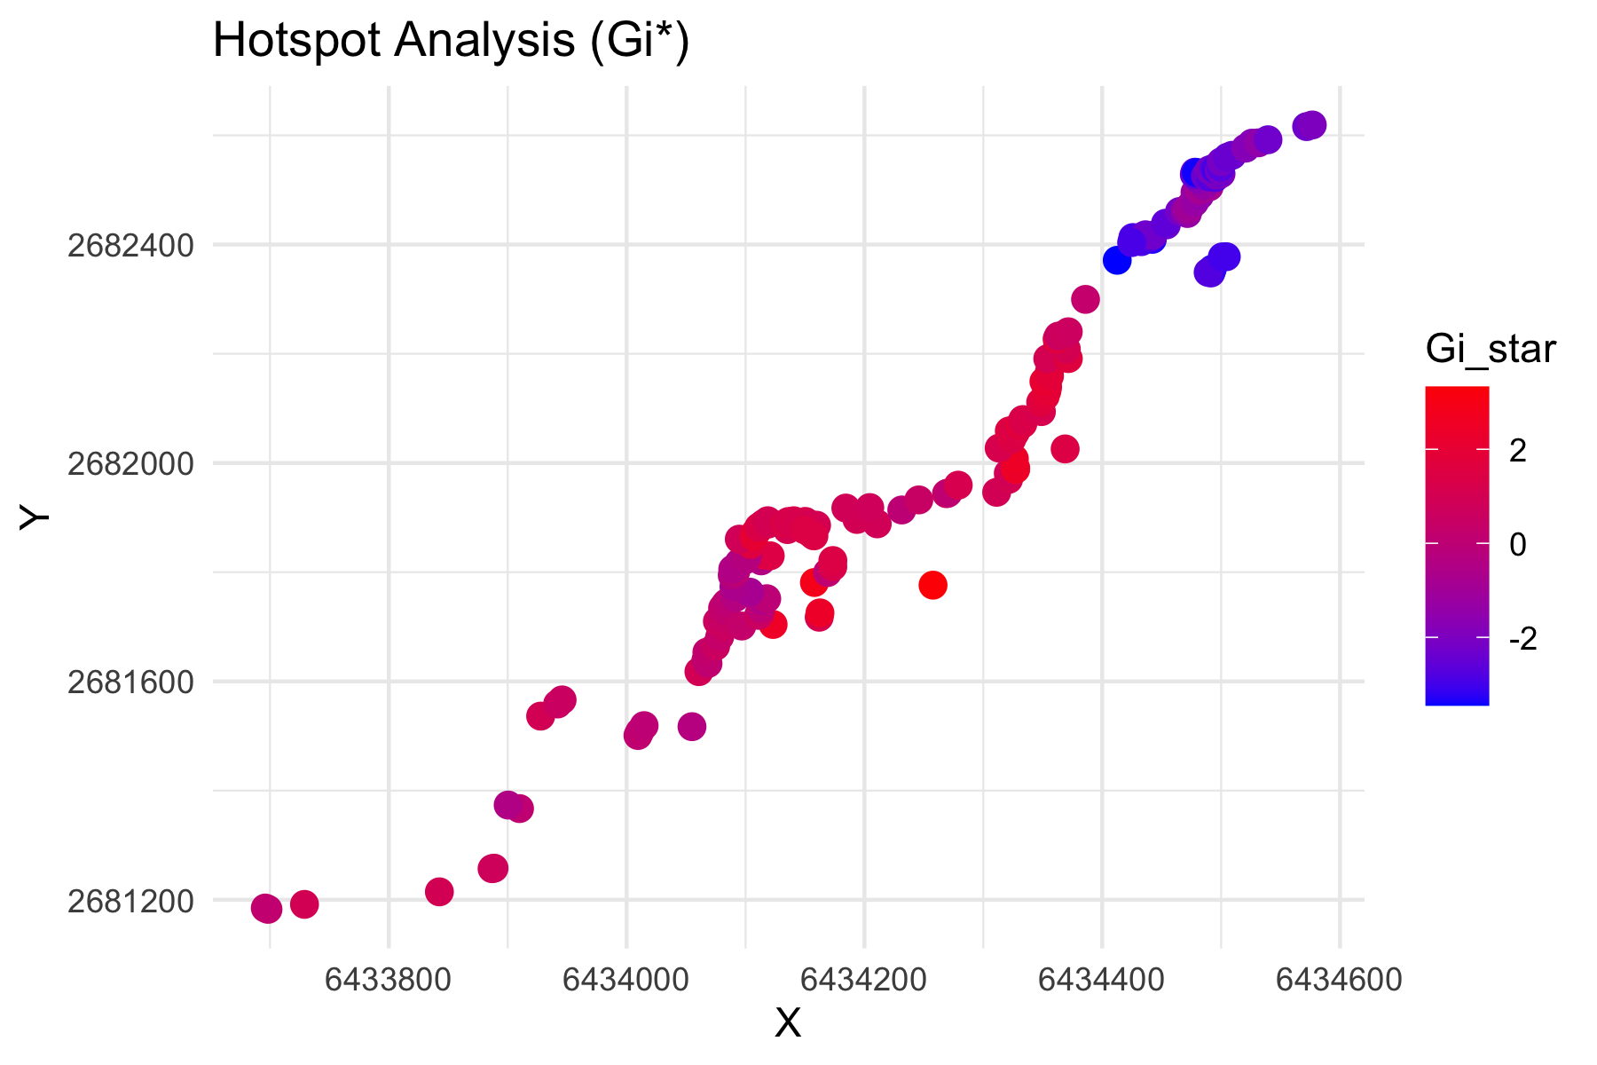
Spatial Statistics: Hotspot Analysis (Gi* statistic)
Hotspot analysis identifies values that cluster together and have any significance at a statistical level.
Hotspot and Coldspots
Evaluation of each feature in relation to its context.
It produced a z-score that reflect how significant the attribute deviates from a random spatial distribution.
Intensity of the hotspots and coldspots measured.
Reveals underlying patterns of spatial distribution that can be due to predefined choices or to environmental constraints.
Ana Sofia Meneses – anasofia.menesespineda@uniroma1.it Marco Solinas – marco.solinas@ingv.it

Slide 7
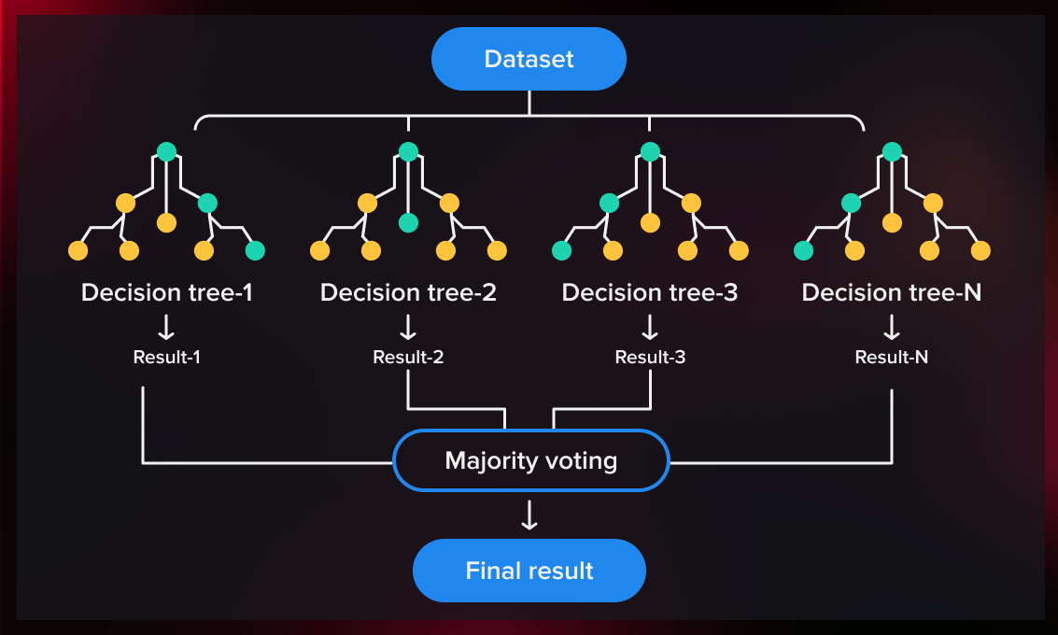
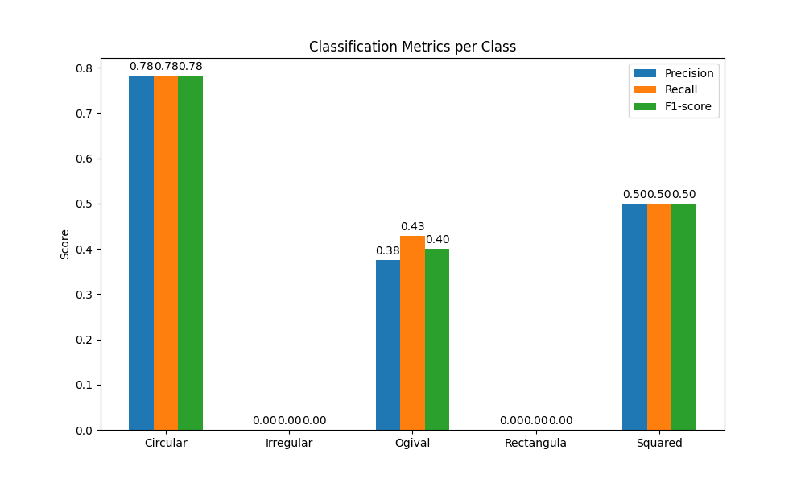
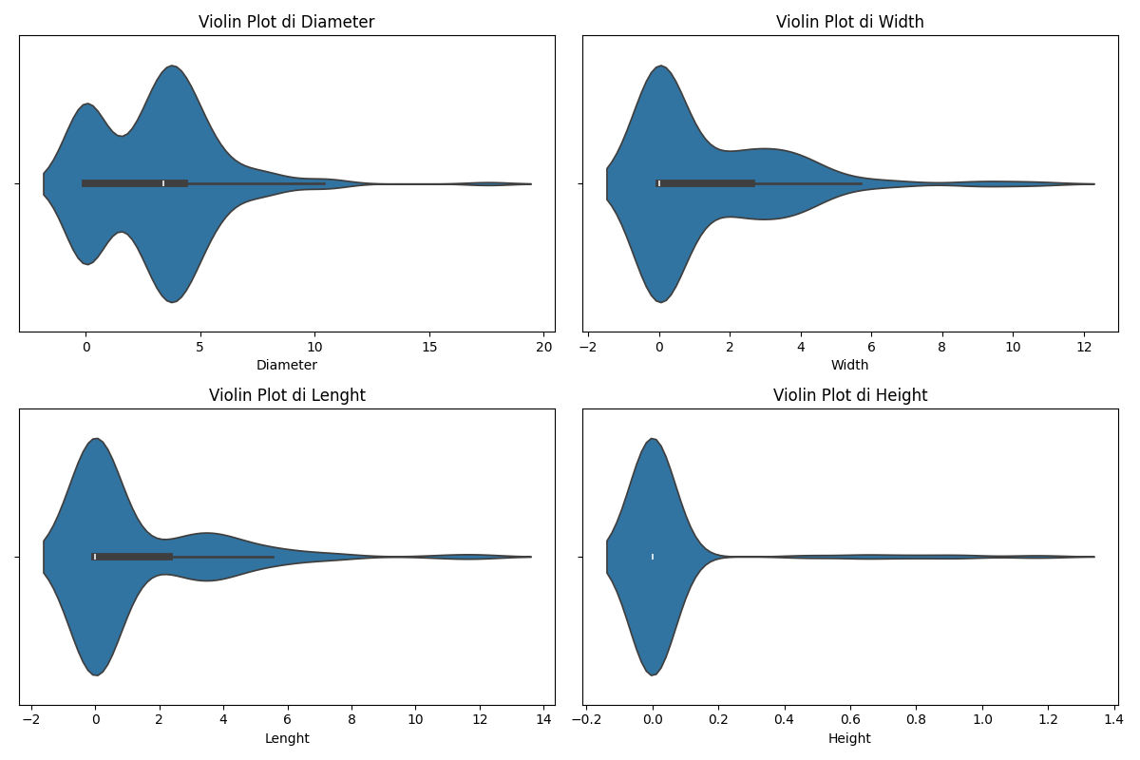
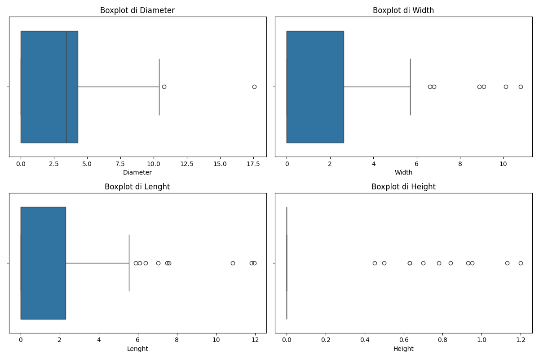
Random Forest model based on geometric dimensions
Model based exclusively on geometric dimensions: Diameter, Length, Width, Height.
Random Forest with basic configuration: decision trees and majority voting.
Overall accuracy: approximately 59.5%.
Limitations: class imbalance and poor discrimination of less frequent tomb types.
Ana Sofia Meneses – anasofia.menesespineda@uniroma1.it Marco Solinas – marco.solinas@ingv.it
Notes:
In the first model, we applied a Random Forest algorithm using only the geometric measurements of the tombs—diameter, length, width, and height—without any spatial or contextual information. As shown in the diagram at the top right, the Random Forest model creates multiple decision trees that collectively vote to determine each tomb’s final class. However, by relying solely on these geometric attributes, we achieved an overall accuracy of 59.5%. Looking at the chart at the bottom left, we see that the classification metrics (precision, recall, and F1-score) are very high for the ‘Circular’ class only, while they are extremely low—sometimes even absent—for all other tomb types, underscoring a major limitation of the model. The violin plots and boxplots on the right further illustrate the large variability and outliers in the geometric measurements, highlighting that these dimensions alone are insufficient to accurately differentiate rarer or less distinctly defined tomb shapes. These constraints primarily stem from the severe class imbalance in the dataset, which causes the model to favor the dominant class (Circular) while almost completely overlooking the less represented tomb types.

Slide 8
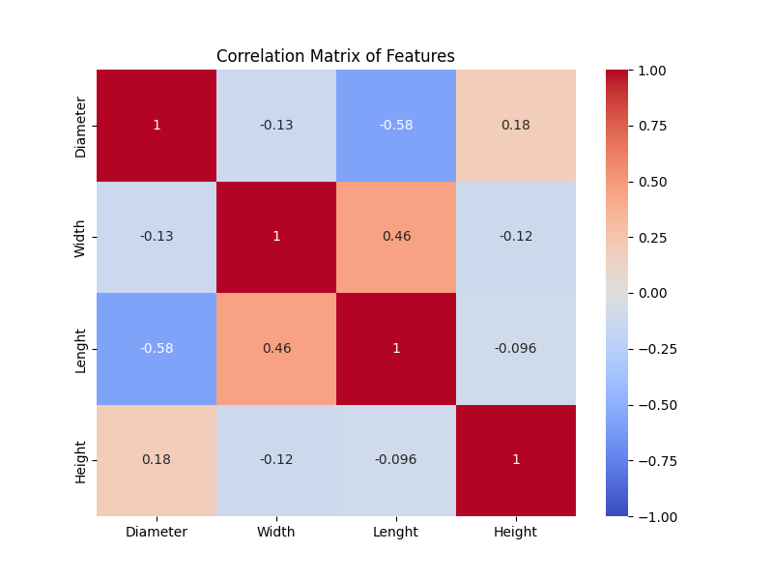
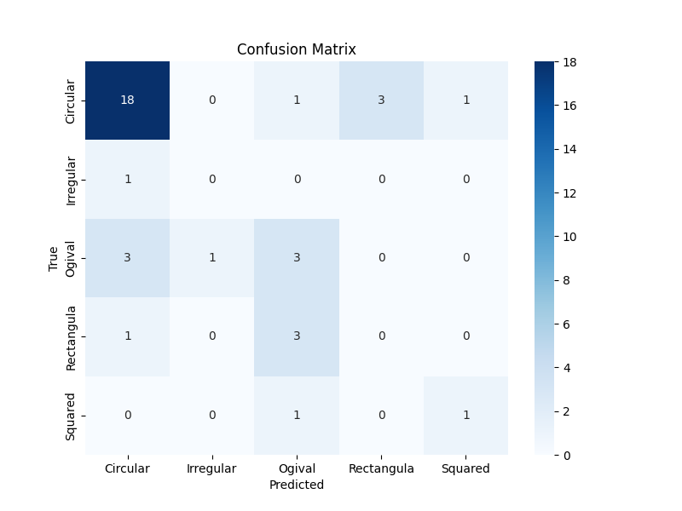
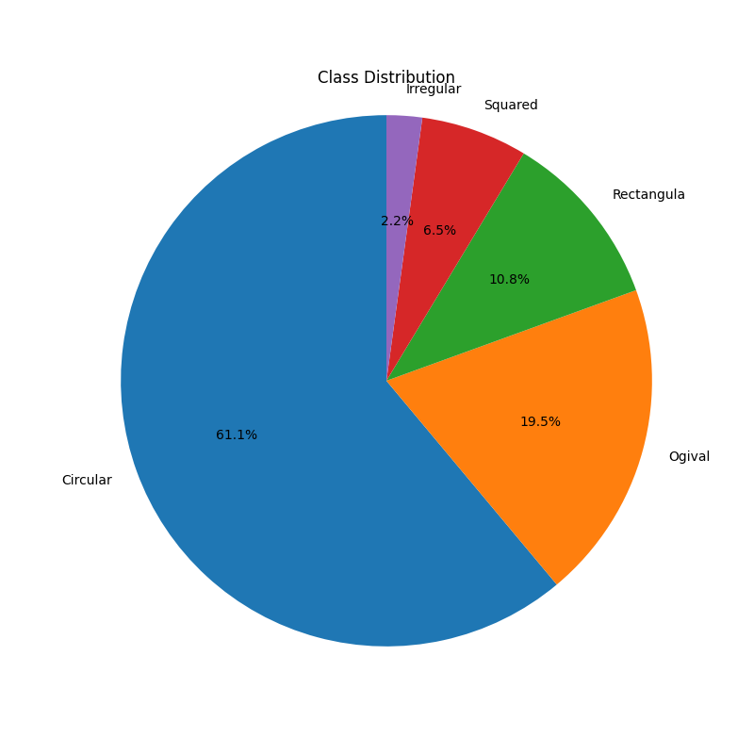
Limitations of the initial approach
Clear class imbalance (dominance of the Circular class).
Low effectiveness in recognizing non-circular shapes.
Absence of spatial context.
It suffers from misclassification and overfitting problems.
Ana Sofia Meneses – anasofia.menesespineda@uniroma1.it Marco Solinas – marco.solinas@ingv.it
Notes:
When critically examining the first approach that relies exclusively on geometric dimensions, several significant shortcomings become apparent. By looking at the pie chart on the right, we can immediately see the pronounced class imbalance: the ‘Circular’ class accounts for over 60% of the dataset, overwhelmingly dominating the other tomb shapes. In the confusion matrix at the center, we can clearly see how this imbalance negatively impacted the model. Most predictions cluster around the Circular class, with very few correct identifications of other classes and a considerable number of misclassifications. This highlights the model’s struggle to recognize less frequent tomb types, such as ‘Irregular’ or ‘Rectangular.’ Finally, the correlation matrix on the left reveals that the geometric variables used exhibit both positive and negative inter-correlations, suggesting that geometric measurements alone are not sufficiently distinctive to accurately identify all the various tomb types. These results make it evident that, to significantly enhance the model’s performance and resolve these issues, additional spatial data must be integrated to capture the genuine differences among the diverse tomb types.

Slide 9
Random Forest model integrated with spatial analyses
Model enhanced with spatial analysis in R (clustering, hotspot detection, autocorrelation).
Significant improvement in accuracy (75.7%).
Better classification of less frequent tomb types.
Input
Geometric dimensions
Process
Output
Diameter, Length, Width, Height
Hotspot & Autocorrelation
Integrated Random Forest Model
Classification of Tombs Types
Gi*, Moran’s I
Geometric data + spatial variables
Circular-Ogival-Irregular-Rectangular
Clustering Analysis (via R)
K-Means, DBSCAN
Ana Sofia Meneses – anasofia.menesespineda@uniroma1.it Marco Solinas – marco.solinas@ingv.it
Notes:
To overcome the limitations highlighted by the first model, we developed a new integrated approach, clearly illustrated by this flowchart. As shown, we enriched the initial Random Forest model with new information derived from spatial analyses performed in R. In particular, alongside the geometric dimensions, we incorporated clustering analysis results (K-Means, DBSCAN), hotspot analysis (Gi*), and spatial autocorrelation (Moran’s I). This combination of geometric and spatial variables represents a substantial methodological advance, enabling the integrated model to achieve a notably higher accuracy of 75.7%. Thanks to this approach, the model more effectively classifies less common tomb types, clearly demonstrating that the inclusion of spatial variables is fundamental to fully understanding the archaeological distribution of these tombs.

Slide 10
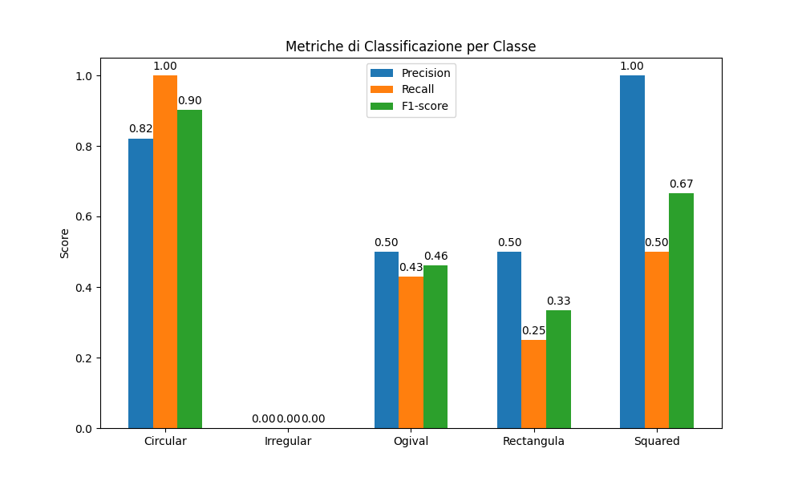
Critical evaluation of the integrated model
Significant improvement due to spatial integration.
Spatial variables are crucial for complex analyses.
Persistent difficulties in classifying the Irregular class.
Further improvement potential with a more balanced dataset.
59,5%
75,7%
Ana Sofia Meneses – anasofia.menesespineda@uniroma1.it Marco Solinas – marco.solinas@ingv.it
Notes:
In this slide, we directly compare the results obtained before and after the integration of spatial variables. On the left, we see the initial model, which relies solely on geometric dimensions and achieves only 59.5% accuracy, performing acceptably only for the Circular class, while virtually ignoring the other tomb types. On the right, however, we can clearly observe the significant improvement attained by the integrated model, which reaches 75.7% accuracy. We note that, in addition to the Circular class, other tomb types such as Ogival and Squared also display substantial gains in classification metrics (precision, recall, F1-score), indicating that incorporating spatial data enables the model to better distinguish even the less frequent tomb shapes. Despite this progress, certain rare tomb classes, such as the Irregular type, remain challenging for the model to identify correctly. This confirms that—although spatial variables play a crucial role—further enhancements will be achievable primarily by increasing both the quantity and the quality of data gathered in upcoming excavation surveys.

Slide 11
Key Results
In terms of the role of dimension in the spatial distribution of the funerary elements we have clear indications that the dimensions were one of the factors in the spatial patterns.
Due to the High spatial autocorrelation, the clustering into 4 main clusters, local clusters of 2 and the presence of hotspots towards the center of the cemetery while the coldspots were located towards the perimeter of the cemetery.
Rejection of a null hypothesis of random allocation of funerary elements across the landscape.
Greater importance placed on the diameter as dimensional parameter rather than length, width or height.
Significant improvement in Random Forest model performance (accuracy increased from 59.5% to 75.7%).
Enhanced interpretive capacity regarding funerary and social dynamics.
Ana Sofia Meneses – anasofia.menesespineda@uniroma1.it Marco Solinas – marco.solinas@ingv.it

Slide 12
Conclusions and Future Developments
Results are already very promising despite the limited dataset.
There is a need to expand the dataset through future archaeological fieldwork.
The work underscores the importance of exploring spatial patterns to understand social dynamics that might have been in place during antiquity.
The work has led to the development of further questions regarding the funerary practices like for example:
Are the 4 classes identified correlated between each other?
Are these 4 classes related to different funerary practices?
Are these 4 classes correlated with other anthropological data like gender, age, etc?
Does the spatial patterns indicate a social practice that was not recorded in the written records but that attest to the hierarchical/social division?
Model performance is expected to improve further with more robust data.
Potential for identifying and understanding similar archaeological sites.
Involvement of anthropological data that can reveal if the clusters, spatial autocorrelation or hotspot/coldspot were also influenced by the information that can be obtained from biological material retrieved during the fieldwork.
Ana Sofia Meneses – anasofia.menesespineda@uniroma1.it Marco Solinas – marco.solinas@ingv.it

