Slide 1


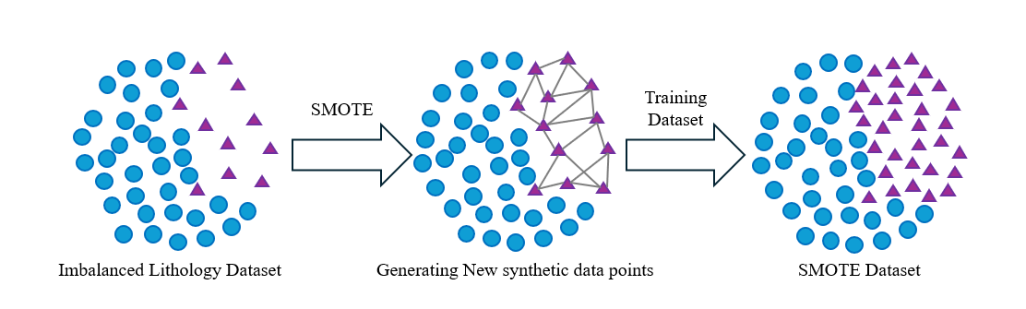
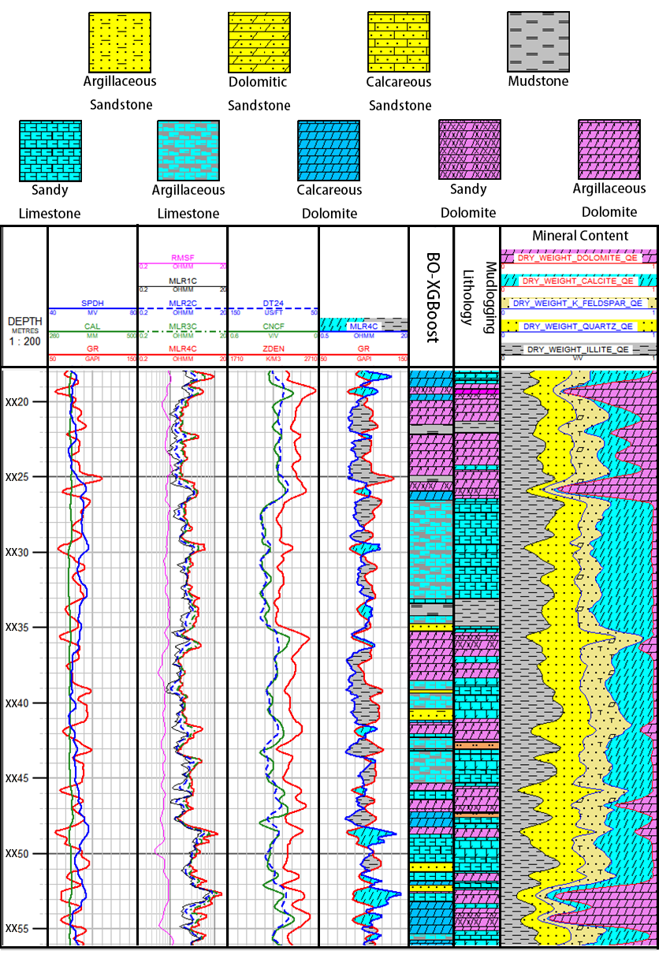
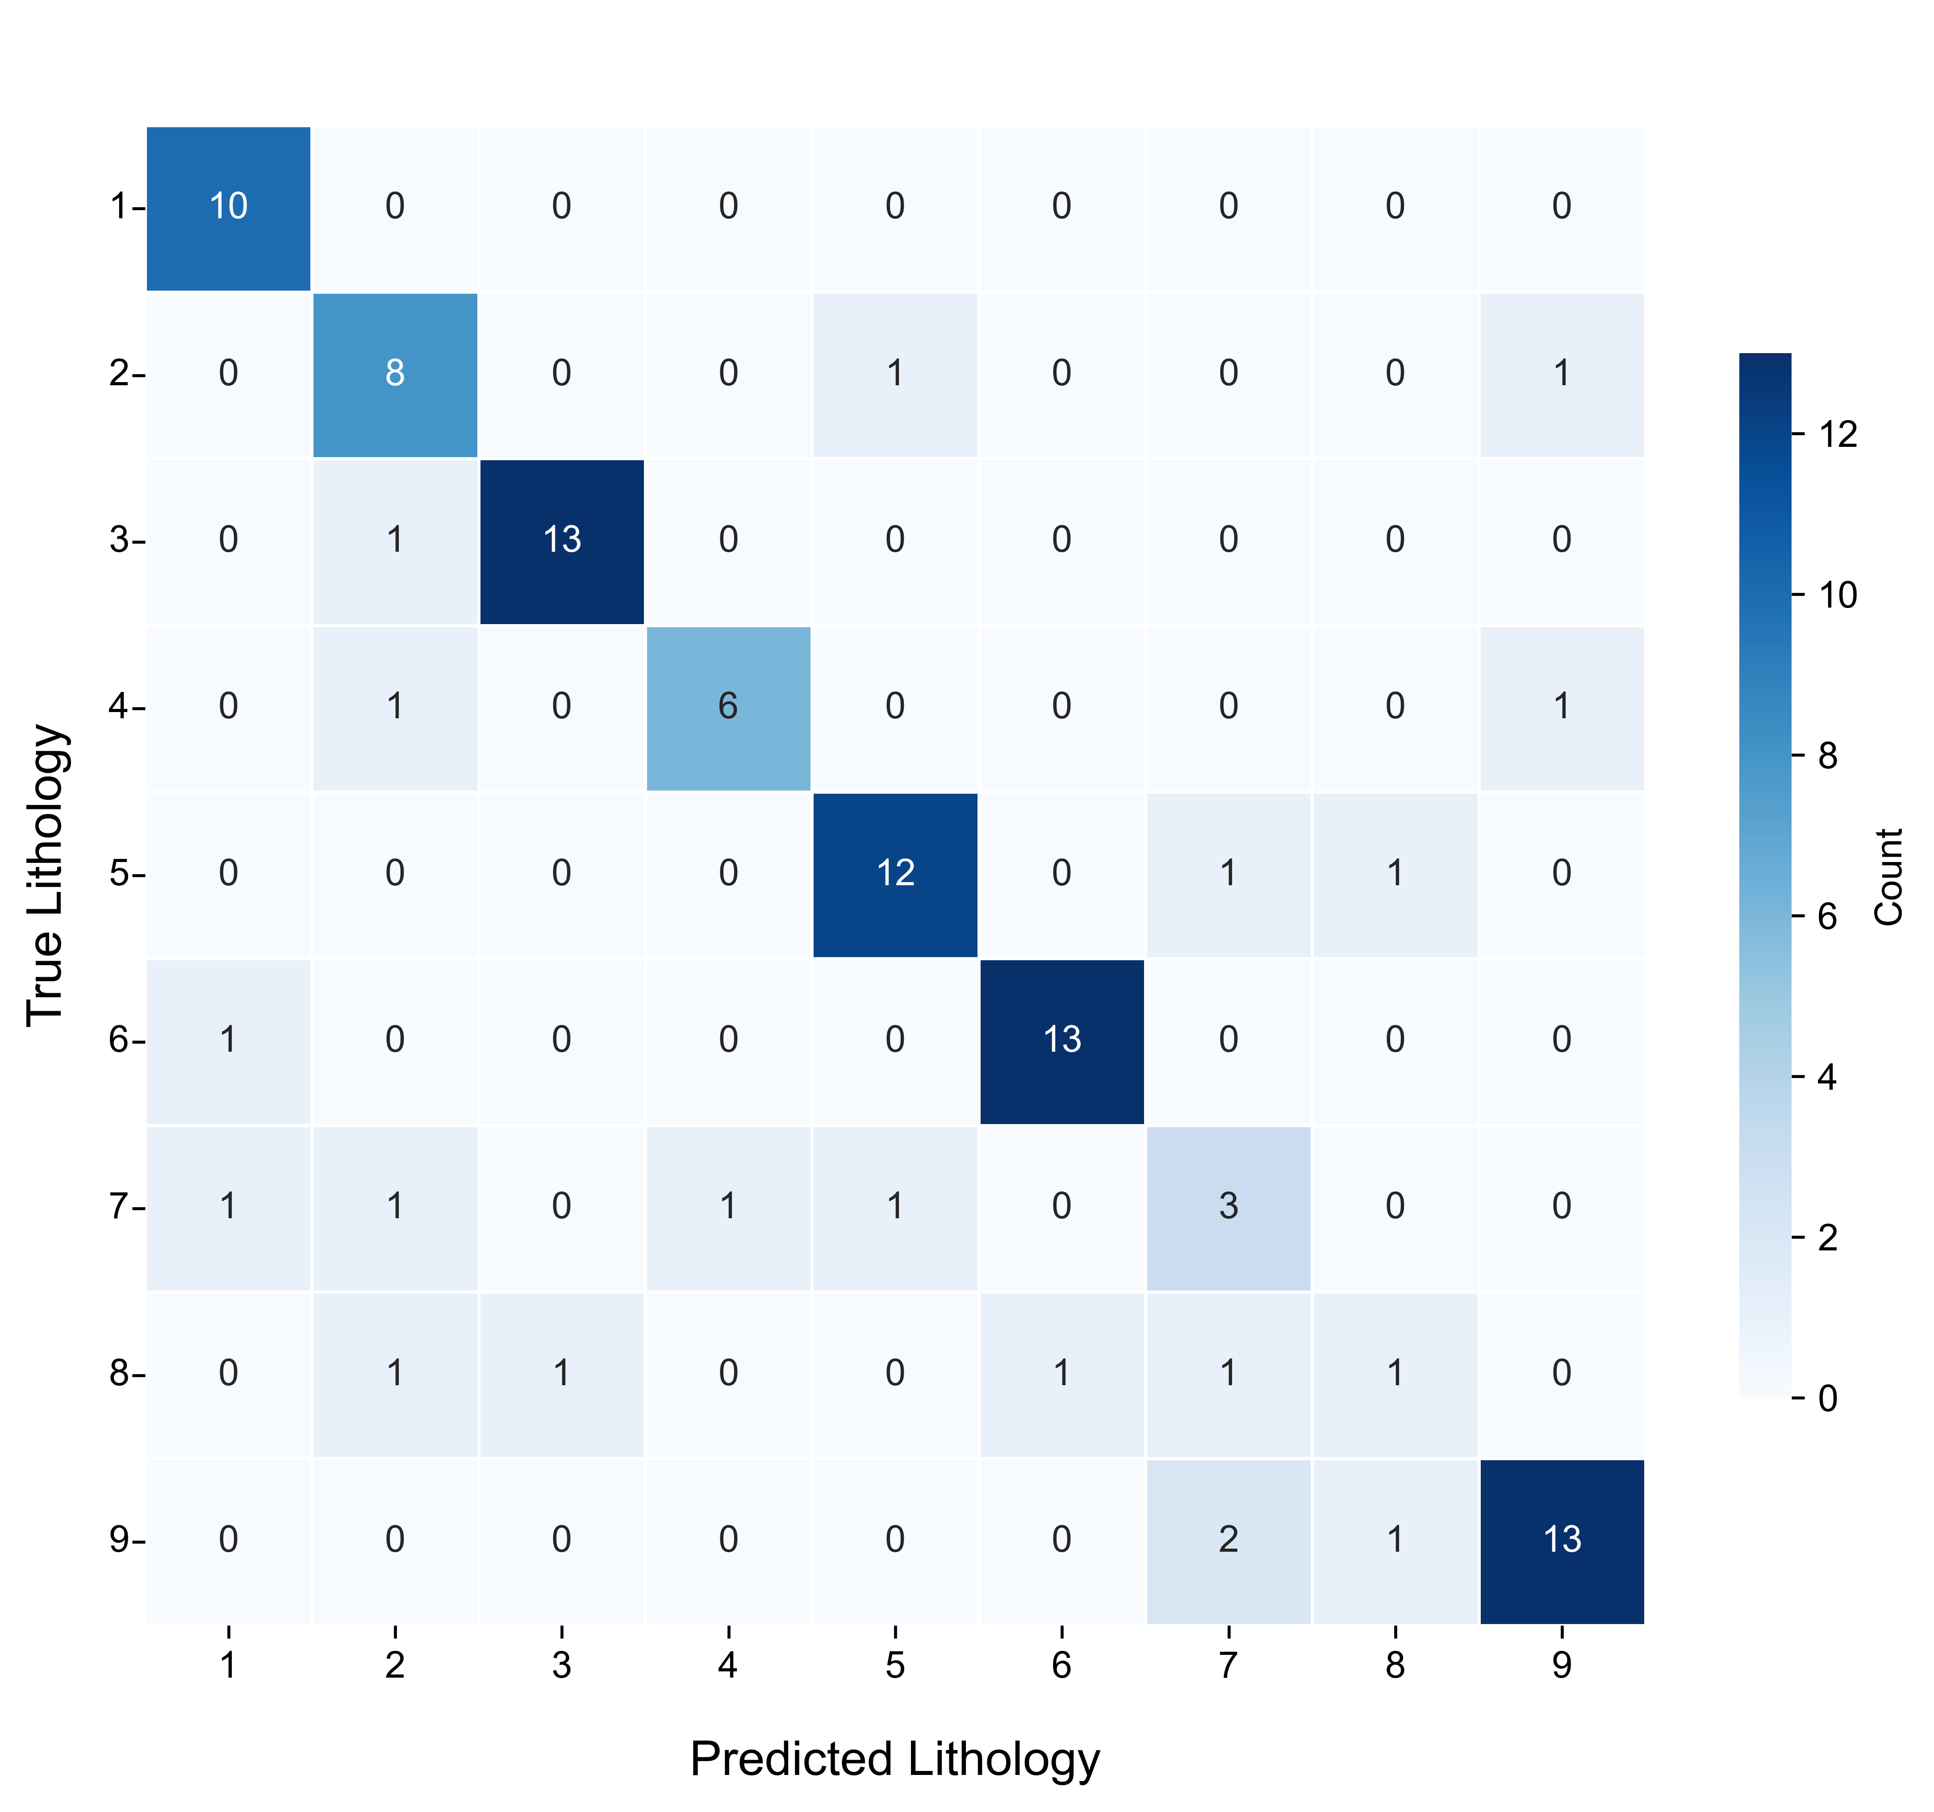
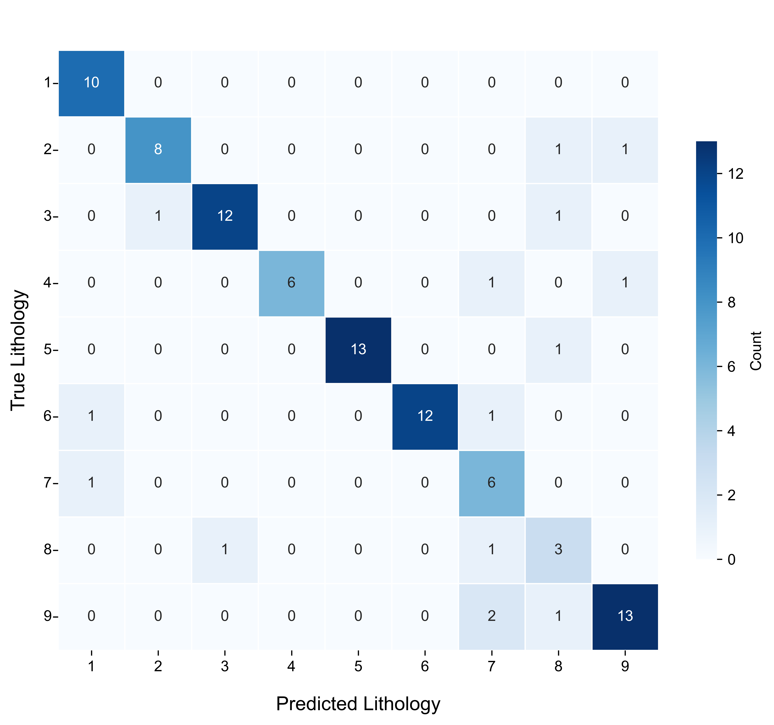

Bayesian-Optimized XGBoost for High-Precision Lithology Identification in Carbonate Reservoirs Using Geophysical Well Logs
Jingyu Yang, Liang Wang, Mingxuan Gu, Yizhuo Ai, and Gang Li
State Key Laboratory of Oil And Gas Reservoir Geology And Exploitation, Chengdu University of Technology, 610059, China
Introduction
Bayesian-optimized XGBoost lithology identification method
Carbonate reservoirs possess substantial resource potential and have increasingly emerged as a primary focus for hydrocarbon exploration and a key contributor to reserve growth. Within this context, accurate lithological classification and identification constitute a critical foundation for effective reservoir characterization. However, constrained by a complex geological setting and pronounced lithological heterogeneity, conventional lithology identification methods often suffer from limited accuracy when discriminating complex mixed-lithology intervals. Therefore, this study proposes an automated lithology identification method based on a Bayesian-optimized XGBoost model, and subsequently performs a lithology-specific petrophysical analysis based on the identification results.
SMOTE for Class Balancing:
SMOTE operates within a multi-dimensional feature space defined by well logs. To balance the dataset, it generates synthetic minority lithology samples by applying linear interpolation between a target sample and its K-nearest neighbors.
XGBoost Core Classifier:
XGBoost is a highly efficient supervised learning algorithm based on gradient boosting decision trees. Its core principle involves iteratively adding new decision trees to fit the residuals of the preceding model, thereby focusing the optimization process on capturing sample features that previous trees failed to model effectively. To achieve a more precise approximation of the loss function, the algorithm incorporates a second-order Taylor expansion into its objective function, which utilizes both first- and second-order derivatives for more precise loss approximation. Furthermore, to prevent overfitting when processing complex well- log data, XGBoost integrates a regularization term into the objective function and employs an approximate quantile algorithm to determine optimal feature splits. The regularized objective function at the t-th iteration is defined as:
Bayesian Optimization Of XGBoost Hyperparameters：
As a global probabilistic optimization algorithm based on Gaussian processes, Bayesian optimization operates by constructing a surrogate model to approximate the objective function’s posterior distribution. Given the vast and complex hyperparameter space of XGBoost, the optimization algorithm leverages historical evaluations to continuously update the Gaussian process. Through the acquisition function, it dynamically balances exploitation and exploration during iterations.
where g_{i} and h_{i} are the first- and second-order gradients of the loss function, f_{t} represents the new tree, and Ω(f_{t}) is the regularization term penalizing tree complexity.
Bayesian-optimized XGBoost lithology identification and results analysis
Conclusions
The lithology identification model was trained on the dataset, and the testing results are shown in Figure 1 and Figure 2. Figure 1 presents the lithological classifications without SMOTE, while Figure 2 displays the results after SMOTE application. Here, the horizontal axis represents the predicted lithology, the vertical axis represents the actual lithology, and the numbers on the main diagonal indicate the count of correctly classified samples. Ultimately, the application of SMOTE yields a notable performance improvement, increasing the overall classification accuracy from 80.61% to 84.69%
The proposed model was applied to Well A, with the lithological classifications illustrated in Figure 3. Track 6 and Track 7 represent the predicted lithology and the original mud logging lithology, respectively. The model accurately captured the interbeds of Mudstone and Argillaceous Dolomite in the XX20–XX25 interval, as well as the frequent Dolomite-Limestone alternations in the XX25–XX30 interval, yielding a satisfactory overall identification result, highlighting its potential for automated lithology identification in complex carbonate reservoirs.
Based on the model’s lithology predictions, porosity and permeability were calculated separately for each lithofacies (Figures 4 and 5). Regarding porosity (Figure 4), setting the absolute error threshold at 3.0 p.u., the coincidence rate improved from 22.58% (unclassified) to 58.06% (classified), while the RMSE decreased from 5.77 to 3.47. For permeability (Figure 5), the classified approach lowered the Log-RMSE from 1.48 to 1.21 and the Log-MAE from 0.45 to 0.35. All these indicators consistently confirm that incorporating lithological classification significantly minimizes prediction errors and aligns closely with actual core measurements.
Petrophysical Impact: Lithology-constrained calculations yield significantly more precise and stable porosity and permeability estimates than unclassified methods, highlighting the critical need for accurate lithology identification.
Algorithmic Innovation: The proposed model effectively captures the nonlinear mapping between lithology and logging responses, overcoming the subjectivity and low precision of traditional methods in highly heterogeneous carbonate formations.
Practical Utility: This approach provides a robust, automated workflow for fine-scale reservoir evaluation in analogous complex geological settings, facilitating future hydrocarbon exploration and development.
Calculation Method
Table 1:Performance metrics of calculation methods
Acknowledgements
Porosity
Permeability
Coincidence Rate(%)
RMSE
Log-RMSE
Log-MAE
This work was funded by the Sub-project Research on Integrated Evaluation Technology of Pressure Solution, Gas Logging, and Wireline Logging in the Ying-Qiong Basin, under the National Science and Technology Major Project Hydrocarbon Accumulation Mechanisms and Key Exploration & Development Technologies in the South China Sea.
Unclassified
22.58
5.77
1.48
0.45
classified
58.06
3.47
1.21
0.35
References
Lan, X., Zou, C., Kang, Z., Wu, X., 2021. Log facies identification in carbonate reservoirs using multiclass semi-supervised learning strategy. Fuel, 302, 121145.
Fatai Anifowose, Jane Labadin, Abdulazeez Abdulraheem, 2015. Improving the prediction of petroleum reservoir characterization with a stacked generalization ensemble model of support vector machines. Applied Soft Computing, 26, 483-496.
Yadigar Imamverdiyev, Lyudmila Sukhostat, 2019. Lithological facies classification using deep convolutional neural network. Journal of Petroleum Science and Engineering, 174, 216-228.
Haibo Liang, Haifeng Chen, Jinhong Guo, Jing Bai, Yingjun Jiang, 2022. Research on lithology identification method based on mechanical specific energy principle and machine learning theory. Expert Systems with Applications, 189, 116142.
Figure1. Lithological Classifications Without SMOTE
(a)
(b)
Figure 4. Crossplot of Calculated Porosity
Zhang, W., Wu, T., Li, Z. et al., 2021. Fracture recognition in ultrasonic logging images via unsupervised segmentation network. Earth Sci Inform, 14, 955-964.
Quan Ren, Hongbing Zhang, Dailu Zhang, Xiang Zhao, 2023. Lithology identification using principal component analysis and particle swarm optimization fuzzy decision tree. Journal of Petroleum Science and Engineering, 220, 111233.
Xu Yang, Shaoqun Dong, Junkun Quan, Tao Xu, Huangshuai Kong, Lianbo Zeng, Guohao Xiong, Ruixiang Bi, 2026. Lithology identification using stratigraphic continuity and petrophysical features of well logs. Results in Engineering, 29, 109913.
Figure2. Lithological Classifications With SMOTE
Figure 3. Lithology Identification Result Map of Well A in the Study Area
(a)
(b)
Figure 5. Crossplot of Calculated Permeability

