Slide 1


Upscaling mass transport with heterogeneous reaction, adsorption and accumulation in porous media
Francisco J. Valdés-Parada and
Jessica Sánchez-Vargas

Slide 2
Motivations
Modeling mass transport with heterogeneous reaction in porous media usually involve simplifications that are overlooked.
01
The classical upscaled models incorporate the interfacial reaction in the differential equation, which may seem counterintuitive.
02
No upscaled model has been derived when interfacial accumulation, as well as adsorption, desorption and reaction are present.
03

Slide 3
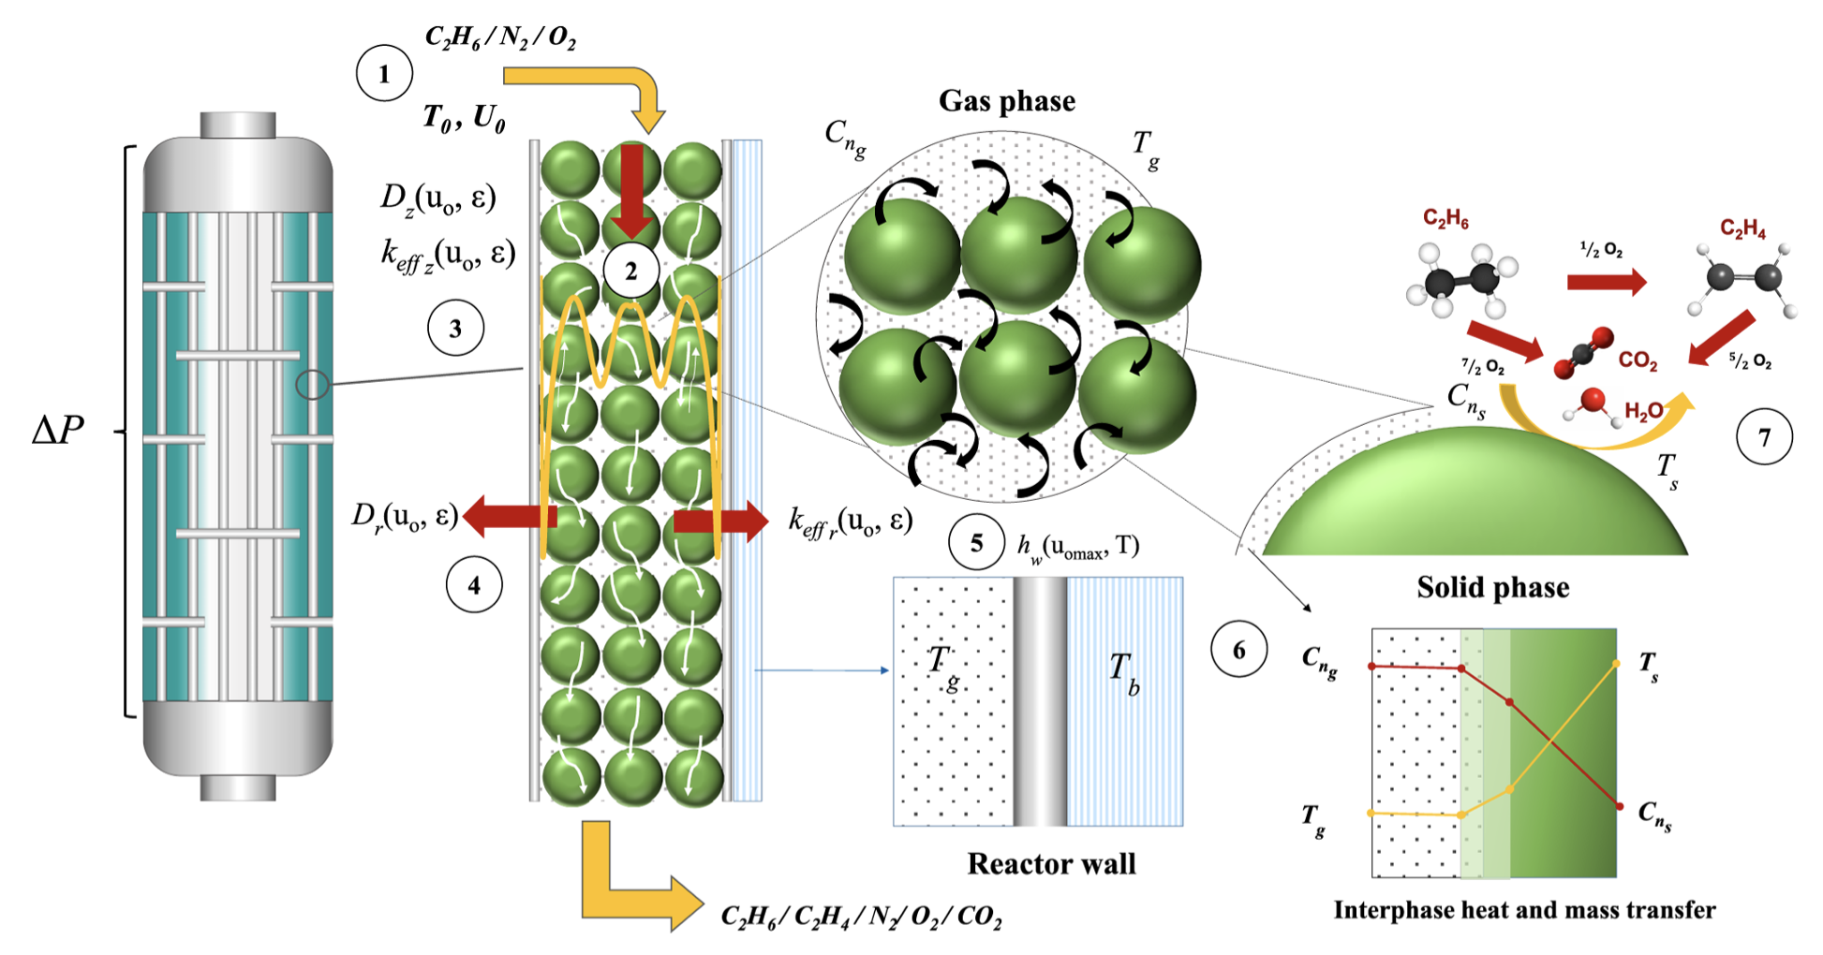
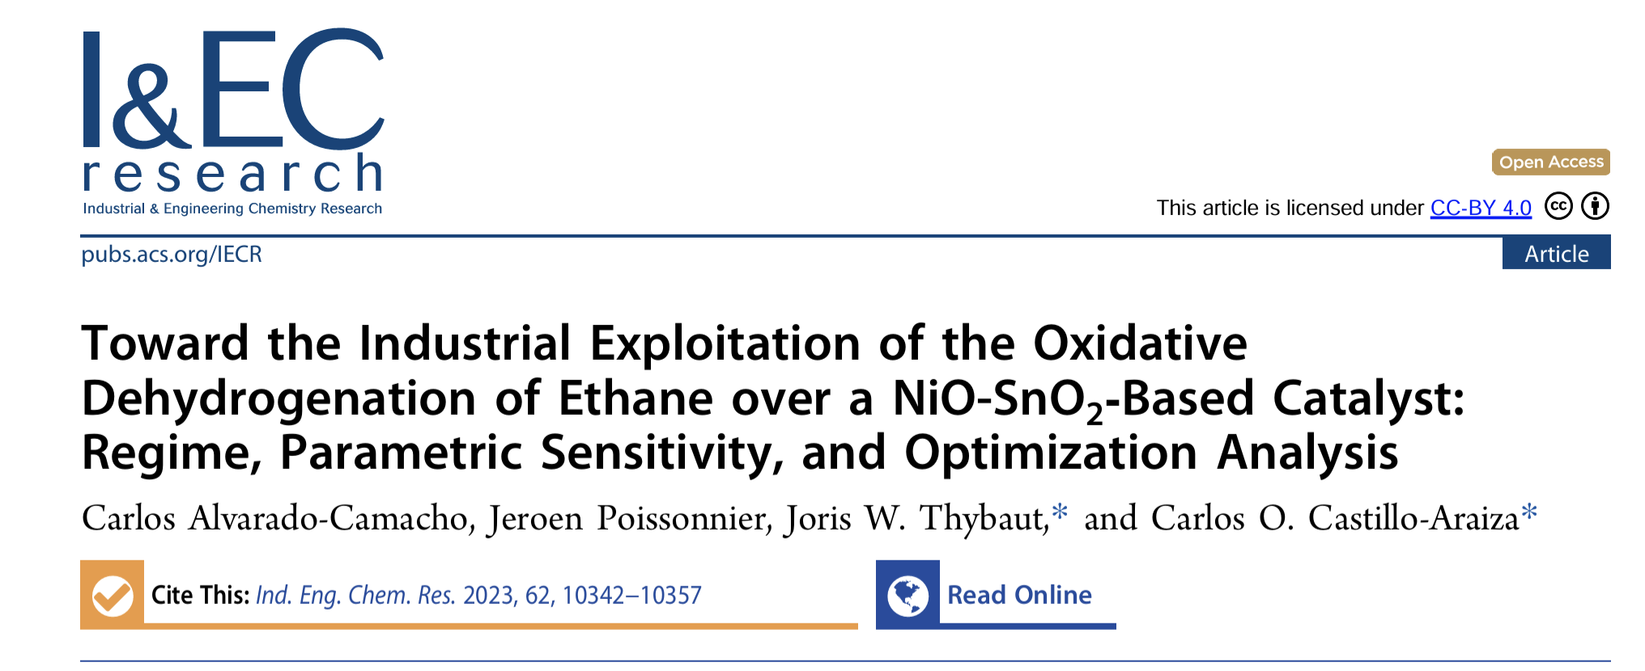

Slide 4
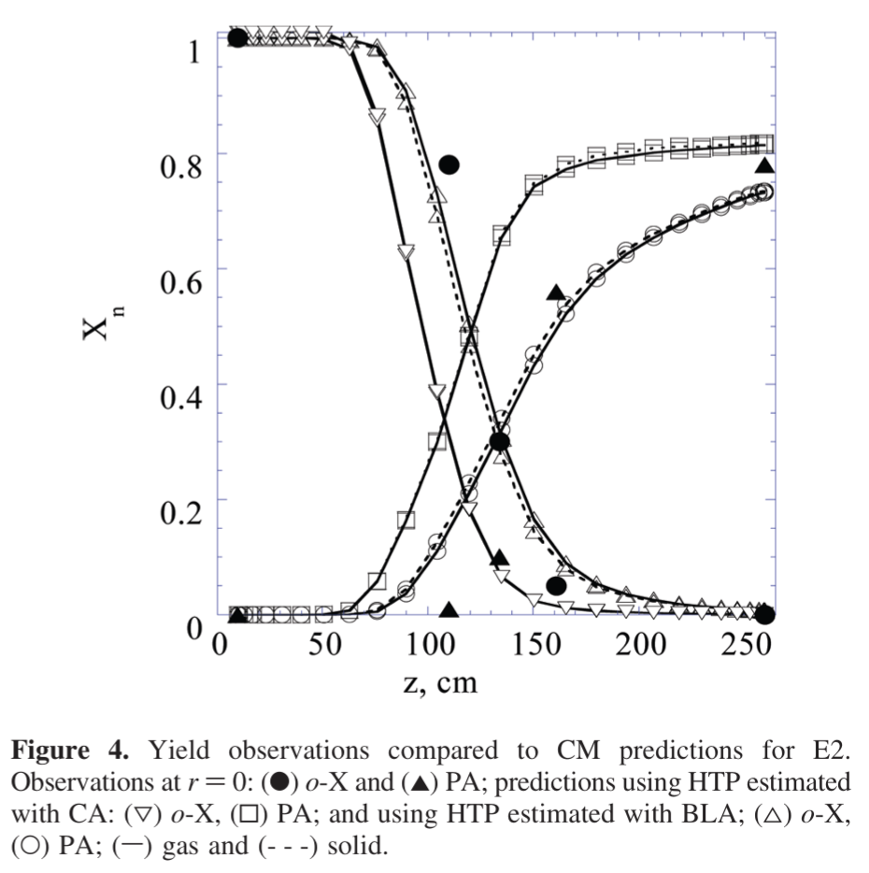
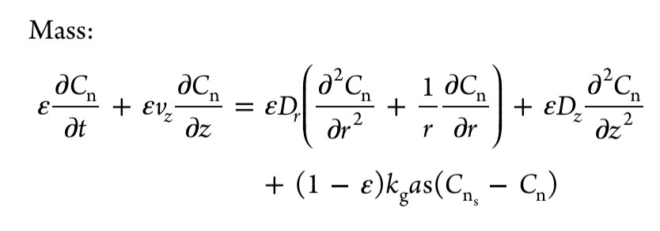
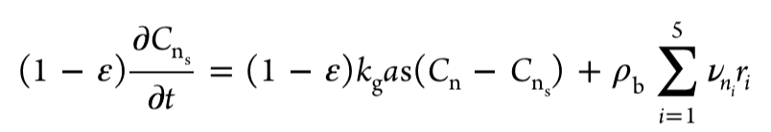
Postulated model vs. experiments

Slide 5

Can we derive this model ?

Slide 6
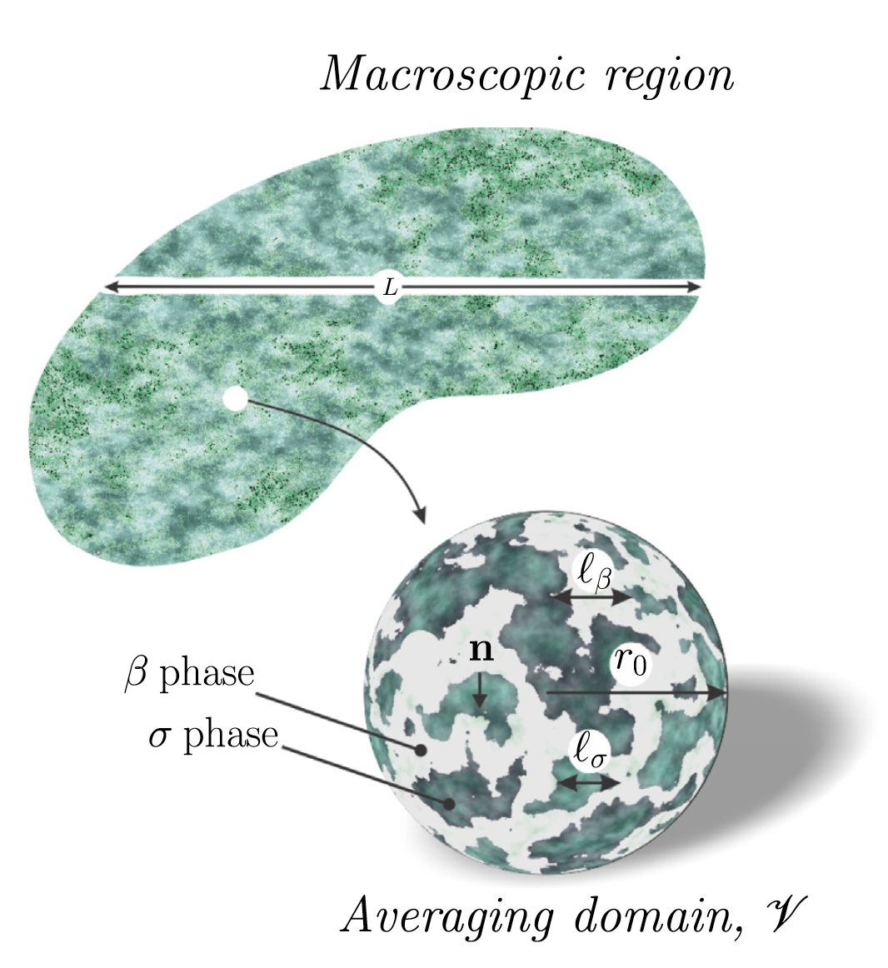
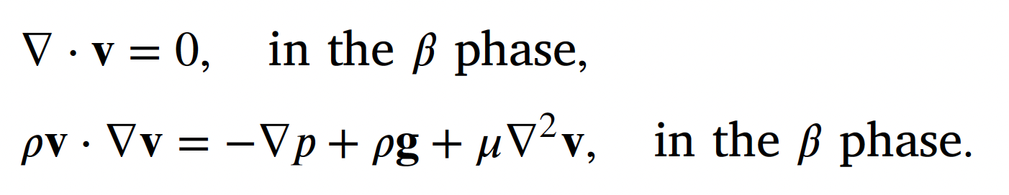
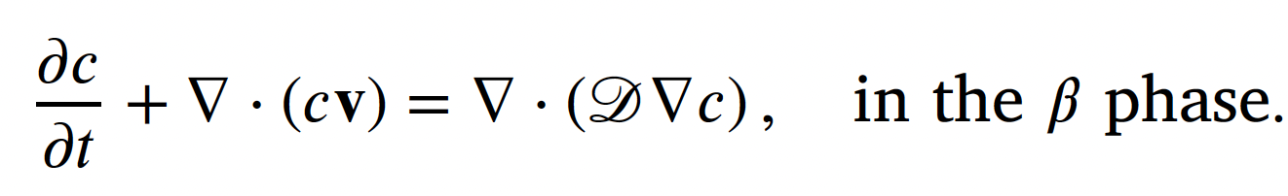


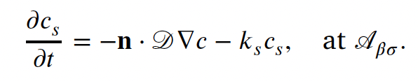
Pore-scale model
What we usually impose:
A more general approach:

Slide 7
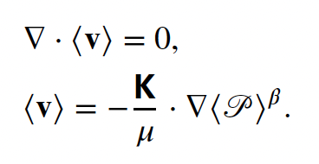
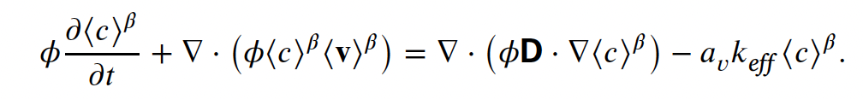
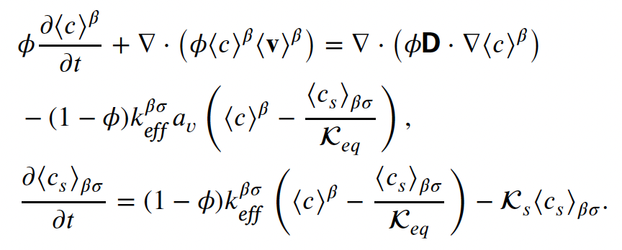
Upscaled models
Momentum transport:
Species mass transport:
  Classical model:
  New model:

Slide 8
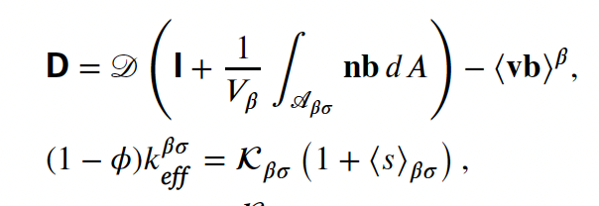
Effective-medium coefficients

Slide 9
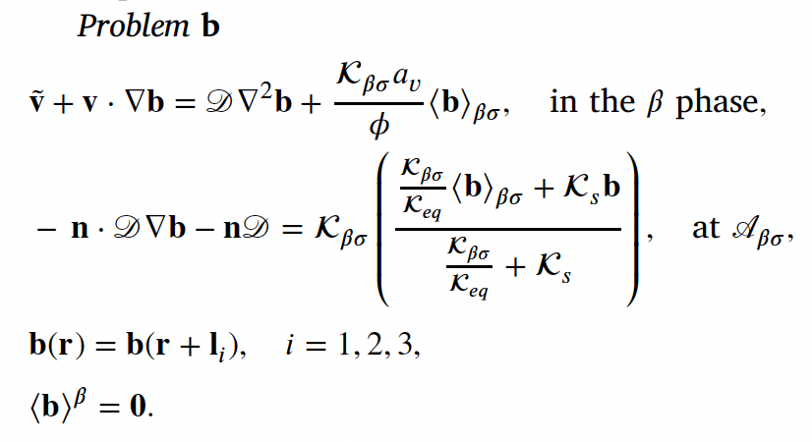
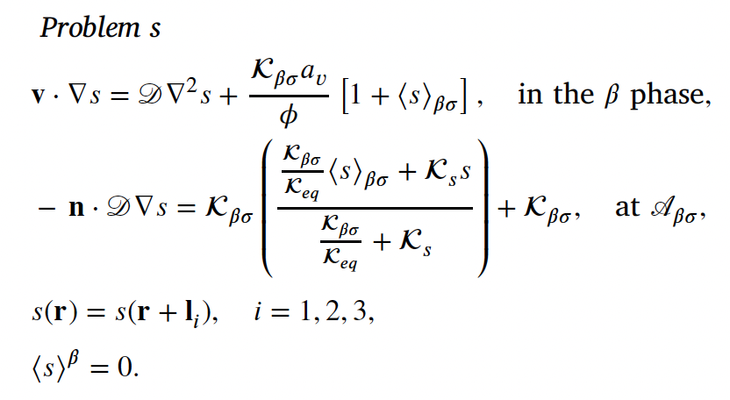
Closure problems

Slide 10

How do the two models compare?

Slide 11
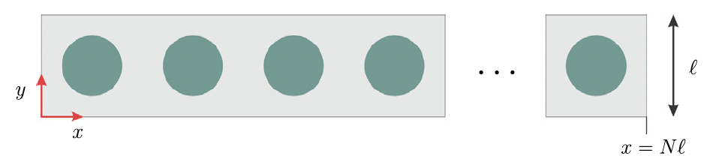
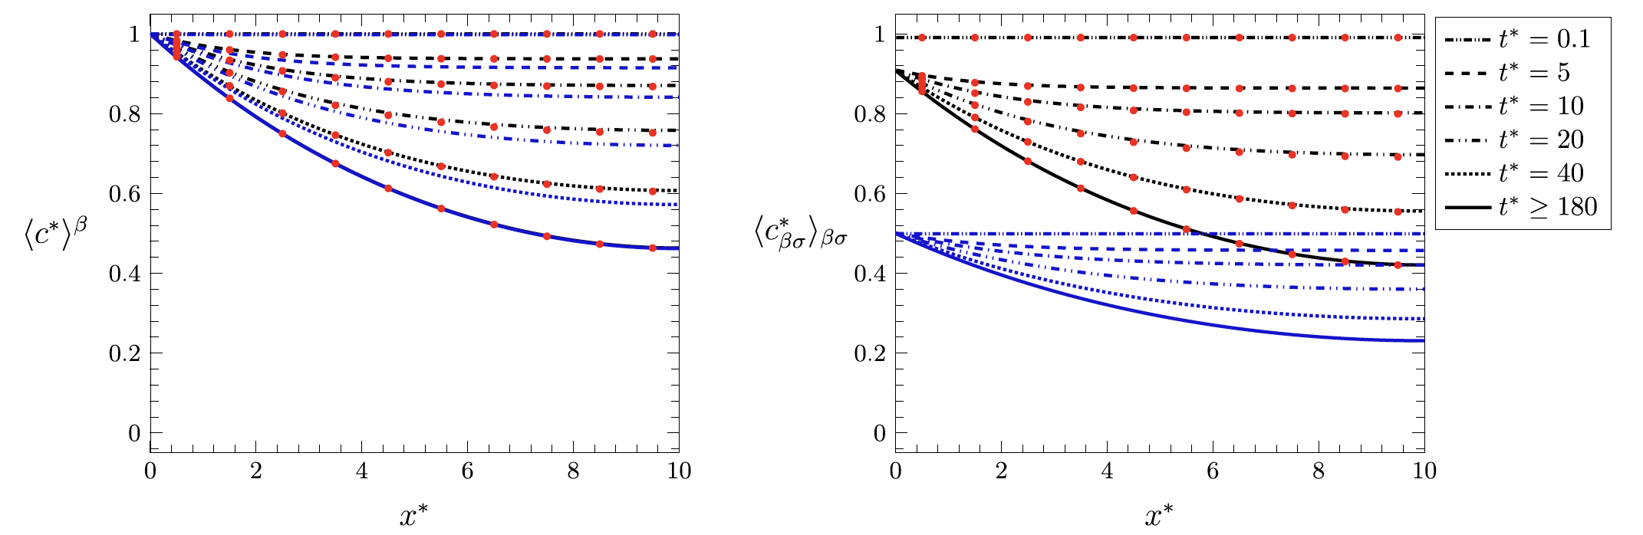

Bi =0.1

Slide 12
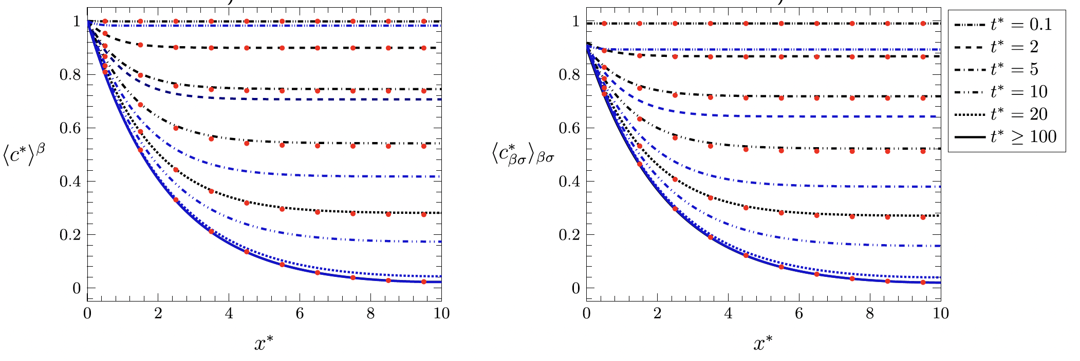
Bi =1

Slide 13
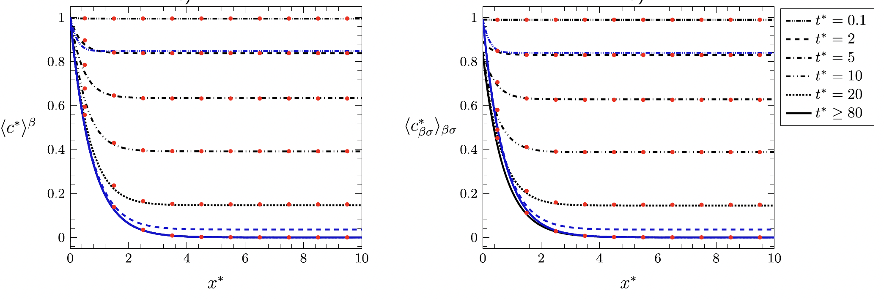
Bi =10

Slide 14
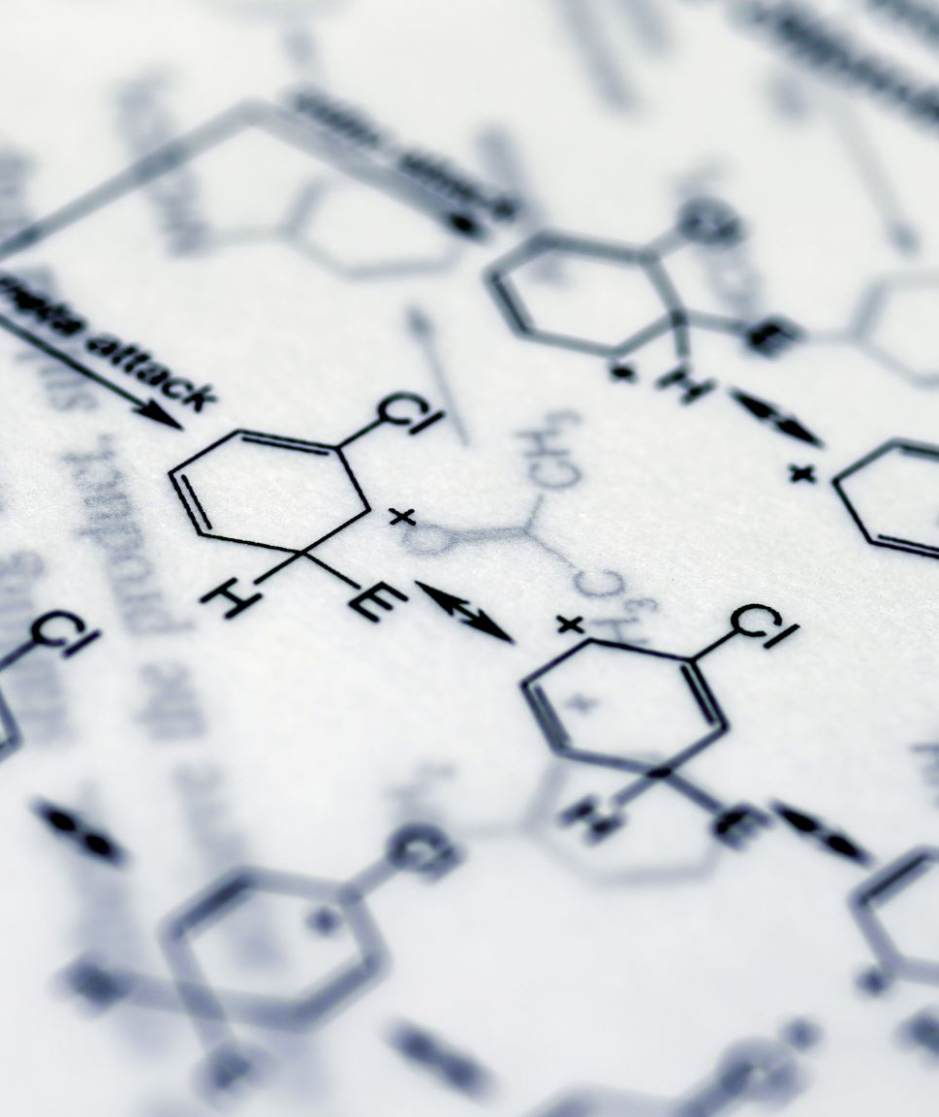
Conclusions
A two-equation macroscopc model (previously postulated and validated experimentally) was rigorously derived and validated with DNS.
The coefficients involved in the two-equation model can be computed a priori from the solution of the associated closure problems.
The classical model only reproduces DNS results for the intrinsic average of the concentration in the fluid phase at early times or steady state.

Slide 15
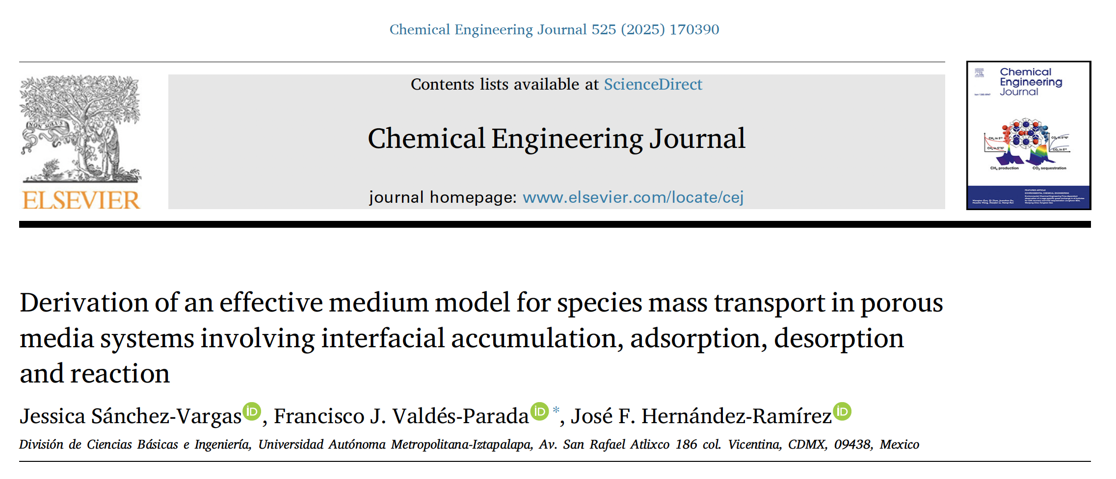
More information

Slide 16
Thank you so much !
Francisco J. Valdés-Parada (iqfv@xanum.uam.mx)
Jessica Sánchez-Vargas (savj@xanum.uam.mx)

