Slide 1


What controls b-value variability in an active oceanic volcanic island? A multi-parameter study of the seismicity of Tenerife (Canary Islands).
Rubén García-Hernández¹ (rgarciahernandez@involcan.org),
Luca D’Auria^{1,2}, Aarón Álvarez-Hernández¹, Víctor Ortega-Ramos¹, David M. van Dorth^{1,2},
Pablo López-Díaz^{1,2}, Sergio de Armas-Rillo^{1,2}, Manuel Calderón-Delgado¹,
Óscar Rodríguez¹, Daniel-Prieto¹ & Nemesio M. Pérez^{1,2}
¹Instituto Volcanológico de Canarias (INVOLCAN),
Puerto de la Cruz, Tenerife, Canary Islands
²Instituto Tecnológico y de Energías Renovables (ITER),
Granadilla de Abona, Tenerife, Canary Islands

Slide 2
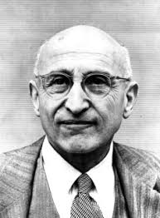
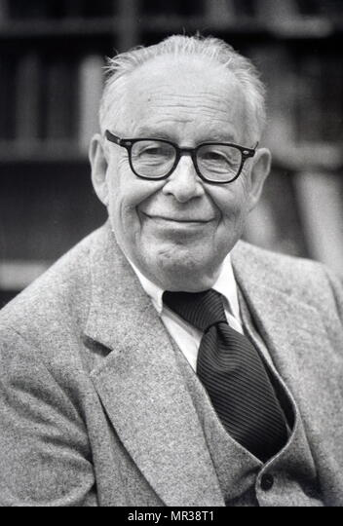
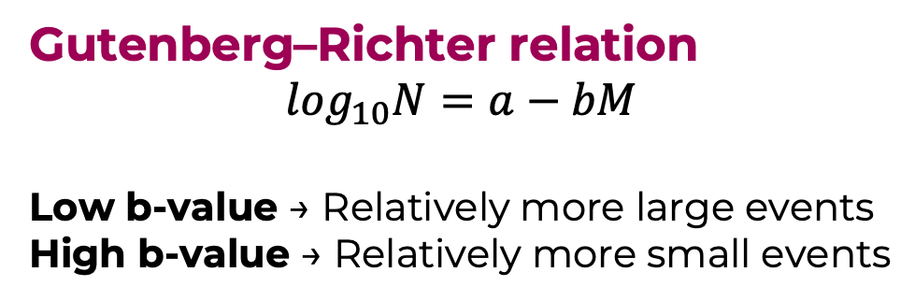
b-value is sensitive to changes in the volcanic-hydrothermal system
Gutenberg–Richter relation
$$\log_{10}N=a−bM$$
Low b-value → Relatively more large events
High b-value → Relatively more small events
Beno Gutemberg
B-value is sensitive to:
Stress state
Fluid pressure and migration
Rock heterogeneity and thermal structure
Catalogue completeness and sampling scale
Charles F. Richter

Slide 3
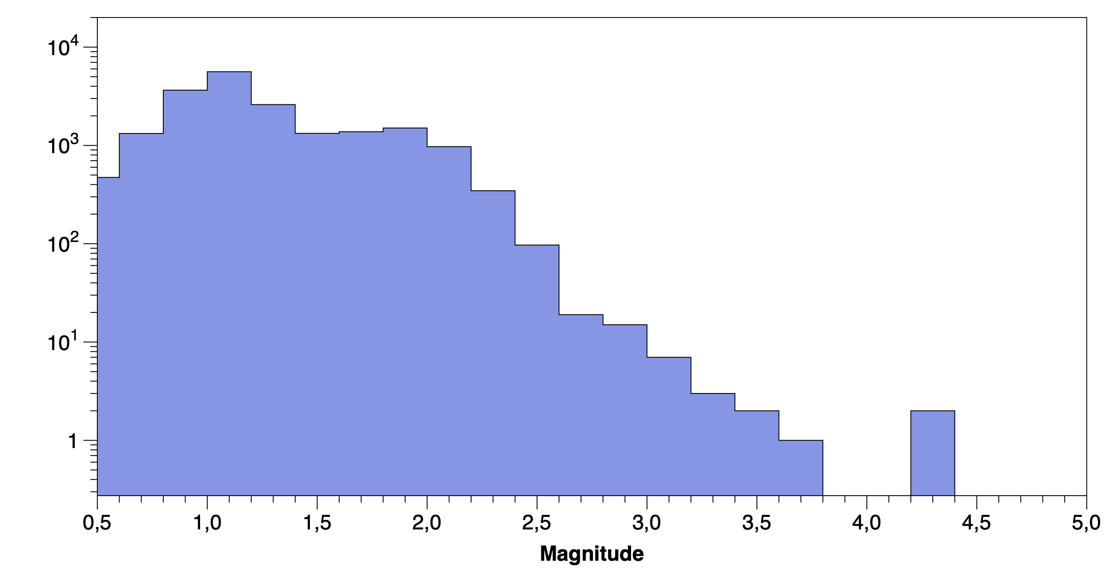
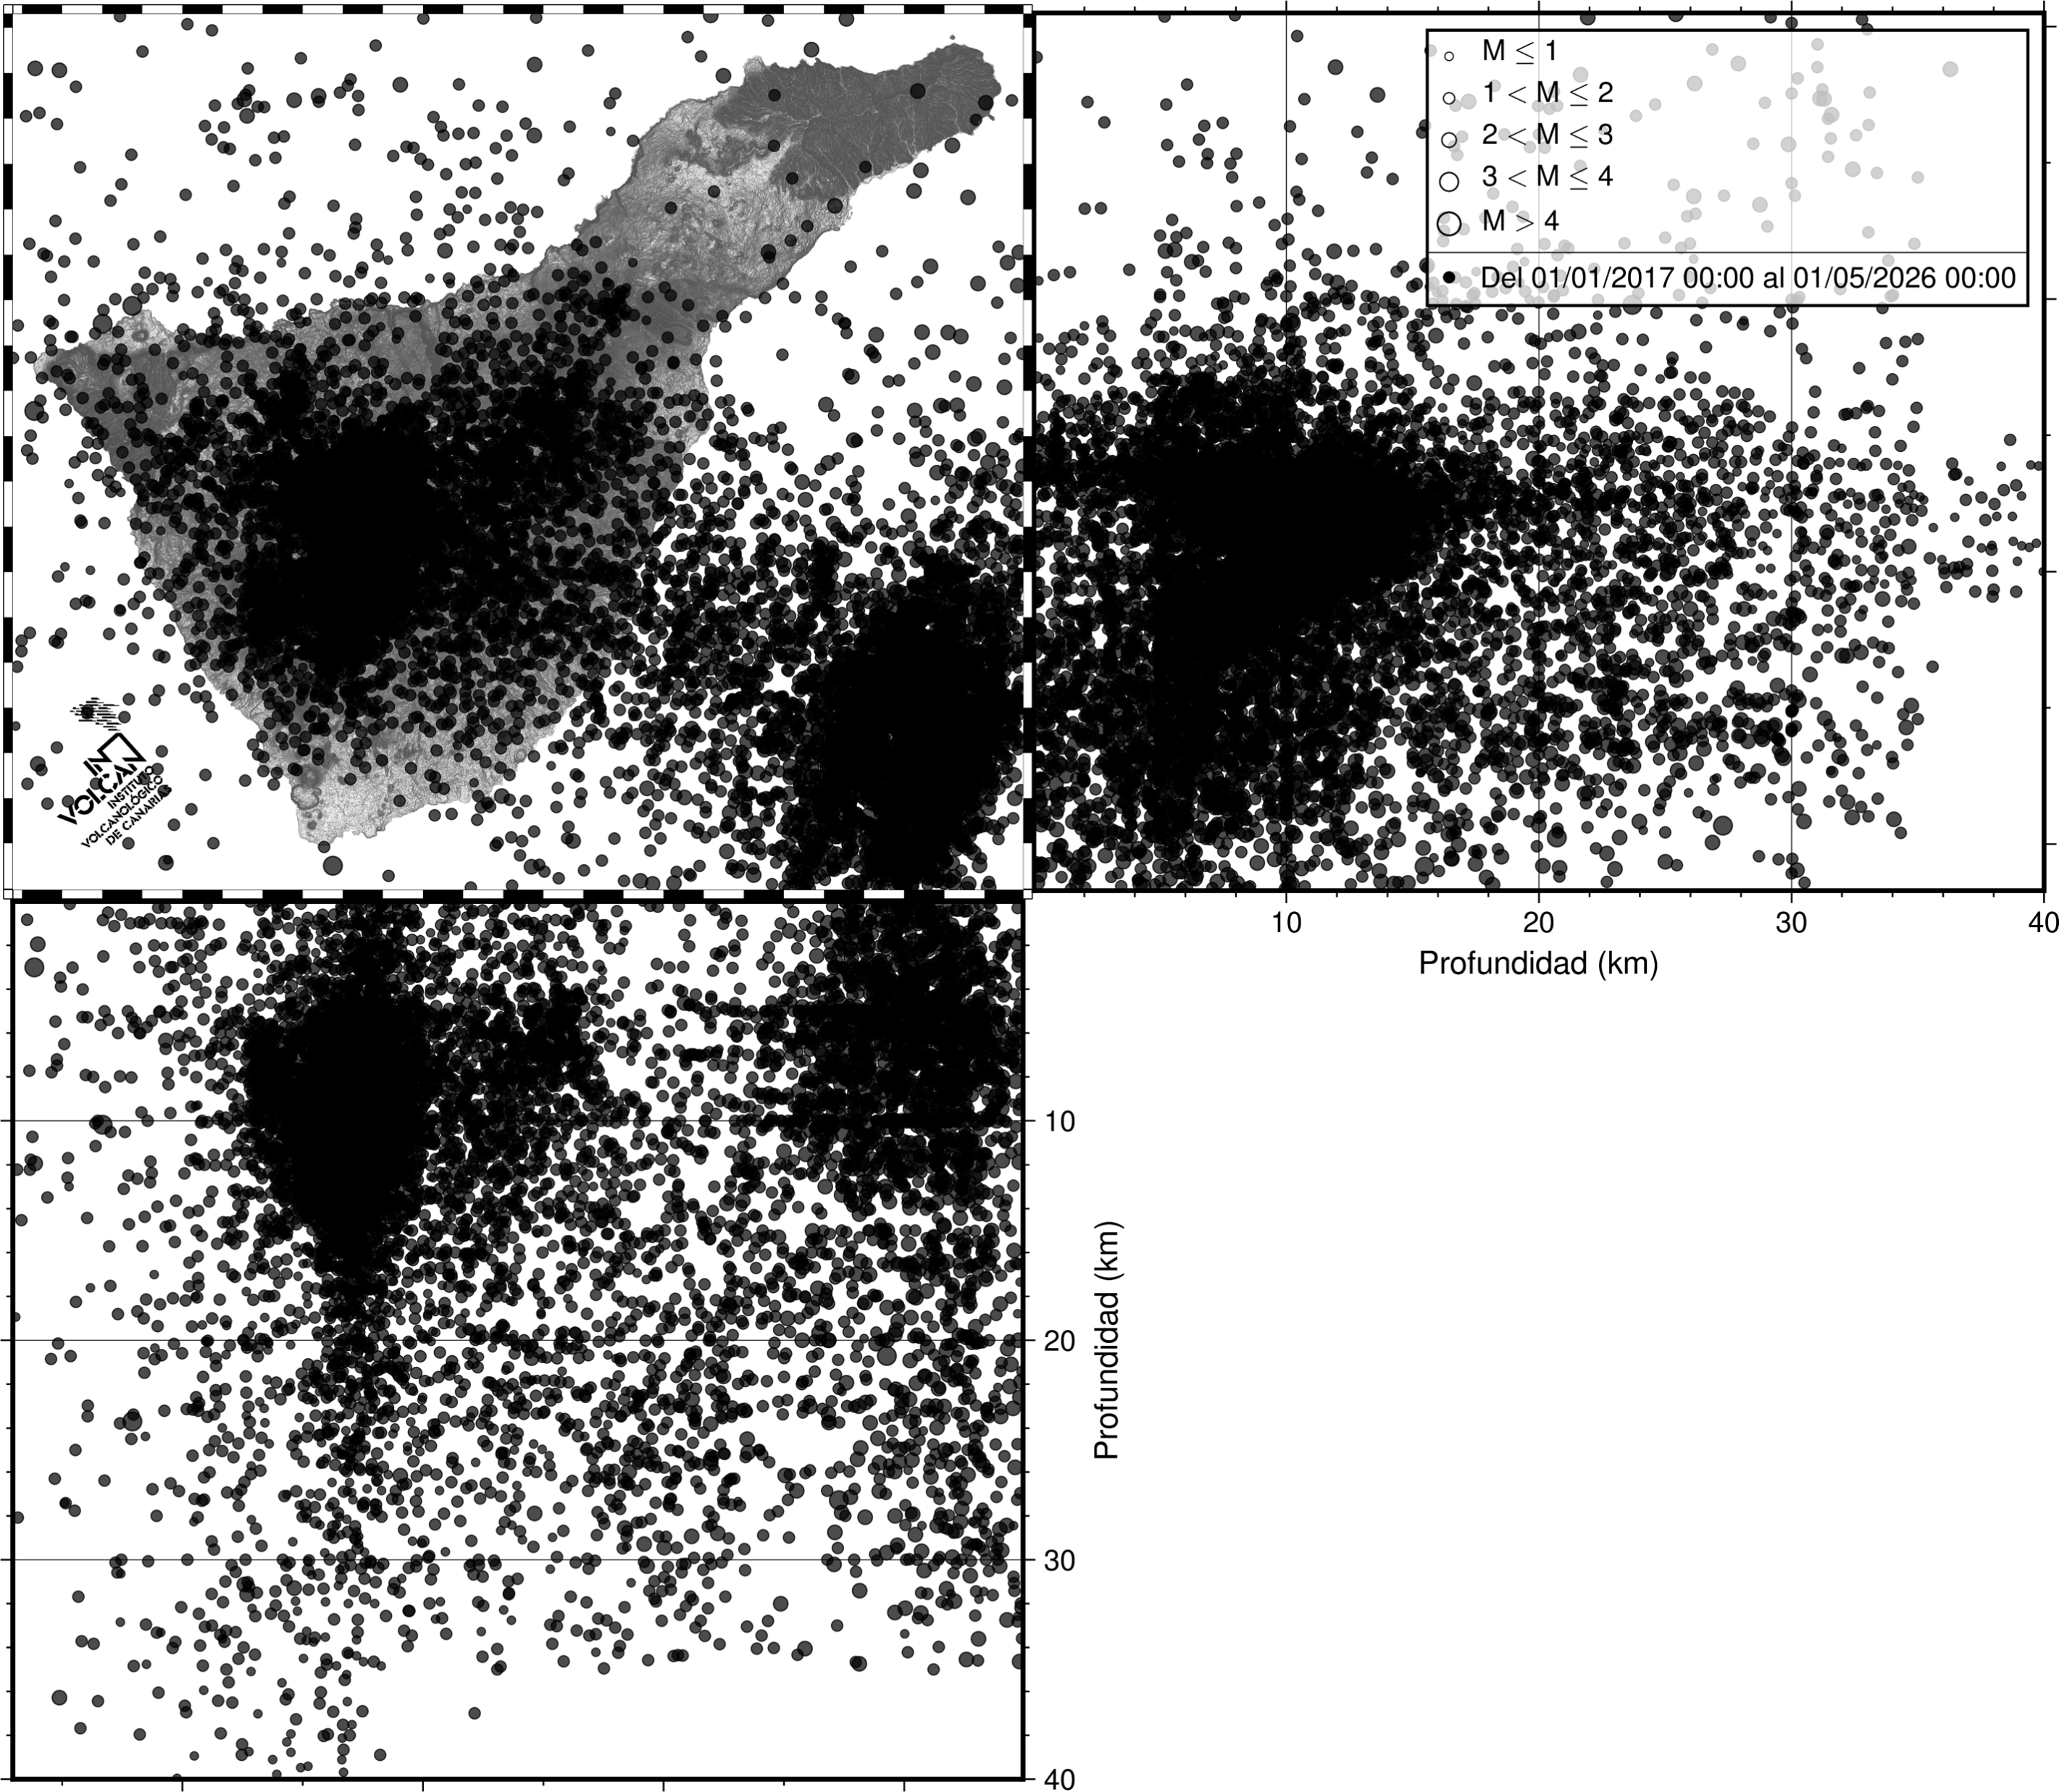
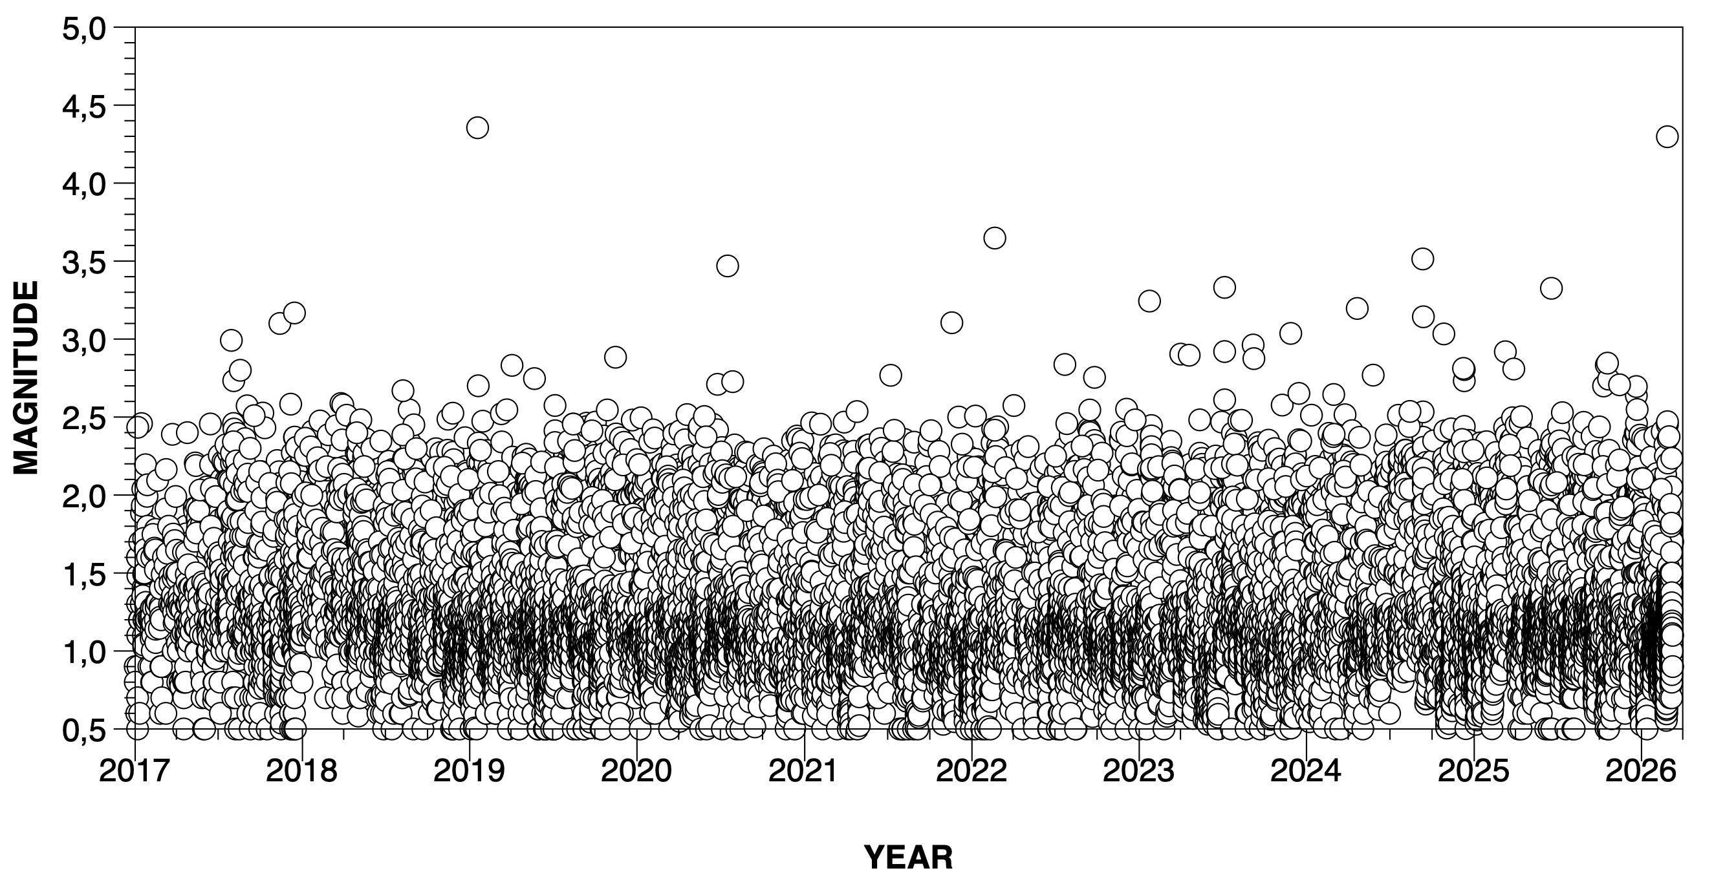
INVOLCAN’s seismic catalogue of Tenerife
(2017-2026)
More than 21000 events, (unbinned) magnitudes up to 4.4

Slide 4
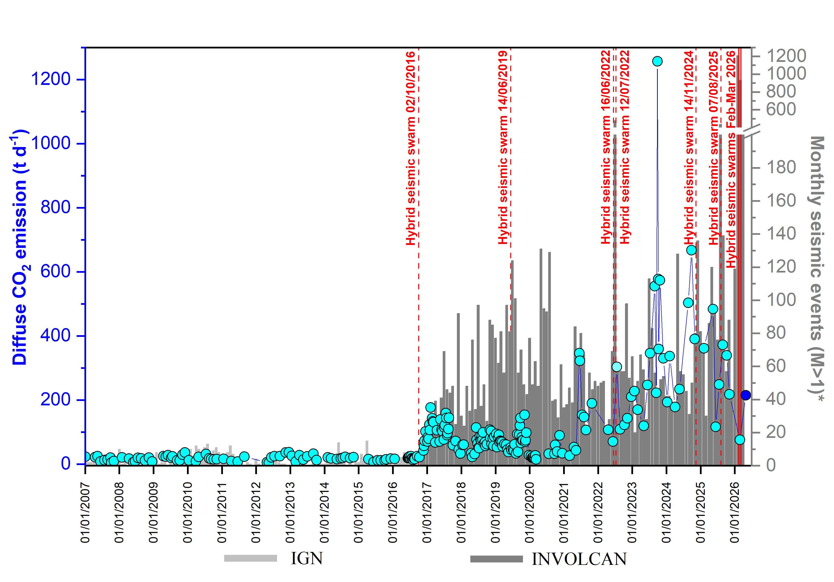
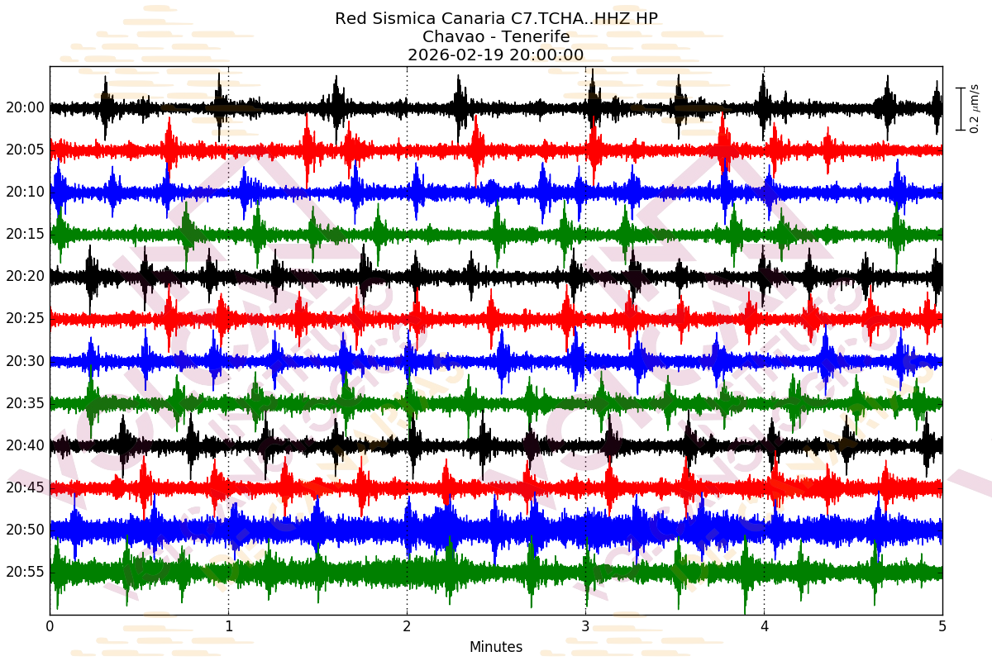
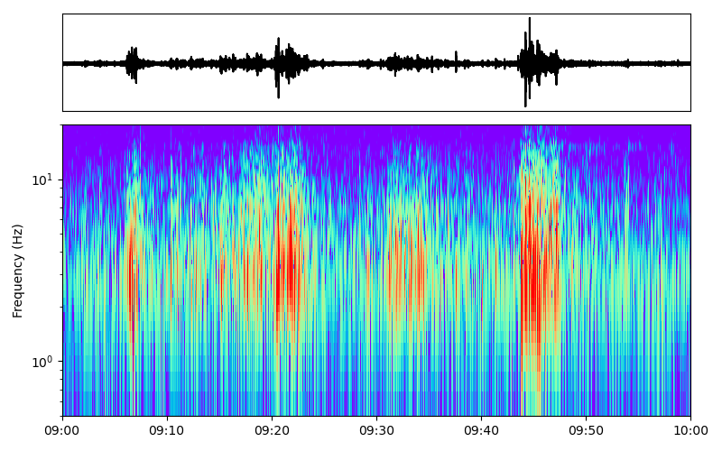
Whas is happening in Tenerife?
Macroscopic increase in the diffuse soil CO₂ emission rate from the crater of Teide
Occurrence of 13 hybrid seismic swarms
Recording of low-frequency signals
Generalized increase in the microseismicity with more than 120 volcano-tectonic seismic swarms since 2017.
Slight (≈2 cm), slow, and shallow ground deformation in the central area
NO significant gravity changes
NO high magnitude seismicity
NO SO₂ from the crater

Slide 5
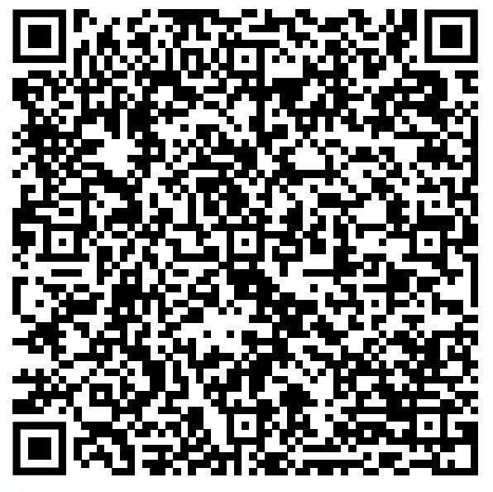
Method: MUST-B (2.0)
MUltiscale Spatial and Temporal estimation of the B-value
Avoids arbitrary choice of spatial/temporal scales
Quality of fit check using the Lilliefors goodness-of-fit test with p=5%
Uncertainties computed through a bootstrap approach
(paper about version 1.0)
García‐Hernández, R., D’Auria, L., Barrancos, J., Padilla, G. D., & Pérez, N. M. (2021). Multiscale temporal and spatial estimation of the b‐value. Seismological Society of America, 92(6), 3712-3724.

Slide 6
Thank you for your attention!
Questions?
Rubén García-Hernández (rgarciahernandez@involcan.org)

