Slide 1





European Geosciences Union General Assembly 2026
Supplementary material for
Beyond Evolutionary Algorithms: A scalable River-Network Approach to Water Distribution Network Design
Surendra Kumar Sahu¹, Dnyanesh Borse², Basudev Biswal¹
¹ Department of Civil Engineering, Indian Institute of Technology Bombay, Mumbai, India
² Department of Civil, Environmental and Construction Engineering, University of Central Florida, Orlando, USA
Session HS5.4.3: Digital water and interconnected urban infrastructure

Slide 2
Problem Statement and Motivation
A 2018 NITI Aayog report highlighted:
600+ million people
0.2+ million deaths annually
120th position
are facing high to extreme water stress.
due to inadequate safe drinking water.
India is placed 120th among 122 countries in the water quality index.
Did you know?
England & Wales
US EPA
Research Papers
Water utility assets valued at £278.3B, with £44B spent on maintenance & replacement (2015–2020)
The US EPA reports a funding gap of $160B in water & wastewater infrastructure (ASCE, 2021).
Over 300 journal papers on WDS design & optimization (Mala-Jetmarova et al., 2018).
Despite extensive research, a quick and reliable model for large real-world WDNs is still missing.
Motivation:
Borse, 2024, PhD Thesis, IIT Bombay: Adapted river network concepts for pipe networks (Hanoi WDN), yielding quick, near-optimal results.

Slide 3

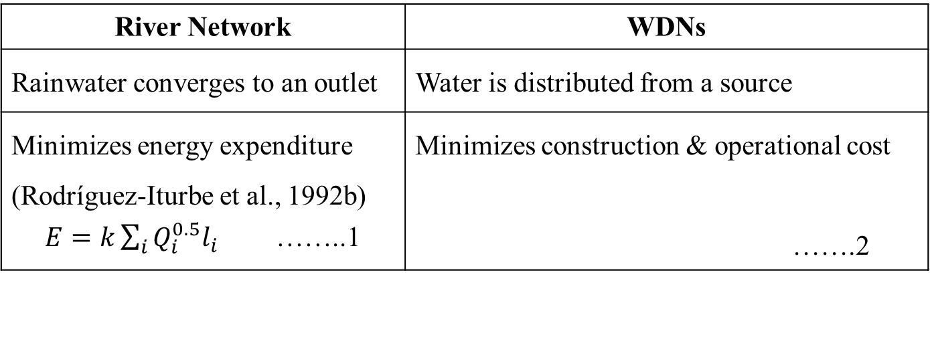
The Core Idea: Learning from Nature
(Borse, 2024, PhD Thesis, IIT Bombay)
Goal: To design a low-cost WDN by mimicking the natural efficiency of river systems.
Problem: WDN design is NP-hard, needing heavy optimization.
Inspiration: River networks self-organize into efficient, energy-minimizing trees.
Approach: A simple probabilistic algorithm evolves networks toward low-cost efficiency.
Simple Analogy:
River Network | WDNs
Rainwater converges to an outlet | Water is distributed from a source
Minimizes energy expenditure (Rodríguez‐Iturbe et al., 1992b) $E=k\sum_{i}{Q_{i}^{0.5}l_{i}}$ ……..1 | Minimizes construction & operational cost …….2

Slide 4




Probabilistic Growth Algorithm for WDN Design
Iterative spanning-tree construction with hydraulically-informed selection
Problem
Algorithm pipeline (one iteration)
1
2
3
Find the cheapest set of pipe diameters from a discrete catalogue such that pressure ≥ P_{min} at every demand node.
Build Tree
Size Pipes
Verify Hydraulics
Probabilistic spanning tree
from reservoirs to all nodes
Continuity-based diameter
from cumulative demand
EPANET solver checks
pressure at every node
Why it is hard
Repeat for N iterations · keep cheapest feasible design
Combinatorial: X^{N} candidate diameter assignments
Hydraulically coupled: every diameter affects pressures everywhere
Discrete + nonlinear: no gradient information available
The algorithm has three independent knobs:
Tree shape
Pipe sizing
Search effort
η, β, γ, δ, θ
V_global
N iterations

Slide 5




Probabilistic Tree Growth
Two-stage roulette guided by a hydraulic attractiveness score $ϕ$
Each iteration grows the tree edge by edge
Attractiveness score for every node v
Step 1 Pick a parent from the frontier
$$ϕ=Q^{γ}L^{−δ}H^{−θ}$$
Roulette weights: $ϕ$(v)^{η}, exponent η sharpens the selection.
High η → almost always picks the most attractive frontier node.
η = 0 → uniform random pick (heuristic ignored).
Q
cumulative demand reaching v through the tree
Step 2 Pick a child from the parent's neighbours
L
downstream path length from a reservoir to v
Roulette weights: $ϕ$(u)^{β}, exponent β sharpens the selection.
H
head difference along that path
High The chosen child is added as a tree edge, its neighbors enter the frontier with updated ϕ values
Roll of γ, δ, and θ
γ > 0 → favour high-demand nodes
δ < 0 → favour short paths from source
θ < 0 → favour easy-to-reach nodes (low head loss)
Step 3 Repeat until every node is assigned
Result: a directed spanning tree rooted at the reservoirs, covering all the demand nodes. Every iteration produces a different tree because the roulette is stochastic.

Slide 6
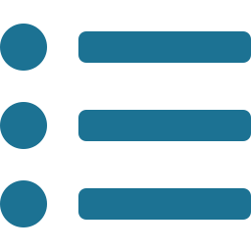

Pipe Sizing and Feasibility Check
Continuity-based sizing, catalogue snapping, and parallel iteration
1
Cumulative demand
2
Theoretical diameter
3
Snap to catalogue
For each tree pipe, flow = sum of demands of all downstream nodes.
D = √( 4Q / (π · V_{global}) )
Choose the closest of the available commercial diameters; cost = length × unit price.
From continuity at fixed sizing velocity V_global.
Trade-off: higher V → smaller D → cheaper pipes, but more head loss → fewer feasible designs.
Feasibility check
Apply diameters to the network and run EPANET hydraulics in memory.
An iteration is feasible when pressure ≥ P_{min} at every demand node.
Loop pipes (those not in the spanning tree) default to the smallest catalogue diameter.

Slide 7
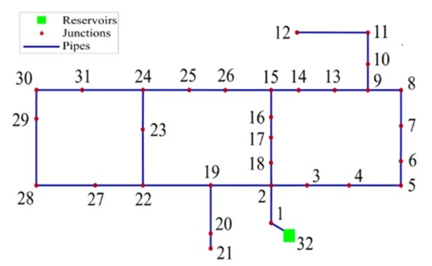
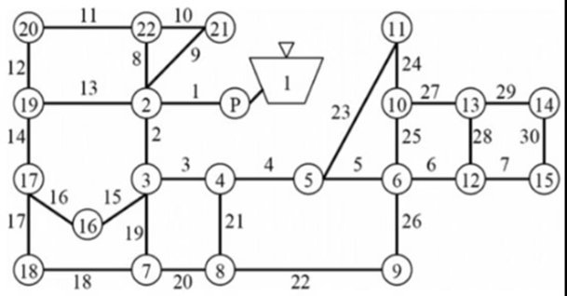
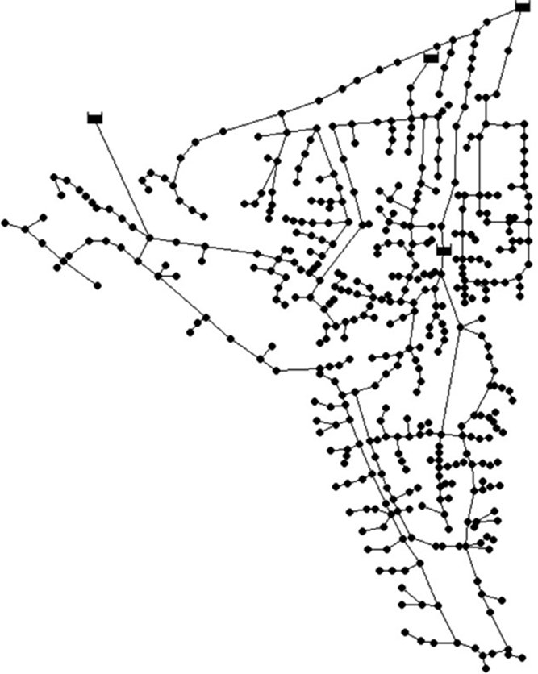
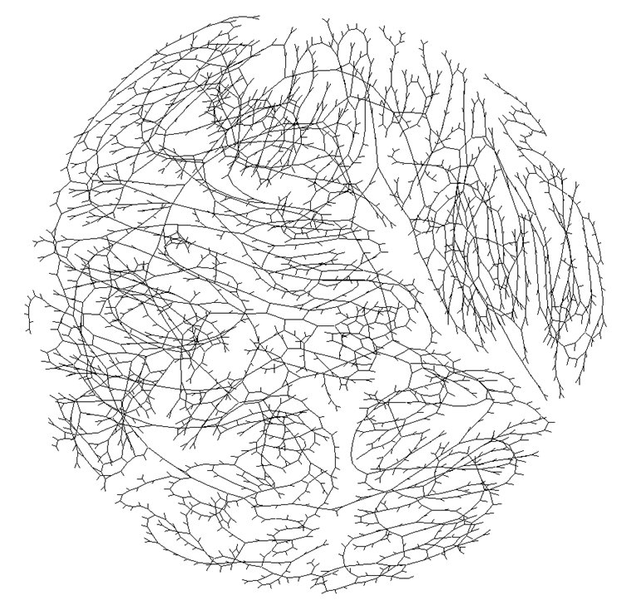
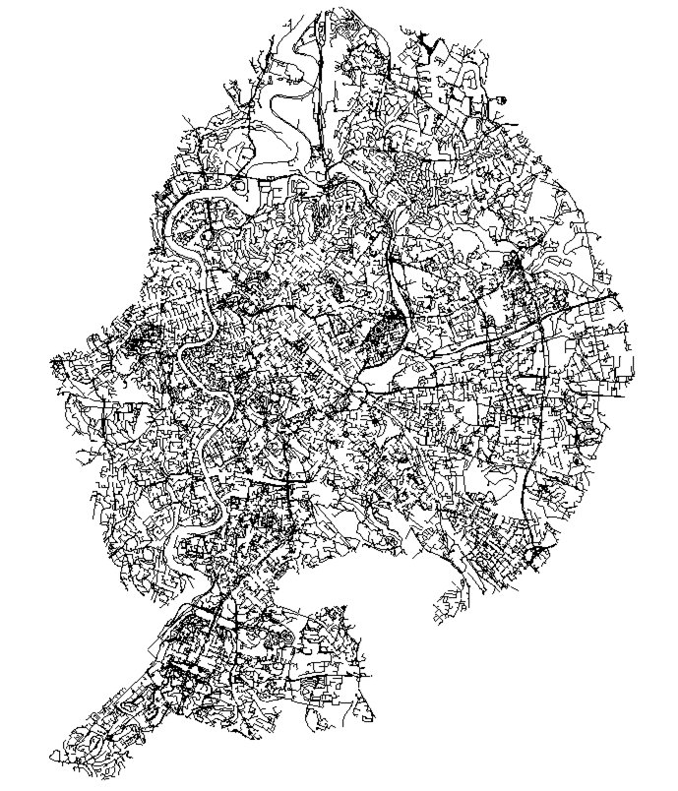
Case Studies
Hanoi Network (HAN)
GoYung Network
Balerma Network (BIN)
4 reservoir
443 demand nodes
454 pipes
8 loops
10 diameters
Reca and Martínez (2006)
1 reservoir • 32 demand nodes • 34 pipes • 3 loops
6 diameters, Fujiwara and Khang (1990)
1 reservoir • 22 demand nodes • 30 pipes • 9 loops
8 diameters, Kim et al. (1994)
Real-world Large WDN
VirtRome
1 reservoir
3558 demand nodes
4021 pipes
211 km of pipes
15 diameters
Sitzenfrei, R., et al. (2020)
4 reservoir
150,630 demand nodes
157,044 pipes
15 diameters
Beyond the reach of standard evolutionary algorithms
Sitzenfrei, R., et al. (2020)

Slide 8
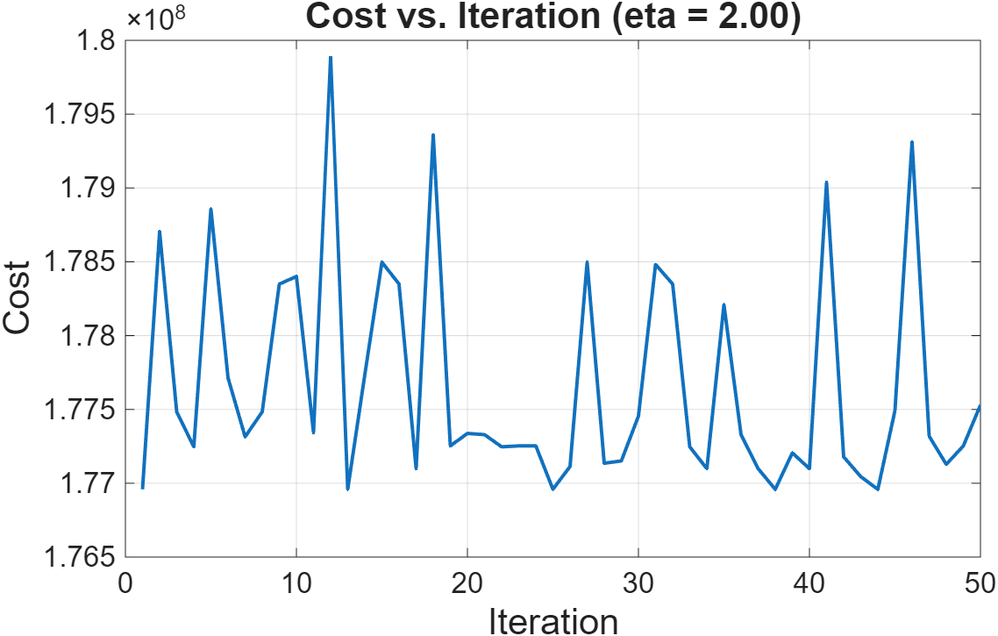
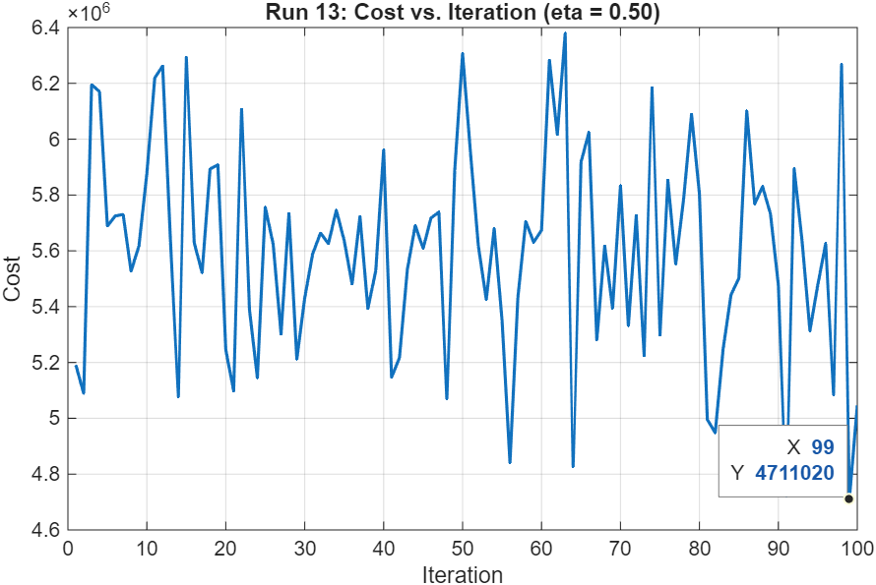
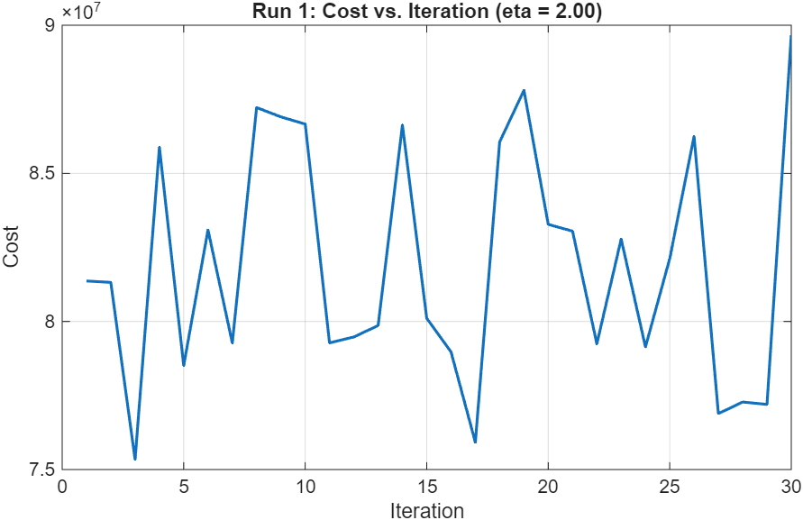
Results and Discussion
GoYung
Large WDN
VirtRome WDN
Cost – 177.09 million won
Time – 6.47 sec (50 iterations)
Vmin – 0.8 m/s
Vmax – 1.2 m/s
Cost – € 4.71 million
Time – 7.86 min (100 iterations)
Vmin – 1.0 m/s
Vmax – 1.8 m/s
Cost - € 81.99 million
Time – 6.34 days, 30 iterations
Vmin – 0.8 m/s
Vmax – 1.37 m/s
Figure: Evolution of design cost with iterations
Figure: Evolution of design cost with iterations
Figure: Evolution of design cost with iterations

Slide 9
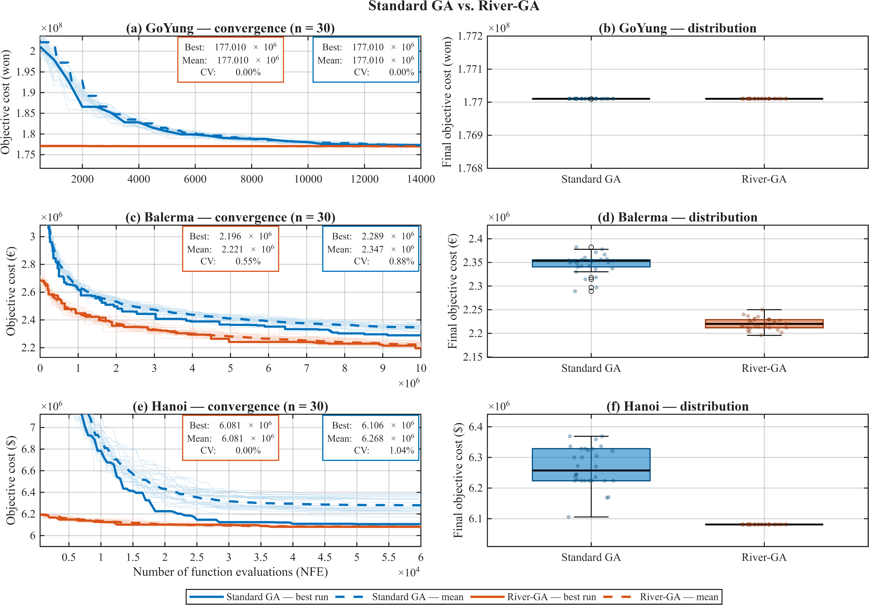

Slide 10
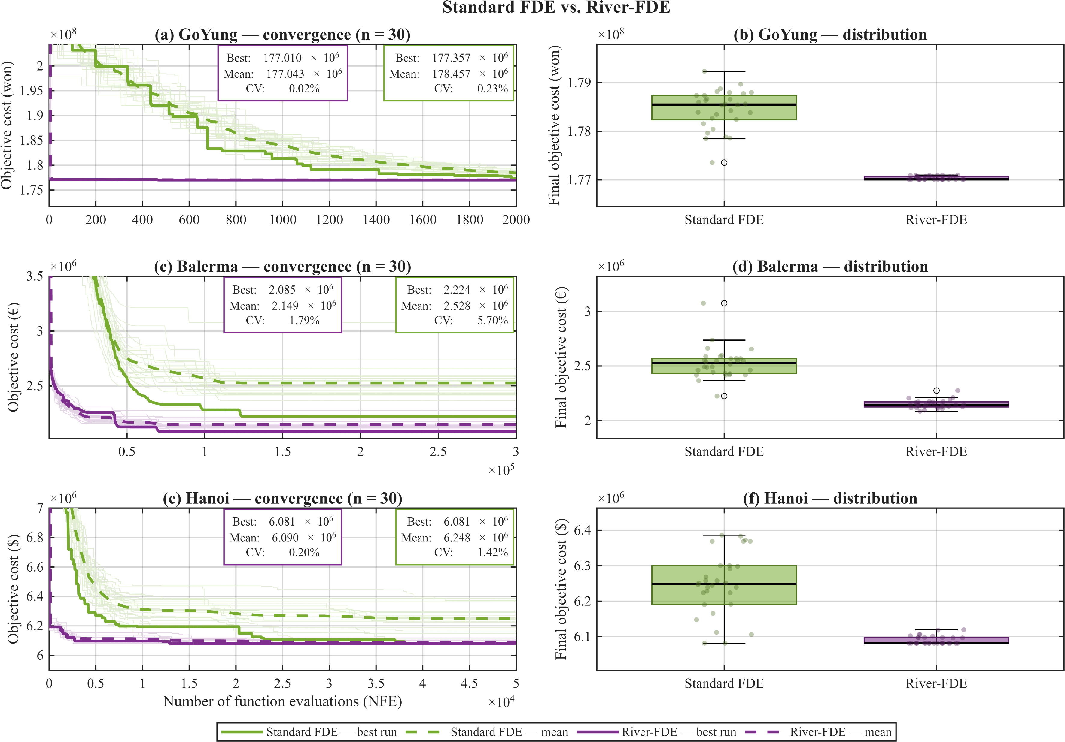
Surendra Kumar Sahu @IIT Bobay, India

Slide 11



Conclusion
Novel river-network-inspired algorithm showed robust performance across scales
Rapid Solutions
Generates competitive, near-optimal network designs in seconds
Achieved costs of $6.15M (Hanoi), 177.09M won (GoYung), and €2.478M (Balerma)
Proven Scalability
Successfully handled large-scale networks
Obtained the cost of €2.478M (Large network), and €81.99 M (VirtRome)
Hybridization Power
River Network + GA achieved global optimum for Hanoi with 64% time reduction and 60% fewer evaluations
The primary breakthrough: It offers efficient initialization, reducing computational cost for traditional metaheuristics and improving solution quality.

Slide 12
REFERENCES
Sitzenfrei, R., Wang, Q., Kapelan, Z., & Savić, D. (2020). Using complex network analysis for optimization of water distribution networks. Water Resources Research, 56, e2020WR027929. https://doi.org/10.1029/2020WR027929
Mohsen Hajibabaei, Sina Hesarkazzazi, Amin Minaei, Dragan Savić, Robert Sitzenfrei; Pareto-optimal design of water distribution networks: an improved graph theory-based approach. Journal of Hydroinformatics 1 September 2023; 25 (5): 1909–1926. doi: https://doi.org/10.2166/hydro.2023.091
Reca, J., and J.Martínez (2006), Genetic algorithms for the design of looped irrigation water distribution networks, Water Resour. Res., 42, W05416, doi:10.1029/2005WR004383.
Zheng, F., A. R.Simpson, and A. C.Zecchin (2011), A combined NLP-differential evolution algorithm approach for the optimization of looped water distribution systems, Water Resour. Res., 47, W08531, doi:10.1029/2011WR010394
Naser Moosavian, Barbara J. Lence; Fittest Individual Referenced Differential Evolution Algorithms for Optimization of Water Distribution Networks. Journal of Computing in Civil Engineering 1 November 2019; 33 (6). doi: https://doi.org/10.1061/(ASCE)CP.1943-5487.0000849
Dnyanesh Borse, Basudev Biswal; Emergence of efficient channel networks in fluvial landscapes. Advances in Water Resources June 2025; 200: 104962. doi: https://doi.org/10.1016/j.advwatres.2025.104962

Slide 13
THANK
YOU!

