Slide 1
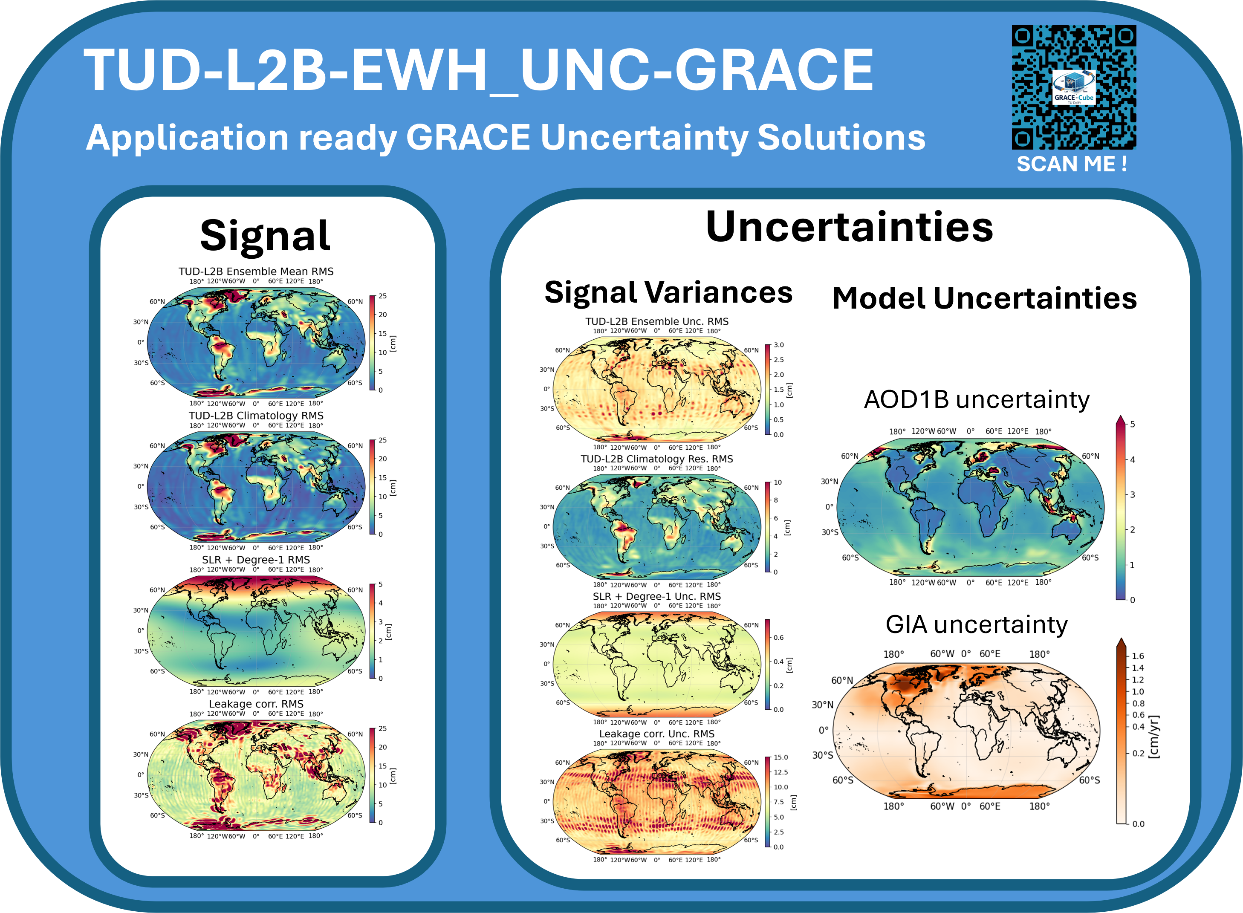





A New Gridded L2(B) Uncertainty Product for GRACE(-FO) Mass Change Studies
M. Cuadrat-Grzybowski
Joao Teixeira da Encarnacao
Pieter N. A. M. Visser
JWG C10. Tailored Parameterization Strategies for Climate Applications of Satellite Gravimetry
SCAN ME!

Slide 2
Introduction
Focus of this work
What are the uncertainties in monthly GRACE Level-2A/B products?
Development of TUD-L2B-EWH_UNC-GRACE
Presentation Outlook
GRACE(-FO) level data
Problem Statement
Methodology
Product structure
Example of Application
Data access & availability

Slide 3
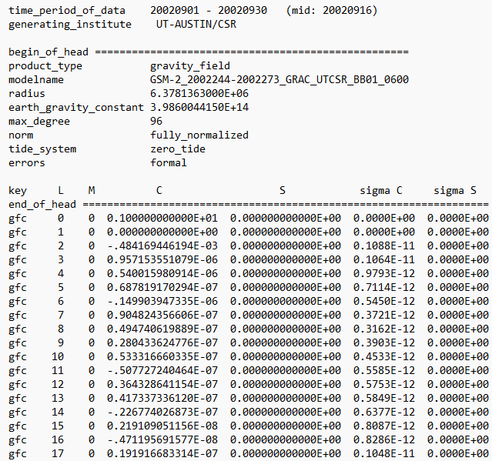
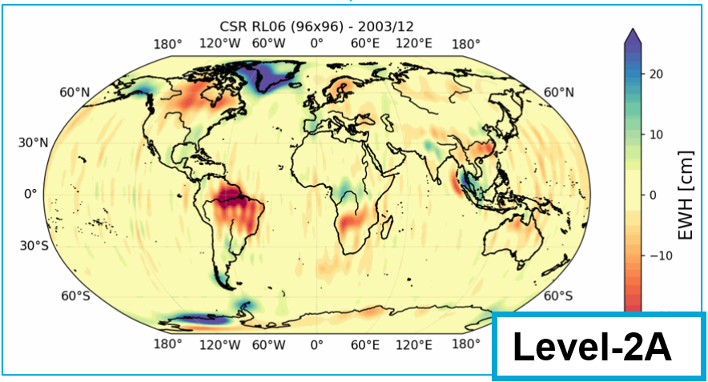



GRACE(-FO) Data
University Of Texas Center For Space Research (UTCSR). (2018). GRACE STATIC FIELD GEOPOTENTIAL COEFFICIENTS CSR RELEASE 6.0 [Data set]. NASA Physical Oceanography Distributed Active Archive Center. https://doi.org/10.5067/GRGSM-20C06 Date Accessed: 2026-04-20
Level-1A/B Satellite orbit data.
KBR, GPS positions, attitude, and accelerometer (2 s, 5 s, 10 s, …).
Level-2 Spherical Harmonic Coefficients (SHC).
Monthly/daily/… sets of gravity field coefficients {${\overline{C}}_{l,m}, {\overline{S}}_{l,m}$}
up to max. degree/order (40, 60, 96, and 120).
Level-2A/B GRACE data product.
Monthly/daily sets of grids of gravity field representations.
Equivalent Water Height (EWH), Geoid, gravity anomaly, …
Level-3 GRACE data product.
Monthly/daily sets of grids of Total Water Storage (TWS in cm), Glacier ice melting mass (in Gt), Ocean Bottom Pressure (OBP, in Pa), …
➔ Essential climatological variables for hydrology / cryosphere / solid Earth.
$${\overline{C}}_{nm}$$
$${\overline{S}}_{nm}$$
Level-2

Slide 4
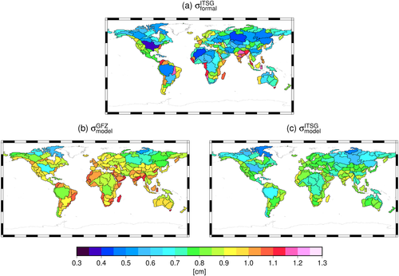
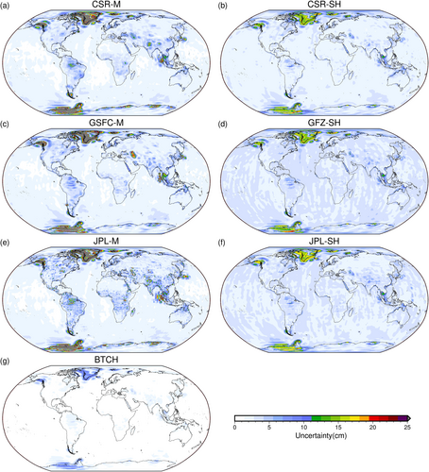
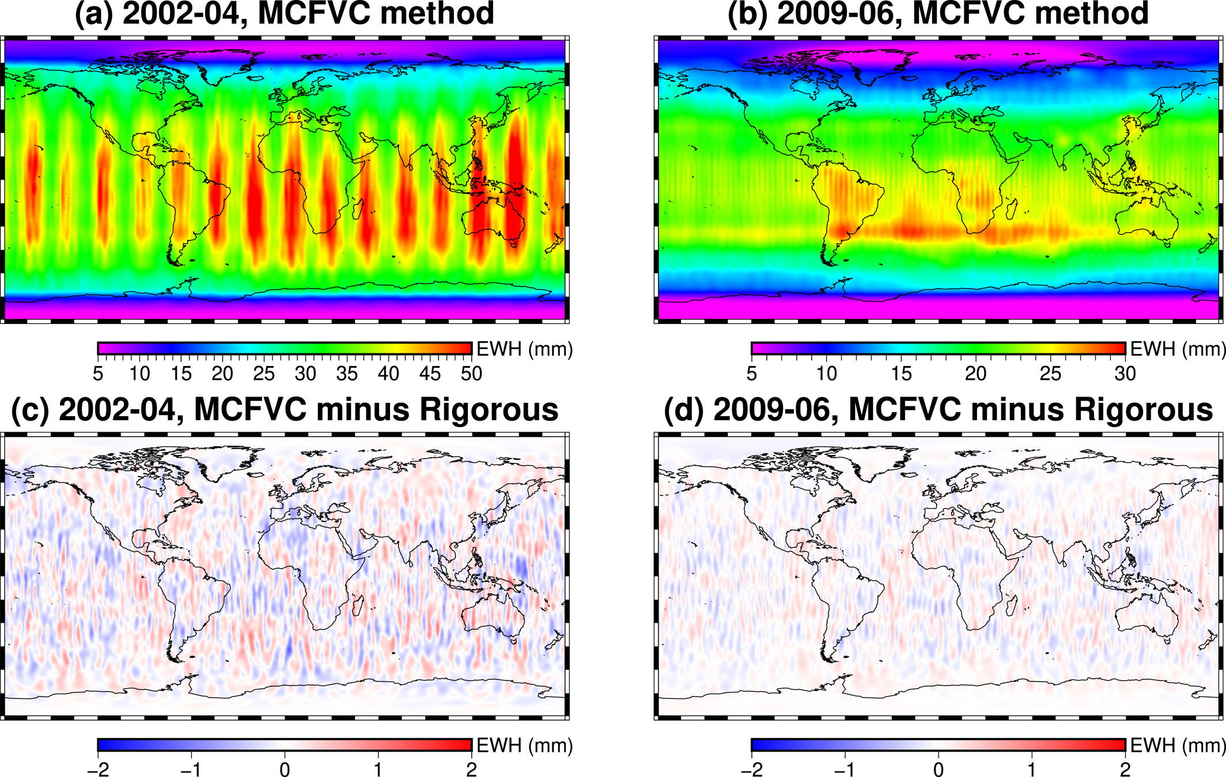
Problem Statement
Main Challenges
Uncertainty information is fragmented.
Full propagation via L2 variance-covariance matrix
→ impractical, incomplete, not provided.
Often treated empirically.
Additional Challenges
Multiple data centre solutions (CSR, GFZ, JPL, …)
Multi-step processing chain from L2 → L2A/B:
  Background models
  Low-degree replacement (SLR)
  GIA correction
  …
Boergens, E., et al. (2022).
Gao, S., et al. (2023).
➔ Need for transparent spatiotemporal uncertainty fields
Yang, F., Forootan, E., Liu, S., & Schumacher, M. (2024).

Slide 5

What we propose
TUD-L2B-EWH_UNC-GRACE
Global gridded Level-2A/B uncertainty product
Equivalent Water Height (EWH) grids
ref. epoch: 2008.
Max. degree: 60.
Built from:
  Ensemble of selected Level-2 solutions.
  Model ensembles (56 GIA models).
  Background model sensitivity (AOD1B).
  Formal errors of low degrees.
  DDK(2-7) filtered versions.

Slide 6
Method – explicit separation
RMS of AOe07 residuals (Shihora et al., 2024)
“Pre-processing” uncertainties (L1B → L2)
Background models:
  AOD1B
      Ocean tide model
Parametrisation differences
“Processing” uncertainties (L2 → L2A/B)
  Replacement of low-degree coefficients
  Inclusion of geocenter motion
  Removal of GIA trend signal
  Effects of filtering = leakage
Weighted Ensemble Statistics of L2 solutions
Weights based on open ocean RMS of residuals w.r.t. COST-G RL02.1
  Propagated formal errors
  Ensemble statistics of 56 known models
  (Bagge et al., 2023)
DDK pair-difference method
(Dobslaw et al., 2020)

Slide 7
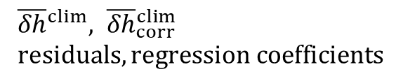

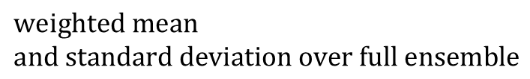
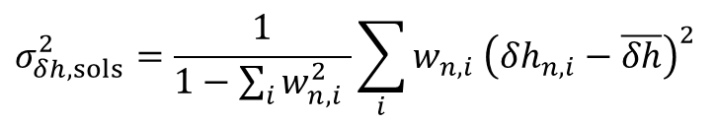
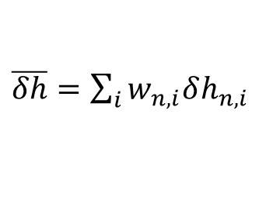
Product Structure
$\overline{δh}=\sum_{i}{w_{n,i}δh_{n,i}}$
Main signal and uncertainty fields
TUD-L2B-EWH_UNC-GRACE
Signal climatology and residuals
TUD-L2B-EWH_CLIM(_CORR)-GRACE
Signal and uncertainty without SLR
TUD-L2B-EWH_UNC_noSLR-GRACE
Leakage climatology and residuals
TUD-L2B-EWH_CLIM_LEAKAGE-GRACE
Usability:
Effects of low degree replacement, filtering, tidal removal, …
→ Uncertainty grids ready for assimilation/regression.
$$σ_{δh, sols}^{2}=\frac{1}{1−\sum_{i}{w_{n,i}^{2} }}\sum_{i}{w_{n,i} {\left(δh_{n,i}−\overline{δh}\right)}^{2}}$$
$$weighted mean$$
$$and standard deviation over full ensemble$$
${\overline{δh}}^{clim}, {\overline{δh}}_{corr}^{clim}$
$residuals, regression coefficients$
$${\overline{δh}}^{GRACE},σ_{δh, sols}^{2}$$

Slide 8
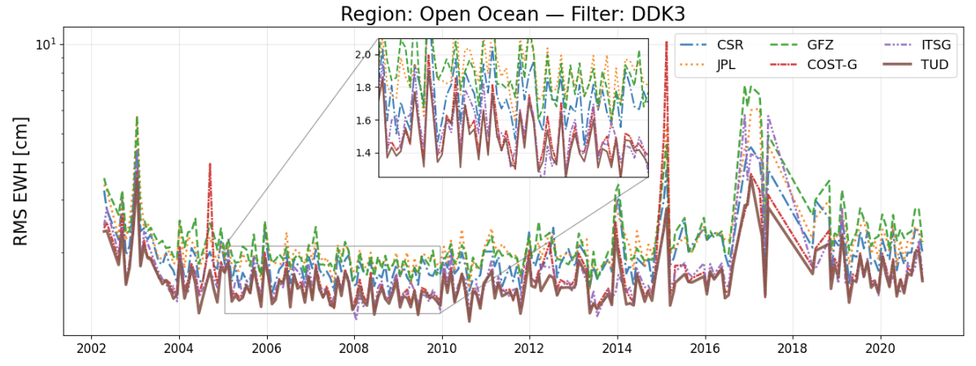
Validation of ensemble method
Open ocean RMS of climatological residuals - Filter DDK3
10
9
8
7
6
5
4
3
2
1
➔ 1st-2nd lowest RMS metric!

Slide 9
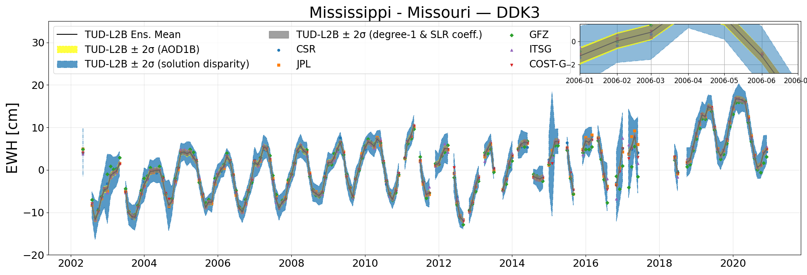
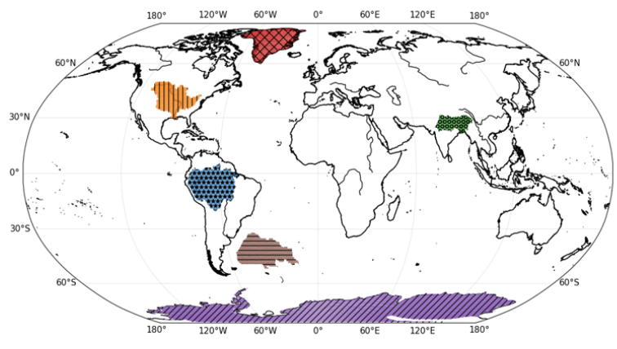
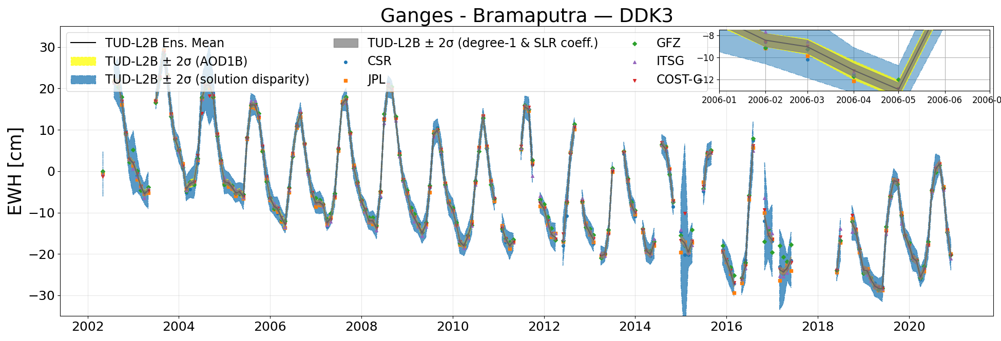
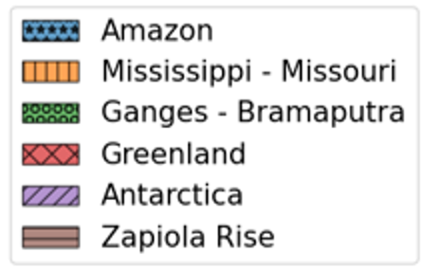
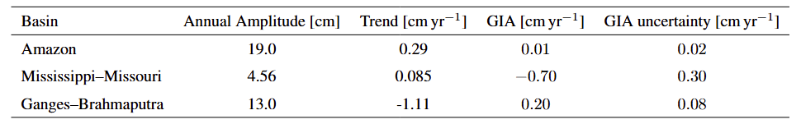
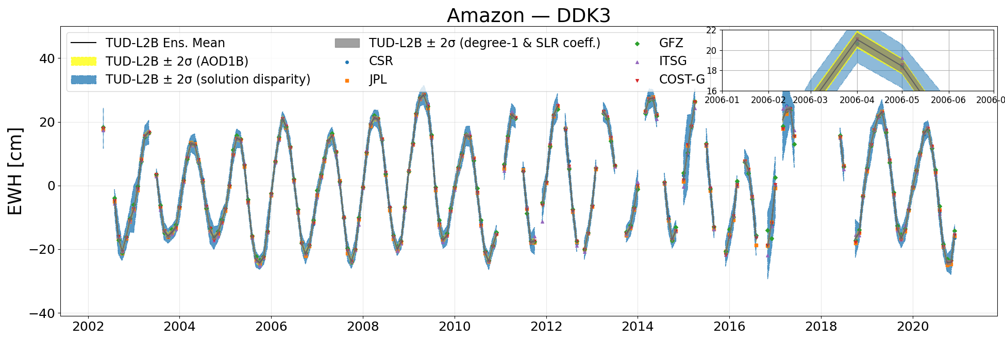
Applications

Slide 10

Data Availability & Access
Available at the 4TU Repository:
https://doi.org/10.4121/4fc748e8-01c7-4f06-87da-653937b078f7.v4
TUD-L2B-EWH_UNC
Also available at the TUDelft GRACE-Cube Portal:
https://grace-cube.lr.tudelft.nl/
NetCDF4 files directly downloadable.
Simple Python Scripts also available for direct use.
TUD GRACE-Cube

Slide 11
Summary
  TUD-L2B-EWH_UNC-GRACE
  Ready-to-use global Level-2B EWH gridded uncertainty product
  Separates pre- and (post-)processing uncertainty sources
  User-friendly multi-layer structure for many geophysical applications
  Data product paper submitted to
  Earth System Science Data (ESSD)
Contact
Michal Cuadrat-Grzybowski: M.Cuadrat-Grzybowski-1@tudelft.nl
SCAN ME!

Slide 12
References
Bagge, M., Klemann, V., Dill, R., & Dobslaw, H. (2023).
Present-day gravity changes from GIA ensemble simulations. GFZ Data Services. https://doi.org/10.5880/GFZ.1.3.2023.002
Boergens, E., Kvas, A., Eicker, A., Dobslaw, H., Schawohl, L., Dahle, C., et al. (2022). Uncertainties of GRACE-based terrestrial water storage anomalies for arbitrary averaging regions. Journal of Geophysical Research: Solid Earth, 127, e2021JB022081. https://doi.org/10.1029/2021JB022081
Cuadrat-Grzybowski, M., Teixeira da da Encarnacao, J.G., Visser, P.N.A.M. (2026).
TUD-L2B-EWH_UNC-GRACE: A Global Level‑2B GRACE(-FO) EWH Uncertainty Product. (submitted to ESSD for review).
Cuadrat-Grzybowski, M., and Teixeira da Encarnação, J. G. (2026).
TUD-L2B-EWH_UNC-GRACEv4: Global 0.5°x0.5° monthly equivalent water height user-friendly dataset with comprehensive uncertainty decomposition (ensemble solution uncertainty, AOD1B uncertainty, DDK leakage error, low-degree coefficient treatment, and GIA ensemble error) 4TU.ResearchData. DOI: http://doi.org/10.4121/4fc748e8-01c7-4f06-87da-653937b078f7
Dobslaw, H., Dill, R., Bagge, M., Klemann, V., Boergens, E., Thomas, M., et al. (2020):
Gravitationally consistent mean barystatic sea level rise from leakage-corrected monthly GRACE data. Journal of Geophysical Research: Solid Earth, 125, e2020JB020923. https://doi.org/10.1029/2020JB020923
Gao, S., Hao, W., Fan, Y., Li, F., & Wang, J. (2023). A multi-source GRACE fusion solution via uncertainty quantification of GRACE-Derived Terrestrial Water Storage (TWS) change. Journal of Geophysical Research: Solid Earth, 128, e2023JB026908. https://doi.org/10.1029/2023JB026908
Shihora, L., Liu, Z., Balidakis, K., et al. (2024).
Accounting for residual errors in atmosphere–ocean background models. Journal of Geodesy, 98, 27. https://doi.org/10.1007/s00190-024-01832-7
Yang, F., Forootan, E., Liu, S., & Schumacher, M. (2024). A Monte Carlo propagation of the full variance-covariance of GRACE-like level-2 data with applications in hydrological data assimilation and sea-level budget studies. Water Resources Research, 60, e2023WR036764. https://doi.org/10.1029/2023WR036764

Slide 13
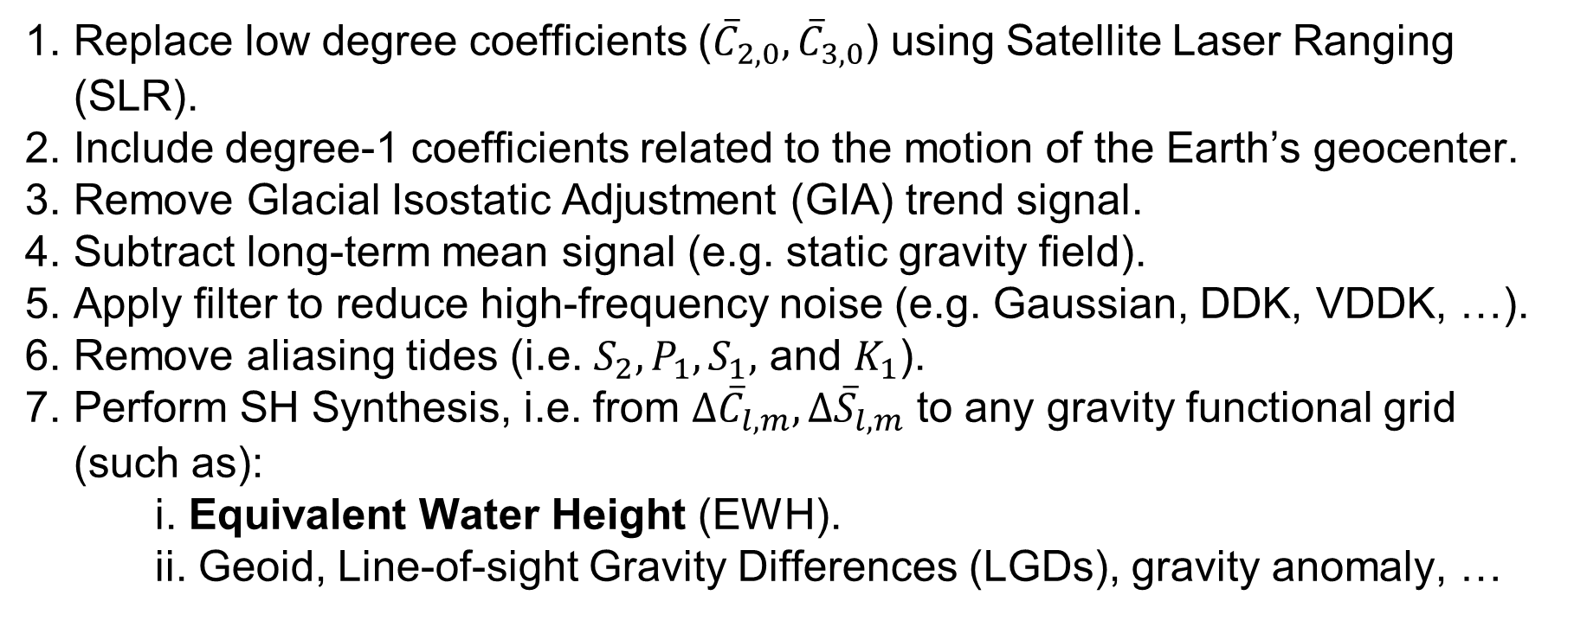
Typical processing steps
Replace low degree coefficients (${\overline{C}}_{2,0},{\overline{C}}_{3,0}$) using Satellite Laser Ranging (SLR).
Include degree-1 coefficients related to the motion of the Earth’s geocenter.
Remove Glacial Isostatic Adjustment (GIA) trend signal.
Subtract long-term mean signal (e.g. static gravity field).
Apply filter to reduce high-frequency noise (e.g. Gaussian, DDK, VDDK, …).
Remove aliasing tides (i.e. $S_{2}, P_{1}, S_{1},$ and $K_{1}$).
Perform SH Synthesis, i.e. from $Δ{\overline{C}}_{l,m}, Δ{\overline{S}}_{l,m}$ to any gravity functional grid (such as):
i. Equivalent Water Height (EWH).
ii. Geoid, Line-of-sight Gravity Differences (LGDs), gravity anomaly, …

Slide 14

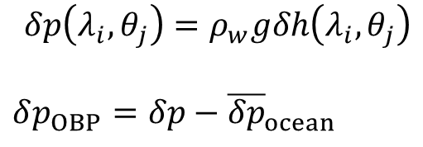
Why EWH?
Ocean Bottom Pressure
Total Water Storage
Mass anomalies
$$δp\left(λ_{i}, θ_{j}\right)=ρ_{w}gδh\left(λ_{i}, θ_{j}\right)$$
$δp_{OBP}=$ $δp−{\overline{δp}}_{ocean}$
➔ Ocean studies
➔ Hydrology studies
➔ Glaciology and hydrology studies
EWH is a proxy variable for many geophysical applications!

Slide 15
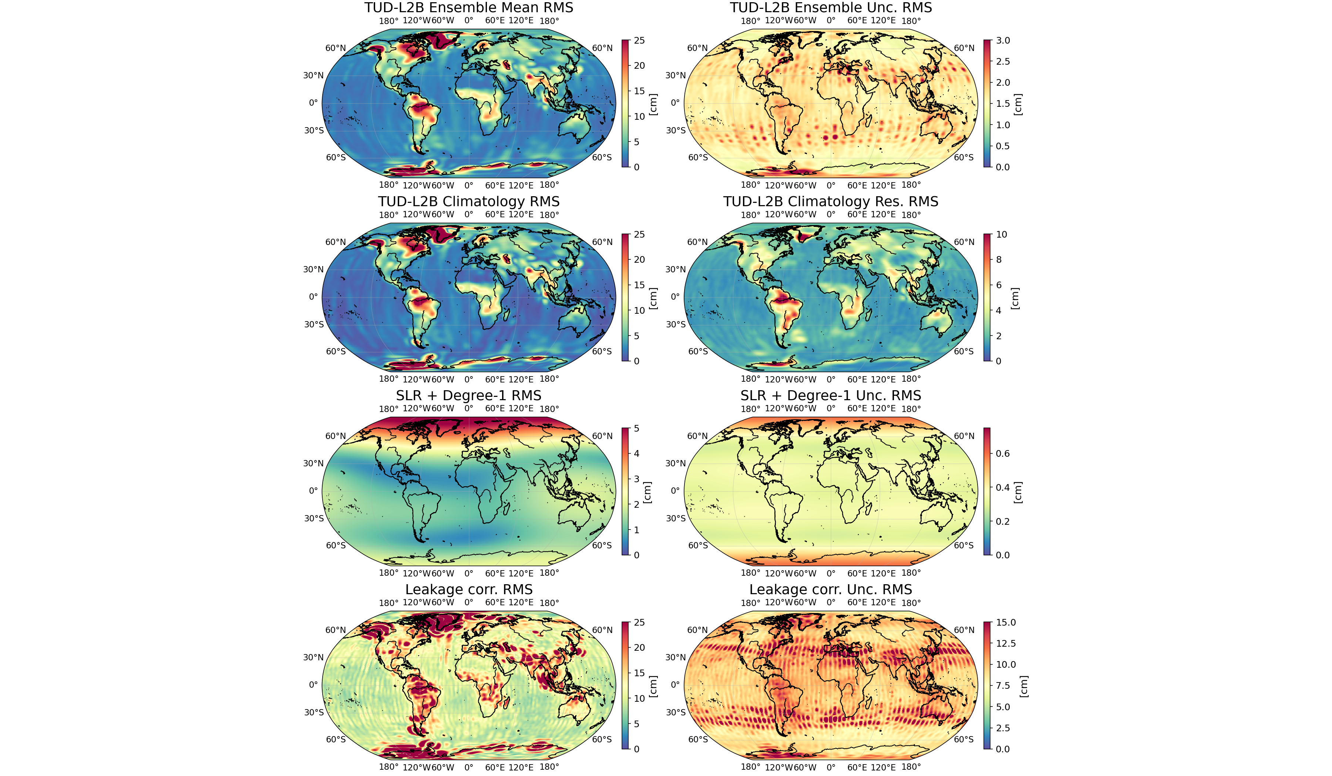
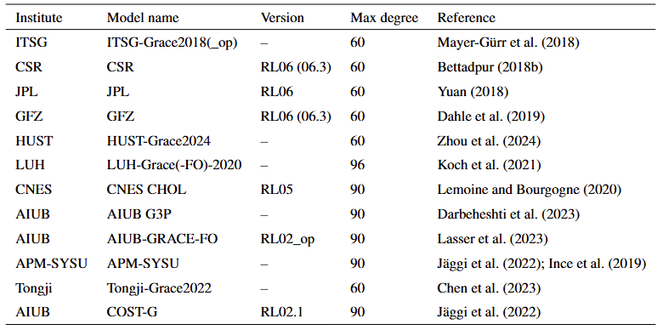
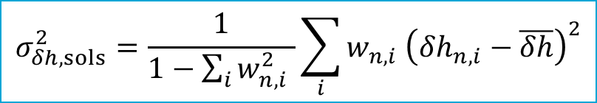

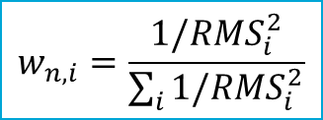
Further details (1)
Weighted ensemble solution statistics
$\overline{δh}=\sum_{i}{w_{n,i}δh_{n,i}}$
Filter: DDK3
$$σ_{δh, sols}^{2}=\frac{1}{1−\sum_{i}{w_{n,i}^{2} }}\sum_{i}{w_{n,i} {\left(δh_{n,i}−\overline{δh}\right)}^{2}}$$
Weight based on open ocean RMS of residuals w.r.t COST-G RL02.1
Selected solutions for combined product
$$w_{n,i}=\frac{1/RMS_{i}^{2}}{\sum_{i}{1/RMS_{i}^{2}}}$$

Slide 16
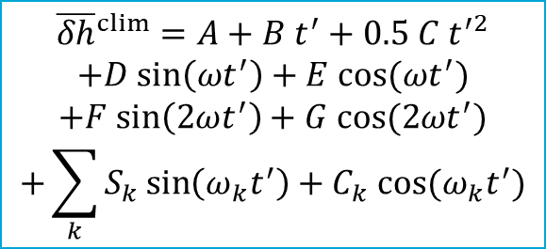
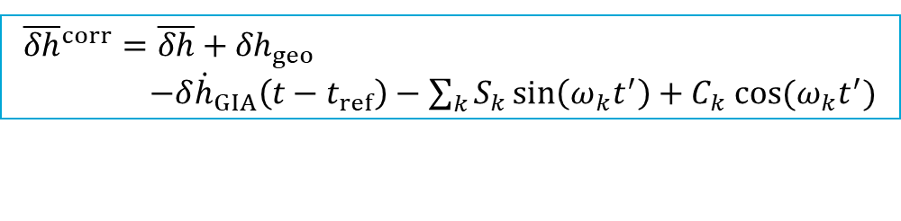
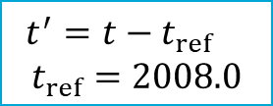
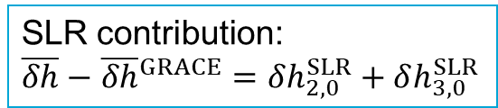
Further details (2)
${\overline{δh}}^{corr}=\overline{δh}+{δh}_{geo}$
$−{δ\dot{h}}_{GIA}\left(t−t_{ref}\right)−\sum_{k}{S_{k}\sin\left(ω_{k}t^{′}\right)+C_{k} cos⁡(ω_{k}t^{′})}$
$${\overline{δh}}^{clim}=A+B t^{′}+0.5 C t^{′2}$$
$$+D sin\left(ωt^{′}\right)+E cos⁡(ωt^{′})$$
$$+F sin\left(2ωt^{′}\right)+G cos⁡(2ωt^{′})$$
$$+\sum_{k}{S_{k}\sin\left(ω_{k}t^{′}\right)+C_{k} cos⁡(ω_{k}t^{′})}$$
Filter: DDK3
SLR contribution:
$\overline{δh}−$ ${\overline{δh}}^{GRACE}=δh_{2,0}^{SLR}+δh_{3,0}^{SLR}$
$t^{′}=t−t_{ref}$
$$t_{ref}=2008.0$$

Slide 17
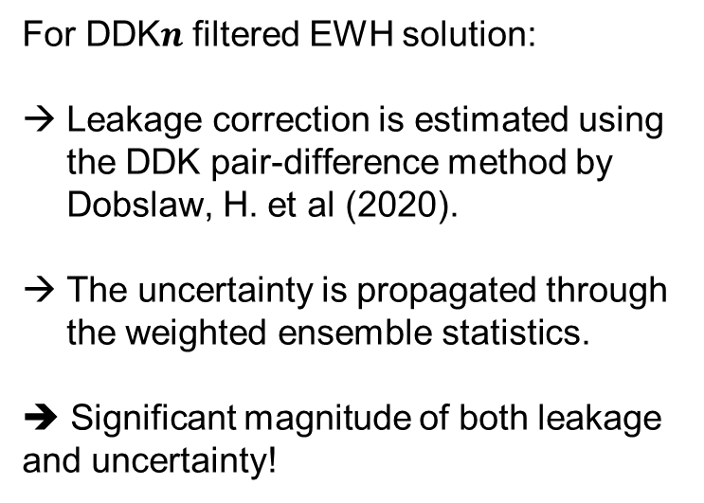

Further details (3)
For DDK$n$ filtered EWH solution:
Leakage correction is estimated using the DDK pair-difference method by Dobslaw, H. et al (2020).
The uncertainty is propagated through the weighted ensemble statistics.
➔ Significant magnitude of both leakage and uncertainty!
Filter: DDK3
$${\overline{δh}}_{leak,n}=c_{n}({\overline{δh}}_{n+1}−{\overline{δh}}_{n−1})$$
n DDK7 DDK6 DDK5 DDK4 DDK3 DDK2
Scale factor 4.4 4.5 4.0 4.5 3.9 2.9
Dobslaw, H., Dill, R., Bagge, M., Klemann, V., Boergens, E., Thomas, M., et al. (2020):
Gravitationally consistent mean barystatic sea level rise from leakage-corrected monthly GRACE data. Journal of Geophysical Research: Solid Earth, 125, e2020JB020923.
https://doi.org/10.1029/2020JB020923

Slide 18

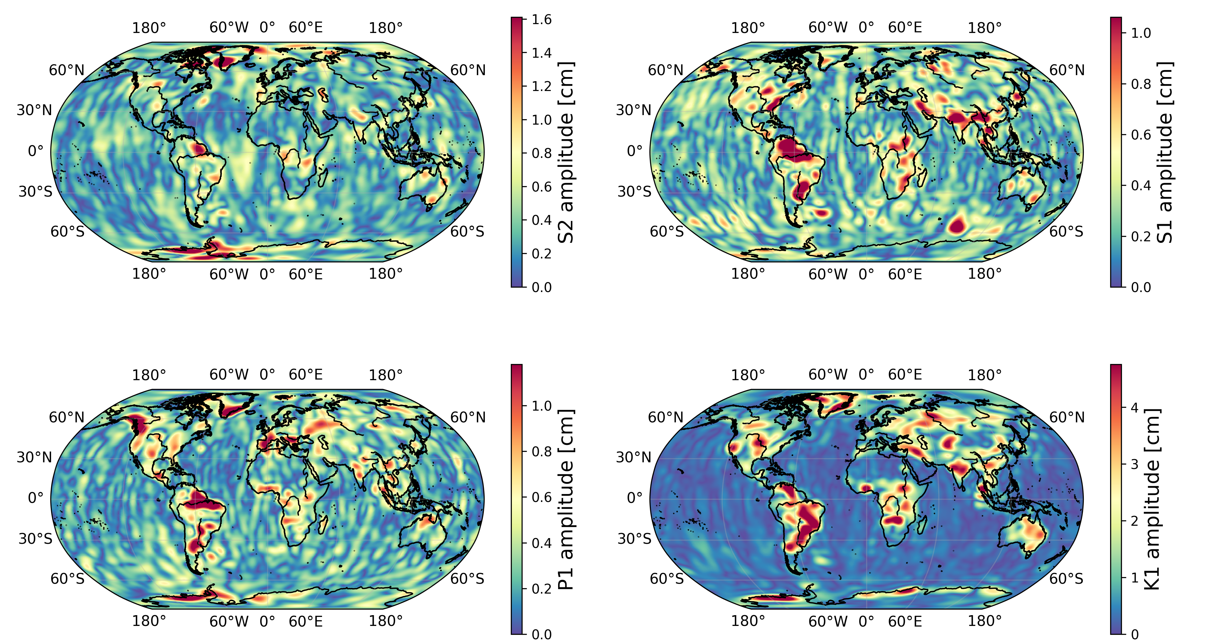
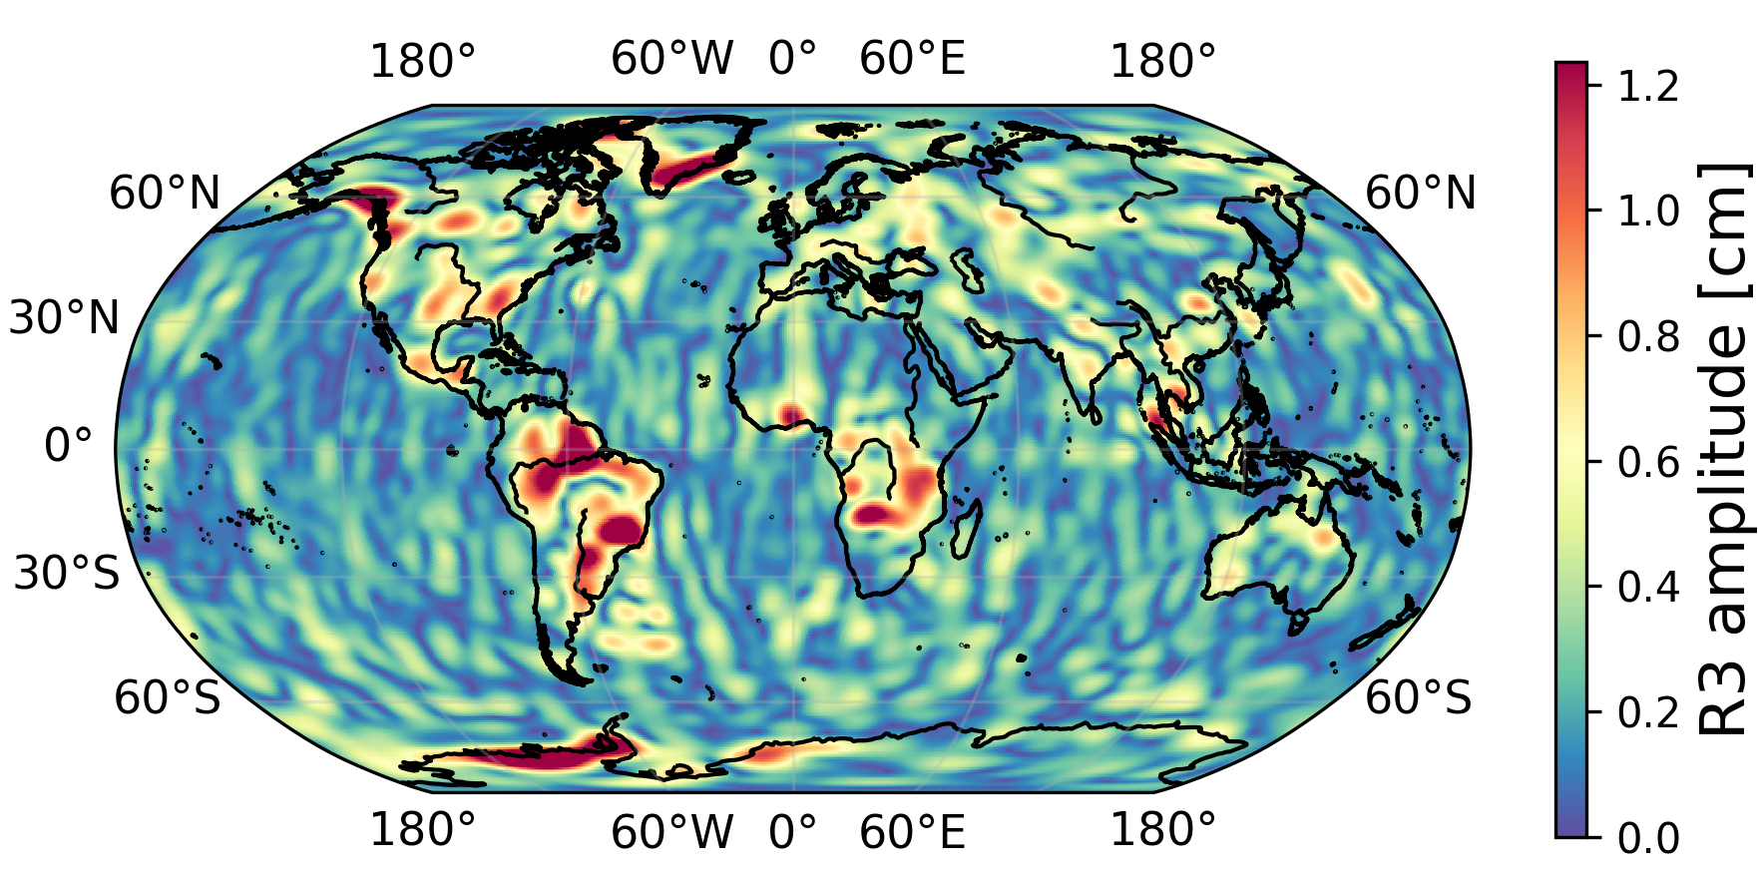
Aliasing tide amplitudes
Tidal aliasing climatological fit with DDK3.
a)
b)
c)
d)
e)

Slide 19
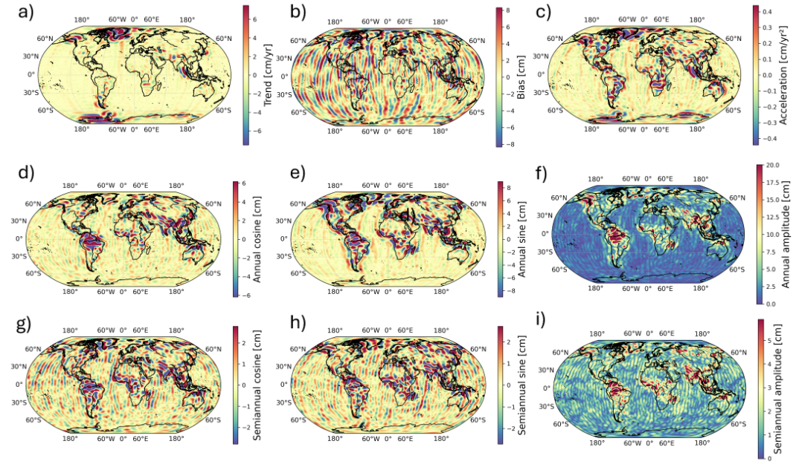
Climatological fit for leakage
Leakage climatological fit for DDK3.

Slide 20
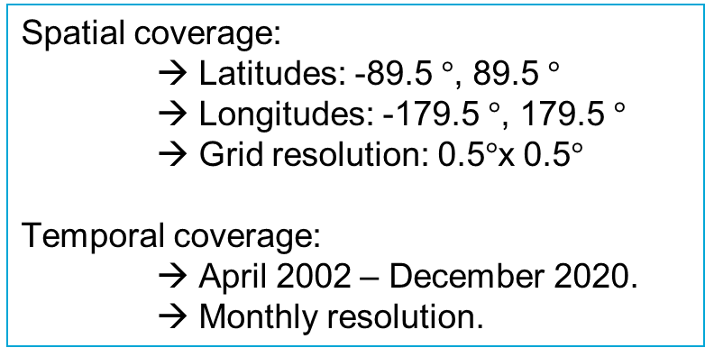
Product details
TUD-L2B-EWH_UNC-GRACE
Gridded Equivalent Water Height (EWH) Product
  File format:
  NetCDF4 (.nc)
  Dimensions:
  time, latitude, longitude.
  Variable units:
  cm EWH.
Spatial coverage:
  → Latitudes: -89.5 $°$, 89.5 $°$
  → Longitudes: -179.5 $°$, 179.5 $°$
  → Grid resolution: 0.5$°$x 0.5$°$
  Temporal coverage:
  → April 2002 – December 2020.
  → Monthly resolution.
  Multi-layered product:
  → weighted mean,
  → weighted std,
        → Degree-1,
        → GIA trend,
        → Leakage (mean+std),
        → Tidal aliasing.
SCAN ME!

Slide 21
Product details (2)
TUD-L2B-EWH_UNC
ewh_mean – weighted mean EWH solution.
ewh_mean_corr –fully corrected EWH.
ewh_degree1 –degree 1 EWH component.
ewh_unc_degree1 – degree-1 uncertainty.
ewh_unc_sols – inter-solution uncertainty.
ewh_unc_degree20 – C_20 propagated uncertainty.
ewh_unc_degree30 – C_30 propagated uncertainty.
ewh_unc_aod1b – AOD1B background model uncertainty.
ewh_mean_leakage – estimated mean leakage due to filtering
ewh_unc_leakage – uncertainty of the leakage estimate.
ewh_gia_mean – ensemble mean of GIA trend [cm/year]
ewh_gia_unc – uncertainty on the GIA trend [cm/year].
TUD-L2B-EWH_CLIM(_CORR)
ewh_mean_beta - gridded climatological regression coefficients with dimensions (lat, lon, coeff)
ewh_mean_beta_std (time, lat, coeff)
ewh_mean_clim (time, lat, lon)
ewh_mean_tides (time, lat, lon)
residuals (time, lat, lon): = ewh_mean – ewh_mean_clim
Dimension “coeff”:
-bias: constant offset term [cm],
-trend: linear trend coefficient [cm yr−1],
-acc: quadratic term [cm yr−2],
-annual_cos, annual_sin: annual harmonic terms [cm],
-semiannual_cos, semiannual_sin: semiannual terms [cm],
-{tide}_cos, {tide}_sin: tidal cosine and sine coefficients [cm]
TUD-L2B-EWH_UNC_noSLR
ewh_mean – weighted mean EWH solution.
ewh_unc_sols – inter-solution uncertainty.
weights: normalized, time-dependent ensemble weights.
SCAN ME!

