Slide 1



A Review of Tools and Resources to Support Decision Making Under Deep Uncertainty
David Gold¹, Julius Schlumberger¹, Valeria Di Fant^{1,2}, Umit Taner², Gundula Winter², Jan Kwakkel³
1: Faculty of Geoscience, Utrecht University
^{2: Deltares}
3: Faculty of Technology, Policy, and Management, TU Delft

Slide 2

2013-2023

Slide 3
Need for a community catalogue
What resources are there to help people get started with DMDU?

Slide 4
Need for a community catalogue
What resources are there to help people get started with DMDU?
What tools can help facilitate DMDU analysis?

Slide 5
Tool
A software package or an implementation of modeling technique(s) used to facilitate DMDU methodology to support a broader DMDU workflow

Slide 6
Tool
Resource
A software package or an implementation of modeling technique(s) used to facilitate DMDU methodology to support a broader DMDU workflow
Informational, educational, and procedural support that enables awareness raising and practical application of DMDU approaches

Slide 7
Cataloging DMDU Tools and Resources
1
Survey
DMDU Society mailing list Mar–May 2024

Slide 8
Cataloging DMDU Tools and Resources
1
2
Survey
Filter & review
DMDU Society mailing list Mar–May 2024
Blind review by co-authors

Slide 9
Cataloging DMDU Tools and Resources
1
2
3
Survey
Filter & review
Classify
DMDU Society mailing list Mar–May 2024
Blind review by co-authors
Mapped to Kwakkel & Haasnoot (2019) DMDU taxonomy

Slide 10
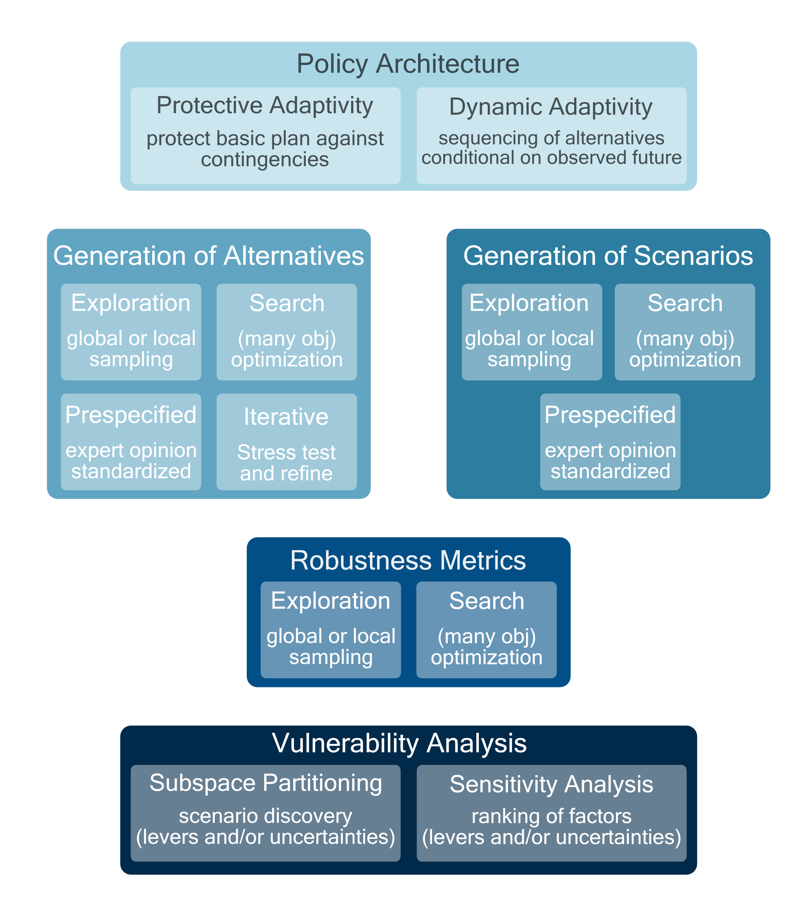
Kwakkel and Haasnoot, 2019
In Decision Making under Deep Uncertainty https://link.springer.com/book/10.1007/978-3-030-05252-2

Slide 11
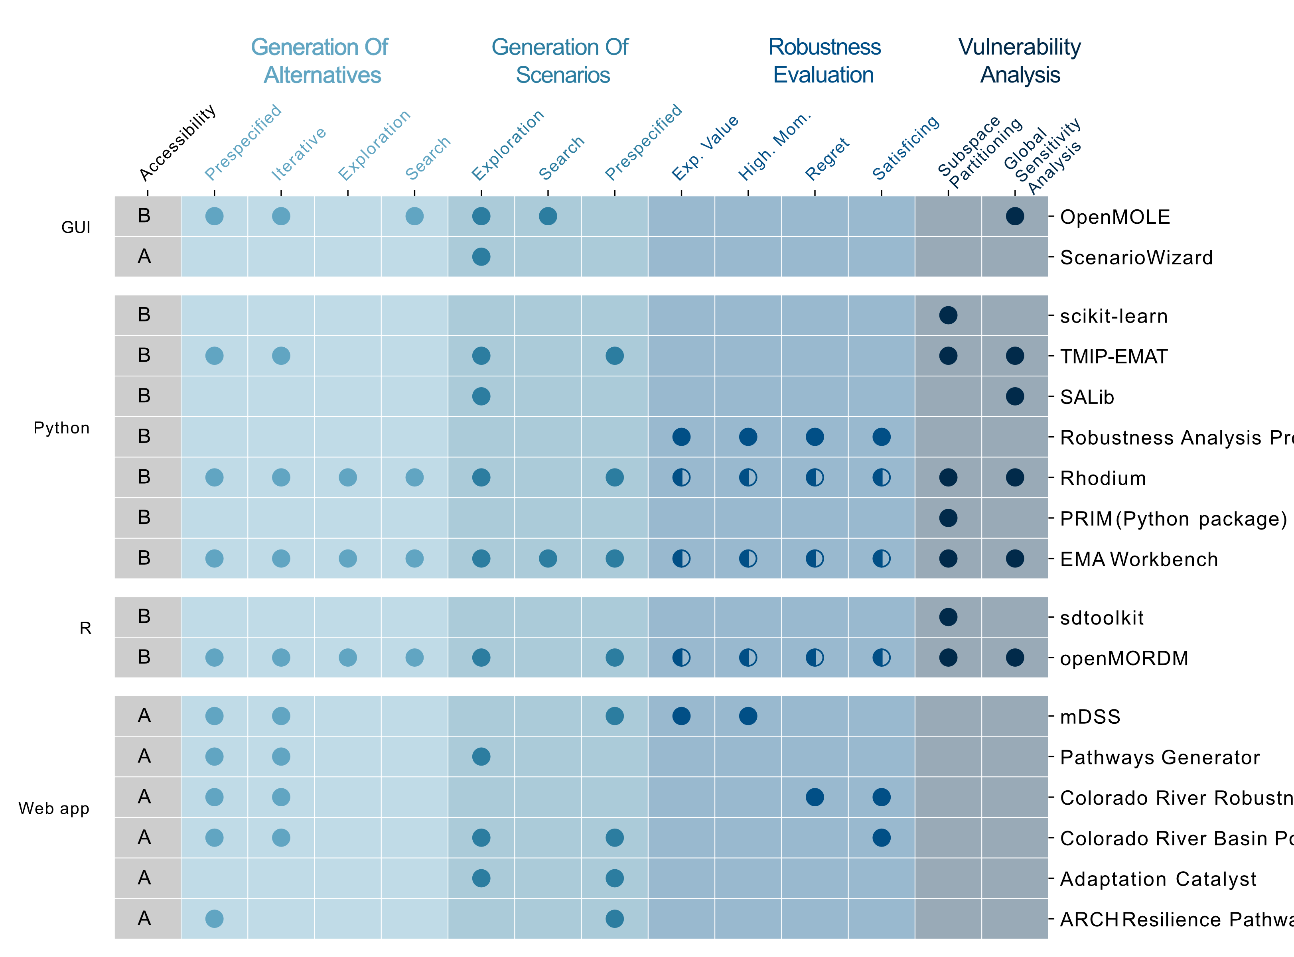
16
tools

Slide 12
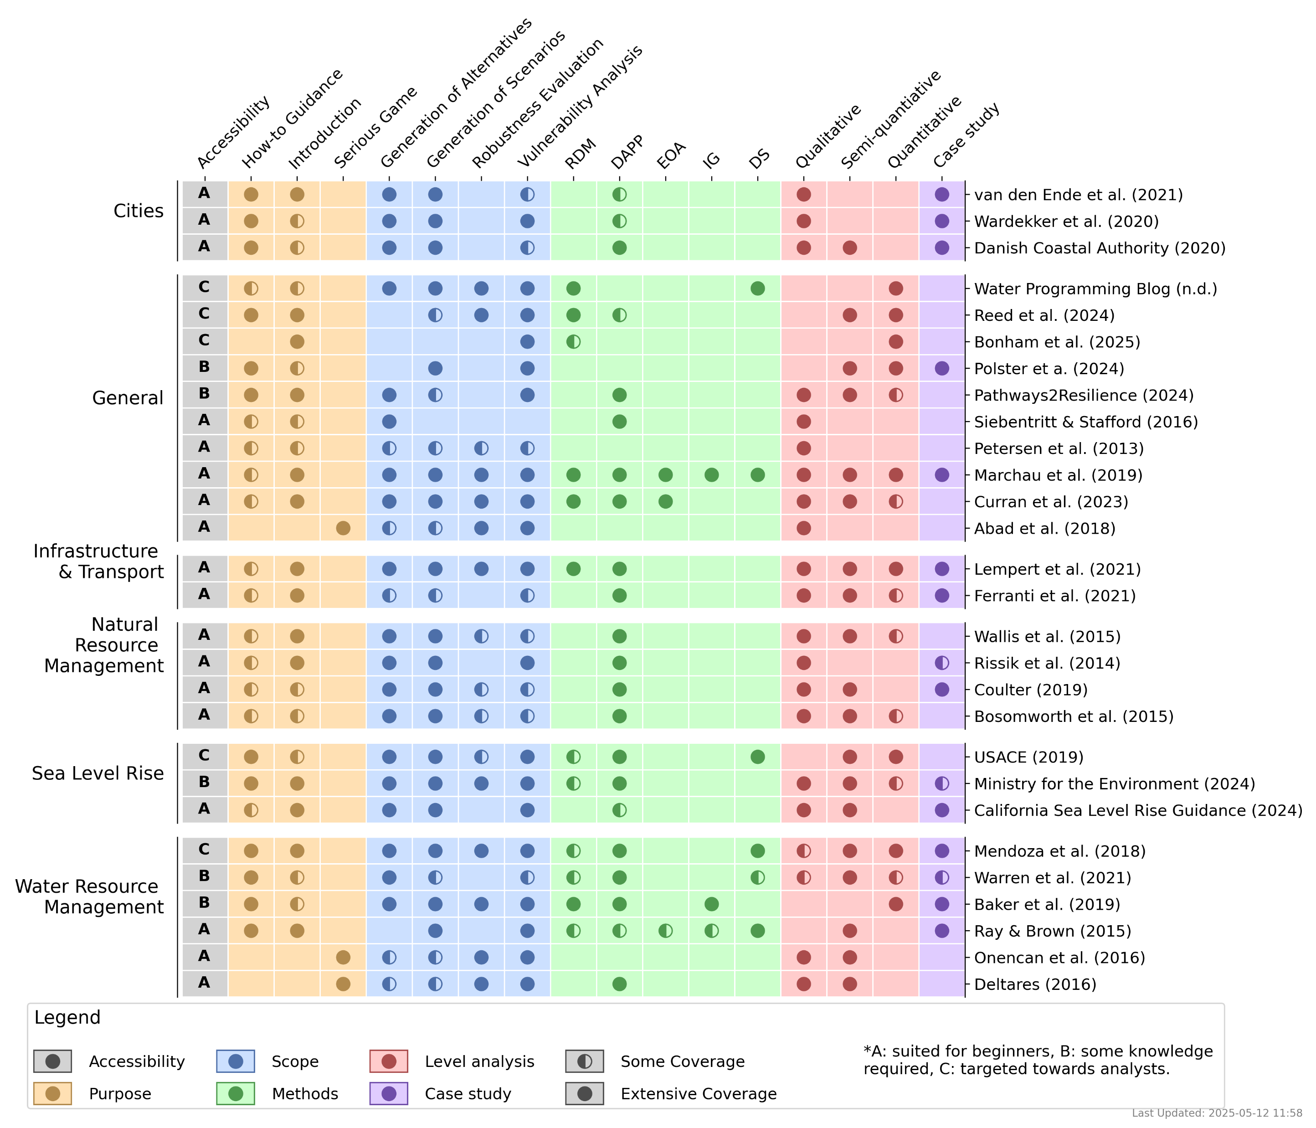
28
resources

Slide 13
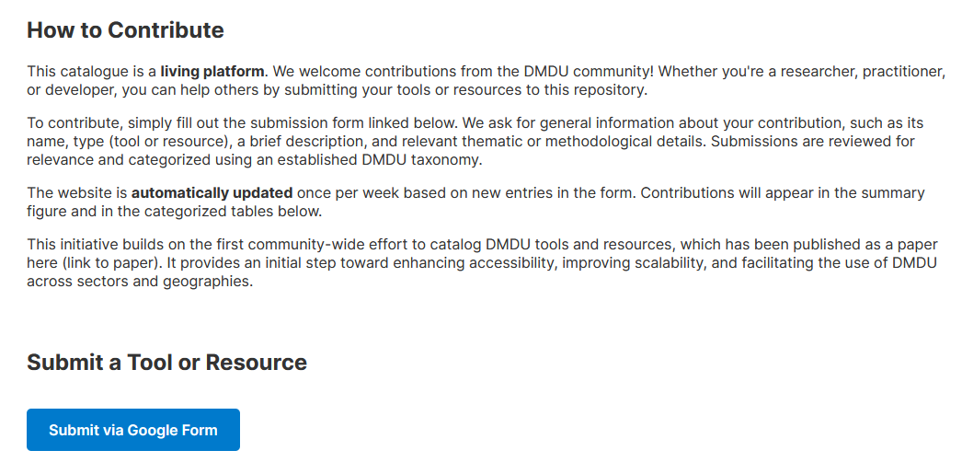
A living repository

Slide 14
