Slide 1
ESA CCI Land Evaporation: Towards a long-term consistent satellite-based global evaporation dataset
Kwint Delbare, Oscar M. Baez-Villanueva, Diego G. Miralles and the ESA CCI E Consortium
Notes:
Have you ever gotten to that point in your research where you have to choose which evaporation dataset or model to use and get lost in the plethora of options out there? So, you end up using the dataset your research group is most familiar with. Sounds familiar? With the ESA climate change initiative land evaporation project we are trying to solve that problem by providing an extensively validated and tested new product, which should in the future act as a benchmark for long-term evaporation datasets.

Slide 2
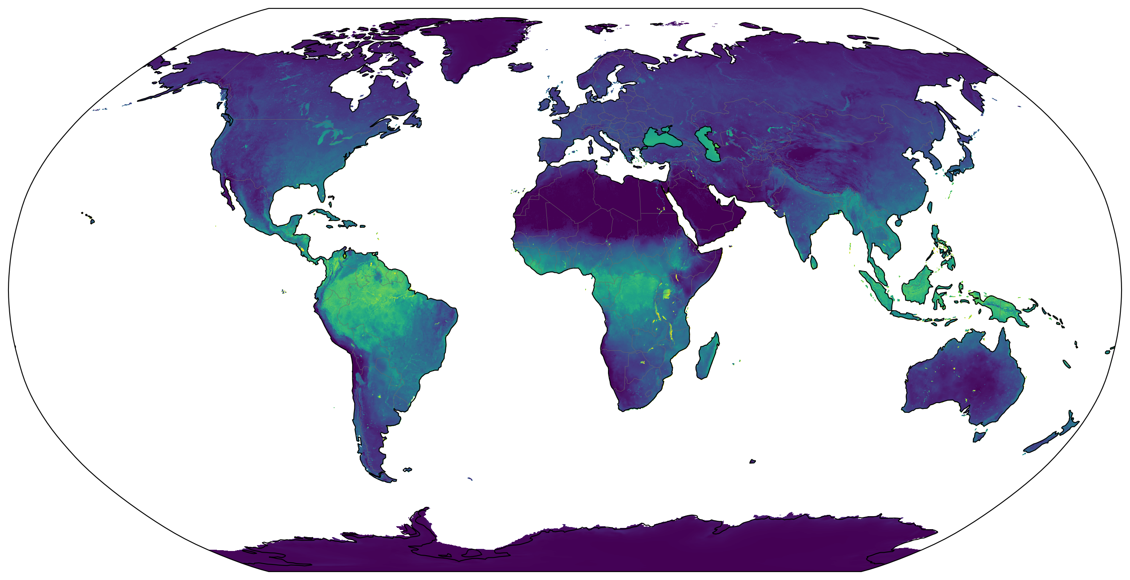
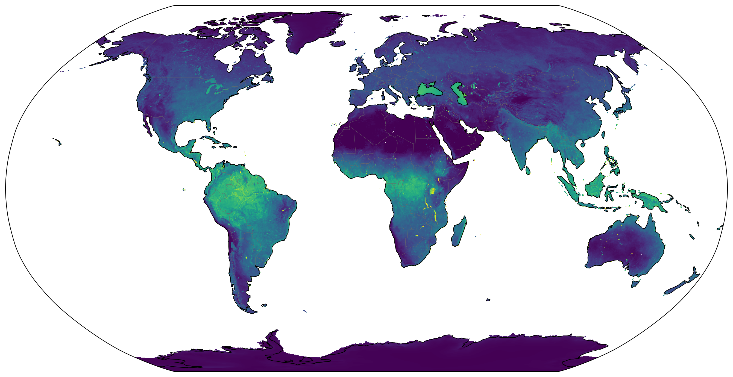
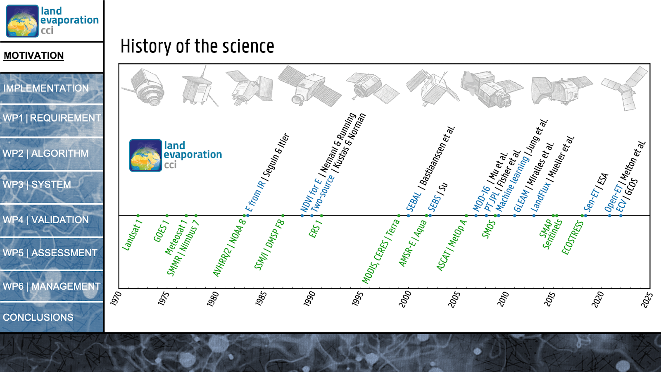
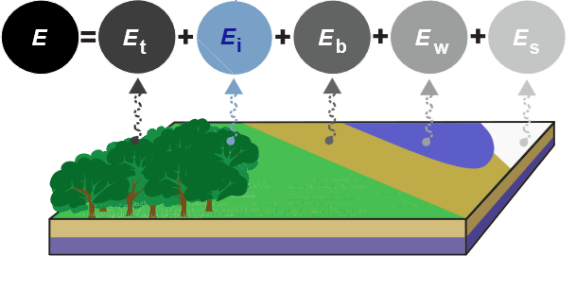
Goals
1980
Present
0.1°
0.1°
Notes:
We want to provide a dataset ranging from 1980 until present, consisting of total land evaporation and all its subcomponents like transpiration, interception loss or bare soil evaporation.
The data will have a spatial resolution of 0.1° and will be estimated as a daily total.
At last, we strive to use as much direct earth observation data as possible.
All of this is nothing very new in the world of evaporation datasets, however…

Slide 3
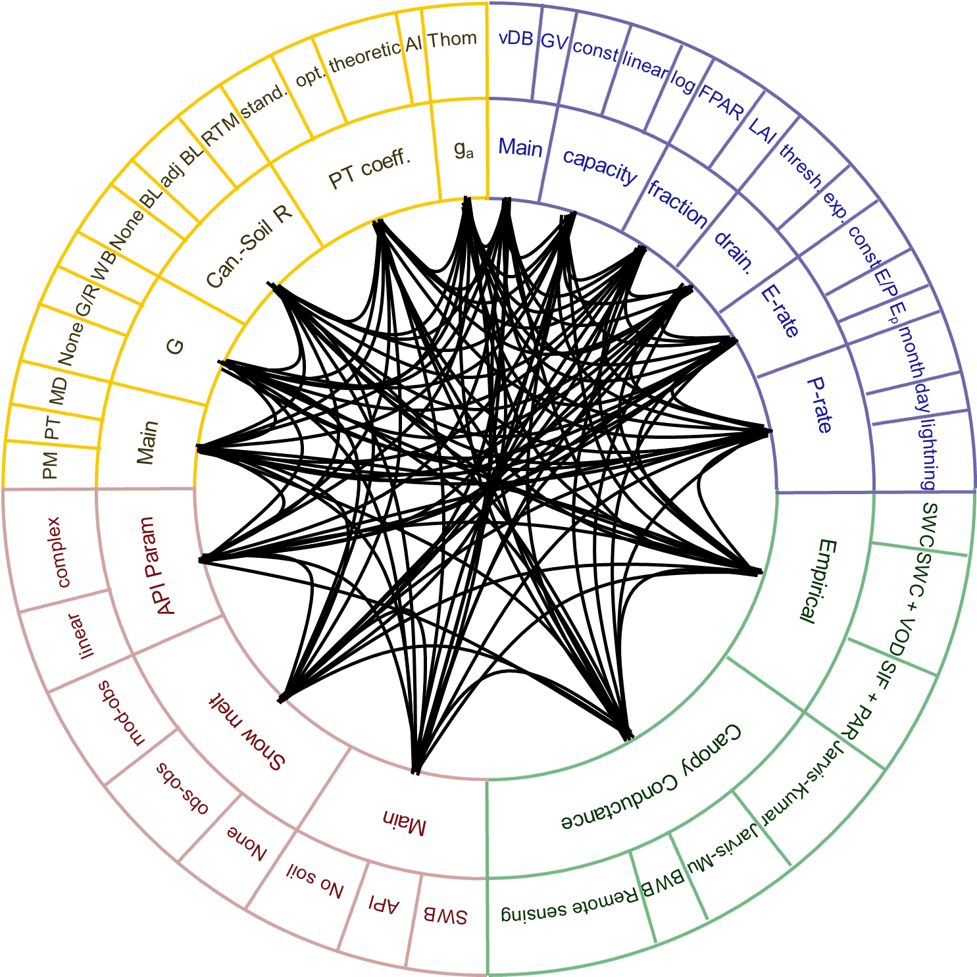
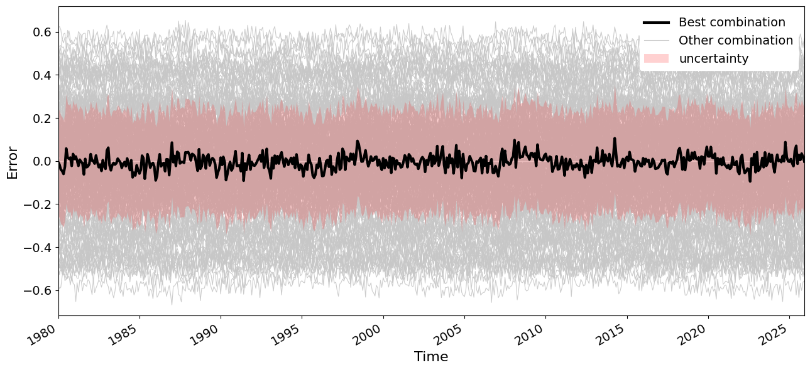
Algorithm
500 000
Combinations
Epistemic
Uncertainty
Notes:
… the algorithm and its selection is what makes the dataset outstanding. The model is split up into 4 modules, which work together to obtain all of the components of the total land evaporation. Each module also has its own subprocesses, for instance how the ground heat flux is modelled for the potential evaporation or which model we use for rainfall interception… For each module we will thus test several implementations, which allows us validate over half a million combinations. By validating these against eddy-covariance data, we will end up with one model combination which performs best and relies as much on earth observation as possible.
Additionally to this huge benchmarking effort, the modular structure also allows us to quantify epistemic uncertainty for each module option by comparing the range in validation results accompanying each option.
In the end, the ESA CCI land evaporation project will thus provide a Multiphysics backed land evaporation model, which will provide a long-term daily dataset of land evaporation and its components, accompanied with both its epistemic and aleatoric uncertainty.
If you want to know more details about the processes we will be testing or the set-up of the algorithm, you can find me at the PICO spot A.6, see you there.

Slide 4

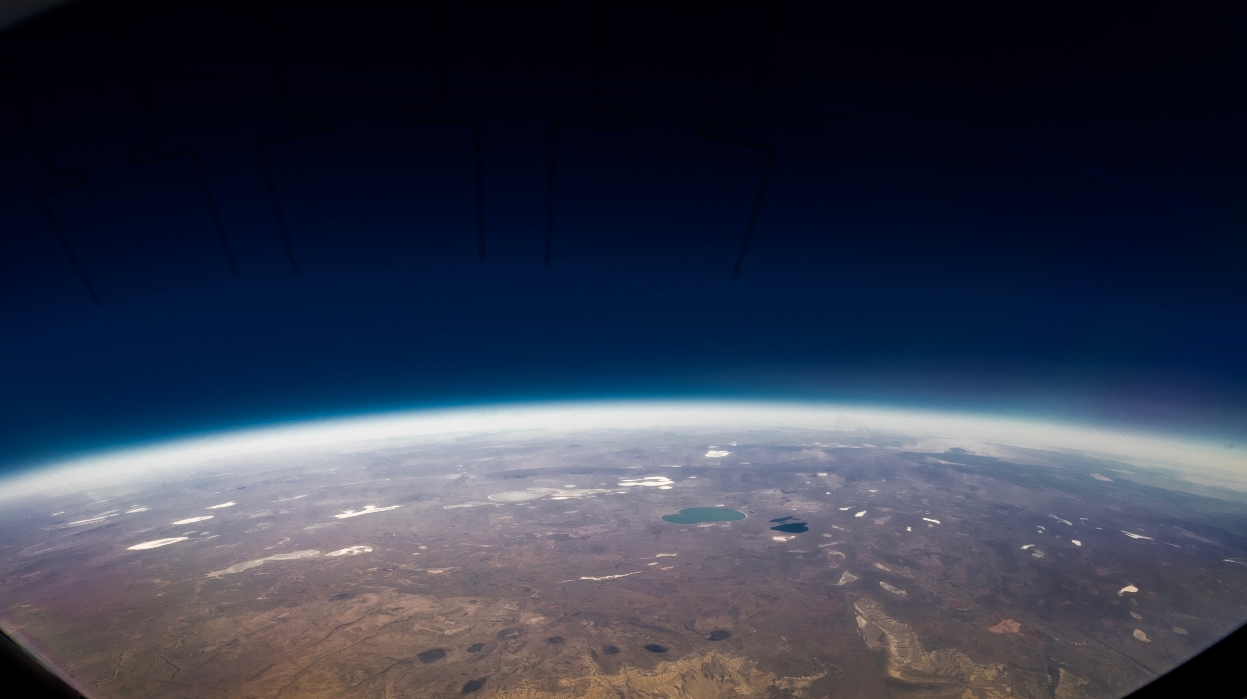



DISCOVER MORE
Are you ready to discover more?
climate.esa.int/en/projects/Land-Evaporation/
@esaclimate
@esaclimate.bsky.social
ESA UNCLASSIFIED - For Official Use
4

Slide 5
ESA CCI Land Evaporation: Towards a long-term consistent satellite-based global evaporation dataset
Kwint Delbare, Oscar M. Baez-Villanueva, Diego G. Miralles and the ESA CCI E Consortium

Slide 6
Goals
1980
Present
0.1°
0.1°

Slide 7
Algorithm
500 000
Combinations
Epistemic
Uncertainty

Slide 8
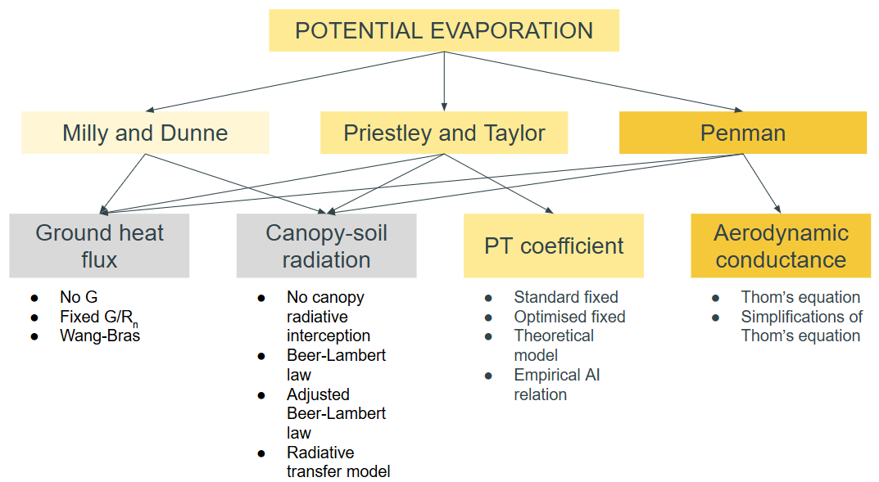
Potential evaporation
INPUT VARIABLES
R_{n}
T_{a}
VPD
Land Cover
LST
q
u
P
Γ
h
CI
χ_{L}
Solar θ
Leaf α and τ
Soil α and ᾱ
LAI
No G
Modelled G/R_{n}
Wang-Bras
No canopy radiative interception
Beer-Lambert law
Adjusted Beer-Lambert law
Radiative transfer model
Standard fixed
Optimised fixed
Theoretical model
Empirical AI relation
Thom’s equation
Simplification of Thom’s equation

Slide 9
Potential evaporation
INPUT VARIABLES
R_{n}
T_{a}
VPD
Land Cover
LST
q
u
P
Γ
h
CI
χ_{L}
Solar θ
Leaf α and τ
Soil α and ᾱ
LAI
No G
Modelled G/R_{n}
Wang-Bras
No canopy radiative interception
Beer-Lambert law
Adjusted Beer-Lambert law
Radiative transfer model
Standard fixed
Optimised fixed
Theoretical model
Empirical AI relation
Thom’s equation
Simplification of Thom’s equation

Slide 10




Potential evaporation
INPUT VARIABLES
R_{n}
T_{a}
VPD
Land Cover
LST
q
u
P
Γ
h
CI
χ_{L}
Solar θ
Leaf α and τ
Soil α and ᾱ
LAI
Miralles et al. (2011)
Allen et al. (2007)
Santanello and Friedl (2003)
No G
Modelled G/R_{n}
Wang-Bras
No canopy radiative interception
Beer-Lambert law
Adjusted Beer-Lambert law
Radiative transfer model
Standard fixed
Optimised fixed
Theoretical model
Empirical AI relation
Thom’s equation
Simplification of Thom’s equation
Kustas and Daughtry (1990)

Slide 11

Potential evaporation
INPUT VARIABLES
R_{n}
T_{a}
VPD
Land Cover
LST
q
u
P
Γ
h
CI
χ_{L}
Solar θ
Leaf α and τ
Soil α and ᾱ
LAI
Wang and Bras (1999)
No G
Modelled G/R_{n}
Wang-Bras
No canopy radiative interception
Beer-Lambert law
Adjusted Beer-Lambert law
Radiative transfer model
Standard fixed
Optimised fixed
Theoretical model
Empirical AI relation
Thom’s equation
Simplification of Thom’s equation

Slide 12
Potential evaporation
INPUT VARIABLES
R_{n}
T_{a}
VPD
Land Cover
LST
q
u
P
Γ
h
CI
χ_{L}
Solar θ
Leaf α and τ
Soil α and ᾱ
LAI
No G
Modelled G/R_{n}
Wang-Bras
No canopy radiative interception
Beer-Lambert law
Adjusted Beer-Lambert law
Radiative transfer model
Standard fixed
Optimised fixed
Theoretical model
Empirical AI relation
Thom’s equation
Simplification of Thom’s equation

Slide 13

Potential evaporation
INPUT VARIABLES
R_{n}
T_{a}
VPD
Land Cover
LST
q
u
P
Γ
h
CI
χ_{L}
Solar θ
Leaf α and τ
Soil α and ᾱ
LAI
Amthor (1994)
No G
Modelled G/R_{n}
Wang-Bras
No canopy radiative interception
Beer-Lambert law
Adjusted Beer-Lambert law
Radiative transfer model
Standard fixed
Optimised fixed
Theoretical model
Empirical AI relation
Thom’s equation
Simplification of Thom’s equation

Slide 14

Potential evaporation
INPUT VARIABLES
R_{n}
T_{a}
VPD
Land Cover
LST
q
u
P
Γ
h
CI
χ_{L}
Solar θ
Leaf α and τ
Soil α and ᾱ
LAI
Amthor (1994)
Sellers (1985)
No G
Modelled G/R_{n}
Wang-Bras
No canopy radiative interception
Beer-Lambert law
Adjusted Beer-Lambert law
Radiative transfer model
Standard fixed
Optimised fixed
Theoretical model
Empirical AI relation
Thom’s equation
Simplification of Thom’s equation

Slide 15

Potential evaporation
INPUT VARIABLES
R_{n}
T_{a}
VPD
Land Cover
LST
q
u
P
Γ
h
CI
χ_{L}
Solar θ
Leaf α and τ
Soil α and ᾱ
LAI
Zhang et al. (2017)
No G
Modelled G/R_{n}
Wang-Bras
No canopy radiative interception
Beer-Lambert law
Adjusted Beer-Lambert law
Radiative transfer model
Standard fixed
Optimised fixed
Theoretical model
Empirical AI relation
Thom’s equation
Simplification of Thom’s equation

Slide 16

Potential evaporation
INPUT VARIABLES
R_{n}
T_{a}
VPD
Land Cover
LST
q
u
P
Γ
h
CI
χ_{L}
Solar θ
Leaf α and τ
Soil α and ᾱ
LAI
Priestley and Taylor (1972)
No G
Modelled G/R_{n}
Wang-Bras
No canopy radiative interception
Beer-Lambert law
Adjusted Beer-Lambert law
Radiative transfer model
Standard fixed
Optimised fixed
Theoretical model
Empirical AI relation
Thom’s equation
Simplification of Thom’s equation

Slide 17

Potential evaporation
INPUT VARIABLES
R_{n}
T_{a}
VPD
Land Cover
LST
q
u
P
Γ
h
CI
χ_{L}
Solar θ
Leaf α and τ
Soil α and ᾱ
LAI
Martens et al. (2017)
No G
Modelled G/R_{n}
Wang-Bras
No canopy radiative interception
Beer-Lambert law
Adjusted Beer-Lambert law
Radiative transfer model
Standard fixed
Optimised fixed
Theoretical model
Empirical AI relation
Thom’s equation
Simplification of Thom’s equation

Slide 18

Potential evaporation
INPUT VARIABLES
R_{n}
T_{a}
VPD
Land Cover
LST
q
u
P
Γ
h
CI
χ_{L}
Solar θ
Leaf α and τ
Soil α and ᾱ
LAI
Liu et al. (2024)
No G
Modelled G/R_{n}
Wang-Bras
No canopy radiative interception
Beer-Lambert law
Adjusted Beer-Lambert law
Radiative transfer model
Standard fixed
Optimised fixed
Theoretical model
Empirical AI relation
Thom’s equation
Simplification of Thom’s equation

Slide 19

Potential evaporation
INPUT VARIABLES
R_{n}
T_{a}
VPD
Land Cover
LST
q
u
P
Γ
h
CI
χ_{L}
Solar θ
Leaf α and τ
Soil α and ᾱ
LAI
Brutsaert et al. (2020)
No G
Modelled G/R_{n}
Wang-Bras
No canopy radiative interception
Beer-Lambert law
Adjusted Beer-Lambert law
Radiative transfer model
Standard fixed
Optimised fixed
Theoretical model
Empirical AI relation
Thom’s equation
Simplification of Thom’s equation

Slide 20




Potential evaporation
INPUT VARIABLES
R_{n}
T_{a}
VPD
Land Cover
LST
q
u
P
Γ
h
CI
χ_{L}
Solar θ
Leaf α and τ
Soil α and ᾱ
LAI
Thom (1972)
Garrat (1994)
Shuttleworth (2012)
No G
Modelled G/R_{n}
Wang-Bras
No canopy radiative interception
Beer-Lambert law
Adjusted Beer-Lambert law
Radiative transfer model
Standard fixed
Optimised fixed
Theoretical model
Empirical AI relation
Thom’s equation
Simplification of Thom’s equation
Knauer et al. (2018)

Slide 21
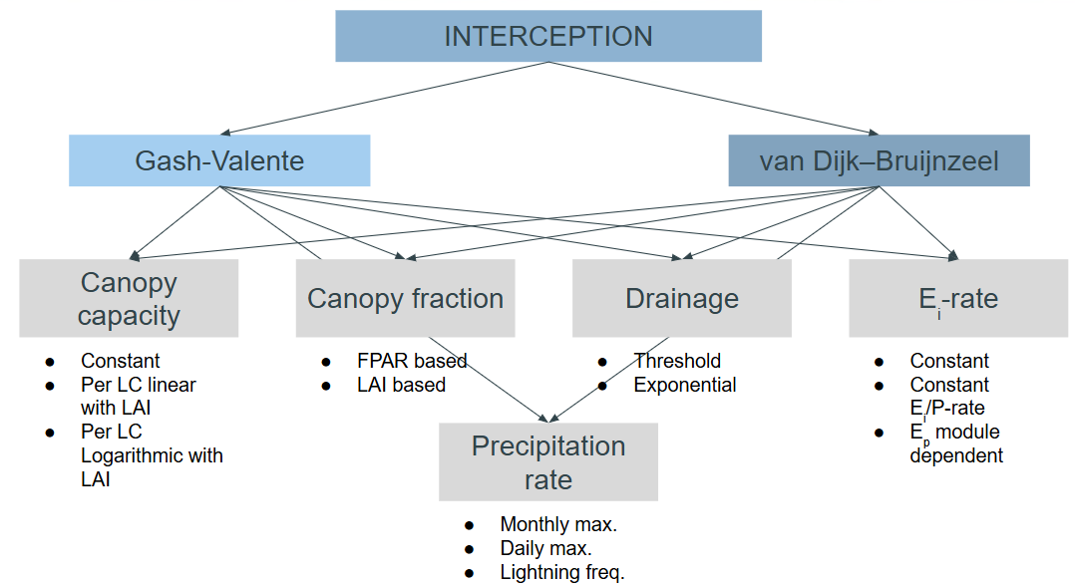
Rainfall interception
INPUT VARIABLES
P_{daily}
P_{hourly}
P_{3hourly}
Lightning freq.
E_{p}
CI
Land Cover
FPAR
LAI
Constant
Per LC linear with LAI
Per LC Logarithmic with LAI
FPAR based
LAI based
Threshold
Exponential
Constant
Constant E_{i}/P-rate
E_{p} module dependent
Monthly max.
Daily max.
Lightning freq.

Slide 22

Rainfall interception
INPUT VARIABLES
P_{daily}
P_{hourly}
P_{3hourly}
Lightning freq.
E_{p}
CI
Land Cover
FPAR
LAI
Zhong et al. (2022)
Constant
Per LC linear with LAI
Per LC Logarithmic with LAI
FPAR based
LAI based
Threshold
Exponential
Constant
Constant E_{i}/P-rate
E_{p} module dependent
Monthly max.
Daily max.
Lightning freq.

Slide 23

Rainfall interception
INPUT VARIABLES
P_{daily}
P_{hourly}
P_{3hourly}
Lightning freq.
E_{p}
CI
Land Cover
FPAR
LAI
Zhong et al. (2022)
Van Dijk and Bruijnzeel (2001)
Constant
Per LC linear with LAI
Per LC Logarithmic with LAI
FPAR based
LAI based
Threshold
Exponential
Constant
Constant E_{i}/P-rate
E_{p} module dependent
Monthly max.
Daily max.
Lightning freq.

Slide 24


Rainfall interception
INPUT VARIABLES
P_{daily}
P_{hourly}
P_{3hourly}
Lightning freq.
E_{p}
CI
Land Cover
FPAR
LAI
Galdos et al. (2012)
Menzel (1996)
Constant
Per LC linear with LAI
Per LC Logarithmic with LAI
FPAR based
LAI based
Threshold
Exponential
Constant
Constant E_{i}/P-rate
E_{p} module dependent
Monthly max.
Daily max.
Lightning freq.

Slide 25
Rainfall interception
INPUT VARIABLES
P_{daily}
P_{hourly}
P_{3hourly}
Lightning freq.
E_{p}
CI
Land Cover
FPAR
LAI
Zhong et al. (2022)
Constant
Per LC linear with LAI
Per LC Logarithmic with LAI
FPAR based
LAI based
Threshold
Exponential
Constant
Constant E_{i}/P-rate
E_{p} module dependent
Monthly max.
Daily max.
Lightning freq.

Slide 26
Rainfall interception
INPUT VARIABLES
P_{daily}
P_{hourly}
P_{3hourly}
Lightning freq.
E_{p}
CI
Land Cover
FPAR
LAI
Zhong et al. (2022)
Amthor (1994)
Constant
Per LC linear with LAI
Per LC Logarithmic with LAI
FPAR based
LAI based
Threshold
Exponential
Constant
Constant E_{i}/P-rate
E_{p} module dependent
Monthly max.
Daily max.
Lightning freq.

Slide 27

Rainfall interception
INPUT VARIABLES
P_{daily}
P_{hourly}
P_{3hourly}
Lightning freq.
E_{p}
CI
Land Cover
FPAR
LAI
Valente et al. (1997)
Van Dijk and Bruijnzeel (2001)
Constant
Per LC linear with LAI
Per LC Logarithmic with LAI
FPAR based
LAI based
Threshold
Exponential
Constant
Constant E_{i}/P-rate
E_{p} module dependent
Monthly max.
Daily max.
Lightning freq.

Slide 28

Rainfall interception
INPUT VARIABLES
P_{daily}
P_{hourly}
P_{3hourly}
Lightning freq.
E_{p}
CI
Land Cover
FPAR
LAI
ORCiD
Constant
Per LC linear with LAI
Per LC Logarithmic with LAI
FPAR based
LAI based
Threshold
Exponential
Constant
Constant E_{i}/P-rate
E_{p} module dependent
Monthly max.
Daily max.
Lightning freq.

Slide 29

Rainfall interception
INPUT VARIABLES
P_{daily}
P_{hourly}
P_{3hourly}
Lightning freq.
E_{p}
CI
Land Cover
FPAR
LAI
Miralles et al. (2010)
Constant
Per LC linear with LAI
Per LC Logarithmic with LAI
FPAR based
LAI based
Threshold
Exponential
Constant
Constant E_{i}/P-rate
E_{p} module dependent
Monthly max.
Daily max.
Lightning freq.

Slide 30
Rainfall interception
INPUT VARIABLES
P_{daily}
P_{hourly}
P_{3hourly}
Lightning freq.
E_{p}
CI
Land Cover
FPAR
LAI
Zhong et al. (2022)
Constant
Per LC linear with LAI
Per LC Logarithmic with LAI
FPAR based
LAI based
Threshold
Exponential
Constant
Constant E_{i}/P-rate
E_{p} module dependent
Monthly max.
Daily max.
Lightning freq.

Slide 31
Rainfall interception
INPUT VARIABLES
P_{daily}
P_{hourly}
P_{3hourly}
Lightning freq.
E_{p}
CI
Land Cover
FPAR
LAI
Constant
Per LC linear with LAI
Per LC Logarithmic with LAI
FPAR based
LAI based
Threshold
Exponential
Constant
Constant E_{i}/P-rate
E_{p} module dependent
Monthly max.
Daily max.
Lightning freq.

Slide 32
Rainfall interception
INPUT VARIABLES
P_{daily}
P_{hourly}
P_{3hourly}
Lightning freq.
E_{p}
CI
Land Cover
FPAR
LAI
Zhong et al. (2022)
Constant
Per LC linear with LAI
Per LC Logarithmic with LAI
FPAR based
LAI based
Threshold
Exponential
Constant
Constant E_{i}/P-rate
E_{p} module dependent
Monthly max.
Daily max.
Lightning freq.

Slide 33
Rainfall interception
INPUT VARIABLES
P_{daily}
P_{hourly}
P_{3hourly}
Lightning freq.
E_{p}
CI
Land Cover
FPAR
LAI
Constant
Per LC linear with LAI
Per LC Logarithmic with LAI
FPAR based
LAI based
Threshold
Exponential
Constant
Constant E_{i}/P-rate
E_{p} module dependent
Monthly max.
Daily max.
Lightning freq.

Slide 34
Rainfall interception
INPUT VARIABLES
P_{daily}
P_{hourly}
P_{3hourly}
Lightning freq.
E_{p}
CI
Land Cover
FPAR
LAI
Miralles et al. (2010)
Constant
Per LC linear with LAI
Per LC Logarithmic with LAI
FPAR based
LAI based
Threshold
Exponential
Constant
Constant E_{i}/P-rate
E_{p} module dependent
Monthly max.
Daily max.
Lightning freq.

Slide 35
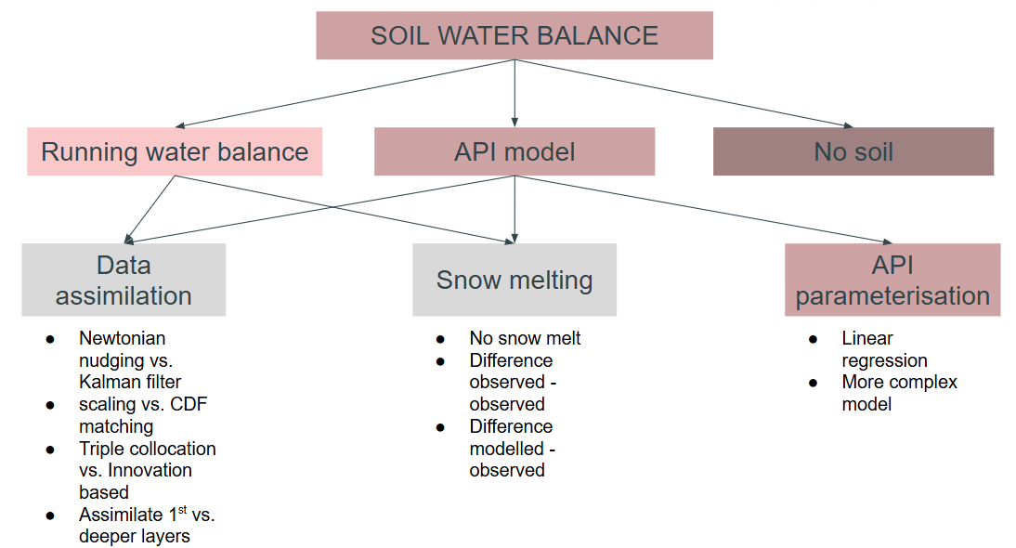
Soil water
INPUT VARIABLES
P_{daily}
E_{i}
Snow mask
θ₁, θ₂, θ₃
API_{t-1}
SM_{a}
TWS
SWE
T_{a}
E_{s}
Clay content
Sand content
No snow melt
Difference observed - observed
Difference modelled - observed
Linear regression
More complex model

Slide 36
Soil water
INPUT VARIABLES
P_{daily}
E_{i}
Snow mask
θ₁, θ₂, θ₃
API_{t-1}
SM_{a}
TWS
SWE
T_{a}
E_{s}
Clay content
Sand content
No snow melt
Difference observed - observed
Difference modelled - observed
Linear regression
More complex model

Slide 37
Soil water
INPUT VARIABLES
P_{daily}
E_{i}
Snow mask
θ₁, θ₂, θ₃
API_{t-1}
SM_{a}
TWS
SWE
T_{a}
E_{s}
Clay content
Sand content
No snow melt
Difference observed - observed
Difference modelled - observed
Linear regression
More complex model

Slide 38
Soil water
INPUT VARIABLES
P_{daily}
E_{i}
Snow mask
θ₁, θ₂, θ₃
API_{t-1}
SM_{a}
TWS
SWE
T_{a}
E_{s}
Clay content
Sand content
No snow melt
Difference observed - observed
Difference modelled - observed
Linear regression
More complex model

Slide 39

Soil water
INPUT VARIABLES
P_{daily}
E_{i}
Snow mask
θ₁, θ₂, θ₃
API_{t-1}
SM_{a}
TWS
SWE
T_{a}
E_{s}
Clay content
Sand content
Zhao et al. (2019)
No snow melt
Difference observed - observed
Difference modelled - observed
Linear regression
More complex model

Slide 40

Soil water
INPUT VARIABLES
P_{daily}
E_{i}
Snow mask
θ₁, θ₂, θ₃
API_{t-1}
SM_{a}
TWS
SWE
T_{a}
E_{s}
Clay content
Sand content
Ramsauer and Marzahn (2023)
No snow melt
Difference observed - observed
Difference modelled - observed
Linear regression
More complex model

Slide 41
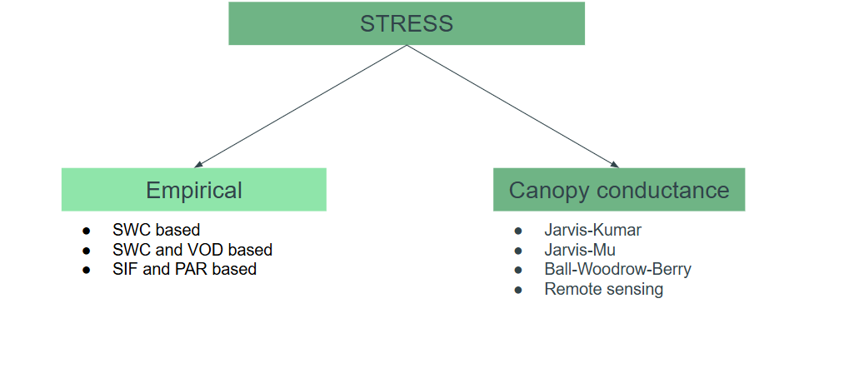
Evaporative stress
INPUT VARIABLES
R_{n}
VPD
T_{a}
T_{a,day}, T_{a,night}
q
RH
[CO₂]
θ/SM_{a}
VOD
LAI
PAR
FPAR/NDVI
SIF
NIR_{v}
Land Cover
Elevation
CI
Solar θ
SWC based
SWC and VOD based
SIF and PAR based
Jarvis-Kumar
Jarvis-Mu
Ball-Woodrow-Berry
Remote sensing

Slide 42
Evaporative stress
INPUT VARIABLES
R_{n}
VPD
T_{a}
T_{a,day}, T_{a,night}
q
RH
[CO₂]
θ/SM_{a}
VOD
LAI
PAR
FPAR/NDVI
SIF
NIR_{v}
Land Cover
Elevation
CI
Solar θ
Miralles et al. (2011)
SWC based
SWC and VOD based
SIF and PAR based
Jarvis-Kumar
Jarvis-Mu
Ball-Woodrow-Berry
Remote sensing

Slide 43
Evaporative stress
INPUT VARIABLES
R_{n}
VPD
T_{a}
T_{a,day}, T_{a,night}
q
RH
[CO₂]
θ/SM_{a}
VOD
LAI
PAR
FPAR/NDVI
SIF
NIR_{v}
Land Cover
Elevation
CI
Solar θ
Martens et al. (2017)
SWC based
SWC and VOD based
SIF and PAR based
Jarvis-Kumar
Jarvis-Mu
Ball-Woodrow-Berry
Remote sensing

Slide 44


Evaporative stress
INPUT VARIABLES
R_{n}
VPD
T_{a}
T_{a,day}, T_{a,night}
q
RH
[CO₂]
θ/SM_{a}
VOD
LAI
PAR
FPAR/NDVI
SIF
NIR_{v}
Land Cover
Elevation
CI
Solar θ
Koppa et al. (2022)
Pagán et al. (2019)
SWC based
SWC and VOD based
SIF and PAR based
Jarvis-Kumar
Jarvis-Mu
Ball-Woodrow-Berry
Remote sensing

Slide 45



Evaporative stress
INPUT VARIABLES
R_{n}
VPD
T_{a}
T_{a,day}, T_{a,night}
q
RH
[CO₂]
θ/SM_{a}
VOD
LAI
PAR
FPAR/NDVI
SIF
NIR_{v}
Land Cover
Elevation
CI
Solar θ
Kumar et al. (2014)
Noilhan and Planton (1989)
SWC based
SWC and VOD based
SIF and PAR based
Jarvis-Kumar
Jarvis-Mu
Ball-Woodrow-Berry
Remote sensing
Chen and Dudhia (2001)

Slide 46

Evaporative stress
INPUT VARIABLES
R_{n}
VPD
T_{a}
T_{a,day}, T_{a,night}
q
RH
[CO₂]
θ/SM_{a}
VOD
LAI
PAR
FPAR/NDVI
SIF
NIR_{v}
Land Cover
Elevation
CI
Solar θ
Mu et al. (2011)
SWC based
SWC and VOD based
SIF and PAR based
Jarvis-Kumar
Jarvis-Mu
Ball-Woodrow-Berry
Remote sensing

Slide 47


Evaporative stress
INPUT VARIABLES
R_{n}
VPD
T_{a}
T_{a,day}, T_{a,night}
q
RH
[CO₂]
θ/SM_{a}
VOD
LAI
PAR
FPAR/NDVI
SIF
NIR_{v}
Land Cover
Elevation
CI
Solar θ
Hu et al. (2017)
Ball et al. (1987)
SWC based
SWC and VOD based
SIF and PAR based
Jarvis-Kumar
Jarvis-Mu
Ball-Woodrow-Berry
Remote sensing

Slide 48


Evaporative stress
INPUT VARIABLES
R_{n}
VPD
T_{a}
T_{a,day}, T_{a,night}
q
RH
[CO₂]
θ/SM_{a}
VOD
LAI
PAR
FPAR/NDVI
SIF
NIR_{v}
Land Cover
Elevation
CI
Solar θ
Wang and He (2025)
Shan et al. (2021)
SWC based
SWC and VOD based
SIF and PAR based
Jarvis-Kumar
Jarvis-Mu
Ball-Woodrow-Berry
Remote sensing

Slide 50
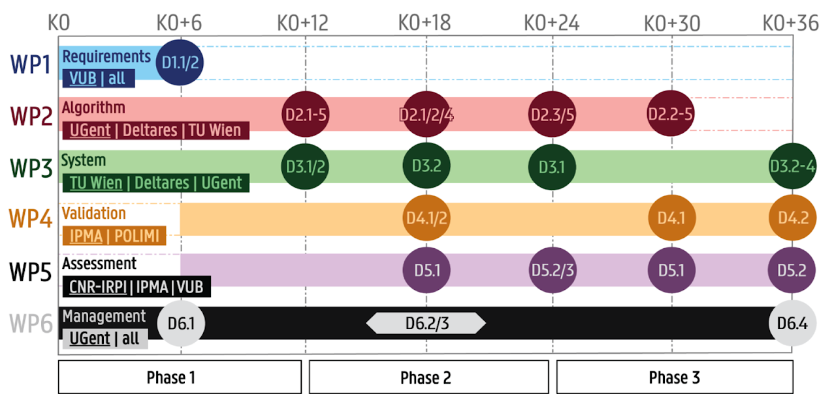
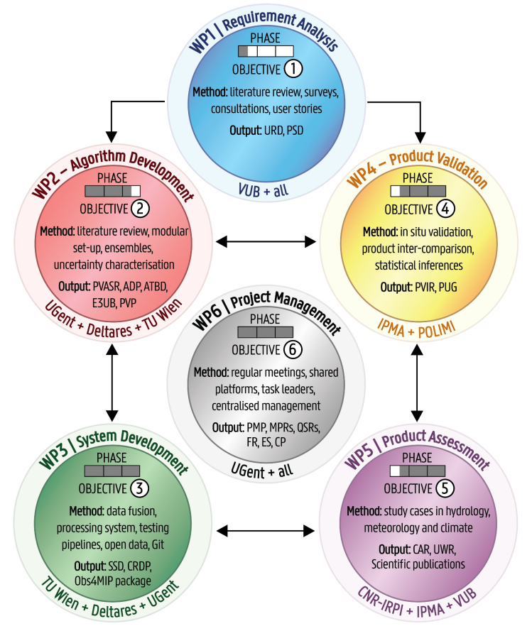
Project overview

Slide 51
Project overview

Slide 52
Project overview

Slide 53
Project overview

Slide 54
Project overview

Slide 55
Project overview

Slide 56
Project overview

Slide 57




Extras
Photos
Abstract
Kwint.Delbare@UGent.be

