Slide 1
EGU26 Extra Slides
Rachel Preca Trapani

Slide 2
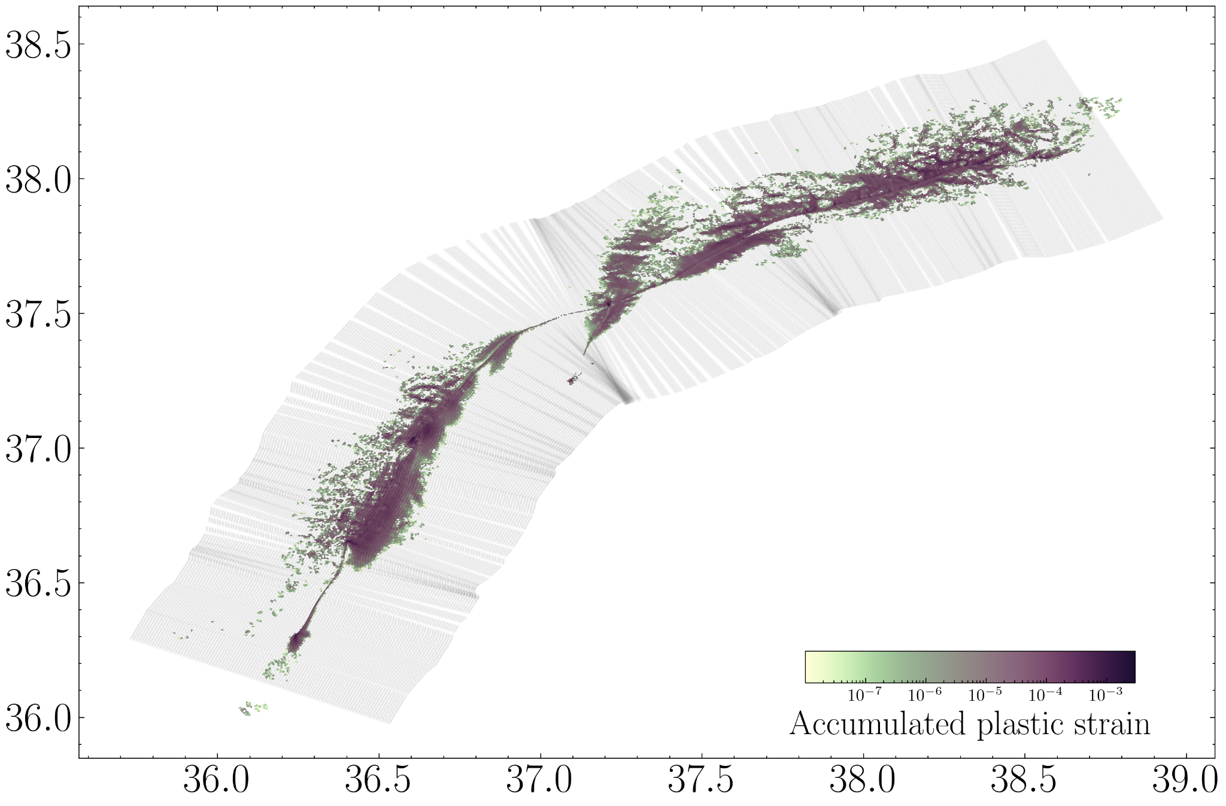

Slide 3
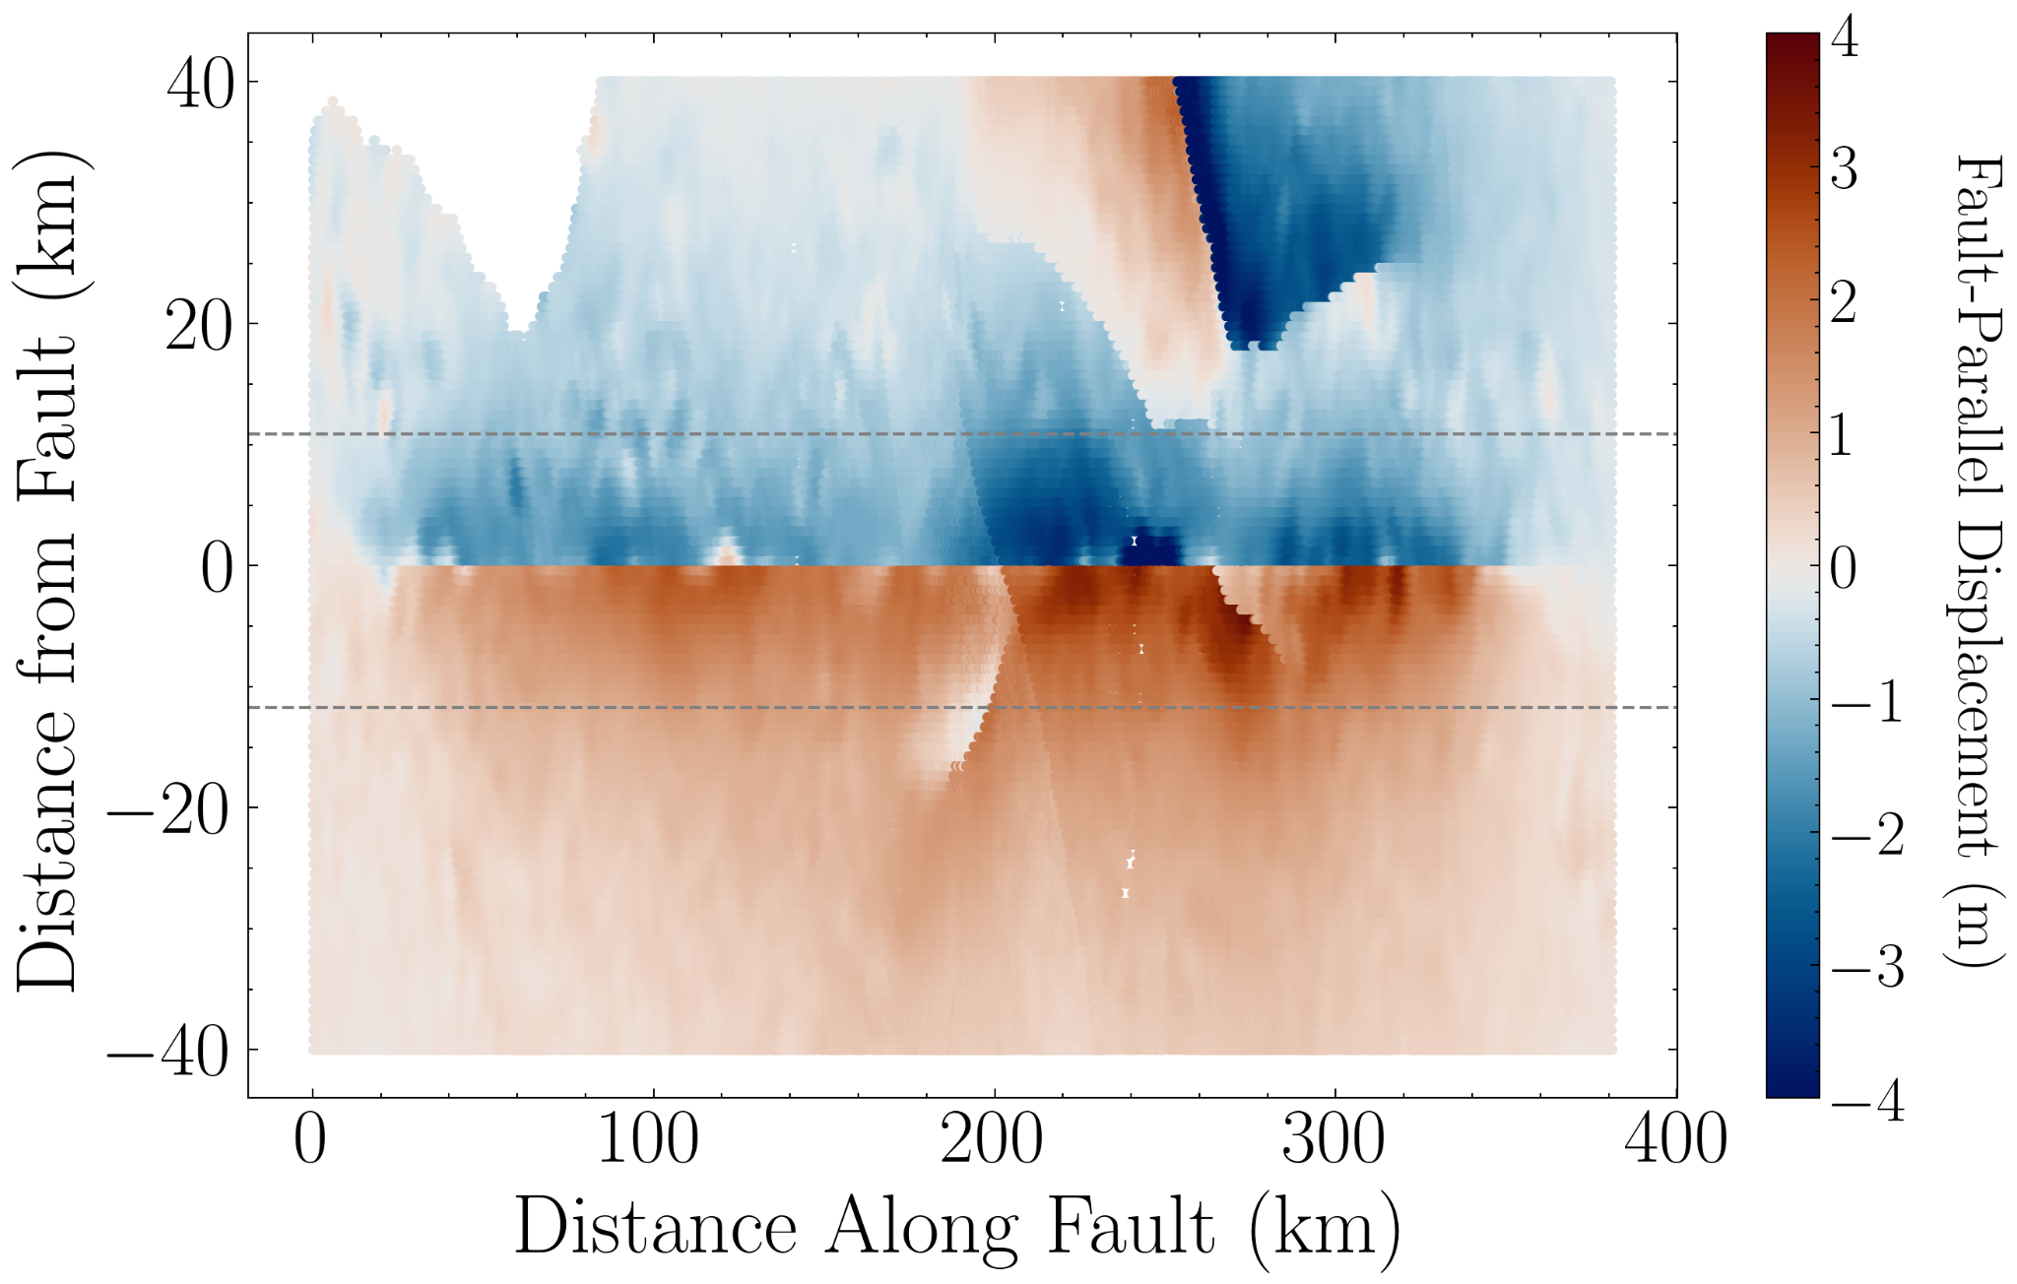
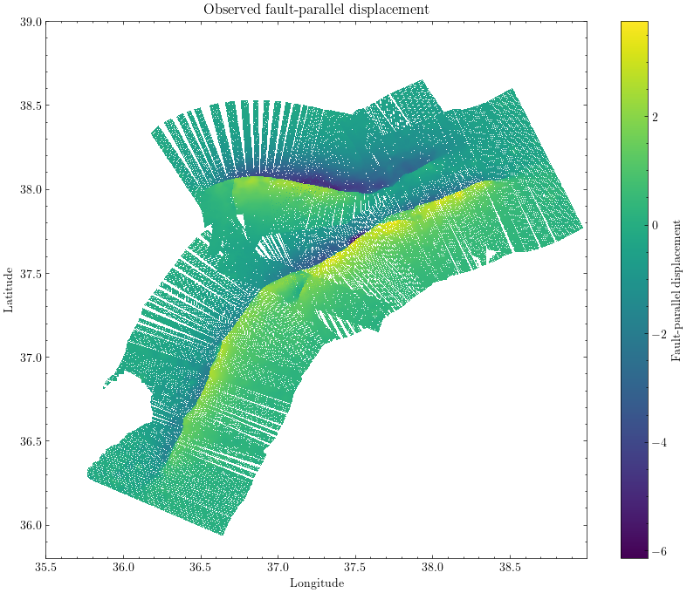
Observed FP Displacement

Slide 4
Reference Model

Slide 5
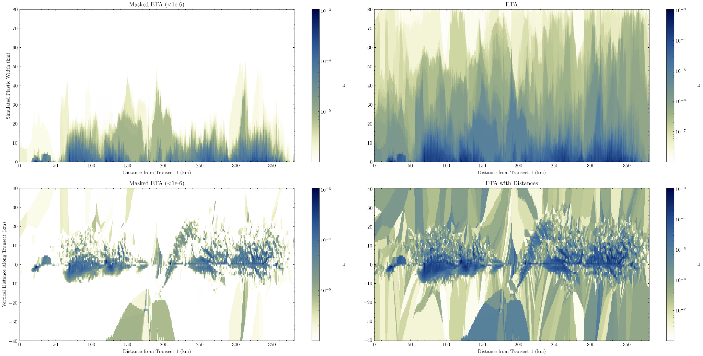
Reference Model

Slide 6
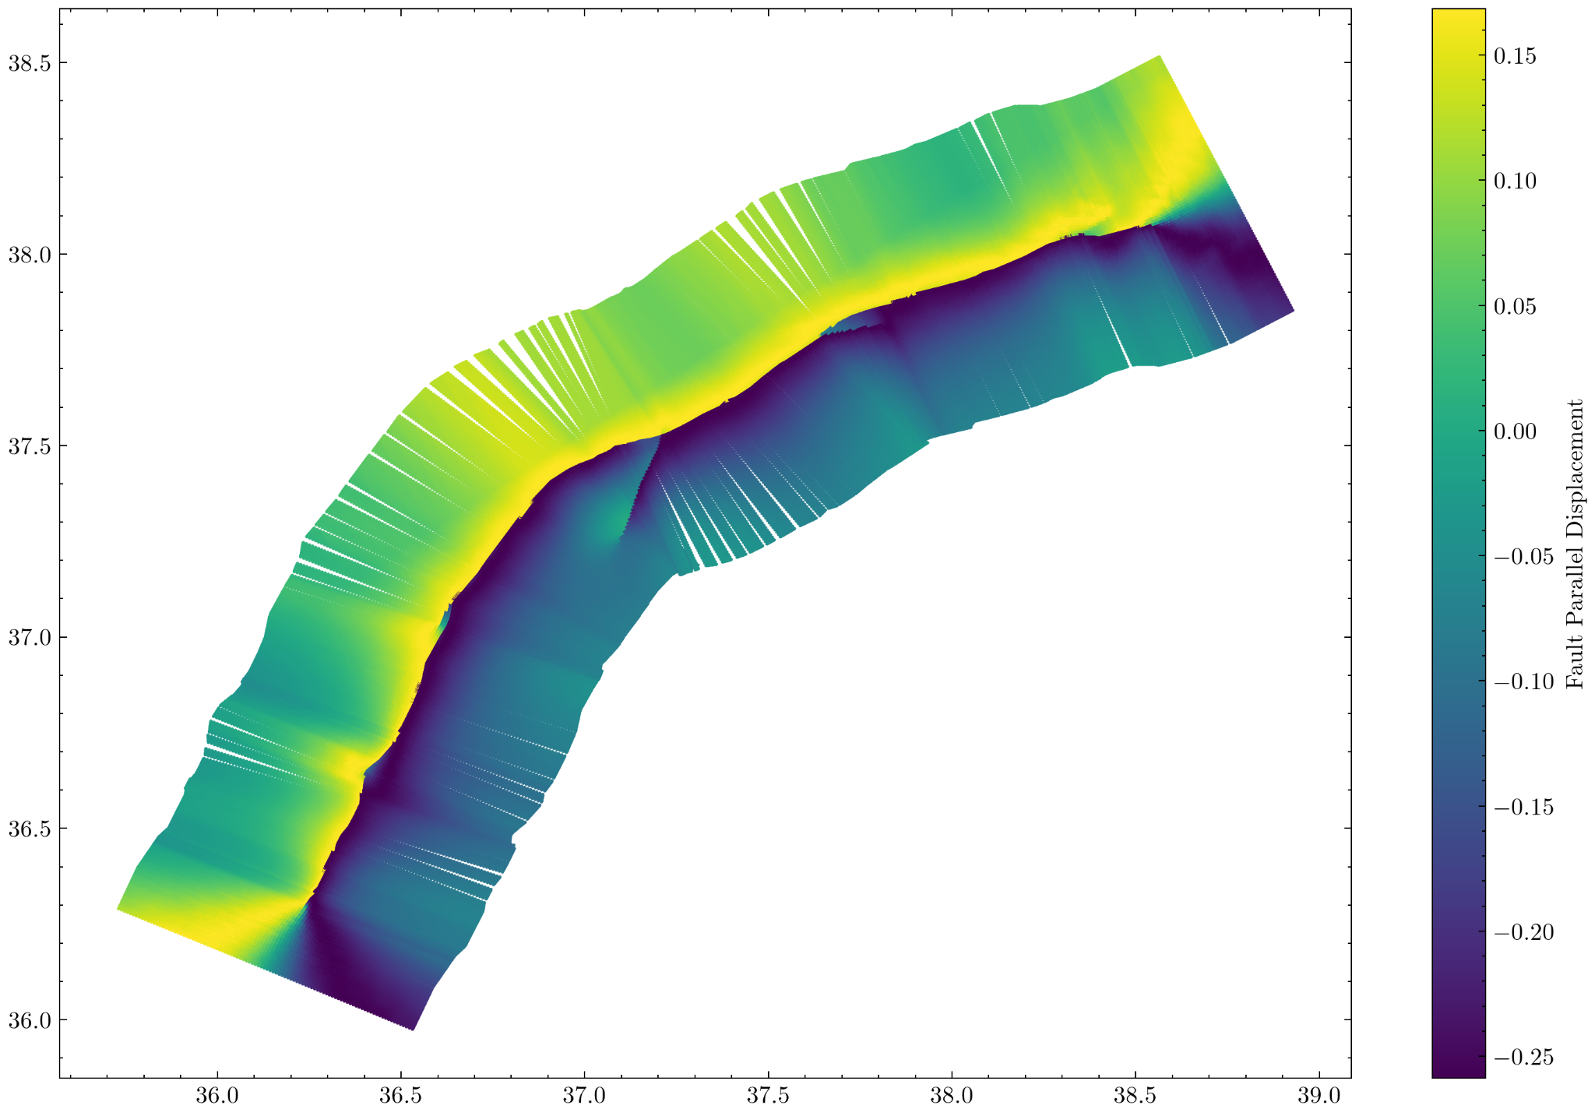
Reference Model

Slide 7
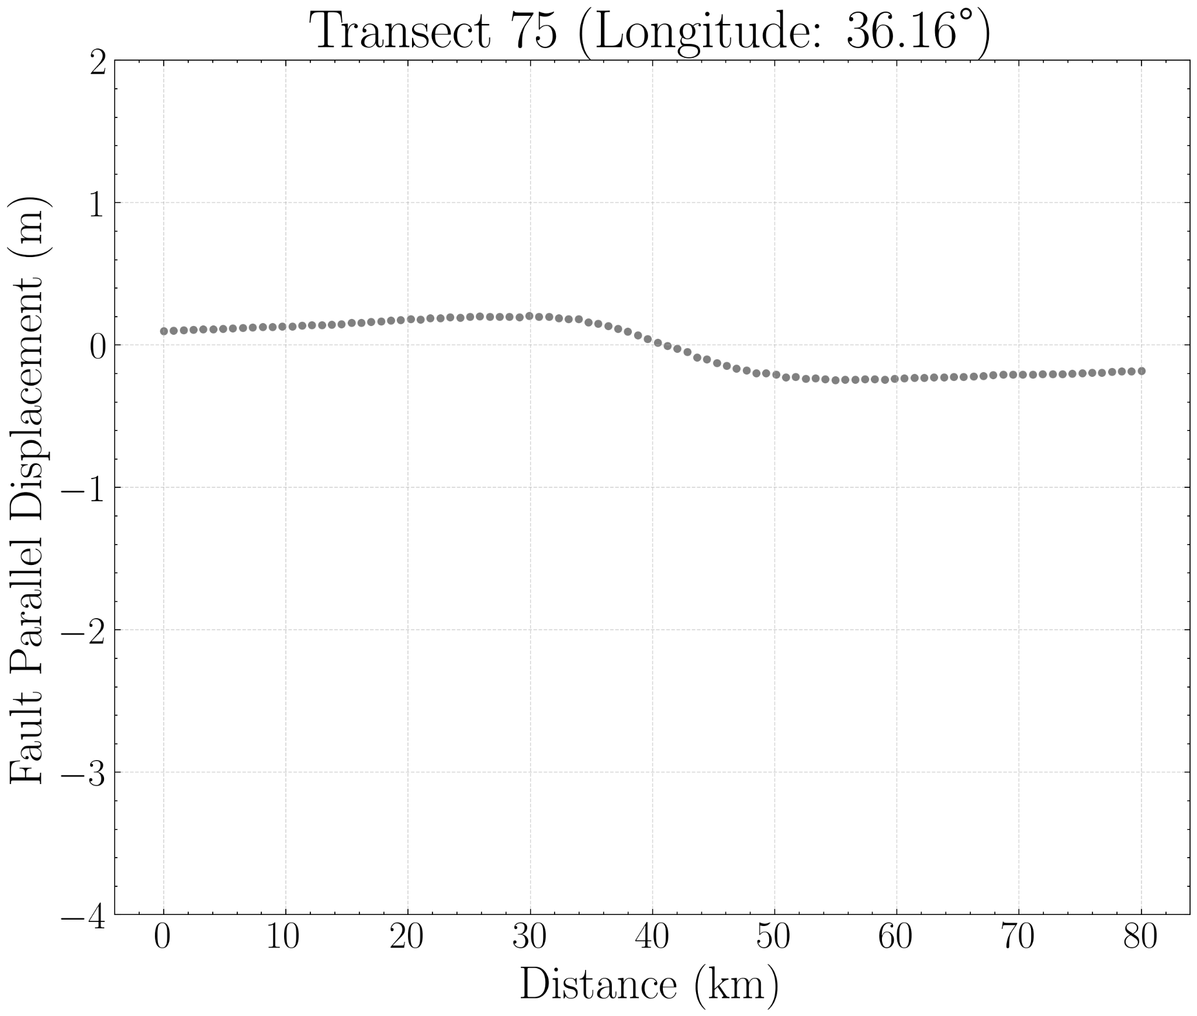
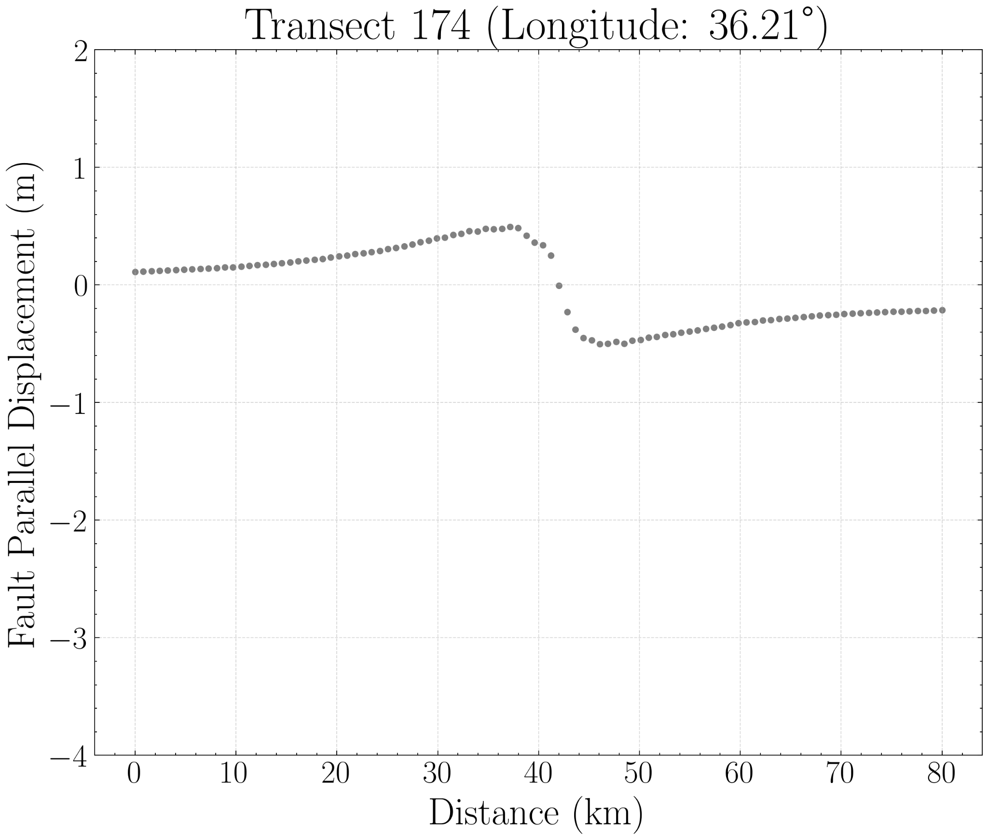
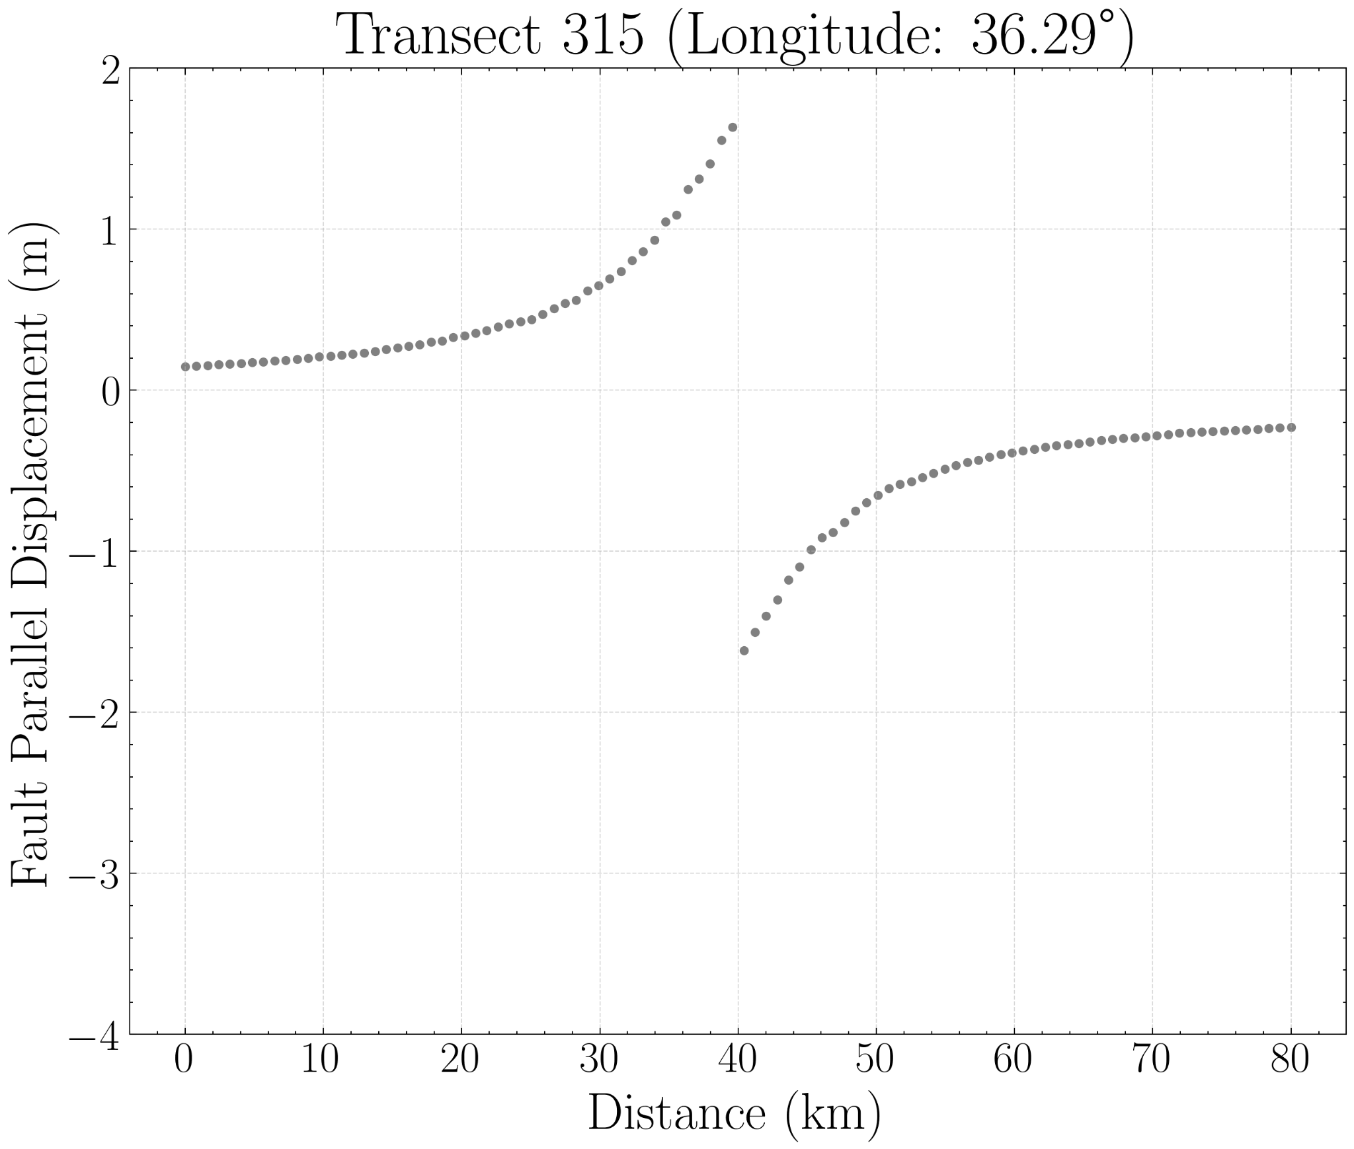
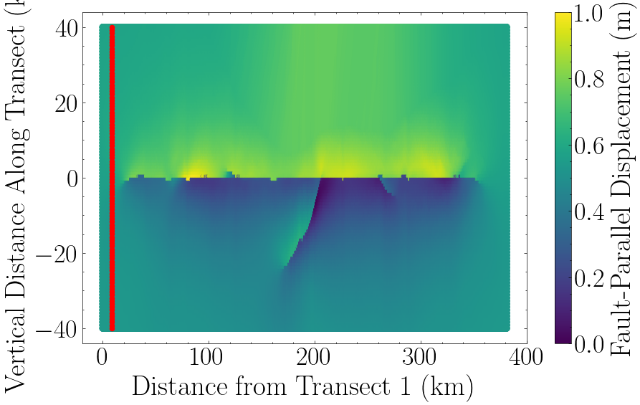
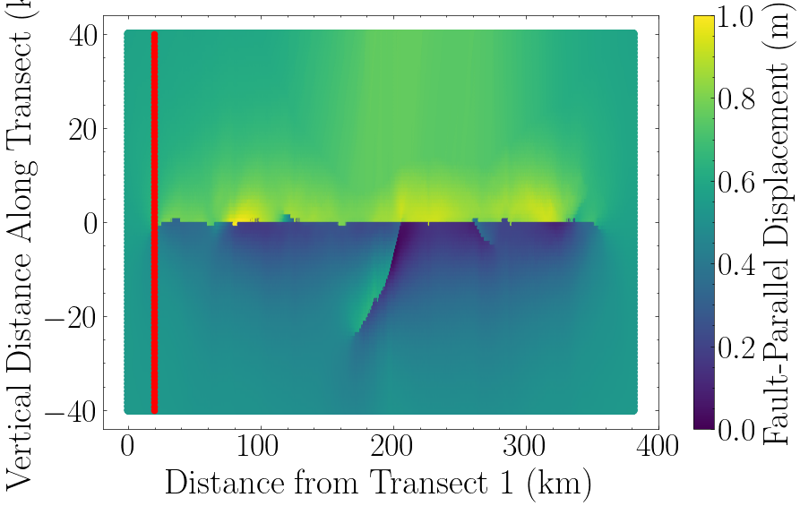

FP Displacement at Different Transects

Slide 8
Supershear Initiation Model

Slide 9
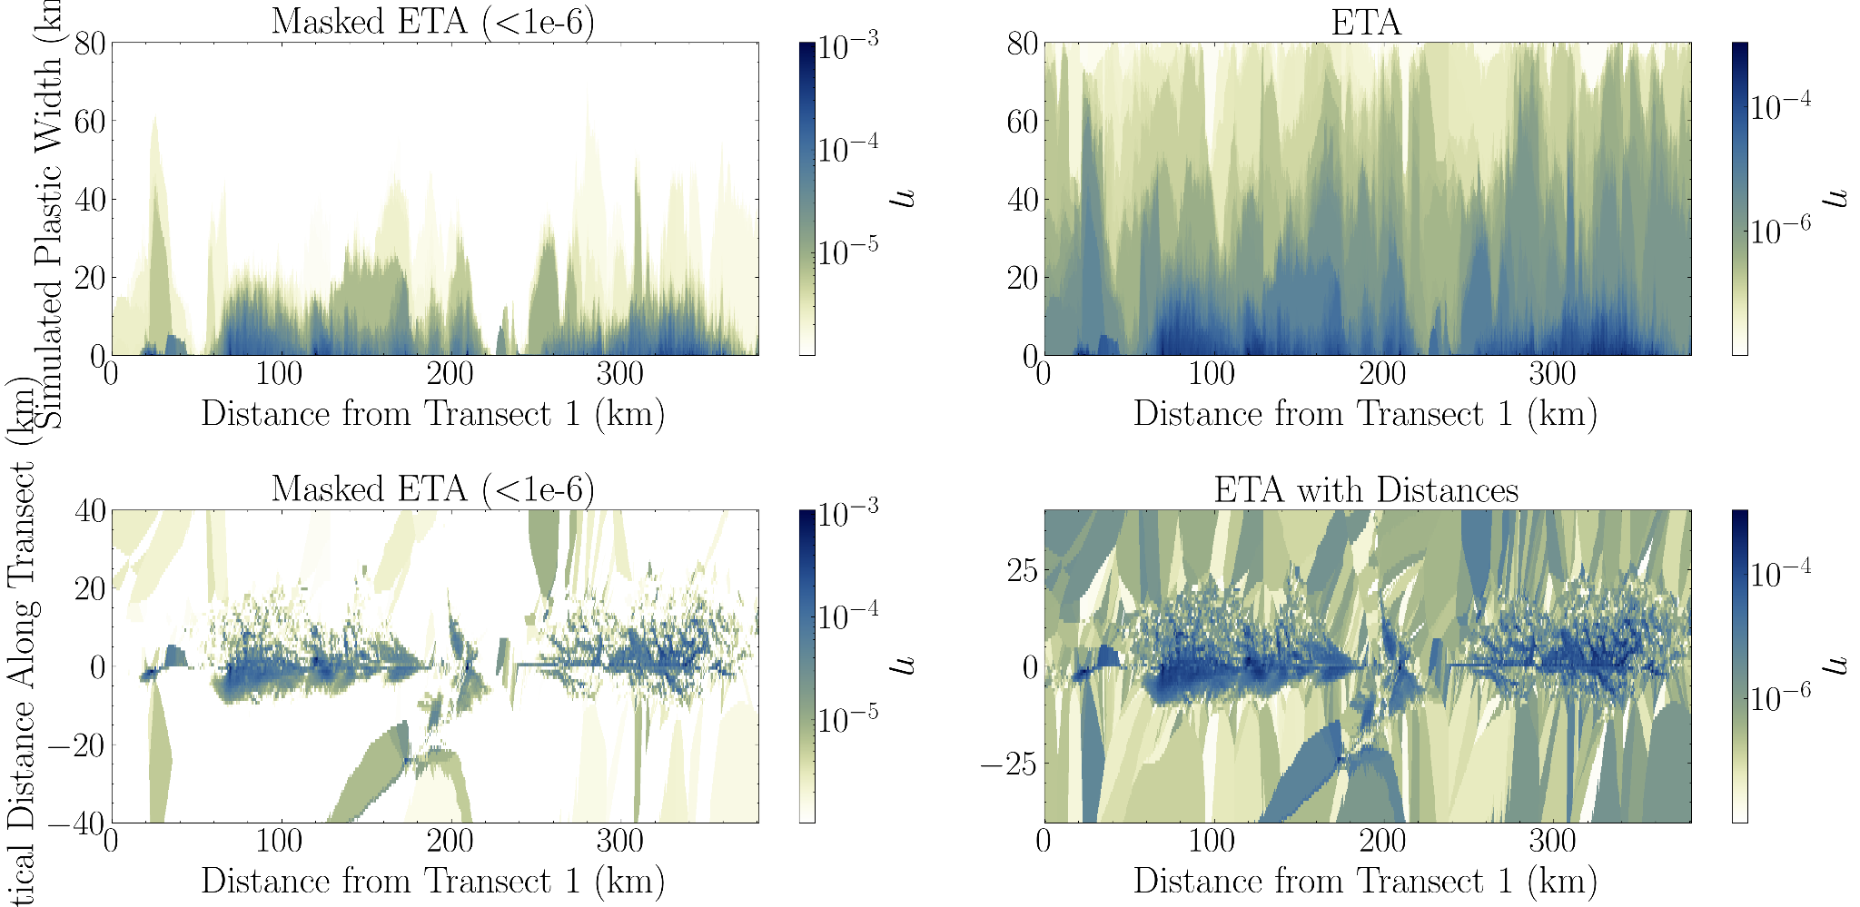
Supershear Initiation Model

Slide 10
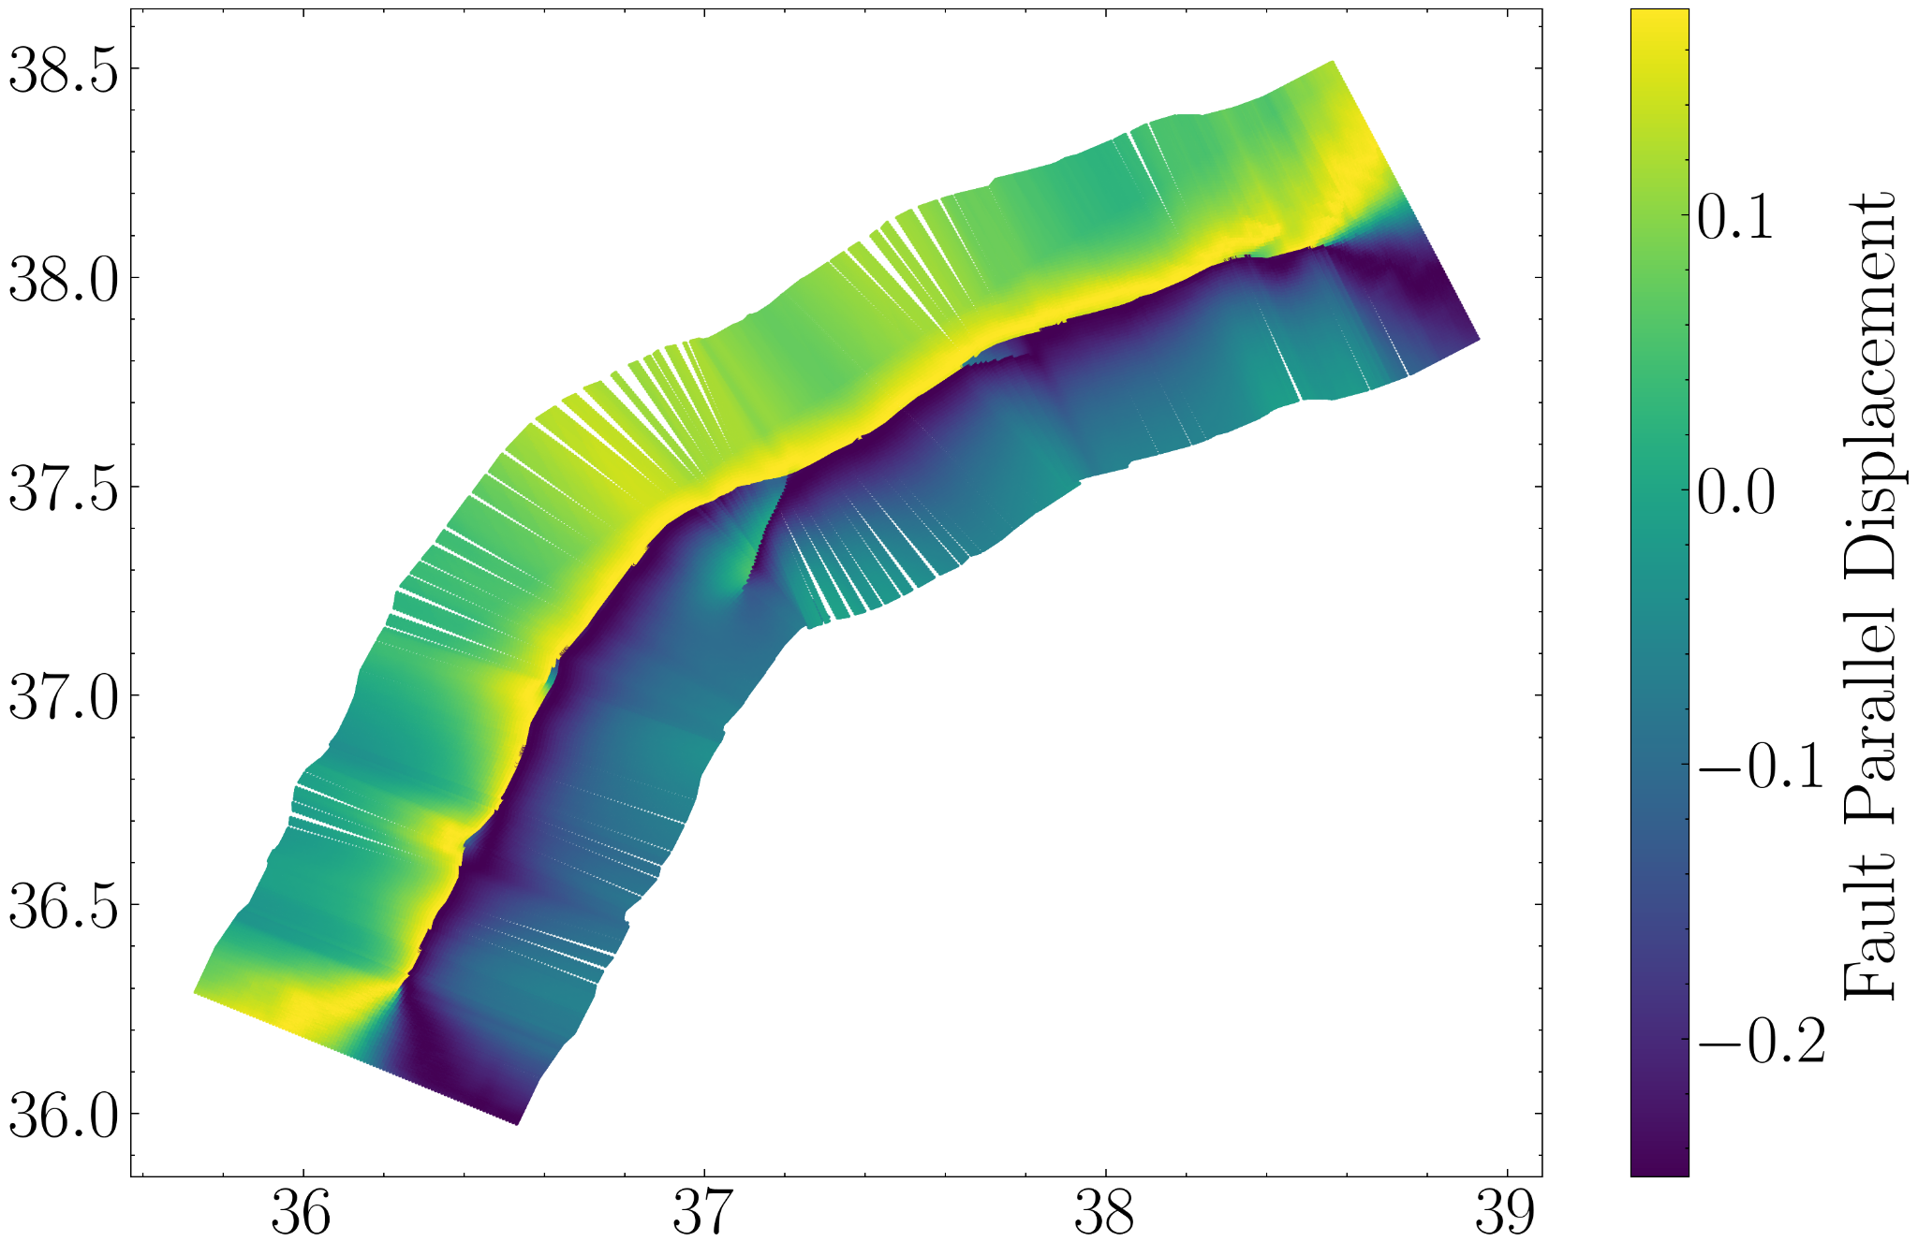
Supershear Initiation Model

Slide 11


FP Displacement at Different Transects

Slide 12
Roughness Model

Slide 13
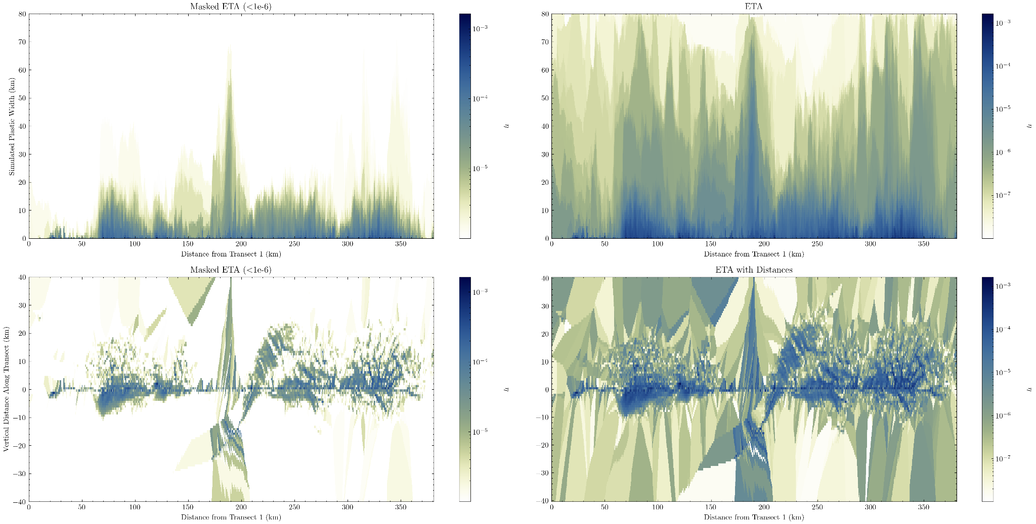
Roughness Model

Slide 14

Roughness Model

Slide 15


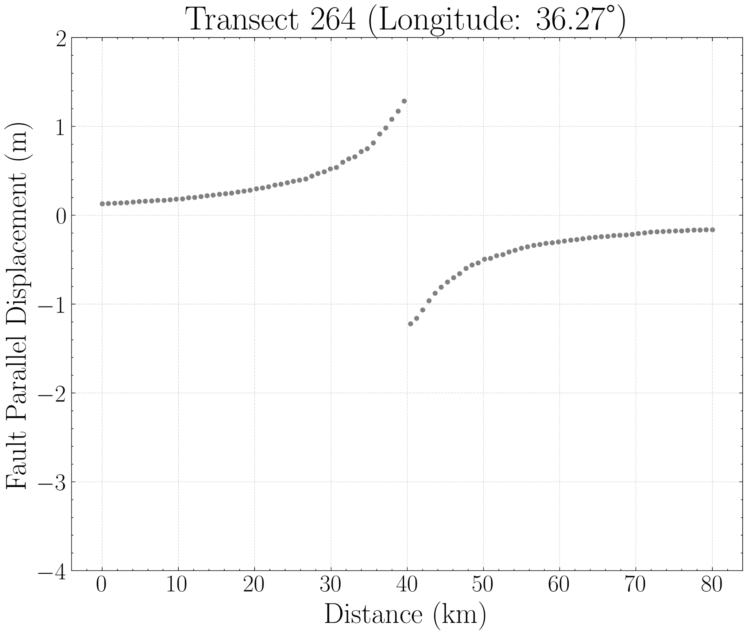

FP Displacement at Different Transects

