Slide 1



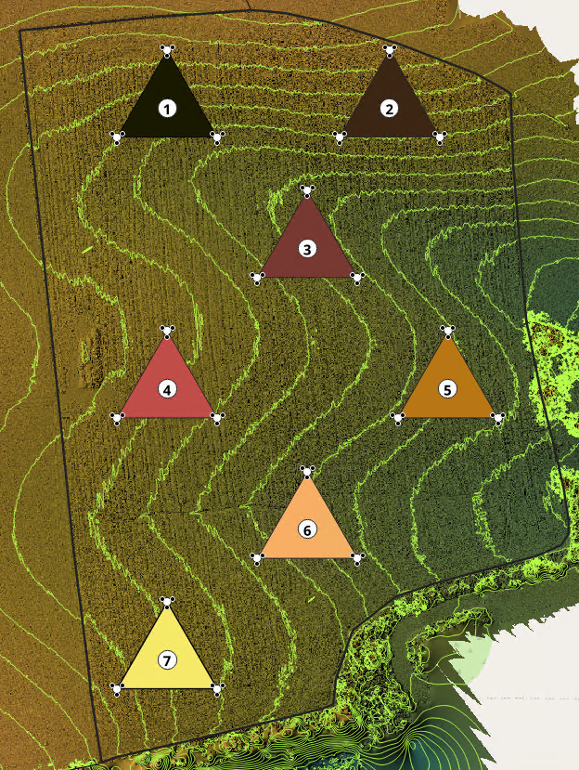
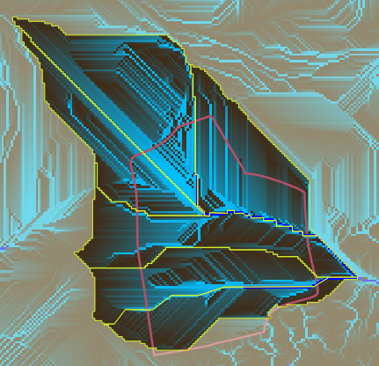
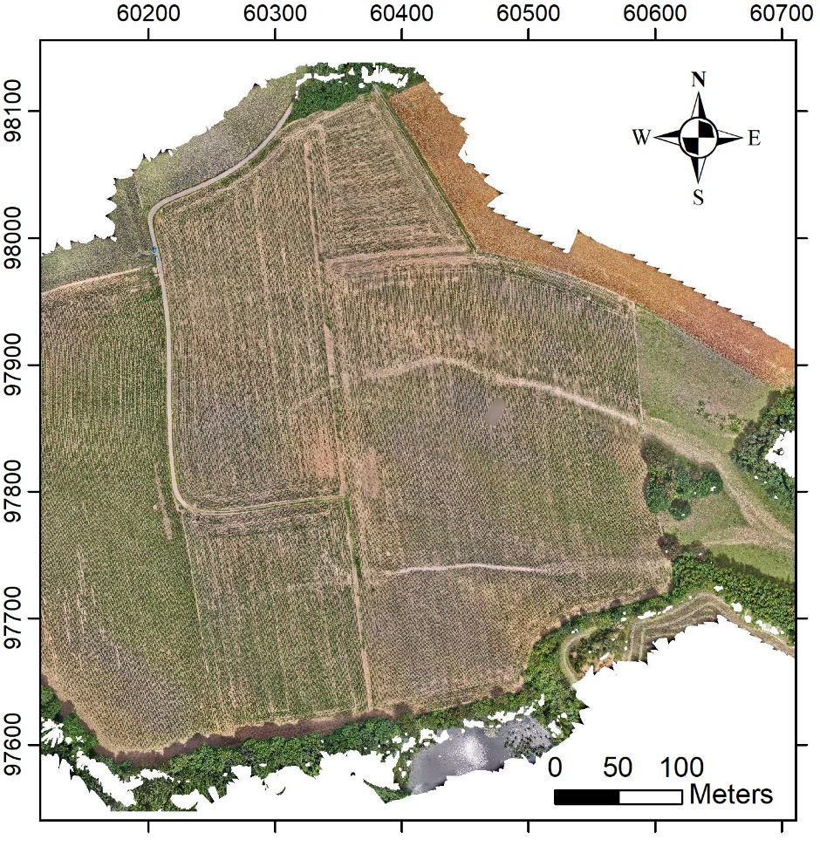
Assessing spatial variability of soil moisture across an erosion-prone agricultural hillslope
Funded by FNR (EROSION: 17965325)
Doğa Yahşi, Svenja Hoffmeister, Mirko Mälicke, Núria Martínez-Carreras, Jean François Iffly, Erwin Zehe
Contact: doga.yahsi@kit.edu
PICOA.7
N

Slide 2

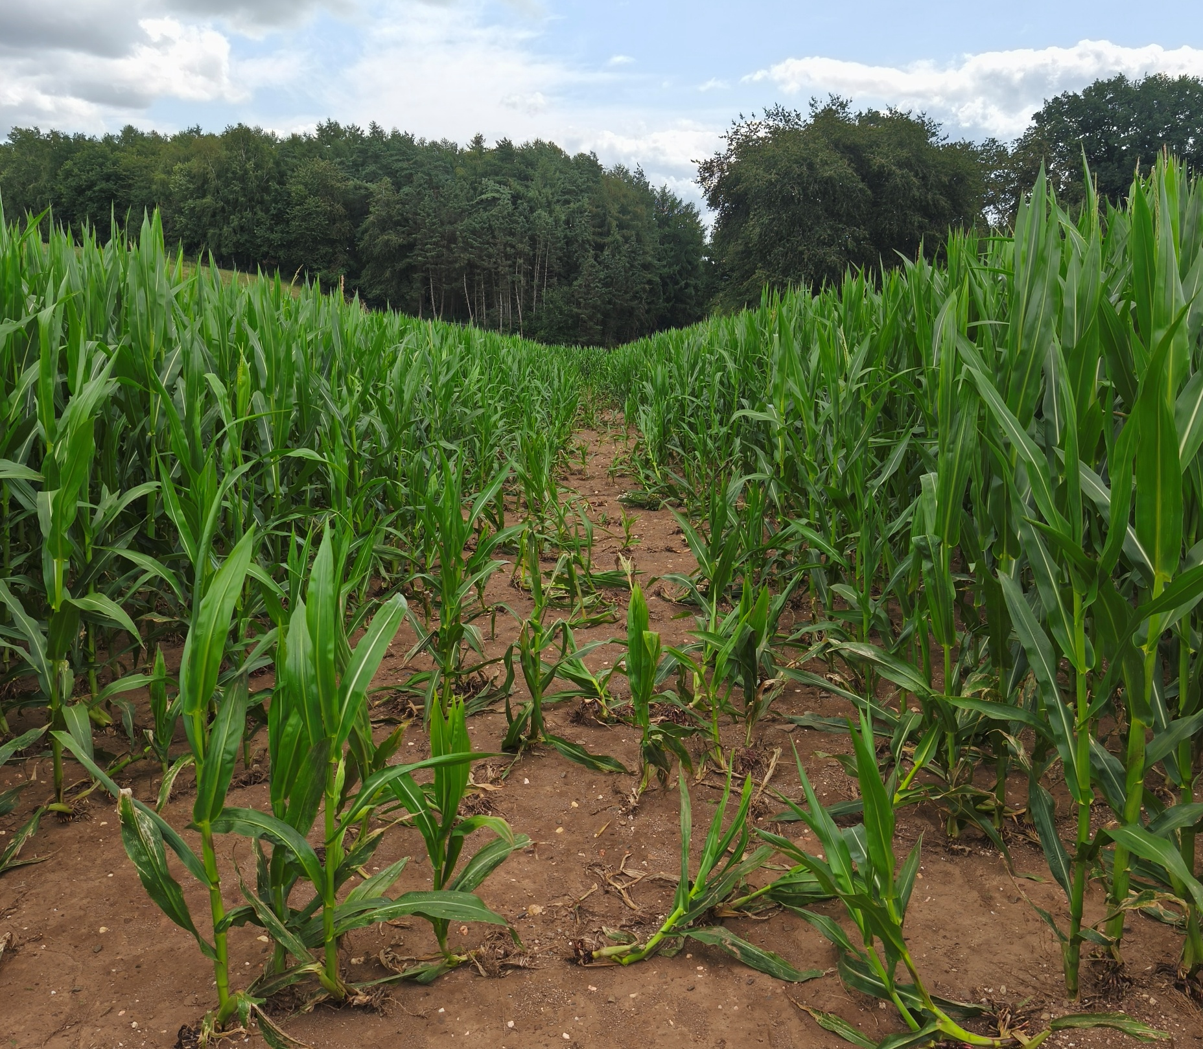
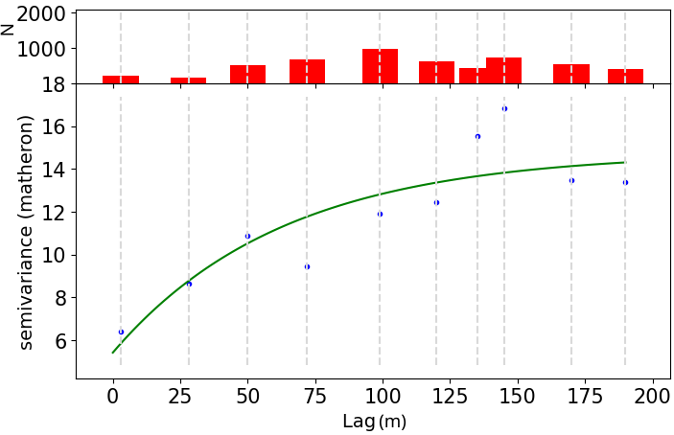



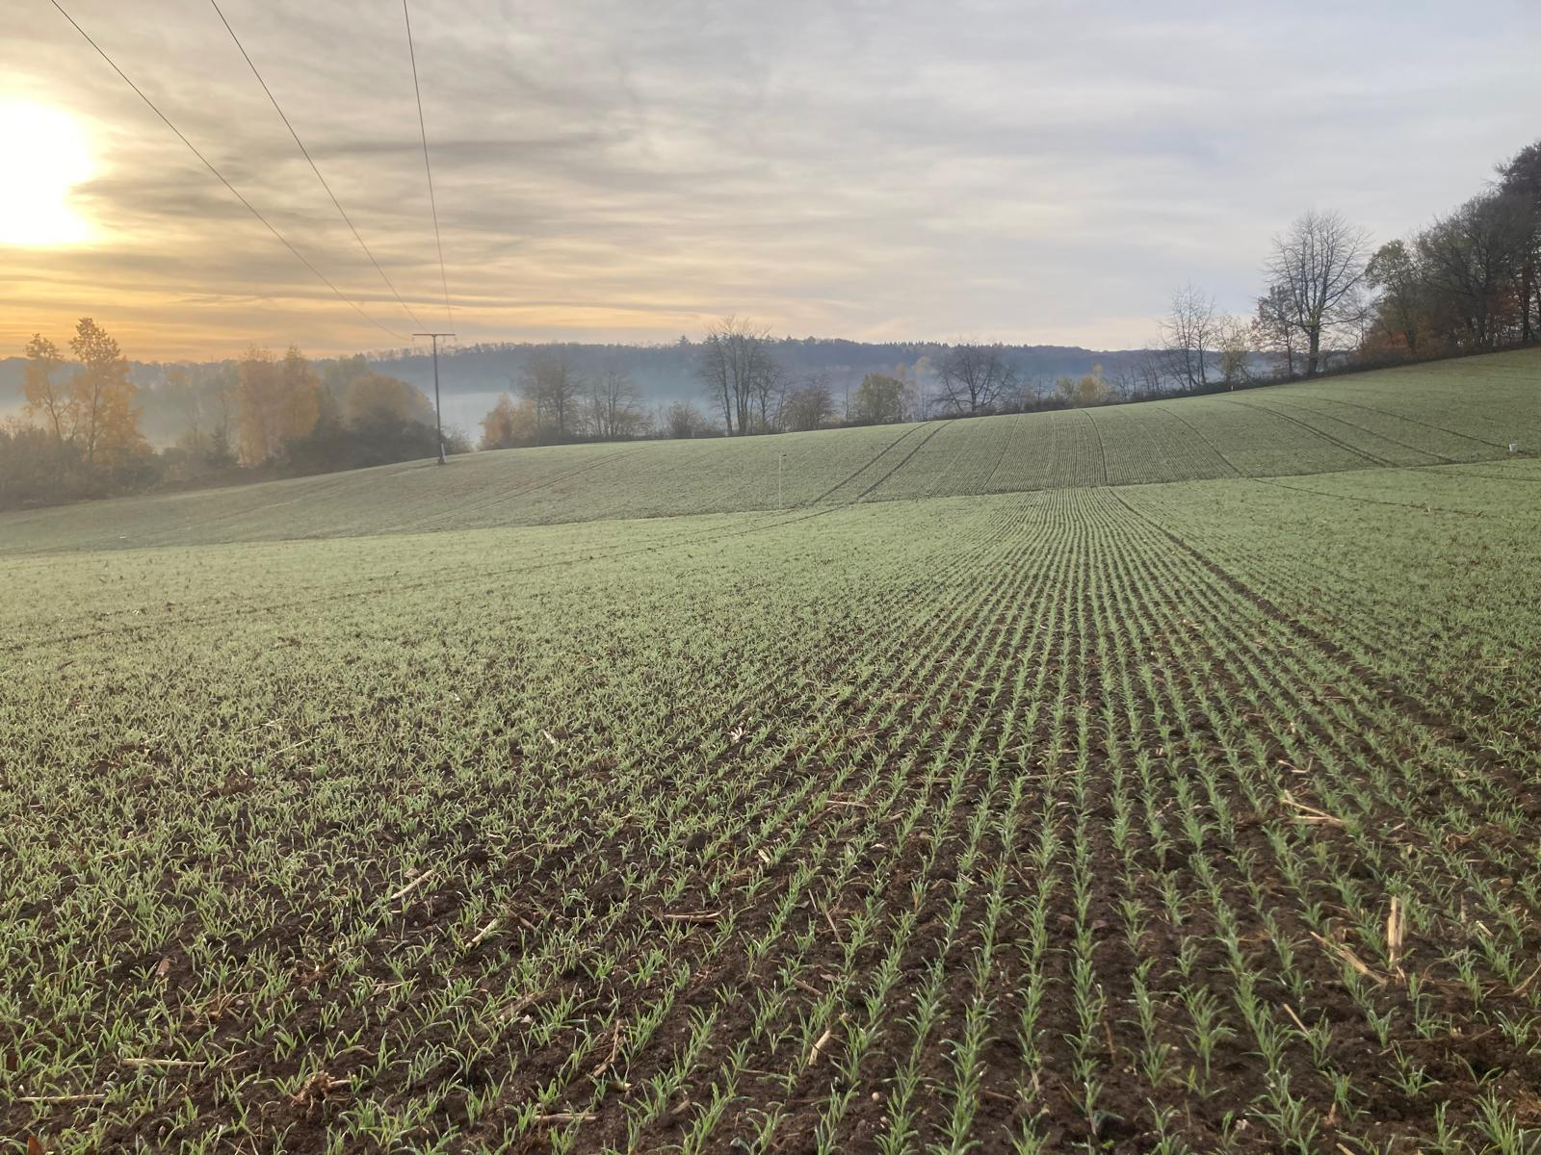
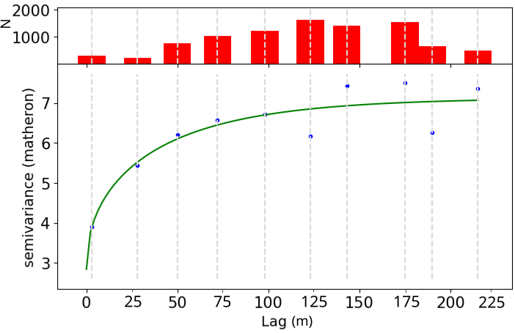
Doğa Yahşi
doga.yahsi@kit.edu
PICOA.7
Dry case
Case
comparison
Systematic
bias
Variogram analysis
Wet case
Interpolation & error
var.
Statistics

Slide 3



Doğa Yahşi
doga.yahsi@kit.edu
EROSION
Project
Soil moisture campaign
Main results
Diving deeper
Let’s discuss!
Why?
Main results
Project summary
Cooperators
How does this fit into the project?
Motivation
Objectives
The effect on erosion and overland flow
Field description
Cluster based sampling
Methods
Statistics
Bias correlation
Variograms
Interpolation
Error variance
Temporal variability
Main findings
Next steps?

Slide 4


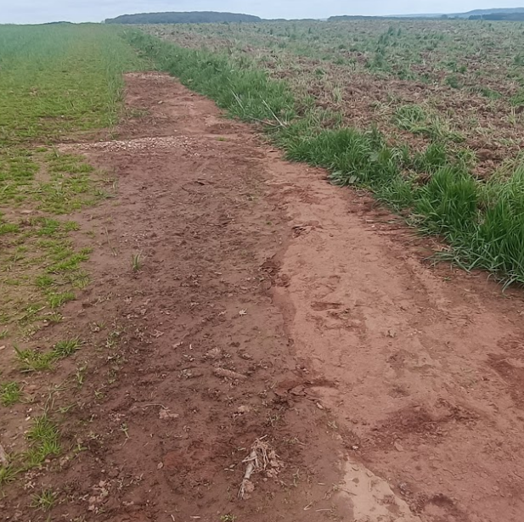
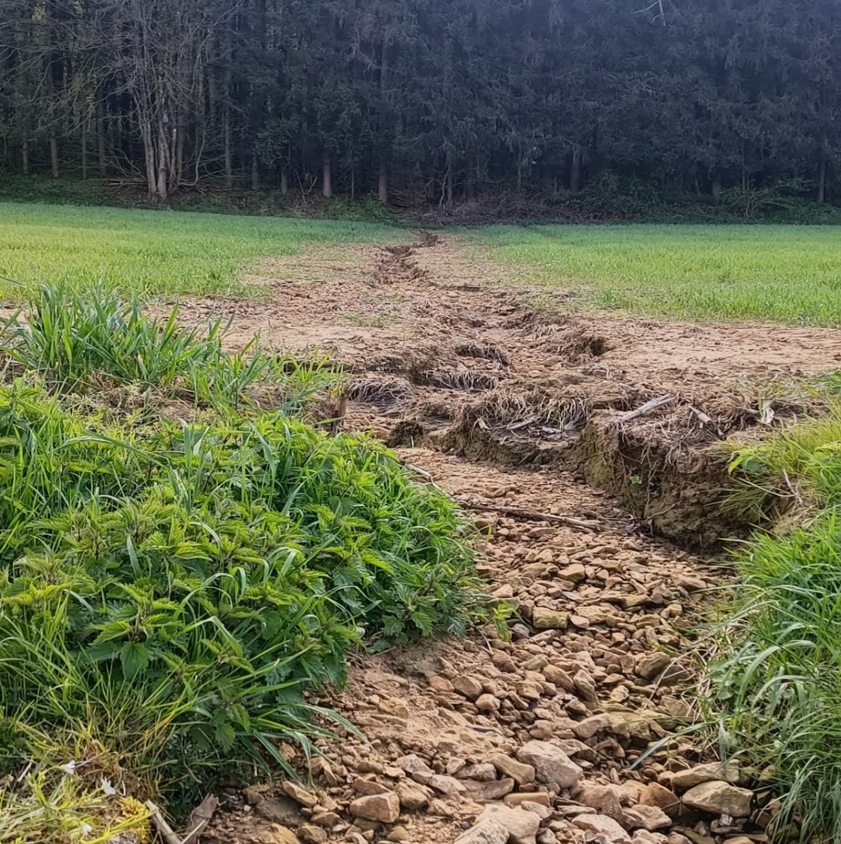
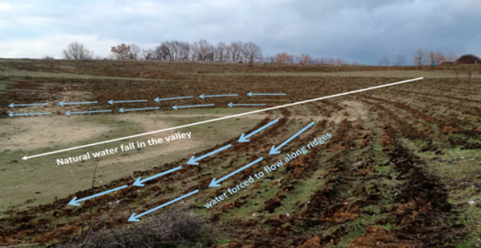
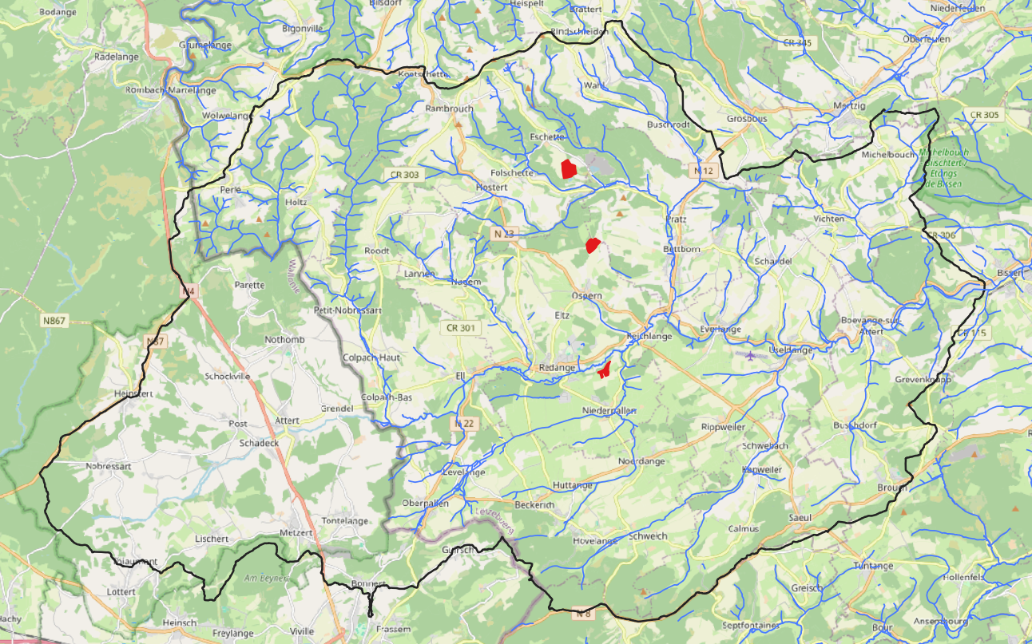
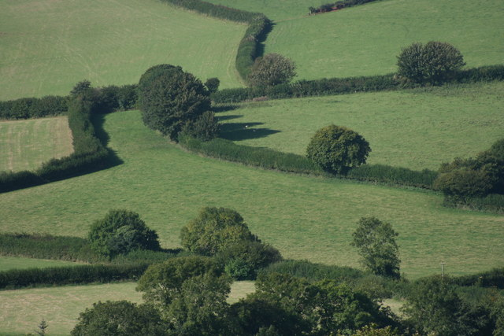

EROSION
Erosion and flash flood mitigation under change - linking fields to agricultural landscapes
Climate change scenarios
Gully erosion
Sheet erosion
Field monitoring & data collection
Assessment of agricultural practice scenarios
Modelling overland flow & erosion
High resolution DEM
Buffer stripes and hedges [2]
3 sites & 3 geologies
Attert River Basin, Luxembourg
Catflow-SED
Keyline design [1]
Funded by FNR (EROSION: 17965325)
[1] Giambastiani, Y., Biancofiore, G., Mancini, M., Di Giorgio, A., Giusti, R., Cecchi, S., Gardin, L., & Errico, A. (2023). Modelling the Effect of Keyline Practice on Soil Erosion Control. Land, 12(1), 100.
[2] Platt, A. (2007, September 11). Hedges on Stipadon Farm [Photograph]. Geograph Britain and Ireland; Wikimedia Commons. https://commons.wikimedia.org/wiki/File:Hedges_on_Stipadon_Farm_-_geograph.org.uk_-_1100291.jpg

Slide 5




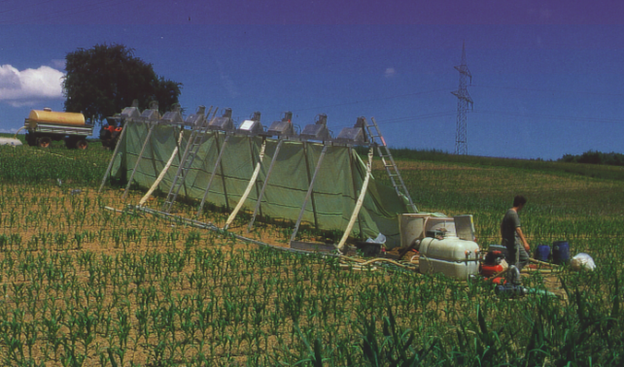
Why is antecedent soil moisture important for soil erosion modelling?
Explore whether geostatistical methods can capture spatial soil moisture variability
Assess the performance of onboard TDR calibration with gravimetric method
Objectives:
Experimental sprinkling setup [3]
[3] Gerlinger, K. (1997). Erosionsprozesse auf Lössböden: Experimente und Modellierung. Institut für Wasserbau und Kulturtechnik der Universität Karlsruhe

Slide 6

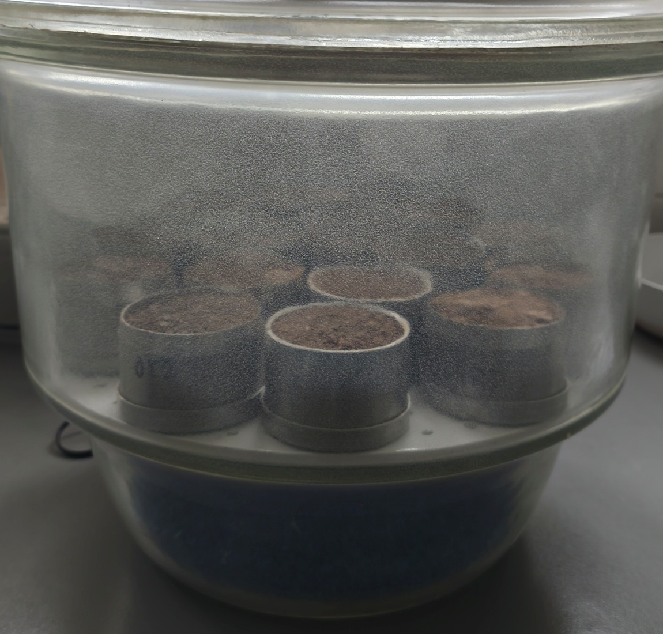
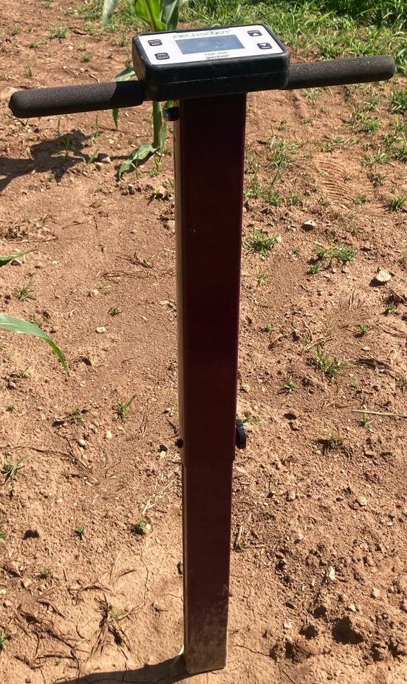
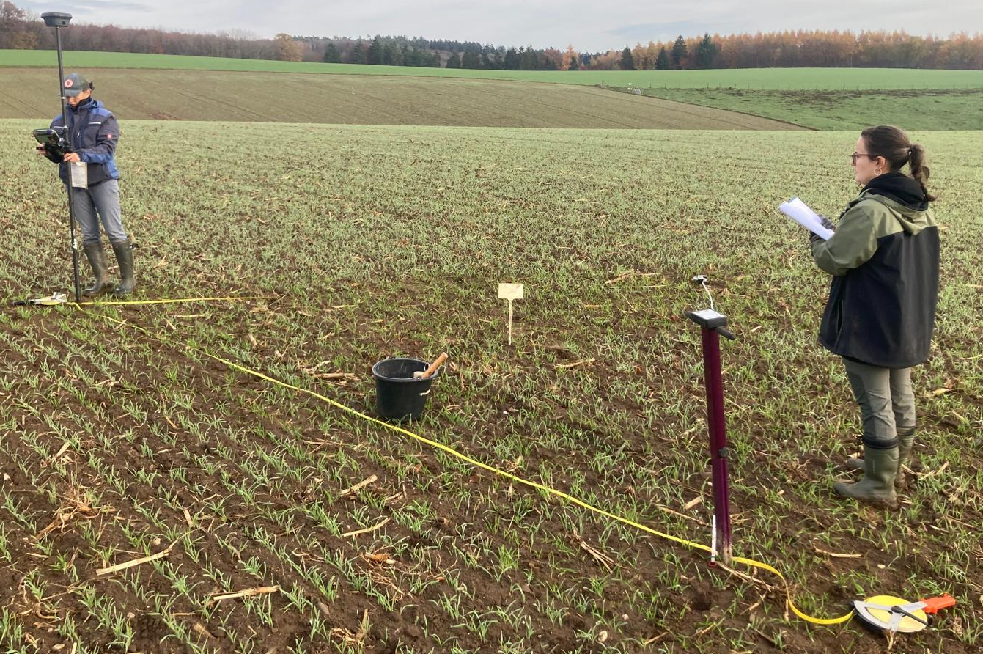
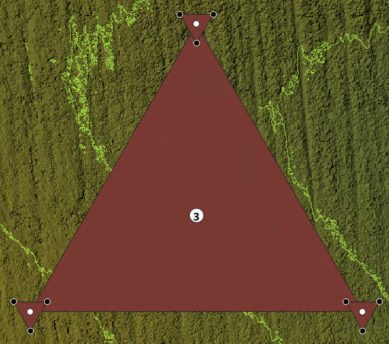
Soil moisture campaign and sampling design:
Gravimetric soil moisture determination to validate TDR measurements
Agricultural hillslope in Luxembourg
Soil moisture measurements with TDR (onboard calibration)
5 m
Cluster-based sampling design
50 m
Two soil moisture campaigns (wet & dry)
N
Nested cluster sampling design.

Slide 7

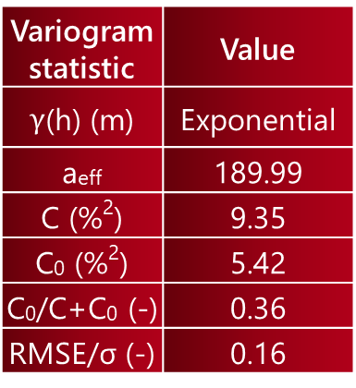
Compare
The dry case:
Statistic | Value
Θ_{min} (%) | 1.6
Θ_{max} (%) | 22.4
Θ_{mean} (%) | 8.1
Θ_{std} (%) | 3.5
Variogram statistic | Value
$γ$(h) (m) | Exponential
a_{eff} | 189.99
C (%²) | 9.35
C₀ (%²) | 5.42
C₀/C+C₀ (-) | 0.36
RMSE/σ (-) | 0.16
Theoretical variogram model for the dry case.

Slide 8
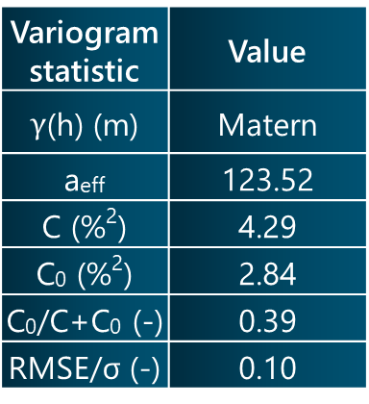
Compare
Compare
The wet case:
Statistic | Value
Θ_{min} (%) | 13.2
Θ_{max} (%) | 27.2
Θ_{mean} (%) | 19.4
Θ_{std} (%) | 2.7
Variogram statistic | Value
$γ$(h) (m) | Matern
a_{eff} | 123.52
C (%²) | 4.29
C₀ (%²) | 2.84
C₀/C+C₀ (-) | 0.39
RMSE/σ (-) | 0.10
Theoretical variogram model for the wet case.

Slide 9
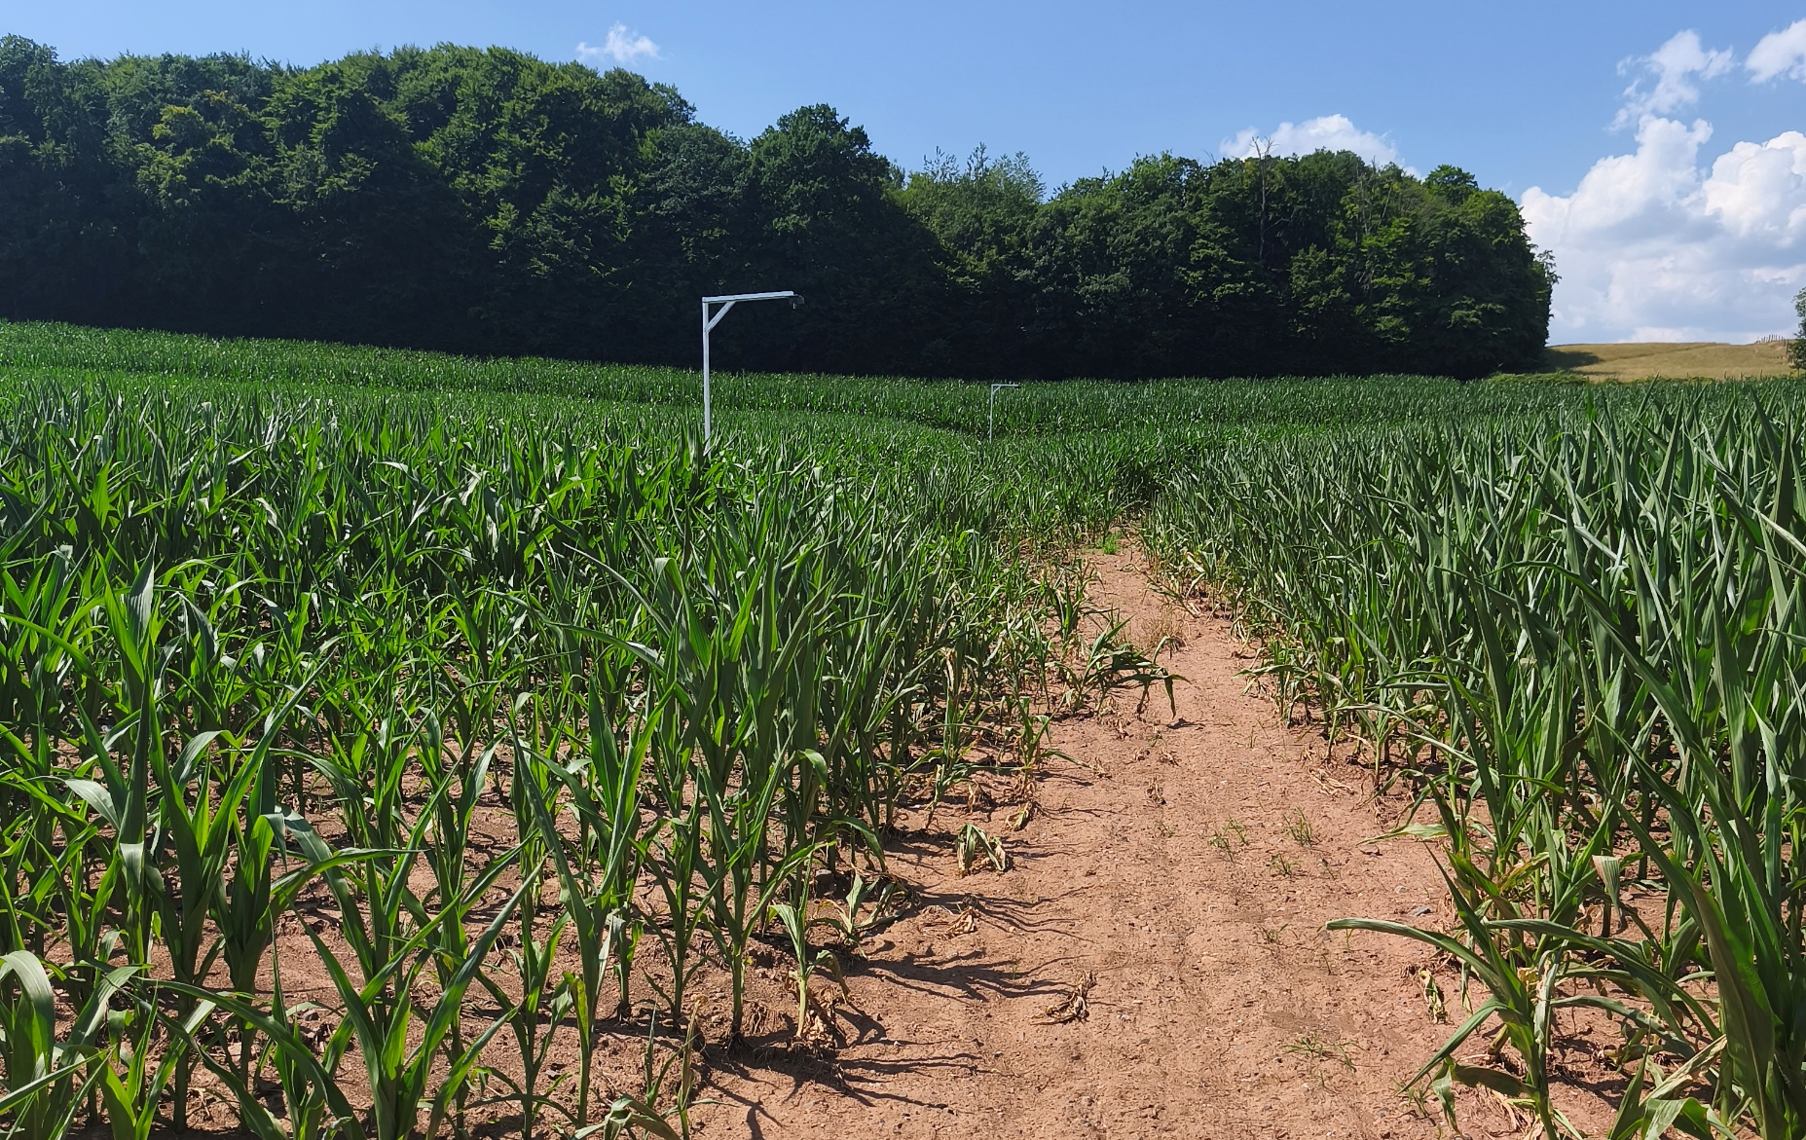
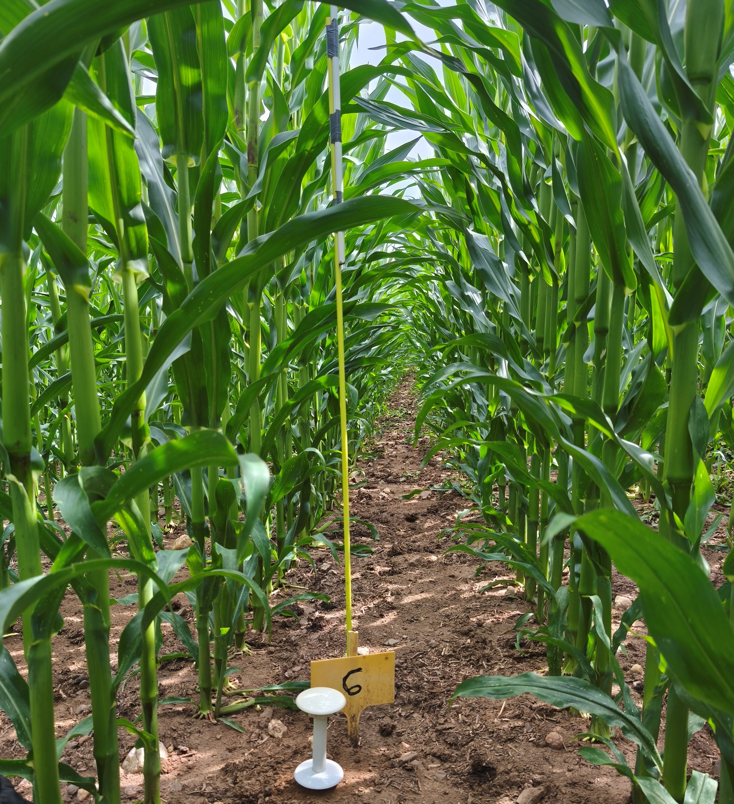
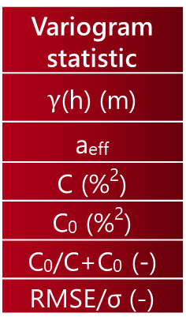
Variogram statistic
$γ$(h) (m)
a_{eff}
C (%²)
C₀ (%²)
C₀/C+C₀ (-)
RMSE/σ (-)
Dry
Exponential
189.99
9.35
5.42
0.36
0.16
Wet
Matern
123.52
4.29
2.84
0.39
0.10
Statistic | Value
Θ_{min} (%) | 1.6
Θ_{max} (%) | 22.4
Θ_{mean} (%) | 8.1
Θ_{std} (%) | 3.5
Statistic | Value
Θ_{min} (%) | 13.2
Θ_{max} (%) | 27.2
Θ_{mean} (%) | 19.4
Θ_{std} (%) | 2.7

Slide 10

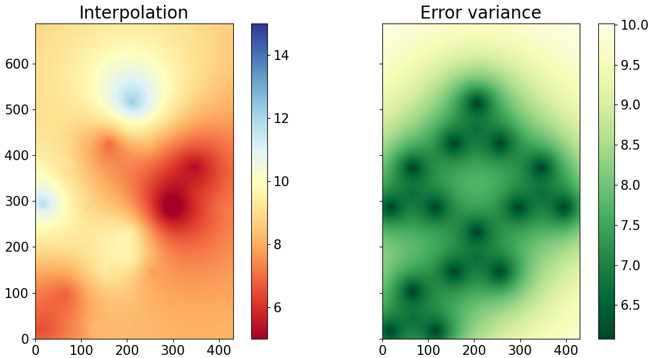
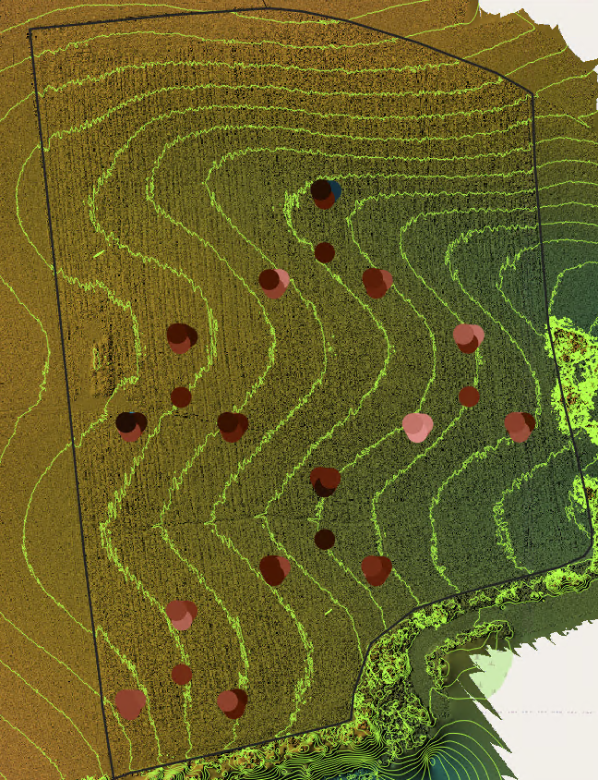
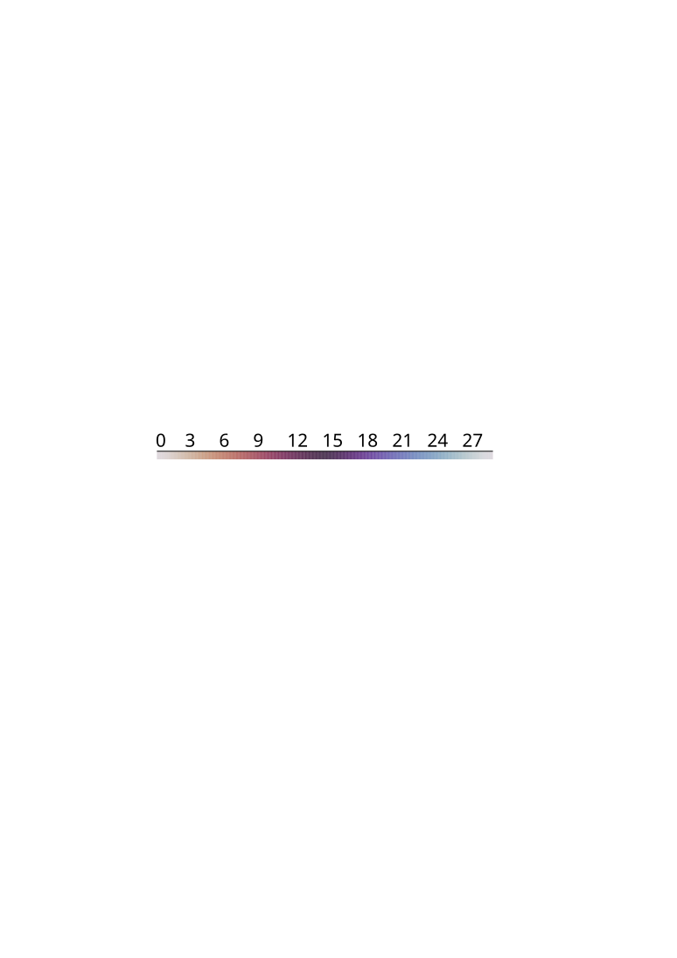
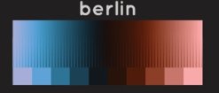
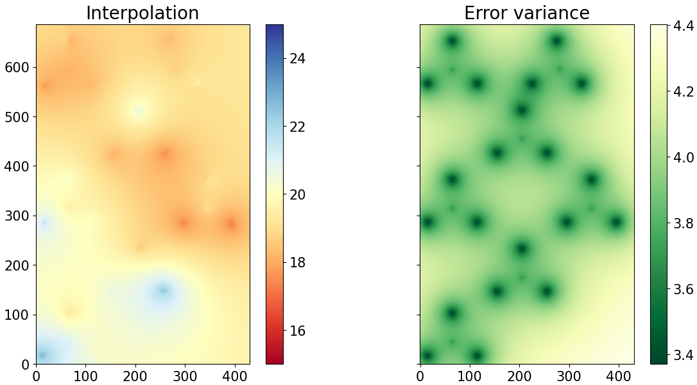
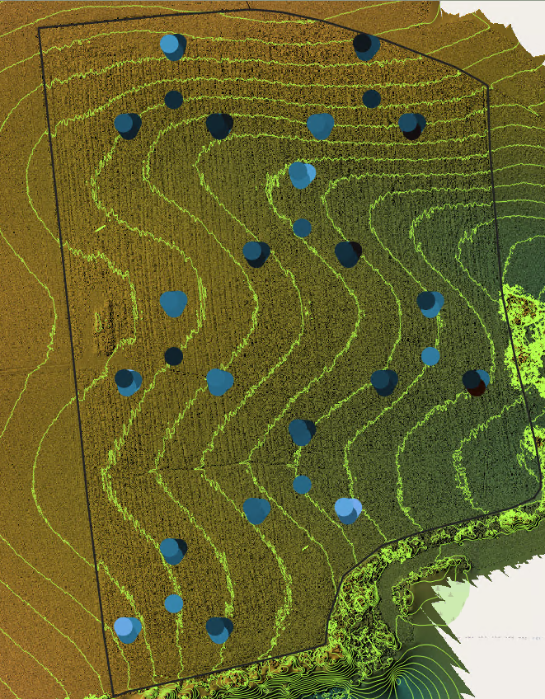
Soil moisture interpolation via ordinary kriging with nugget effect for both cases.
Wet case
Dry case
No correlation to distance-to-stream or elevation for either of the cases.

Slide 11

Temporal variability of soil moisture at the cluster centres:
N
Nested cluster sampling design.
Soil moisture time series at cluster centers (CC).

Slide 12



Conclusions & points to discuss:
Under wet conditions, a shorter effective range:
> weaker spatial continuity and stronger small-scale variability.
Onboard TDR calibration underestimated soil moisture:
> Need for site-specific calibration.
Soil moisture exhibited strong temporal (rank) stability and persistent spatial heterogeneity.
Bias correction did not affect the nugget-to-sill ratio:
> Consistent spatial structure despite measurement bias.
Trends suggest stable wet and dry zones:
> Controlled by soil properties and topography.

Slide 13

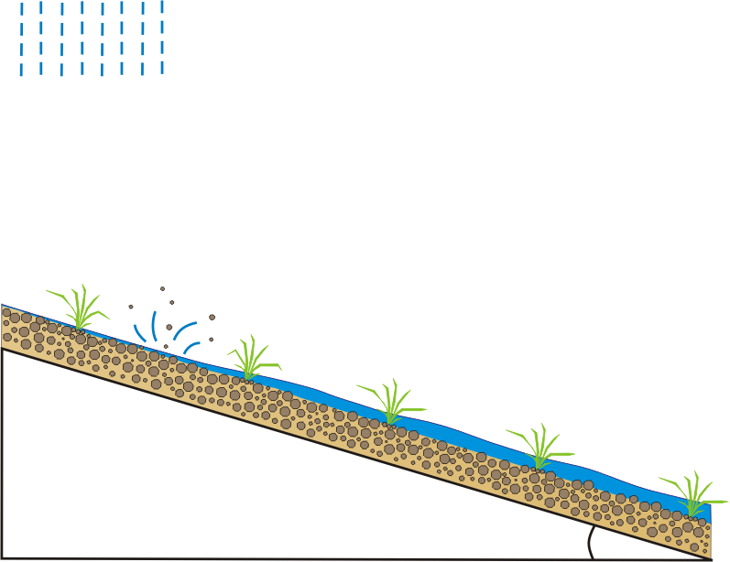
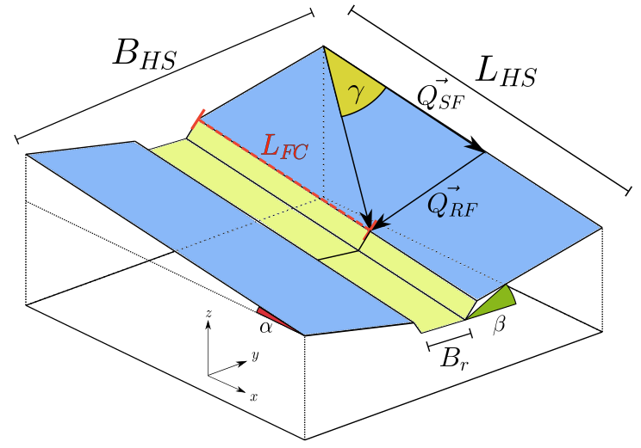

Model Catflow-SED:
m_{r} momentum of rainfall
Catchment concept:
Multiple 2D hillslopes
An interconnected river network
Evapotranspiration & Interception
Penman–Monteith equation
Overland Flow & Streamflow
Saint-Venant equations (diffusion wave approach)
Upstream finite volume methods
Soil Water Dynamics
2D Richards equation
Macropore flow
Implicit, mass-conservative Picard iteration
Sediment Transport
Sediment continuity (detachment, transport, deposition)
τ
shear stress
[4]
attacking forces
detachment rate
erosion resistance
of the soil
[4] Schroers, S., Eiff, O., Kleidon, A., Scherer, U., Wienhöfer, J., & Zehe, E. (2022). Morphological controls on Hortonian surface runoff: An interpretation of steady-state energy patterns, maximum power states and dissipation regimes within a thermodynamic framework. Hydrology and Earth System Sciences, 3125-3150.

Slide 14
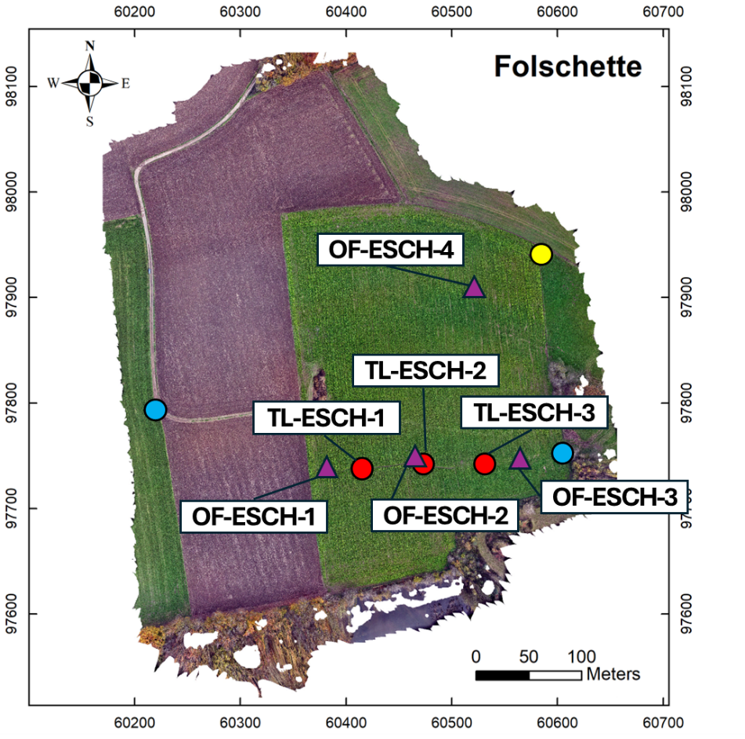
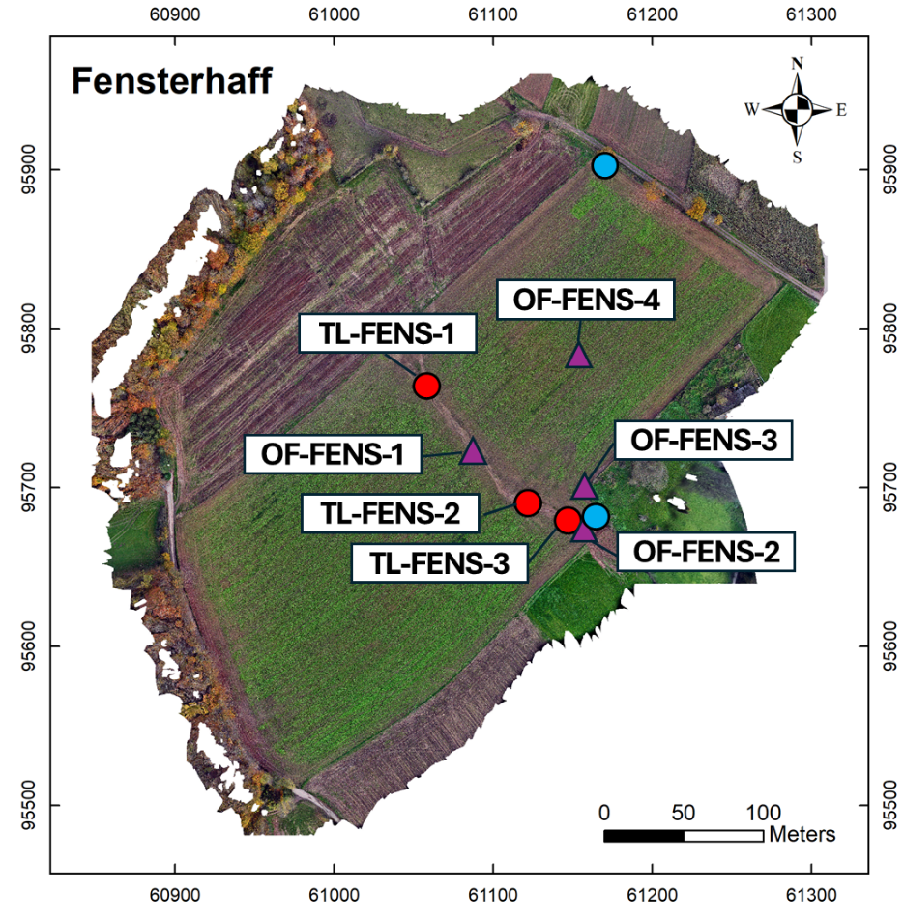
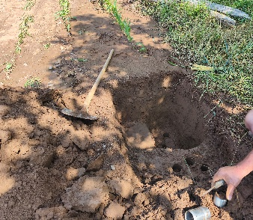
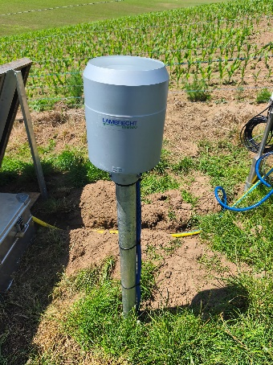
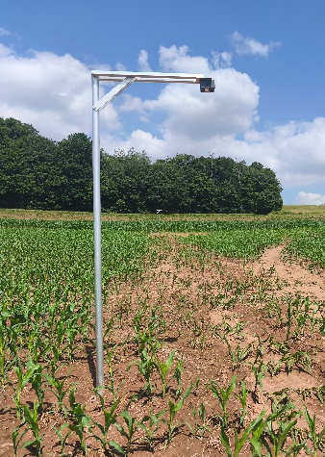
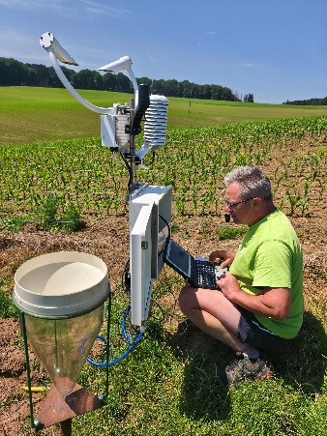
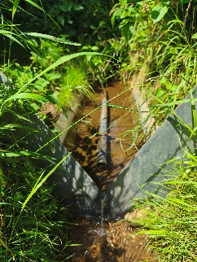
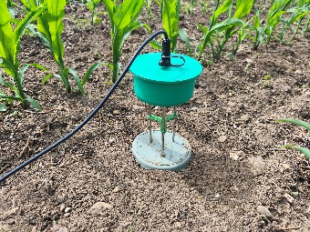
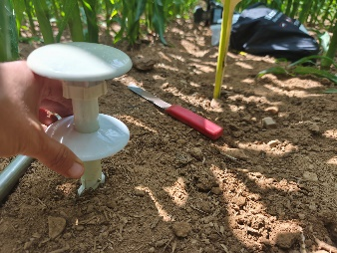
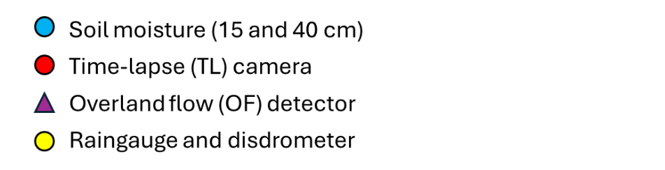
Field monitoring:
Eschette

Slide 15
Eschette: before/after erosion event 15th June 2025
22/05/2025
25/06/2025

Slide 16
Eschette: elevation difference after the event 15th June 2025

