Slide 1
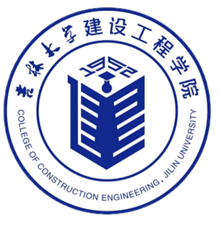



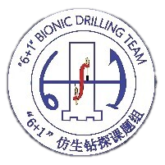

European Geosciences Union General Assembly EGU26
Dynamic Modeling and Performance Analysis of a Self-Balancing Drill Hoisting System for Efficient Resource Development
Song Wei, Gao Ke, Yu Yongping
Key Laboratory of Complex Conditions Drilling and Production Technology of the Ministry of Natural Resources,
College of Construction Engineering, Jilin University
May 5th, 2026

Slide 2
Outline
1
Background
2
Method
3
Conclusions
4
Outlook

Slide 3
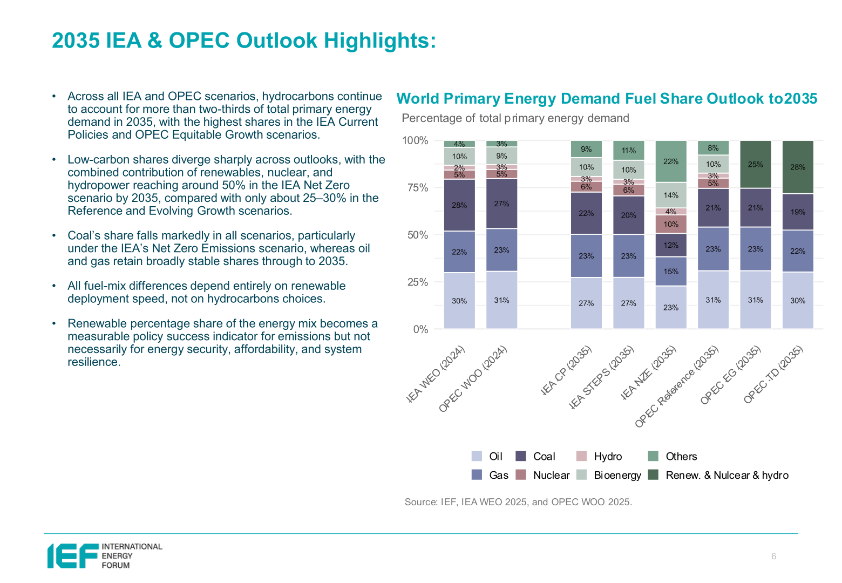

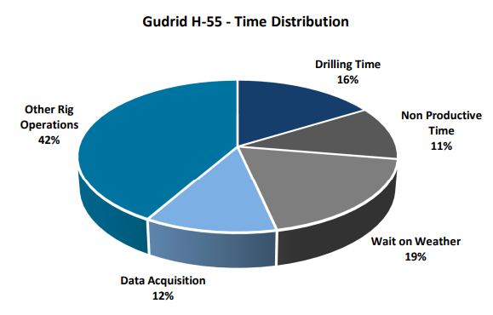

Background
According to forecast scenarios published by the International Energy Agency (IEA) and the Organization of the Petroleum Exporting Countries (OPEC), fossil fuels are projected to account for more than two-thirds of global primary energy demand through 2035. Against this backdrop, the continuous upgrading and iteration of drilling equipment is imperative to meet the twin demands of efficient resource extraction and environmental protection.
Other drilling operations
42%
Drilling time
16%
Non-productive time
16%
Weather factor
19%
Data collection
12%
World Primary Energy Demand Fuel Share Outlook to 2035
Drilling Time Allocation

Slide 4
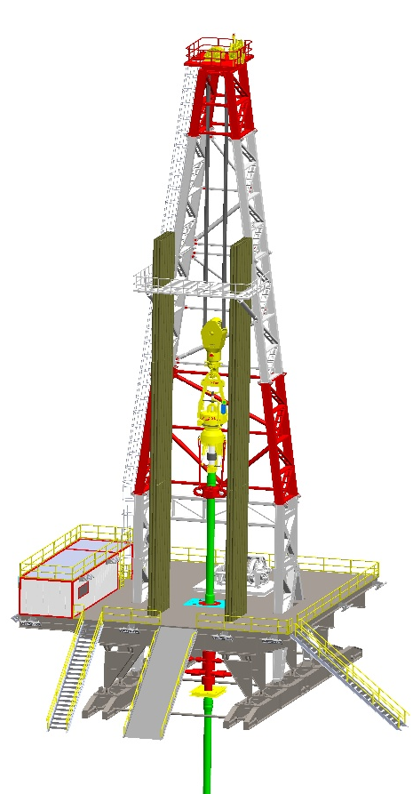
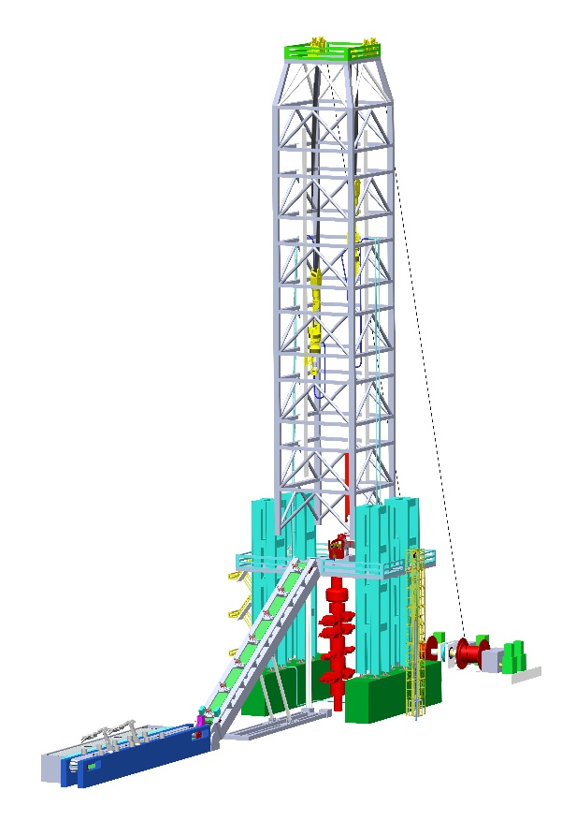
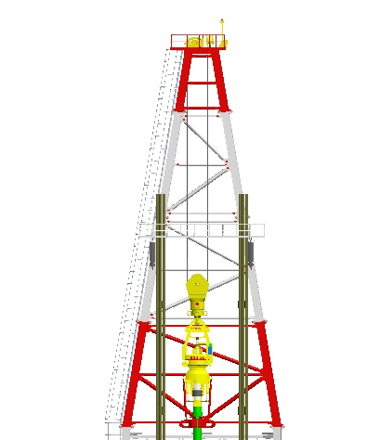
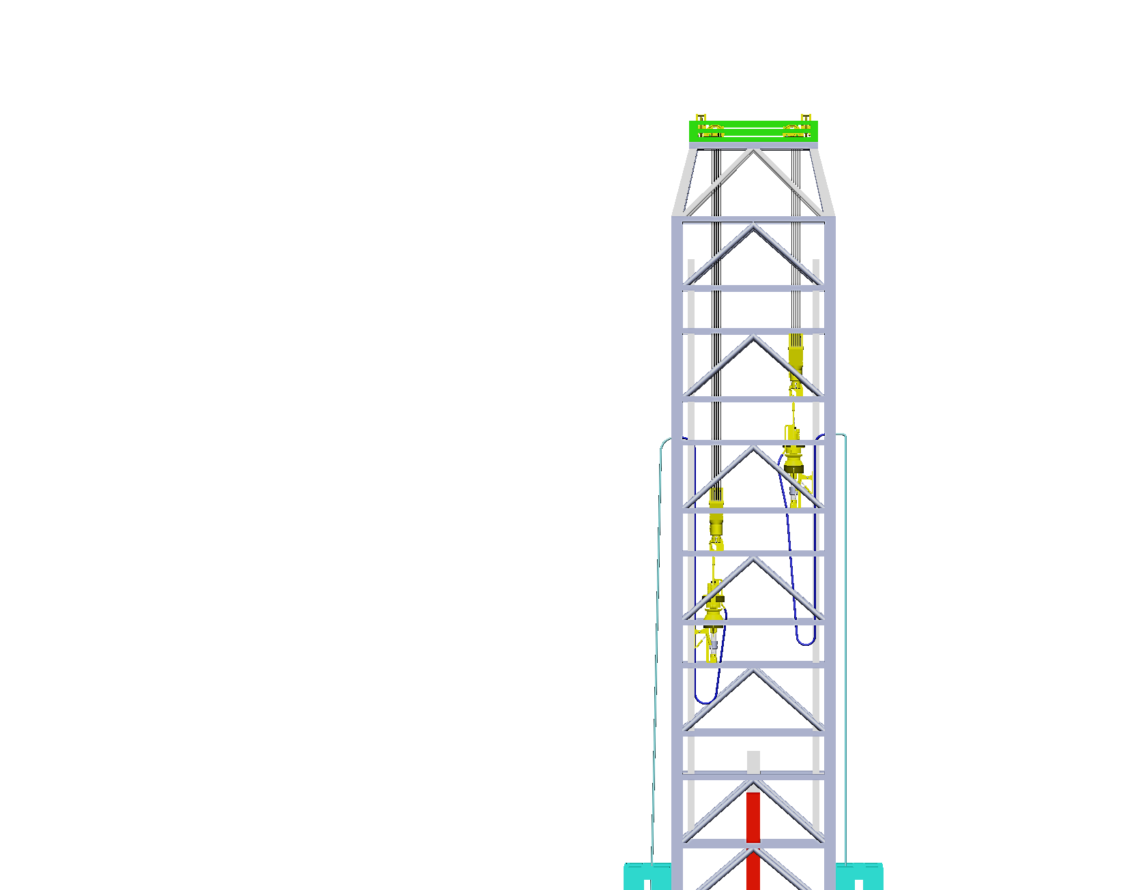
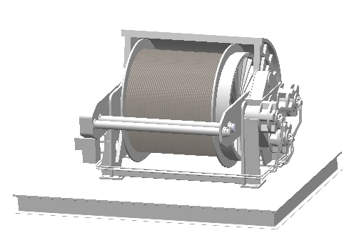
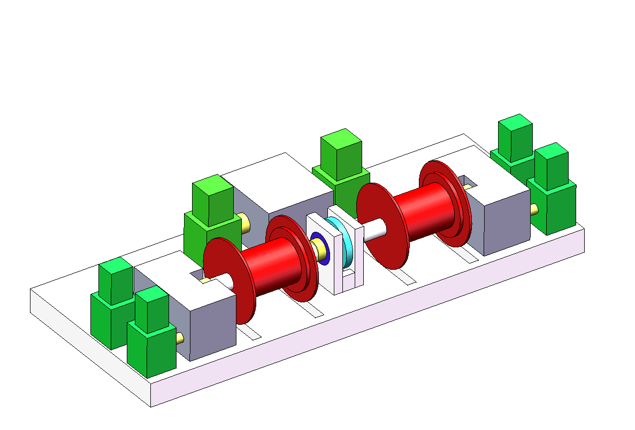
Background
XJ003
Continuous Self-Balancing Drilling Rig System
Hoisting System
Self-Balancing
Hoisting System
Winch
Self-Balancing
Double Winch
To improve tripping efficiency and lower energy consumption in drilling, a novel self-balancing rig system has been created. It introduces a new tripping method where two hoisting units work in tandem. Using torque self-balancing technology, the system offsets the weight of the traveling block system, achieving both higher productivity and significant energy savings.

Slide 5

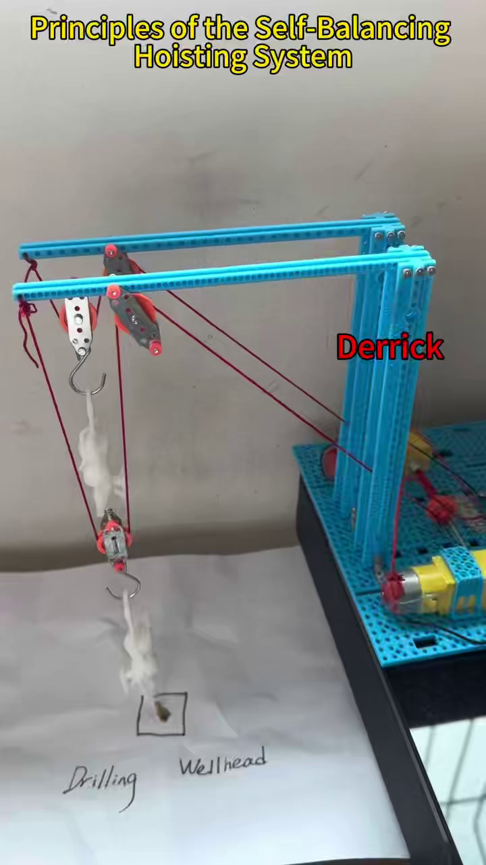
Method
Principles of the Self-Balancing Hoisting System

Slide 6
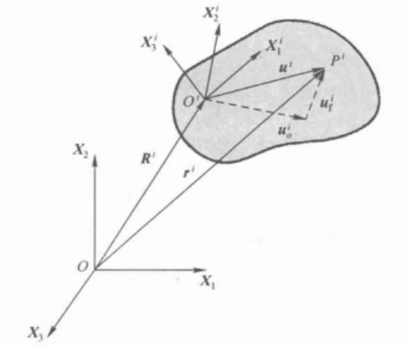
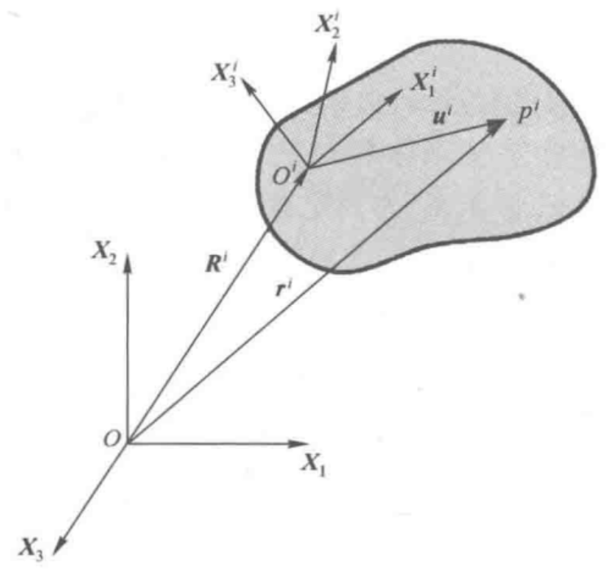
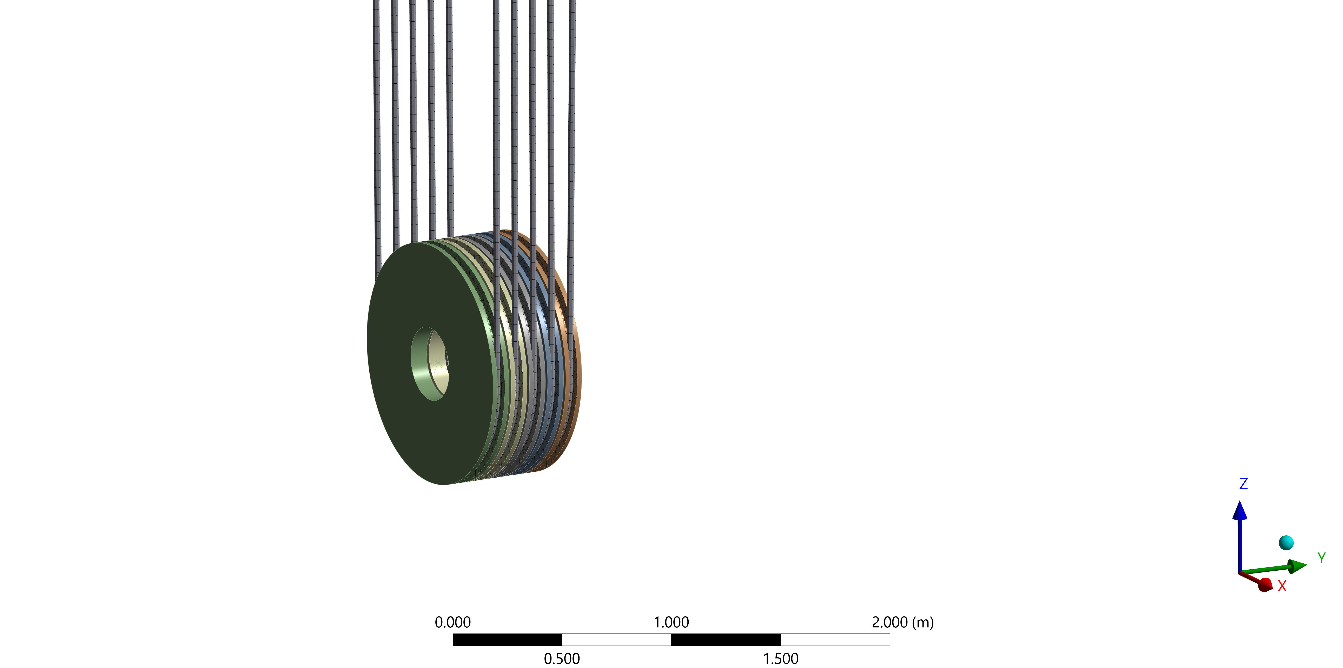
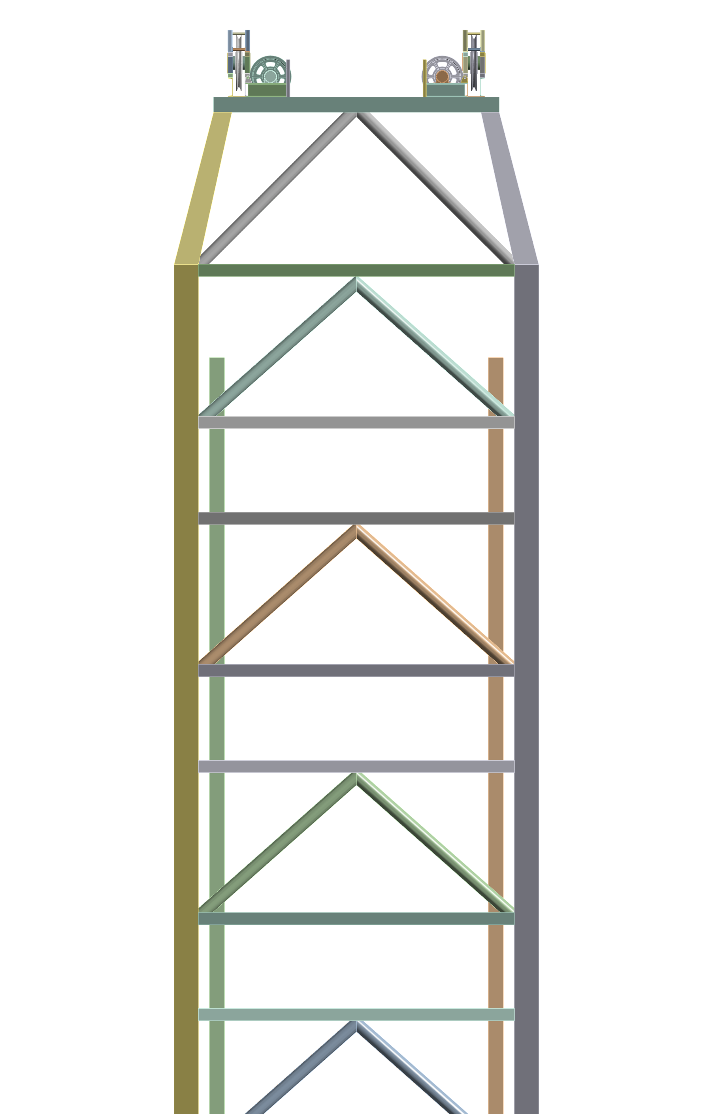
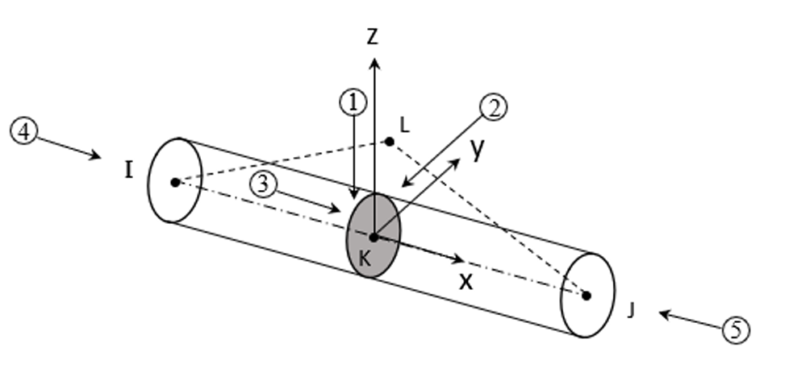
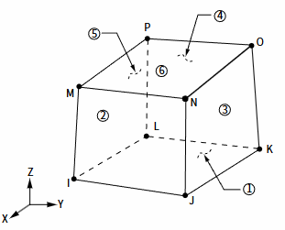
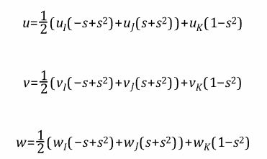
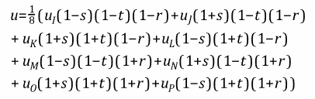
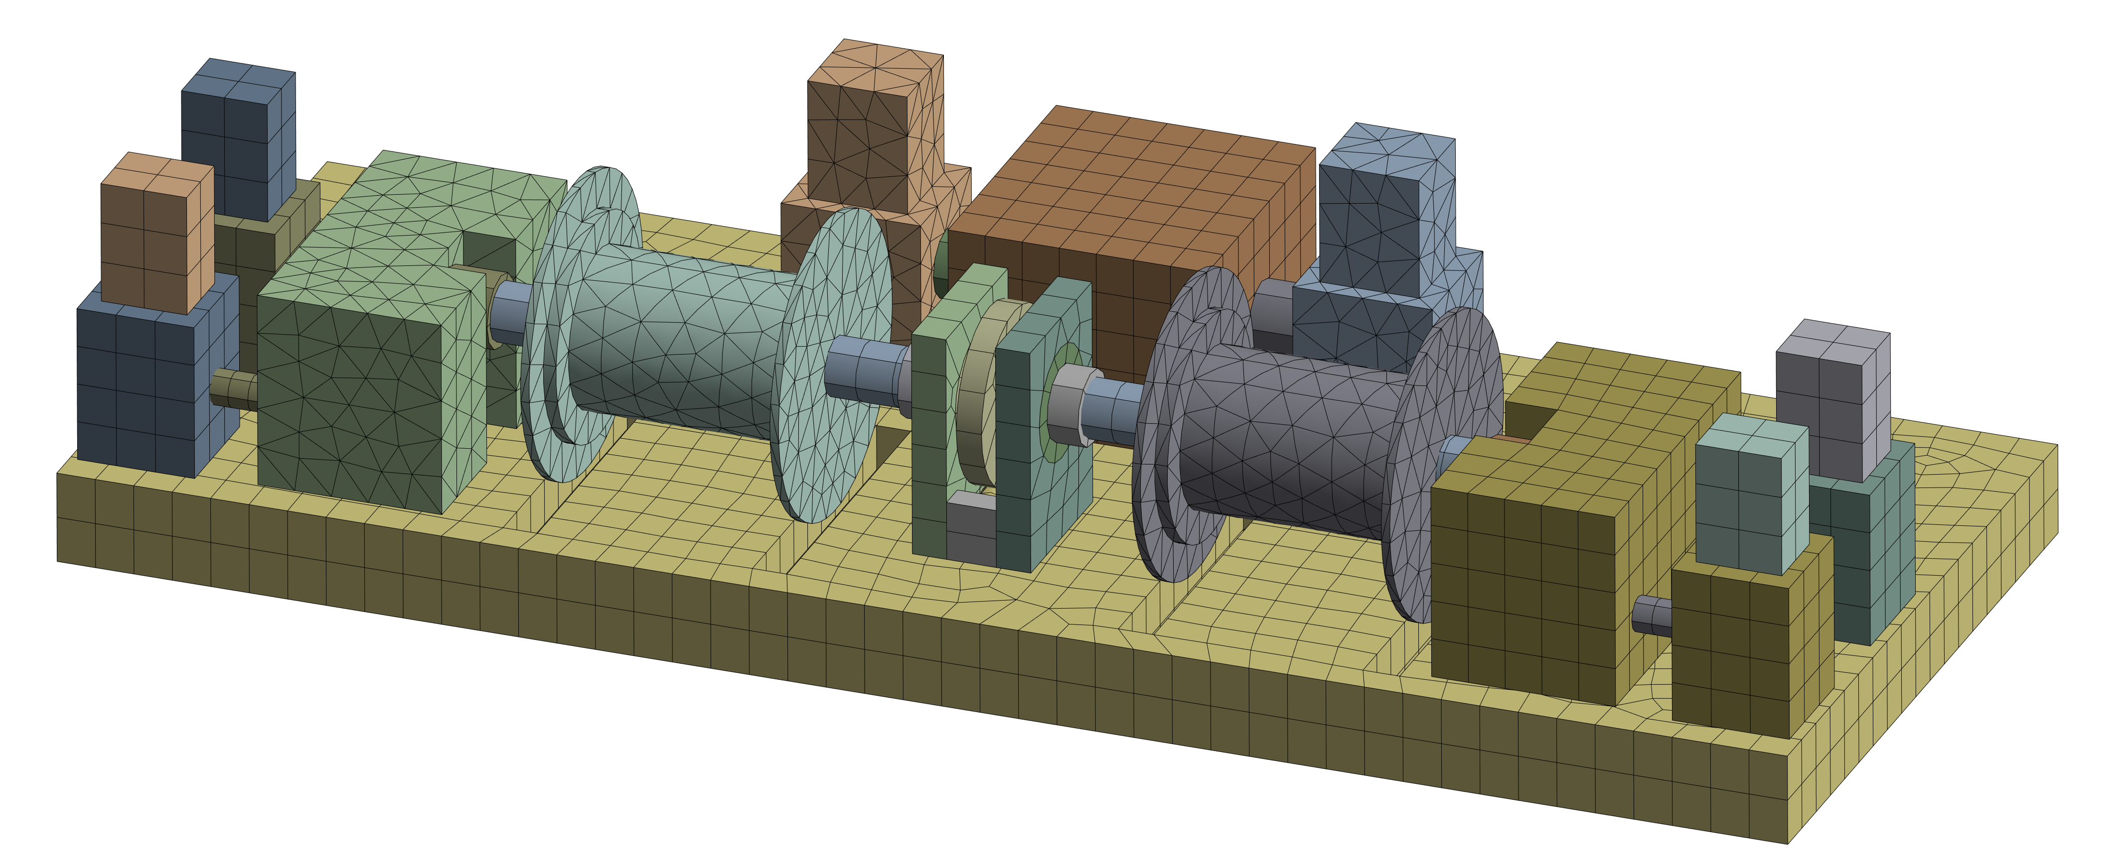
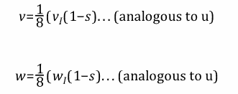








Method
Finite element model schematic diagram
Flexible Body-Only Steel Wire Rope
Rigid Body
$$r^{i}=R^{i}+A(u_{o}^{i}+u_{f}^{i})$$
$$r^{i}=R^{i}+Au^{i}$$
$$u_{f}^{i}=φ_{p}q_{f}$$
$${\dot{r}}^{i}={\dot{R}}^{i}+\dot{A}u^{i}$$
$${\dot{r}}^{i}={\dot{R}}^{i}+\dot{A} \left(u_{o}^{i}+u_{f}^{i}\right)$$
$+$ $Aφ_{p}{\dot{q}}_{f}$
$${\ddot{r}}^{i}={\ddot{R}}^{i}+A{[\overline{ω}}^{i}×({\overline{ω}}^{i}×{\overline{u}}^{i})]$$
$$+2A({\overline{α}}^{i}×{\overline{u}}^{i})]$$
$${\ddot{r}}^{i}={\ddot{R}}^{i}+\ddot{A} \left(u_{o}^{i}+u_{f}^{i}\right)$$
$+2\dot{A}$ $φ_{p}{\dot{q}}_{f}+Aφ_{p}{\ddot{q}}_{f}$
Cable280
Soild185
Multibody Dynamics (MBD) Equations
$$M\ddot{q}+Kq+C_{q}^{T}λ=Q_{e}+Q_{v}$$
$$\left[\begin{matrix}m_{rr} & m_{rf} \\ m_{rf} & m_{ff}\end{matrix}\right]\left[\begin{matrix}{\ddot{q}}_{r} \\ {\ddot{q}}_{f}\end{matrix}\right]+\left[\begin{matrix}0 & 0 \\ 0 & K_{ff}\end{matrix}\right]\left[\begin{matrix}q_{r} \\ q_{f}\end{matrix}\right]+\left[\begin{matrix}C_{qr}^{T} \\ C_{qf}^{T}\end{matrix}\right]λ=\left[\begin{matrix}{(Q_{r})}_{e} \\ {(Q_{f})}_{e}\end{matrix}\right]+\left[\begin{matrix}{(Q_{r})}_{v} \\ {(Q_{f})}_{v}\end{matrix}\right]$$
$$\ddot{q}=f(q,\dot{q},t)$$

Slide 7
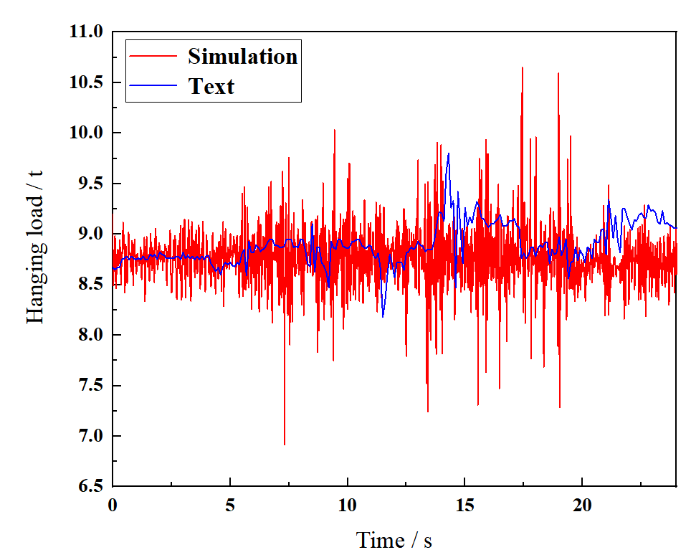
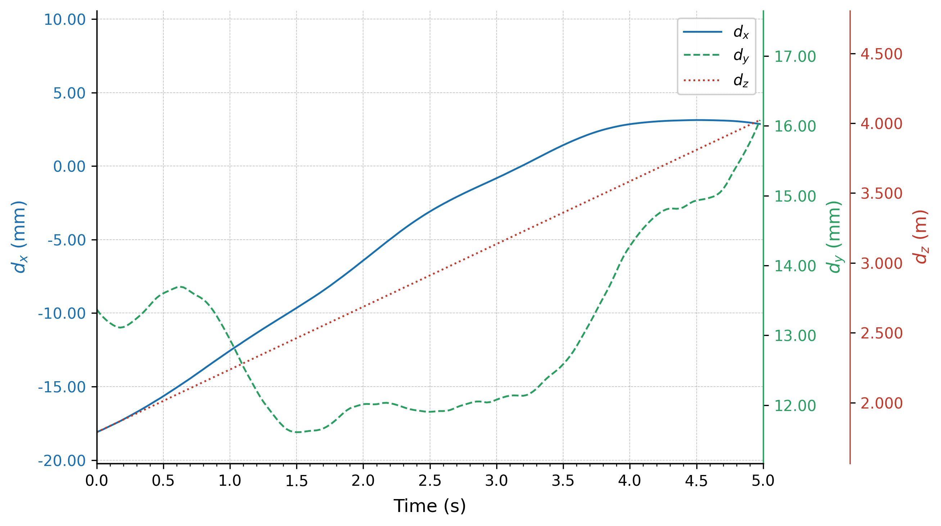
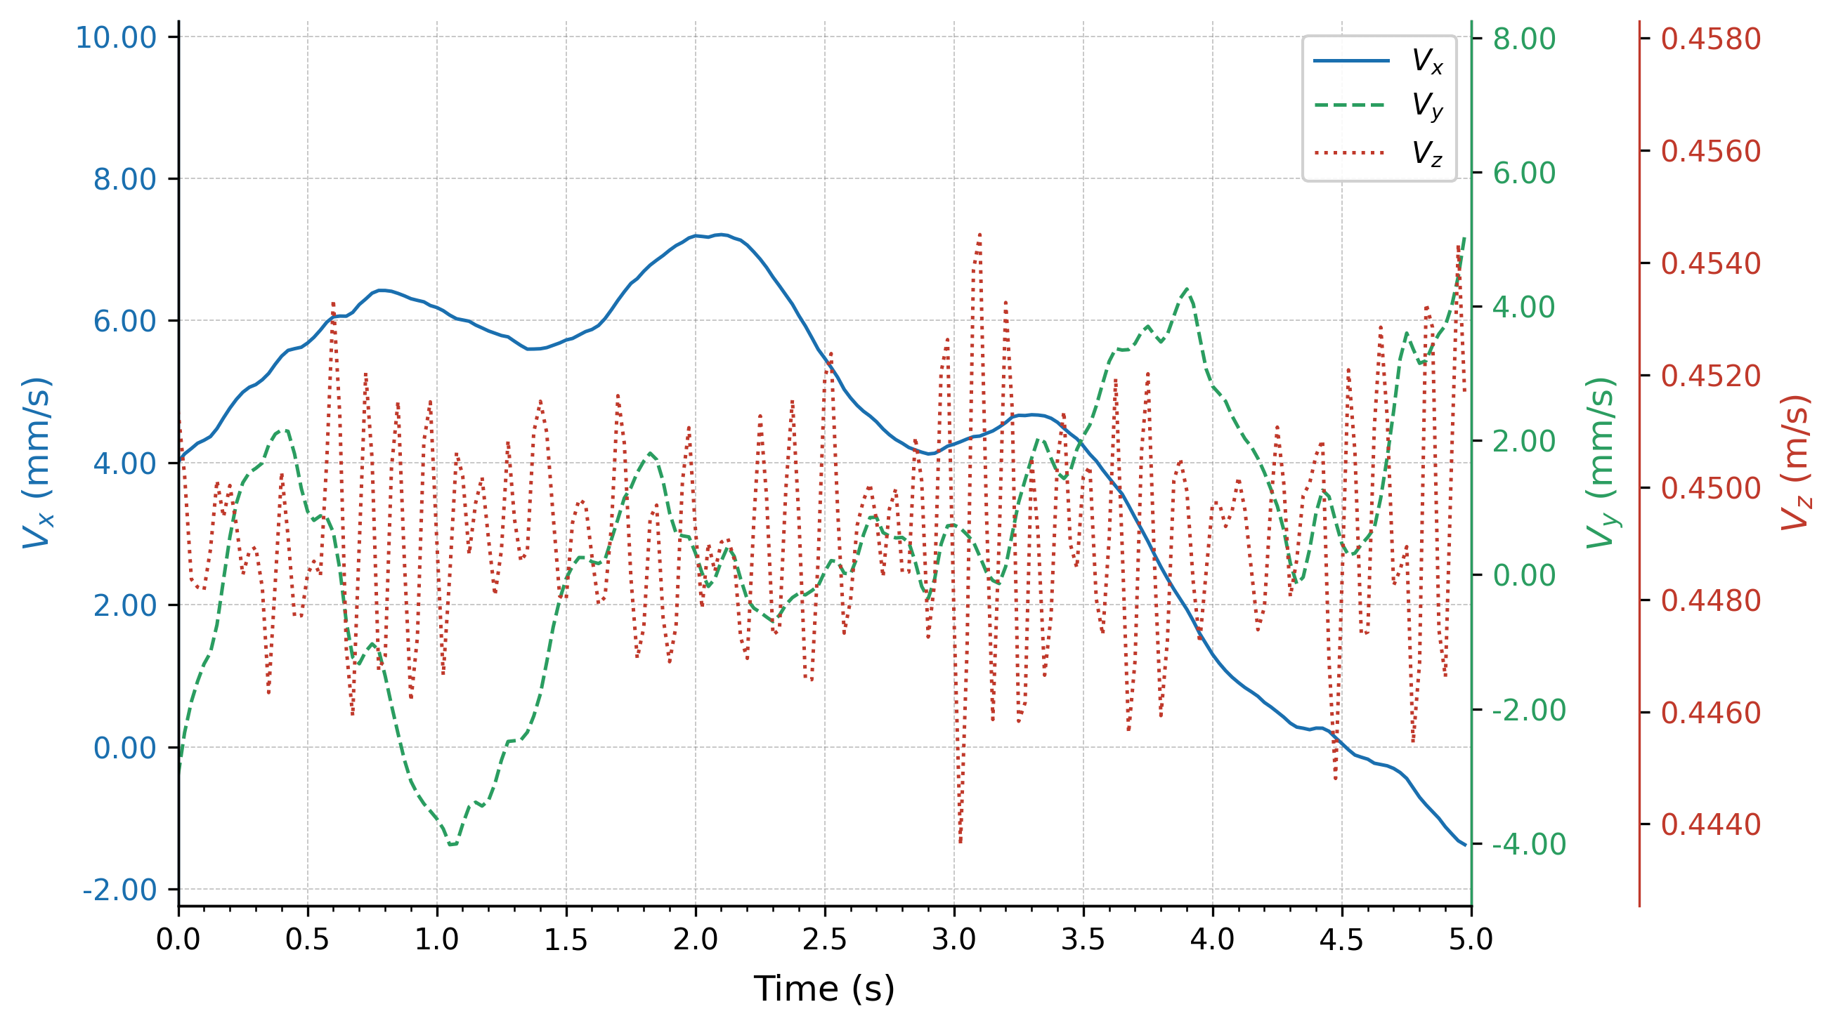
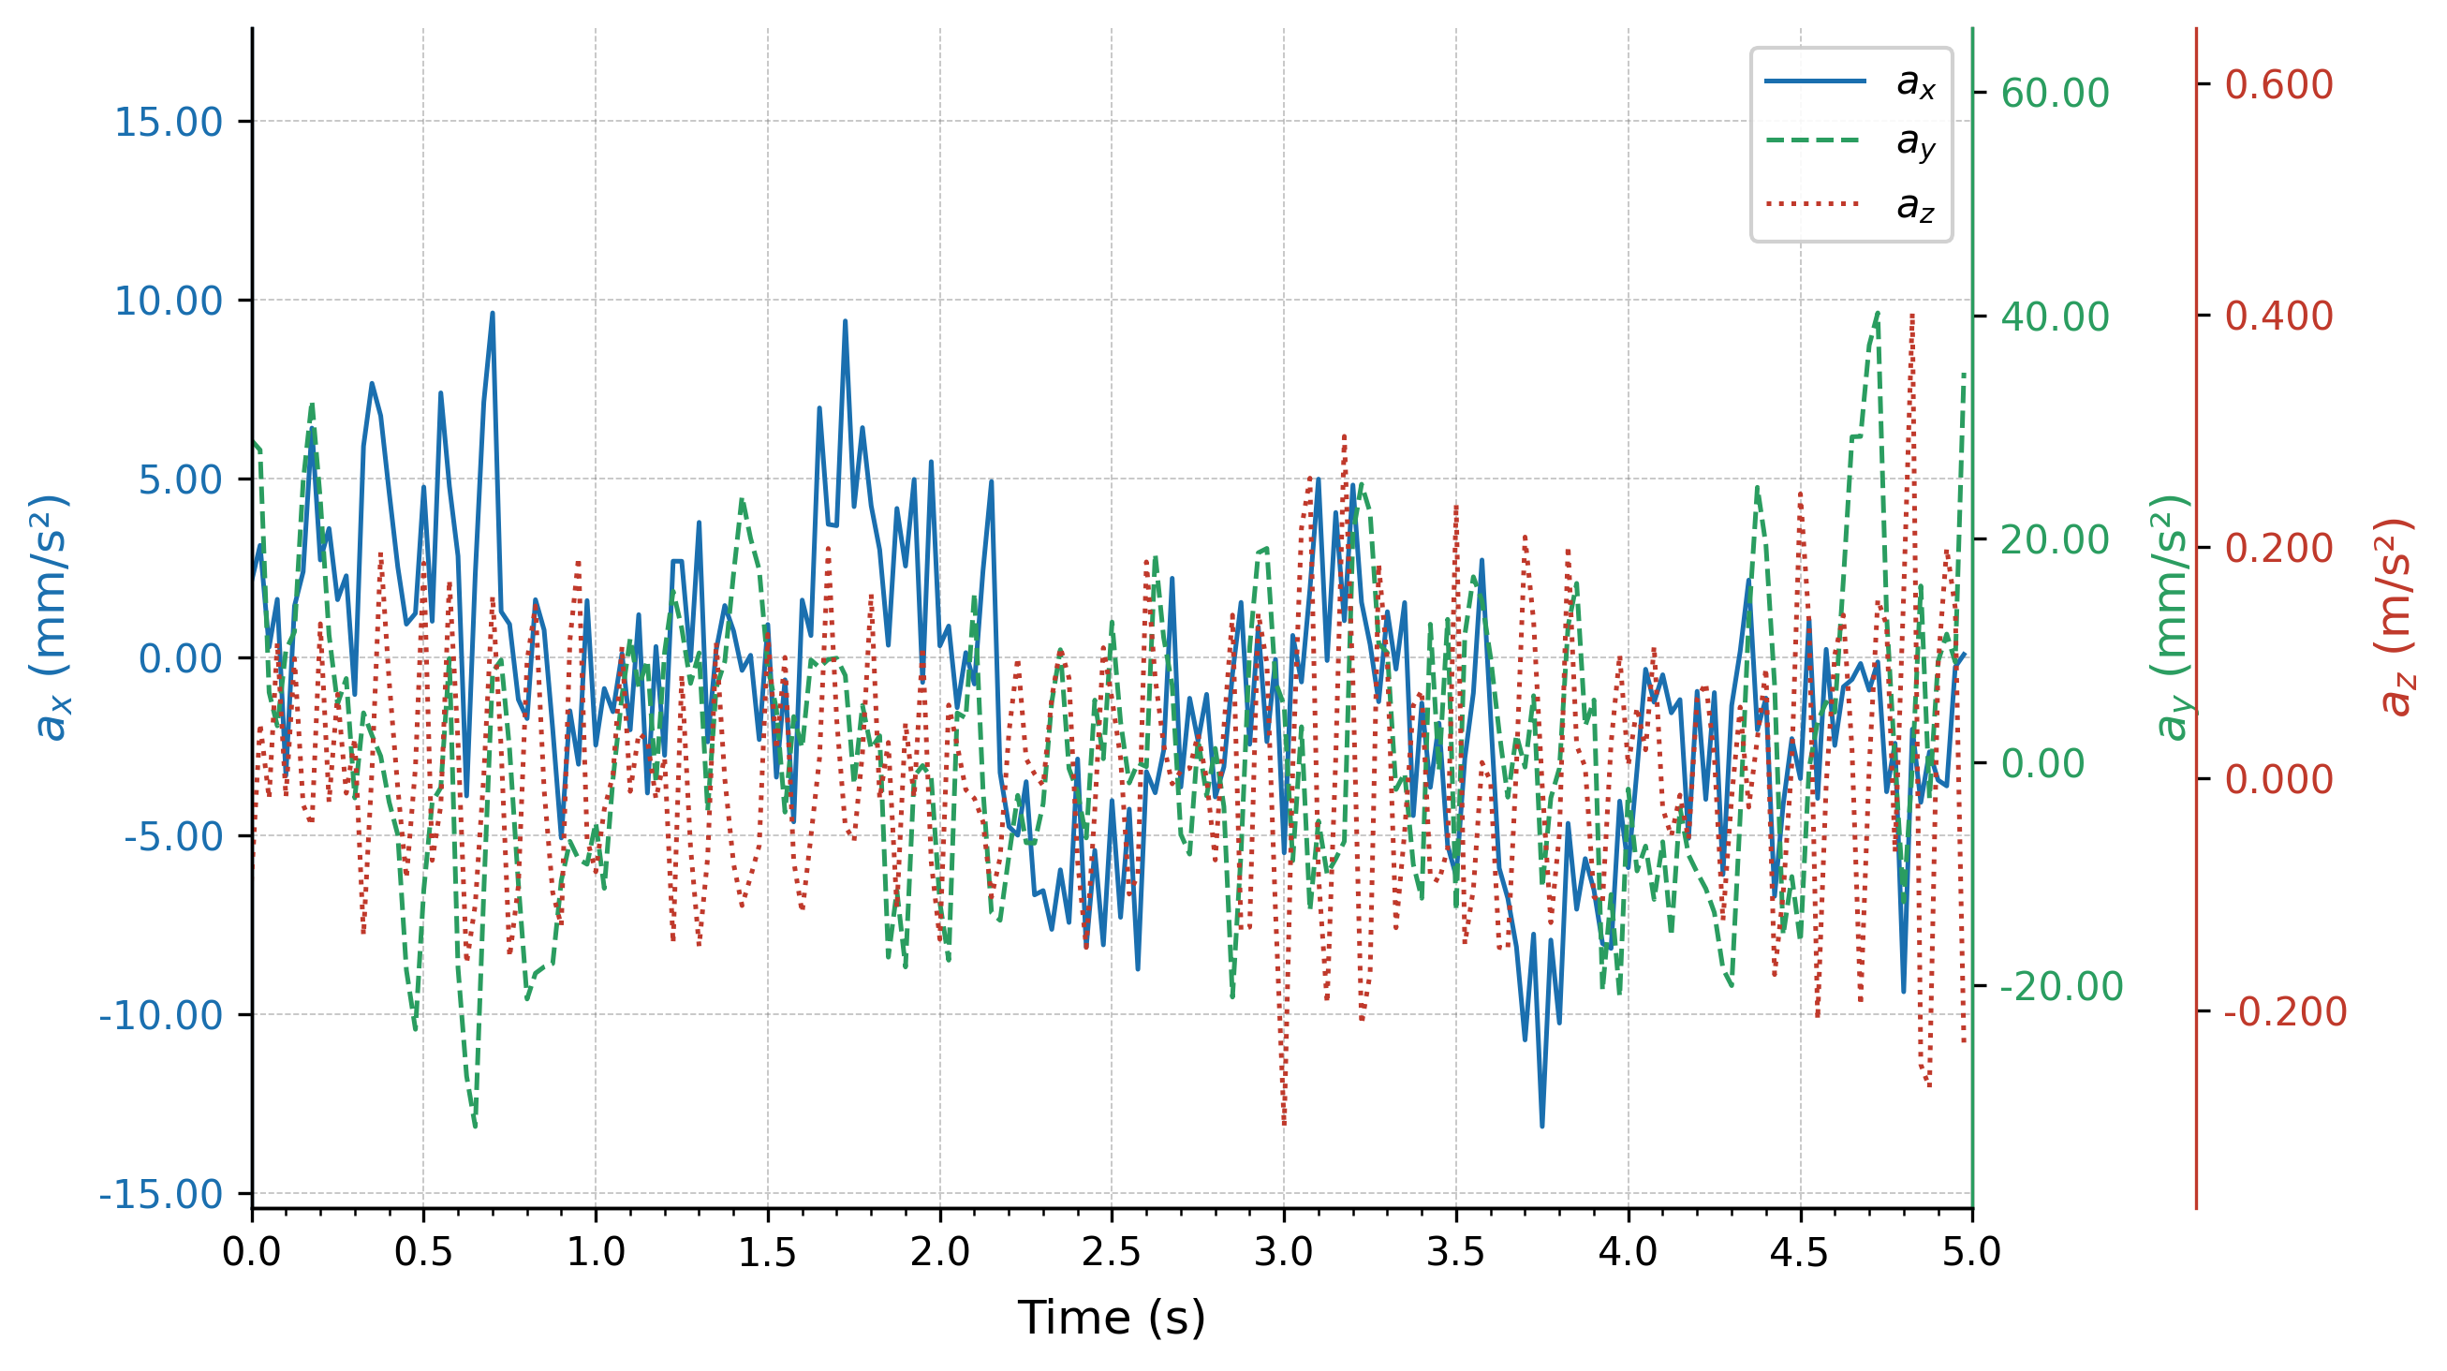
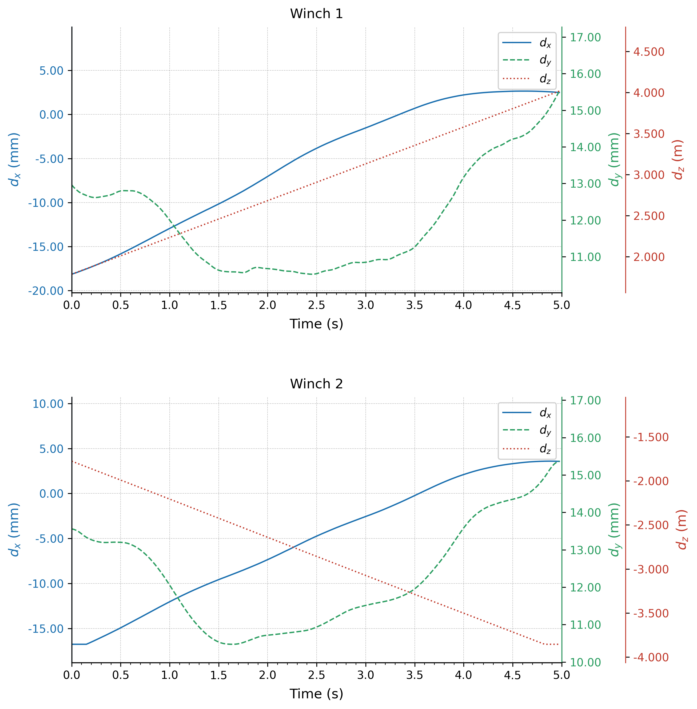
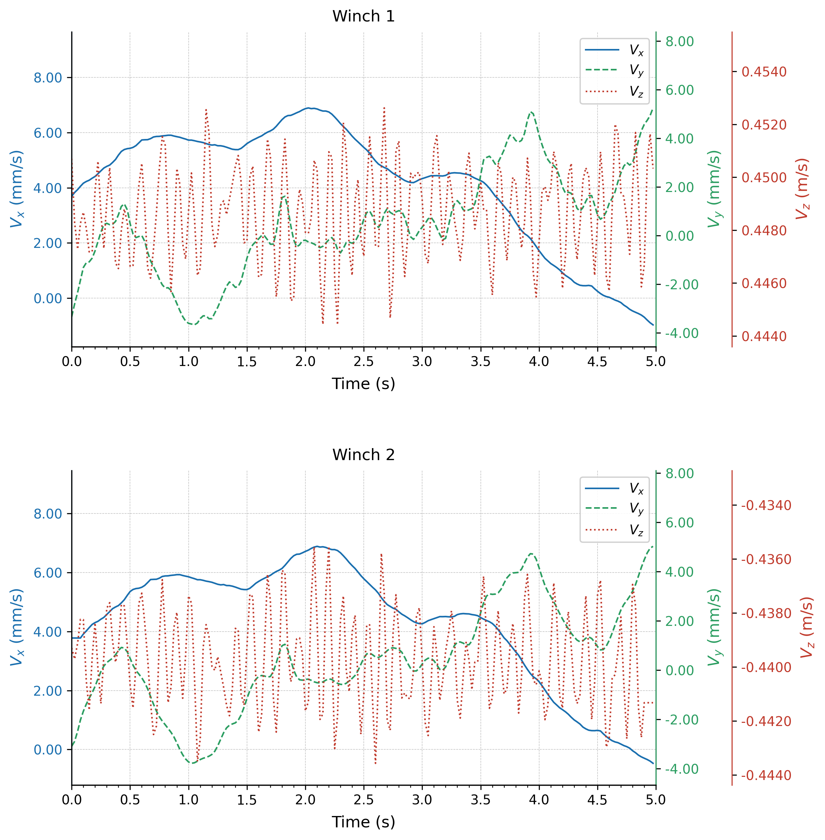
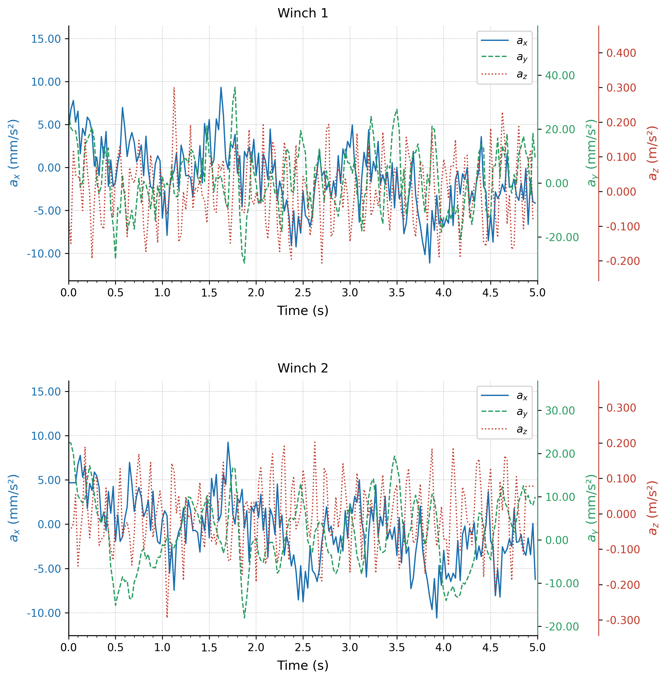
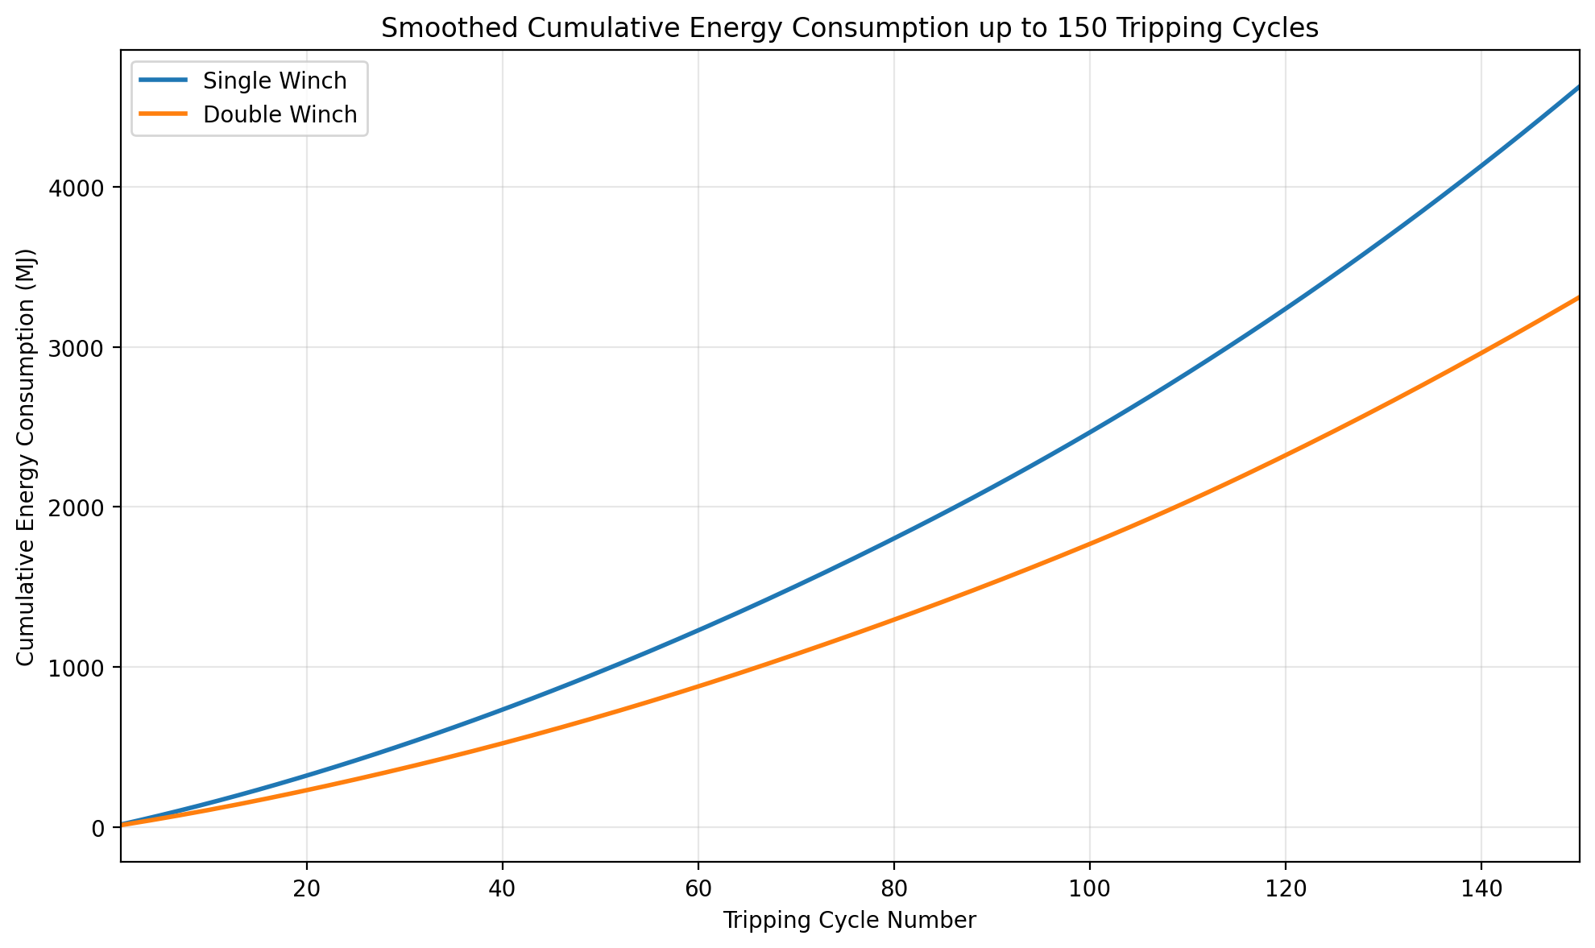
Conclusion
Dynamic response
XJ003
Continuous Self-Balancing Drilling Rig System
Hook Load (XJ003)
Project
Displacement
Velocity
Acceleration
Energy Consumption Comparison
The self-balancing dual-drawworks operating scheme exhibits more stable dynamic performance, lower energy consumption, and higher efficiency than conventional drawworks.

Slide 8
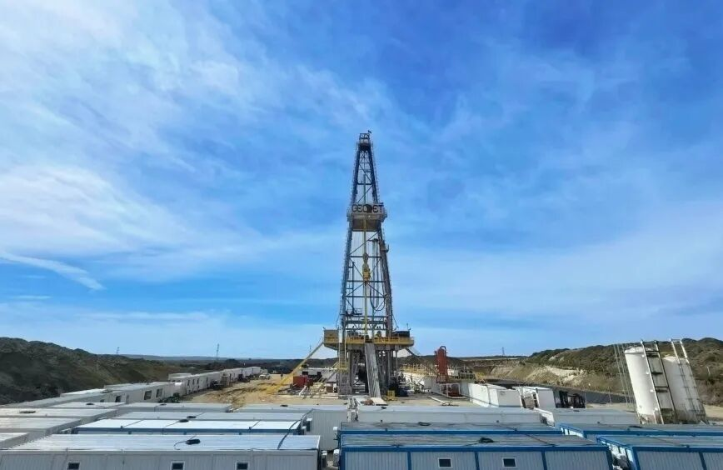
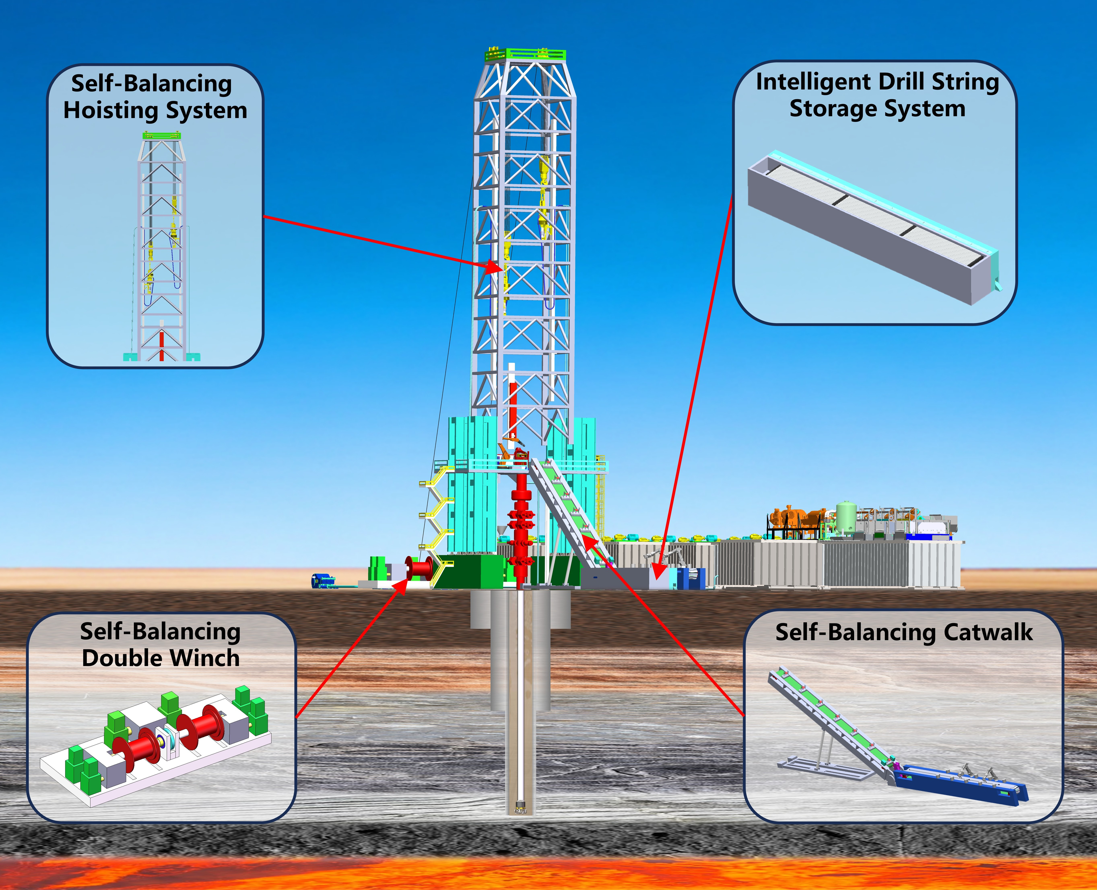
Outlook
The new rig design features lower operational and maintenance demands, reduced structural loading, greater running stability, and lower costs for manufacturing, operation, maintenance, and upgrading. In theory, it can comprehensively improve drilling efficiency, significantly reduce operating costs, and further decrease rig energy consumption.

Slide 9
European Geosciences Union General Assembly EGU26
Thank you for your listening
weisong24@mails.jlu.edu.cn

