Slide 1











UK-Flow15: Sub-hourly river flow data observations from 1369 river gauges in the UK, 1948-2023
Felipe Fileni, Hayley J. Fowler, Elizabeth Lewis,
Fiona McLay, Gemma Coxon, David Archer,
Emma Bruce, Longzhi Yang, Matt Fry,
Hollie Cooper, and Ollie Swain
abstract and information

Slide 2
Why Visit UK-Flow15?
Title slide + QR abstract
Build it
I’m Interested in producing high-resolution flow datasets.
Use it
I Want to use 15-min flows for scientific outputs.
Apply it
I’m Curious how it informs policy and decisions.
Explore it
This presentation just caught my attention, and I want to know more about it.

Slide 3

Home
Data suitability
Artefact removal
Hydrological modelling
Event study
Extreme study
Access to high-res data matters!
Real-world impact of the data
Getting started
Inside the data
Dataset coverage
Dataset Structure
Visual Quality Control
Statistical Quality control
Planned updates
Using the data
Why it matters
Why build it?
How long did it take?

Slide 4
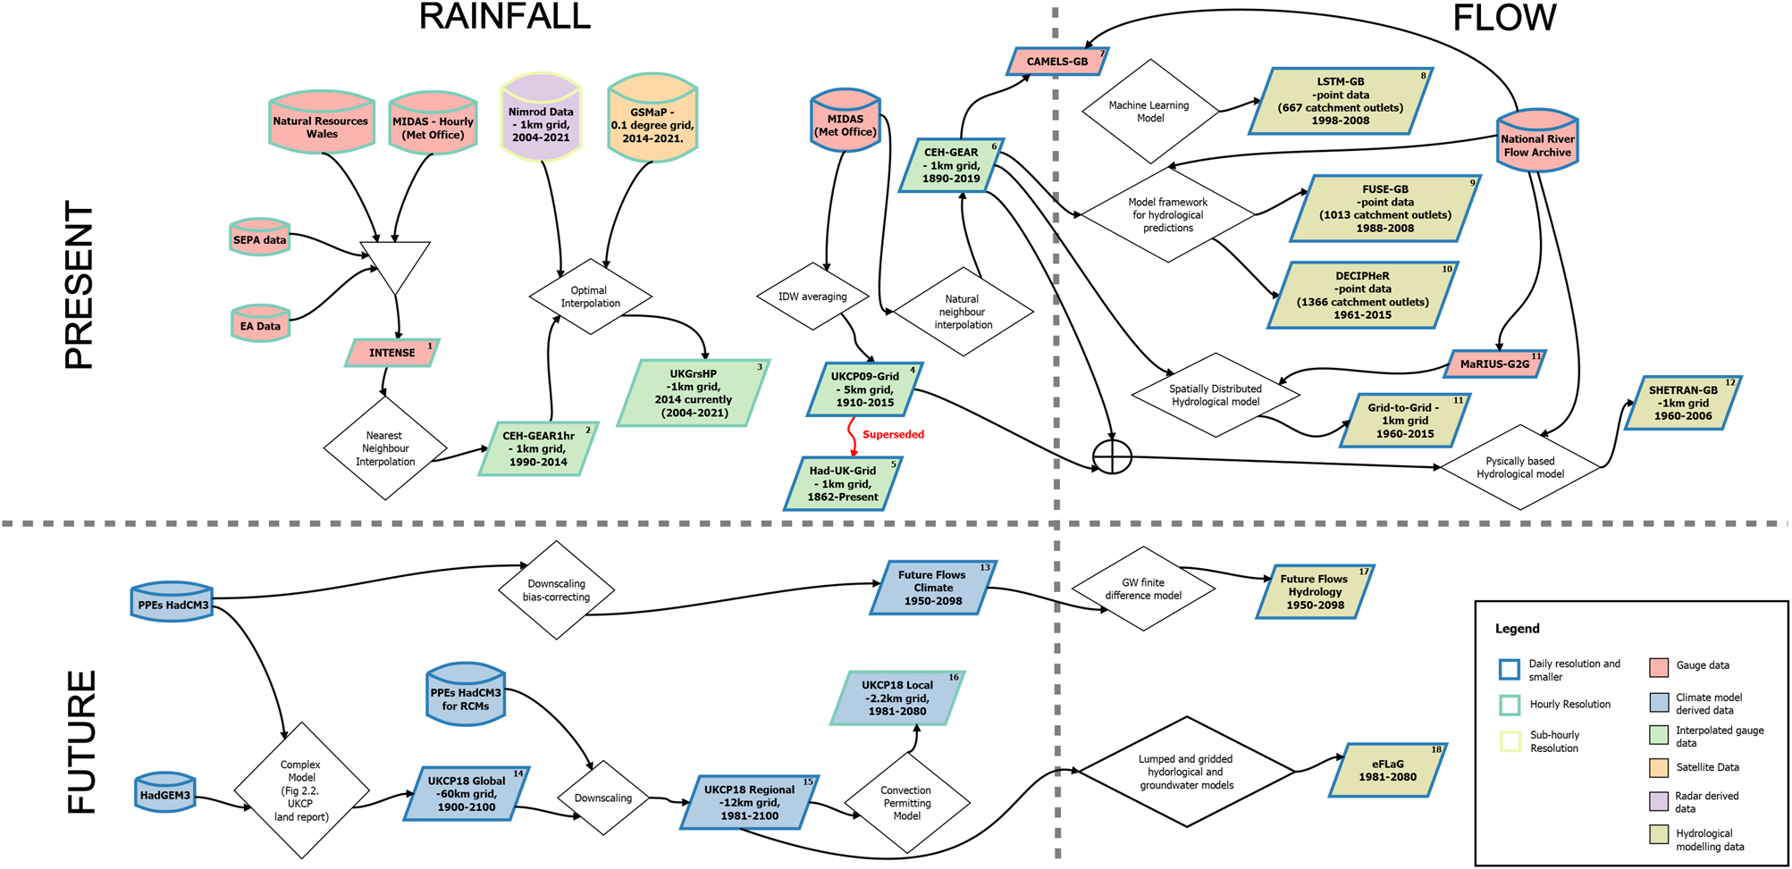

Why build a 15-min dataset?
Home
Explore it!
Build it ->
A summary of UK datasets in 2022…
Sub-daily flows nowhere to be found!
(Fileni et al. 2023)

Slide 5
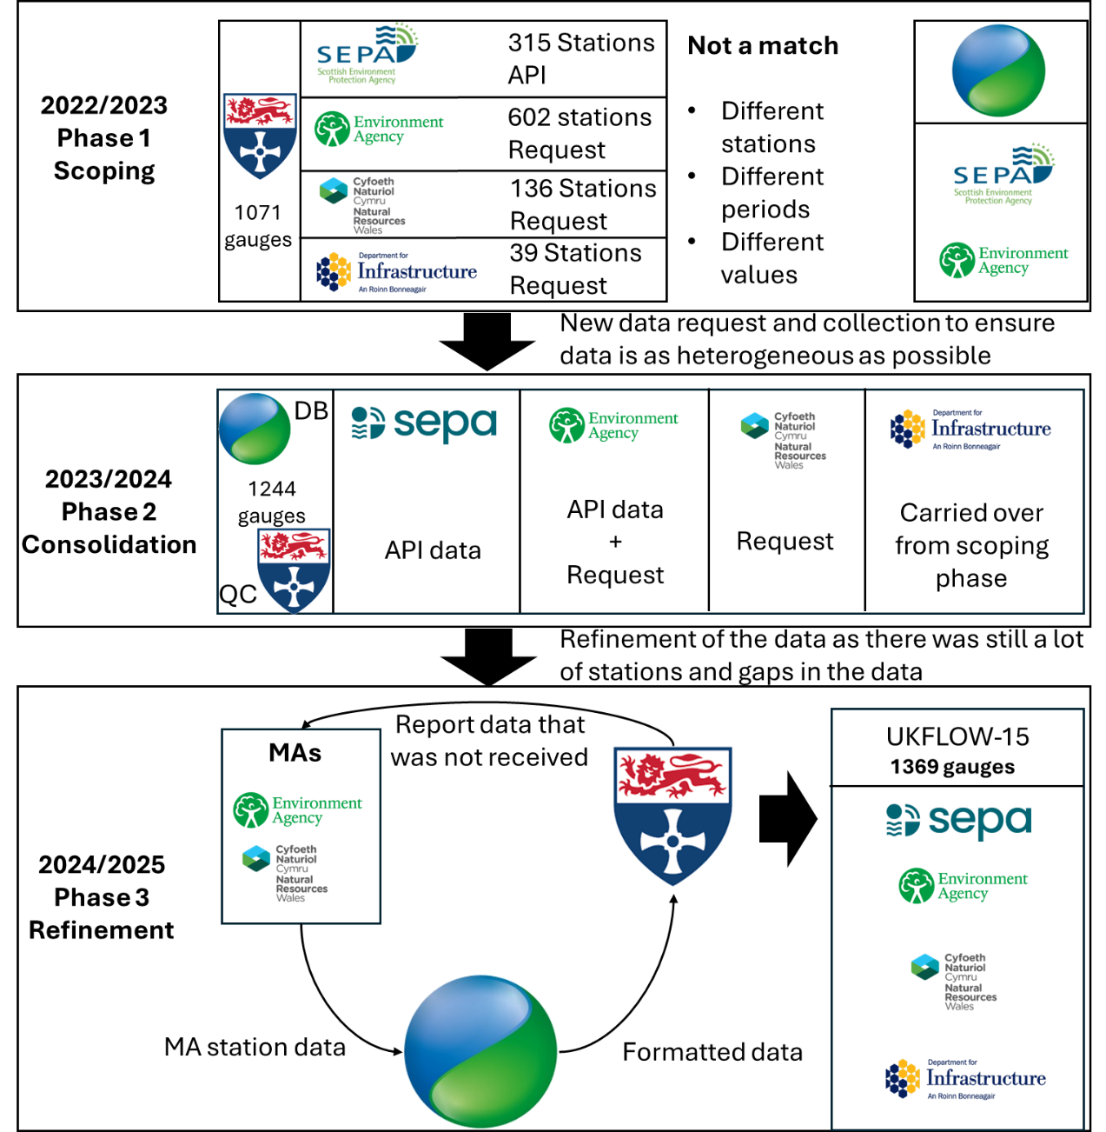
How Long did it take?
Home
Explore it!
<- Build it
Build it ->
a scoping phase, in which we explored which data were available and valuable;
a consolidation phase, where the dataset was organised into a semi-final version;
a refinement phase, during which the dataset was further improved and additional data incorporated

Slide 6
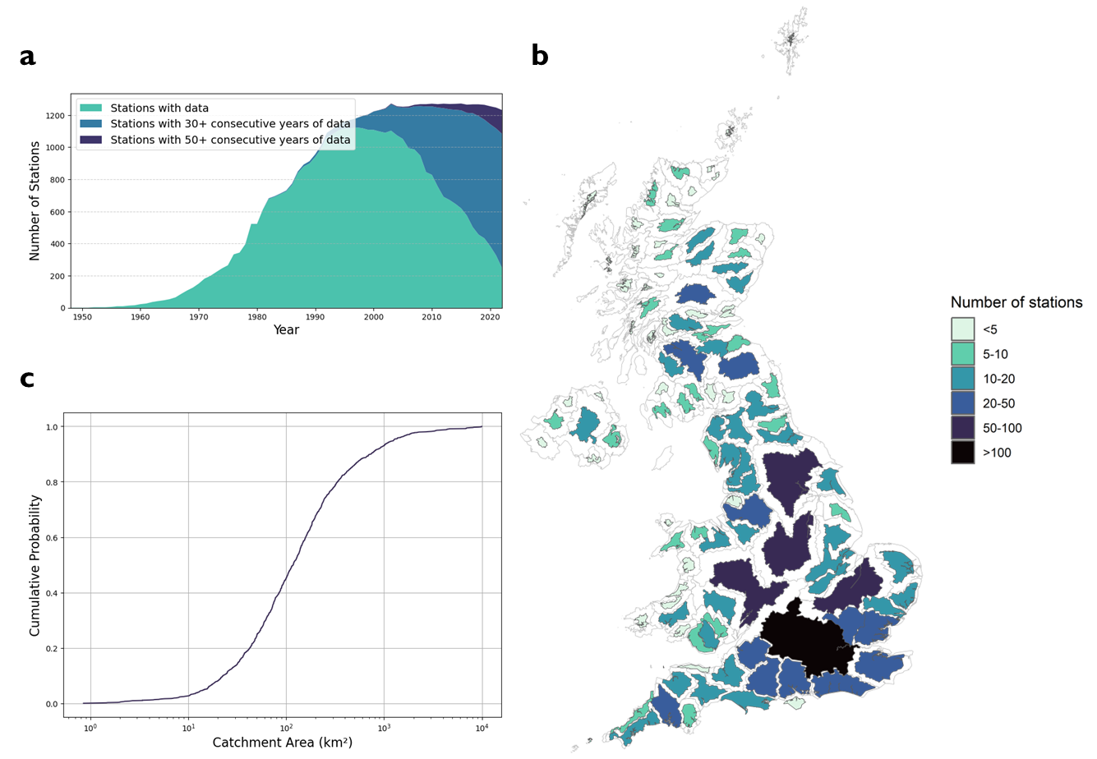


Dataset coverage
Home
Explore it!
<- Build it
Build it ->
Use it->
1369 stations
1.8 billion observations
Earliest record: 1948
Largest catchment: 9948km2
Smallest catchment: 0.85km2
Paper
Data
(Fileni et al, in review, a)
(Fileni et al, 2025,a)

Slide 7
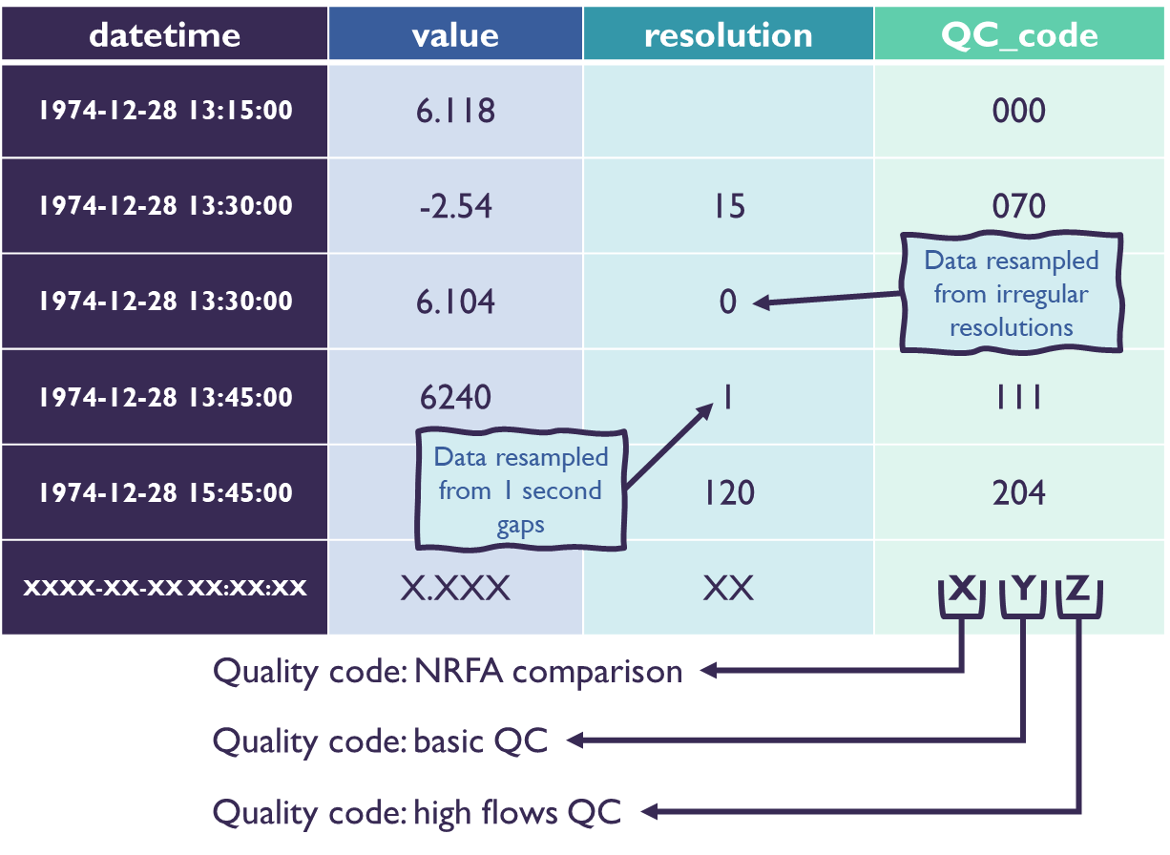
Dataset structure
Home
Explore it!
<- Build it
Build it ->
<- Use it
Use it->
Time series (core data)
Datetime: timestamp
Value: river flow (m³/s)
Resolution: native data timestep
QC_code: outcome of quality control checks
Metadata (7 files for full transparency)
Identification metadata: station info, location, source
Quality control metadata: flags, checks, detected issues
Traceability metadata: full record of processing decisions
(Fileni et al, in review, a)

Slide 8
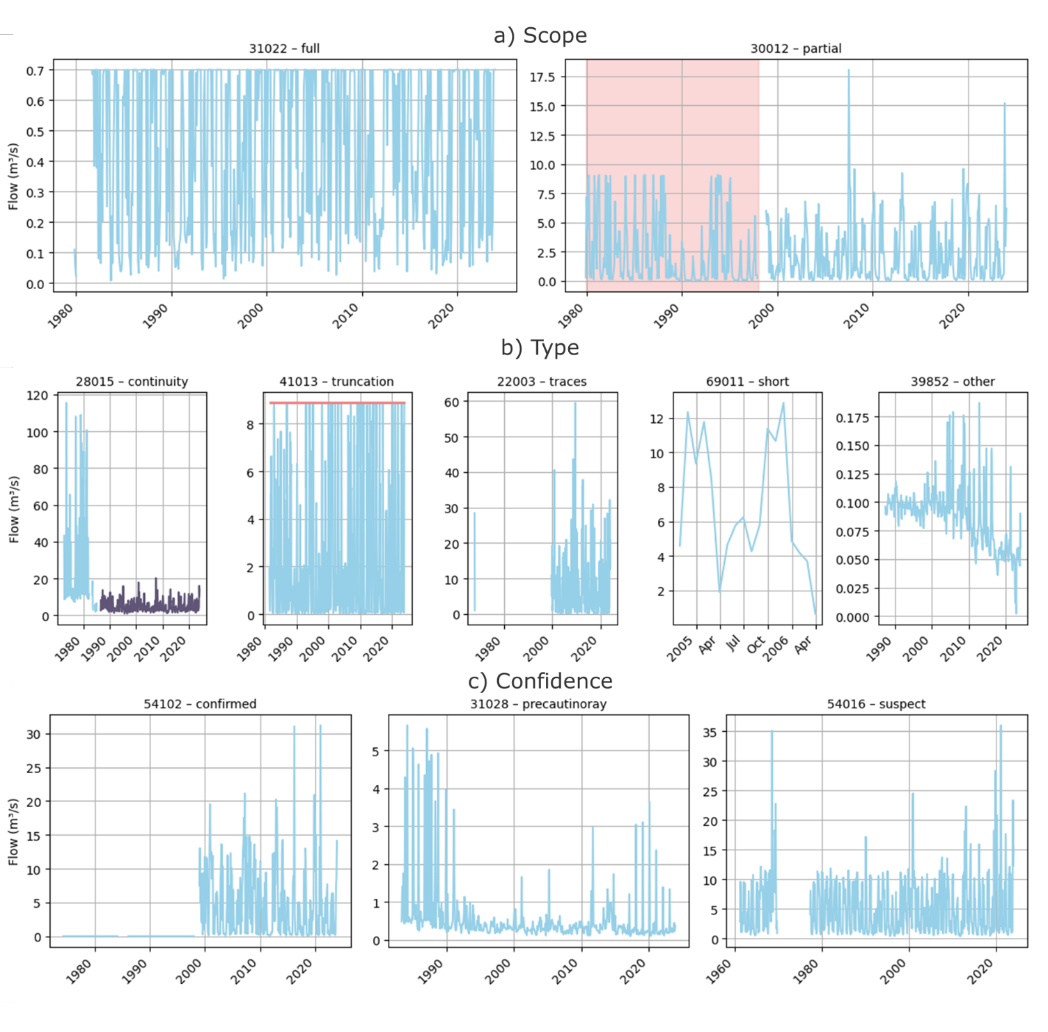

Visual Quality Control
Home
Explore it!
<- Build it
Build it ->
<- Use it
Use it->
Automated checks flag anomalies, but cannot always confirm their validity
Visual inspection helps distinguish real hydrological events from artefacts
Essential for identifying issues such as rating curve shifts, truncations, and timing errors
(Fileni et al., in review, b)

Slide 9
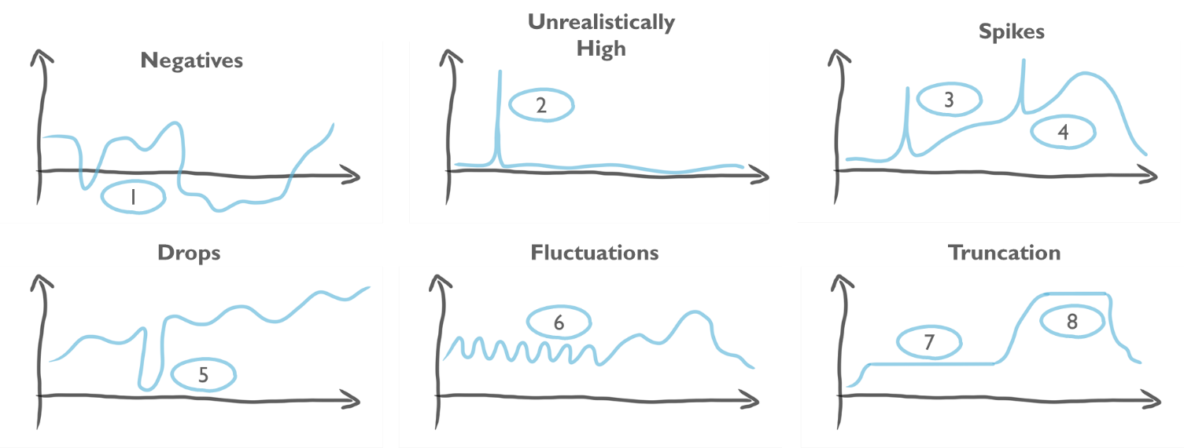

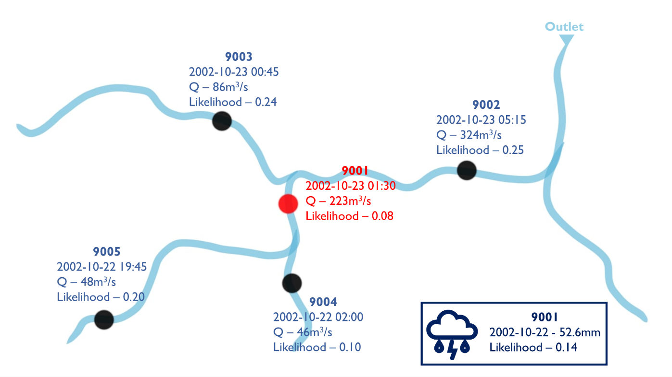
Statistical Quality Control
Home
Explore it!
<- Build it
Build it ->
<- Use it
Use it->
Paper
GitHub
(Fileni et al., in review, b)
(Fileni)
Automated statistical QC enables consistent, scalable detection of anomalies at national-scale datasets

Slide 10
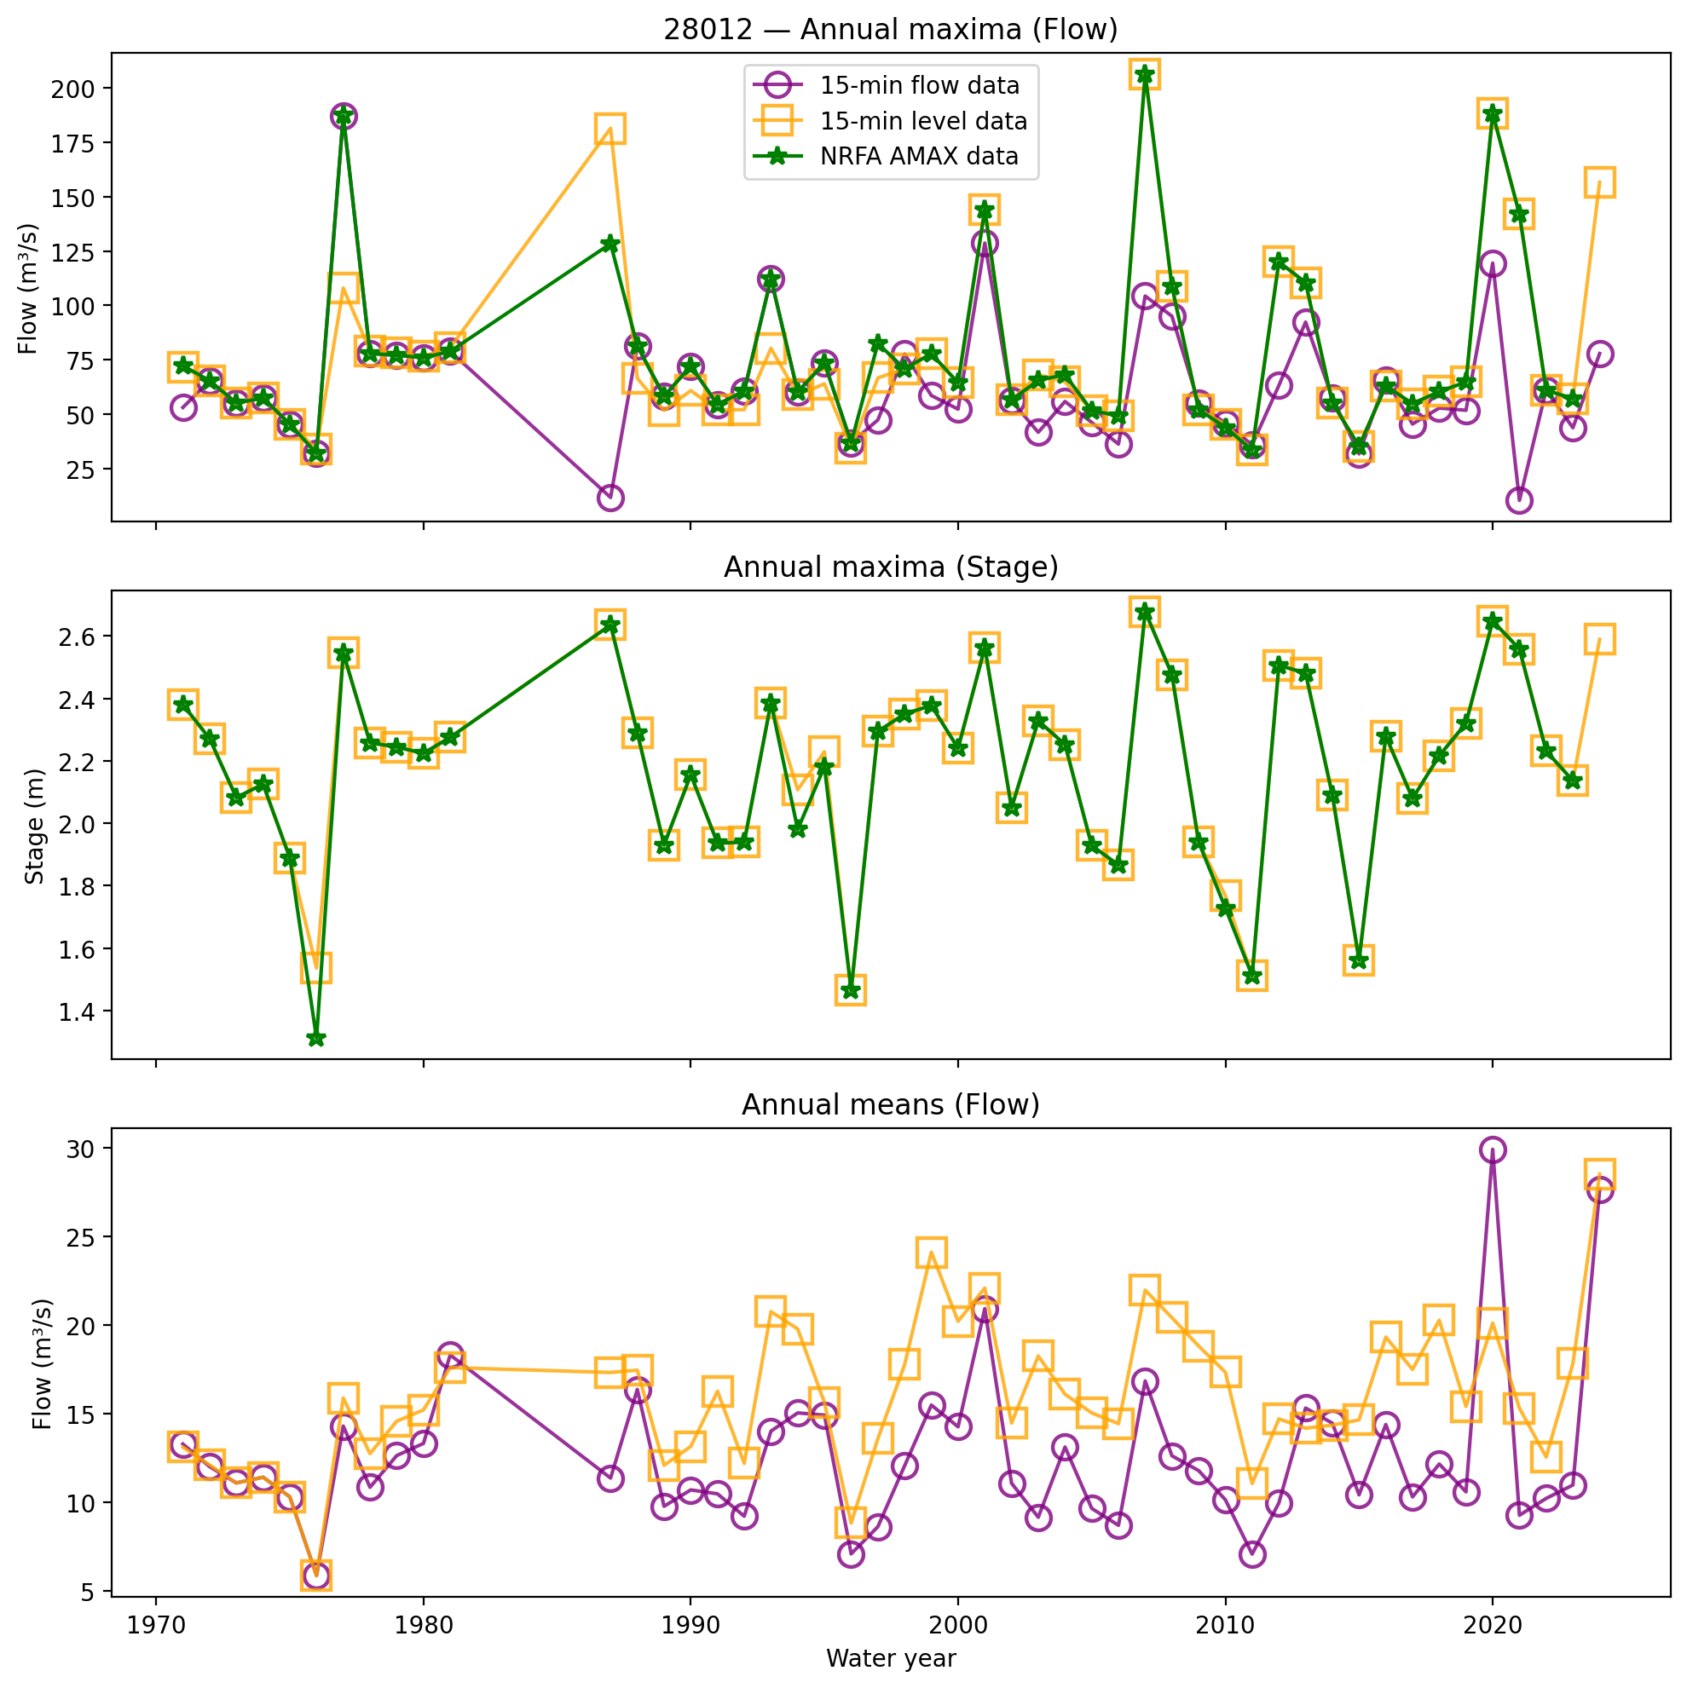
Planned Updates
Home
Explore it!
<- Build it
Build it ->
Data & Quality Control
Integration of level data in the dataset
Request of some of the missing flow stations/time periods
Update the dataset to 2025
Workflow Development
Ensure that we have a procedure in place for sporadic updates of the data
Further evaluation of automated QC

Slide 11
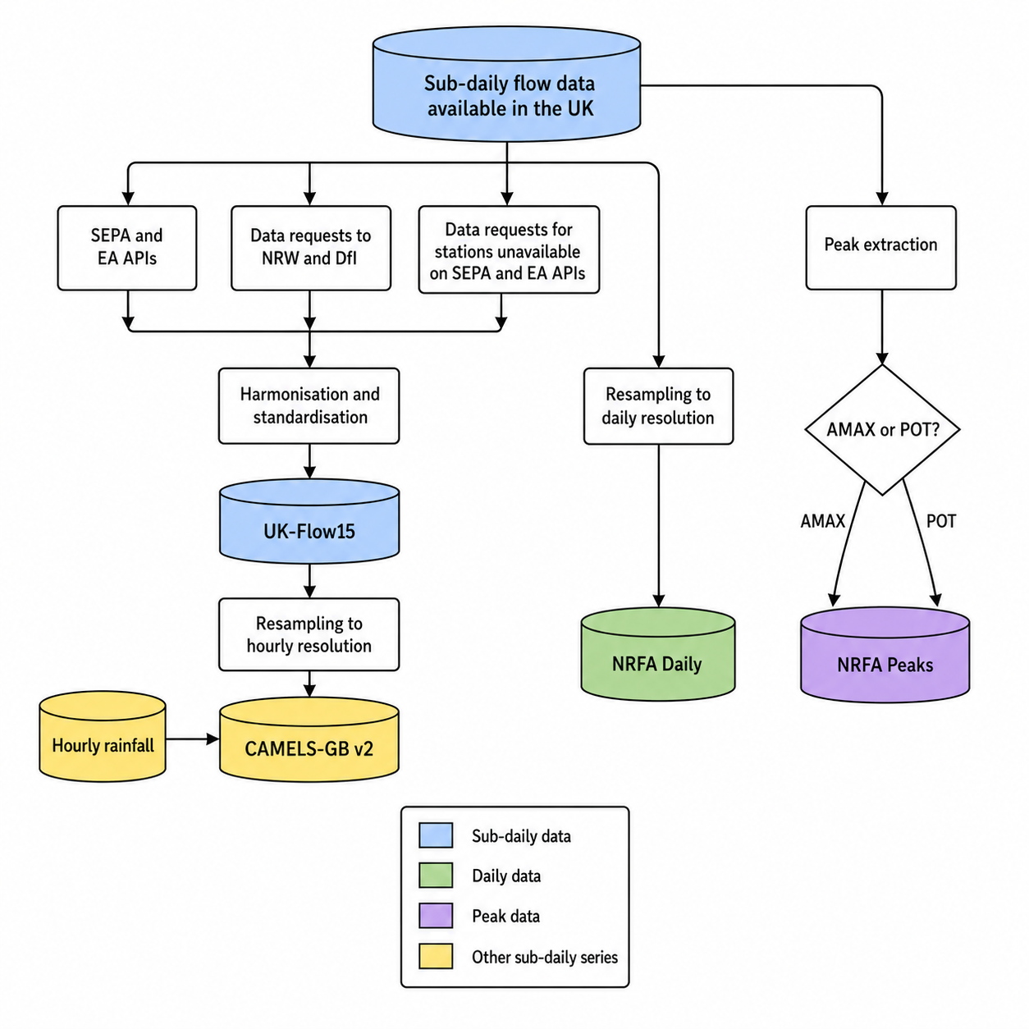
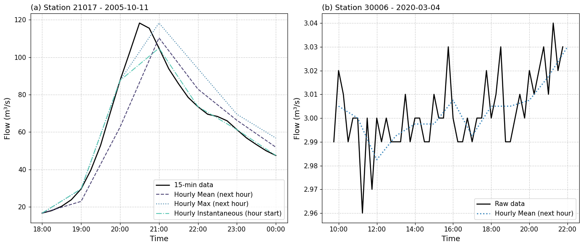
Data suitability
Home
Explore it!
<- Use it
Use it->
Which data to pick?
When do you need high resolution data?
High Flow in groundwater dominated catchment
High Flow in fast response catchments
vs

Slide 12
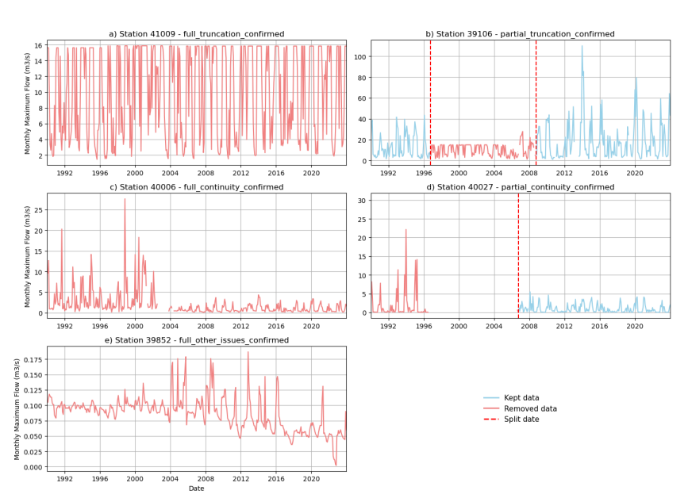

Artefact removal
Home
Explore it!
<- Use it
Use it->
UK-Flow15 data
Open access: all available data is provided to the user
User responsibility: data suitability depends on the analysis → filtering may be required
Transparent QC: data are flagged, not removed
Reproducibility: clear procedures provided for high-flow screening and filtering
Paper
Github
(Fileni et al, in review, a)
(Fileni)

Slide 13
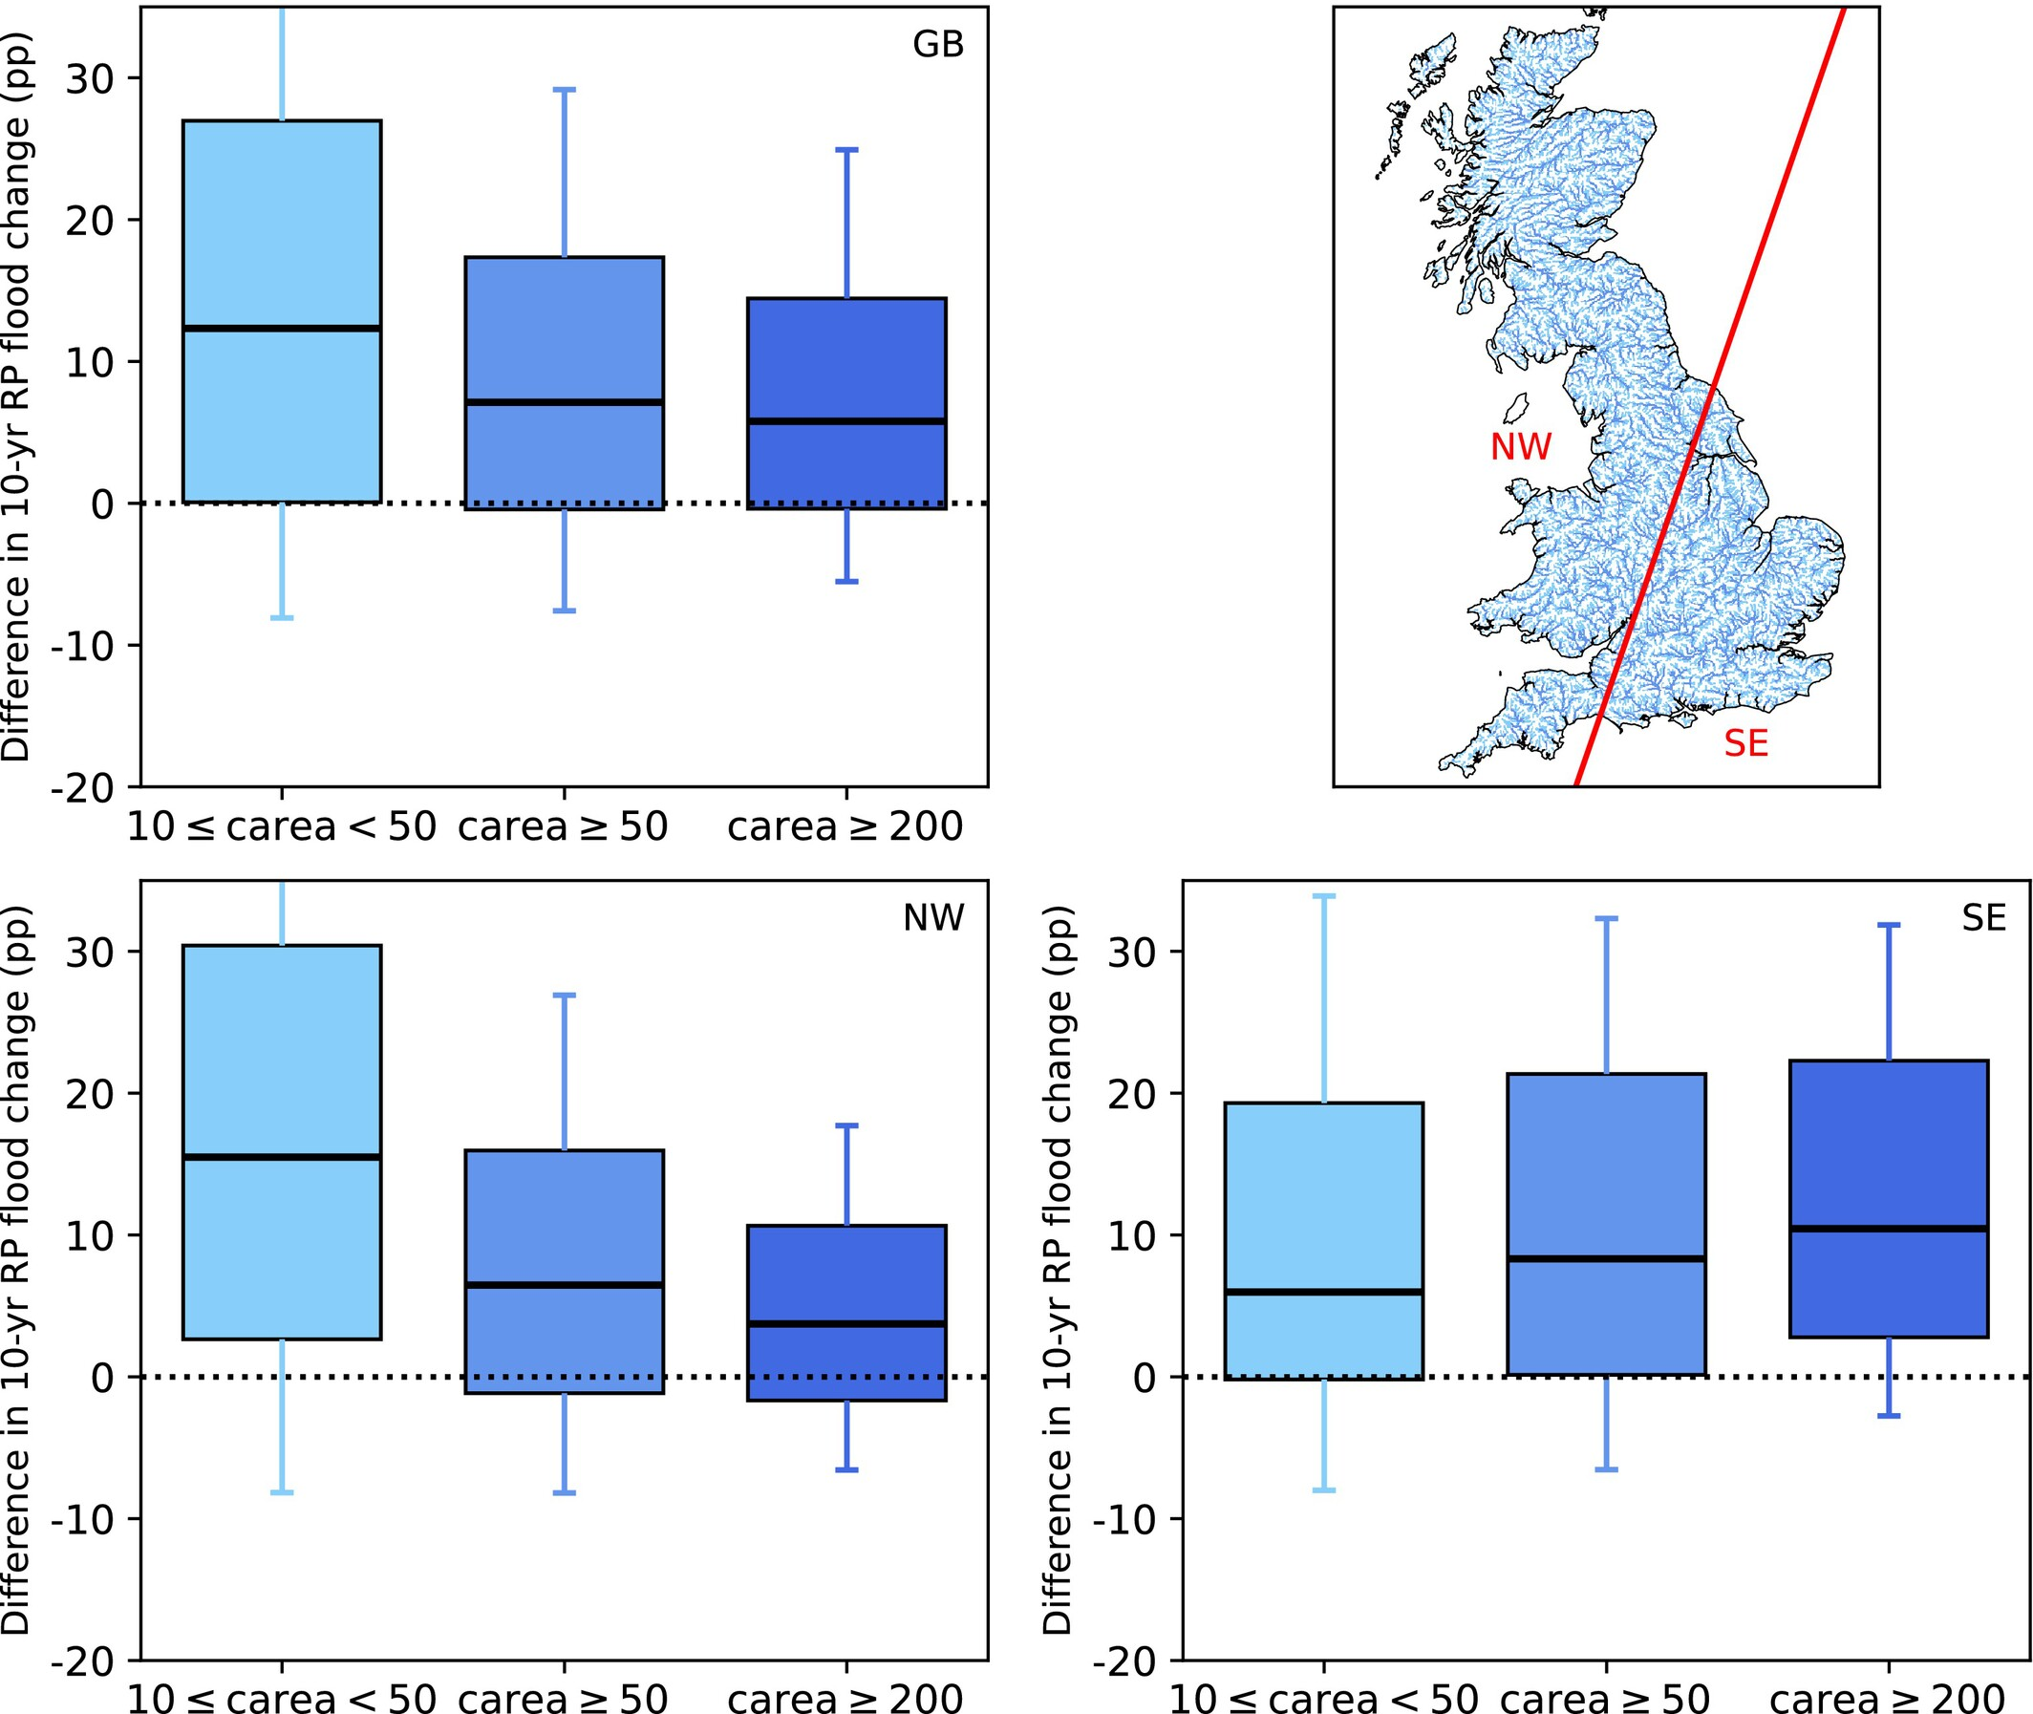

Hydrological modelling example
Home
Explore it!
<- Use it
Use it->
Apply it ->
Impacts of using sub-daily outputs for future-flood estimates:
Flood increases are consistently higher when models are calibrated at hourly resolution (median ≈ +11.8% at the 10-year return period)
The effect is amplified in smaller catchments (median ≈ +12% at 10-year RP)
The strongest increases occur in north-west UK, particularly for small catchments (median ≈ +16% at 10-year RP)
(Kay, 2026)

Slide 14
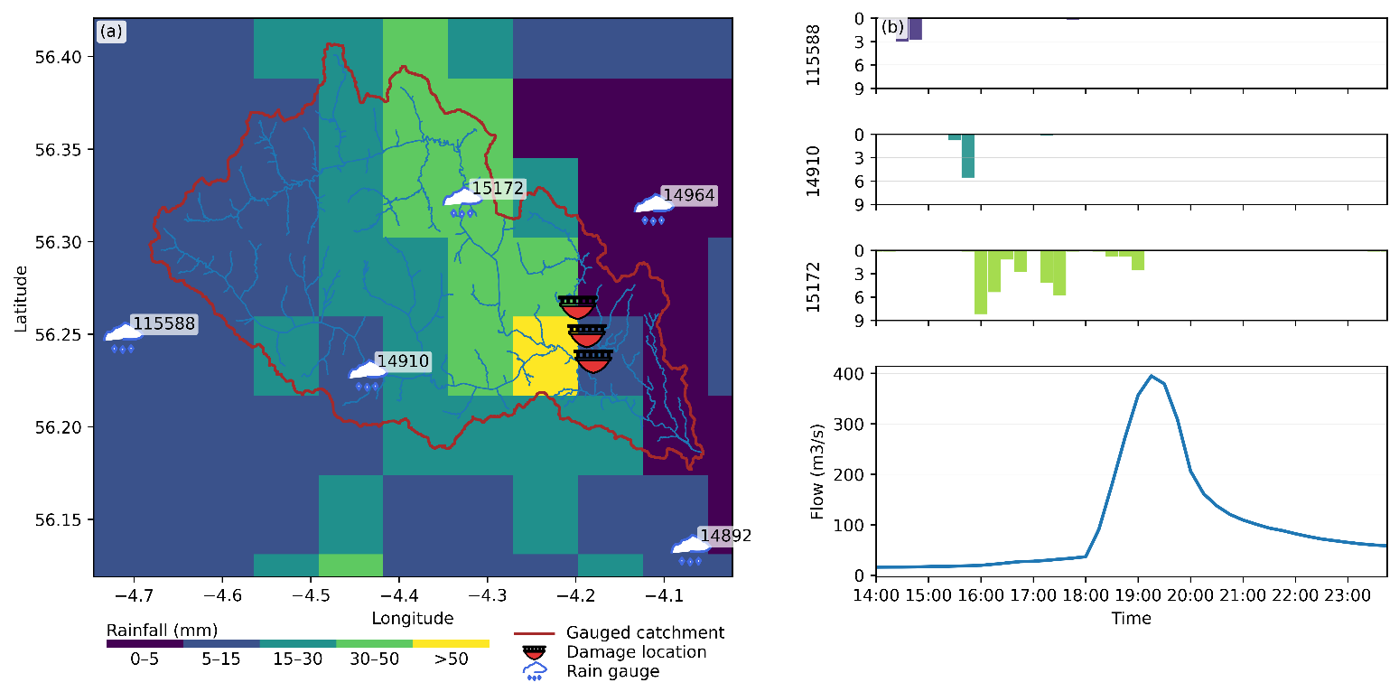
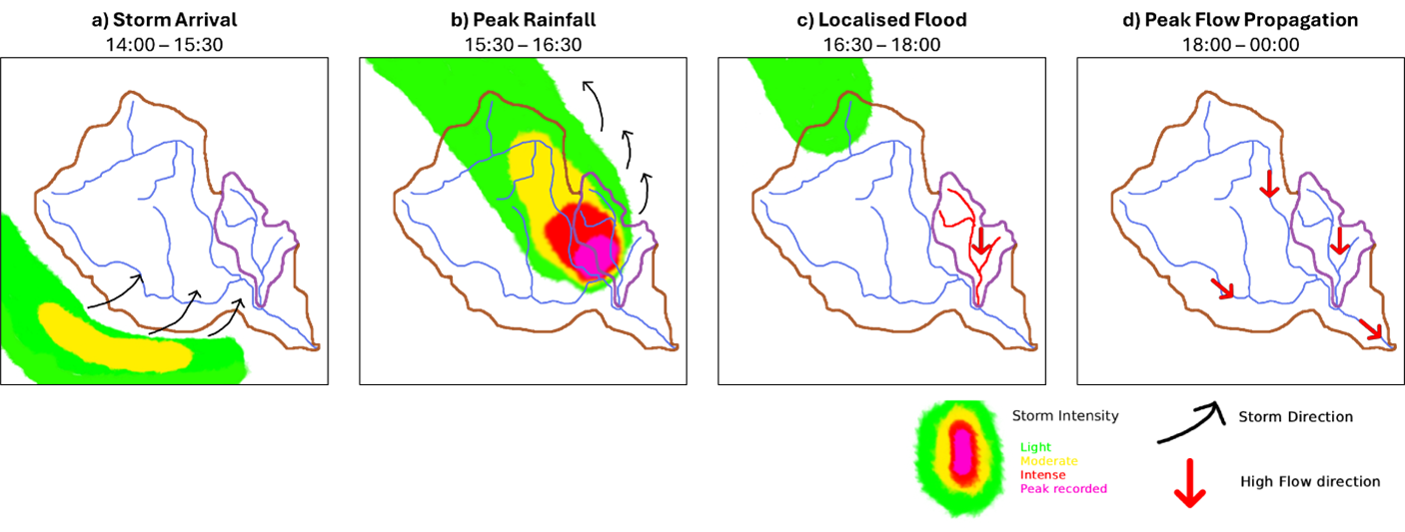
Event study example
Home
Explore it!
<- Use it
Use it->
<- Apply it
Apply it ->
High temporal resolution data captures rapid flood dynamics and impacts
Summer convective storms generate extremely fast, localised responses
Combining high-resolution rainfall and flow data enables reconstruction of the full event:
rainfall -> runoff ->damage
e.g. Keltie Burn, 2004
(Archer et al., submitted)

Slide 15
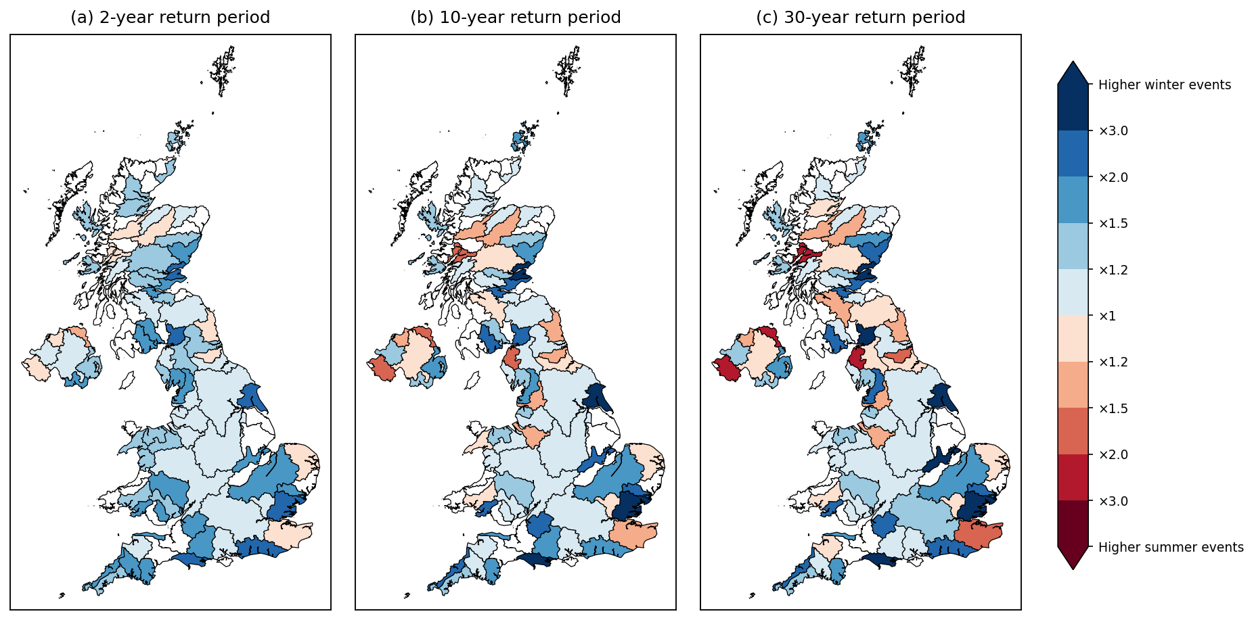
Extremes study example
Home
Explore it!
<- Use it
Use it->
<- Apply it
Apply it ->
15-min data:
Captures short-duration, high-intensity events driving summer extremes
Reveals seasonal shifts in flood-generating processes
Avoids underestimation of extremes seen in daily datasets
(Fileni et al., submitted)

Slide 16
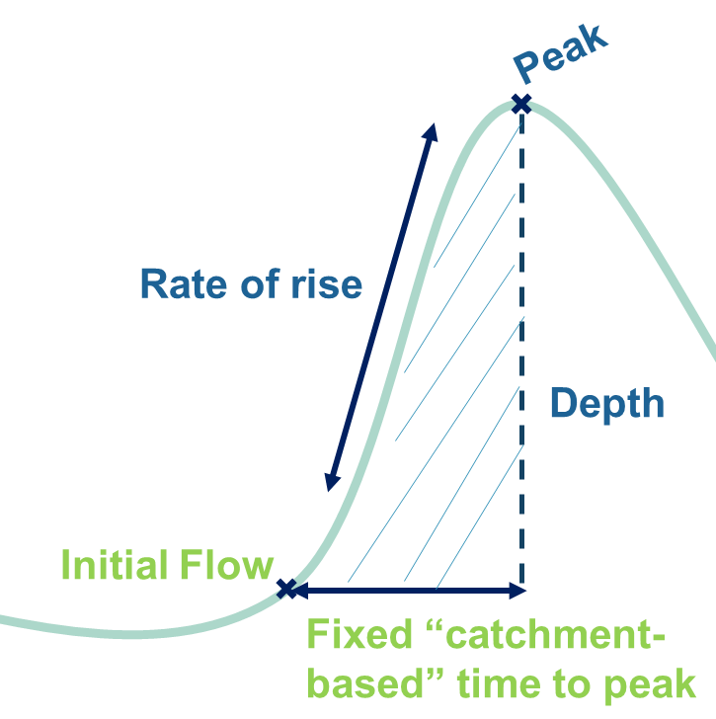
Access to high-res data matters!
Home
Explore it!
<- Apply it
Apply it ->
Unlocks the representation of real flood dynamics
Peak Datasets: Capture only the peak events without representation physical processes within the catchment
Daily datasets: Underestimation of events on mesoscale catchments which need higher resolution data for flood wave representation

Slide 17

Real-world impact of the data
Home
Explore it!
<- Apply it
Apply it ->
Sub-daily flows were one of the missing pieces for updating the guidelines for flood risk assessments under climate change in the UK.
adapted from (Fileni et al, 2025b)

Slide 18
Summary on how we built the dataset
Home
Explore it!
<- Build it
Scope & data collection
Identify user needs
Gather available data
Building a consistent dataset
Checking the structure of collected data
Harmonisation and standardisation
Identifying shortcomings of the data
Leads to
Nevertheless, it’s needed
Quality control framework
Visual verification of the data for artefact detection
Automated anomaly detection
Transparent flagging for communication
Which requires
to understand that a dataset will never be perfect…
… and that there’s always scope for an update if there’s demand.

Slide 19
Summary on how to use the dataset
Home
Explore it!
<- Use it
1) Check suitability
Do you need that high of a resolution?
Do you need a continuous series?
Do you need flows only (or also other products)?
The dataset
UK-wide coverage
Simple timeseries csv format
Rich metadata available for full context
Before use
Used in
2) Clean the data
Use metadata to identify and exclude unsuitable data for your specific analysis
Case studies
Hydrological modelling
Flood event studies
Large sample extremes
Data ready for use!

Slide 20
Summary on the applicability of the dataset
Home
Explore it!
<- Apply it
High resolution data improves
Hydrological Modelling Better calibration of models at event scale
Statistical analysis
Ability to capture and represent flood event dynamics
Climate change
Ability to capture the sub-daily flood intensification within the years
Reducing Uncertainty
Better estimation of extreme events
Better representation of climate change
By
Leading to
Impact on Practice
More robust flood risk estimation guidelines
Improved design flood estimates
Enhanced flood resilience

