Slide 1
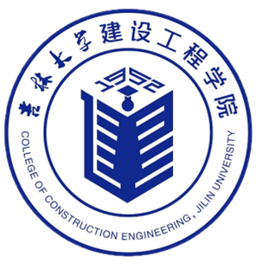



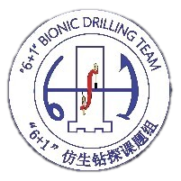

European Geosciences Union General Assembly EGU26
Design and Experimental Study of an Ultra-Long Drill Pipe Transfer System for Efficient Continuous Operations in Resource Development
Prof.Dr. Ke Gao
Key Laboratory of Complex Conditions Drilling and Production Technology of the Ministry of Natural Resources,
College of Construction Engineering, Jilin University
May 5th, 2026

Slide 2
  Outline
1
  Background
2
  Method
3
  Conclusions

Slide 3
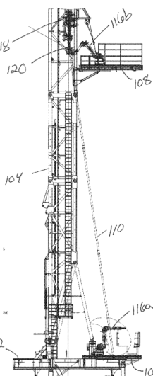
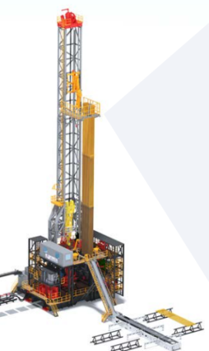
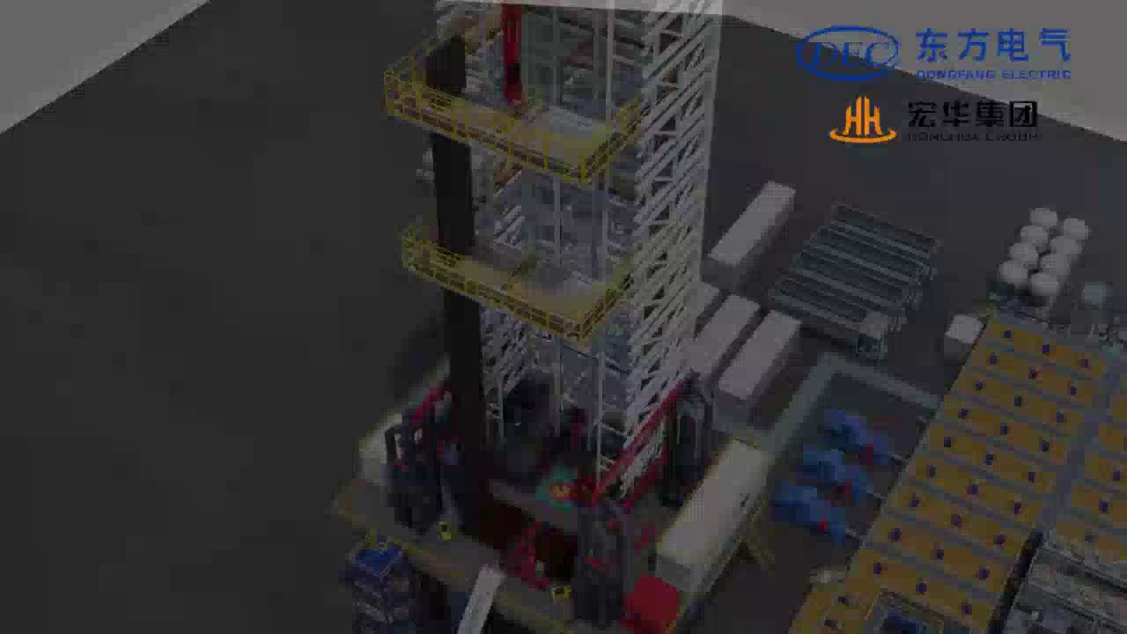
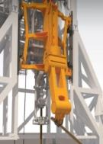
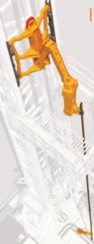
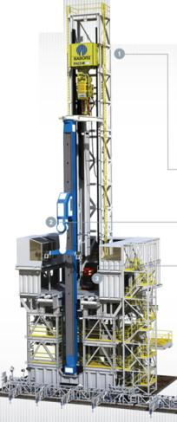
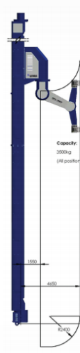

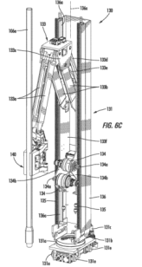
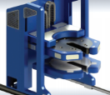
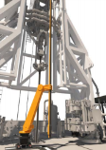
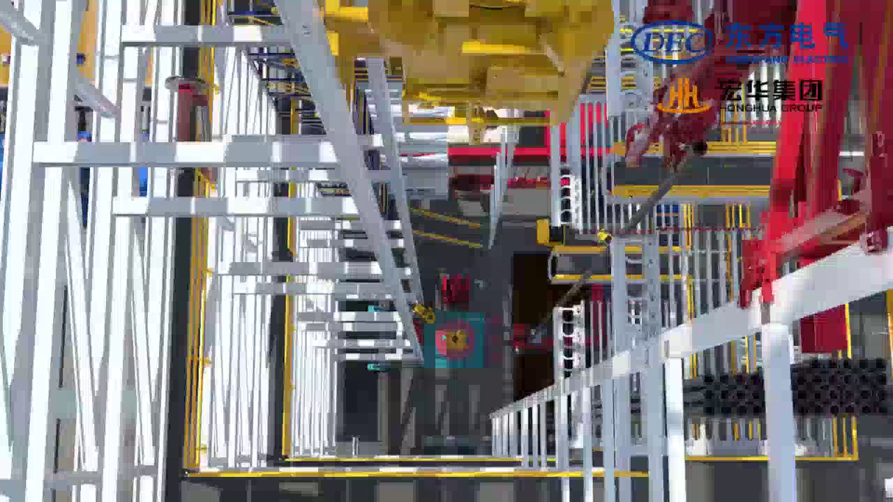
  Background
Against the backdrop of sustainable development and the demand for high-efficiency drilling, frequent coring and tripping operations in ultra-deep scientific drilling result in low wellhead operation efficiency. To achieve faster tripping, a high-efficiency handling system suitable for extra-long string needs to be designed.
Wireline Coring Operation
NOV
Drillmec
NABORS
Features of the Current String Handling System：
The existing system features a low degree of automation and insufficient precision and accuracy；Low tripping efficiency；High labor intensity.
Tripping Operation

Slide 4
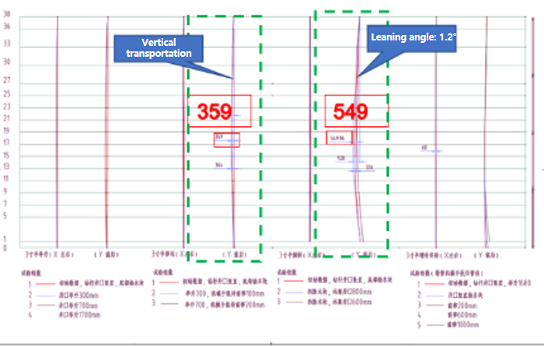
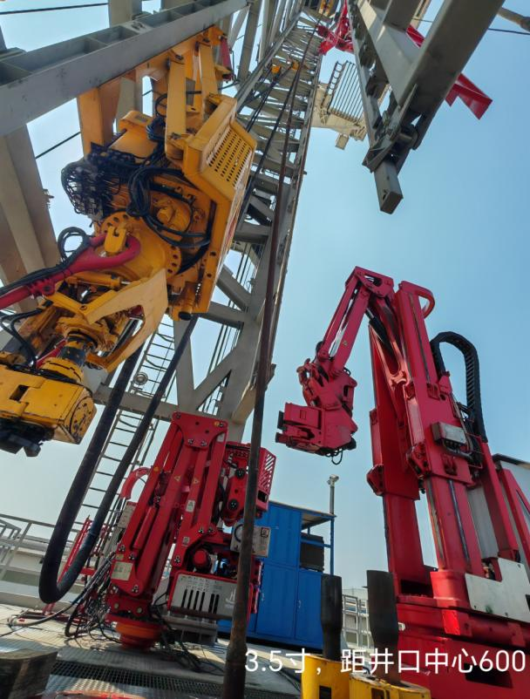
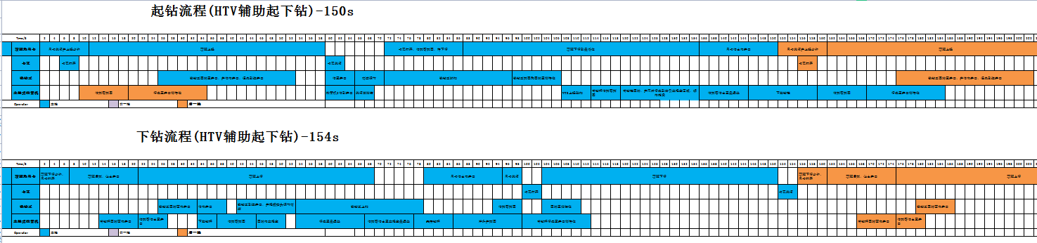
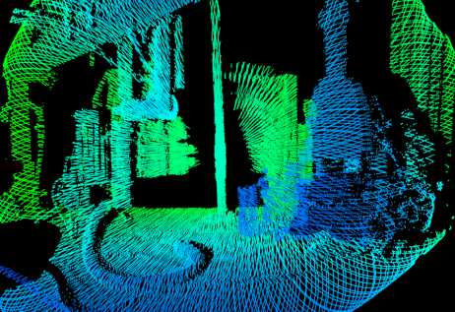

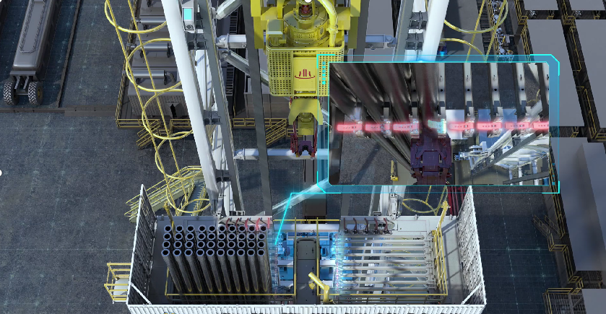
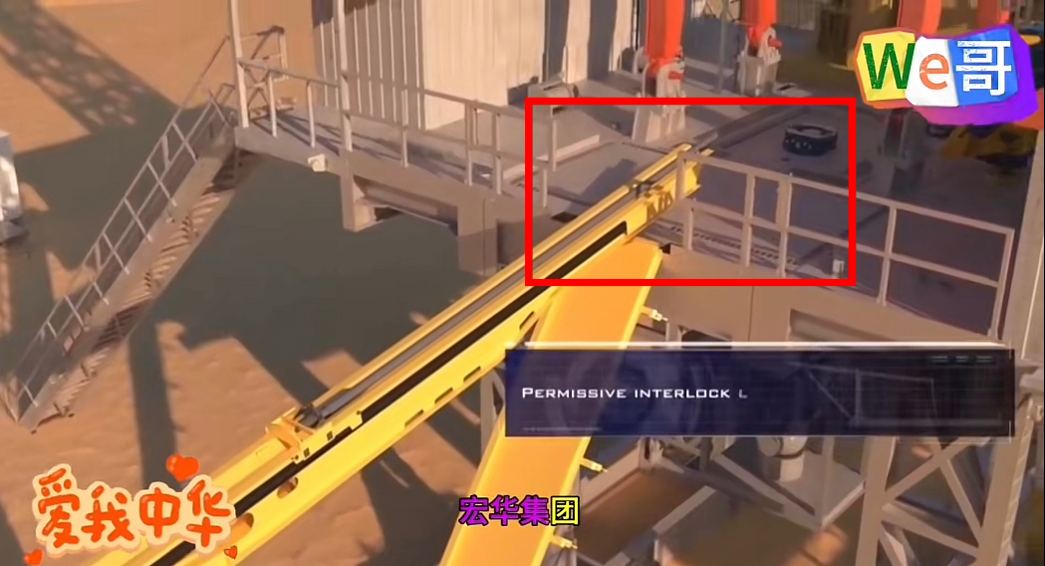
  Background
  Technical Solution
Key Technical Challenges
Key Research Contents
tored bending
Study on effective deformation control technology of string
Study on the stable storage technology of string
Study on the rapid transportation technology of string
Study on the precise grasping technology of string
Wireline coring drill pipe has a small section modulus and poor stability
Difficult to position
Excessive shaking
Prone to thread slippage
Alignment is difficult
Hoisting Operation - 140s
Study on the integration of dynamic intelligent recognition technology
Study on the establishment of one-key linkage offline operation control technology
Long response time
Low operating efficiency
Complex operation
Runing Operation - 140s
Low hoisting or running operation efficiency
Low offline operation efficiency
Study on sensor and vision-based ZMS technology
Study on machine intelligent recognition, safety early warning and control technology
Poor safety
Incomplete ZMS protection
Lack of string status identification

Slide 5
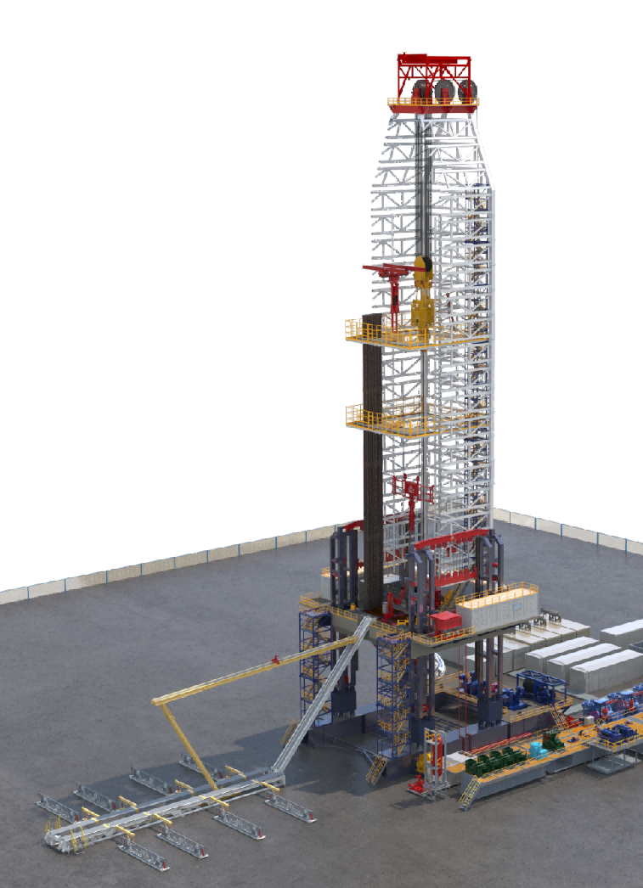
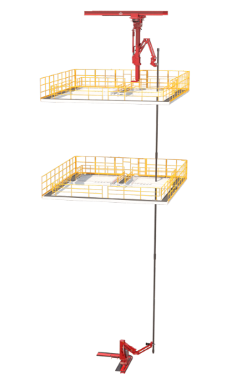
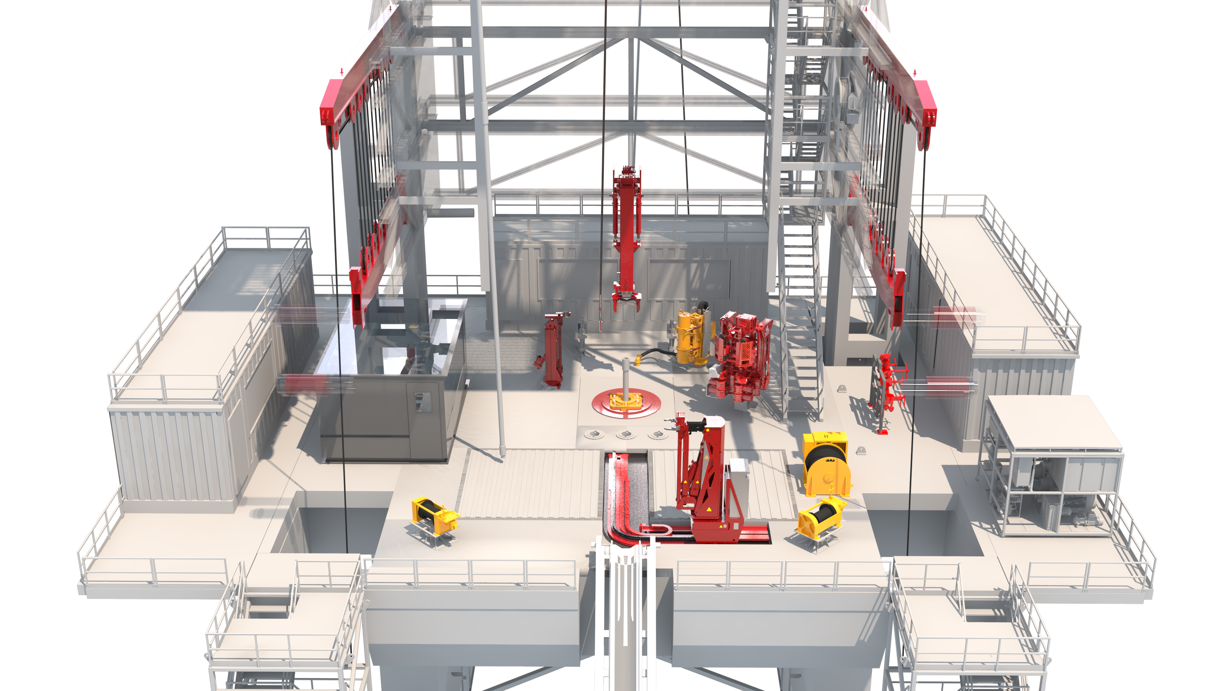
  Method
  Overall Design of an Extra-Long String Handling System
Surface Cluster（2 sets）
①Double Power Catwalk 1 set
②Power Pipe Rack 1 set
Deck Cluster（4 sets）
③Iron Roughneck 1 set
④Powered Mud Box 1 set
⑤Power Slip 1 set
⑥Thread Compound Applicator 1 set
Rack Standpipe Cluster（6 sets）
⑦Bridge-Type Pipe Rack 1 set
⑧Drill Floor Manipulator 1 set
⑨Buffer Manipulator 1 set
⑩Hydraulic Elevator 1 set
⑪‌Powered Intermediate Platform 1 set
⑫Powered Monkey Board 1 set
Offline Cluster（5 sets）
⑬Offline Manipulator 1 set
⑭Powered Mouse Hole 3 sets
⑮Core Sampling Robot 1 set
9
41.4m
15
4
6
7
34.5m
5
3
26.5m
14
12
8
10
11
Key Technical Parameters
Drill Floor Height | 17m | Maximum Collar Diameter | 11in
Maximum Length of Surface Tubular String | 19.6m | Stand Capacity | Drill Pipe 6 5/8in/384 stands
Stand Length | 38m |  | Drill Collar 8in/6 stands 9in/2 stands；11in/2 stands
Drill Pipe Diameter | 6 5/8in
13
Structural Features
Designed to transport four-joint stand of string
Drill pipe clamping and hoisting; Drill collar pushing and supporting
One-click tripping operation; One-click offline stand setting
Comprehensive maintenance space planning and monitoring & detection systems
2
1

Slide 6
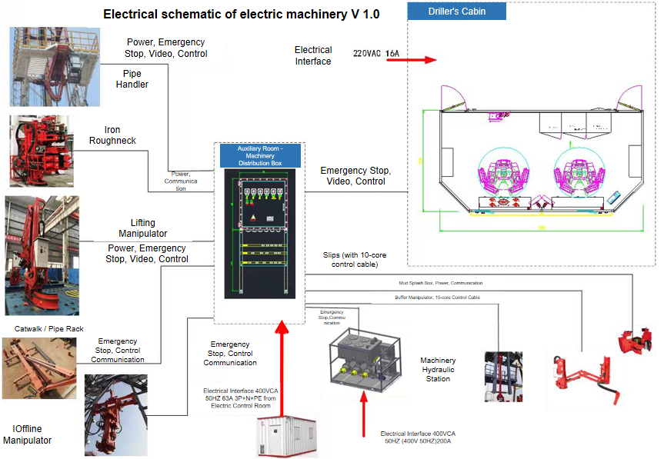
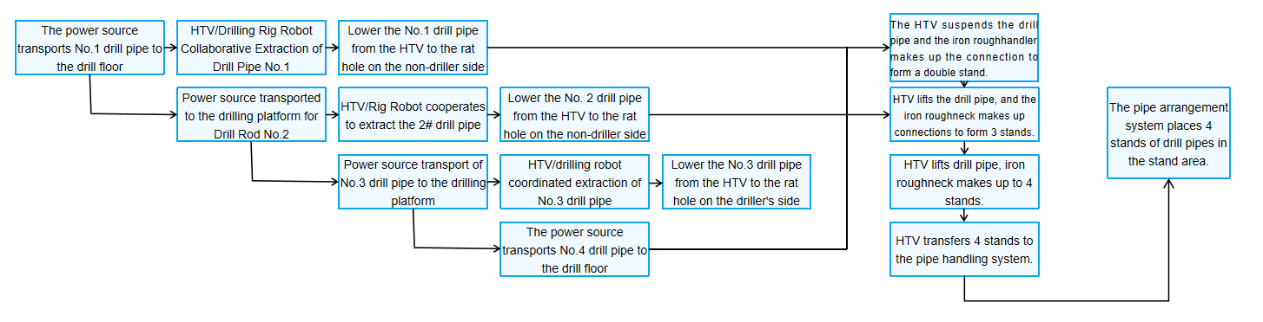
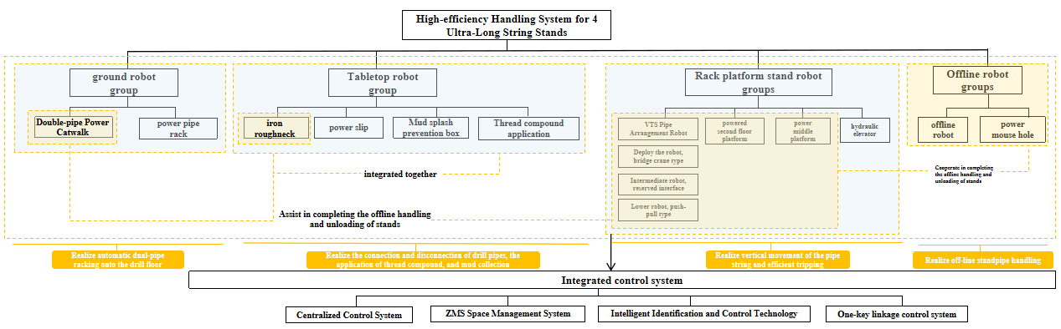
  Method
  Intelligent Management Strategy
Integrated Control Strategy
Automated String Handling Operation Process
Framework and Functional Division of Multi-Robot System

Slide 7
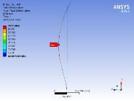
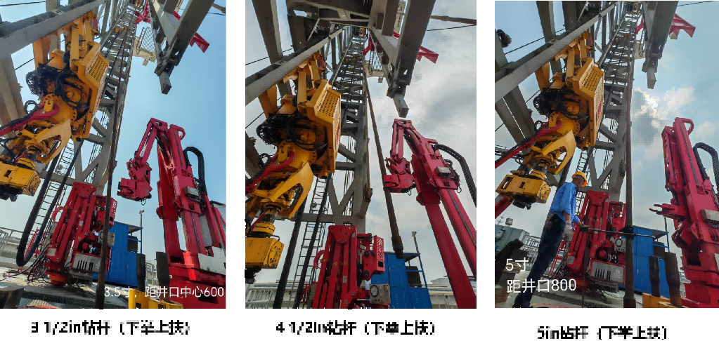
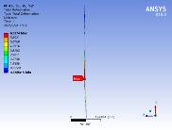
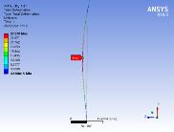
  Conclusions
  Test and Simulation
Conclusions：
（1）Test and finite element analysis results demonstrate that the proposed optimal integrated control strategy effectively coordinates the key control processes during the handling, makeup/breakout, and stacking of ultra-long string, meeting the requirements of engineering operations.
（2）Based on the four-stand test results and the characteristics of the ultra-long tubular handling system, the combined configuration of lower support and upper clamping provides better overall performance.
（3）The tripping operation adopts a method centered on the ultra-long string robot system with relevant equipment, ensuring efficiency and stability at 25 joints per hour. The offline operation adopts a "parallel drilling and hoisting" mode with necessary equipment to ensure smooth and efficient operation.
3 1/2in
4 1/2in
3 1/2in
4 1/2in
5in
5in
5in
String Specification | Maximum bending position |  | Tripping Operation Time / s
 | Test / m | Simulation / m
3 1/2in | 15-21 | 17.005 | 140
4 1/2in | 15-19 | 16.555 | 140
5in | 15-19 | 16.277 | 140

Slide 8
European Geosciences Union General Assembly EGU26
Thank you for your attention
gaokenm@jlu.edu.cn

