Slide 1




Earthvism - Dangers and Dwellers: a project to promote civic engagement through a board game on geological hazards
Emanuele Intrieri, Francesco Cardi, Olga Nardini, Alessio Gatto, Samuele Segoni

Slide 2
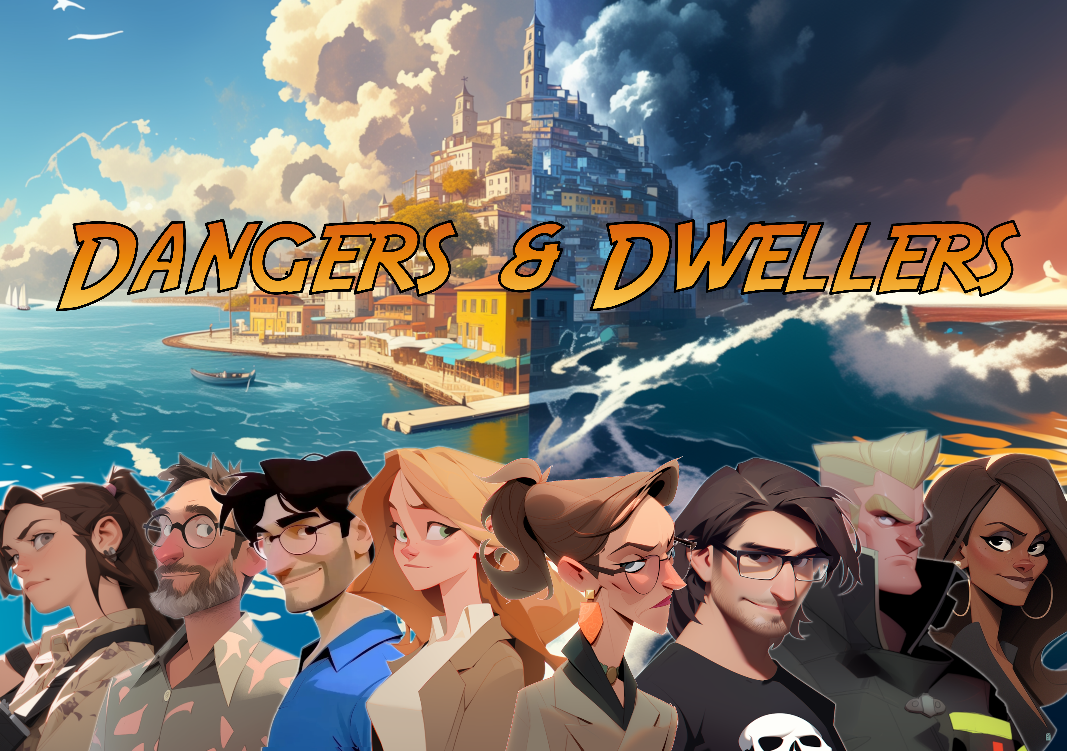
Notes:
We came up with a game that we called dangers and dwellers.
As you know educational games risk to be not funny as non-educational games so it’s always a balance between the message and the fun. We leaned towards the fun to make a game we would have liked to play ourselves as gamers

Slide 3
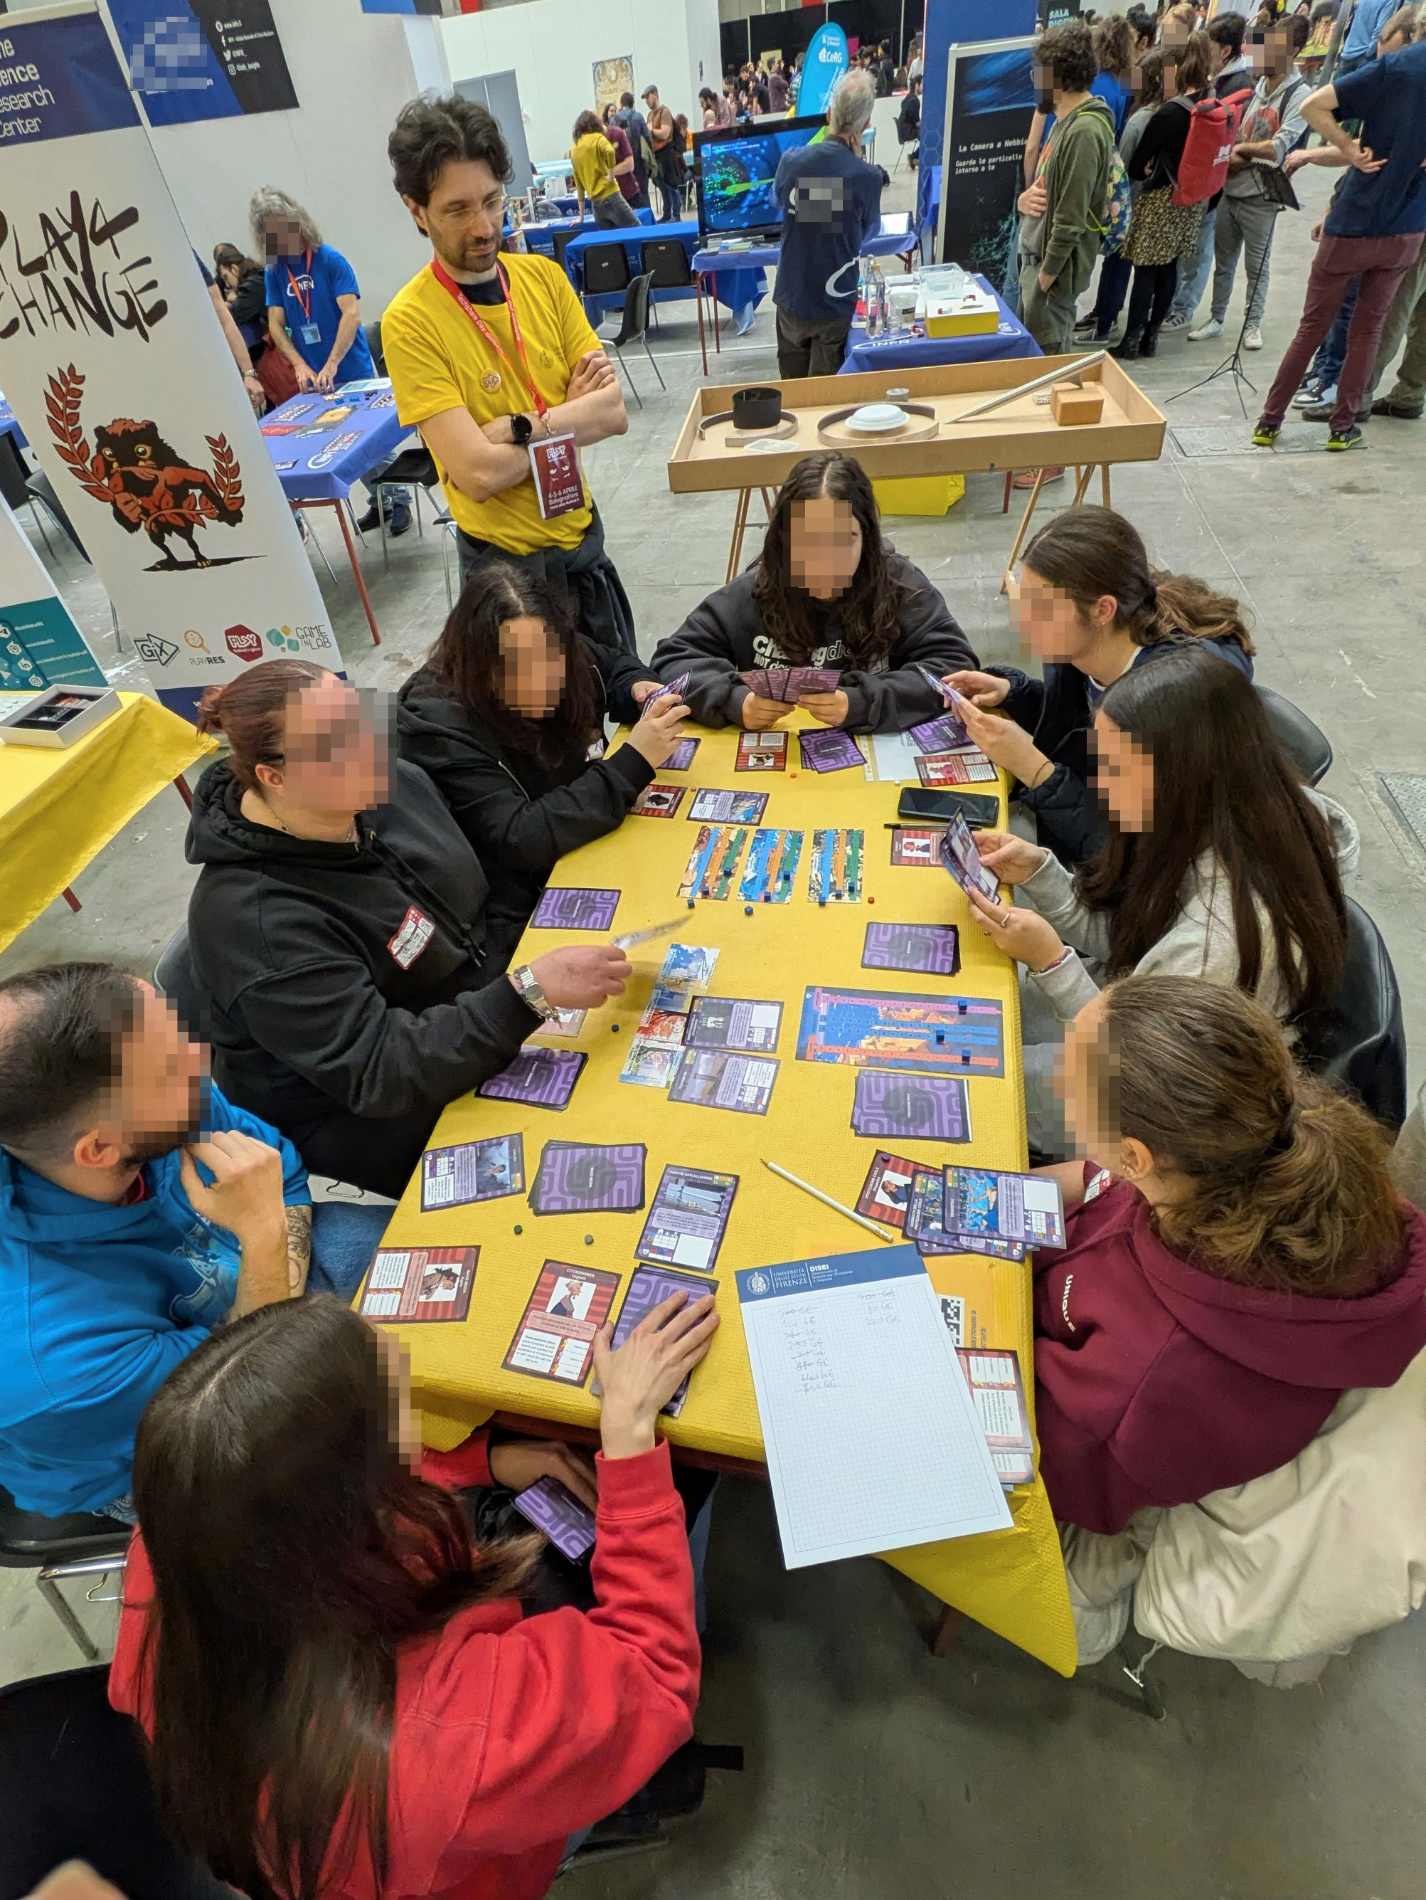
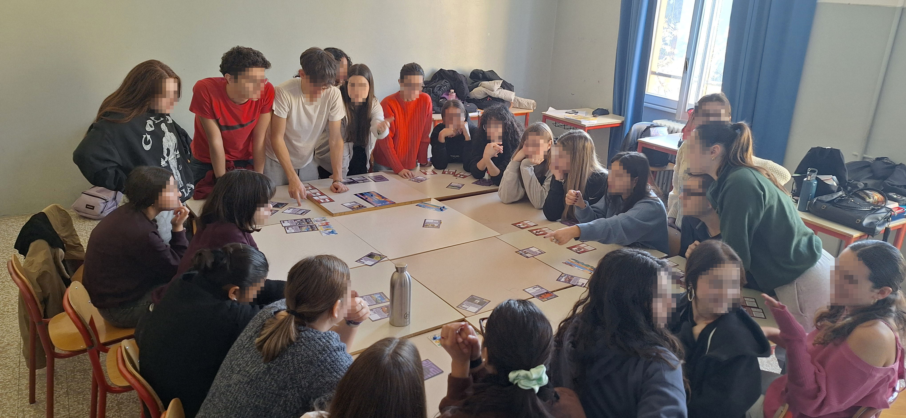
Mission
Promote STEM and Earth Science
Increase geological risk reduction awareness
Explain the complexity of risk management
Notes:
The story of this games starts in the early phases of the pandemic. The main reason why we decided to develop it is that we enjoyed it, but we also had side quests. One is that we are experiencing a drop in the number of new eath science students so we were looking for an engaging way to promote earth science and in particular increase awareness on geological risks, all of it without oversimplifying this topic
We wanted to delve into the game-based learning

Slide 4
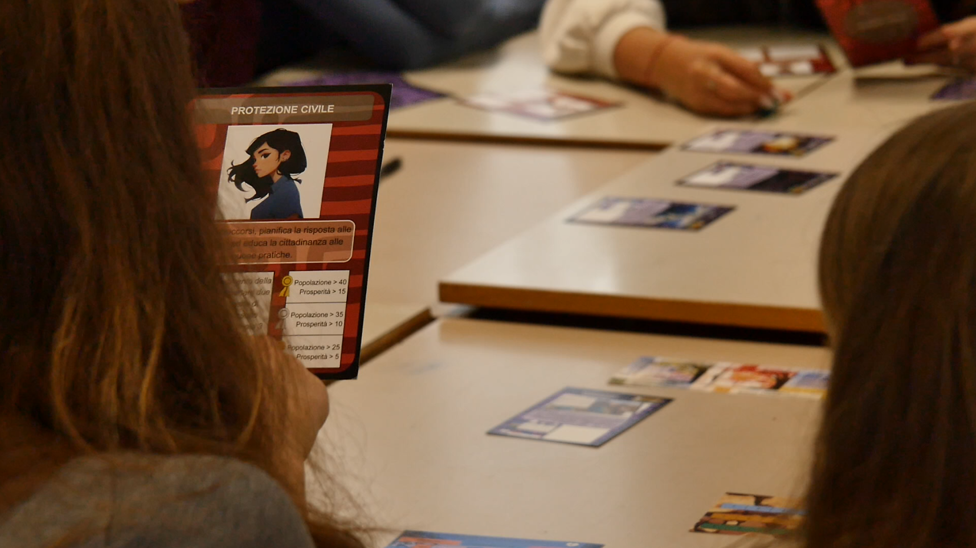
The game
Strategy boardgame set in a fictional island hit by landslides, floods and earthquakes
8 players (age 10+)
Debate phase and disaster phase
The aim is to survive for 6 turns
Semi-collaborative
Notes:
Players can team up so that we have played in schools with as many as 24 students
Every player has its own agenda

Slide 5
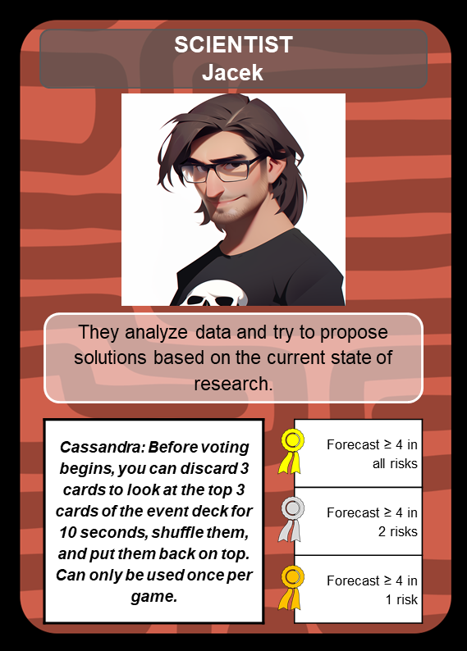
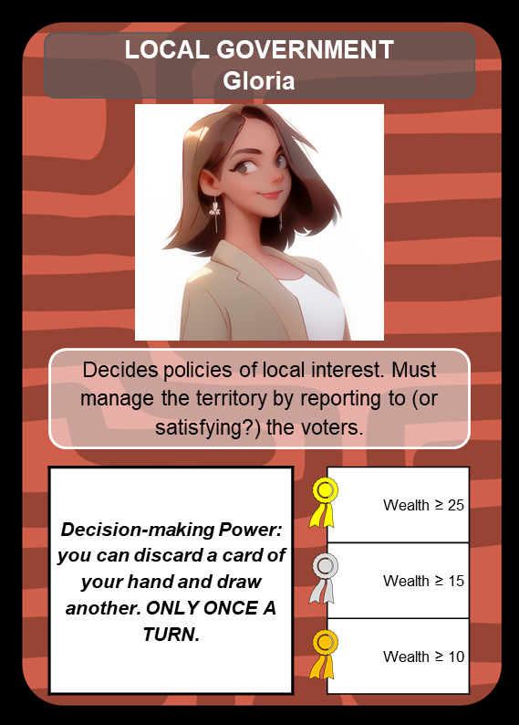
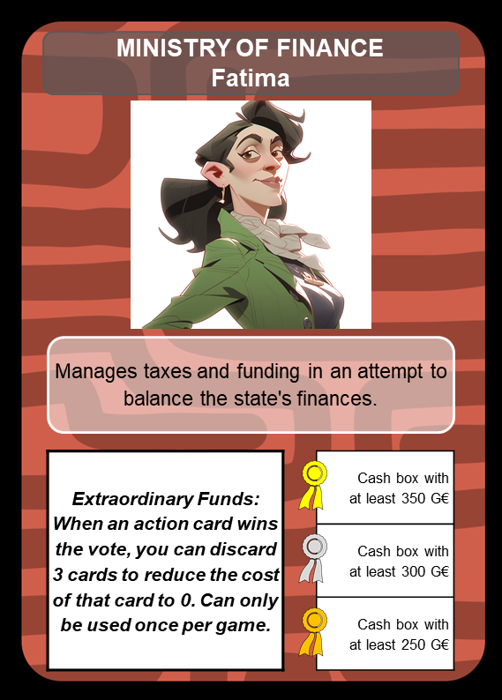
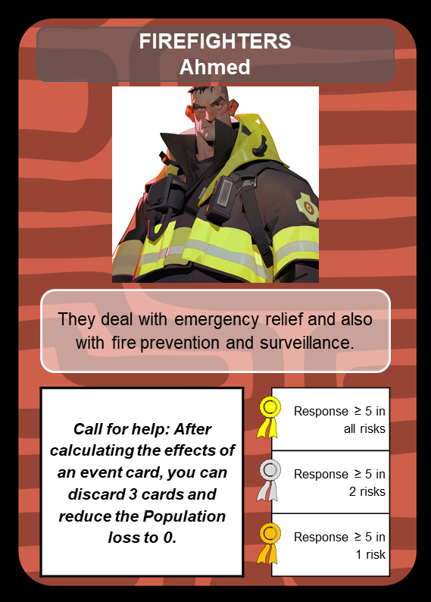
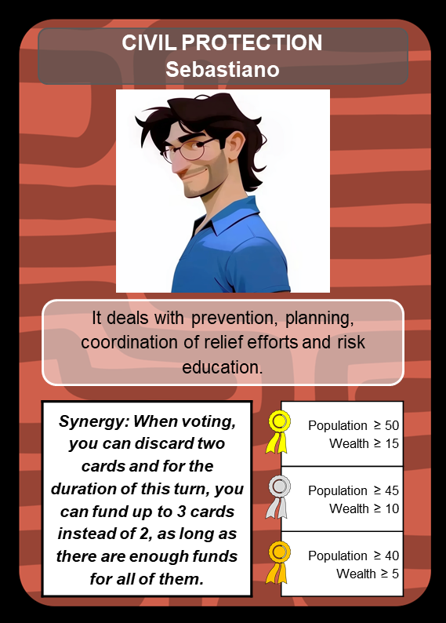
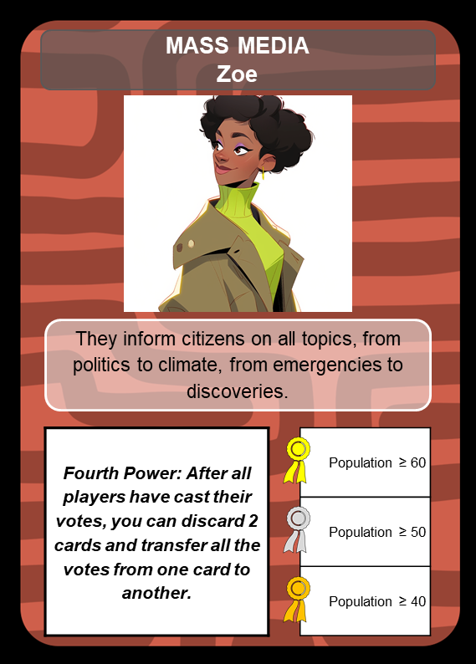
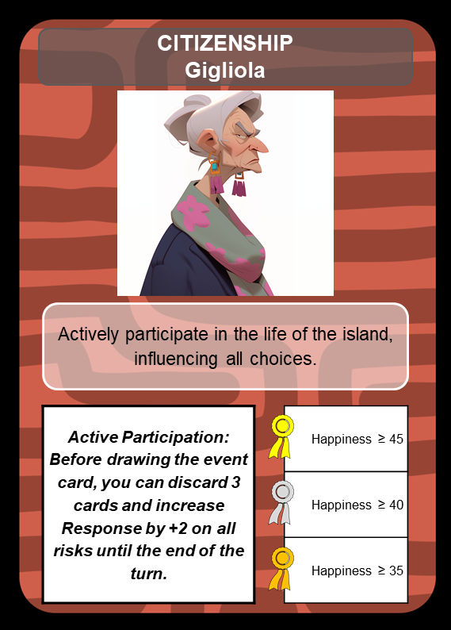
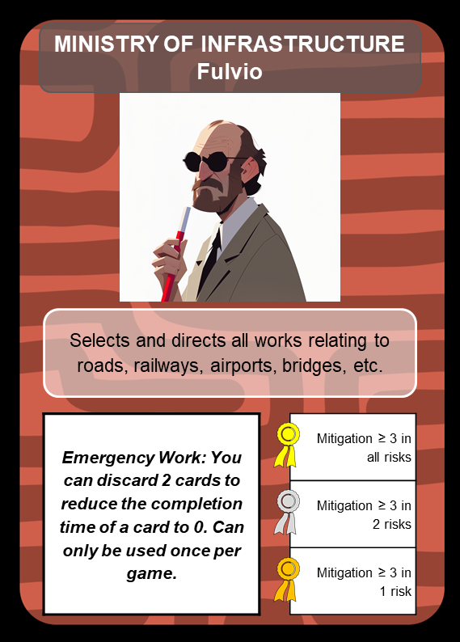
The characters
Notes:
4 variants per character to include the diversity normally found within a thriving society
We want to show the role of every part of the society, like citizens and scientists

Slide 6
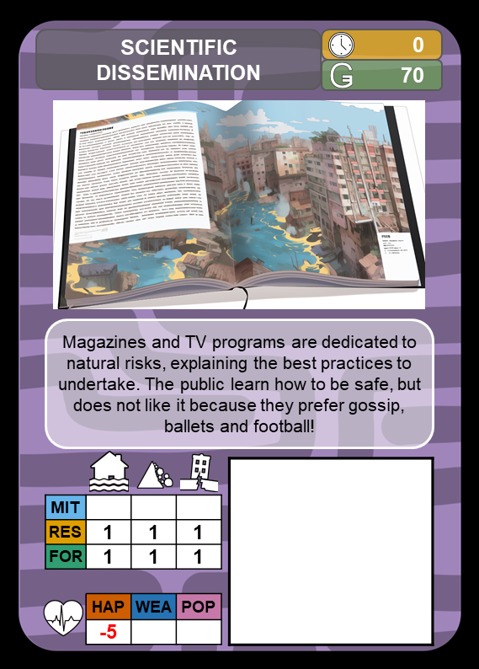
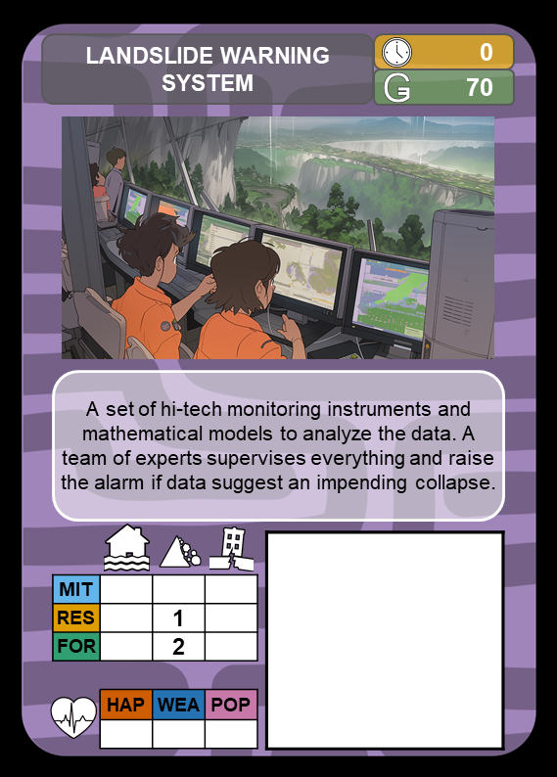
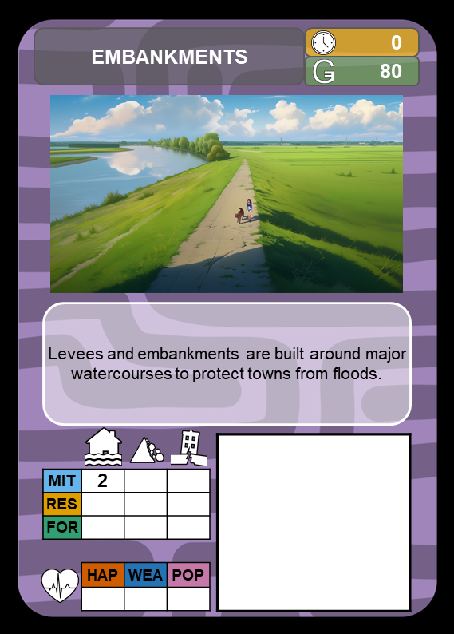
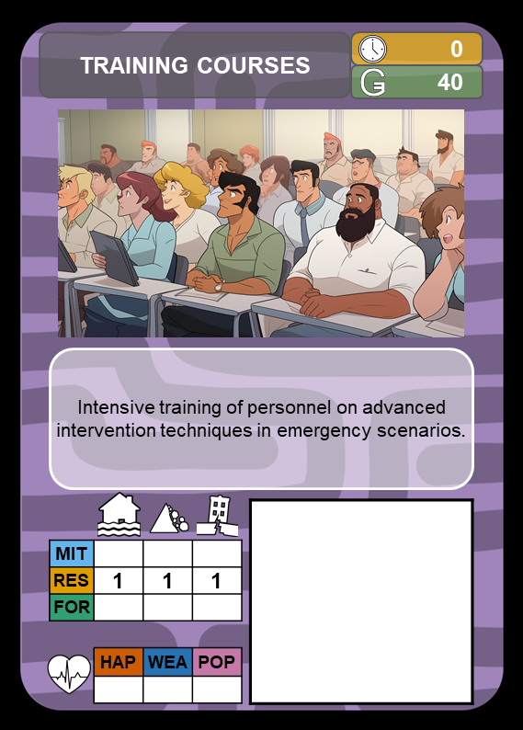
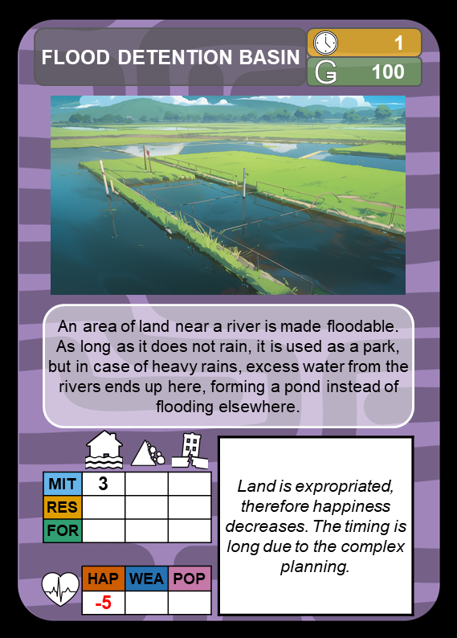
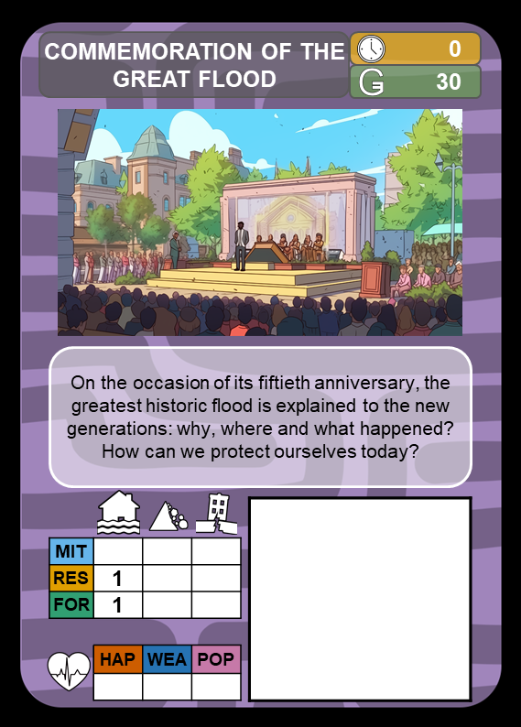
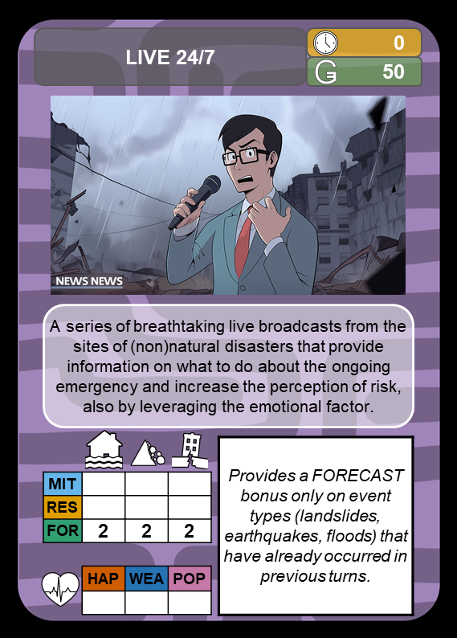
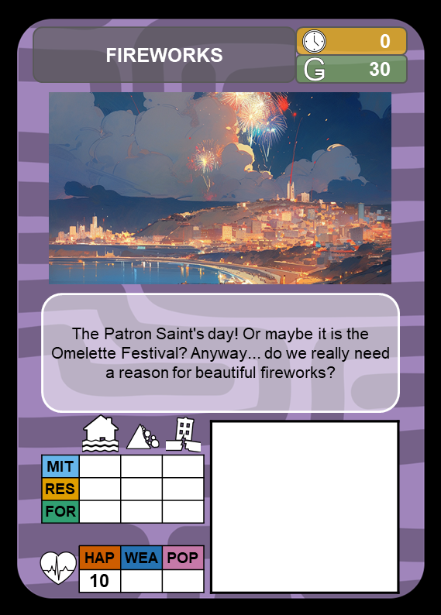
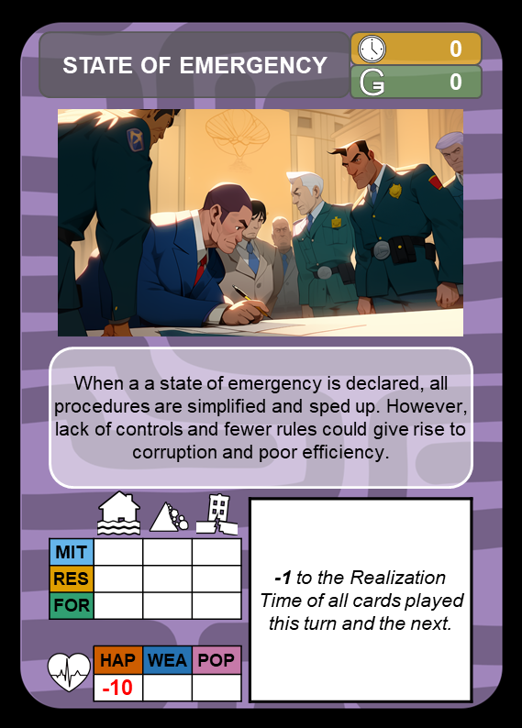
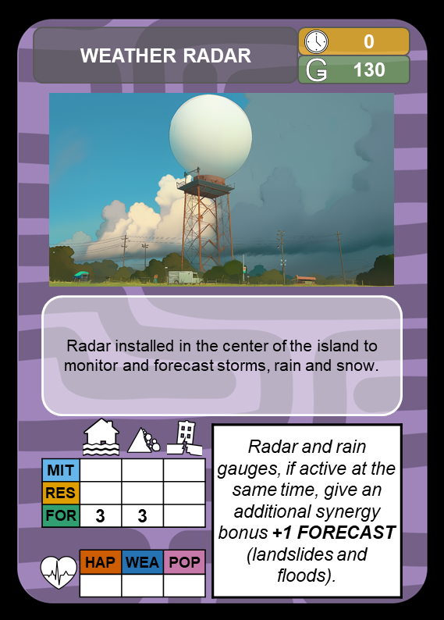
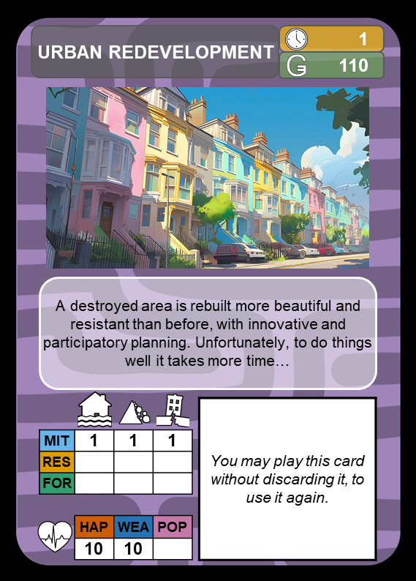
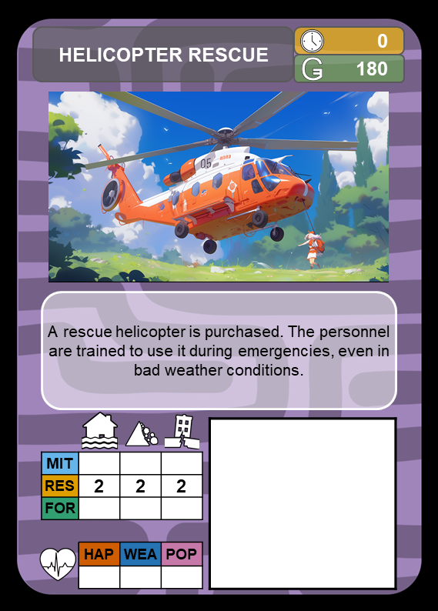
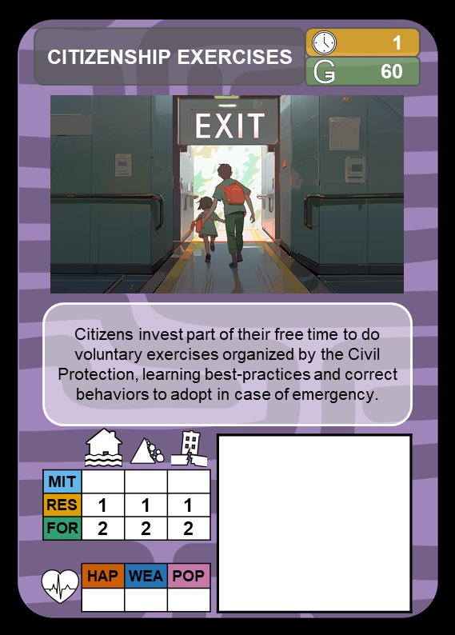
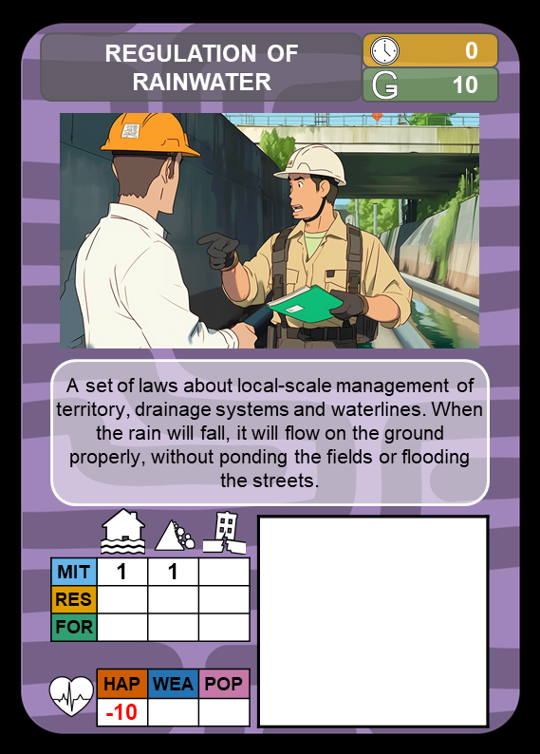
Action cards
Notes:
Represent complexity, rationale, advantages and shortcomings of any action. You need to mitigate the risk and account for the reaction of the population, the cost or the time needed to implement the action
You don’t only have to preserve the integrity of the island and the safety of people but also the happyness of people
Each character has its own set of prerogatives and types of action

Slide 7
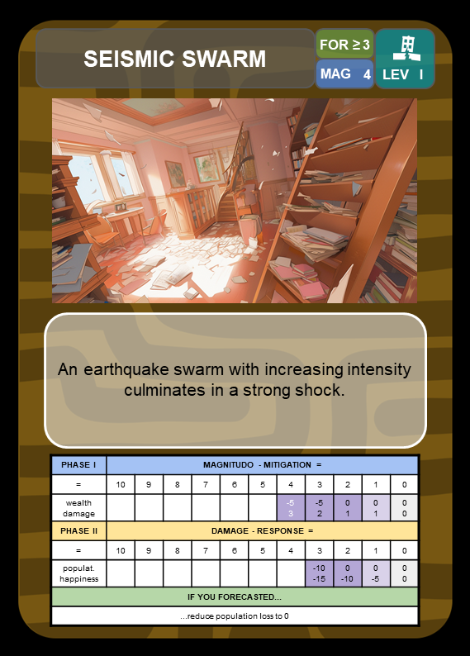
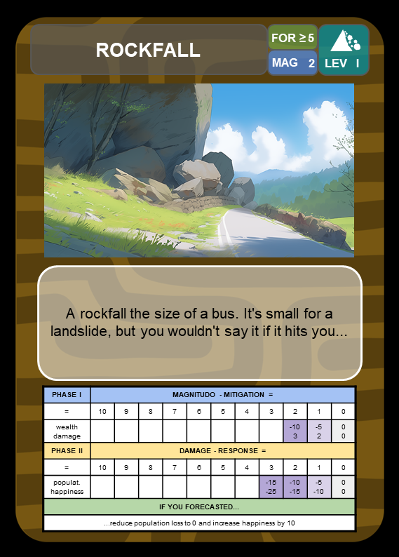
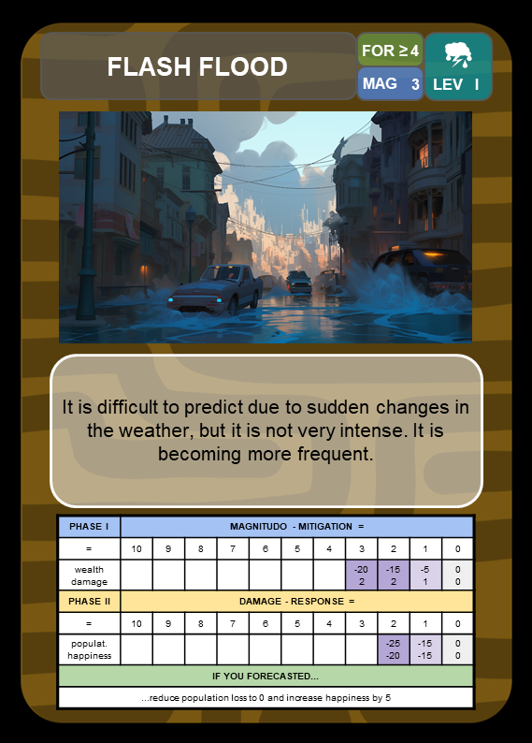
Event cards
Notes:
Different types of events that are described

Slide 8
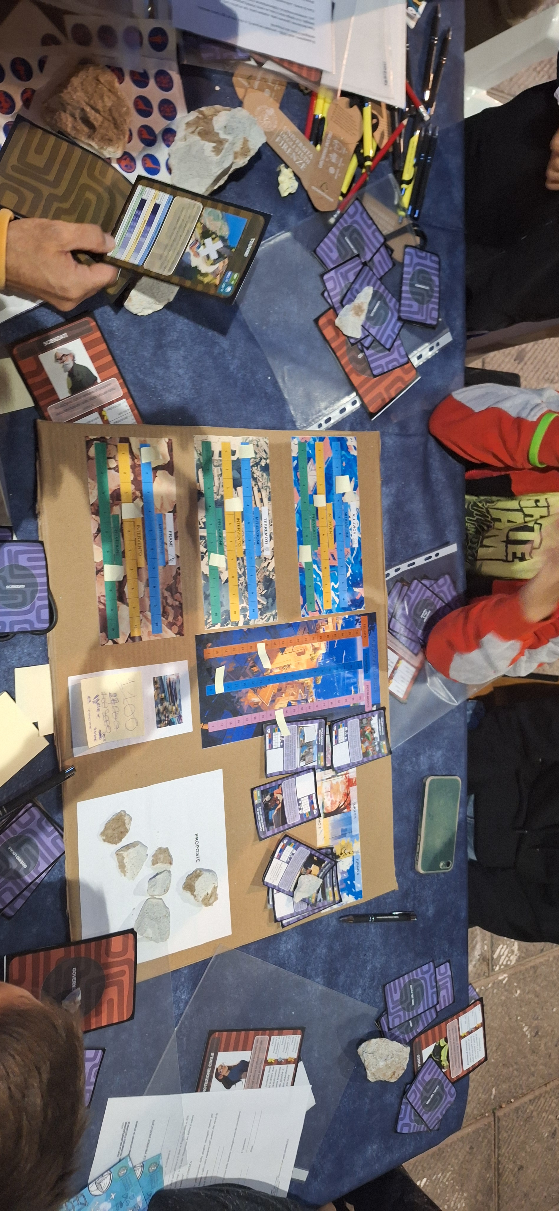
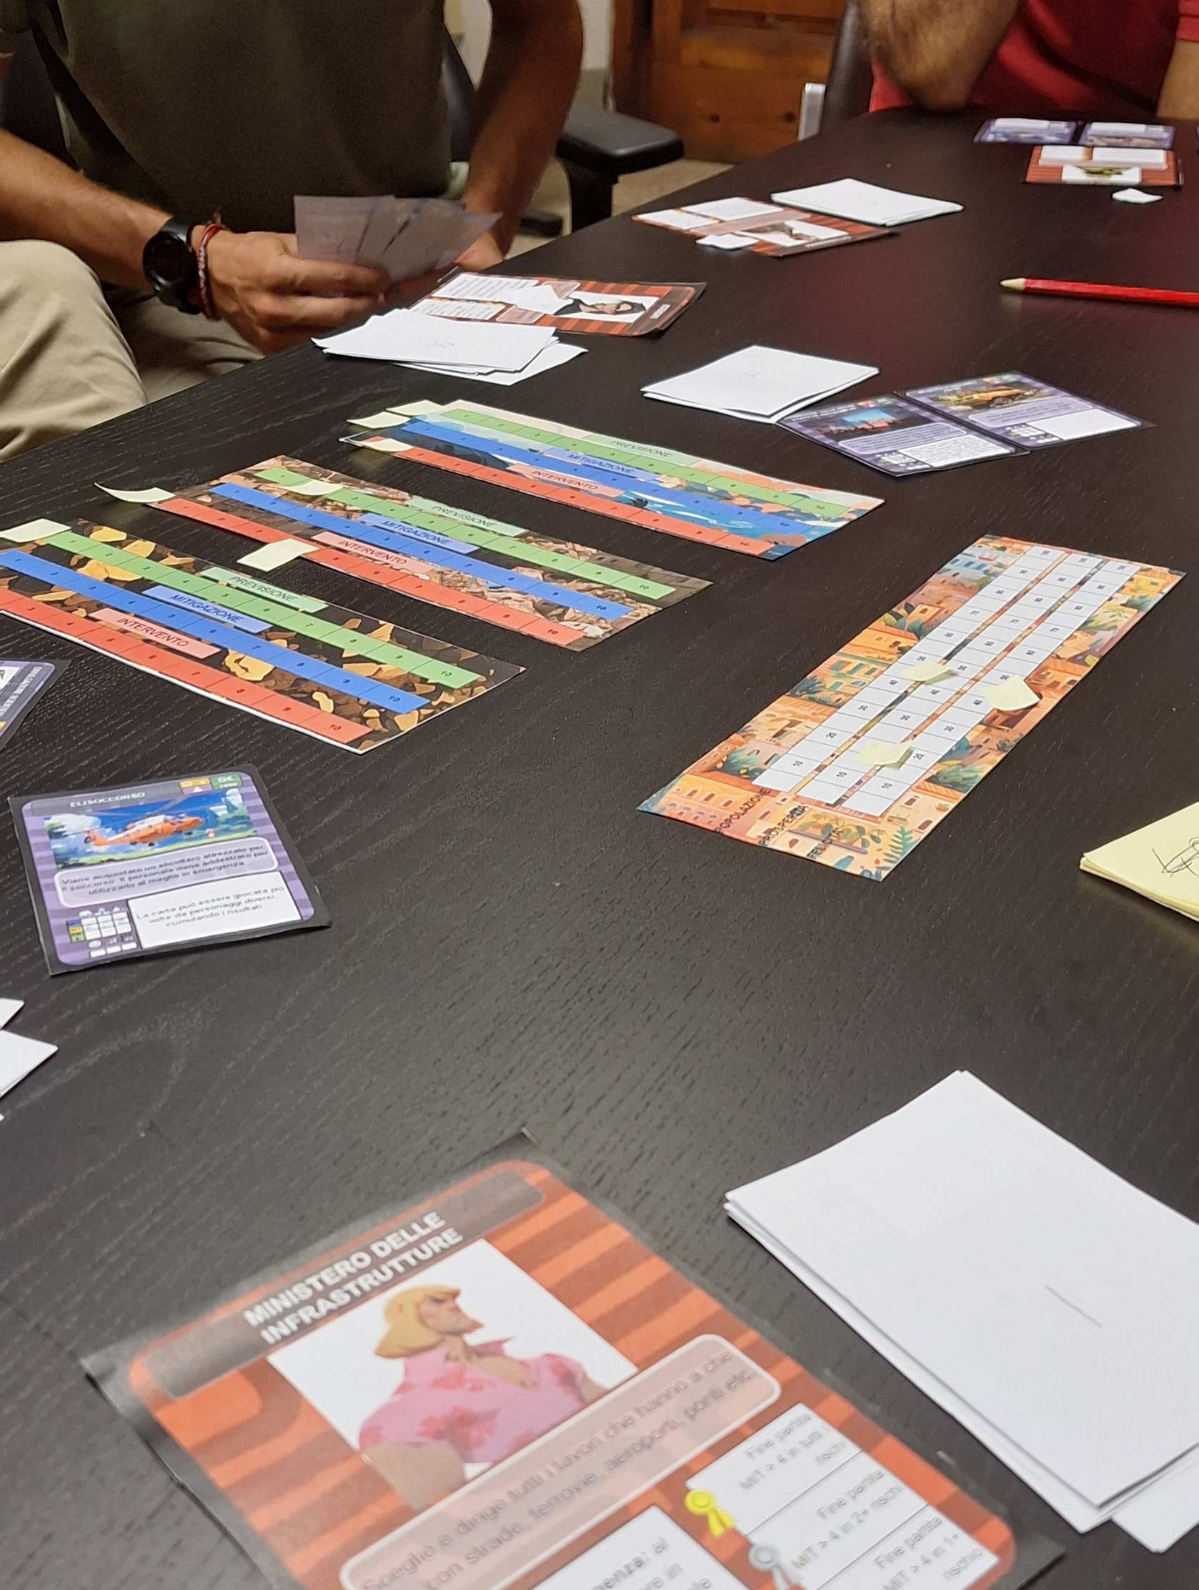
Playtest
Notes:
Tested it many time first internally then with earth science students finally externally

Slide 9


Earthvism project (Erasmus+)
Cooperation partnership in school education
Participation and civic engagement
Psychometric tests

Slide 10
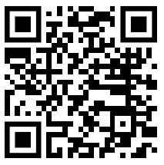
Earthvism project timeline
Dec. 2025
Sep. 2026
May 2027
Dec 2028
Project kick-off
Instagram page
Website
Free print and play
Digital Dangers & Dwellers beta
Digital Dangers & Dwellers 1.0
Play it later:
Geoscience Games Night
18:00-19:30
Foyer D
Get in touch!

Slide 11
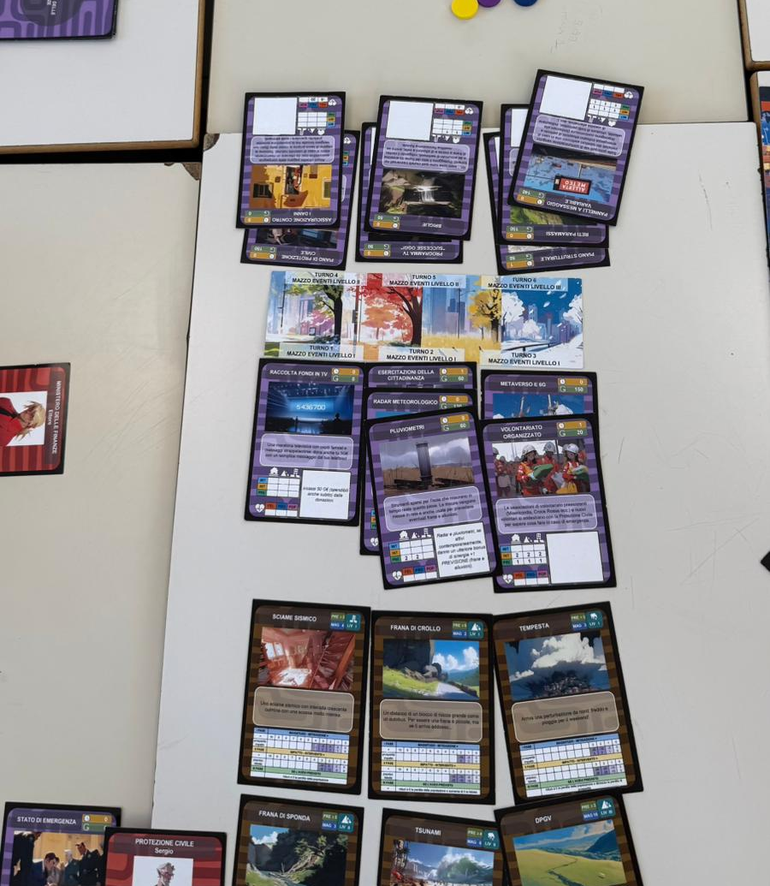
Conclusion
Technical concepts are conveyed explicitly
Concepts like collaboration and complexity are conveyed implicitly
Soon print and play and digital version

