Slide 1


Optimising crop-residue burning PM_{2.5} emissions over the Indo-Gangetic Plain using inverse modelling
European Geosciences Union | Vienna, Austria| 3–8 May 2026
Theme – Atmospheric Sciences | AS3.29
Akanksha Arora, Harish Gadhavi, Prabir K Patra
Physical Research Laboratory
Ahmedabad
India

Slide 2
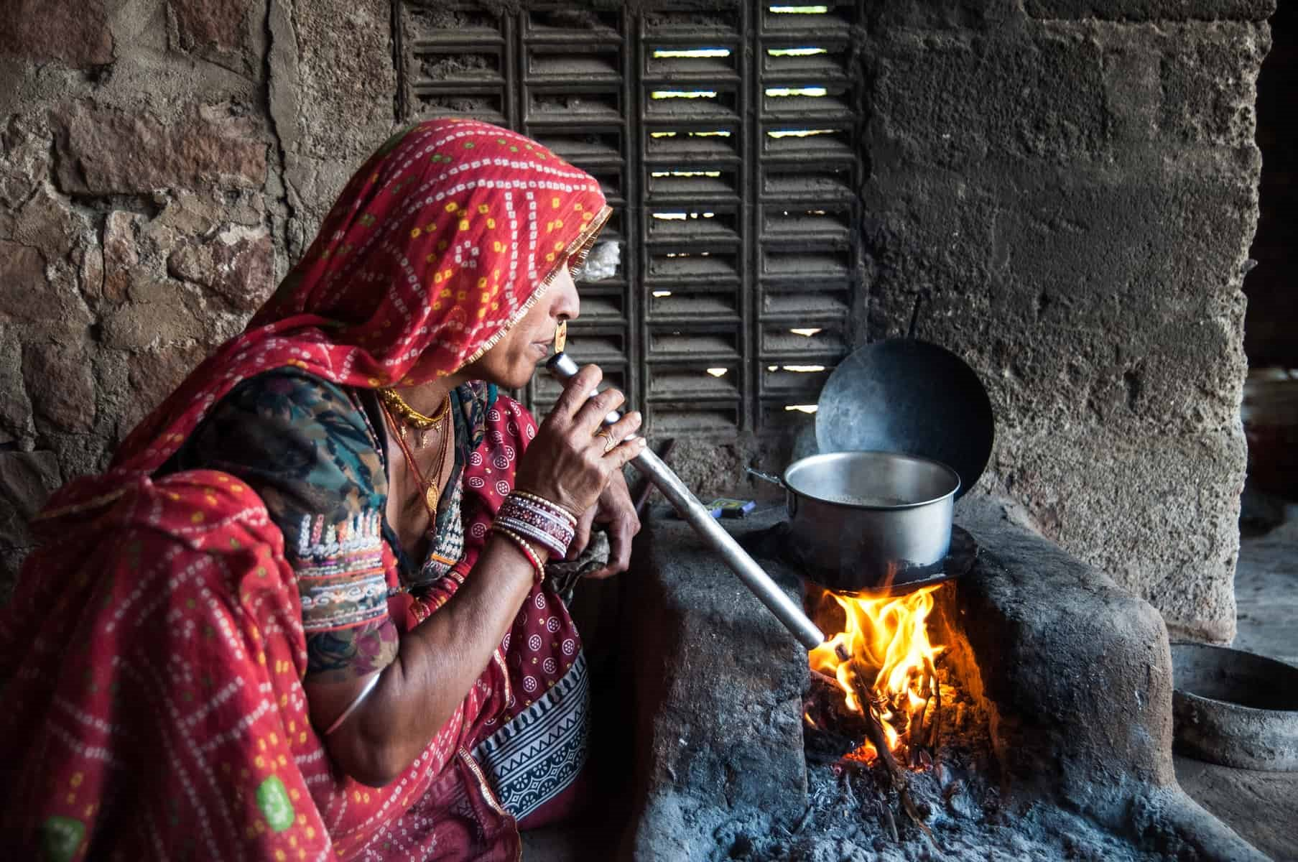
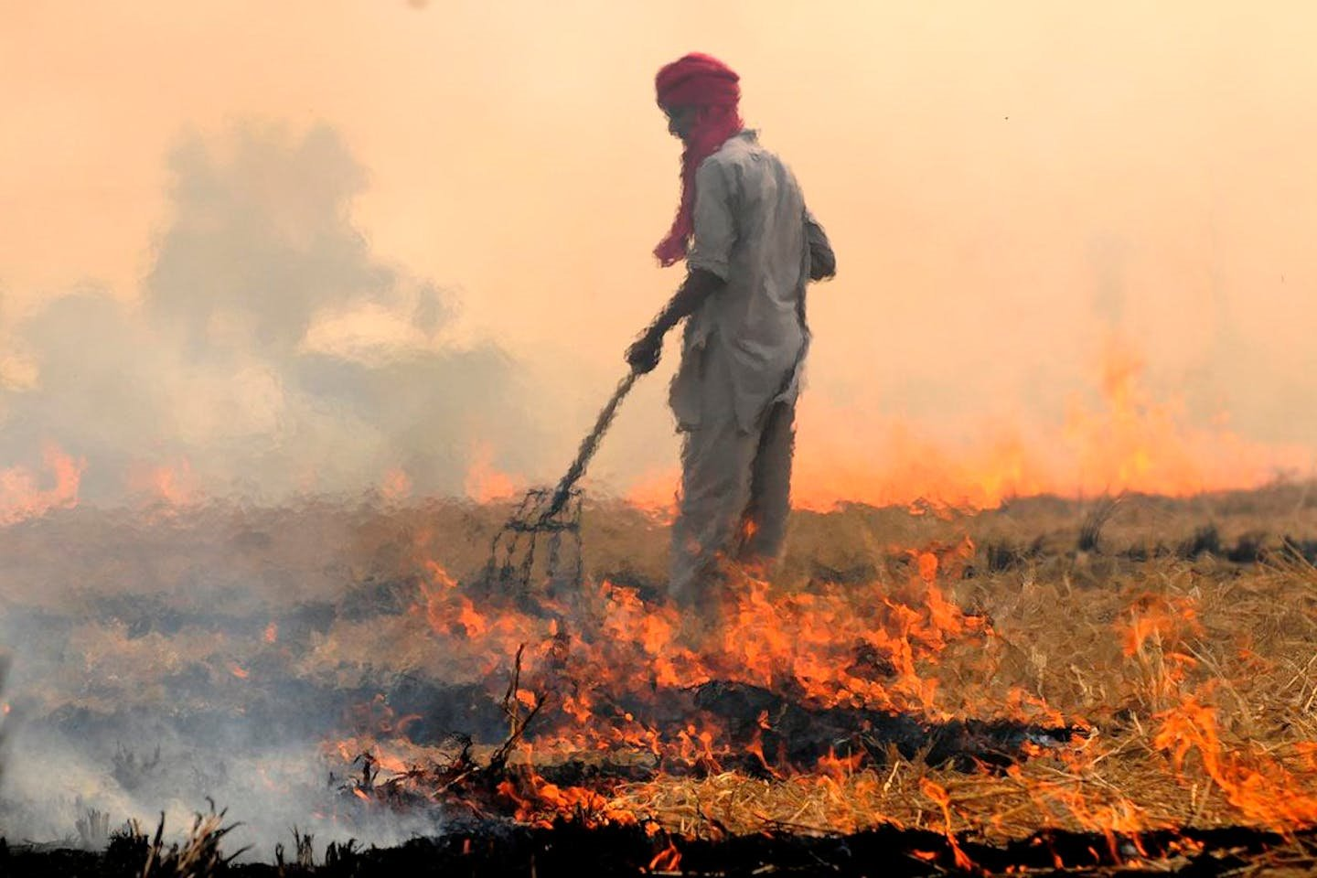
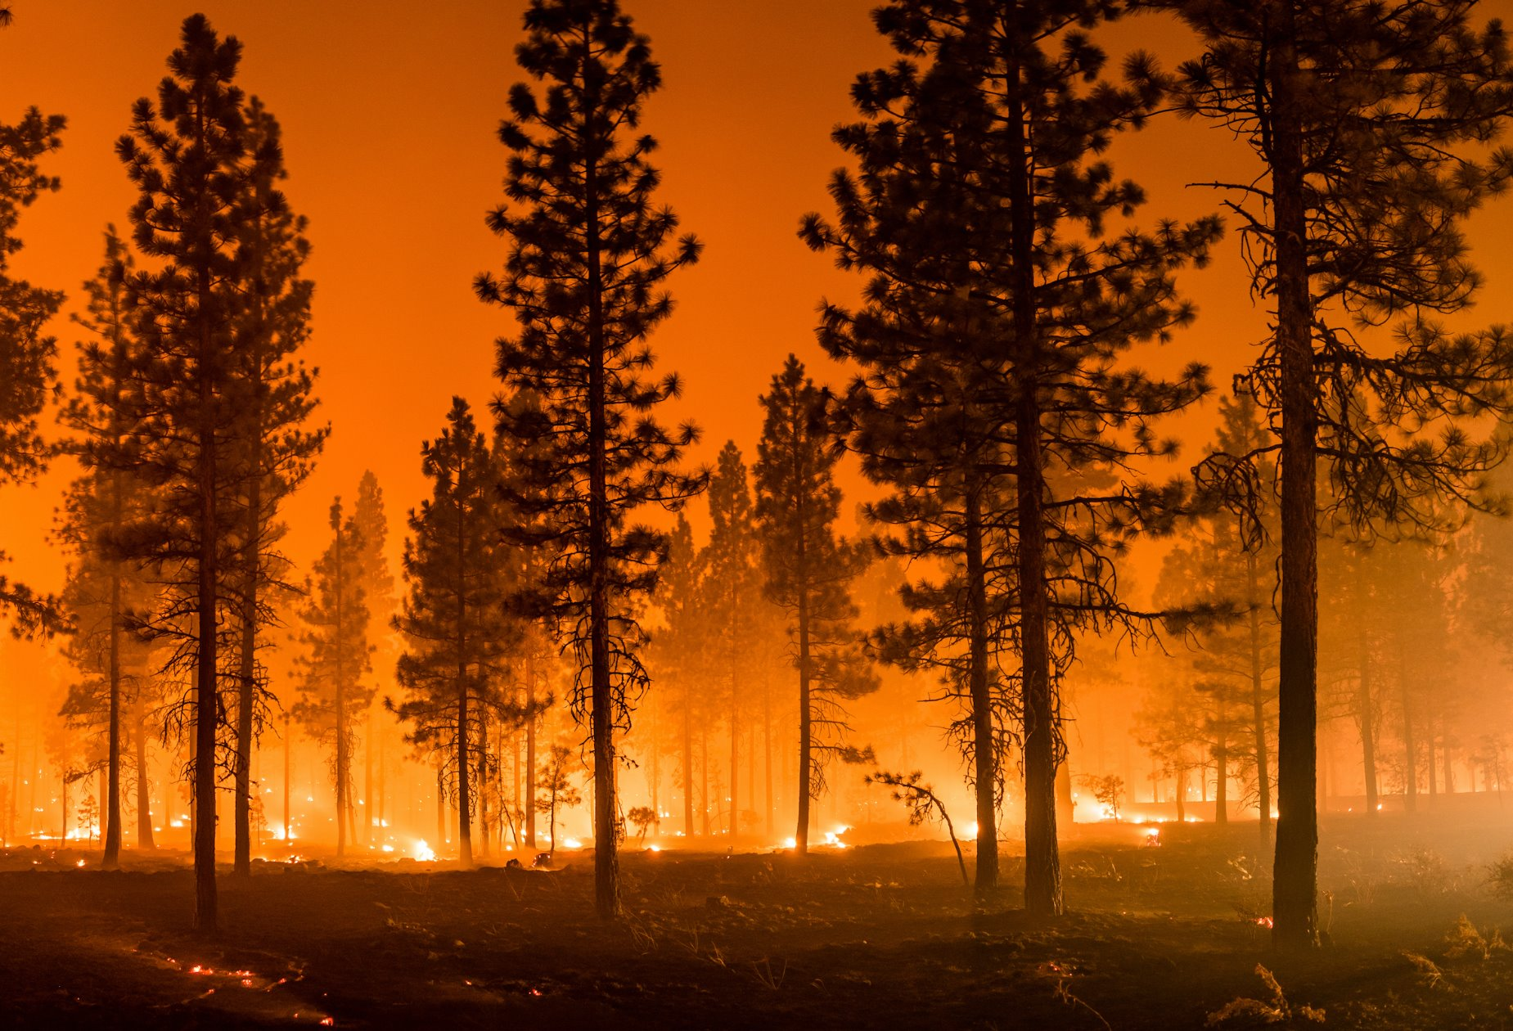
Biomass burning as a source of atmospheric aerosols
Biomass burning (BB) refers to combustion of vegetation or biofuels through
Wildfires
Agricultural waste burning
Residential biomass use for heating or cooking purposes
Biomass burning releases significant amounts of atmospheric aerosols including PM_{2.5}, Black carbon (BC) and organic carbon (OC). Globally, BB contributes ~51 Tg of primary PM_{2.5} and ~4.6 Tg of BC emissions annually.
Biomass burning is a major source of air pollution in South Asia.
residential combustion
agricultural waste burning
wildfires
Small scale
Distributed
Not captured in satellite
Large scale
Clustered
Captured in satellite

Slide 3
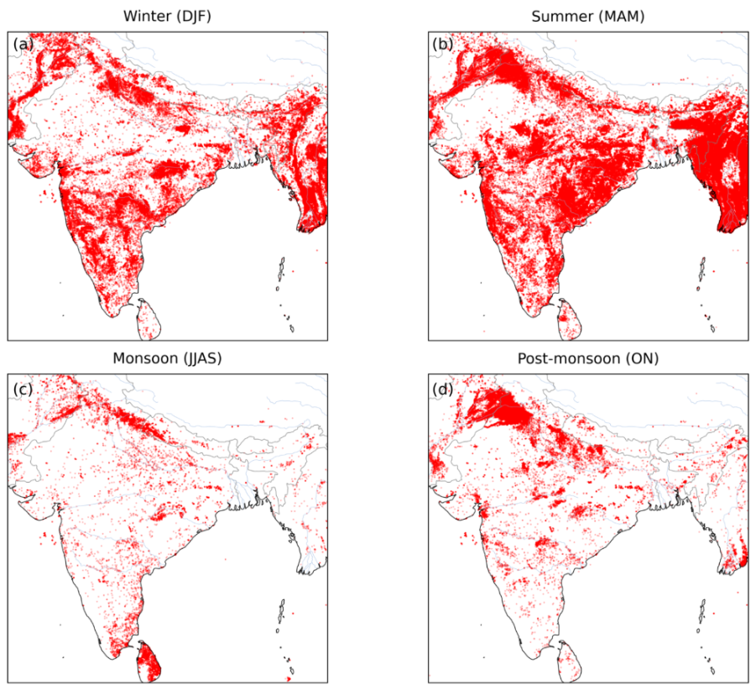
Fire seasonality over South Asia​
Fires peak in Mar-May
Air pollution worsens in North India during Sep-Nov fire season

Slide 4

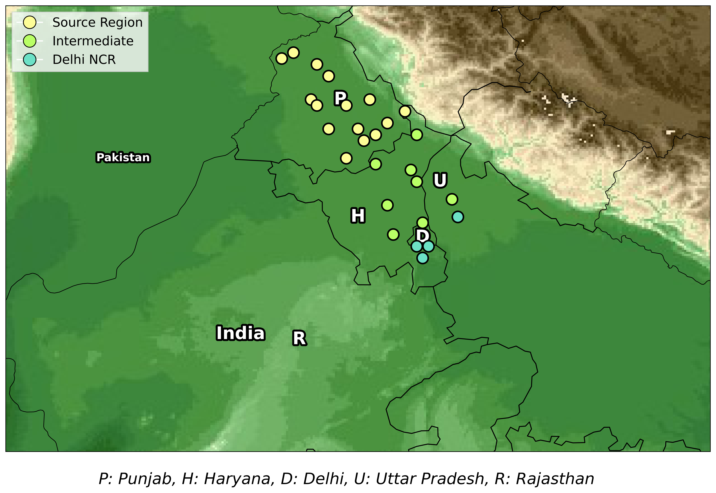
PM_{2.5} sensors network across northwetern Indo-Gangetic Plain
Source
Intermediate
Delhi NCR

Slide 5
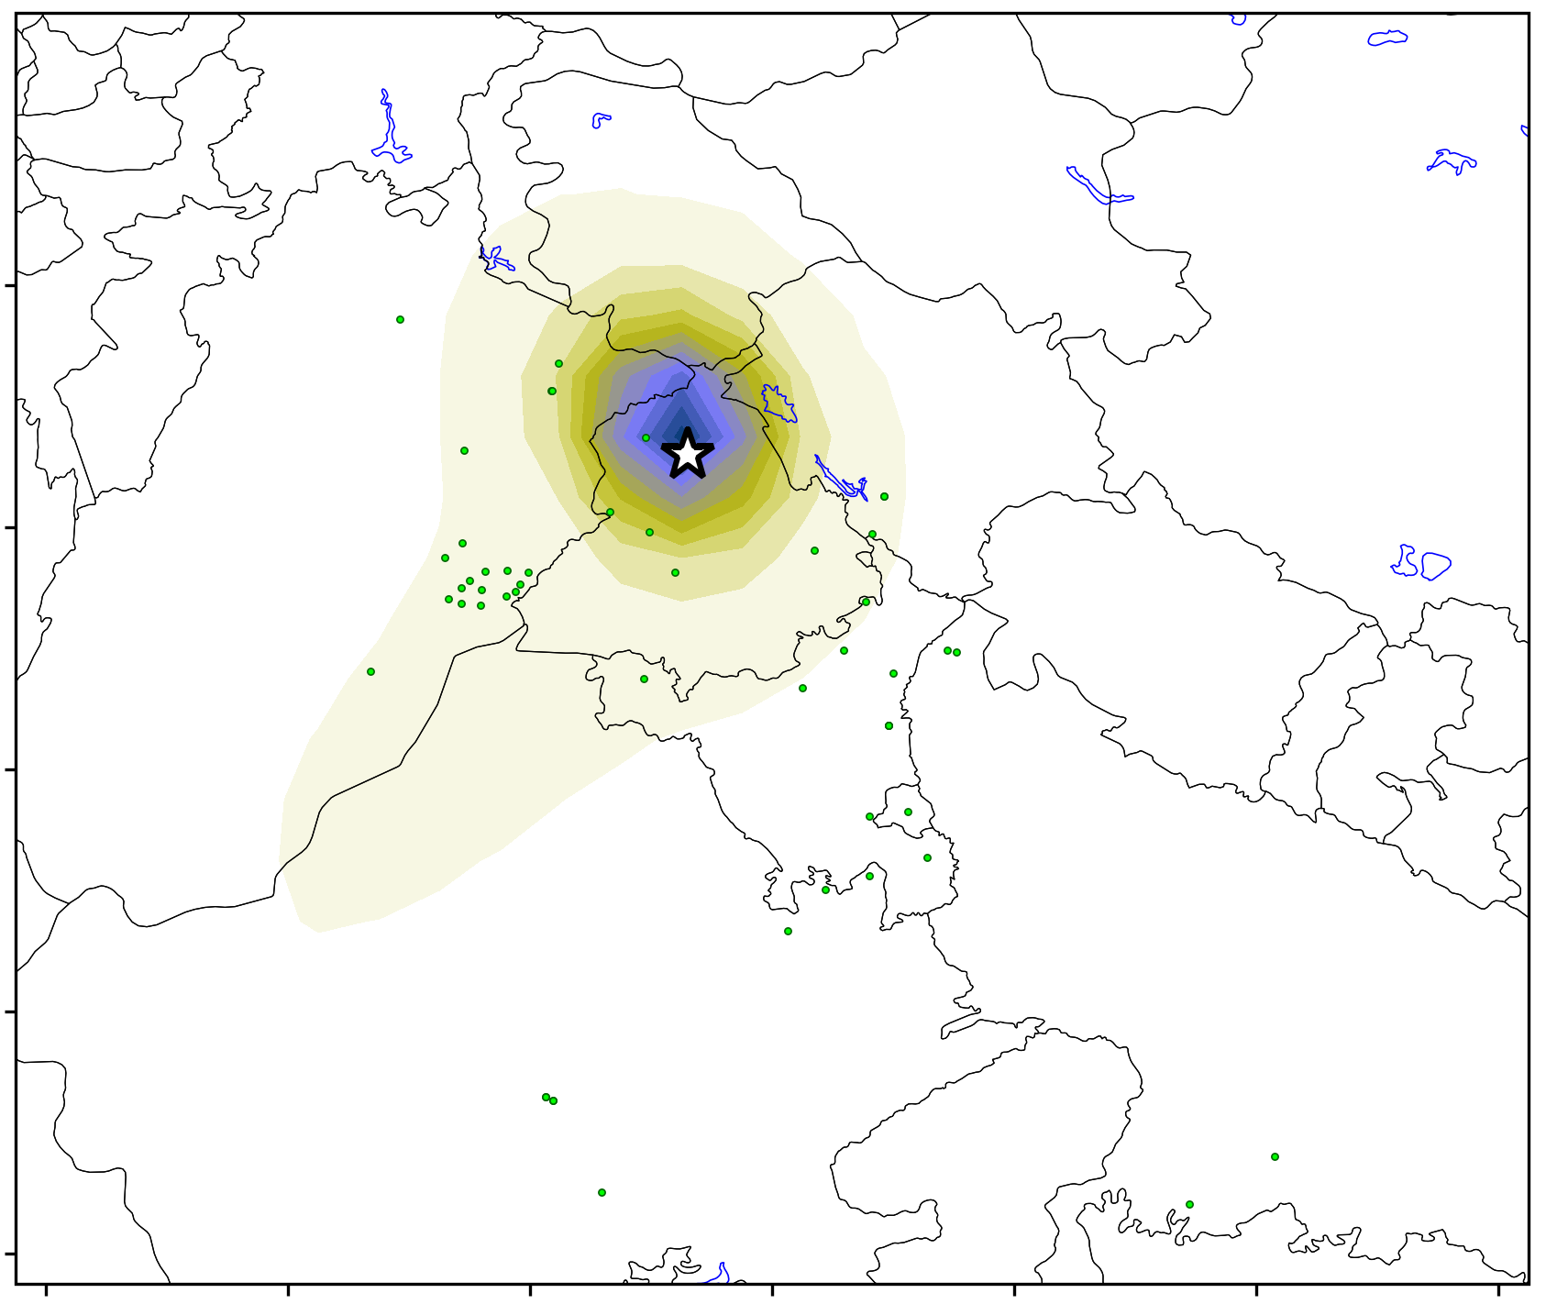
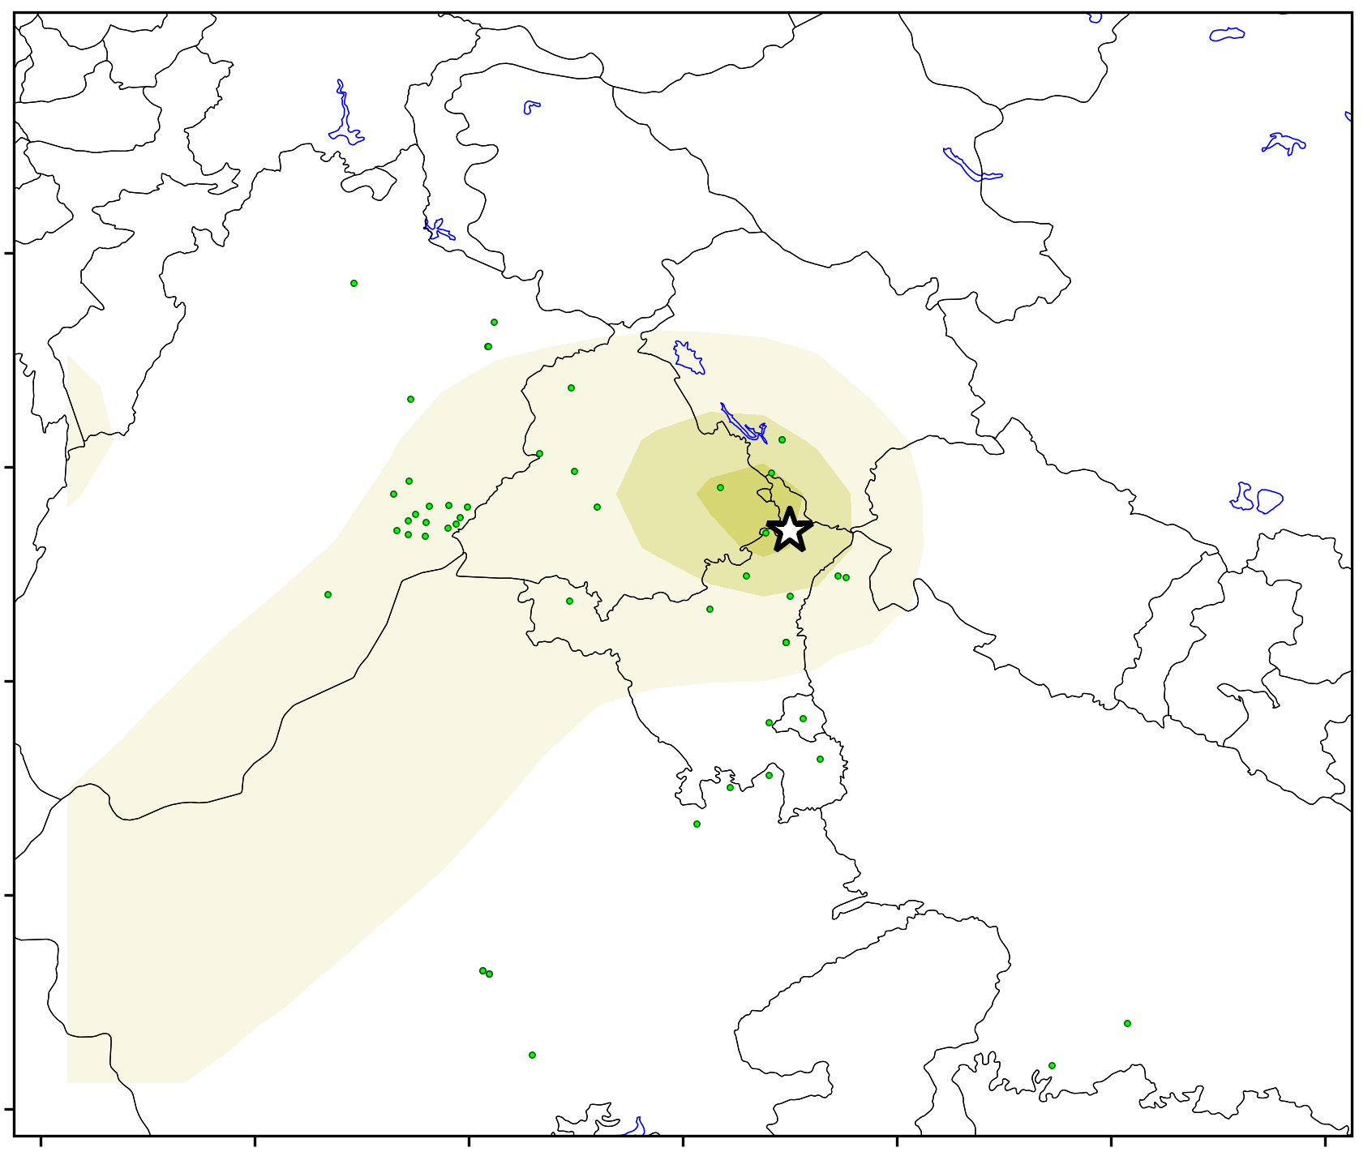
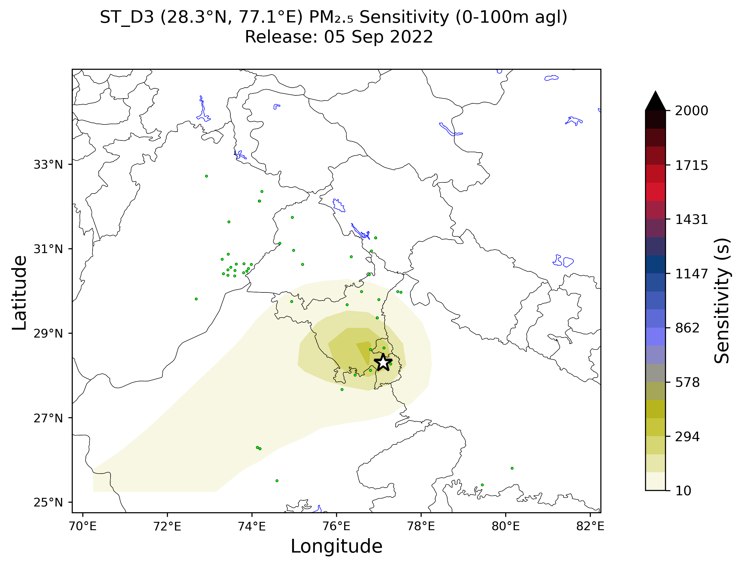
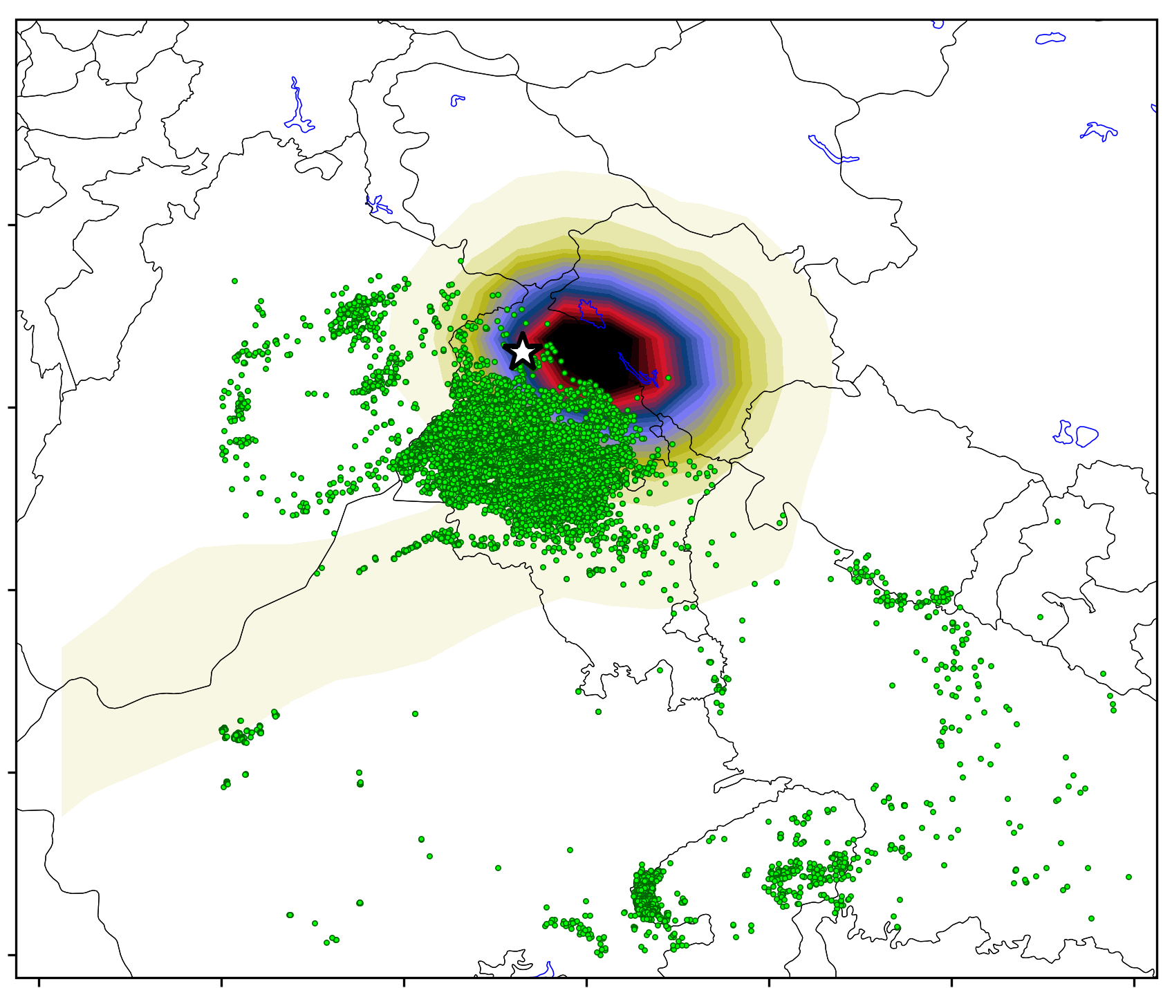
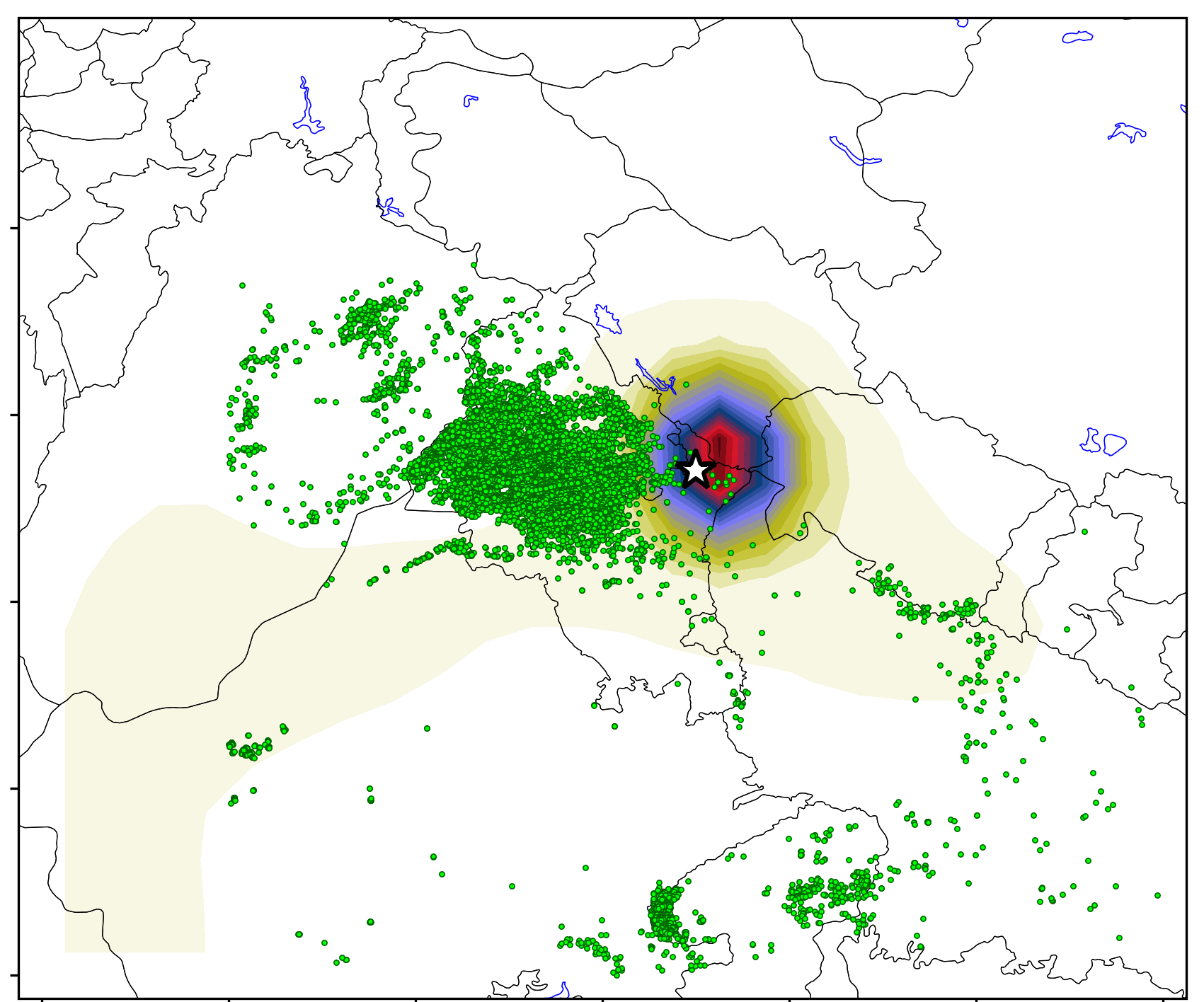
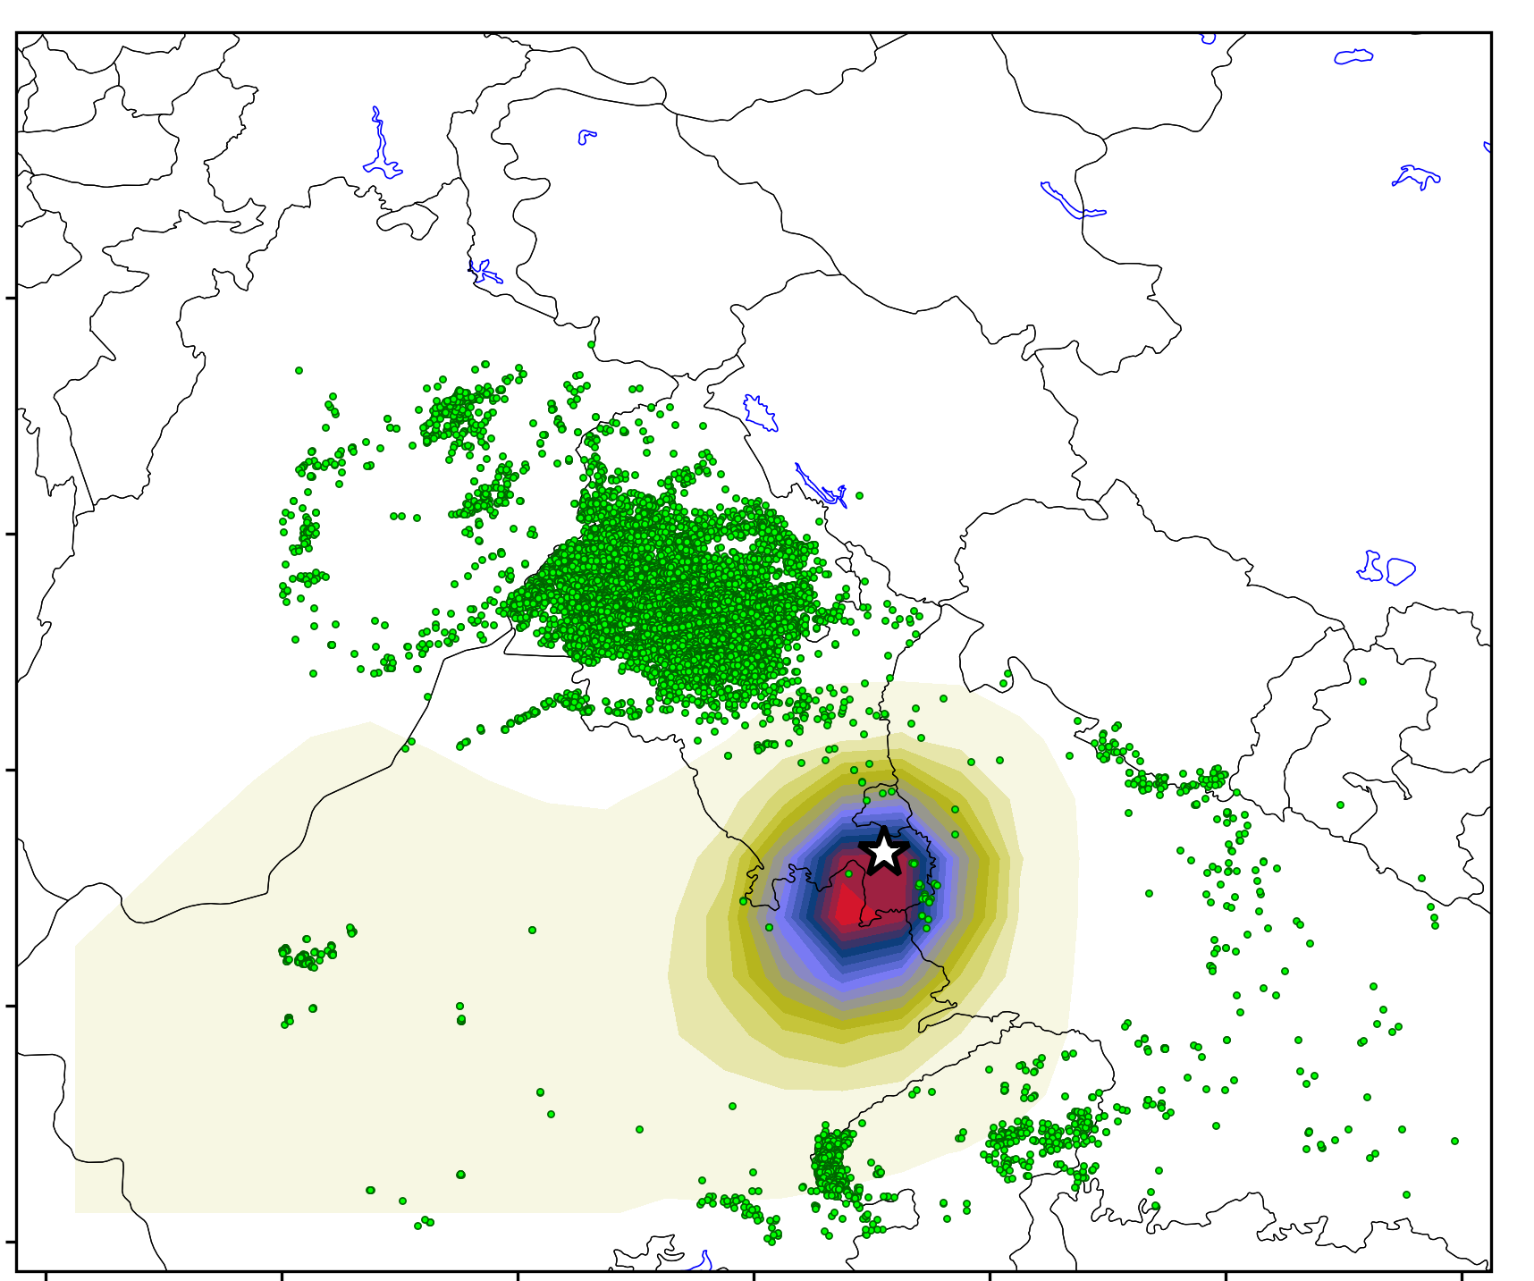
Source-receptor sensitivity (or PES) over north-western IGP
Source
Intermediate
Delhi NCR​
sensitivity (s)
Non-biomass burning
5 September
reference
Biomass burning
6 November
* represents site location for reference

Slide 6
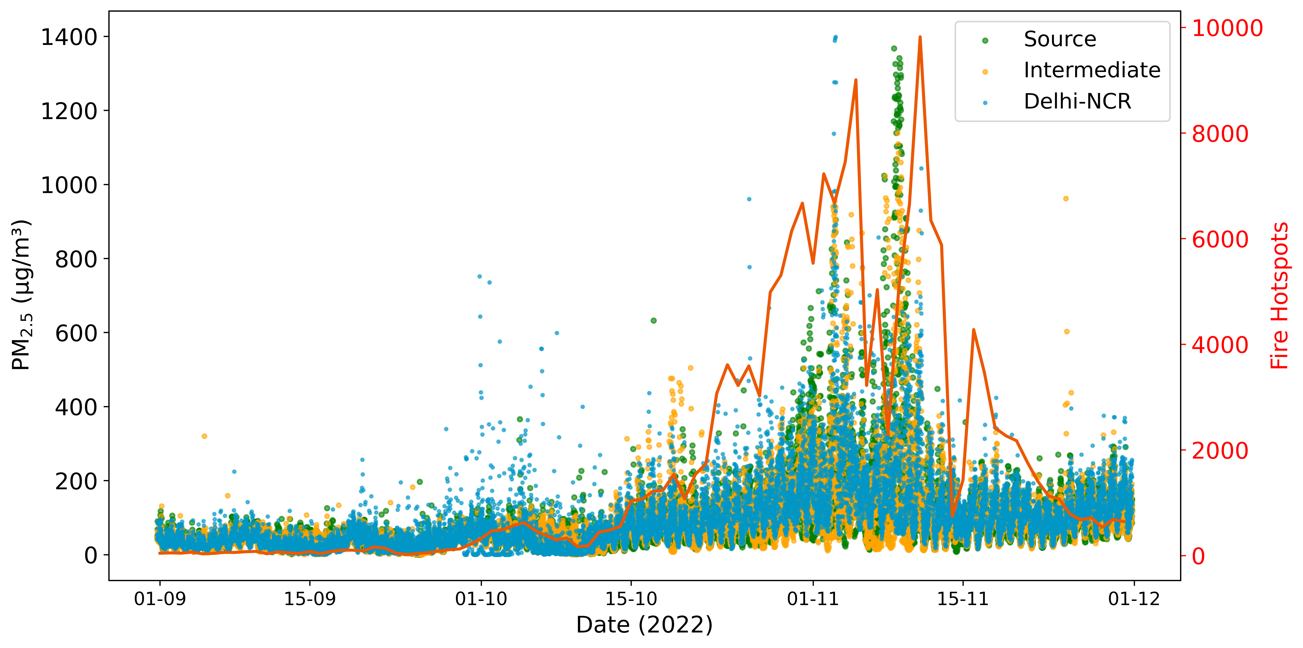
Active fires vs PM_{2.5} concentrations in north-western IGP
PM_{2.5} surface mass concentrations are elevated across IGP during periods of intense crop-residue burning (CRB).
Establishing a probable causal relationship between fire activity and surface PM_{2.5} concentrations is challenging as CRB occurs simultaneously with stagnant meteorological conditions

Slide 7
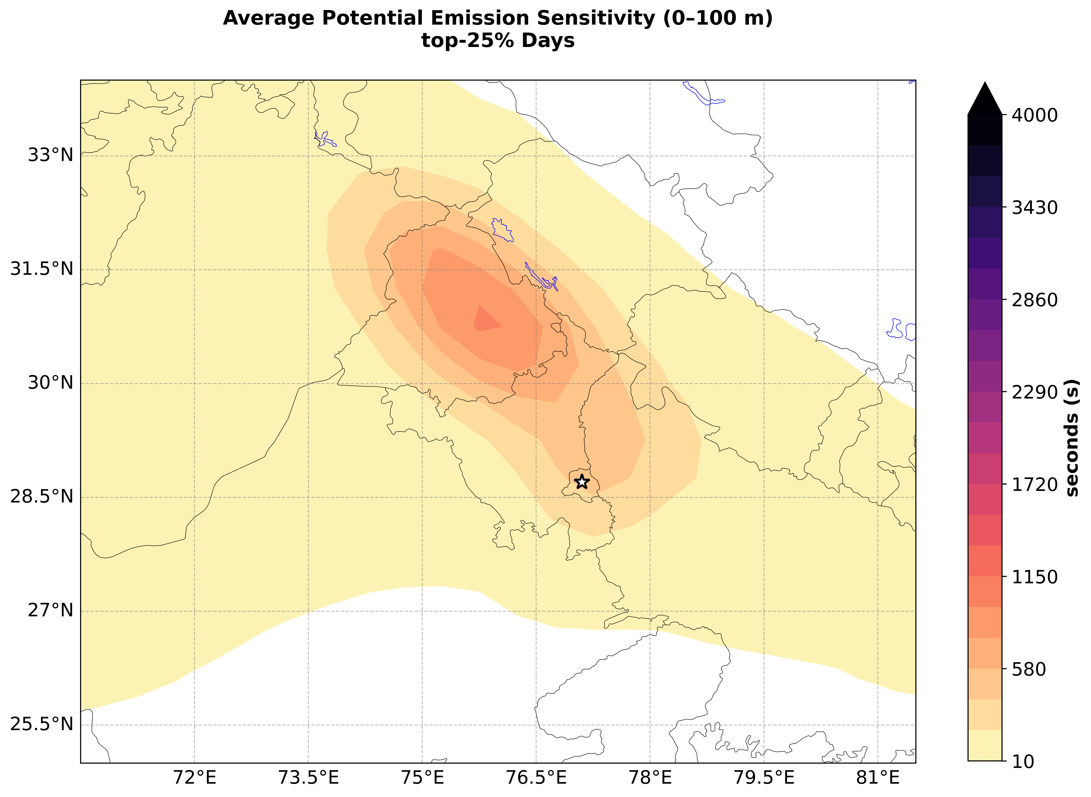
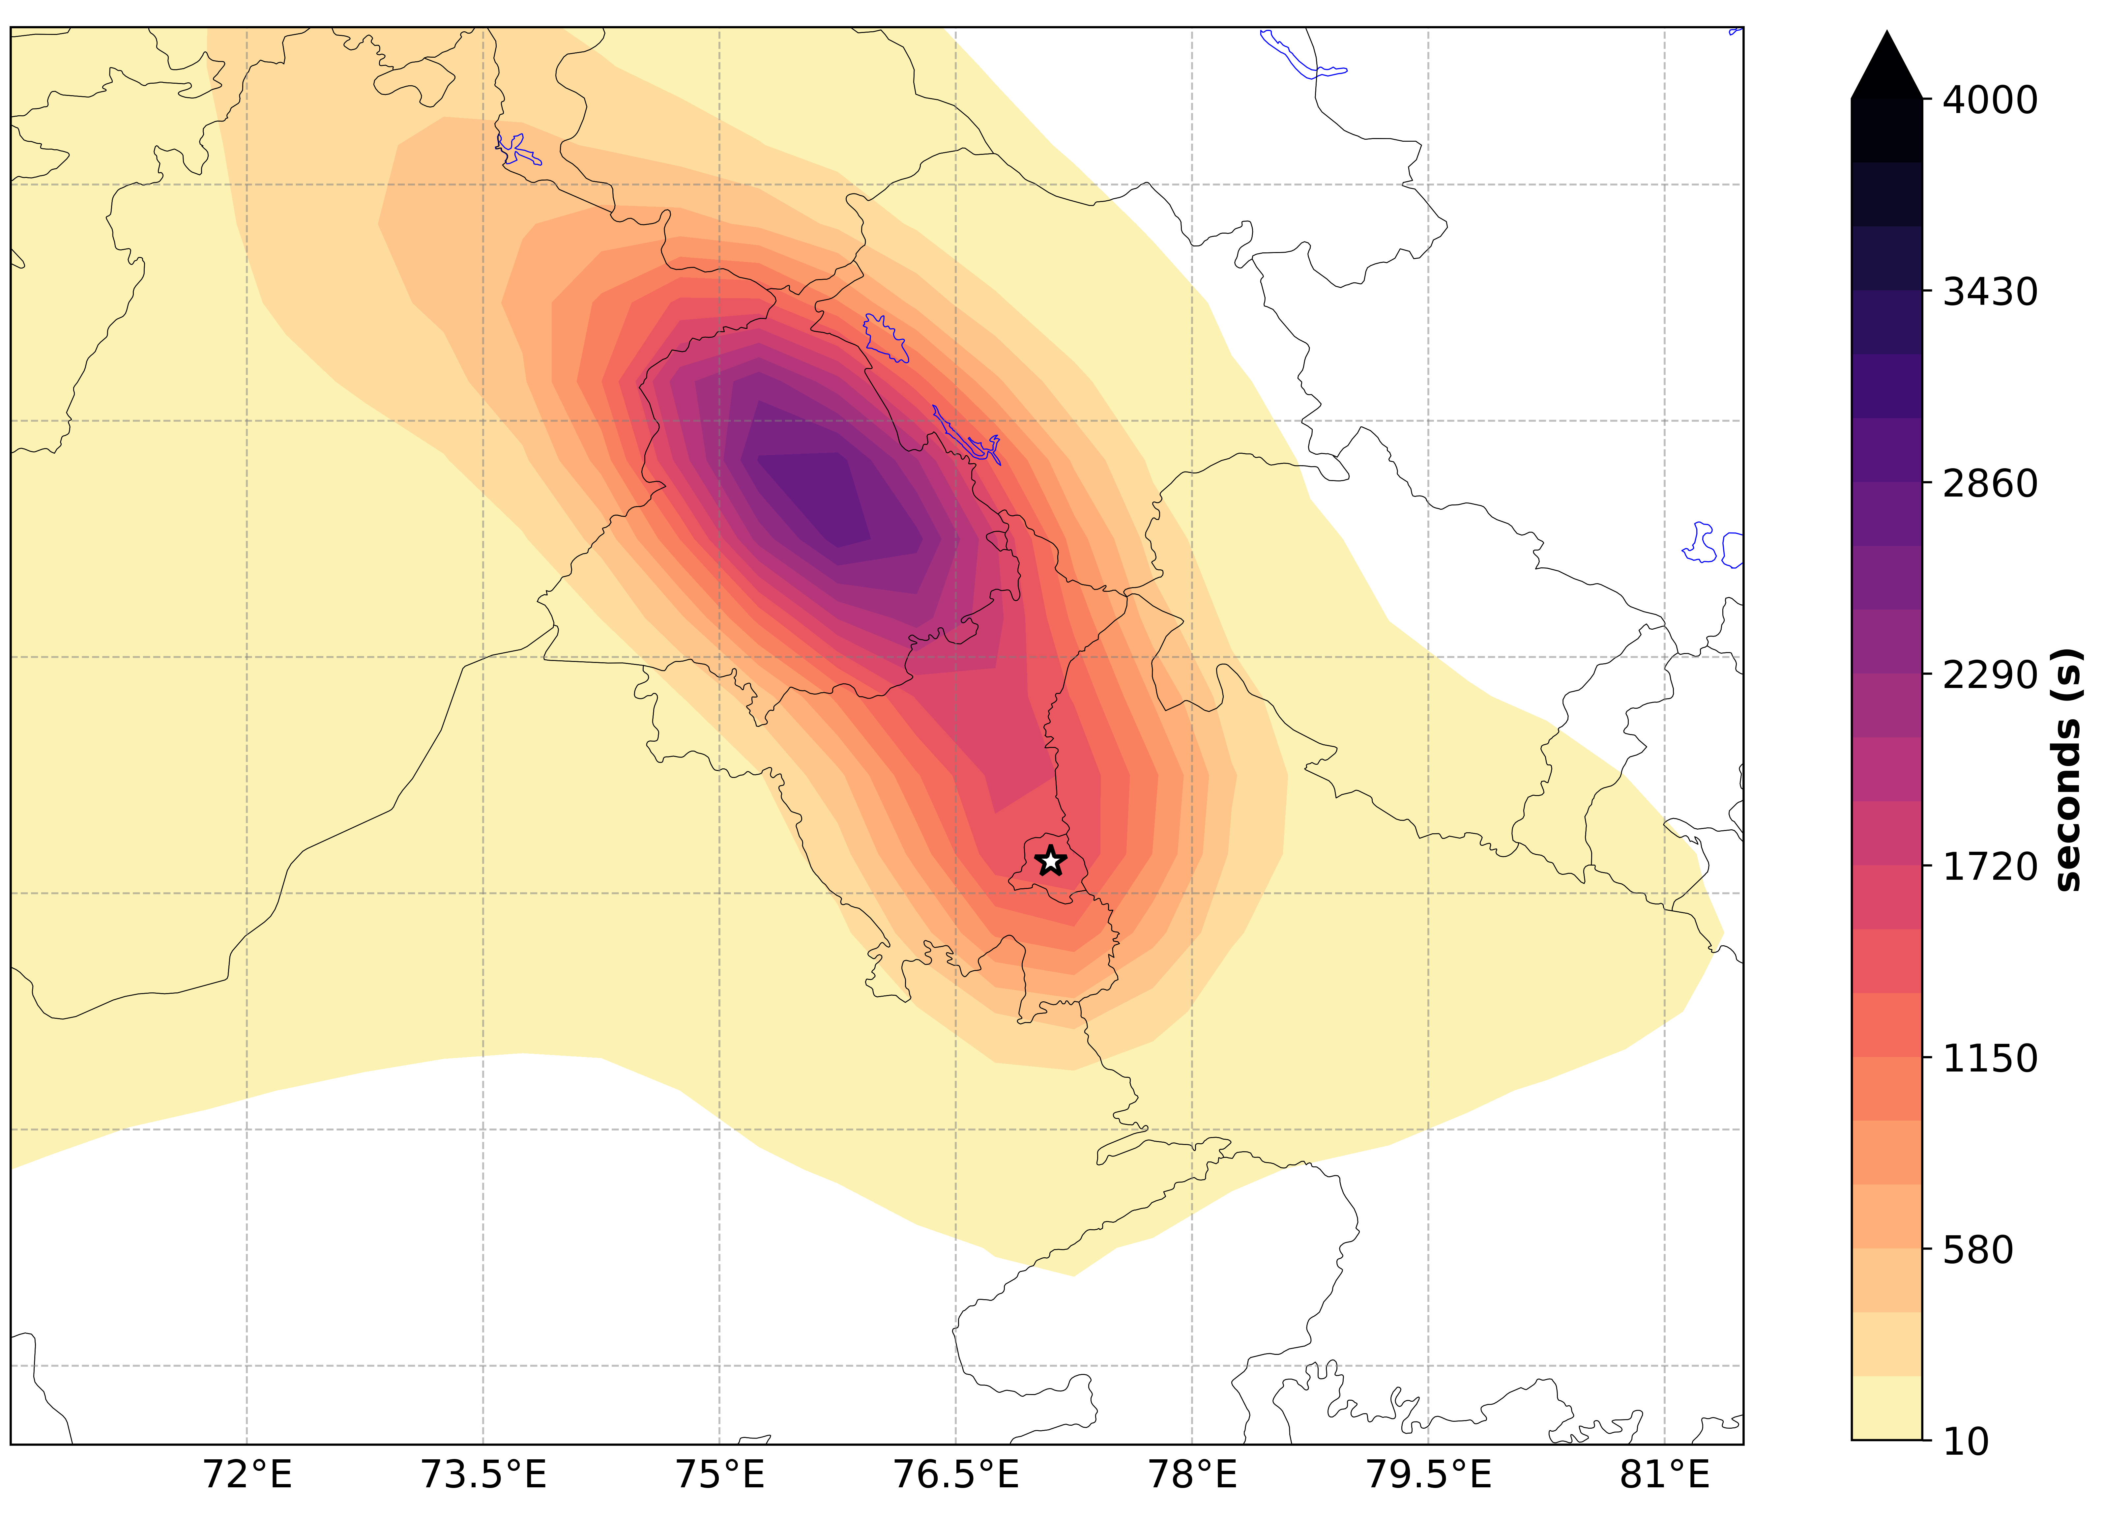
Average PES representing regional transport influence across all the receptor sites
Weighing each fire by overlapping fires over PES, period between Sept-Nov is divided into :
PES values during the biomass burning period are nearly twice those during the non-burning period owing to meteorological stagnation and weaker atmospheric ventilation during winter
Non-biomass burning (NBB)​
Biomass burning (BB)​
Source
Intermediate
Delhi NCR

Slide 8
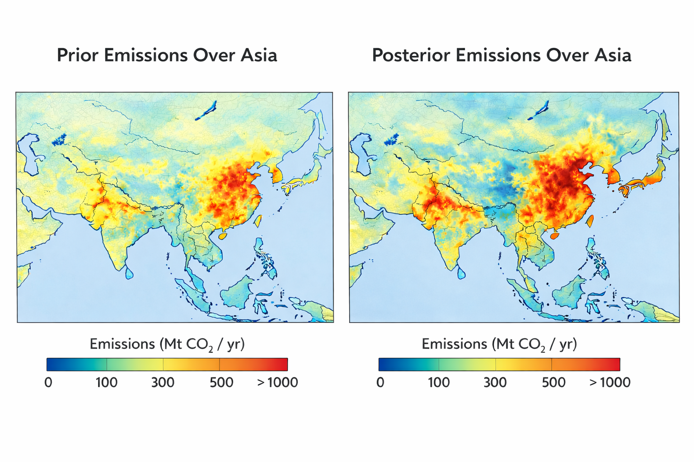
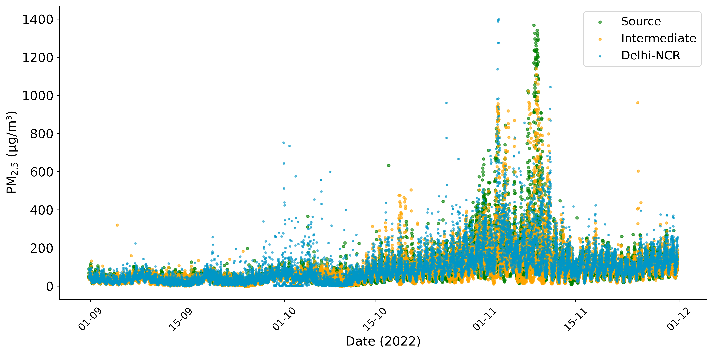
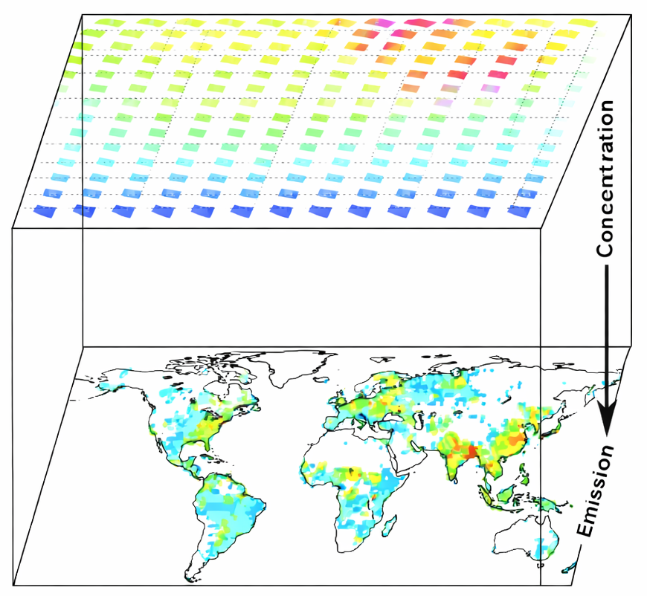
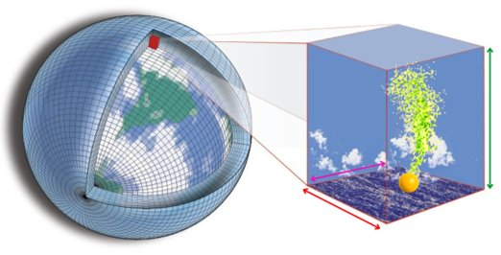
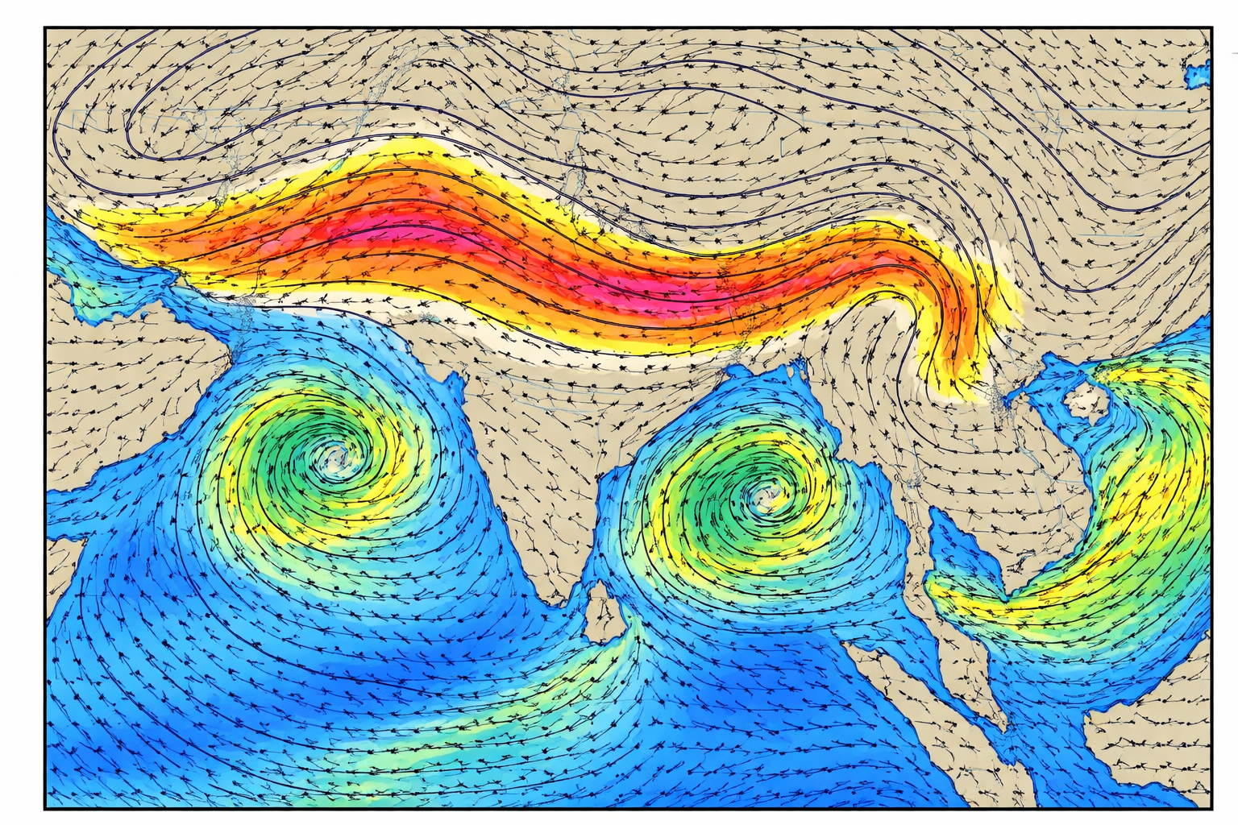
FLEXINVERT+
PM_{2.5} concentration at 32 sites
over NW IGP
ECLIPSE v6 emissions
A priori emissions
Atmospheric concentrations
Inverse model
Optimiser
Gridded reanalysis
A posteriori emissions​
+
Uncertainty estimates
+
Optimised concentrations
FLEXPART dispersion model
3-days back trajectory

Slide 9
PM_{2.5} emission fluxes during non-biomass burning period
Prior emission fluxes
Posterior emission fluxes
Positive emission adjustments over industrial and urban regions indicate that anthropogenic emissions are underestimated in the prior inventories
Negative emission adjustments over rural Punjab and central Delhi suggest that baseline emissions in these regions are slightly overestimated in global inventories
PM₂.₅ levels before the usual stubble burning are driven predominantly by industrial fuel combustion, vehicular emissions, and waste burning rather than agricultural
residue burning in Ludhiana and Mandi district
(https://timesofindia.indiatimes.com/city/chandigarh/punjabs-air-pollution-crisis-deepens-beyond-stubble-burning/articleshow/122789792.cms)
Diff = posterior - prior
% diff

Slide 10
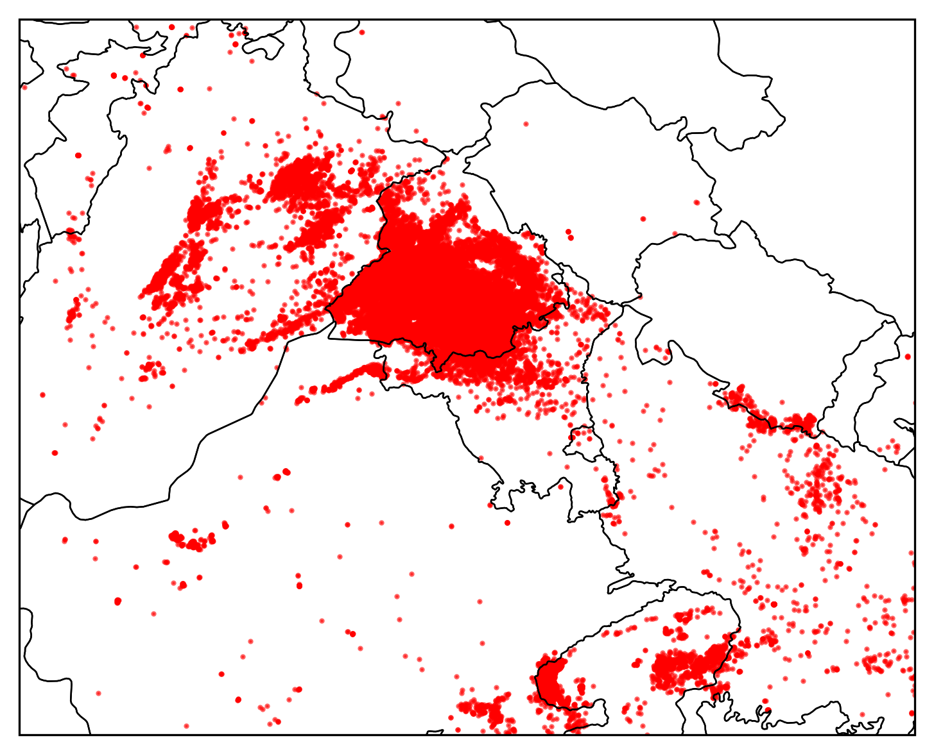
PM_{2.5} emission fluxes during biomass burning period
Posterior emission fluxes
Diff = posterior - prior
% diff
Fires from 1-10 Nov
The largest emission increases occur over the agricultural states of Punjab and Haryana, where the emission increments spatially coincide with MODIS and VIIRS fire detections.

Slide 11
Contribution from crop residue burning (CRB)
x_{NBB} = diff (NBB)
x_{BB} = diff (BB)
(x_{BB} - x_{NBB})/x_{NBB} * 100
Separating the analysis period into NBB and BB helps isolate the contribution from crop-residue burning (CRB).
Largest fractional increases occur over the upwind agricultural regions of Punjab and western Haryana (~800%) rather than urban Delhi (~100%)

Slide 12
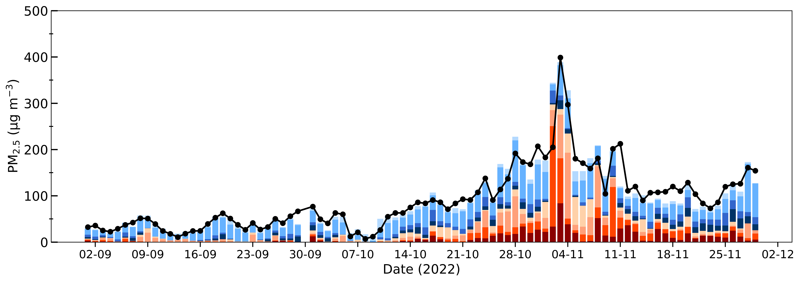
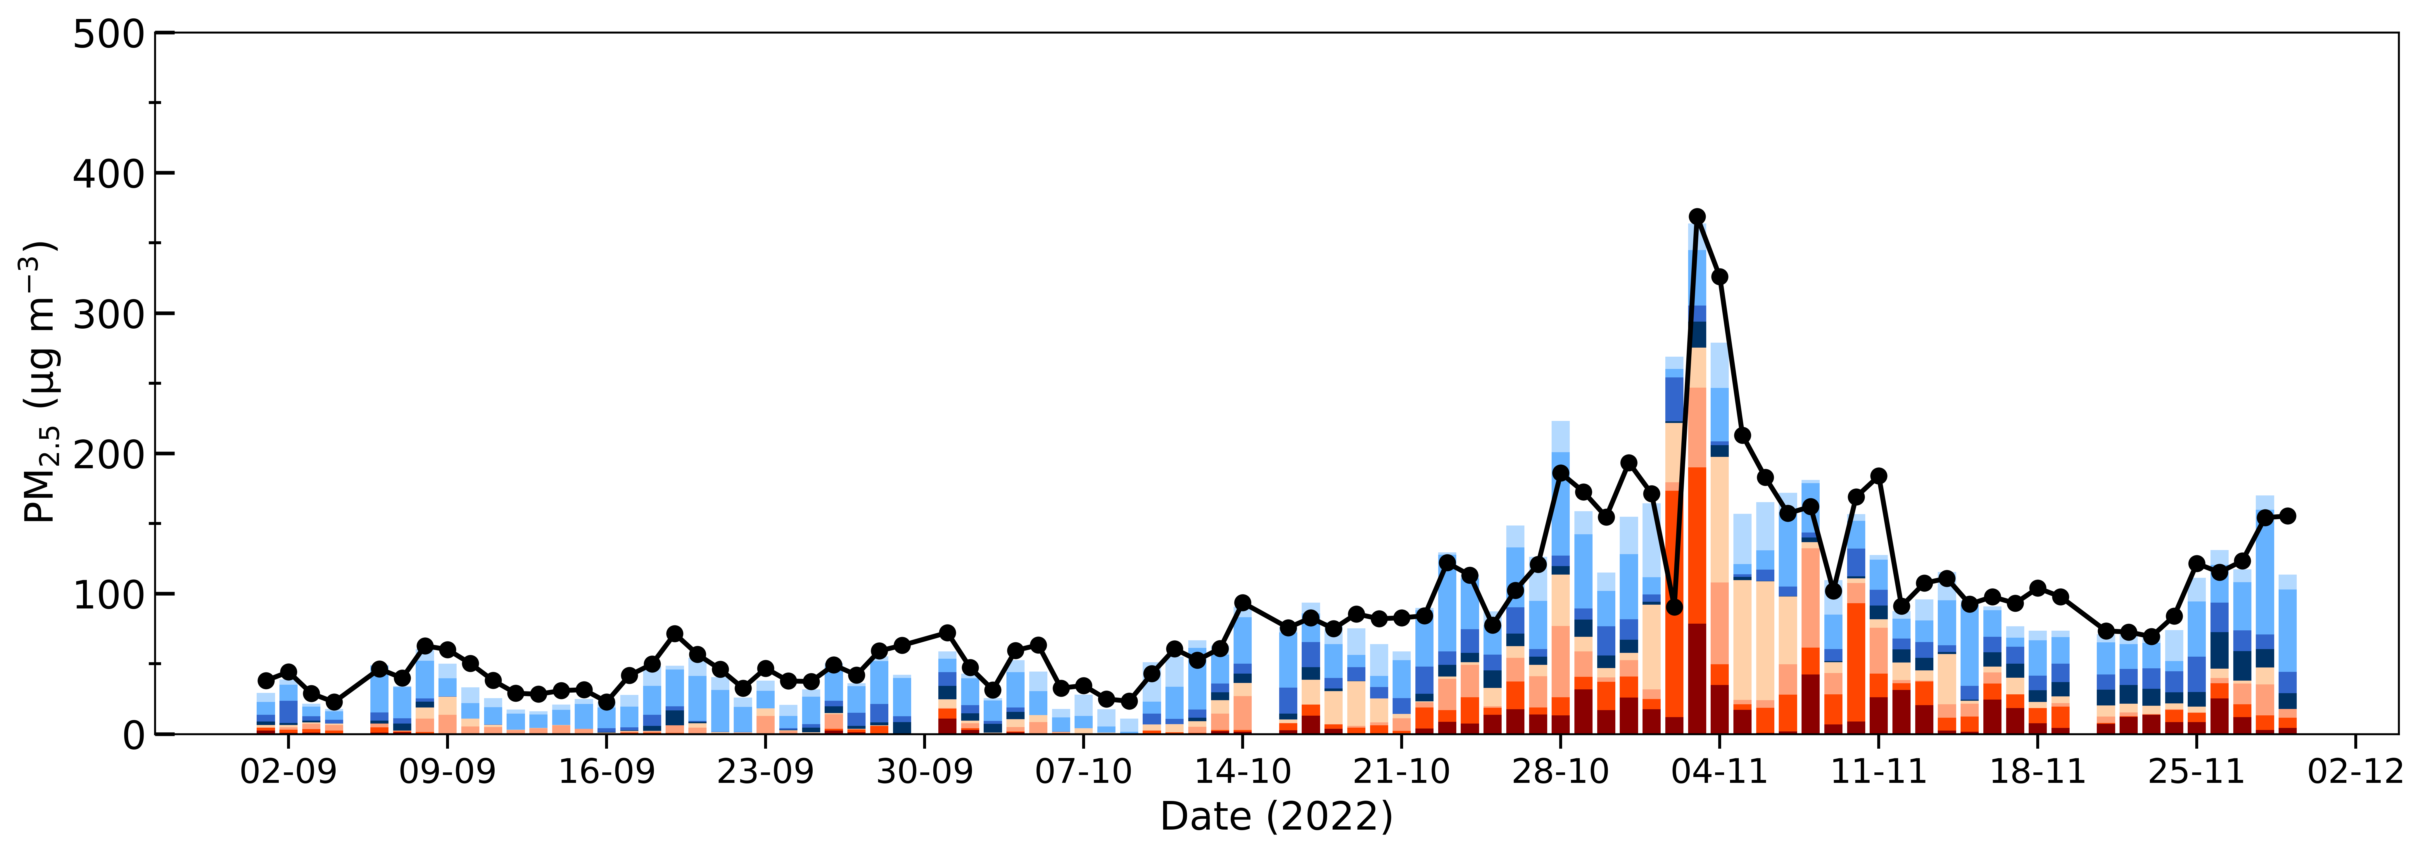
Contribution from crop residue burning (CRB) to Delhi NCR
Gurugram
Local anthropogenic emissions dominate until mid-October
CRB contribution starts increasing thereafter
During high pollution episodes (1-2 Nov), peak PM₂.₅ on 1–2 Nov is driven mainly by CRB from Haryana
Local anthropogenic emissions from Delhi remain relatively persistent throughout
Sohna

Slide 13
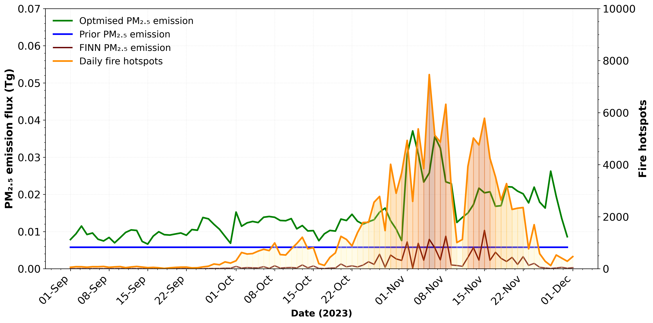
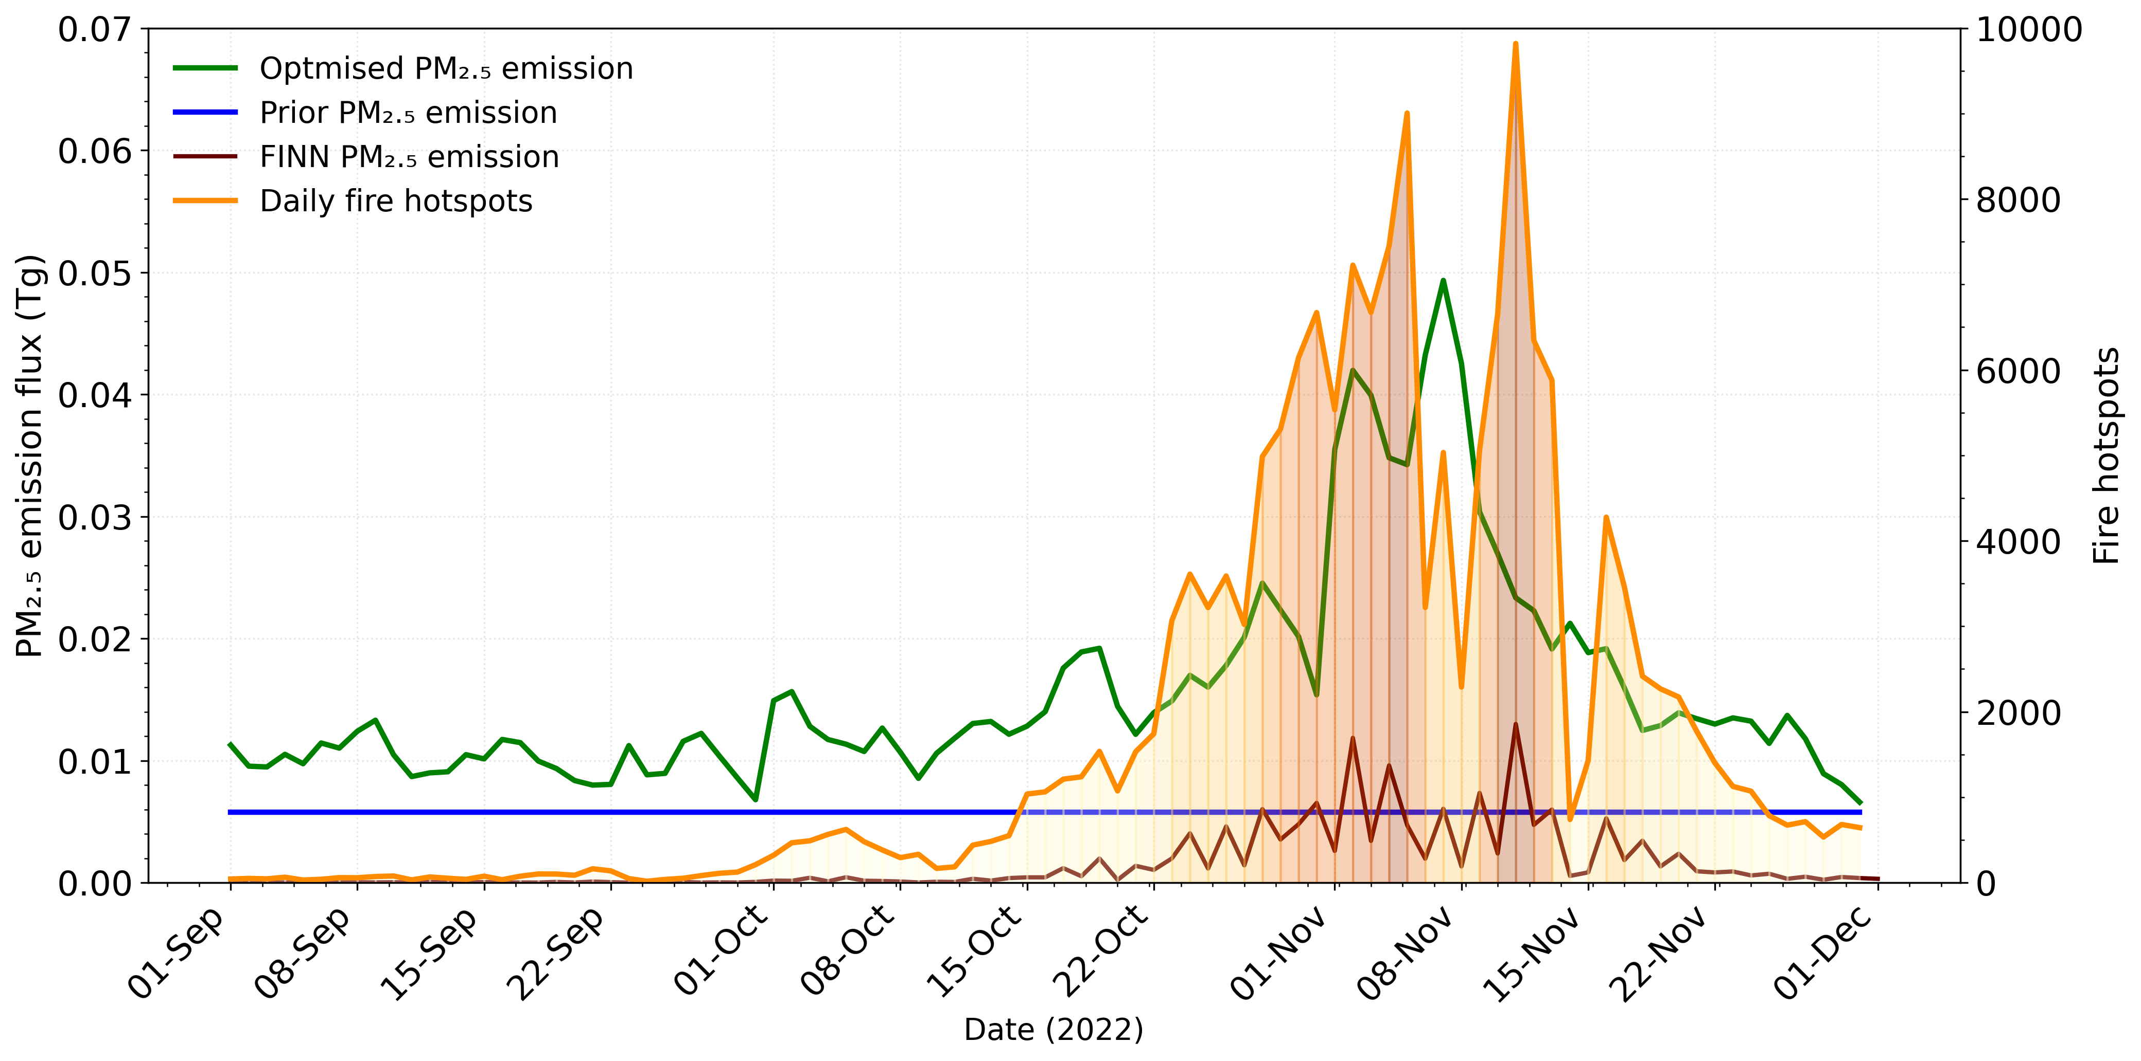
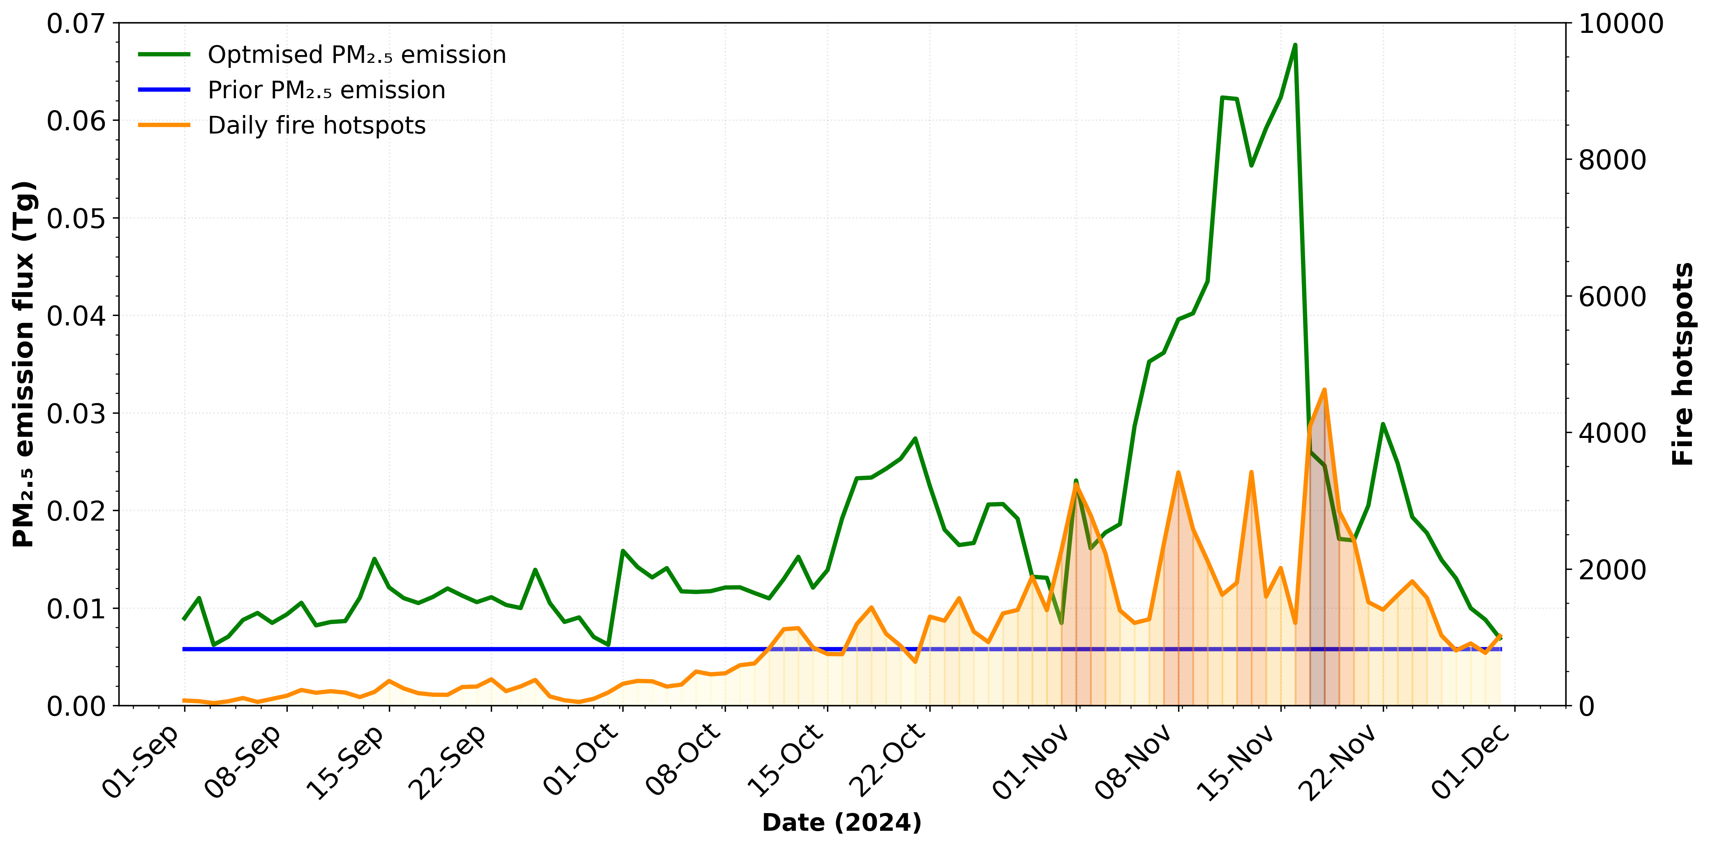
2022
Daily optimised fluxes vs active fires vs bottom-up emission inventories
Optimised PM₂.₅ emissions show strong temporal correspondence with satellite fire hotspots.
Emissions increased in 2024, in spite of the decreased satellite measured fire activity.
FINN emissions capture the timing of burning events but underestimate the magnitude.
Satellite fire counts alone are insufficient to quantify CRB emissions.
The additional biomass burning emissions are nearly 16% to 23% of total annual emissions.
2023
2024

Slide 14

Acknowledgement
Aakash Project and the personnel associated with maintenance and calibration of instruments, and the curation of data for PM_{2.5} data over Northwest India,
FLEXPART and FLEXINVERT+ model Developers,
ECMWF for meteorological data,
International Institute for Applied Systems Analysis (IIASA) for ECLIPSEv6 PM_{2.5} emission inventory
Thank you!

Slide 15
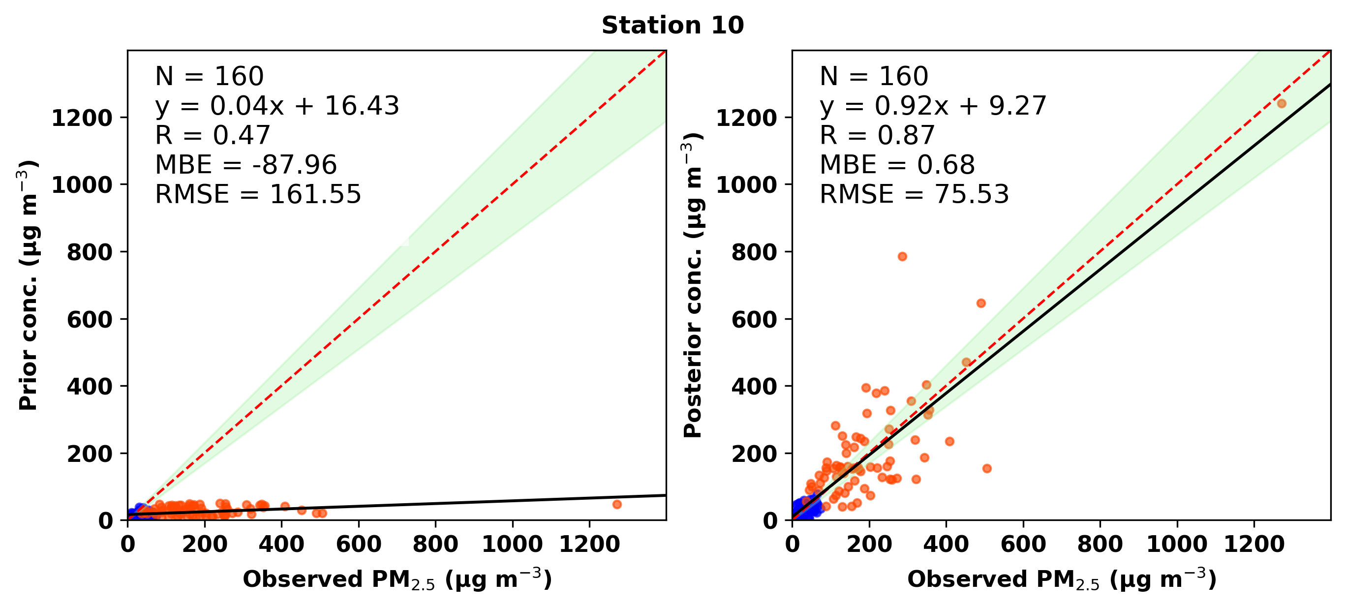
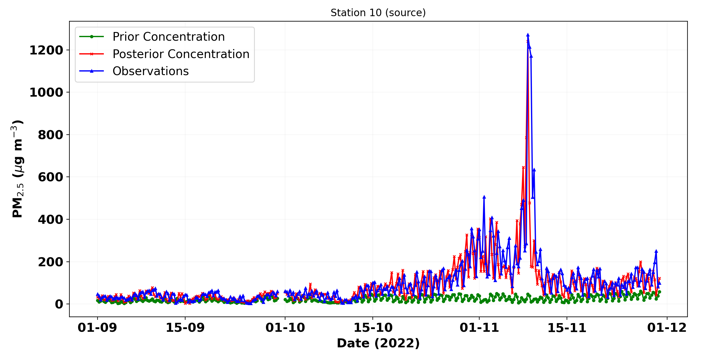
Observed vs Prior vs posterior concentrations : Source region (Sangrur, rural)
NBB
BB

Slide 16
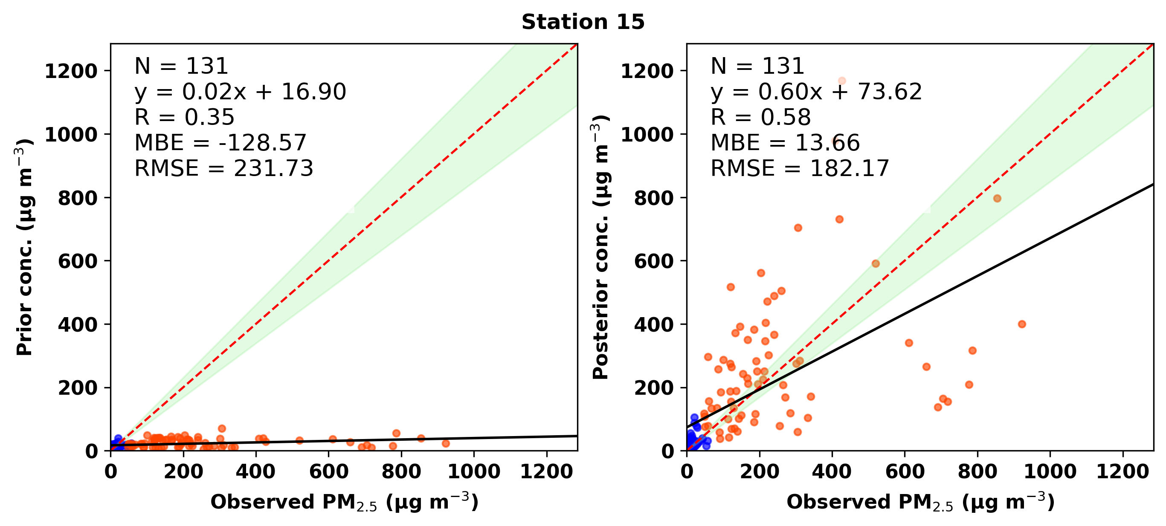
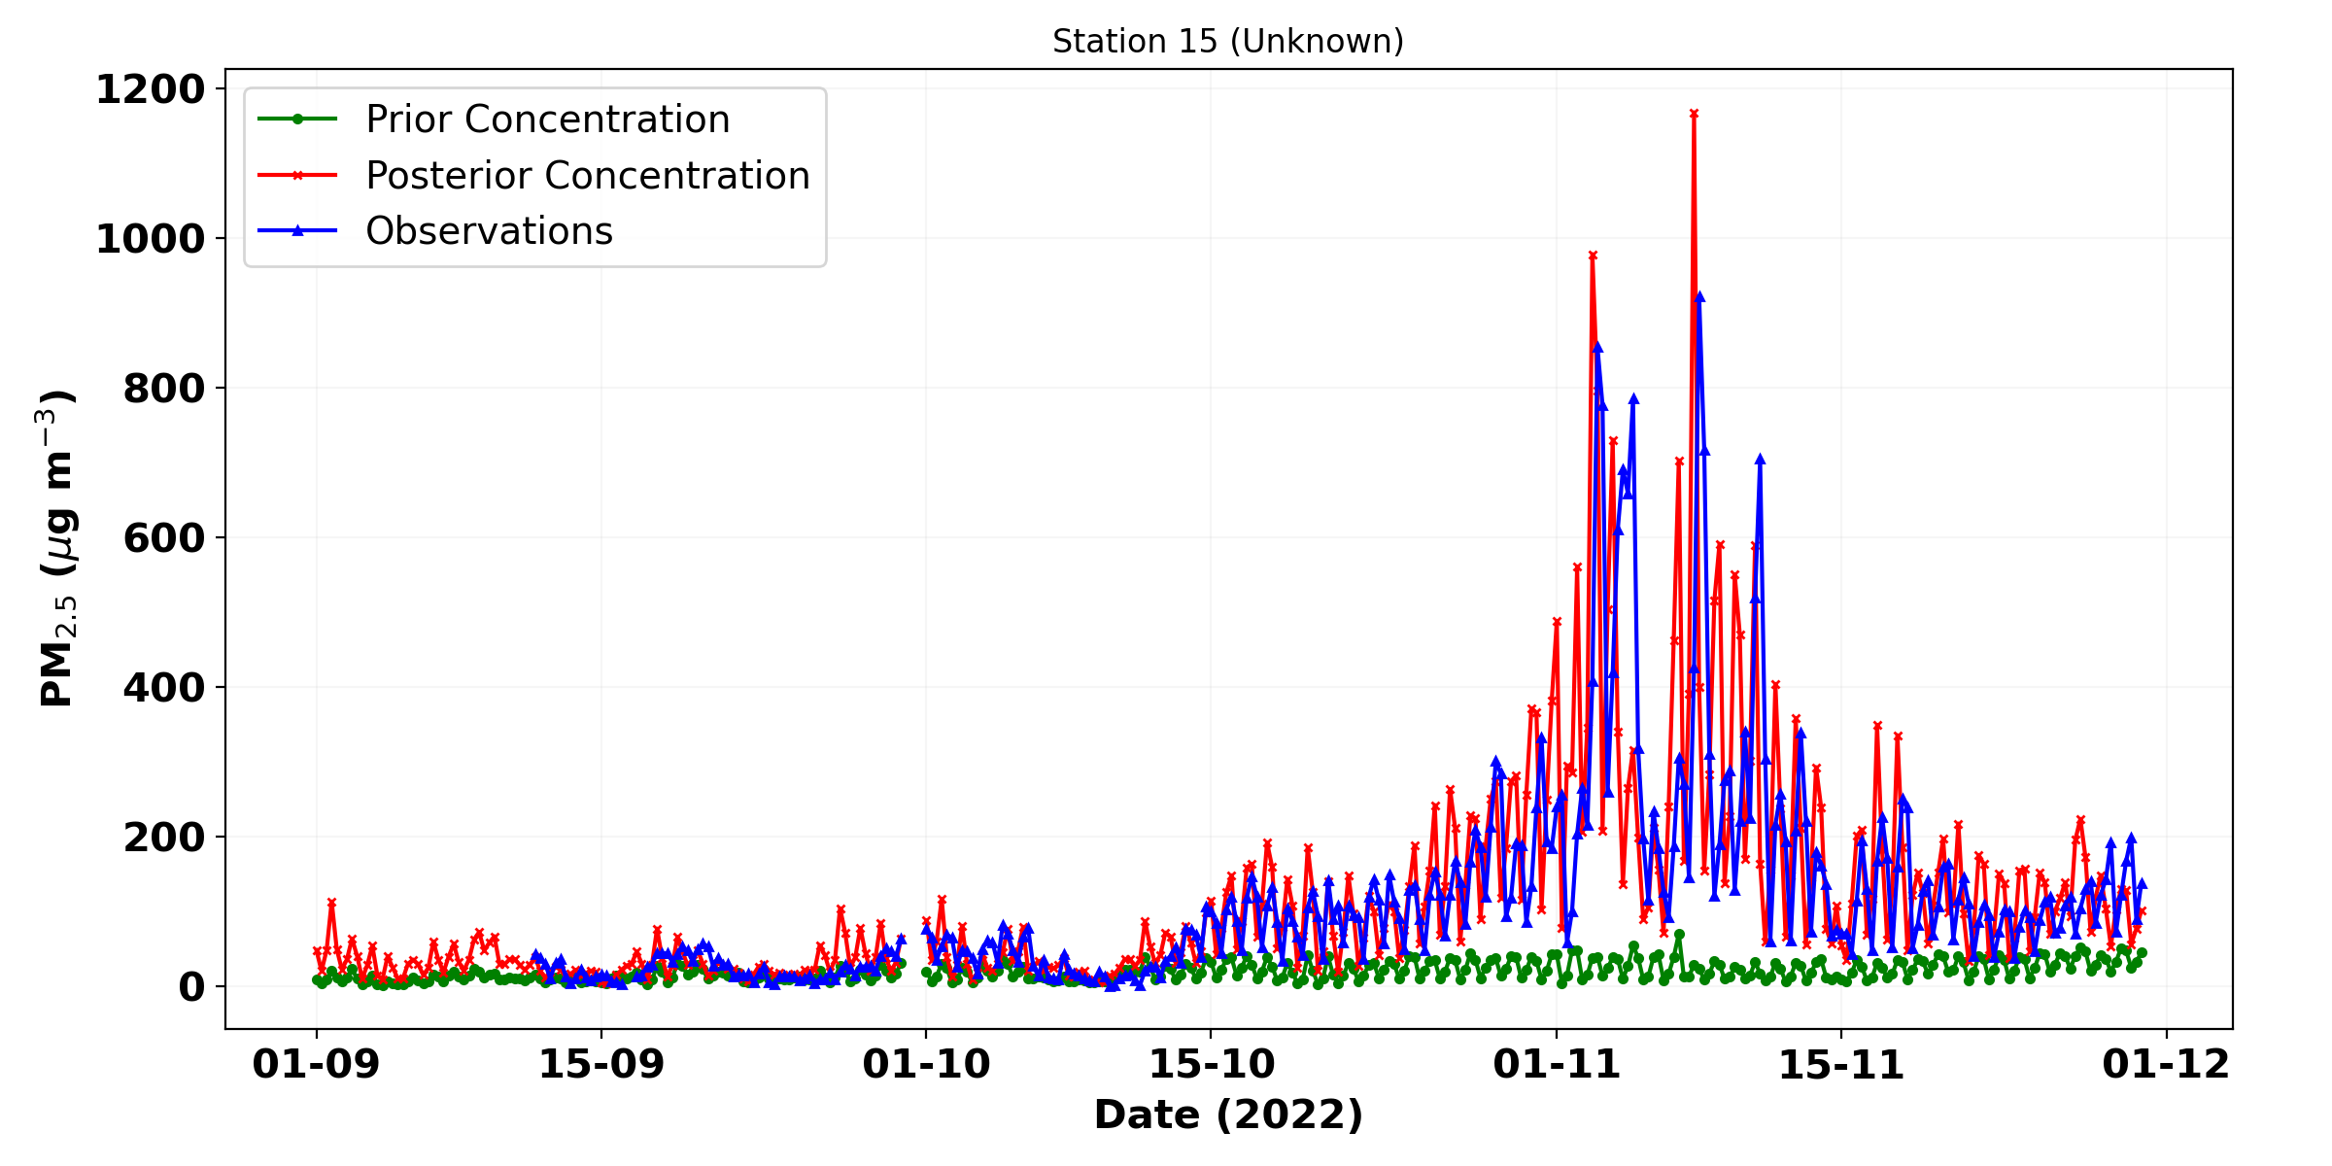
Observed vs Prior vs posterior concentrations : Independent station (Hisar, Haryana)
Prior concentrations strongly underestimate observed PM₂.₅ variability.
Posterior concentrations better reproduce the temporal variability and show improved agreement with observations
NBB
BB

Slide 17
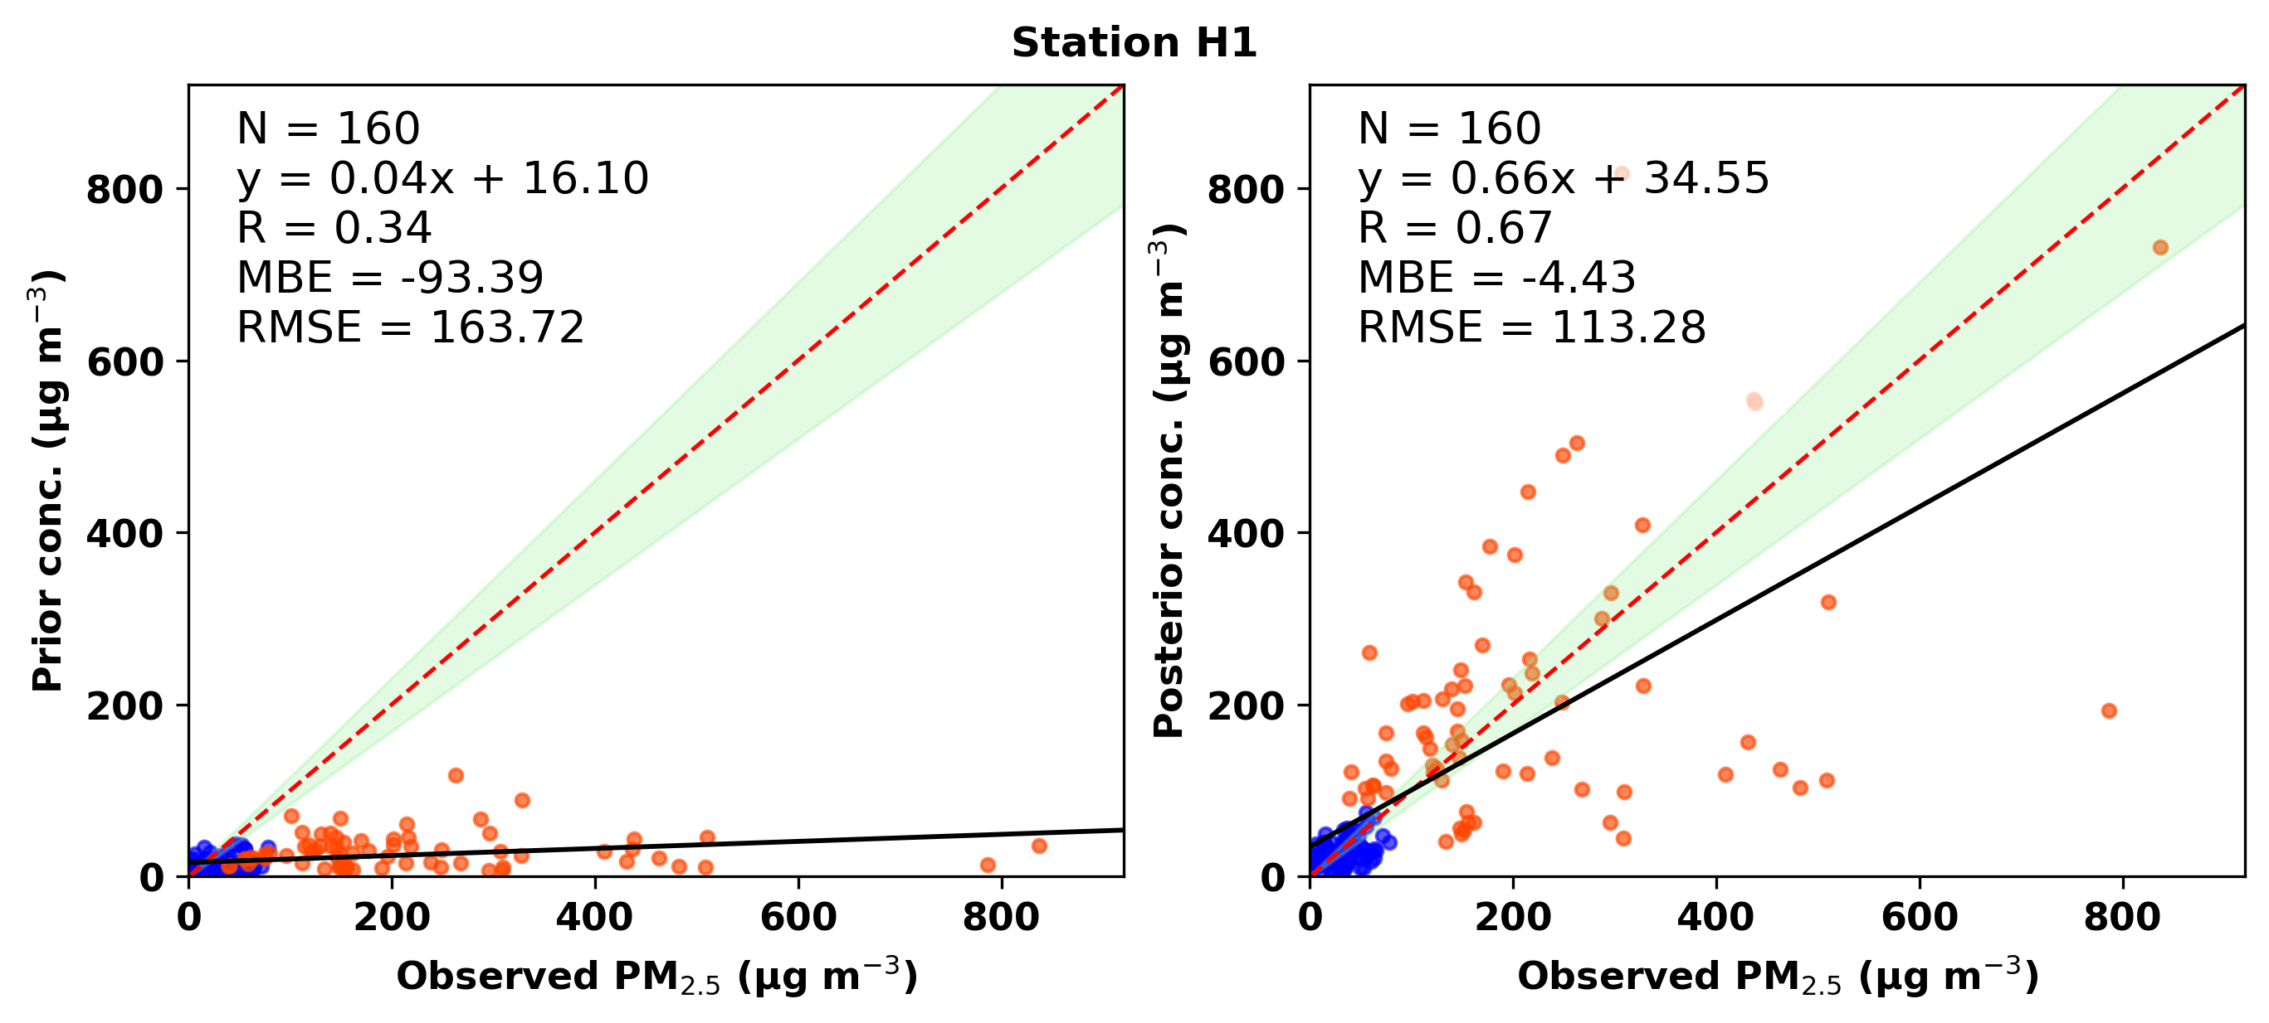
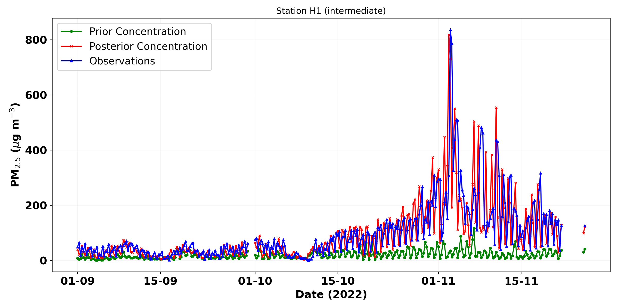
Observed vs Prior vs posterior concentrations : Intermediate region (Jind, rural)
NBB
BB

Slide 18
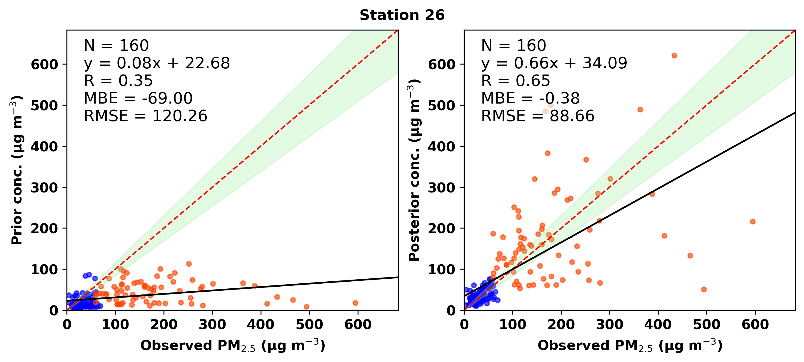
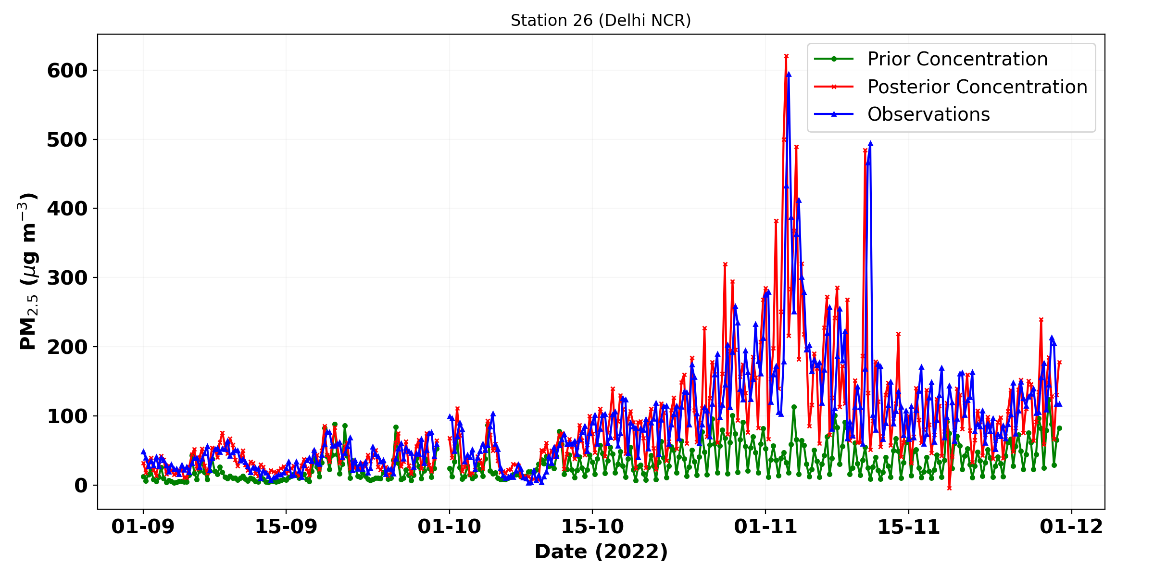
Observed vs Prior vs posterior concentrations : Delhi NCR region (Gurugram, urban)
NBB
BB

Slide 19
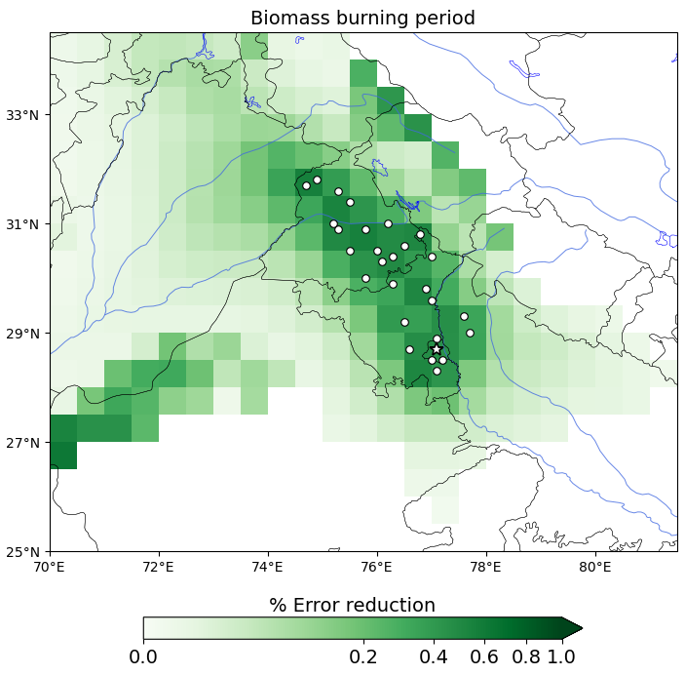
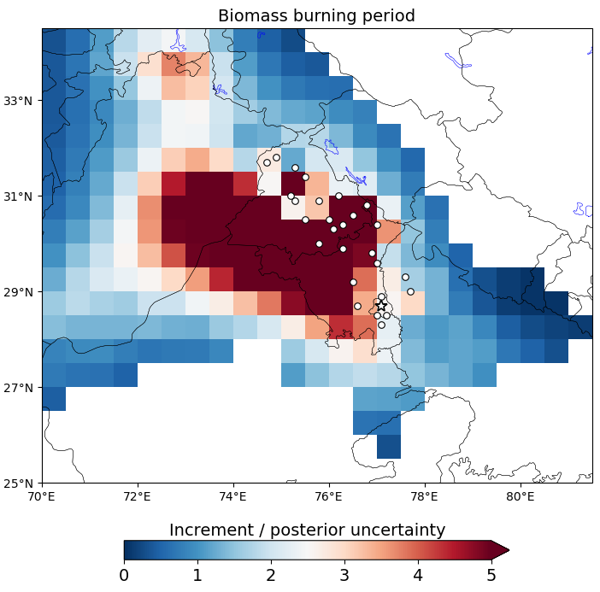
Uncertainty reduction​ and significance of posterior increments
(posterior – prior)
posterior uncertainty
Substantial uncertainty reduction is observed in regions with strong source–receptor sensitivity and dense observation coverage.
Significance value ~ 5 occur over Punjab and Haryana where intense crop-residue burning occurs.
>1
Indicates where emission adjustments are statistically significant

Slide 20
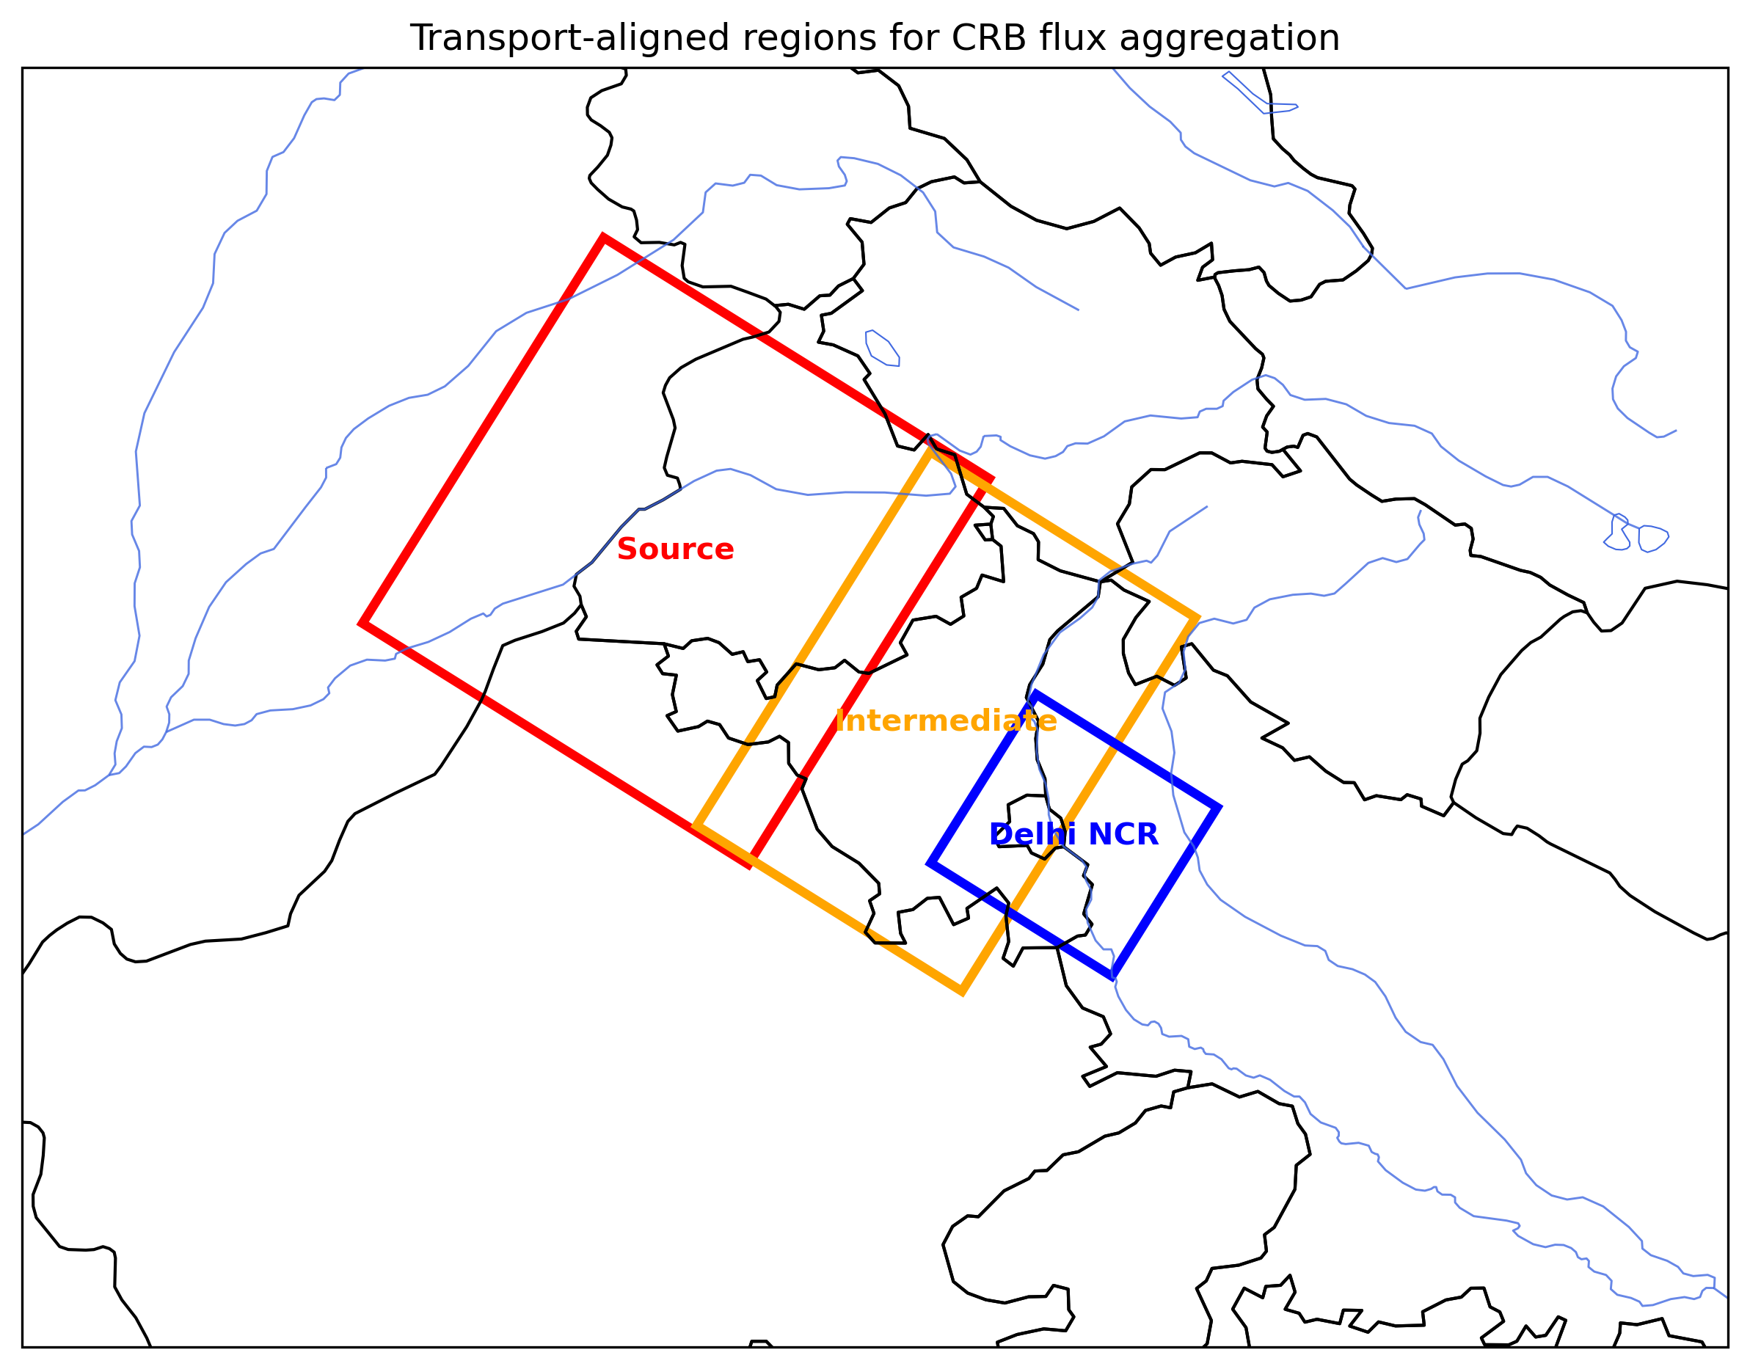
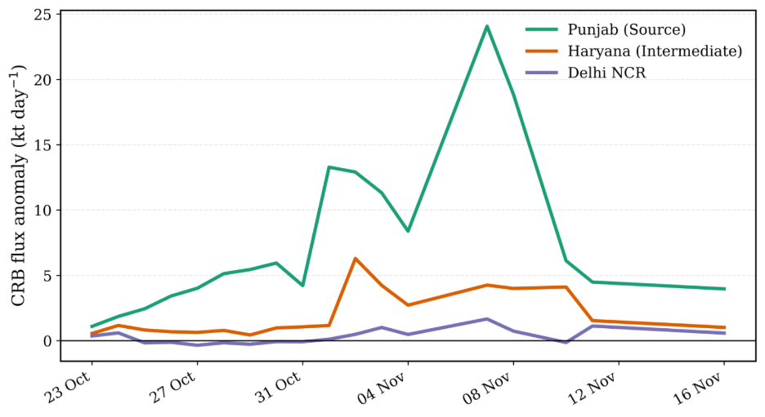
Daily optimised fluxes during biomass burning period

