Slide 1
AMOC Storylines to inform Ireland's National Climate Projections
Markus Todt, John Hanley, Paul Nolan*, Enda O’Dea, Tido Semmler
* Irish Centre for High-End Computing

Slide 2
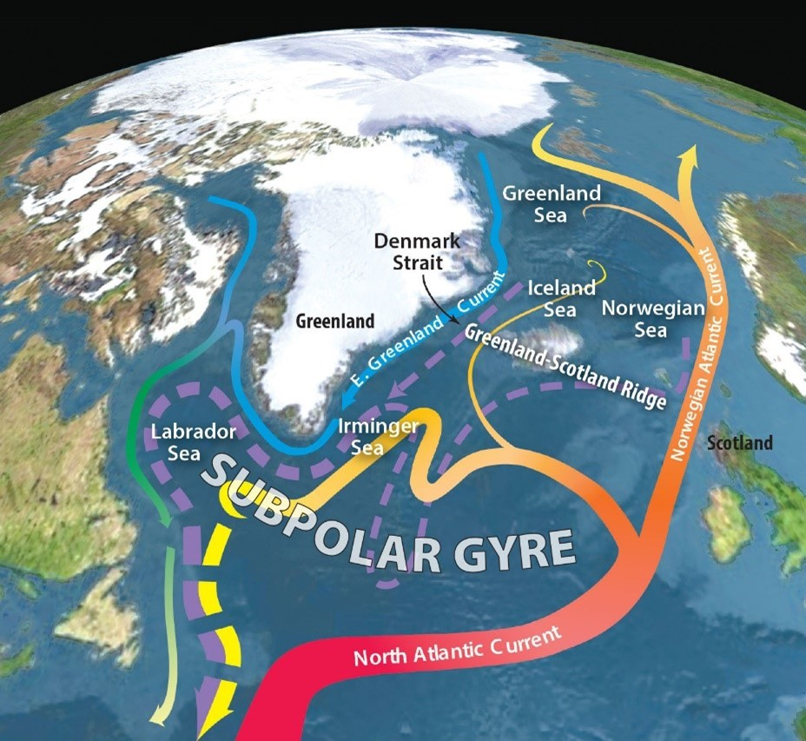
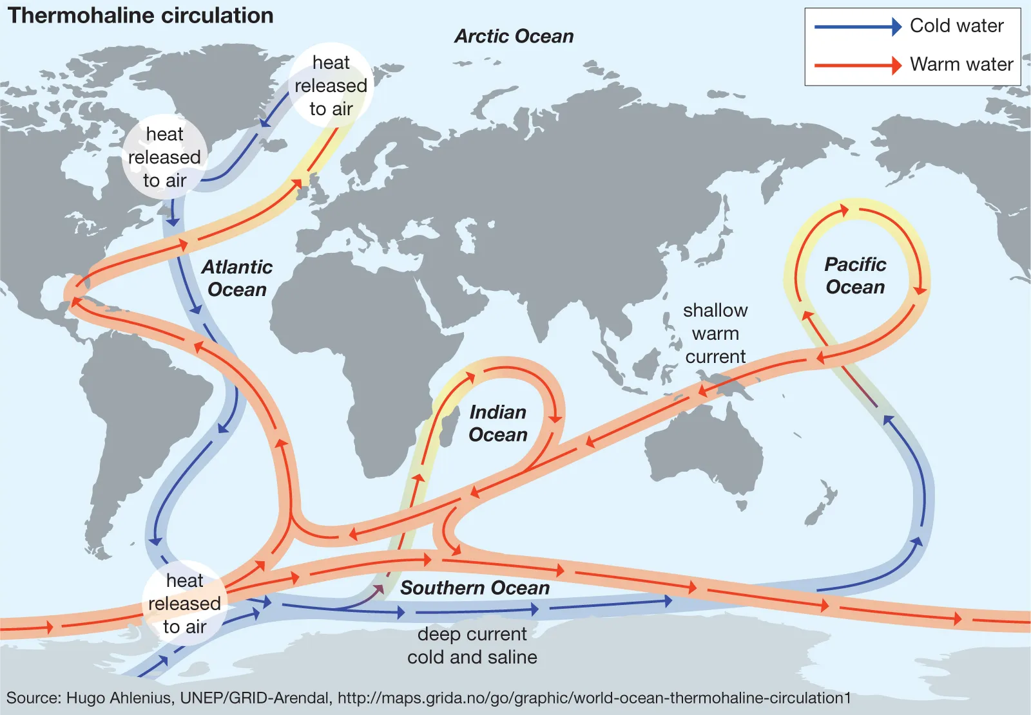
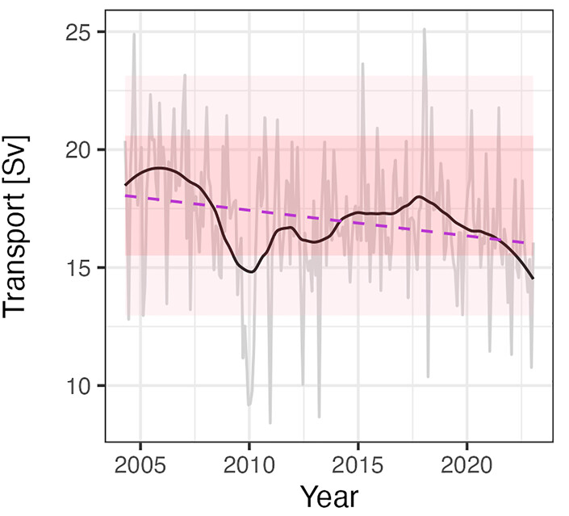
AMOC =
Atlantic Meridional Overturning Circulation
Rahmstorf (2024, modified from R. Curry and C. Mauritzen at WHOI)
Measurements from RAPID array (McCarthy et al., 2025)

Slide 3
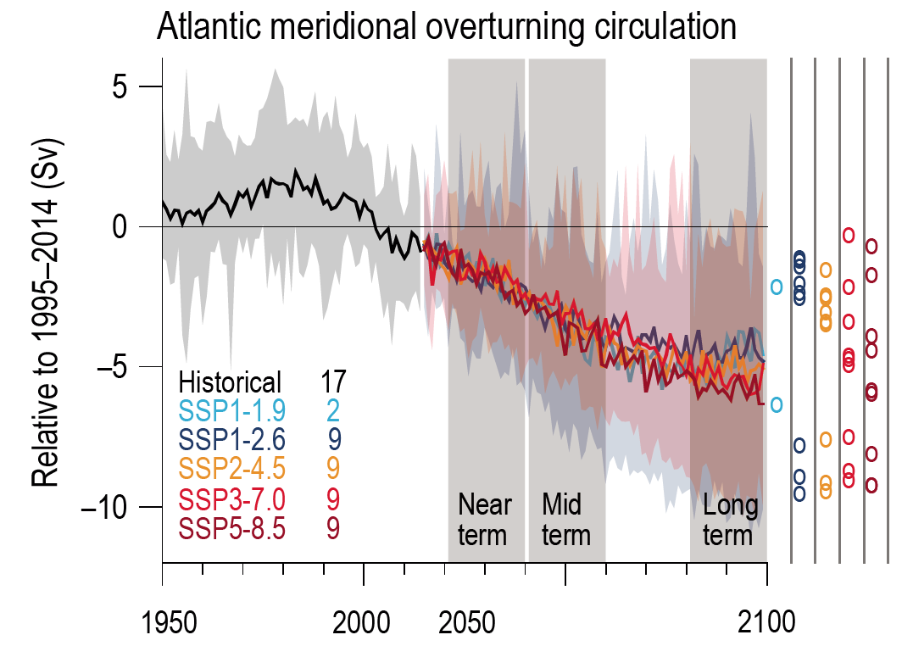
Figure 4.6 in IPCC AR6 (2021)
Weijer et al. (2020):
“In fact, AMOC decline in CMIP6 is surprisingly insensitive to the scenario at least up to 2060. We find an emergent relationship among a majority of models between AMOC strength and 21st century AMOC decline. Constraining this relationship with RAPID observations suggests that the AMOC might decline between 6 and 8 Sv (34–45%) by 2100.”
Notes:
Looked at AMOC decline in Irish National Projections/Euro-CORDEX but cut here for brevity. Included as supplementary slides after Summary.

Slide 4
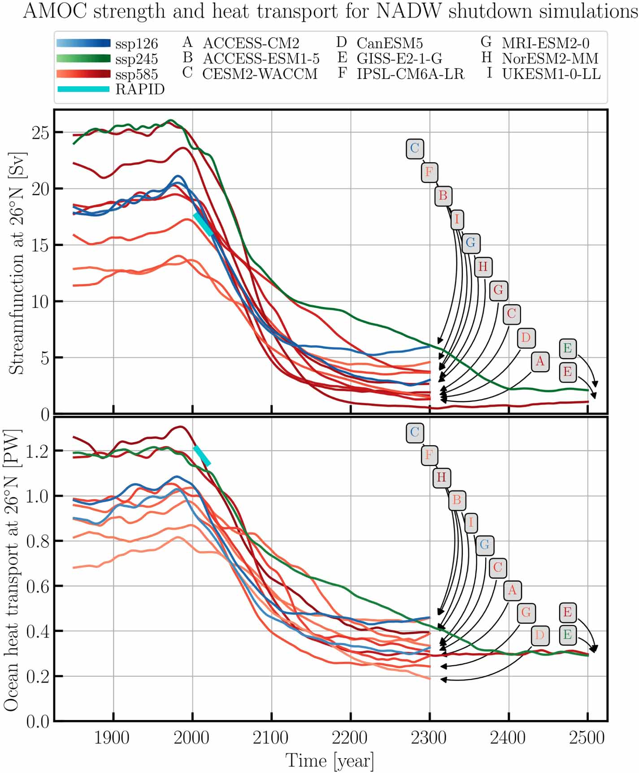
Drijfhout et al. (2025):
“In the CMIP6 ensemble a northern AMOC shutdown by 2300 occurs in 67% of all model-runs in an SSP585 scenario; 30% of all model-runs in an SSP245 and 21%, in an SSP126 scenario.”
Adapted from Drijfhout et al. (2025)
Notes:
Note that the simulations shown in this figure are only a subset of all the CMIP6 simulations that extend past 2100.

Slide 5
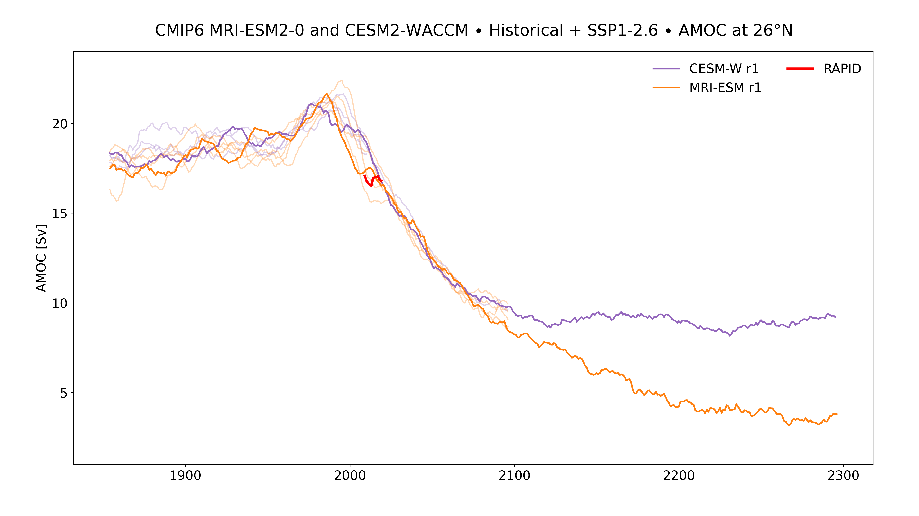
AMOC Storyline: strong decline under low SSP

Slide 6
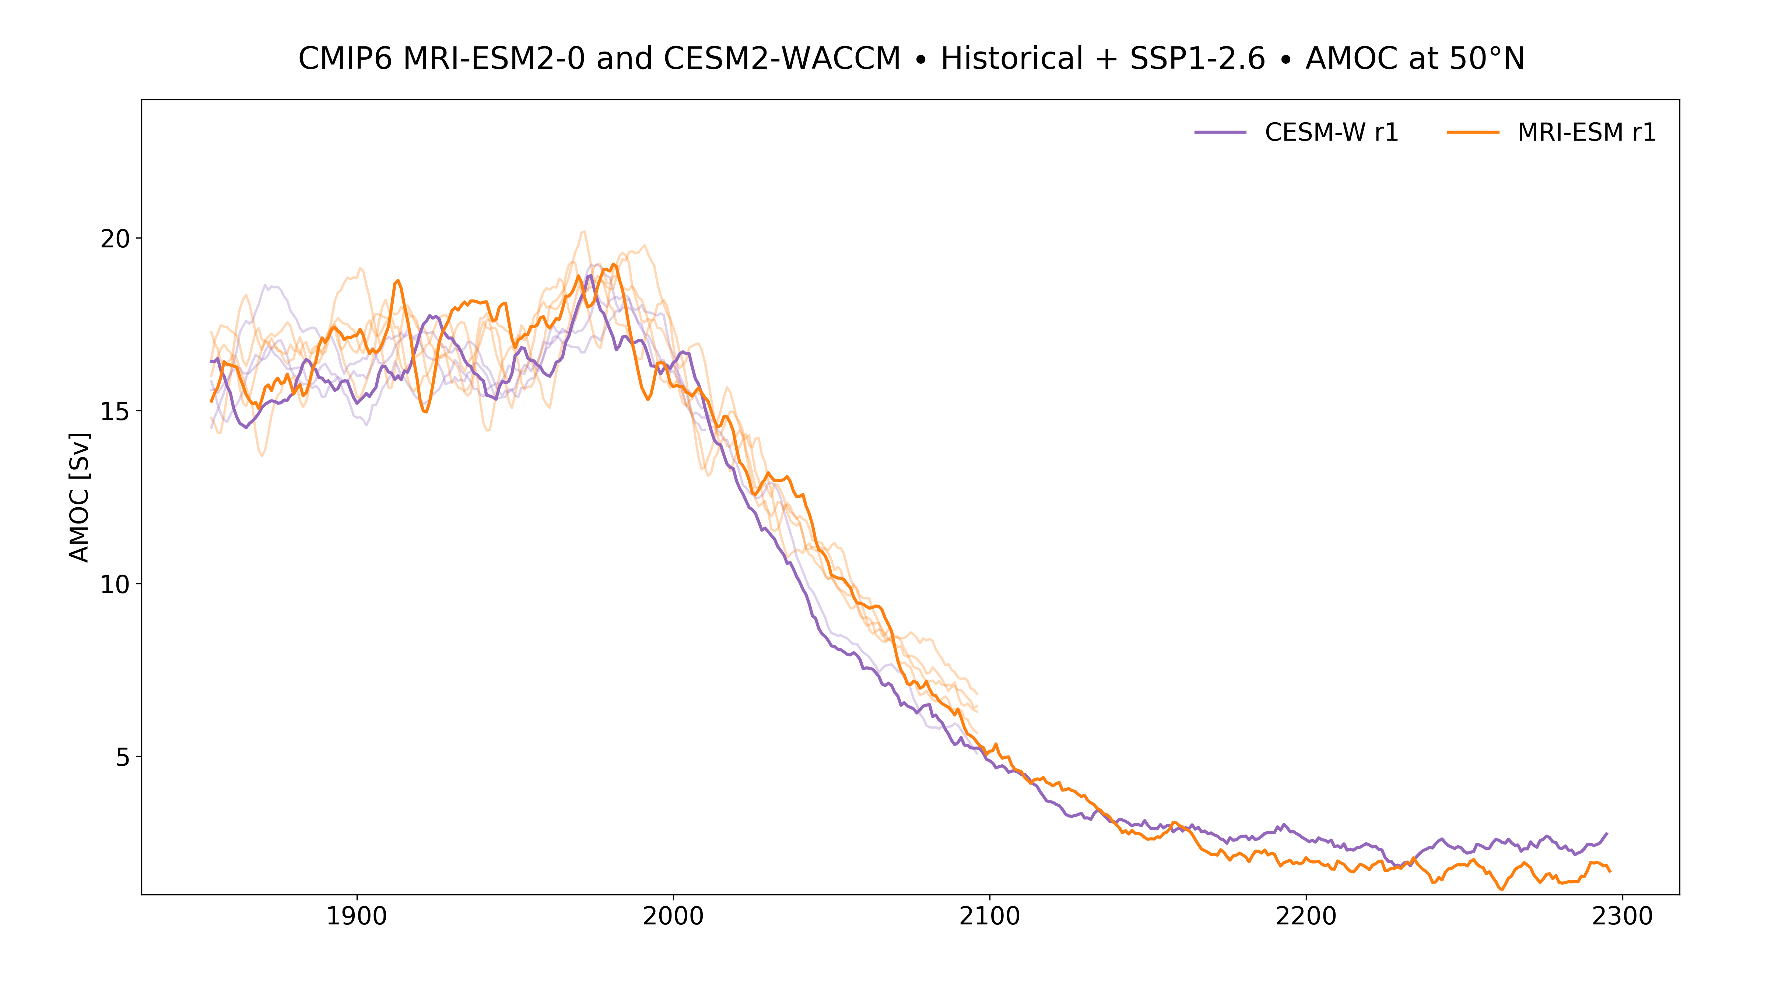
AMOC Storyline: strong decline under low SSP

Slide 7
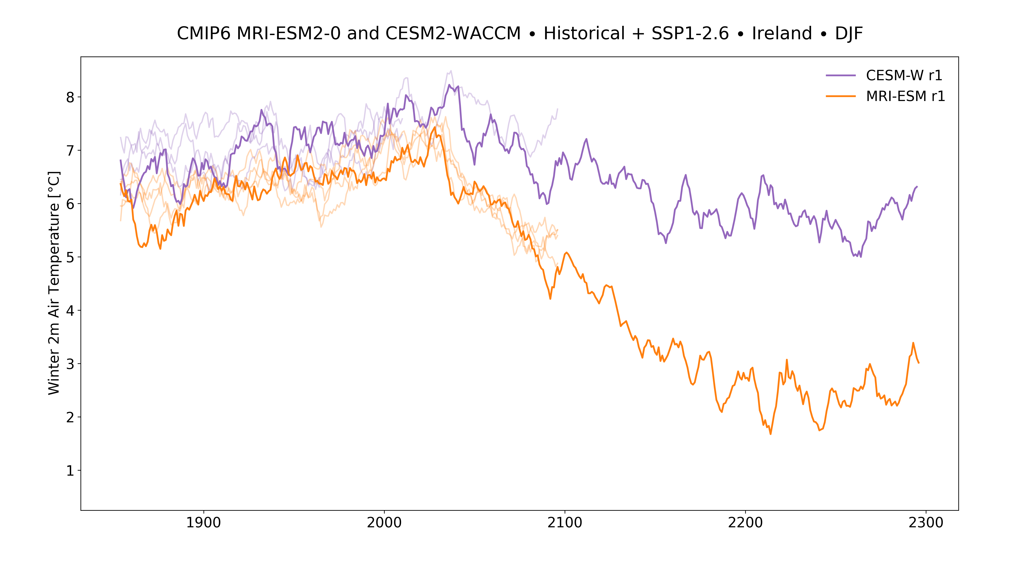
AMOC Storyline: strong decline under low SSP

Slide 8
Summary
CMIP6 GCMs included in Ireland’s national projections (and Euro-CORDEX) feature a range of AMOC weakening trends.
Degree of weakening shows clear influence on Ireland’s temperature and to a lesser degree on Ireland’s summer precipitation.
Two CMIP6 simulations extend beyond 2100 under SSP1-2.6 while featuring a strong AMOC decline.
We plan to dynamically downscale these as high-impact, low-likelihood scenarios for Ireland to supplement national projections.
Questions?

Slide 9

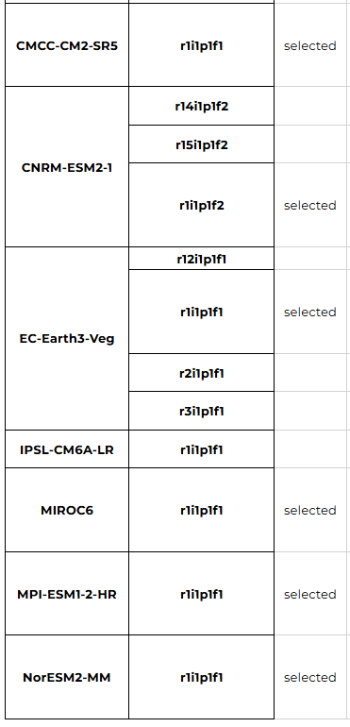
AMOC decline in National Projections/Euro-CORDEX
Irish national projections are a combination of Euro-CORDEX and dynamically downscaled simulations at 4km (mainly with WRF and COSMO). Next iteration will include:
EC-Earth3 (r11i1p1f1)
EC-Earth3-Veg (r1i1p1f1, r12i1p1f1, r14i1p1f1)
MPI-ESM1-2-HR (r1i1p1f1, r2i1p1f1)
MIROC6 (r1i1p1f1)
NorESM2-MM (r1i1p1f1)
CNRM-ESM2-1 (r1i1p1f2)
CMCC-CM2-SR5 (r1i1p1f1)
Euro-CORDEX

Slide 10
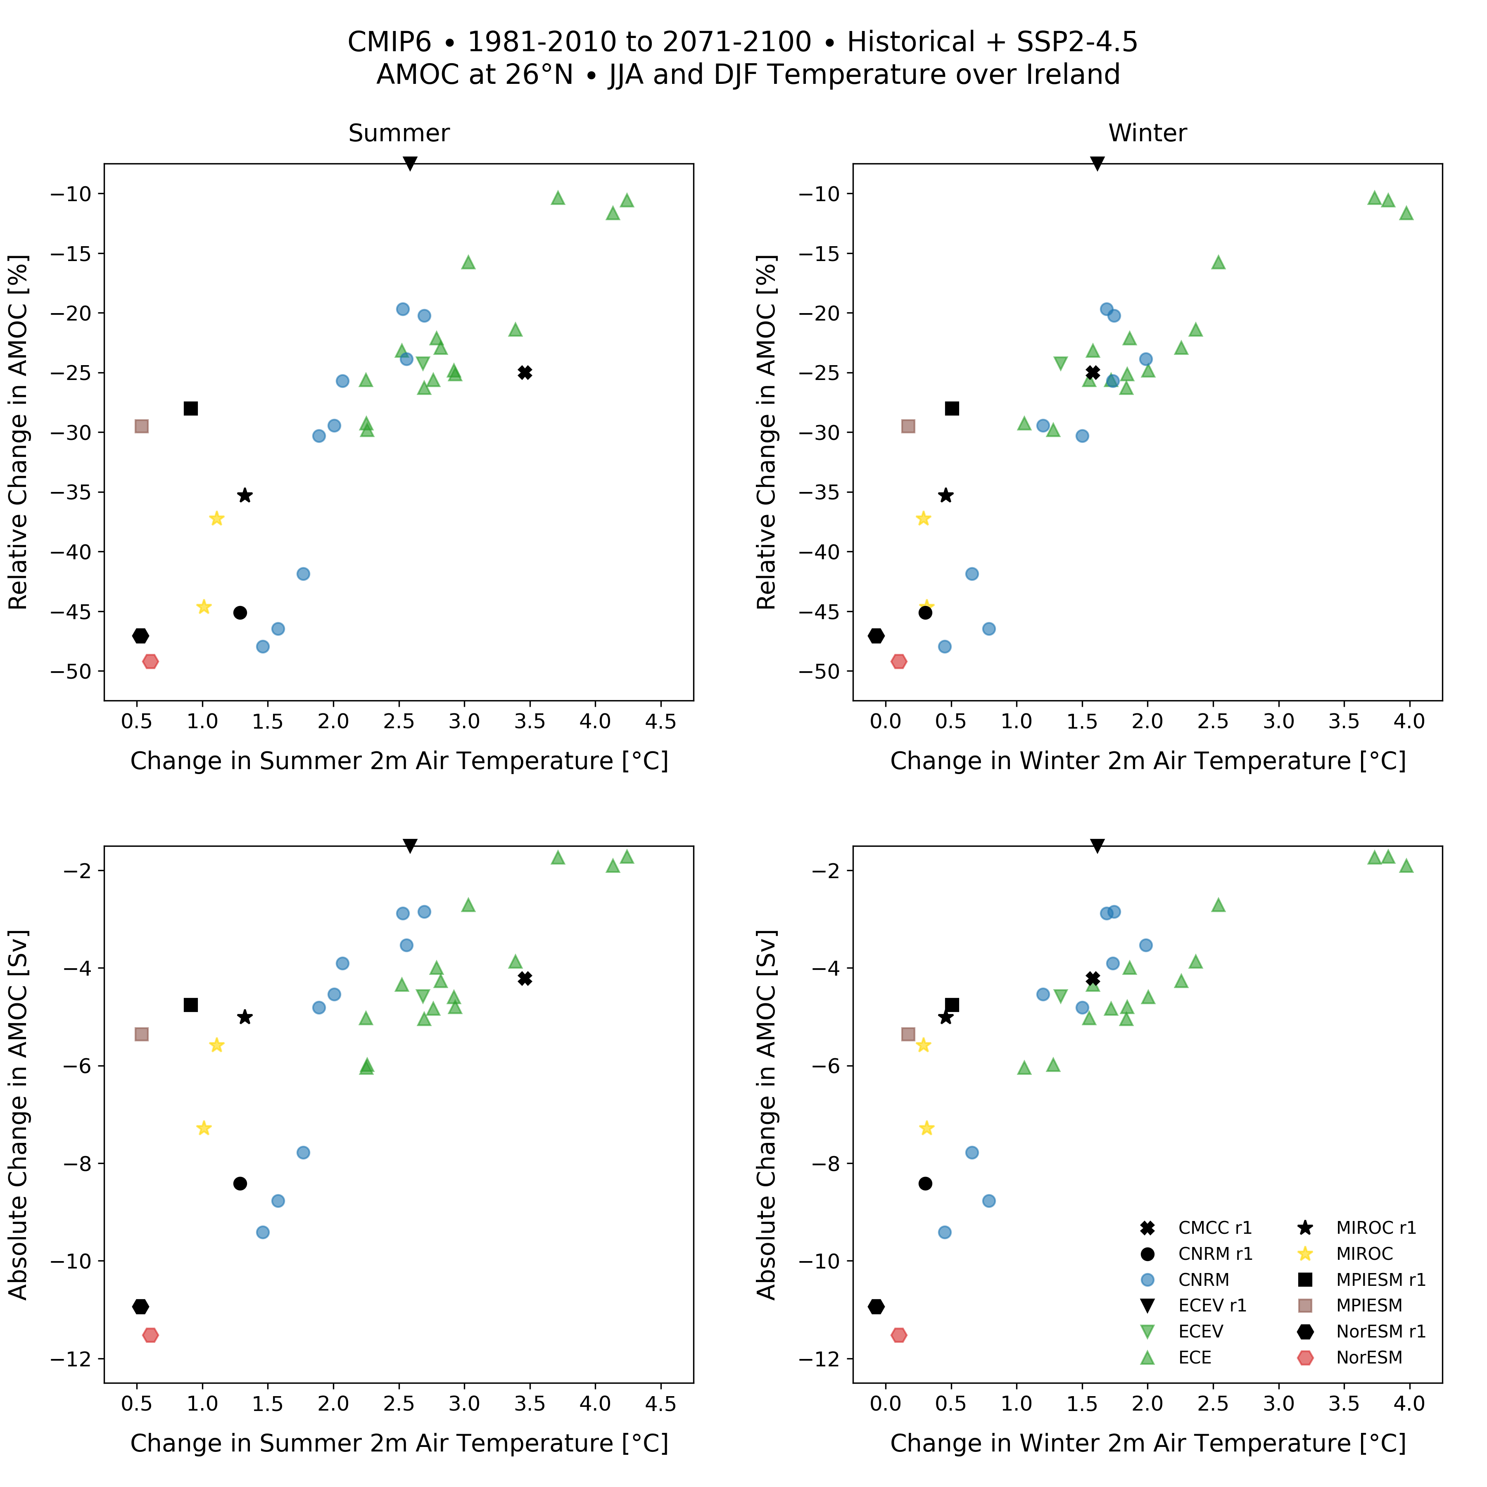
pre-processed meridional transport wasn’t available on ESGF node
Notes:
What is shown?
Differences between 30-year averages over 1981-2010 and 2071-2100 for AMOC strength and temperature (or precipitation on next slide) over Ireland.
GCMs are different colours/symbols with Euro-CORDEX ones in black.
ECEV r1 is on top as pre-processed meridional transport isn’t available on ESGF nodes (but temperature and precipitation are).
Note the large variability for CNRM and ECE (both use NEMO) in AMOC strength and consequently temperature.

Slide 11
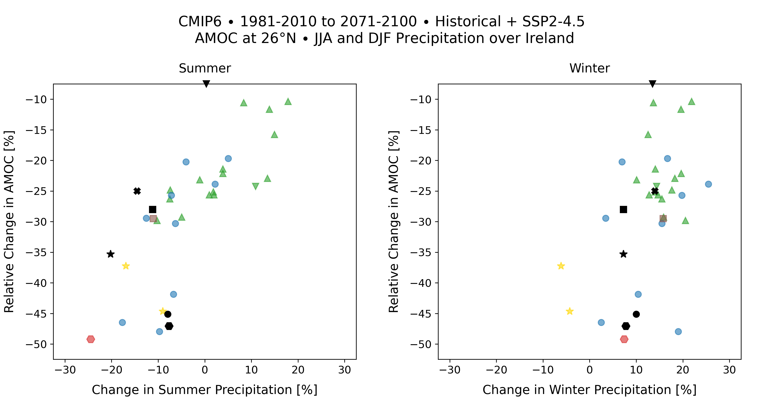
pre-processed meridional transport wasn’t available on ESGF node

Slide 12
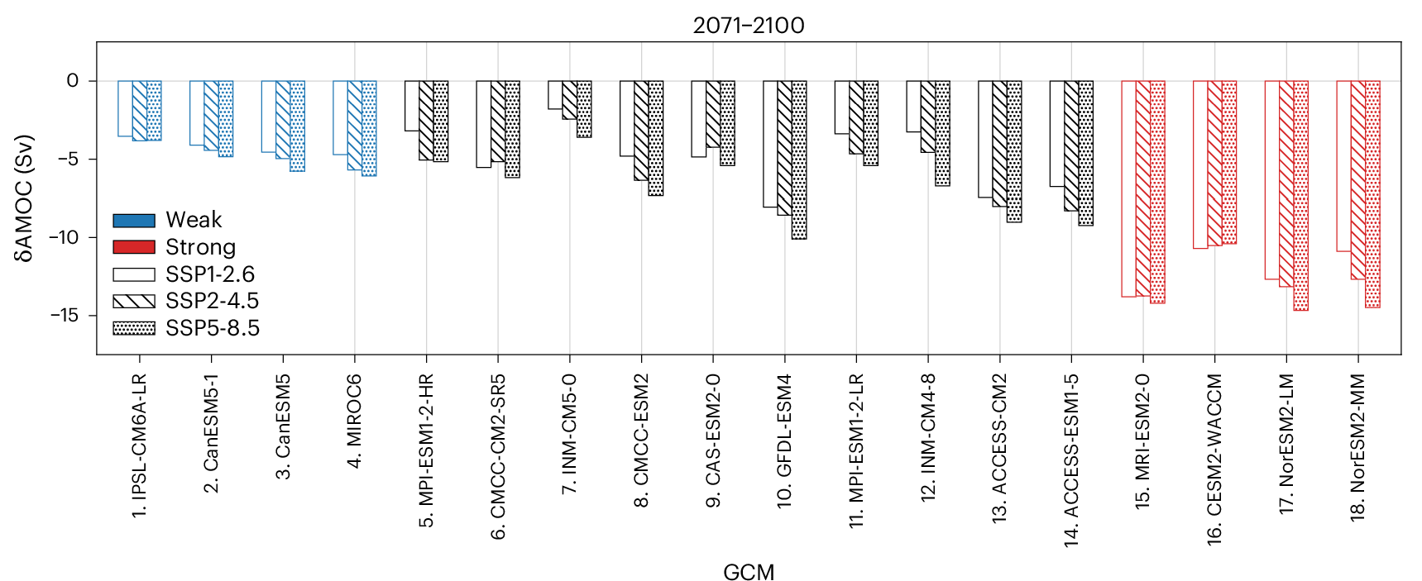
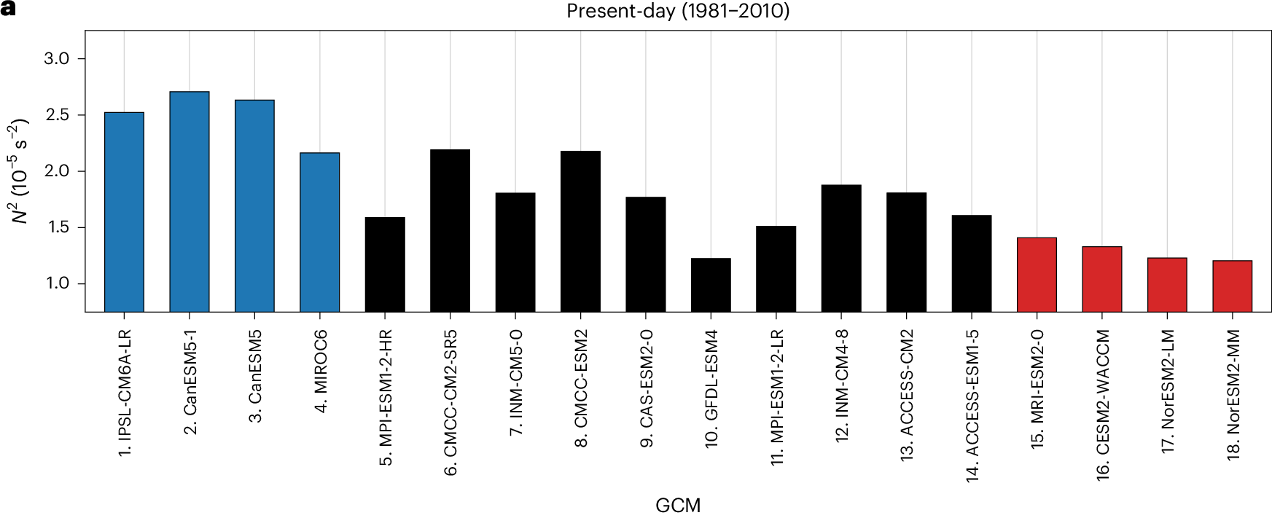
Adapted from Bonan et al. (2025)
Bonan et al. (2025):
“This emergent constraint, which we derive from physical principles, corrects these biases and suggests limited AMOC weakening over the twenty-first century. An AMOC weakening of approximately 3–6 Sv represents a decline of approximately 18–43% relative to the observed AMOC strength.”
Notes:
This study highlights that GCMs with strong AMOC decline feature weak stratification in the North Atlantic. CESM2-WACCM and MRI-ESM2-0 are among those, but we are using them for storyline simulations – they are just physically consistent scenarios of what the impact from a strong AMOC decline (or collapse) might look like.

Slide 13
References
D. B. Bonan, A. F. Thompson, T. Schneider, L. Zanna, K. C. Armour, and S. Sun, Observational constraints imply limited future Atlantic meridional overturning circulation weakening, Nat. Geosci., 18, 479–487, 2025, https://doi.org/10.1038/s41561-025-01709-0
S. Drijfhout, J. R. Angevaare, J. Mecking, R. M. van Westen, and S. Rahmstorf, Shutdown of northern Atlantic overturning after 2100 following deep mixing collapse in CMIP6 projections, Environ. Res. Lett., 20, 094062, 2025, https://doi.org/10.1088/1748-9326/adfa3b
IPCC AR6 (2021) used for: V. Masson-Delmotte, P. Zhai, A. Pirani, S. L. Connors, C. Péan, S. Berger, N. Caud, Y. Chen, L. Goldfarb, M. I. Gomis, M. Huang, K. Leitzell, E. Lonnoy, J. B. R. Matthews, T. K. Maycock, T. Waterfield, O. Yelekçi, R. Yu, and B. Zhou, Climate Change 2021: The Physical Science Basis. Contribution of Working Group I to the Sixth Assessment Report of the Intergovernmental Panel on Climate Change, Cambridge University Press, https://doi.org/10.1017/9781009157896
G. D. McCarthy, G. Hug, D. Smeed, K. J. Morris, and B. Moat, Signal and noise in the Atlantic meridional overturning circulation at 26°N, Geophysical Research Letters, 52, e2025GL115055, 2025, https://doi.org/10.1029/2025GL115055
S. Rahmstorf, Is the Atlantic overturning circulation approaching a tipping point?, Oceanography, 37 (3), 16–29, 2024, https://doi.org/10.5670/oceanog.2024.501
W. Weijer, W. Cheng, O. A. Garuba, A. Hu, and B. T. Nadiga, CMIP6 models predict significant 21st century decline of the Atlantic Meridional Overturning Circulation, Geophysical Research Letters, 47, e2019GL086075, 2020, https://doi.org/10.1029/2019GL086075

