Slide 1
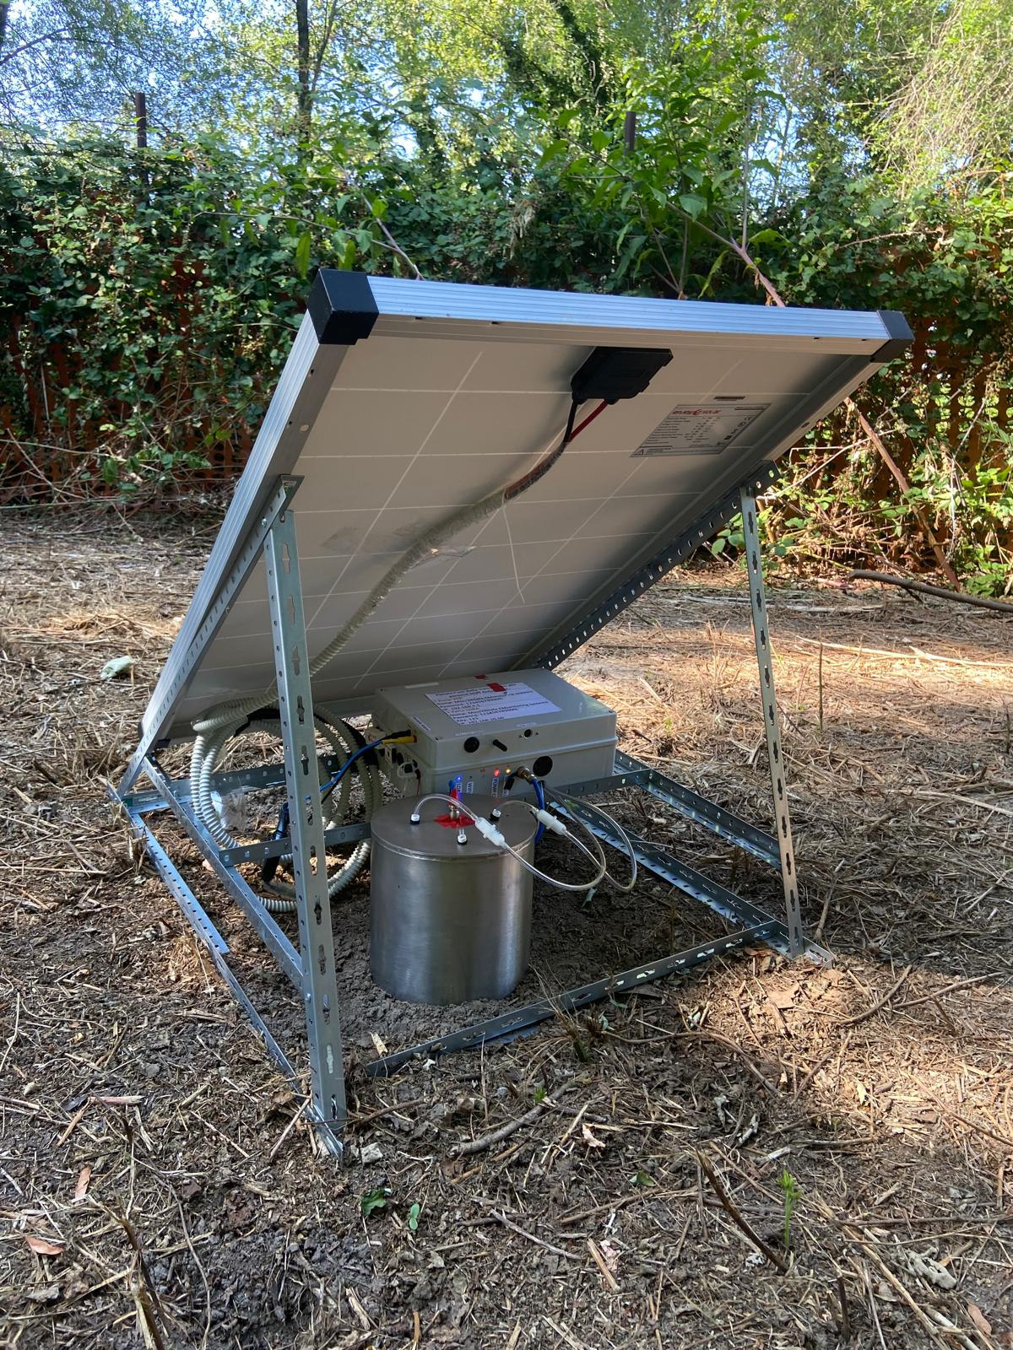





An Innovative IoT-Based Automated Flux Chamber for Continuous Monitoring of CO₂ and VOC Emissions from the Subsurface
Nicolò Tonolo¹, Sergio Teggi², Simona Berardi³, Maria Paola Bogliolo³, Iason Verginelli¹
¹ Laboratory of Environmental Engineering, Department of Civil Engineering and Computer Science Engineering, University of Rome Tor Vergata
² “Enzo Ferrari” Department of Engineering, University of Modena and Reggio Emilia
³ Department of Technological Innovations and Safety of Plants, Products and Anthropic Settlements- National Institute for Insurance against Accidents at Work (INAIL)
^{Session BG2.10, EGU 2026}

Slide 2
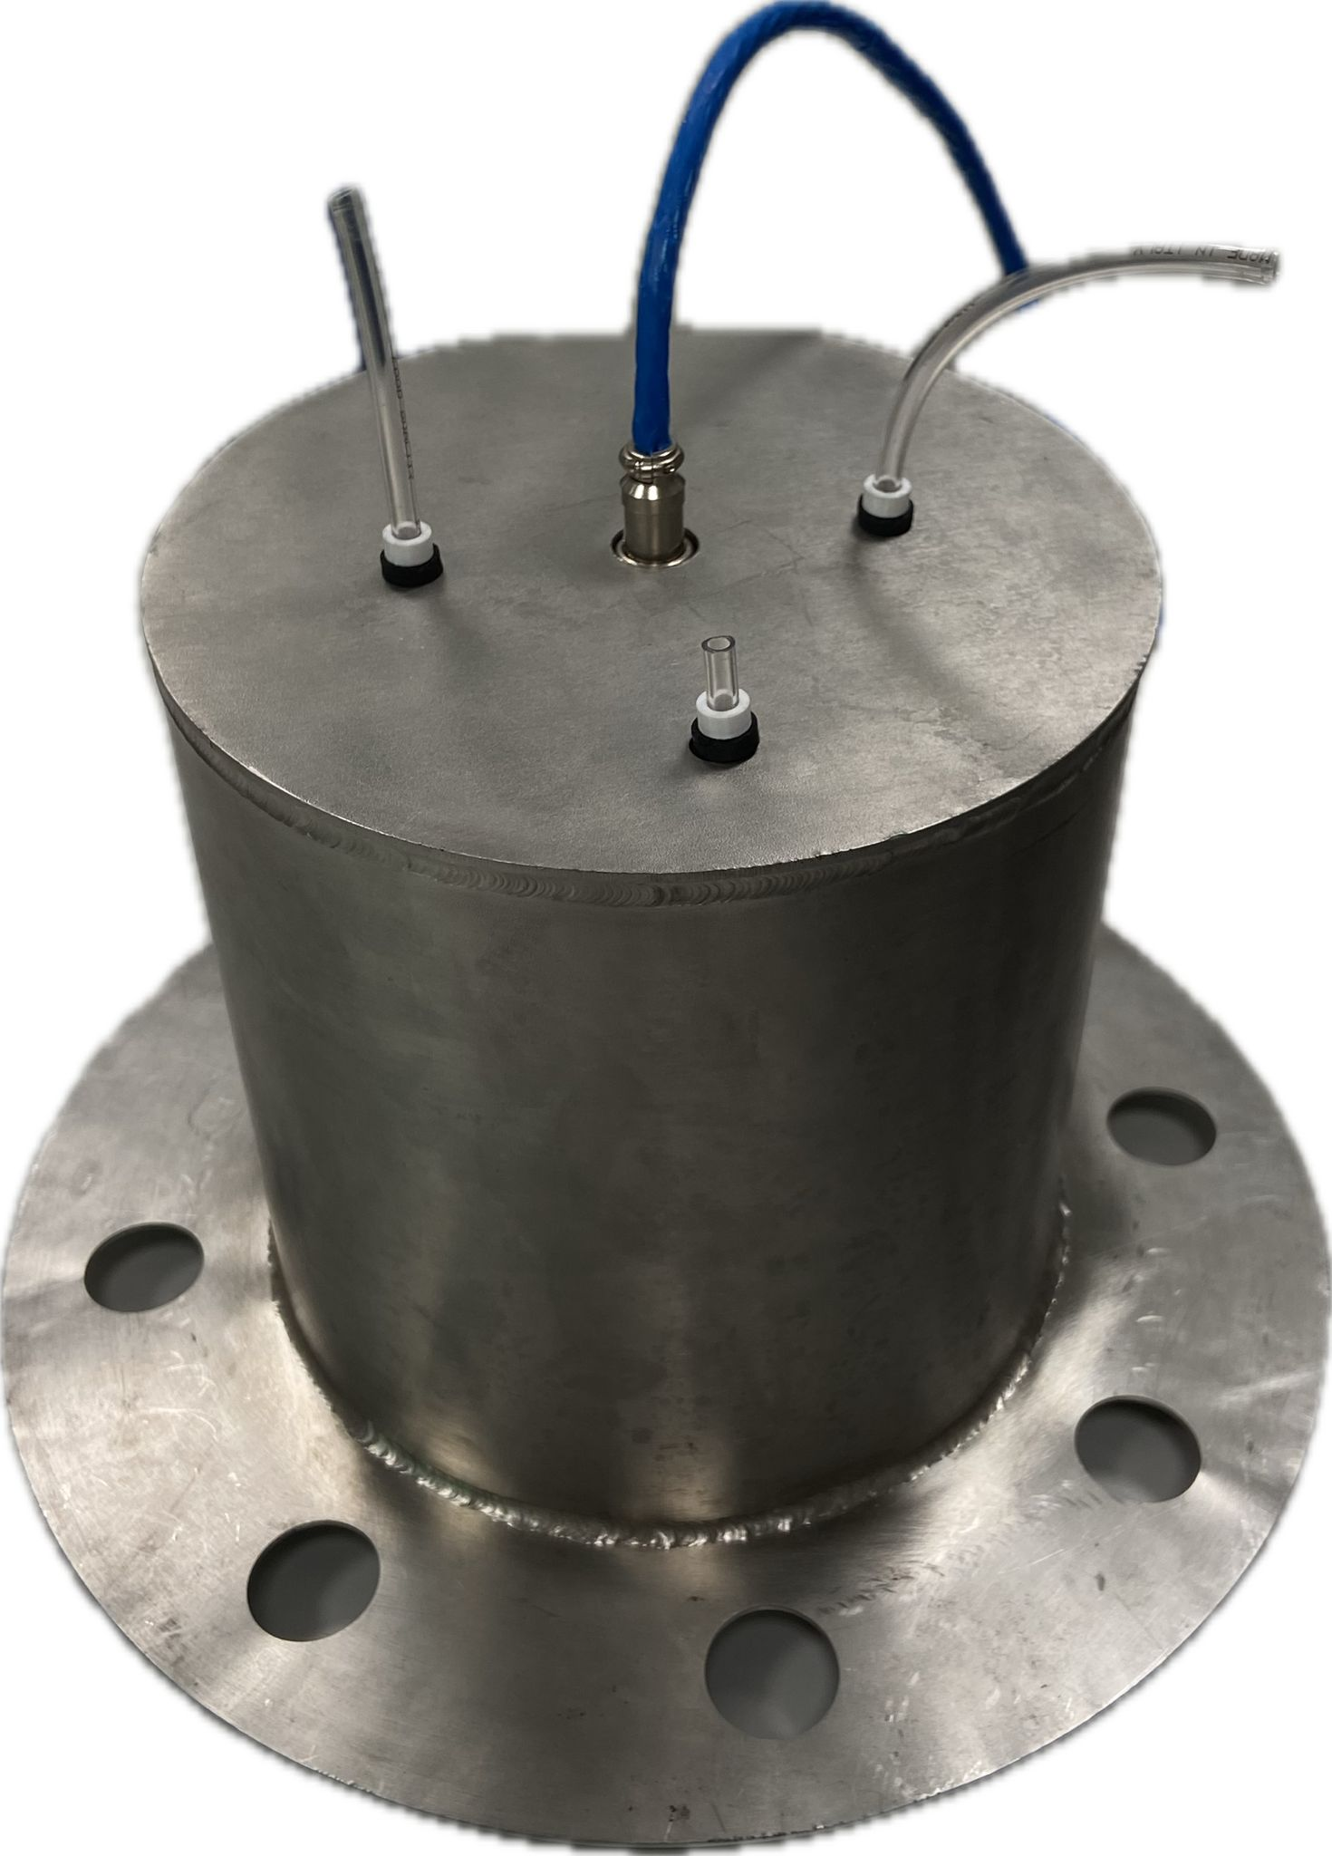
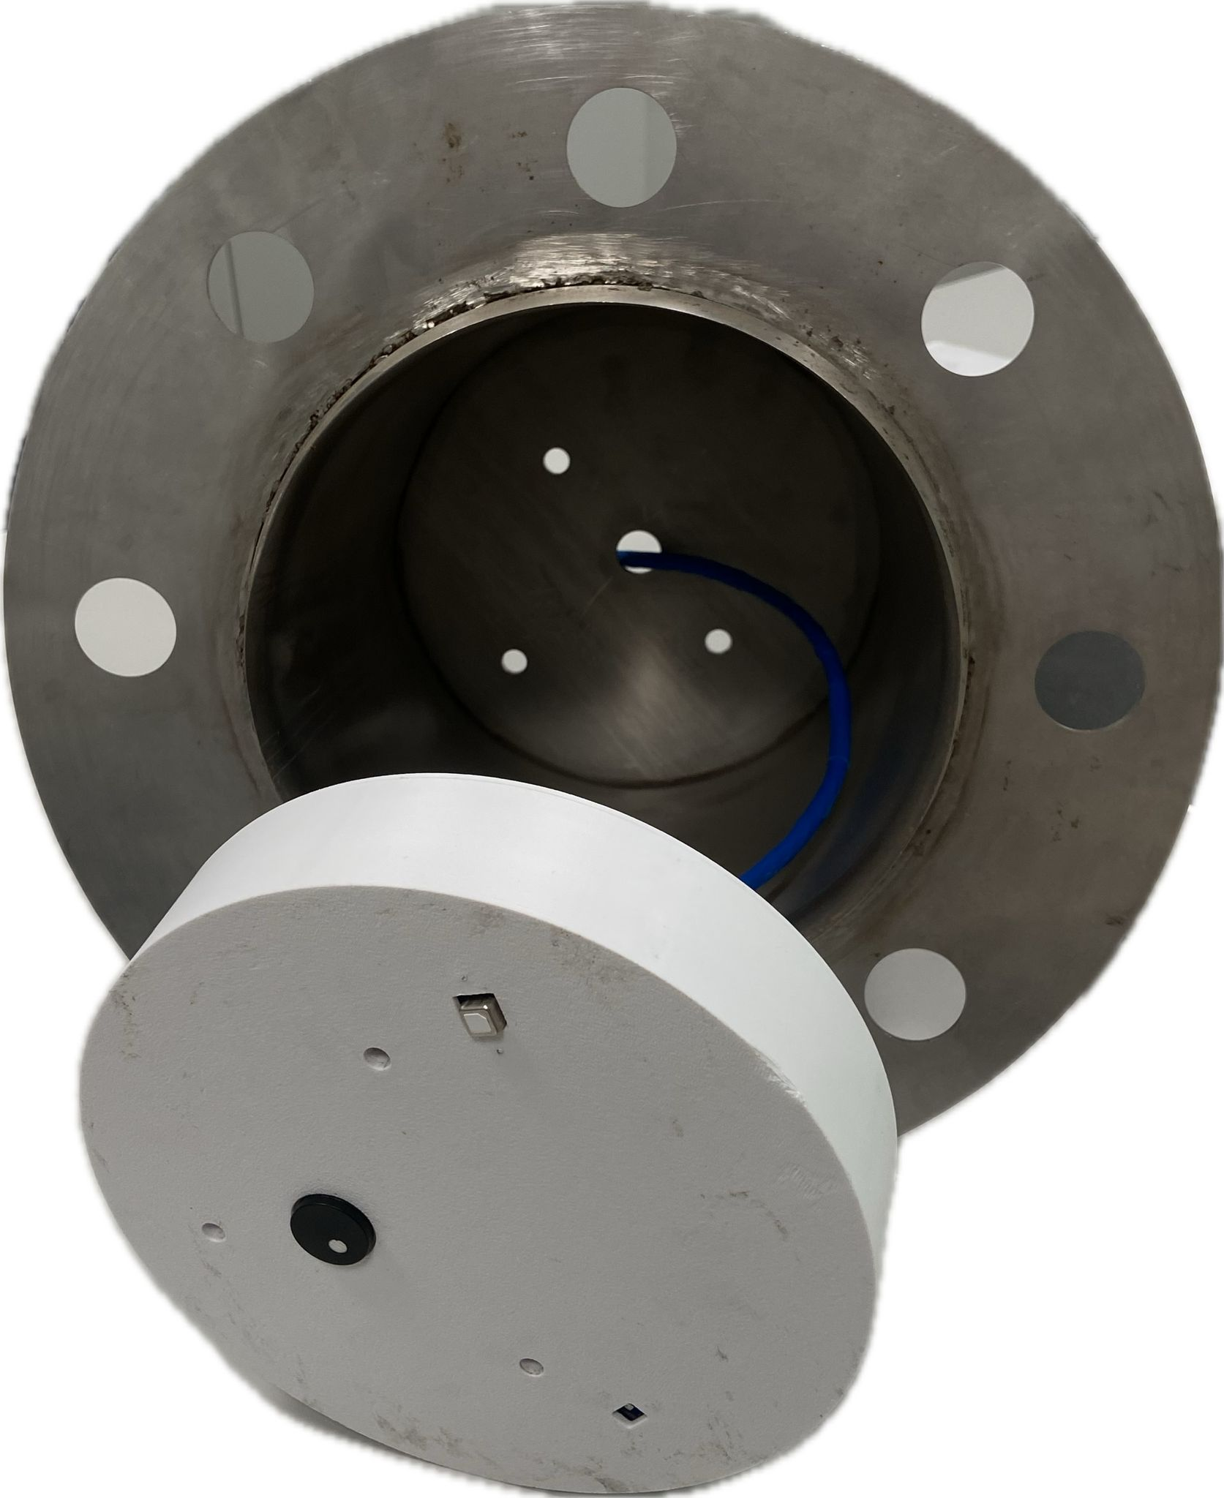


Flux Chamber Description
Stainless Steel Cylindrical Flux Chamber
(V ~ 6 L)
External Hardware connector
Stainless Steel Chamber
Photoionization Detector (PID) sensor for VOCs measurements
Non-Dispersive Infrared (NDIR) sensor for CO₂ measurements
Vent
LoRaWAN transmission system for remote connectivity to IoT clouds
Photovoltaic panel for energy
self-sufficiency
PID sensor
NDIR sensor
An Innovative IoT-Based Automated Flux Chamber for Continuous Monitoring of CO₂ and VOC Emissions from the Subsurface
(Session BG2.10)
1

Slide 3
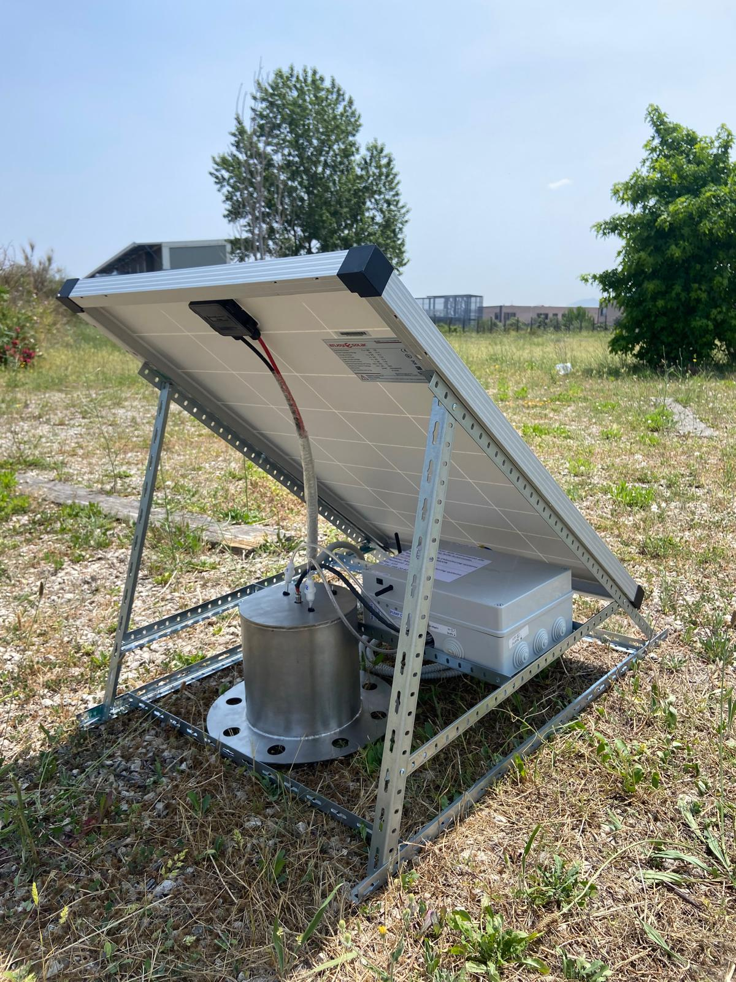
Flux Chamber Description
Stainless Steel Cylindrical Flux Chamber
(V ~ 6 L)
Photovoltaic Panel
Photoionization Detector (PID) sensor for VOCs measurements
Non-Dispersive Infrared (NDIR) sensor for CO₂ measurements
LoRaWAN transmission system
LoRaWAN transmission system for remote connectivity to IoT clouds
Photovoltaic panel for energy
self-sufficiency
An Innovative IoT-Based Automated Flux Chamber for Continuous Monitoring of CO₂ and VOC Emissions from the Subsurface
(Session BG2.10)
1

Slide 4

Principle of Operation
Measurement Phase
(10 min)
Measured flux transitted to the IoT cloud
Concentration increase measured by the internal sensors
Air Exchange Phase
(10 min)
Activation of two micro-pumps for internal air exchange. Generation of optimal conditions for a new measurement phase
Autonomous measurement every 20 min
An Innovative IoT-Based Automated Flux Chamber for Continuous Monitoring of CO₂ and VOC Emissions from the Subsurface
(Session BG2.10)
2

Slide 5
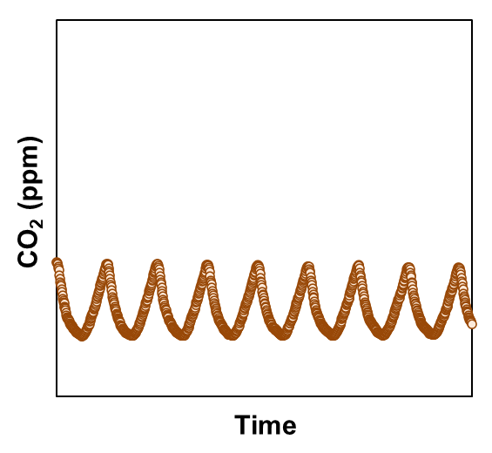
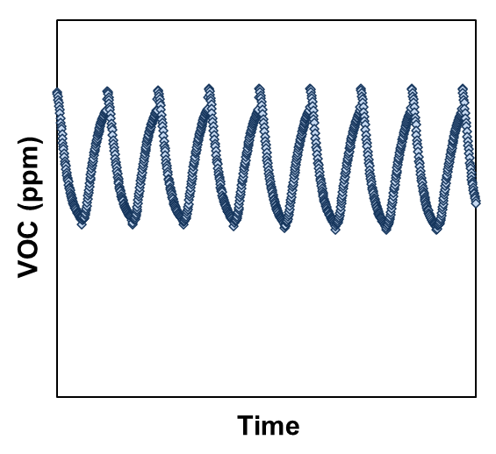
Laboratory Emission Test
High stability in consecutive measurements
Elevated linearity of regressions for flux calculation
An Innovative IoT-Based Automated Flux Chamber for Continuous Monitoring of CO₂ and VOC Emissions from the Subsurface
(Session BG2.10)
3

Slide 6

Monitoring Campaign at a Real Site
12 days of continuous measurements
Collected ~ 2000 VOCs and CO₂ flux measurements
Trend consistent with day/night temperature variations
Emission reduction in rainy days
An Innovative IoT-Based Automated Flux Chamber for Continuous Monitoring of CO₂ and VOC Emissions from the Subsurface
(Session BG2.10)
4

Slide 7



VOC and CO₂ Monitoring at Contaminated Sites
Fuel Spill
The monitoring of Volatile Organic Compound (VOC) emissions and their natural attenuation from the subsurface is typically conducted by specialized operators through the collection, transport, and laboratory analysis of samples
CO₂ production
VOCs Diffusion and Attenuation
$$C_{n}H_{2n+2}+\frac{3n+1}{2} O_{2} →nCO_{2}+\left(n+1\right)H_{2}O$$
Monitoring carried out on a seasonal basis, without temporal continuity
Unsaturated Soil
Groundwater
High operational costs
Limited data availability (~ 4 measurements/year)
An Innovative IoT-Based Automated Flux Chamber for Continuous Monitoring of CO₂ and VOC Emissions from the Subsurface
(Session BG2.10)
5

Slide 8
VOC and CO₂ Monitoring at Contaminated Sites
Fuel Spill
Influencing Parameters
Temperature
Humidity
Precipitation
Variation in contamination
Subsurface Heterogeneity
CO₂ production
VOCs Diffusion and Attenuation
$$C_{n}H_{2n+2}+\frac{3n+1}{2} O_{2} →nCO_{2}+\left(n+1\right)H_{2}O$$
Unsaturated Soil
Groundwater
Need for continuous, low-cost monitoring of subsurface emissions
An Innovative IoT-Based Automated Flux Chamber for Continuous Monitoring of CO₂ and VOC Emissions from the Subsurface
(Session BG2.10)
5

Slide 9
Flux Chamber Description
Component | Quantity | Model | Unitary Price
Microcontroller | 1 | Arduino Uno R4 wifi | 30 €
Analogue Digital Converter (ADC) | 1 | ADS1115 | 20 €
Temperature, Humidity and Pressure Sensor | 1 | BME280 | 20 €
VOC Sensor | 1 | PID-AH5 | 500 €
VOC Sensor | 1 | PID-A15 | 450 €
CO₂ Sensor | 1 | SCD41 | 50 €
LoRaWan Transmission Module | 1 | Nucleo WL55JC1 | 53 €
Lead-Acid Battery | 1 | Pro-elec 12V, 16.5Ah | 35 €
H Bridge | 1 | DRI0042 | 20 €
Micro Air Pump | 2 | BTX-MVP-B1M | 300 €
SD Module | 1 | DFR0229 | 6 €
SD Card | 1 | Micro SD kingstone, 32GB | 8 €
Electronic Hardware Housing | 1 | ABB (310x240x110 mm) | 35€
Sensor Housing | 1 | 3D Printed | 3 €
Stainless Steel Chamber | 1 | Self Designed | 450 €
MPPT Regulator | 1 | MPPT | 20 €
Photovoltaic Panel | 1 | Enjoy Solar 100W | 100 €
 |  | Total | 2400 €
An Innovative IoT-Based Automated Flux Chamber for Continuous Monitoring of CO₂ and VOC Emissions from the Subsurface
(Session BG2.10)
6

Slide 10
Calibration Test
Test Setup
Calibration conducted comparing sensor signal with concentration measurements of a commercial VOCs analyzer
1,2,8 L/min Nitrogen Fluxes for generating concentration fluctuations with different gradients during the test.
Calibration tests performed with 6 different organic compounds
An Innovative IoT-Based Automated Flux Chamber for Continuous Monitoring of CO₂ and VOC Emissions from the Subsurface
(Session BG2.10)
7

Slide 11
Calibration Test
CV < 20%
of calibration parameters
Results independent from the calibration compound
An Innovative IoT-Based Automated Flux Chamber for Continuous Monitoring of CO₂ and VOC Emissions from the Subsurface
(Session BG2.10)
7

Slide 12
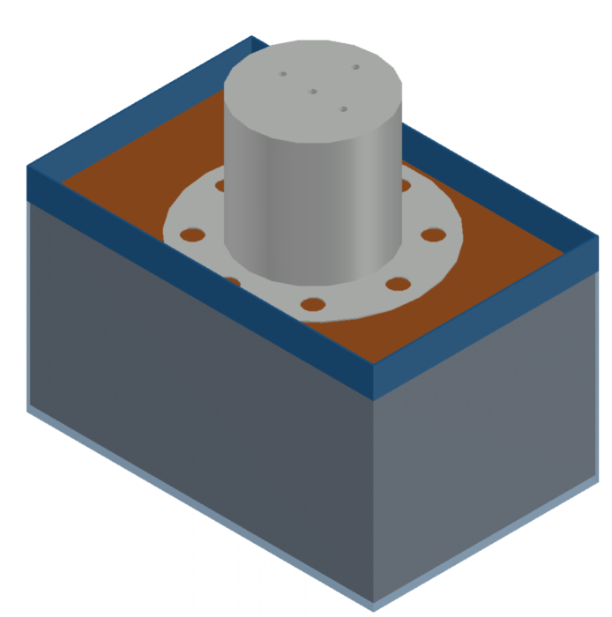
Laboratory Emission Test
Emission test from an artificially contaminated soil
Artificially contaminated soil
Evaluating VOCs natural attenuation processes in the subsurface
25 cm
Test replicated with two different fuel mixtures (i.e. gasoline and diesel)
VOCs Diffusion and Biodegradation
Continuous monitoring over a two month period
An Innovative IoT-Based Automated Flux Chamber for Continuous Monitoring of CO₂ and VOC Emissions from the Subsurface
(Session BG2.10)
8

Slide 13
Laboratory Emission Test
Emission test (1–2 months) to evaluate the device’s performance in continuously monitoring the natural attenuation of two fuel mixtures
An Innovative IoT-Based Automated Flux Chamber for Continuous Monitoring of CO₂ and VOC Emissions from the Subsurface
(Session BG2.10)
8

Slide 14
Monitoring Campaign at a Real Site
Measurements representative of real site-specific atmospheric conditions
No significant overheating within the chamber volume
An Innovative IoT-Based Automated Flux Chamber for Continuous Monitoring of CO₂ and VOC Emissions from the Subsurface
(Session BG2.10)
9

Slide 15

EGU26 Abstract
Reference
An Innovative IoT-Based Automated Flux Chamber for Continuous Monitoring of CO₂ and VOC Emissions from the Subsurface
(Session BG2.10)
10

