Slide 1
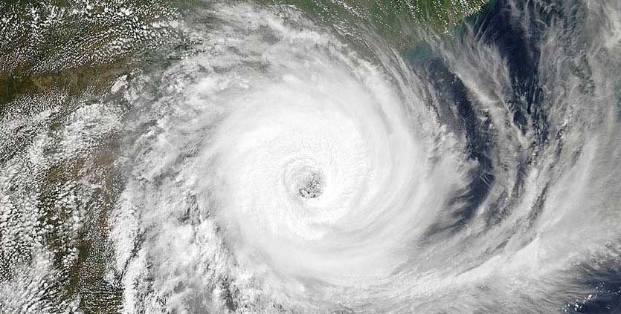
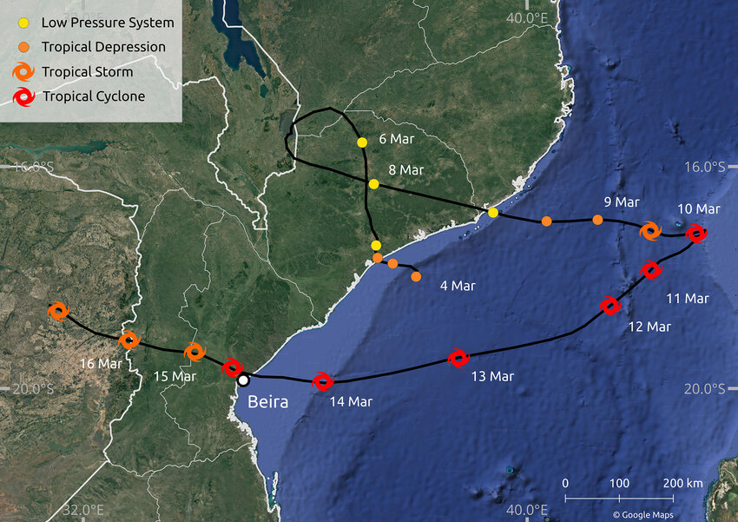

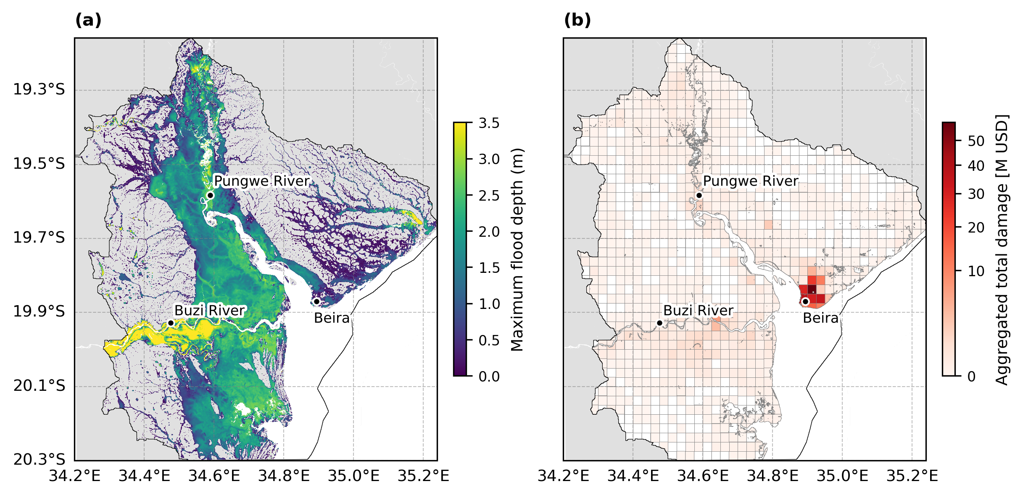






Attributing the effect of climate change and population change on compound flood impacts from tropical cyclone Idai in Mozambique
Doris M. Vertegaal^{1,2}, Bart J. J. M. van den Hurk^{1,2}, Anaïs Couasnon^{1,2}, Dominik Paprotny^{3,4,5}, and Sanne Muis^{1,2}
From Mester et al. (2023)
²
³
⁴
⁵
¹
EGU 2026 – HS2.4.6
Notes:
Compound flooding from tropical cyclones can be considered as such a complex event, as it is driven by the co-occurrence and interaction of multiple flood drivers such as fluvial, pluvial, and coastal flooding
A relevant example of such a devastating event is TC Idai.
TC Idai made main landfall close to the city of Beira, located in the Sofala Province in central Mozambique in March 2019 and is regarded as one of the deadliest cyclones to have ever hit the Southern Hemisphere (Warren, 2019).
Most of the flooding of this event was driven by rainfall but there was also a storm surge flooding parts of the coast, resulting on compound flooding. The magnitude of Idai’s impact was heightened due to the region’s very high vulnerability and exposure to flood hazards.
[Fig left is the TC track with wind speed; Fig right is the flooding from Idai (larger than our case study region) based on a satellite analysis]

Slide 2

IMPACT
Exposed population
Disaggregated
Climate change
9 %
Population change
80 %
Doris Vertegaal
Contact: doris.vertegaal@deltares.nl
Compound extremes attribution of climate change: towards an operational service
www.compass-climate.eu
Find me at PICO4.8

Slide 3

Supplementary material – PICO 4.8
Attributing the effect of climate change and population change on compound flood impacts from tropical cyclone Idai in Mozambique
Doris M. Vertegaal^{1,2}, Bart J. J. M. van den Hurk^{1,2}, Anaïs Couasnon^{1,2}, Dominik Paprotny^{3,4,5}, and Sanne Muis^{1,2}
Contact: doris.vertegaal@deltares.nl
²
³
⁴
⁵
¹
EGU 2026 – HS2.4.6

Slide 4
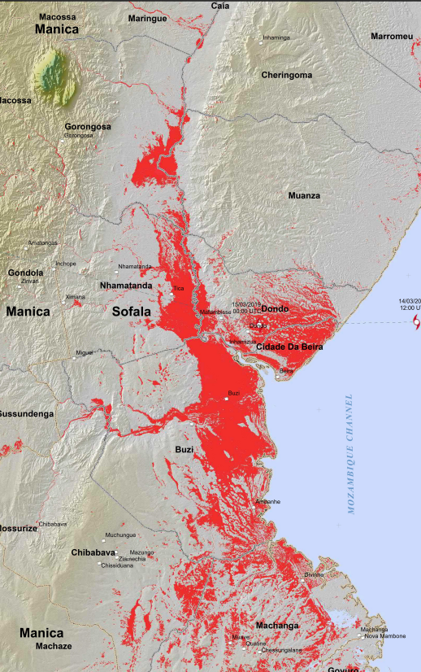
TC Idai (2019) was one of the deadliest cyclones to hit the southern hemisphere
From Mester et al. (2023)
From Unitar.org
Introduction
Methods
Results
Conclusion
Notes:
Compound flooding from tropical cyclones can be considered as such a complex event, as it is driven by the co-occurrence and interaction of multiple flood drivers such as fluvial, pluvial, and coastal flooding
A relevant example of such a devastating event is TC Idai.
TC Idai made main landfall close to the city of Beira, located in the Sofala Province in central Mozambique in March 2019 and is regarded as one of the deadliest cyclones to have ever hit the Southern Hemisphere (Warren, 2019).
Most of the flooding of this event was driven by rainfall but there was also a storm surge flooding parts of the coast, resulting on compound flooding. The magnitude of Idai’s impact was heightened due to the region’s very high vulnerability and exposure to flood hazards.
[Fig left is the TC track with wind speed; Fig right is the flooding from Idai (larger than our case study region) based on a satellite analysis]

Slide 5
Research questions
How do historical changes in climate and population influence the impacts of compound flooding from TC Idai in the Sofala province, Mozambique?
How are these changed impact distributed among society?
Introduction
Methods
Results
Conclusion
Notes:
In the context of climate change and vast growing population in Mozambique, with this work we are aiming to answer:
(read RQ)

Slide 6
Attribution framework
Counterfactual exposure conditions
Climate attribution
Exposure
Counterfactual climate conditions
Climate drivers
Hazard
IMPACT
Socio-economic drivers
Adapted from Figure 16.1 in IPCC AR6 report (IPCC, 2023)
Counterfactual impacts
Counterfactual vulnerability conditions
Impact attribution
Vulnerability
Introduction
Methods
Results
Conclusion
Notes:
Evaluating the effect of climate drivers such as climate change on the hazard is called climate attribution
Propagating the effect from hazard to impact is called impact attribution, which is a newer and rapidly evoling field within attribution science. Only recent studies are expanding impact attribution to also evaluate the effect of non-climate drivers, such as socio-economic drivers. In this study, we focus on impact attribution considering both climate and non-climatic drivers

Slide 7
Population change
Flood depth disaggregation
Low
Very high
…
Moderate high
Counterfactual exposure conditions
Climate change
Exposure
Counterfactual climate conditions
IMPACT
(Exposed population)
Socio-economic disaggregation
Hazard
Education
Age
Adapted from Figure 16.1 in IPCC AR6 report (IPCC, 2023)
Wealth
…
Household size
Counterfactual impacts
Counterfactual vulnerability conditions
Sex
Settlement
type
Vulnerability
Introduction
Methods
Results
Conclusion
Notes:
Compound flooding from tropical cyclones can be considered as such a complex event, as it is driven by the co-occurrence and interaction of multiple flood drivers such as fluvial, pluvial, and coastal flooding
A relevant example of such a devastating event is TC Idai.
TC Idai made main landfall close to the city of Beira, located in the Sofala Province in central Mozambique in March 2019 and is regarded as one of the deadliest cyclones to have ever hit the Southern Hemisphere (Warren, 2019).
Most of the flooding of this event was driven by rainfall but there was also a storm surge flooding parts of the coast, resulting on compound flooding. The magnitude of Idai’s impact was heightened due to the region’s very high vulnerability and exposure to flood hazards.
[Fig left is the TC track with wind speed; Fig right is the flooding from Idai (larger than our case study region) based on a satellite analysis]

Slide 8
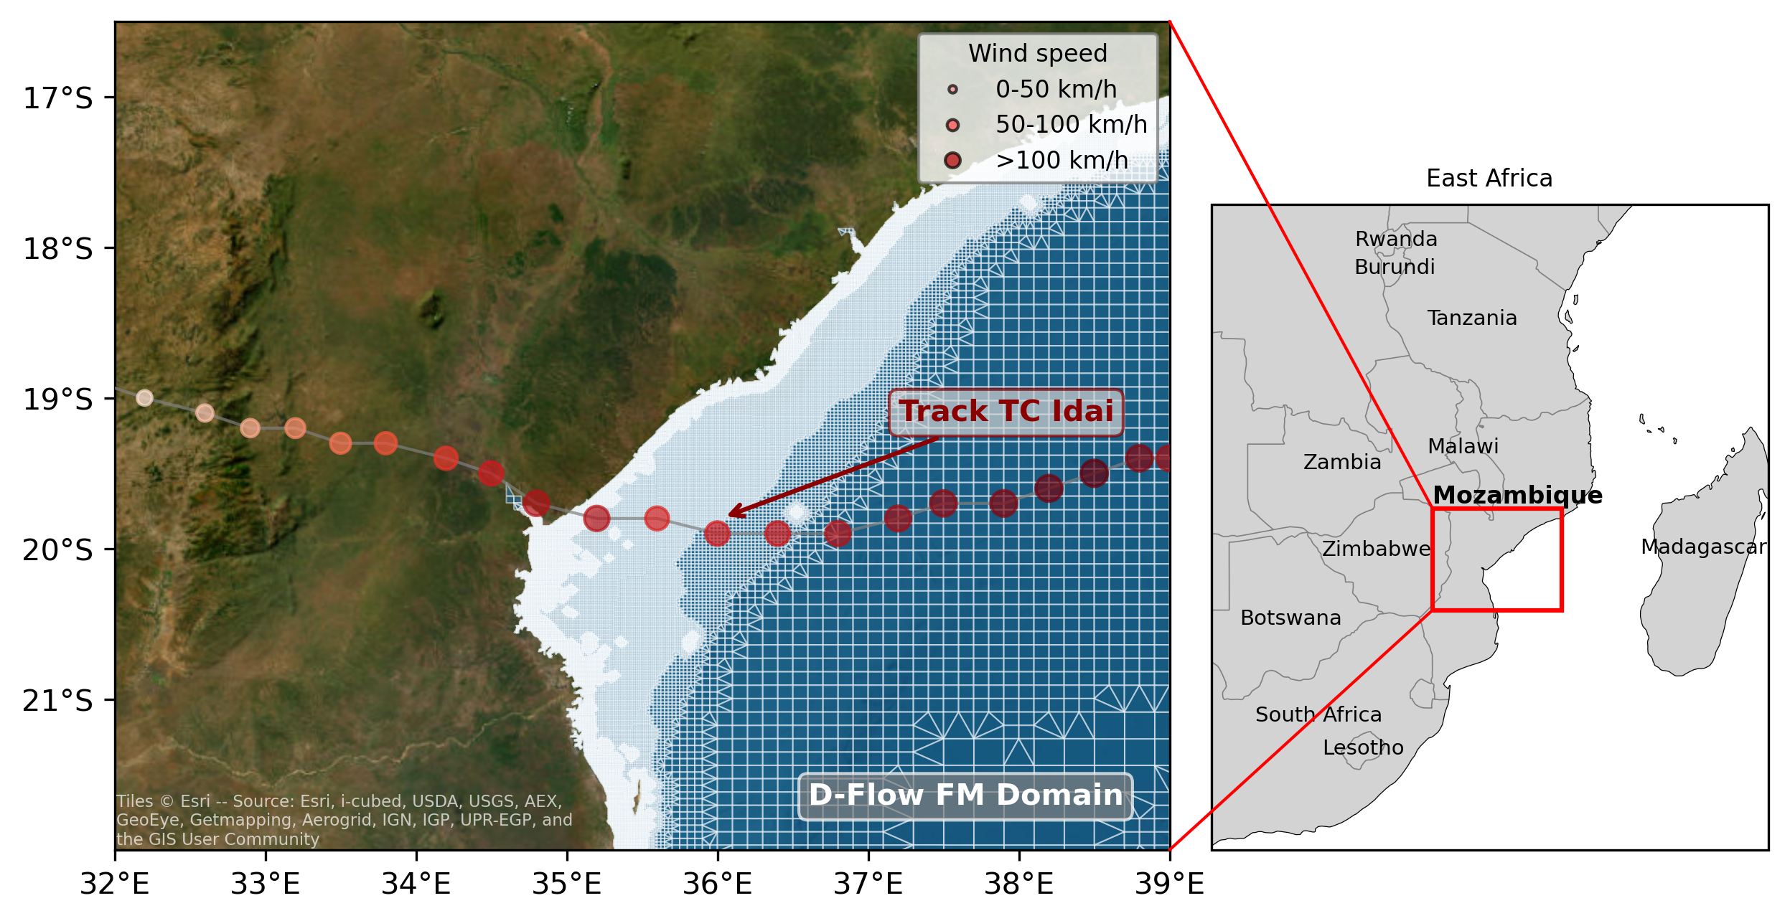
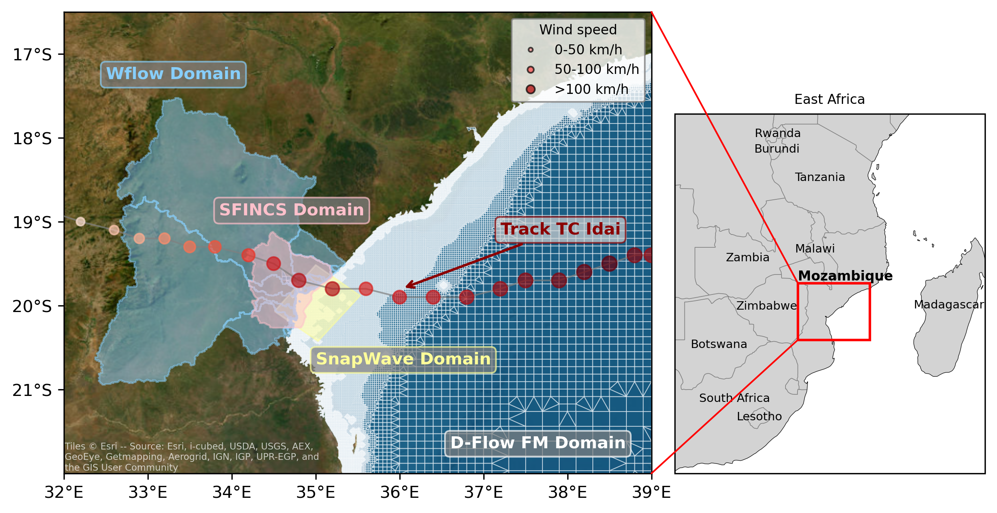
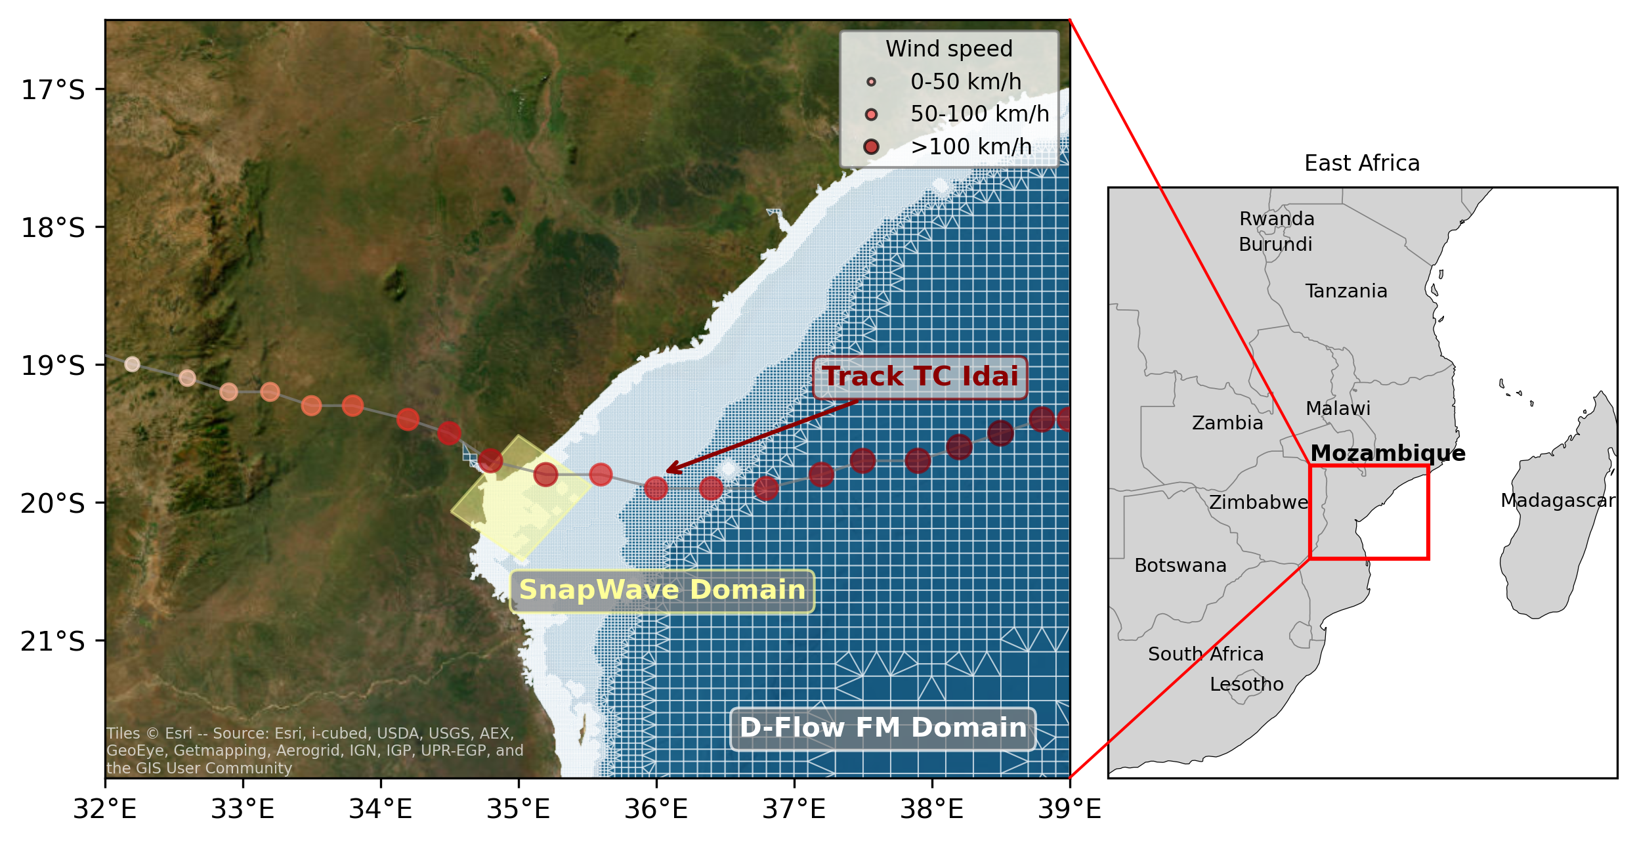
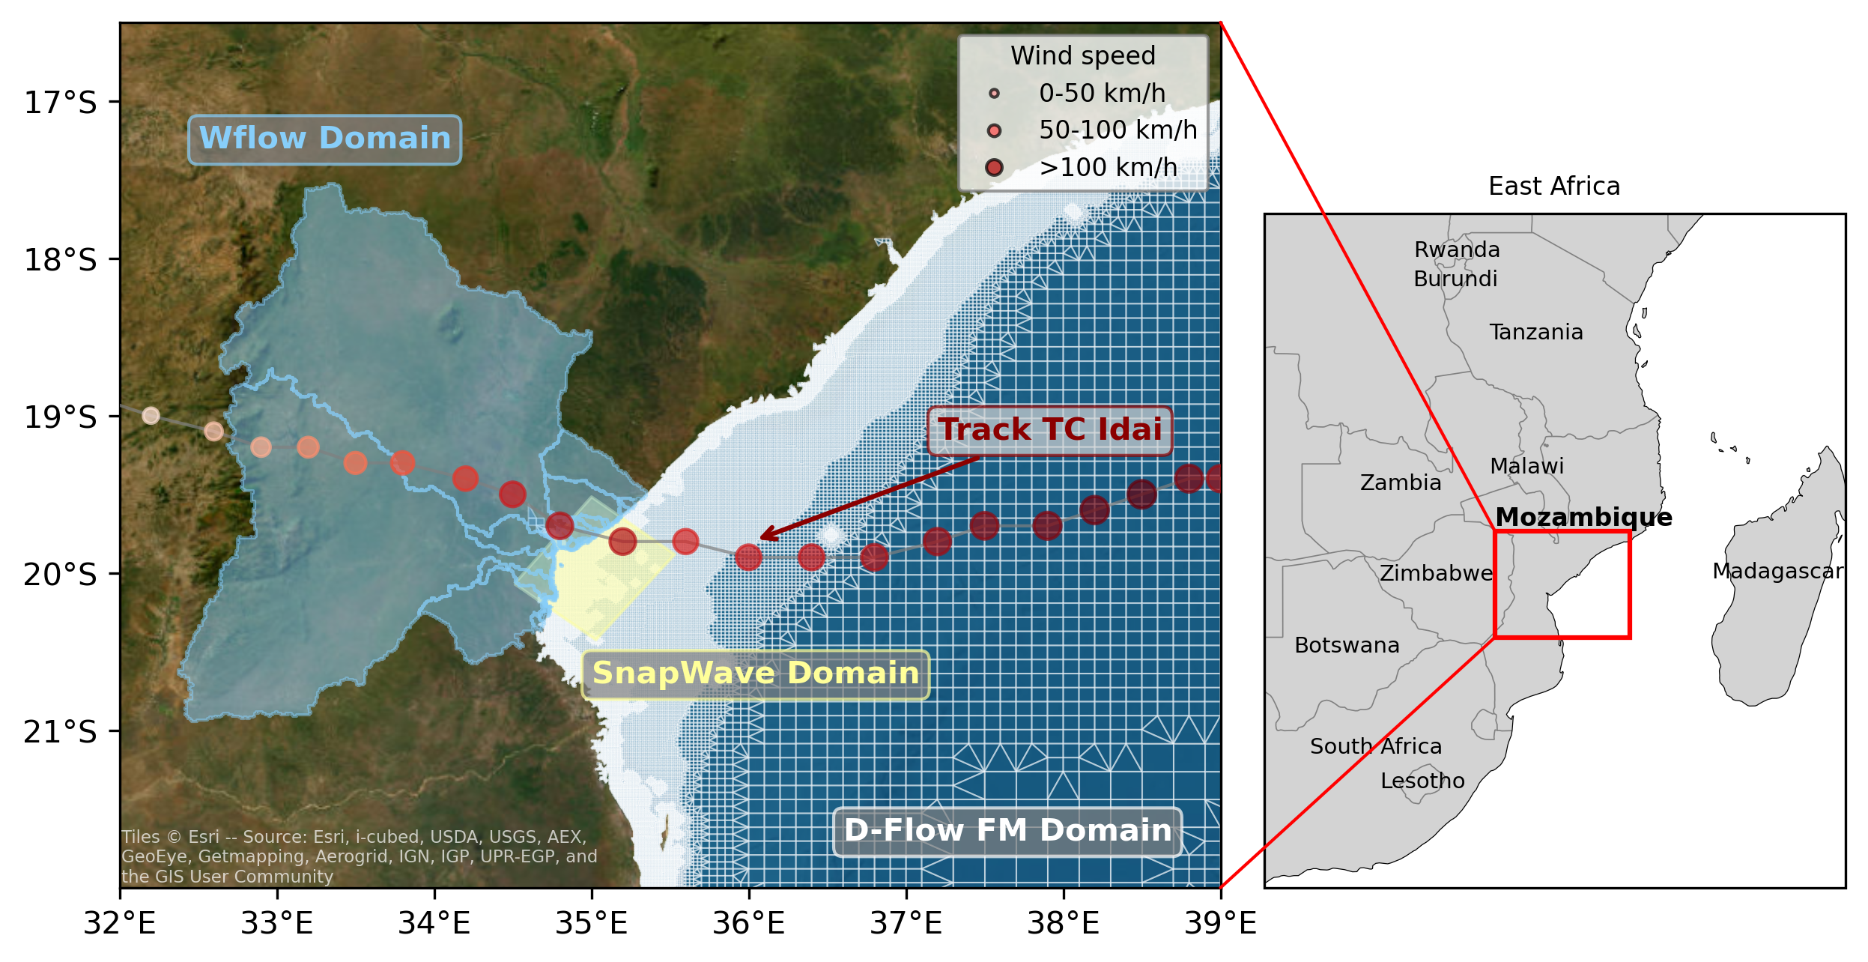
We model compound flooding using a state-of-the-art hydrodynamic modelling chain
Vertegaal et al. (2026)
Introduction
Methods
Results
Conclusion
Notes:
Here is our case study area with in red the track of TC Idai, where bigger and more red circles resemble stronger wind speeds.
We adopt multiple models to simulate the compound flooding under the different scenarios.
The tide and storm surge are simulated using a regional hydrodynamic D-Flow FM model, shows in white
Which is combined with dynamically modelled wave setup, calculated from SnapWave simulations, here in yellow
River discharge is simulated using the distributed hydrological model wflow, in blue
All of which provide boundary conditions for the compound flood model SFINCS, here in pink

Slide 9
The flood maps are overlayed with the population raster to estimate the exposed population
Downscaled to flood raster (100 m to 25 m)
Introduction
Methods
Results
Conclusion
Notes:
The factual and counterfactual flood maps are overlayed with the factual and counterfactual population rasters, which are first downscaled to match the flood grid

Slide 10
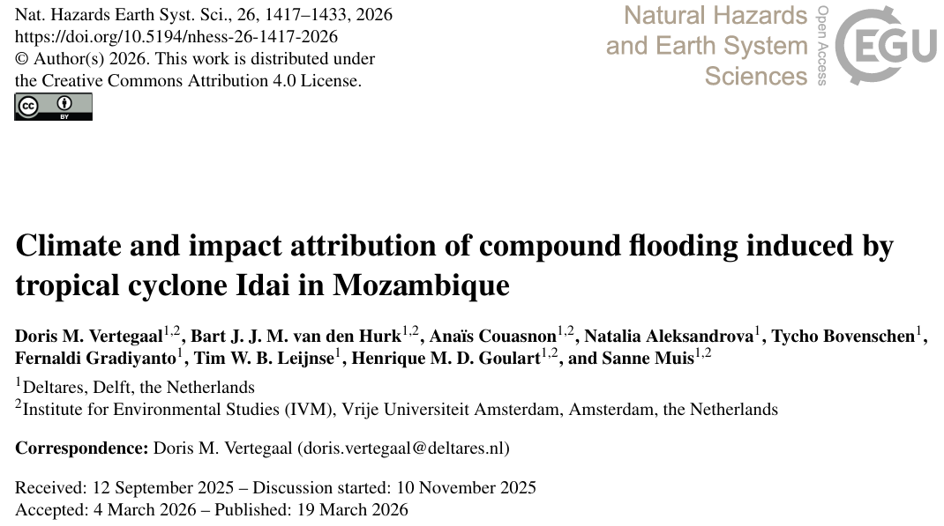

Attribution scenarios for climate and population change
Scenario | Description
Factual | Climate conditions during TC Idai in 2019 & population of 2019
Counterfactual climate | Climate trend removal of rain, wind and SLR until 1975
Counterfactual population | Population of 1975
Counterfactual climate + population | Climate trend removal of rain, wind and SLR and population of 1975
Introduction
Methods
Results
Conclusion
Notes:
This means that we have four attribution scenarios
1990: Single human generation & because population dynamic are faster than climate dynamics. Also after Civil war
Medium counterfactual scenario of paper 1: -8 % rain, -5 % wind, -10 cm SLR

Slide 11
Plausible climate trend
Variable | Climate trend between 1975 and 2019 | Reference
Average atmospheric warming | 0.9 °C | (Copernicus Climate Change Service, n.d.)
Rain (7%/°C) | 6 % | Clausius-Clapeyron
Wind (0.2 kn per yr) | 4 % | Knutson et al. (2020); Mester et al. (2023)
Sea level rise | 7 cm | Treu et al. (2024)
Introduction
Methods
Results
Conclusion
Notes:
https://climate.copernicus.eu/climate-indicators/temperature

Slide 12
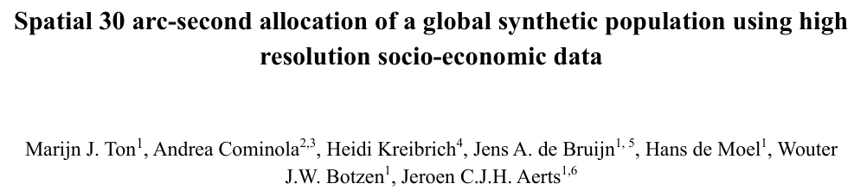
Disaggregated attribution per socio-economic group
Using GLOPOP-SG as example
At 1 km resolution
Modelled data for Mozambique using DHS (3 similar countries)
For the year 2015
Nr | Characteristic | Higher vulnerability | Lower vulnerability
1 | Wealth | Poor | Rich
2 | Settlement type | Rural | Urban
3 | Age | <5 & 65+ yr | 5-65 yr
4 | Education | Low | High
5 | Gender | Woman | Man
6 | Household size | 1 | 1+
Ton et al. (2025) based on Ton et al. (2024)
Introduction
Methods
Results
Conclusion
Notes:
https://statics.teams.cdn.office.net/evergreen-assets/safelinks/2/atp-safelinks.html

Slide 13
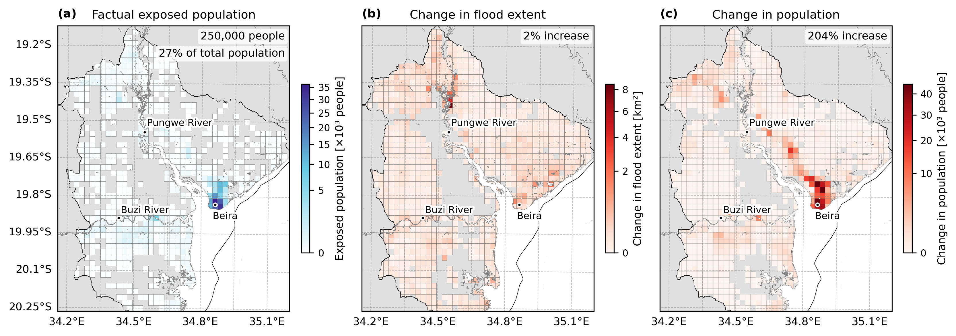
The increase in population is concentrated in urban areas, while climate change increases the flooding more widespread
Vertegaal et al. (in prep)
Introduction
Methods
Results
Conclusion
Notes:
Make sure to explain figure!!

Slide 14
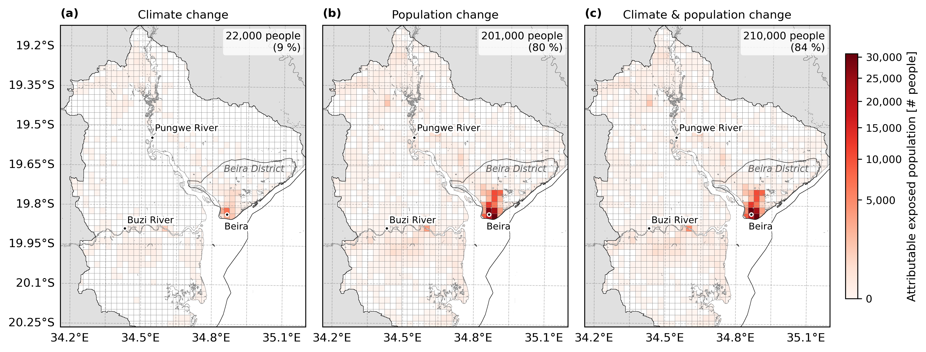
The exposed population is reduced substantially when removing the contributions from climate change and population change
Vertegaal et al. (in prep)
Introduction
Methods
Results
Conclusion
Notes:
Climate change result in 24,000 people more exposed to flooding from Idai, which is 7% of the total exposed population in the factual scenario. Population change has a larger effect on the exposed population, accounting for 43 % of the exposed population and 154,000 people. The combined effect of the two drivers is not additive, as areas where there is climate change and population change are not double counted, yet the combined effect is still more than that of population change alone.
Here we use exposed population as a binary metric, so when a person lives in a flooded cell they are exposed, regardless of flood depth. Climate change can only drive additional exposure through changes in flood extent. This is not the case for the population change scenario where it can lead to more people exposed in already flooded areas.

Slide 15
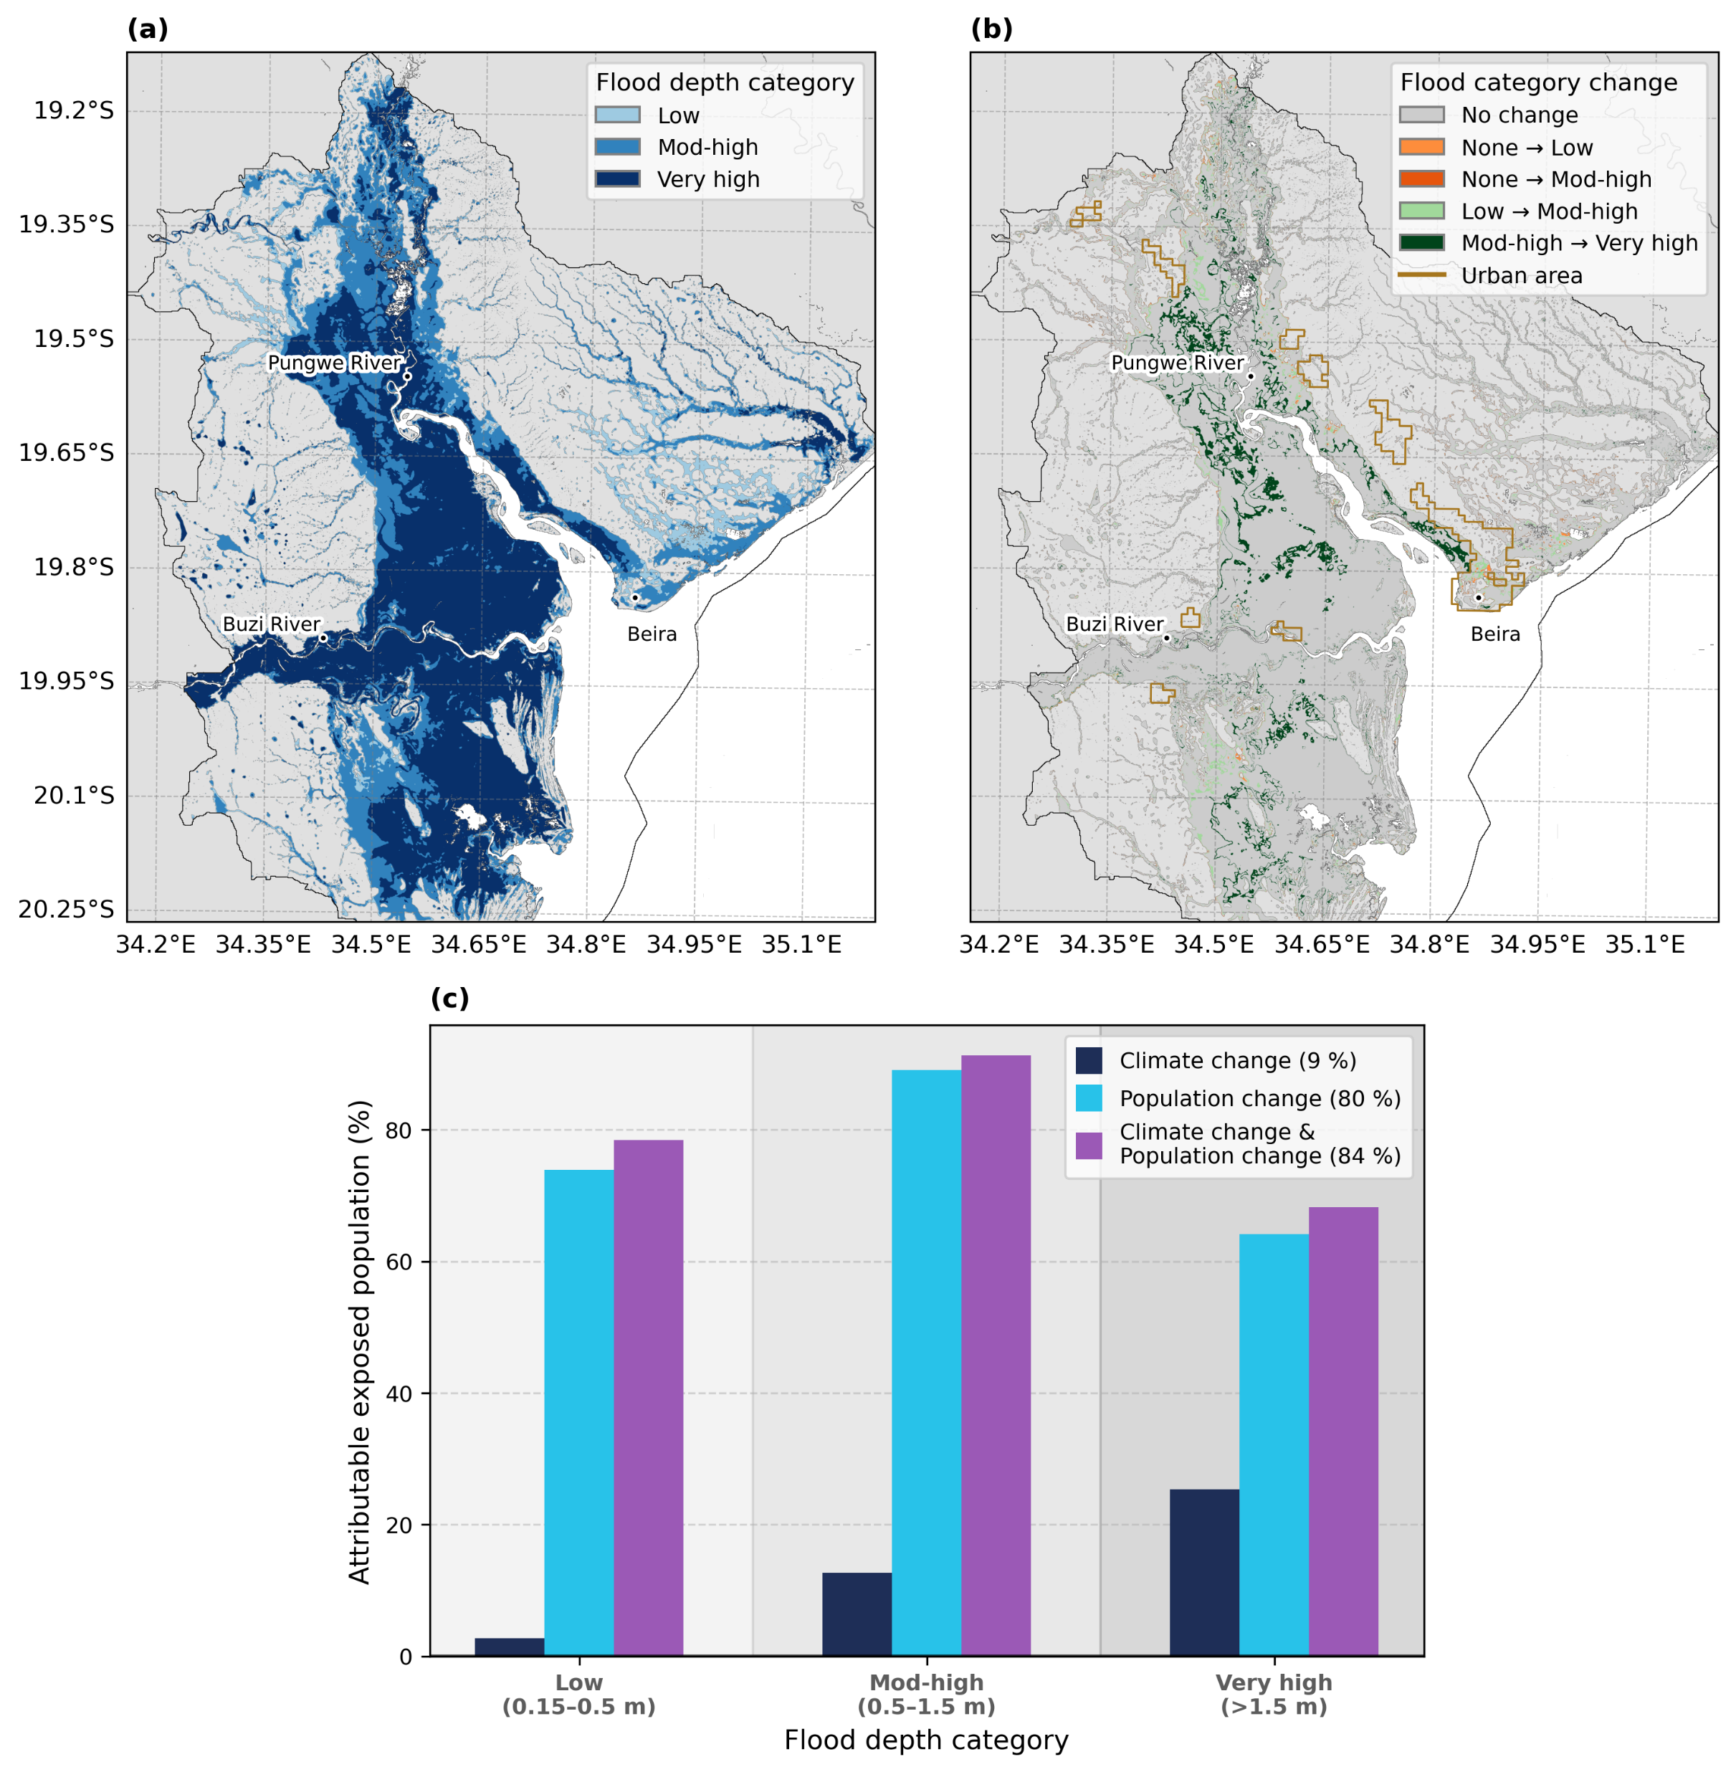
Climate change and population change alter the distribution of the exposed population per flood depth category
Vertegaal et al. (in prep)
Relatively more people moved into moderate-to-high flood depth zones flood, where climate change increases the flood depth among the peak exposed population by 11 cm (from 1.10 m to 1.21 m)
Introduction
Methods
Results
Conclusion
Notes:
When we move from this binary metric of exposed population to a flood depth based metric, we find that climate change and population change alter the distribution of the exposed population per flood depth category.
We have divided this flood maps in low, moderate and high flood depth categories as can be seen in panel a, where the blue intensity is linked to flood depth category. In panel b you can see the change in flood depth category because of climate change across the flood plain. We find the most changes from moderate to high flood depth category in rural areas, and less in Beira, although there we see some changes of low to moderate flood depth.
When looking at the attributable exposed population per flood depth category in panel c, we that climate change results in less people exposed to low flood depths, as this population is now exposed to medium flood depths. The attributable affected population to climate change is greatest at high flood depths.
Compared to climate change, population change accounts for larger changes in affected population over each flood depth category. The largest difference is found at low and medium flood depths, where 38 % (~73,000 people) and 52 % (~71,000 people) can be attributed to population change, respectively (Fig. 4c3 and Table S2). For exposure changes at high flood depths, 30 % (9,000 people) can be attributed to population change.
Since population change increases the total population, fewer people are affected to low and high flood depths in relative terms (-2 % and -1 %, respectively). However, in absolute terms, the population exposure still increases (with 73,000 and 9,000 people, respectively). This means that relatively more people moved to medium- compared to low- and high-flood depth zones (Fig. S6).
For medium and high flood depths, the largest change in affected population can be attributed to the combined effect of climate and population change (62 % and 46 %, respectively). Climate and population change have an opposite effect on changes in affected population to low flood depths, resulting in a smaller combined change
The actual flood depth that most people within the medium flood depth category are affected to is pushed ~17 cm higher due to climate change (from 1.04 m to 1.21 m; Fig S4).

Slide 16
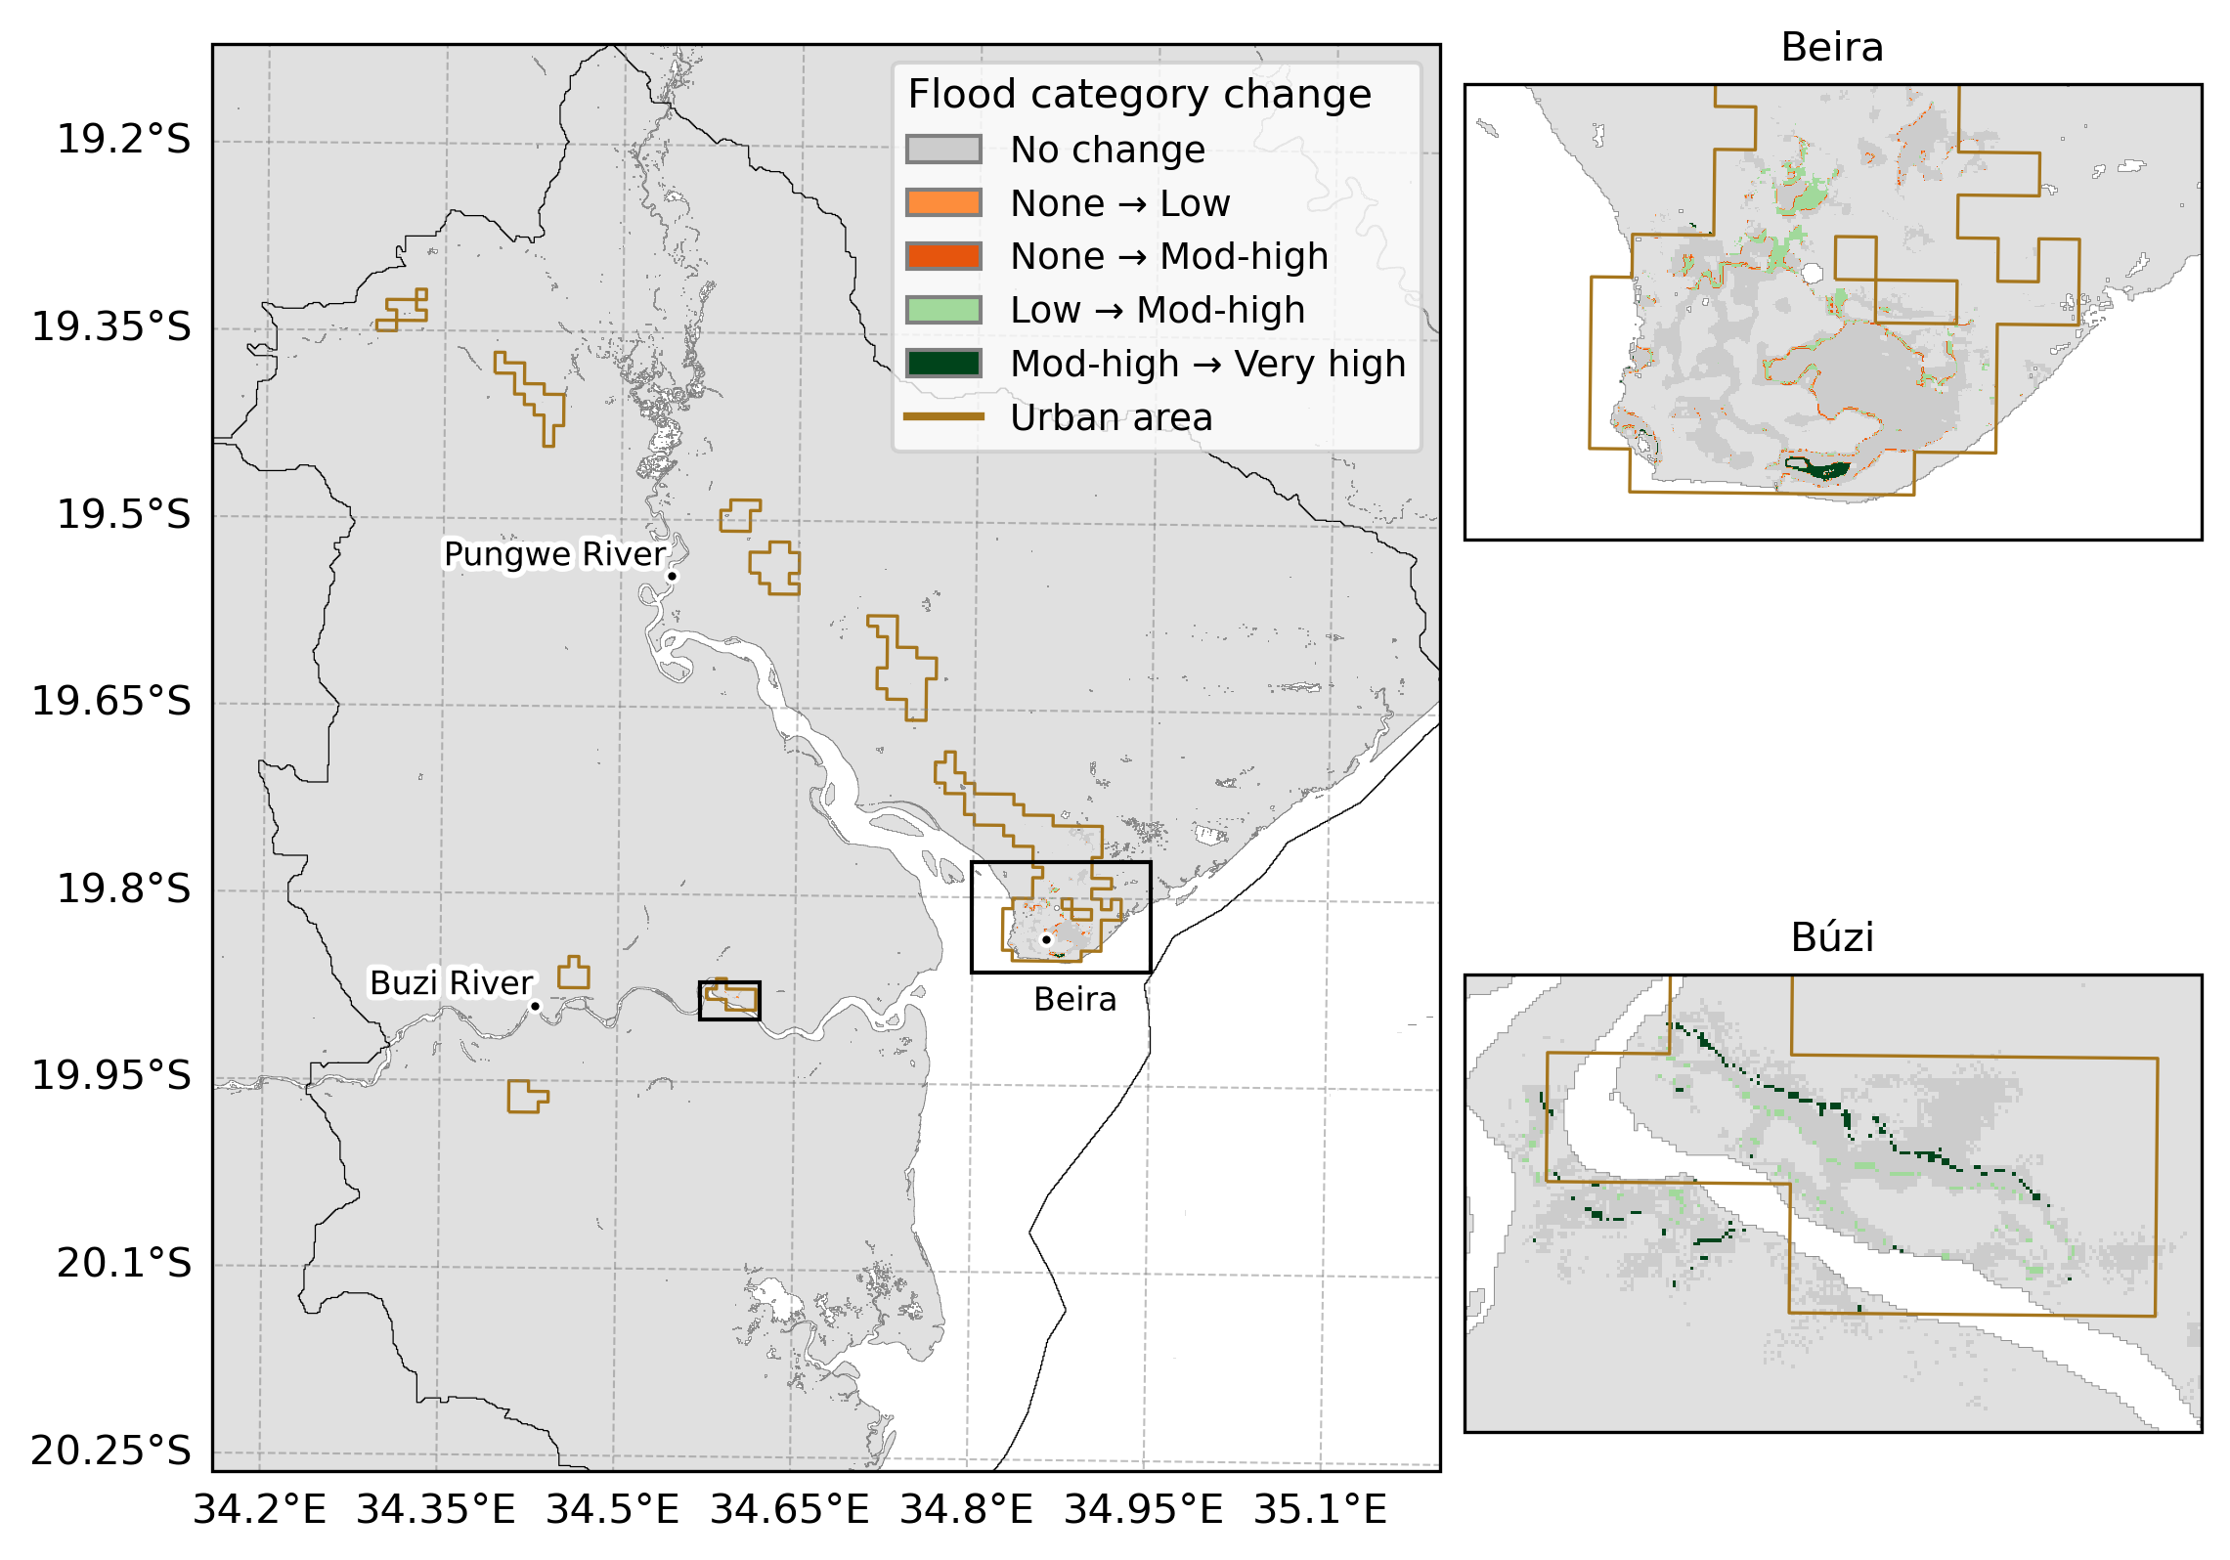
Among the exposed population, changes to mod-high and very high happen mostly in urban areas
Vertegaal et al. (in prep)
Introduction
Methods
Results
Conclusion

Slide 17
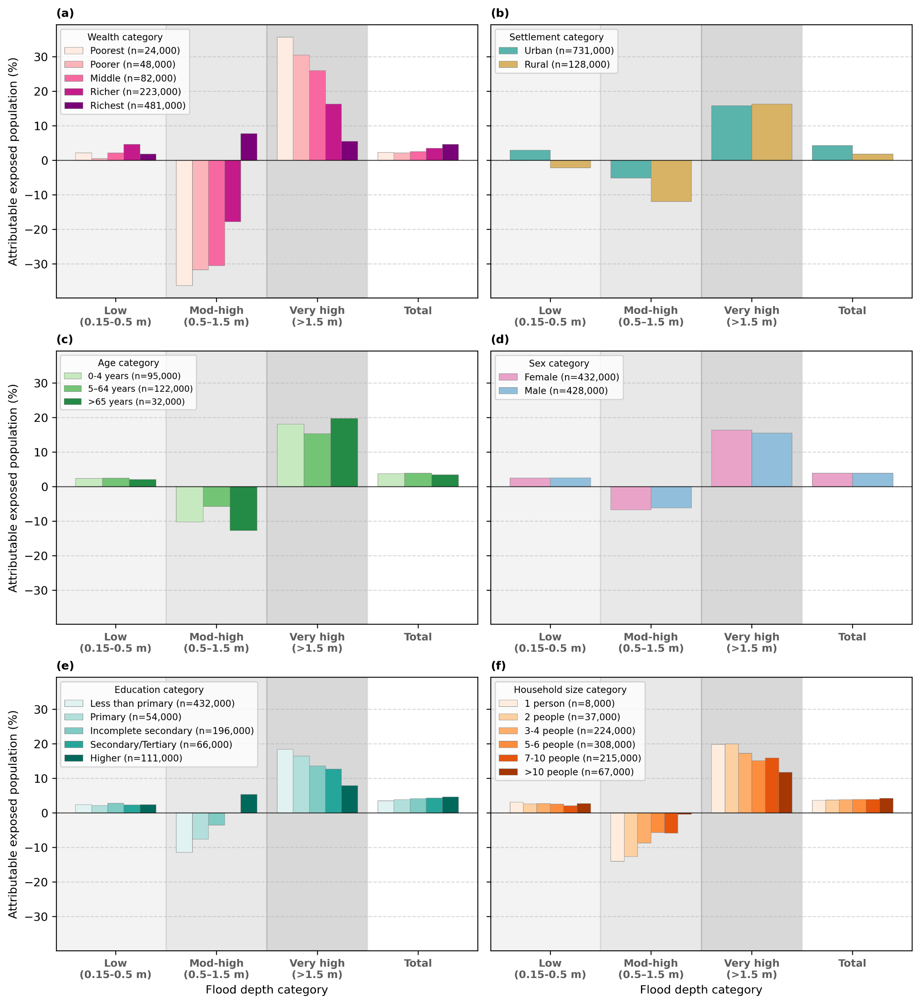
We exemplify how climate change can disproportionally impact different socio-economic groups
Vertegaal et al. (in prep)
Introduction
Methods
Results
Conclusion
Notes:
By disaggregating per socio-economic group, we exemplify that climate change disproportionally impacts different socio-economic groups. Which group is concluded as disproportially impacted depends on wheter flood depths are aggregated or disaggregated, and whether absolute or relative changes in exposed population are considered.

Slide 18
Take aways of impact attribution of TC Idai
EGU abstract
Our storyline attribution framework can attribute the effect of climate and non-climate drivers on compound flooding from TCs in data-scarce regions
We find that 80 % the exposed population can be attributed to population change alone, and 9 % to climate change alone. Climate and population change combined further exacerbate the exposed population (84 %).
Climate change affects the flood depth distribution and population change the spatial distribution of residential area, leading to different attribution assessments per flood depth category
Spatial aggregation has the potential to mask the disproportional effect of climate change between social groups
Earlier paper
Doris Vertegaal
Contact: doris.vertegaal@deltares.nl
Compound extremes attribution of climate change: towards an operational service
www.compass-climate.eu
Introduction
Methods
Results
Conclusion
Notes:
The largest part of the exposed population to flooding from TC Idai can be attributed to population change, with climate change further exacerbating the exposed population
Effect of climate and population change are projected to further worsen in the (near-)future

Slide 19
Supplement results

Slide 20
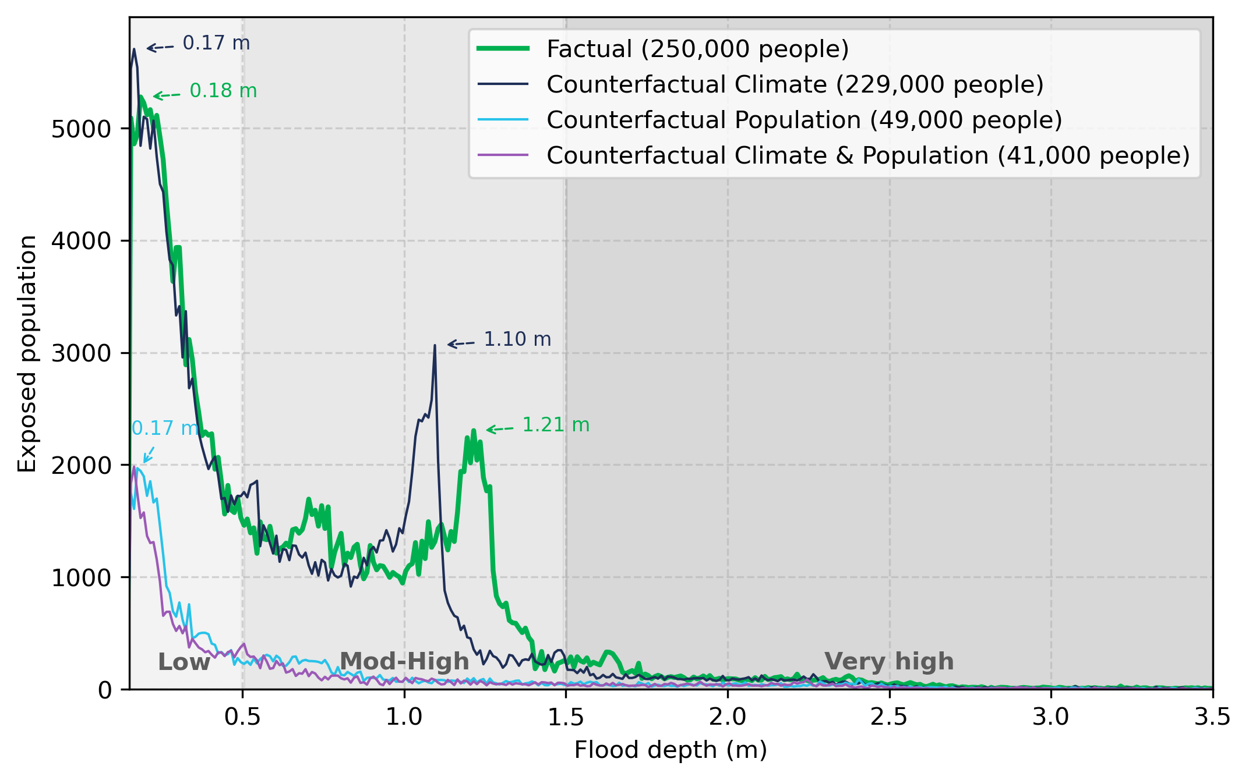
Climate change pushed the exposed population peak of the moderate flood depth category by 17 cm
Climate change

Slide 21
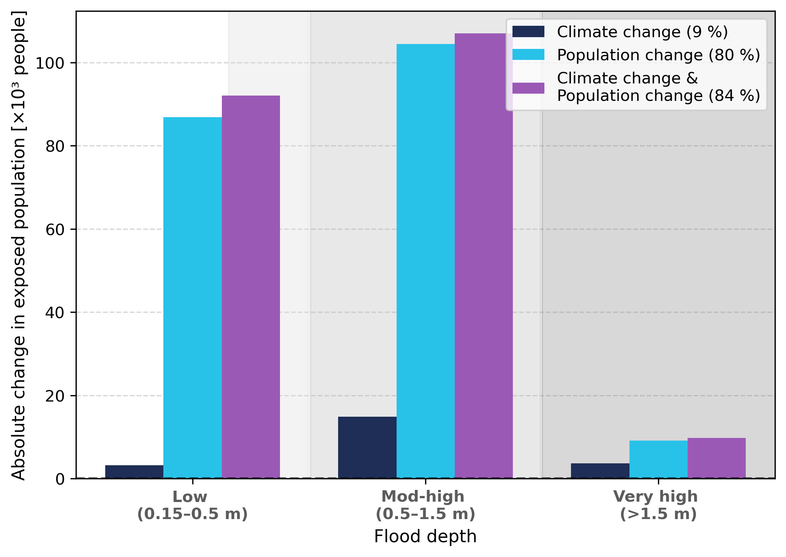
Absolute change in exposed population

Slide 22
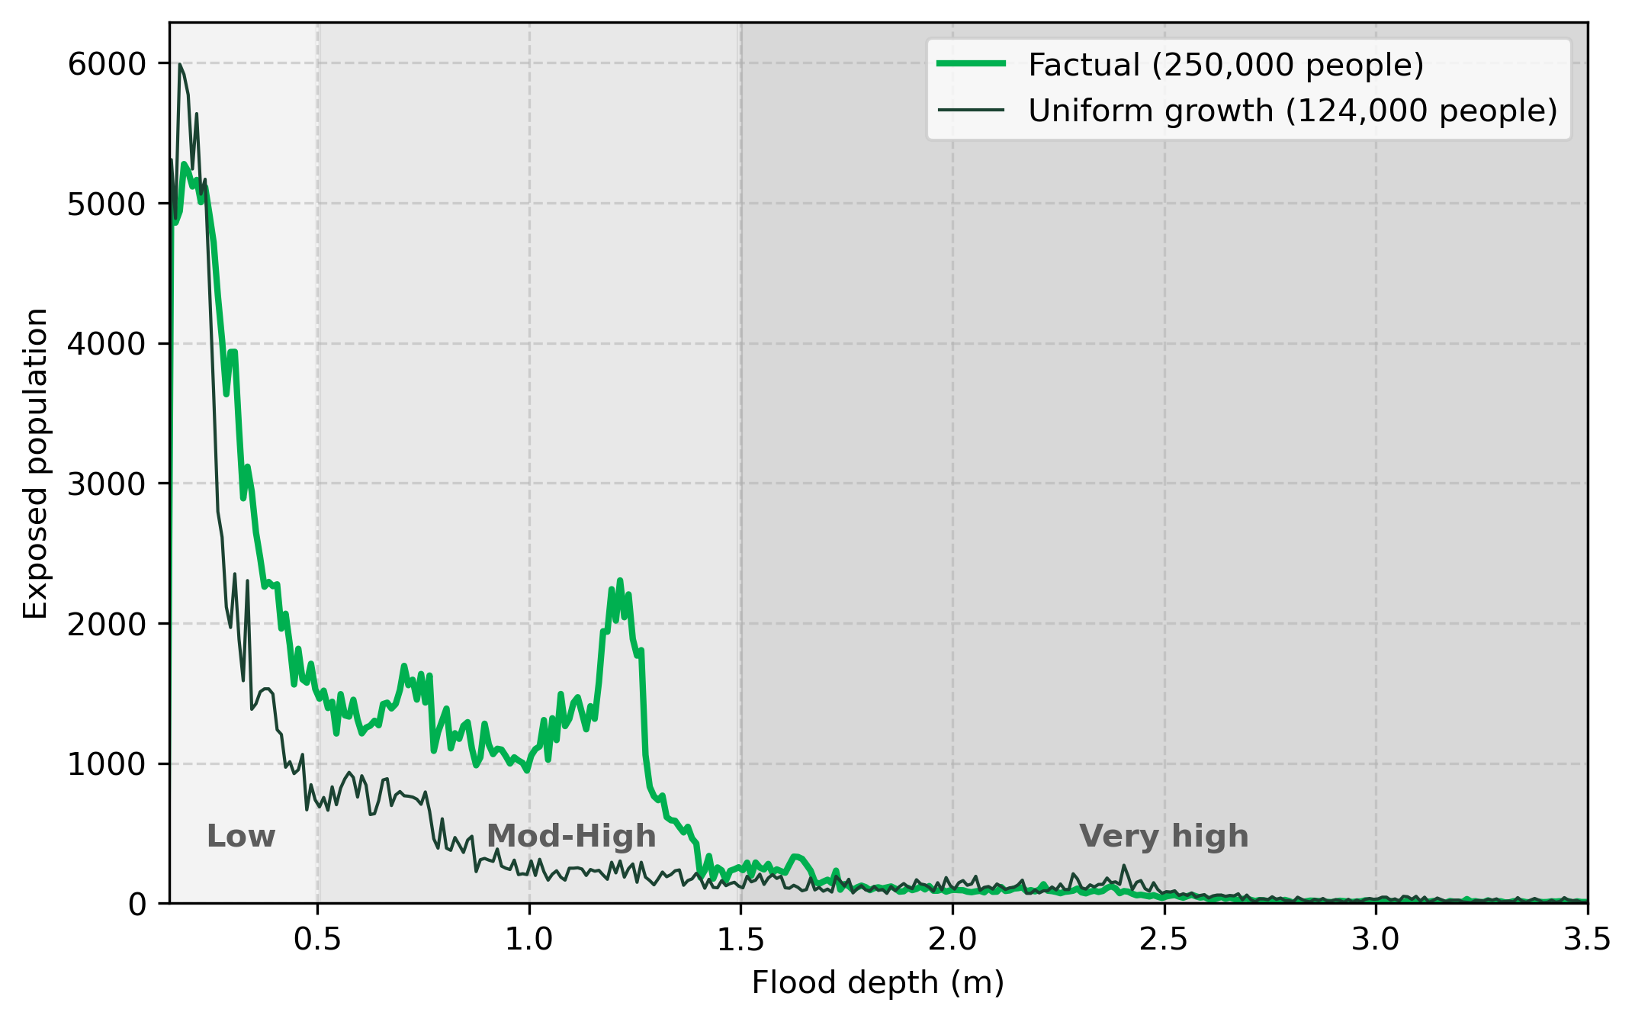
Uniform population growth

Slide 23
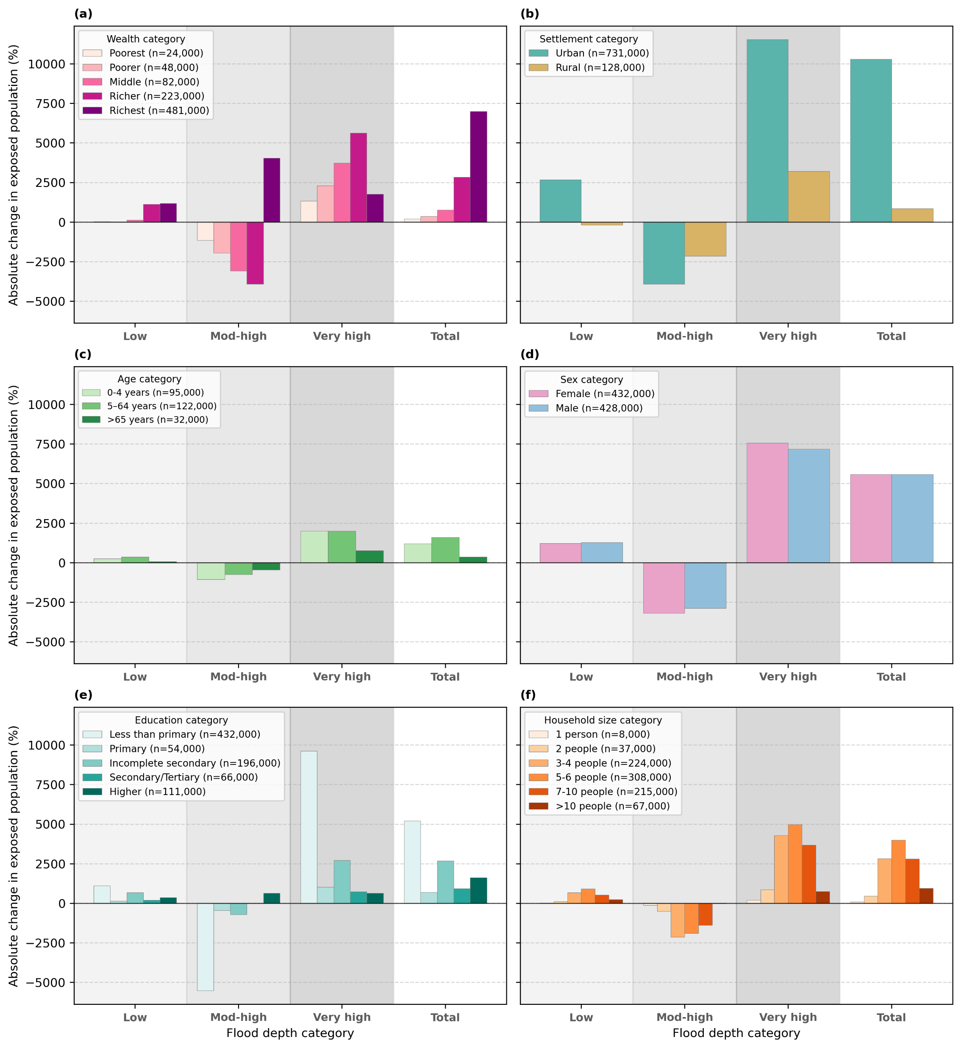
Absolute changes disaggregated per socio-economic group reflects the regional socio-economic distribution
Notes:
https://statics.teams.cdn.office.net/evergreen-assets/safelinks/2/atp-safelinks.html

Slide 24
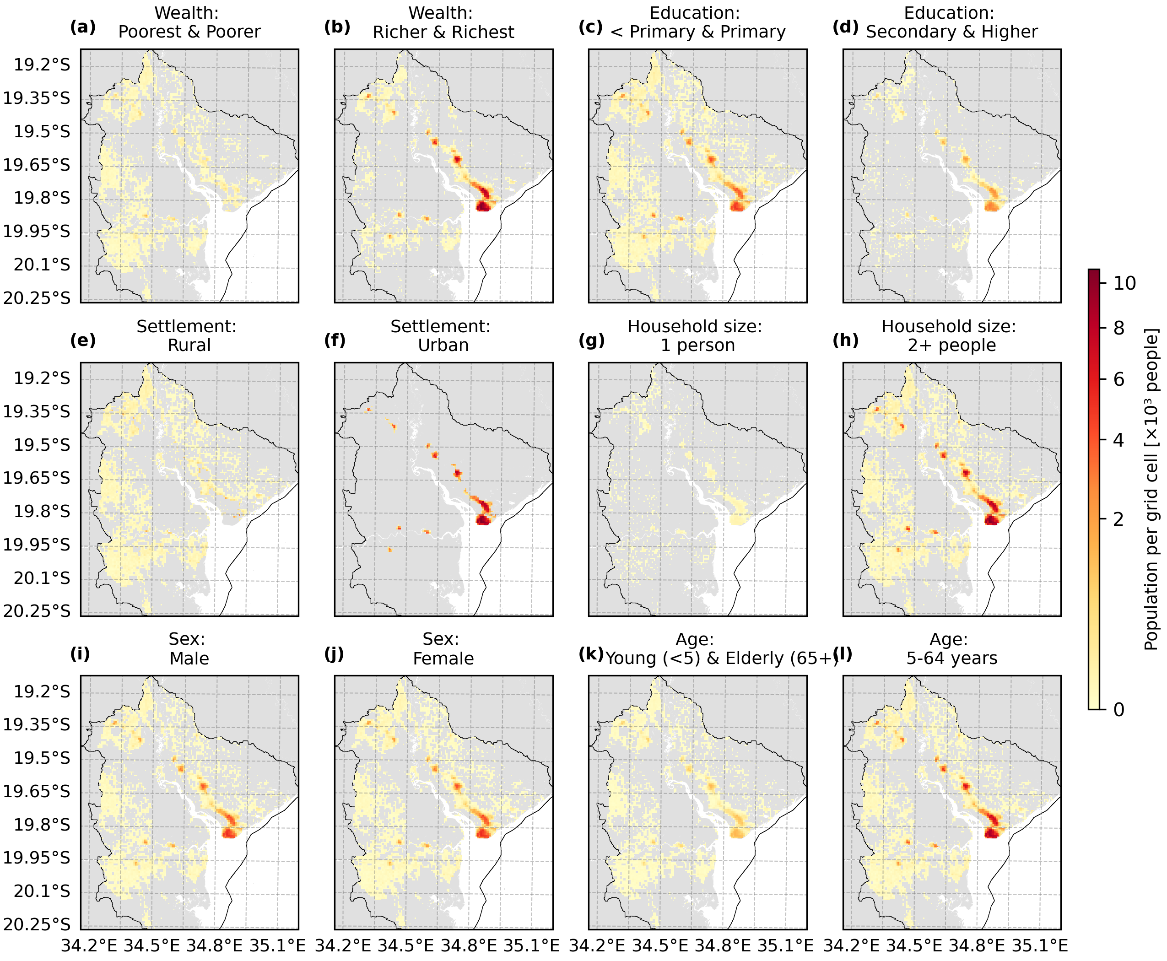
Spatial distribution of socio-economic groups

Slide 25
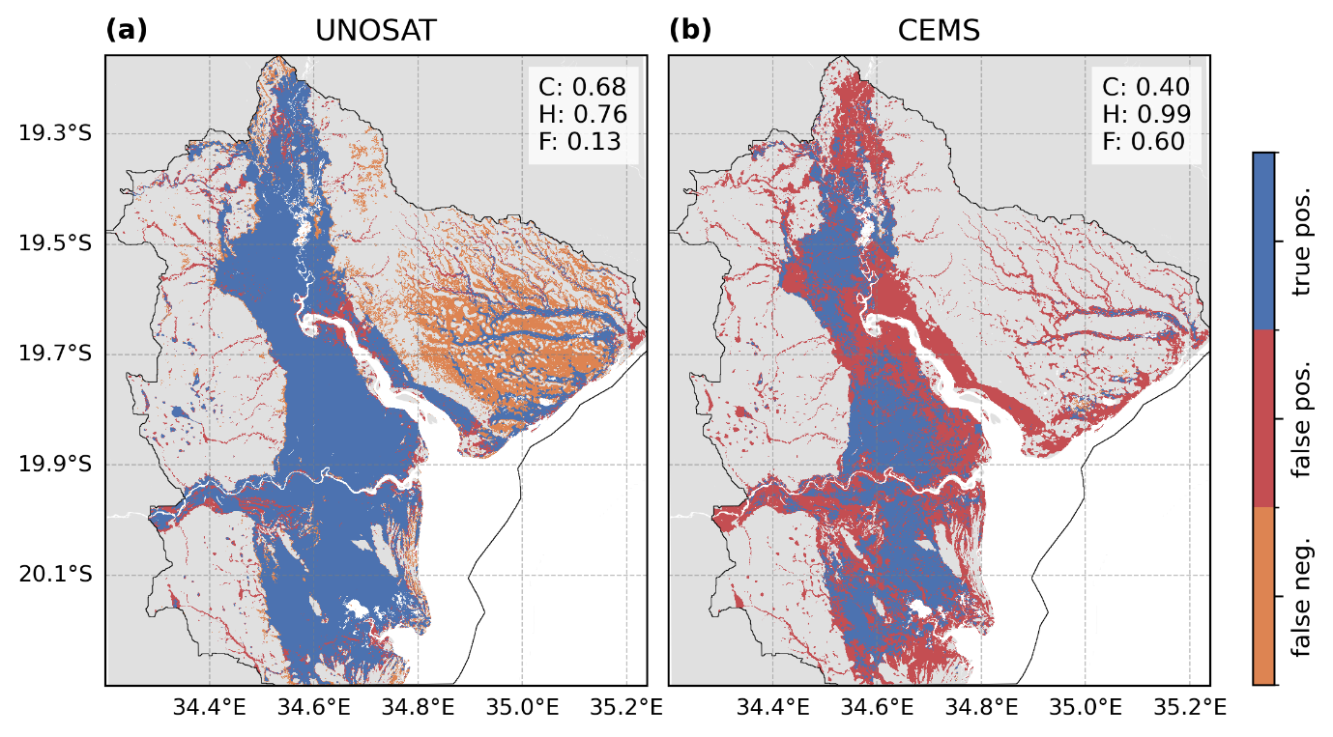
Reasonable agreement with satellite observations
Vertegaal et al. (2026)
Notes:
The maximum flood extent is validated against two satellite products, which show reasonable agreement (hit rate >76 %), but also considerable uncertainty in flood detection; especially North of Beira.
[explain metrics]
The critical success index (C) is the ratio between the correctly classified instances and the union of both error and correct instances.
The hit rate (H) is the proportion of observed flooding that is correctly estimated by the model.
The false-alarm ratio (F) is the proportion of modelled flooded area that is not flooded in the observation dataset.
For the region North East of Beira, we underpredict flooding compared. This area might be difficult to observe due to the larger elevation gradient with forest transitioning to grass- and cropland (Lisboa et al., 2024)
With regards to the flood damage, the Government of Mozambique (2019) estimated the total housing damages at 410 million USD for the Sofala, Manica, Tete and Zambezia provinces in Mozambique. Our estimated damage of 349 million USD only includes districts within the most heavily impacted Sofala province and is thus in agreement with reported damages.

Slide 26
References
Copernicus Climate Change Service. (n.d.). Temperature. Retrieved May 1, 2026, from https://climate.copernicus.eu/climate-indicators/temperature
Intergovernmental Panel on Climate Change (IPCC). (2023b). Key Risks across Sectors and Regions. Climate Change 2022 – Impacts, Adaptation and Vulnerability, 2411–2538. https://doi.org/10.1017/9781009325844.025
Knutson, T., Camargo, S. J., Chan, J. C. L., Emanuel, K., Ho, C. H., Kossin, J., Mohapatra, M., Satoh, M., Sugi, M., Walsh, K., & Wu, L. (2020). Tropical Cyclones and Climate Change Assessment: Part II: Projected Response to Anthropogenic Warming. Bulletin of the American Meteorological Society, 101(3), E303–E322. https://doi.org/10.1175/BAMS-D-18-0194.1
Mester, B., Vogt, T., Bryant, S., Otto, C., Frieler, K., & Schewe, J. (2023). Human displacements from Tropical Cyclone Idai attributable to climate change. Hazards Earth Syst. Sci, 23, 3467–3485. https://doi.org/10.5194/nhess-23-3467-2023
Ton, M. J., Cominola, A., Kreibich, H., de Bruijn, J. A., de Moel, H., Botzen, W. J. W., & Aerts, J. C. J. H. (2025). GLOPOP-SG. https://doi.org/10.5281/ZENODO.17076088
Ton, M. J., Ingels, M. W., de Bruijn, J. A., de Moel, H., Reimann, L., Botzen, W. J. W., & Aerts, J. C. J. H. (2024). A global dataset of 7 billion individuals with socio-economic characteristics. Scientific Data, 11(1), 1–11. https://doi.org/10.1038/S41597-024-03864-2;SUBJMETA
Treu, S., Muis, S., Dangendorf, S., Wahl, T., Oelsmann, J., Heinicke, S., Frieler, K., and Mengel, M.: Reconstruction of hourly coastal water levels and counterfactuals without sea level rise for impact attribution, Earth Syst. Sci. Data, 16, 1121–1136, https://doi.org/10.5194/ESSD-16-1121-2024, 2024.
Vertegaal, D. M., van den Hurk, B. J. J. M., Couasnon, A., Aleksandrova, N., Bovenschen, T., Gradiyanto, F., Leijnse, T. W. B., Goulart, H. M. D., & Muis, S. (2026). Climate and impact attribution of compound flooding induced by tropical cyclone Idai in Mozambique. Natural Hazards and Earth System Sciences, 26(3), 1417–1433. https://doi.org/10.5194/nhess-26-1417-2026

