Slide 1

Resilience in Transition: Spatio-Temporal Dynamics and Correlates of Community Flood Resilience in Nepal
Dipesh Chapagain, Romain Clercq-Roques, Jung-Hee Hyun, Stefan Hochrainer-Stigler, Stefan Velev, Raquel Guimaraes, Adriana Keating, Anup Shrestha, & Reinhard Mechler

Slide 2
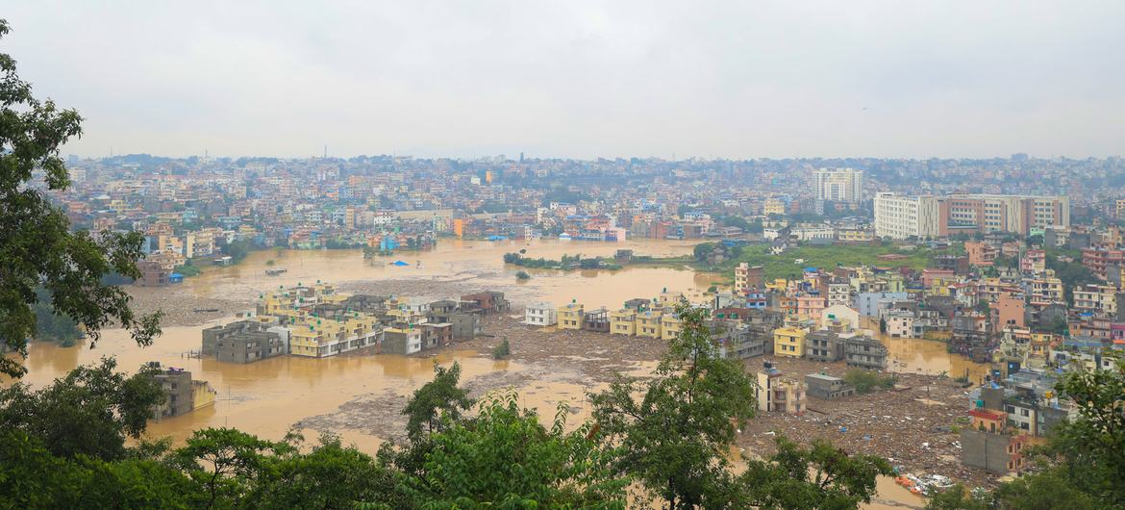
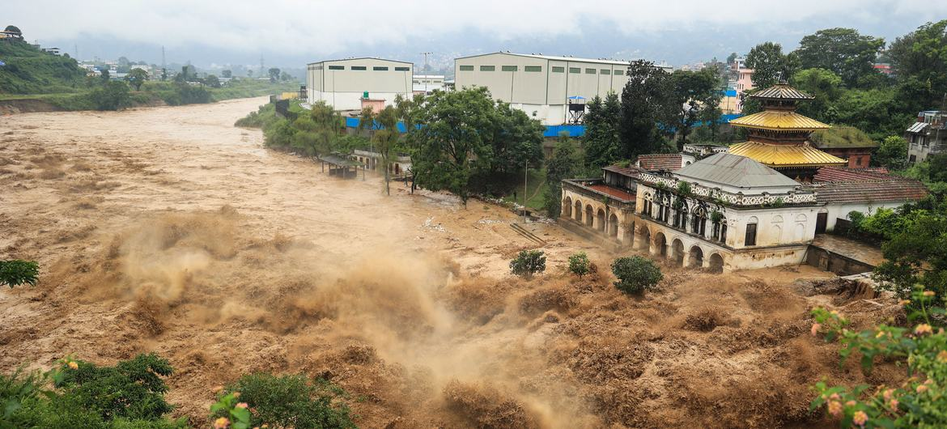
Background & Motivation
Floods are among the most frequent, deadly and damaging hazards, with risks rising due to climate change and development pressures.
Nepal is highly exposed to recurrent flooding.
Limited longitudinal evidence on flood resilience dynamics.
Need to link resilience measurement with drivers and interventions.
Photo: UNICEF/Laxmi-Prasad-Ngakhusi

Slide 3
Research Questions & Objectives
We focus on four key questions:
How does community flood resilience change over time?
What mechanisms drive these changes?
What role do socio-economic factors and hazard play?
To what extent can changes be attributed to interventions?

Slide 4
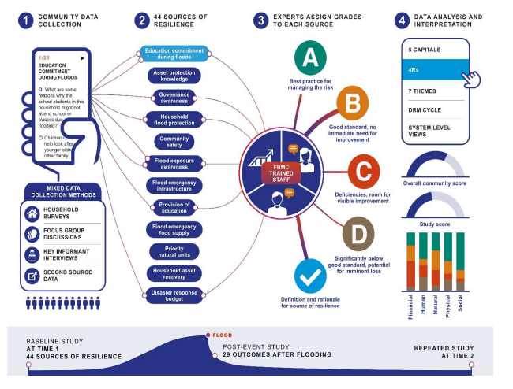
Conceptual Framework: Flood Resilience Measurement for Communities (FRMC)
FRMC is a multidimensional, survey-based framework for assessing community flood resilience.
Based on 44 standardized indicators.
Measures resilience across five capitals and five DRM cycle stages.
Measured at: baseline (T0), post-event, and over time (T1, T2,..Tn).
Enables longitudinal assessment.
Laurien et al., 2020

Slide 5
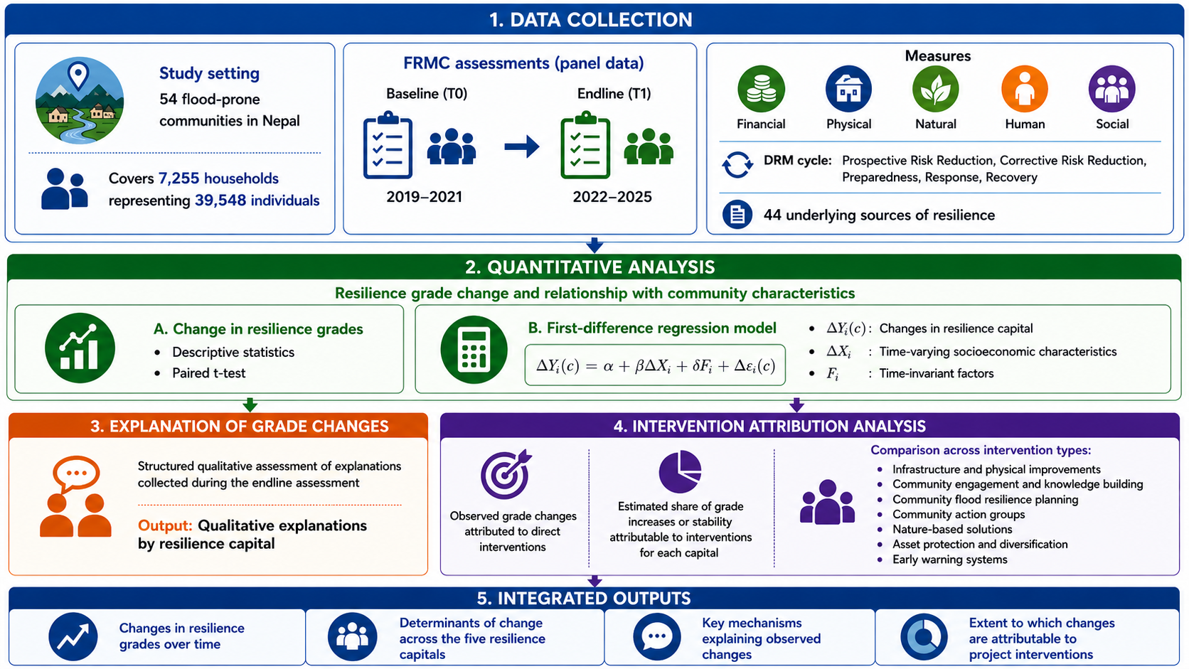
Research Design & Methodology

Slide 6
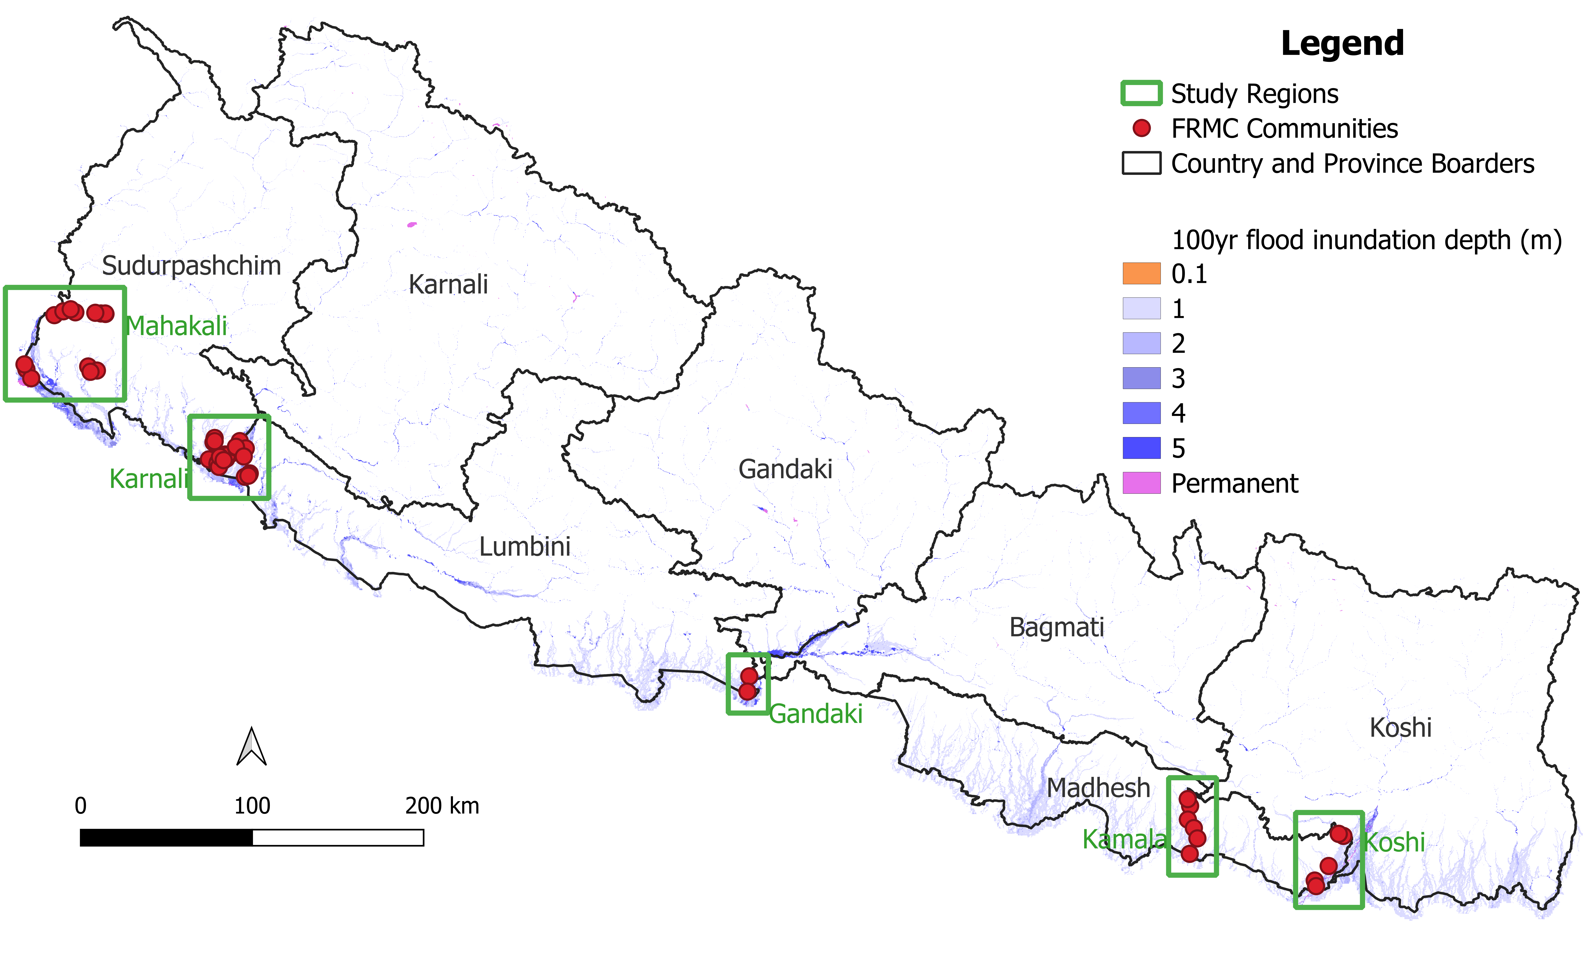
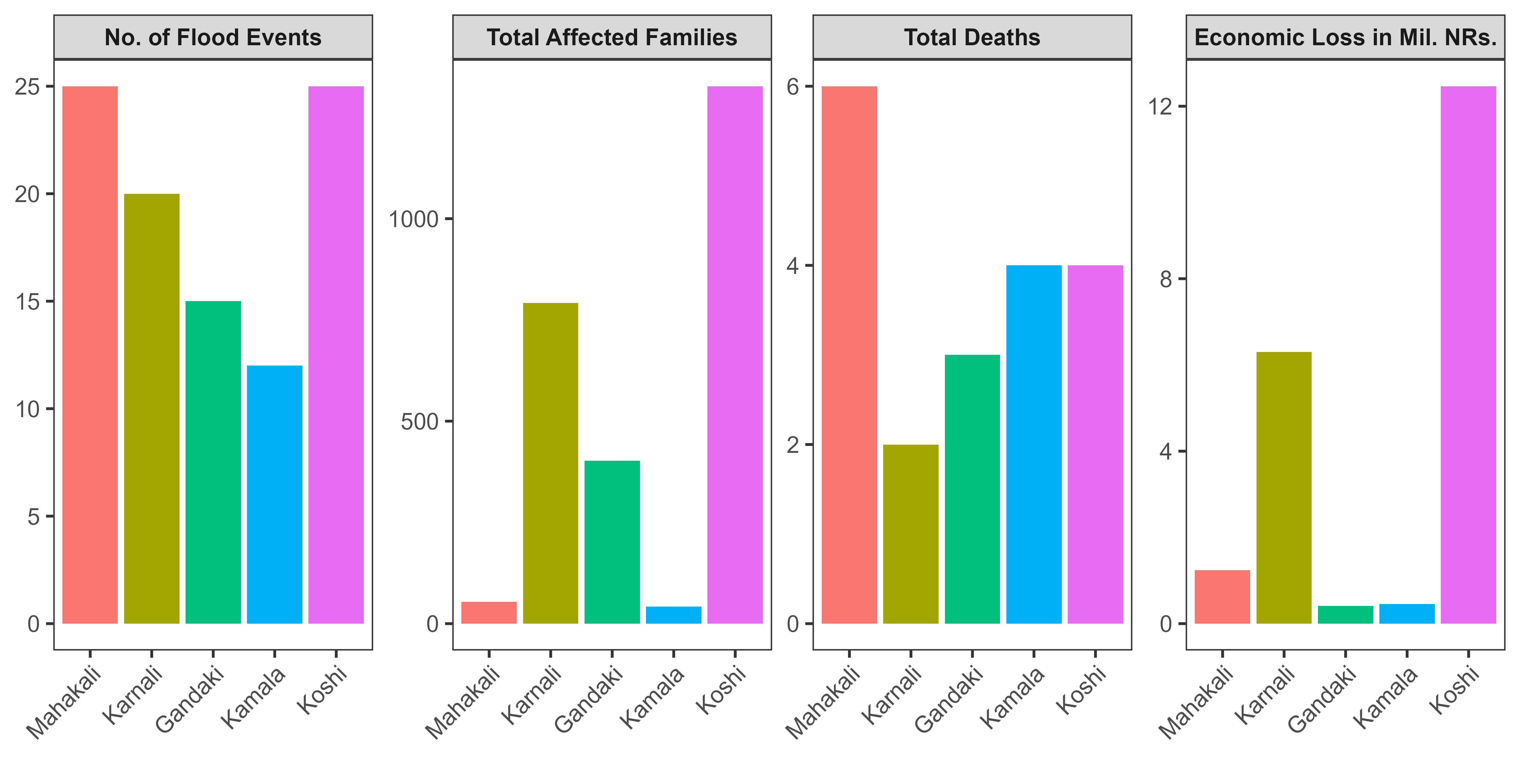
Flood Risks in the Study Regions
10-year floods: Average inundation of 0.45 m, affecting up to 60% of community areas.
100-year floods: Deeper and more extensive flooding (median 0.75 m), impacting up to 97% of areas.
Observed impacts (2016–2025): 97 flood events led to 19 deaths, 3 missing persons, 2,617 affected families, and substantial economic losses - highlighting persistent risk.

Slide 7
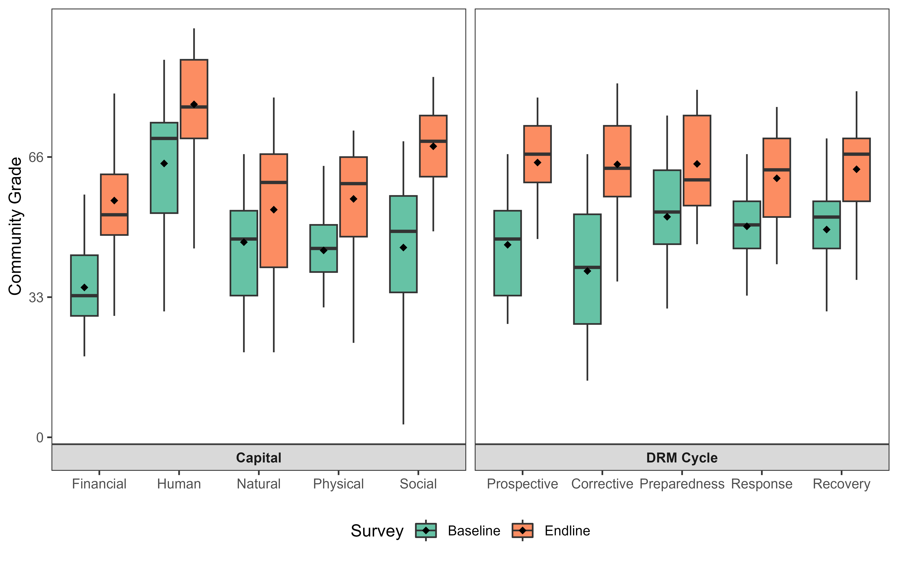
Key Result: Resilience Improved
Significant improvements across all 5 capitals and DRM Cycle
Largest gains:
Social capital (+23.8)
Financial capital (+20.5)
Smallest gain: Natural capital (+7.7)
Strongest gains in
Corrective risk reduction
Prospective risk reduction
Indicates shift toward proactive risk management

Slide 8
Socio-Economic Drivers of Resilience Change
Socio-economic factors explain limited variation so much variation unexplained potentially due to short timeframe
Key findings:
Poverty reduction is strongly linked to improvement in financial capital
Proportion of female-headed households are positively associated with financial & physical capital
Female education is associated with higher human capital
Remittance: weak positive association with physical and natural capital, but significant negative association with human capital (loss of trained youth)
Population size is associated with higher human capital but lesser natural capital
Resilience not determined by structural factors alone

Slide 9
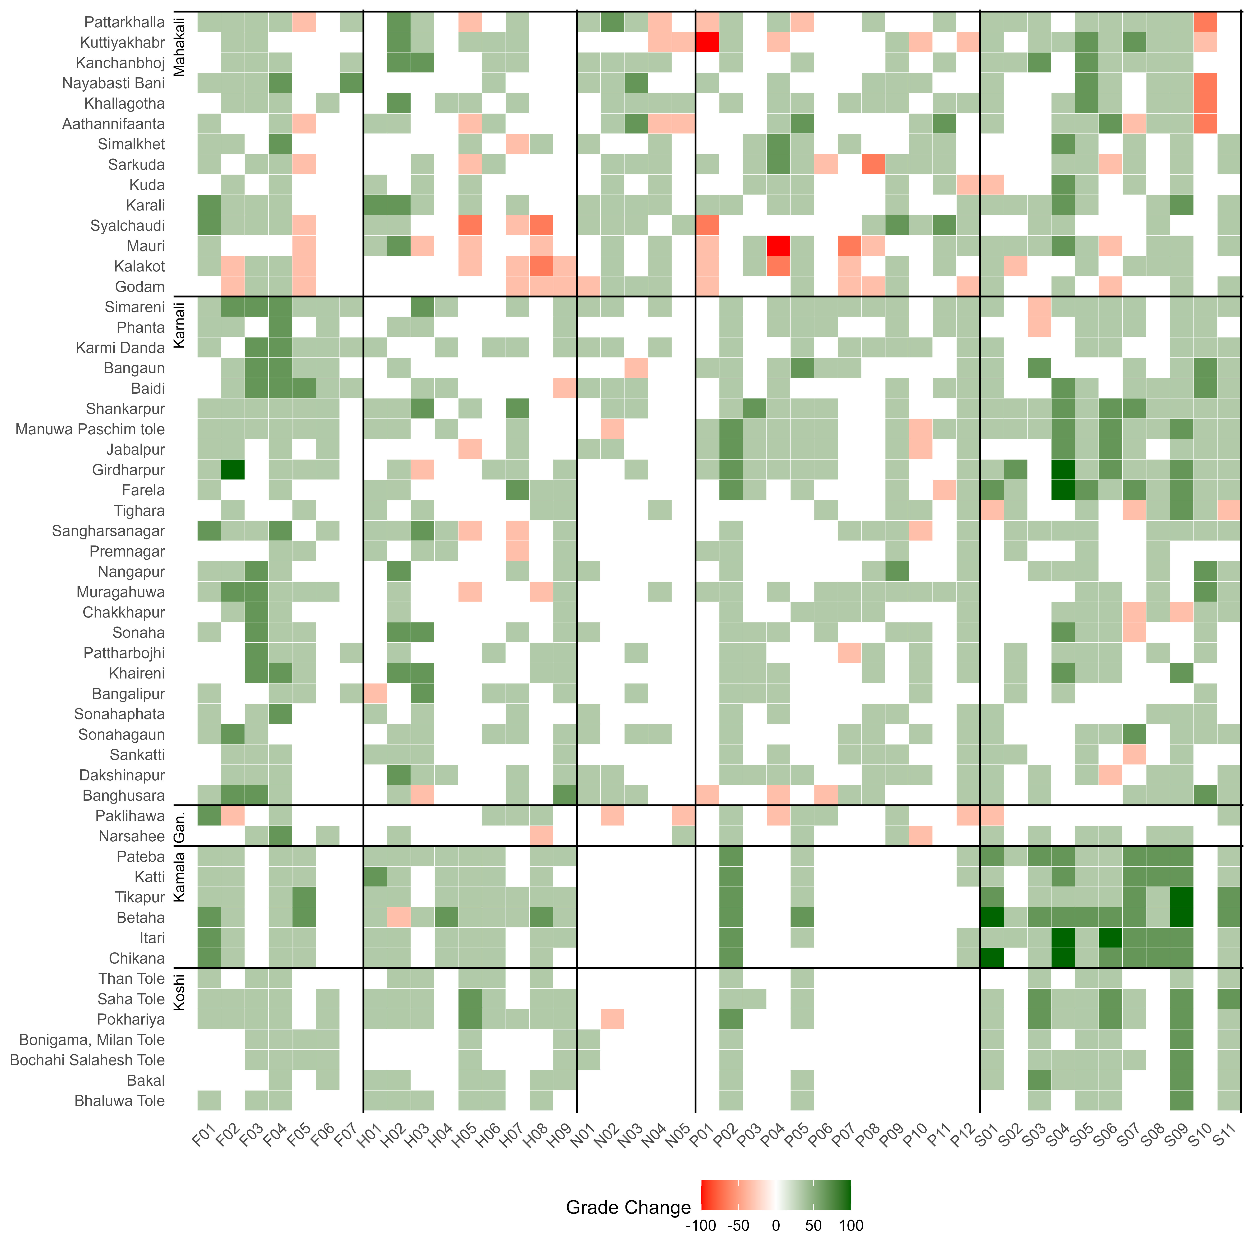
Mechanisms of Resilience Change
Financial: Household & community preparedness strengthened - insurance, disaster funds, continuity planning
Human: Improved disaster knowledge and preparedness skills - training and awareness
Physical: Better EWS, flood protection, shelters, and emergency food supply
Social (strongest): Improved coordination, governance, inclusion, leadership, and inter-community collaboration
Natural: Limited progress, likely due to longer restoration times
Constraints:
Out-migration reducing human capital
Limited funding

Slide 10
Role of Interventions
Around 43% of resilience improvements can be linked to project interventions
Intervention focus and strongest impact:
Social capital: Community organization and planning
Financial capital: Asset protection and livelihood diversification
Weakest impact:
Natural capital: Long-term processes
Interventions matter - but intervention focus and effects are uneven across capitals

Slide 11
Key Takeaways
Community flood resilience can improve even in high-risk settings
The most effective investment include:
Community governance & coordination
Financial preparedness mechanisms
Early warning & preparedness systems
Should be complemented by:
Long-term nature based solutions
Scaled infrastructure investments

Slide 12

Thank you.
Dr. Dipesh Chapagain Advancing Systems Analysis Program, Systemic Risk and Resilience (SYRR) Research Group chapagain@iiasa.ac.at

Slide 13
Table 1: Regression (explicit first difference model) results with the FRMC 5Cs as the dependent variables and community socio-economic characteristics and flood‐hazard indicators (average inundation depth) as explanatory variables.
 | Financial Change |  | Physical Change |  | Natural Change |  | Human Change |  | Social Change
Predictors | Estimates | p | Estimates | p | Estimates | p | Estimates | p | Estimates | p
(Intercept) | 18.66 | <0.001 | 12.29 | <0.001 | 4.24 | 0.093 | 13.58 | <0.001 | 23.42 | <0.001
Poverty Change (% point) | -0.18 | 0.018 | -0.11 | 0.139 | -0.06 | 0.493 | -0.07 | 0.297 | 0.07 | 0.424
Remittance Change (% point) | 0.04 | 0.480 | 0.08 | 0.125 | 0.07 | 0.177 | -0.15 | 0.070 | -0.01 | 0.948
Minority Change (% point) | 0.01 | 0.882 | -0.04 | 0.471 | 0.06 | 0.397 | -0.07 | 0.136 | -0.06 | 0.346
Sec Education Male Change (% point) | -0.13 | 0.576 | 0.05 | 0.833 | 0.06 | 0.818 | -0.49 | 0.049 | -0.26 | 0.461
Sec Education Female Change (% point) | 0.11 | 0.674 | -0.04 | 0.858 | -0.29 | 0.335 | 0.58 | 0.054 | 0.27 | 0.540
Female Household Head Change (% point) | 0.2 | <0.001 | 0.13 | 0.008 | 0.09 | 0.163 | 0.07 | 0.240 | -0.02 | 0.813
Population (thousands) | 1.69 | 0.263 | -1.3 | 0.282 | -2.46 | 0.047 | 3.94 | 0.032 | 4.44 | 0.280
10-year flood average inundation depth (m) | -3.96 | 0.109 | -2.03 | 0.292 | 4.88 | 0.040 | -2.74 | 0.364 | -2.98 | 0.435
Observations | 54 |  | 54 |  | 54 |  | 54 |  | 54
R² / R² adjusted | 0.258 / 0.126 |  | 0.253 / 0.120 |  | 0.274 / 0.145 |  | 0.212 / 0.071 |  | 0.103 / -0.057
AIC | 405.571 |  | 385.137 |  | 406.88 |  | 420.208 |  | 448.068

