Slide 1
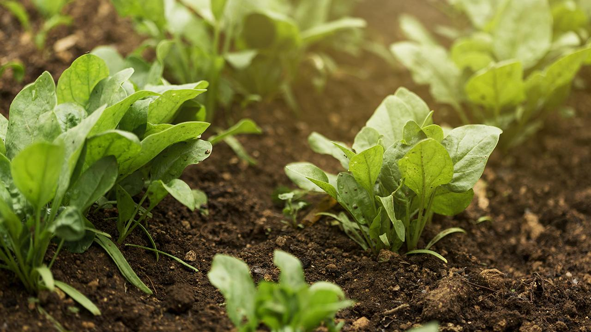
Eating food from my backyard: Urban and peri‑urban agriculture as a climate‑resilient strategy
A global synthesis towards climate‑smart food systems
Aisha Javed, Postdoctoral Researcher
Department of Physical and Environmental Sciences
University of Toronto, Ontario, Canada
EGU 2026 Vienna, Interactive discussion

Slide 2
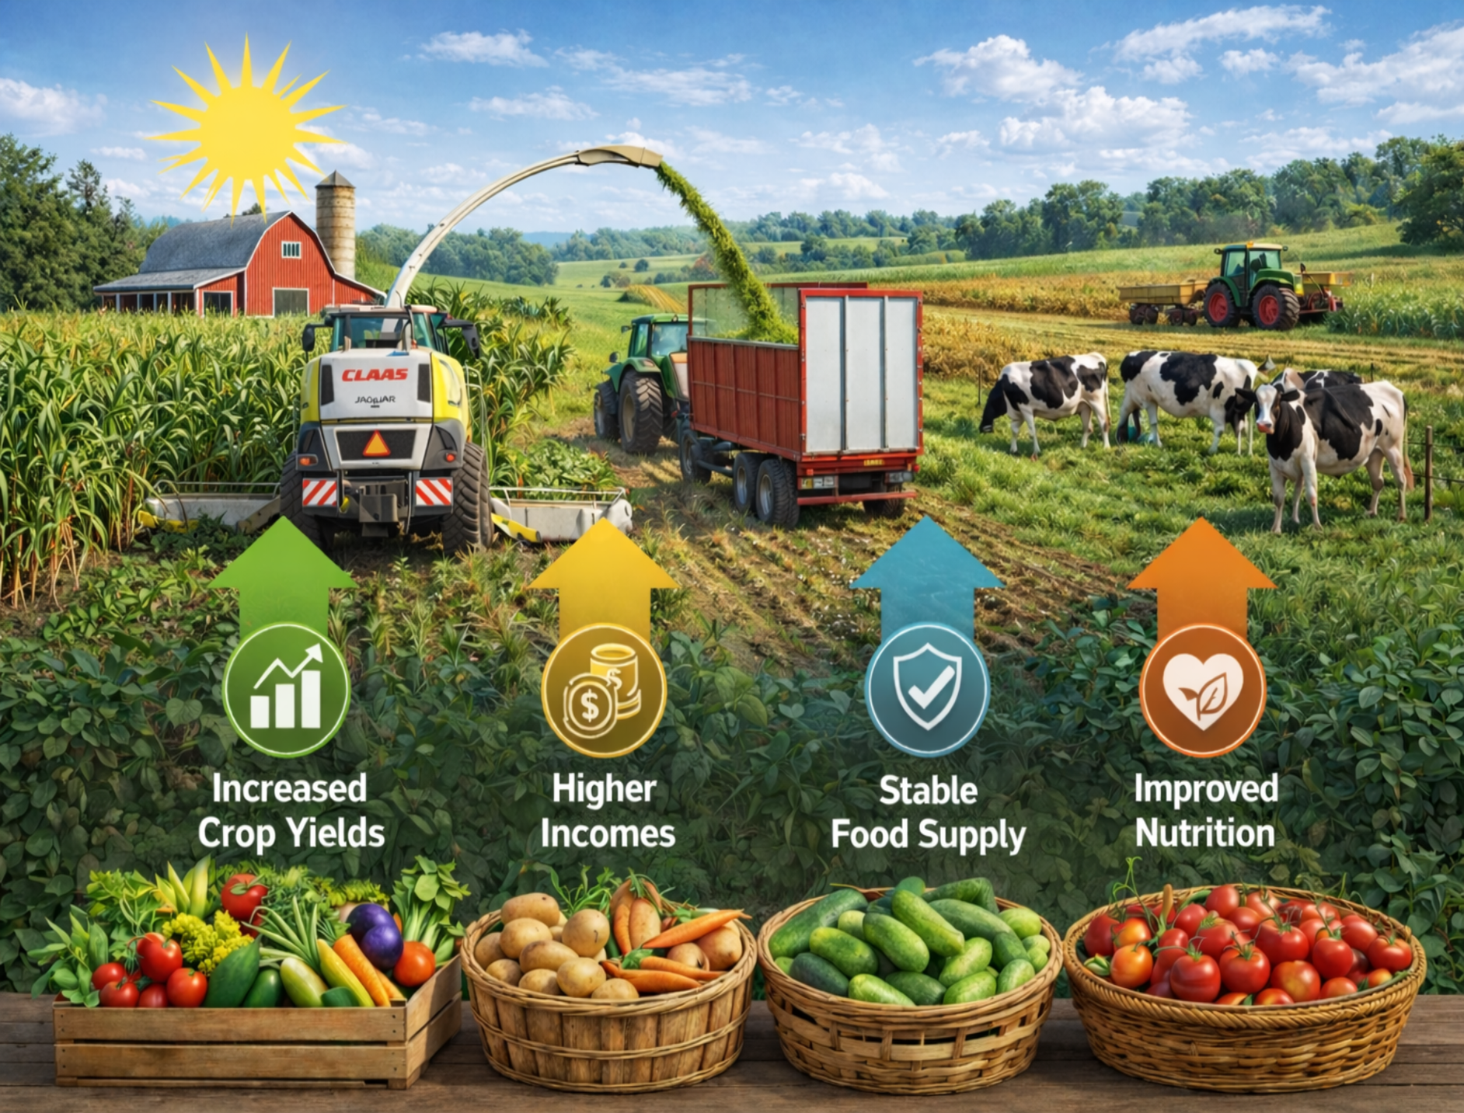
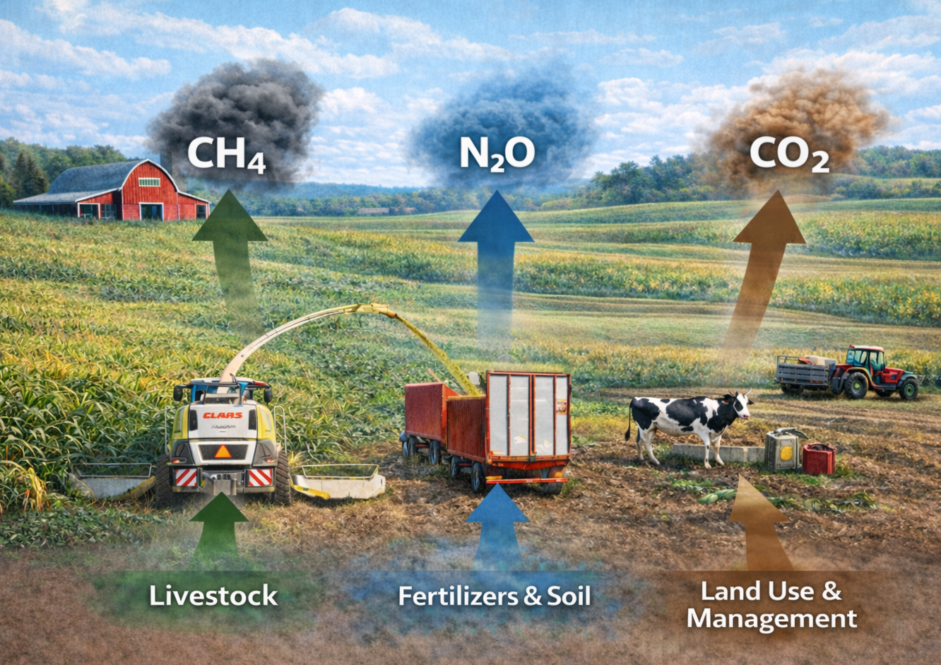
Conventional agriculture (UPA)
Important food source
Leading source of global greenhouse gas emissions
Nitric Oxide
Carbon Dioxide
Methane
2

Slide 3
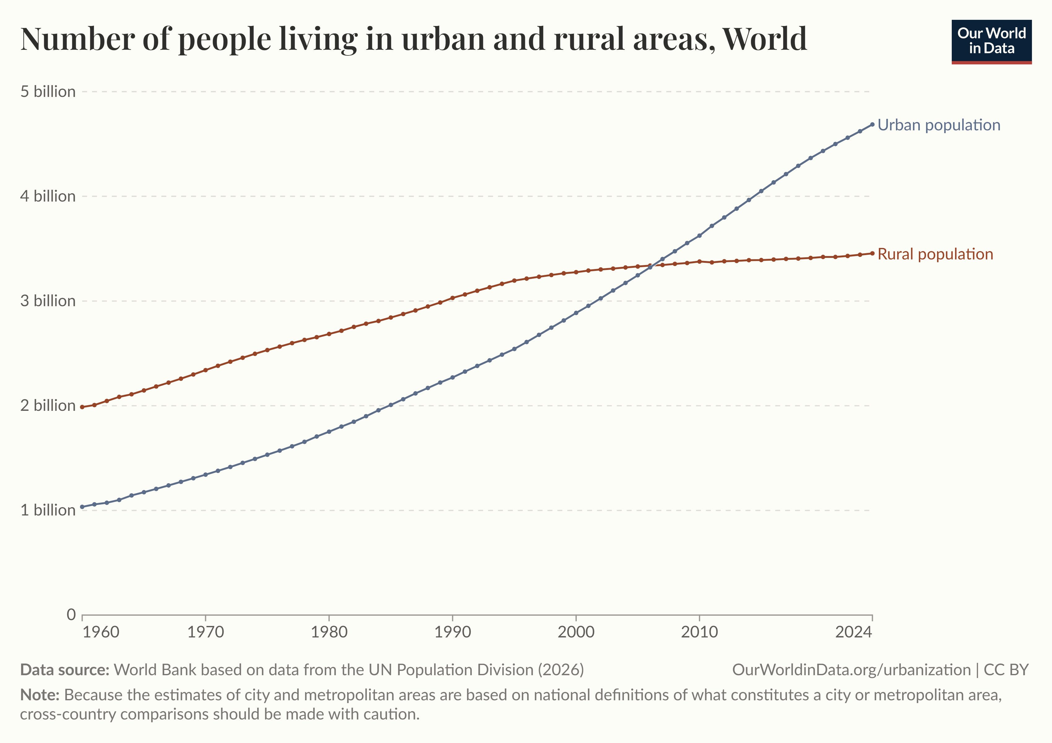
≈ 68%
Rapid urbanization and population growth
of the projected global human population growth is expected to occur in urban areas (United Nations, 2019).
How do we sustainably feed growing cities?
3

Slide 4
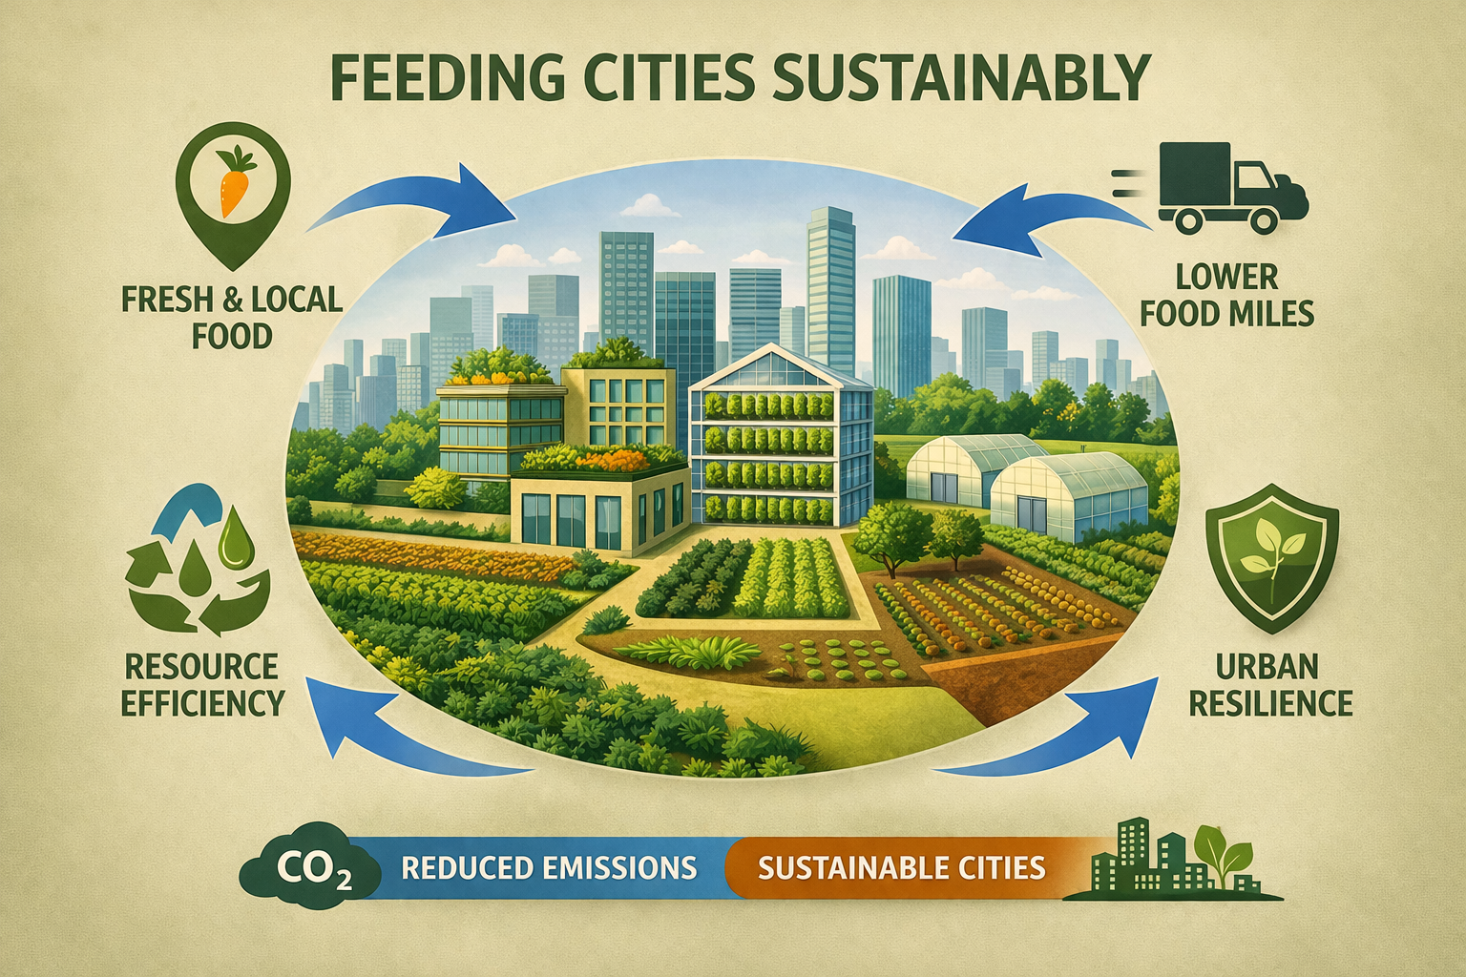
Urban and peri-urban agriculture (UPA)
4

Slide 5
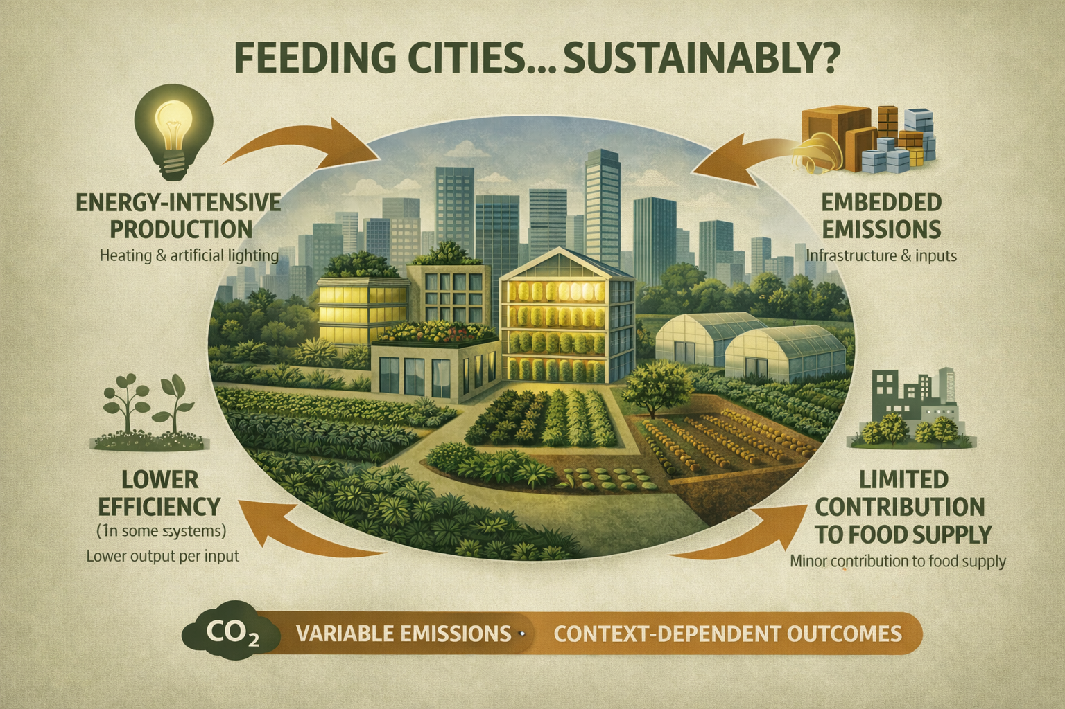
Mixed views
5

Slide 6
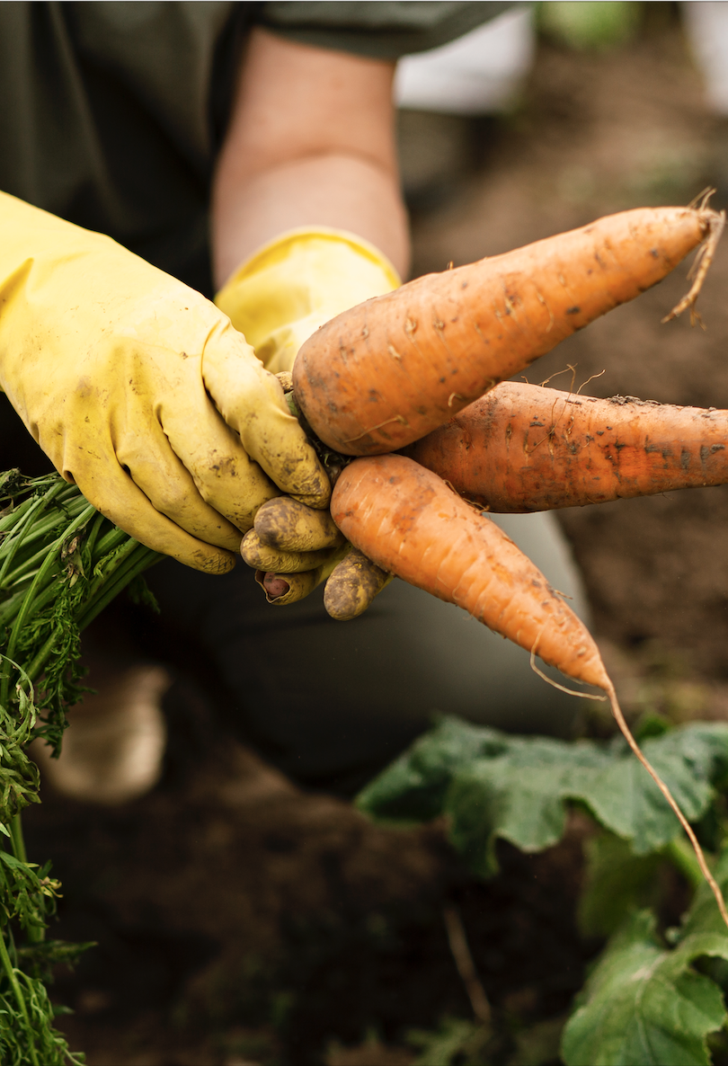
Research Objectives
Is UPA truly climate-friendly, or are its benefits being overestimated?
Global synthesis covering:
Definitions
Impact assessment
Vegetation types
Quantitative Tools
6

Slide 7
Defining UPA
22 unique definitions
1987–2025
0/9 dimensions universally agreed
Tap any card to view the full definition
1987
1992
1996
2000
2001
2005
2006
2007
2008
2010
2011
2012
2014
2016
2019
2022
2025
Yeung
Smit & Nasr †
Smit et al.
Mougeot
Smit et al.
Viljoen et al.
Van Veenhuizen
Vagneron
Graefe et al.
Zezza & Tasciotti
Pearson et al.
Van der Schans et al.
Thebo et al.
Opitz et al.
Weidner et al.
FAO et al. †
Fei et al.
De Zeeuw et al.
Adam
Petts
Enete & Achike
Ellis & Sumberg
SCOPE
Narrow (0–3 dimensions)
Moderate (4–6 dimensions)
Broad (7–9 dimensions)
† Same paper, two distinct definitions published.

Slide 8
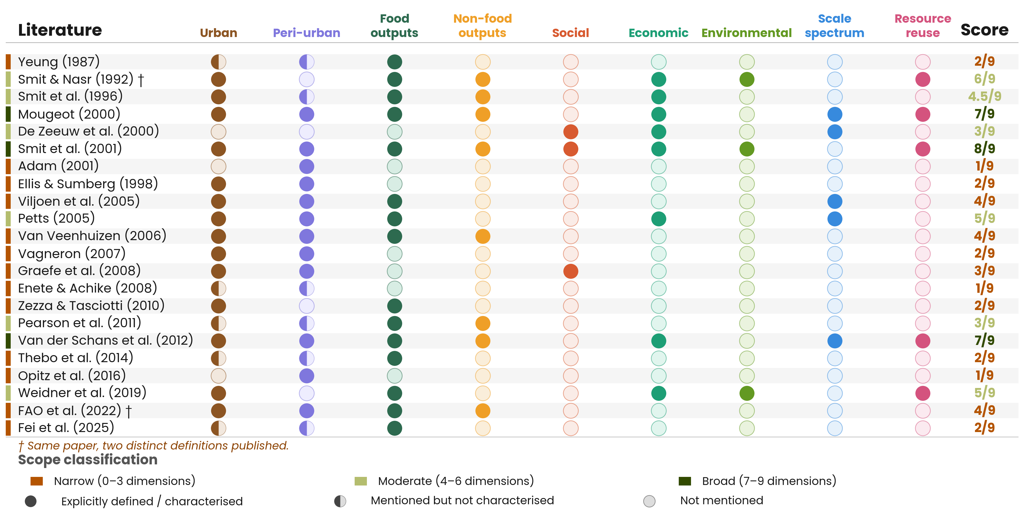
Defining UPA
Notes:
“Definitions vary, systems are inconsistent , studies are not directly comparable”
Change van der schans et al to van der schans and Wiskerke
Non-food outputs
● if non-food products are explicitly named alongside food — e.g. fuel, fibre, pharmaceuticals, or "other outputs."
○ if the definition is food-only or does not name other product categories.
Social dimension
● if the definition explicitly names social actors, conditions, or functions — e.g. gender, low-income groups, livelihoods of urban residents, community, or food security as a social outcome.
○ if the definition is production- or market-oriented without social reference.
Economic dimension
● if the definition explicitly addresses economic characteristics — e.g. market orientation, commercialisation, response to consumer demand, income generation, or home consumption as an economic category.
○ if economic context is absent.
Environmental
● if the definition explicitly references environmental functions or processes — e.g. closing ecological loops, reuse of urban waste streams, environmental benefits, or sustainability outcomes.
○ if environmental dimensions are absent.
Scale spectrum
● if the definition makes an explicit attempt to define the geographic or spatial extent of UPA — e.g. specifying a km radius, distinguishing a range from subsistence to commercial as a spatial indicator, or distinguishing site types in relation to location.
○ if references to scale describe production intensity, plot size, or beneficiaries rather than spatial extent. Simply using "urban" or "peri-urban" without further spatial delimitation does not qualify.
Resource reuse
● if the definition explicitly references the use or reuse of urban material streams as agricultural inputs — e.g. urban wastewater, solid waste, organic waste, or urban energy flows.
○ if resource flows are not mentioned.

Slide 9
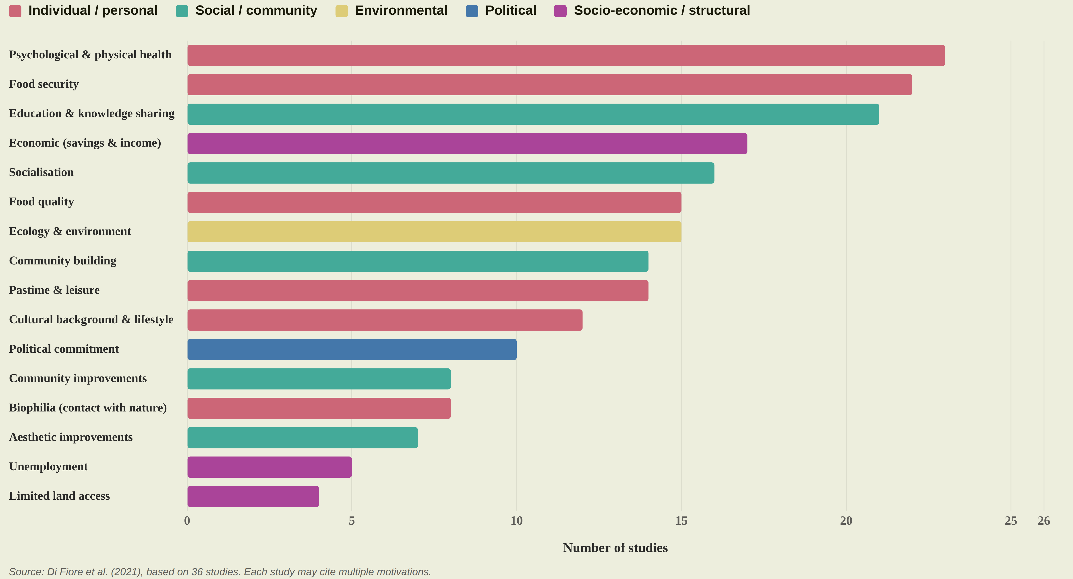
Motivations

Slide 10
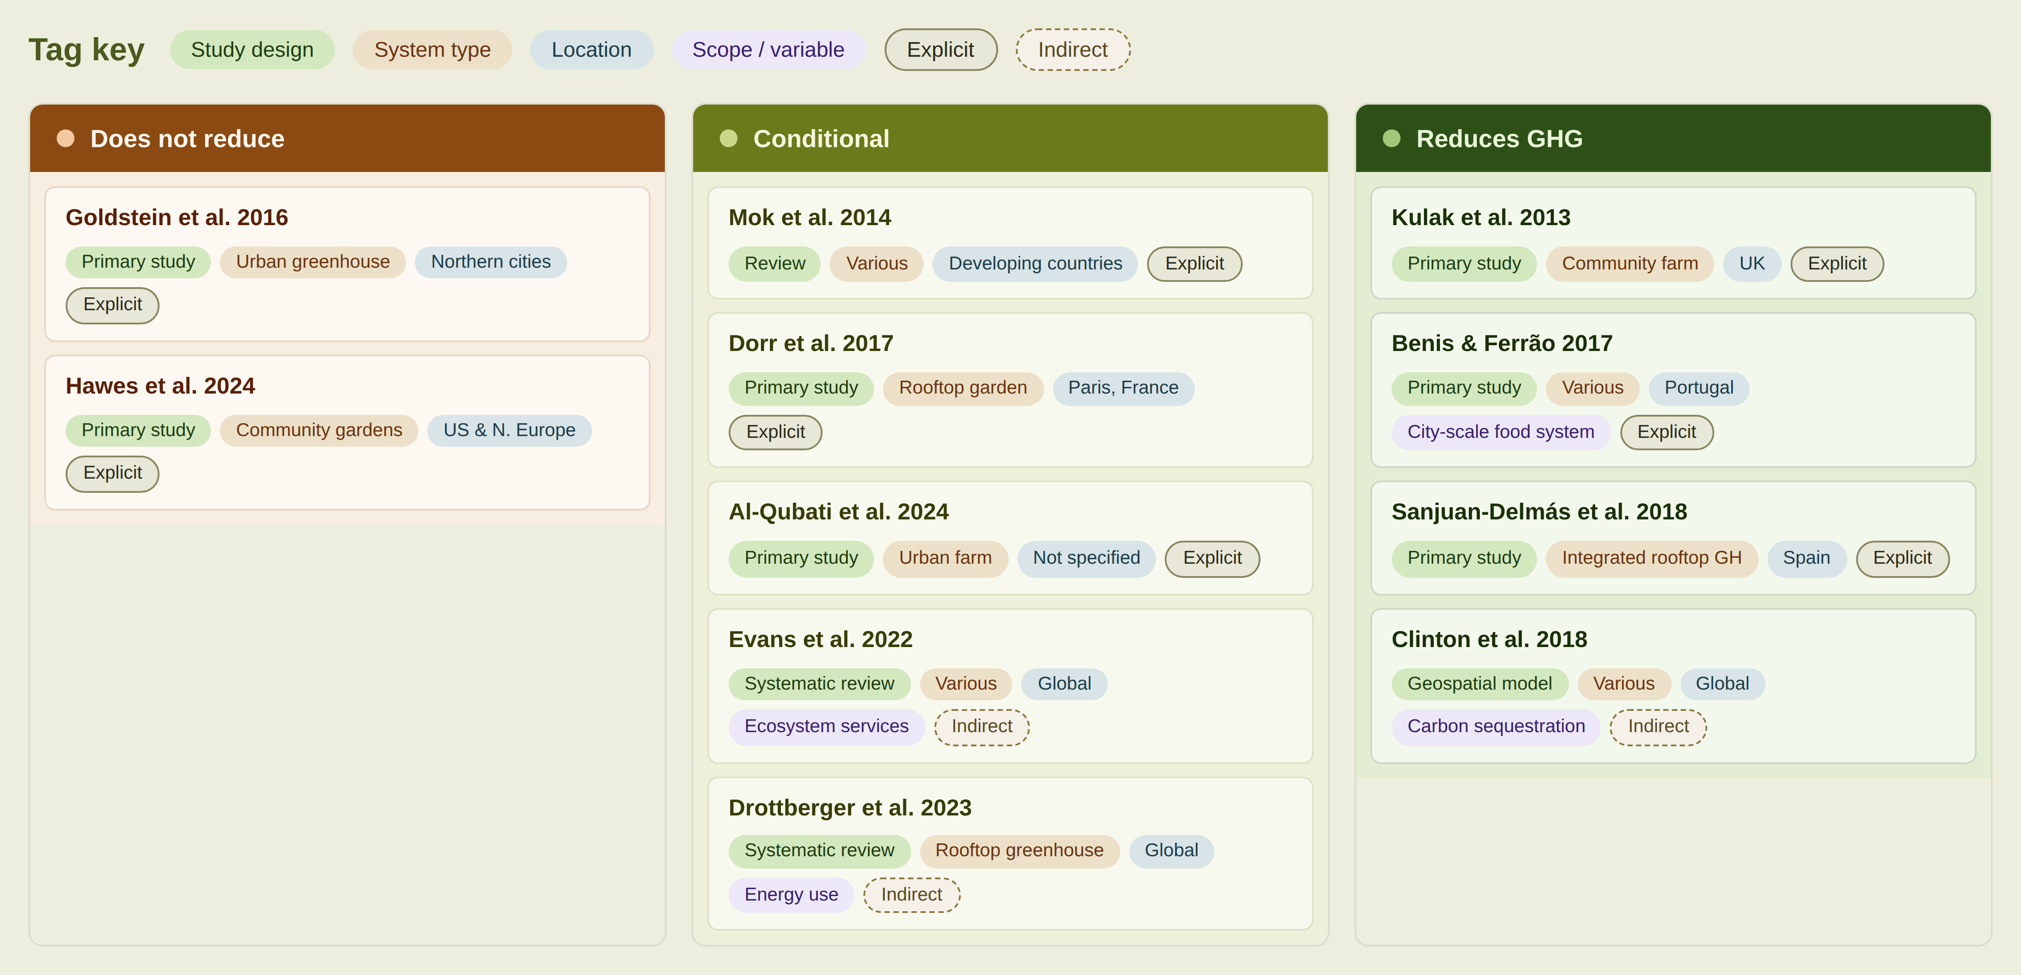
Greenhouse gas (GHG) reduction potential across studies
Different systems,
Different methods,
Different contexts=
Different results!!
Notes:
Different systems
Different methods
Different contexts
→ Different results. Variability in results reflects variability in the studies themselves.
Change the colour of the reduces GHG dot, scope missing for some.

Slide 11
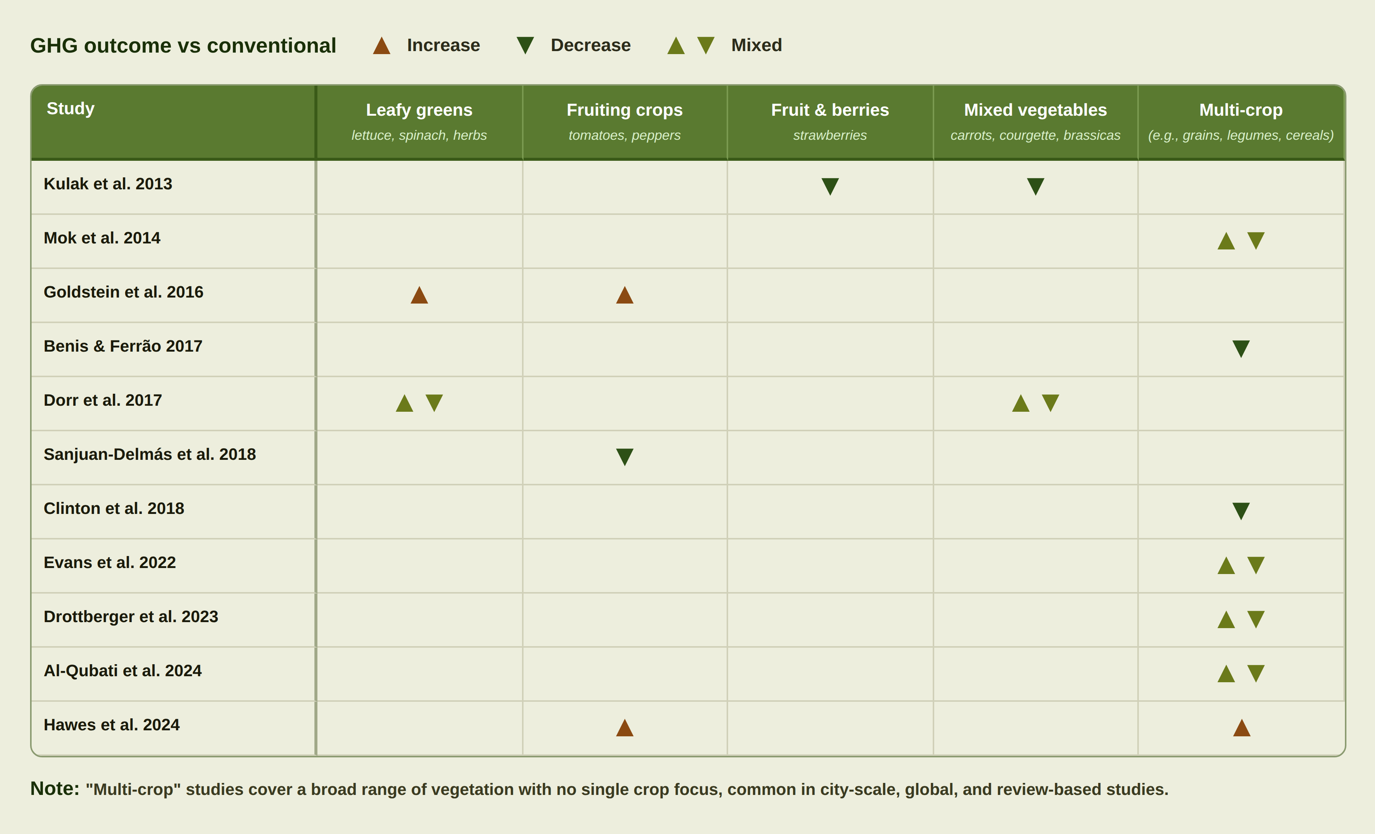
GHG reduction potential across vegetation

Slide 12
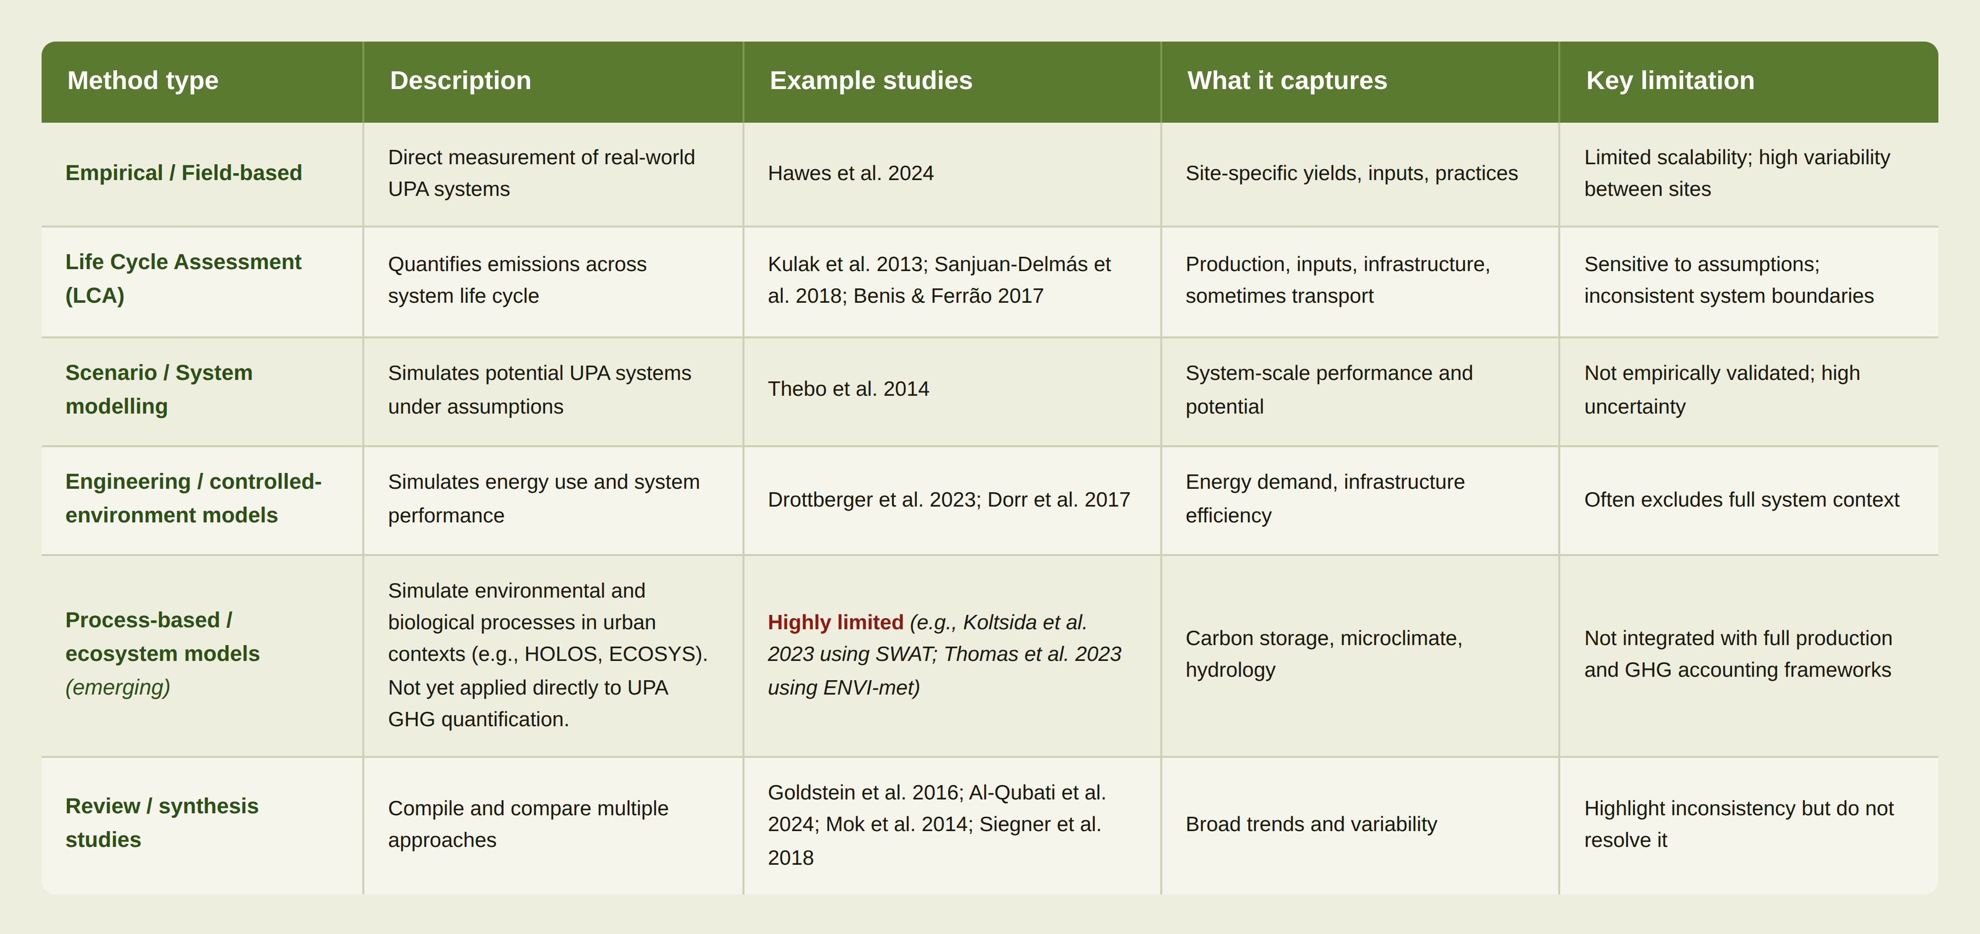
GHG Modelling methods

Slide 13
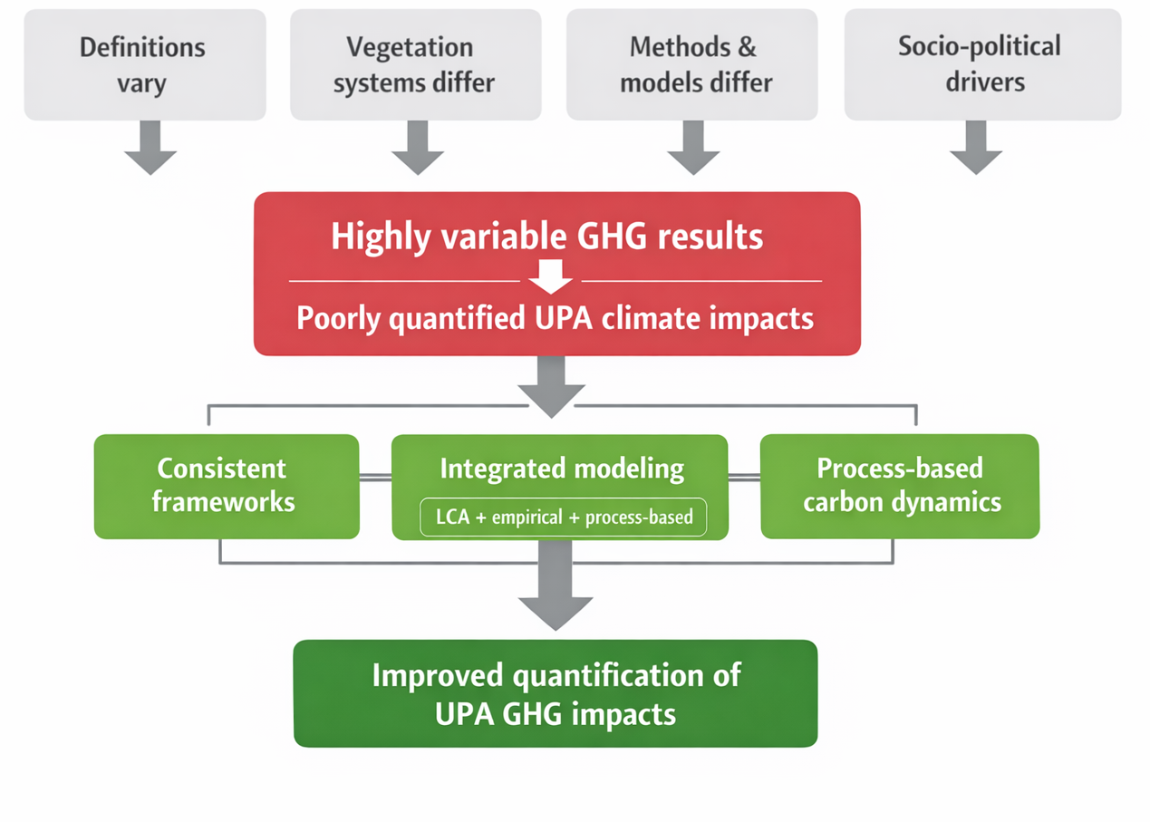
Towards consistent frameworks for quantifying UPA GHG impacts
Notes:
At the same time, cities are growing rapidly, increasing pressure on food systems. Sustainably feeding growing urban populations under climate change is therefore a major current global challenge.

Slide 14
Original modern agriculture perspective
Other farming perspectives:
Organic
No-till
Fair trade
Conservation tillage
Integrated weed management
Food quantity/forage (yield)
Soil temperature
Water infiltration & runoff
Capillarity
Erosion
Soil physical health (e.g., texture, aggregation, compaction)
Soil organic matter
Nutrient dynamics
Plant-plant competition
Energy (fuel) use and costs
Production costs
Labour
Impact of pesticides and herbicides on weeds and pests
Soil biological health:
Microbial biomass
Microbial functional groups
Plant interactions (facilitation)
Food quality (nutrients content)
Evolution of pests
Plants resilience to pest pressure
Predators of pests
Pollinators
Pesticides and herbicides on health, water, environment:
Transport
Impact
Surrounding biodiversity
From a review of 13 crop models often used to inform crop management!
Arnillas et al (2026)
Important considerations
90-100%
60-90%
40-60%
What is missing in crop models necessary for urban crops?
10-40%
0-10%
Seldom represented by crop models
Often represented by crop models

Slide 15
Facilitation:
Plant-plant interactions
Plant-pollinators
Plant-fungi
Weeds:
Species-specific parameters
Invasions as pre-defined events
Models focus on fields, but management unit is the farm.
Non-crops are seldom included; hence, environment positive effects cannot be modelled.
Key model gaps
From a review of 13 crop models often used to inform crop management!
Arnillas et al (2026)
90-100%
60-90%
40-60%
10-40%
0-10%
What is missing in crop models necessary for urban crops?

Slide 16
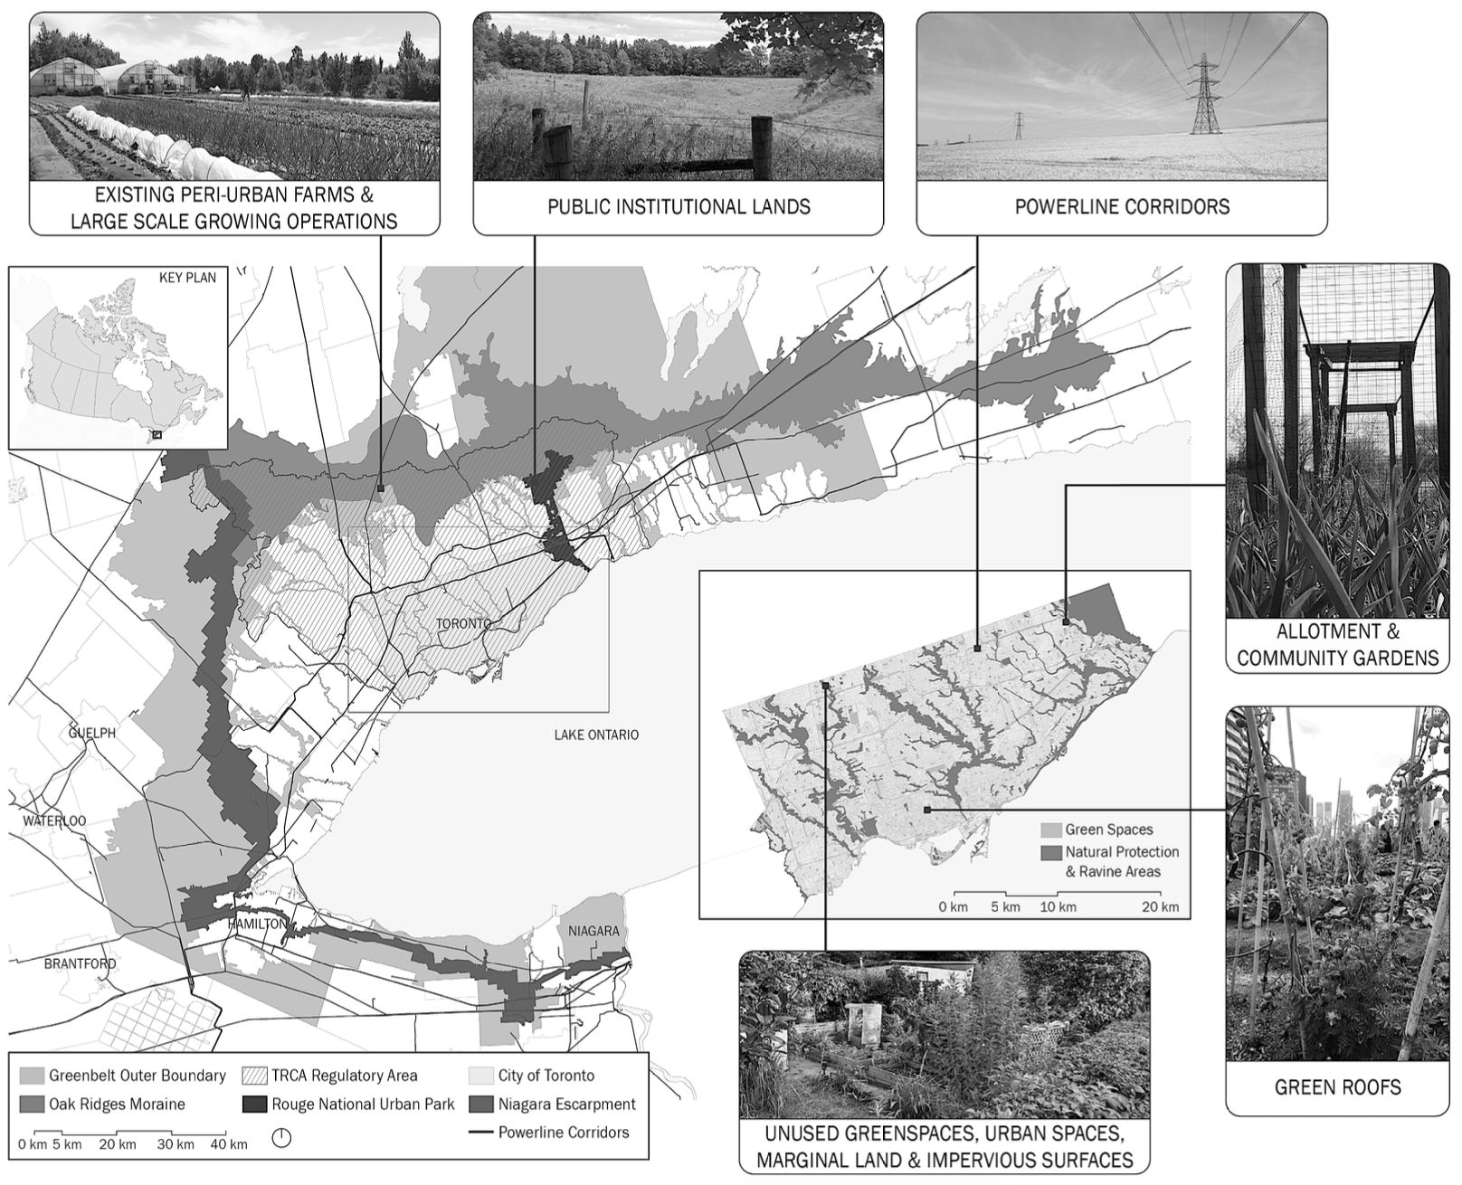
Other plants, microbes, insects, …
Different weather conditions
Different types of landscape surrounding them affect weather and pollinators.
Pollutants and N in the air
Markets are closer.
Low carbon soil.
➔ What else?
Context!
What is missing in crop models necessary for urban crops?

Slide 17
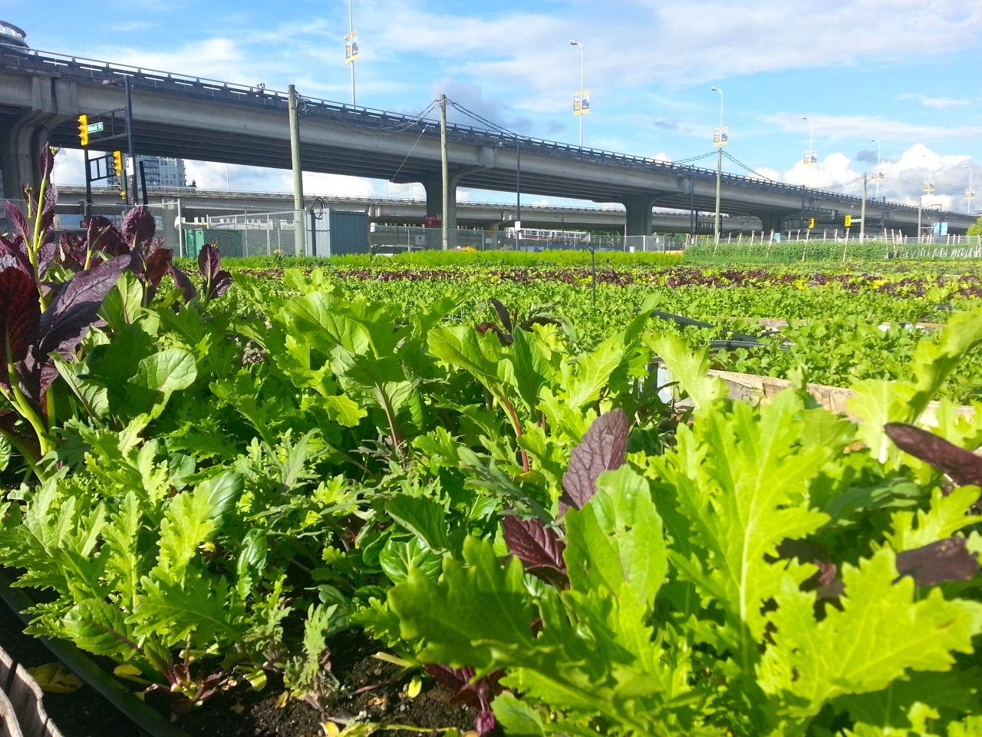
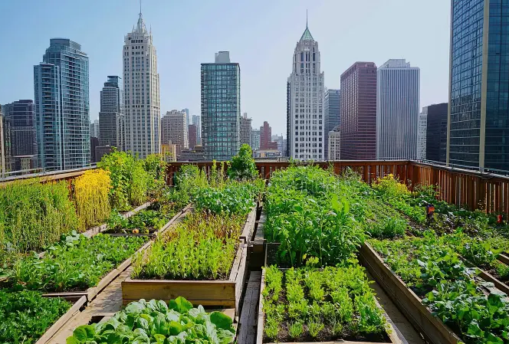
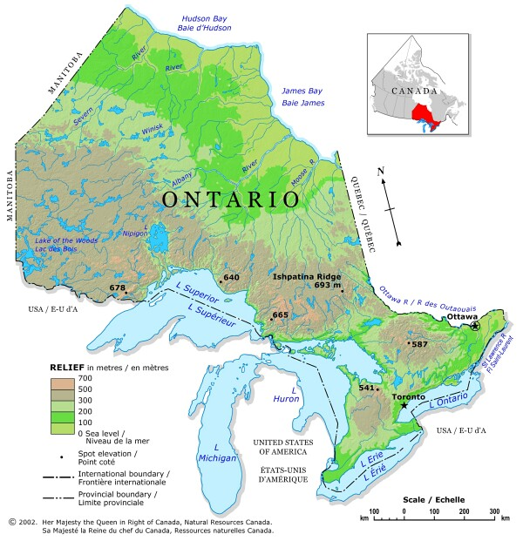
Modelling framework
Single field-scale modelling
Multiple field-scale modelling
Regional-scale modelling
Image retrieved from: https://www.milkwood.net/2013/07/24/portable-urban-farming-for-real/
Image retrieved from: https://www.dreamstime.com/community-garden-sunny-day-urban-setting-planting-sustainable-living-image368971381
Scaling up

Slide 18
The ecosys field-scale model
An advanced terrestrial ecosystem model, originally developed by Professor Robert Grant at the University of Alberta, that simulates water, energy, carbon, and biogeochemical cycles down to the hourly time step across the soil-plant-atmosphere domain (Grant, 2013).
Plant growth is represented more mechanistically (Arnillas et al., 2026).
More difficult to generate and use, but more powerful to predict novel conditions!
Simulates both natural and managed ecosystems
Allows for the simulation of dynamic responses of emissions of major GHGs to different environmental conditions and management scenarios (Grant et al., 2010; Grant, 2015).
Capable of being scaled from the farm to large spatial scales without the need for substantial calibration if provided with high-quality soil and climate input data (Grant et al., 2012).

Slide 19
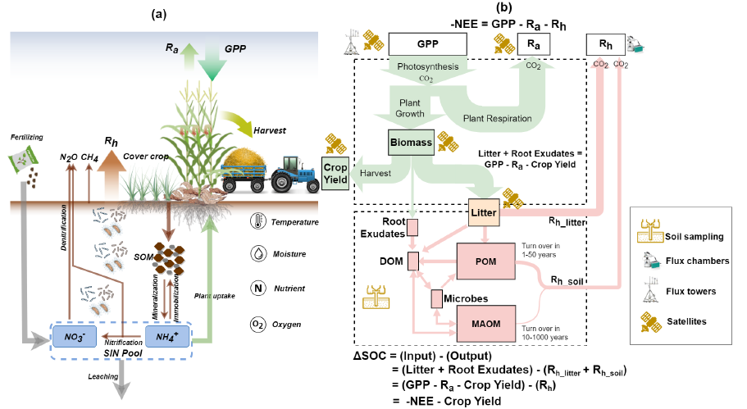
The ecosys model
Farm carbon and nitrogen budget (Guan et al., 2023)
Notes:
Plant growth is represented more mechanistically (Arnillas et al. In review).
More difficult to generate and use, but more powerful to predict novel conditions!
Simulates both natural and managed ecosystems
Allows for the simulation of dynamic responses of emissions of major GHGs to different environmental conditions and management scenarios (Grant et al., 2010; Grant, 2015).
Capable of being scaled from the farm to large spatial scales without the need for substantial calibration if provided with high-quality soil and climate input data (Grant et al., 2012).
- process-based ecosystem model which simulates the holistic and coupled energy, water, carbon, and nutrient cycles from aboveground to belowground using a mechanistic way
Farm carbon budget and changes of SOC at the fieldlevel are holistically relatedto the farmland carbonbudget in ecosys.
he ecosys model presents the holistic carbon and nitrogen balance and its
linkage with greenhouse gas emissions throughout the agroecosyste

Slide 20
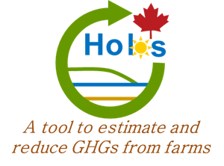
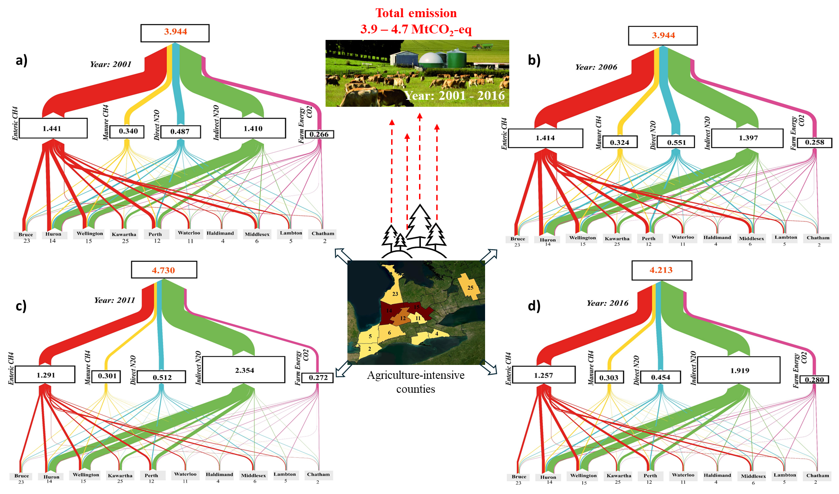
The HOLOS field-scale model
A whole-farm platform developed by Agriculture and Agri-Food Canada that uses Intergovernmental Panel on Climate Change [IPCC] (2006) methodology to estimate anthropogenic emissions and sinks of GHGs for Canadian conditions at the individual farm scale to national inventories (Little et al., 2008).

Slide 21
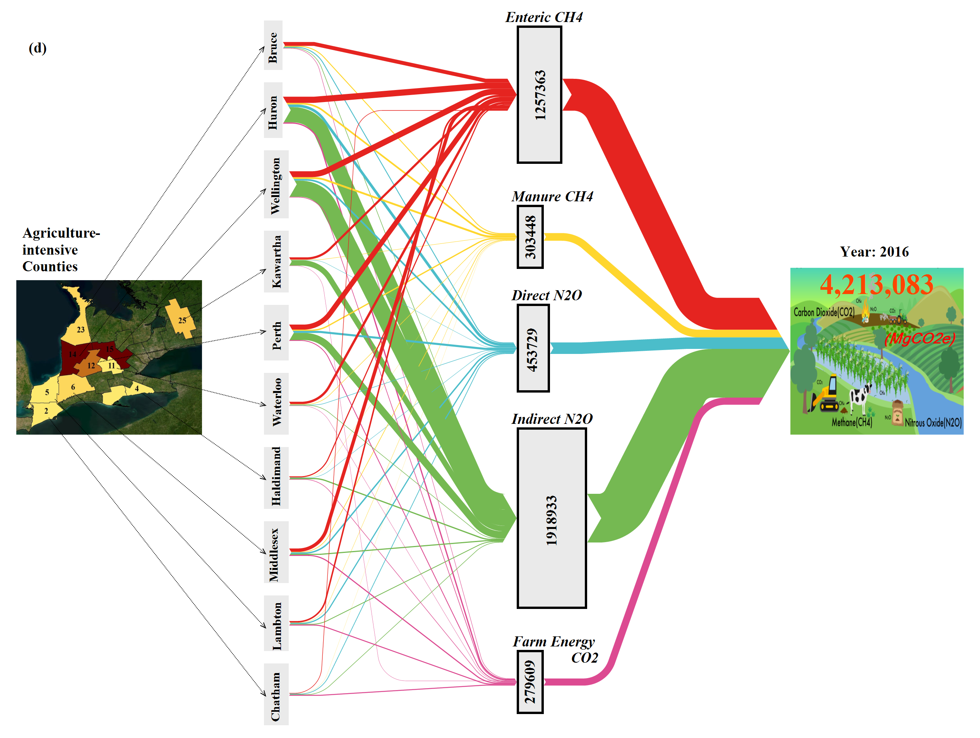
GHG Fluxes from agricultural farms
Year: 2016
Fig 12. GHG flux from all agricultural farms in agriculture-intensive counties in 2016 in ON
Page 13

Slide 22
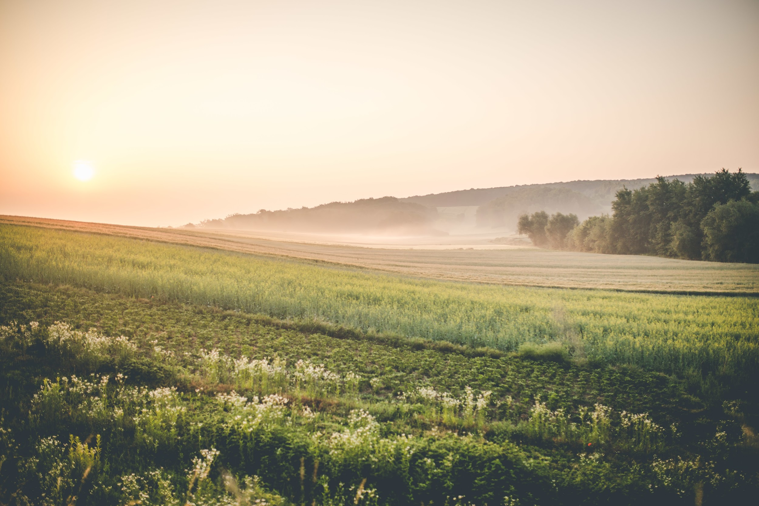


Thanks!
Contact information: aisha.javed@mail.utoronto.ca
Special thanks to my collaborators, Drs. Marney Issac, Adam Martin, and my PI, Dr. George Arhonditsis
Some figures were prepared with the help of AI

Slide 23
References
Adam, R.W., 2001. Wastewater use in periurban agriculture. In: Drakakis-Smith, D. (ed.) The Third World City. Routledge, London. Al-Qubati, A., Zhang, L., Forkel, M., 2024. Urban and peri-urban agriculture under climate change: A review on carbon emissions and sequestration. Sustainable Cities and Society, 115, 105830.
Arnillas, C. A., Shah, L., Martin, A., & Arhonditsis, G. (2026). Three key directions toward the development of a holistic crop modelling framework. Ecological Informatics, 103723. Benis, K., Ferrão, P., 2017. Potential mitigation of the environmental impacts of food systems through urban and peri-urban agriculture (UPA): A life cycle assessment approach. Journal of Cleaner Production, 140, 784–795. Clinton, N., Stuhlmacher, M., Miles, A., et al., 2018. A global geospatial ecosystem services estimate of urban agriculture. Earth's Future, 6, 40–60. De Zeeuw, H., Dubbeling, M., 2000. Key issues and courses of action for municipal policy on urban agriculture. ETC-RUAF, Leusden. Di Fiore, G., Specht, K., Zanasi, C., 2021. Assessing motivations and perceptions of stakeholders in urban agriculture: A review and analytical framework. International Journal of Urban Sustainable Development, 13(2), 351–367. Dorr, E., Goldstein, B., Horvath, A., Aubry, C., Gabrielle, B., 2021. Environmental impacts and resource use of urban agriculture: A systematic review and meta-analysis. Environmental Research Letters, 16(9), 093002. Dorr, E., Sanyé-Mengual, E., Gabrielle, B., Aubry, C., 2017. Proper selection of substrates and crops enhances the sustainability of Paris rooftop garden. Agronomy for Sustainable Development, 37, 51. Drottberger, A., Zhang, Y., Yong, J.W.H., Dubois, M.C., 2023. Urban farming with rooftop greenhouses: A systematic literature review. Renewable and Sustainable Energy Reviews, 188, 113884. Ellis, F., Sumberg, J., 1998. Food production, urban areas and policy responses. World Development, 26(2), 213–225.
Enete, A.A., Achike, A.I., 2008. Urban agriculture and urban food insecurity/poverty in Nigeria: The case of Ohafia, South-east Nigeria. Outlook on Agriculture, 37(2), 131–134. Evans, D.L., Falagán, N., Hardman, C.A., et al., 2022. Ecosystem service delivery by urban agriculture and green infrastructure: A systematic review. Ecosystem Services, 54, 101405. FAO, RUAF, ICLEI, 2022. City region food systems and short food supply chains: Sustainable development goals. FAO, Rome. Fei, X., et al., 2025. Urban and peri-urban agriculture (UPA), defined as the production of agri-food and related activities within urban and peri-urban areas. [Citation to be confirmed.] Goldstein, B., Hauschild, M., Fernández, J., Birkved, M., 2016. Urban versus conventional agriculture, taxonomy of resource profiles: A review. Agronomy for Sustainable Development, 36, 9.
Graefe, S., Schlecht, E., Buerkert, A., 2008. Opportunities and challenges of urban and peri-urban agriculture in Niamey, Niger. Outlook on Agriculture, 37(1), 47–56. Hawes, J.K., Goldstein, B.P., Newell, J.P., et al., 2024. Comparing the carbon footprints of urban and conventional agriculture. Nature Cities, 1, 132–142.
Koltsida, E., Mamassis, N., Stefopoulou, A., 2023. Urban and peri-urban agriculture under different water management scenarios: An assessment using SWAT. Sustainability, 15(3), 2385. Kulak, M., Graves, A., Chatterton, J., 2013. Reducing greenhouse gas emissions with urba
n agriculture: A life cycle assessment perspective. Landscape and Urban Planning, 111, 68–78.
Mok, H.F., Williamson, V.G., Grove, J.R., et al., 2014. Strawberry fields forever? Urban agriculture in developed countries: A review. Agronomy for Sustainable Development, 34(1), 21–43. Mougeot, L.J.A., 2000. Urban agriculture: Definition, presence, potentials and risks. In: Bakker, N., et al. (eds.) Growing Cities, Growing Food. ZEL, Feldafing, pp.1–42. Opitz, I., Berges, R., Piorr, A., Krikser, T., 2016. Contributing to food sovereignty: urban gardens and urban agriculture in Berlin. Local Environment, 21(10), 1139–1161. Pearson, L.J., Pearson, L., Pearson, C.J., 2010. Sustainable urban agriculture: Stocktake and opportunities. International Journal of Agricultural Sustainability, 8(1–2), 7–19. Sanjuan-Delmás, D., Llorach-Massana, P., Nadal, A., et al., 2018. Environmental assessment of an integrated rooftop greenhouse for food production in cities. Journal of Cleaner Production, 177, 326–337. Siegner, A., Sowerwine, J., Acey, C., 2018. Does urban agriculture improve food security? A systematic review. Sustainability, 10(9), 2988. Smit, J., Nasr, J., 1992. Urban agriculture for sustainable cities: Using wastes and idle land and water bodies as resources. Environment and Urbanization, 4(2), 141–152. Smit, J., Ratta, A., Nasr, J., 1996. Urban Agriculture: Food, Jobs and Sustainable Cities. UNDP, New York. Smit, J., Ratta, A., Nasr, J., 2001. Urban Agriculture: Food, Jobs and Sustainable Cities. The Urban Agriculture Network, Washington DC.
Thebo, A.L., Drechsel, P., Lambin, E.F., 2014. Global assessment of urban and peri-urban agriculture: Irrigated and rainfed croplands. Environmental Research Letters, 9(11), 114002. Thomas, G., Thomas, J., Mathews, G.M., Alexander, S.P., Jose, J., 2023. Assessment of the potential of green wall on modification of local urban microclimate using ENVI-met model. Ecological Engineering, 187, 106868. Vagneron, I., Faure, G., Loeillet, D., 2009. Is there a pilot in the chain? Identifying the key drivers of change in the fresh pineapple sector. Food Policy, 34(5), 437–446. Van der Schans, J.W., Wiskerke, J.S.C. (eds.), 2012. Urban Harvest+: Finding Synergies in Metropolitan Regions. Wageningen UR, Wageningen. Van Veenhuizen, R. (ed.), 2006. Cities Farming for the Future: Urban Agriculture for Green and Productive Cities. RUAF Foundation, IIRR, IDRC, Ottawa. Viljoen, A., Bohn, K., Howe, J. (eds.), 2005. Continuous Productive Urban Landscapes: Designing Urban Agriculture for Sustainable Cities. Architectural Press, Oxford. Weidner, T., Yang, A., Hamm, M.W., 2019. Consolidating the current knowledge on urban food production in productive urban landscapes. Cities, 85, 1–9. Yeung, Y.M., 1987. Examples of urban agriculture in Asia. Food and Nutrition Bulletin, 9(2), 14–23. Zezza, A., Tasciotti, L., 2010. Urban agriculture, poverty, and food security: Empirical evidence from a sample of developing countries. Food Policy, 35(4), 265–273.
1 / 2

Slide 24
Extra Slides

Slide 25
Yeung (1987)
Narrow
(0–3 dims)
“Urban agriculture is defined as food production within the urban and periurban area.”
Dimensions addressed:
½
½
✓
–
–
–
–
–
–
Urban
Peri-urban
Food outputs
Non-food outputs
Social
Economic
Environmental
Scale spectrum
Resource reuse
Score: 2/9
← Back to timeline
✓ = explicitly defined ½ = mentioned, not characterised – = not mentioned

Slide 26
Smit & Nasr † (1992)
Moderate
(4–6 dims)
“(a) The urban agriculture referred to in this paper is food and fuel grown within the daily rhythm of the city or town, produced directly for the market and frequently processed and marketed by the farmers or their close associates. (b) Urban agriculture is presented as a large and growing industry that uses urban waste water and urban solid waste as inputs which close ecological loops when processed on idle land and water bodies.”
Dimensions addressed:
✓
–
✓
✓
–
✓
✓
–
✓
Urban
Peri-urban
Food outputs
Non-food outputs
Social
Economic
Environmental
Scale spectrum
Resource reuse
Score: 6/9
← Back to timeline
✓ = explicitly defined ½ = mentioned, not characterised – = not mentioned
† Same paper, two distinct definitions published.

Slide 27
Smit et al. (1996)
Moderate
(4–6 dims)
“UA refers to food and fuel grown within a city or peri-urban area, produced directly for the market or for home consumption, and frequently marketed by the farmers themselves or their close associates.”
Dimensions addressed:
✓
½
✓
✓
–
✓
–
–
–
Urban
Peri-urban
Food outputs
Non-food outputs
Social
Economic
Environmental
Scale spectrum
Resource reuse
Score: 4.5/9
← Back to timeline
✓ = explicitly defined ½ = mentioned, not characterised – = not mentioned

Slide 28
Mougeot (2000)
Broad
(7–9 dims)
“UA is an industry located within (intra-urban) or on the fringe (peri-urban) of a town, a city or a metropolis, which grows or raises, processes and distributes a diversity of food and non-food products, (re-)using largely human and material resources, products and services found in and around that urban area, and in turn supplying human and material resources, products and services largely to that urban area.”
Dimensions addressed:
✓
✓
✓
✓
–
✓
–
✓
✓
Urban
Peri-urban
Food outputs
Non-food outputs
Social
Economic
Environmental
Scale spectrum
Resource reuse
Score: 7/9
← Back to timeline
✓ = explicitly defined ½ = mentioned, not characterised – = not mentioned

Slide 29
De Zeeuw et al. (2000)
Moderate
(4–6 dims)
“Participants consider urban agriculture as a dynamic concept that comprises a variety of farming systems, ranging from subsistence production and processing at household level to fully commercialised agriculture. Urban agriculture normally has a niche function in terms of time (transitory), space (interstitial) as well as specific social (e.g. women and low income groups) and economic (e.g. financial crisis, food shortage) conditions.”
Dimensions addressed:
–
–
–
–
✓
✓
–
✓
–
Urban
Peri-urban
Food outputs
Non-food outputs
Social
Economic
Environmental
Scale spectrum
Resource reuse
Score: 3/9
← Back to timeline
✓ = explicitly defined ½ = mentioned, not characterised – = not mentioned

Slide 30
Smit et al. (2001)
Broad
(7–9 dims)
“Sometimes called metropolitan-intensive agriculture, urban agriculture can be defined as: an industry that produces, processes, and markets food, fuel, and other outputs, largely in response to the daily demand of consumers within a town, city, or metropolis, on many types of privately and publicly held land and water bodies found throughout intra-urban and peri-urban areas. Typically urban agriculture applies intensive production methods, frequently using and reusing natural resources and urban wastes, to yield a diverse array of land-, water-, and air-based fauna and flora, contributing to the food security, health, livelihood, and environment of the individual, household, and community.”
Dimensions addressed:
✓
✓
✓
✓
✓
✓
✓
–
✓
Urban
Peri-urban
Food outputs
Non-food outputs
Social
Economic
Environmental
Scale spectrum
Resource reuse
Score: 8/9
← Back to timeline
✓ = explicitly defined ½ = mentioned, not characterised – = not mentioned

Slide 31
Adam (2001)
Narrow
(0–3 dims)
“The common features of the UPA system are its adaptability and mobility compared with rural agriculture and the competition for resources (land, water, energy, labour) that could also satisfy other requirements of the urban population. In more detail, the true peri-urban interface or ‘rurban fringe’ is shown to be that where competition for land use is at its most intense and change of land use, from agriculture to urban, is most rapid.”
Dimensions addressed:
–
✓
–
–
–
–
–
–
–
Urban
Peri-urban
Food outputs
Non-food outputs
Social
Economic
Environmental
Scale spectrum
Resource reuse
Score: 1/9
← Back to timeline
✓ = explicitly defined ½ = mentioned, not characterised – = not mentioned

Slide 32
Ellis & Sumberg (1998)
Narrow
(0–3 dims)
“The more advocatory strand of the urban agriculture literature tends to define its focus in undifferentiated terms that encompass all farming in and around towns.”
Dimensions addressed:
✓
✓
–
–
–
–
–
–
–
Urban
Peri-urban
Food outputs
Non-food outputs
Social
Economic
Environmental
Scale spectrum
Resource reuse
Score: 2/9
← Back to timeline
✓ = explicitly defined ½ = mentioned, not characterised – = not mentioned

Slide 33
Viljoen et al. (2005)
Narrow
(0–3 dims)
“Urban agriculture is: agriculture which occurs within the city; in most cases high yield market gardens for fruit and vegetable growing; found on the ground, on roofs, facades fences and boundaries; if economic conditions are difficult, likely to include small animals; developing to include aquaculture. Peri-urban agriculture is: agriculture occurring on the urban-rural fringe, or within peripheral low-density suburban areas; similar to urban agriculture, although the size of sites is often larger.”
Dimensions addressed:
✓
✓
✓
–
–
–
–
✓
–
Urban
Peri-urban
Food outputs
Non-food outputs
Social
Economic
Environmental
Scale spectrum
Resource reuse
Score: 4/9
← Back to timeline
✓ = explicitly defined ½ = mentioned, not characterised – = not mentioned

Slide 34
Petts (2005)
Moderate
(4–6 dims)
“Urban agriculture (UA) refers to small areas, such as verges, allotments, private and community gardens, and balconies within the city, for growing crops and raising poultry and livestock for eggs, meat, milk, etc., for home consumption or sale in neighbourhood markets. Peri-urban agriculture refers to farm units close to town which operate semi or entirely commercial farms and market gardens to grow crops and raise poultry and livestock.”
Dimensions addressed:
✓
✓
✓
–
–
✓
–
✓
–
Urban
Peri-urban
Food outputs
Non-food outputs
Social
Economic
Environmental
Scale spectrum
Resource reuse
Score: 5/9
← Back to timeline
✓ = explicitly defined ½ = mentioned, not characterised – = not mentioned

Slide 35
Van Veenhuizen (2006)
Narrow
(0–3 dims)
“Urban agriculture can be defined as the growing of plants and the raising of animals for food and other uses within and around cities and towns, and related activities such as the production and delivery of inputs, and the processing and marketing of products.”
Dimensions addressed:
✓
✓
✓
✓
–
–
–
–
–
Urban
Peri-urban
Food outputs
Non-food outputs
Social
Economic
Environmental
Scale spectrum
Resource reuse
Score: 4/9
← Back to timeline
✓ = explicitly defined ½ = mentioned, not characterised – = not mentioned

Slide 36
Vagneron (2007)
Narrow
(0–3 dims)
“Peri-urban agriculture refers to farming activities – horticulture and crop production, animal husbandry, aquaculture and forestry – carried out within, or at the periphery of, the cities.”
Dimensions addressed:
✓
✓
–
–
–
–
–
–
–
Urban
Peri-urban
Food outputs
Non-food outputs
Social
Economic
Environmental
Scale spectrum
Resource reuse
Score: 2/9
← Back to timeline
✓ = explicitly defined ½ = mentioned, not characterised – = not mentioned

Slide 37
Graefe et al. (2008)
Narrow
(0–3 dims)
“Urban and peri-urban agriculture (UPA) refers to agricultural activities in and around cities, which directly contribute to the livelihoods of urban residents.”
Dimensions addressed:
✓
✓
–
–
✓
–
–
–
–
Urban
Peri-urban
Food outputs
Non-food outputs
Social
Economic
Environmental
Scale spectrum
Resource reuse
Score: 3/9
← Back to timeline
✓ = explicitly defined ½ = mentioned, not characterised – = not mentioned

Slide 38
Enete & Achike (2008)
Narrow
(0–3 dims)
“Urban agriculture – the intensive farming of small plots of land available in the urban and peri-urban areas.”
Dimensions addressed:
½
½
–
–
–
–
–
–
–
Urban
Peri-urban
Food outputs
Non-food outputs
Social
Economic
Environmental
Scale spectrum
Resource reuse
Score: 1/9
← Back to timeline
✓ = explicitly defined ½ = mentioned, not characterised – = not mentioned

Slide 39
Zezza & Tasciotti (2010)
Narrow
(0–3 dims)
“Urban agriculture (UA) is defined as the production of crop and livestock goods within cities and towns.”
Dimensions addressed:
✓
–
✓
–
–
–
–
–
–
Urban
Peri-urban
Food outputs
Non-food outputs
Social
Economic
Environmental
Scale spectrum
Resource reuse
Score: 2/9
← Back to timeline
✓ = explicitly defined ½ = mentioned, not characterised – = not mentioned

Slide 40
Pearson et al. (2011)
Moderate
(4–6 dims)
“Urban agriculture (UA) is the producer, processor and market for food, plant- and animal-sourced pharmaceuticals, fibre and fuel on land and water dispersed throughout the urban and peri-urban areas, usually applying intensive production methods.”
Dimensions addressed:
½
½
✓
✓
–
–
–
–
–
Urban
Peri-urban
Food outputs
Non-food outputs
Social
Economic
Environmental
Scale spectrum
Resource reuse
Score: 3/9
← Back to timeline
✓ = explicitly defined ½ = mentioned, not characterised – = not mentioned

Slide 41
Van der Schans et al. (2012)
Broad
(7–9 dims)
“Urban agriculture can be defined as: an industry that produces, processes and markets food and fuel, largely in response to the daily demand of consumers within a town, city, or metropolis, on land and water dispersed throughout the urban and peri-urban area, applying intensive production methods, using and reusing natural resources and urban wastes, to yield a diversity of crops and livestock. Exactly where the urban area ends and the rural starts is a matter of definition (in Canada local food is within a 100 miles radius, in the Netherlands 40 km or even 25 km).”
Dimensions addressed:
✓
✓
✓
✓
–
✓
–
✓
✓
Urban
Peri-urban
Food outputs
Non-food outputs
Social
Economic
Environmental
Scale spectrum
Resource reuse
Score: 7/9
← Back to timeline
✓ = explicitly defined ½ = mentioned, not characterised – = not mentioned

Slide 42
Thebo et al. (2014)
Narrow
(0–3 dims)
“The terms urban and peri-urban agriculture can refer to a diverse range of agricultural activities including crop, livestock, poultry, and aquaculture production, and this at any scale from a roof-top gardens to larger cultivated open spaces.”
Dimensions addressed:
½
½
✓
–
–
–
–
–
–
Urban
Peri-urban
Food outputs
Non-food outputs
Social
Economic
Environmental
Scale spectrum
Resource reuse
Score: 2/9
← Back to timeline
✓ = explicitly defined ½ = mentioned, not characterised – = not mentioned

Slide 43
Opitz et al. (2016)
Narrow
(0–3 dims)
“Peri-urban agriculture is a residual form of agriculture at the fringes of growing cities.”
Dimensions addressed:
–
✓
–
–
–
–
–
–
–
Urban
Peri-urban
Food outputs
Non-food outputs
Social
Economic
Environmental
Scale spectrum
Resource reuse
Score: 1/9
← Back to timeline
✓ = explicitly defined ½ = mentioned, not characterised – = not mentioned

Slide 44
Weidner et al. (2019)
Moderate
(4–6 dims)
“Urban agriculture as a primary production process can be viewed as a component embedded in the urban food system, which further includes processing, packaging, distribution and retail. These closely interact with urban material and resource streams such as water, energy, and organic waste.”
Dimensions addressed:
✓
–
✓
–
–
✓
✓
–
✓
Urban
Peri-urban
Food outputs
Non-food outputs
Social
Economic
Environmental
Scale spectrum
Resource reuse
Score: 5/9
← Back to timeline
✓ = explicitly defined ½ = mentioned, not characterised – = not mentioned

Slide 45
FAO et al. † (2022)
Narrow
(0–3 dims)
“Urban and peri-urban agriculture can be defined as the production of food and other outputs and related processes, taking place on land and other spaces within cities and surrounding regions. (Short definition — FAO also published an extended comprehensive definition.)”
Dimensions addressed:
✓
✓
✓
✓
–
–
–
–
–
Urban
Peri-urban
Food outputs
Non-food outputs
Social
Economic
Environmental
Scale spectrum
Resource reuse
Score: 4/9
← Back to timeline
✓ = explicitly defined ½ = mentioned, not characterised – = not mentioned
† Same paper, two distinct definitions published.

Slide 46
Fei et al. (2025)
Narrow
(0–3 dims)
“Urban and peri-urban agriculture (UPA), defined as the production of agri-food and related activities within urban and peri-urban areas.”
Dimensions addressed:
½
½
✓
–
–
–
–
–
–
Urban
Peri-urban
Food outputs
Non-food outputs
Social
Economic
Environmental
Scale spectrum
Resource reuse
Score: 2/9
← Back to timeline
✓ = explicitly defined ½ = mentioned, not characterised – = not mentioned

