Slide 1

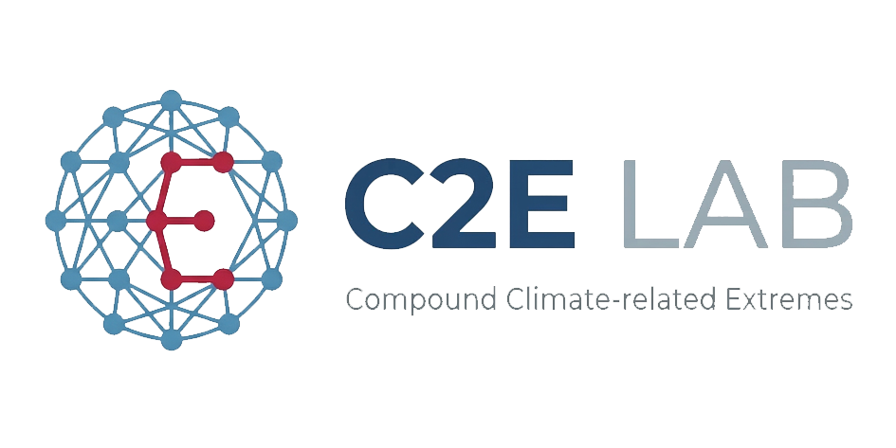

EGU General Assembly 2026
Quantifying the Radiative Impact of
Light-Absorbing Particles on
Alpine Snowpack Dynamics
Sepehr Norouzi¹ · Carlo De Michele¹ · Biagio Di Mauro²
¹ Politecnico di Milano, Civil and Environmental Engineering, Milan, Italy
² Institute of Polar Sciences, National Research Council of Italy, Milan, Italy
Oral | Monday, 04 May 2026 | 09:05–09:15 CEST
Funded by: PRIN22 – LAPSE Project (MUR)

Slide 2
Outline
01
02
Motivation
Modeling Framework
Impacts of light-absorbing particles on snowpack dynamics and hydrological processes
Coupling the HyS 3.0 snowpack model with the BioSNICAR radiative transfer model
03
04
Study Site & Data
Snowpack model Development and Validation
Col de Porte, French Alps – 18 hydrological years (2005–2023)
HyS 3.0 Snowpack model Performance (NSE)
05
06
Results
Indirect LAPs impact: Grain Radius, SSA, Dry Density
Direct LAPs impact: Melt-out timing, SWE, snow depth & SSA response
Conclusion & Outlook

Slide 3
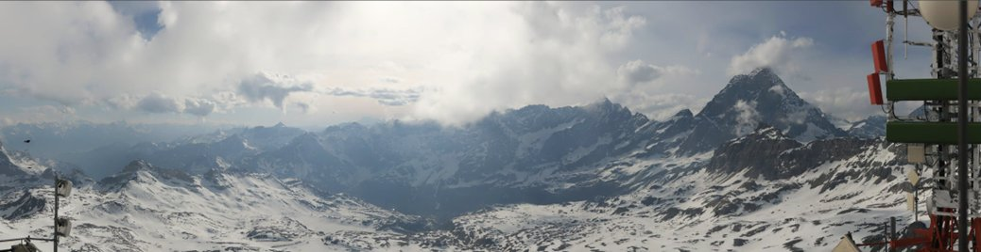
Motivation: Toward Spatialised LAPs Hydrological Assessment
Modelling Framework
1
Sentinel-2 BBA retrieval
LAPSE – Light-Absorbing ParticleS in the Cryosphere and Impact on Water Resources— PRIN22 · MUR | CNR-ISP · Politecnico di Milano · UniMiB
KNN + BioSNICAR LUT
Challenge
Spatial forcing assimilation
Alpine catchments need a physically-consistent, low-cost energy-budget model that responds to albedo change to assess spatialised LAPs impact on snowmelt and water availability.
2
Rad · T · RH · Precip
3
Distributed HyS 3.0
Objective
Energy budget per pixel
Develop and apply - a low-computational-cost – Energy budget distributed Snowpack model coupled with Sentinel-2 BBA (via KNN–BioSNICAR LUT) for basin-scale spatialised LAPs assessment over alpine catchments.
4
Pure Snow vs LAPs scenario
BioSNICAR clean albedo
KNN Albedo Retrieval:
Each Sentinel-2 pixel spectrum is matched against a BioSNICAR LUT to retrieve BBA, grain size, and LAP load per pixel.
5
Melt-out & SCE comparison
Hydrological indicators
Plateau Rosa, Western Alps (3000–3500 m a.s.l.)

Slide 4
Snowpack Model Development & Point-Scale Assessment
HyS 3.0 — One-Layer Energy Budget Snowpack Model
De Michele et al. (2013) — HyS
Kondo & Yamazaki (1990)
Original single-layer snow model providing the structural backbone: snow mass balance, accumulation, and basic melt parameterisation.
Heat balance formulation for the surface energy budget — drives the radiation-sensitive melt computation.
HyS 3.0 = Radiation-Driven Energy Budget
Simulates snowpack dynamics in detail: SWE, snow depth, runoff, SSA, grain radius, dry density. Responds directly to broadband albedo (BBA) input, making it suitable for LAPs sensitivity assessment.
BioSNICAR coupling — Pure Snow BBA reconstruction
BioSNICAR generates a clean-snow albedo reference (no impurities) based on measured grain size and snow structure. Comparing this pure-snow BBA with the measured albedo isolates the radiative forcing of LAPs, enabling direct impact quantification on melt dynamics.

Slide 5

Study Site & Observational Data
Col de Porte — French Alps
Key Variables Observed
Elevation:
1325 m a.s.l.
Snow Depth
Location:
45.30° N, 5.77° E
Seasonal accumulation & melt
Season tested:
2013–2014 (Jan–May 2014)
SWE
Observations:
SD, SWE, snow depth, density, runoff
Snow water equivalent
Spectral albedo:
Sub-hourly VNIR (400–1050 nm)
SSA & impurities:
Retrieved from spectral inversion
Spectral Albedo
Broadband & hyperspectral
Why Col de Porte 2014?
LAP Concentration
Simultaneous continuous spectral albedo + standard snowpack measurements confirm impurity presence and effects on surface properties — ideal for validating the HyS 3.0 + BioSNICAR LAPs assessment framework.
Total BC · Dust · OC
Runoff
Dumont et al. (2017), The Cryosphere, 11, 1091–1110 · doi: 10.5194/tc-11-1091-2017
Daily Runoff

Slide 6
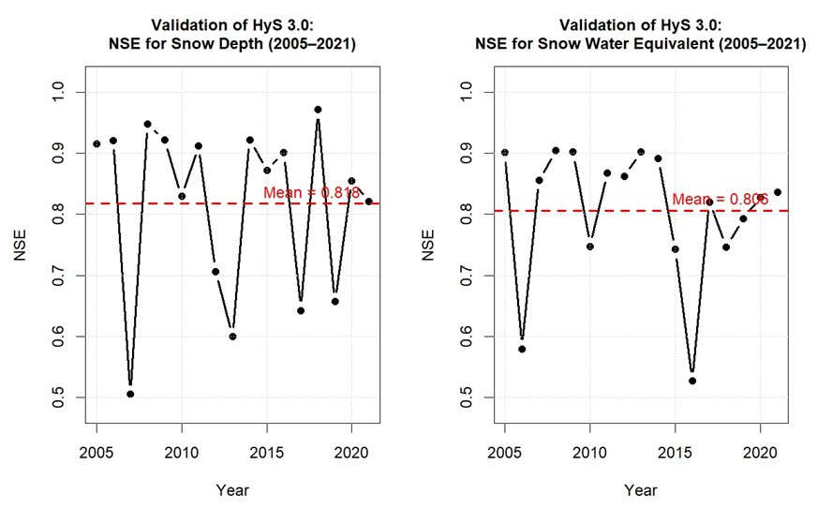
HyS 3.0 Validation — Col de Porte, French Alps (2005–2021)
Snow Depth
0.818
Mean NSE (2005–2021)
SWE
0.806
Mean NSE (2005–2021)
Model Capability
• Consistent NSE > 0.8 across 18 years
• Captures seasonal accumulation & melt
• Low computational cost — suitable for basin-scale application
• Directly responds to albedo forcing (BBA input)
Dumont et al. (2017) Col de Porte dataset · 18 hydrological years evaluated
Site: Col de Porte · 1325 m a.s.l. · French Alps · Long-term CEN experimental station · Validation period: 2005–2021 (18 hydrological years)

Slide 7
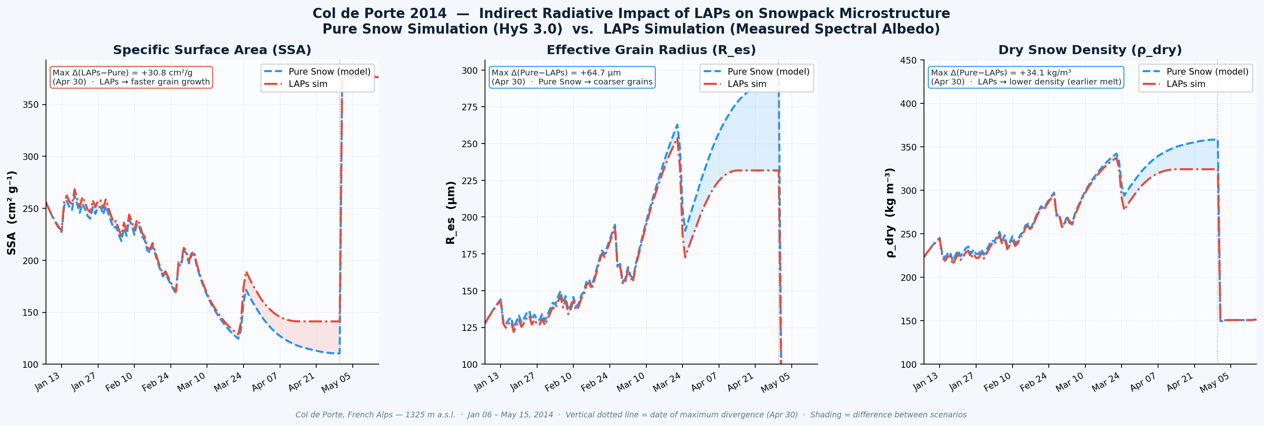
Results: Indirect Impact of LAPs — Snowpack Microstructure Evolution
Physical Interpretation
SSA (cm² g⁻¹)
Specific Surface Area
LAPs accelerate grain metamorphism → SSA decreases faster. Max divergence +30.8 cm²/gr on Apr 30.
R_es (µm)
Effective Grain Radius
Pure snow develops coarser grains (+64.7 µm larger). LAPs suppress grain growth during melt season.
ρ_dry (kg m⁻³)
Dry Snow Density
Pure snow is denser (+34.1 kg/m³). LAPs reduce density via earlier structural breakdown.
Col de Porte, French Alps — Jan 06 – May 15, 2014 · Pure Snow (blue) vs. LAPs sim (red)

Slide 8
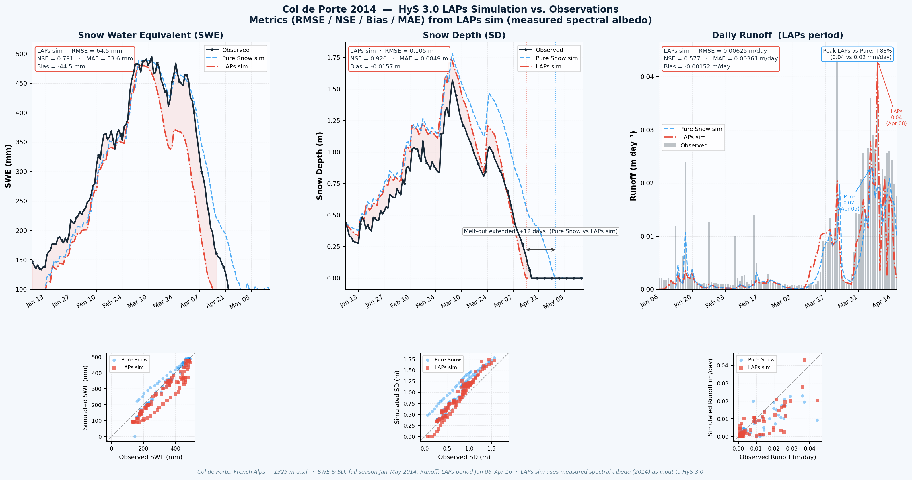
Results: Direct Laps Impact Col de Porte 2014 — LAPs Simulation vs. Observations
Model Performance — LAPs Sim
Variable
RMSE
NSE
Bias
SWE
64.5 mm
0.79
−44.5 mm
Snow Depth
0.105 m
0.92
-0.0157 m
Runoff
0.006 m/day
0.58
-0.001m/day
Measured spectral albedo (2014) used as LAPs sim input
SWE underestimated — lower albedo drives earlier melt
Snow Depth well reproduced (NSE=0.92)
Runoff timing captured; magnitude sensitive to drainage
LAP-driven albedo reduction measurably advances melt-out by 12 Days
Col de Porte, French Alps — 1325 m a.s.l. | Jan 06 – Apr 16, 2014

Slide 9
Conclusion & Outlook
Conclusions
Outlook
01
HyS 3.0 reproduced long-term snowpack dynamics at Col de Porte, with good performance for snow depth and SWE.
01
Extend the framework spatially using Sentinel-2 broadband albedo, AWS forcing, and data assimilation within the LAPSE project.
02
Coupling HyS 3.0 with BioSNICAR allowed LAP impact assessment through the comparison between impurity-affected and clean-snow albedo scenarios.
02
Apply distributed HyS 3.0 to Plateau Rosa to quantify LAP impacts on snow cover evolution, melt-out timing, and basin-scale SWE storage.
03
LAP-induced albedo reduction advanced melt-out and reduced SWE, showing a measurable hydrological effect.
03
Test the framework at additional alpine sites, including Col du Lautaret and Col de Porte, using spectral-to-broadband albedo conversion.
04
Snow microstructure also responded to LAP forcing, with changes in SSA, grain radius, and dry density during the melt season.
04
Move from snowmelt indicators toward runoff and discharge impacts for hydrological water-resource assessment.

Slide 10


Thank You
Abstract & DOI
Questions & Discussion
EGU26-12689
doi.org/10.5194/egusphere-egu26-12689
Sepehr Norouzi
Oral | Monday, 04 May 2026 | 09:05–09:15 CEST
Funded by: PRIN22 – LAPSE Project
Light-Absorbing ParticleS in the Cryosphere
and Impact on Water ResourcEs (MUR)
Research Assistant— Politecnico di Milano
Civil and Environmental Engineering Department
sepehr.norouzi@polimi.it
EGU 2026 · Vienna, Austria

