Slide 1
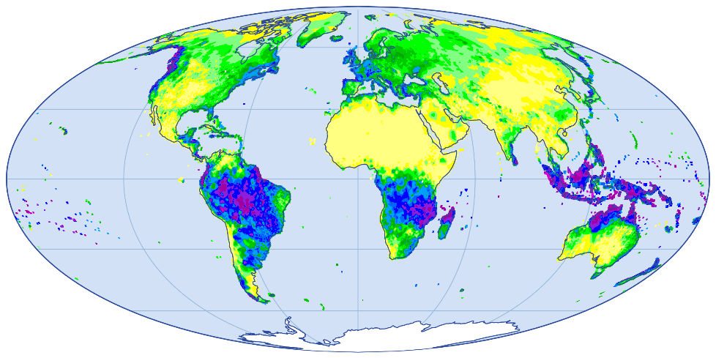


Global Precipitation Climatology Centre
Release of a new Version of global gridded Daily and Monthly Precipitation Analyses
Zora Schirmeister Dr. M. Ziese
E. Rustemeier
P. Finger
J. N. Breidenbach
S. Fränkling
A. Heller
M. Jahn
R. Schulze
M. Zepperitz
Precipitation totals for January 1989
Source: GPCC Precipitation Analysis Monthly Version 2025

Slide 2
New GPCC Monthly Version 2025
New GPCC Climatology Version 2025
In preparation: GPCC Daily Version 2025
About GPCC
Access and Contribution

Slide 3
New GPCC Monthly Version 2025
New GPCC Climatology Version 2025
In preparation: GPCC Daily Version 2025
About GPCC
Access and Contribution

Slide 4

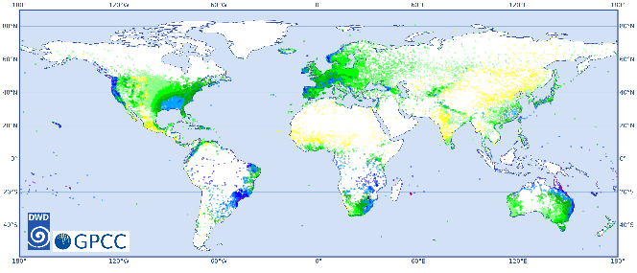
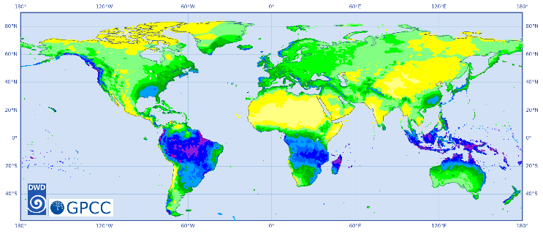

About GPCC
Rain gauge measure-ments
Established at the beginning of 1989 at Deutscher Wetterdienst (DWD) on invitation by WMO
Main tasks
Collection and quality control of rain gauge measurements world-wide
  Largest precipitation data base in terms number of stations and of length of timeseries
Provide gridded analyses of precipitation for the Earth’s land surface
Interpo-lated raster fields
GPCC collects rain gauge measurements, performs quality control and then interpolates on global raster fields starting in 1891 for monthly sums and 1982 for daily sums.

Slide 5
New GPCC Monthly Version 2025
New GPCC Climatology Version 2025
In preparation: GPCC Daily Version 2025
About GPCC
Access and Contribution

Slide 6

New GPCC Precipitation Analysis Monthly Version 2025
Gridded Monthly precipitation totals for the Earth’s land surface
1891 to present
Reprocessing of the whole time period up to now
Based on:
  data provided by the national hydrological and/or meteorological services (NHMS) > 190 countries
  global and regional data collections
  SYNOP and CLIMAT reports
Spatial resolutions of 0.25°, 0.5°, 1° and 2.5°
Anomaly interpolation with modified SPHEREMAP
Open access
The graphic shows precipitation totals for
January 1989 - GPCC‘s founding date
Source: GPCC Precipitation Analysis Monthly Version 2025
1891
now

Slide 7
What‘s new?
Its name: Full Data Monthly → GPCC Precipitation Analysis Monthly (short: GPCC Monthly)
Near realtime dataset, starting in 1891
  regular monthly updates, with a latency of 2 months
  Historic and near real-time monthly analyses in one product from now on
  Full Data Monthly + Monitoring Product kllöllöklkläömä öm = GPCC Precipitation Analysis Monthly Version 2025
More data sources used to calculate the Monthly appended updates (ex-Monitoring Product)
    WIS/GTS (SYNOP-reports, CLIMATS)
    NEW: available national data from APIs
  Improvement of Analysis Quality, due to more stations included
2 new variables:
  dist_int (mean distance of stations, that were used by interpolating the grid cell)
  gauge_int (number of gauges, that were used by interpolating the grid cell)
Climatological infilling, can be used to improve the quality in regions with scarce station coverage by using the variable precip_infill.

Slide 8
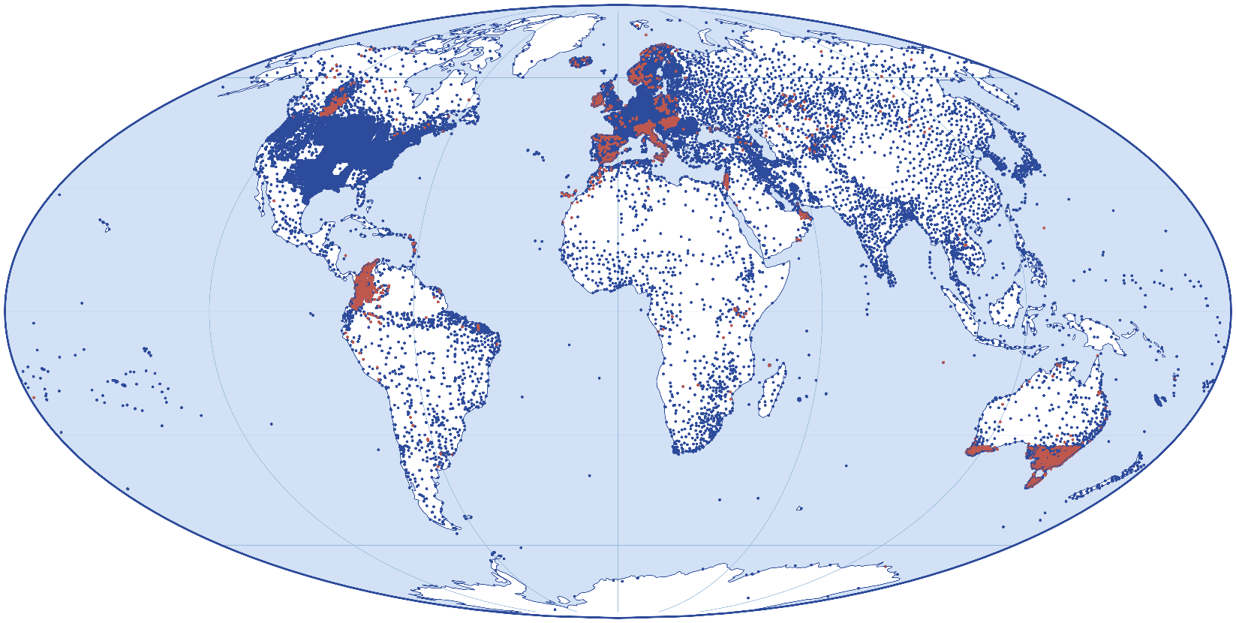

Improvements
Added stations since Full Data Monthly Version 2022
Added data records since Full Data Monthly Version 2022
The graphic depicts in red the new stations and in blue the stations to which data records have been added or have been corrected in GPCC‘s database since the release of the last version Full Data Monthly Version 2022.
→ We added 5430 stations.
→ We added data to ~46’000 stations.

Slide 9
New GPCC Monthly Version 2025
New GPCC Climatology Version 2025
In preparation: GPCC Daily Version 2025
About GPCC
Access and Contribution

Slide 10
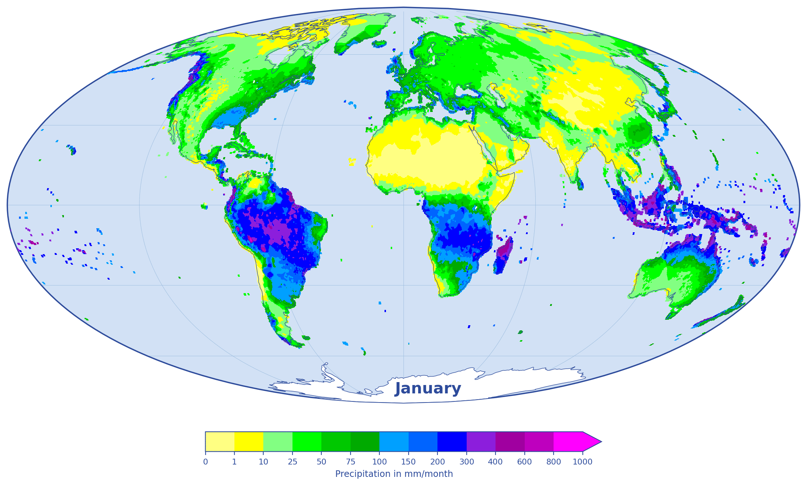
GPCC Precipitation Analysis Climatology Version 2025
Gridded Monthly precipitation climatology for the Earth’s land surface
Based on normals:
    collected by WMO (CLINOs)
    or delivered by the countries to GPCC
    or calculated from time-series of monthly data (with at least 10 complete years of data)
Spatial resolutions of 0.25°, 0.5°, 1° and 2.5°
All other GPCC products utilize this product as background fields to grid the monthly data at the corresponding resolution with the anomaly interpolation method
Open access
The Animation shows GPCC Climatology Version 2025
(Reference Period 1951 - 2000)
Available 30-yr periods: 1931-1960, 1941-1970, 1951-1980, 1961-1990, 1971-2000, 1981-2010, 1991-2020
And 1951-2000

Slide 11
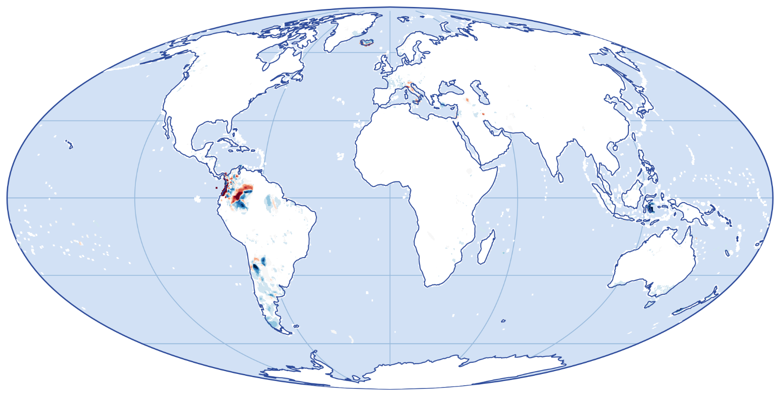
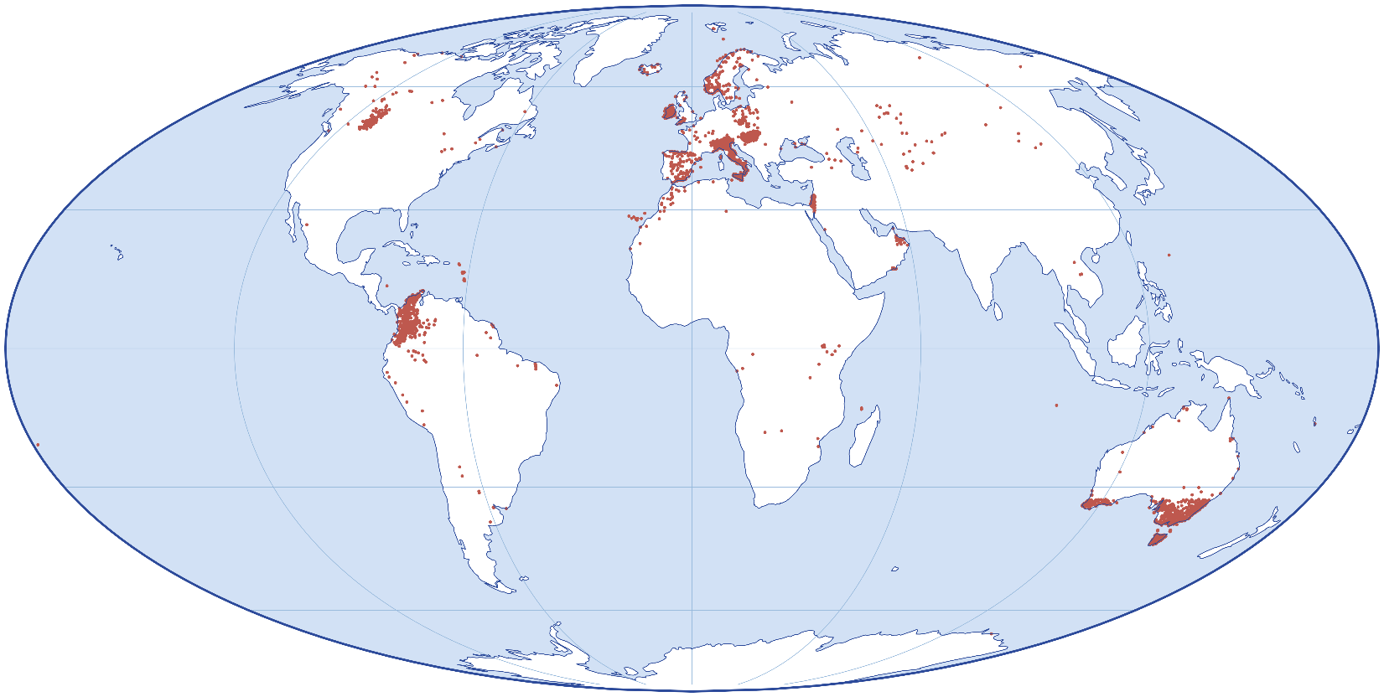

Improvements of GPCC Climatology V. 2025
-150 mm
-125 mm
-50 mm
-25 mm
Differences between Version 2025 and Version 2022
-10 mm
-1 mm
1 mm
10 mm
25 mm
50 mm
125 mm
150 mm
5430 new stations since the last Version.
Precipitation difference in mm/month
January (Reference period 1951 – 2000)

Slide 12
New GPCC Monthly Version 2025
New GPCC Climatology Version 2025
In preparation: GPCC Daily Version 2025
About GPCC
Access and Contribution

Slide 13
New GPCC Precipitation Analysis Daily Version 2025
In preparation
Full Data Daily
Gridded Daily precipitation totals for the Earth’s land surface
1982 to 2025
Reprocessing of the whole time period
Based on:
  data provided by the national hydrological and/or meteorological services (NHMS) > 190 countries
  global and regional data collections
  SYNOP reports
Spatial resolutions of 1°x1°
Anomaly interpolation with modified SPHEREMAP
Open access
Information on the release: gpcc@dwd.de
1982
2025

Slide 14
New GPCC Monthly Version 2025
New GPCC Climatology Version 2025
In preparation: GPCC Daily Version 2025
About GPCC
Access and Contribution

Slide 15
GPCC gratefully acknowledges all data contributors for their support!

Slide 16
Take Home Message
Global Precipitation Climatology Centre
Head Dr. Markus Ziese
E-Mail: gpcc@dwd.de
Webpage: https://www.gpcc.dwd.de/
Deutscher Wetterdienst
Frankfurter Straße 135
63067 Offenbach am Main
New GPCC Precipitation Analysis Monthly Version 2025
  Near real-time (1891 – present)
New GPCC Precipitation Analysis Climatology Version 2025
  Monthly totals
New GPCC Precipitation Analysis Daily Version 2025
  1982 – 2025
  In preparation!
Data and Product Access
  DWD OpenData-Server https://opendata.dwd.de/climate_environment/GPCC/
  GPCC Download Gate https://opendata.dwd.de/climate_environment/GPCC/html/download_gate.html
  Visualizer https://kunden.dwd.de/GPCC/Visualizer
  Website https://gpcc.dwd.de

Slide 17
Appendix

Slide 18
New GPCC Precipitation Analysis Monthly Version 2025
- Variables -
Variable overview of the new GPCC Monthly product:
Variable | Description | Unit
precip | Precipitation | mm / month
gauge | Number of gauges | number of gauges per grid cell
err | Interpolation error (YAMAMOTO) | mm / month
sys_err | GPCC undercatchment gauge error correction factor | Multiplier
gauge_int | Number of gauges used by interpolation | Number gauges used for interpolation
dist_int | Mean distance of gauges used by interpolation | Mean distance in kilometer
liquid | Proportion of liquid precipitation | % / month
solid | Proportion of solid precipitation | % / month
precip_infill | Precipitation with climatological station values infilling | mm / month

Slide 19
New GPCC Precipitation Analysis Monthly Version 2025
- more information -
Version cycle: every 3-5 years reprocessing from 1891 to “now”
Termination of Monitoring Product:
  Version 2020 planned until analysis 12/2026 (provided in 02/2027)
  Version 2022 planned until analysis 12/2026 (provided in 02/2027)
Interpolation method: modified SPHEREMAP Anomaly Interpolation
  Anomaly calculated against the new GPCC Climatology Version 2025 (1951-2000)
Spatial Resolution: 0.25°, 0.5°, 1.0°, 2.5°

Slide 20
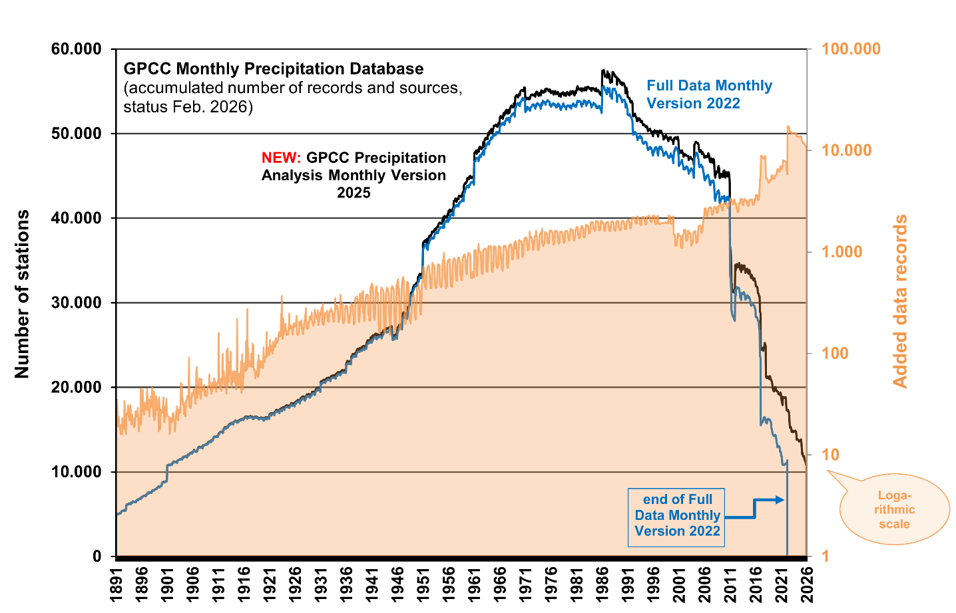
Improvements
Added data records per month since Full Data Monthly Version 2022

