Slide 1

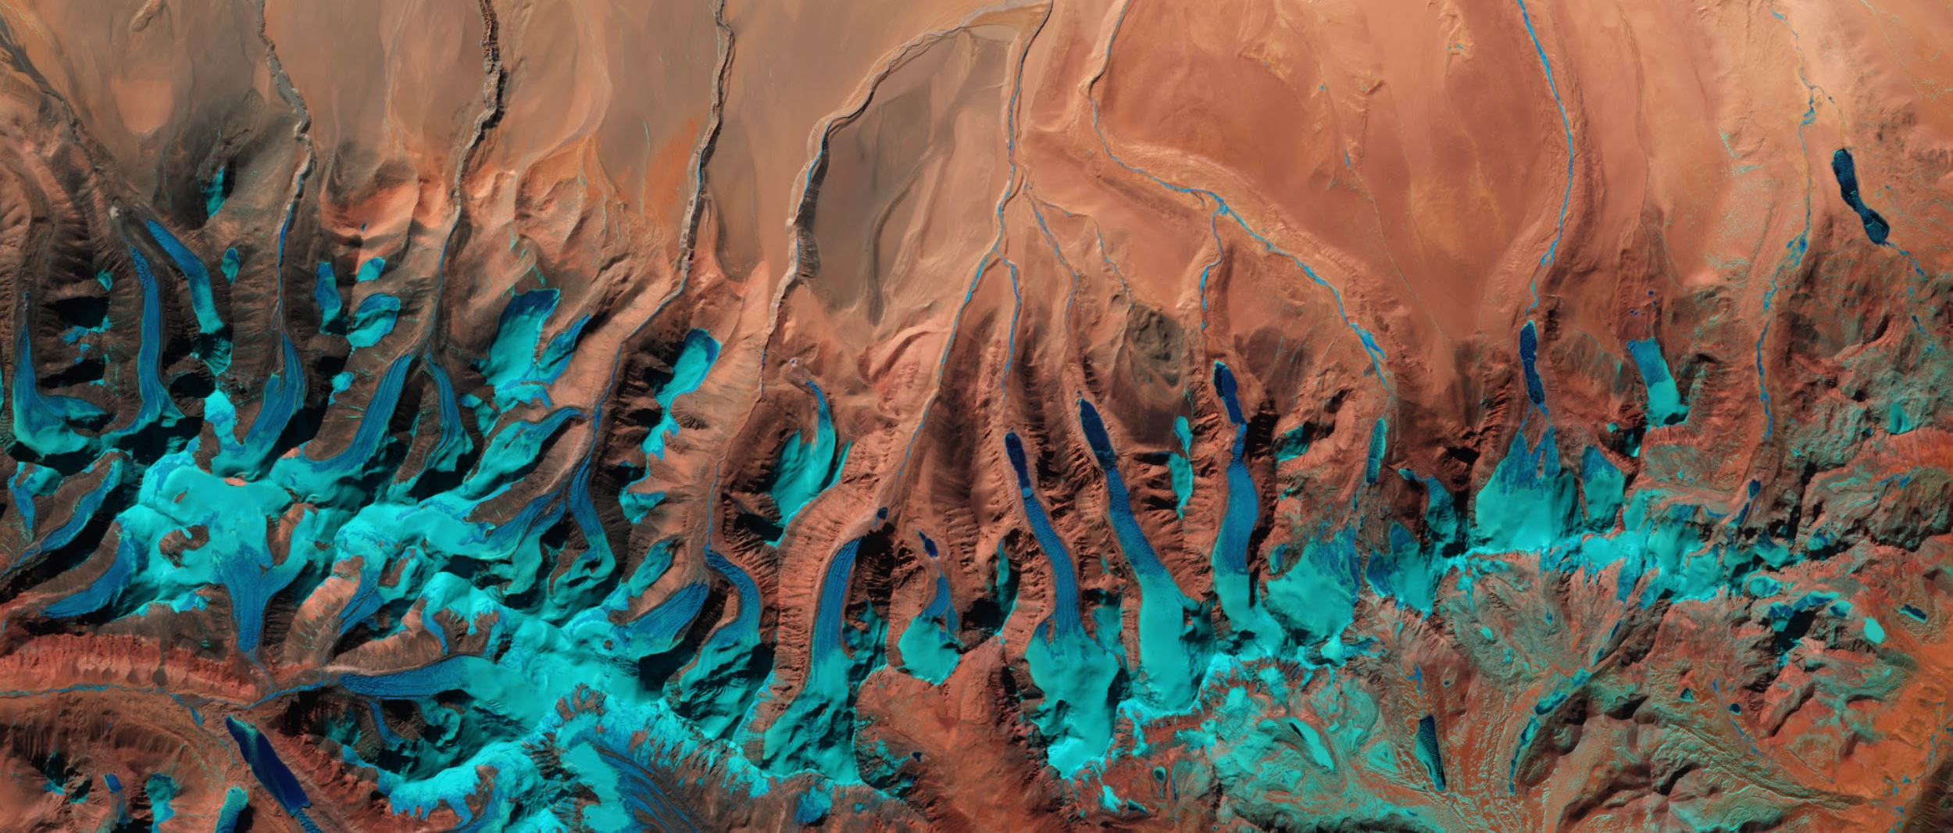




EARTH VIRTUAL EXPERT – EVE
EGU26
2026-05-05 | Vienna
Notes:
Time for presentation: ~60 min slides + 10 min QA
Small demo? https://eve-chat.chat/

Slide 2
What is this talk about ?​
Rationale and starting point​
Why EO & Earth Science Need AI‑Powered Digital Assistants​
EVE Large Language Model (LLM) development​
How is EVE built
Specialized EO and Earth Science document corpus​
Fine-tuning and adaptation strategies leading to a task-specialized model​
From model to system: End-to-end EO AI system with Retrieval-Augmented Generation (RAG)​
Evaluation​
Conclusions & What’s Next

Slide 3

Rationale and starting point​

Slide 4
Why EO & Earth Science Need AI‑Powered Digital Assistants​
The Challenge​
Knowledge fragmentation: Scientific insights distributed across papers, reports, technical documentation, models, and repositories, often difficult to cross‑query​
High entry barrier: Extracting actionable knowledge requires expert EO, thematic, and technical skills​
Trust & usability gap: Decision‑makers need transparent, and scientifically robust answers​
The Opportunity​
LLMs enable natural language interaction with complex EO and Earth Science knowledge​
Retrieval‑augmented approaches connect LLM reasoning directly to trusted, citable, domain‑specific sources​
From “finding data” to “asking questions and getting explanations”, across disciplines and expertise levels​

Slide 5
Why EO & Earth Science Need AI‑Powered Digital Assistants​
The Impact​
Democratisation of EO knowledge: Non‑experts can interrogate EO science using plain language​
Acceleration of science & innovation: Faster literature review, synthesis, and cross‑domain insight generation​
Decision‑ready intelligence: Clear, explainable answers supporting policy, environmental monitoring, and operational services​
Alignment with Open Science: Transparent use of references, traceability to sources, and reproducibility of knowledge​
Vision and Future: a trusted EO virtual expert acting as a Digital Assistant to EO and Earth Science​
Now: From textual information & documents to informed human decisions​
Next: Mining petabyte‑scale EO data through reasoning‑driven, agentic AI, leveraging geospatial tools and EO foundation models​​

Slide 6
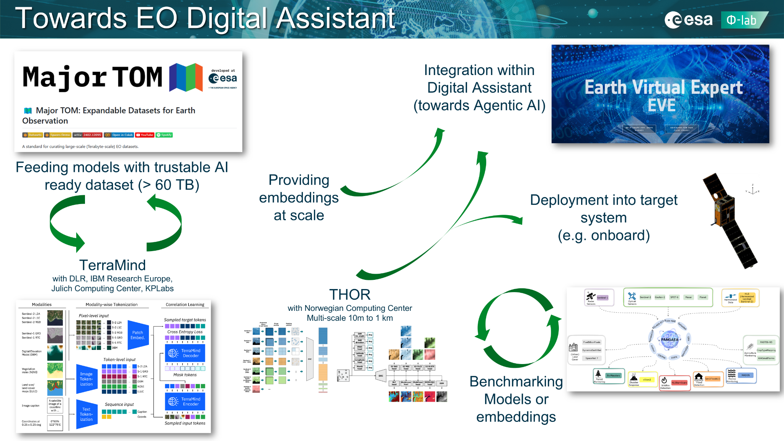
Towards EO Digital Assistant

Slide 7
Earth Virtual Expert (EVE) in a nutshell​
What is EVE?​
Developed under ESA FutureEO - Φ-lab, empowered by Pi School (IT), Imperative Space (UK/IT), Mistral AI (FR), and supported by Wiley (UK)​
Suite of open-source agentic LLM assistant (Mistral 3.2 24B) and specialized datasets for Earth Observation​ ​
Accessible via a web platform and API​ ​
EO assistant that answers natural language queries with trusted insights​
Capabilities​
Explain EO concepts in natural Question-Answering​ ​
Guides users to relevant EO trusted sources using Retrieval-Augmented Generation (RAG) via standardized interface (MCP) ​ ​
Summarize scientific documents​ ​
Delivers insights on EO trends and applications (web and tool connection)​

Slide 8

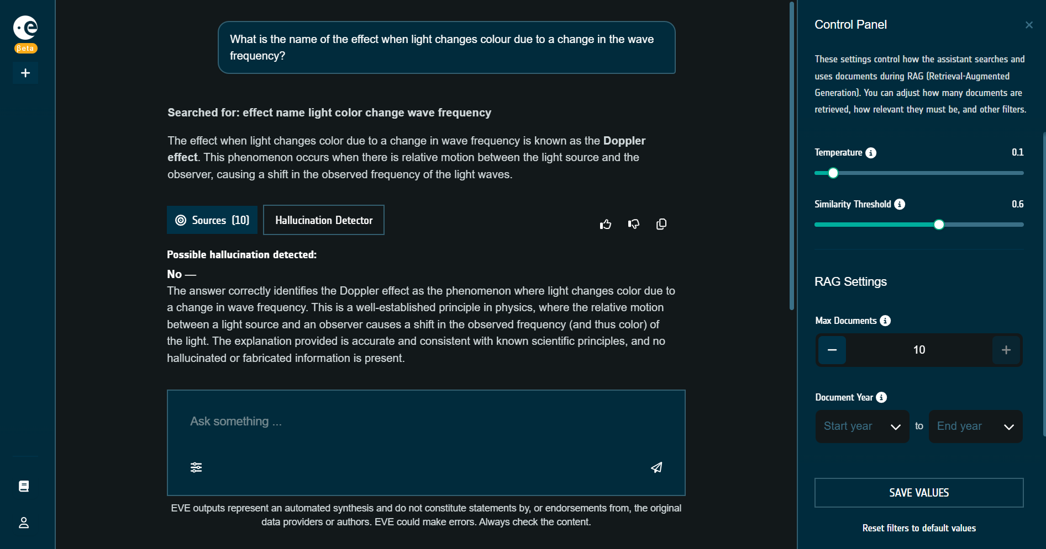
EVE user interface
Able to detect hallucinations of the model and correct itself
Control panel allows user to set preferences for document retrieval
Retrieve information from relevant sources
Ask any Earth Observation related question

Slide 9
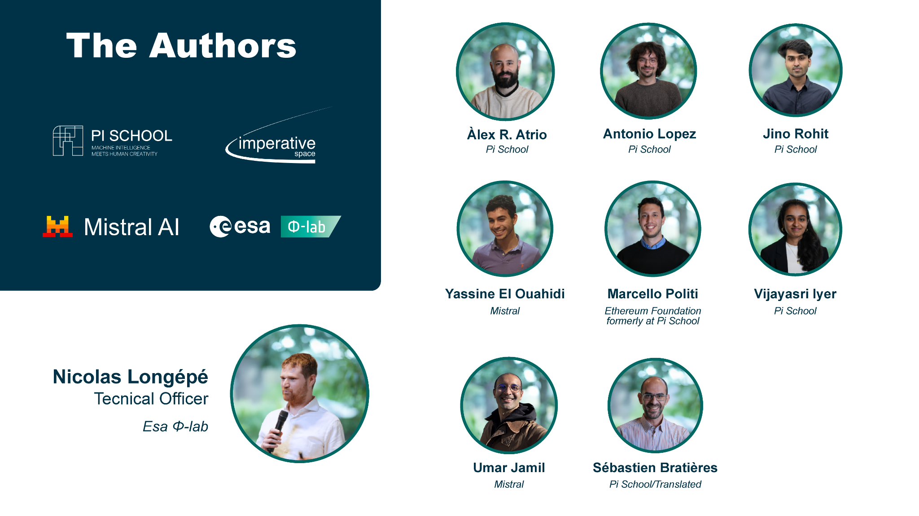

Slide 10
EVE LLM development​

Slide 11
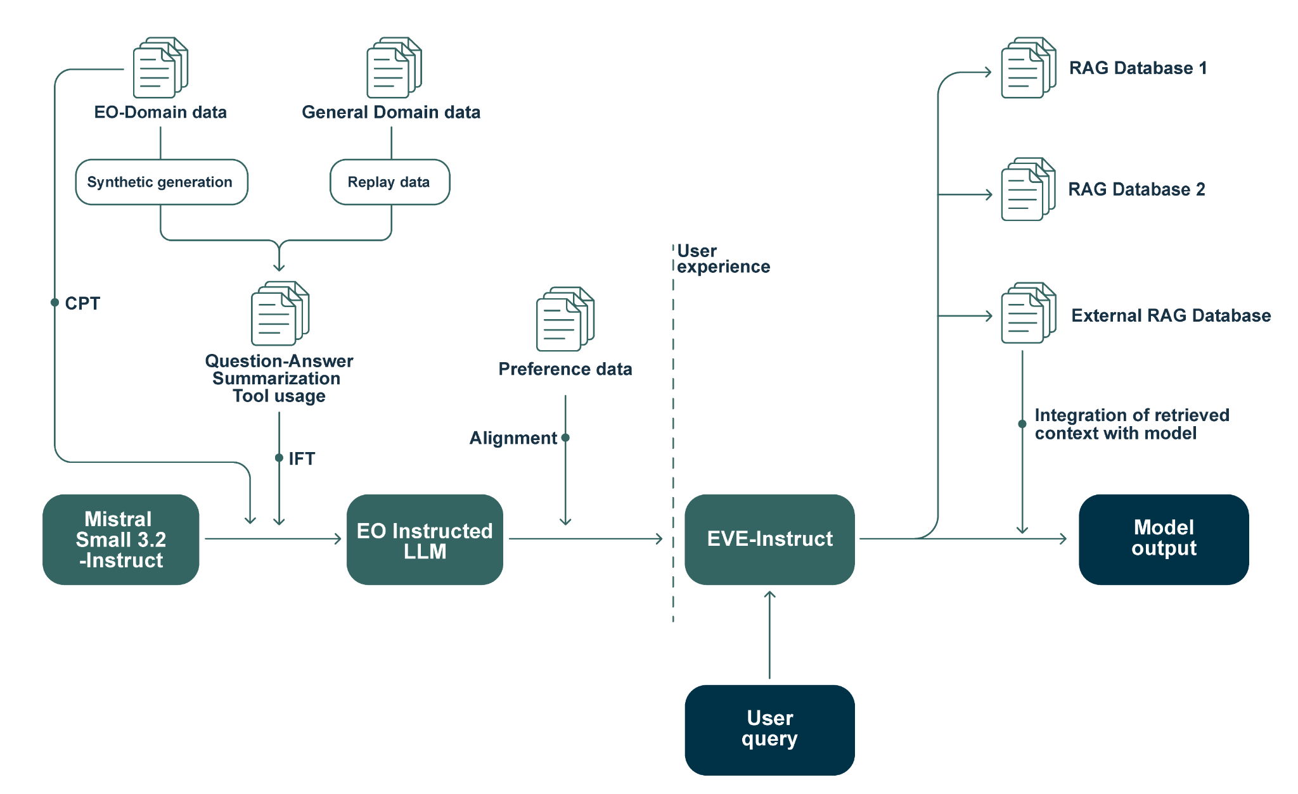
EVE Training and Inference Pipeline
Notes:
Say that “user query” at this stage is text-only

Slide 12
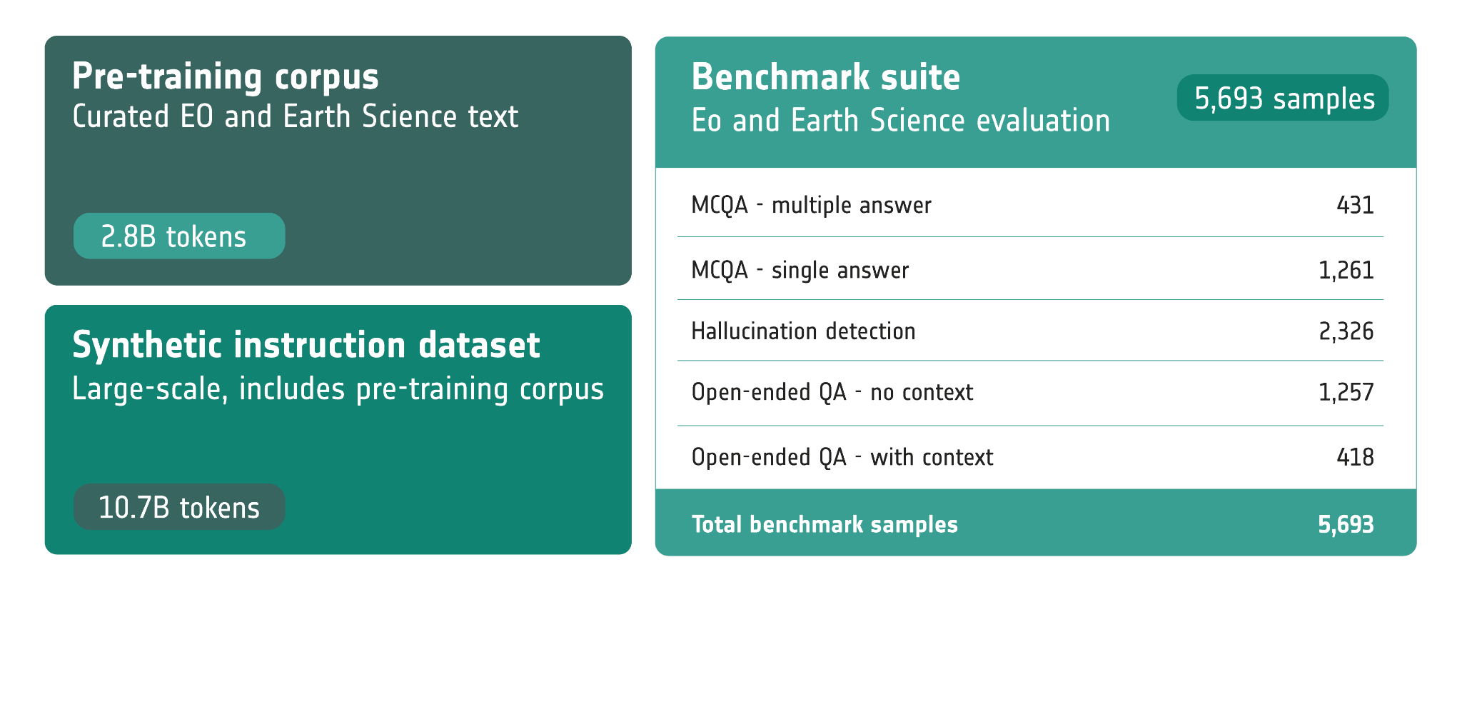
Overview of EO data
Notes:
Say that “user query” at this stage is text-only

Slide 13
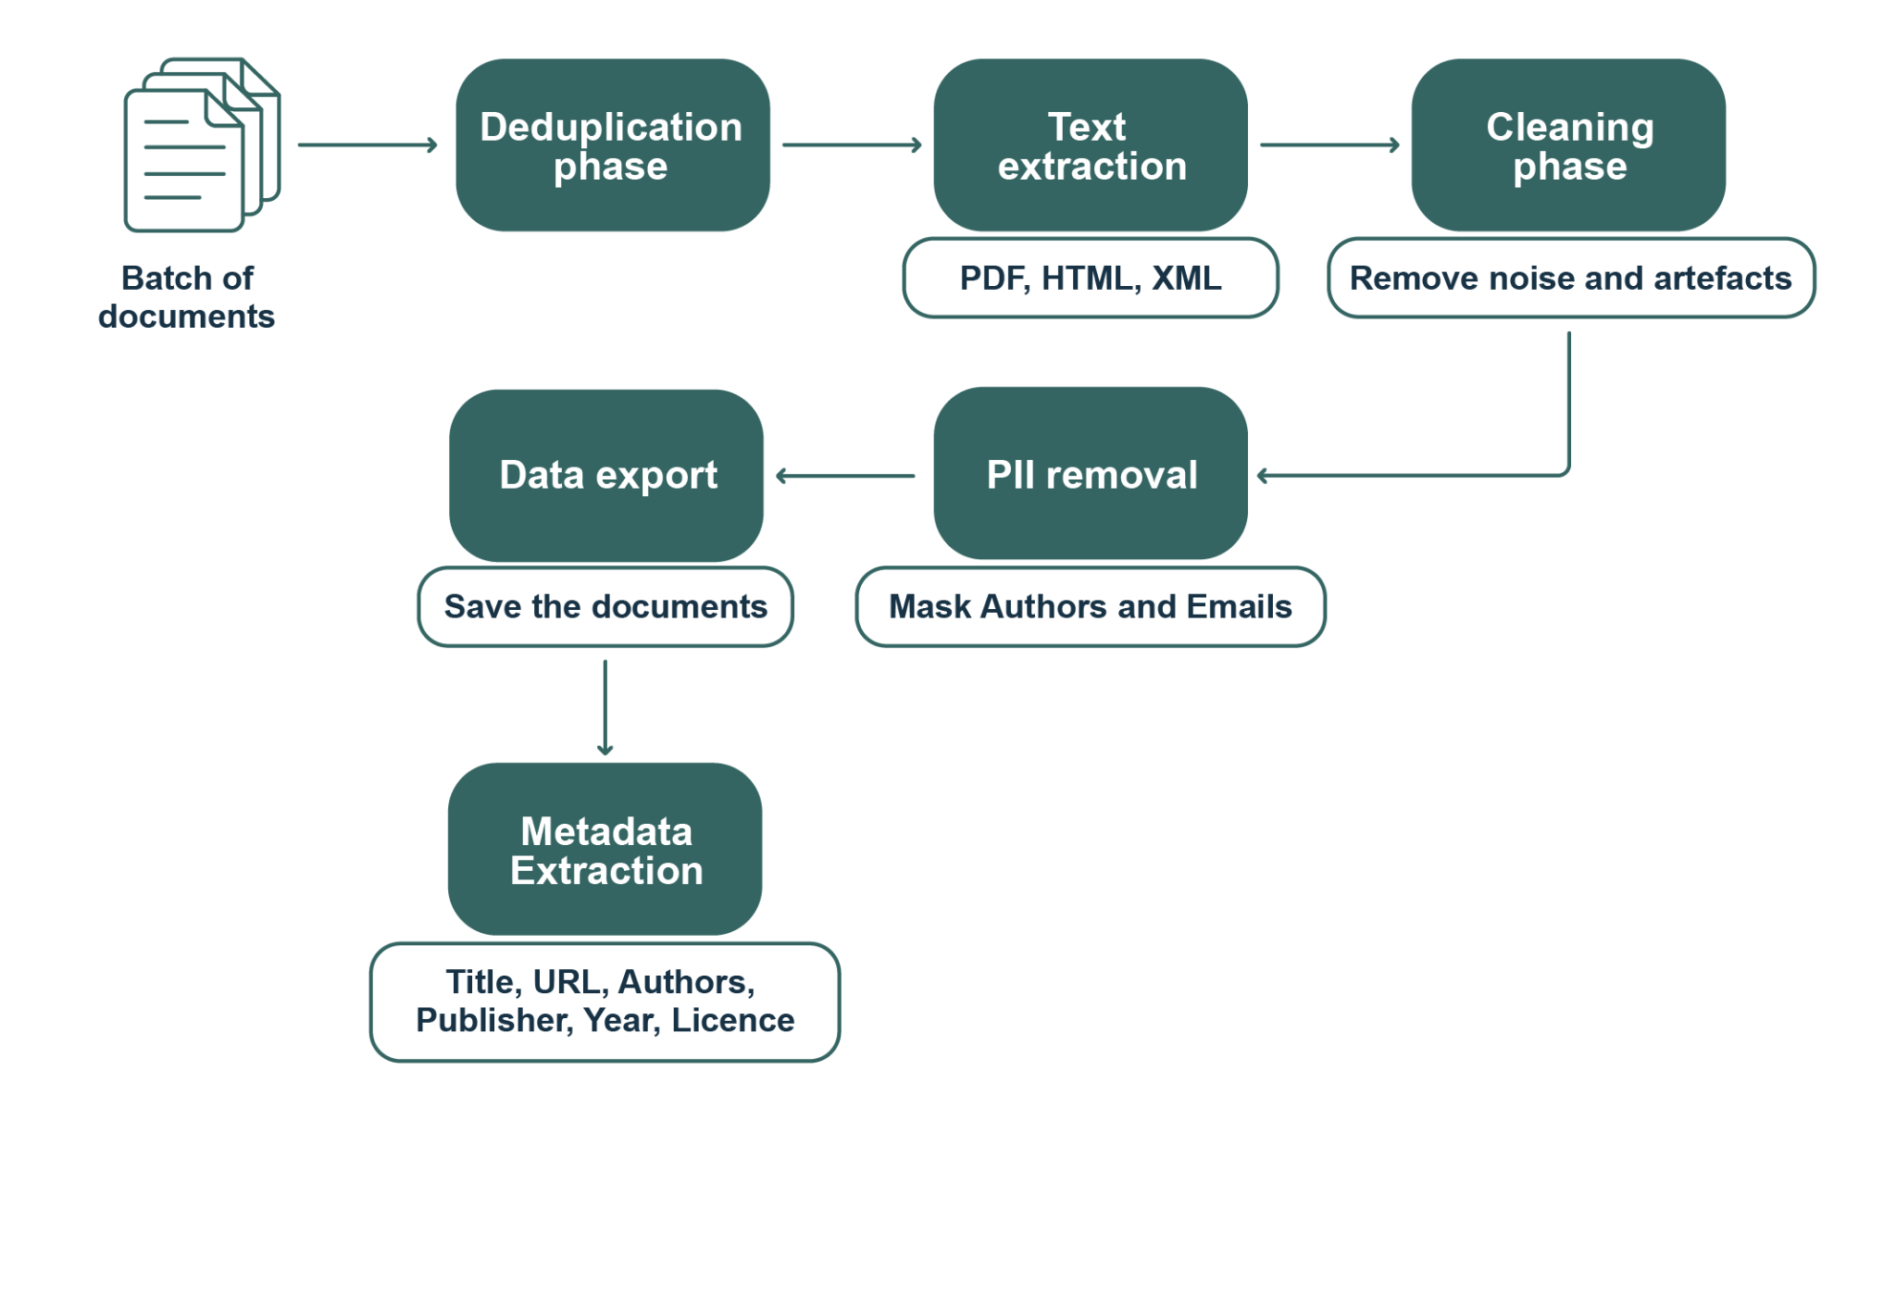
Corpus Creation Workflow
Manual identification of high-quality, trusted sources​ (MDPI, NCBI, Springer, etc.)
Notes:
Say that “user query” at this stage is text-only

Slide 14
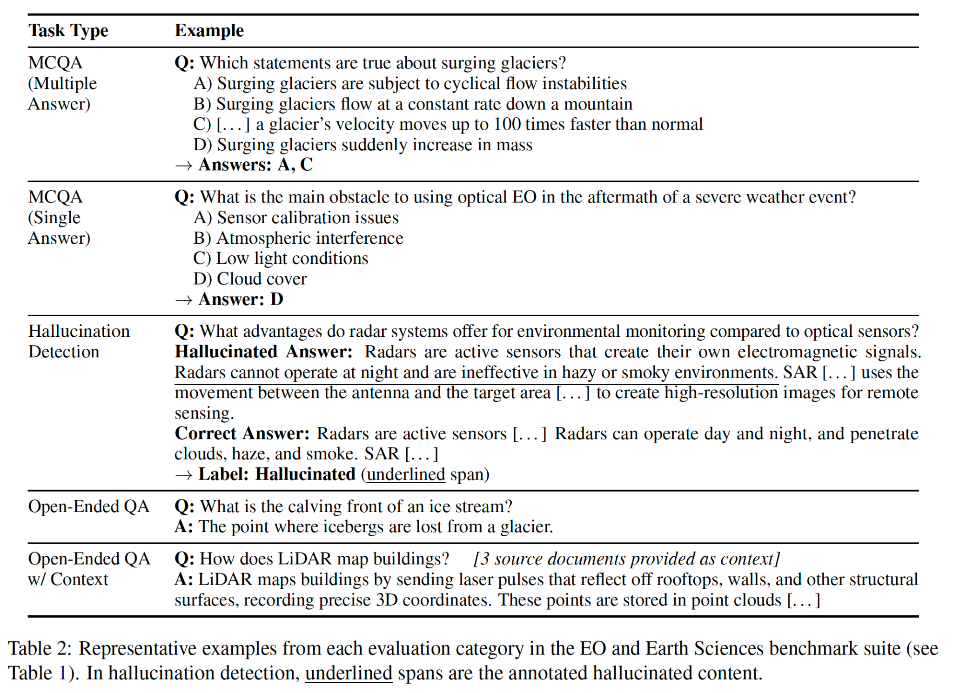
EO New Benchmarks
25 academic EO and Earth Sciences annotators

Slide 15
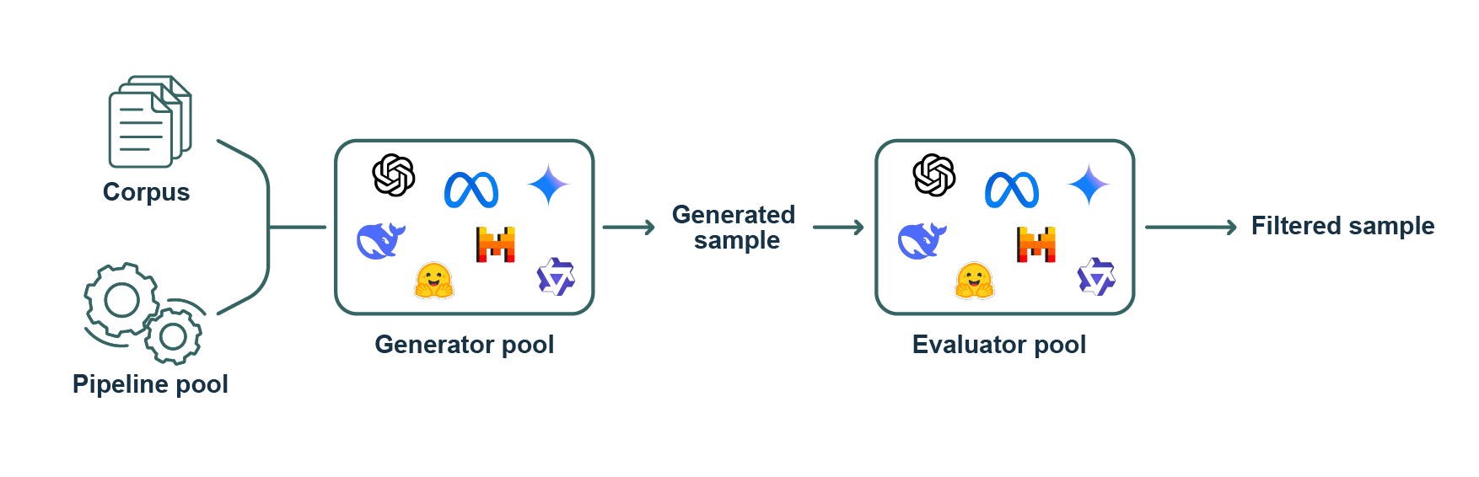
Synthetic EO Instruction data
Creation of structured data with LLM: <context, query, answer>​
Ground LLM with authentic context to ↓ hallucinations​
We generate different QA pipelines synthetically, with the following basic schema (several models to maximize diversity):​

Slide 16
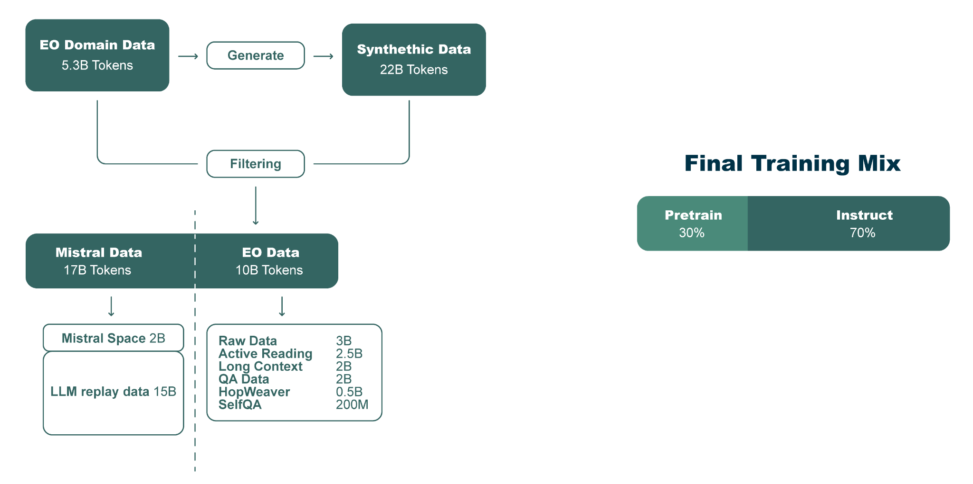
Training data mix

Slide 17
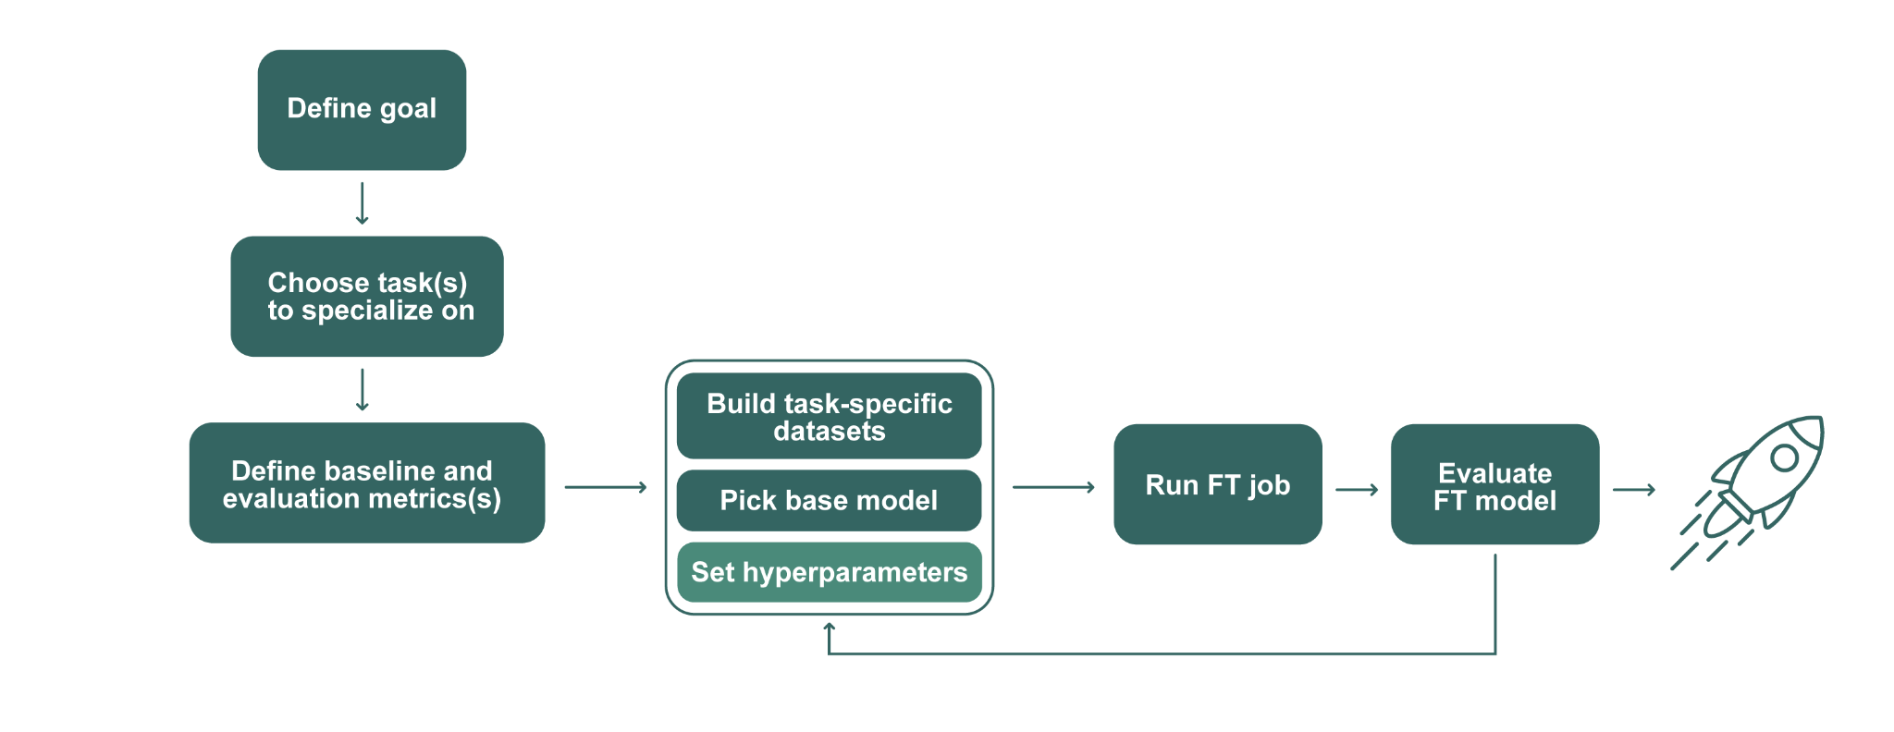
Training EVE
Fine-tuning
Full fine-tuning (no PEFT)
Checkpoint merging (different data mixtures, 10 cpts.)
Alignment: online DPO to refine formatting, style and preference

Slide 18
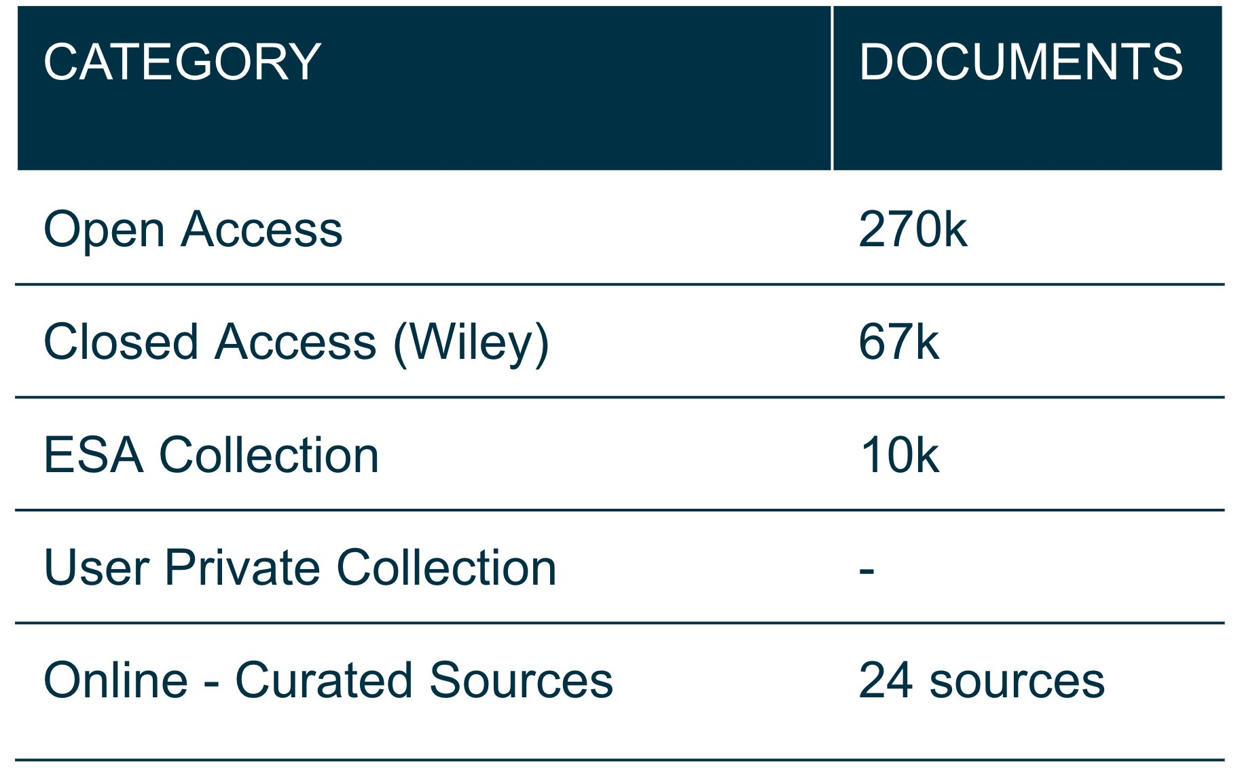
Retrieval-Augmented Generation (RAG)
Models
Qwen3-Embedding-4B
Qwen3-Reranker-4B​
Chunking​
Hierarchical chunking and filtering
Query rewrite to optimize retrieval
Metadata augmentation

Slide 19
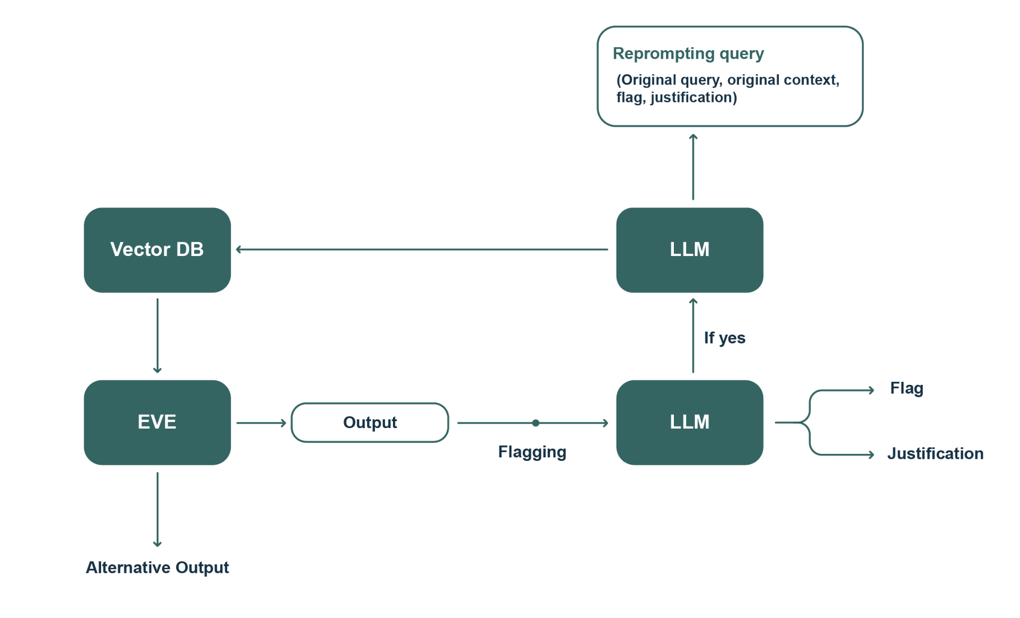
Hallucination Detection

Slide 20
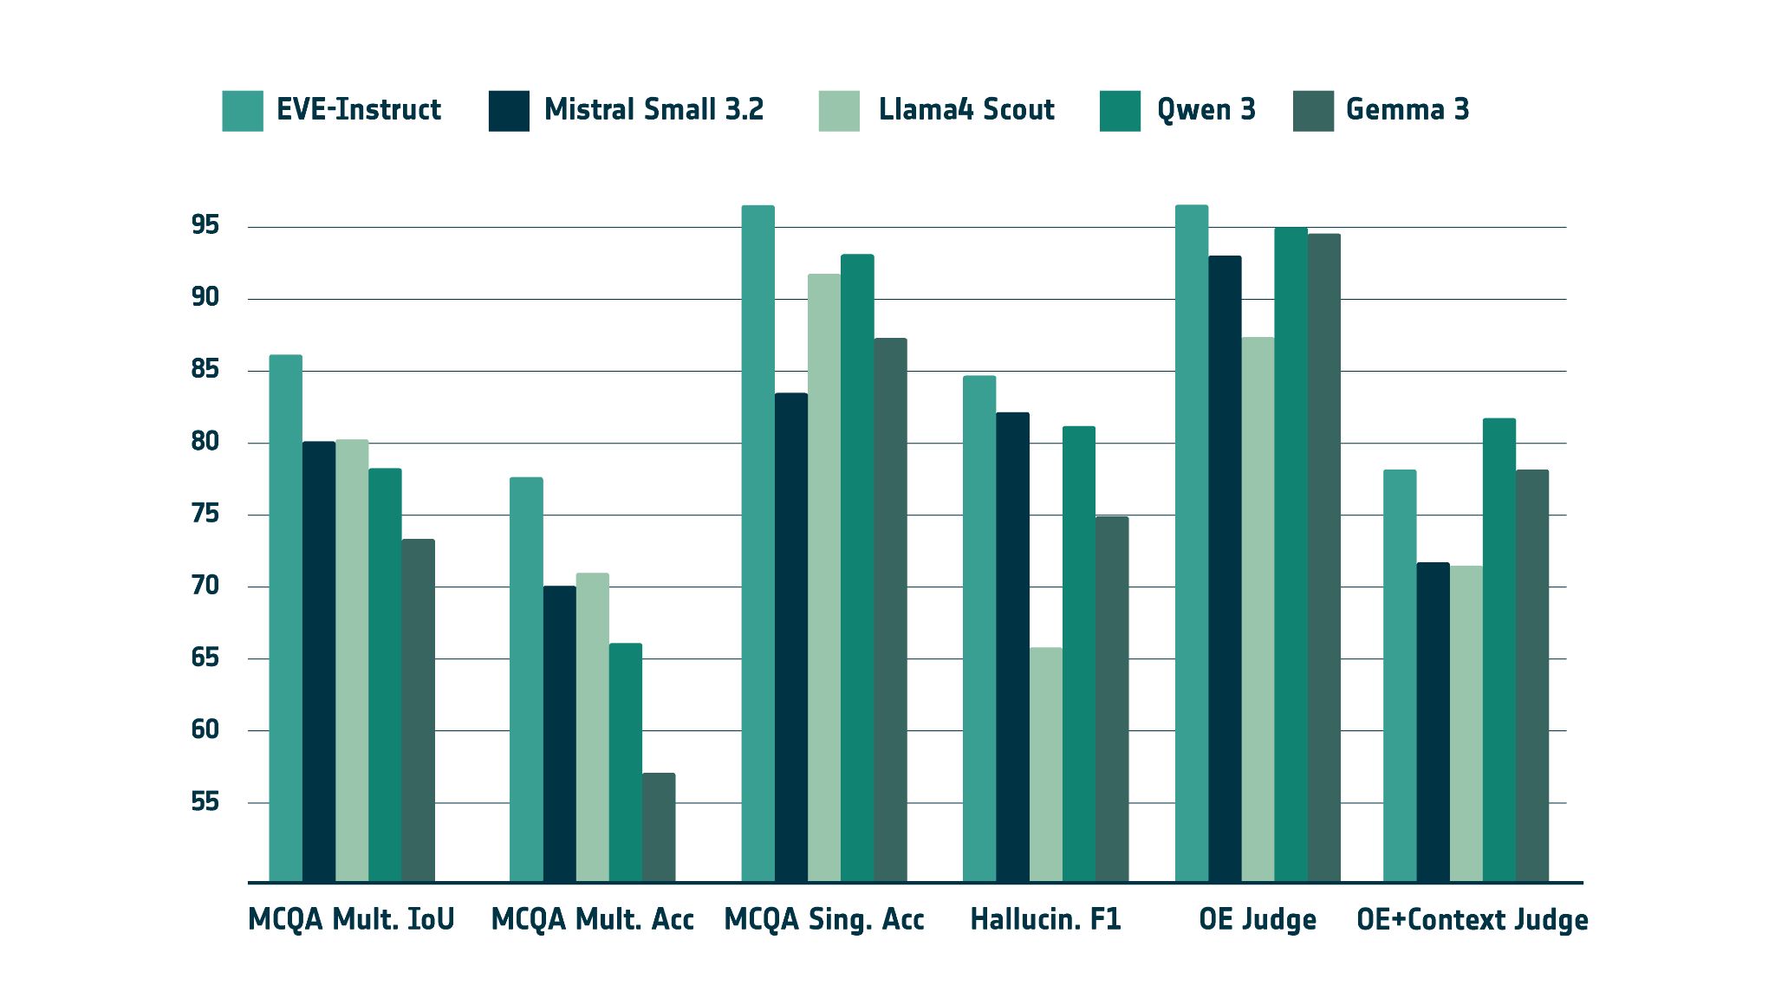
Evaluation - EO benchmarks EVE outperforms comparable models in EO

Slide 21
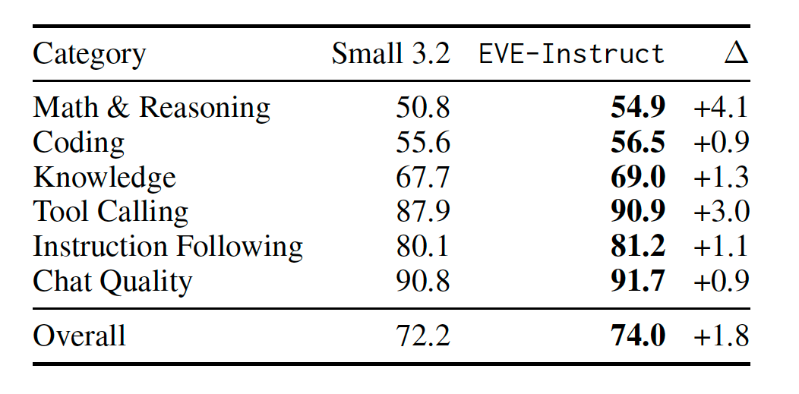
Evaluation - General-domain Benchmarks EVE preserves and improves general capabilities

Slide 22
Pilot & Deployment
Chat System
Memory management
Context management
RAG + hallucination detection
Configurable model and RAG parameters
Private documents
Pilot
355 users in 6 months
Academia and research (37.7%)
Industry and commercial (29.1%)
Space and EO agencies (11.2%)
Government (5.8%)
Students or unaffiliated users (13.5%)
577 conversations, 1,086 messages
84.6% RAG usage

Slide 23
Conclusions & What’s Next

Slide 24
Conclusions
Takeaways
EVE-Instruct: a specialized 24B LLM for EO
Authentic and synthetic EO datasets:
2.8B token curated corpus
10.7B tokens for fine tuning
5693 samples for evaluation
Full open-access codebase (data, evaluation, RAG, etc.)
Fully open-access pipeline under ESA Φ-lab, with web/API access
Coming soon!
Limitations
No full corpus release due to licensing, affect reproducibility.
Grounded generation depends on retriever quality
Text-only, cannot reason across other data formats.

Slide 25
EVE at EGU26!
Tuesday 5 May |  | Thursday 7 May | Thursday 7 May
Poster |  | Live Demo | Agentic Demo
16h15 - 18h00 |  | 9h30 - 11h00 | 11h00 - 12h30
Hall X4, board number X4.31 |  | ESA booth, Hall X2, stand X201

Slide 26
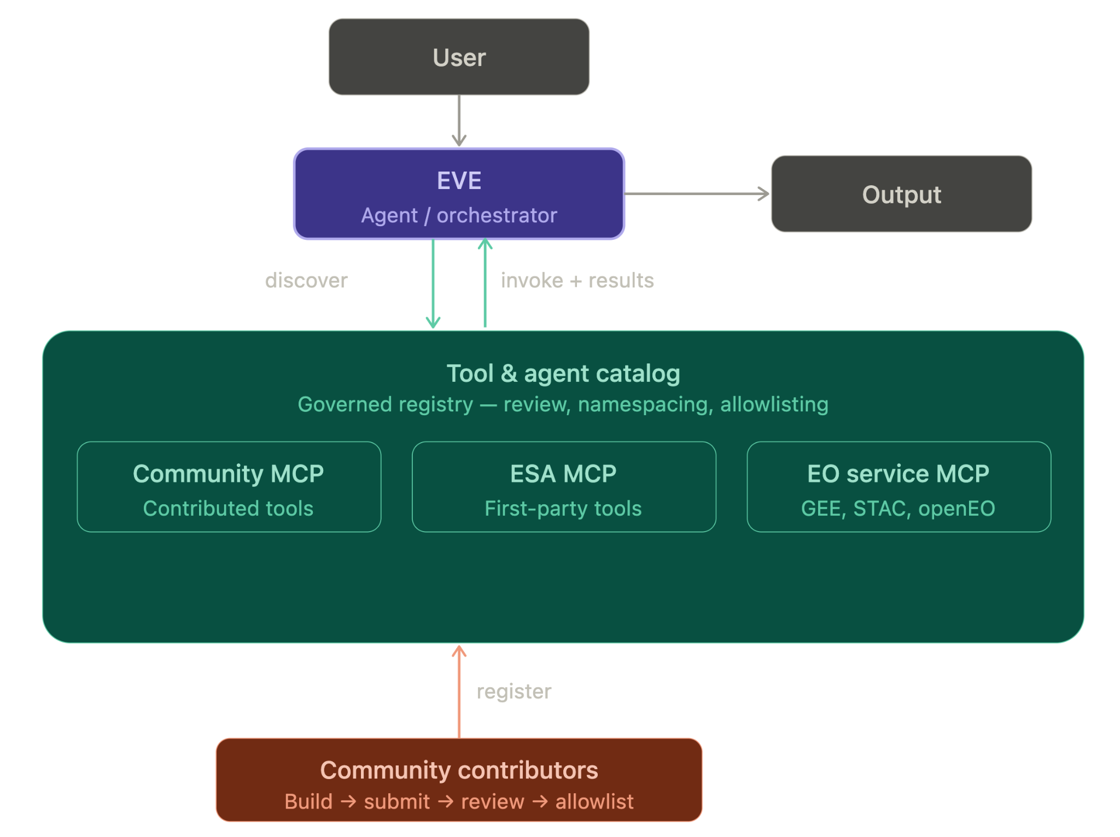
Next Steps
Public opening of operational EVE system (API & web app)
Q2 2026
Multimodal expansion
reason and query over both text and images
Evolution towards agentic EVE
Tool calling to geospatial resources
Orchestrator and sub-agents
Open-source
Community contributions

Slide 27



Thanks, any questions?
Àlex R. Atrio | Pi School, Italy | alex.atrio@picampus-school.com
Eva Gmelichmeijling | ESA Φ-lab, Italy | eva.gmelichmeijling@esa.int
Resources
Register
to the launch
Follow EVE
Notes:
Conversations
Copy
Feedback
Sources
Collections
Upload private docs
Advanced settings

