Slide 1



Biochar Modulates Leucine Aminopeptidase Hotspots and Kinetics under Salinity Stress in the Wheat Rhizosphere
Tahereh Hozhabri, Akram Halajnia, Amir Lakzian, and Seyed Sajjad Hosseini
Ferdowsi University of Mashhad, Iran

Slide 2
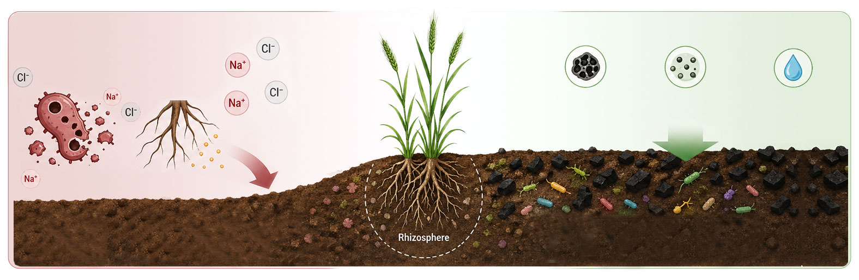
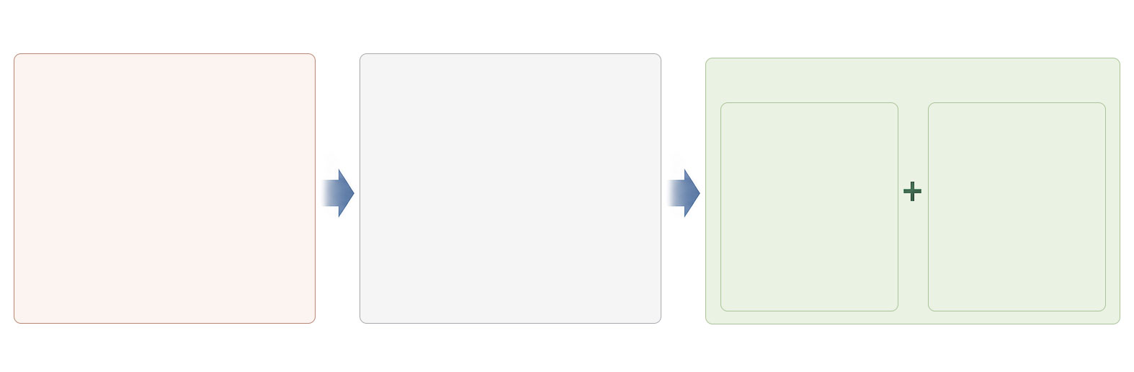

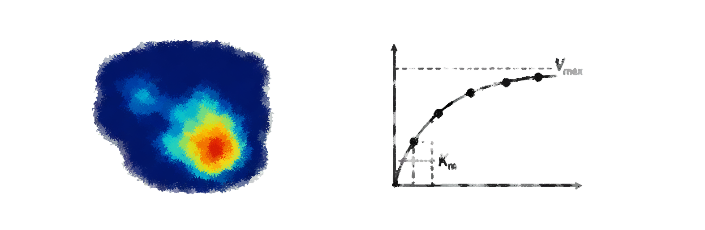
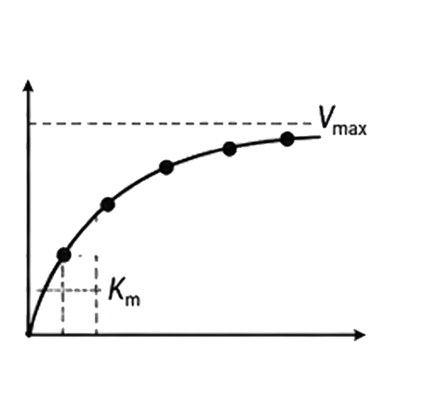


Introduction
Introduction
Biochar
Salinity stress
Improves soil structure
Increases nutrient retention
Enhances water holding capacity
Destroys
microbial cells
Disrupts root exudation
Impairs microbial activity in soils
Improvement of soil physicochemical properties
Objective
To evaluate the combined effects of salinity stress and biochar application on the spatial distribution and kinetics of leucine aminopeptidase activity in the wheat rhizosphere.
Salinity (NaCl)
    Measured variables
0mM
150mM
Zymography
Enzyme kinetics
0%
Biochar
(%W/W)
2%
Spatial distribution of LAP activity
Kinetic parameters

Slide 3
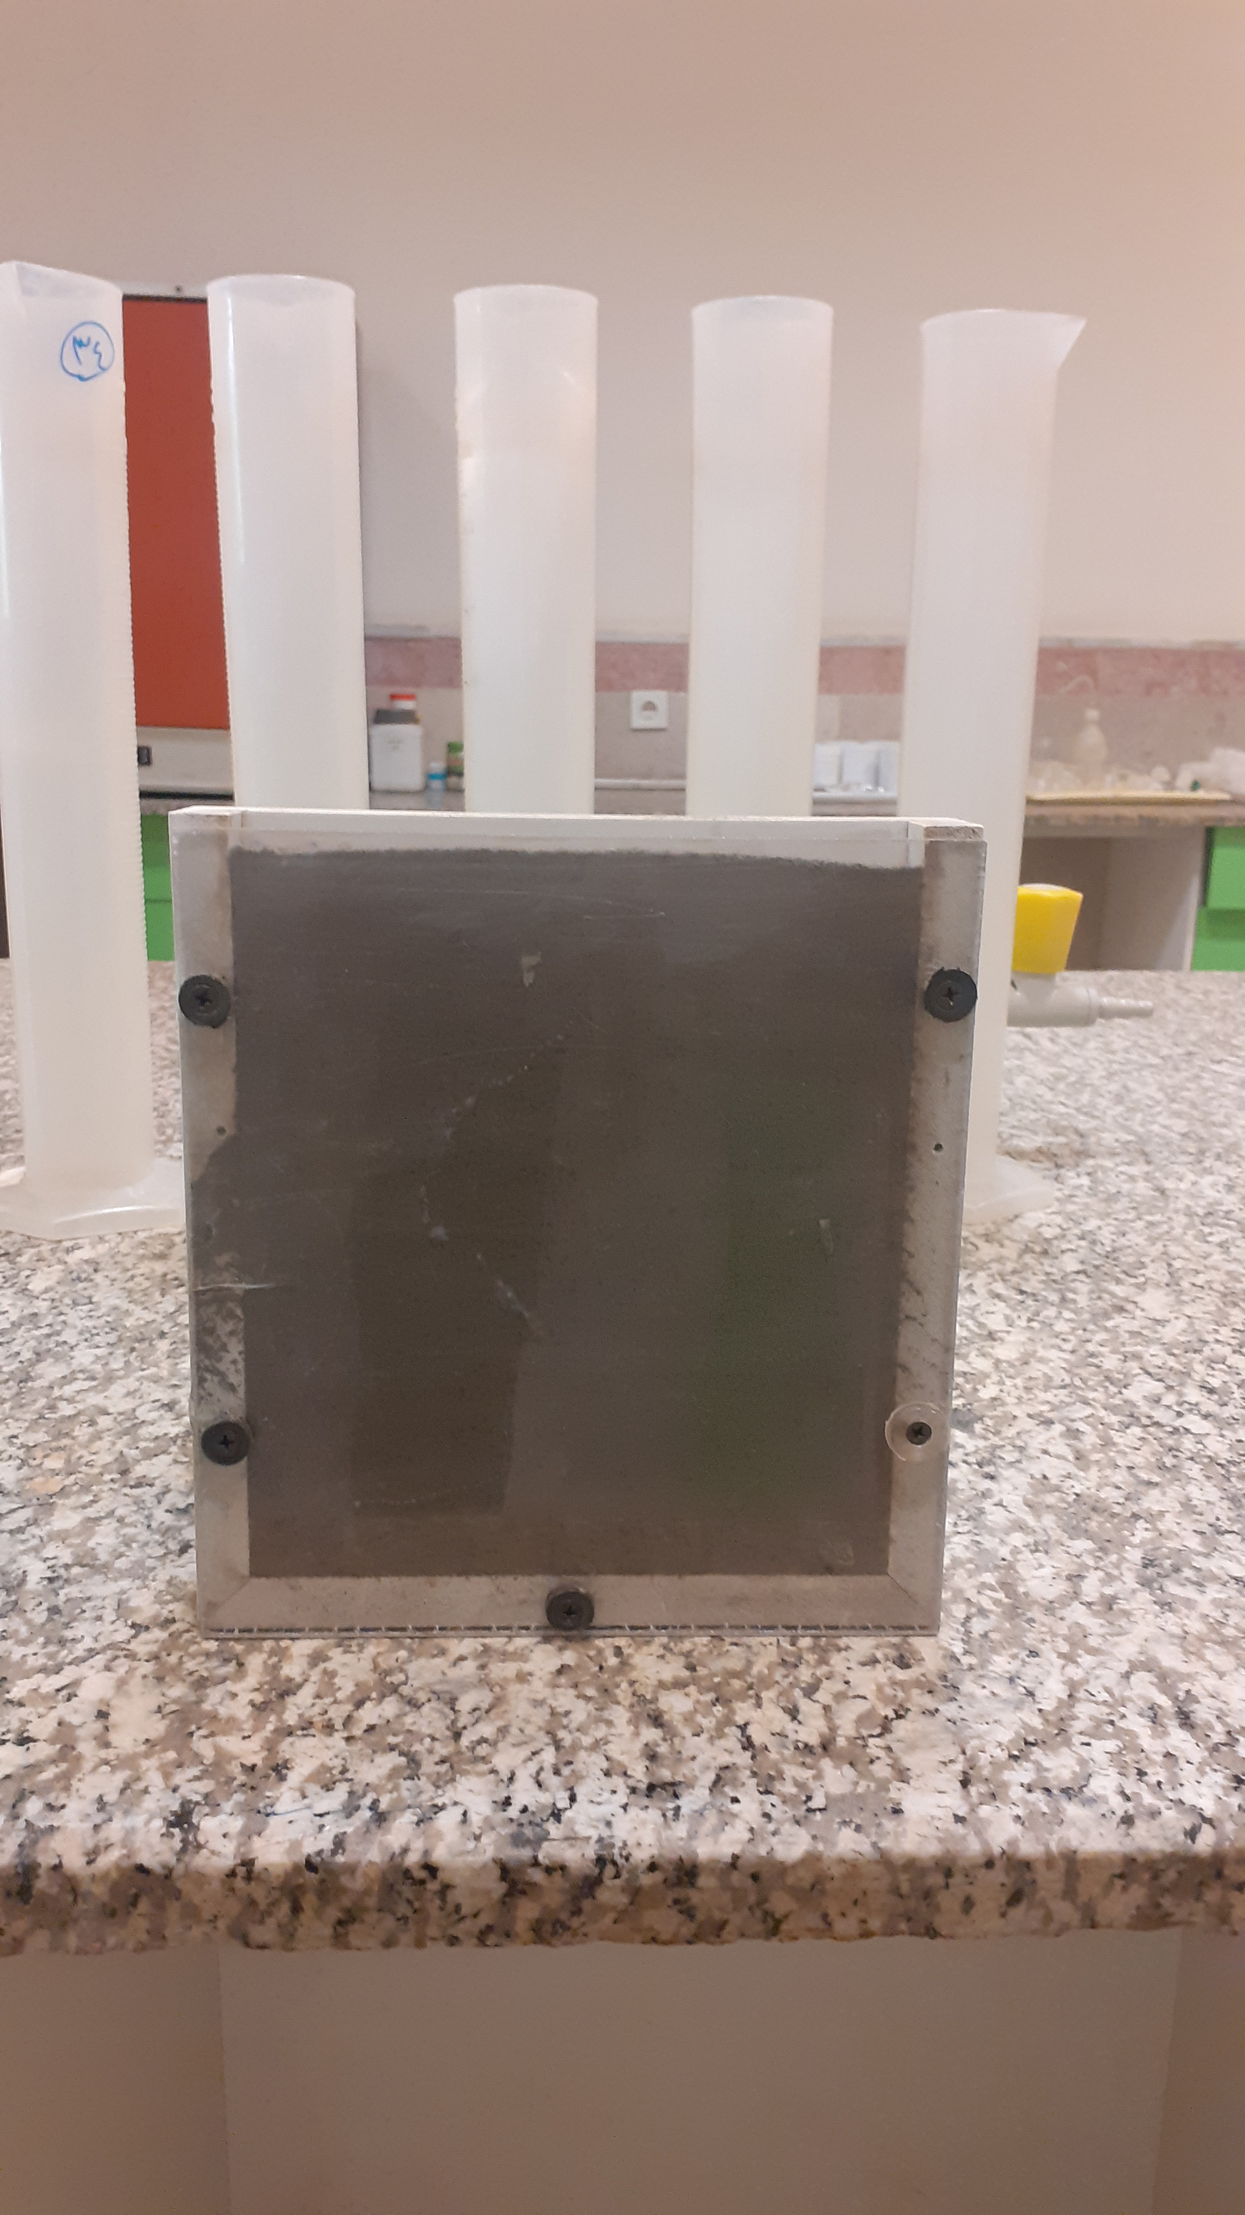
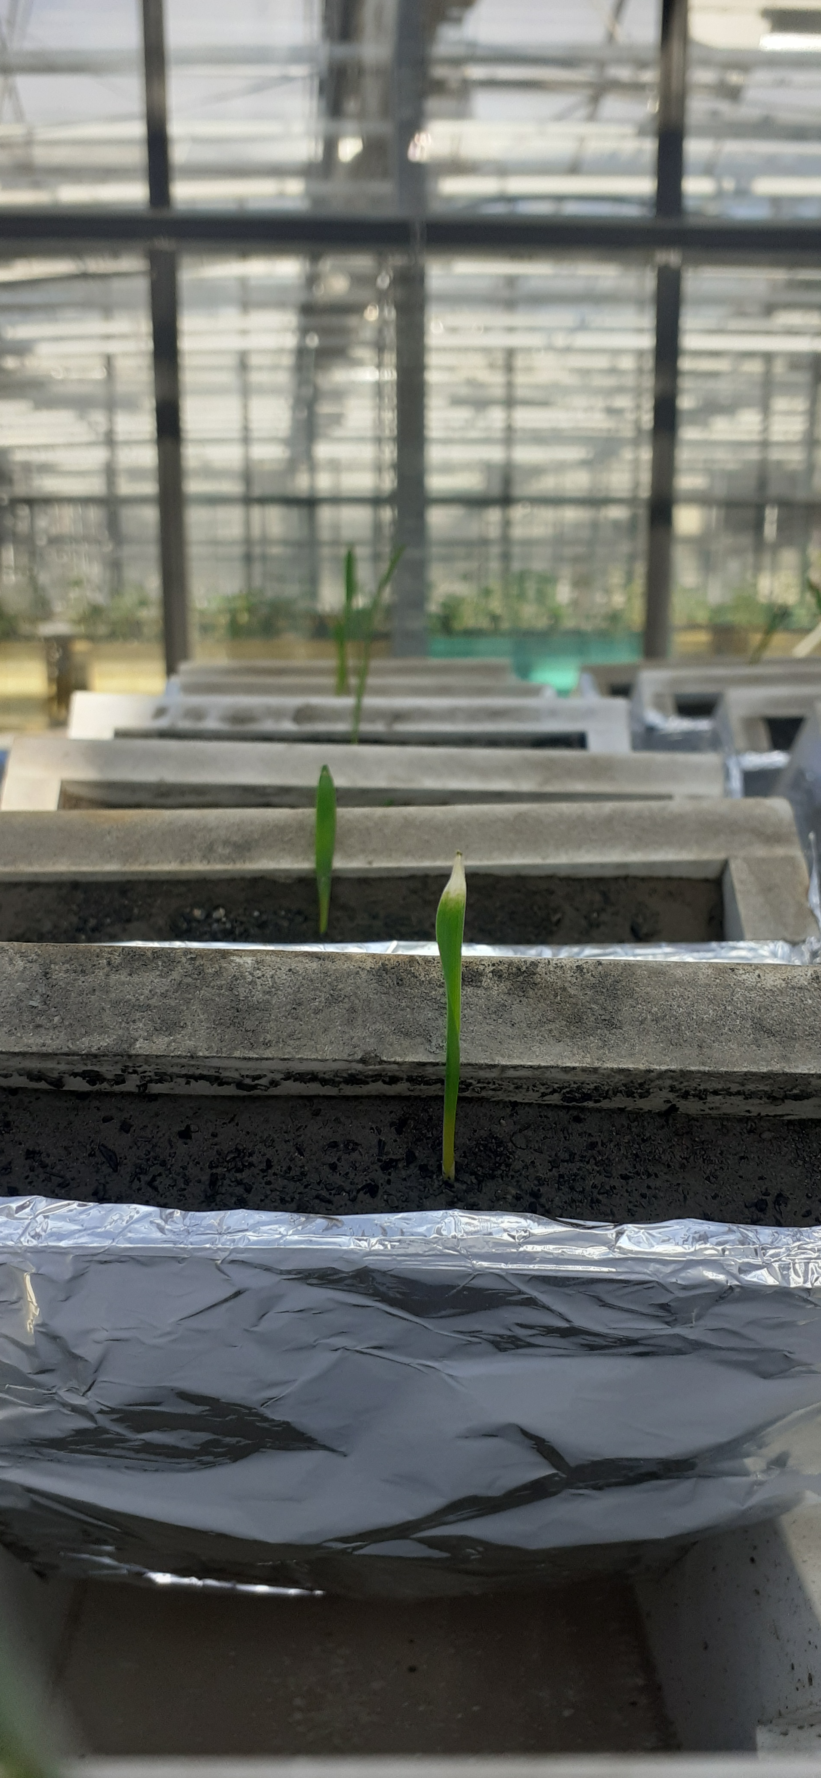


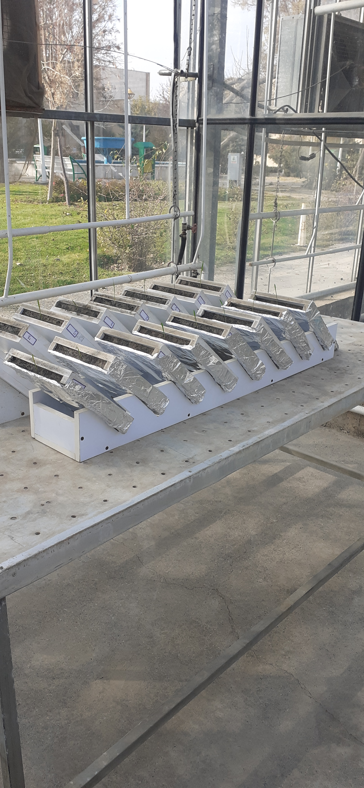
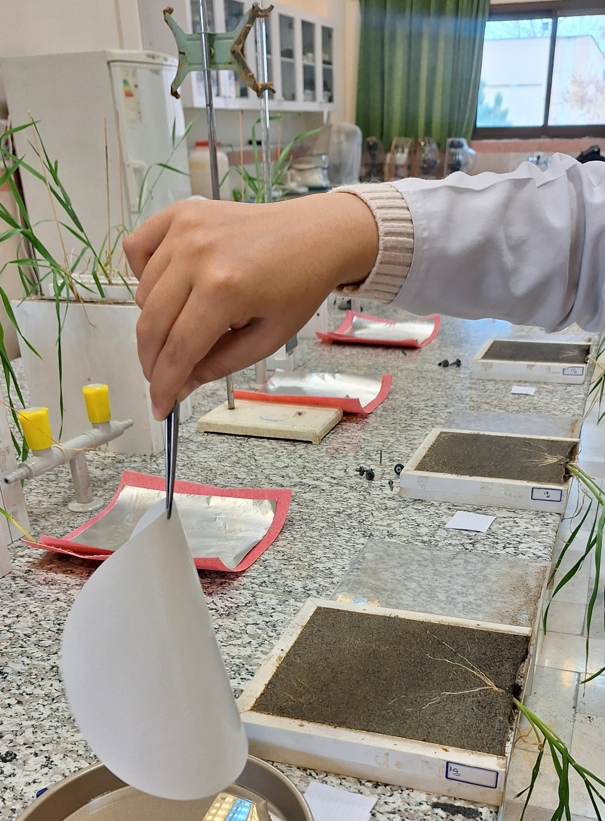
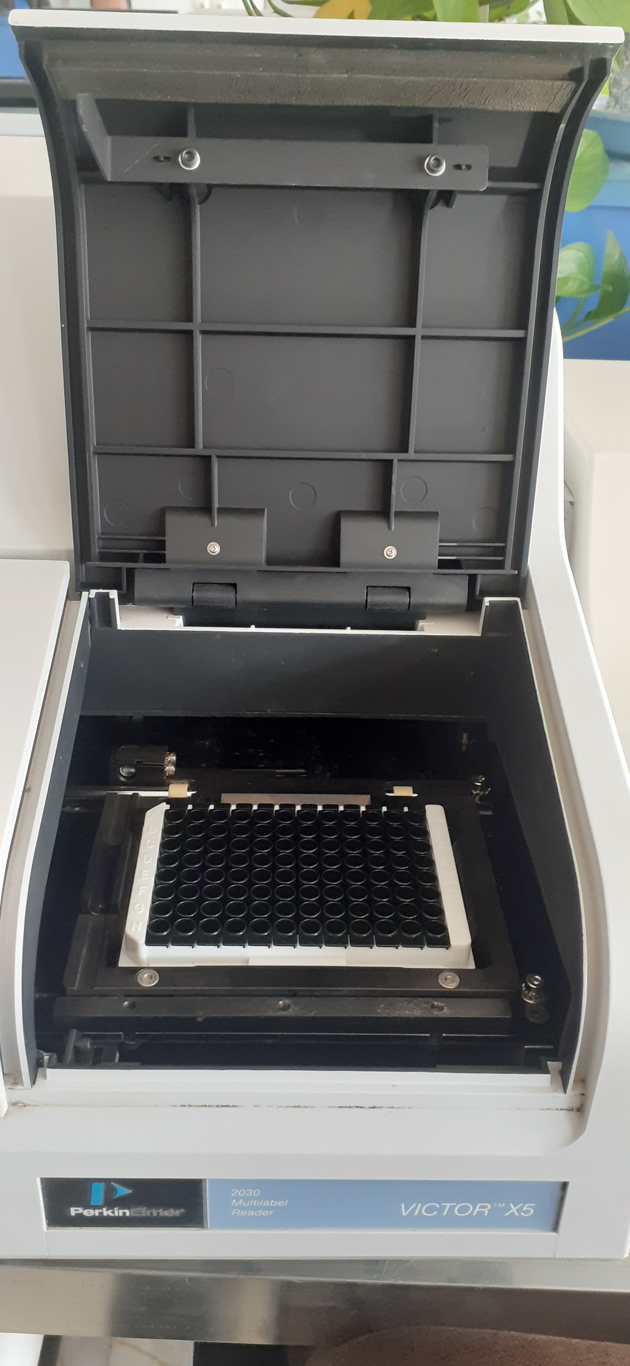

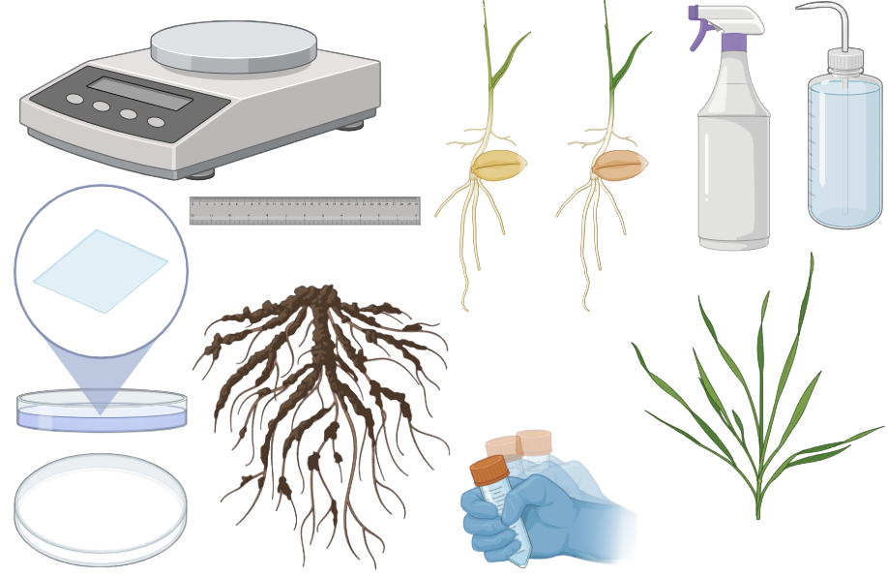

Methods
Biochar treatments
Two biochar treatments applied.
Soil processed, and filled into PVC rhizoboxes.
Salinity treatments
No biochar
0%
biochar
2% (W/W)
3
0 Mm NaCl
150 Mm NaCl
1
Two salinity treatments imposed (from week 3)
2
4
Wheat (Triticum aestivum L.,Talaei genotype) grown in rhizoboxes under greenhouse conditions.
Growth period: 8 weeks.
Rhizoboxes were placed at a 45° angle on special holders.
LAP activity analyzed by zymography & enzyme kinetics (Vmax, Km)

Slide 4
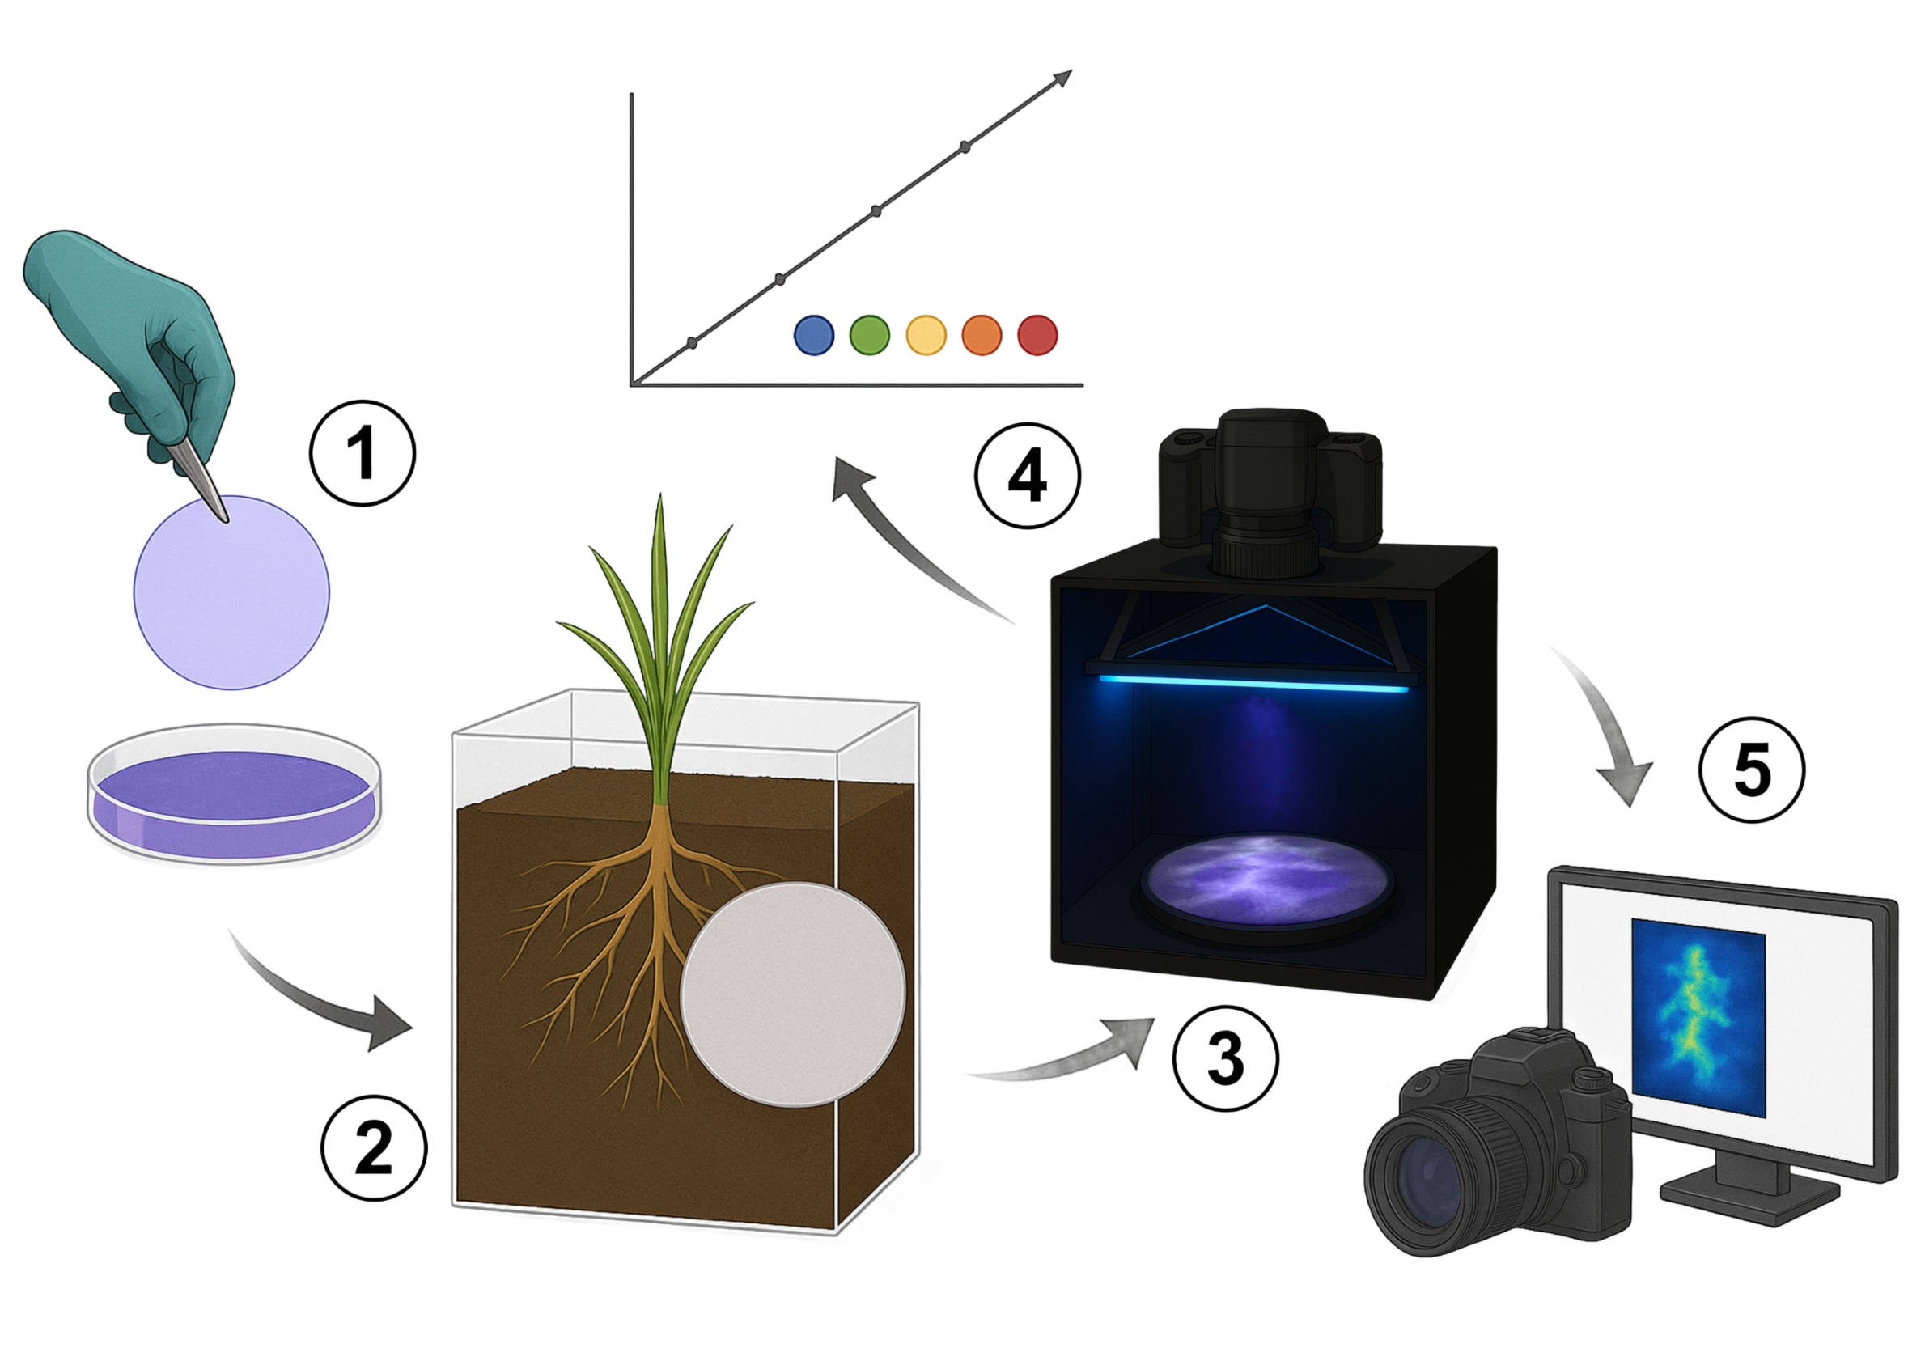
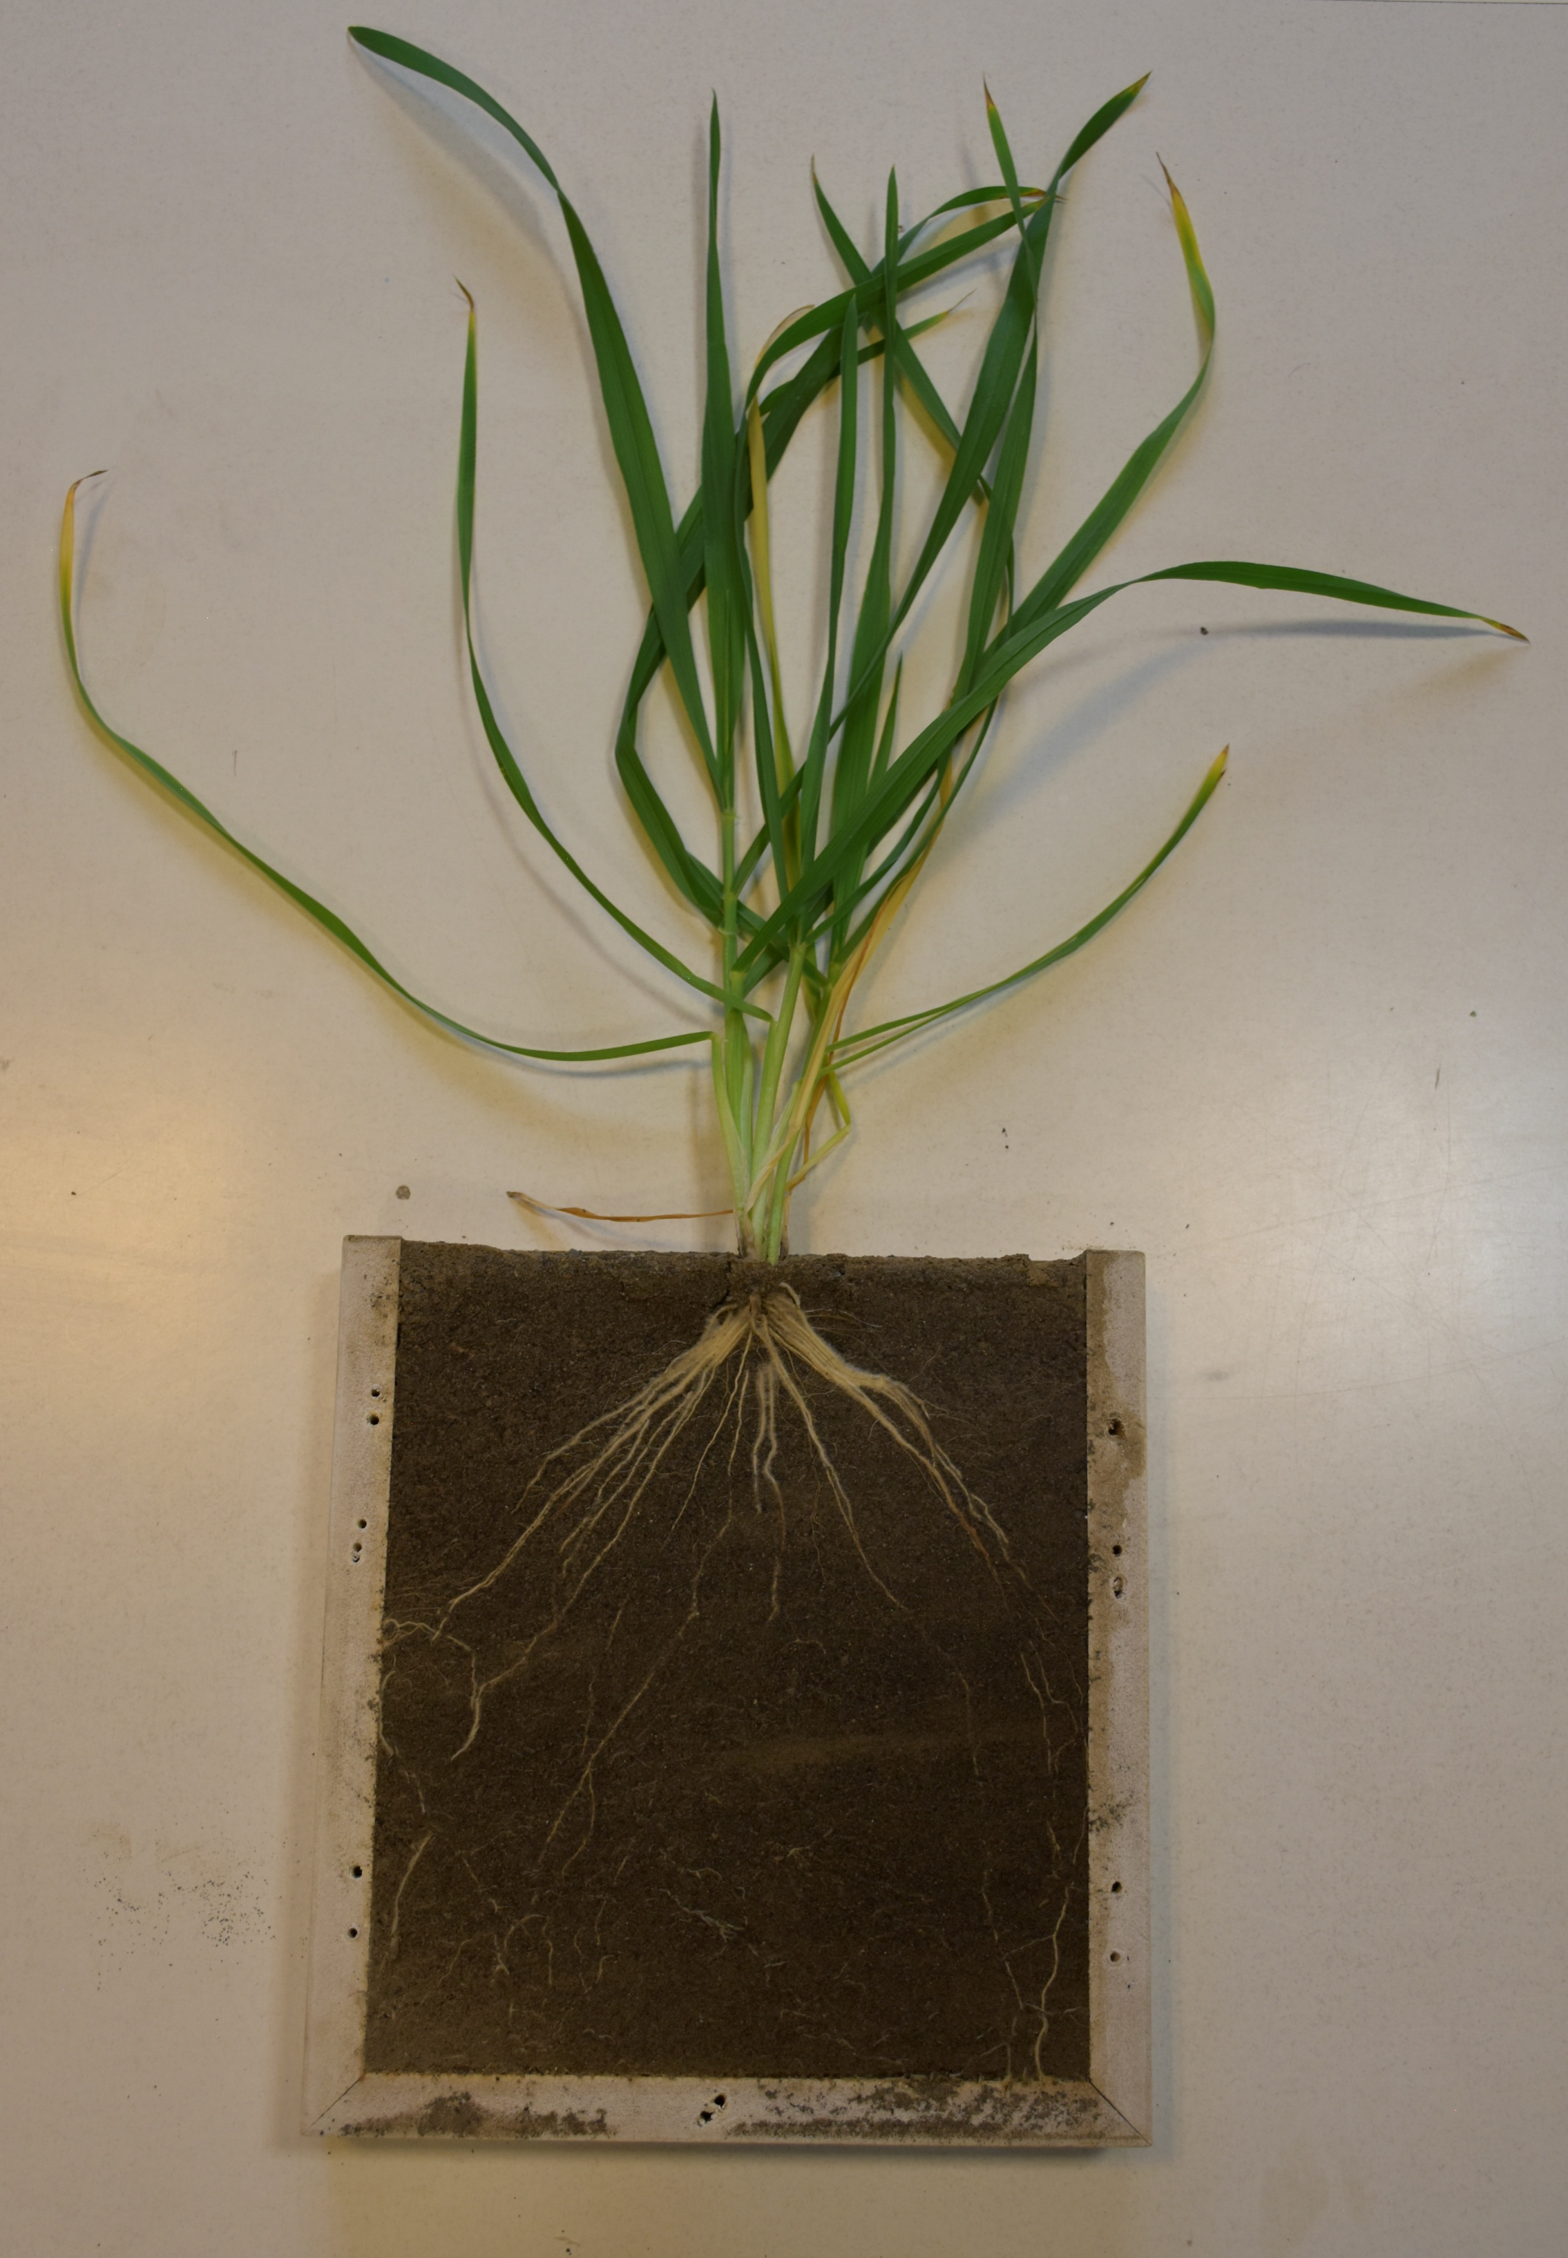

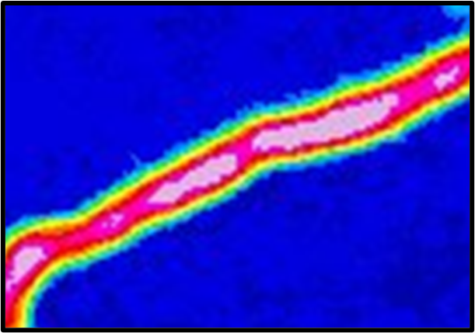


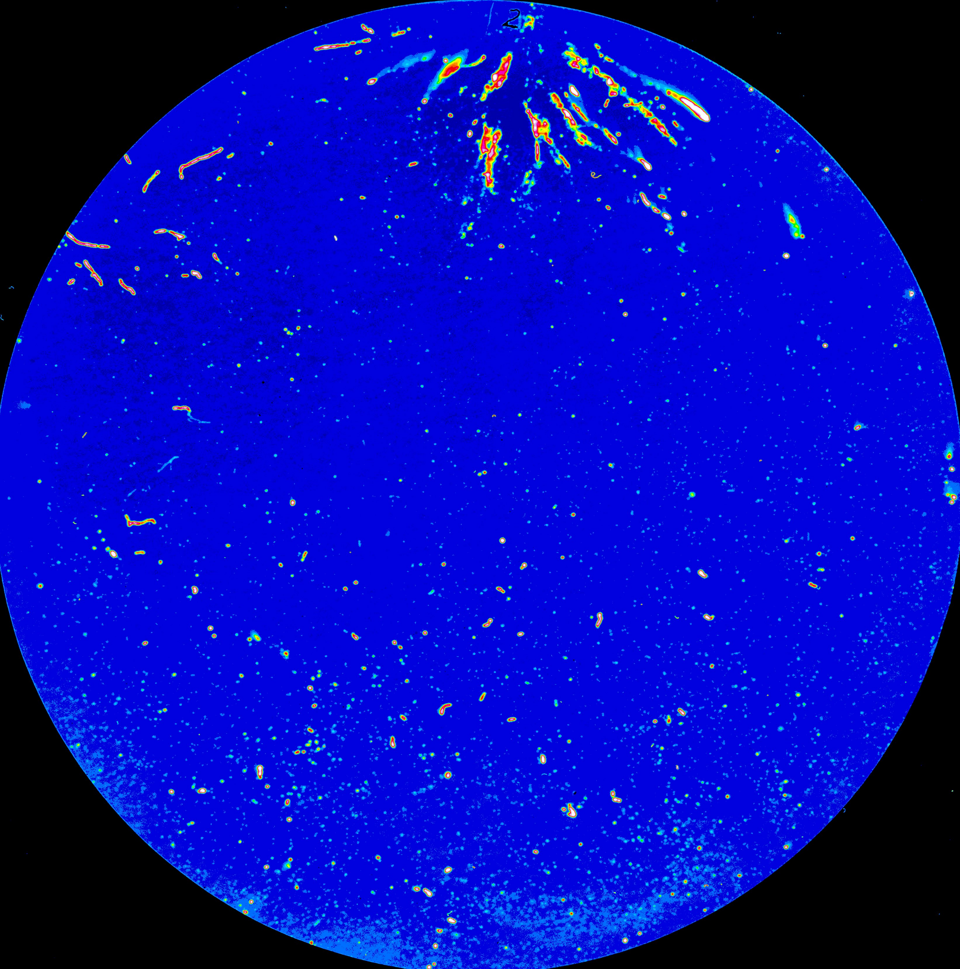

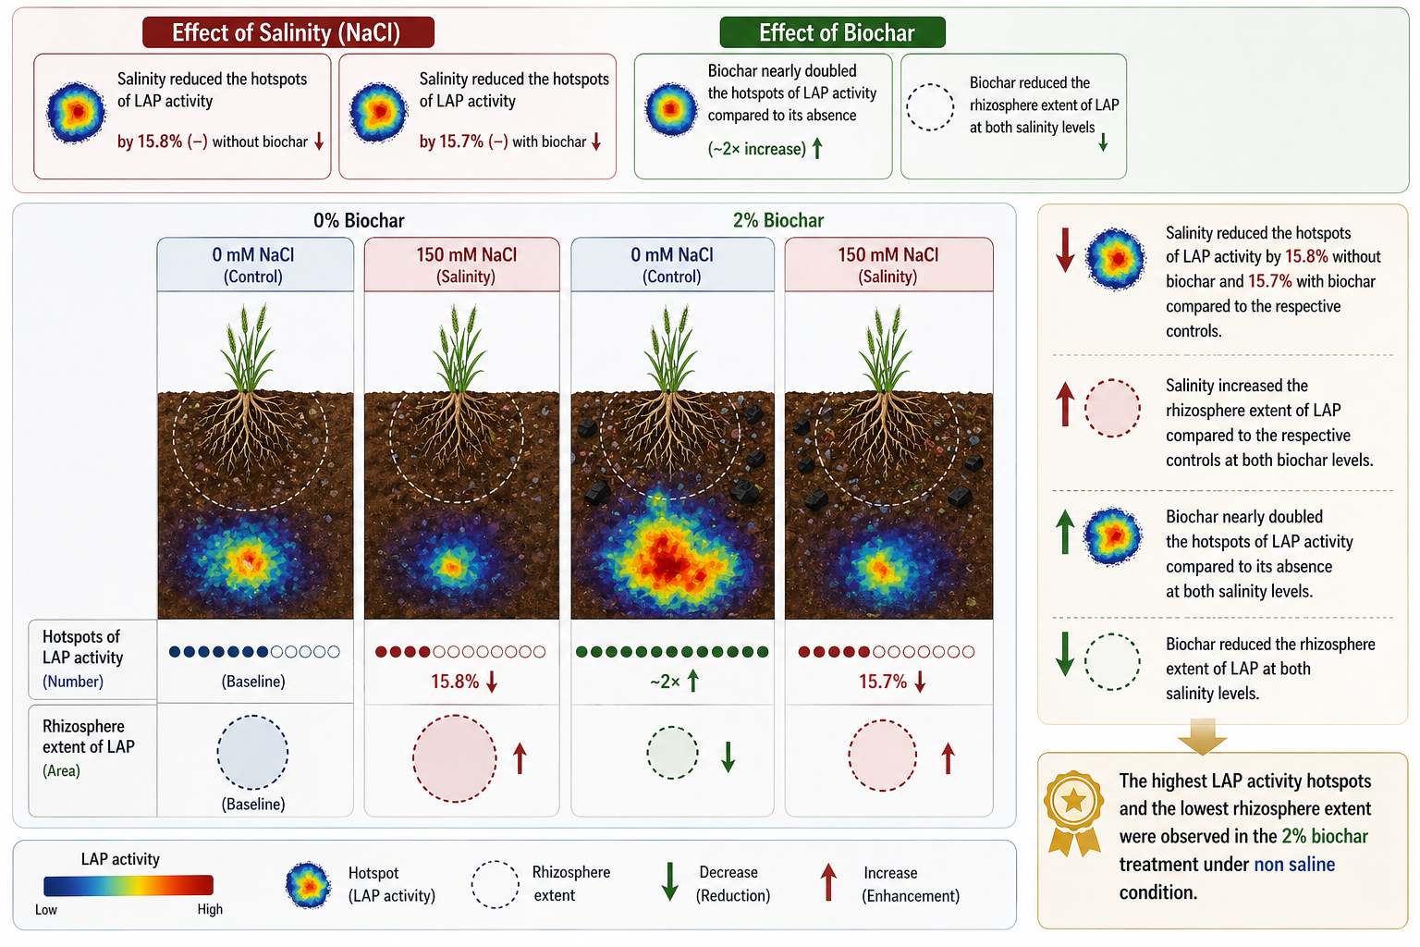
Methods-zymography
zymography workflow
Hotspots
Wheat in rhizobox, before zymography.
Polyamide membranes
Incubated with 12 mM enzyme-specific substrate solution in Trizma buffer
Image of the results captured using a Canon EOS camera
Outputs
1) Hotspots
2) rhizosphere extent
substrate
Areas where enzyme activity significantly exceeds background
From root center outward until enzyme activity is <20% above bulk soil
LAP
l-Leucine-7-amino-4-methylcoumarin

Slide 5
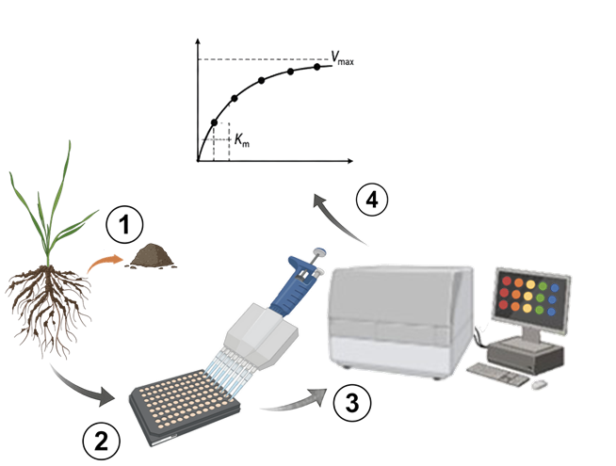
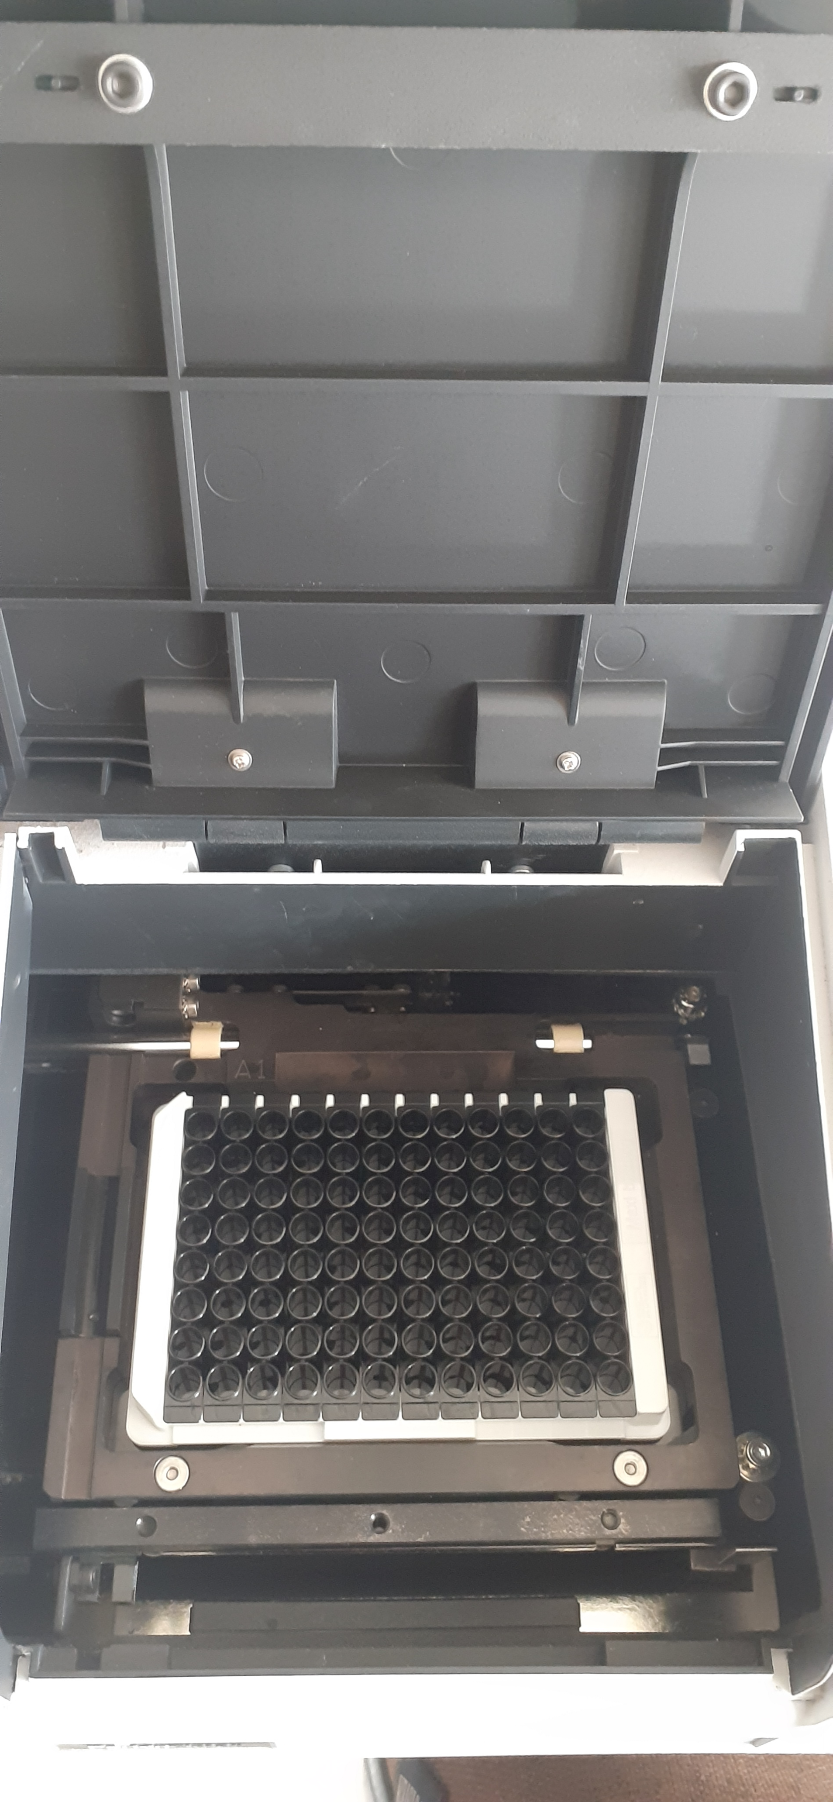
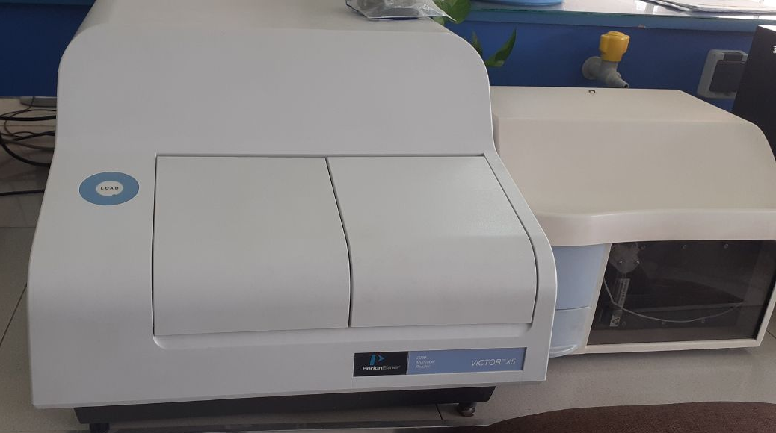



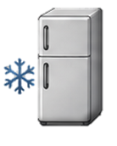


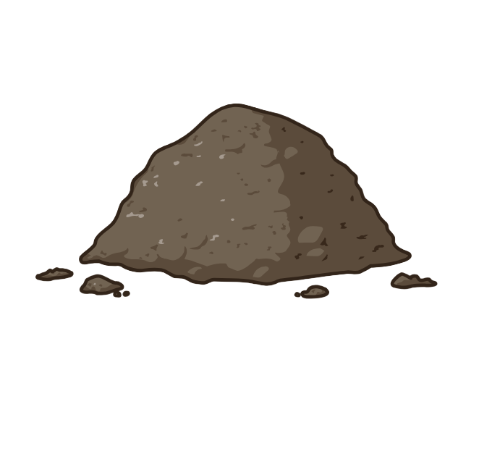
Methods-enzyme kinetics
Microplate workflow
Measurements were performed using a VICTOR X5 Multilabel Plate Reader (PerkinElmer, USA).
Fluorescence:
355 nm (ex) / 460 nm (em)
Rhizosphere Sampling
Outputs
1) V_{max}
2) K_{m}
Maximum reaction rate at substrate saturation
Substrate concentration at ½ V_{max}
Harvest wheat plants
Remove bulk soil
Collect rhizosphere soil
Store at 4 C until analysis
(total catalytic capacity)
(indicator of enzyme–substrate affinity(

Slide 6
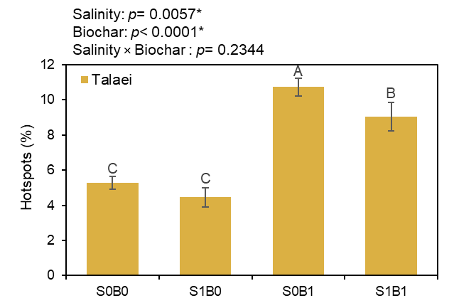
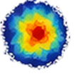




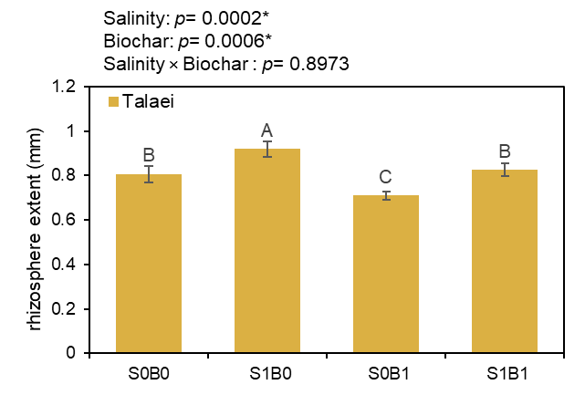

Results
Effect of salinity
Salinity reduced the hotspots of LAP activity
Salinity increased the rhizosphere extent of LAP
by 15.8% without biochar
by 15.7% with biochar
Effect of biochar
Biochar nearly doubled the hotspots of LAP activity
Biochar reduced the rhizosphere extent of LAP
the highest LAP activity hotspots and the lowest rhizosphere extent were observed in the 2% biochar treatment under non saline condition.

Slide 7
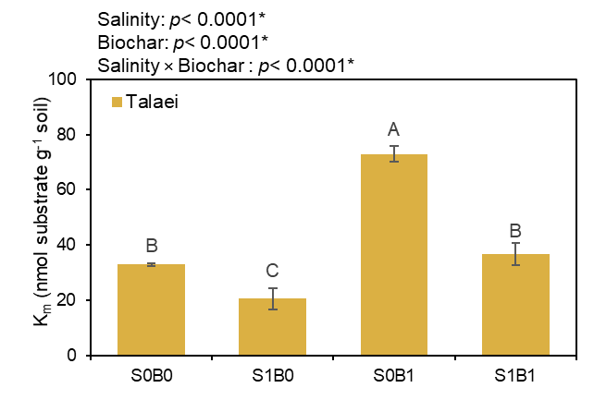
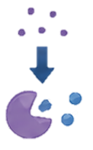

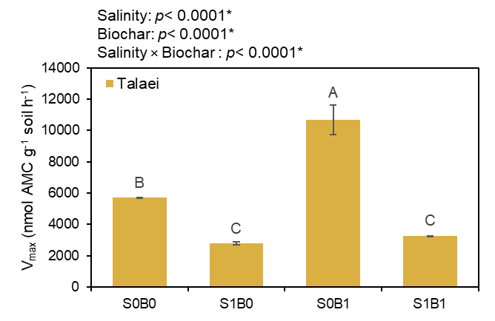
Results
Effect of salinity
Salinity increased enzyme affinity for substrate
Salinity decreased potential enzymatic activity
K_{m} decreased by 37.9% to 49.7%
Effect of biochar
Biochar decreased enzyme affinity for substrate
Biochar increased potential enzymatic activity
by a 1.8- to 2.2-fold increase in K_{m}
1.9 times higher than without biochar
The 2% biochar treatment under non-saline condition showed the highest Vmax and Km, while the non-biochar treatment under saline condition showed the lowest.

Slide 8
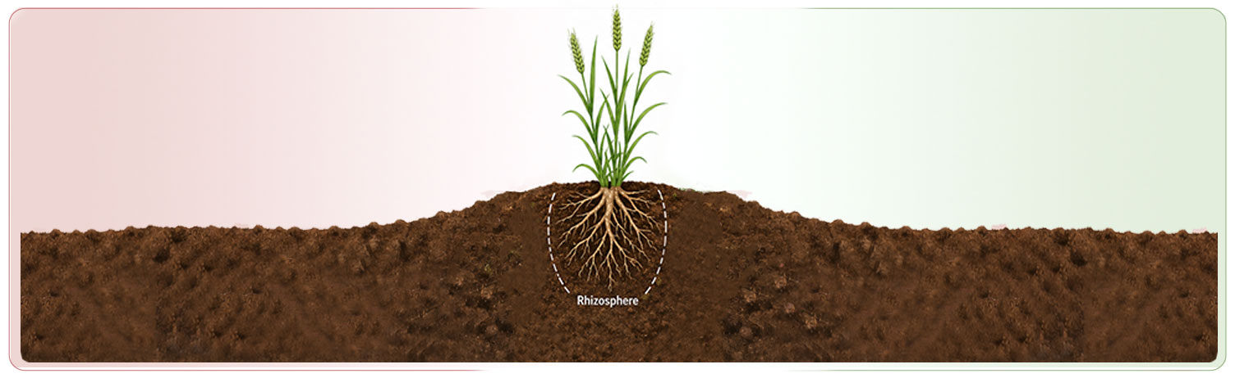
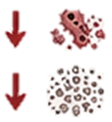





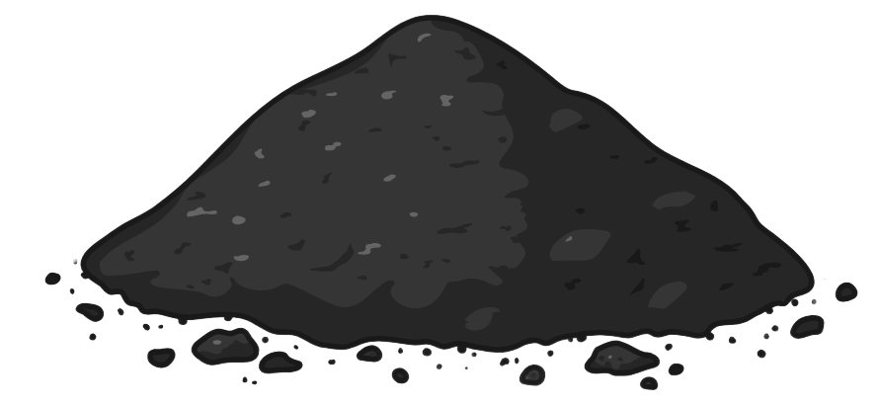
Discussion
Salinity imposes stress and reduces substrate supply
Biochar enhances microhabitat quality
Drives dispersed activity and high-affinity enzymes
VS
Stimulates activity and catalytic capacity
Overall improvement of rhizosphere functioning, but cannot fully counteract salinity
Overall inhibition of microbial metabolism and enzymatic efficiency
Biochar strengthens rhizosphere functioning but cannot fully offset
the inhibitory effects of salinity on microbial metabolism and enzymatic efficiency.
Cl⁻
Na⁺
Salinity
Biochar

Slide 9
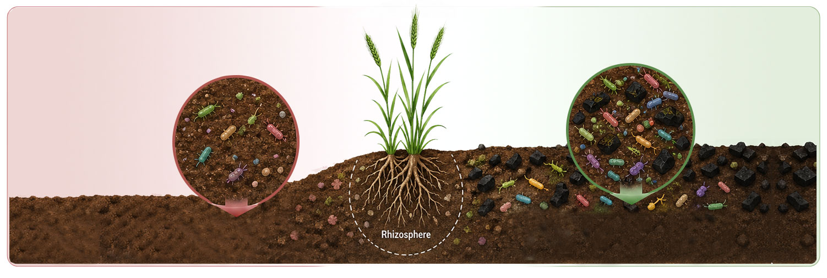





Summary
Biochar
Salinity
rhizosphere enzyme activity and microbial functioning
rhizosphere enzyme activity and microbial functioning
  Biochar partially alleviates but does not fully overcome salinity stress.
  2% biochar under non-saline (optimal) condition.

Slide 10
Acknowledgement
Sincere thanks to my supervisors and professors for their guidance, and to the Copernicus Meetings Team for their coordination.
Special gratitude to the audience for their attention.
Financial support: Ferdowsi University of Mashhad.
tahereeh.hozhabry@gmail.com

