Slide 1
TROPOMI + EarthCARE
Horizontal meets vertical to characterize UV-absorbing aerosols
6 May 2026, EGU Session AS3.14
KNMI: Deborah C Stein Zweers*, Annabel Chantry, Martin de Graaf, Maarten Sneep, Gerd-Jan van Zadelhoff & Emiel van der Plas
stein@knmi.nl
Royal Netherlands Meterological Institute, R&D Satellite Observations

Slide 2
Take Home Messages
Sentinel-5P/TROPOMI provides 8+ years of UV Aerosol Index data
    Can be readily combined with OMI, 20+ years (2004-present)
Daily global coverage, captures areal variability over time of regions of persistent and episodic aerosol emission due to:
    Smoke, desert dust, and volcanic ash, insensitive to presence of cloud
TROPOMI also provides a NIR Aerosol mid-height Layer product (ALH)
EarthCARE data provides high vertical resolution detailing aerosol and cloud optical properties for a narrow swath
    Identify composition (aerosol type, properties) of complex, multi-layered aerosol plume & cloud structures
TROPOMI gives horizontal context (plume origins) + complementary aerosol layer height information to highly resolved vertical slices by EarthCARE
https://portal.maap.eo.esa.int/ini/earthcare/timelineviewer/viewer/ https://maps.s5p-pal.com https://dataspace.copernicus.eu

Slide 3
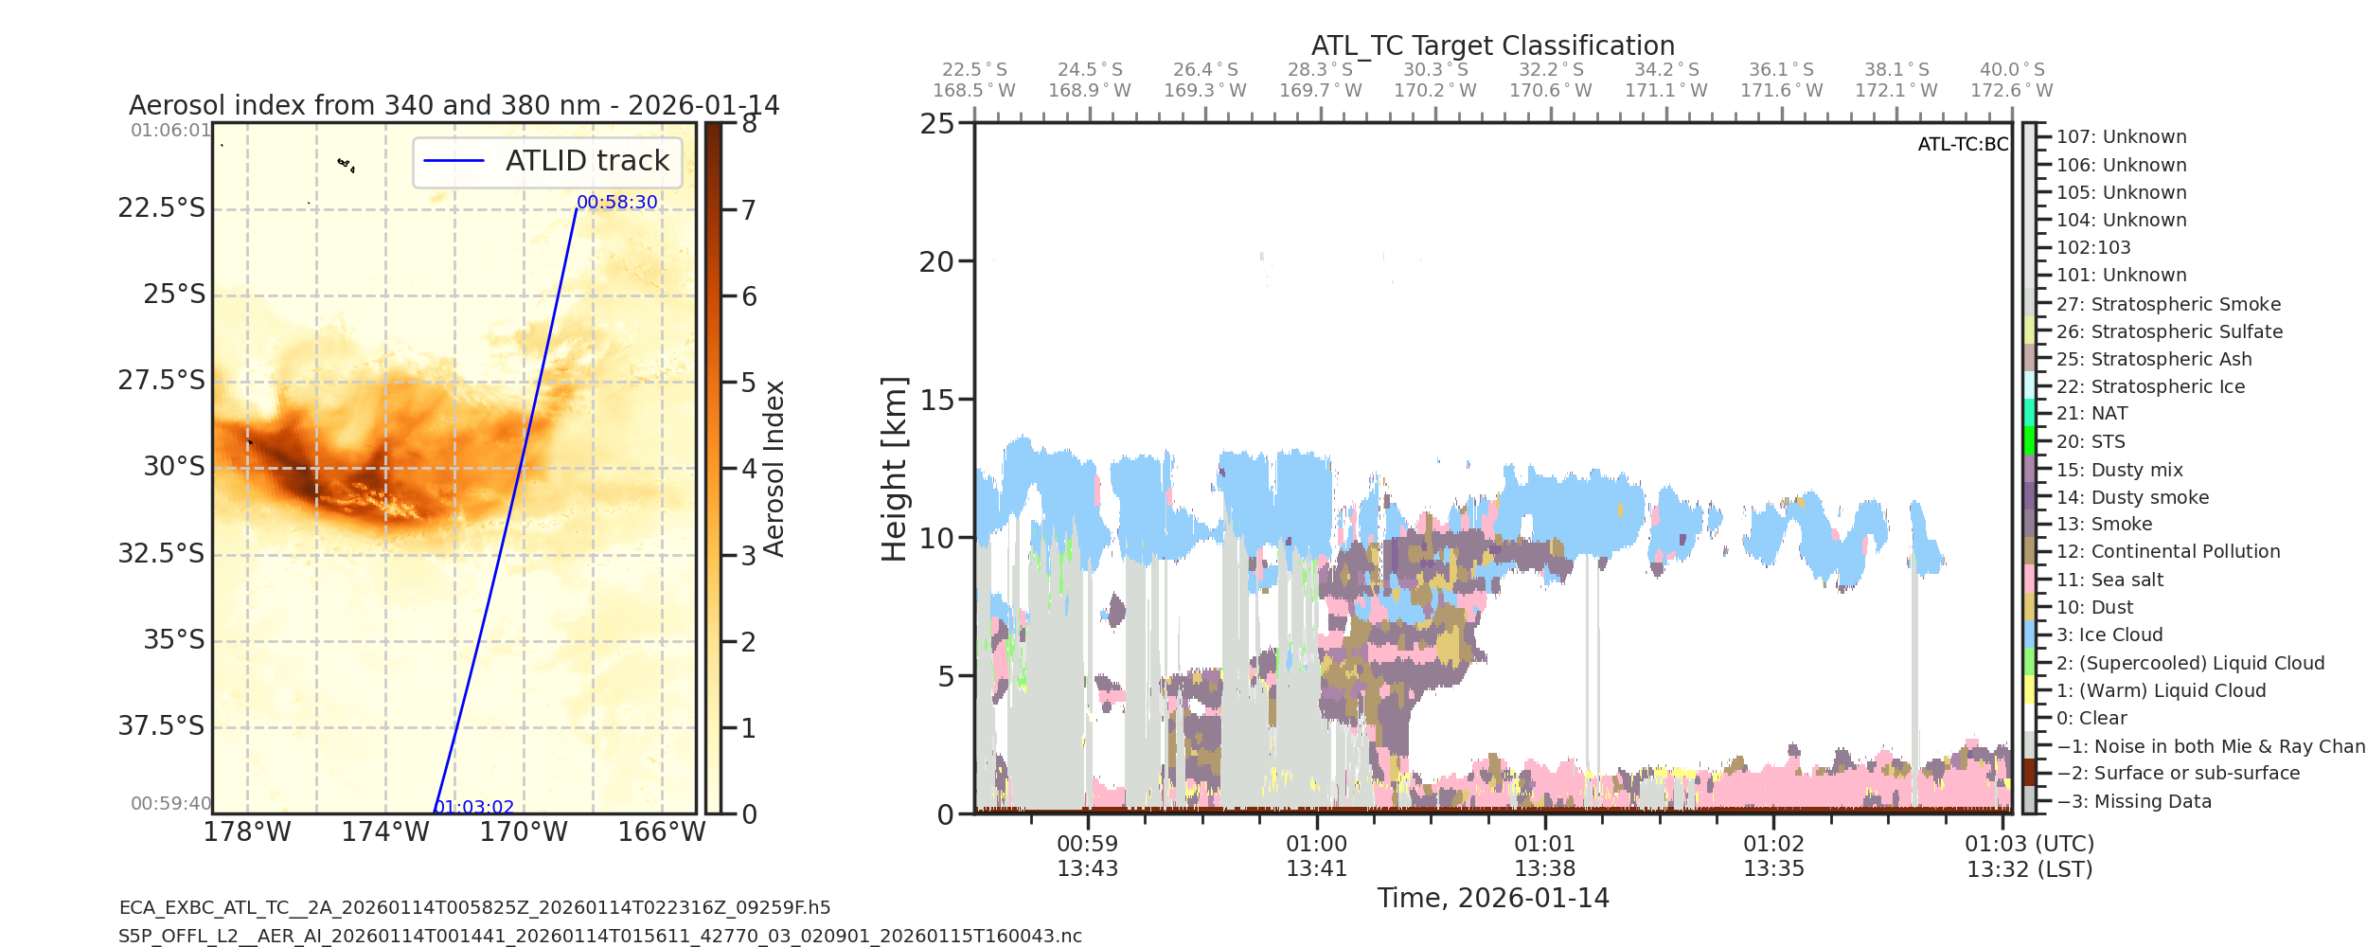
Overview of Case Study
Australian Wildfires : January 8-16, 2026
    Transport and plume evolution over NZ and the Pacific
Which data?
TROPOMI Aerosol Index 340/380 nm
TROPOMI Aerosol Mid-Layer Height, a centroid pressure (O2-A band)
    AS3.33, talk Martin de Graaf on Thursday morning detailing dust cases
SPEXone Aerosol Optical Thickness at 500nm
EarthCARE vertical slices from ATLID – Atmosperhic Lidar (ATL_EBD)
    Derived extinction at 355 nm
    Extinction to backscatter ratio at 355 nm
    Target classification → more than 15 key (tropospheric) types

Slide 4
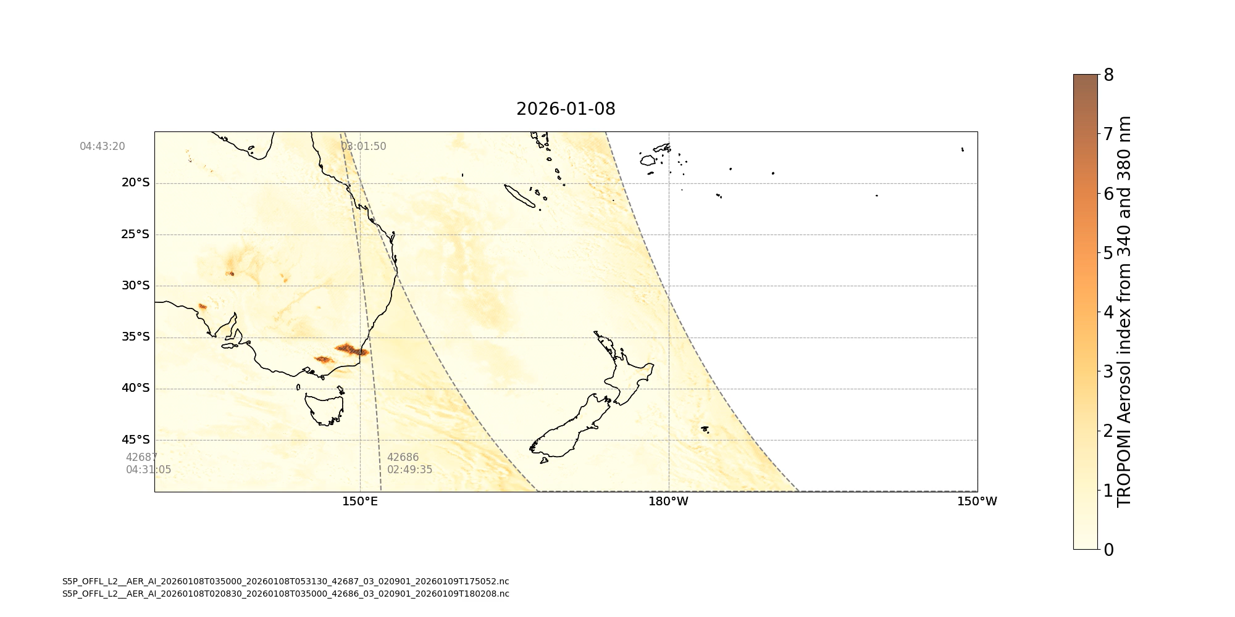
TROPOMI aerosol index: Jan 8-16 2026, Australian wildfires
Notes:
- TROPOMI provides horizontal and temporal context not available with EarthCARE only

Slide 5
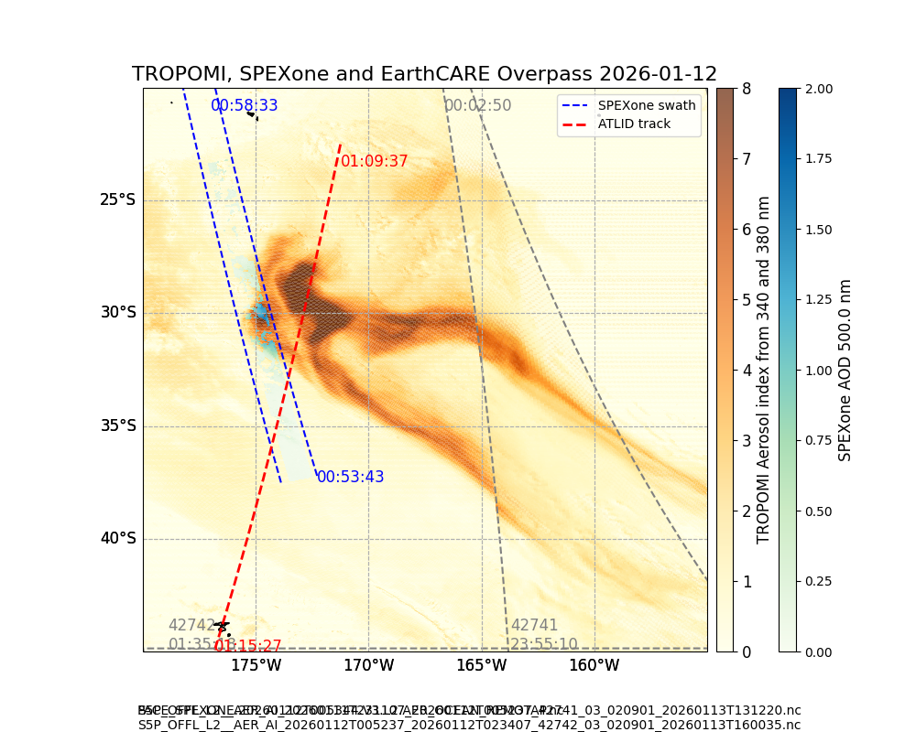
12 Jan 2026,
S5P/TROPOMI Aerosol Index
shows 2 distinct regions
Day 5
Aged smoke;
EarthCARE slice through thickest part of plume
SPEXone gives AOD₅₀₀ = 1.0-2.0
Notes:
TROPOMI shows interesting ‘tails’ to the plume
ATLID lidar ratio differentiates absorbing smoke from less absorbing sea salt layer below
ATLID aerosol target classification based on lidar ratio and depolarisation ratio
TROPOMI ALH gives information about aerosol in area where ATLID is attenuated (greyed out in the target classification)

Slide 6
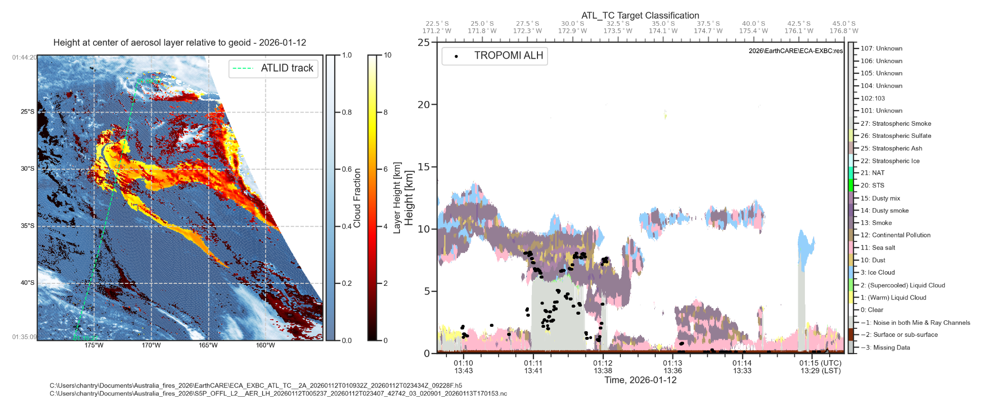
12 Jan 2026,
S5P/TROPOMI Layer Height &
Cloud Fraction
ALH indicates two distinct layers
~ 8 km & 4 km
EarthCARE slice appears to transect both regimes
Notes:
TROPOMI shows interesting ‘tails’ to the plume
ATLID lidar ratio differentiates absorbing smoke from less absorbing sea salt layer below
ATLID aerosol target classification based on lidar ratio and depolarisation ratio
TROPOMI ALH gives information about aerosol in area where ATLID is attenuated (greyed out in the target classification)

Slide 7
12 Jan 2026,
S5P/TROPOMI Layer Height (ALH) & Cloud Fraction
ALH indicates two distinct layers
~ 8 km & 4 km
EarthCARE slice appears to transect both regimes
Notes:
TROPOMI shows interesting ‘tails’ to the plume
ATLID lidar ratio differentiates absorbing smoke from less absorbing sea salt layer below
ATLID aerosol target classification based on lidar ratio and depolarisation ratio
TROPOMI ALH gives information about aerosol in area where ATLID is attenuated (greyed out in the target classification)

Slide 8
12 Jan 2026,
S5P/TROPOMI Layer Height &
Cloud Fraction
ALH indicates possible layers
~ 8 km & 4 km
Lowest values of ALH correspond to contamination from optically thin cloud
Notes:
TROPOMI shows interesting ‘tails’ to the plume
ATLID lidar ratio differentiates absorbing smoke from less absorbing sea salt layer below
ATLID aerosol target classification based on lidar ratio and depolarisation ratio
TROPOMI ALH gives information about aerosol in area where ATLID is attenuated (greyed out in the target classification)

Slide 9
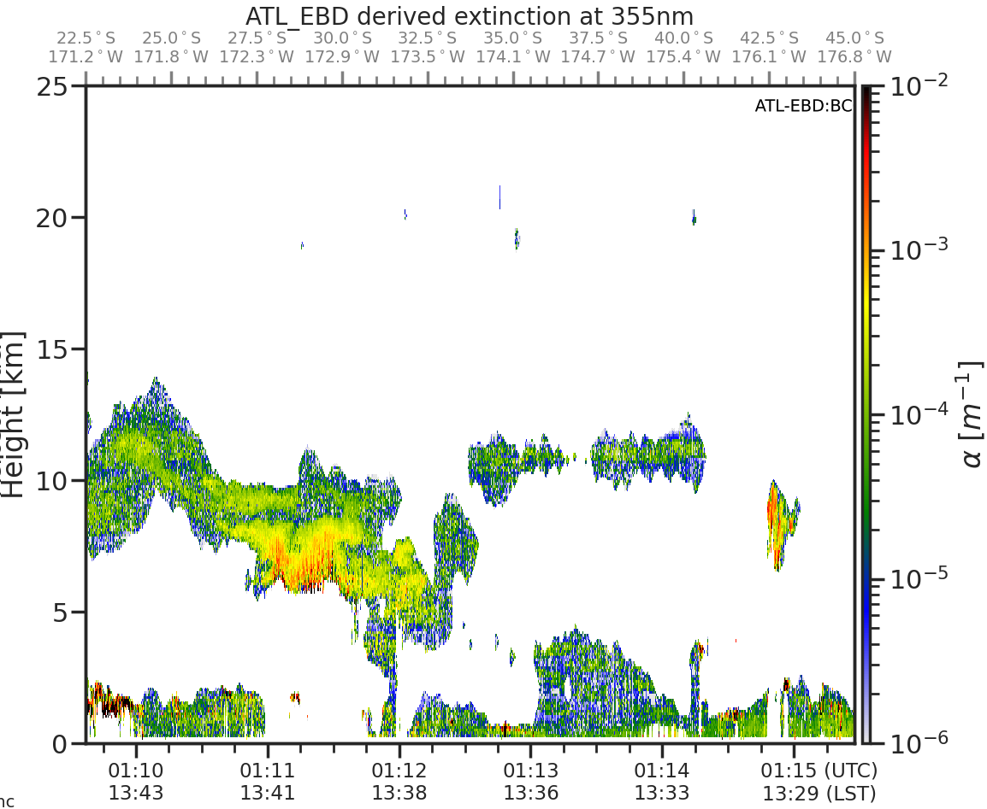
12 Jan 2026,
EarthCARE ATLID
Extinction at 355 nm
Thickest part has two distinct layer,
Upper at 8-9 km
Notes:
TROPOMI shows interesting ‘tails’ to the plume
ATLID lidar ratio differentiates absorbing smoke from less absorbing sea salt layer below
ATLID aerosol target classification based on lidar ratio and depolarisation ratio
TROPOMI ALH gives information about aerosol in area where ATLID is attenuated (greyed out in the target classification)

Slide 10
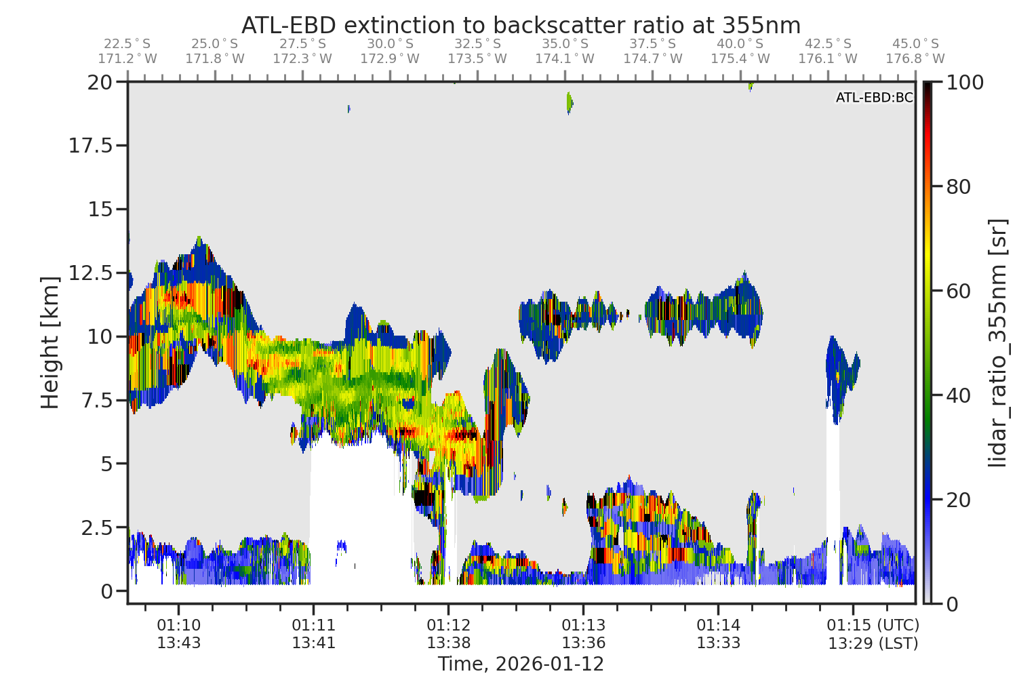
12 Jan 2026,
EarthCARE ATLID
Extinction to backscatter ratio at 355 nm
Notes:
TROPOMI shows interesting ‘tails’ to the plume
ATLID lidar ratio differentiates absorbing smoke from less absorbing sea salt layer below
ATLID aerosol target classification based on lidar ratio and depolarisation ratio
TROPOMI ALH gives information about aerosol in area where ATLID is attenuated (greyed out in the target classification)

Slide 11
12 Jan 2026,
EarthCARE ATLID
Target Classification
TROPOMI ALH mid-height captures info where EarthCARE is saturated
Second layer at ~ 4-5km
Notes:
TROPOMI shows interesting ‘tails’ to the plume
ATLID lidar ratio differentiates absorbing smoke from less absorbing sea salt layer below
ATLID aerosol target classification based on lidar ratio and depolarisation ratio
TROPOMI ALH gives information about aerosol in area where ATLID is attenuated (greyed out in the target classification)

Slide 12
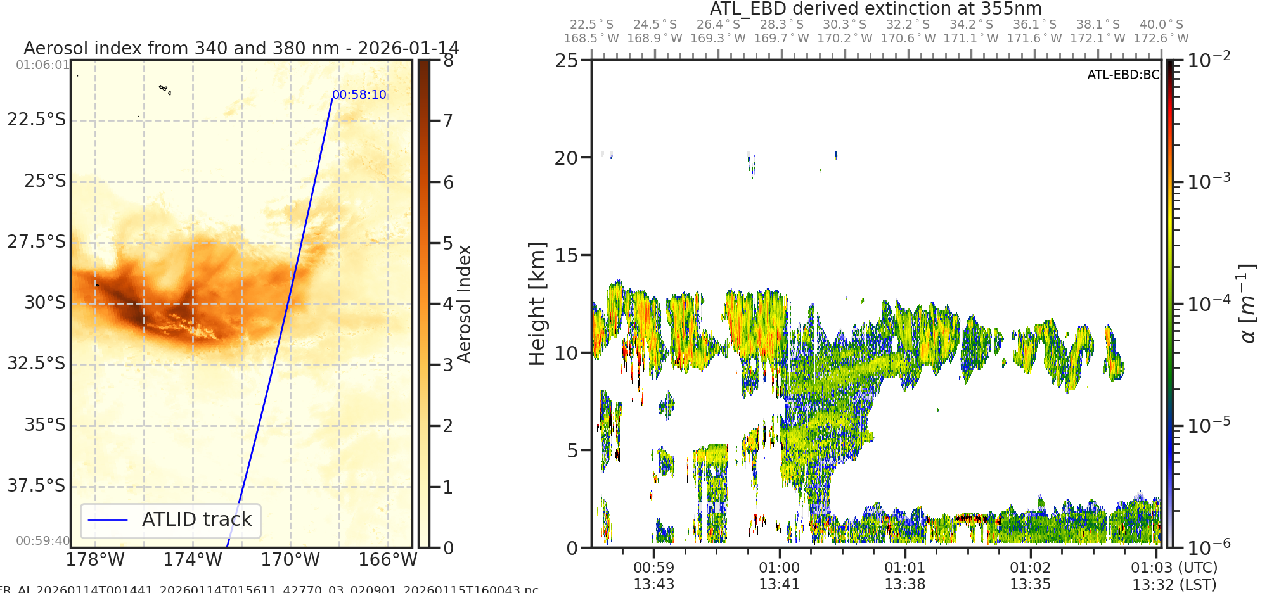
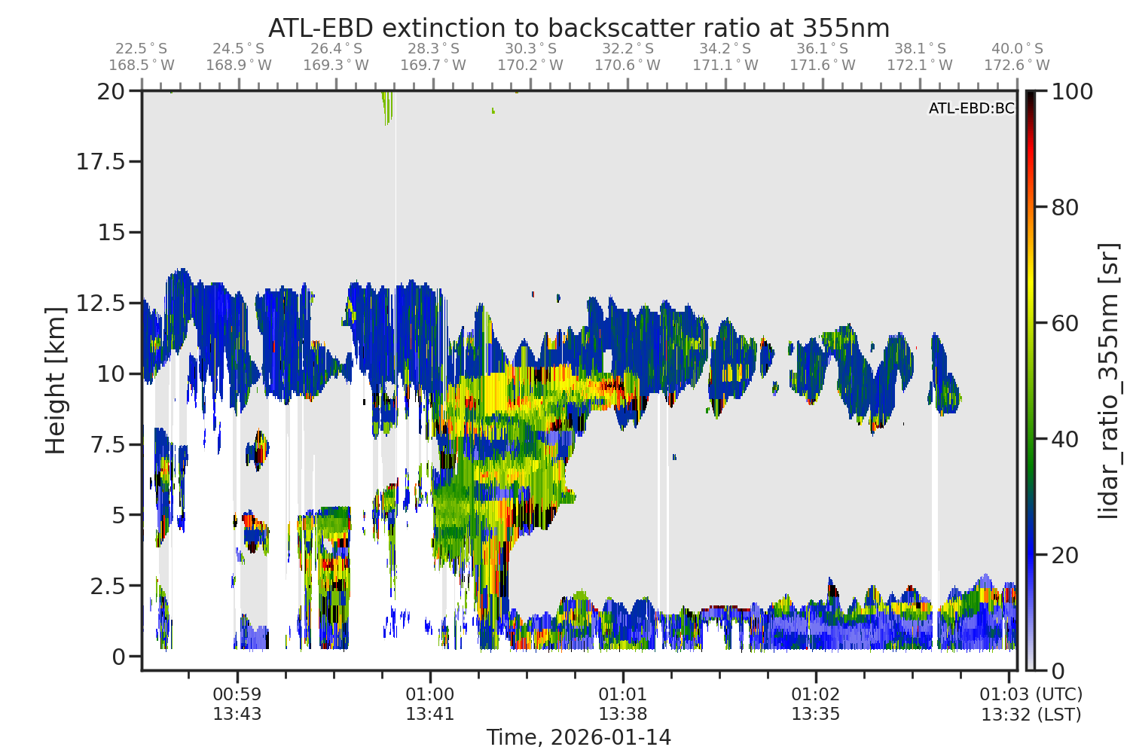
14 Jan 2026,
TROPOMI AER AI + EarthCARE ATLID
Day 7 of event; slice through seemingly diffuse part of plume, detailed vertical structure remains!
Notes:
ATLID separates ice cloud from absorbing aerosol
Both AAI and ATLID can see aerosol below thin cloud- unavailable from a conventional aod retreival

Slide 13
Recap: Take Home Messages
TROPOMI (+OMI) can establish the case-based and climatological context for radiatively important dust and smoke aerosol transport episodes and is greatly enhanced by EarthCARE vertical structure
Modeling studies show that the afternoon orbit time is vital for capturing plumes at peak fire activity, Sentinel 5 and 5P can work together to get global, diurnal information for better plume tracking
  TROPOMI - Sentinel 5-PM + Sentinel 5-AM
We are building up a catalog of TROPOMI + EarthCARE intersections, focusing on ATLID data to systematically evaluate height and optical properties for target regions of persistent emission (smoke vs dust)
  Examine the relationship of aerosol index to SSA and height
  Better describe TROPOMI ALH dependencies

Slide 14
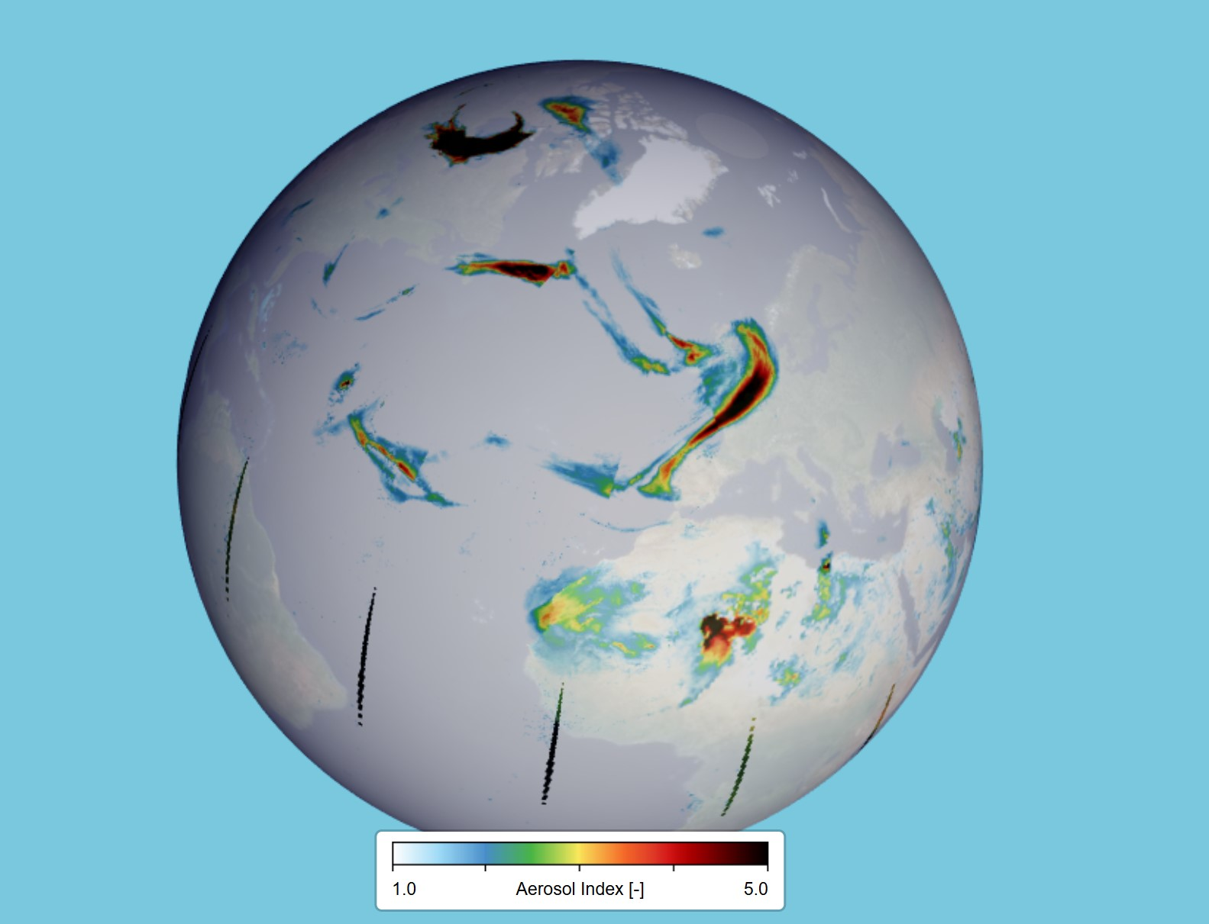
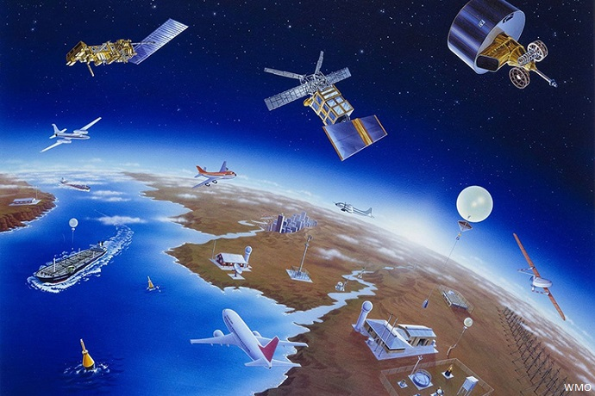
Thank you for your attention! Any Questions?
Visualize the combined perspective of aerosol measurement from multiple missions! Try it out yourself …. https://portal.maap.eo.esa.int/ini/earthcare/timelineviewer/viewer/ https://maps.s5p-pal.com https://dataspace.copernicus.eu
Feel free to contact me: stein@knmi.nl www.tropomi.eu

Slide 15
Open Data Links for Visualization & Download
Mapping portal for S5P Operational data products
https://maps.s5p-pal.com
Data (download) portal for L2 and L3 S5P operational and research data products
https://data-portal.s5p-pal.com
Copernicus Dataspace Ecosystem – the official source for all TROPOMI Level 1 (radiances) and Level 2 (trace gases etc) data
Includes browsing, visualization and download options
https://dataspace.copernicus.eu/explore-data/data-collections/sentinel-data/sentinel-5p

Slide 16


Acknowledgements
TROPOMI efforts funded by:
  Netherlands Space Office (NSO)
  European Space Agency (ESA)
https://www.tropomi.eu
Instagram: knmi_nl
Twitter: @tropomi
Notes:
Today I want to tell you about the Aerosol Index, a well-known data product useful for mapping and tracking UV absorbing aerosol, I don’t just want to show you nice plots including comparisons with OMI, but I want to show you how you can use tools and information to use and analyze the data yourself.

Slide 17
14 Jan 2026,
TROPOMI AER AI + EarthCARE ATLID
Day 7 of event; slice through seemingly diffuse part of plume, detailed vertical structure remains!
Notes:
ATLID separates ice cloud from absorbing aerosol
Both AAI and ATLID can see aerosol below thin cloud- unavailable from a conventional aod retreival

Slide 18
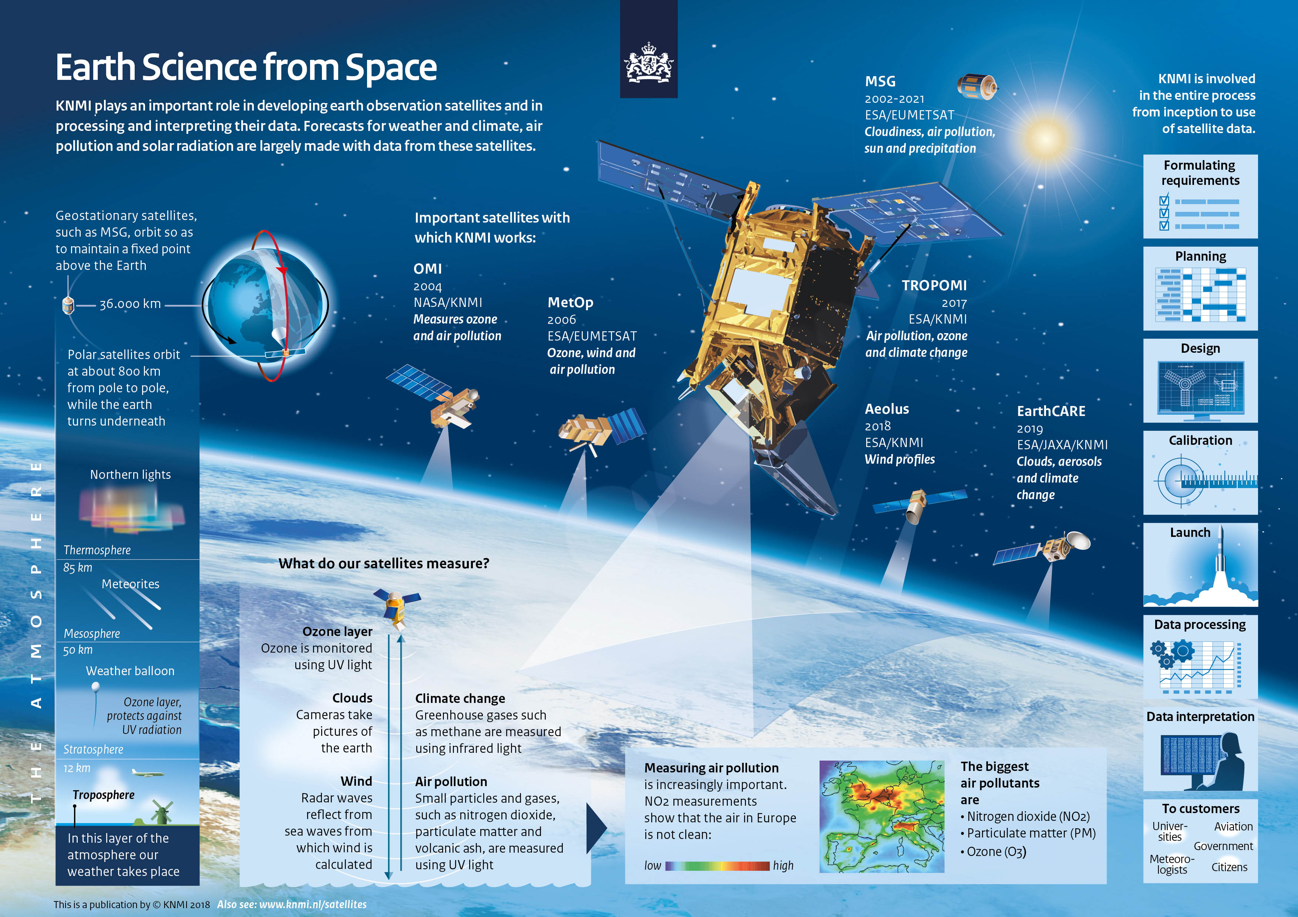
KNMI – Royal Netherlands Meteorological Institute: R&D Satellite Observations Department

