Slide 1


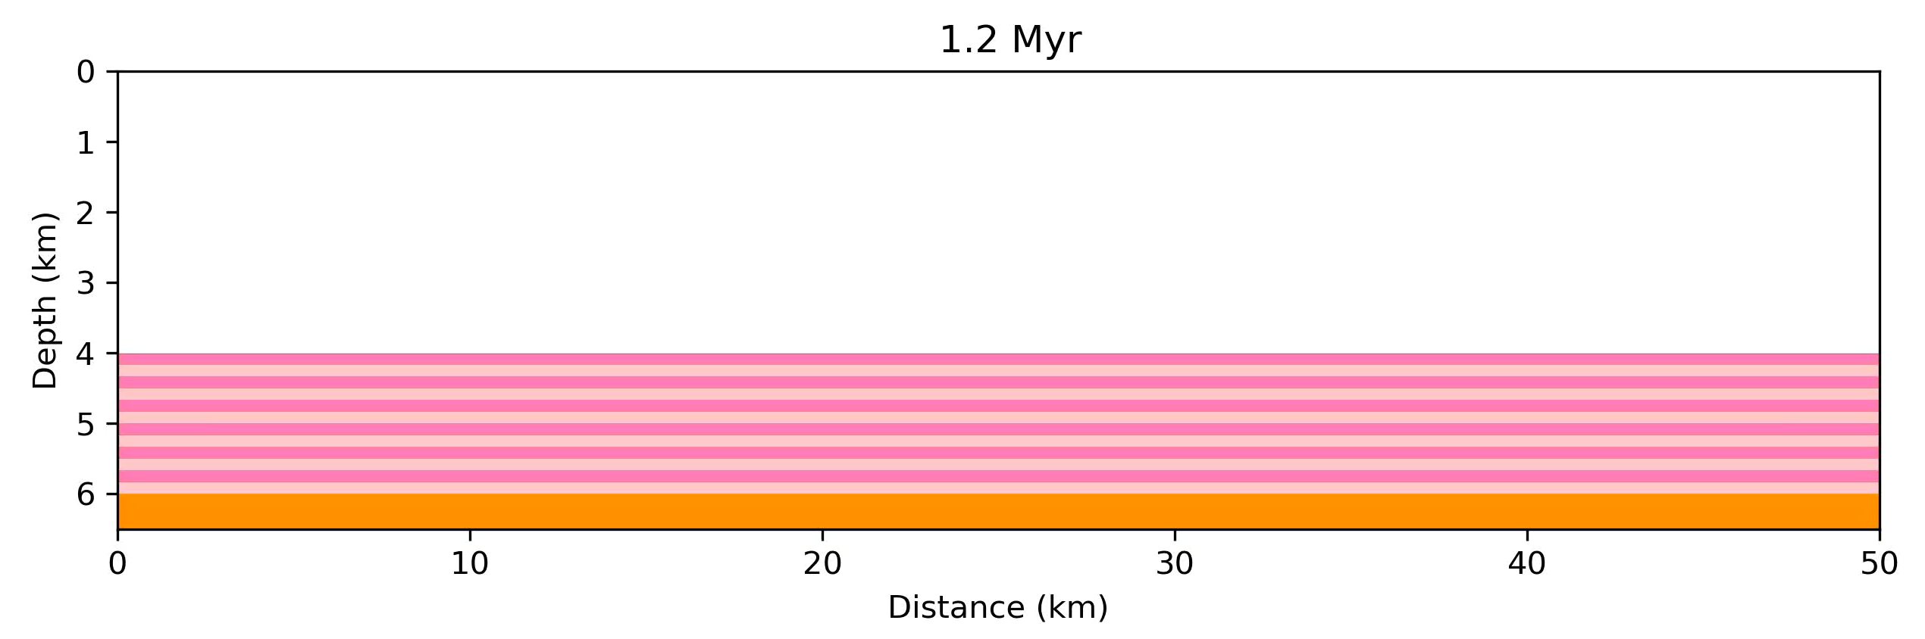
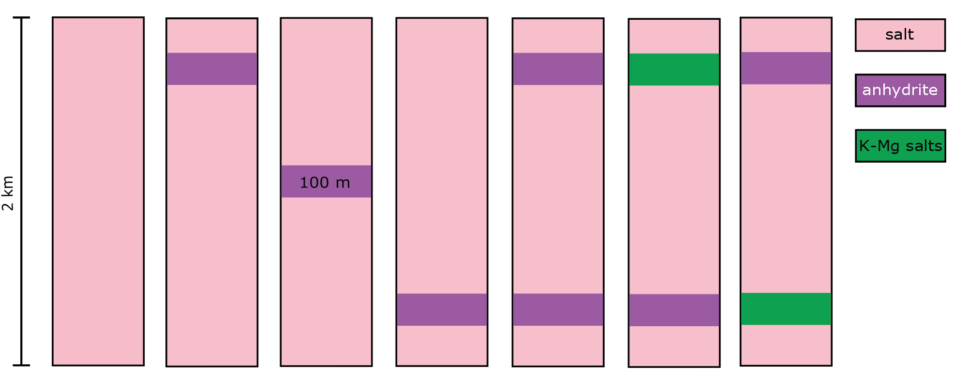
EXTRA: Homogeneous salt

Slide 2


M1: Upper Anhydrite

Slide 3
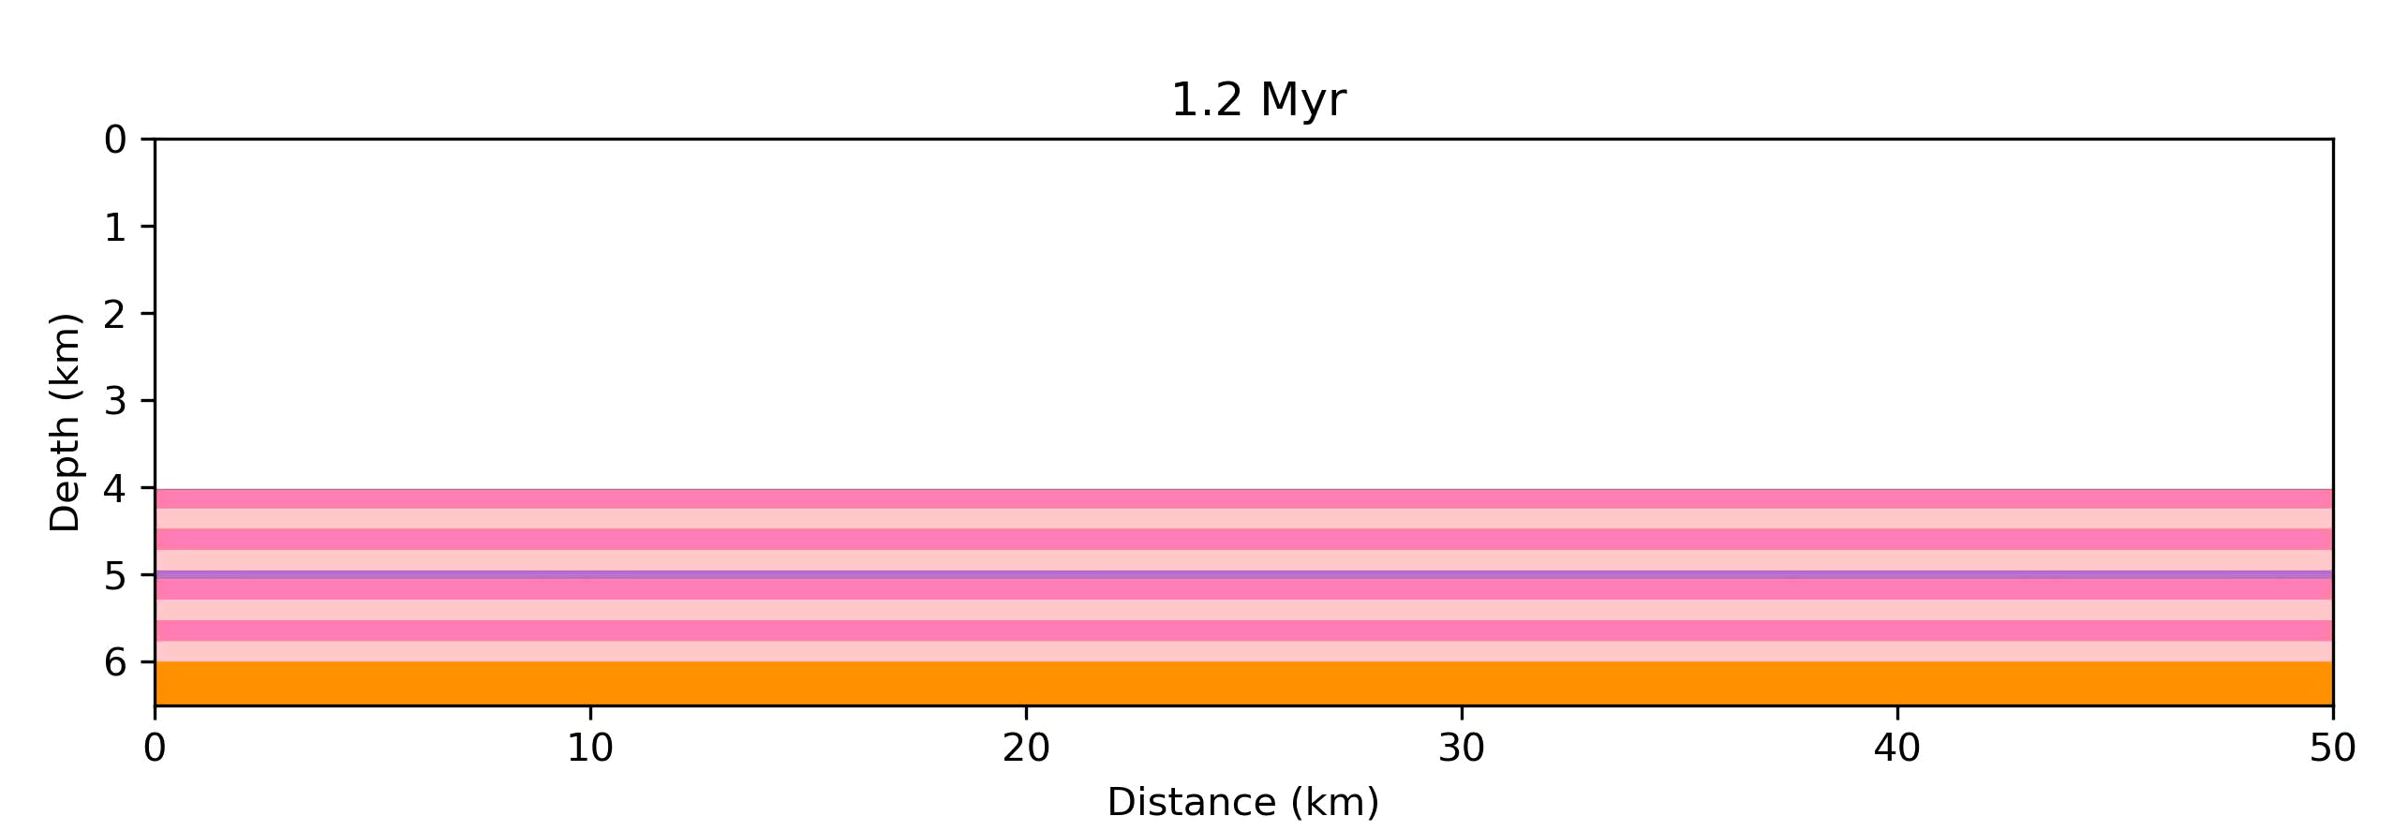
M2: Middle anhydrite

Slide 4

M3: Lower Anhydrite

Slide 5

M5: Upper & Lower Anhydrite (low agg.)

Slide 6

M4: Upper K-Mg & Lower Anhydrite

Slide 7

M6: Lower K-Mg & Upper Anhydrite

