Slide 1
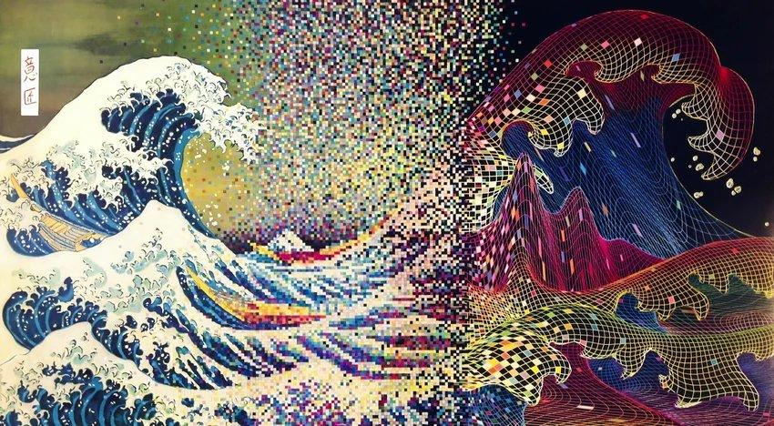
Fast Screening of Dispersion-Sensitive Tsunami Waves
For Early Warning and Hazard Mapping Rayan Malik and Costas Synolakis

Slide 2

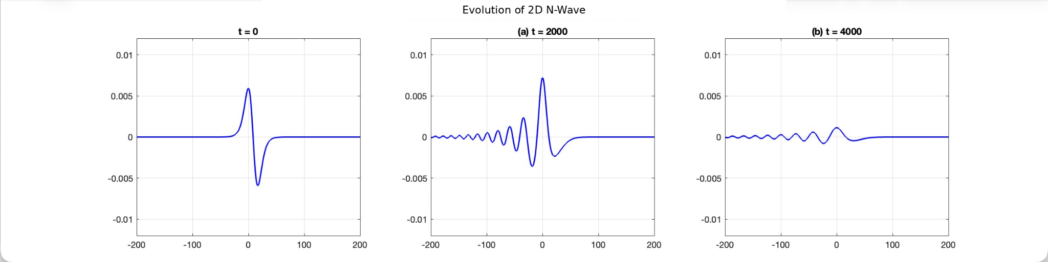
What is Dispersion?
Different wavelengths traveling at different speeds
The same physics applies to tsunamis crossing the ocean
Over thousands of kilometers, they separate
What started as one wave becomes a train of many
Notes:
The same physics applies to tsunamis crossing the ocean. A single pulse of water from an earthquake contains many wavelengths bundled together. Over thousands of kilometers, they separate — what started as one wave becomes a train of many.

Slide 3
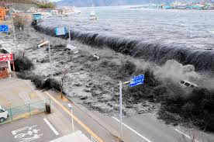
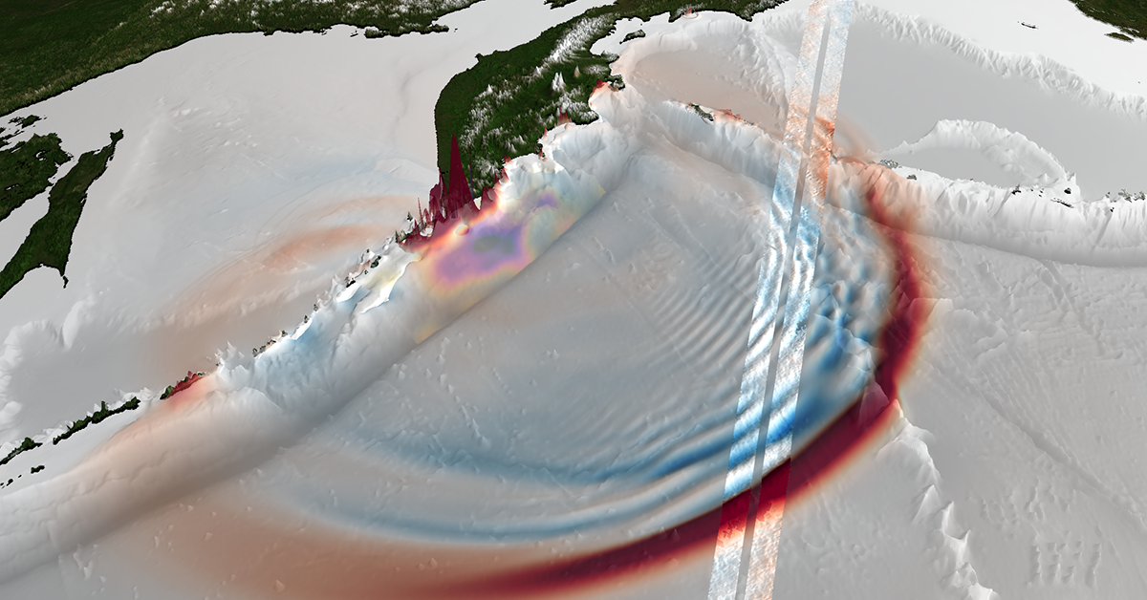
Why Dispersion Matters for Tsunamis
Arrival times shift
Leading waves may arrive earlier, dangerous waves keep coming hours after the forecast window closes.
Multiple waves instead of one
Later waves after the “first wave” can be just as dangerous.
Wave heights change
Sometimes dispersion reduces peaks. Or, it can concentrate energy and increase flooding.
Harbor resonance
A dispersed wave train contains many frequencies. Water amplifies dramatically in locations predicted as safe.
Non-dispersive models assume the wave keeps its shape from source to coast. When that assumption is wrong, the forecast is wrong.
Notes:
Dispersion changes what arrives at the coast — and standard forecasting tools can't see it.

Slide 4
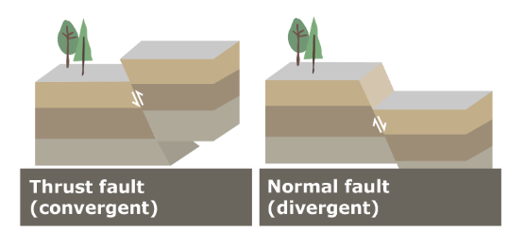
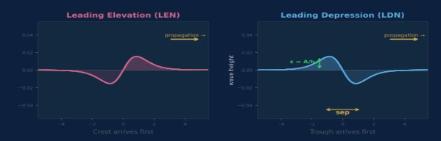
[ Insert fault diagram ]
Showing seafloor uplift on one side,
subsidence on the other,
water displaced into N-shape
NOAA or USGS public domain
What is an N-wave?
How a fault creates an N-wave
When it ruptures, one side of the seafloor rises and the other drops.
This creates two lobes of water displacement. Paired shape propagates outward as an N-wave.
Parameters defining the wave:
ε = amplitude ÷ water depth (how tall)
sep = crest-to-trough distance (how wide)
polarity = which side leads

Slide 5
How Do We Model Tsunamis?
Shallow Water Equations (MOST)
Boussinesq Equations (COULWAVE)
Assumes all wavelengths travel at the same speed
Fast — runs in minutes
Accurate when waves are long relative to ocean depth
Used by NOAA for operational tsunami forecasting
Includes wavelength-dependent speed differences
Slow — runs in hours
Captures wave break-up, trailing oscillations, energy redistribution
Needed when short-wavelength components carry significant energy
The operational problem
Forecasters have minutes to decide which model to run. COULWAVE is more accurate when dispersion matters, but computationally expensive. How do you know which one to use before running either?

Slide 6
Previous Work on Tsunami Dispersion
Glimsdal et al. (2013)
"Dispersion of tsunamis: does it really matter?"
They proposed a single screening metric:
Their main finding: short-wavelength sources (landslides, volcanic collapses) disperse significantly. Great Mw 9+ earthquake tsunamis generally do not.
τ = h₀²t / (6L³)
h₀ = water depth t = travel time L = wavelength
This insight is correct — our 4,000 simulations confirm it.
What's missing
Polarity ignored
Wavelength ambiguous
Linear theory only
τ gives the same answer whether the trough or crest arrives first.
How do you measure the "wavelength" of an N-wave?
Glimsdal's τ is derived from linear wave theory — it ignores how wave amplitude affects dispersion.
Notes:
As we showed in slide 4, a tsunami propagates as an N-wave — one side leads with a trough (LDN), the other with a crest (LEN). These behave completely differently. Our finding: LDN disperses up to 7.6× faster than LEN.
We resolved this with a new method: characteristic wavelength (λ_c) . The KdV equation captures these nonlinear effects.
Different reasonable methods (crest half-width, full span, spectral peak) give answers that differ by 2–3×. Since τ scales as L⁻³, that means 8–27× error in the screening result.
Nonlinear effects drive soliton formation, the polarity asymmetry, and the consolidation-reversal. None of this appears in a linear model.

Slide 7
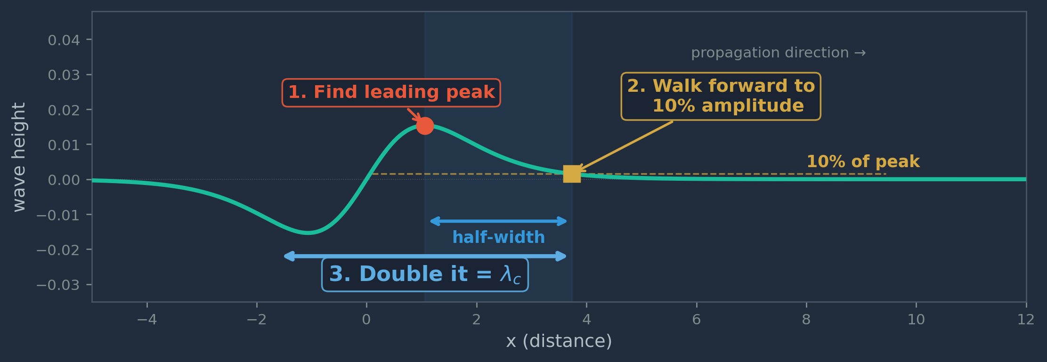
Characteristic Wavelength (λ_c)
1
Find the leading peak
Locate the highest point of the wave's leading feature
2
Walk forward to 10% decay
Move in propagation direction until amplitude drops to 10% of peak
3
Double the distance
This gives λ_c — the characteristic wavelength of the leading pulse
Why this matters
The problem
What λ_c gives us
An N-wave doesn't have a single clean wavelength like a sine wave. It's a bipolar pulse with asymmetric lobes.
Works for both initial condition families.
Tracks the actual spectral content of the leading pulse.
Eliminates the sensitivity in Glimsdal's wavelength
Notes:
10% threshold: high enough to ignore dispersive tails that have already formed, low enough to capture the full energy footprint of the pulse. Similar decay-threshold approaches exist in radar and laser physics — this application to tsunami N-waves is new.
Defines k_split = 2π/λ_c — cleanly divides the spectrum into "original wave" vs "dispersive components."
Reasonable measurement methods give different answers

Slide 8
Our Approach
1
2
3
Simulate
Detect
Learn
→
→
Build a comprehensive dataset of how N-waves evolve under nonlinear dispersive physics.
4000 simulations, 2 ICs, 2 polarities, wide parameter range
Track how spectral energy moves from low frequencies to high frequencies over time.
“Disp-metric”: measures what fraction of the wave’s energy has shifted to short wavelengths
Train a gradient boosting model on the simulation results.
The model learns to predict, from 5 initial wave parameters, whether dispersion
will occur
when it starts
how much energy transfers
Earthquake parameters in → routing decision out, in under one second.
Notes:
This builds a comprehensive dataset of how N-waves evolve under nonlinear dispersive physics.
Run 4,000 KdV wave simulations covering two initial condition families, two polarities (LDN and LEN), and a wide parameter range across ε and sep.
We define a new metric — disp-metric — that measures what fraction of the wave's energy has shifted to short wavelengths. When this fraction grows past a threshold, dispersion has started.

Slide 9
The KdV equation
The PDE that governs how the wave evolves over time. First derived by Boussinesq (1877), rediscovered by Korteweg & de Vries (KdV) (1895)
u_t + u_x + (3/4)(u²)_x + (1/6)u_xxx = 0
Emerges from the full Euler equations under two assumptions: weak nonlinearity (ε = A/h₀ ≪ 1) and weak dispersion (μ = (h₀/λ)² ≪ 1)
u_x
(3/4)(u²)_x
(1/6)u_xxx
Linear advection
Nonlinear steepening
Frequency dispersion
The wave moves forward at a constant speed. No shape change.
Taller parts of the wave travel faster. Wave fronts steepen. This drives spectral energy transfer.
Shorter wavelengths travel slower. Dispersive tails form behind the main pulse.
ε = A / h₀
(wave amplitude ÷ water depth)
This ratio controls the balance between steepening and dispersion.
Notes:
Below ε ≈ 0.002, nonlinearity is too weak — the wave propagates unchanged. Above that, the wave's fate depends on its shape.

Slide 10
Initial Wave Conditions
Family 1: Coupled
Hammack & Segur (1974)
u₀ = ±A·sech²(γ·x₁) ∓ A·sech²(γ·x₂) where γ = √(3ε/4)
The width parameter γ is locked to the amplitude
Family 2: Decoupled
Tadepalli & Synolakis (1994), modified
η = ±C·sech²(γ·x)·tanh(γ·x) where γ = 1.5/sep, C = ε/0.4
Width and height are independent
Why use both?
ML training purposes. Family 1 is theoretically clean but unrealistic; real tsunamis don't couple width to amplitude. Family 2 matches the physics of real earthquake sources.
Notes:
Two N-wave families from the literature — each tests a different physical regime
Family 1 compresses the polarity asymmetry because the width is locked to amplitude. When you increase ε, the wave gets narrower at the same time — the two effects partially cancel. The 7.6× polarity ratio only appears when width and amplitude are free to vary independently (Family 2).
This means the coupled family underestimates the importance of polarity. If Glimsdal had tested with decoupled waveforms, he might have discovered the asymmetry.
If our ML model works on both, it's more likely to generalize to the messy, non-idealized waves that real earthquakes produce.
Two soliton-shaped pulses placed side by side. The width parameter γ is locked to the amplitude ε — taller waves are automatically narrower.
Width and height are independent. This matches real tsunamis: wavelength is set by fault geometry, amplitude by seafloor displacement.

Slide 11
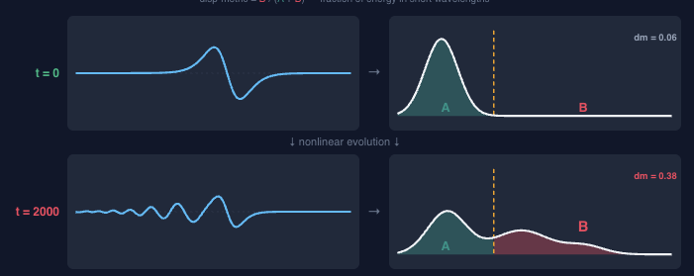
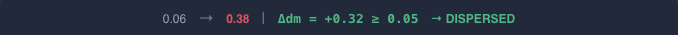
Detecting Dispersion Onset
How do we know when a wave has started to disperse?
1
Measure λ_c
2
Set k_split = 2π / λ_c
3
Track disp-metric
4
Δ(d-m) ≥ 0.05 triggers
Find the characteristic wavelength of the leading pulse.
→
Below k_split is the "original wave," above is "dispersive components."
→
Compute what fraction of total spectral energy sits above k_split.
→
When ≥ 0.05 from its initial value, dispersion is significant.
Notes:
Glimsdal’s τ is a single number from linear theory. It doesn't track evolution — it predicts a threshold. Disp-metric watches the wave evolve in real time and measures the actual energy redistribution.
Why spectral, not spatial? : We tested 5 spatial detection methods (windowed amplitude tracking). All were wave-type-dependent — "where to look" changes between LDN and LEN. Spectral detection uses the full domain FFT and works identically for all wave types.
What disp-metric measures
We take the full-domain FFT of the waveform at each diagnostic time step. The power spectrum is split at k_split into low-k (original wave structure) and high-k (dispersive components). The disp-metric is the ratio of high-k energy to total energy.
When energy moves from low-k to high-k → the wave is breaking apart into shorter wavelengths → dispersion is happening.

Slide 12
The Simulation Dataset
 | IC Family | Wave Classes | ε Range | sep Range | Cases
Batch 1 | Coupled (Hammack & Segur) | LDN, LEN, Symmetric | 0.005 – 0.025 | 20 – 60 | 1,500
Batch 2 | Decoupled (Tadepalli & Synolakis) | S-LDN, S-LEN | 0.001 – 0.025 | 50 – 300 | 2,500
Combined | Both | 5 classes | 0.001 – 0.025 | 20 – 300 | 4,000
10⁻⁷
97%
7.6×
energy conservation
S-LDN dispersion
trigger rate
max polarity
asymmetry ratio
Sampling: maximin Latin Hypercube design. Full spectral snapshots at t = 0, 250, 500, 1000, 1500, 2000, 3000, 4000, 5000.
Dispersion trigger rates
S-LDN: 97% trigger — nearly every trough-first decoupled wave disperses. S-LEN: 48% trigger — many crest-first waves consolidate instead of dispersing.

Slide 13
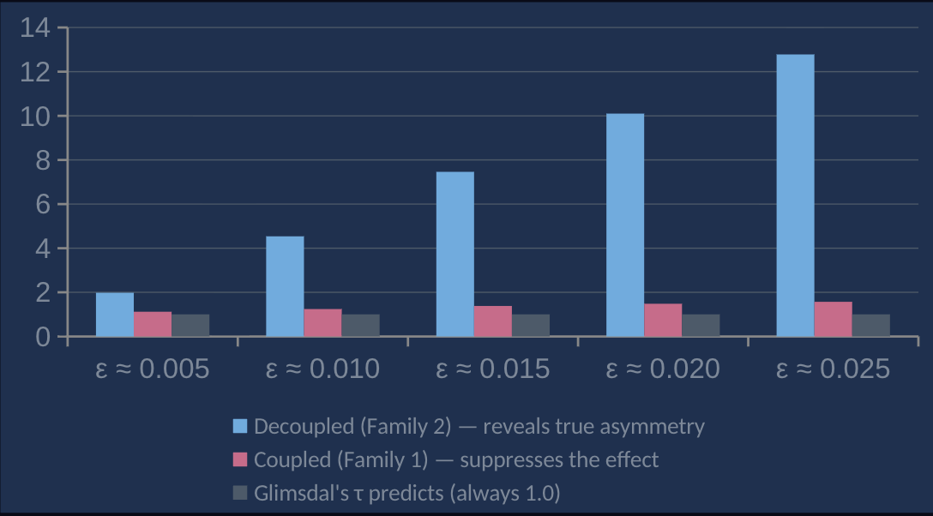
Key Finding: The Polarity Asymmetry
Trough-first (LDN) waves disperse dramatically faster than crest-first (LEN)
Why the asymmetry grows with ε
At low ε
nonlinear effects are weak
both polarities behave similarly (linear regime)
As ε increases
the nonlinear term (3/4)(u²)_x grows
For LDN, it drives energy to higher frequencies
For LEN, it drives energy to lower frequencies (consolidation)
Why this matters
Coupled initial conditions underestimate the polarity effect by 2–7× at high amplitude
Glimsdal's τ is completely blind to it
Any screening tool that ignores polarity will misclassify LDN events as safe
Notes:
The gap widens because these are opposite directions — LDN accelerates while LEN slows down.

Slide 14
The Machine Learning Screening Model
Trained on 4,000 KdV simulations. Gradient boosting (XGBoost) — builds hundreds of small decision trees, each correcting mistakes of the previous.
5 Inputs
3 Outputs
ε
wave amplitude ÷ water depth
Will it disperse?
ML
Model
Classification: yes or no
sep
crest-to-trough distance
→
→
Polarity
LDN (trough first) or LEN (crest first)
When does onset occur?
< 1 second
Dispersion time (regression)
IC type
coupled or decoupled family
How much energy transfers?
Steepness
amplitude ÷ lobe width
Spectral energy shift Δ(disp-metric)
Notes:
These 5 parameters are all you need because the KdV equation is deterministic — the wave's entire future is set by its initial shape. The ML model learns the mapping from shape to outcome without solving the PDE.

Slide 15
How Accurate is the Model?
Tested on cases the model never saw during training (5-fold cross-validation)
99.75%
0.997
0.999
classification accuracy
10 wrong out of 4,000
onset time R²
explains 99.7% of variation
energy transfer R²
near-perfect prediction
Does adding more features help?
Features | Count | What's included | Classification | Onset R² | Energy R²
Minimal | 3 | ε, sep, polarity | 98.9% | 0.984 | 0.995
Operational | 5 | ε, sep, polarity, IC type, steepness | 99.75% | 0.997 | 0.999
Full spectral | 24 | All spectral + shape descriptors | 99.80% | 0.998 | 0.999
Notes:
The 5-feature model captures 99.75% of classifications — nearly identical to the full 24-feature model. Adding 19 more spectral descriptors buys almost nothing. The physics is controlled by just a few parameters.
Compare to best-fit linear formulas (ε + sep only): R² = 0.21–0.64 for onset time. Our ML model: R² = 0.997. The gap is nonlinear physics that linear scaling cannot capture.

Slide 16
From Earthquake to Model Choice
Earthquake
occurs
Estimate
fault size
Seafloor
motion
Extract wave
parameters
ML
screening
→
→
→
→
Mw, depth,
fault dip
Length, width
(Wells & Coppersmith)
Okada (1985)
uplift & subsidence
ε, sep, polarity
from Kajiura filter
5-feature model
< 1 second
Routing decision
Non-dispersive
Slow onset (> 60 min)
Fast onset (< 10 min)
Run MOST
MOST → Boussinesq
Run Boussinesq
Standard shallow water model
Used by NOAA/PTWC operationally
Runs in minutes
Start with MOST for near-field
Switch to COULWAVE or FUNWAVE
for far-field where dispersion develops
COULWAVE or FUNWAVE from the start
Dispersion matters immediately
Can't afford to use MOST at all

Slide 17
Real Earthquake Scenarios
What does our pipeline predict for past and future events?
Scenario | Mw | Fault type | Depth | ε (x 10^3) | Disperses? | Route to
2004 Sumatra | 9.1 | Megathrust | 4,000 m | 0.43 | No | MOST
2011 Tohoku | 9.0 | Megathrust | 3,000 m | 0.98 | No | MOST
2025 Kamchatka | 8.8 | Megathrust | 5,000 m | 0.14 | No* | MOST
Cascadia (future) | 9.0 | Megathrust | 2,500 m | 0.48 | No | MOST
1933 Sanriku | 8.3 | Normal (outer-rise) | 4,000 m | 0.86 | Yes | COULWAVE
Mw 7.0 shallow | 7.0 | Stress | 500 m | 1.17 | Yes | COULWAVE
*2025 Kamchatka: main wave non-dispersive. But SWOT satellite detected dispersive trailing waves from near-trench slip. A secondary source our tool could flag in future extensions.
Notes:
Mw 8.3 outer-rise normal fault. Steep dip (45°) produced a narrow 31 km lobe — compact LDN wave in 4,000 m water.
Baba et al. (2021): dispersive modeling gave 10% higher inundation than non-dispersive. Dispersion concentrated energy at the coast.
Our model correctly predicts this event as dispersive.
The steep fault dip (45° vs 12–14°) is what makes 1933 Sanriku different. It produces a narrow source → compact wave → fast dispersion. Our pipeline captures this through the sep parameter.
Great Mw 8.5+ megathrust earthquakes in deep water produce ε ≈ 0.0001–0.001 — below the dispersion threshold. MOST is sufficient for the main wave. The screening tool's value is for moderate events in shallower water, outer-rise normal faults, and near-trench slip — where ε reaches levels that trigger dispersion.
*2025 Kamchatka: main wave non-dispersive. But SWOT satellite detected dispersive trailing waves from near-trench slip — a secondary source our tool could flag in future extensions.

Slide 18
Fast Screening of Dispersion-Sensitive Tsunami Waves
Thank You, Questions? Rayan Malik and Costas Synolakis

