Slide 1
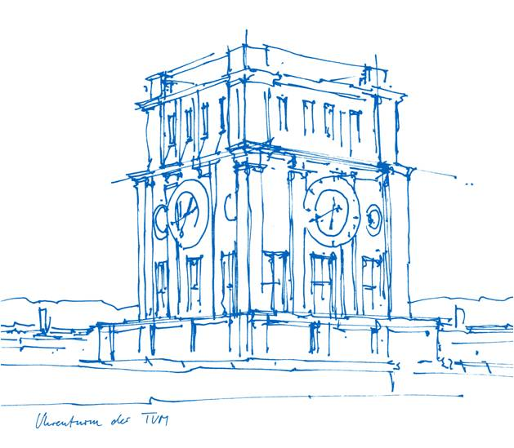

Learning Through Simulated Governance: A Game-Based Approach to Interdisciplinary Sustainability Education
Tobias Bendzko and Ezgi Turgut
Technische Universität München
European Geosciences Union 2026 EOS2.1
Vienna, Austria / 7 May 2026

Slide 2
Why sustainability governance is difficult to teach?
Complexity of sustainability problems
Interconnected sectors: land, climate, economy, infrastructure, ecology and sociology
Long-term consequences and impacts of short-term perspectives
Governance is difficult to understand and experience
Policy decisions involve trade-offs
Uncertainty and unintended effects
Notes:
Sustainability challenges are rarely isolated. A decision in one area, such as agriculture, can affect land use, economic development, climate resilience, ecological systems, and even public well-being. These interconnections make sustainability governance inherently complex. For students, this complexity is difficult to grasp through lectures or readings alone, because many consequences remain abstract, delayed, or difficult to observe directly. In addition, governance processes involve uncertainty, trade-offs, and unintended effects, which are central to real-world decision-making.

Slide 3
From theoretical understanding to simulated experience
Traditional teaching
Concepts are explained
Sectors often taught separately
Low exposure to uncertainty
Individual learning
Teacher-centred-learning
Simulation-based learning
Consequences are experienced
Sectors interact dynamically
Decisions unfold over time
Collaborative governance
Student-centered-learning
Evidence/Experience based learning
Notes:
Traditional teaching remains highly valuable, but it often presents sustainability problems in a relatively linear, theory-based way. Concepts may be explained clearly, yet sectors are often treated separately, and students have limited opportunities to engage with uncertainty or experience how decisions unfold over time. What is often missing is the chance to negotiate, make decisions collaboratively, and deal with the consequences of those choices. In contrast, simulation-based learning creates a more student-centered and experience-based environment, where complexity becomes something, participants do not only study but actively engage with.

Slide 4
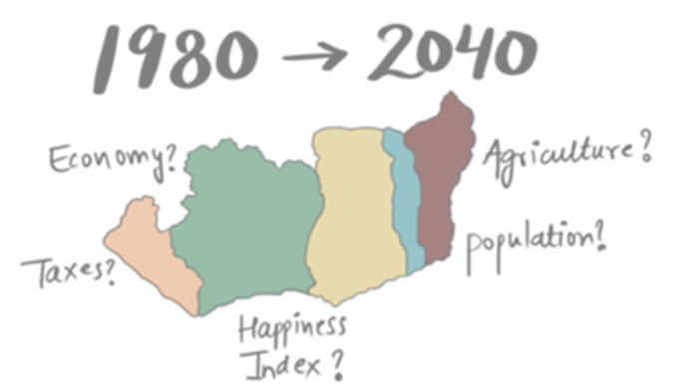
A game-based governance simulation setup: Five countries, one timeline
Five West African countries
Time frame: from the 1980s to 2040
Students divided into country teams
Each student takes a governance role
Decisions unfold over multiple rounds
Past decisions | present challenges | future consequences
Notes:
To address this gap, the simulation places participants in a dynamic governance scenario across five West African countries. The timeline runs from the 1980s to 2040, which allows participants to connect past decisions, present challenges, and future consequences. Students work in country teams and take on specific governance roles, such as president or sectoral ministers. Across multiple rounds, they make strategic decisions and observe how these decisions shape the development of their country over time. In this way, the simulation creates an interactive environment for exploring long-term governance dynamics.

Slide 5
Role-based decision-making under constraints
Each country is governed by a student team:
Each role represents a different governance perspective.
Students must negotiate priorities within the country team.
President/Head of State
Minister of Finance
Minister of Land
Minister of Transportation
Diplomat
Graphic. Role diagram of the country team
Notes:
Each country is governed by a student team that reflects a simplified political structure. At the top is the president, or head of state, who coordinates the overall direction of the country. The other participants take on sector-specific roles, such as minister of finance, minister of land, minister of transportation, and diplomat. Each role represents a different governance perspective, with its own priorities, responsibilities, and interests. This creates an actor-based model of decision-making, where students must negotiate within the team, balance competing goals, and develop a shared strategy under constraints.

Slide 6
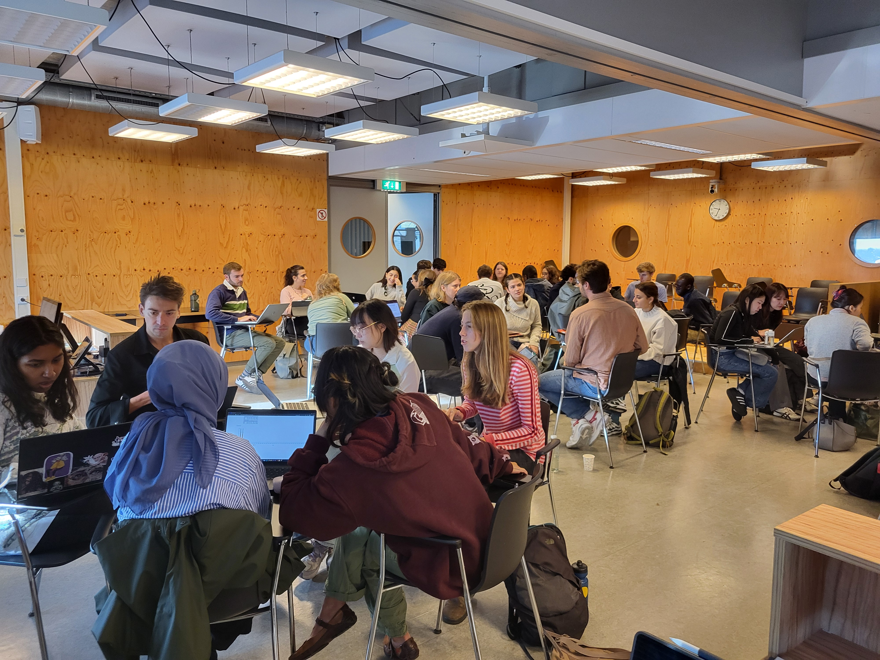
One simulation round: from situation to decision
Policy choices
Input on website
Updated indicators
Reflection & next round
Team discussion
Country situation
Tutorial
Survey
Key dynamics:
Multi-year rounds
Elections after several rounds
Public satisfaction/performance feedback
Possible leadership changes
Cascading consequences across sectors
Picture: Simulation class at IHS Erasmus University Rotterdam Sept 2024
Notes:
Before the simulation all participants will go through a basic tutorial and must reply to an online survey that will be repeated after the simulation is finished. Then they will be randomly assigned to one of the five countries and to one of the state roles. Each simulation round follows a repeated decision cycle. Students first receive information about the current situation of their country, including key developments and challenges. Based on this, they discuss priorities within their team, choose policy actions, and submit their decisions through the web-based platform. After that, they receive updated feedback in the form of indicators, which reflect how their choices affect development over time. Because the rounds represent multiple years, this allows students to experience not only immediate effects, but also delayed consequences, cross-sectoral impacts, and possible political changes such as elections or leadership shifts.

Slide 7
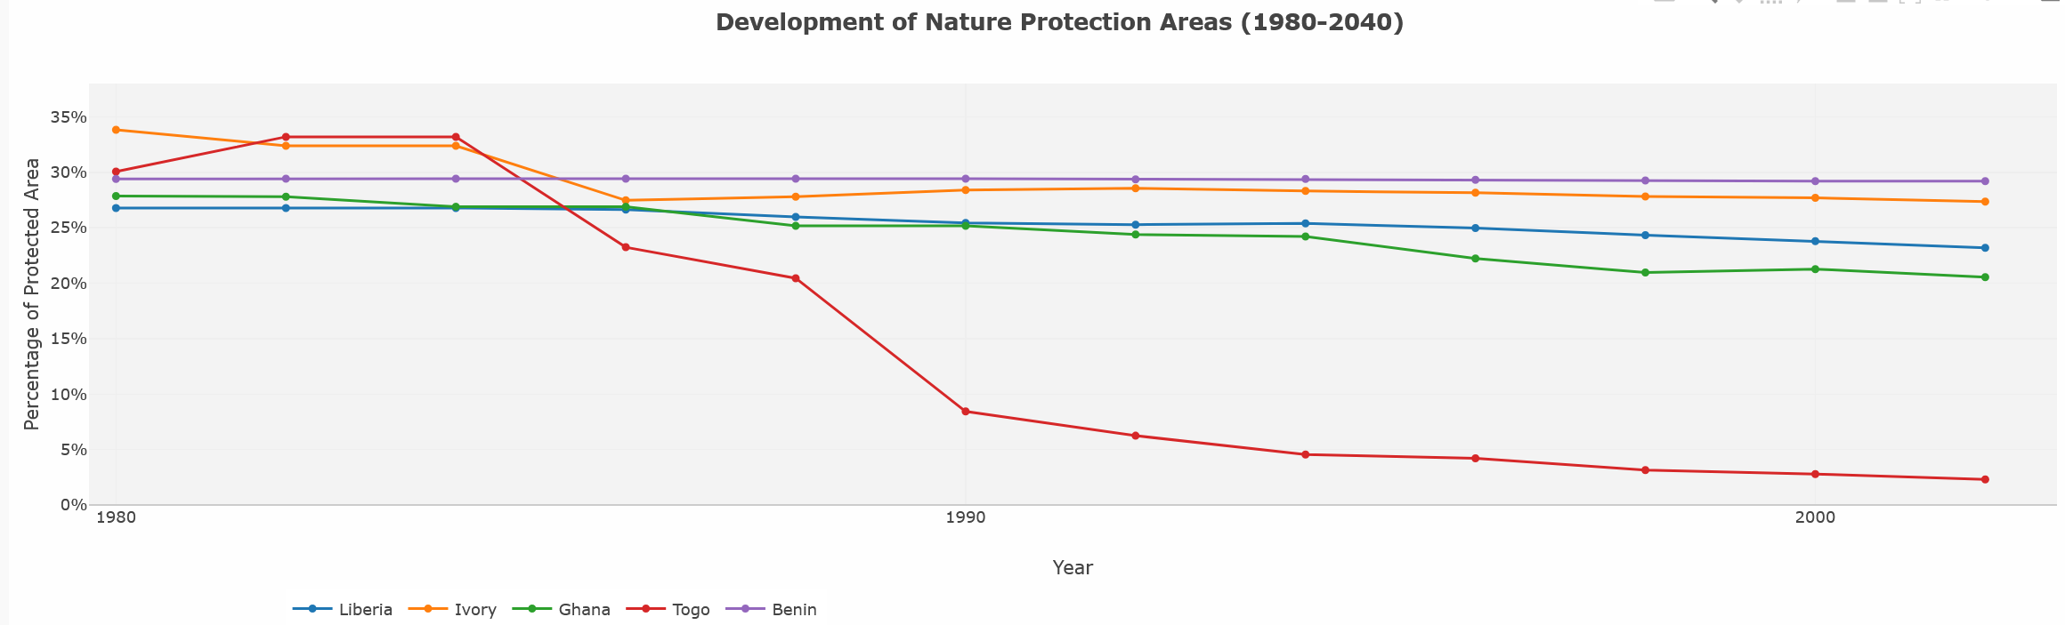
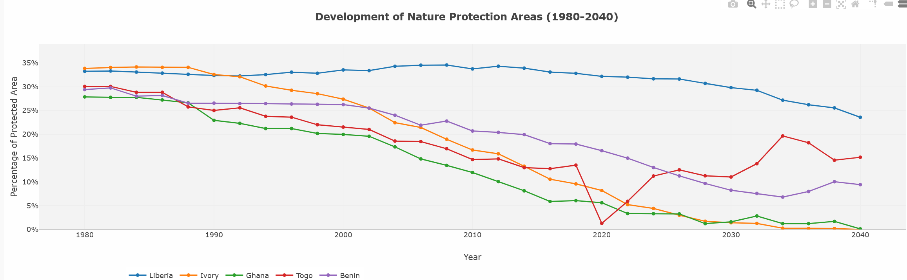
Making consequences visible through indicators
Decision input
Country indicators
Feedback after round
Comparison over time
Graph: Simulation class at TUM July 2025
Graph: Simulation class at Aalto University Helsinki June 2025
Notes:
The platform provides feedback after each round through a set of indicators, which make the consequences of decisions visible over time. In this way, students can directly connect their policy choices to changing outcomes at the country level. For example, a decision may support economic development in the short term, while later increase environmental pressure or reduce public satisfaction. The comparison across countries and across time also makes different development pathways visible. This feedback is essential because it turns otherwise abstract policy consequences into something students can observe, discuss, and reflect on.

Slide 8
Learning outcomes: What students learn through the simulation?
Students experience
Policy trade-offs
First-hand experiences
Finding common ground
Unintended consequences
Long-term vs short-term thinking
Cros-sectoral interdependencies
Exogenous factors
Students develop
Systems thinking (comprehensive understanding)
Collaboration/Conflict resolution
Negotiation (national and international)
Strategic decision making
Develop new perspectives
Pragmatism
Notes:
The main learning value of the simulation is that students do not only study sustainability challenges but experience them through decision-making and feedback. They encounter policy trade-offs first-hand, learn to find common ground within the team, and observe how decisions can lead to unintended consequences over time. The simulation also helps them understand long-term and short-term tensions, cross-sectoral interdependencies, and the influence of external or exogenous factors. At the same time, the role-based format supports the development of systems thinking, collaboration, negotiation, conflict resolution, and strategic decision-making. Overall, this creates a deeper understanding of feedback loops, emergent behavior, and the complexity of governance in sustainability contexts.

Slide 9
Why simulated governance matters for sustainability education?
Strengths
Practical/Applied learning
Simplified factors
Protected laboratory
Encourages peer learning
Supports interdisciplinary thinking
Makes abstract concepts tangible
Student-centred-learning
Illustrates strategic outputs
Limitations
Simplifies real-world complexity
Depends on scenario design
Needs evaluation through feedback/surveys
Trivialize negative outcomes
Illusion of controllability
Affords to understand the game’s logic
Groupthink pressure
Notes:
The simulation does not aim to reproduce the full complexity of real political decision-making, and that is also not its purpose. Its value lies in making complexity pedagogically accessible. It creates a protected, low-stakes environment in which students can test strategies, make mistakes, adapt, and reflect on the consequences of governance decisions. At the same time, it supports applied and student-centred learning, encourages both inter- and intra-peer learning, and helps make abstract concepts more tangible. However, the approach also has limitations: it simplifies reality, depends strongly on scenario design, and may create effects such as groupthink, strategic gaming of the system, or an illusion of controllability. This is why systematic evaluation through feedback and surveys remains important.

Slide 10

“Simulated governance helps students move from understanding sustainability complexity to experiencing it.”
It connects land, climate, economy, and policy decisions.
It supports systems thinking, collaboration, and negotiation.
It prepares future professionals for uncertain, interdisciplinary decision-making.
Notes:
To conclude, simulated governance helps students move from understanding sustainability complexity to experiencing it. By connecting land, climate, economy, and policy decisions within one interactive setting, the simulation supports systems thinking, collaboration, and negotiation. It also prepares future professionals to engage with uncertainty, interdependence, and long-term consequences in decision-making. In this sense, simulation-based learning can make an important contribution to interdisciplinary sustainability education.

Slide 11
Thank you!

