Slide 1


Understanding the behaviour of indoor radon to prevent health issues
Lola Pereira
Universidad de Salamanca (SPAIN)
Secretary General of the International Medical Geology Association (IMGA)

Slide 2
Facts:
Rn derives from disintegration of U. Therefore, geological materials with U will exhale Rn.
Granite can exhale Rn.
Rn is one cause of lung cancer.
Low atmospheric pressures increase Rn indoor.
Ventilation is the cheapest and easiest way of getting rid of Rn indoors*.
Some facts to be reviewed…

Slide 3
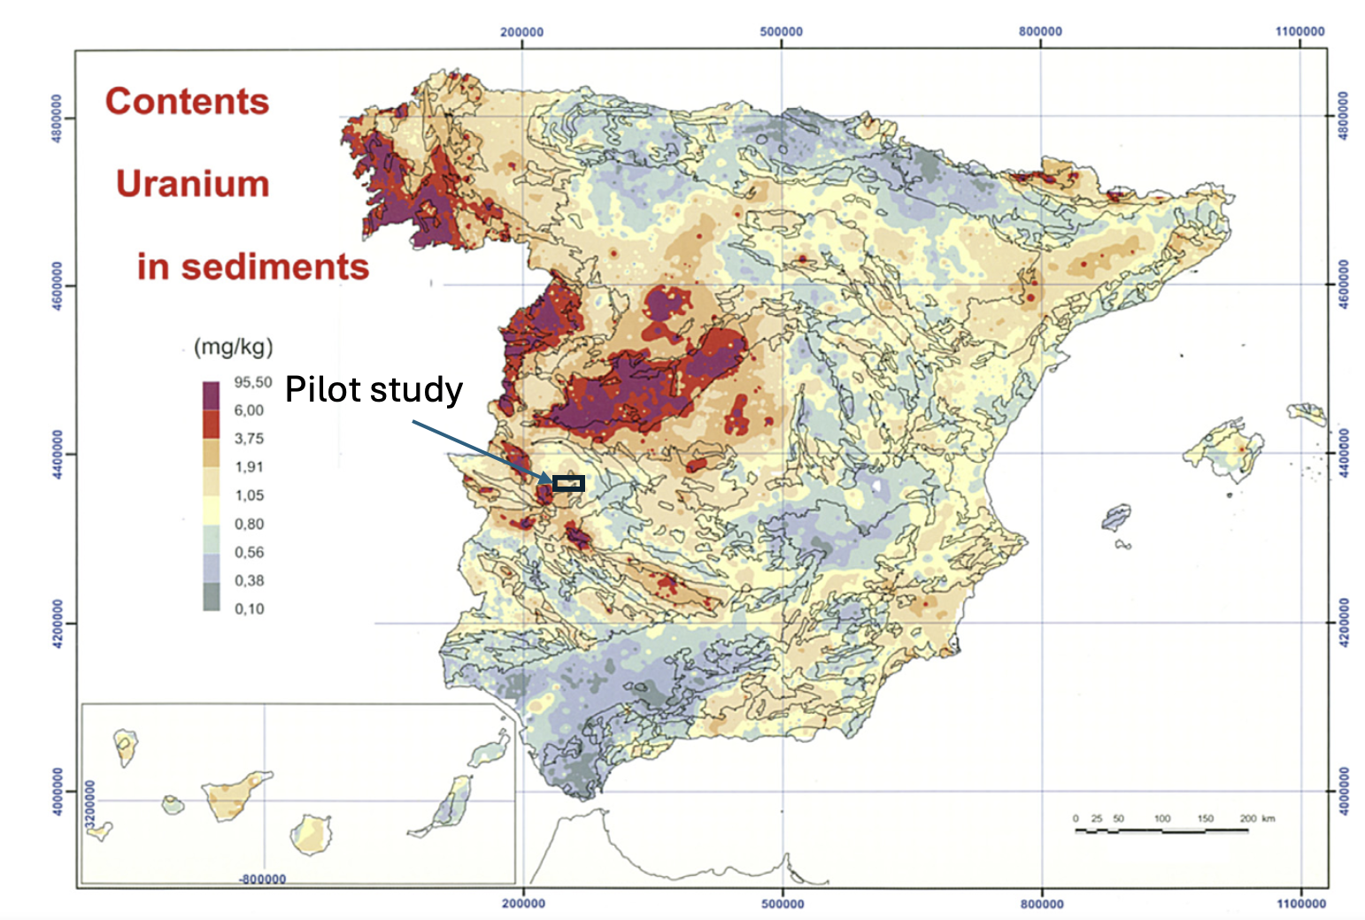
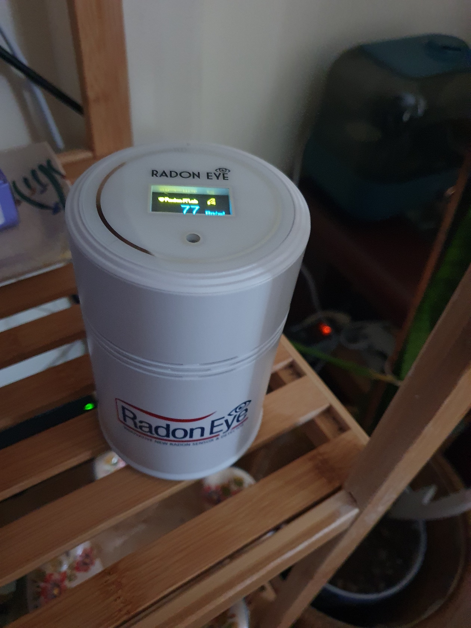
Case study:
Modified from Locutura Rupérez et al., (2012)
Water:
Rain
Watering gardens
Drainage failures
Is humidity a problem?
Geology: opal-cemented conglomerate

Slide 4
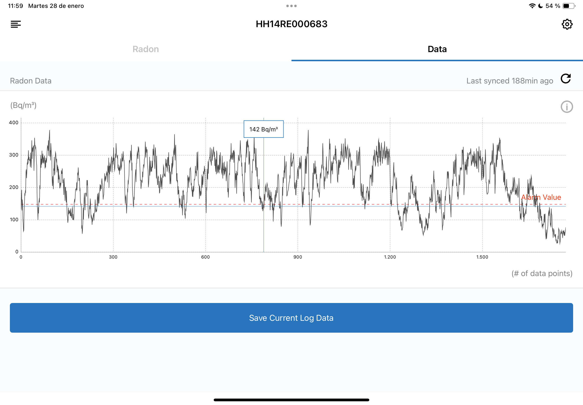
Storm Kristin
Recommended limits:
USA: 148 Bq/m³
UK: 200 Bq/m³
Europe: 300 Bq/m³
WHO: 100 Bq/m³

Slide 5
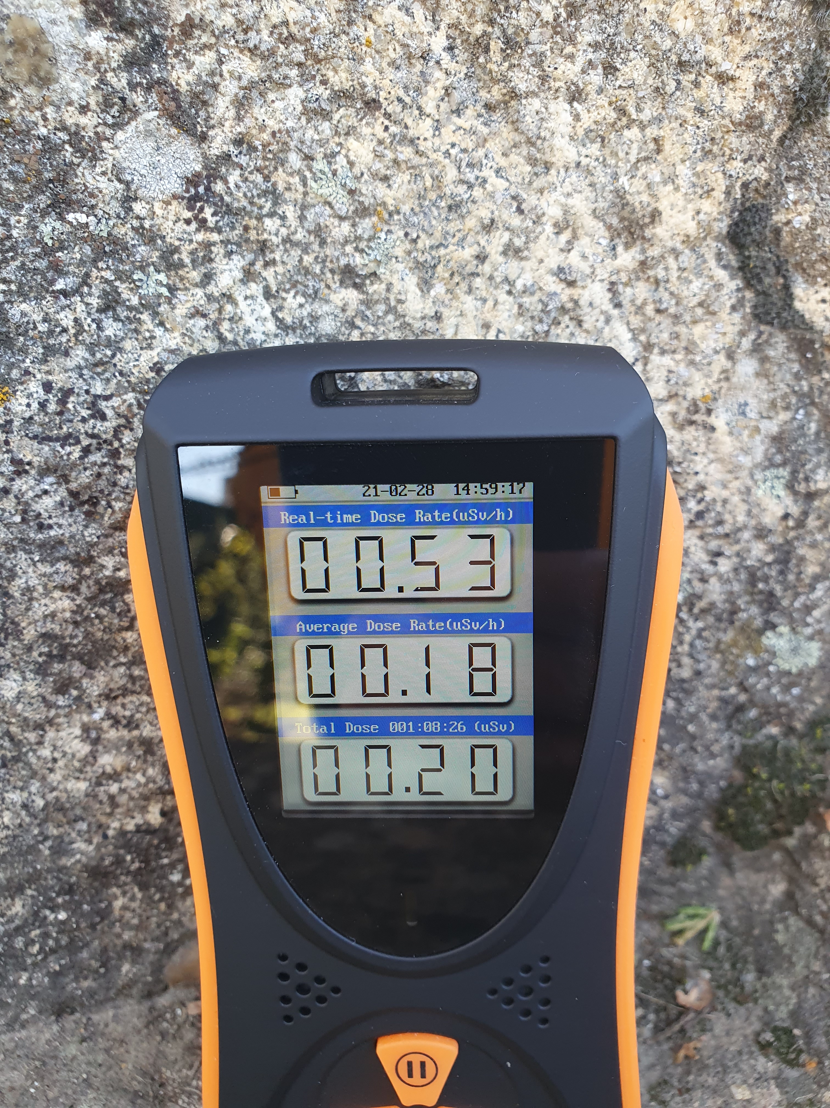
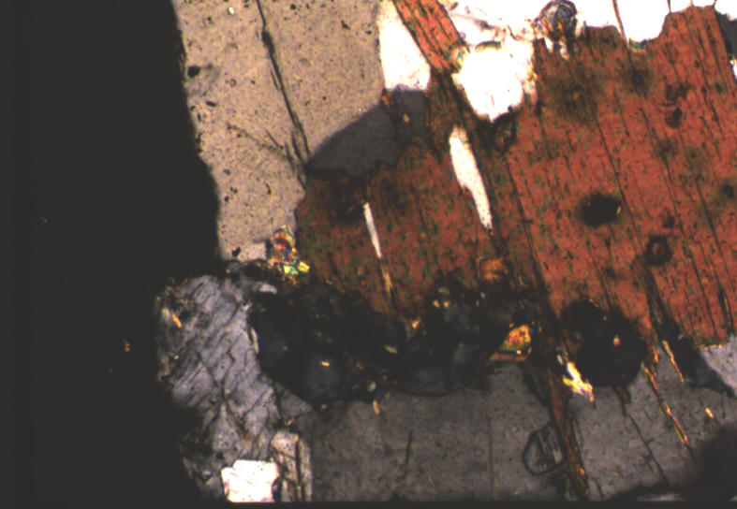
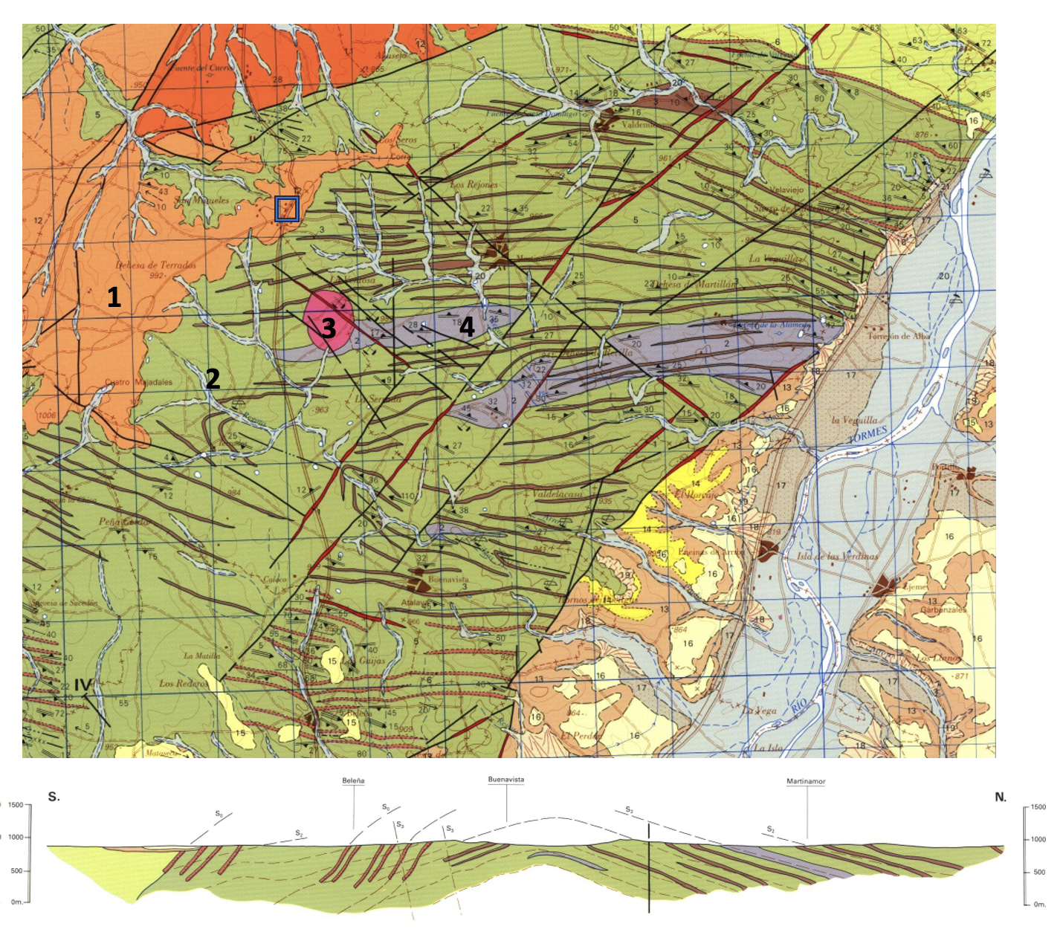
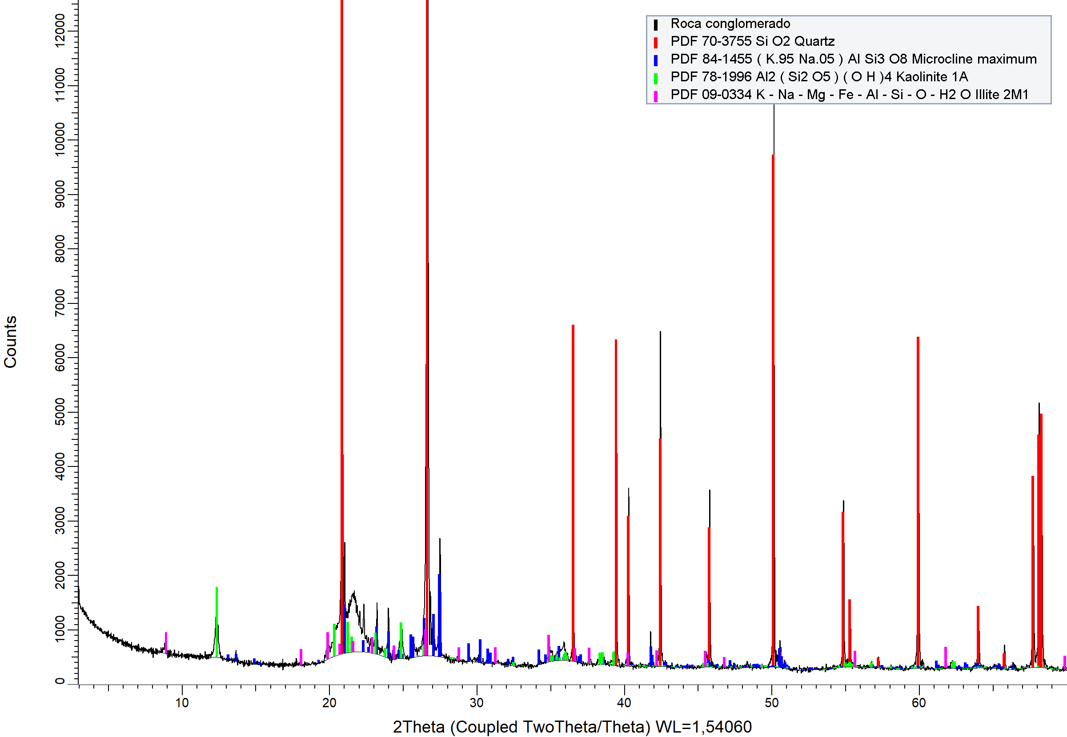
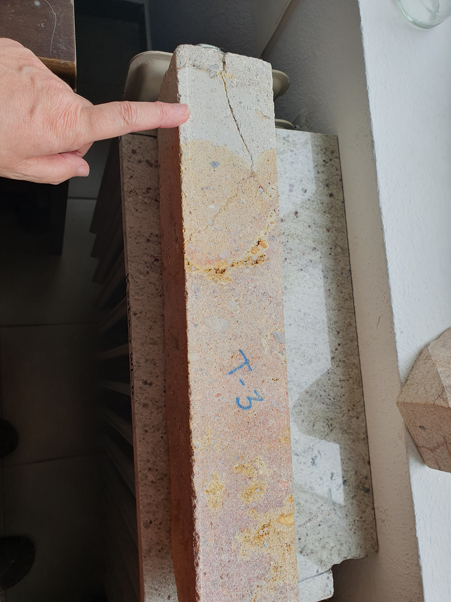
To discuss:
Are all granites radioactive?
Can other geological materials exhale Rn?
Pereira, A., Pereira, D., Neves, L., Peinado, M., Armenteros, I., 2013. Nat. Hazards Earth Syst. Sci., 13, 3493–3501, https://doi.org/10.5194/nhess-13-3493-2013.
Pereira (Geoheritage, under review)
Pereira (Social Sciences & Humanities Open, under review)

Slide 6
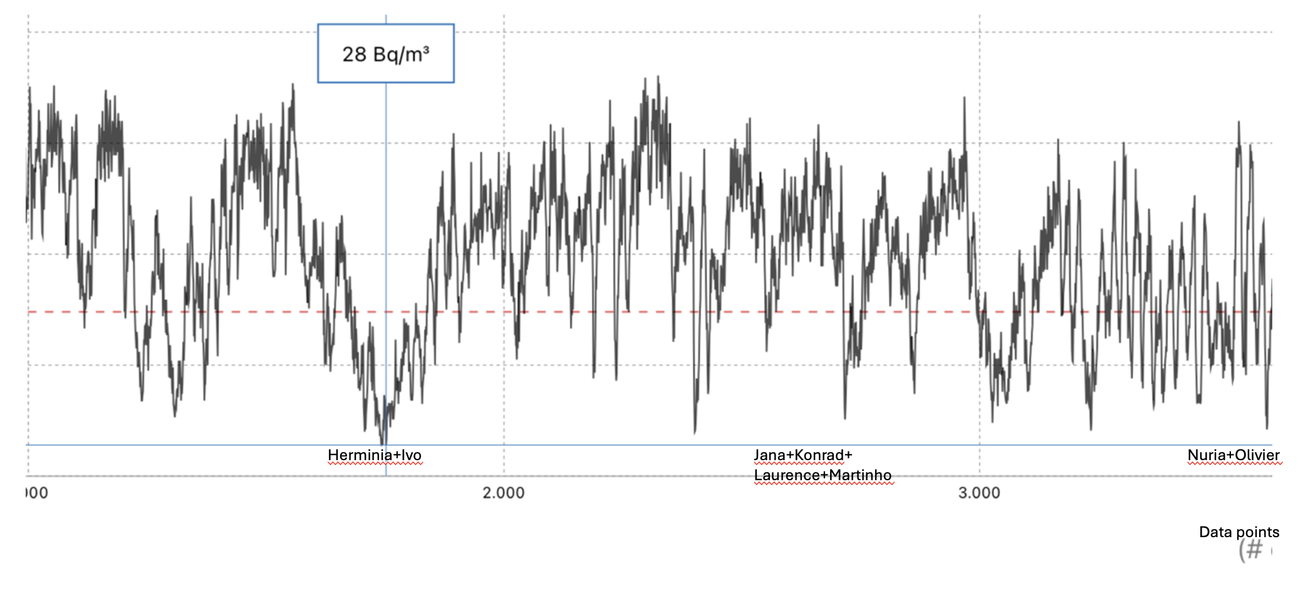
To discuss:
Low atmospheric pressure induces an increment of Rn indoors??.

Slide 7
Impact storms in 2025: studied time
Date | Storm name |  | Pressure (hPa) |  | Radon (Bq/m³)
24th January | Herminia |  | 1016 |  | 28
27th January | Ivo |  | 1017 |  | 28
6th March | Jana |  | 1015 |  | 30
10th March | Konrad |  | 1015 |  | 35
14th March | Laurance |  | 1020 |  | 35
18th March | Martinho |  | 1010 |  | 30
1st April | Nuria |  | 1020 |  | 25
7th April | Olivier |  | 1020 |  | 25

Slide 8
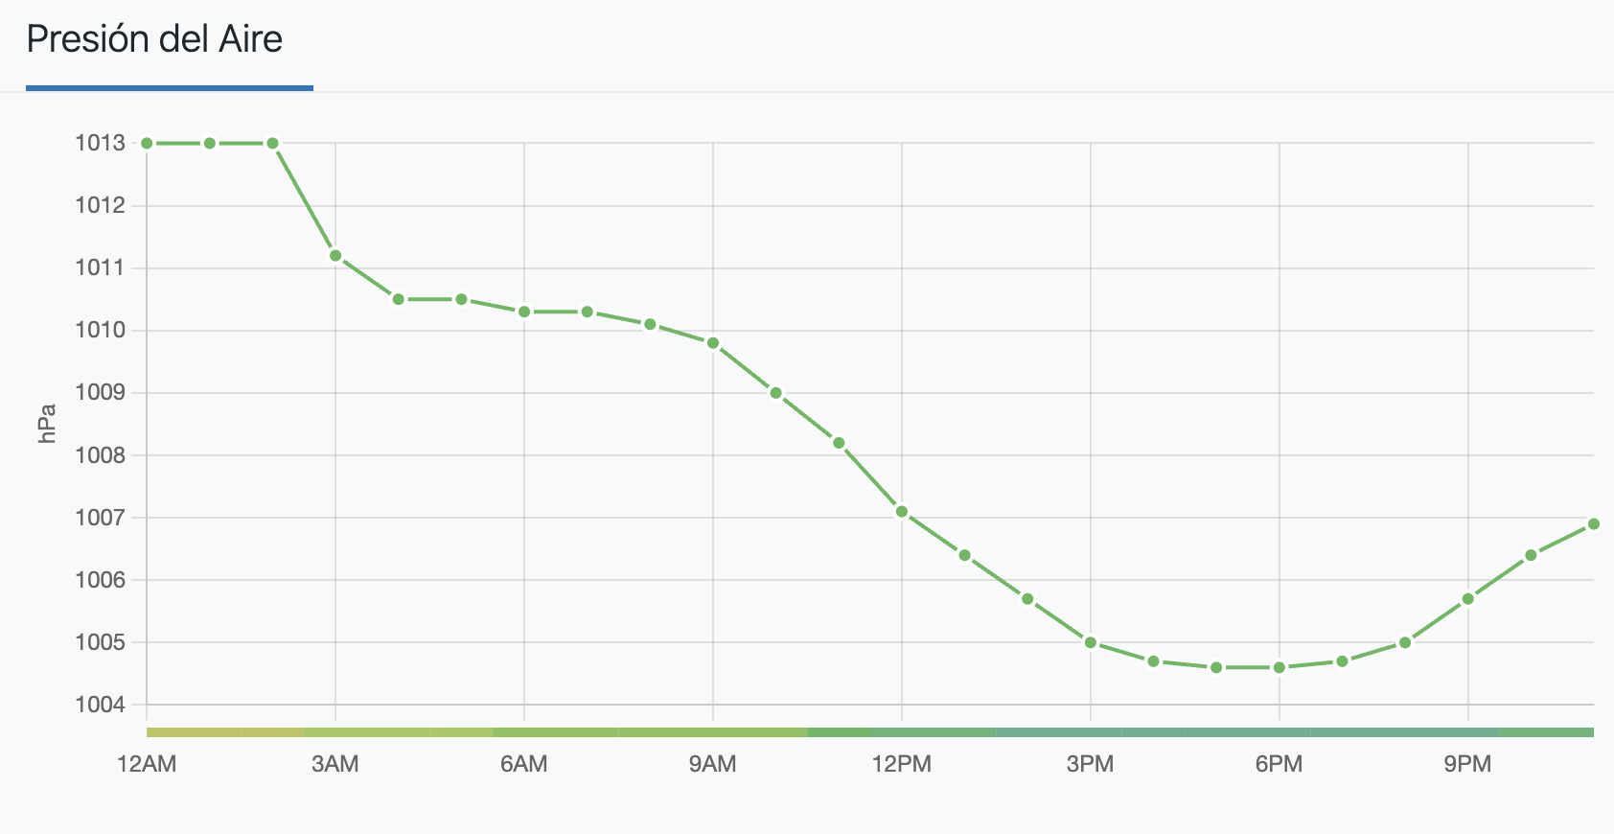
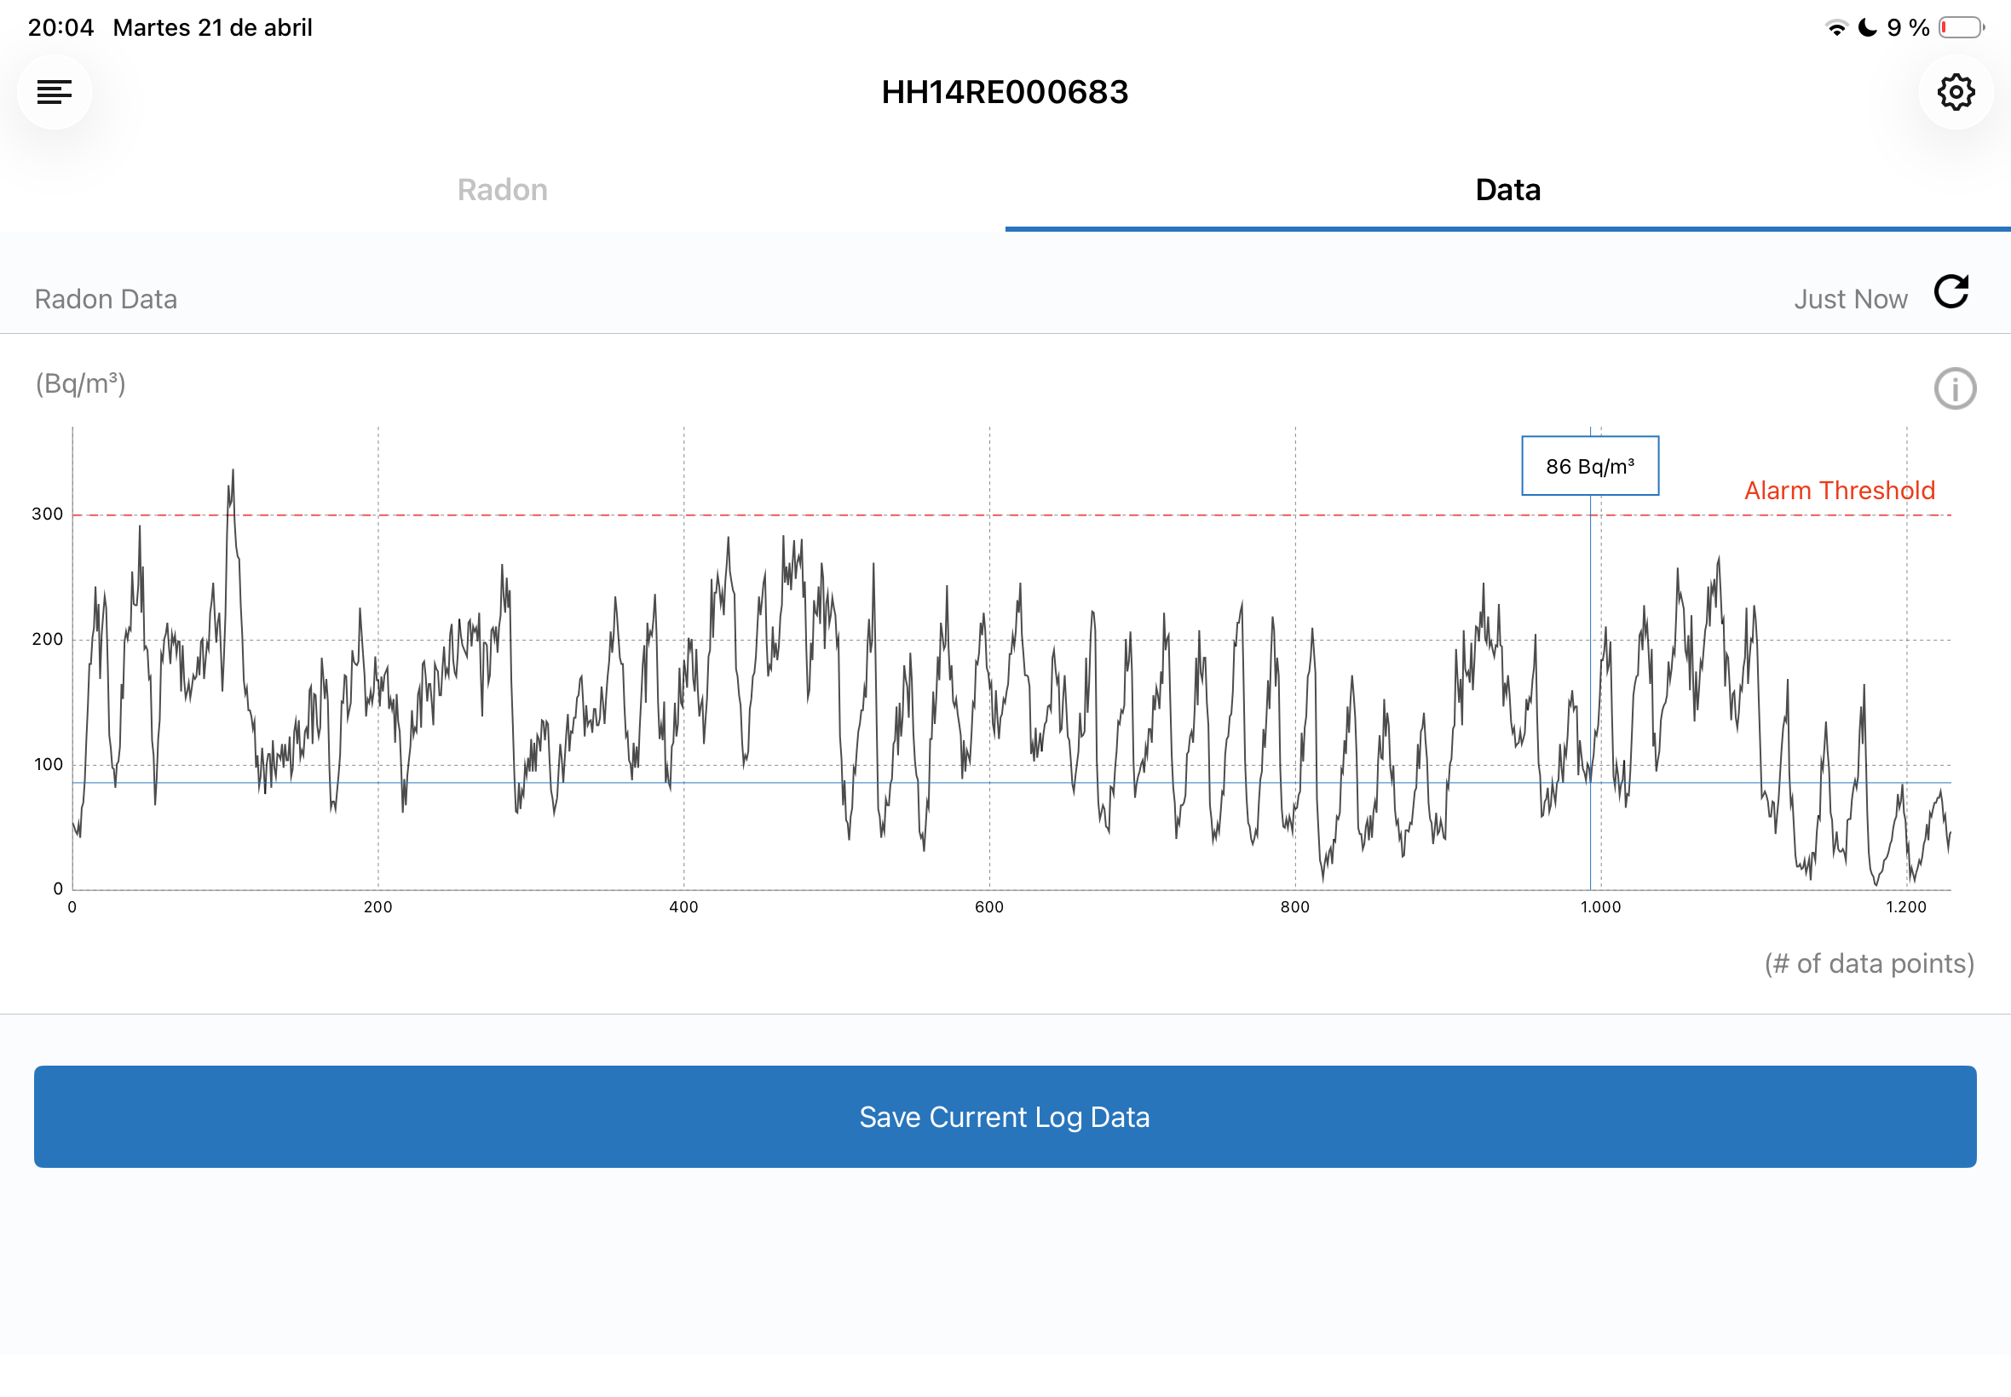
Low pressure (storm)
21st April

Slide 9
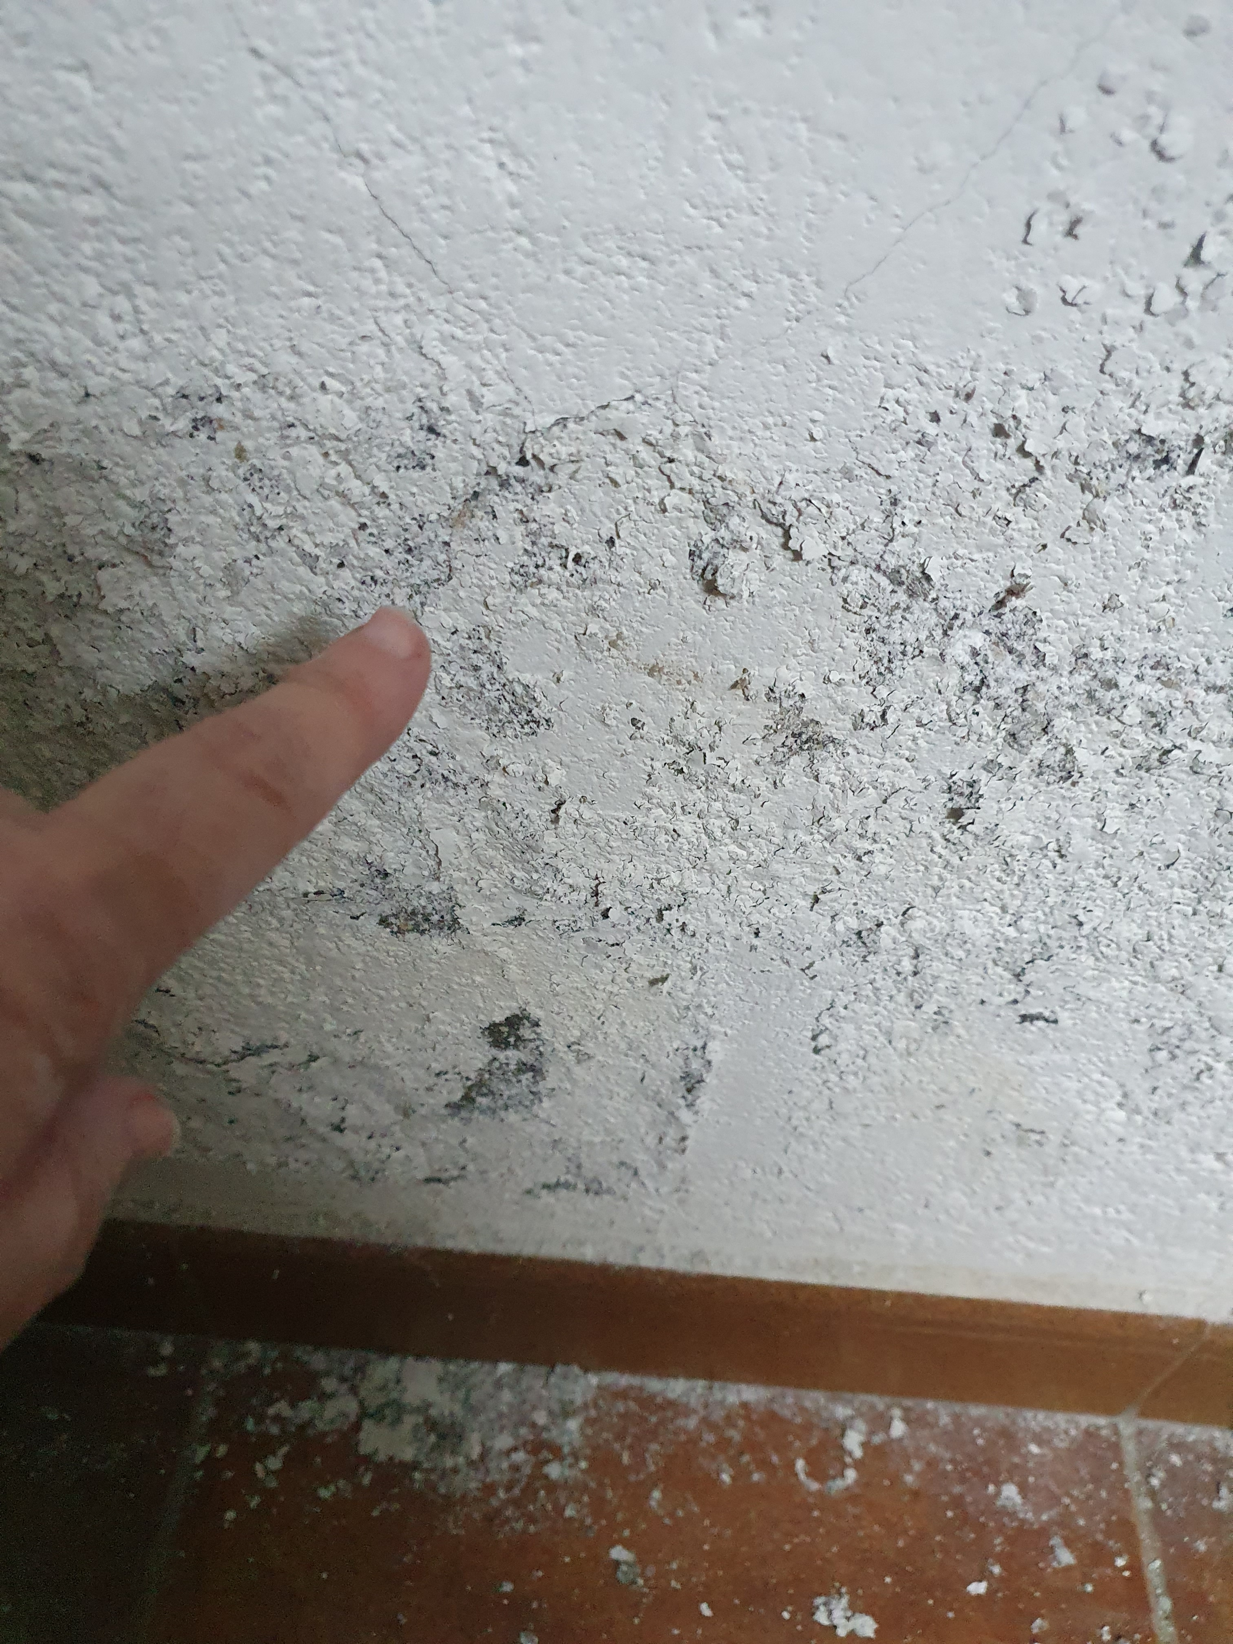
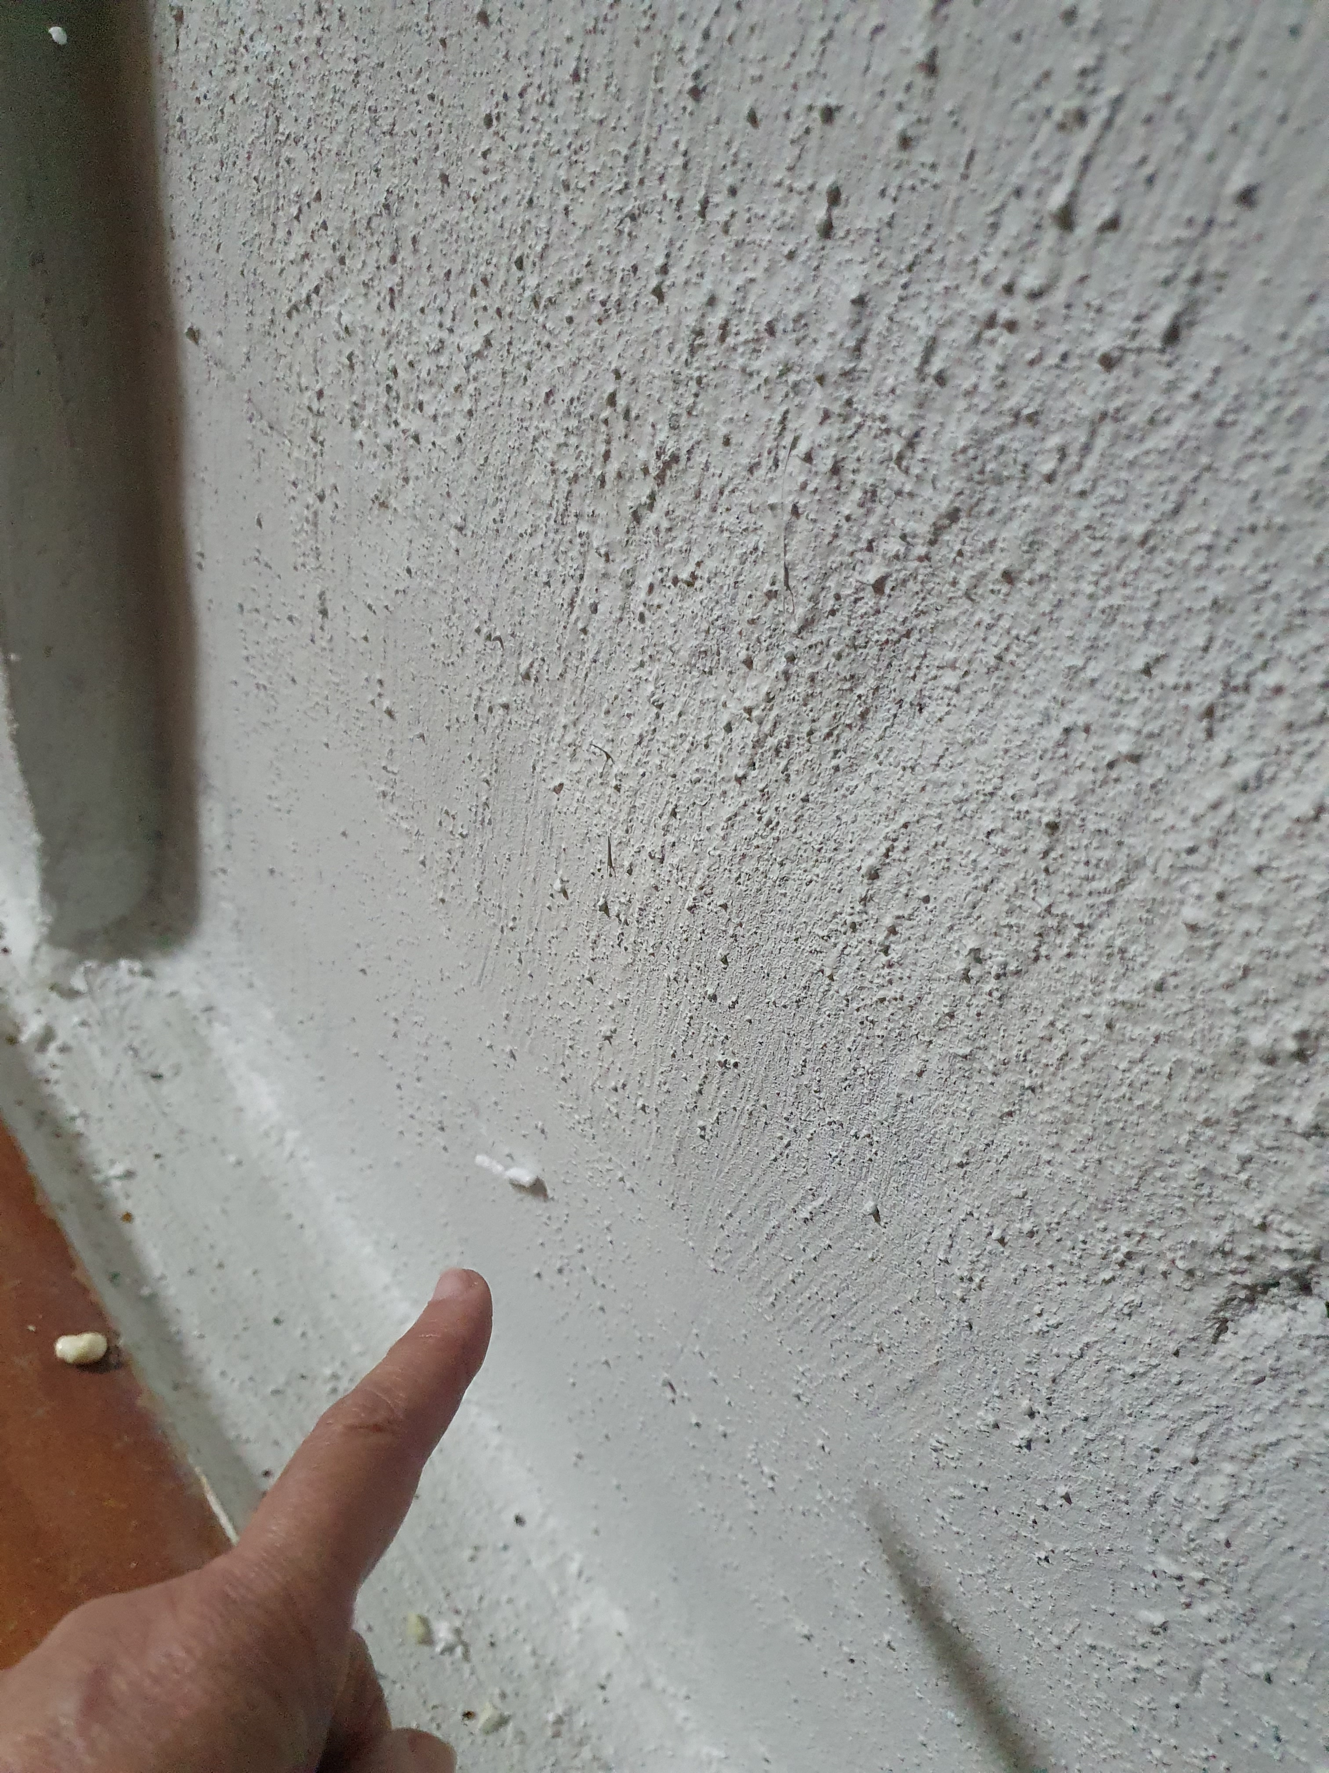
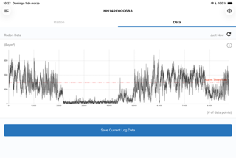
To discuss:
High humidity correlated to high levels of Rn indoor??
Impermeabilization of walls may help?
Capillary
absorption
in a wall
Ten months
after
epoxy treatment

Slide 10
To discuss:
Rn is one possible cause of lung cancer?

Slide 11
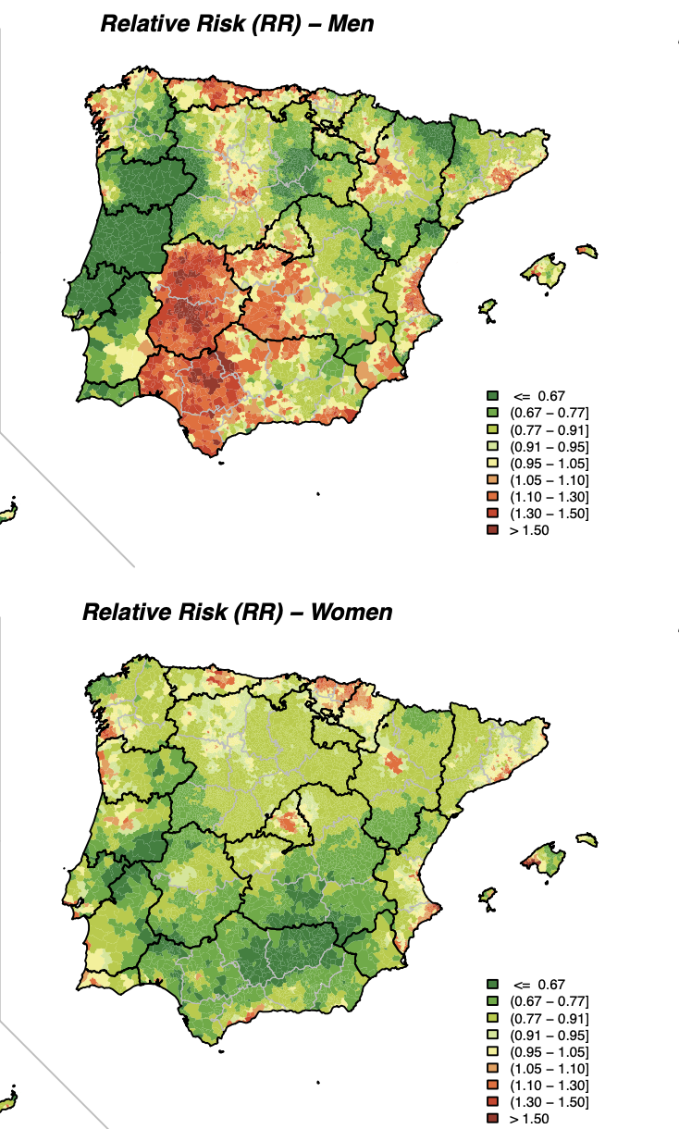
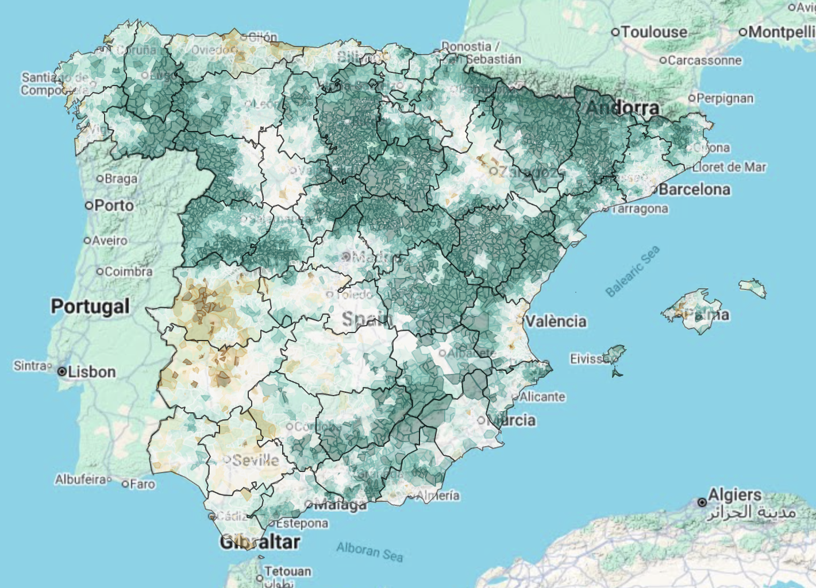
Lung cancer. Relative Risk (2003-2012)
Source: Project “Atlas of Cancer Mortality in Portugal and Spain (2003–2012)”, AMOCAPE
Source: https://medea3.shinyapps.io/atlas_nacional/

Slide 12
To discuss:
Ventilation is the cheapest and easiest way of getting rid of Rn indoors.

Slide 13
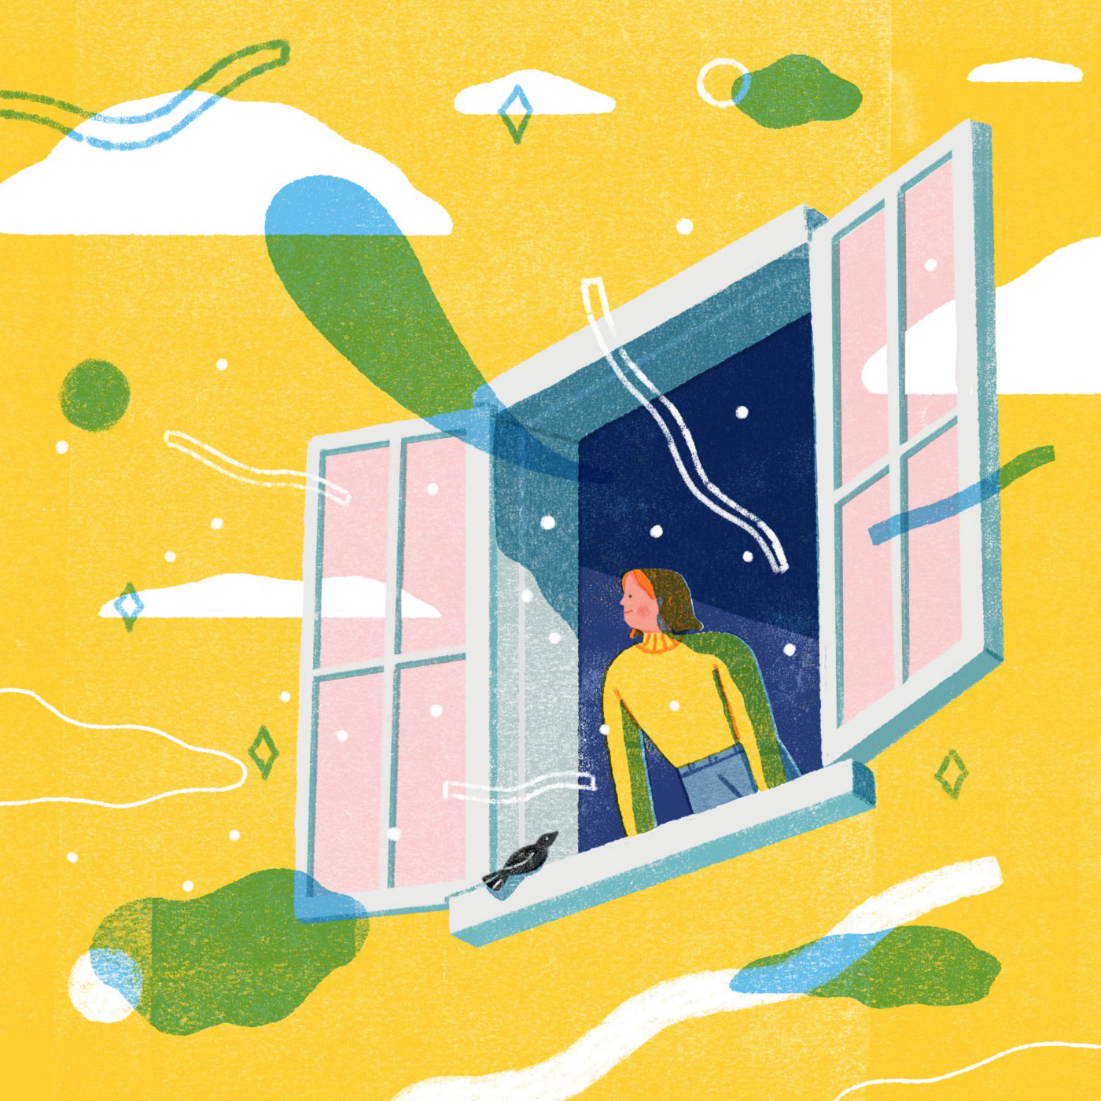
Preliminary conclusions:
Most of the assumed facts must be reviewed.
There are more questions than answers!
It is important to know the risk perception by society (in Spain, only few papers have dealt with Rn risk perception).
It is important to involve the society in the testing. Controversial results of this pilot project must be verified through more data.
Transfer of knowledge to the society is the best prevention measure.
To help to reach a comfortable environment, natural ventilation must be promoted.
https://elemental.medium.com/the-germ-cleaning-power-of-an-open-window-a0ea832934ce.
Kieran Blakey : "The Germ-Cleaning Power of an Open Window"

