Slide 1


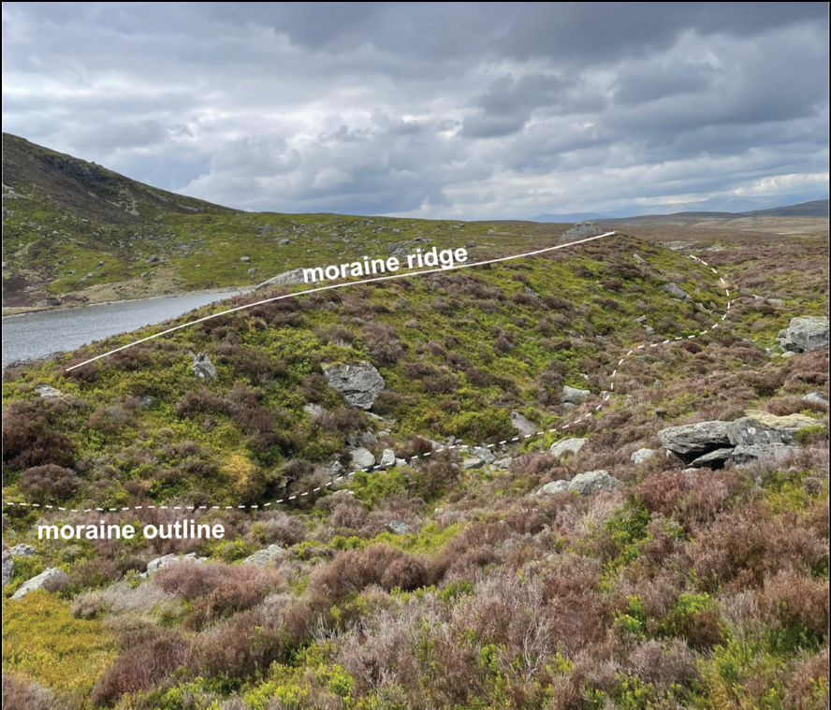
Examining the nature and timing of deglaciation in Britain
New evidence from the Arenigs, Brecon Beacons and South Wales Valleys (and other areas)
Philip Hughes¹,
Oliver Thomas¹, Christopher Darvill¹ Peter Ryan¹,
David Fink²
¹Department of Geography, The University of Manchester, Manchester, United Kingdom
²Australian Nuclear Science and Technology Organisation, PMB1, Menai, NSW 2234, Australia

Slide 2
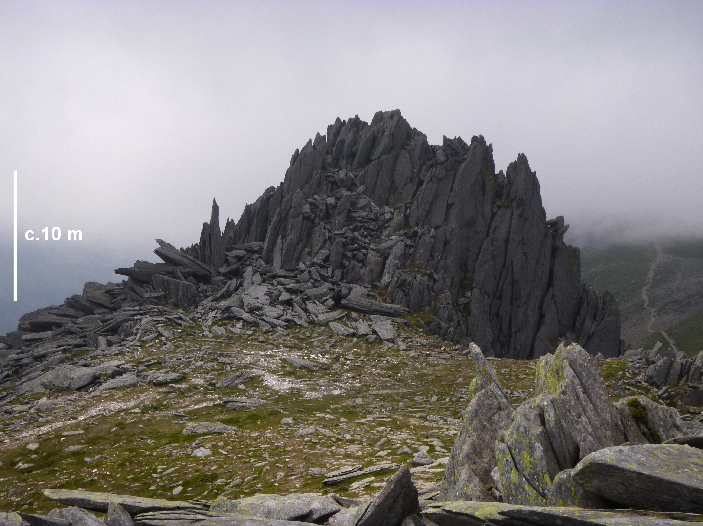
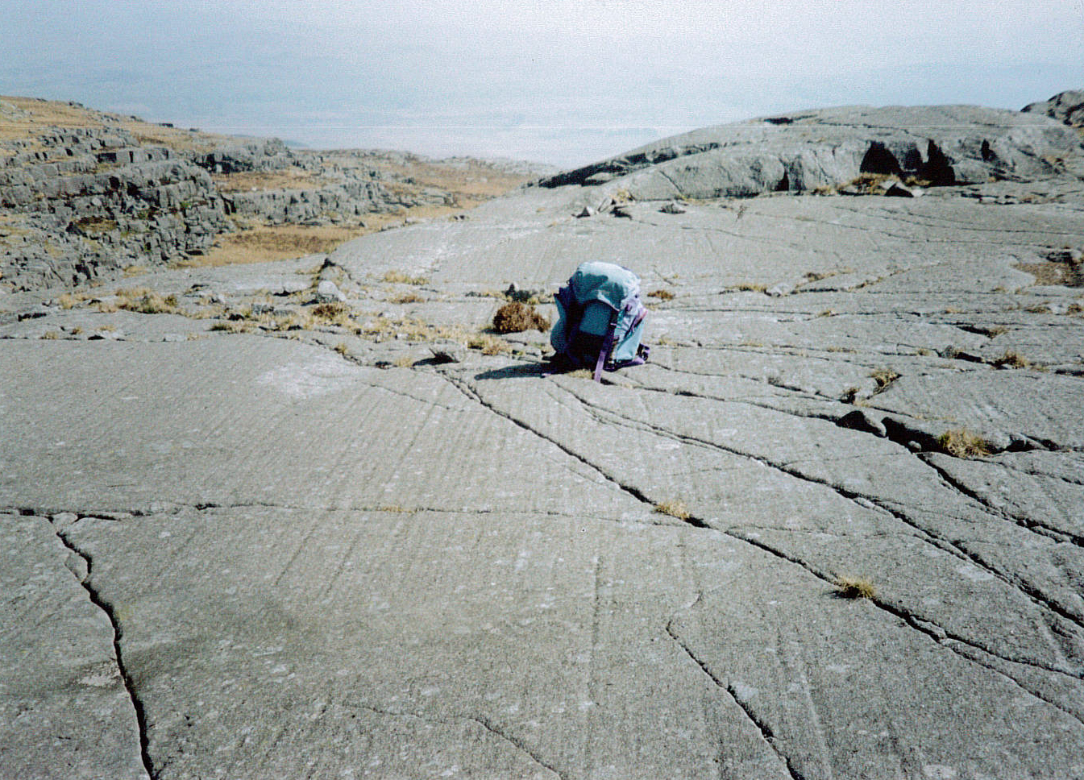
Timing of deglaciation in Wales from summits to cirques
What was the timing of ice cap thinning and summit exposure ages?
What was the timing of the last valley and cirque glaciers in Wales?
Were there differences in the timing of the last cirque glaciers across Wales?
Geochronological control: >100 ¹⁰Be/²⁶ Al ages, 30 ³⁶Cl ages combined with ¹⁴C and pollen stratigraphy

Slide 3
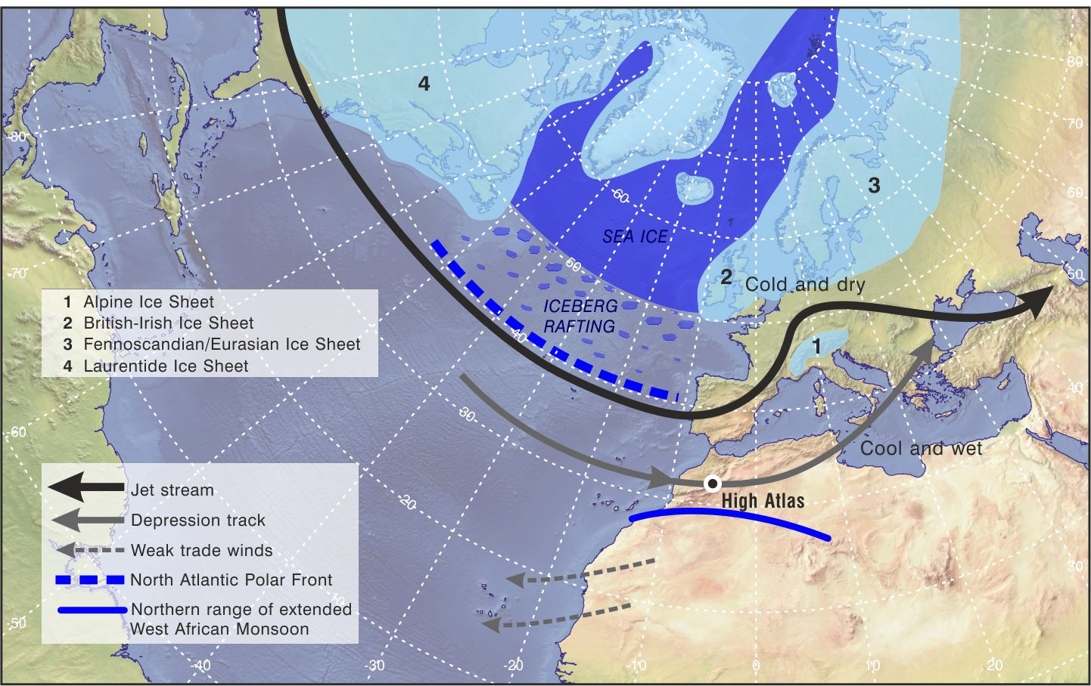
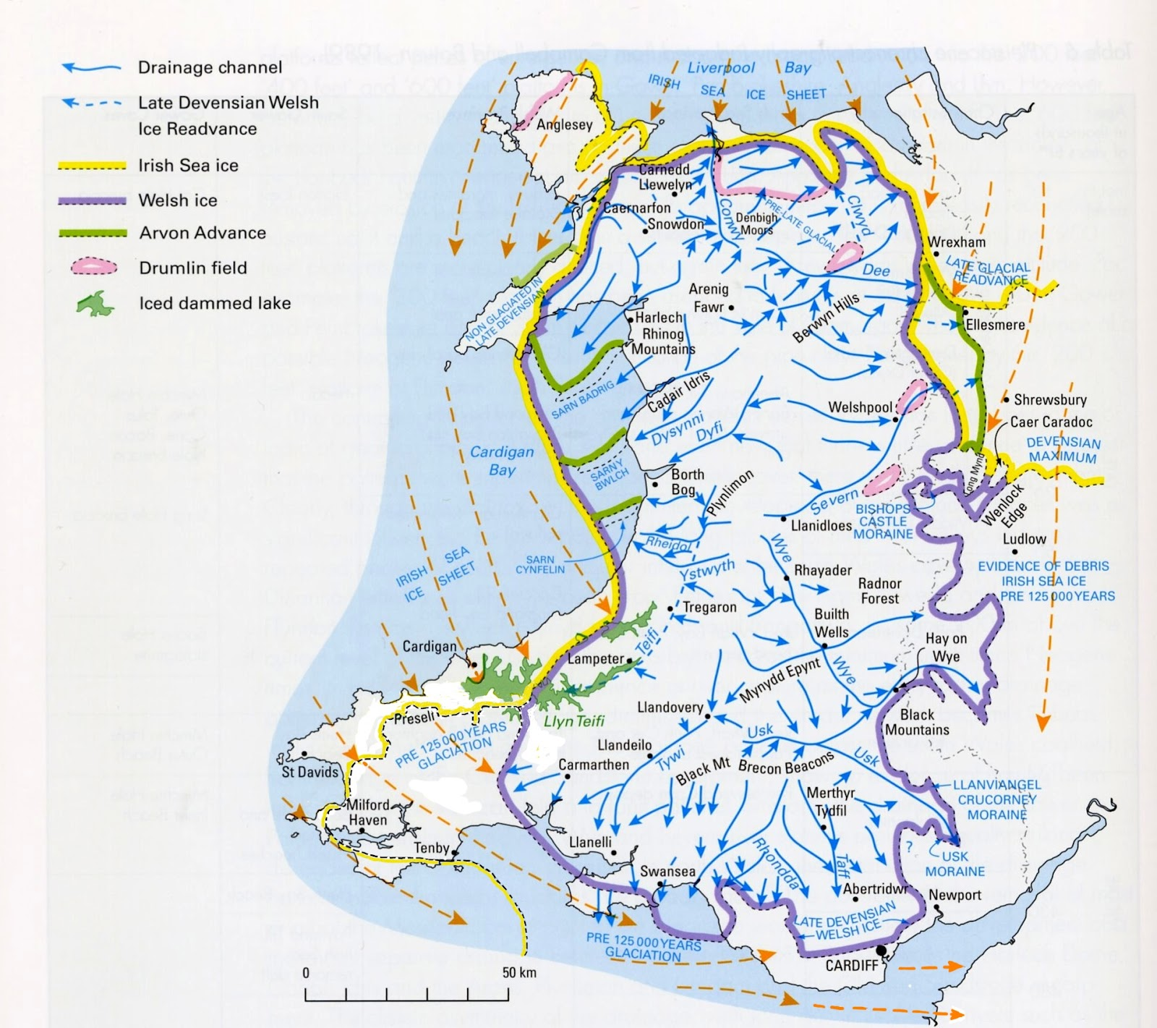
Wales map, source: M. F. Howells 2008. Wales. British Regional Geology. x + 230 pp. + map in folder. Keyworth: British Geological Survey.

Slide 4
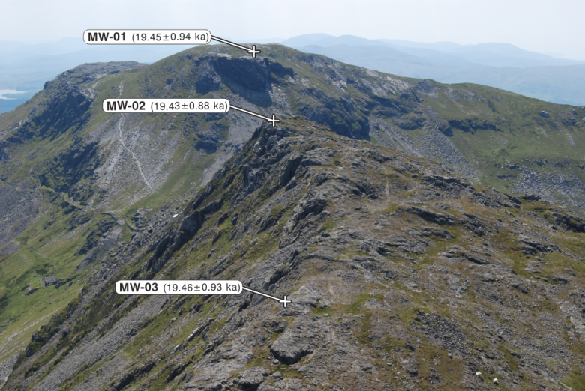
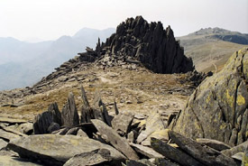
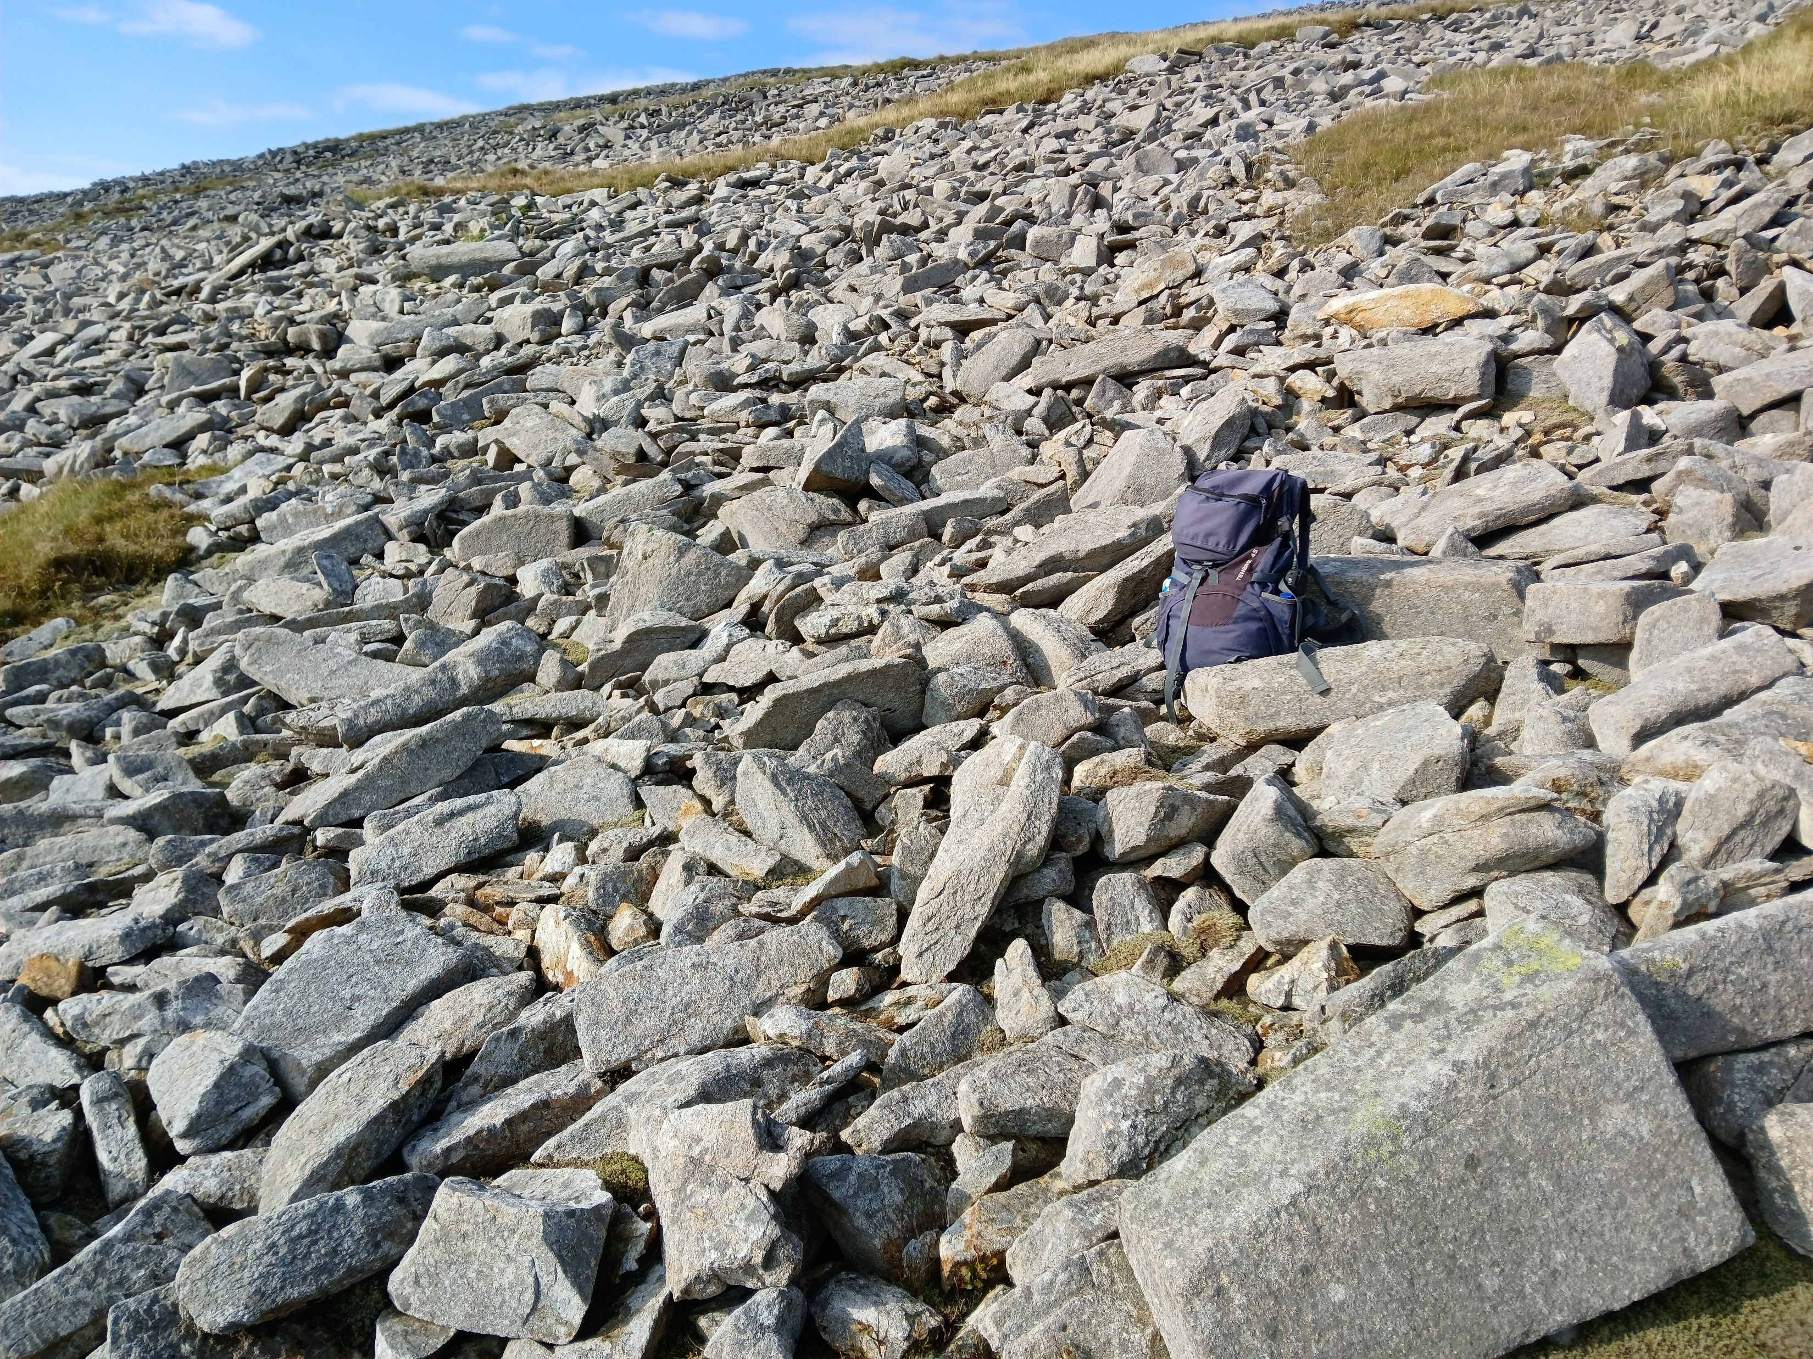
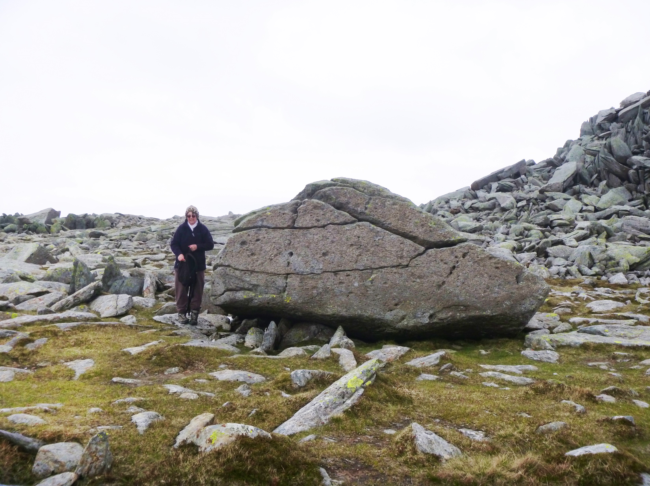
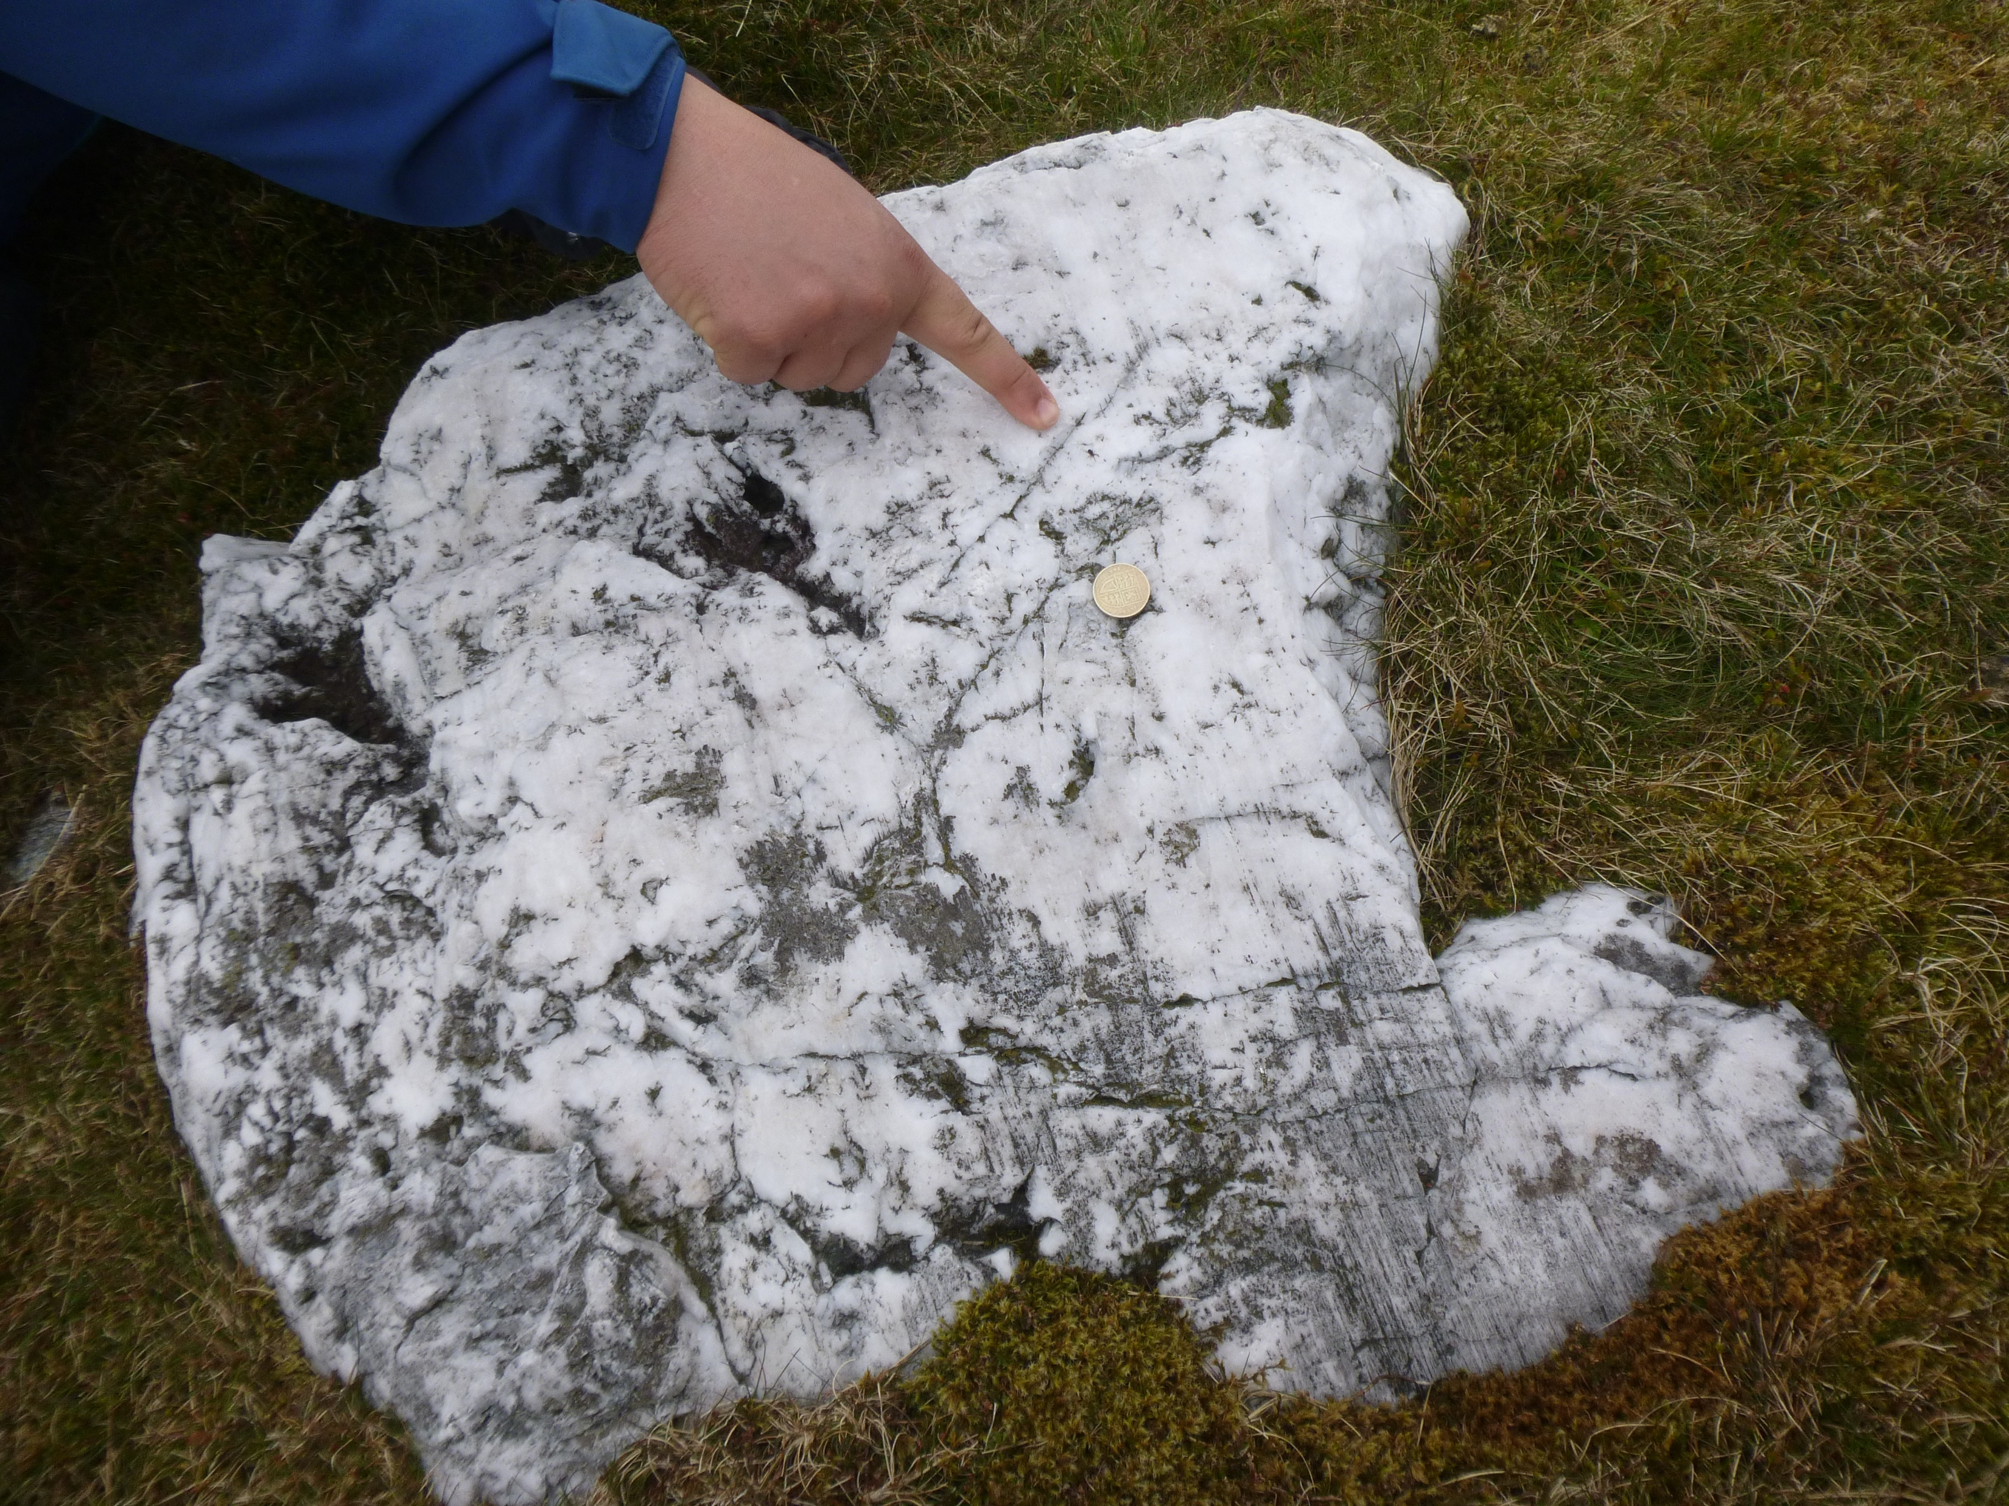
Summit exposure Determing the timing of Ice cap thinning Nunataks v ice-abraded summits
60-80 ka exposure ages
21-18 ka exposure ages

Slide 5
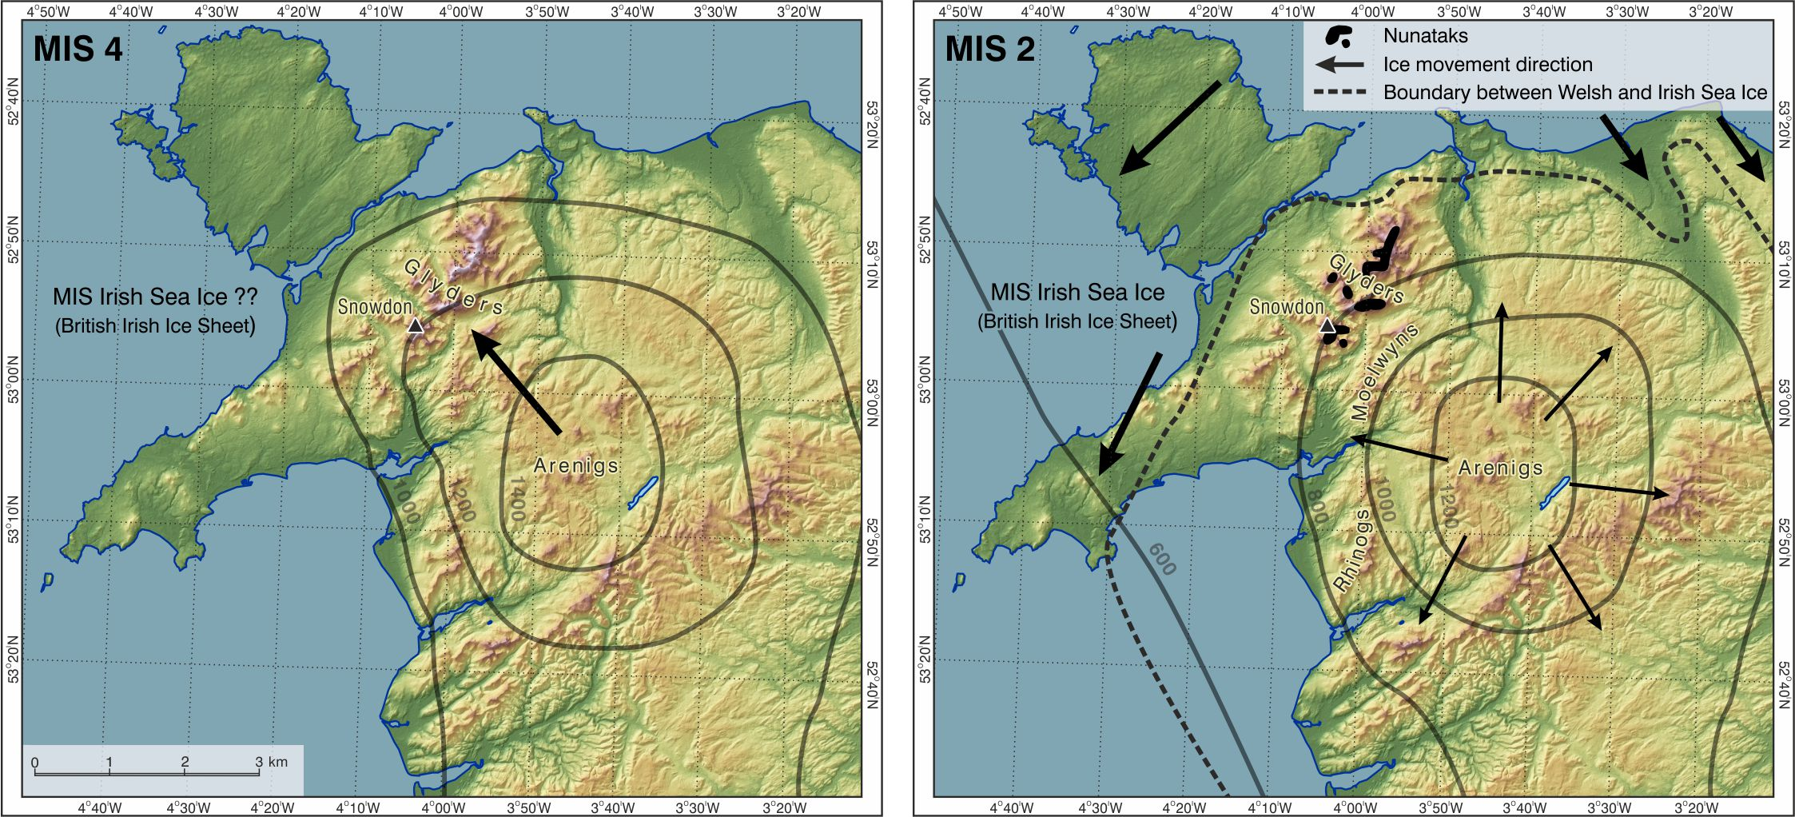
10
20
30 km

Slide 6
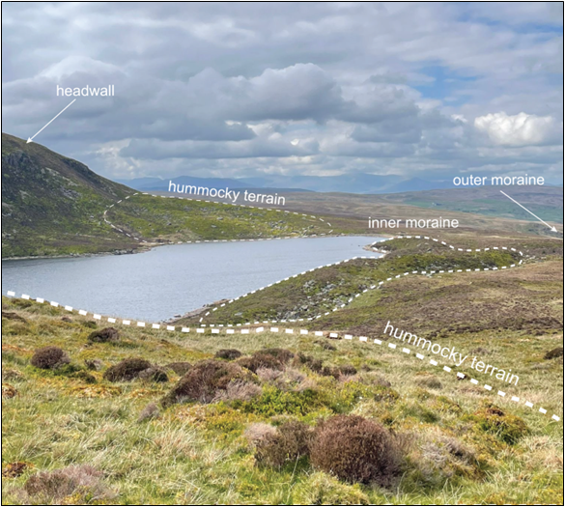
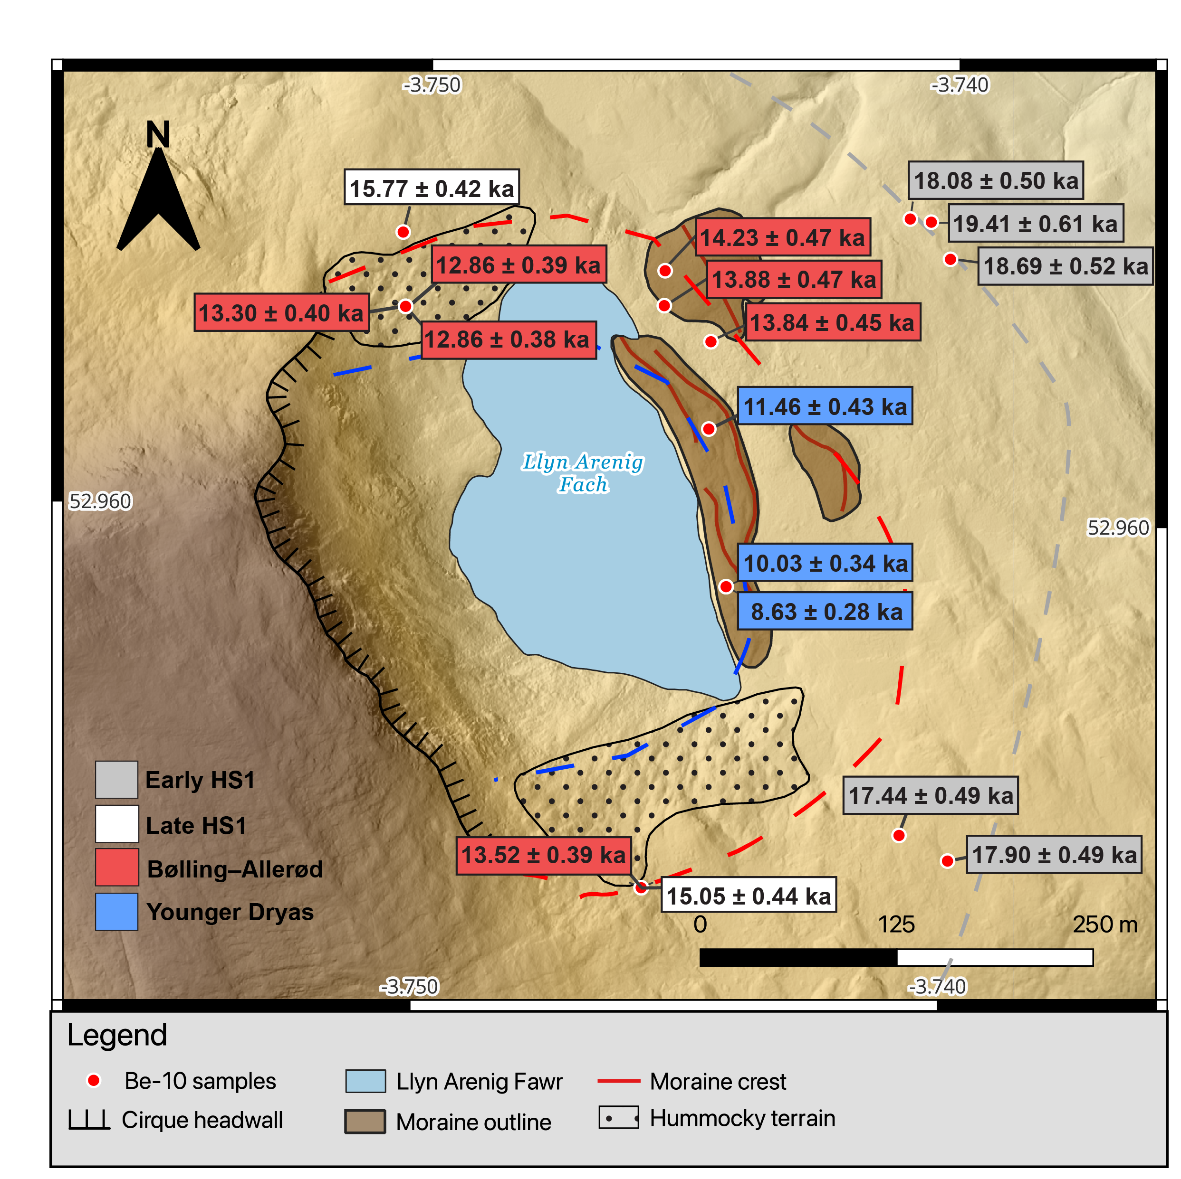




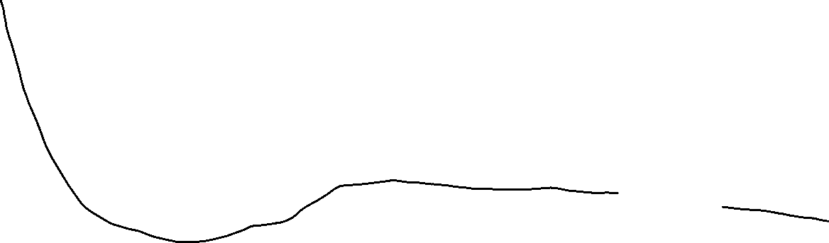

[lateral boulders date to 15-16 ka]
Glacier likely present 14-18 ka in OD/HS1 but moraines in front of lake sequence date to retreat in BA
Retreat to outer cirque position
by OD/H1
YD advance
BA retreat
Inner moraine
Outermost
moraine/boulder limit
9-11 ka (min)
Outer moraine
13-14 ka
18-19 ka
13.5 cal ka (14C)
Minimum age
11-12 ka (pollen strat, Lowe 1994)
Llyn Arenig Fach

Slide 7
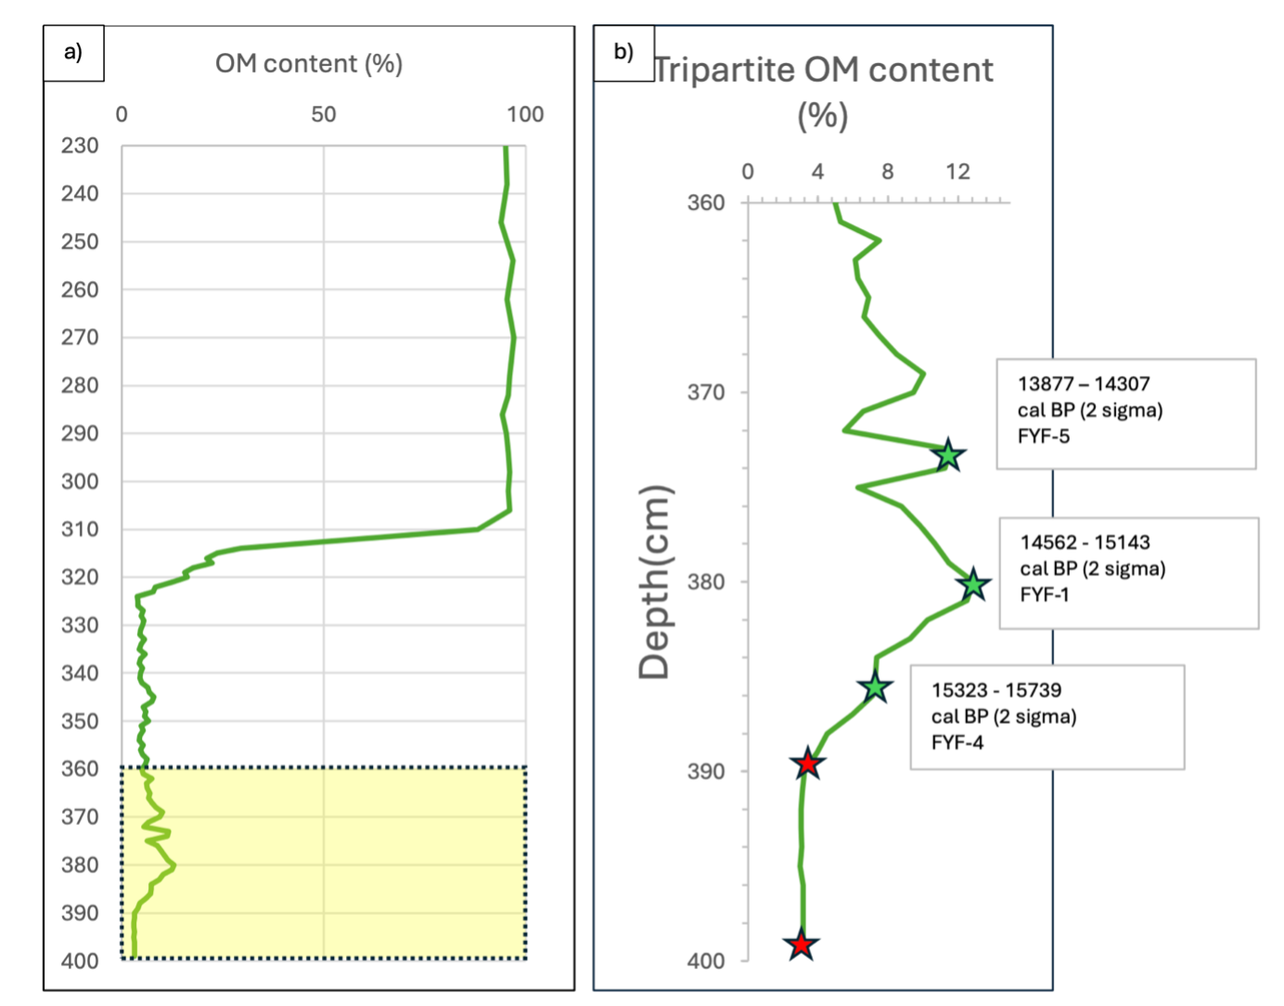
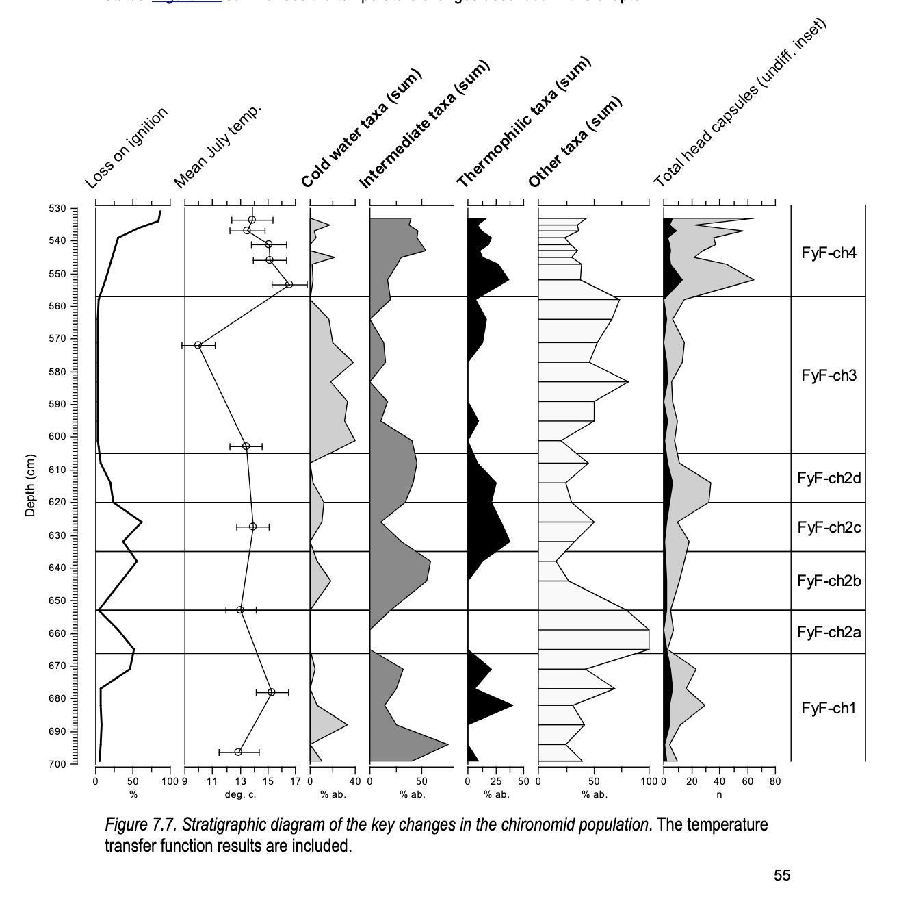
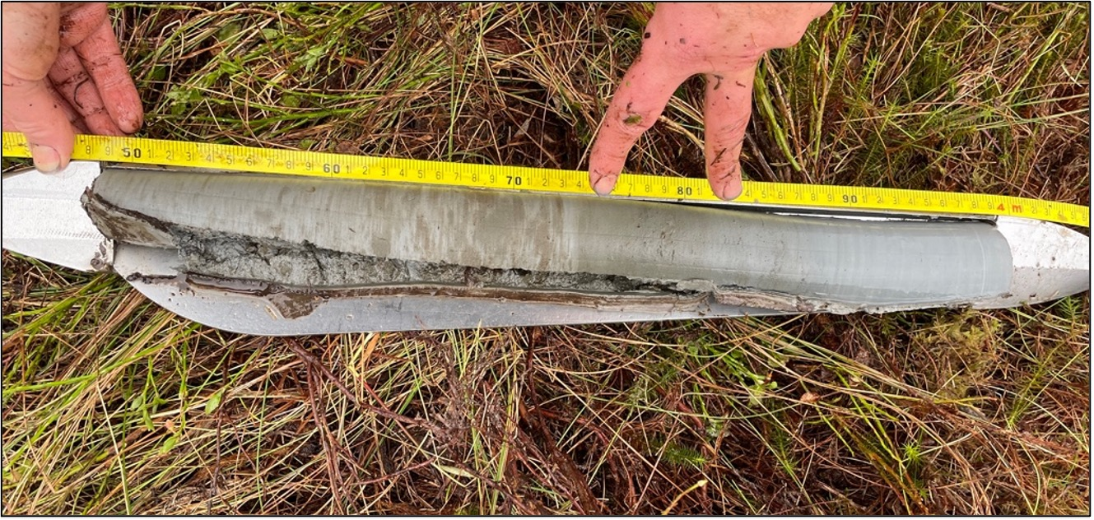
B-A
YD
B-A
Figure credit: Tom Bishop, University of Manchester

Slide 8
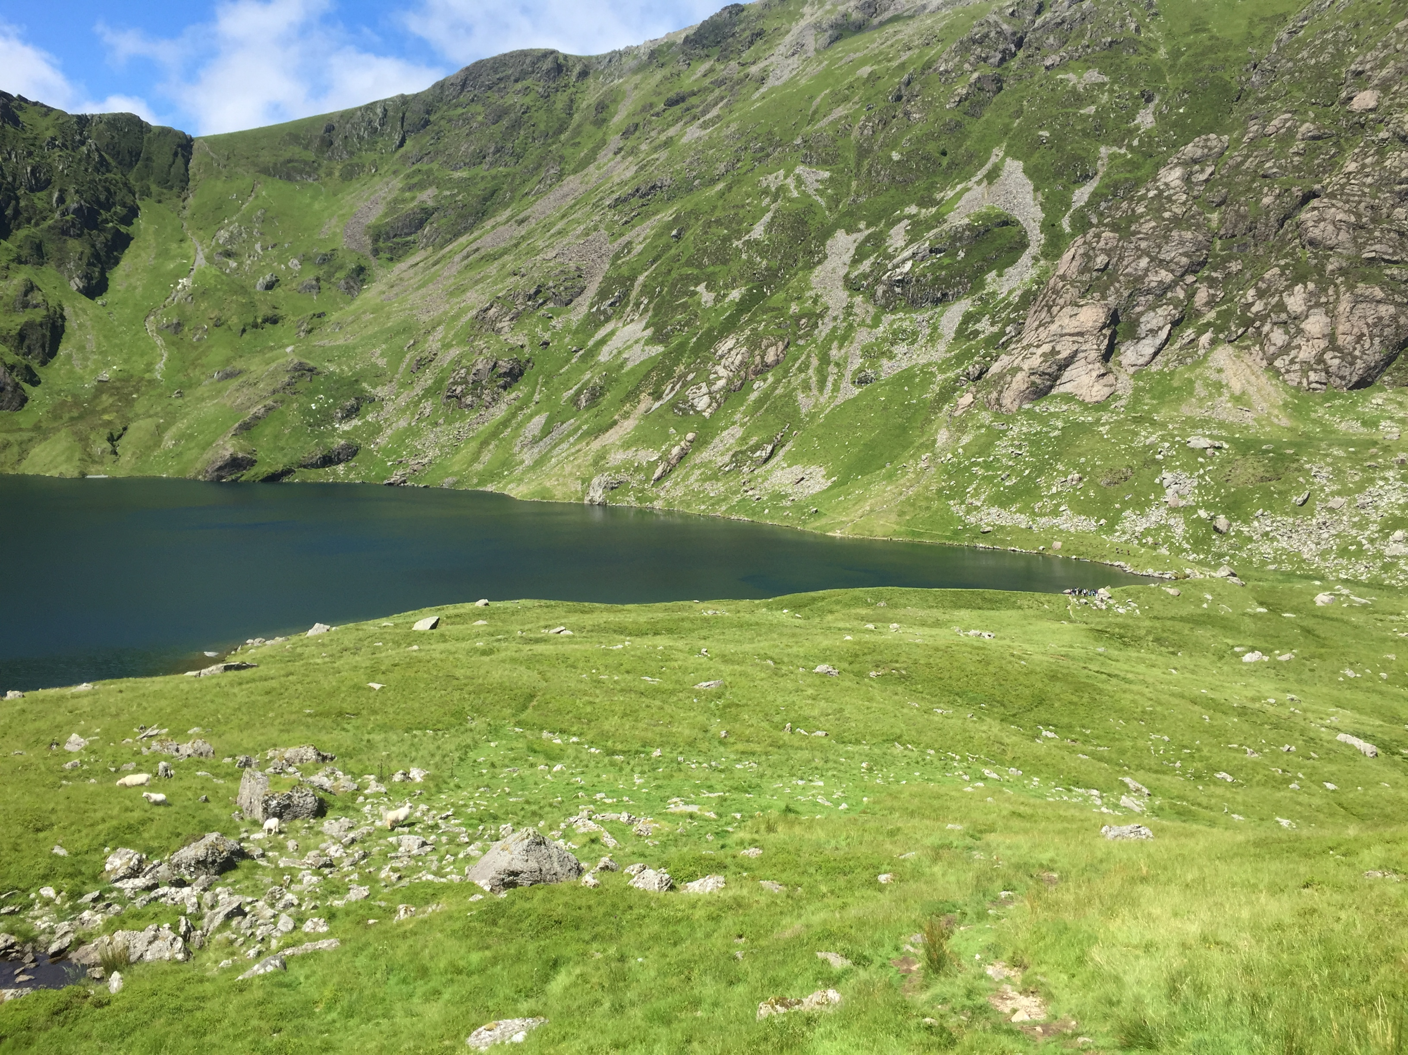
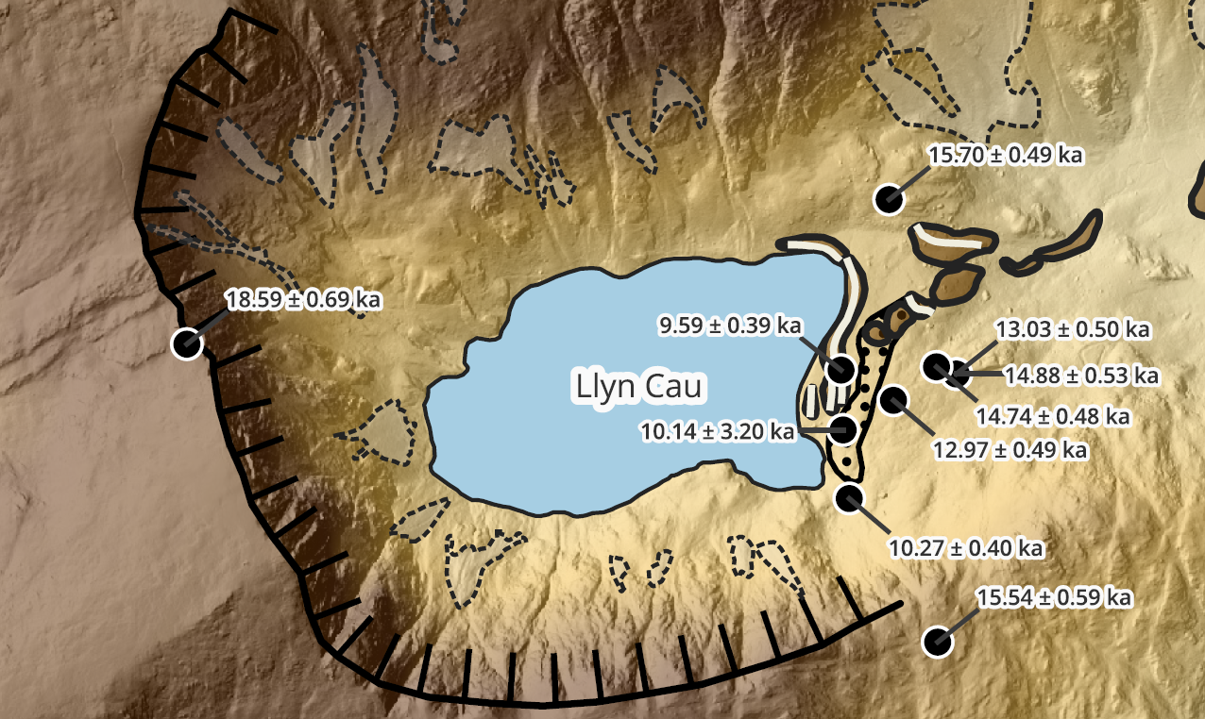
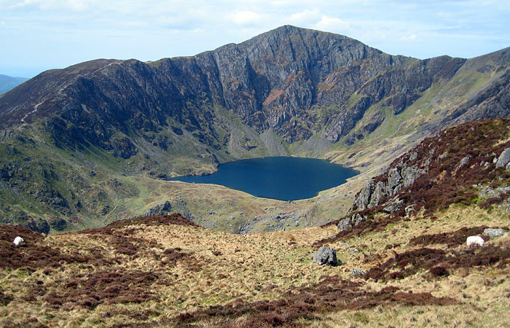
Ice had thinned exposing the ridges by 18 ka Oldest Dryas outer lateral moraines Bolling-Allerod boulders (retreat) Younger Dryas – pollen stratigraphy from Llyn Cau lake (S. Lowe 1994) and Early Holocene min ages

Slide 9
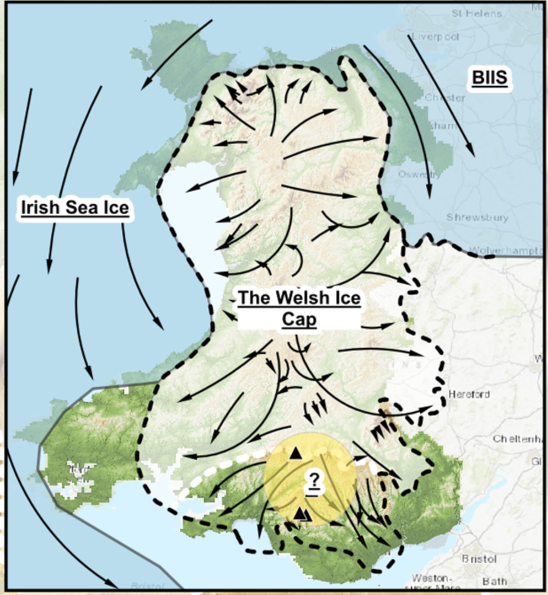
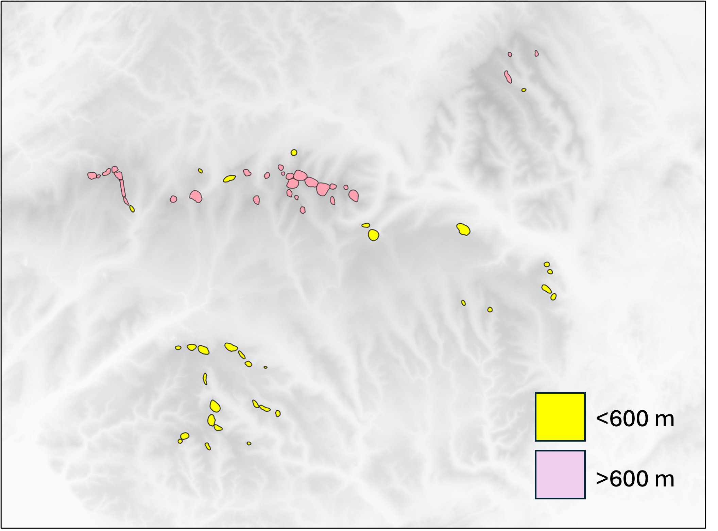
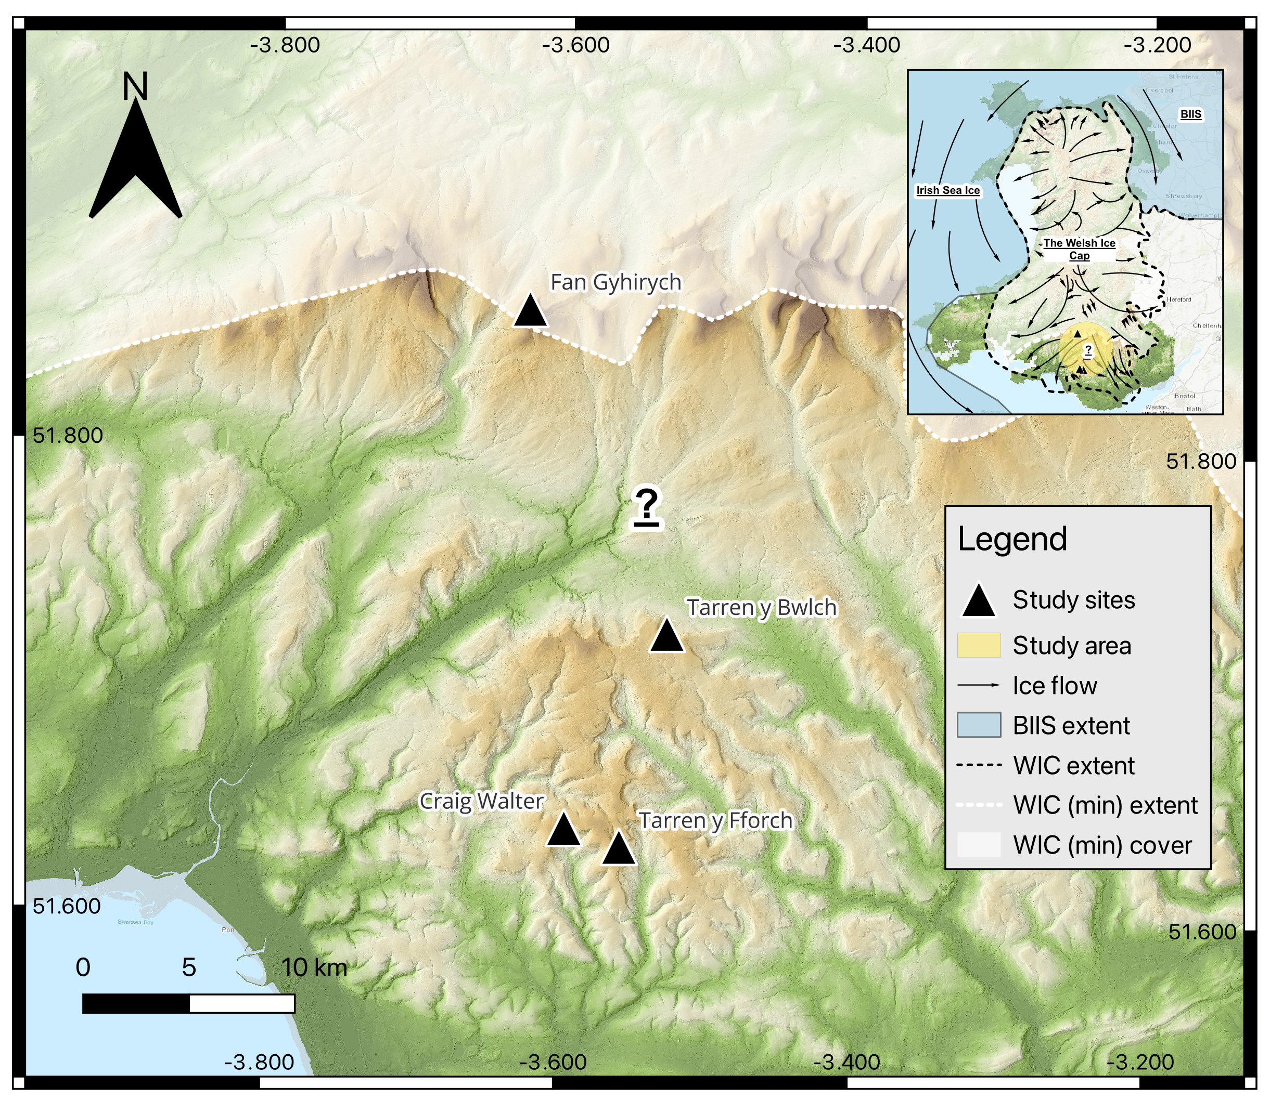
Brecon Beacons and the South Wales Valleys

Slide 10
Conclusions
The Welsh Ice Cap completely collapsed and almost disappeared entirely within 3,000-2,000 years from 21-18 ka. Terrestrial ice cap. Irish Sea ice stream preceded this
The centre of the ice cap had thinned revealing the Arenig summits by 21 ka
Ice had retreated to the cirques by 18-19 ka
Whilst most of Wales was ice-free by 18 ka, ice persisted in some cirques
A succession of moraines reveal the presence of ice in the Oldest Dryas, the Bolling Allerod and the Younger Dryas
Significant moraine-building occurred in the Oldest Dryas and Younger Dryas
Moraines dating to the Bolling Allerod are subdued and are interpreted here as recessional, though questions remain
The last cirque moraines in South Wales Valleys are lower than elsewhere in Wales. This raises questions regarding their age and/or climate differences that characterised the deglaciation of Wales
Cosmogenic exposure dating, whilst powerful and providing insights previously beyond reach, has limited capacity to help resolve some Late-glacial questions. Nevertheless, combined with geomorphological context and the help of sediment sequences from inter-morainal basins, the Late-glacial questions may be eventually resolved

