Slide 1
Supplementary materials

Slide 2
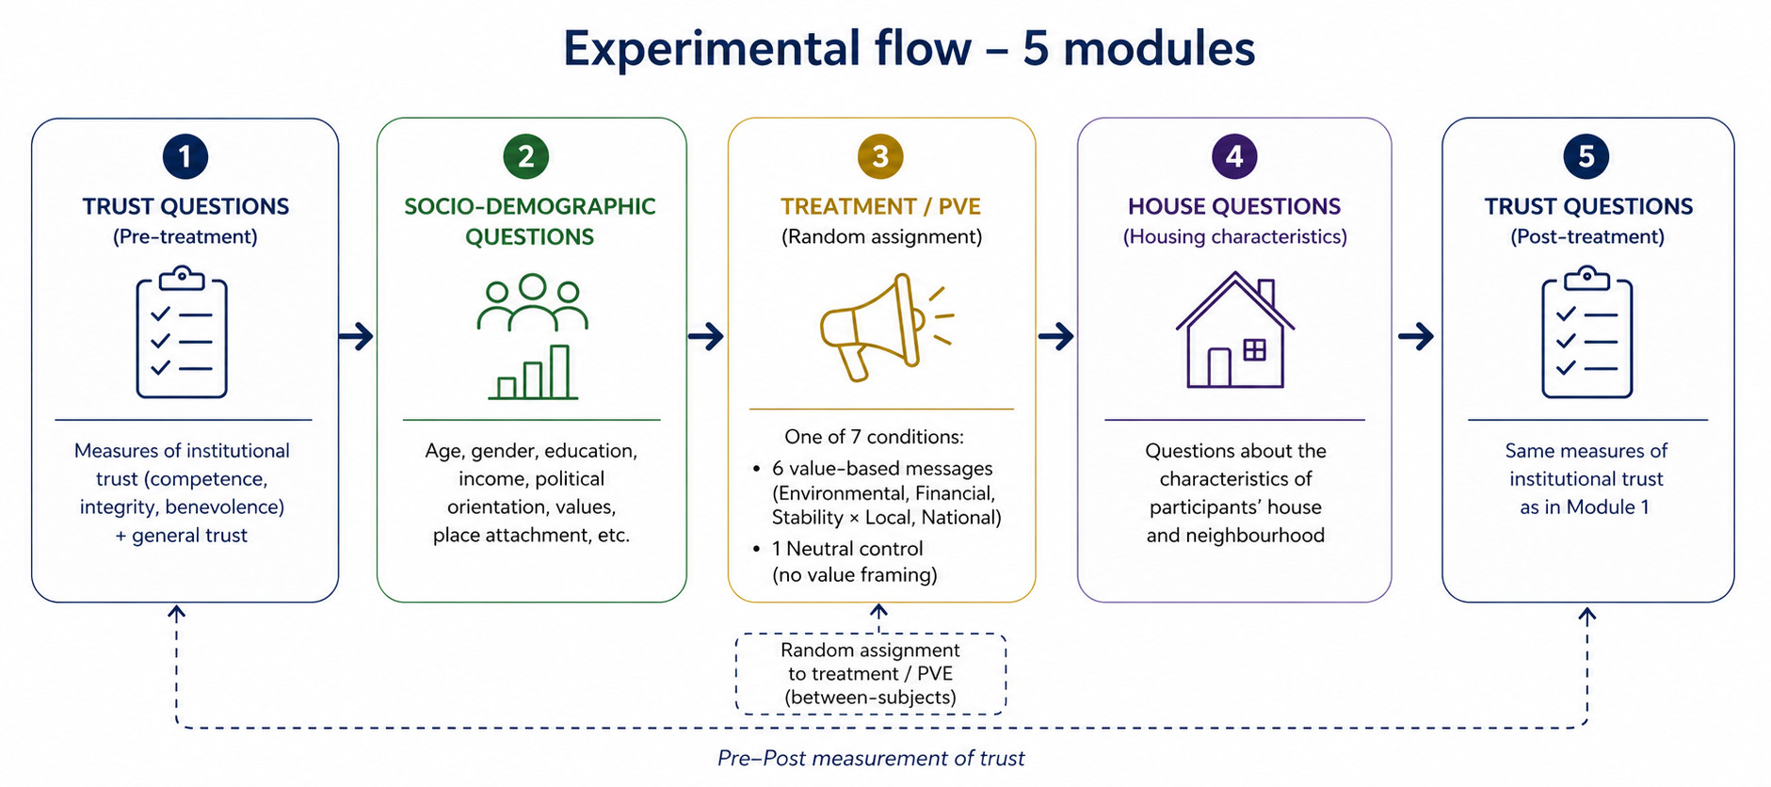

Slide 3
Framing treatments
 | Environmental framing | Financial framing | Stability framing
Local Government | T1: LocalEnviron | T3: LocalFinan | T5: LocalStab
National Government | T2: NatEnviron | T4: NatFinan | T6: NatStab

Slide 4
Trust questions
Item by Grimmelikhuisen and Knies (2017) | Translated and applied
ADDED PREFIX: When it concerns energy policy (…) | Als het gaat om energiebeleid, (…)
COMP1: [The municipality of XX] is capable. | (…) is de overheid bekwaam
COMP2: [The municipality of XX] is effective. | (…) is de overheid effectief
COMP3: [The municipality of XX] is skilful. | (…) is de overheid vaardig
COMP4: [The municipality of XX] is expert. | (…) is de overheid een expert
COMP5: [The municipality of XX] carries out its duty very well. | (…) voert de overheid zijn taak goed uit
BEN1: If citizens need help, [the municipality of XX] will do its best to help them. | (…) zal de overheid zijn best doen burgers te helpen, als zij hulp nodig hebben
BEN2: [The municipality of XX] acts in the interest of citizens. | (…) handelt de overheid in het belang van inwoners
BEN3: [The municipality of XX] is genuinely interested in the well-being of citizens. | (…) is de overheid werkelijk geïnteresseerd in het welzijn van inwoners
INT1: [The municipality of XX] approaches citizens in a sincere way. | (…) benadert de overheid inwoners op een oprechte manier
INT2: [The municipality of XX] is sincere.* | (…) is de overheid oprecht
INT3: [The municipality of XX] keeps its commitments. | (…) houdt de overheid zich aan zijn afspraken
INT4: [The municipality of XX] is honest.* | (…) is de overheid eerlijk

Slide 5
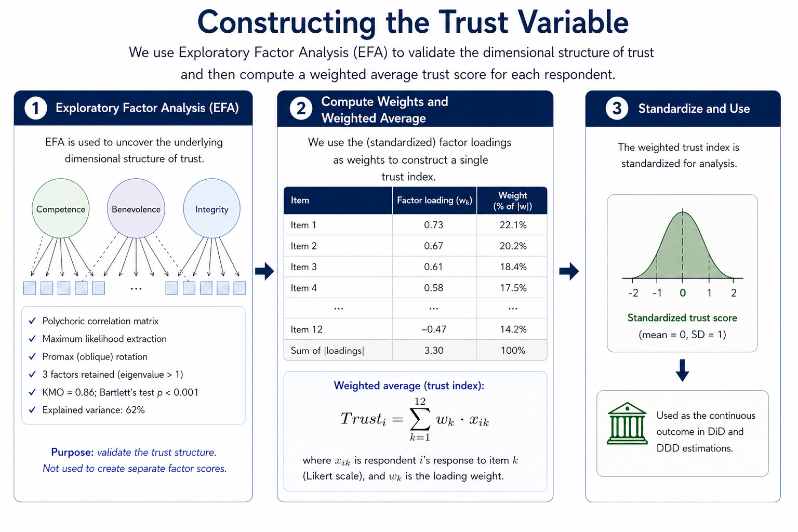

Slide 6
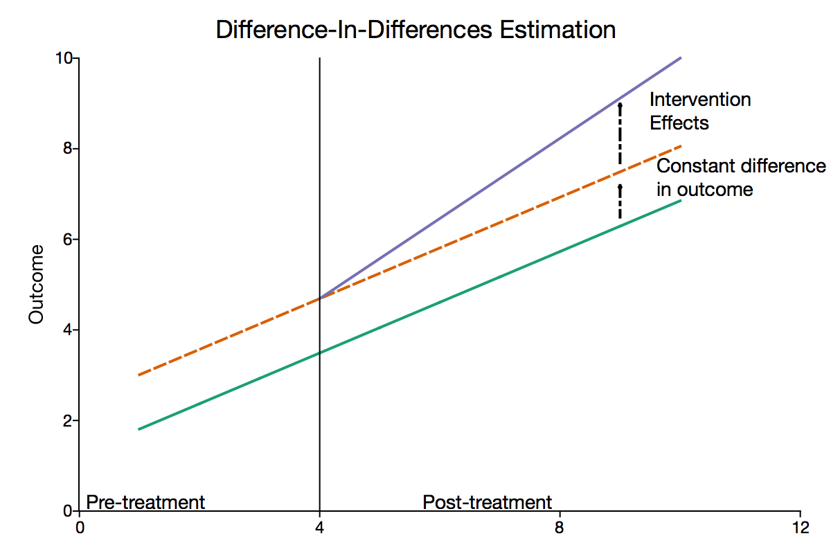
Model
Difference in Difference: $Y_{it}= α+ β_{1}T_{i}+ γt_{t}+ δ\left(T_{i}∗t_{t}\right)+β_{cov}+ ε_{i}$
Triple Difference: $Y_{it}= α+ β_{1}T_{i}+ γt_{t}+ δ\left(T_{i}∗t_{t}\right)+β_{2}C_{i}+β_{3}\left(C_{i}∗T_{i}\right)+β_{4}(C_{i}∗t_{t})+ β_{5}{(C}_{i}∗ \left(T_{i}∗t_{t}\right))+β_{cov}+ ε$

Slide 7
LPA
Trust class | n (pre) | Mean pre | 95% CI pre | n (post) | Mean post | 95% CI post
1 | 428 | 1.16 | [1.14; 1.17] | 428 | 1.26 | [1.22; 1.30]
2 | 1019 | 2.04 | [2.03; 2.06] | 1014 | 2.12 | [2.09; 2.15]
3 | 86 | 2.44 | [2.44; 2.44] | 86 | 2.55 | [2.45; 2.66]
4 | 895 | 2.90 | [2.88; 2.91] | 887 | 2.91 | [2.88; 2.95]
5 | 465 | 3.73 | [3.71; 3.76] | 463 | 3.61 | [3.57; 3.66]
6 | 103 | 4.62 | [4.58; 4.67] | 103 | 4.34 | [4.21; 4.46]

Slide 8
DiD results
Variable | DiD | DDD | DiD + Demo | DDD + Demo
Post | 0.054** | 0,048 | 0.049* | 0,048
 | (0.025) | (0.048) | (0.025) | (0.048)
LocalEnviron | -0,019 | 0,000 | -0,013 | 0,001
 | (0.014) | (0.029) | (0.015) | (0.030)
NatEnviron | -0,007 | 0,024 | -0,002 | 0,024
 | (0.015) | (0.029) | (0.016) | (0.030)
LocalFinan | -0,018 | 0,006 | -0,019 | -0.000
 | (0.015) | (0.030) | (0.015) | (0.030)
NatFinan | 0,008 | 0,04 | 0,019 | 0,044
 | (0.014) | (0.029) | (0.015) | (0.030)
LocalStab | 0,006 | 0.052* | 0,014 | 0.054*
 | (0.015) | (0.030) | (0.015) | (0.031)
NatStab | -0.010 | 0,02 | -0,001 | 0,026
 | (0.015) | (0.029) | (0.016) | (0.030)
Post × LocalEnviron | -0,054 | -0,072 | -0,048 | -0,072
 | (0.034) | (0.065) | (0.035) | (0.066)
Post × NatEnviron | -0,001 | 0,052 | 0,004 | 0,054
 | (0.034) | (0.062) | (0.035) | (0.062)
Post × LocalFinan | -0.066** | -0.113* | -0.064* | -0.113*
 | (0.033) | (0.061) | (0.033) | (0.061)
Post × NatFinan | -0,022 | 0,032 | -0,017 | 0,036
 | (0.034) | (0.063) | (0.034) | (0.064)
Post × LocalStab | -0.059* | -0,065 | -0.055* | -0,065
 | (0.033) | (0.062) | (0.033) | (0.063)
Post × NatStab | -0.020 | -0,045 | -0,015 | -0,045
 | (0.033) | (0.061) | (0.033) | (0.061)
Controls (Demo) | NO | NO | YES | YES
N | 5962 | 5962 | 5936 | 5936
R² | 0.824 | 0.828 | 0.829 | 0.833

Slide 9
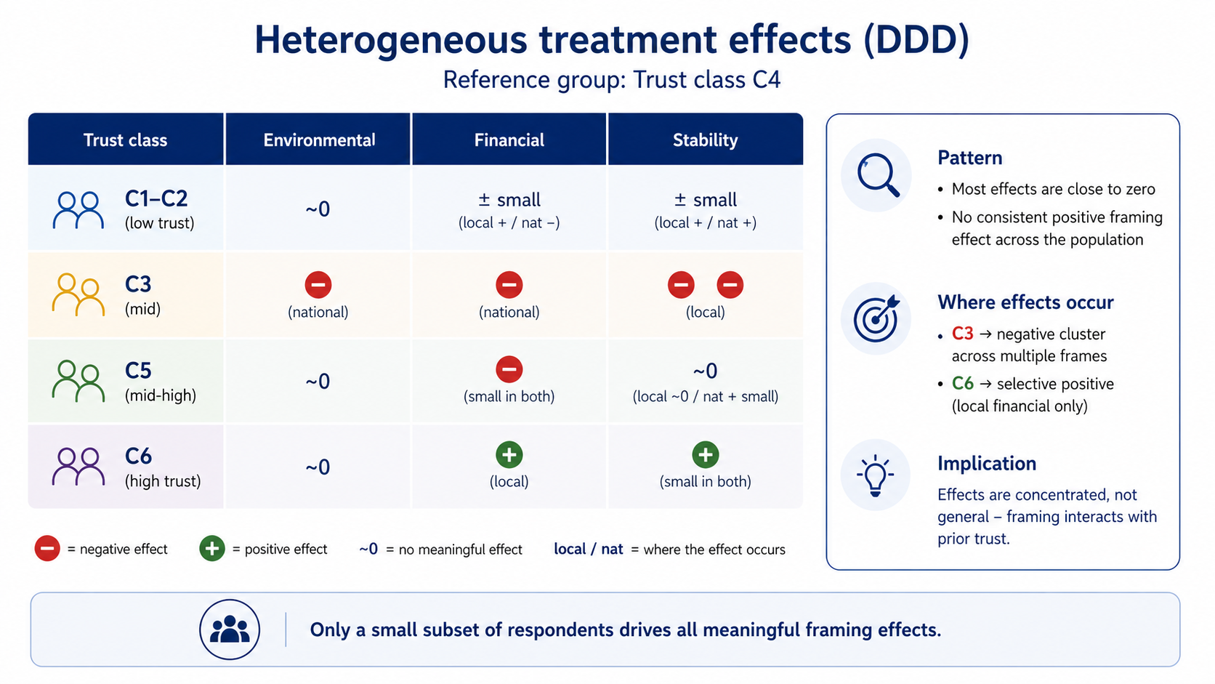

Slide 10
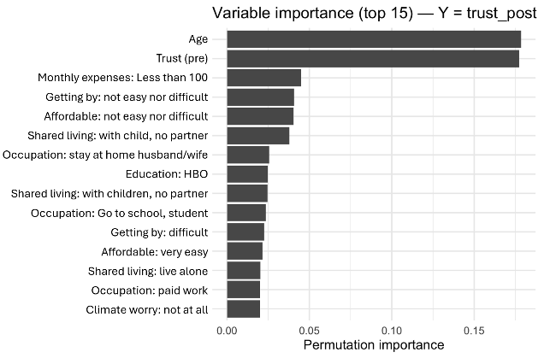
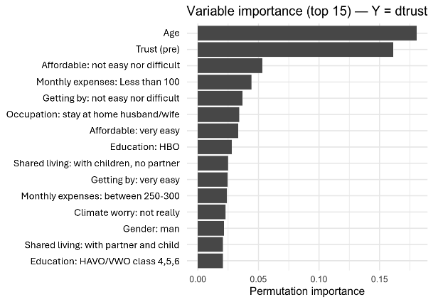
Honest Causal Forest

Slide 11
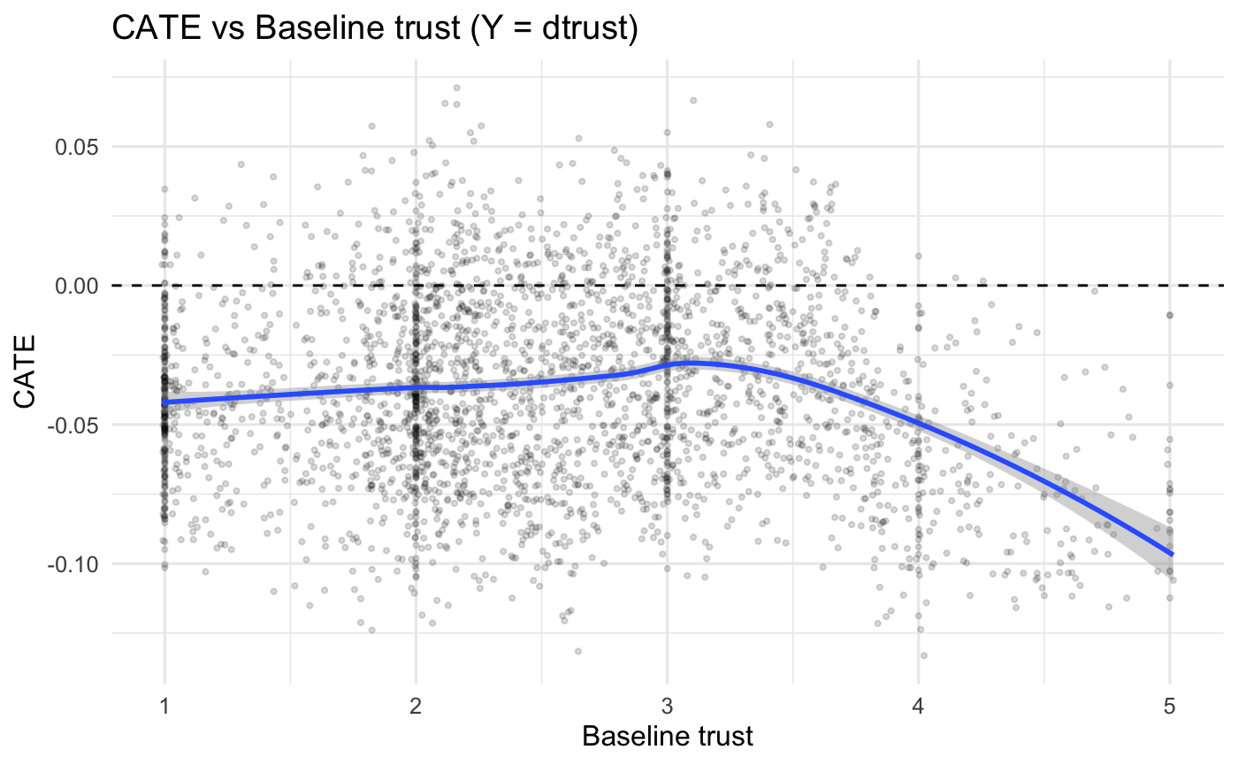
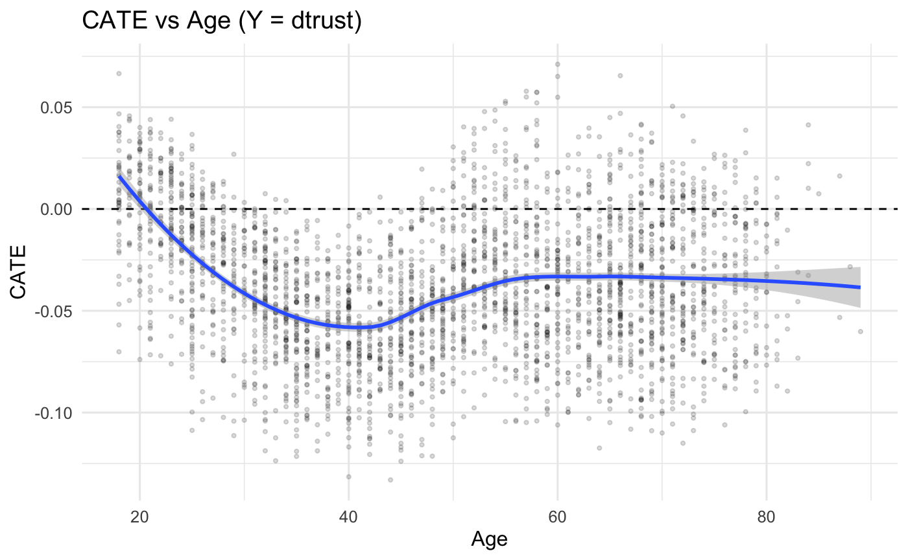
HCF - sociodemo

Slide 12

www.align4energy.nl align4energy@vu.nl

