Slide 1



Safeguarding Geoheritage in a Changing World: An interdisciplinary assessment of the value and vulnerability for Neamț County's geosites
Vienna, Austria & Online | 3–8 May 2026
Maria Cristina CIMPOEȘU¹, Nicușor NECULA^{1,2}, Ionuț GRĂDIANU^{1,3}, Adrian GROZAVU¹
¹ Alexandru Ioan Cuza” University of Iaşi, Faculty of Geography and Geology, Geography, Iasi, Romania
² „Alexandru Ioan Cuza” University of Iaşi, Tulnici Research Centre, Bd Carol I 11, 700506
³ Natural Sciences Museum of Piatra-Neamț, Petru Rareș 26A, 610119, Neamț, Romania

Slide 2
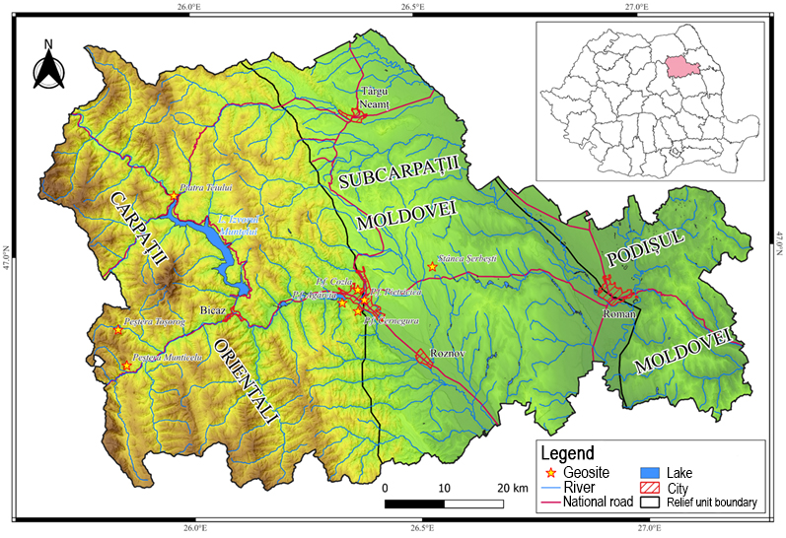
Introduction
As a modern concept with deep historical roots, geological heritage requires the systematic identification and evaluation of sites as a basis for effective management.
In Neamț County, Romania, a remarkable geological heritage awaits protection, including:
LANDMARKS
Munticelu Cave
Toșorog Cave
NATURAL MONUMENTS
Piatra Teiului
Stânca Șerbești
PALEONTOLOGICAL RESERVES
Cozla
Pietricica
Cernegura
Agârcia
Context and Objective
Fig. 1. Map of geosite locations
The Problem
Lack of coordinated conservation - Despite their importance, these sites are vulnerable to natural degradation and human activities.
Our Approach
Quantify value of geosites and vulnerability to geomorphological processes, weathering, and anthropogenic impact. Assess tourist accessibility using GIS and terrain modelling.

Slide 3
Framework and Methodology
Table 1. Conceptual framework for the geosite assessment according to Brilha (2016), with modifications
Table 2. Assessment Method (after Brilha, 2016)-27 criteria applied across four categories
GEOSITES
Inventory of restricted areas | Inventory of extended areas
Literature review Consultation with experts who have worked in the area
 | Identification of representative geosites for each geological framework. Identification of representative geosites for each geological setting.
List of geosites
Fieldwork for the identification of geosites and for the qualitative evaluation of each geosite from the list of potential geosites, based on the following four criteria: representativeness, integrity, rarity, scientific knowledge.
Final list of geosites with complete characterization
Final list of geosites in the area, sorted by scientific value (SV) and risk of degradation
Quantitative assessment of scientific value (SV)
Quantitative assessment of educational potential (PEU) | Quantitative assessment of tourism potential (PTU)
Quantitative assessment of the risk of degradation
Category | Criteria | Score Range
Scientific Value | 7 criteria | 1, 2, 4 (scientific value did not include a score of 3)
Educational Value | 10 common + 2 separate | 1 – 4
TourismValue (accessibility and value) | 10 common + 3 separate | 1 – 4
Degradation Risk | 5 criteria | 1 – 4
Results
Table 3. Quantitative assessment results for the eight geosites in Neamț County
GEOSITES/CRITERIA | SCIENTIFIC VALUE | EDUCATIONAL VALUE | TOURISM VALUE | DEGRADATION RISK
Munticelu Cave | 255 | 290 | 235 | 205
Toșorog Cave | 310 | 265 | 280 | 165
Piatra Teiului | 270 | 335 | 280 | 275
Stânca Șerbești | 280 | 255 | 270 | 170
Paleontological reserve Cozla | 335 | 349 | 290 | 340
Paleontological reserve Pietricica | 250 | 325 | 285 | 250
Paleontological reserve Cernegura | 240 | 325 | 285 | 195
Paleontological reserve Agârcia | 240 | 329 | 275 | 165

Slide 4
Table 4. Brief description of the eight geosites inventoried in Neamț County
Nr. | Geosites | Geographic coordinates | Surface area / Elevation (m) | Main characteristics | Geodiversity type | Integrity
1 | Munticelu Cave | 46°50′03″N 25°51′08″E | 1 ha/300 m | Stalactites, stalagmites, draperies, tubular stalactites, transparent stalactites. Fossils of Ursus spelaeus Rosenmüler & Heinroth, 1794. | Natural monument | Average
2 | Toșorog Cave | 46°53′19″N 25°50′03″E | 0,1 ha/965 m | The largest cave in the country, developed in Cretaceous conglomerates. | Natural monument | High
3 | Piatra Teiului | 47°5′27.89″N 25°57′39.30″E | 0,2 ha/508m | Cretaceous calcareous reef. | Natural monument | Average
4 | Stânca Șerbești | 46°58′37.78″N 26°31′56.72″E | 5 ha/512 m | Fossil site: fossil bivalve and gastropod remains, of Miocene age (Sarmațian). | Natural monument | High
5 | Cozla Fossil Site | 46°56′39″N 26°21′58″E | 10 ha/ 657m | Fossil site: fossil isopods, fish skeletons of Oligocene age (34 M.Y.). | Nature reserve | Low
6 | Pietricica Fossil Site | 46°55′43″N 26°22′49″E | 39,50 ha/ 532 m | Fossil site: bivalves, fish skeletons of Oligocene age (34 M.Y.). | Nature reserve | High
7 | Cernegura Fossil Site | 46°54′42″N 26°21′57″E | 198,2 ha/ 852m | Fossil site: bivalves, fish skeletons of Oligocene age (34 M.Y.). | Nature reserve | High
8 | Agârcia Fossil Site | 46°55′29″N 26°19′52″E | 1 ha/400 m | Fossil site: fish skeletons of Oligocene age (34 M.Y.). | Nature reserve | High

Slide 5
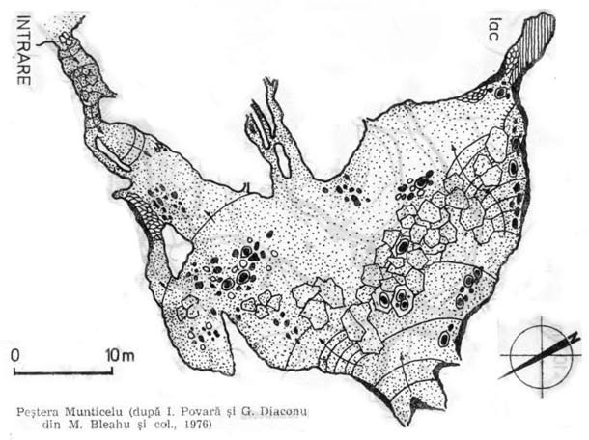
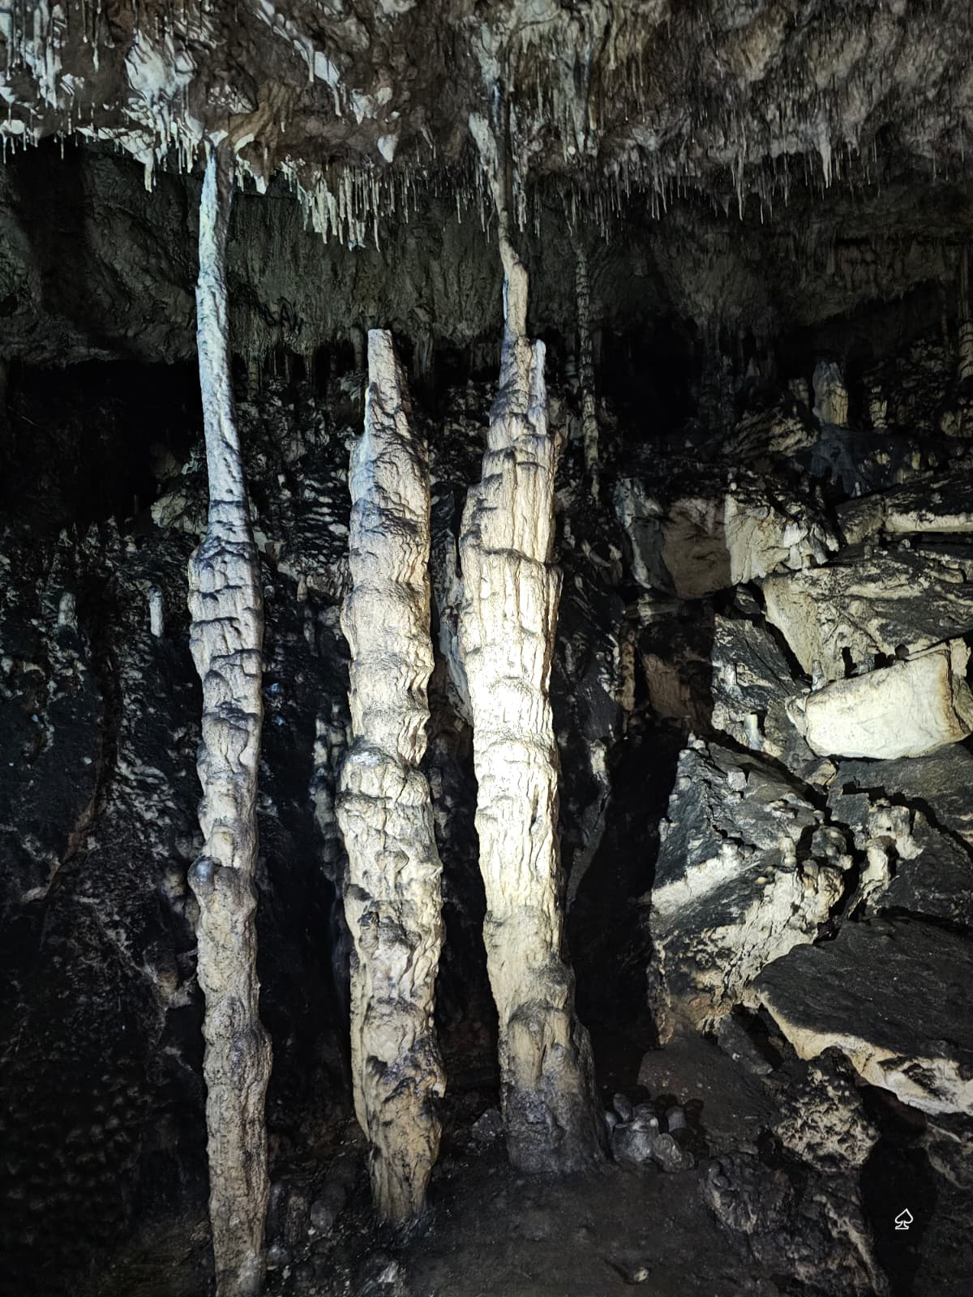
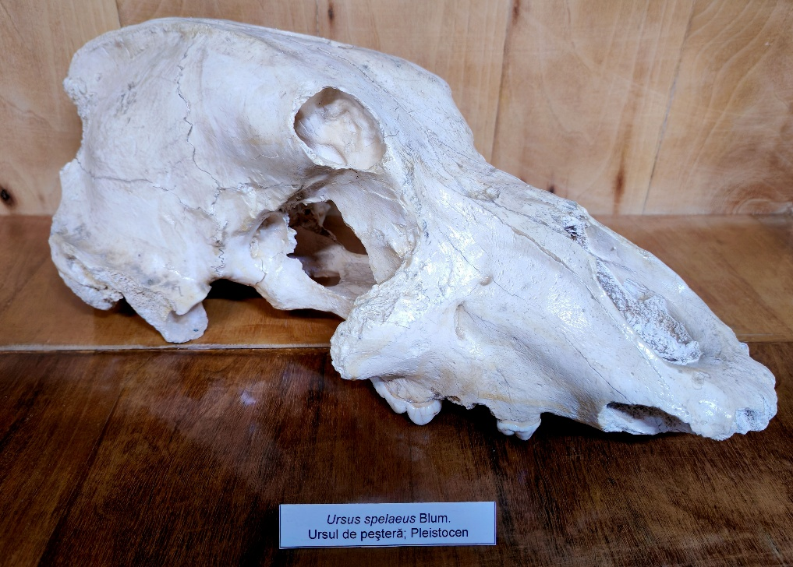
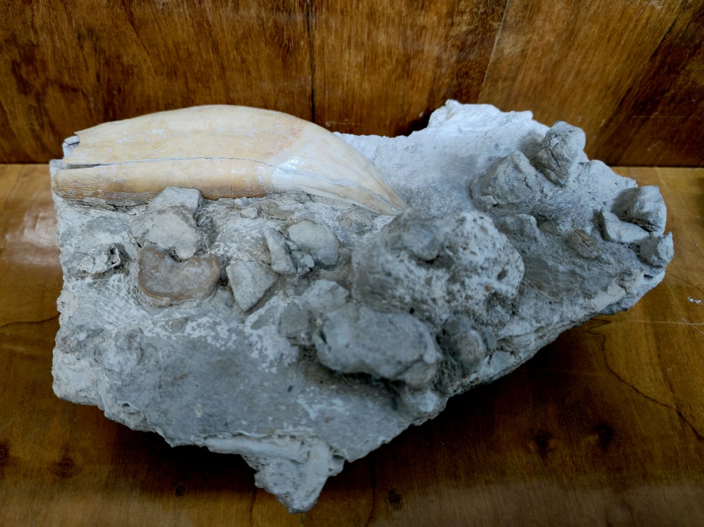
Munticelu Cave
Legal status: Law no. 5/2000; HCJ no. 15/1994
Location: Bicazu Ardelean commune, Neamț County
Category: Natural Monument, speleological reserve (IUCN category III), part of the karst complex of the Bicaz Gorges
Significance/Importance: Stalactites, stalagmites, draperies, tubular stalactites, transparent stalactites, fossils of Ursus spelaeus Rosenmüler & Heinroth, 1794 (Bleahu et al. 1976).
Fig. 2. Sketch of Munticelu Cave (after Bleahu et al. 1976)
Fig. 4. Skull of Ursus spelaeus, Munticelu Cave. Paleontological collection of the Piatra-Neamț Museum of Natural Sciences
Fig. 5. Canine of Ursus spelaeus, Munticelu Cave. Paleontological collection of the Piatra-Neamț Museum of Natural Sciences.
Fig. 3. Fistulous stalactites (soda straws), stalagmites, columns, Munticelu Cave

Slide 6
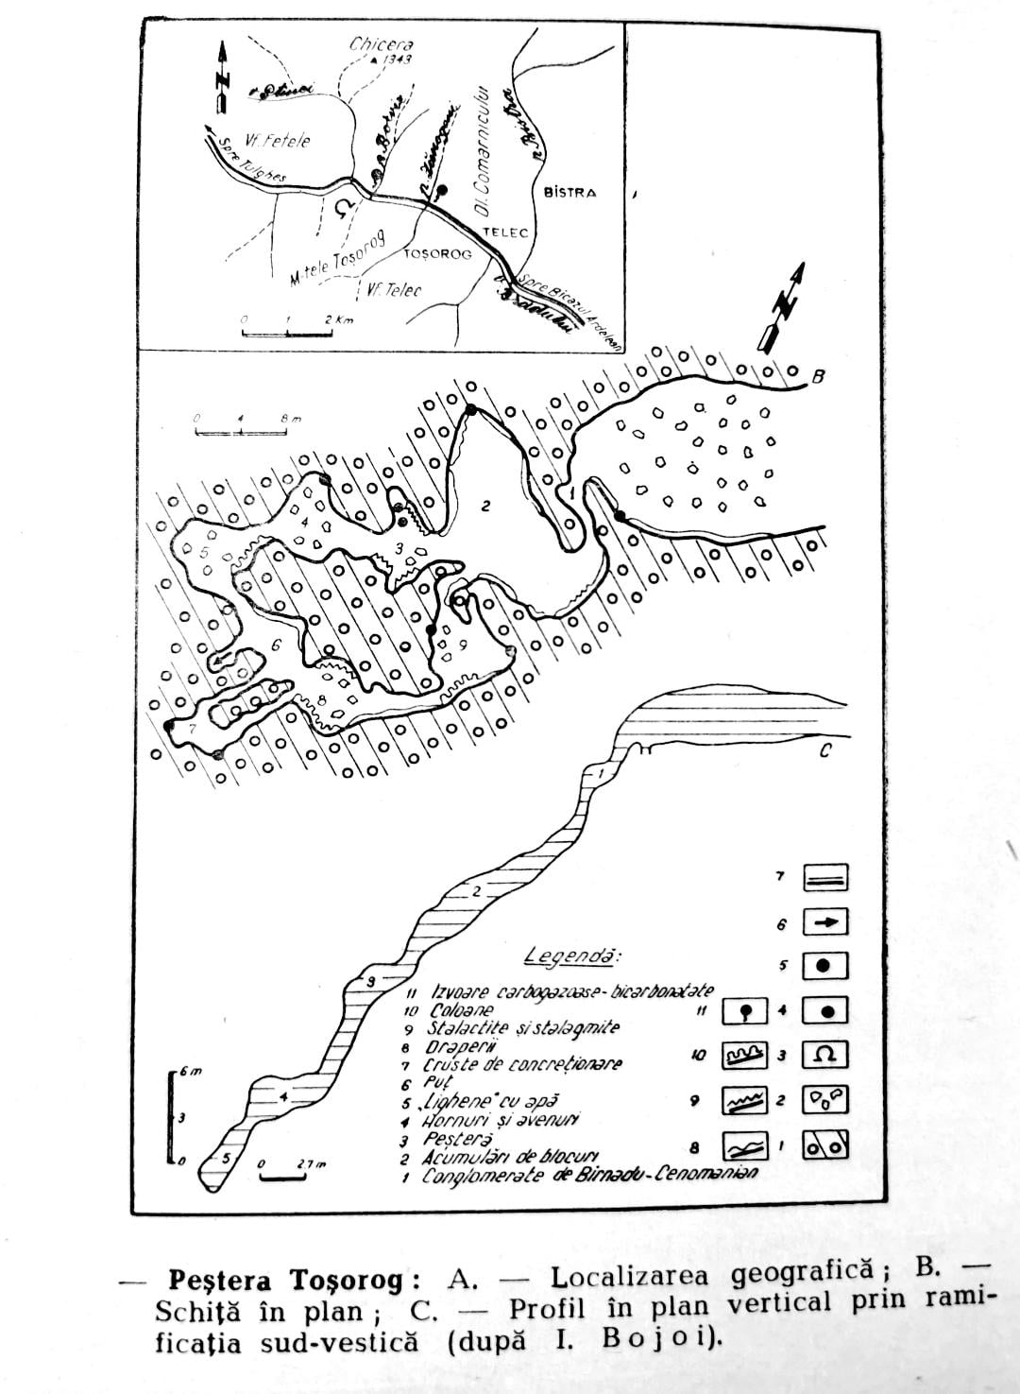
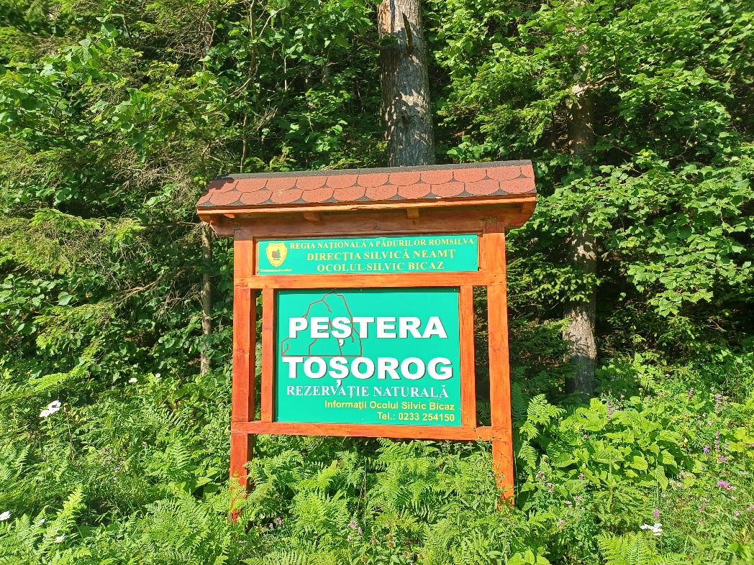
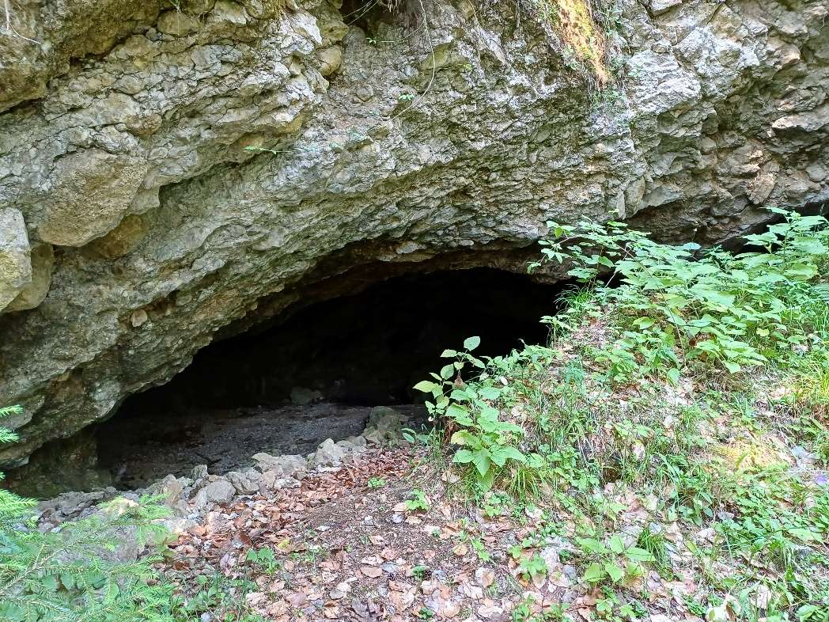
Toșorog Cave
Legal status: Law no. 5/2000; HCJ no. 15/1994
Location: Bicazu Ardelean commune, Neamț County
Category: Natural Monument, speleological reserve (IUCN category III), part of the Hășmaș Mountains
Significance/Importance: The cave formed as a result of tectonic processes, developing in Cretaceous conglomerates. This origin makes it a unique case in the Eastern Carpathians, as karst in this area developed on conglomerates rather than limestones. It is the longest cave in Romania with this specific genesis (Ciobanu et al. 1971).
Fig. 6. Sketch of Toșorog Cave
(after Ciobanu et al. 1971)
Fig. 7, 8. Entrance of Toșorog Cave

Slide 7
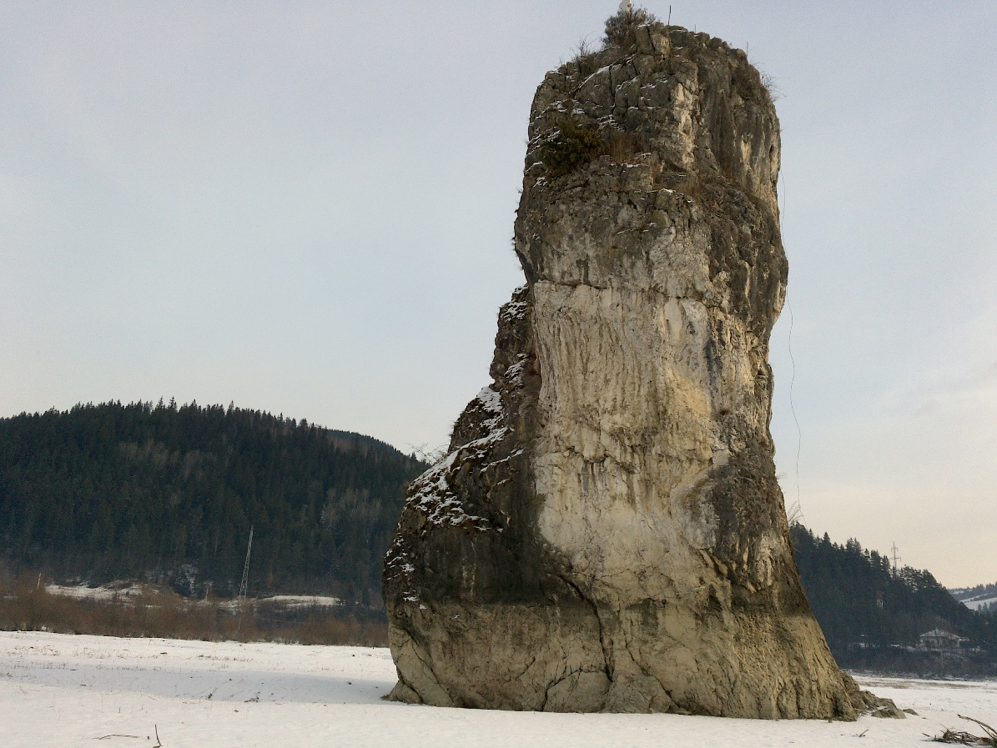
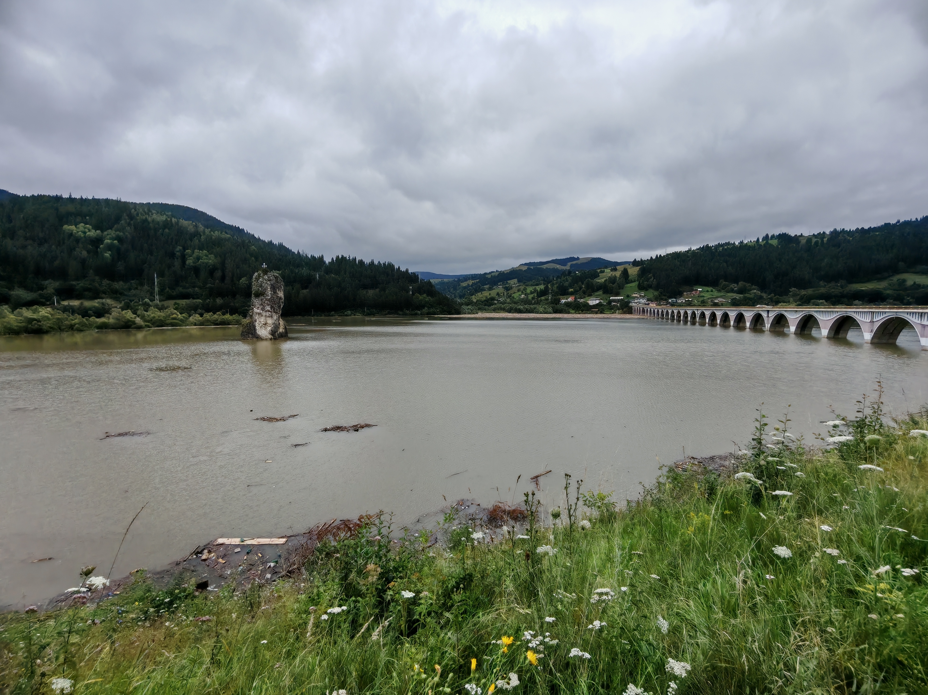
Piatra Teiului
Legal status: Law no. 5/2000; HCJ no. 15/1994
Location: Poiana Teiului commune, Neamț County
Category: Natural Monument, geological reserve (IUCN category III)
Significance/Importance: From a geological perspective, it formed during the Cretaceous and constitutes a limestone reef, currently preserved in the internal flysch. Paleontologically, it contains the remains of marine organisms, including foraminifera and echinoderms. The presence of foraminifera with thick tests indicates an abundance of calcium carbonate, conditions encountered today in the littoral zones of tropical seas (Ciobanu et al. 1971).
Fig. 9. Piatra Teiului natural monument
Fig. 10. Piatra Teiului natural monument

Slide 8
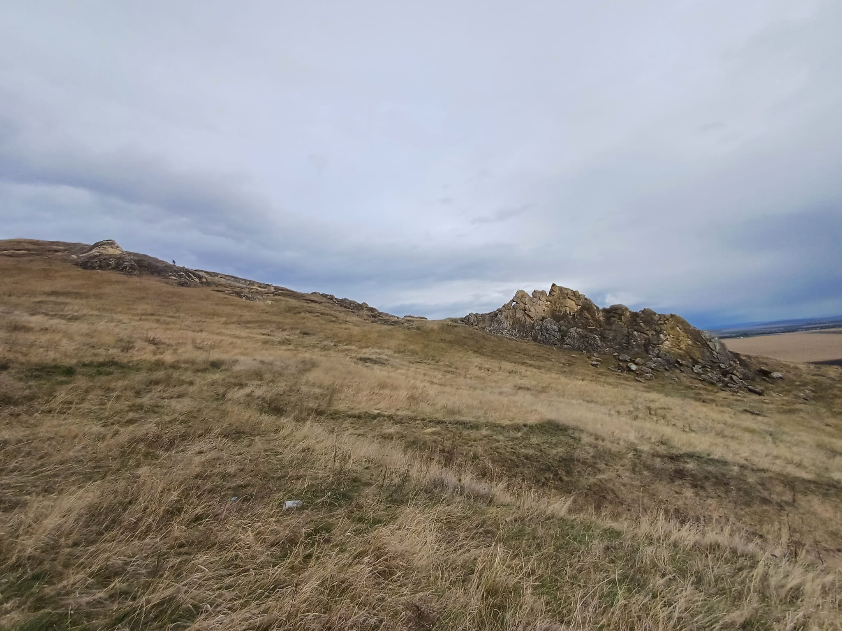
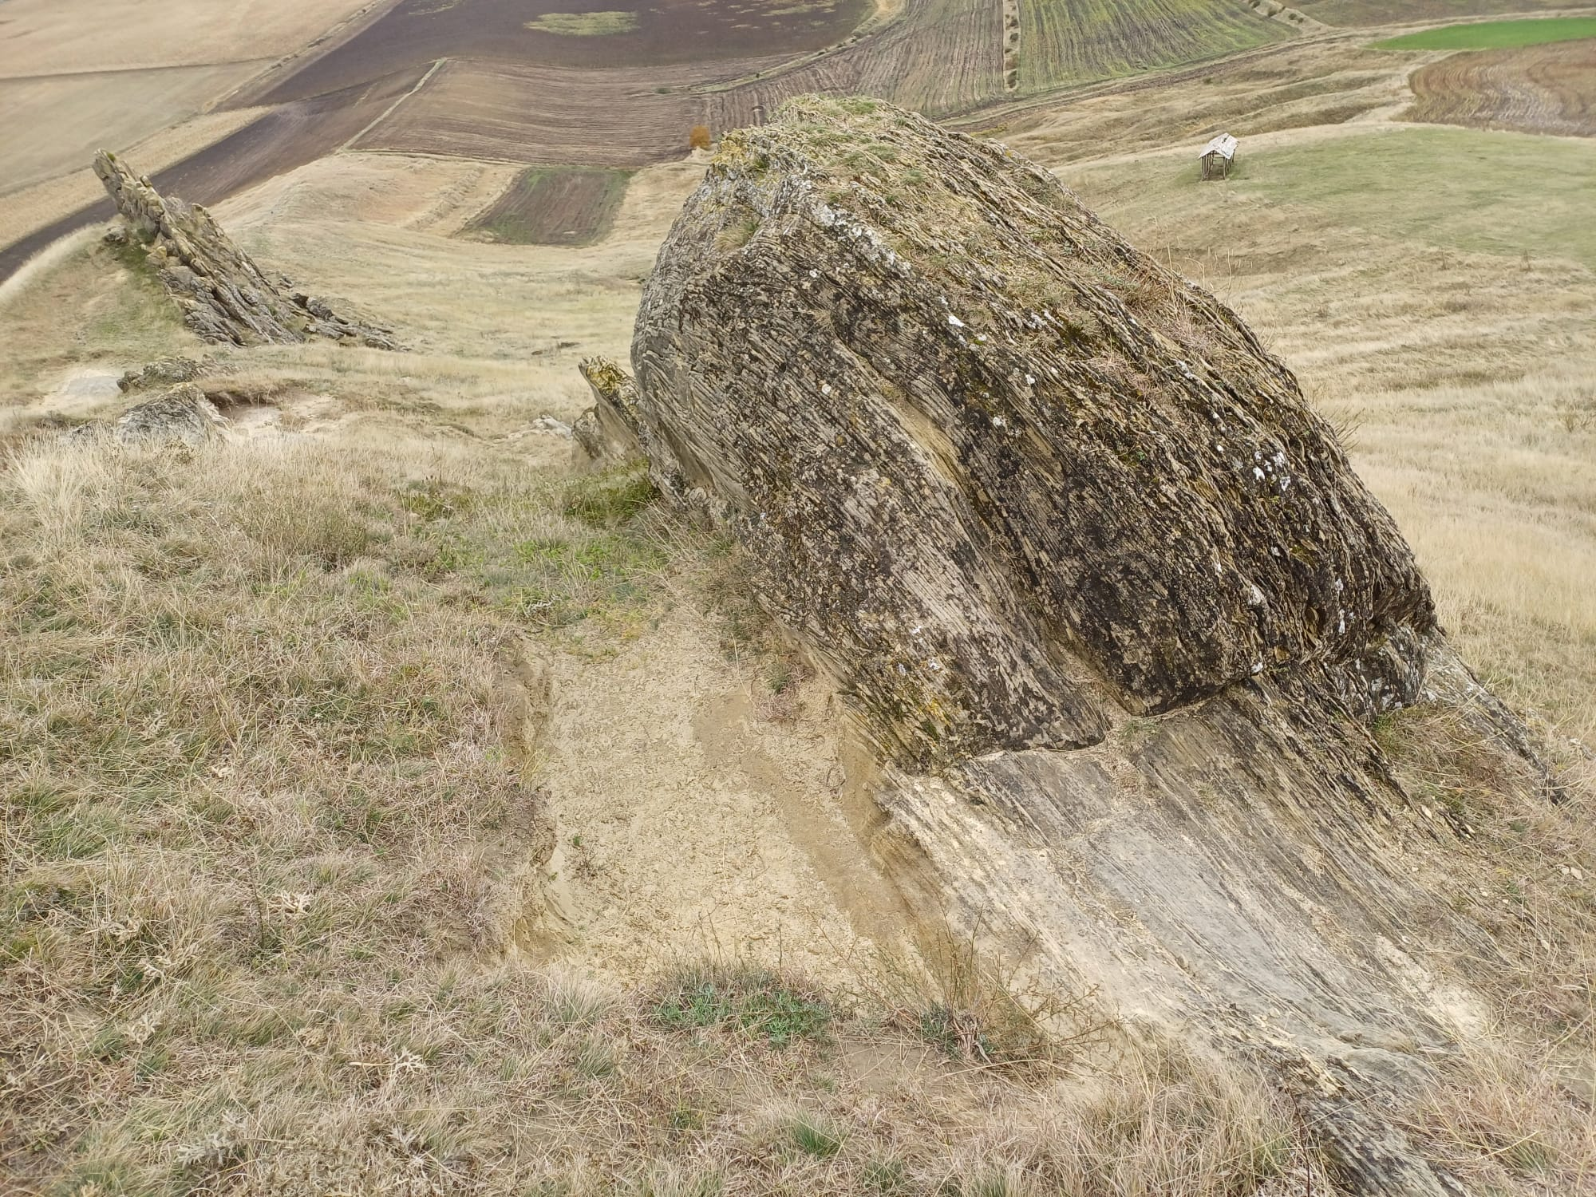
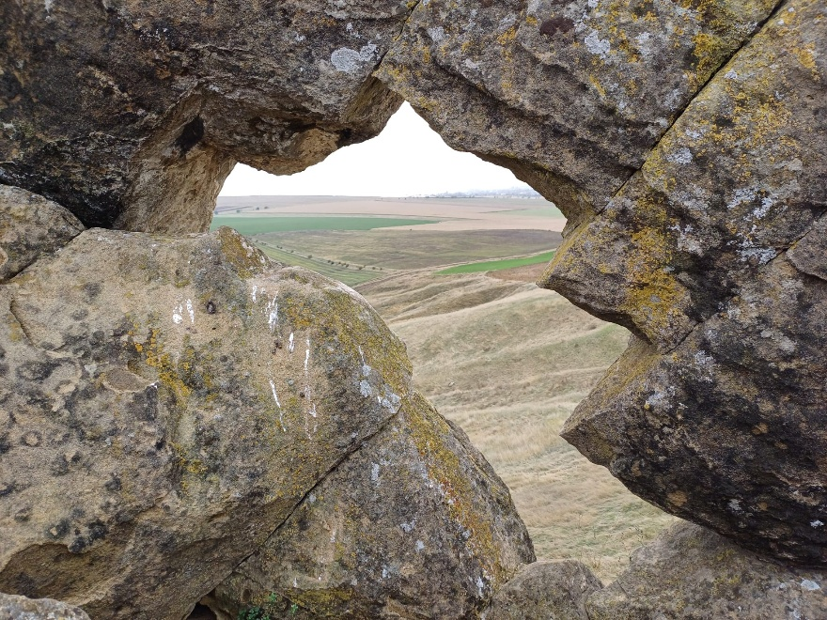
Stânca Șerbești
Legal status: Law no. 5/2000; HCJ no. 15/1994
Location: Ștefan cel Mare commune, Neamț County
Category: Natural Monument, geological and landscape reserve (IUCN category III)
Significance/Importance: represents a key site for understanding the complexity of geological phenomena in the contact zone between the Eastern Carpathians orogen and the platform unit. The rarity of areas where deposits of the Moldavian Platform are strongly tectonically deformed at the contact with the Subcarpathians, together with the fossiliferous character of the sandstones containing molluscs (Mactra vitaliana) and plant impressions, makes Stânca Șerbești an important geological landmark (Ciobanu et al. 1971; Miclăuş şi Grasu, 2002).
Fig. 11, 12, 13. Stânca Șerbești natural monument

Slide 9
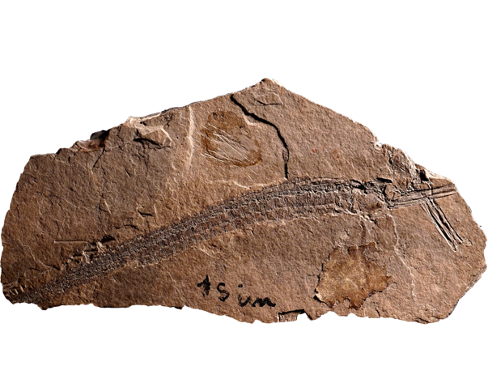
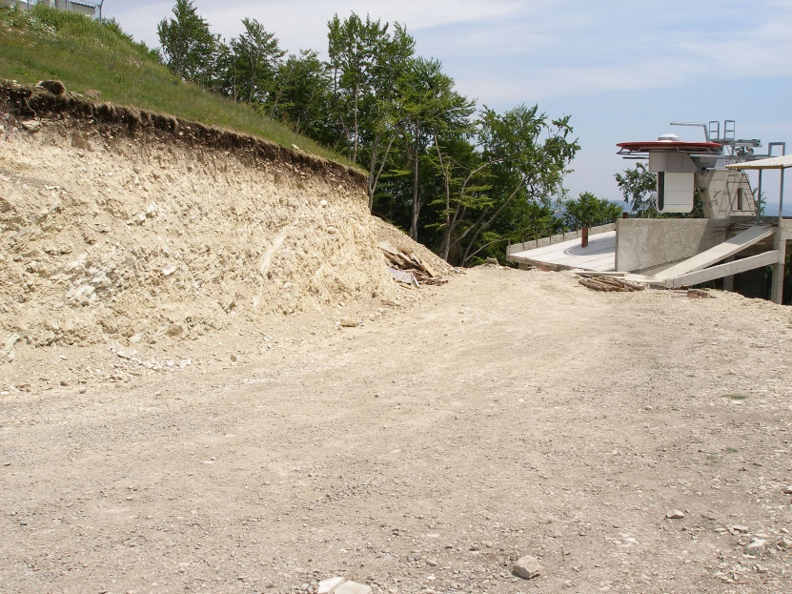
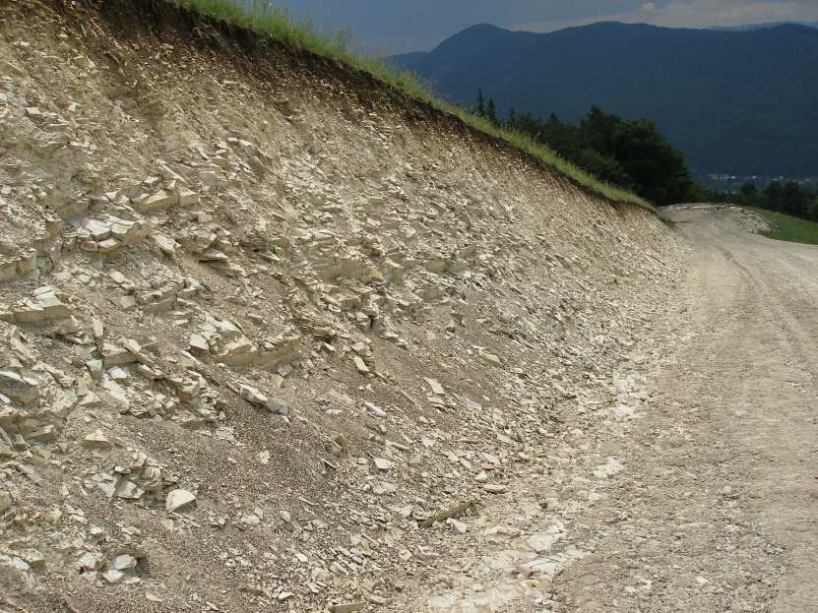
Paleontological reserves Cozla, Pietricica, Cernegura, Agârcia
Statut Legal status: Law no. 5/2000; HCJ no. 15/1994
Location: Piatra-Neamț, Neamț County
Category: Paleontological nature reserve (IUCN category IV)
Significance/Importance: The beginnings of research on fossil fishes in the external flysch of the Eastern Carpathians date back to the 19th century, specifically 1883, when Leon C. Cosmovici (1857–1921) collected the first fossil fishes from Cozla Mountain (Piatra-Neamț region) (Cosmovici, 1887).
Due to the uniqueness and diversity of the fossiliferous deposits (Cozla, Pietricica, Cernegura, Agârcia), the Piatra-Neamț region is a reference point in European paleoichthyology. The study and correlation of Oligocene fossil fishes (34 Ma) with similar fauna from the entire Paratethys (from Iran to Central Europe) make an essential contribution to understanding the biogeographic relationships and the origin of the current fish fauna of the Atlantic, Mediterranean, and Indo-Pacific, thus consolidating the primary scientific importance of these sites (Ciobanu 1977, Baciu 2001).
Fig. 14. Syngnathus incompletus Cosmovici, 1887, holotype, nr. 130, Cozla Mountain. Paleontological Collection, Department of Geology, Faculty of Geography and Geology, 'Al. I. Cuza' University of Iași
Fig. 15. The fossiliferous deposits of Cozla Mountain

Slide 10
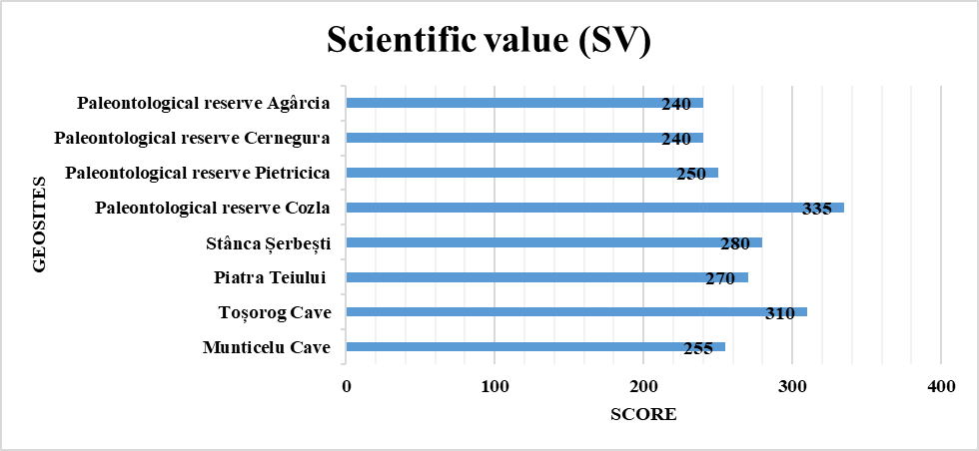
Quantitative assessment of scientific value (SV)
Table 5. Assessment of the scientific value of the geosites
Geosites/Criteria | A. Representativity | B. Key locality | C. Scientific knowledge | D. Integrity | E. Geological diversity | F. Rarity | G. Use restrictions
Munticelu Cave | 4 | 1 | 2 | 1 | 2 | 4 | 2
Toșorog Cave | 4 | 1 | 2 | 4 | 4 | 4 | 2
Piatra Teiului | 4 | 1 | 2 | 2 | 4 | 4 | 1
Stânca Șerbești | 4 | 1 | 2 | 2 | 4 | 4 | 2
Paleontological reserve Cozla | 4 | 4 | 4 | 1 | 4 | 4 | 2
Paleontological reserve Pietricica | 2 | 2 | 4 | 3 | 4 | 3 | 2
Paleontological reserve Cernegura | 2 | 2 | 4 | 4 | 2 | 2 | 2
Paleontological reserve Agârcia | 2 | 2 | 4 | 4 | 2 | 2 | 2
Table 6. Weighting of the scientific value criteria
Very low Low Moderate High
SCIENTIFIC VALUE (SV)
Criteria | Weight (%)
A. Representativity | 30
B. Key locality | 20
C. Scientific knowledge | 5
D. Integrity | 15
E. Geological diversity | 5
F. Rarity | 15
G. Use restrictions | 10
Fig. 16.

Slide 11
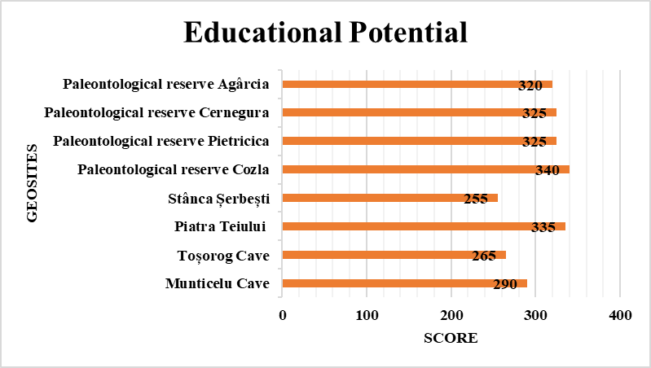
Quantitative assessment of the educational potential (PEU)
Table 7. Assessment of the educational potential of the geosites
Geosites/Criteria | A. Vulnerabily | B. Accesibility | C. Use restrictions | D. Safety | E. Logistics | F. Population density | G. Association with other assets | H. Landscape | I. Uniqueness | J. Observation conditions | K. Didactic potential | L. Geological diversity
Munticelu Cave | 1 | 1 | 2 | 3 | 4 | 1 | 4 | 4 | 3 | 3 | 4 | 4
Toșorog Cave | 3 | 3 | 2 | 3 | 4 | 1 | 4 | 2 | 4 | 4 | 1 | 3
Piatra Teiului | 1 | 4 | 1 | 4 | 4 | 1 | 4 | 4 | 3 | 4 | 4 | 4
Stânca Șerbești | 3 | 2 | 2 | 4 | 4 | 1 | 3 | 2 | 3 | 4 | 1 | 3
Paleontological reserve Cozla | 1 | 4 | 2 | 4 | 4 | 4 | 4 | 4 | 4 | 2 | 4 | 4
Paleontological reserve Pietricica | 2 | 4 | 2 | 4 | 4 | 4 | 3 | 3 | 3 | 2 | 4 | 3
Paleontological reserve Cernegura | 3 | 4 | 2 | 4 | 4 | 4 | 3 | 3 | 3 | 2 | 4 | 2
Paleontological reserve Agârcia | 3 | 4 | 2 | 4 | 4 | 1 | 3 | 3 | 3 | 2 | 4 | 3
Table 8. Weighting of the educational potential criteria
Very low Low Moderate High
EDUCATIONAL POTENTIAL
Criteria | Weight %
A. Vulnerabily | 10
B. Accesibility | 10
C. Use restrictions | 5
D. Safety | 10
E. Logistics | 5
F. Population density | 5
G. Association with other assets | 5
H. Landscape | 5
I. Uniqueness | 5
J. Observation conditions | 10
K. Didactic potential | 20
L. Geological diversity | 10
Fig. 17

Slide 12
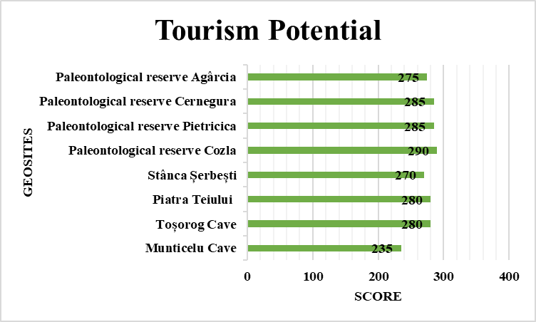
Quantitative assessment of tourism potential (PTU)
Table 9. Assessment of the tourism potential of the geosites
Geosites/Criteria | A. Vulnerabily | B. Accesibilty | C. Use restrictions | D. . Safety | E. Logistics | F. Population density | G. Association with other assets | H. . Landscape | I. Uniqueness | J. Observation conditions | K. Interpretive potential | L. Economic level | M. Proximity to recreational areas
Munticelu Cave | 1 | 1 | 2 | 3 | 4 | 1 | 4 | 4 | 3 | 3 | 4 | 1 | 4
Toșorog Cave | 3 | 3 | 2 | 3 | 4 | 1 | 4 | 2 | 4 | 4 | 4 | 1 | 4
Piatra Teiului | 1 | 4 | 1 | 4 | 4 | 1 | 4 | 4 | 3 | 4 | 4 | 1 | 4
Stânca Șerbești | 3 | 2 | 2 | 4 | 4 | 1 | 3 | 2 | 3 | 4 | 4 | 1 | 4
Paleontological reserve Cozla | 1 | 4 | 2 | 4 | 4 | 4 | 4 | 4 | 4 | 2 | 4 | 2 | 4
Paleontological reserve Pietricica | 2 | 4 | 2 | 4 | 4 | 4 | 4 | 3 | 3 | 2 | 4 | 2 | 4
Paleontological reserve Cernegura | 3 | 4 | 2 | 4 | 4 | 4 | 4 | 3 | 3 | 2 | 3 | 2 | 4
Paleontological reserve Agârcia | 3 | 4 | 2 | 4 | 4 | 1 | 4 | 3 | 3 | 2 | 4 | 1 | 4
Table 10. Weighting of the tourism potential criteria
Very low Low Moderate High
TOURISM POTENTIAL
Criteria | Weight %
A. Vulnerabily | 10
B. Accesibility | 10
C. Use restrictions | 5
D. Safety | 10
E. Logistics | 5
F. Population density | 5
G. Association with other assets | 5
H. Landscape | 5
I. Uniqueness | 5
J. Observation conditions | 10
K. Interpretive potential | 10
L. Economic level | 5
M.Proximity to recreational areas | 5
Fig. 18

Slide 13
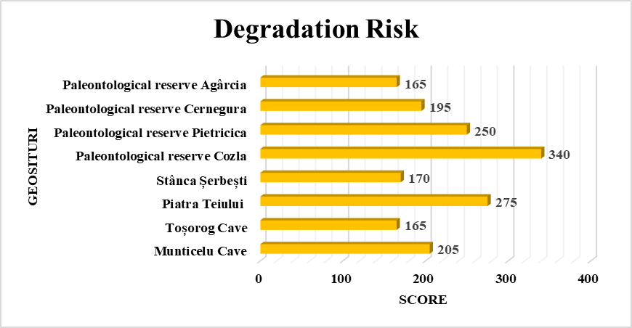
Quantitative assessment of degradation risk
Table 11. Assessment of the degradation risk of the geosites
Geosites/Criteria | A. Deterioration of geological elements | B. Proximity to areas/activities with degradation potential | C. Judicial protection | D. Accesibility | E. Population density
Munticelu Cave | 4 | 1 | 1 | 1 | 1
Toșorog Cave | 2 | 1 | 1 | 3 | 1
Piatra Teiului | 3 | 4 | 1 | 4 | 1
Stânca Șerbești | 2 | 2 | 1 | 2 | 1
Paleontological reserve Cozla | 4 | 4 | 1 | 4 | 4
Paleontological reserve Pietricica | 2 | 3 | 1 | 4 | 4
Paleontological reserve Cernegura | 1 | 2 | 1 | 4 | 4
Paleontological reserve Agârcia | 1 | 2 | 1 | 4 | 1
Table 12. Weight of Degradation Risk Criteria
DEGRADATION RISK
Criteria | Ponderea %
A. Deterioration of geological elements | 35
B. Proximity to areas/activities with degradation potential | 20
C. Judicial protection | 20
D. Accesibility | 15
E. Population density | 10
Very low Low Moderate High
Fig. 19

Slide 14
Conclusions
Scientific value:
The Cozla Fossil Reserve and Toșorog Cave have the highest scientific value, being key elements of the geoheritage of Neamț County.
The other geosites (Munticelu Cave, Piatra Teiului, Șerbești Rock, Cernegura, Pietricica, and Agârcia reserves) have high scientific value but relatively lower importance in the context of geological research.
Educational potential:
Piatra Teiului and the fossiliferous reserves (Cozla, Pietricica, Cernegura, Agârcia) present high educational potential, being valuable resources for didactic activities and public awareness.
The other geosites (Munticelu Cave, Toșorog Cave, Șerbești Rock) have moderate educational potential, suggesting more limited opportunities for formal or informal education.
Tourism potential:
All analysed geosites have moderate tourism potential, indicating that, although attractive, they require promotion, infrastructure, or other investments to become top tourist destinations.
Degradation risk:
The Cozla Fossil Reserve presents the highest degradation risk, requiring urgent conservation and monitoring measures.
2) Piatra Teiului and the Pietricica Fossil Reserve follow in terms of risk level, being also vulnerable, but to a lesser extent.
3) The other geosites (Munticelu Cave, Toșorog Cave, Șerbești Rock, Cernegura and Agârcia reserves) have a lower degradation risk, but must be monitored to prevent deterioration.

Slide 15
General recommendations:
Prioritising the conservation of the Cozla Fossil Reserve, due to its high scientific value and high degradation risk.
Developing educational and tourism programs centred on Piatra Teiului and the fossiliferous reserves, in order to capitalise on their high educational potential.
Implementing a monitoring and protection plan for all geosites, with emphasis on those with high degradation risk.

Slide 16
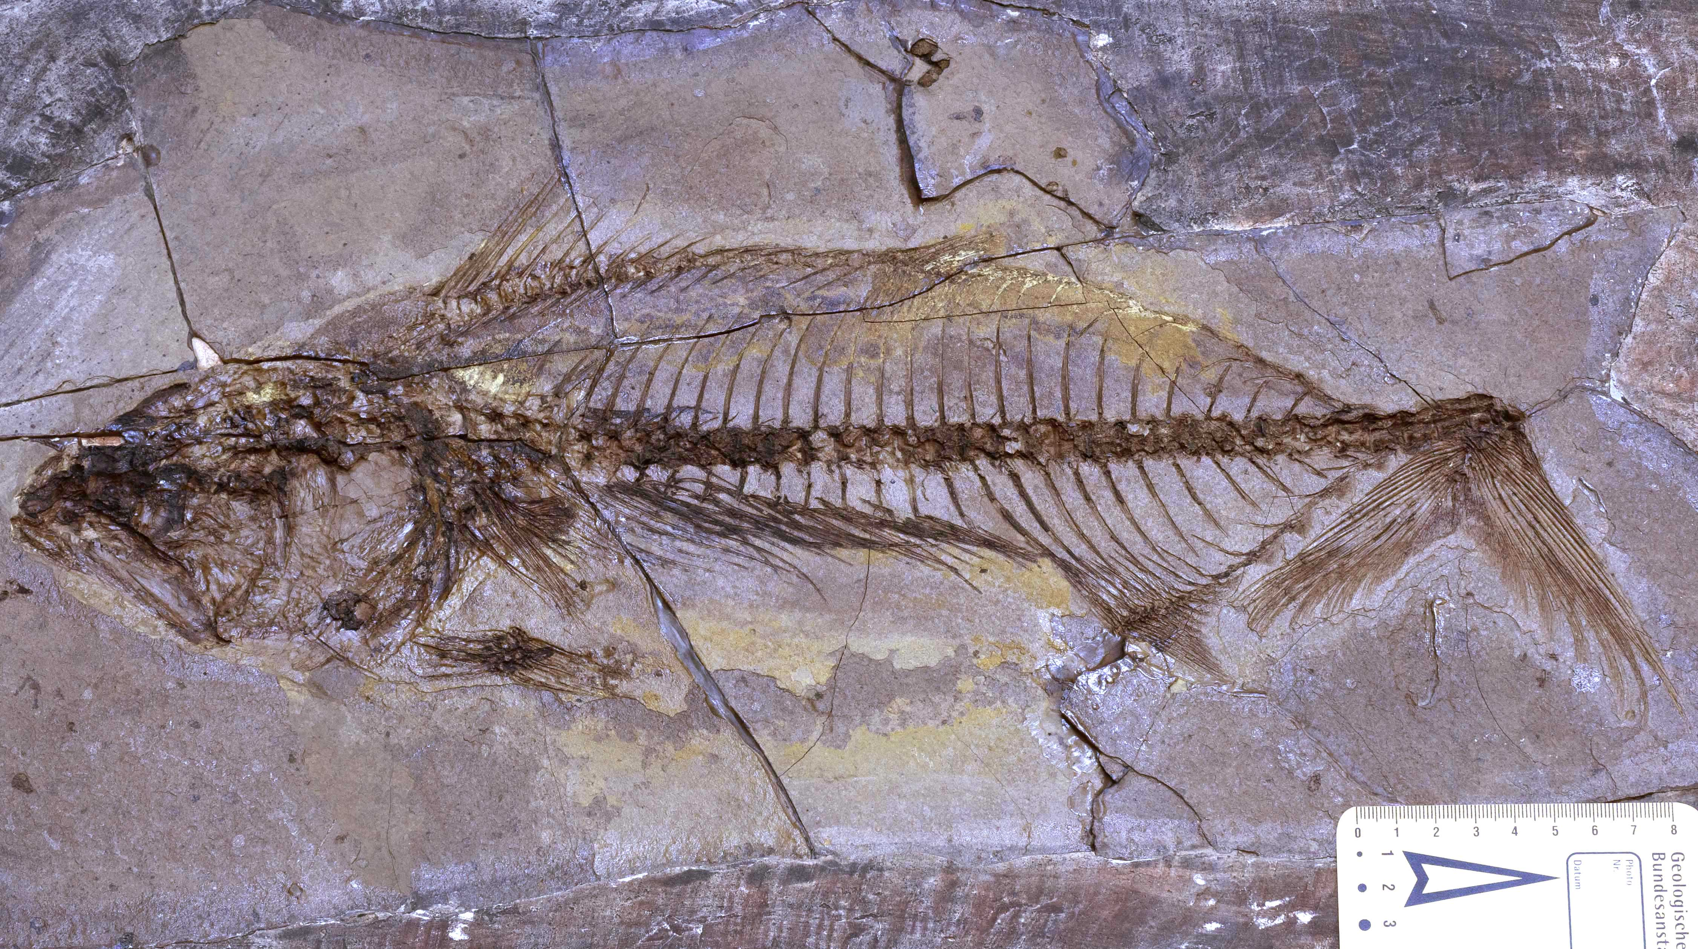
Thank you for your attention!
Fig. 20. †Gymnosarda disodilica Ciobanu, 1977, MSNPN-PC no. 156, Lower Dysodilic Shales Formation,
Cozla Mountain, Piatra-Neamț

